Slide 1






Metsähovi Radio Observatory Triple-Band Receiver Project
Tuomas Savolainen^{1,2}
Derek McKay¹, Kaj Wiik¹, Juha Aatrokoski¹, Bela Dixit^{1,2}, Kjetil Holmberg¹, Talvikki Hovatta^{1,2,3}, Christian Malino¹, Ari Mujunen¹, Joni Tammi¹, Merja Tornikoski¹
¹Metsähovi Radio Observatory, Aalto University
²Department of Electronics and Nanoengineering, Aalto University
³Finnish Centre for Astronomy with ESO, University of Turku

Slide 2
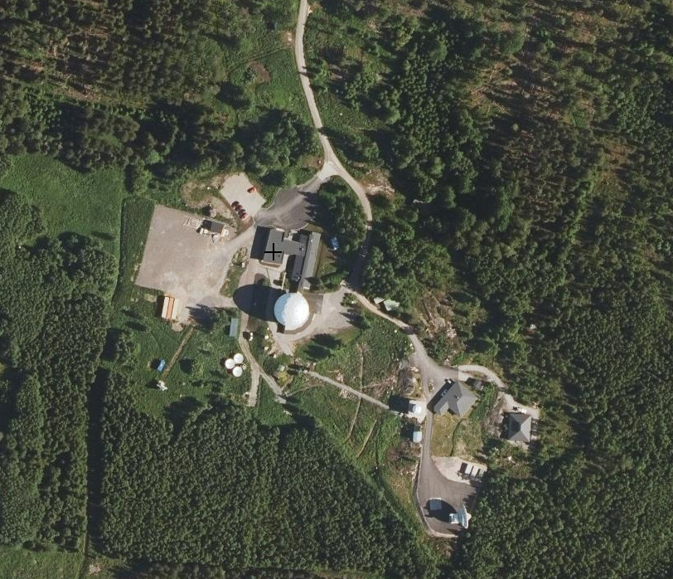
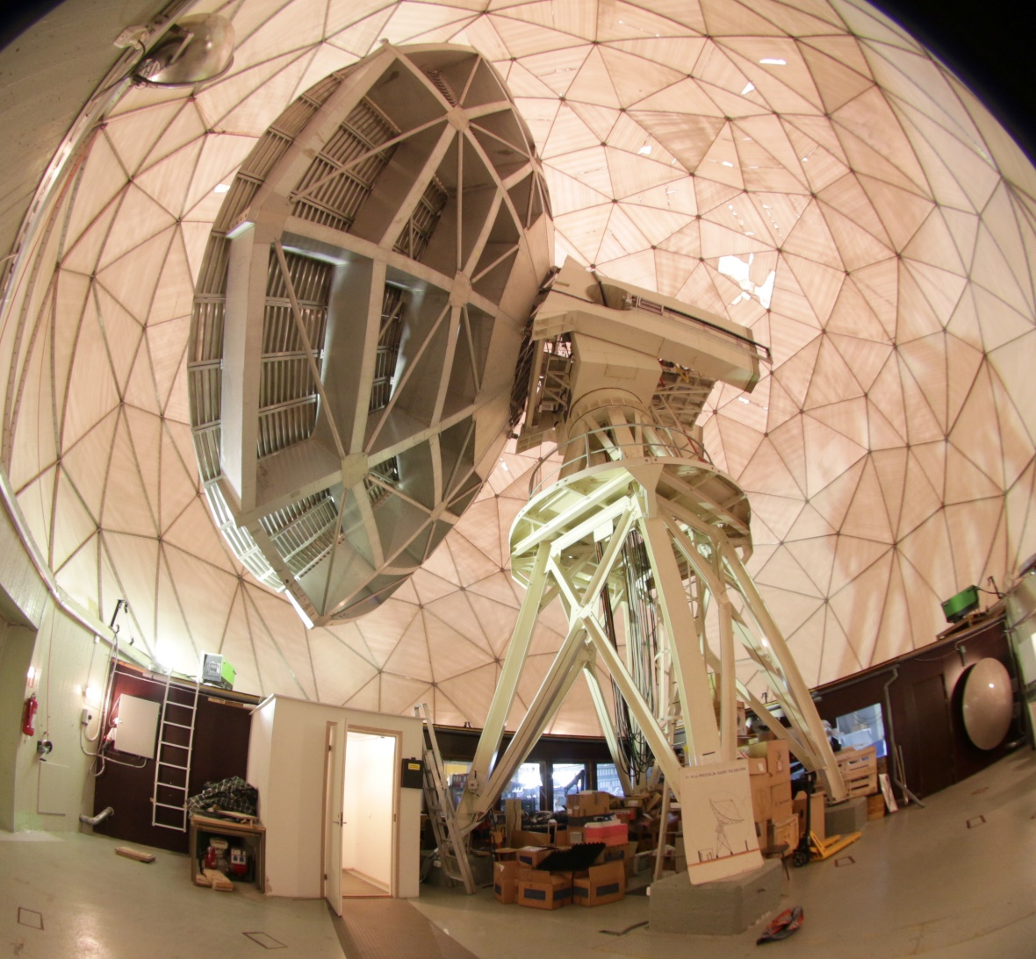
Aalto University Metsähovi Radio Observatory in Kirkkonummi

Slide 3
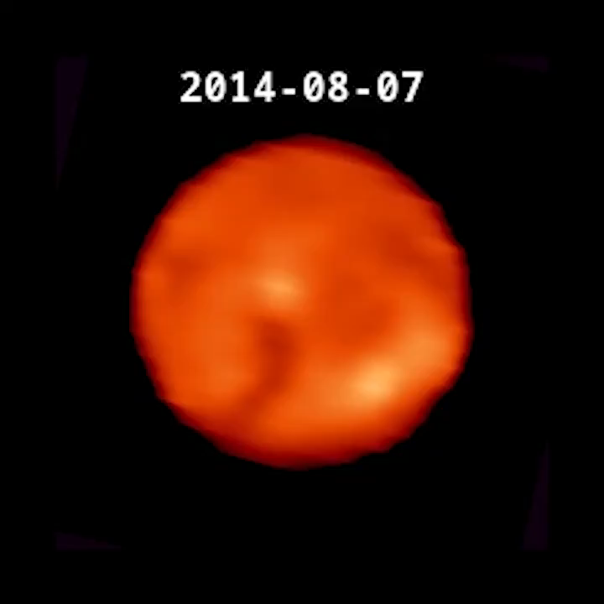
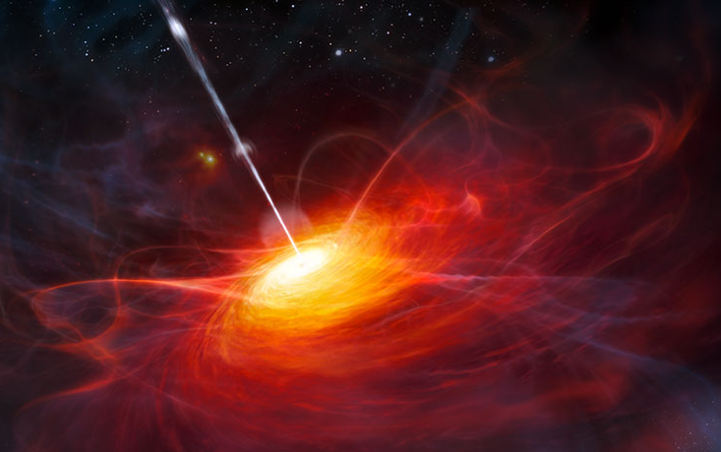
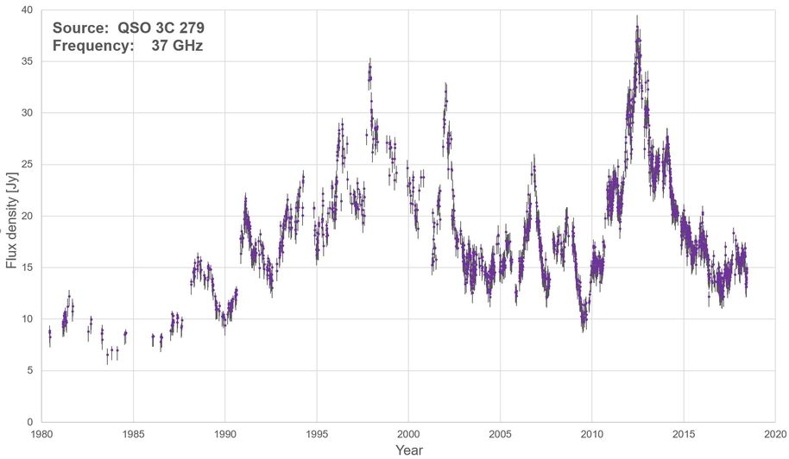
Science with MRO 14-m telescope – Radio monitoring of the Sun and active galaxies at mm-wavelengths
Current “single-dish” receivers
Two receivers: 22 and 37 GHz
Room temperature, dual-beam
1 GHz bandwidth

Slide 4
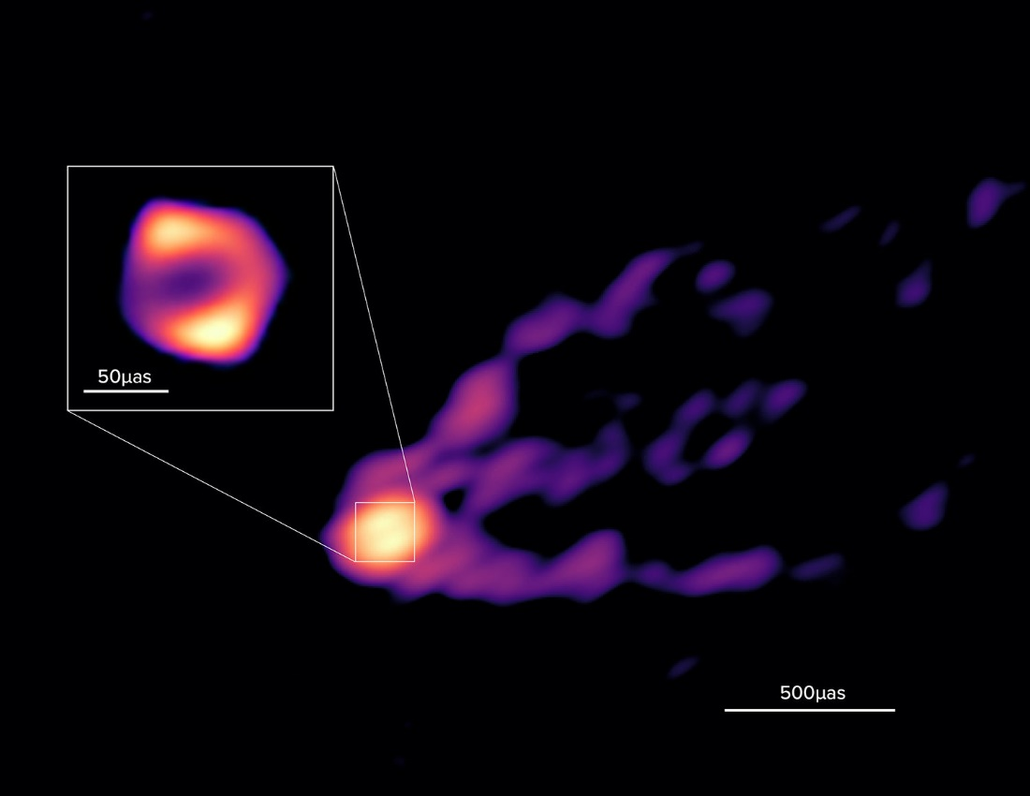
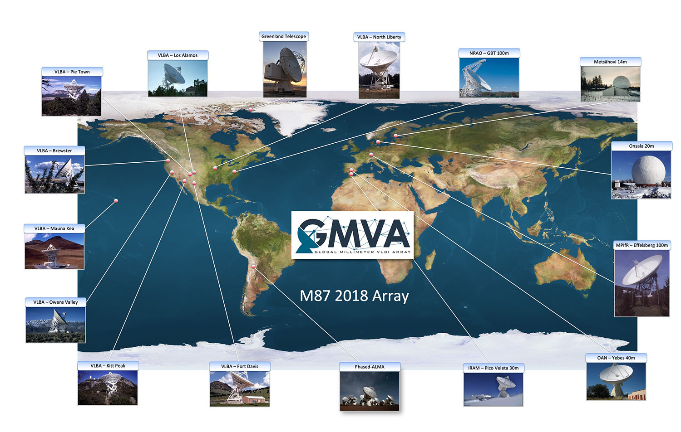
Science with MRO 14-m telescope
– Very Long Baseline Interferometry
Black hole in M87 and its jet
Current VLBI receivers
Three receivers: 22, 43, 86 GHz
Cryogenically cooled, single-beam
500 MHz bandwidth
Lu et al. (2023, Nature 616, 686)

Slide 5
Metsähovi 14-m antenna receiver upgrade
– What do we want?
Sensitivity
  Target: 10x increase in sensitivity compared to the current room-temperature receivers
  Decrease T_{rec}: cooled receiver, state-of-the-art LNAs
  Increase bandwidth to 8/16 GHz
  Dual beam for beam switching in the single-dish mode
Simultaneous multi-band observing at 22 GHz (K), 43 GHz (Q) and 86 GHz (W)
  Allow using frequency-phase-transfer technique
  Spectral information is important for astrophysical modelling
  Minimize the need for receiver changes
Dual polarization

Slide 6
Metsähovi 14-m antenna receiver upgrade
– What do we want?
Sensitivity
  Target: 10x increase in sensitivity compared to the current room-temperature receivers
  Decrease T_{rec}: cooled receiver, state-of-the-art LNAs
  Increase bandwidth to 8/16 GHz
  Dual beam for beam switching in the single-dish mode
Simultaneous multi-band observing at 22 GHz (K), 43 GHz (Q) and 86 GHz (W)
  Allow using frequency-phase-transfer technique
  Spectral information is important for astrophysical modelling
  Minimize the need for receiver changes
Dual polarization
Has to fit in the receiver cabin’s tight space!

Slide 7
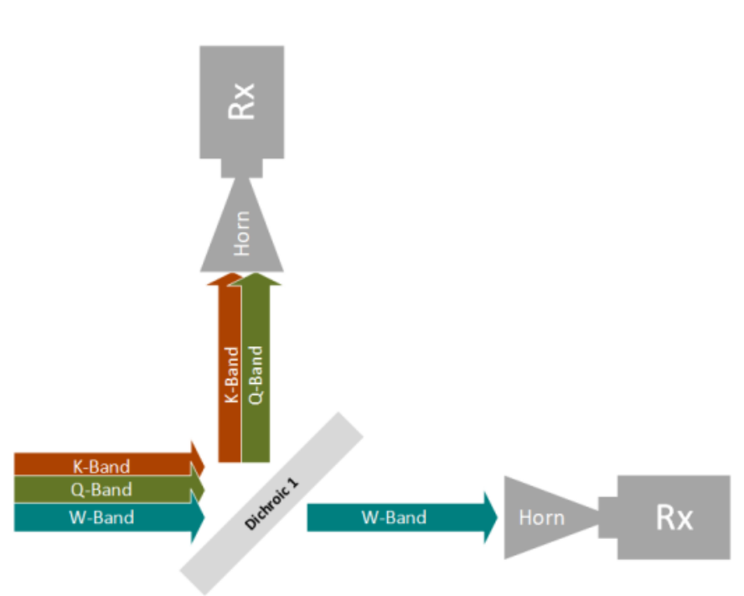
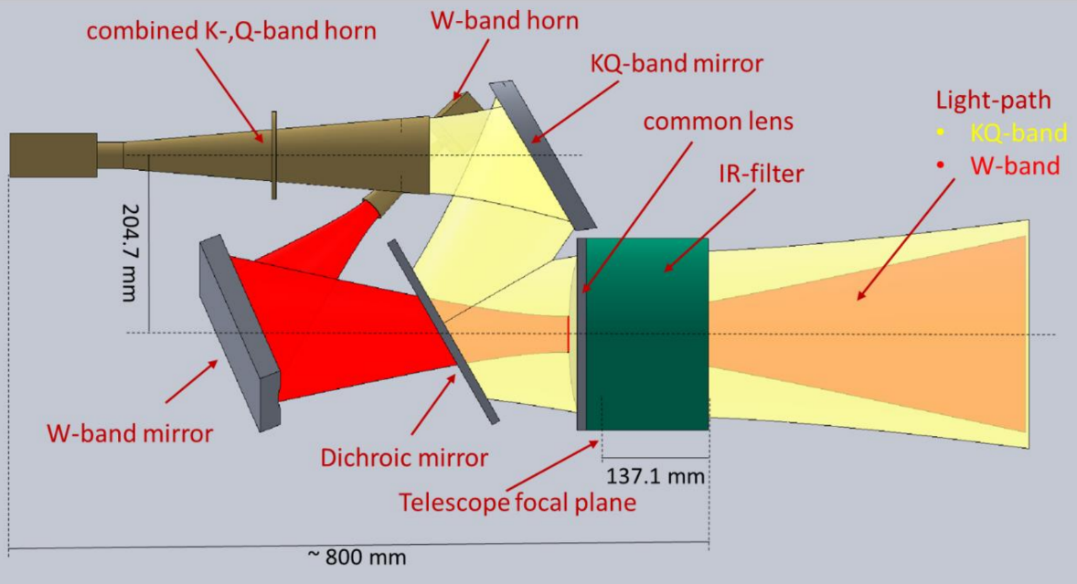
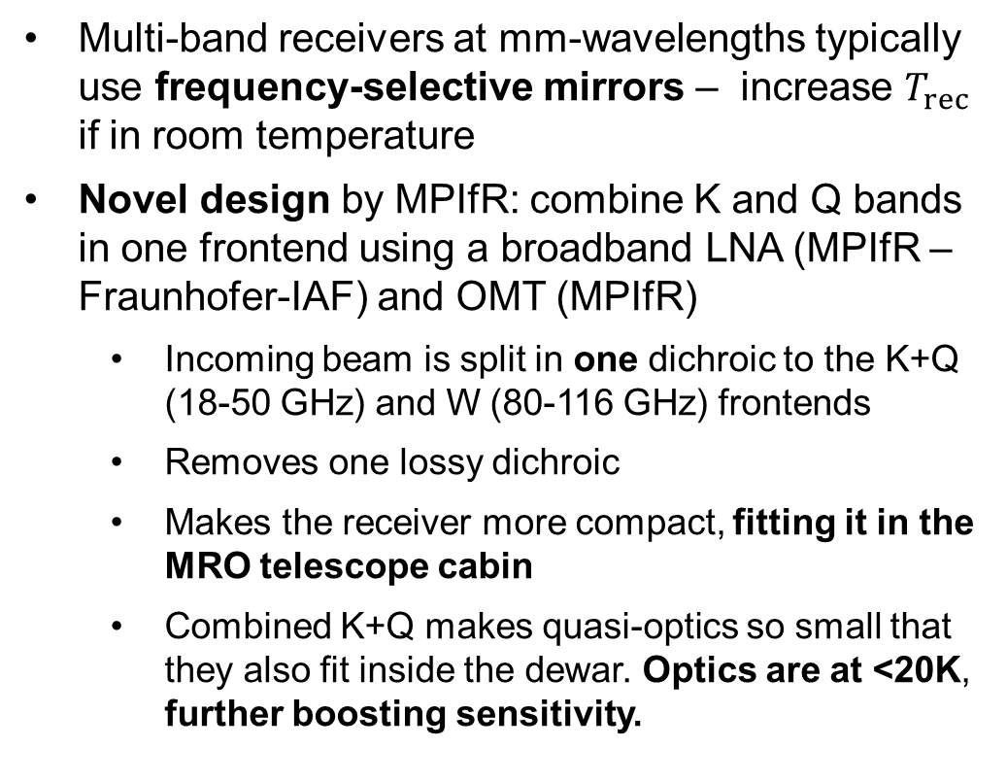
MRO Triple-Band Receiver (3BR) – Design by Max-Planck-Institut für Radioastronomie Electronics Division
Multi-band receivers at mm-wavelengths typically use frequency-selective mirrors – increase $T_{rec}$ if in room temperature
Novel design by MPIfR: combine K and Q bands in one frontend using a broadband LNA (MPIfR – Fraunhofer-IAF) and OMT (MPIfR)
    Incoming beam is split in one dichroic to the K+Q (18-50 GHz) and W (80-116 GHz) frontends
    Removes one lossy dichroic
    Makes the receiver more compact, fitting it in the MRO telescope cabin
    Combined K+Q makes quasi-optics so small that they also fit inside the dewar. Optics are at <20K, further boosting sensitivity.
Figures: MPIfR Electronics Div.
Notes:
Baseline design for dichroic: stack of individually structured copper layers separated by stacks of different dielectric materials

Slide 8
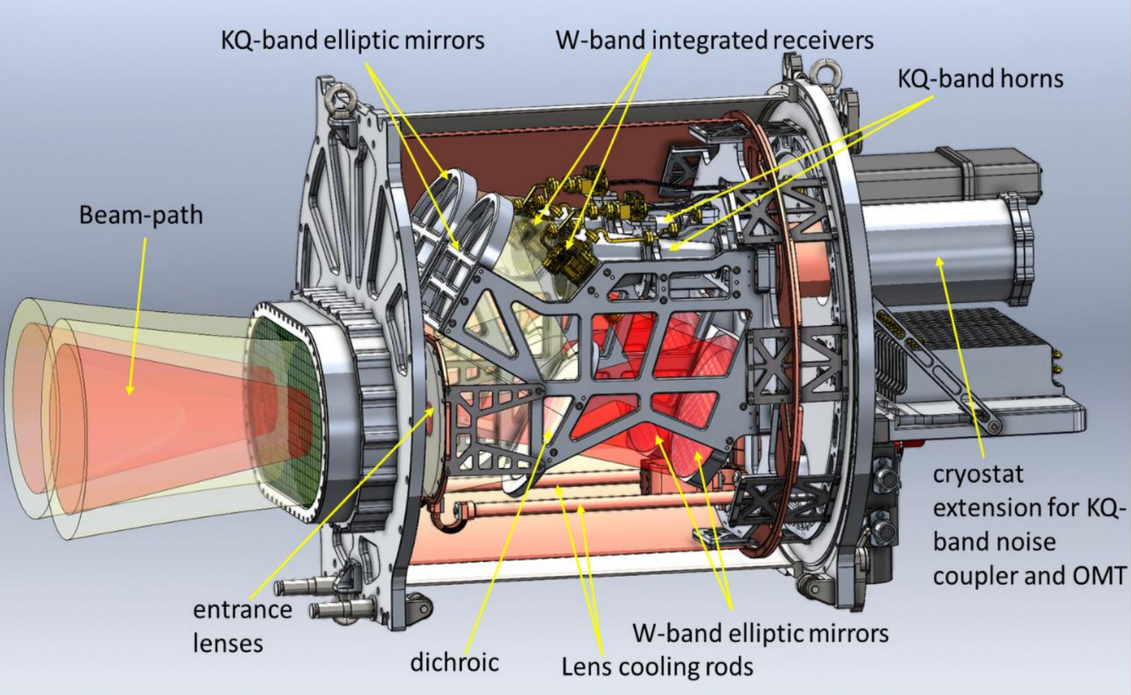
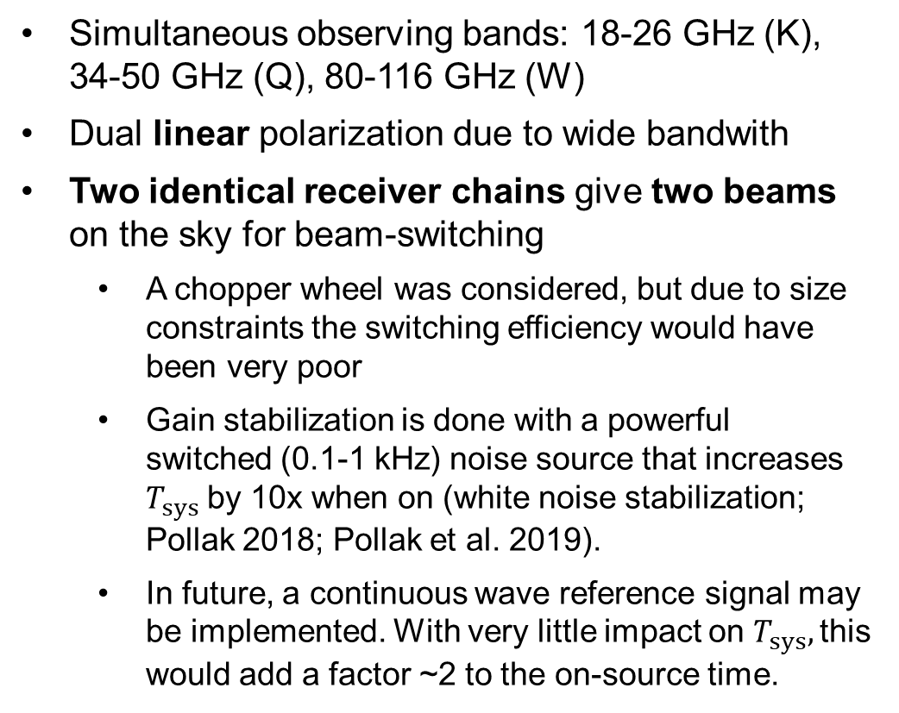
MRO Triple-Band Receiver (3BR) – Design by Max-Planck-Institut für Radioastronomie Electronics Division
Simultaneous observing bands: 18-26 GHz (K), 34-50 GHz (Q), 80-116 GHz (W)
Dual linear polarization due to wide bandwith
Two identical receiver chains give two beams on the sky for beam-switching
    A chopper wheel was considered, but due to size constraints the switching efficiency would have been very poor
    Gain stabilization is done with a powerful switched (0.1-1 kHz) noise source that increases $T_{sys}$ by 10x when on (white noise stabilization; Pollak 2018; Pollak et al. 2019).
    In future, a continuous wave reference signal may be implemented. With very little impact on $T_{sys},$this would add a factor ~2 to the on-source time.
Figure: MPIfR Electronics Div.
1150 mm

Slide 9
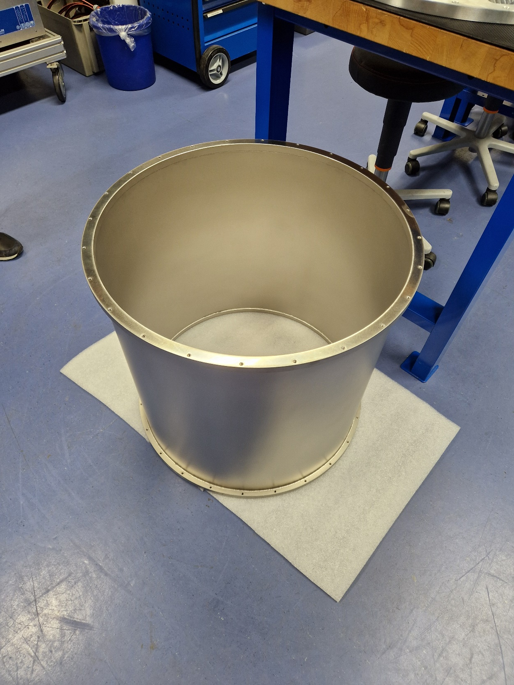
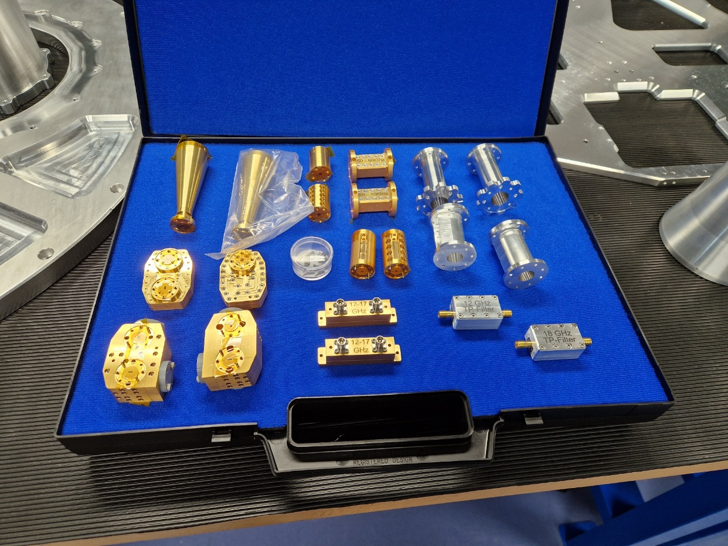
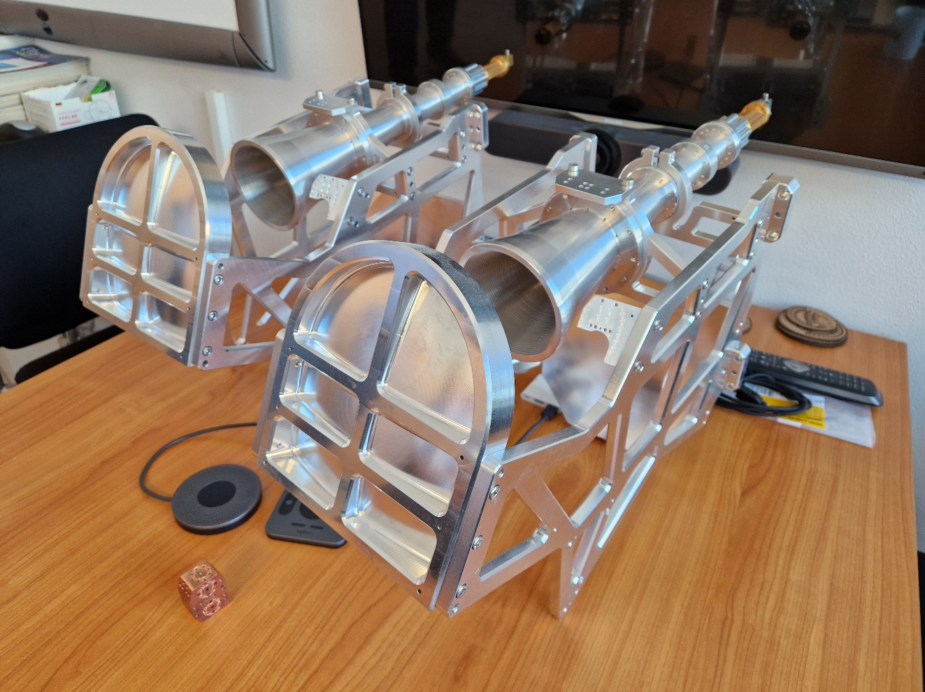
MRO Triple-Band Receiver (3BR) – Design by Max-Planck-Institut für Radioastronomie Electronics Division
Timeline:
  Contract signed with the MPIfR in 03/2023
  PDR in 06/2023
  CDR in 02/2024
  Delivery and installation expected in 09/2026

Slide 10
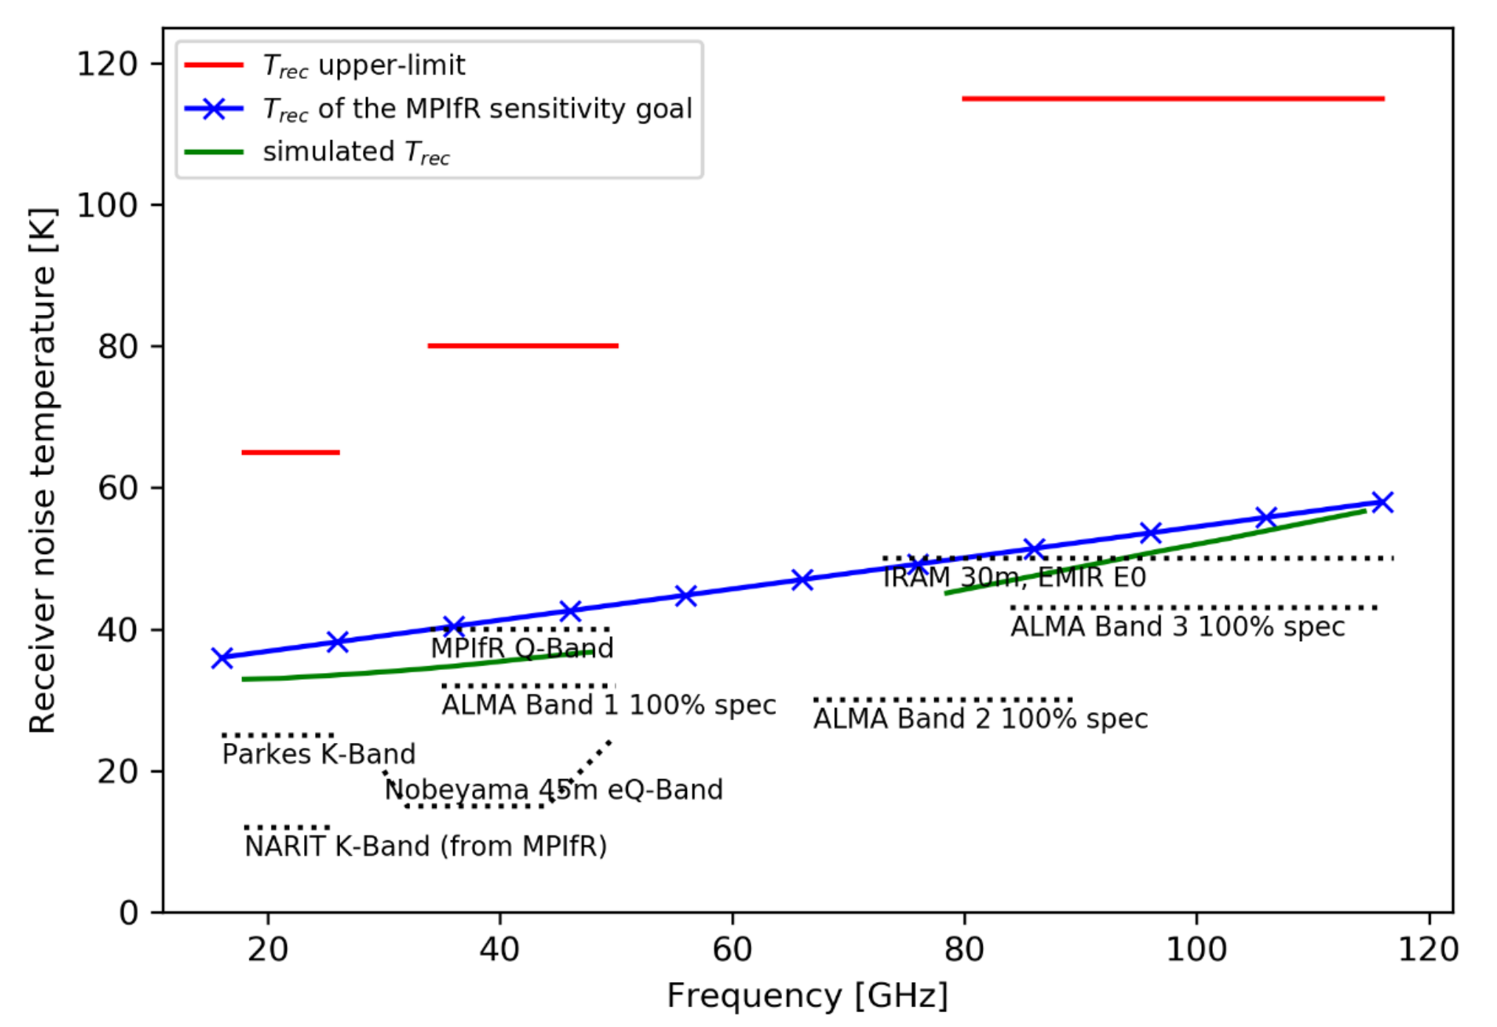
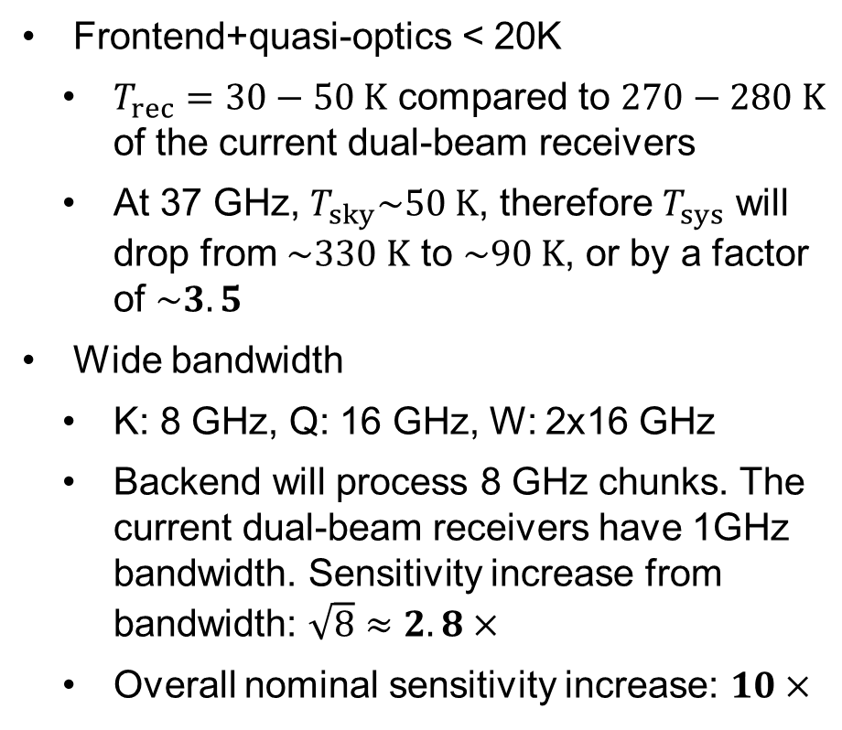
Sensitivity in single-dish mode
Current VLBI Rx
270 K
280 K
Current dual-beam Rx
Frontend+quasi-optics < 20K
  $T_{rec}=30−50 K$ compared to $270−280 K$ of the current dual-beam receivers
  At 37 GHz, $T_{sky}\sim 50 K$, therefore $T_{sys}$ will drop from $\sim 330 K$ to $\sim 90 K$, or by a factor of $\sim 3.5$
Wide bandwidth
  K: 8 GHz, Q: 16 GHz, W: 2x16 GHz
  Backend will process 8 GHz chunks. The current dual-beam receivers have 1GHz bandwidth. Sensitivity increase from bandwidth: $\sqrt{8}≈2.8×$
  Overall nominal sensitivity increase: $10×$
Figure: MPIfR Electronics Div.

Slide 11
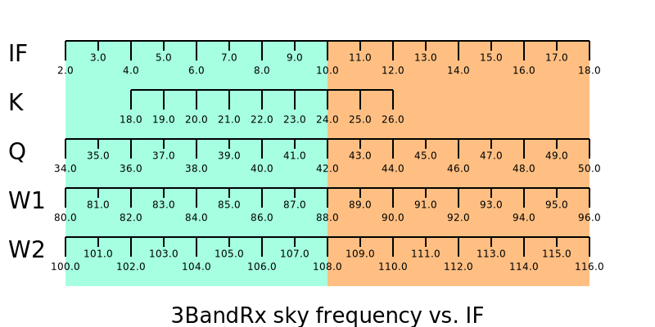
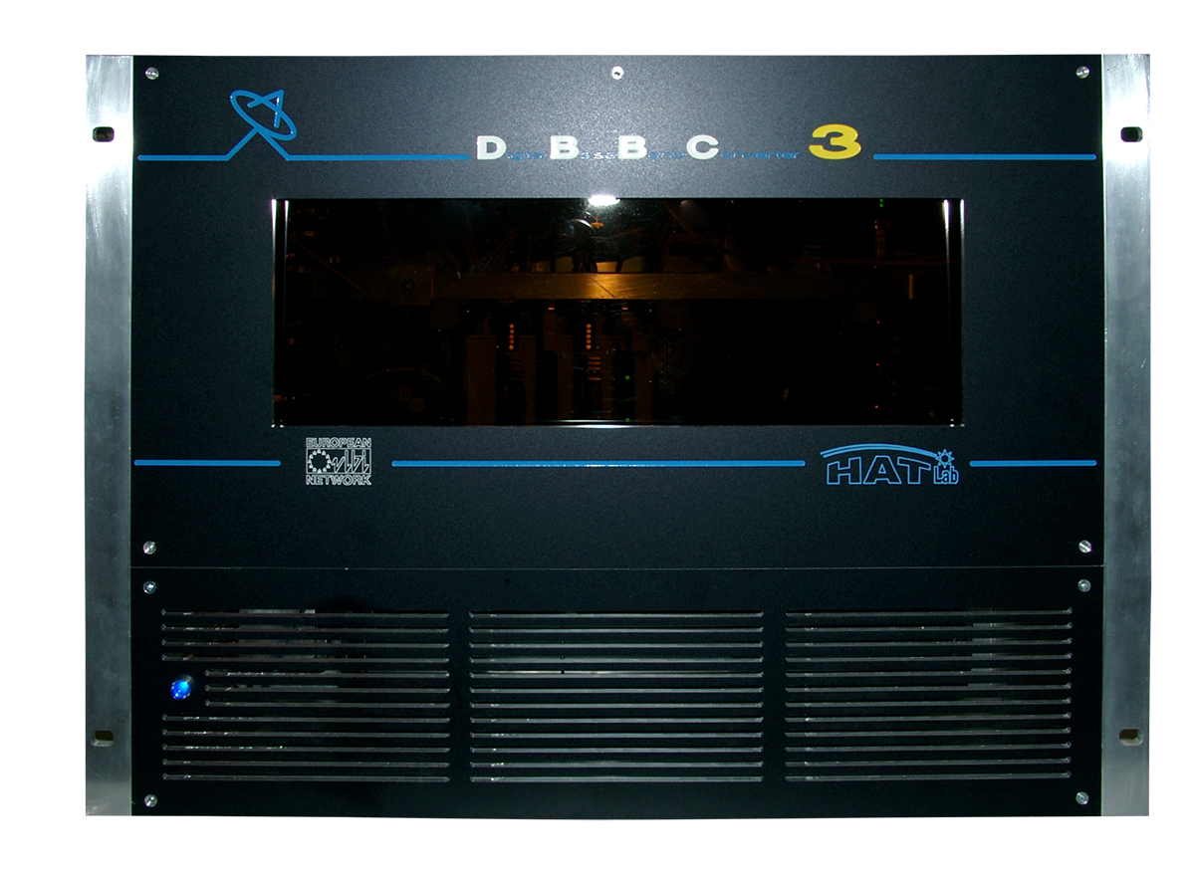
Backends
IF output
VLBI backend
DBBC3 already acquired
Can process 3 x 4 GHz, dual-pol
Will require a downconverter, which is being built in-house

Slide 12
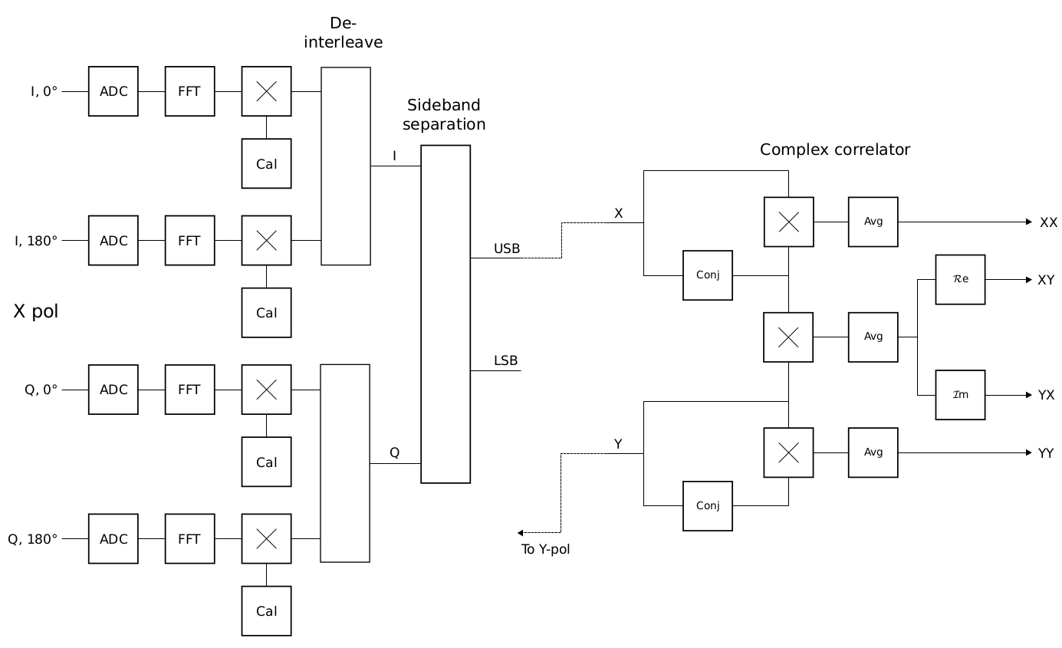
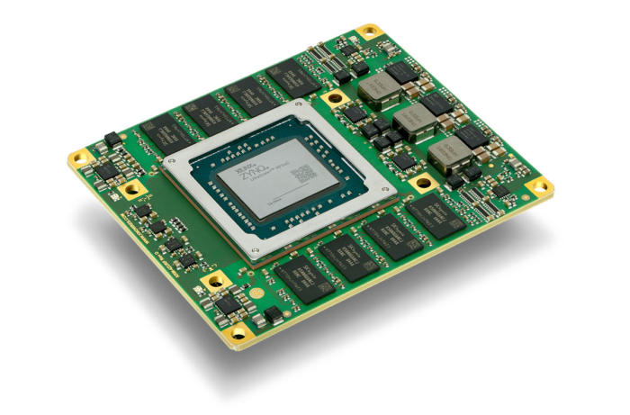
Backends
Single-dish backend (“3DBE”)
RFSoC-based backend under development (design by K. Wiik)
Polarimeter with full Stokes output, instantaneous bandwidth 224 GHz (7 x 8 GHz x 2-pol x 2-beam)
Design is based on Knowledge Resources module KRM-4ZU48DR and a custom carrier board containing digital interface and analog frontend
Development and building supported by RCF and ERC grants (PI T. Hovatta) as well as by AMD and Knowledge Resources

Slide 13
Summary
MRO will have a cryogenically cooled, dual-beam, dual-linear-polarization, triple-band receiver capable of simultaneously observing at 18-26 GHz, 34-50 GHz and 80-116 GHz
An order-of-magnitude increase in single-dish sensitivity
Backends:
  DBBC3 for VLBI
  In-house developed 3DBE for single-dish
Receiver delivery in 09/2026, commissioning in Q4/26-Q1/27
Receiver funded by Aalto U. and by donations from the Weisell Foundation, Magnus Ehrnrooth Foundation and over 80 private donors

Slide 14
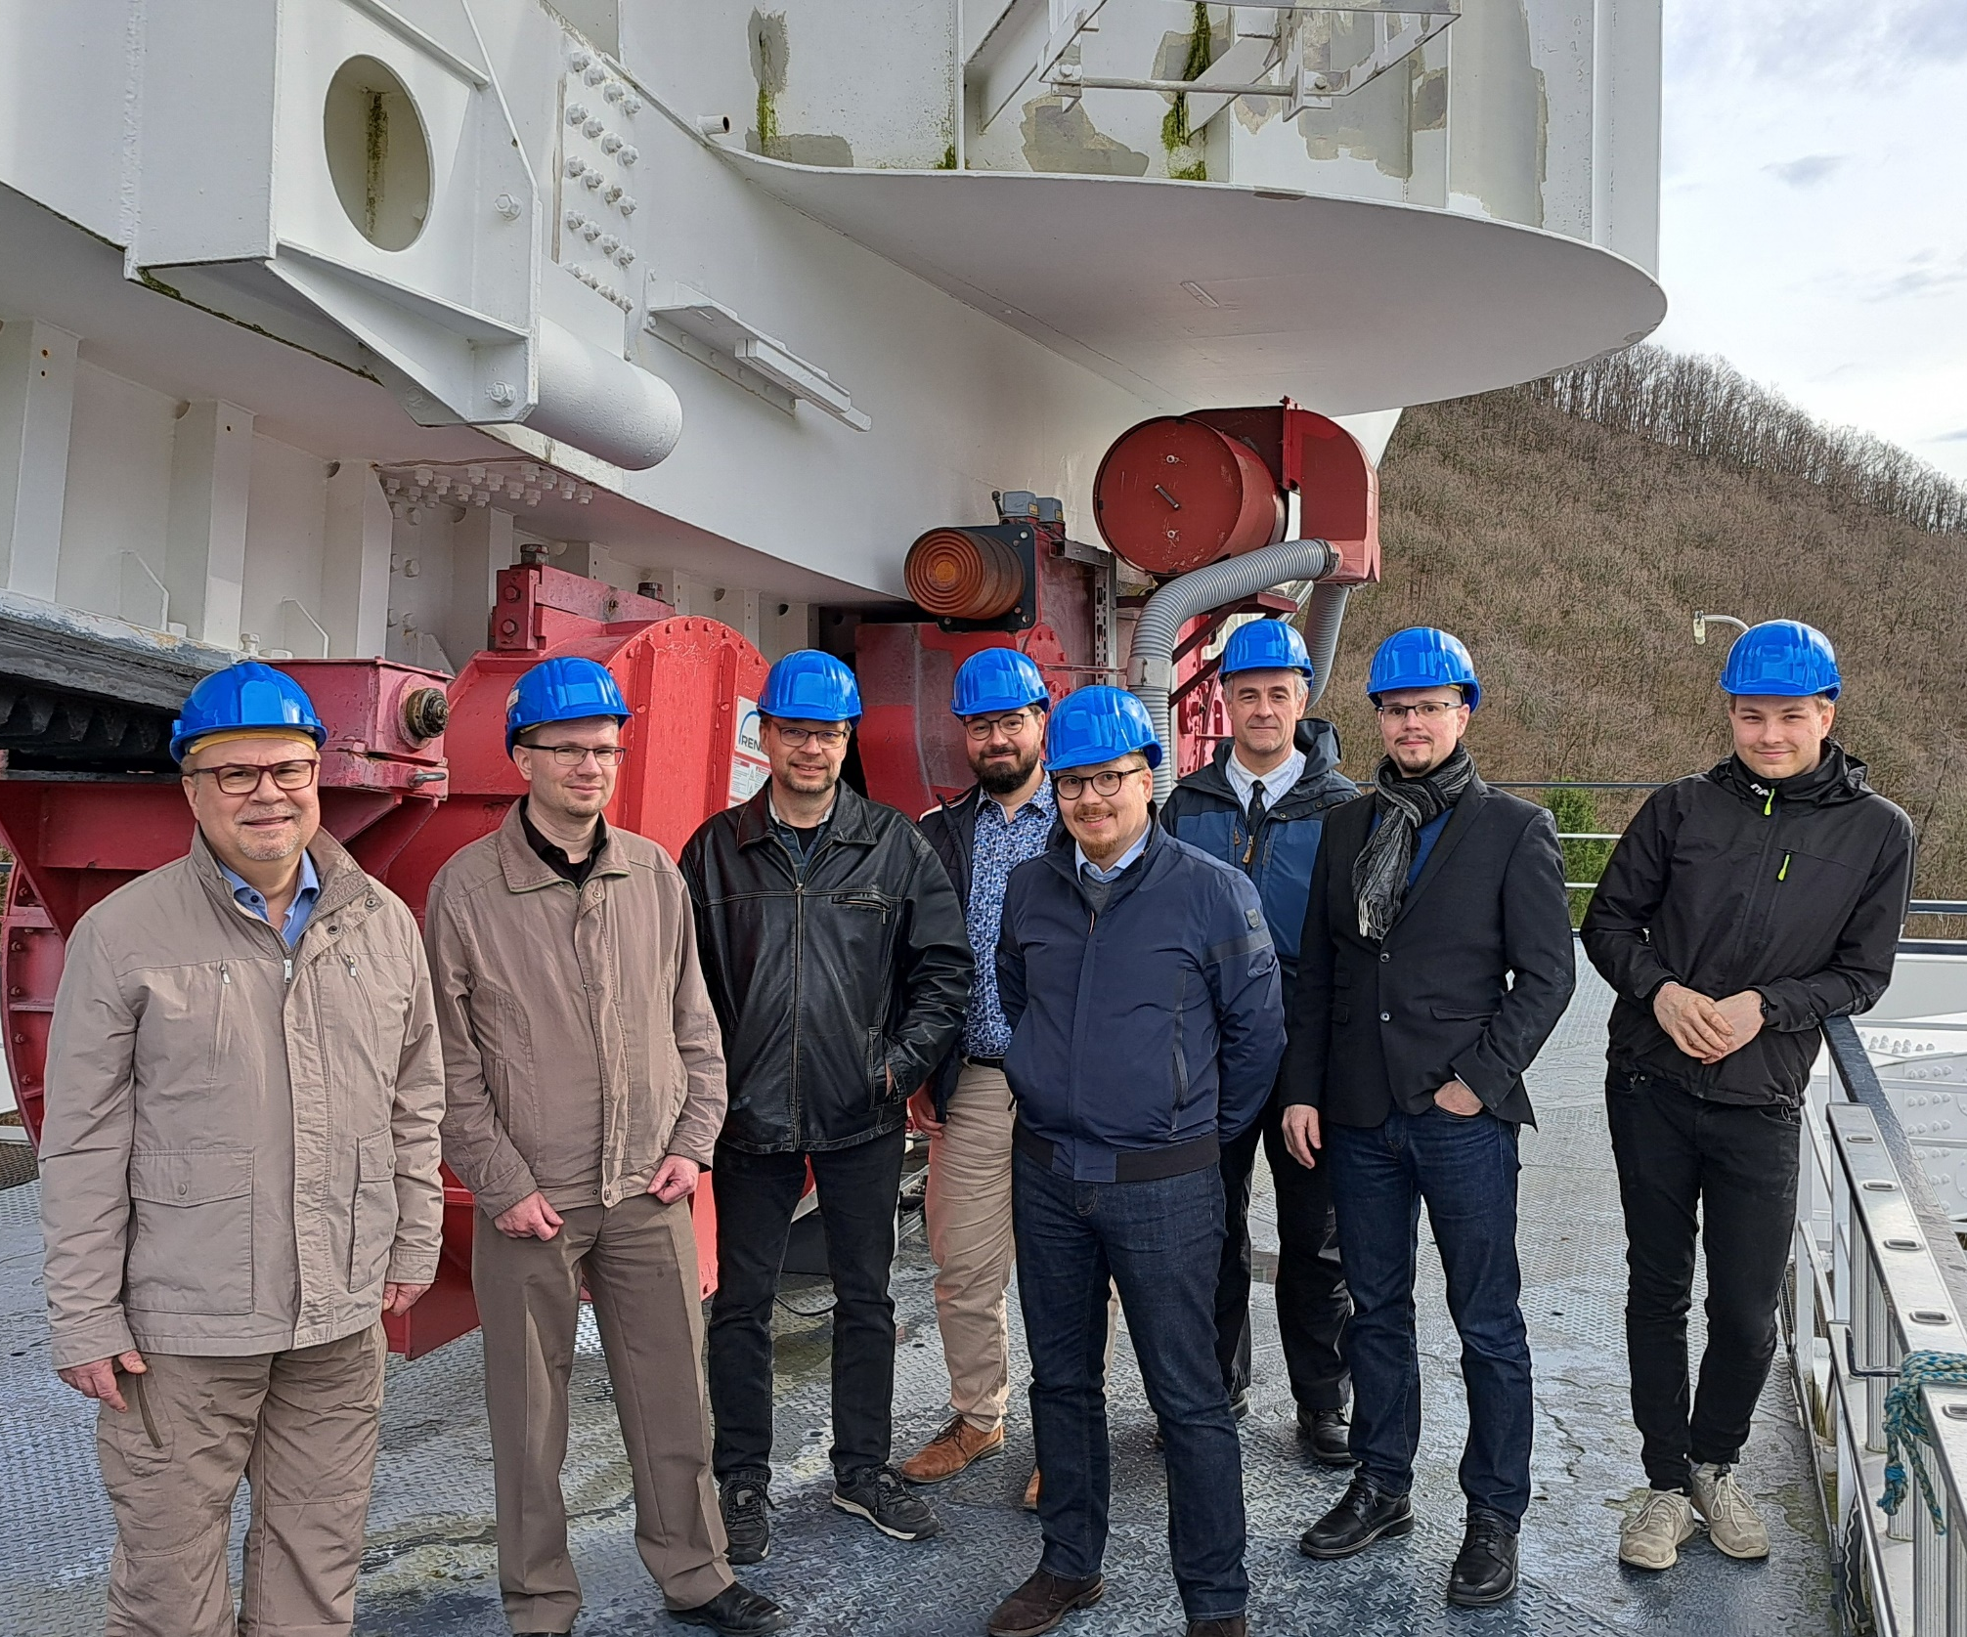
MRO receiver upgrade team
Triple-band receiver: J. Aatrokoski, K. Holmberg, C. Malino, D. McKay, A. Mujunen, T. Savolainen, J. Tammi, M. Tornikoski, K. Wiik
Single-dish backend: B. Dixit, T. Hovatta, K. Wiik
3-band receiver is designed and being build by the Electronics Division of the Max-Planck-Institut für Radioastronomie, Bonn, Germany

Slide 15
Backup slides

Slide 16
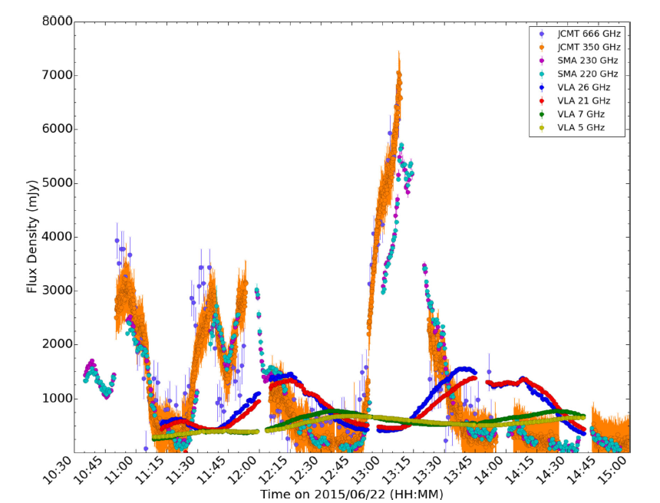
Use cases: single-dish flux density monitoring
An order-of-magnitude sensitivity improvement → detection threshold of 10-20 mJy at Q-band is the goal
    Much shorter integration times
      Larger source samples
      Ability to track rapid variability (e.g., microquasars)
    New source classes
V404 Cygni
Tetarenko et al. 2017

Slide 17
Use cases: single-dish flux density monitoring
An order-of-magnitude sensitivity improvement → detection threshold of 10-20 mJy at Q-band is the goal
    Much shorter integration times
      Larger source samples
      Ability to track rapid variability (e.g., microquasars)
    New source classes
Simultaneous observations at 18-116 GHz in total intensity, linear and circular polarization
    Broadband full Stokes spectrum gives a handle on the magnetic fields and particle composition (pair plasma vs. normal plasma) in black hole jets (ERC/Hovatta)
Figure: T. Hovatta

Slide 18
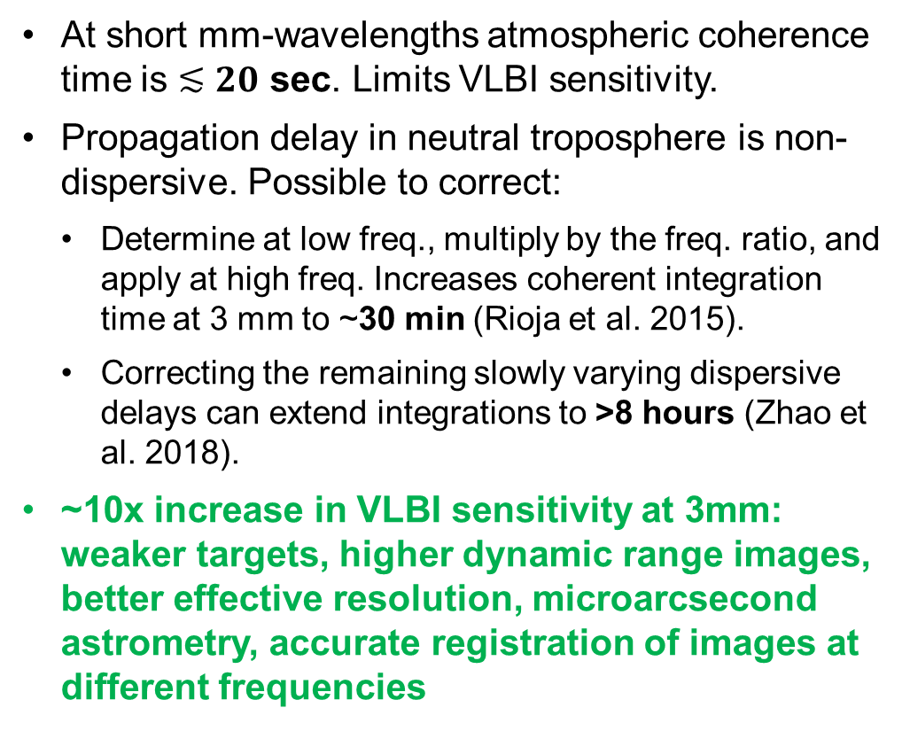
Use cases – mm-VLBI with frequency-phase-transfer (FPT)
  At short mm-wavelengths atmospheric coherence time is $≲20$ sec. Limits VLBI sensitivity.
  Propagation delay in neutral troposphere is non-dispersive. Possible to correct:
    Determine at low freq., multiply by the freq. ratio, and apply at high freq. Increases coherent integration time at 3 mm to ~30 min (Rioja et al. 2015).
    Correcting the remaining slowly varying dispersive delays can extend integrations to >8 hours (Zhao et al. 2018).
  ~10x increase in VLBI sensitivity at 3mm: weaker targets, higher dynamic range images, better effective resolution, microarcsecond astrometry, accurate registration of images at different frequencies
Image: Taehyun Jung

Slide 19
Use cases – mm-VLBI with frequency-phase-transfer (FPT)
FPT
FPT
Image: Taehyun Jung

Slide 20

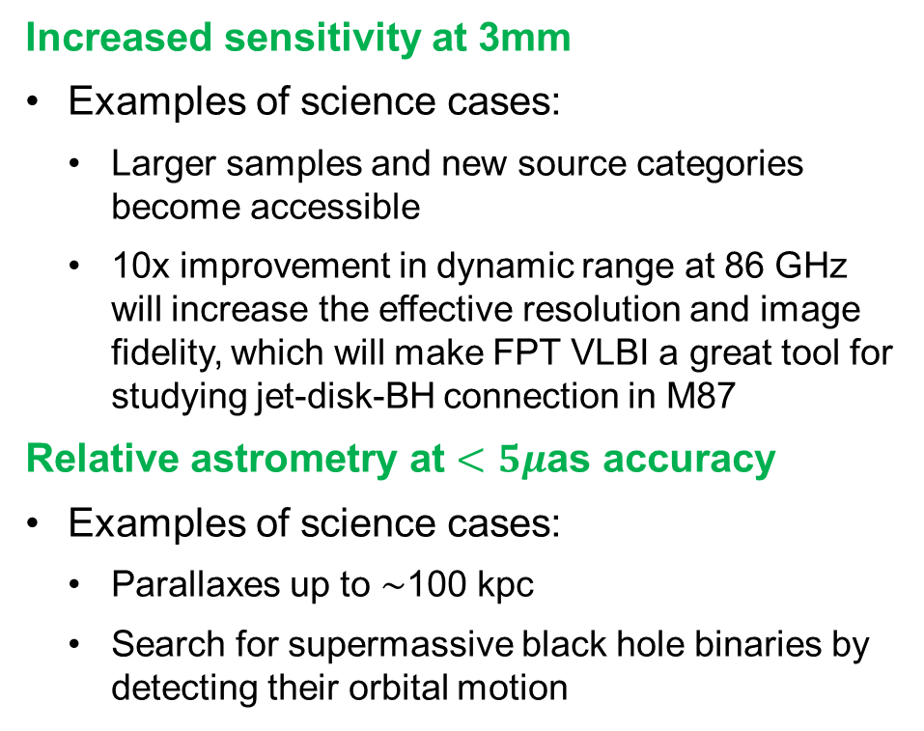
Use cases – mm-VLBI with frequency-phase-transfer
M87 with GMVA+ALMA at 86 GHz
Lu et al. 2023
Increased sensitivity at 3mm
  Examples of science cases:
    Larger samples and new source categories become accessible
    10x improvement in dynamic range at 86 GHz will increase the effective resolution and image fidelity, which will make FPT VLBI a great tool for studying jet-disk-BH connection in M87
Relative astrometry at $<5μ$as accuracy
  Examples of science cases:
    Parallaxes up to $\sim$100 kpc
    Search for supermassive black hole binaries by detecting their orbital motion

Slide 21
Use cases – mm-VLBI with frequency-phase-transfer
Chamani 2022
Accurate astrometric registration of images between different bands:
  Science cases:
    Core-shift in AGN jets gives a handle on jet magnetic field strength
    Faraday rotation measure maps, and polarization spectrum maps in general, additionally give a handle on magnetic field geometry
    Accurate astrometry of different maser transitions e.g., around evolved stars provides information on detailed dynamics of the envelope and the physical conditions there
AGB star R-LMi
Red: H20 masers
Blue and Green: SiO masers
Dodson et al. 2014

Slide 22
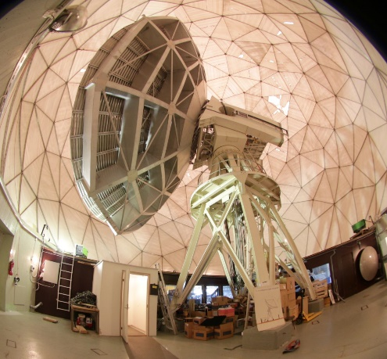
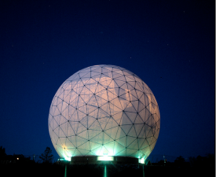
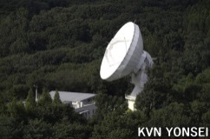
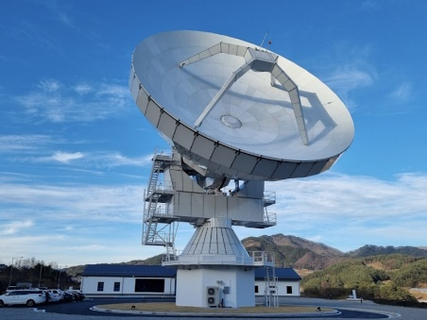
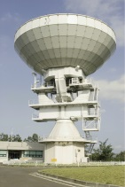

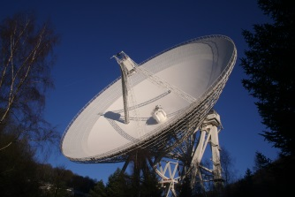
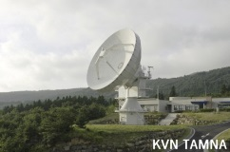
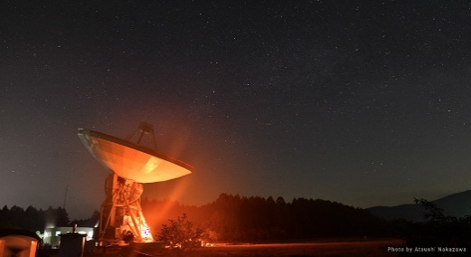
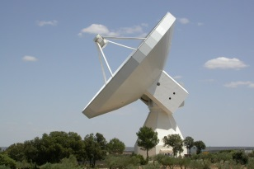
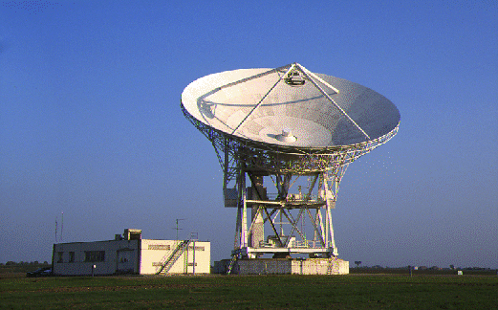
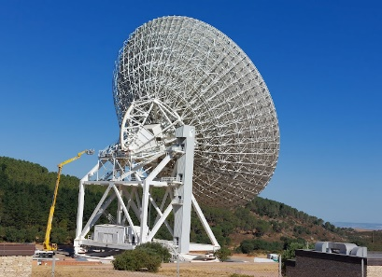
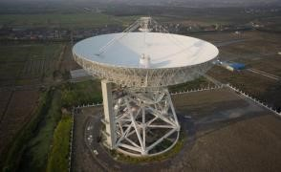
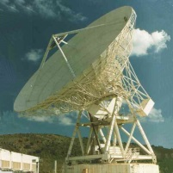
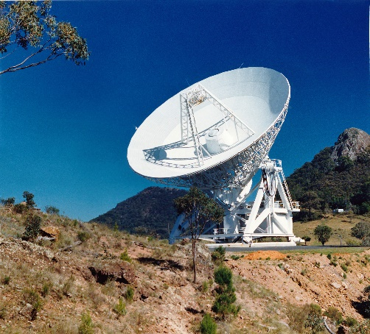
FPT-capable VLBI stations

