Slide 1
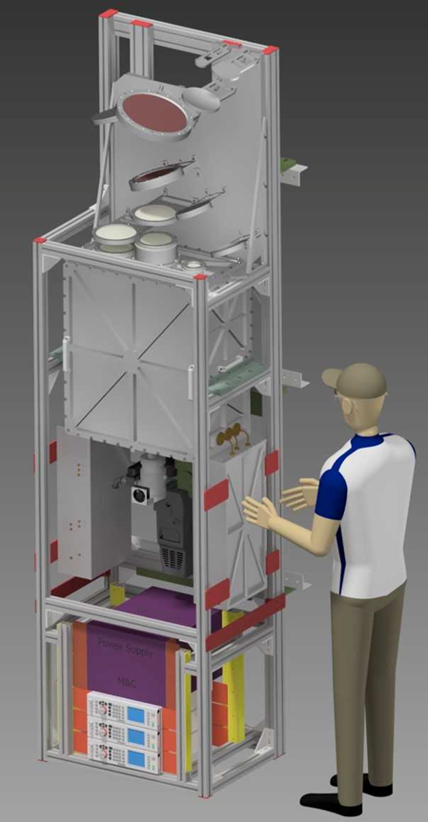


Towards high-performance mm-VLBI science operations with multi-band receivers Tri-band receivers for INAF radio telescopes: first light
Pietro Bolli, INAF – Arcetri Astrophysical Observatory
Bologna, 28-31 October 2025

Slide 2
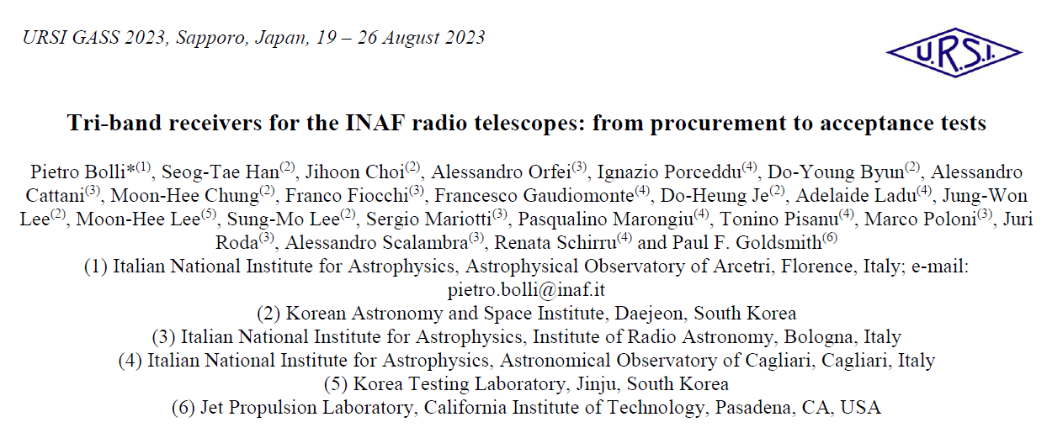
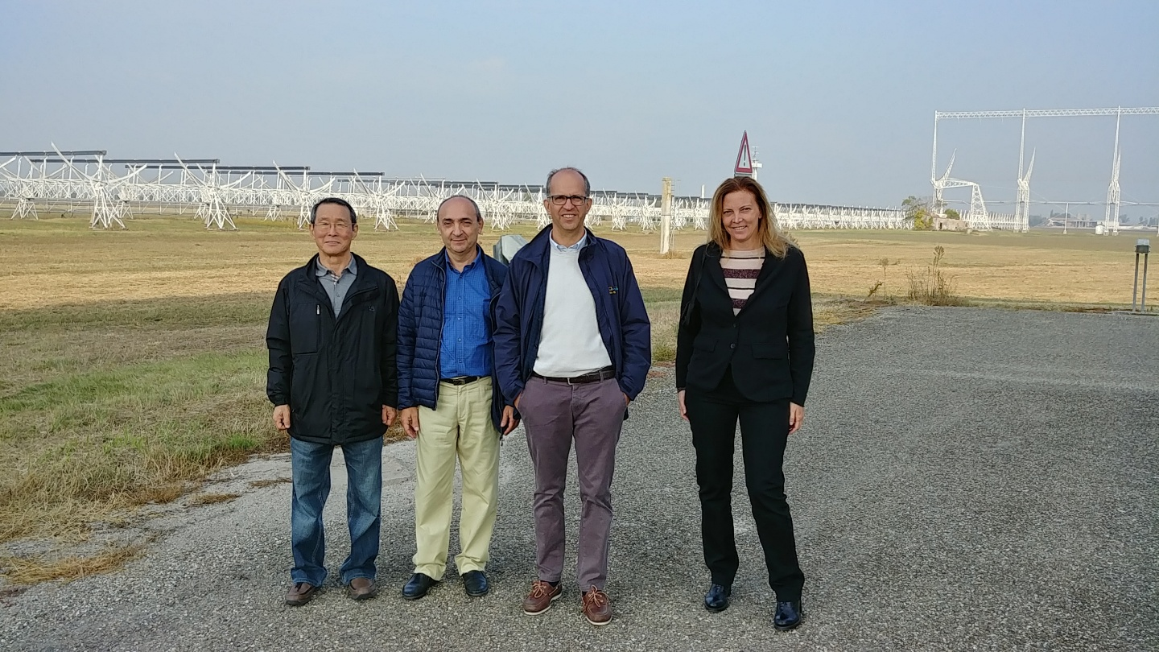
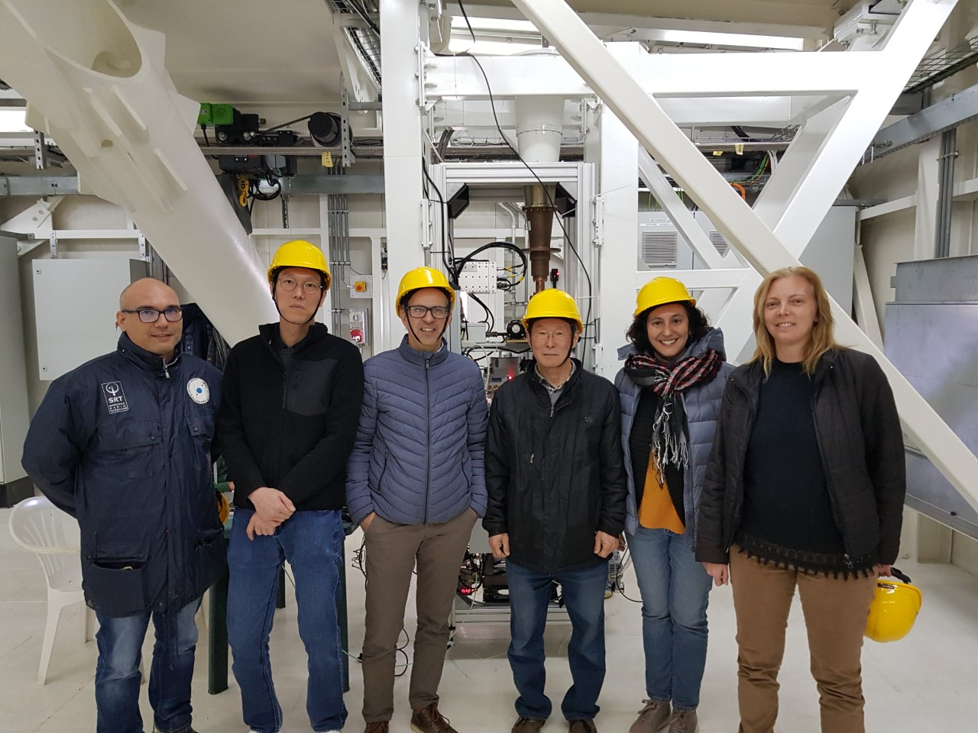
From SRT: Luca Schirru, Giuseppe Carboni, Sergio Poppi, Matteo Murgia, Gian Paolo Vargiu, Mauro Pili, Pierluigi Ortu, Roberto Caocci, Silvio Pilia

Slide 3
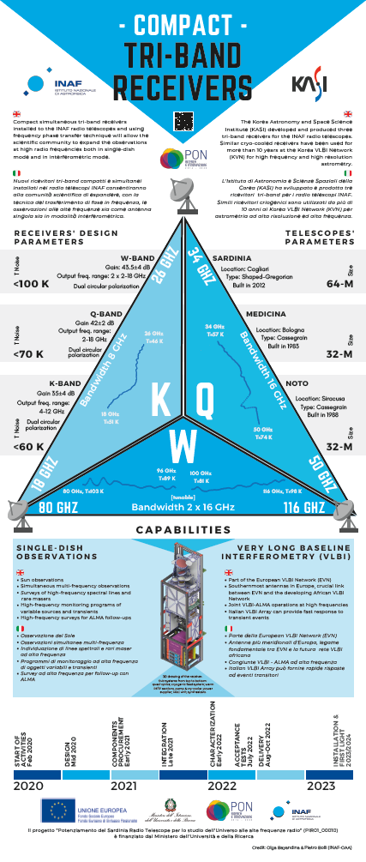
Agenda
Procurement (≤Y2022)
Receiver
Performance
Integration (≥Y2023)

Slide 4

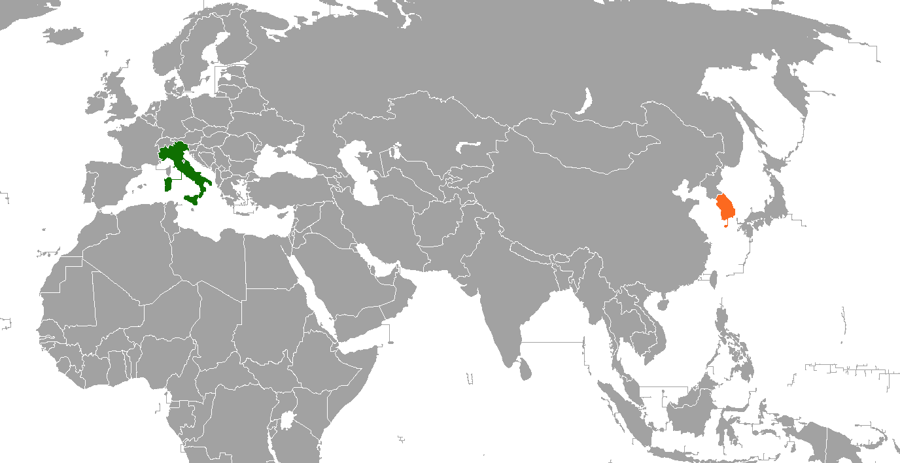
Part i: procurement

Slide 5
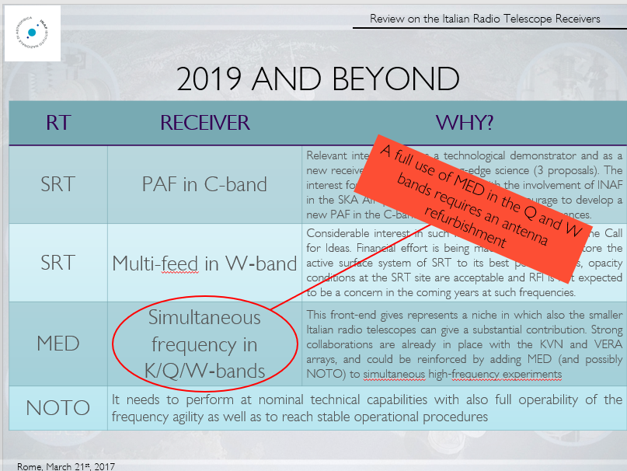


Front-end survey
In 2016/2017, an internal review for future front-ends for the INAF radio telescopes was initiated by the Scientific Directorate of INAF.
Proposal for simultaneous observations at 22, 43, 90 GHz. Based on a receiver being used for >10 years at the Korea VLBI Network for high frequencies astrometry.
By combining observations at two frequencies, it is possible to transfer calibration data from 22 GHz up to ~100 GHz (Frequency Phase Referencing) to compensate for the non-dispersive phase errors due to tropospheric variations, greatly extending coherence time at high frequency.

Slide 6


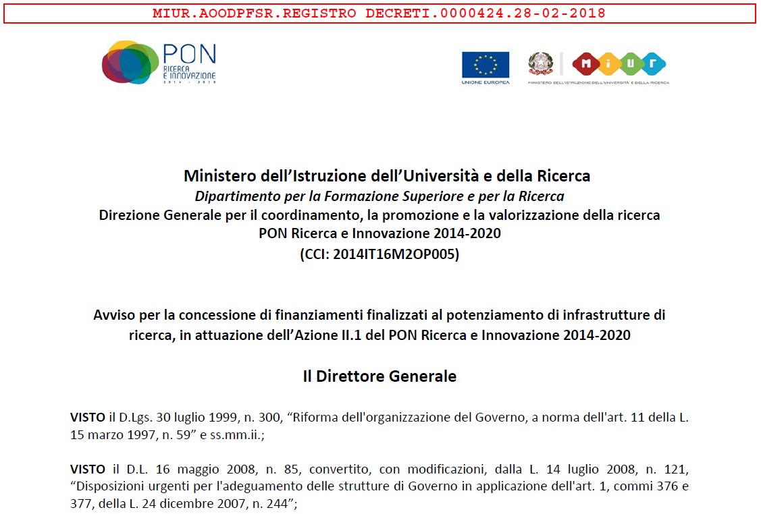
SRT-pon project approved
INAF project: Enhancement of the SRT for the study of the Universe at high radio frequencies – PI: F. Govoni
WP1: Multi-beam cryogenic receiver in W Band for SRT (75-116 GHz) – PI: A. Navarrini
WP2: Multi-beam cryogenic receiver in Q Band for SRT (33-50 GHz) – PI: A. Orfei
WP3: Millimetre camera for SRT (80-116 GHz) – PI: M. Murgia
WP4: Simultaneous mw CTR (K,Q,W-bands) receiving system for the three INAF radio telescopes – PI: P. Bolli
WP5: Backends for SRT – PI: G. Comoretto
WP6: Metrology System for SRT – PI: S. Poppi
WP7: Integration – PI: A. Orlati
WP8: HPC and storage systems for the archival and the use of the SRT data– PI: A. Possenti
WP9: Upgrade of laboratories for the development of microwave technologies – PI: T. Pisanu
Approved budget: ~18.7 M€ (15% outside Sardinia)
Time-scale: 32 months starting from 25 June 2019 → 25 February 2022

Slide 7
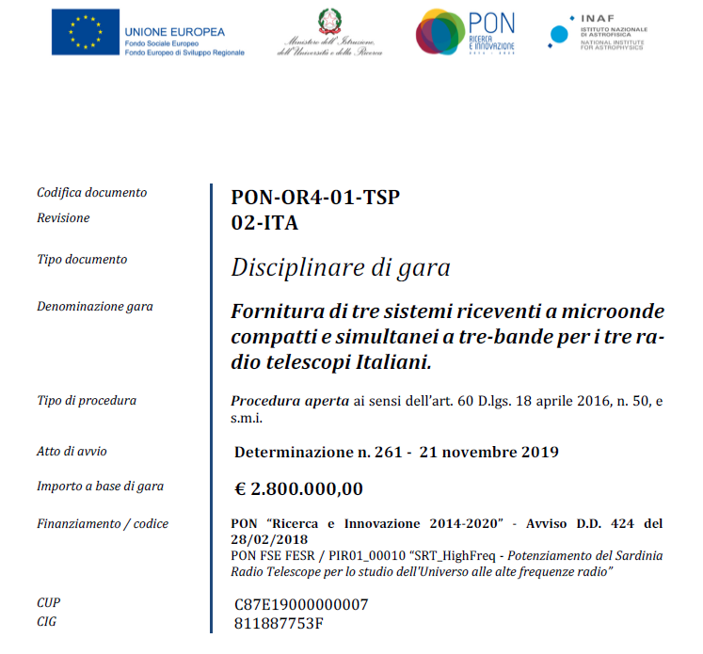
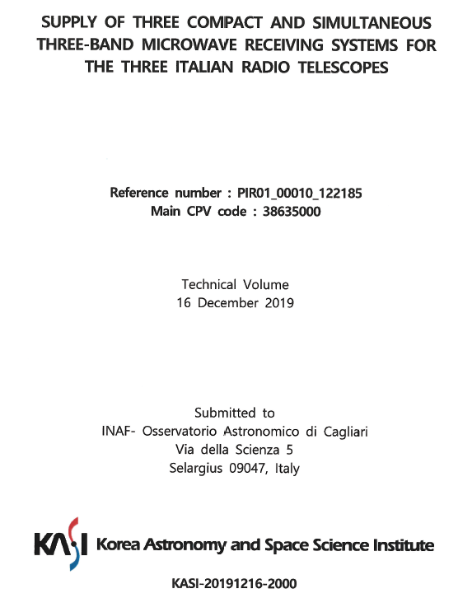
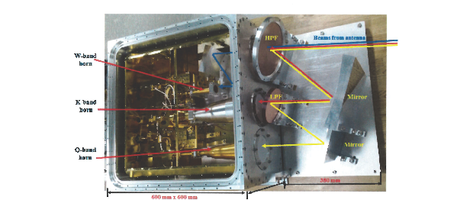
tender
On Nov. 2019, after a first unsuccessful attempt, a call for tender “Supply of three compact and simultaneous three-band microwave-receiving systems for the three Italian radio telescopes” was issued by INAF.
On Feb. 2020, the tender awarded to KASI (only applicant)
Delivery time: 25 months
Budget: 2.8 M€ (w/o VAT)

Slide 8
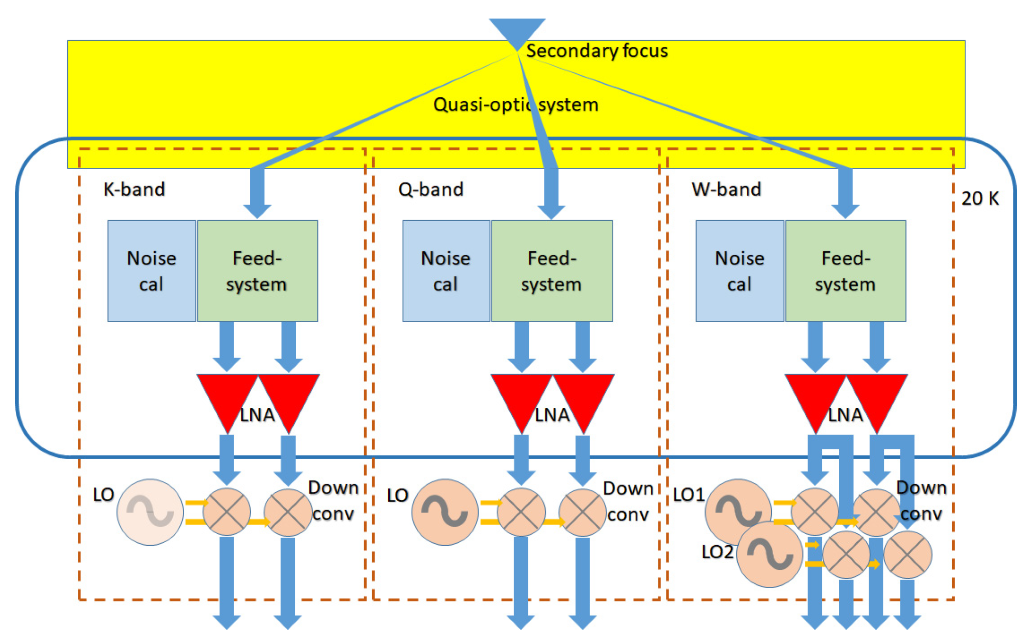
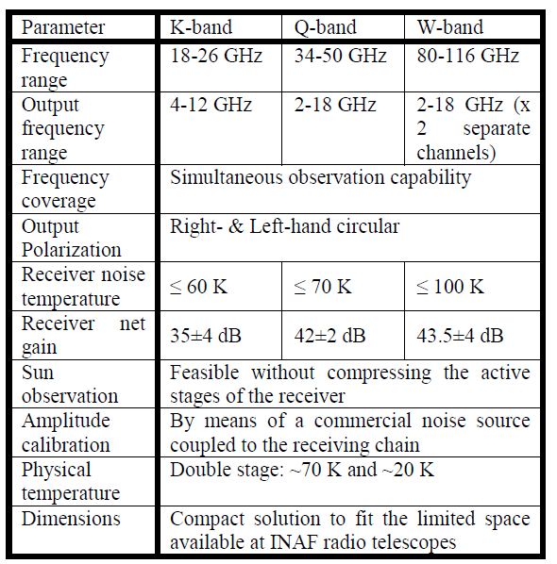
Requirements
3 receivers: 32-m MED, 32-m NOTO, 64-m SRT
4 bands: K, Q, W-low (80-98 GHz), W-high (98-116 GHz)
IF BW = 112 GHz (2 polarizations)
Reasonably good receiver noise temperature
Frequency independent aperture efficiency
High dynamic for sun observation
No chopper system for beam switching / no instrumental phase calibration (phase cal)

Slide 9
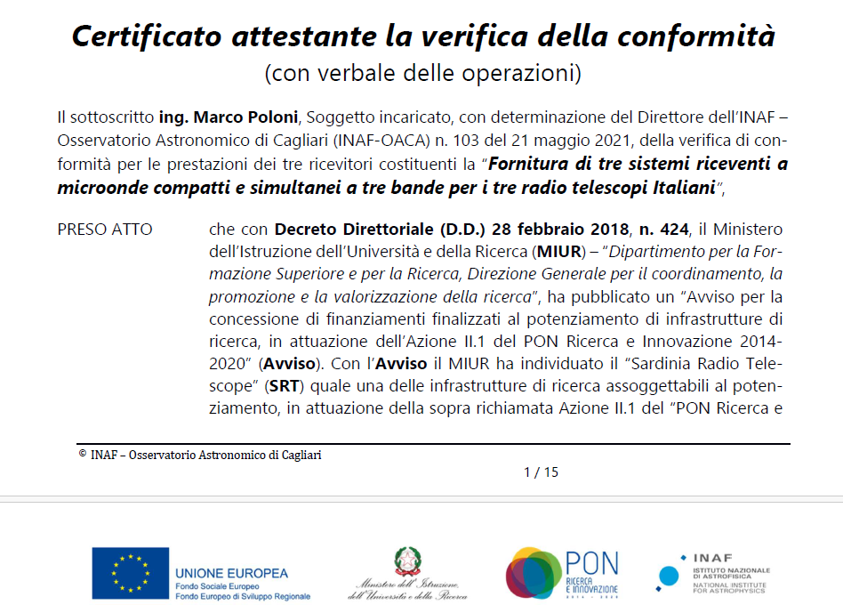

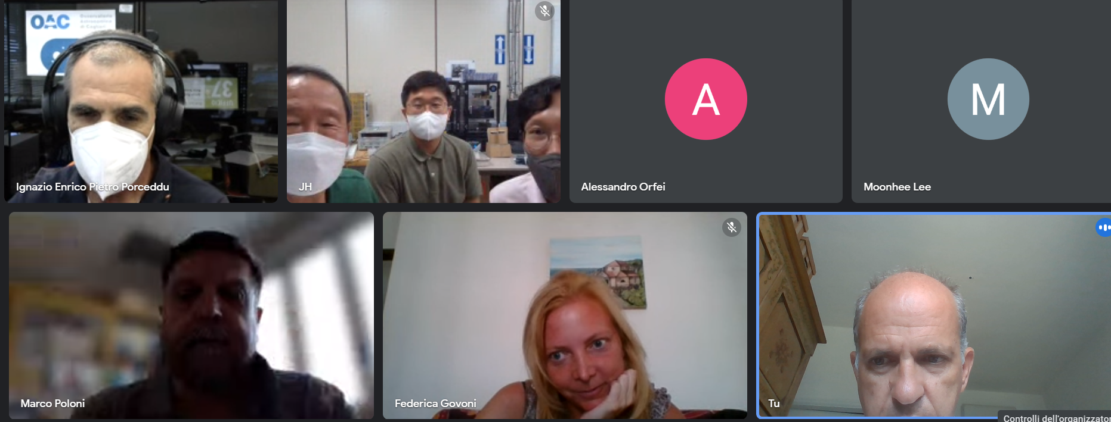
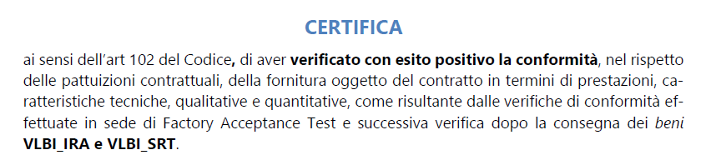
Actual Schedule
PDR ($20%)
CDR ($20%)
FAT ($30%)
Shipment
FAT ($30%)
Shipment
KOM
Contract
COTS ($30%)
2020
2021
2022
March/April
May /June
July/August
Sept/Oct
Nov/Dec
Jan/February
March/April
May /June
July/August
Sept/Oct
Nov/Dec
Jan/February
March/April
May /June
July/August

Slide 10

the tri-band receiver has been proposed by the INAF radio astronomical community. thanks to fortunate circumstances three units were immediately funded.

Slide 11
in recent years (PON/PNRR) there has been a strong tendency to purchase receivers. skills in R&D on RECEIVER technology are therefore decreasing in our institute.

Slide 12
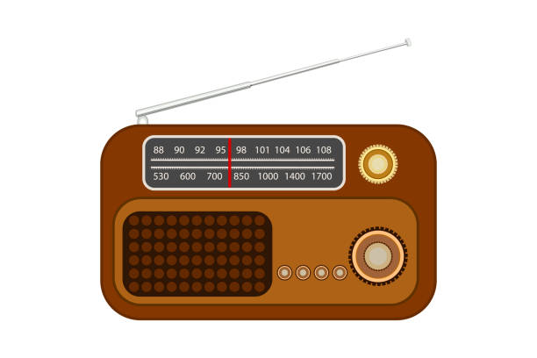

Part ii: receiver

Slide 13
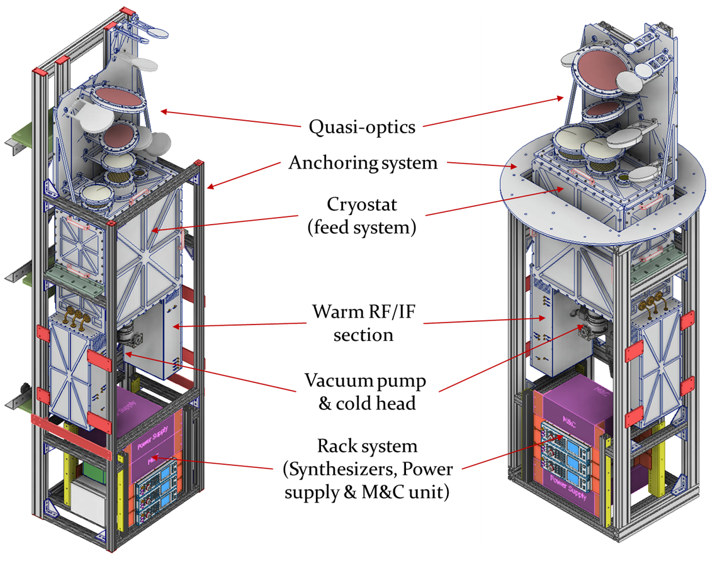

SRT
MED/NOTO

Slide 14
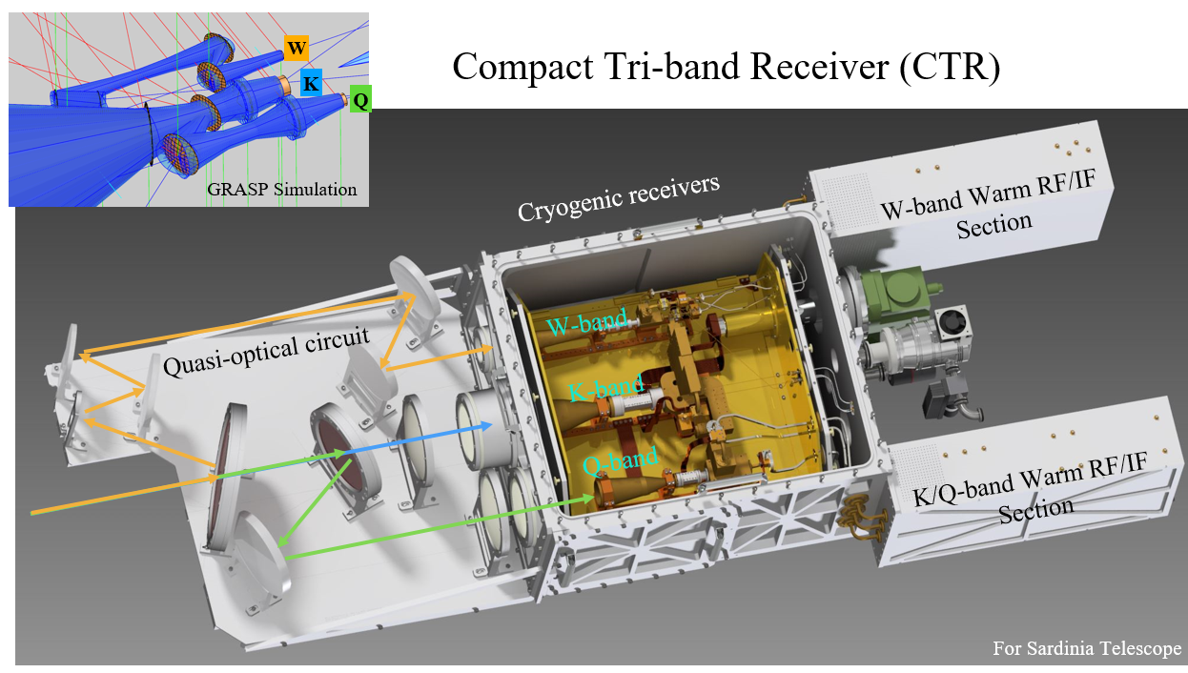
Yellow box

Slide 15
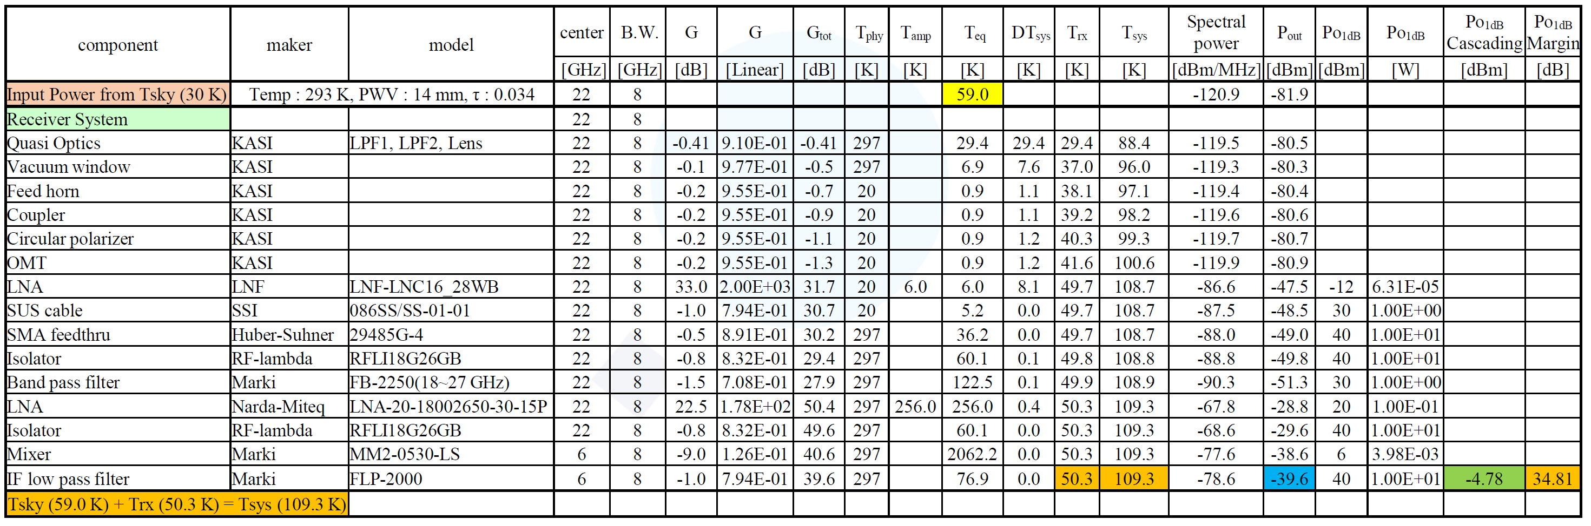
Noise Power Budget Estimation
22 GHz

Slide 16
W-band

Slide 17
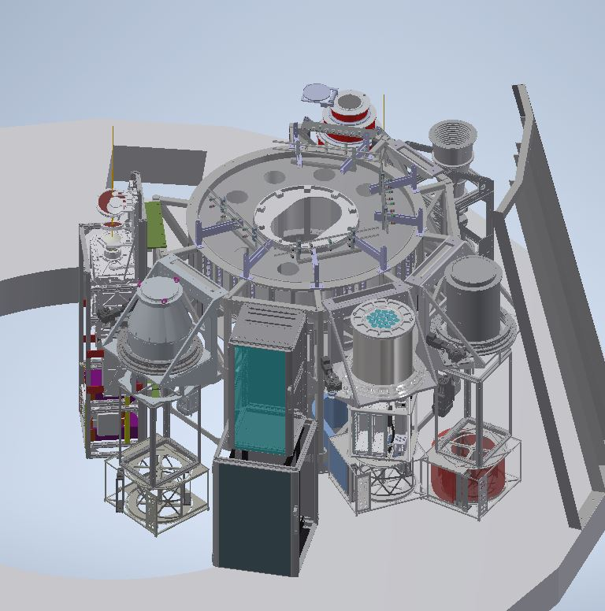
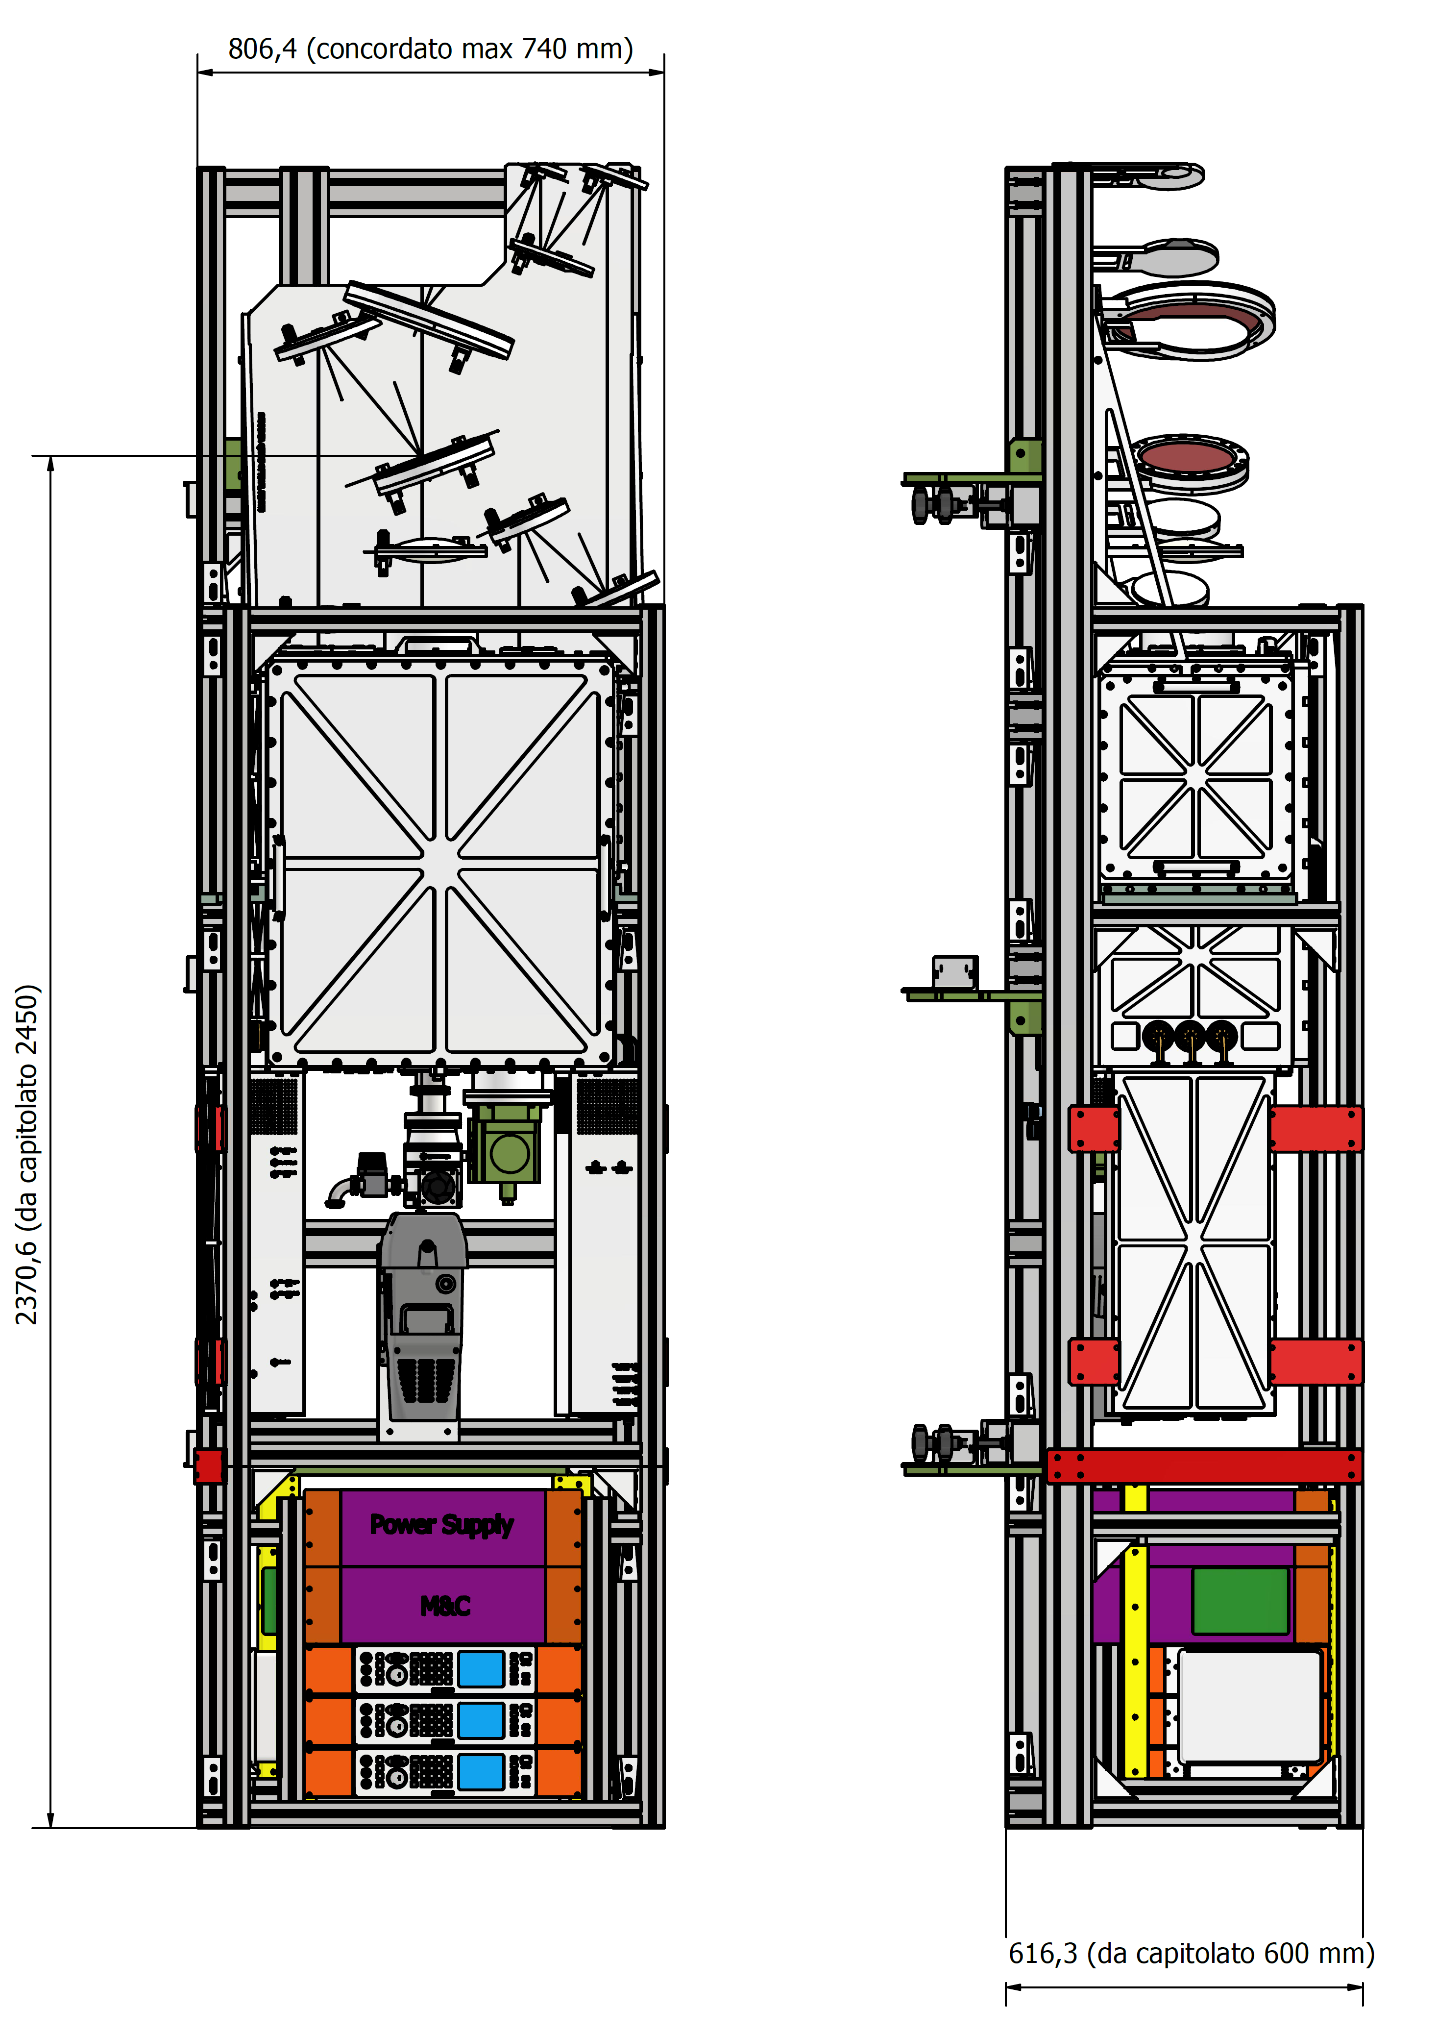
W-band
bolometer
~2.9 m
Antenna
focus
High-
C-band
Tri-band
Q-band
MF
K-band
MF
W-band
MF
Weight ~350 kg
Rack

Slide 18
the tri-band receivers are custom systems designed by kasi in tight collaboration of INAF. they are conceived to satisfy all inaf radio telescopes constraints and interfaces.

Slide 19
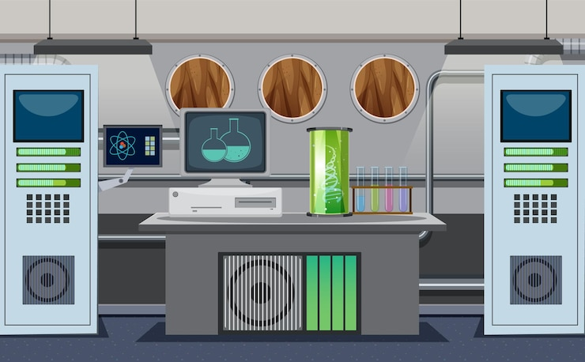
Part iIi: performance

Slide 20
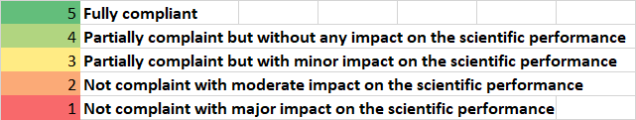
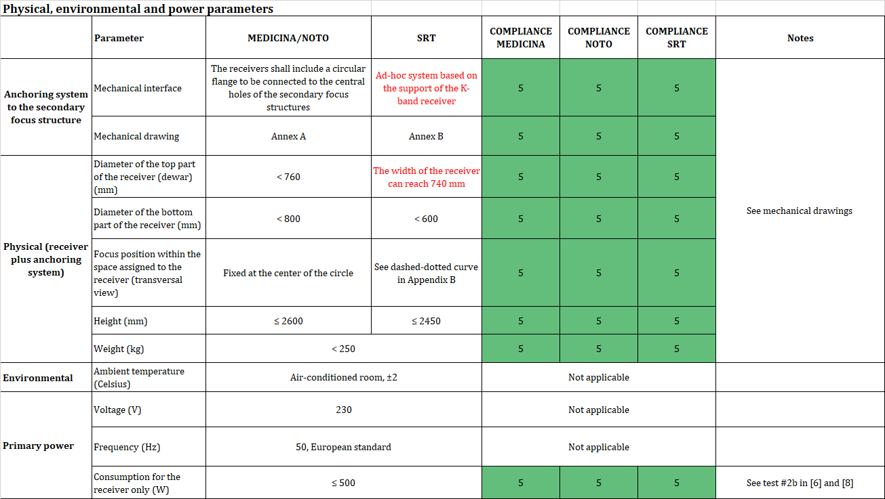
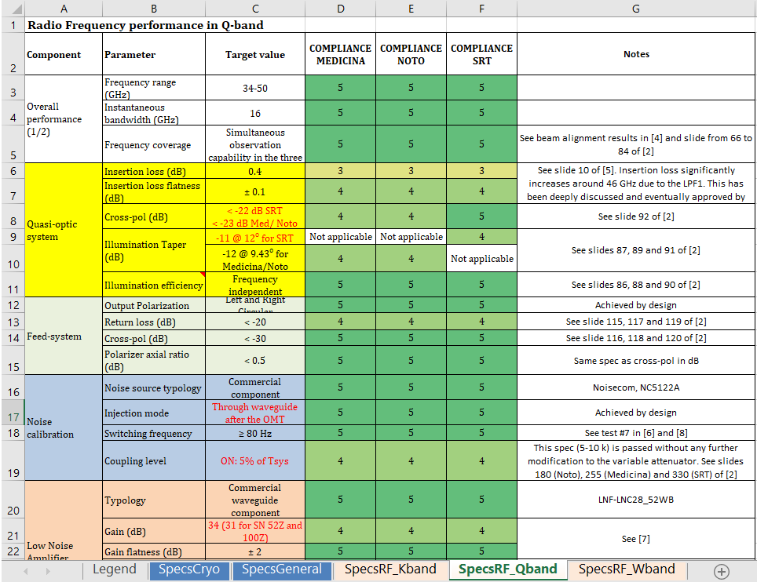
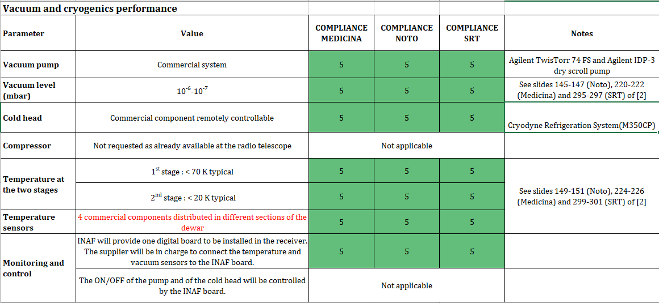
specs compliance

Slide 21
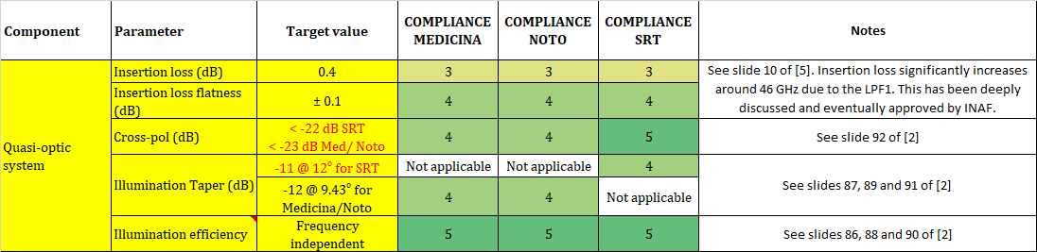
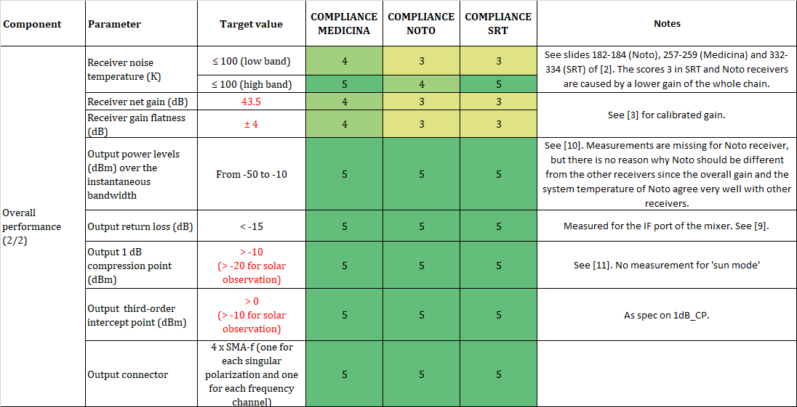
Q-band
W-band

Slide 22
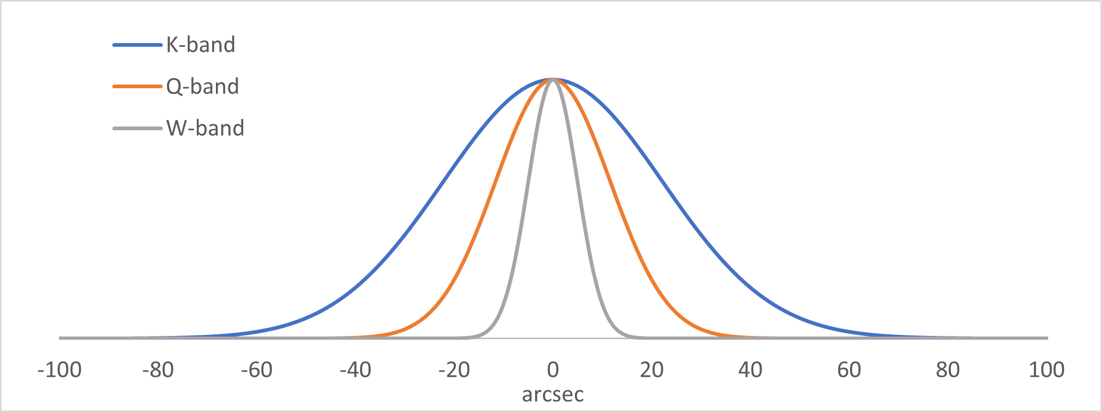
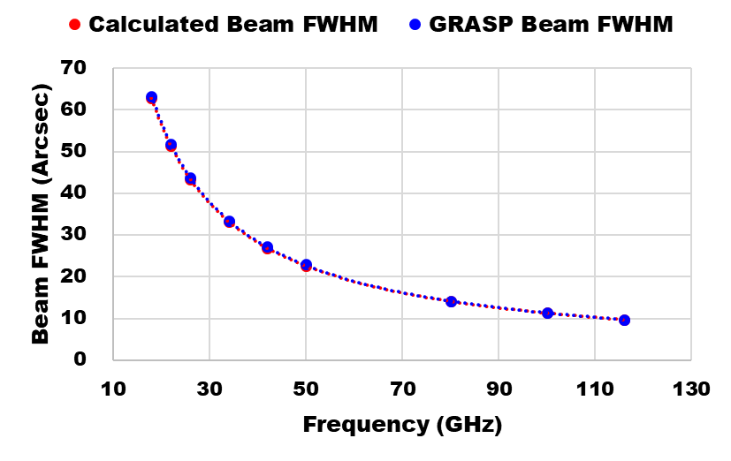
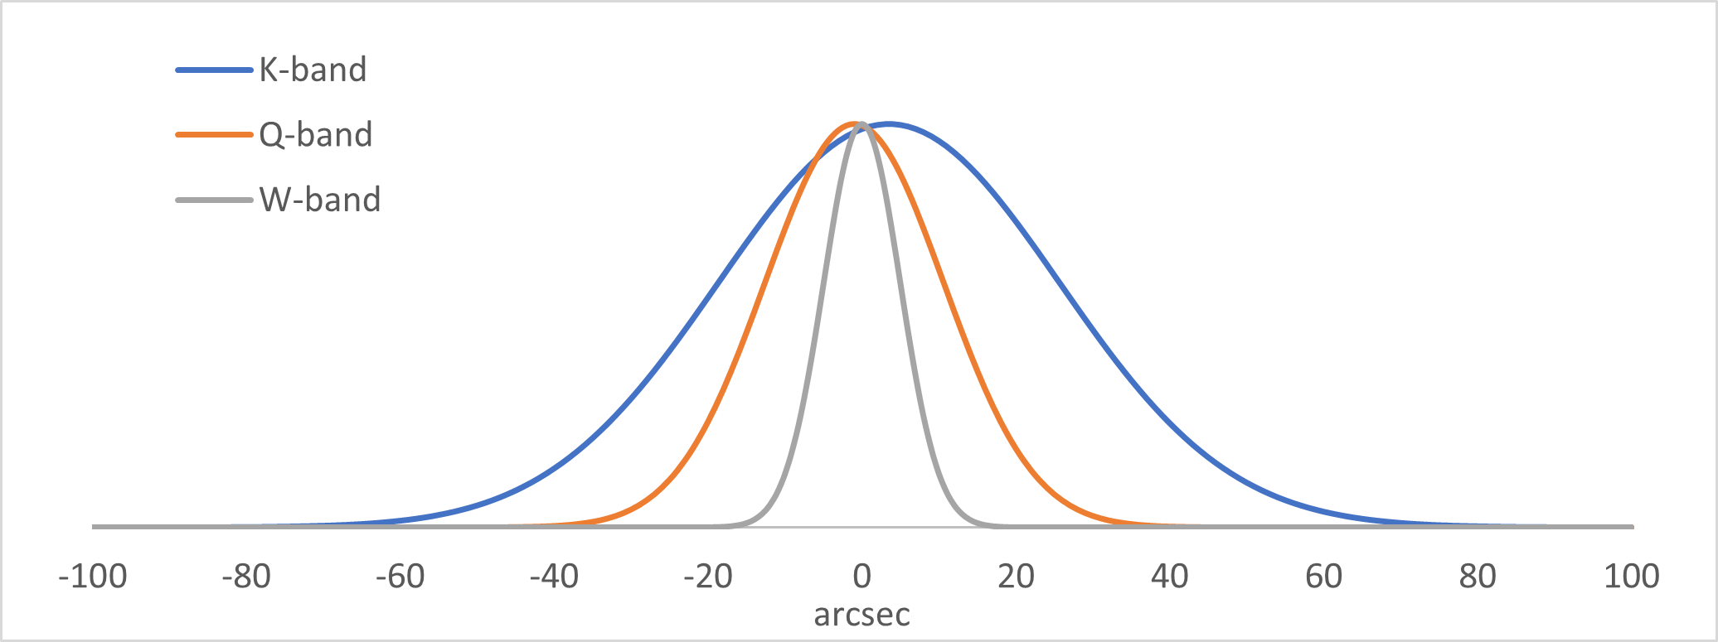
Beam alingment
Ideal
Real

Slide 23
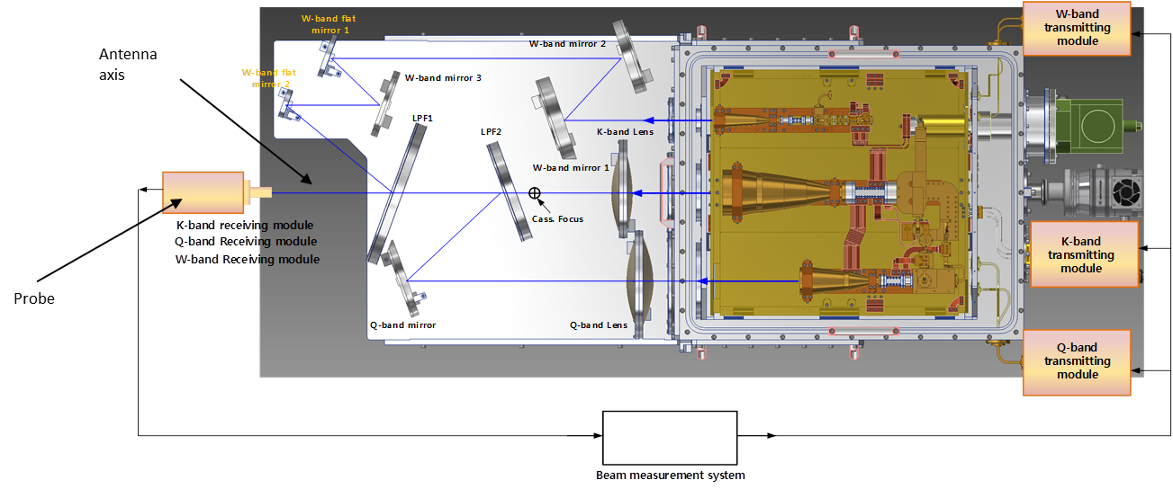
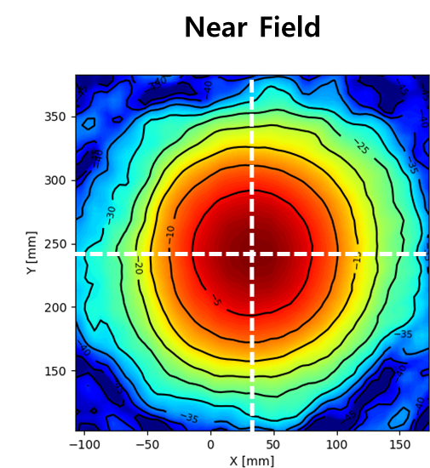
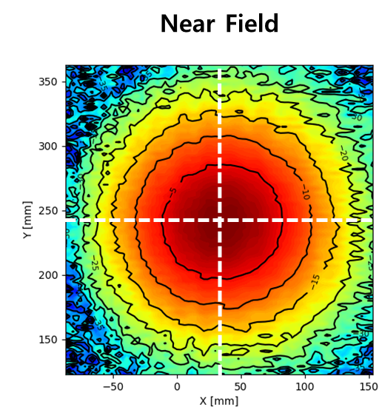
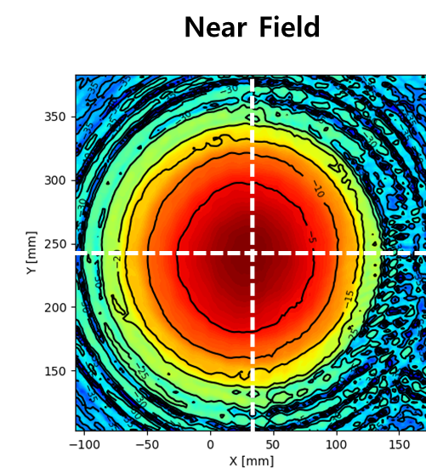
Beam alingment
Near-field lab measurement at room and cryogenic temperatures. Crucial to conduct simultaneous observation for K/Q/W-bands.
Beam alignment error among the three frequency channels < 2-3 mm.
This corresponds to:
pointing off-set < 4-5 arcsec (wrt the W-band beam)
antenna efficiency loss < 3%
22 GHz
42 GHz
99 GHz

Slide 24
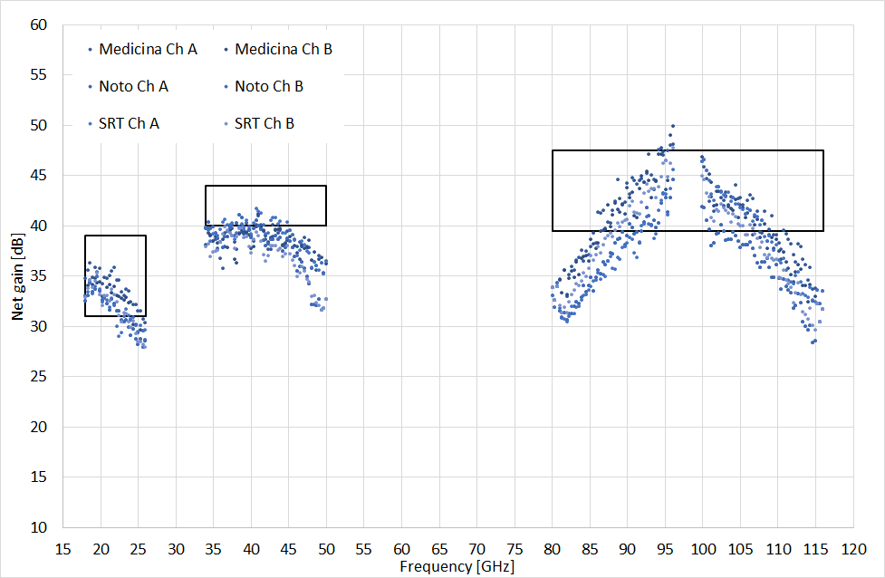
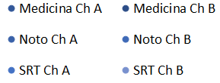
Receiver gain
Receiver Gain

Slide 25
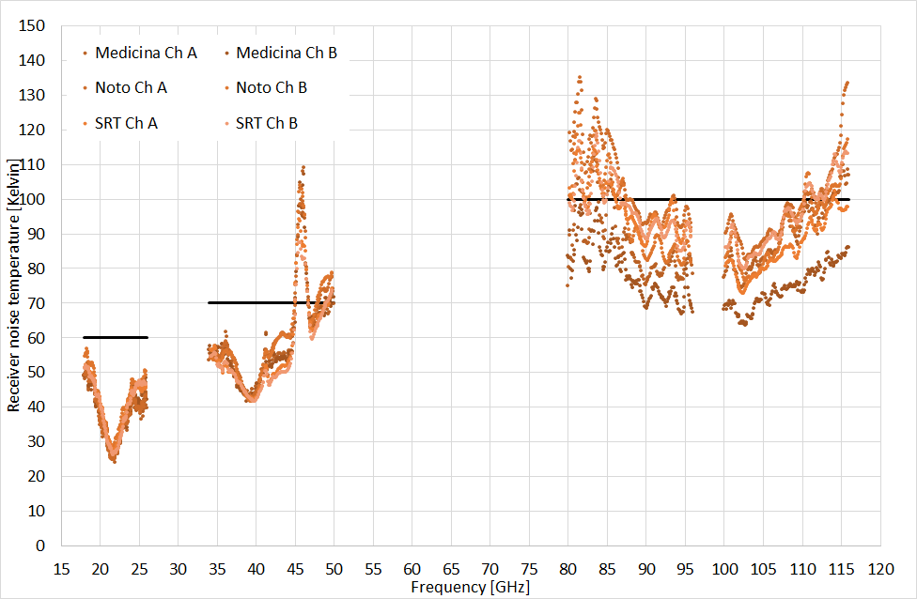
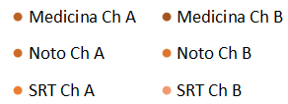
Receiver noise temp.
Notes:
For W-band, LO is set to 98 GHz. However, the gain and the noise temperatures between 96 to 100 GHz can be measured by tuning the LO frequency

Slide 26
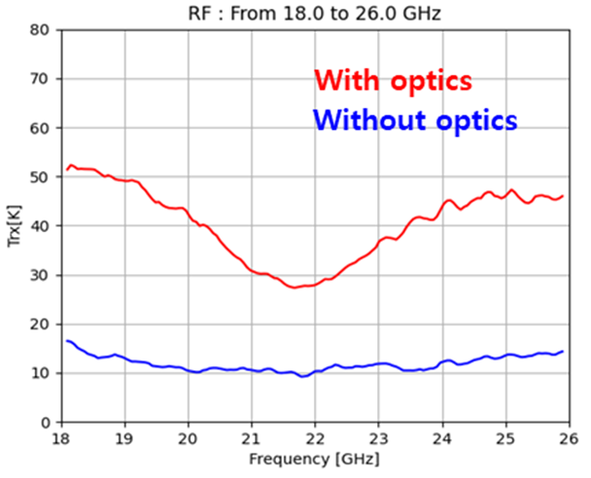
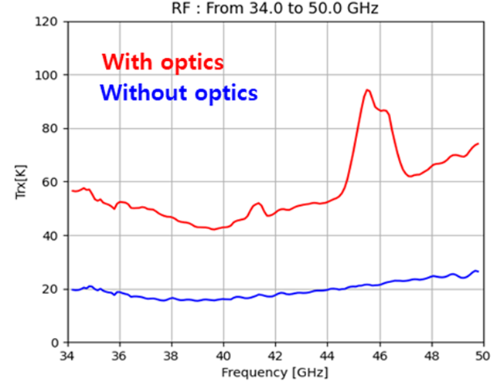
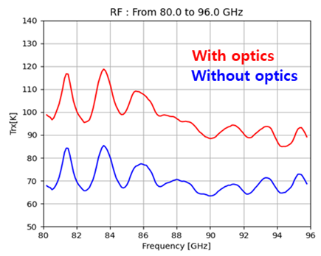
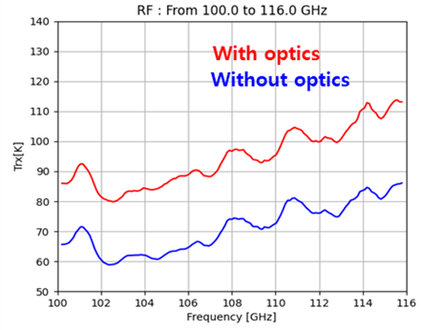
QO loss 0.45-0.4dB
K-band
Q-band
QO loss 0.2dB
W_{low}-band
W_{high}-band
Notes:
K-band: 60 k vs Mfeed at SRT = 20-40 K (measured)
Q-band: 70 k vs Mfeed under-development for SRT = 22-35 K (estimated)
W-band: 100 k vs CARUSO under-development for SRT = 75 K over 80% of 75-116 GHz (specification)

Slide 27
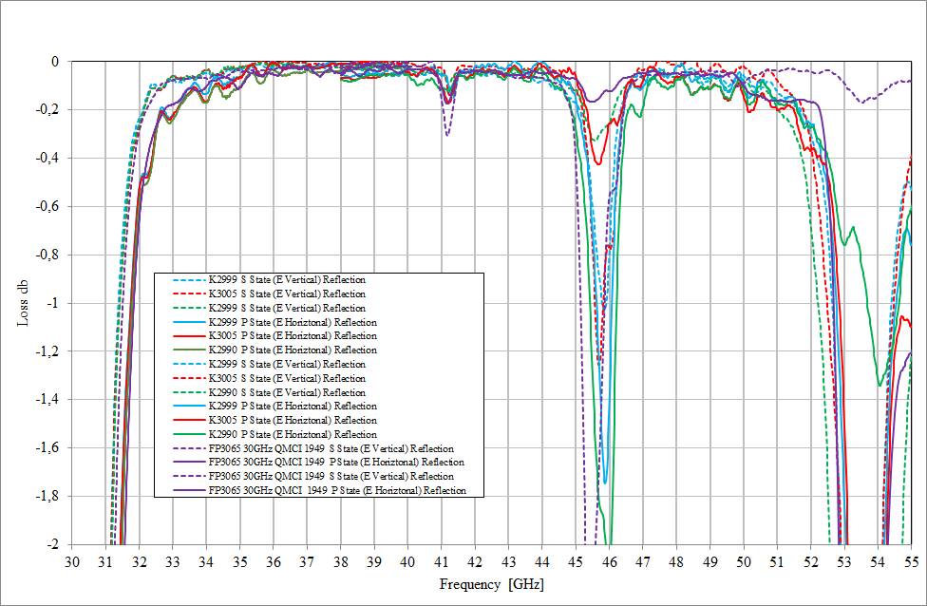
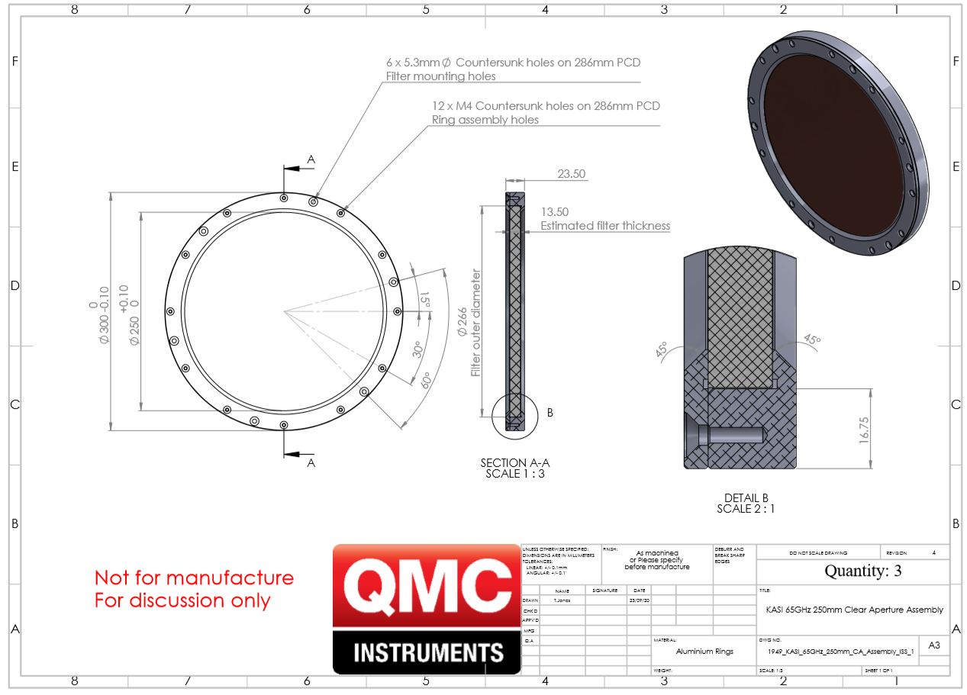
Low paSS FILTER # 2
Transmit K-band / reflect Q-band
Resonance in the reflection coefficient at 46 GHz
Target loss → 0.2 dB = 14 k
Measured loss → 0.7 dB = 50 k

Slide 28
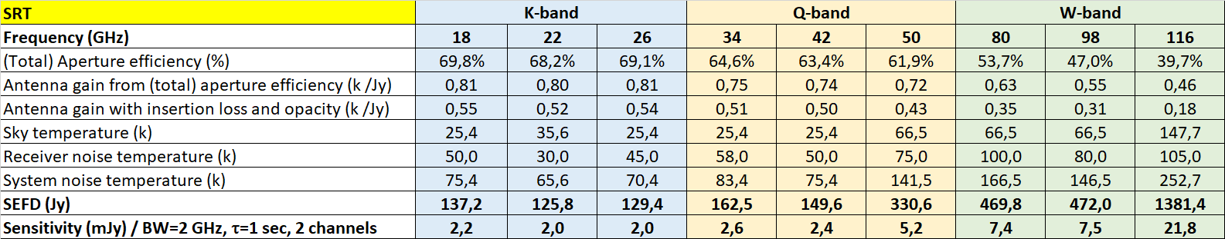
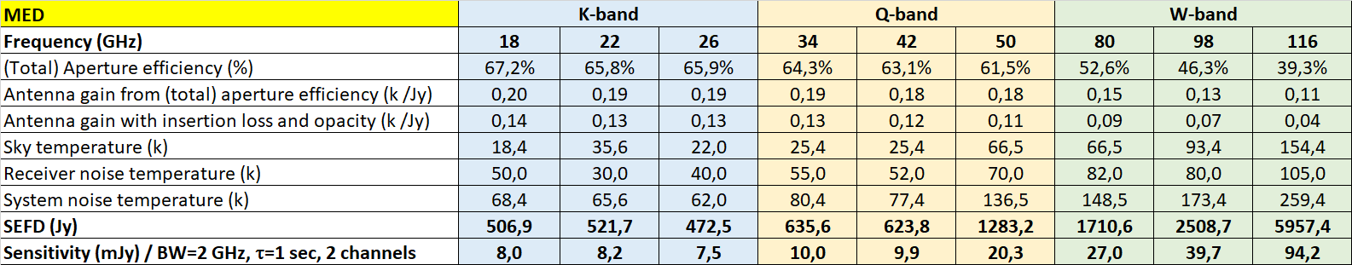
Sensitivity (expected)

Slide 29
Altough frequency simultaneity does not come for free, the tri-band receivers are state of the art equipments.

Slide 30
Part iV: integration

Slide 31
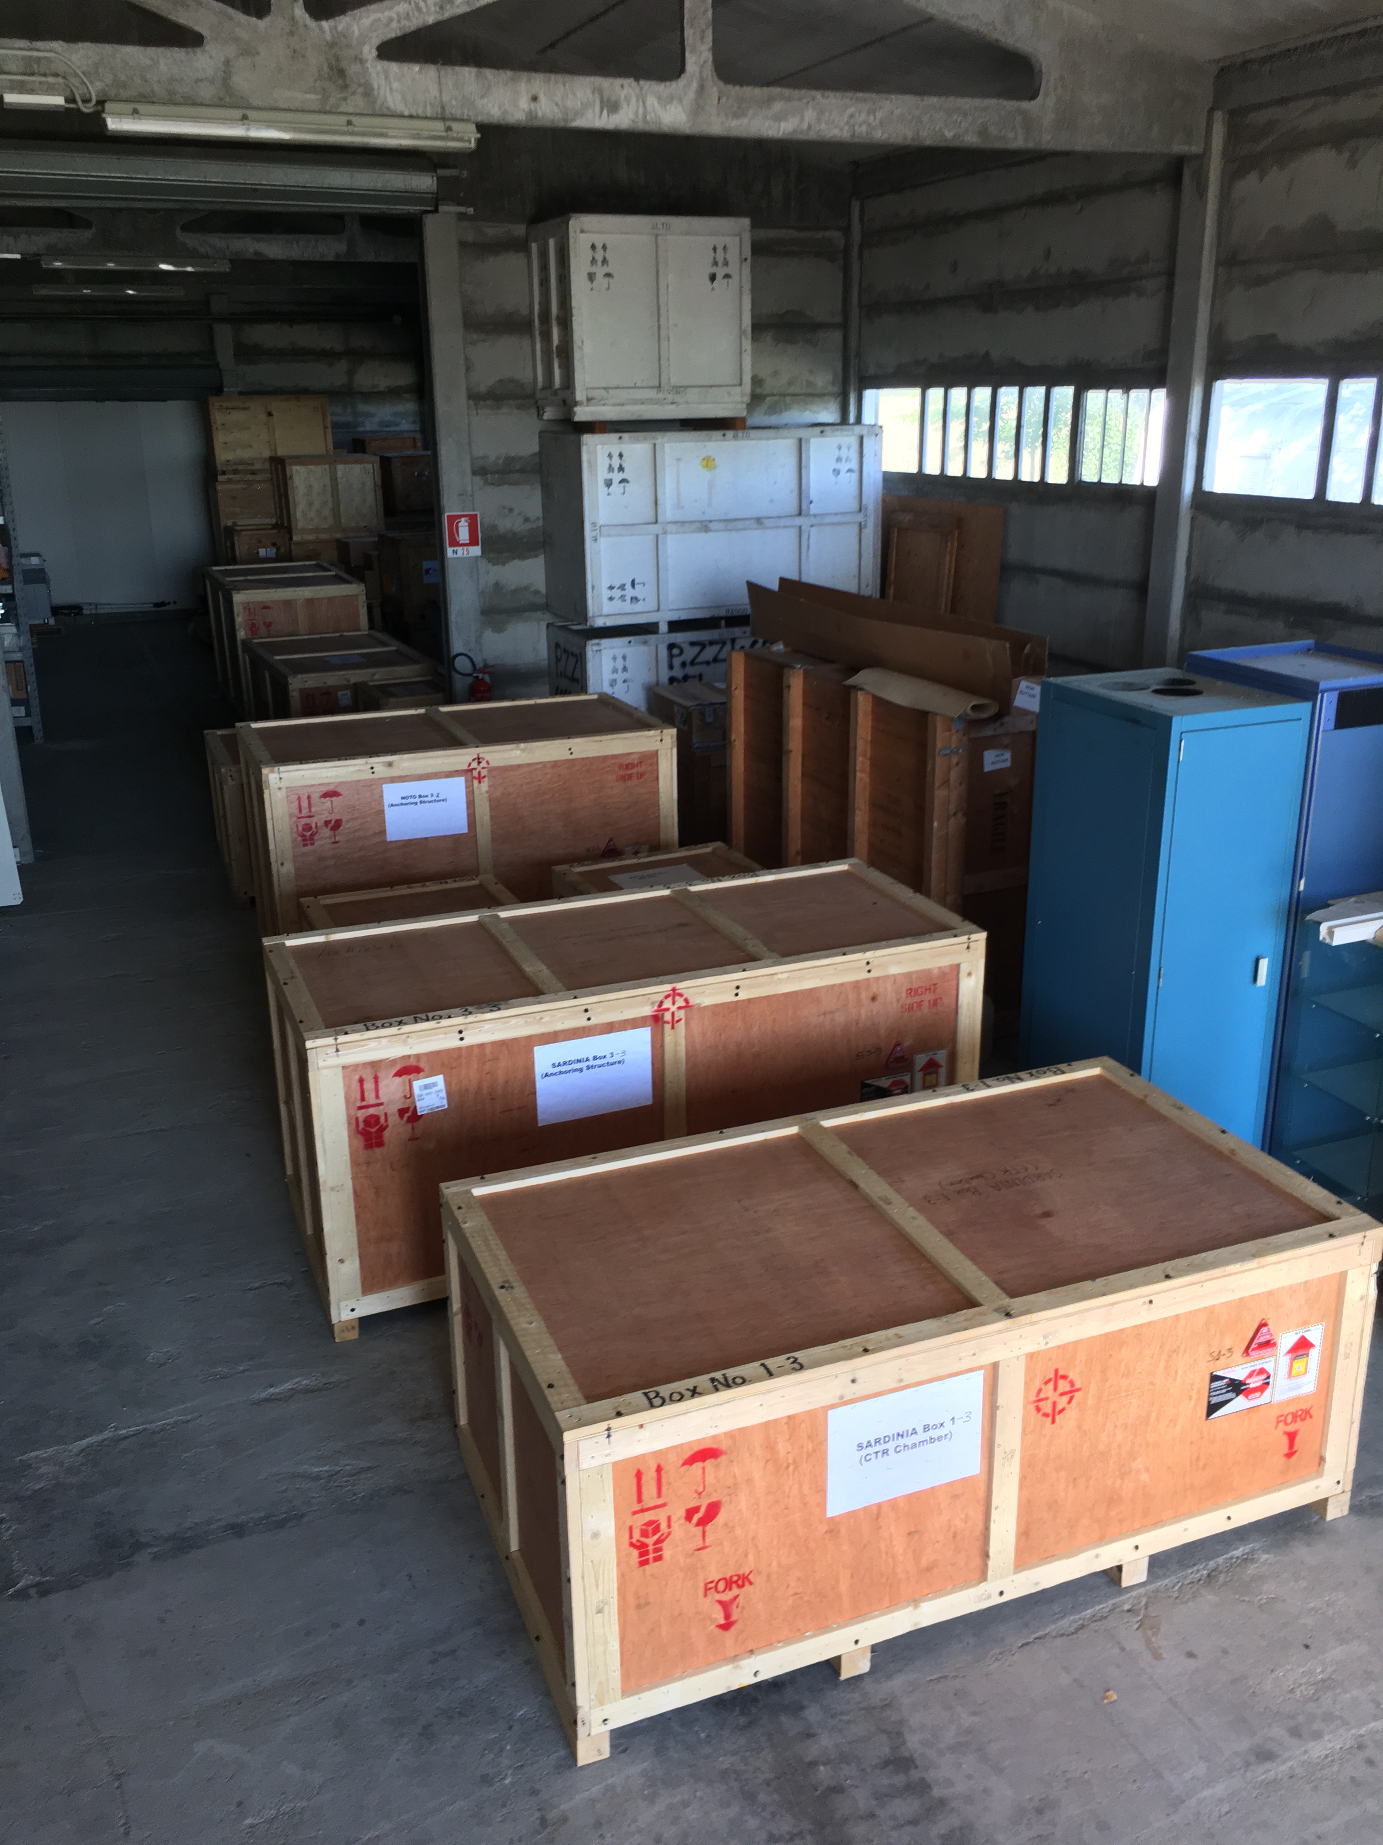
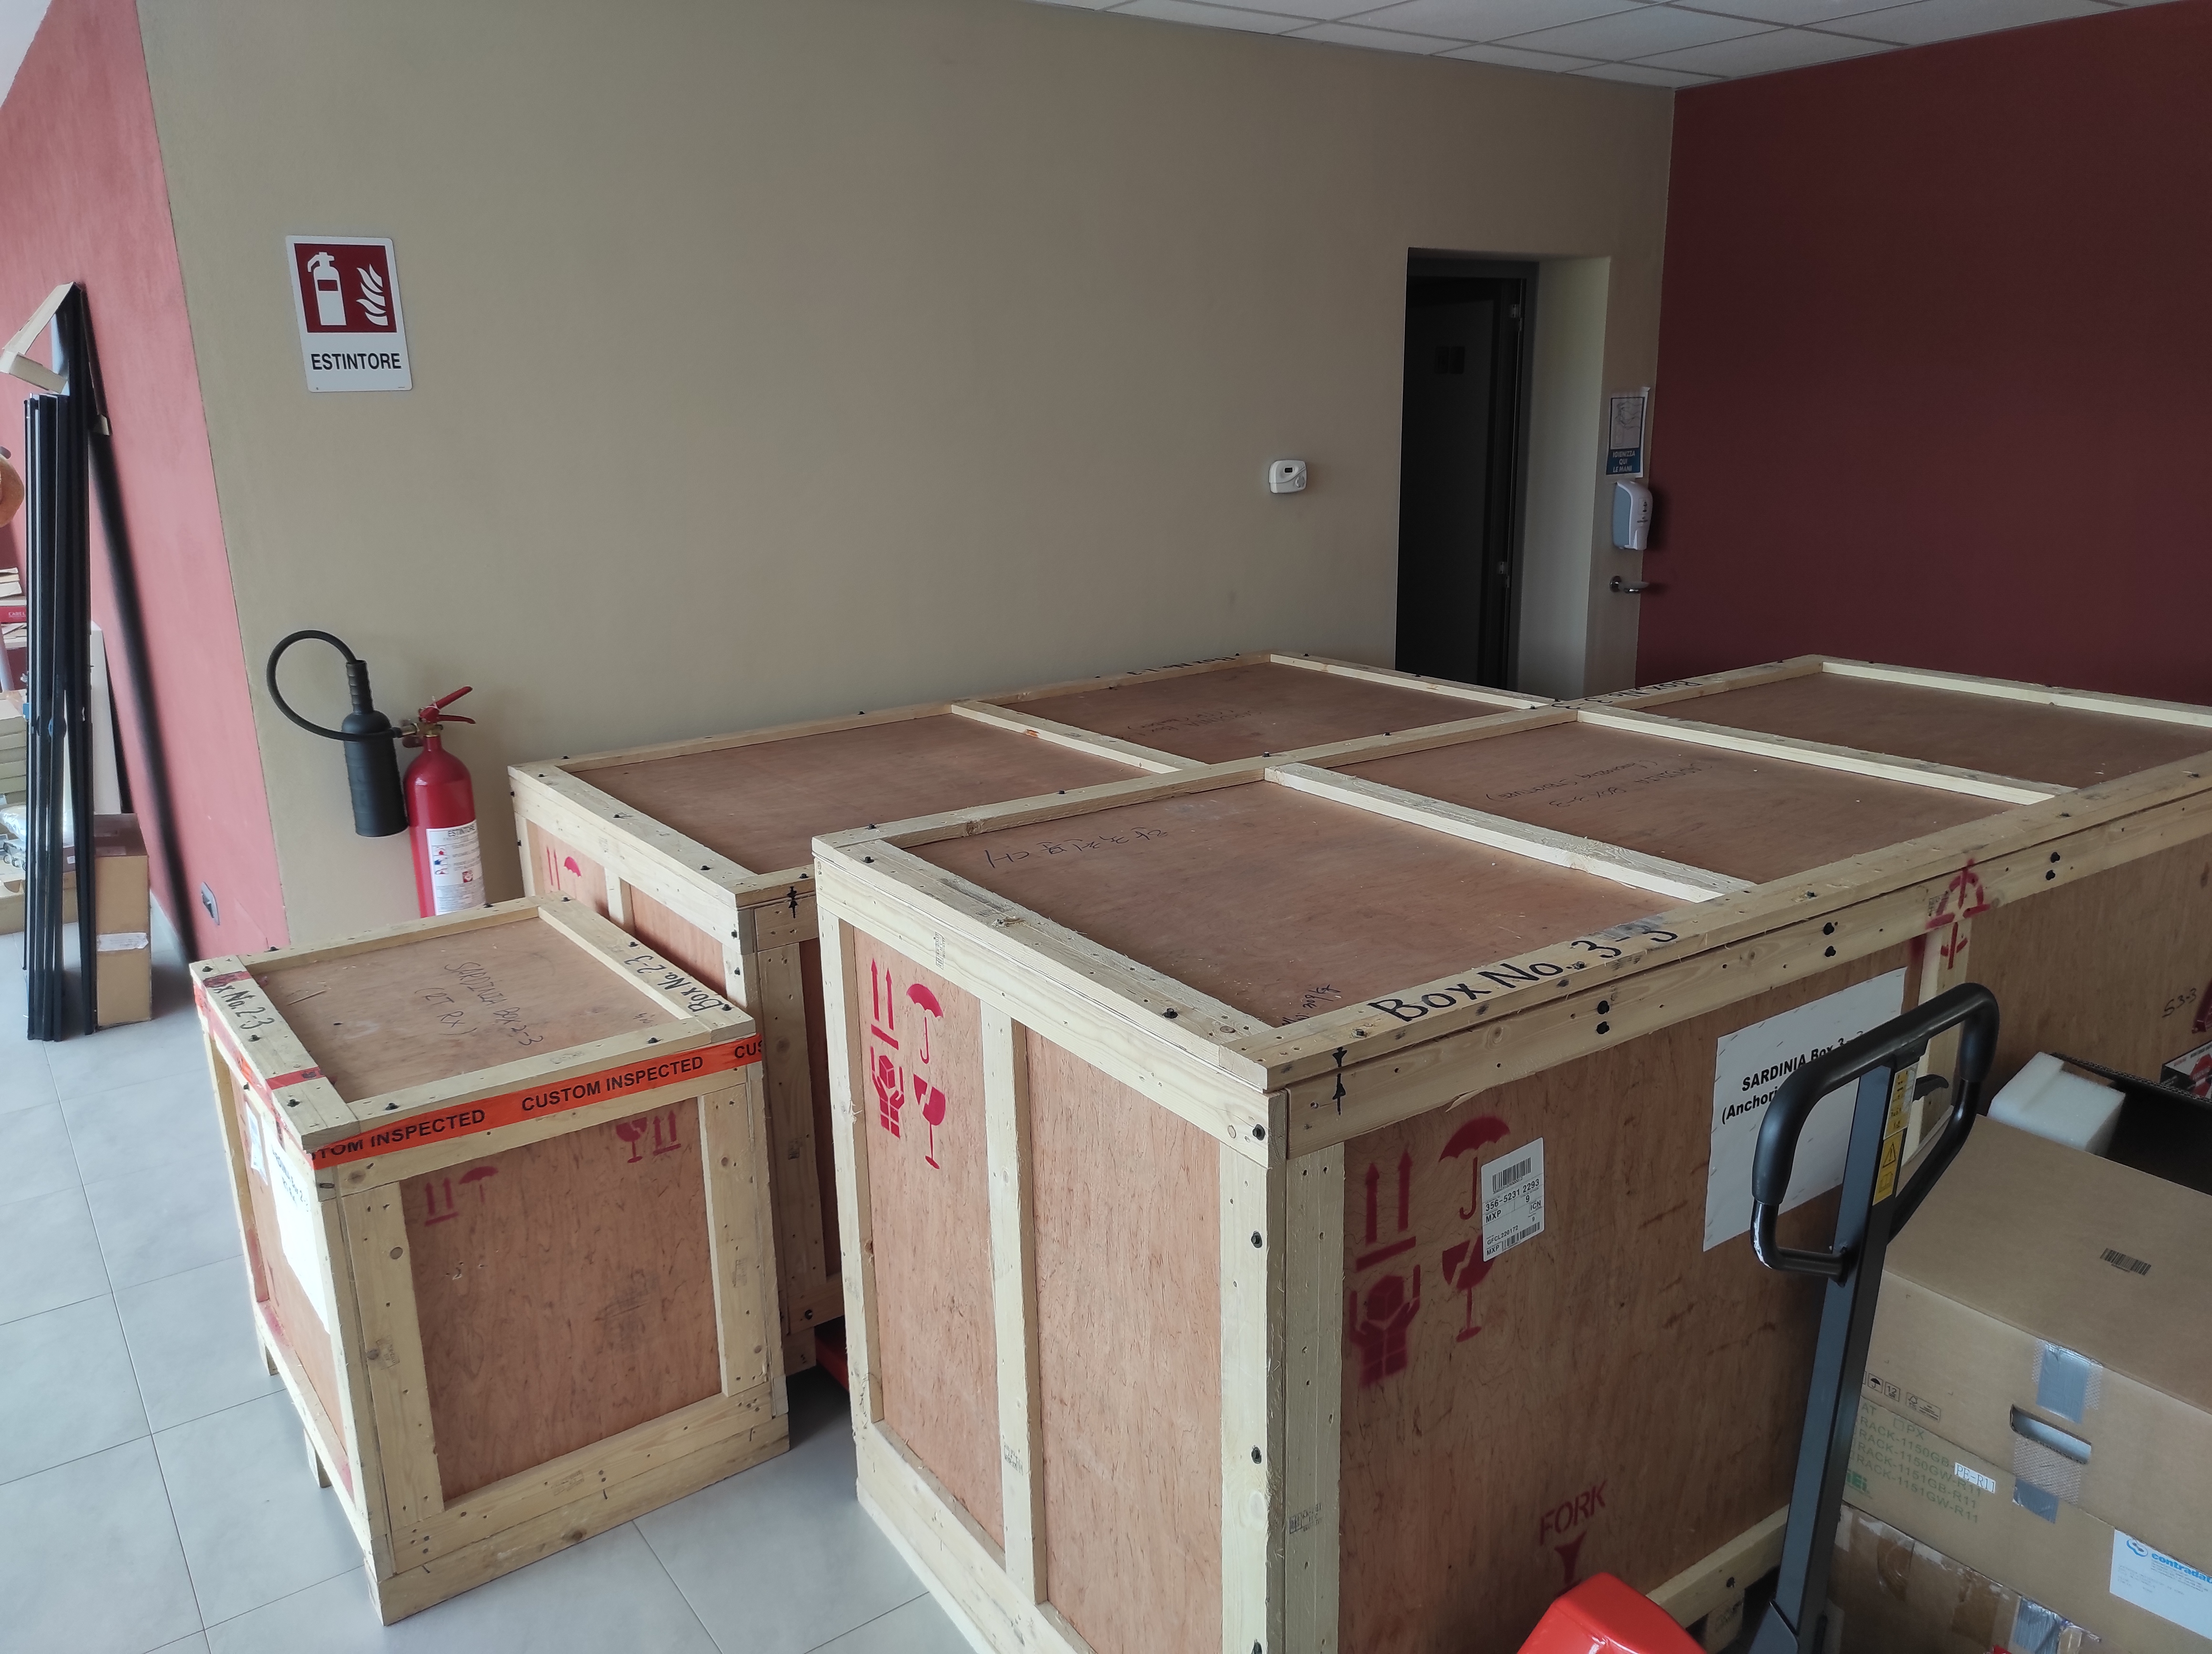
Receivers arrival: august 2022
MED
SRT
Foto Noto e SRT

Slide 32
After that …….
 | Verification in INAF laboratories (vacuum, cooling, RF, M&C)
SRT | Skipped
MED | Sept. 2023 / Jan. 2024
NOTO | Nov. 2024

Slide 33
After that …….
 | Verification in INAF laboratories (vacuum, cooling, RF, M&C) | Installation on the radio telescope (mechanical fitting and other tests)
SRT | Skipped | July 2023
MED | Sept. 2023 / Jan. 2024 | Sept. 2025
NOTO | Nov. 2024 | Nov. 2024 / April 2025 (now removed)

Slide 34
After that …….
 | Verification in INAF laboratories (vacuum, cooling, RF, M&C) | Installation on the radio telescope (mechanical fitting and other tests) | Preliminary tests in antenna, first light and commissioning
SRT | Skipped | July 2023 | Since July 2024 (not continuosly)
MED | Sept. 2023 / Jan. 2024 | Sept. 2025 | >2025
NOTO | Nov. 2024 | Nov. 2024 / April 2025 (now removed) | >2026

Slide 35



MED
SRT
NOTO

Slide 36


See talks on Tuesday morning:
SRT status and challenges, S. Poppi
Multi-frequency enabling at the stations of Medicina and Noto, A. Orlati
Notes:
Three units purchased, one for each of INAF radio telescopes (PON project).
Current hardware only allows to handle 6 IFs. Ongoing upgrade to expand to 8 IFs.
Each IF has a 4 GHz input bandwidth.

Slide 37

Temporary solution
PHAROS multi-channel heterodyne rack is used to realize the operations of filtering, RF amplification and down-conversion from 2-8 GHz to 10–700 MHz → Only narrow band test and with constraints in the sky frequencies!
Combined with single-dish back-end SARDARA (Sardinia ROACH2-based Digital Architecture for Radio Astronomy) / fully operational since 2018.
Receiver is operated without using the dedicated component (not yet fully integrated in DISCOS).
Notes:
Per applicazioni single-dish, a regime si useranno le SKARAB, al momento il sistema è stato solo parzialmente commissionato quindi si sta usando SARDARA che è invece fully-operational dal 2018 e quindi molto più attendibile e affidabile.
Il DBBC3 si usa solo in modalità VLBI, a parte un piccolo problema con un connettore interno che a volte fa perdere la connessione sarebbe già utilizzabile per dei test VLBI. Tuttavia, l'EVN non ha ancora fatto azioni decise per passare dal DBBC2 al DBBC3.

Slide 38







RF Tests at INAF
MED, Poloni
NOTO, Mariotti
SRT, Schirru
Notes:
The component to integrate the control of the tri-band receiver under DISCOS is almost completed.

Slide 39



condensation
Differential temperature (ΔT) between vacuum window and ambient temperature: 13 °C.
NOTO/MED receivers upgraded with thermal insulators (foam) → ΔT = 6 °C.

Slide 40


Waveguide switches
Issues with the remote control of the W-band switches at SRT. Now solved by adjusting some jumpers in the controller board.
CH_B_SW1
TTL High – POS-2
CH_B_SW2
TTL High – POS-2
CH_B_SW1
TTL Low – POS-1
CH_B_SW2
TTL Low – POS-1
Normal Observation Mode (LNA included)
Sun Observation Mode (LNA Bypass)
CH_A_SW2
TTL Low – POS-1
CH_A_SW1
TTL High – POS-2
CH_A_SW2
TTL High – POS-2
CH_A_SW1
TTL Low – POS-1
LNA
(Gain : 26 dB)
LNA
(Gain : 26 dB)
Waveguide
Switch

Slide 41



If band
SRT
Gain reduction (~10 dB):
SRT:
Q-band ch. B
W-high ch. B
NOTO:
Q-band ch. B
MEDICINA:
OK (during lab tests)
K BAND
Q BAND
W-LOW BAND
W-HIGH BAND
Notes:
banda K (alto a sinistra), banda Q (alto a destra), banda W-low (basso a sinistra) e W-high (basso a destra).

Slide 42


Pointing Focus in k-band (19 Ghz)
FWHM (arcsec)
Meas: 58.7±1.4
Sim (GRASP): 60.44

Slide 43








uncalibrated maps of 3c84 @ srt

Slide 44


First ever Q-band images at srt

Slide 45
Validation at srt
Tests | K | Q | W-low | W-high
IF band | Ch. A: OK Ch. B: OK | Ch. A: OK Ch. B: NO | Ch. A: OK Ch. B: OK | Ch. A: OK Ch. B: NO
Focusing | OK | OK | Not yet | Not yet
Pointing | OK (ele ~ 45°) | OK (ele ~ 45°) | OK (ele ~ 45°) | OK (ele ~ 45°)
Cal. mark | OK | OK | OK | OK
Mapping | OK | OK | OK | OK
System temperature | Higher than expected | Higher than expected | Higher than expected | Higher than expected
Antenna gain | Almost as expected | Lower than expected | Lower than expected | Lower than expected
Repeatability | Not yet | Not yet | Not yet | Not yet

Slide 46
At the receiver arrivals, The radio telescopes were far to be ready to operate the PON receivers. even now some equipment is still not available. warranty expired; kasi always supportive.

Slide 47
the first light is coming now at medicina, while several tests completed at SRT. Some issues are being noted requiring a continuous allocated time to fully debug the receivers. great opportunity to have three equal receivers.

Slide 48

Thank you

