Slide 1


Slide 2
AI agents can help us do faster and more creative science
It is important to discuss the potential impact of this technology

Slide 3
Outline
LLMs & AI agents
Denario: presentation & live demonstration
Capabilities & Future
Ethics

Slide 4
Large Language Models (LLMs)
Very large corpus of data
Designed for next token prediction
LLM
Billions to trillions of parameters
ChatGPT, Gemini, Claude,
DeepSeek, Grok, Qwen…
Trained used self-supervised learning
Usually constructed with transformer layers

Slide 5

Large Language Models (LLMs)
LLM
Query
Output
Notes:
Mention that this mode will not be able to solve complex tasks.

Slide 6
AI Agents
AI agents are autonomous or semi-autonomous computational entities designed to perceive their environment, process information, and take actions toward achieving specific goals.
Tool
LLM
Query
Output
Notes:
When equipped with the ability to use external tools and execute actions, these LLMs can function as autonomous agents, capable of complex decision-making and task completion.
Agents are good for complex tasks.
ReAct (Reason + Act)

Slide 7
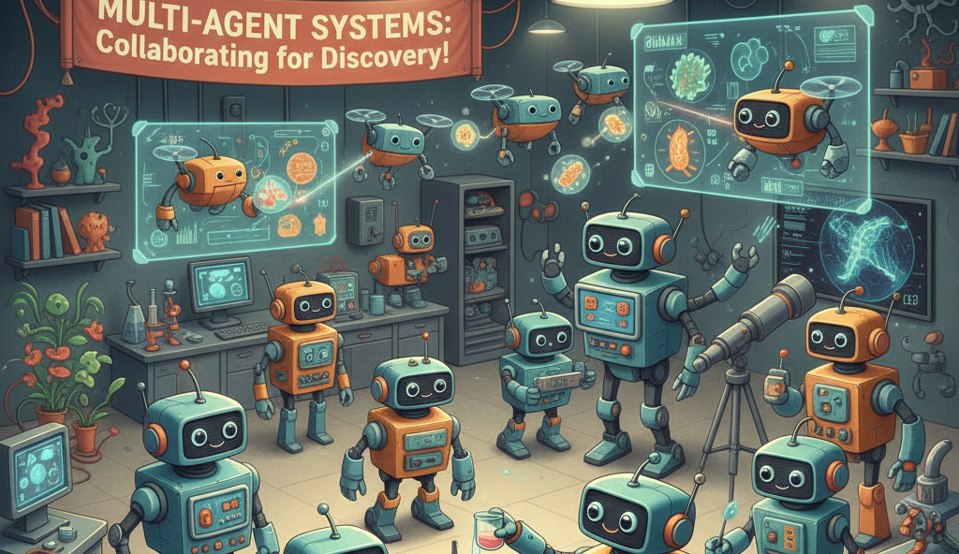

Slide 8
AI-agents for science
Literature search and summarization
Generate hypothesis
Experiment design
Data analysis and interpretation
Code generation
Cross-domain reasoning and integration
Writing documents
Critique and refinement

Slide 9
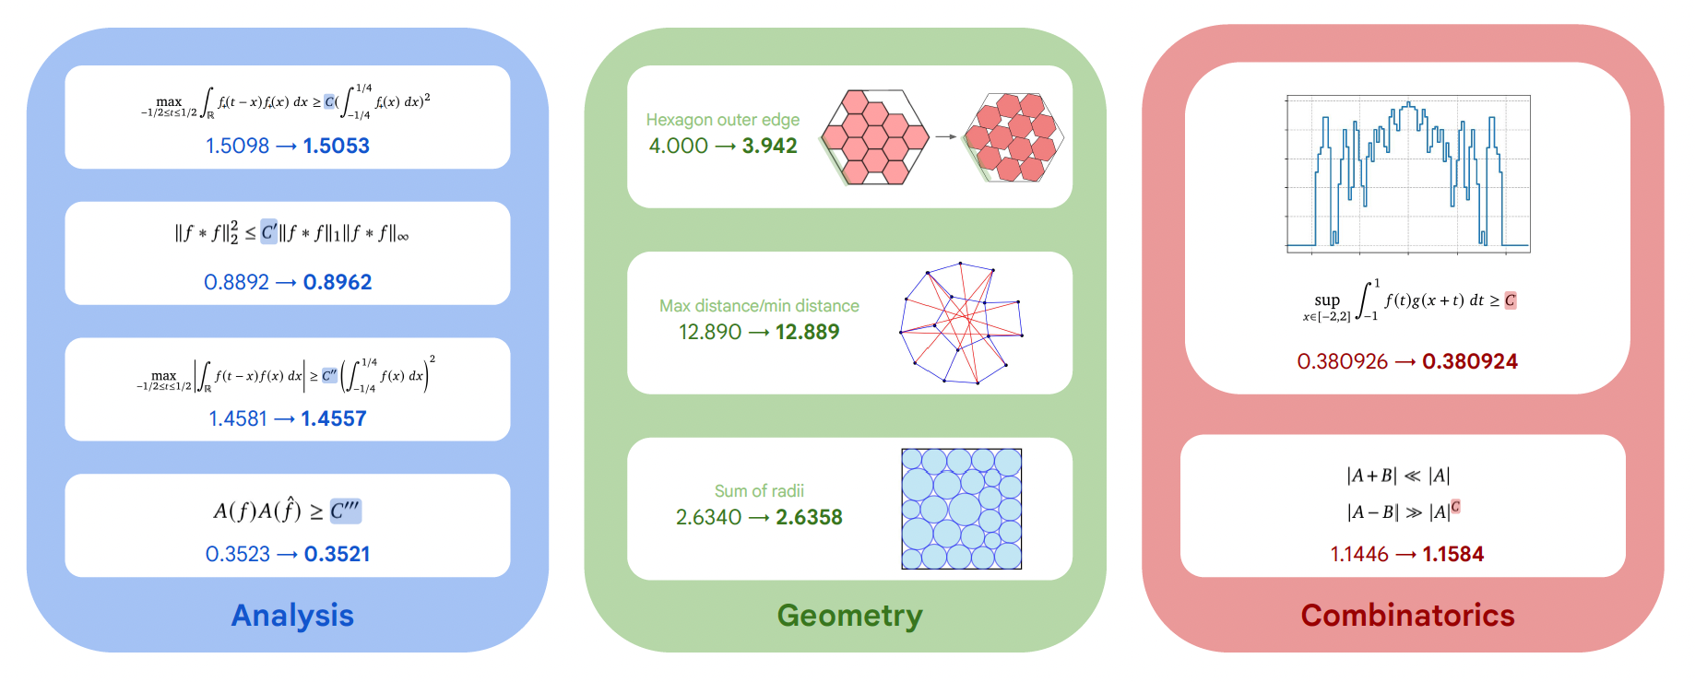
AI-agents achievements
New solutions for the cap set problem
Bin packing problem
FunSearch:
better algorithm to multiply 4x4 matrices with 48 multiplications
Develop a more efficient scheduling algorithm for data centers
Simplified hardware design
AlphaEvolve:
Virtual Lab: AI agents design new COVID nanobodies
Gemini & OpenAI: Gold medal at IMO 2025
Gemini: Gold medal at ICPC 2025
Notes:
First improvement after 56 years with the Strassen algorithm.
There was experimental validation
Most of these discoveries have been made in Mathematics and computer science
Bin packing is done by heuristics and depends on the problem. FunSearch found particular better solutions
International Collegiate Programming Contest. It solved a problem that no human team solved

Slide 10
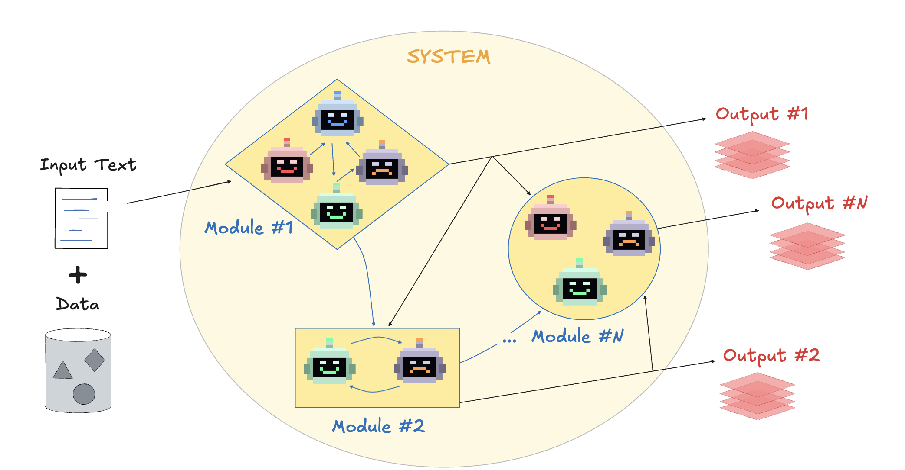
Denario: Architecture
Goal: Automate science
Goal: Accelerate scientific discovery
Notes:
Our modules can:
Generate ideas
Check the literature
Develop methodology
Write and execute code
Write papers
Review papers

Slide 11
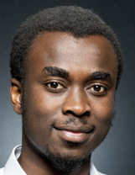
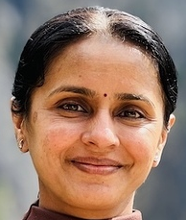
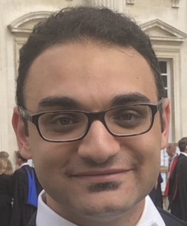
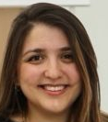

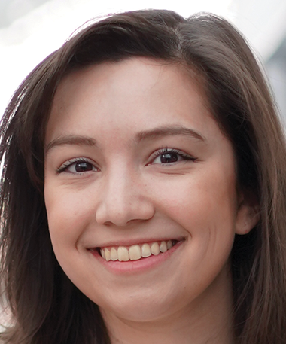
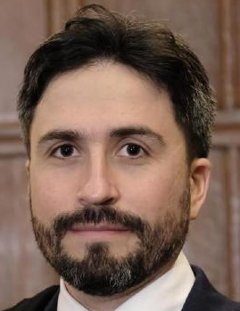
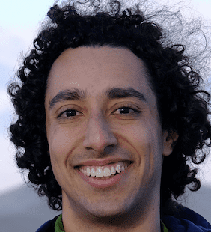
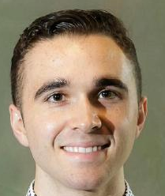

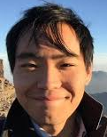
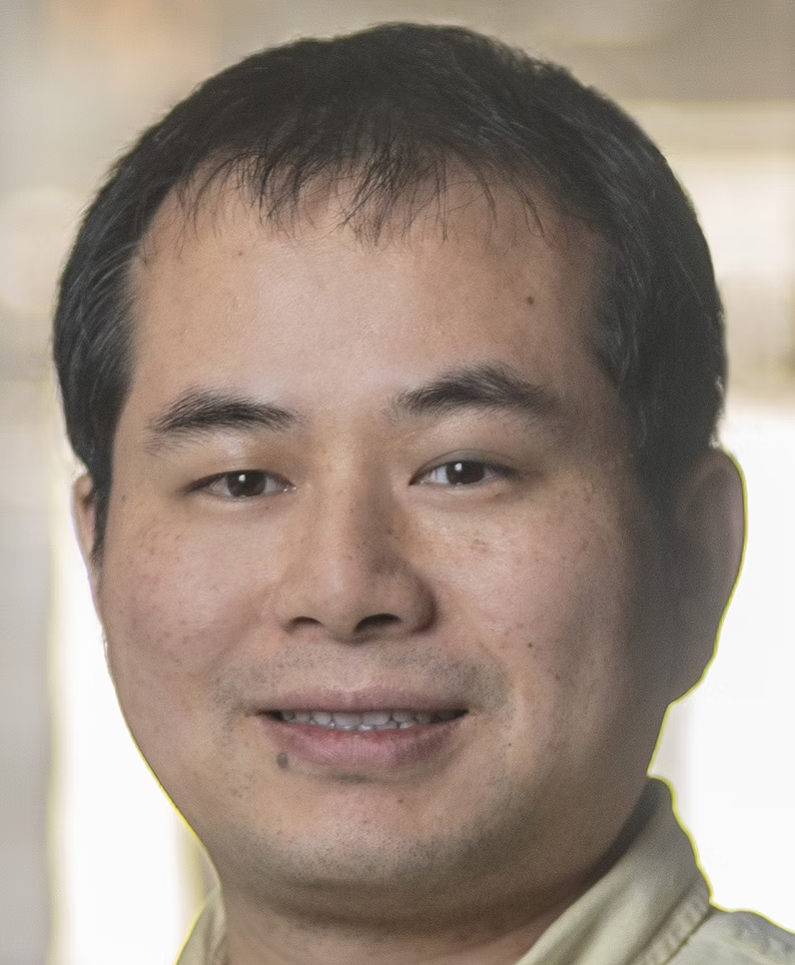
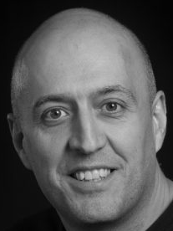

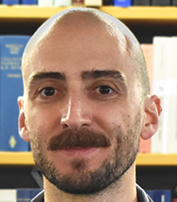
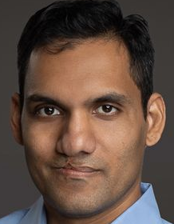
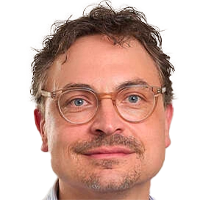
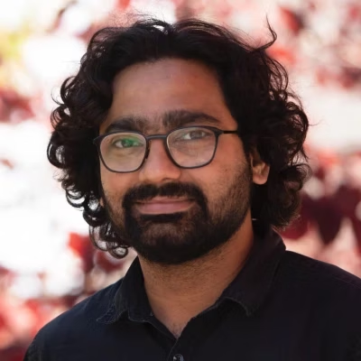
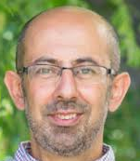
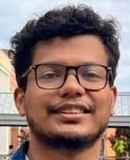

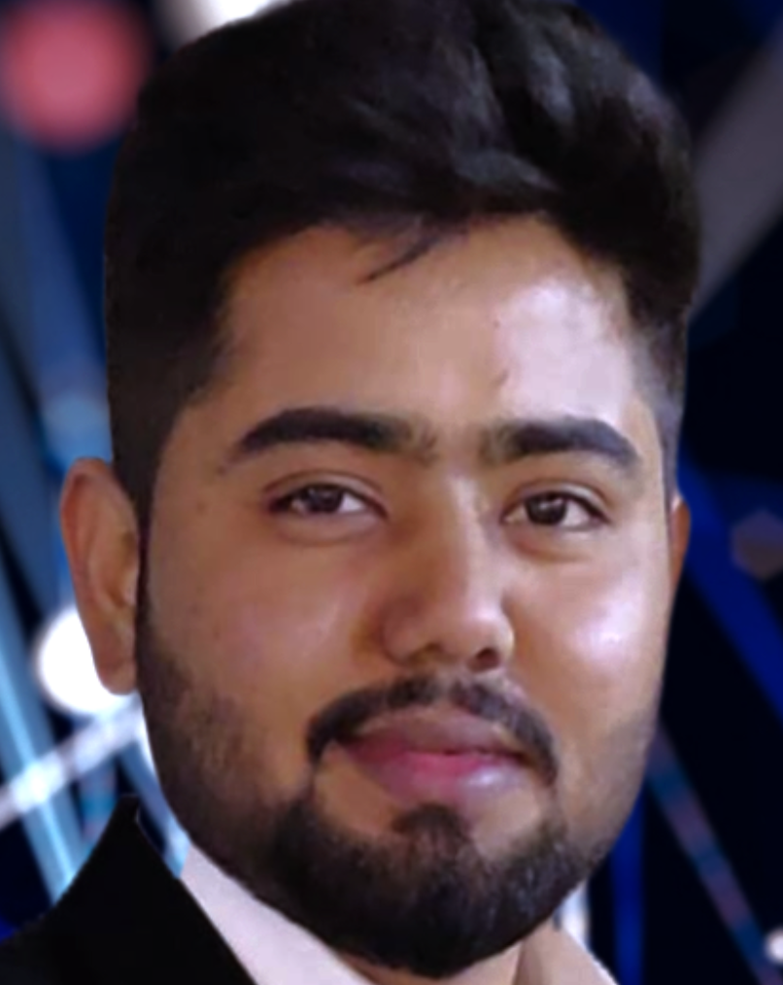
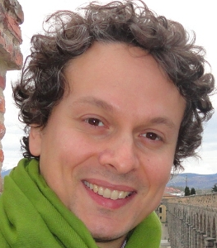
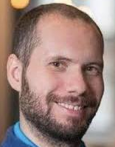

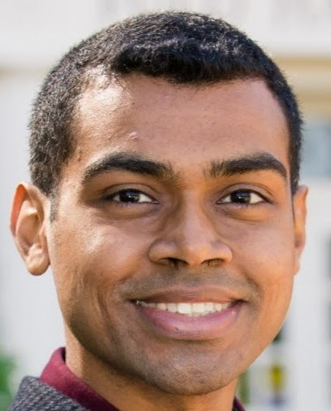
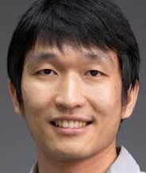
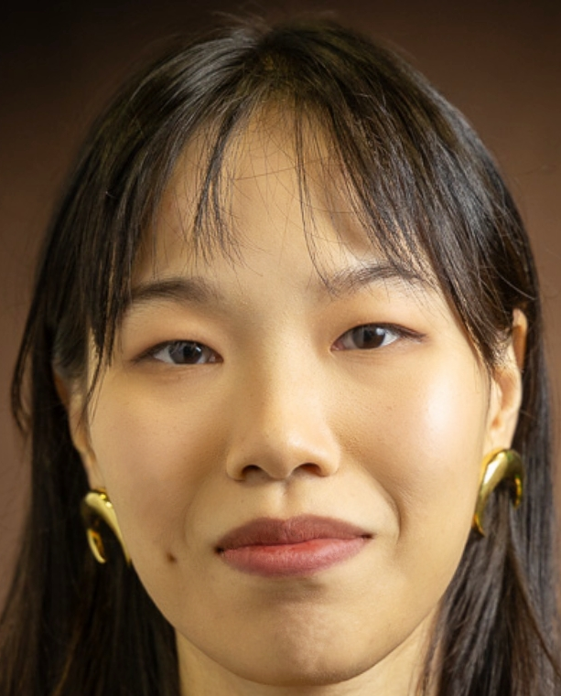
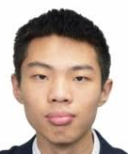
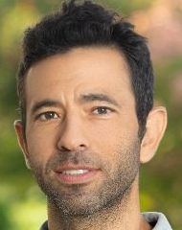
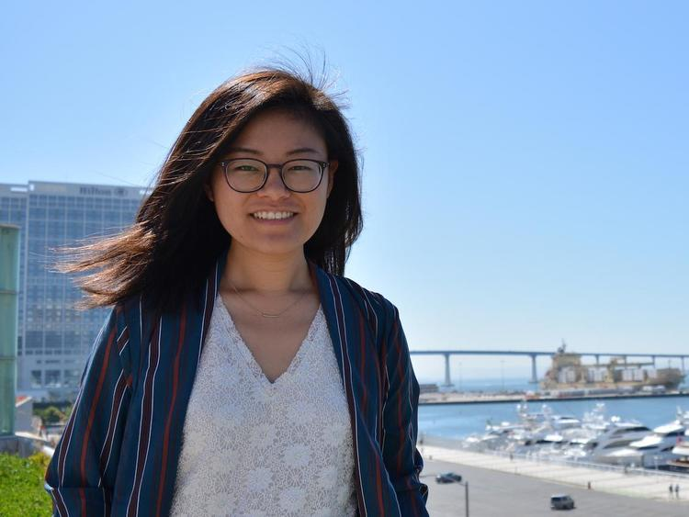
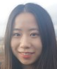
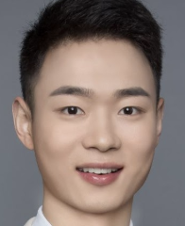
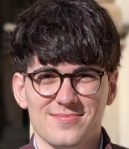
Denario team

Slide 12
Developers
Boris Bolliet
(Cambridge)
Pablo Villanueva-Domingo
(Barcelona)
Notes:
Pablo is a Machine Learning scientist

Slide 13
Denario team

Slide 14
Astrophysics
Adrian Bayer
(CCA/Princeton)
ChangHoon Hahn
(UT Austin)
Jun-Young Lee
(Princeton)
Licong Xu
(Cambridge)
Yan-Fei Jiang
(CCA)
Jay Wadekar
(John Hopkins)
Matteo Viel
(SISSA)
Iñigo Zubeldia
(Cambridge)

Slide 15
Denario team

Slide 16
Biology
Aidan Acqua
(Oxford)
Pablo Cardenas Ramirez
(Cornell/MIT/Harvard)
Qiyao Zhu
(CCB)
Anupam Anand Ojha
(CCB/CCM)
Chemistry
Camille Bilodeau
(Virginia)
Shimanto Roy
(Virginia)

Slide 17
Denario team

Slide 18
Neuroscience
Yossi Yovel
(Tel-Aviv)
Almog Barzilay-Siegal
(Tel-Aviv)
Jiajun Zou
(SISSA)
Material Science
Osman Mamun
(Cornell)
Shuwen Yue
(Cornell)

Slide 19
Denario team

Slide 20
Machine Learning
Chi Wang
(DeepMind)
Pavlos Protopapas
(Harvard)
Miles Cranmer
(Cambridge)
Planetary Science
Wenhan Zhou
(Tokyo)
Bonny Wang
(Chicago)

Slide 21
Denario team

Slide 22
Physics
Raul Jimenez
(Barcelona)
Pedro Tarancon
(Barcelona)
Software engineering
Chetana Amancharla (Infosys)
Ujjwal Tiwari
(Infosys)

Slide 23
Denario team

Slide 24
Quantum physics Medicine
Pablo Bermejo
(Google/DIPC/CCQ)
Urbano França
(Harvard)
Mathematics Philosophy
Antonio Lerario
(SISSA)
Thomas Meier
(Munich)

Slide 25
Denario team

Slide 26

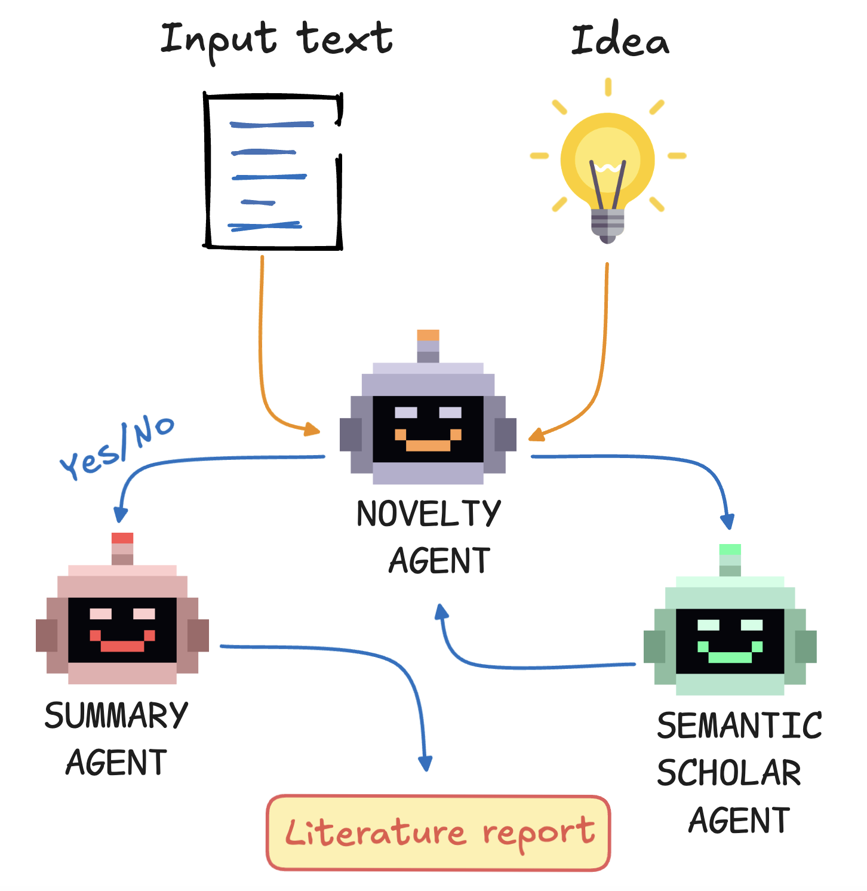
Denario
GitHub repository:
https://github.com/AstroPilot-AI/Denario
Installation:
>> pip install denario
HuggingFace app:
https://huggingface.co/spaces/astropilot-ai/Denario
Open invitation to everyone to join us!
Notes:
For documentation, example papers, GUI, HuggingFace app, videos…etc check the website

Slide 27
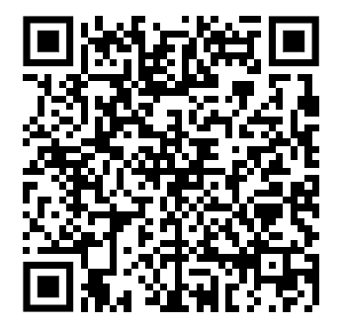
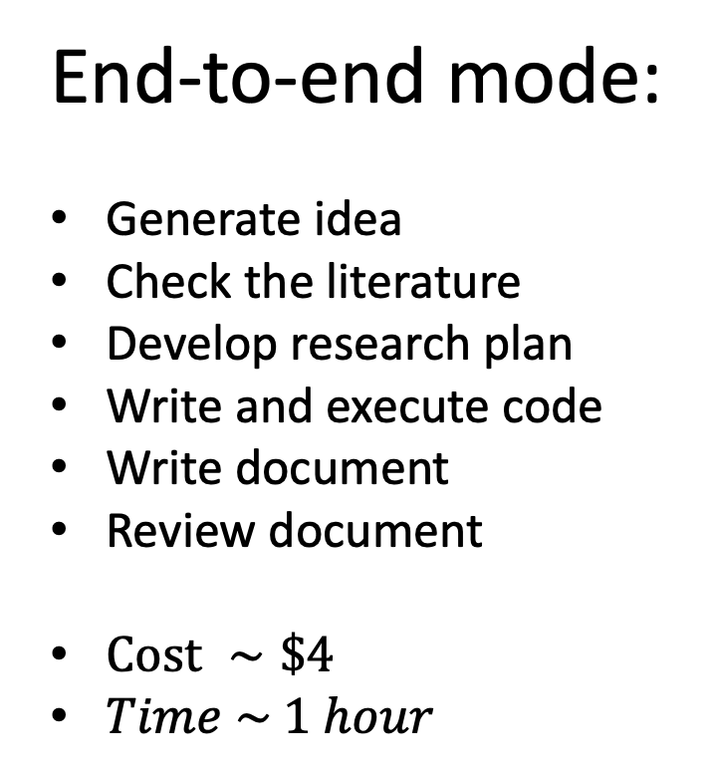
Scan to check Denario in action
End-to-end mode:
Generate idea
Check the literature
Develop research plan
Write and execute code
Write document
Review document
$Cost ∼\$4$
$Time \sim 1 hour$
Notes:
Not designed to replace humans, but to help us with the boring tasks so that we have more time to think deeply.
Suggesting directions for research
Danger: do not use this document as something to submit the journal

Slide 28
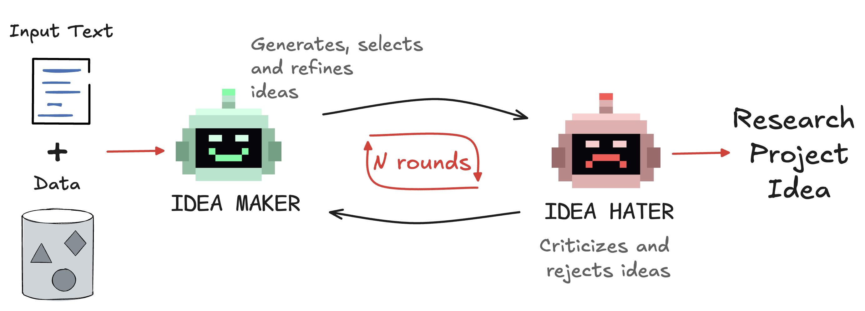
Idea module

Slide 29
Literature module
Notes:
Write review paper is very easy

Slide 30
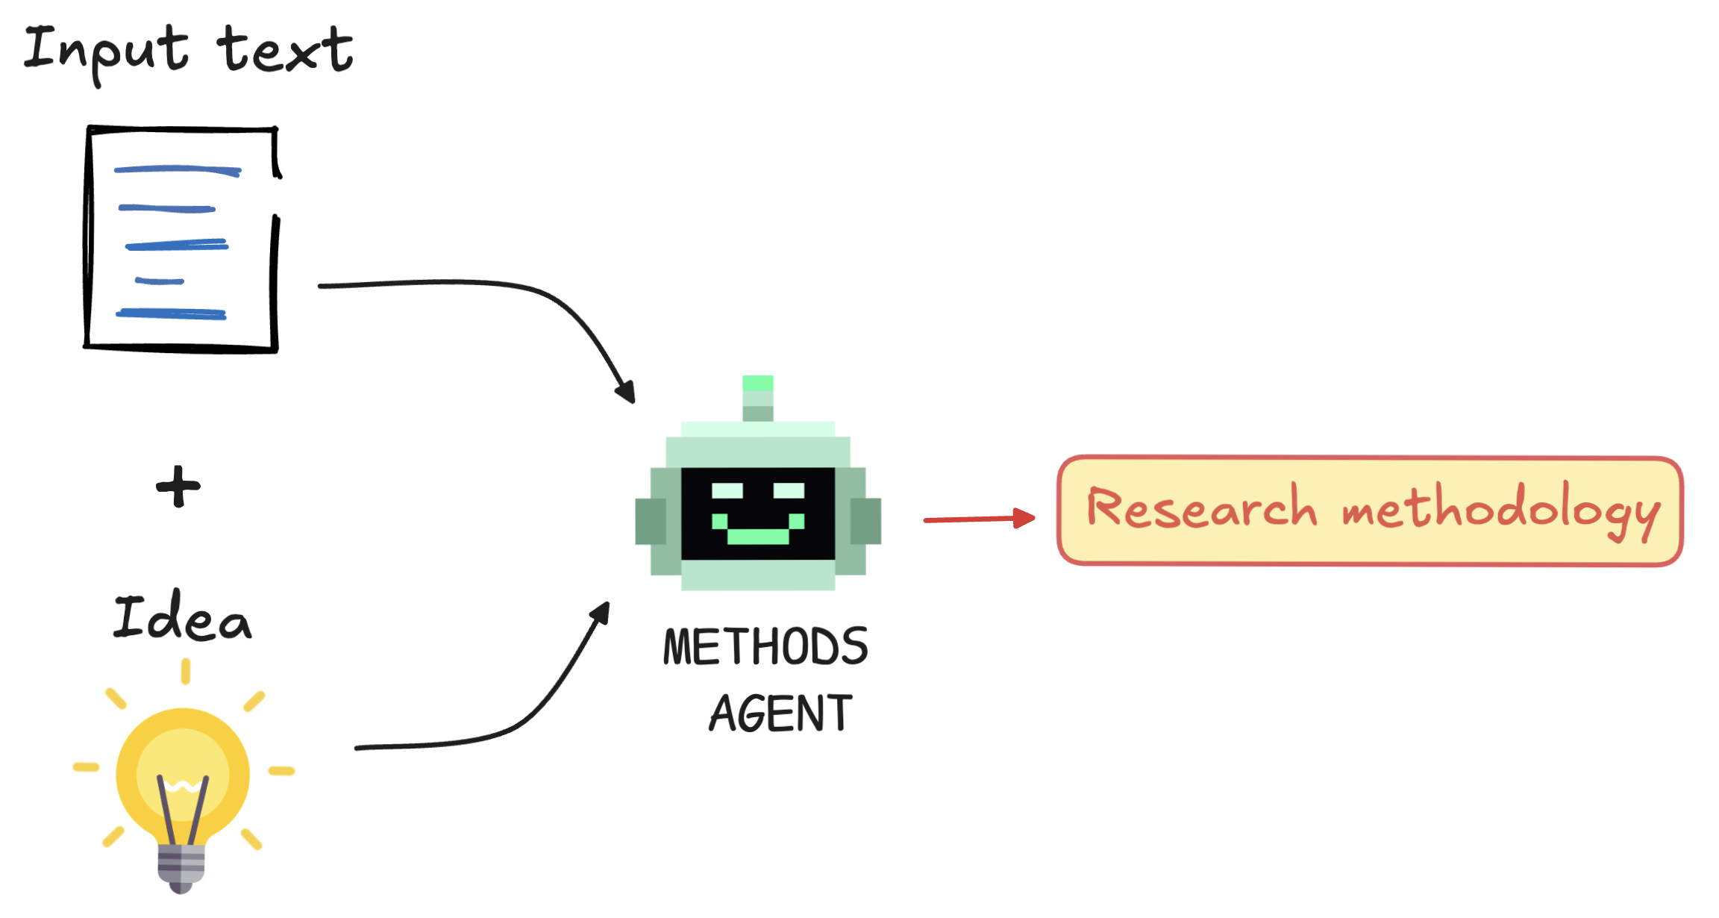
Methods module

Slide 31
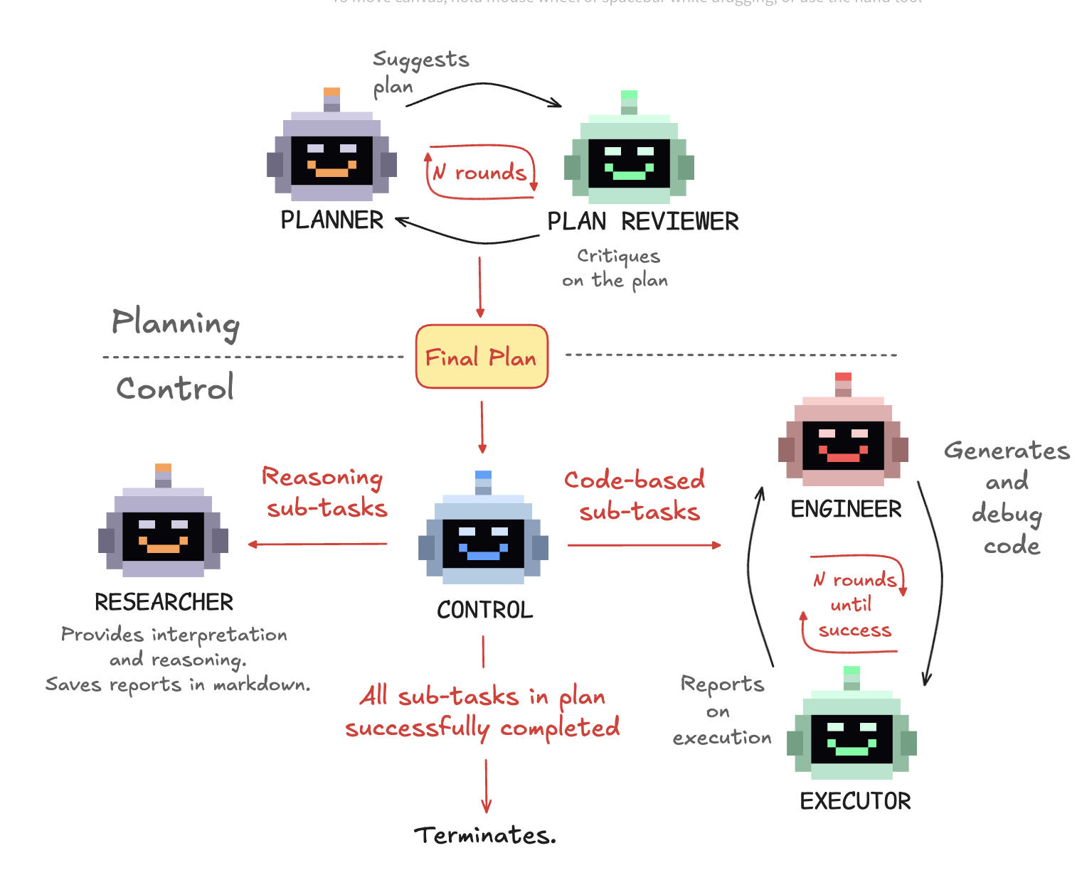
Deep Research module

Slide 32
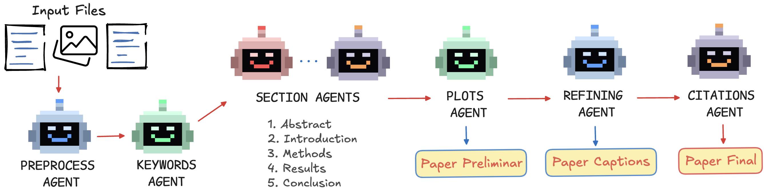
Writing module

Slide 33
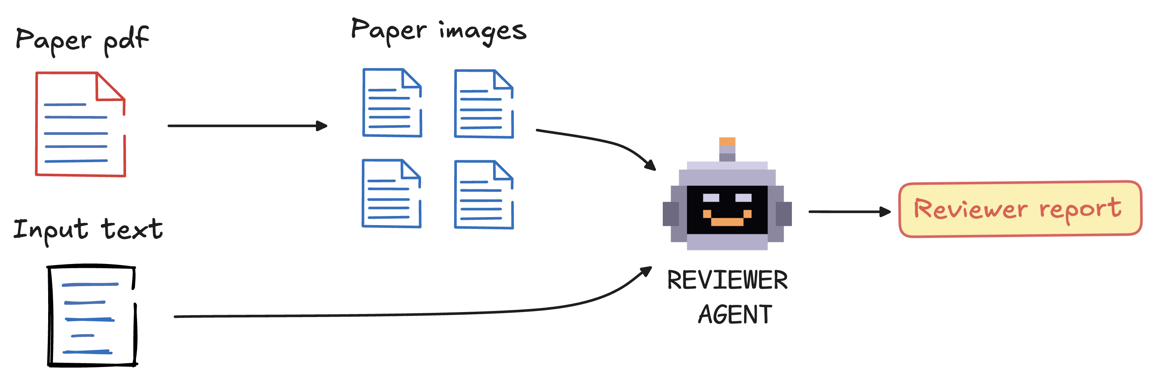
Reviewer module

Slide 34
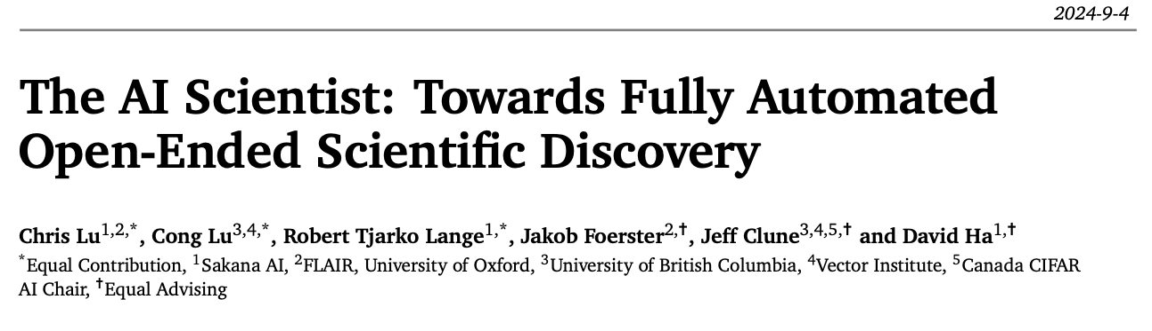
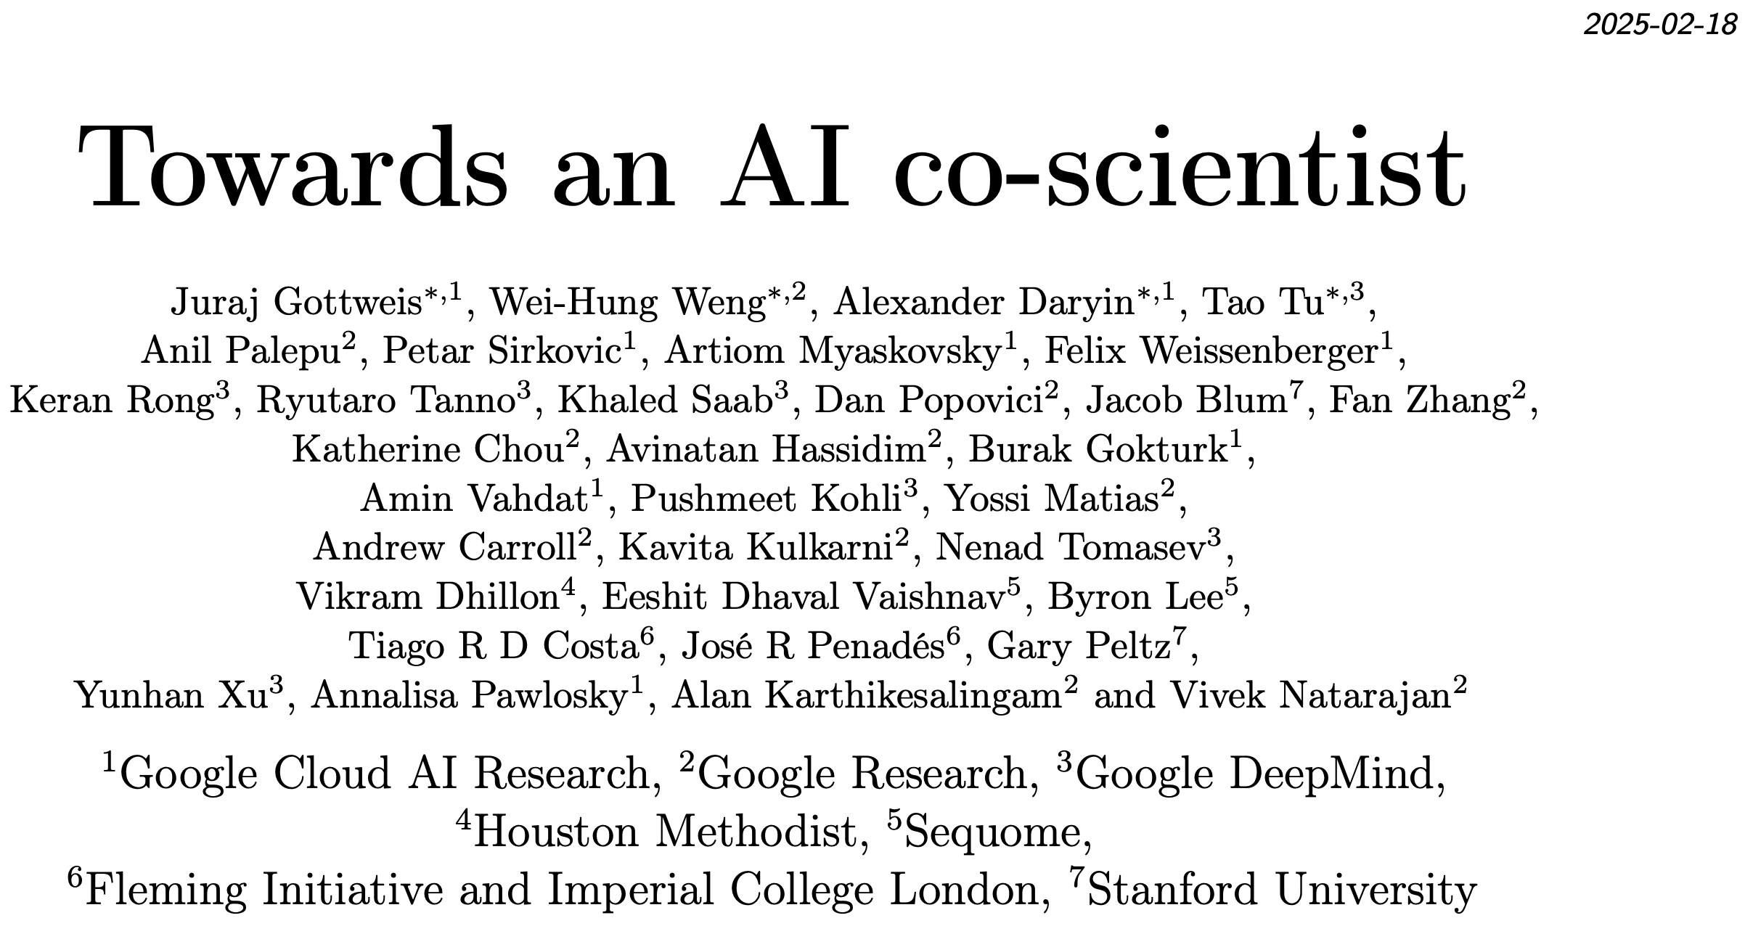
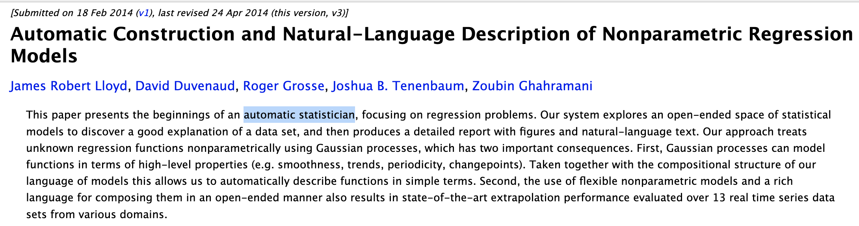
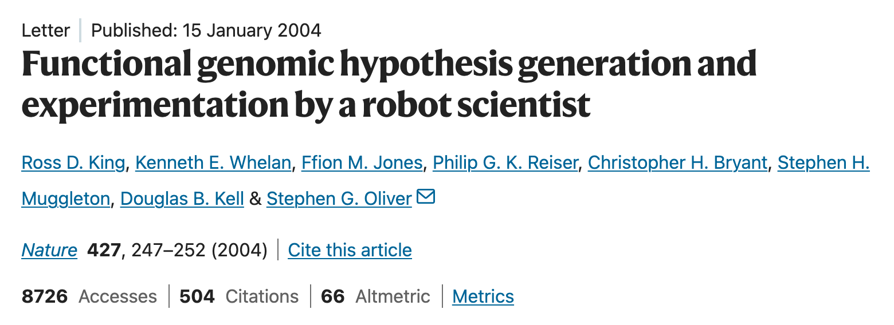
DENDRAL (1960s)
Notes:
DENDRAL: helps organic chemists in identifying unknown organic molecules from mass spectra
It is considered the first expert system because it automated the decision-making process and problem-solving behavior of organic chemists
The concept is well established
put video of robot scientist
By 1970, Dendral was performing structural interpretation at post-doc level.

Slide 35
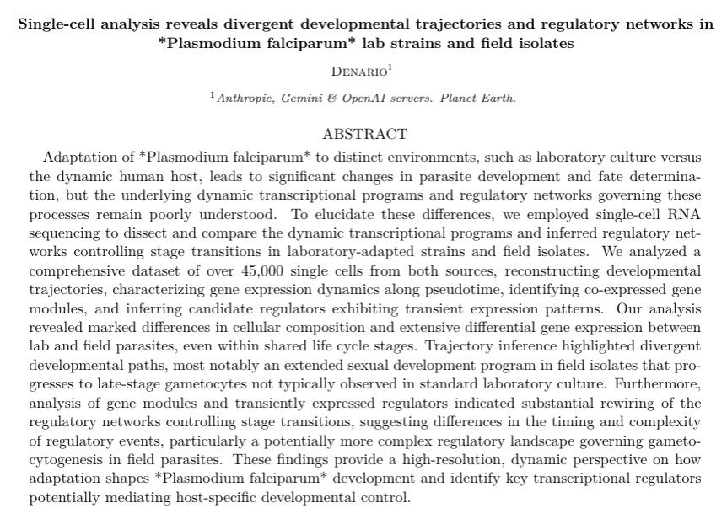
Biology
Pablo Cardenas-Ramirez
(Cornell/MIT/Harvard)

Slide 36
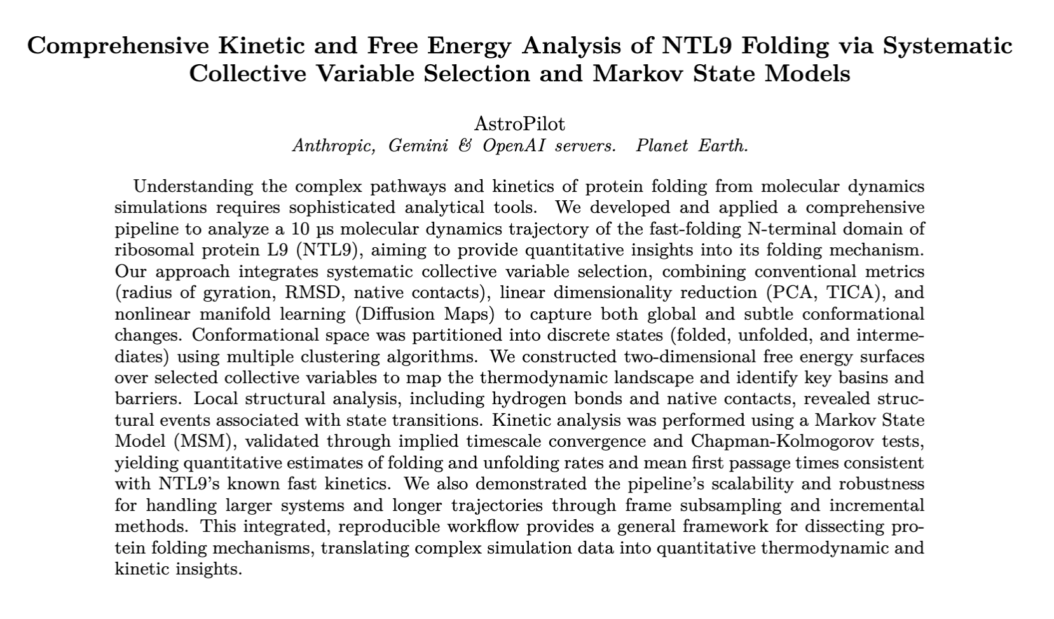
Biophysics
Anupam Anand Ojha (CCB/CCM)

Slide 37
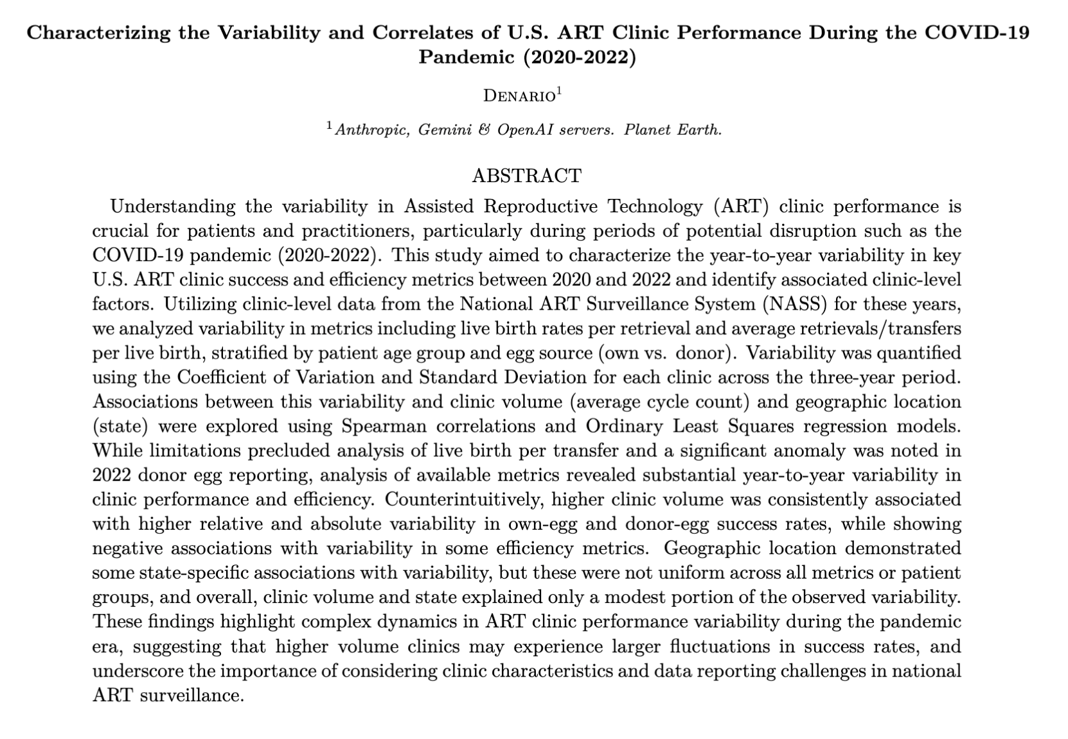
Medicine
Urbano Franca
(Harvard Medical School)
Notes:
The impressive part of this research was the contextualization and characterization of the research question. DENARIO quantified the year-to-year variability in success and efficiency metrics of ART clinics, such as live birth rates per retrieval and average retrievals per live birth. There is a large literature discussing variability in outcomes among different clinics, populations, etc, but little to no attention has been given to year-to-year intra-clinic fluctuations in ART clinic performance (that is, how the outcomes of each clinic vary from year to year), particularly after a systemic shock like the COVID-19 pandemic. I think this was not a topic of research before because of the assumption that the performance does not change significantly from year-to-year, but what DENARIO found was that apparently high-volume clinics have some interesting year-to-year variation in their outcomes (although one would still need to see if it is clinically relevant, etc). DENARIO contextualized the research by not only identifying an overlooked topic in the literature, but also by recognizing the impact of the global pandemic on healthcare systems through disruptions such as clinic closures, supply chain issues, and shifts in patient behavior.

Slide 38
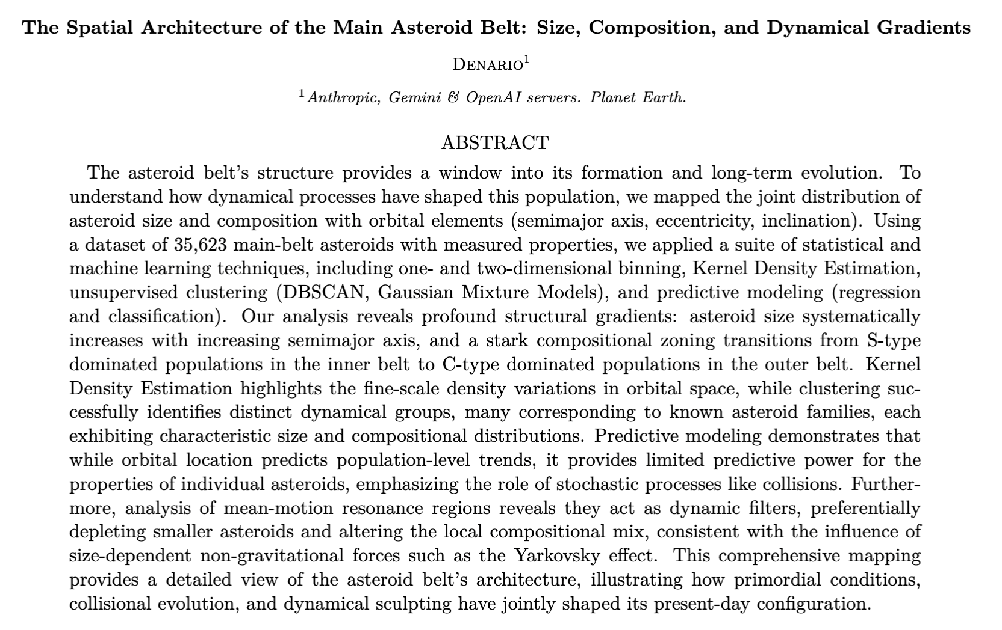
Planetary science
Wenhan Zhou
(Tokyo)
Bonny Wang
(Chicago)
Notes:
A large collection of asteroids from different datasets.
Denario did dimensionality reduction and identified families of asteroids.
Patterns found were known.
It was able to reproduce well-known results, but not going beyond.
For other paper, it was able to find new families but its lack of domain expertise invalidated it to going further and explore it more or highlight those.

Slide 39
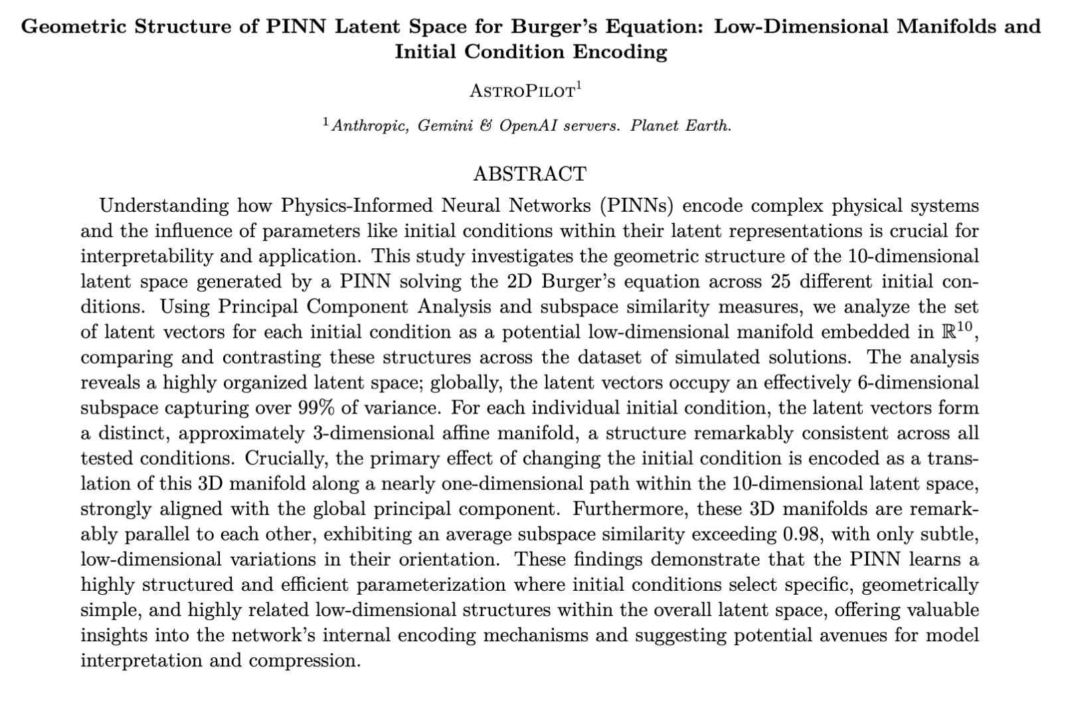
Mathematical physics
Pedro Tarancon
(Barcelona)
Raul Jimenez
(Barcelona)

Slide 40
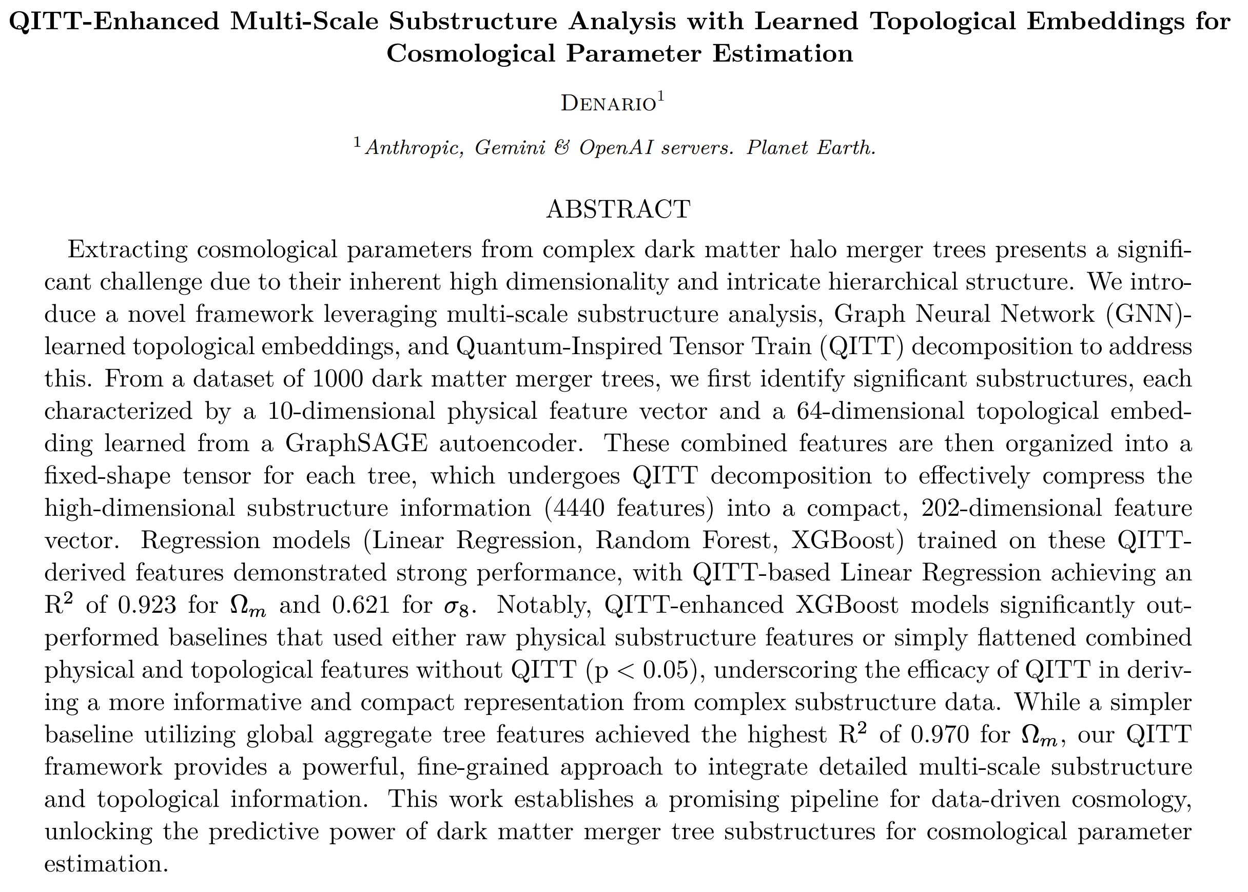
Quantum physics + cosmology + machine learning
Pablo Bermejo
(Google/DIPC/CCQ)
Notes:
First, it performs global node normalization. 1000 simulations, each with 25 trees. It splits by simulations, not trees (very smart).
Multi-scale substructure identification (significant progenitor branch that merges into the main branch, or when substantial changes to the halo structure happen).
The statistics used to identify substructure were: mass accretion rate, significant property changes (things that deviate from smooth evolution). Each substructure is identified as a graph.
Each graph is assigned a feature vector, combining physical and topological structures.
Physical features (10 features): mass ratio, merger scale factor, property differences at merger, mean and std of substructure inside subgraph.
Topological features (64 features) learned via graph autoencoder using GraphSAGE as the architecture.
Thus, for each tree, there are (Nsub, 74) features, where Nsub=60. If a tree has less, it is padded with zeros.
The 4440 vector was then flattened and reshaped into a (2,2,2,3,5,37) tensor.
Tensor train decomposition was carried out with the TensorLy library to get the TT-ranks. The vector was then flattened. The dimensionality was reduced from 4440 to 202.
Several regression models were used: linear, random forest, and XGBoost.
Hyperparameter tuning, including TT-ranks, was carried out.
It compared the results against some baselines: Graphlets counts, aggregate graph-level features, physical features w/o topology…etc
It studied topological features of subgraphs using t-sne
QITT-features with linear regression yield R2=0.921, while just global features led to R2=0.970,
This paper was the base for another paper carried out by Jun-Young.
feedback

Slide 41

Chemistry
Camille Bilodeau
(Virginia)
Notes:
The final round, I provided it with a specific set of directions/hypotheses to explore. Importantly, I had only read about the methods I suggested at a surface level and I did not know how to do the analyses I suggested in python. Based on this prompt, Denario was able to develop a series of analyses applying graph theory to understand the peptide aggregation process, specifically quantifying the Fiedler value and the largest connected cluster and connecting these quantities to aggregate formation and stability. This was very useful because it helped us quickly explore how many different graph theoretical techniques could be applied to peptide aggregation and helped us determine which ones would be most effective for describing our process. In this way, even though we wouldn’t necessarily directly submit the produced paper, it significantly helped catalyze a research direction that we are now pursuing in a few different ways, which I expect will form more complete research stories.

Slide 42

Neuroscience
Almog Barzilay-Siegall
(Tel-Aviv)
Yossi Yovel
(Tel-Aviv)

Slide 43

Material Science
Shuwen Yue
(Cornell)
Osman Mamun
(Cornell)

Slide 44

Astrophysics
Yan-Fei Jiang
(CCA)

Slide 45

Biomedical informatics
Aidan Acquah
(Oxford)
Notes:
This paper outlines the use of traditional peak detection models, as compared to deep learning models, to count steps from accelerometer data collected during free-living. This was compared across different device locations and sampling frequencies. The results show the best performance in the traditional peak detection algorithm deployed on a hip sensor, sampling at 100Hz, however, all deep learning models trained failed to appropriately produce accurate step estimations.

Slide 46

Research plan
Really
bad
Really
good
Notes:
Papers are undergraduate / early graduate student level

Slide 47
Failure modes
Peptide generation
Mathematics

Slide 48
Advantages | Limitations
New and broader ideas | Citations
Fast research | Shallow research
Fully reproducible results | Connection with known knowledge
Interdisciplinary | Failure modes
Explore risky ideas | Hallucinations
More time to think! | Can sidestep learning
Notes:
Progress in scientific discovery is rarely the result of a single "Eureka" moment, but is rather the product of hundreds of scientists incrementally working together toward a common goal.
Stochasticity
Human in the loop
misclasification

Slide 49

Depth vs Breadth
AI research assistant
Breadth
Scientific
discovery
Humans
Depth
Notes:
Perhaps a new way of doing science. Kind of brute force approach. Put the example of AlphaTensor
Automation was a driving force for much of 19th and 20th centuries
Can we discover something new?
How far can we go?
Accuracy

Slide 50
Future
Self-improvement
Learn from previous experiments
Hierarchical learning
Efficiency
Notes:
AgentRxiv showed that Agents ca built on top of their own research

Slide 51
Ethics / Concerns
Low-quality papers | Break the system (arXiv and Journals)
Inflate citations | Validation*
Malicious usage* | Training and education*
Authorship | Homogenization
Access | Environmental issues*
Plagiarism*
Notes:
We need to find the root cause. A paper is still the fundamental unit we use to rank researchers
Training and education: are writing and creativity and data analysis be useful skill?
https://arxiv.org/abs/2502.16487 discussed many novel ideas being plagiarized
These tools are here, and we need to think about this
* Problems beyond AI

Slide 52
Conclusions
Denario can be a useful research assistant.
Primitive version of AlphaEvolve for scientific ideas.
The AI-human collaboration could accelerate scientific discovery
This technology may change the way we approach science
Notes:
Progress needs to be done by AI-human collaboration. AI by itself can't advance science

Slide 53

Philosophy of Science
Science develops through periods of “normal science” in which knowledge is incorporated into existing theoretical frameworks, alternated with “paradigm shifts” during which those frameworks are overhauled.
Thomas Kuhn

Slide 54


