Slide 1
Writing Software Pipelines The Northern Cross Case
Training Meeting
NG-Croce
Lunedì 12 Maggio - Giovedì 15 Maggio
Radiotelescopi di Medicina
IRA - Bologna
Alessio Magro

Slide 2
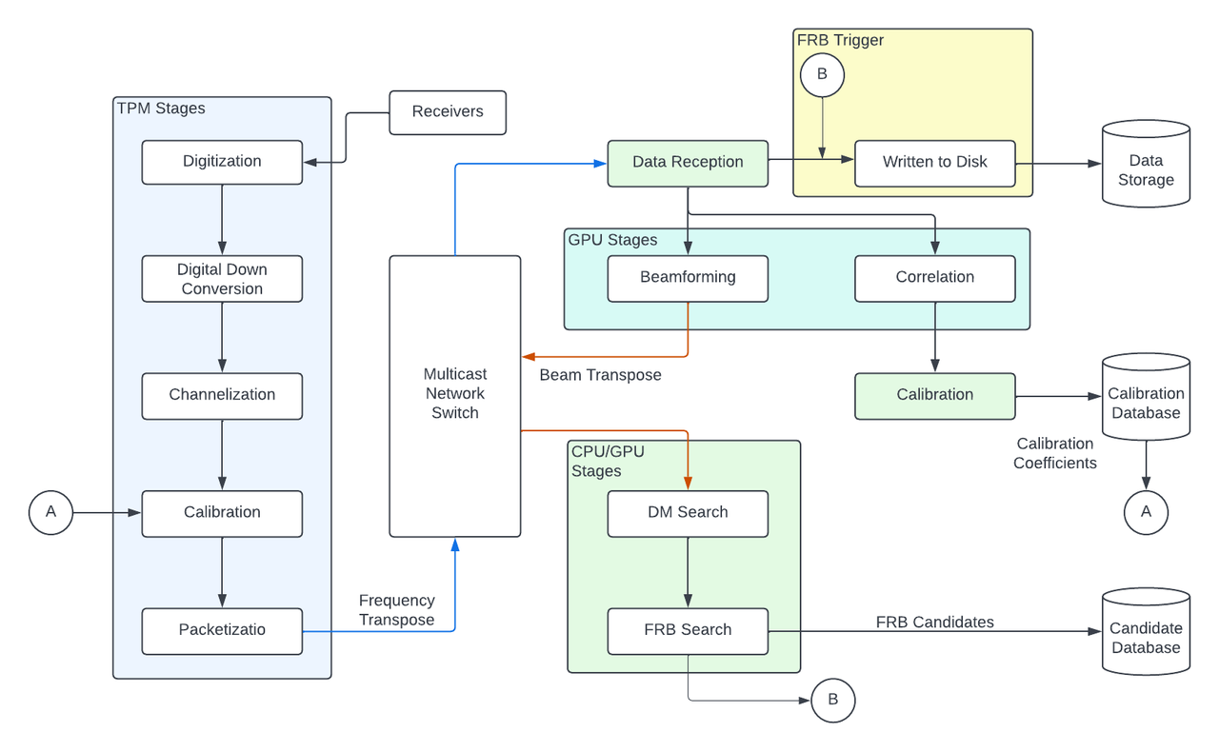
Missione 4 • Istruzione e Ricerca
Missione 4 • Istruzione e Ricerca

Slide 3
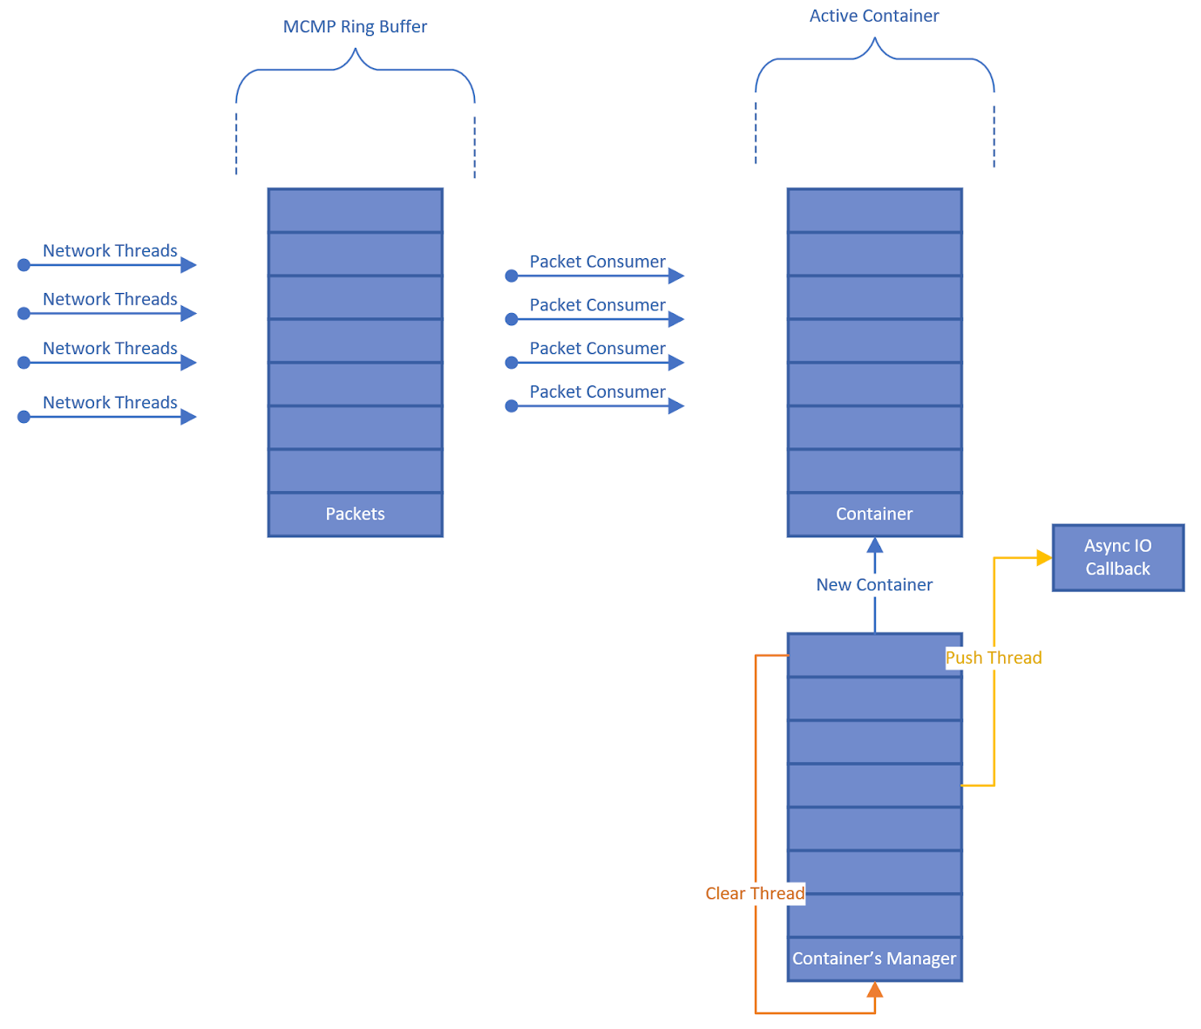
Channelized Data Stream from TPMs
Data stream goes to the beamformer/correlator nodes
Ingested using an optimized version of the SKA DAQ software
Support for multiple producers and consumer
Optimization to ring buffer locking mechanism
Optimizations to channelized data consumer
Concurrent multi-container support for consumer processing
Missione 4 • Istruzione e Ricerca
Missione 4 • Istruzione e Ricerca

Slide 4
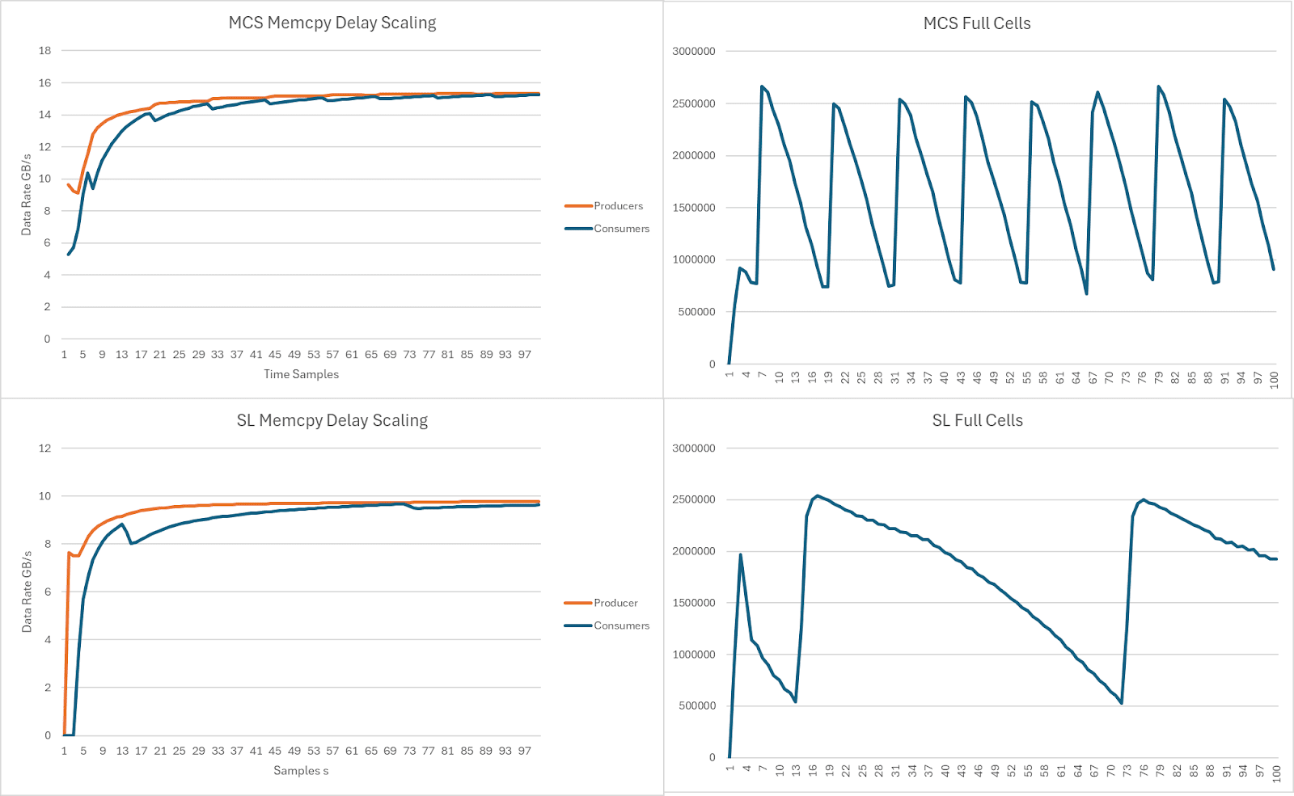
Channelized Data Stream from TPMs
8 producers 8 consumer
SL: Spinlock
MCS: Mellor Crumney Scott lock
Missione 4 • Istruzione e Ricerca
Missione 4 • Istruzione e Ricerca

Slide 5
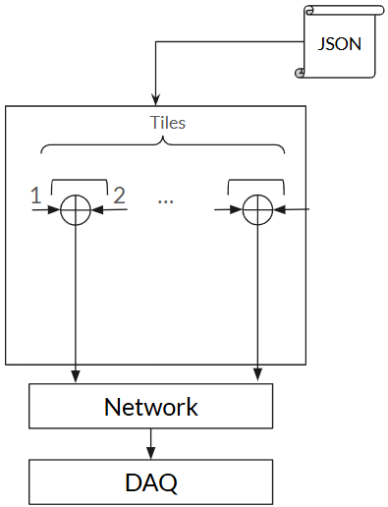
Channelized Data Simulator
A packet simulator was implemented to aid development and benchmarking
Accepts JSON for packet and tile config
Two threads per tile, one updating packet metadata and the other transmitting the packets
Simulator set up to match a particular data rate
Missione 4 • Istruzione e Ricerca
Missione 4 • Istruzione e Ricerca

Slide 6
Beamformer
Data stream goes to the beamformer/correlator nodes
Beamformer implemented on GPU within a Bifrost pipeline
Various versions of the beamforming kernel implemented and benchmarked
Top performing on RTX ADA 6000, with 256 antennas, 512 channels, 64 beams gives 2x real-time
Further profiling and optimization is possible
Missione 4 • Istruzione e Ricerca
Missione 4 • Istruzione e Ricerca

Slide 7
Correlator
New CUDA kernel developed based on xGPU
Several variations of the kernel implemented and benchmarked
For 256 antennas, hardware managed caching delivers best performance
Top performing on RTX ADA 6000, with 256 antennas and 512 channels, gives 10x real-time
Further profiling and optimization is possible
Missione 4 • Istruzione e Ricerca
Missione 4 • Istruzione e Ricerca

Slide 8
Beamformed/Correlated Data Stream
Beamformer and correlated data needs to be streamed to FRB/SD nodes for processing
Currently investigating possible protocols and frameworks suitable for this, such as Open Fabrics Interfaces
Implemented basic workflows to support RMA and RDMA, and to simulate the orchestration between the components using containers
RDMA operations needs to be synchronized
Missione 4 • Istruzione e Ricerca
Missione 4 • Istruzione e Ricerca

Slide 9
FRB Pipeline
Heimdall benchmarked to determine a good performance to sensitivity ratio
Simulated dataset generated by Andrea Geminardi used to cover the FRB search space
Each file ran through 25 parameters combination in Heimdall (boxcar 21-512, DM tolerance 1.001-1.2), with their detection values and running times extracted
T-SNE and Friedman tests run on the resulting timings and detection values to narrow down selection of optimal parameter combinations
Missione 4 • Istruzione e Ricerca
Missione 4 • Istruzione e Ricerca

Slide 10
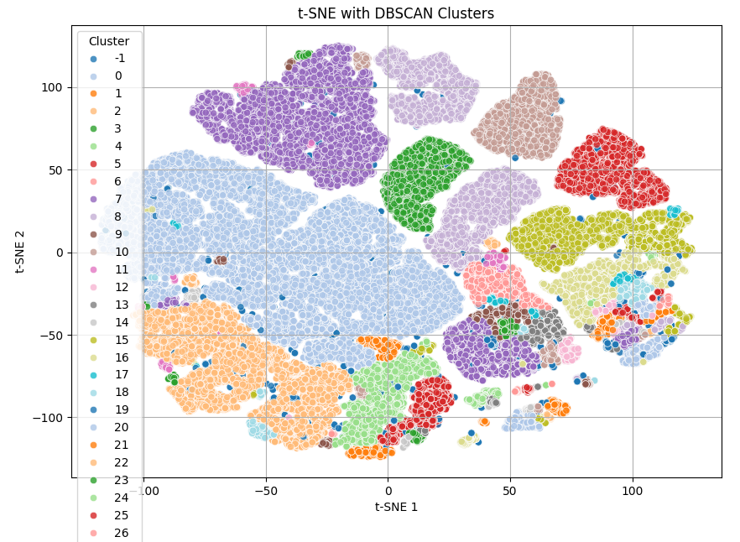
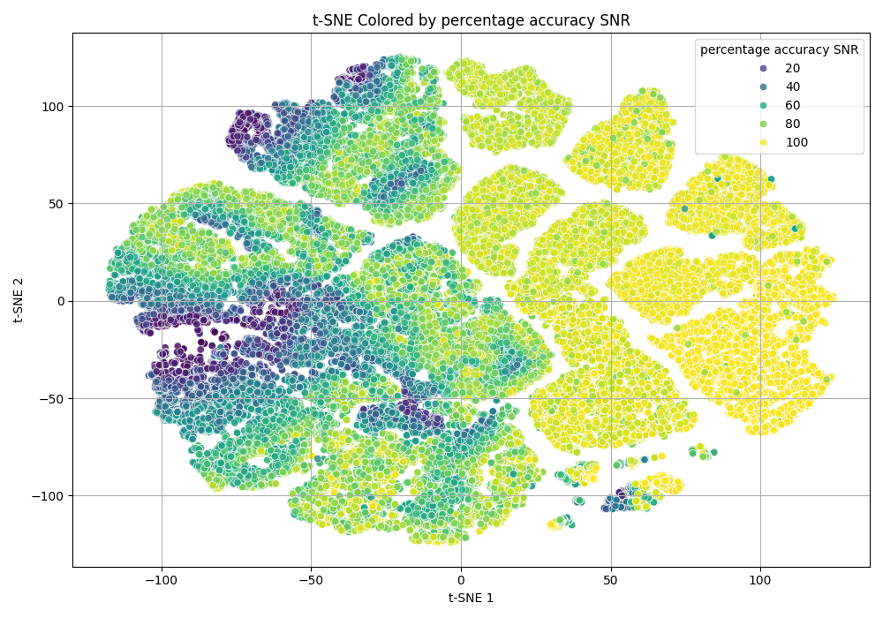
Missione 4 • Istruzione e Ricerca
Missione 4 • Istruzione e Ricerca

Slide 11
BIRALES Update
Updated TPM firmware to use DDC
PyBIRALES extended to support 256 antennas, 256 beams and allows for sub-array configurations.
All primary signal-processing blocks extended to support offload to GPU for processing (beamformer, channelizer, correlator)
Standardized output file format for all modes (using HDF5)
Updated User Interface
Preliminary commissioning performed earlier this year
In theory, only changes to the channelizer required to support PNRR FW
Missione 4 • Istruzione e Ricerca
Missione 4 • Istruzione e Ricerca

Slide 12
Radar Signal Simulator
A physics-based simulator that mimics raw radar antenna signals from orbiting LEO objects
Signal generation based on realistic orbital dynamics using TLE data
Emulates raw I/Q data as received by a radar antenna
Compatible and integrated with PyBIRALES pipeline
Build from first principles. Implements signal propagation, Doppler effects, and realistic noise
Ground truth embedded for ML training/labelling
Useful for labelled dataset generation, regression testing, benchmarking
Missione 4 • Istruzione e Ricerca
Missione 4 • Istruzione e Ricerca

Slide 13
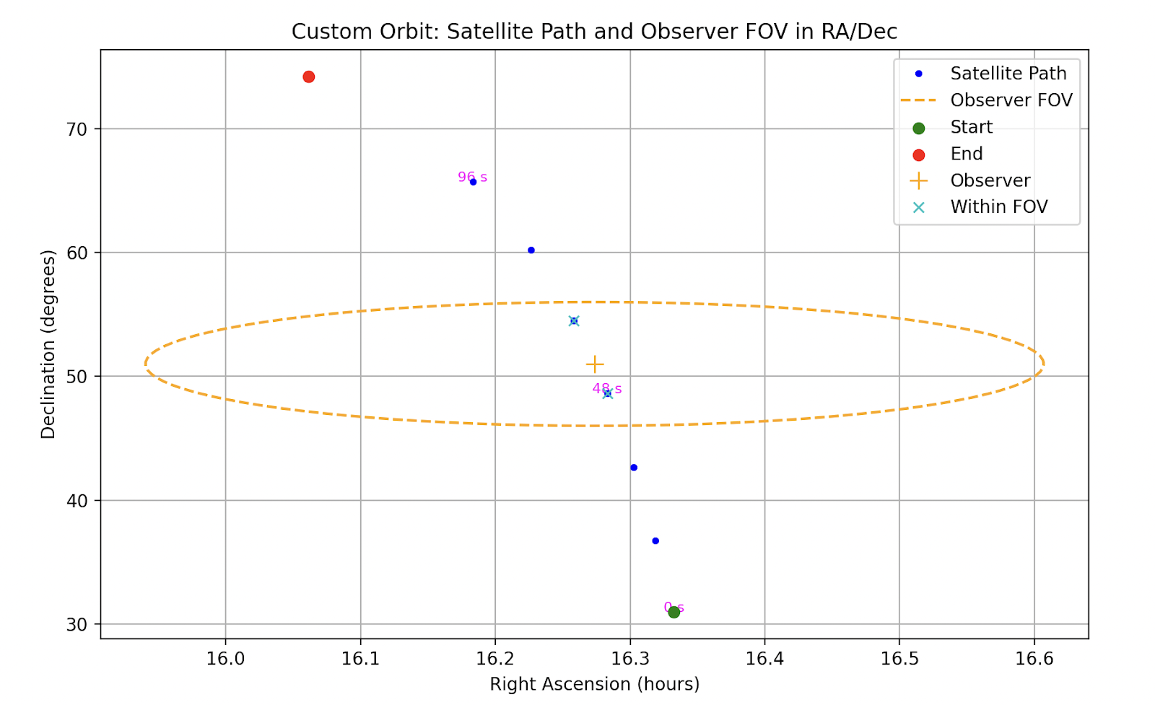
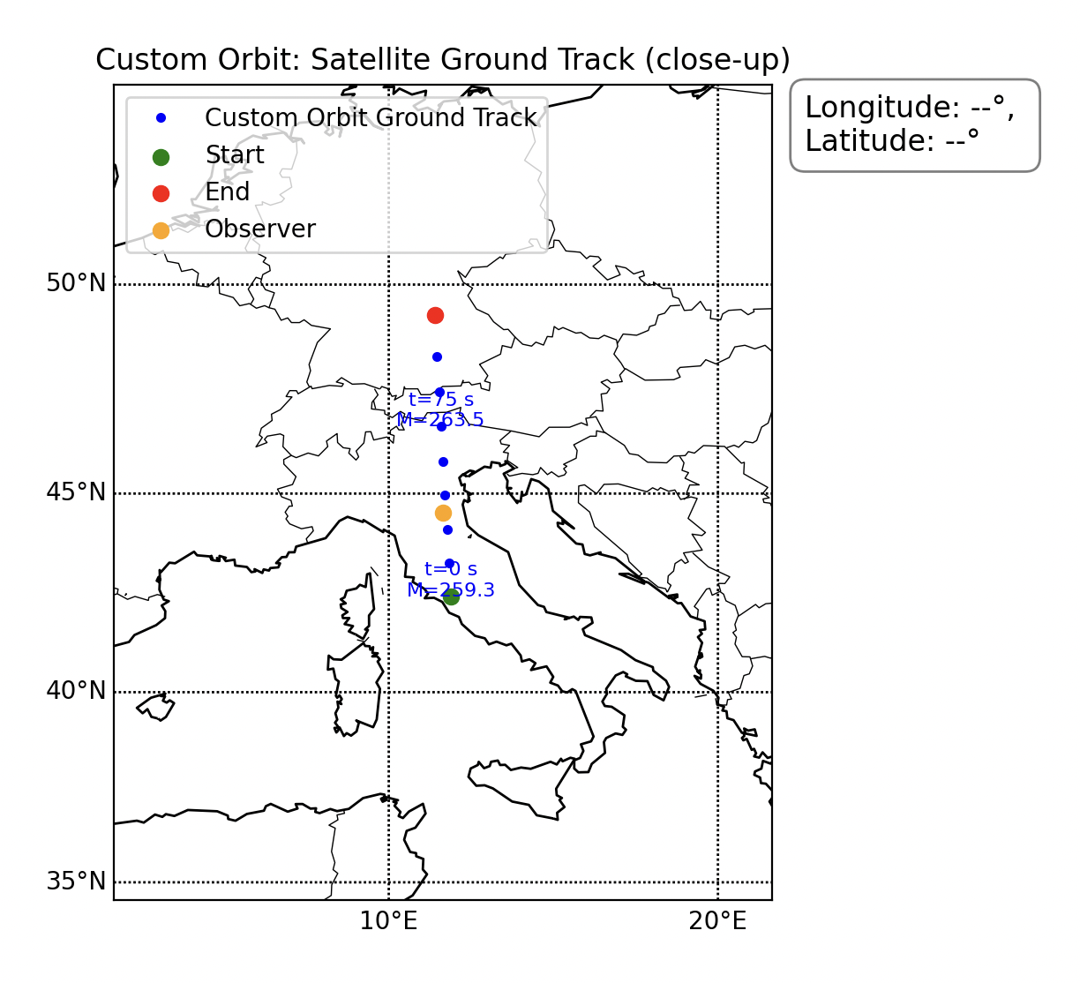
Radar Signal Simulator
Missione 4 • Istruzione e Ricerca
Missione 4 • Istruzione e Ricerca

Slide 14
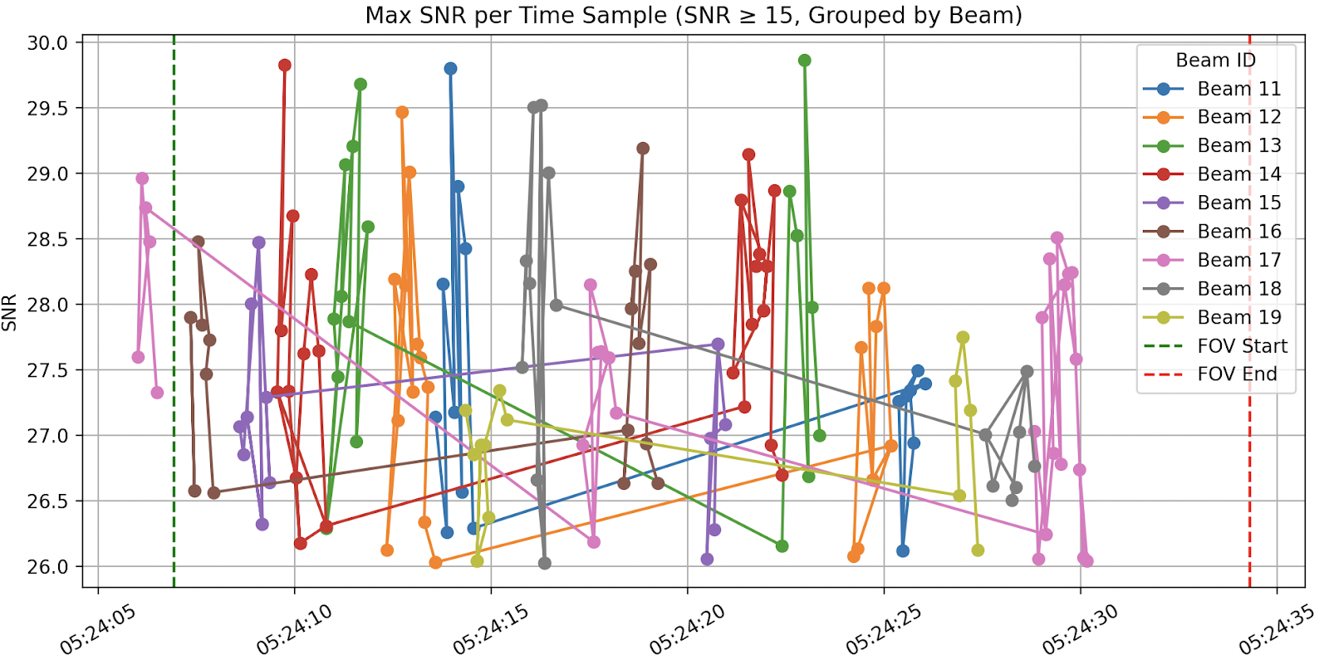
Radar Signal Simulator
Missione 4 • Istruzione e Ricerca
Missione 4 • Istruzione e Ricerca

Slide 15
Software Infrastructure
The NCR will be a sophisticated observatory, leveraging advanced software frameworks and methodologies
We need to specify parameters for scalability, extensibility and interoperability
A solid automated testing framework needs to be developed
Ideally, a policy for development environments, tooling specifications, version control and coding standard is put into place
Missione 4 • Istruzione e Ricerca
Missione 4 • Istruzione e Ricerca

