Slide 1
Ottimizzazione EM Nuova Linea focale Yagi E/W
Training Meeting
NG-Croce
Lunedì 12 Maggio - Giovedì 15 Maggio
Radiotelescopi di Medicina
IRA - Bologna
Pietro Bolli

Slide 2
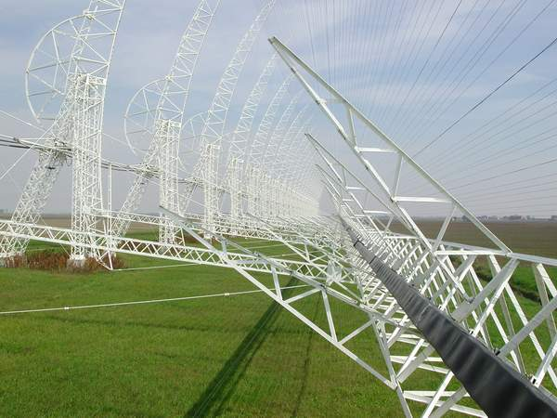
Studio EM e progettazione meccanica:
rete di adattamento e sintesi dei segnali con definizione di un nuovo sezionamento di un ricevitore per ogni 8 (TBD) dipoli per aumentare il numero di fasci indipendenti
linea focale attraverso soluzioni migliorative rispetto alle prestazioni attuali in termini principalmente di efficienza di apertura con rivisitazione del corner reflector o adozione di patch panel o array co-lineari.
Attività affidata a IDS - Ingegneria dei Sistemi (febbraio – settembre 2024)
Missione 4 • Istruzione e Ricerca
Missione 4 • Istruzione e Ricerca

Slide 3
Field of View
Sensitivity
Robustness,
maintenance …
Effective area
Noise Temperature

Slide 4
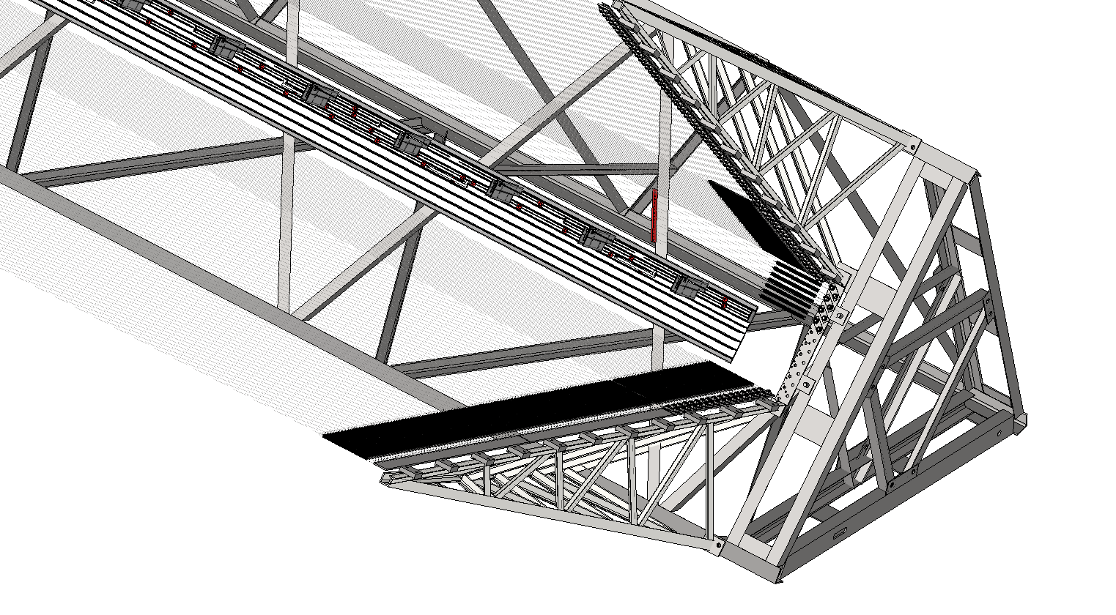
Optimization of the focal line
Dipoles
Symmetrization element
Corner reflector
Metallic cavities
Missione 4 • Istruzione e Ricerca
Missione 4 • Istruzione e Ricerca

Slide 5
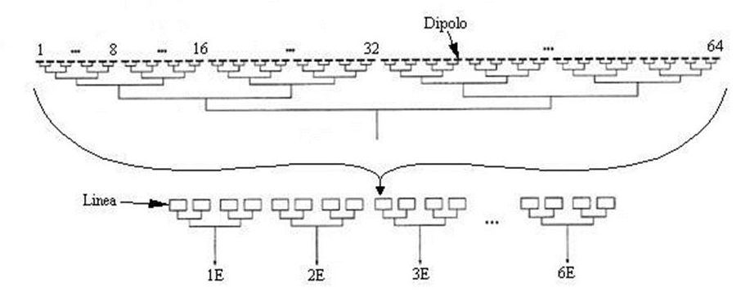
Existing focal line
Corporate Beam Forming Network: combines the signal received by the 1488 dipoles into 6 sections having 248 dipoles each.
For each section a sequential sum of the signals is performed to form a single sub-array beam by:
cascade of metallic cavities to subgroup 62 dipoles
3 coaxial couplers to combine the subgroups
Insertion loss = 0.8 dB (60 Kelvin) up to the pre-amplifiers.
The 6 sub-array beams are finally combined to form the array beam.
x
x
Sub-array beam
Array beam

Slide 6
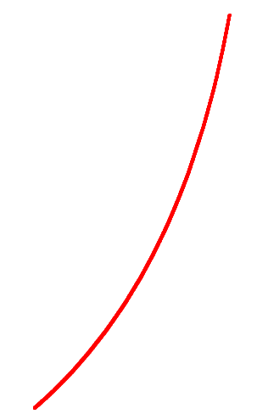
H-plane: mechanical pointing
6
Array beam
Sub-array
beam
HPBW=1.8 deg
Zenith angle range: from 68 deg North to 73 deg South
Secondary
beam
38°
Primary beam
38°
Focus
North
South
Ground
Ground
Notes:
Angoli in declinazione (zenith=44,52°)
Intermediate array beam e Array beam

Slide 7
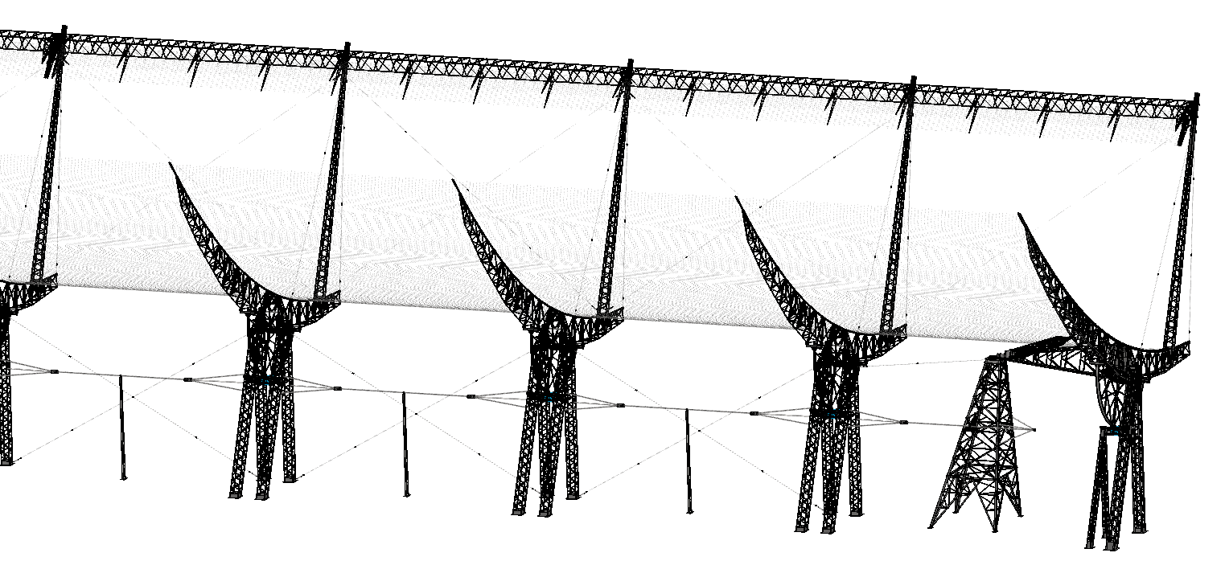
E-plane: electronic pointing
HPBW=0.07 deg
Array beam
Sub-array beam
Secondary beam
Primary beam
Notes:
Field of View - Maximum angle where the peak directivity decreases by 3 dB with respect to the directivity with uniform phase

Slide 8
E-plane: existing configuration

Slide 9
E-plane: existing configuration
FoV=0.4 deg

Slide 10
E-plane: existing configuration
FoV=0.4 deg

Slide 11
E-plane: existing configuration
FoV=0.4 deg

Slide 12
E-plane: desired configuration
Notes:
Significant limitation in the tracking of the celestial objects

Slide 13
E-plane: desired configuration
FoV=27 deg

Slide 14
E-plane: desired configuration
FoV=27 deg

Slide 15
E-plane: desired configuration
FoV=27 deg

Slide 16
E-plane: desired configuration
FoV=27 deg
Flexible and programmable multi-beam software capability!

Slide 17
Selected antenna: Yagi-Uda
Simple structure with well-established technology
Mechanically robust, reduced weight, resistant to atmospheric agents and to aging in general
Corner reflector not needed
Easy installation, operation and maintenance
Equipped with balun, while low noise amplifier and optical fiber transmitter supported by the antenna boom
Parameter | Value
Nominal Directivity | ≥ 14 dBi
Bandwidth | 400-416 MHz
Voltage Standing Wave Ratio | ≤ 1.5:1 (RL > 14 dB)
HPBW E-plane | 36±1 deg @ 408 MHz 36±3 deg @ other frequencies
HPBW H-plane | 39±1 deg @ 408 MHz 39±3 deg @ other frequencies
Front/Back Ratio | ≥ 25 dB @ 408 MHz ≥ 15 dB @ other frequencies
Insertion loss (including the RF connector and the pigtail cable if any) | ≤ 0.25 dB

Slide 18
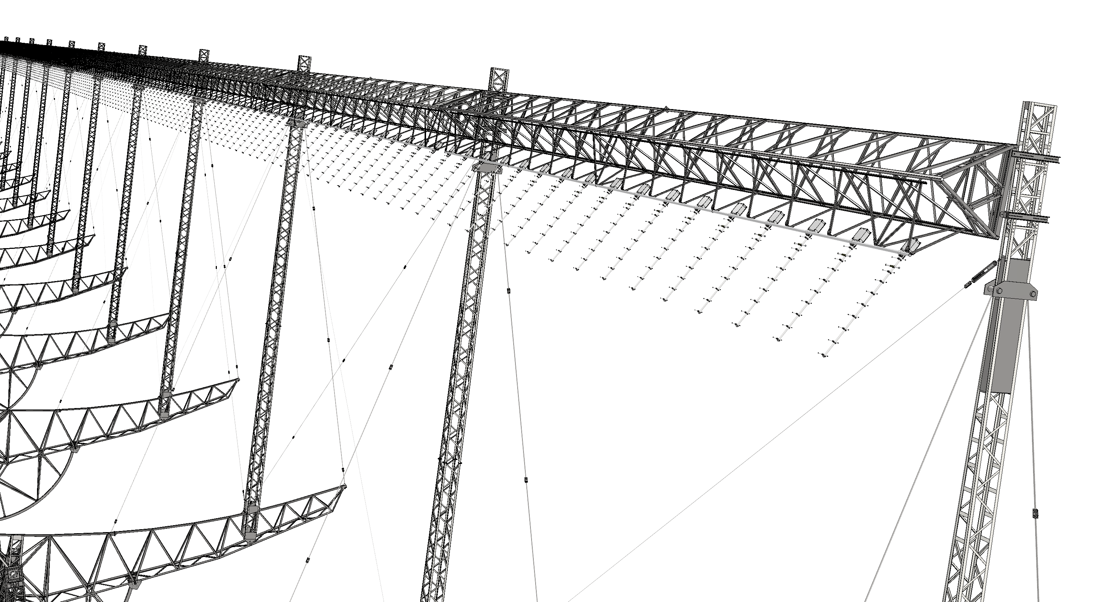
Future configuration: 416 uniformly distributed Yagi-Uda antennas with an inter-element spacing of 1.36 m
Customized version of the antenna model WY380-10N for the supply of 450 antennas

Slide 19
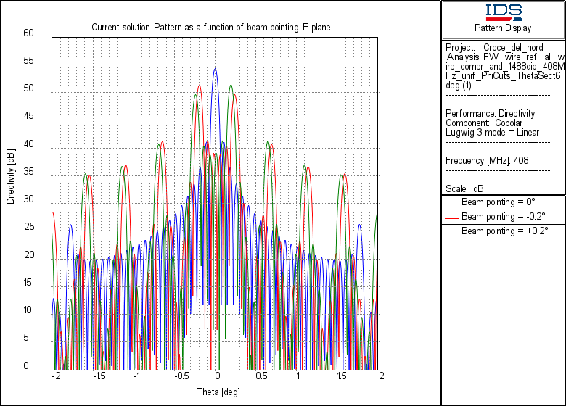
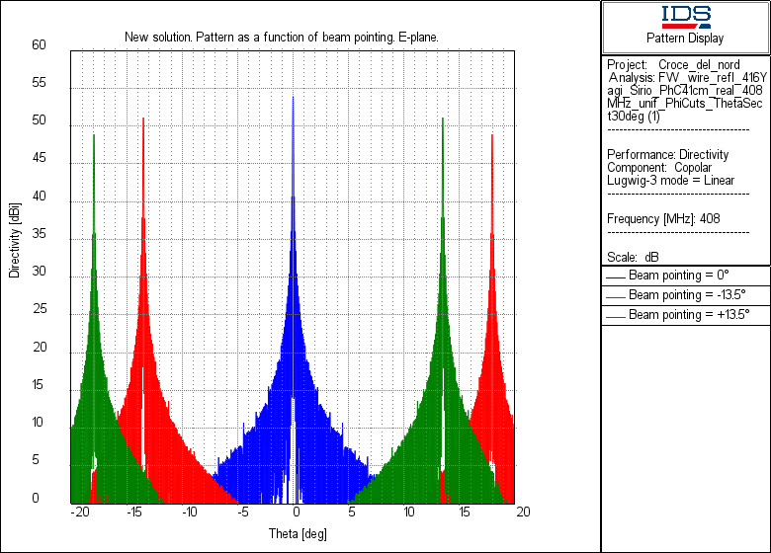
Array beam (E-plane)
Existing (dipole) configuration
New (Yagi-Uda) configuration

Slide 20
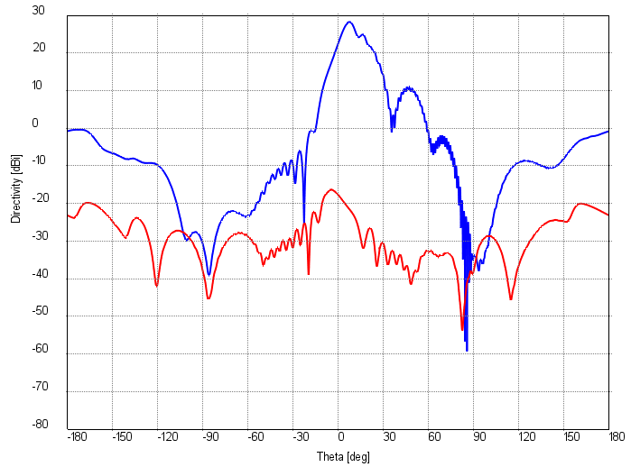
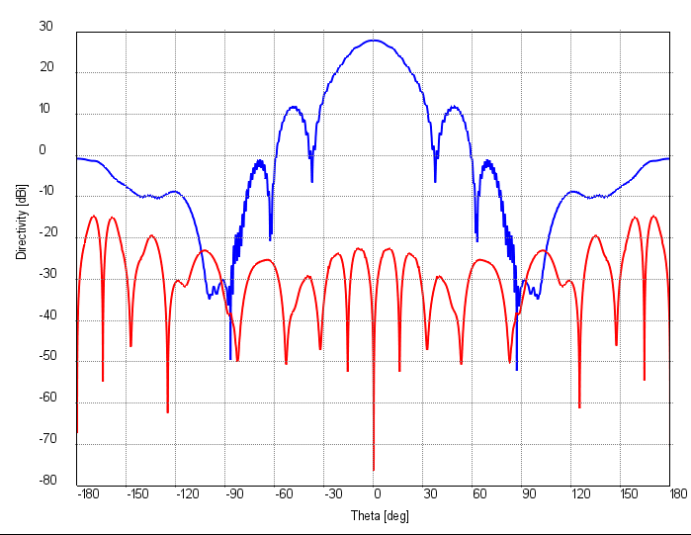
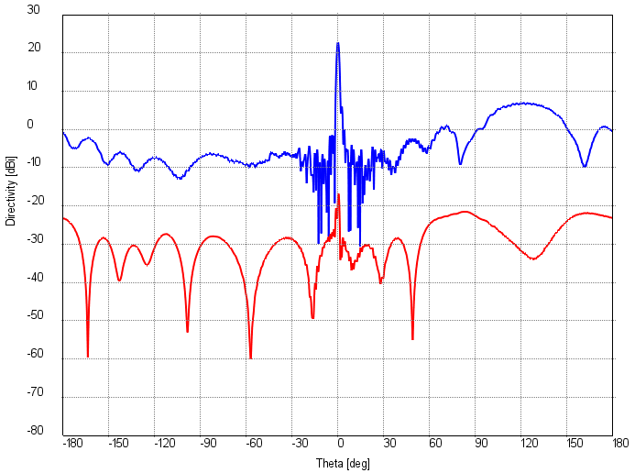
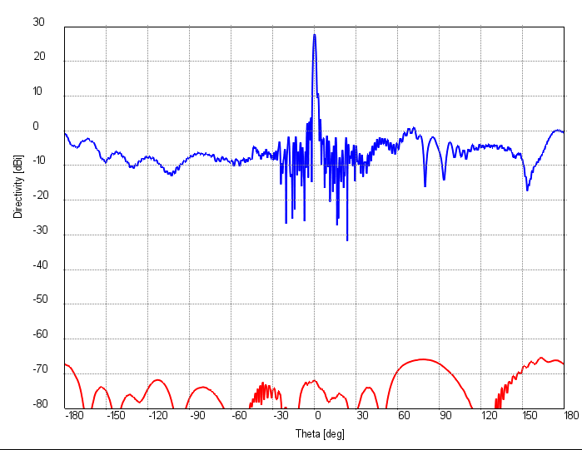
Secondary beam
E-plane
E-plane
H-plane
H-plane
1
208

Slide 21
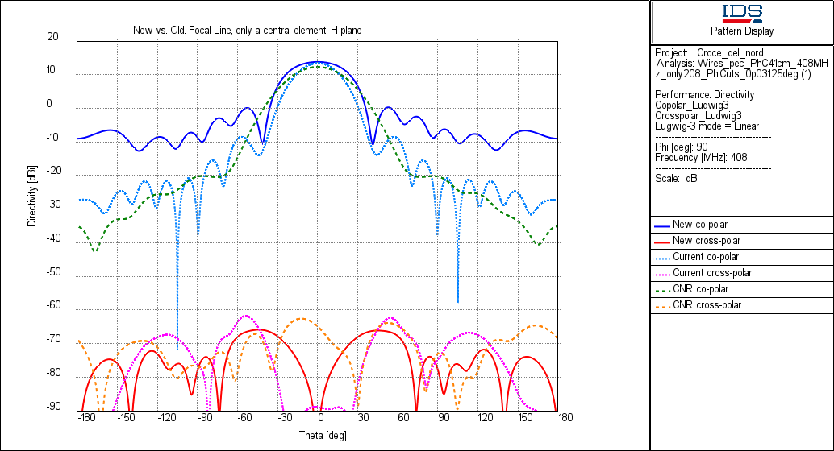
Primary beam (H-plane)
Ground
Notes:
Vecchio à max. = 13.41 dBi, @38° = -9.05 dBi, @-38° = -9.12 dBi Nuovo à max. = 13.79 dBi, @38° = -6.02 dBi, @-38° = -6.03 dBi

Slide 22
Existing configuration (dashed light blue) | Value
Peak | 13.4 dBi
HPBW | 30°
Relative taper at 38° (*) | -21.5 dB
CNR configuration (dashed green)
Peak | 12.3 dBi
HPBW | 40°
Relative taper at 38° (*) | -10.8 dB
New configuration (continuos blue)
Peak | 13.8 dBi
HPBW | 39-43°
Relative taper at 38° (*) | -19.8 dB
38°
0 dBi
-10 dBi
* w/o FSPL

Slide 23
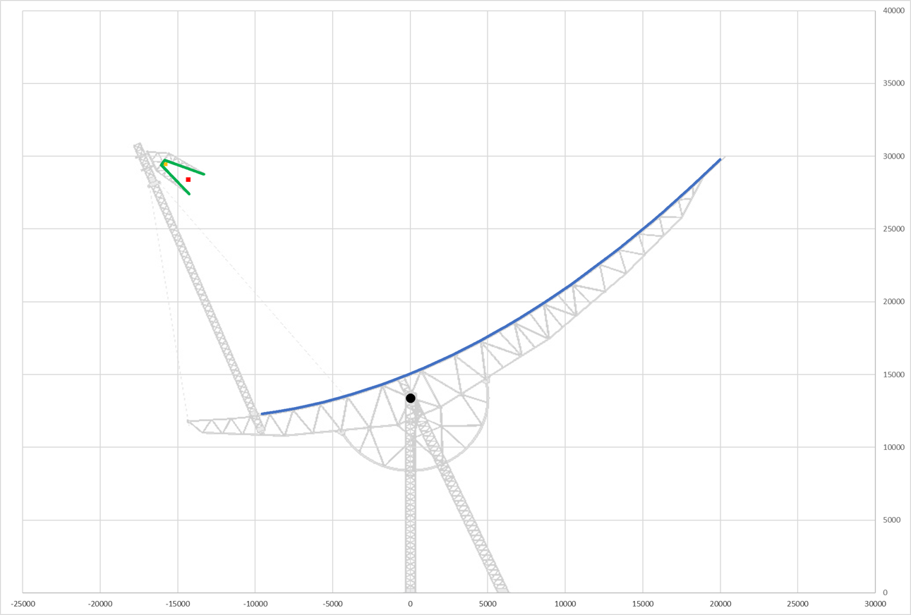
ZENITH (44,52°)
θ=-37.5°
θ=145.5°
θ=108°
θ=0°
θ=37.5°

Slide 24
Performance comparison
Parameter | Existing (dipole) configuration | New (Yagi-Uda) configuration
Max directivity (boresight pointing) / aperture efficiency | 54.46 dBi / 70% | 54.14 dBi / 65%
Taper efficiency H-plane | 75% | 77%
Spillover efficiency H-plane | 99% | 92%
Noise from ground | 1.2 – 2.3 k | 8.5 – 12.5 k
System noise temperature | 160-170 k (meas.) | 92 k (est.*)
Sensitivity | 72 m²/k | 121 m²/k
*T_sky=25 k, T_ground=12.5 k, T_BFN=17 k, T_LNA/Loss_BFN=37.1 k → T_sys=91.6 k

Slide 25
Performance comparison
Parameter | Existing (dipole) configuration | New (Yagi-Uda) configuration | CNR (dipole) configuration
Max directivity (boresight pointing) / aperture efficiency | 54.46 dBi / 70% | 54.14 dBi / 65% | 54.87 dBi / 78%
Taper efficiency H-plane | 75% | 77% | 87%
Spillover efficiency H-plane | 99% | 92% | 97%
Noise from ground | 1.2 – 2.3 k | 8.5 – 12.5 k | 4.2 – 8.3 k
System noise temperature | 160-170 k (meas.) | 92 k (est.*) | 87 k (est.)
Sensitivity | 72 m²/k | 121 m²/k | 151 m²/k
*T_sky=25 k, T_ground=12.5 k, T_BFN=17 k, T_LNA/Loss_BFN=37.1 k → T_sys=91.6 k
Notes:
riducendo la lunghezza del corner reflector

Slide 26
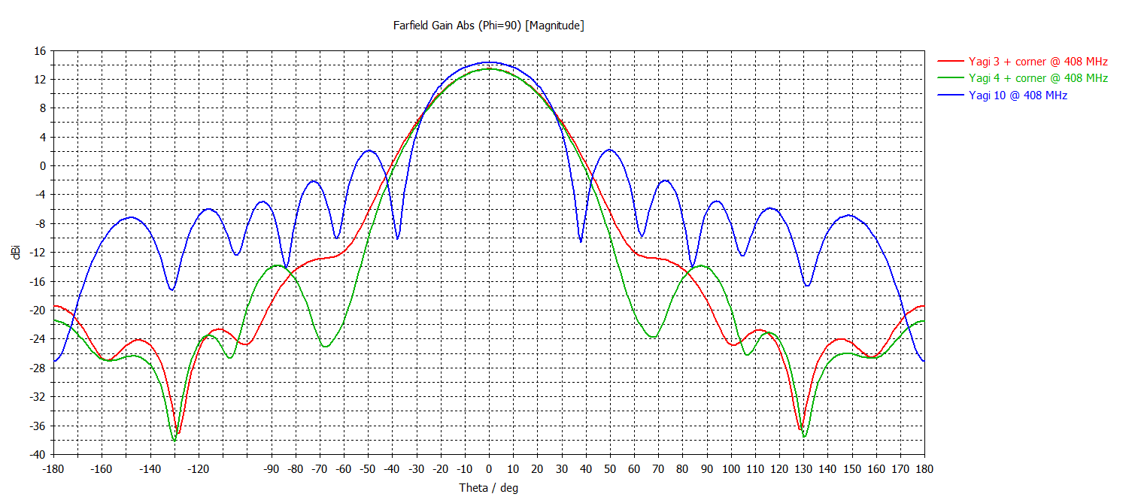
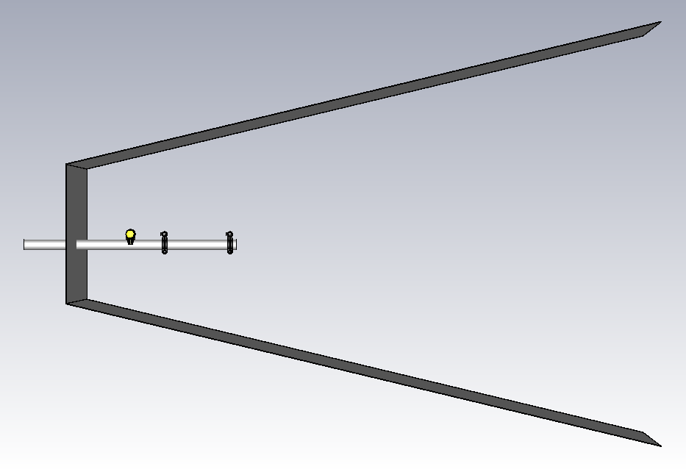
What’s next?
The contract for the supply of 450 Yagi-Uda antennas has been signed in March 2025 with Sirio Antenne and kicked off in April (delivery time 5 months).
Initially, Sirio Antenne will study a modified Yagi-Uda illuminator to optimize the secondary lobes. A hybrid solution Yagi-Uda with 3-4 elements plus a reduced corner reflector seems promising.

Slide 27
Acknowledgment: The research activities described in this paper were carried out with contribution of the NextGenerationEU funds within the National Recovery and Resilience Plan (PNRR), Mission 4 - Education and Research, Component 2 - From Research to Business (M4C2), Investment Line 3.1 - Strengthening and creation of Research Infrastructures, Project IR0000026 – Next Generation Croce del Nord.

