Slide 1
INAF contribution to CHORD and synergies with the Northern Cross (WP6)
Training Meeting
NG-Croce
Mercoledì 14 Maggio
Radiotelescopi di Medicina
IRA - Bologna
Andrea Possenti

Slide 2
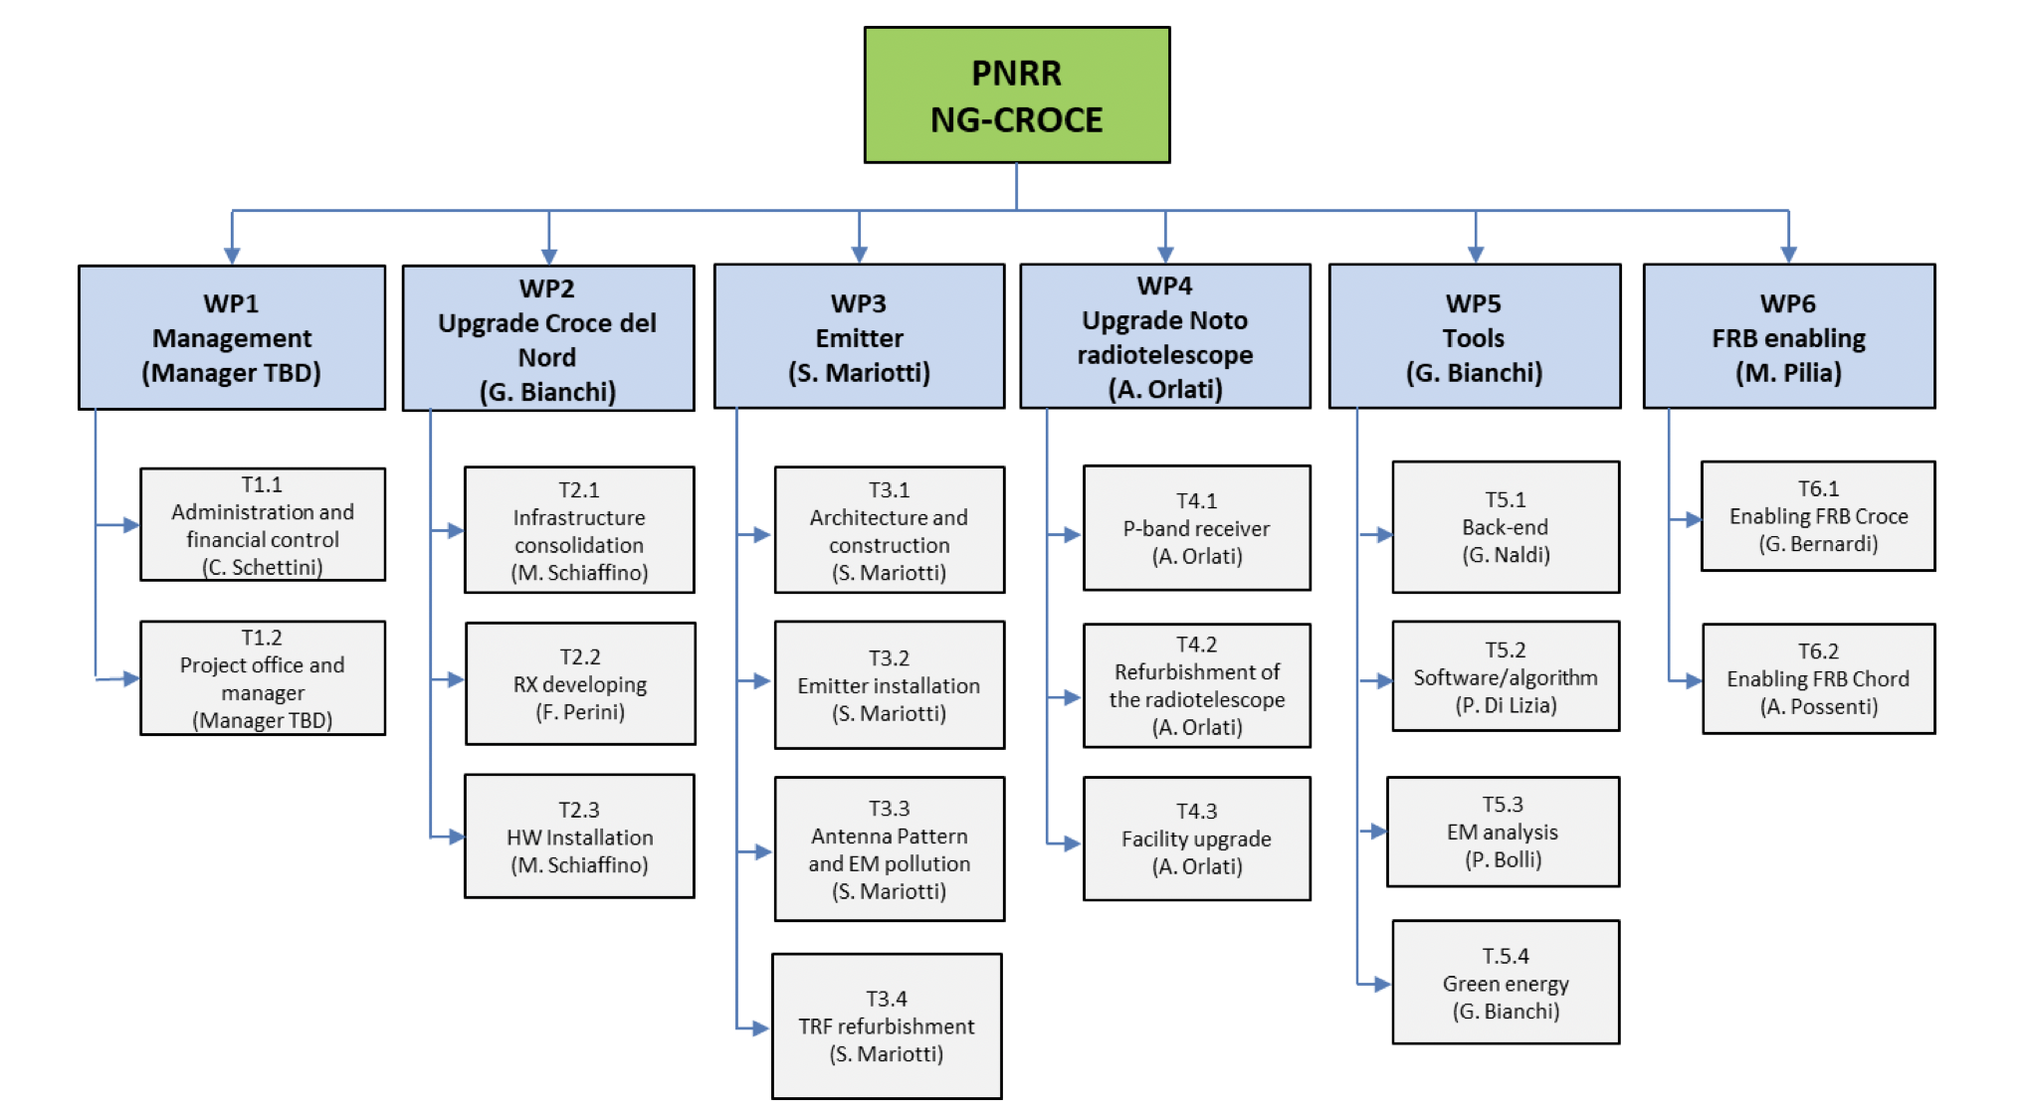
The PNRR NG-CROCE’s WPs, Tasks and Budgets
Mid 2023 to End 2026
PI : Germano Bianchi Project Manager: Andrea Orlati

Slide 3
The members of the CHORD collaboration

Slide 4
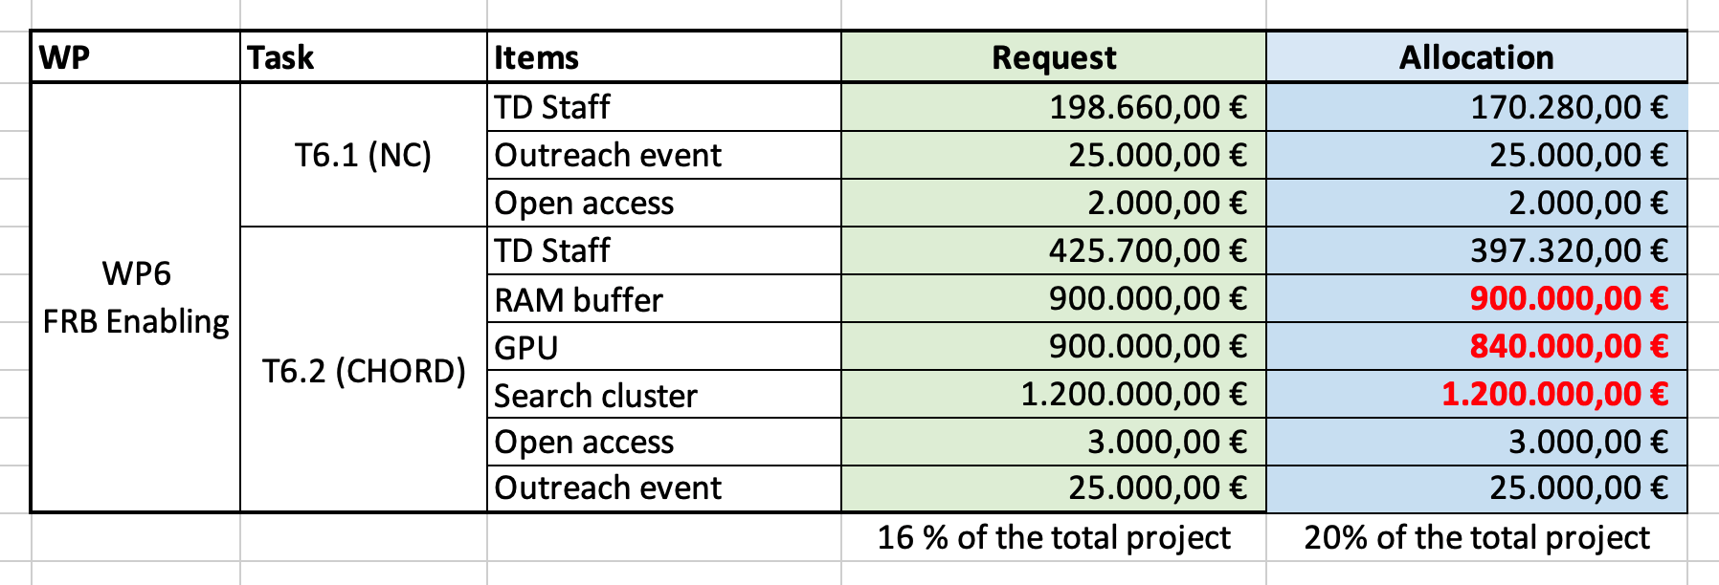
The INAF financial contribution to the CHORD case
2 biennial TD contracts (starting in 2023) + 3 annual TD contracts (starting in 2024)

Slide 5
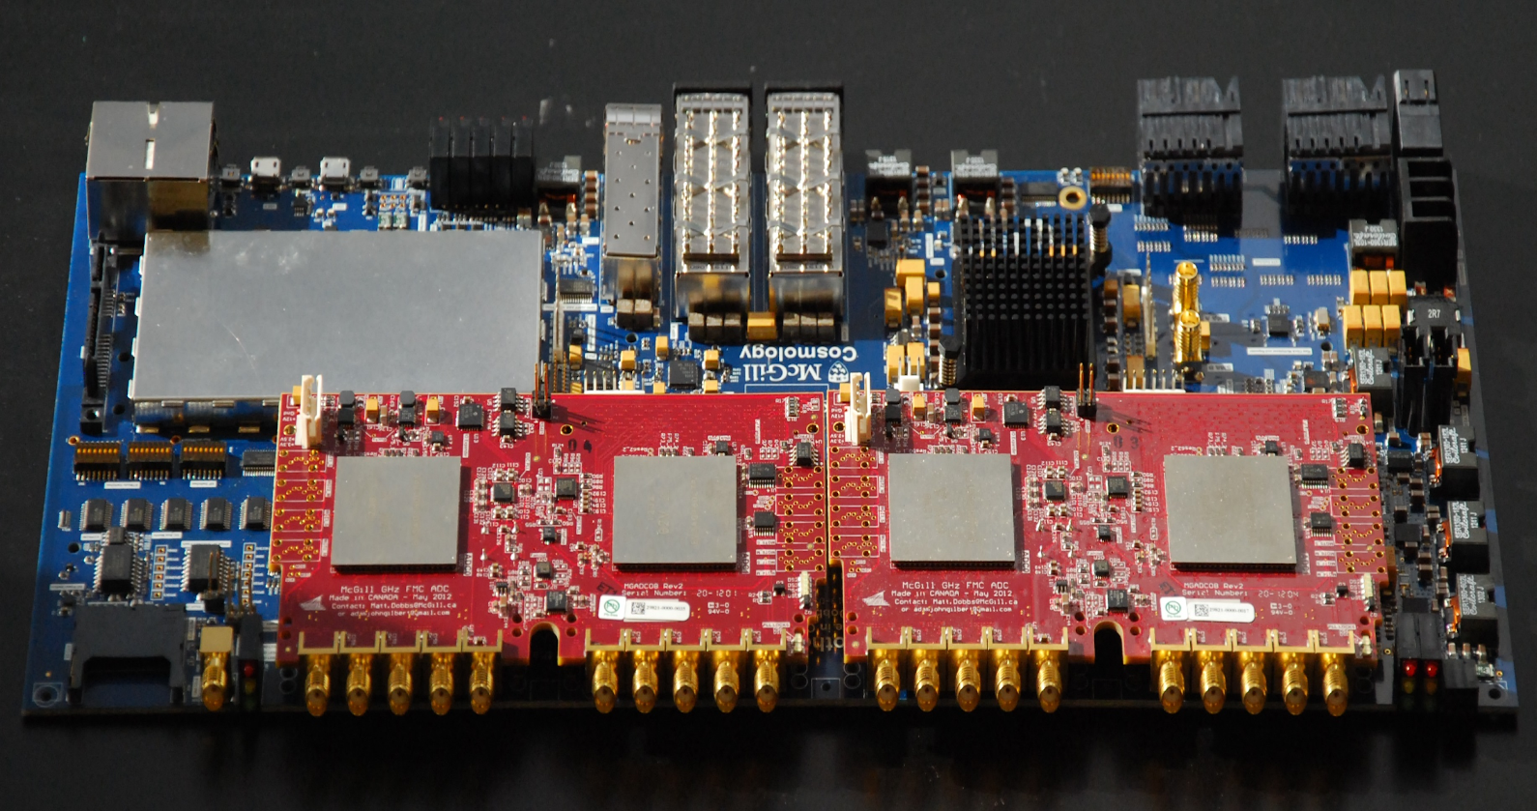
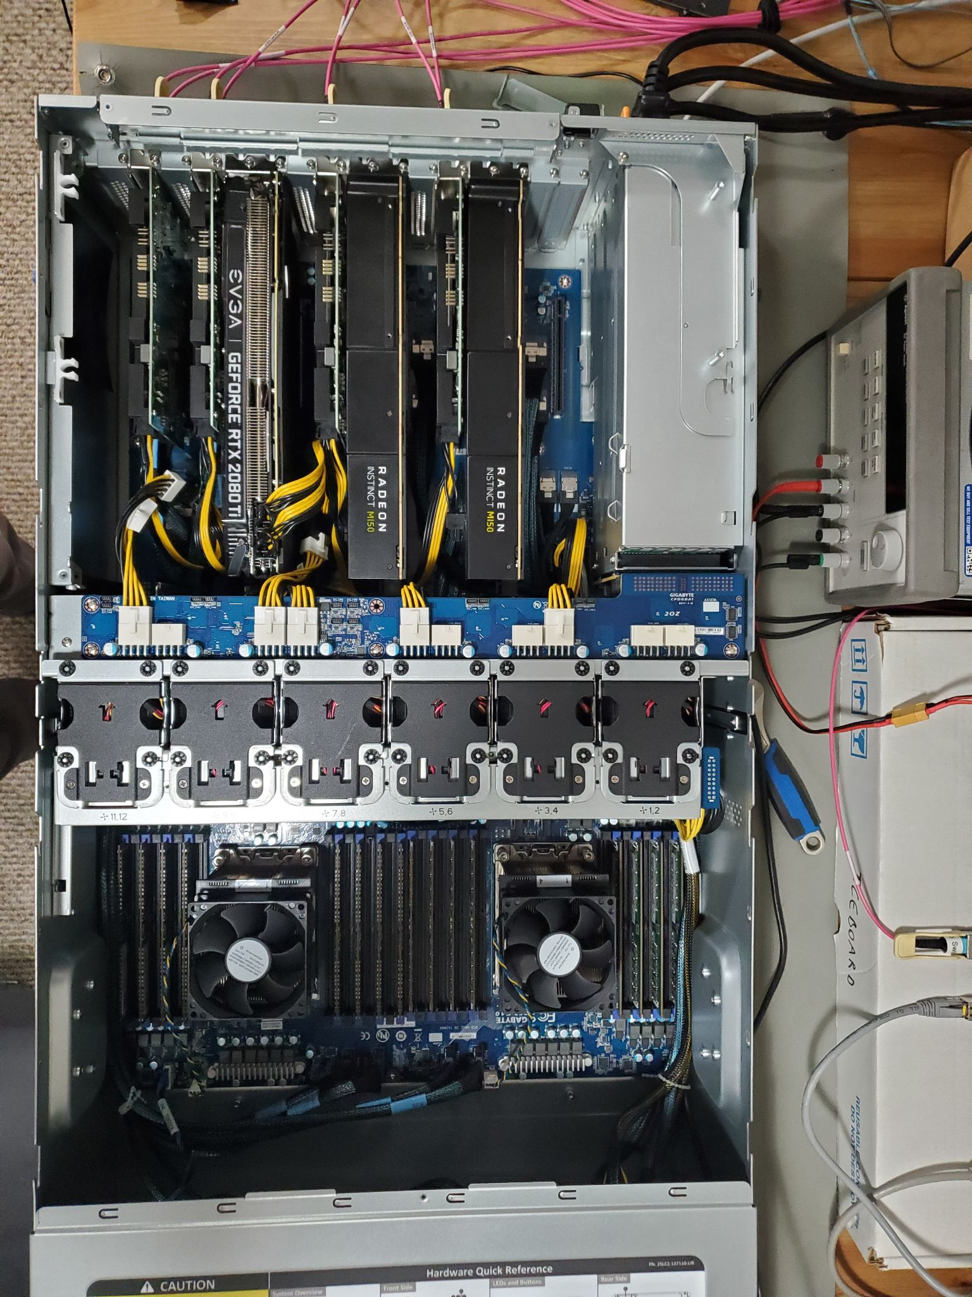
CHORD Correlator(s) and Back-Ends
FX-engine architecture uses an FPGA-based channelizer and a GPU-based correlator
Multiple digital backends, including raw visibilities, transient/FRB search, pulsar search and timing
Images: Bandura+ 2016, Andre Renard (Toronto)

Slide 6
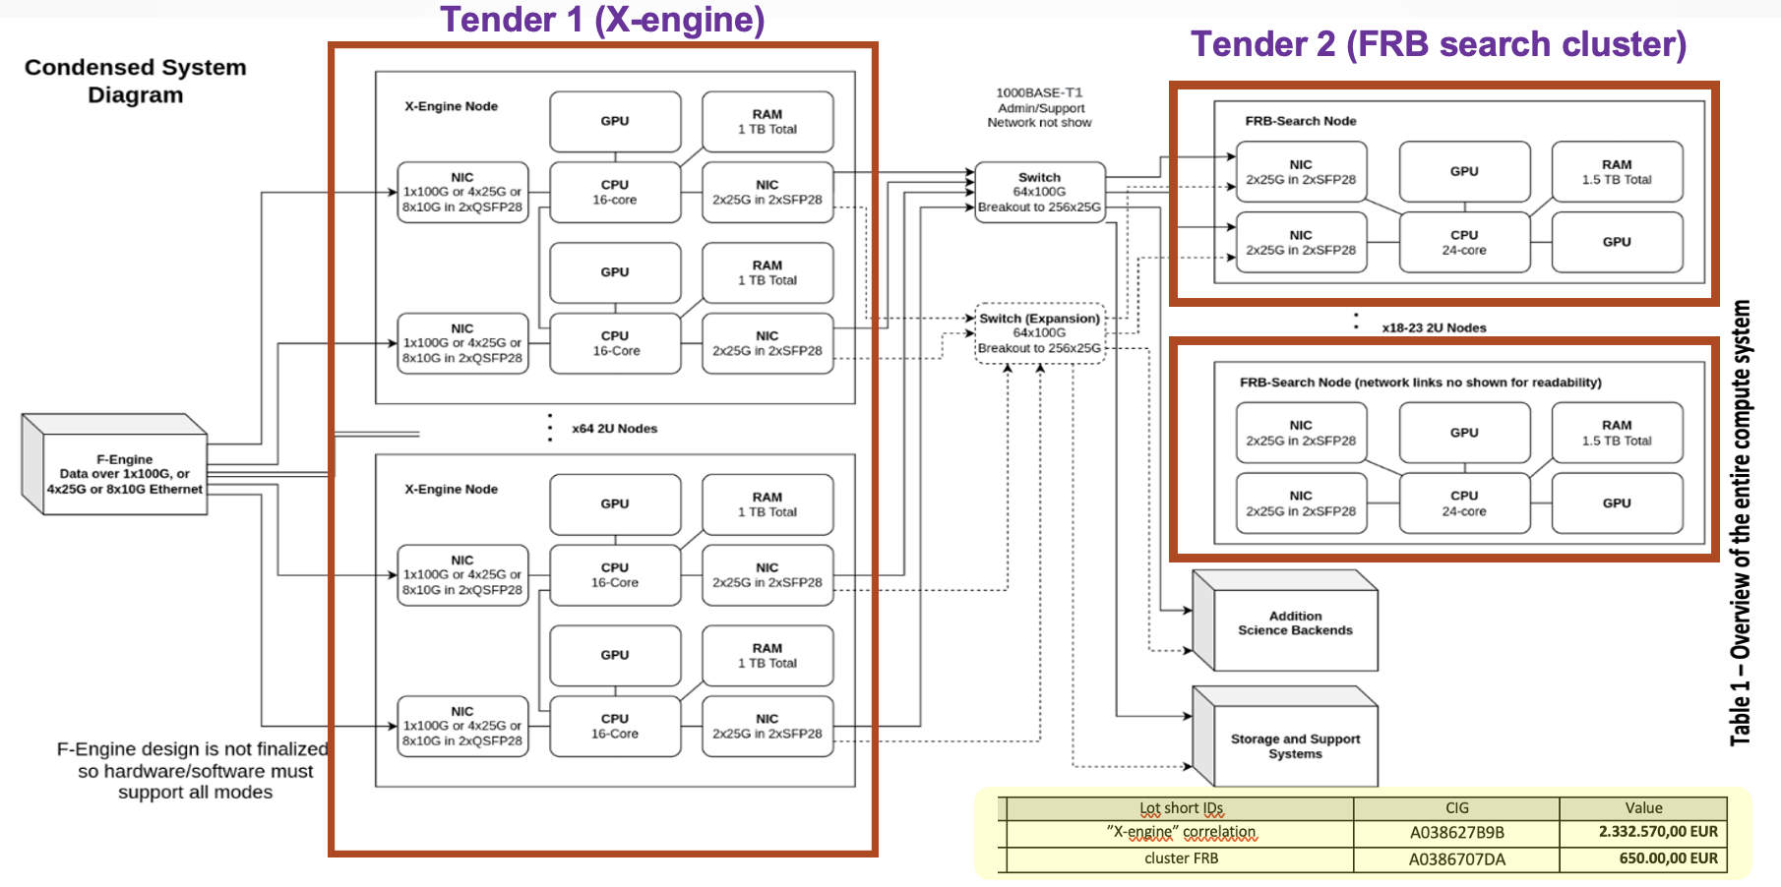
Missione 4 • Istruzione e Ricerca
Missione 4 • Istruzione e Ricerca

Slide 7
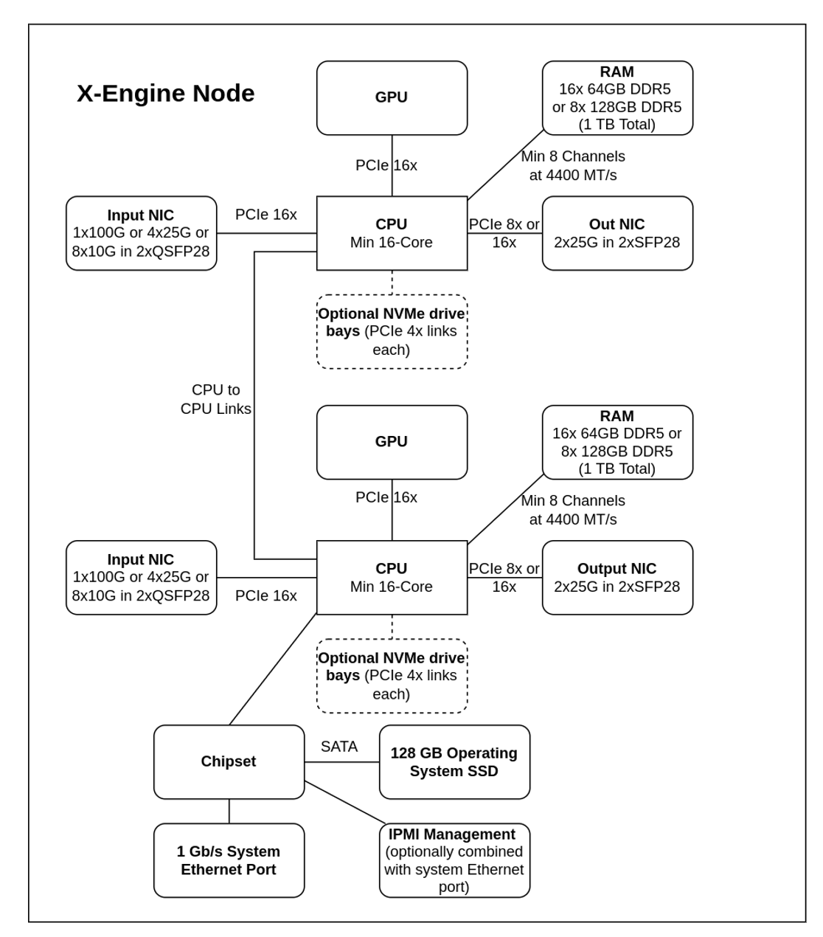
X-engine system (Tender 1)
70 boards delivered at DRAO
(delivered and verified on Sept 2024)

Slide 8
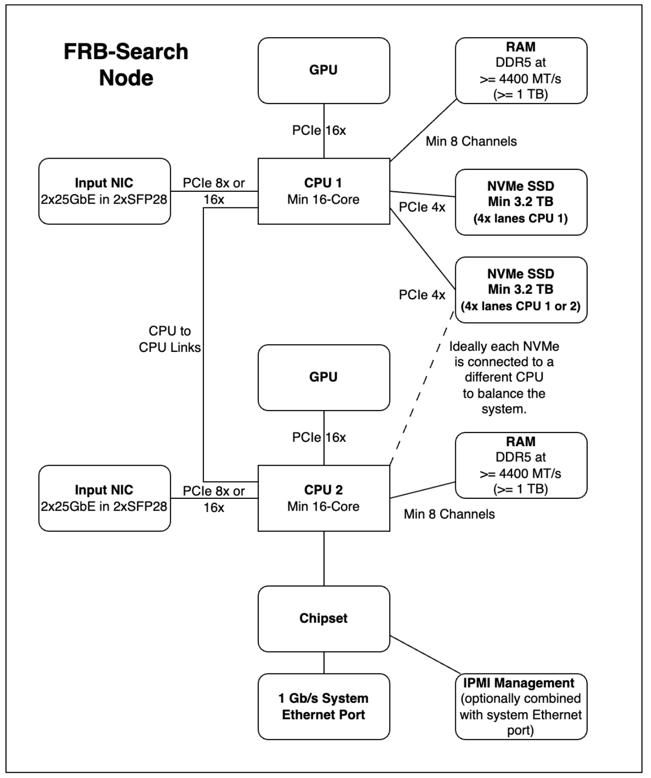
FRB search cluster (Tender 2)
14 nodes plus
3 storage servers (340 TB HDD each) plus
2 management servers
(delivered and tested on April 2025)

Slide 9
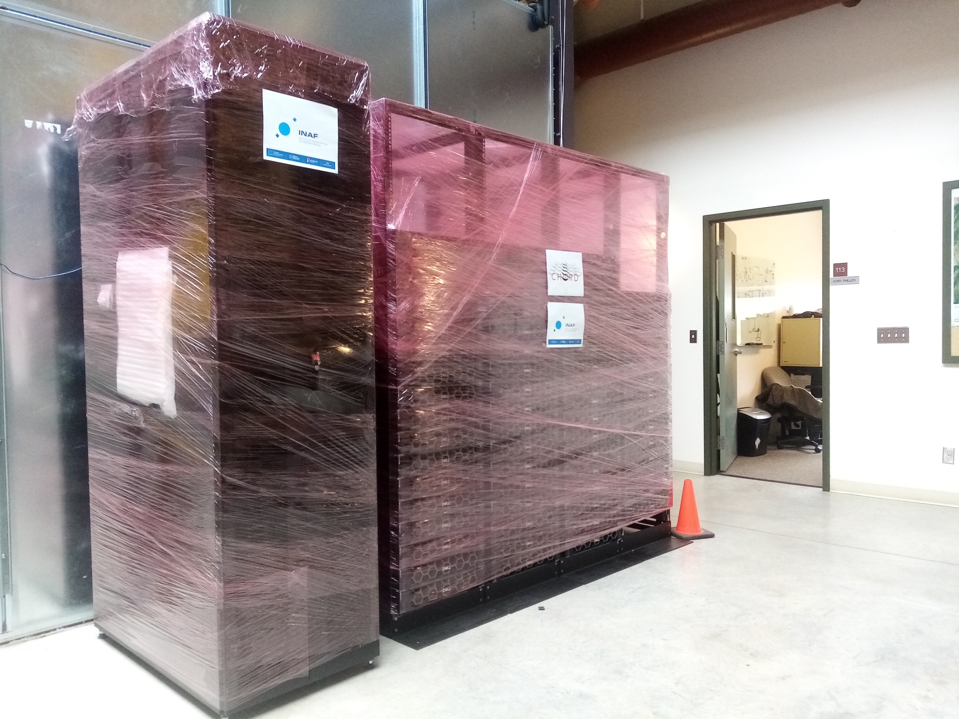
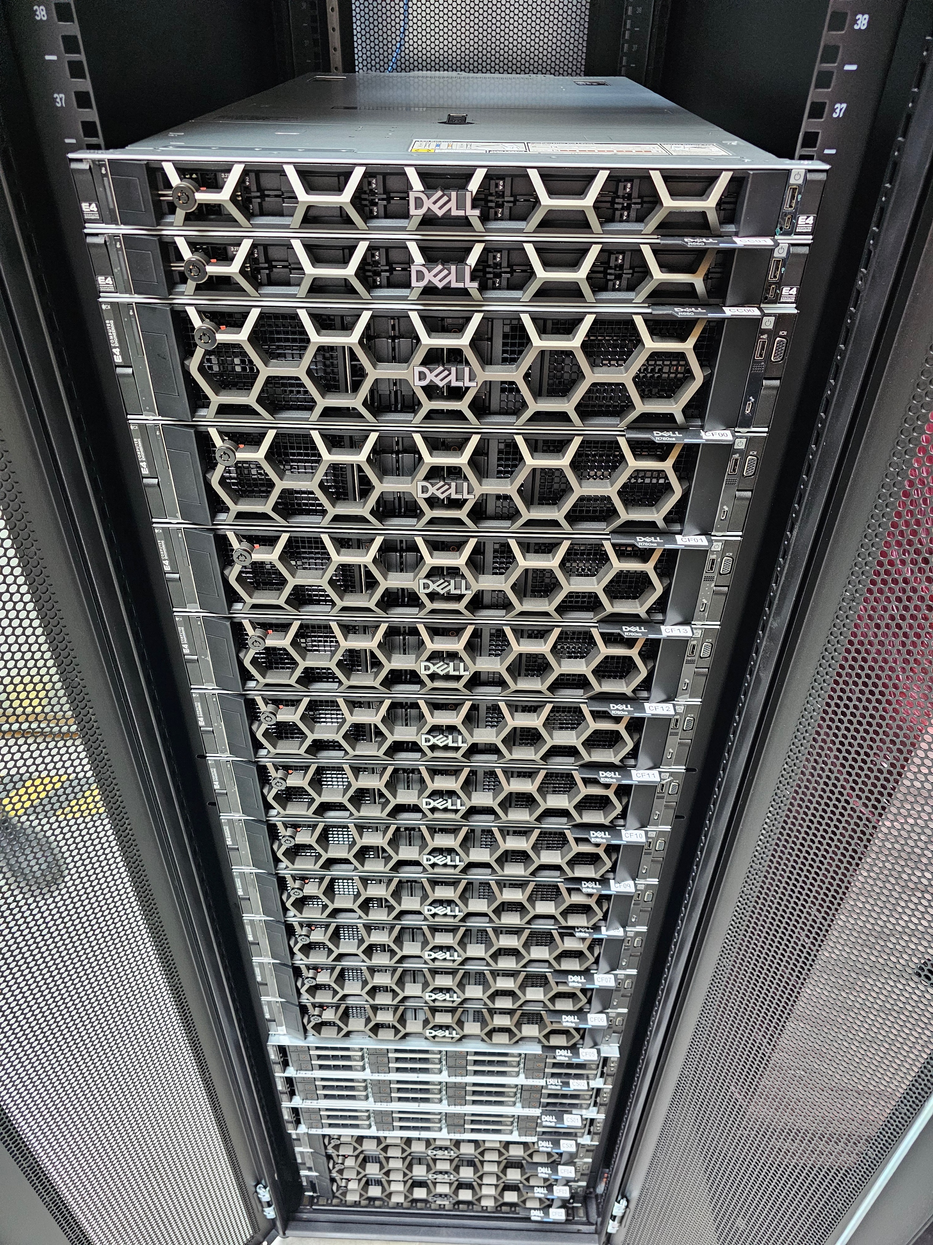
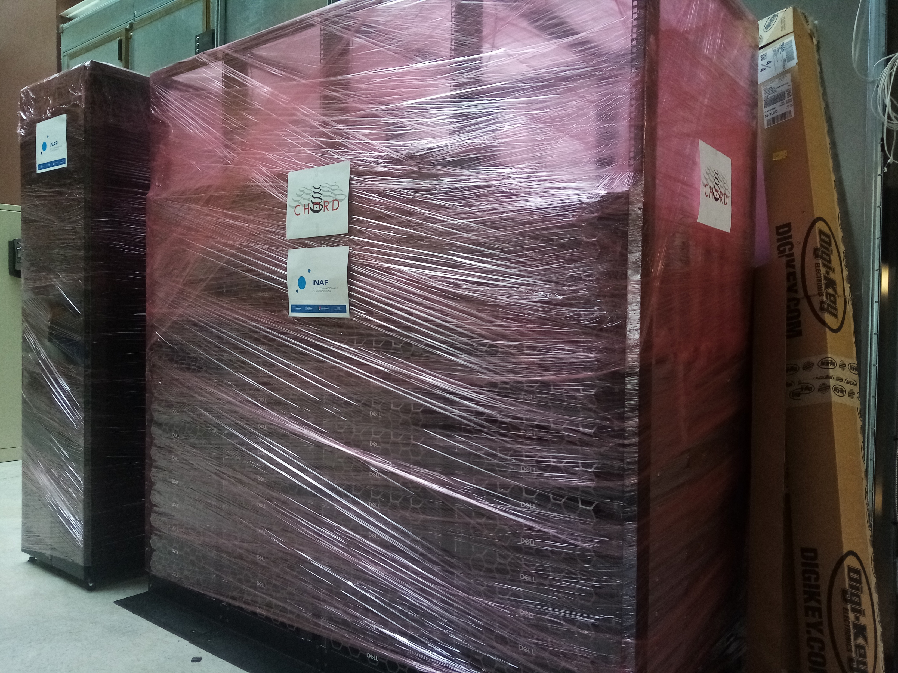
The delivered and verified hardware, stored at DRAO
Cluster FRB & X-engine

Slide 10
INAF contribution: software development
Many activities running in parallel
Inaf contributions:
Matteo Trudu → subband searches
Martin Topinka → RFI vs FRB discrimination
Matteo Cinus → software actions orchestration

Slide 11
INAF contribution: science WGs
Science Working Groups have started or are in the verge of starting their activities:
FRB working group
Pulsar working group
Cosmology working group
HI working group
Cosmic magnetism working group

Slide 12
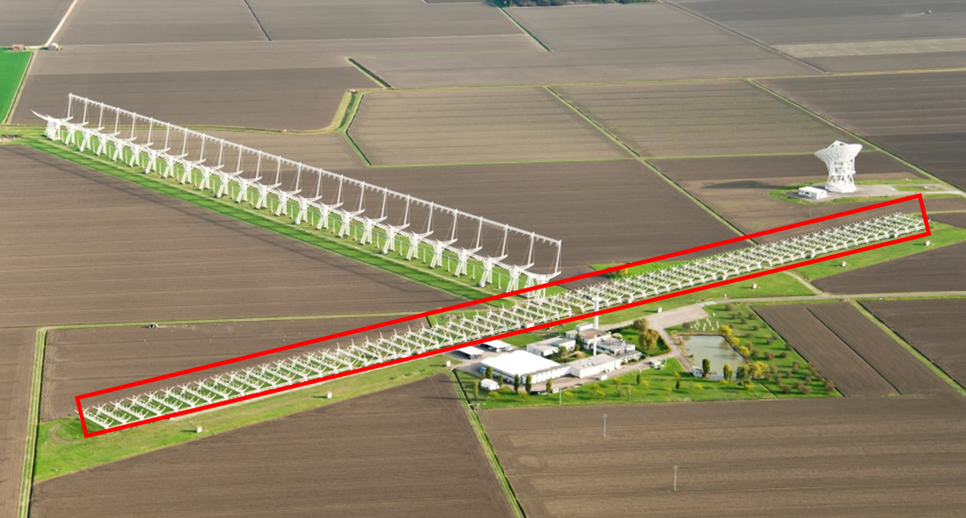
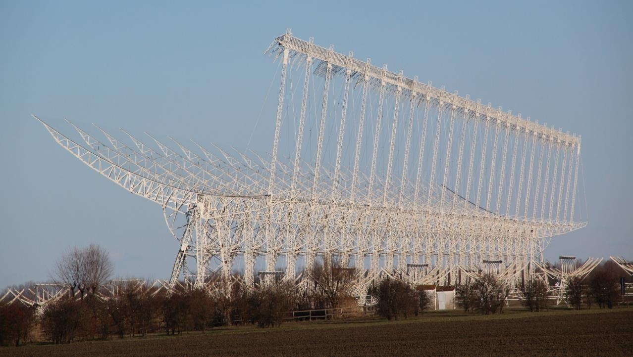
Developments/upgrade at the Northern Cross
Refurbishment of the total N-S arm of the Northern Cross (64 cylindrical parabolic reflectors available by 2023)
10.000 m² of collection area
→ Sensitivity > 1cm @ 2000km slant range
Extension of the field of view up to 90°x7°
→ Increase the number of trackable objects
European Grants
FoV = 7° x 7°
Power = 10kW
Sensitivity to space debris
>1 cm @ 4000 km of slant range
Resolution = 4 x 4 arcmin
Upgrade of the E-W arm and construction of a new transmitting antenna
PNRR Funds

Slide 13
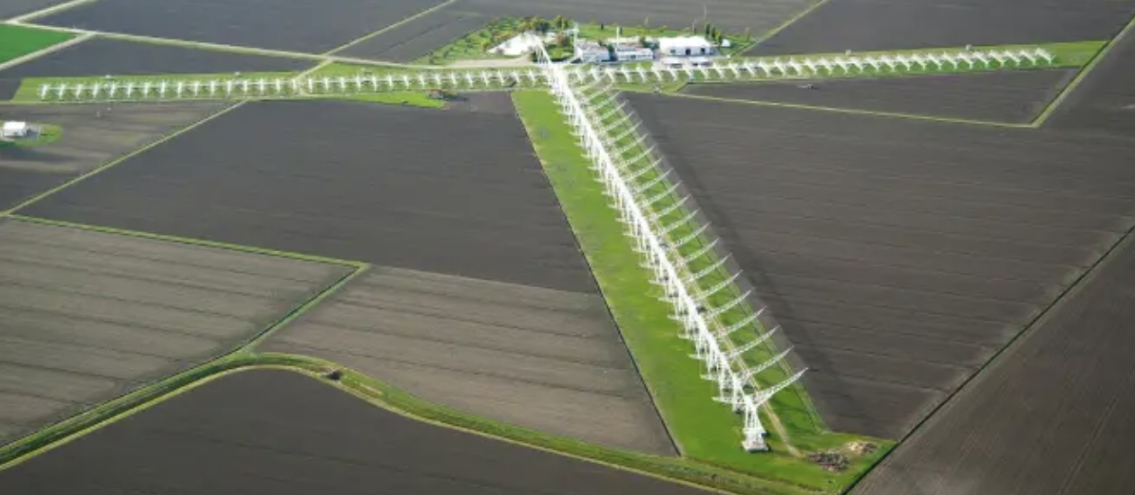
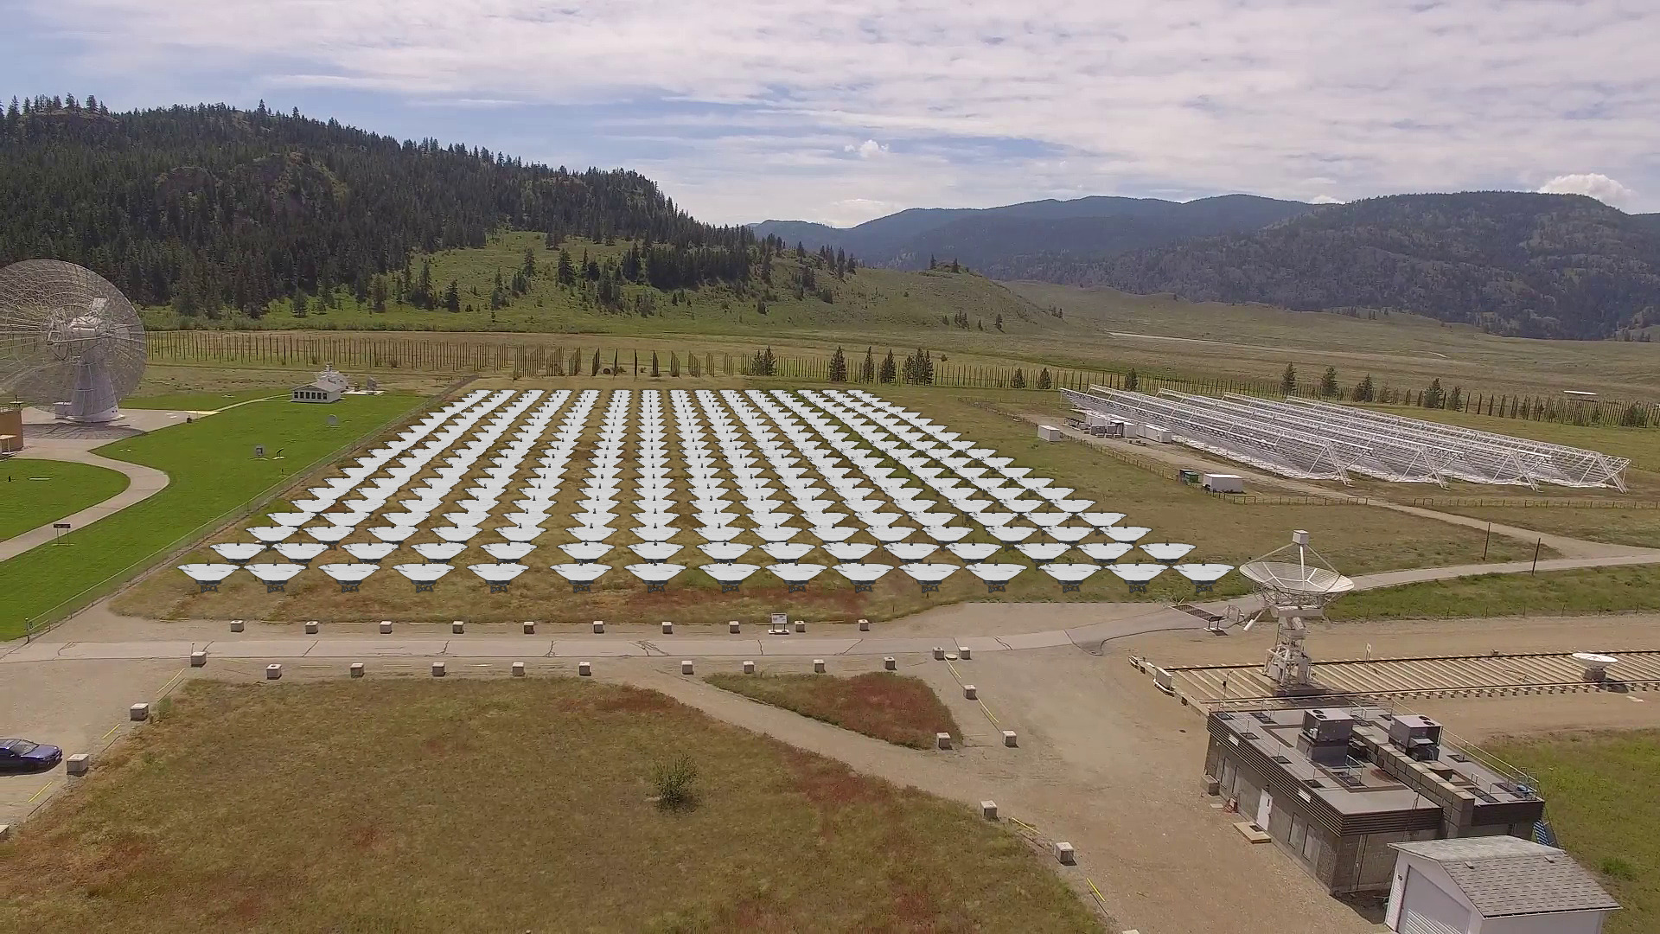
Synergies with the Northern Cross
Northern Cross (NC) collecting Area about twice that of CHORD
For most repeating FRBs with a signal covering the 400 MHz band, the Northern Cross sensitivity is only a factor ≈2-3 worse than CHORD
Northern Cross bandwidth (BW) much smaller than that of CHORD
…but…
most repeating FRBs are BW-limited to ≈ hundreds MHz, i.e. ≈ 10-20 times the Northern Cross BW implying a factor 3-4 less in sensitivity of NC wrt CHORD
Several repeaters can be daily followed up by the NC in parallel with CHORD and replacing CHORD when CHORD will repoint in alternate directions in the sky
© Tracy Zhuo @CITA
Missione 4 • Istruzione e Ricerca
Missione 4 • Istruzione e Ricerca

Slide 14
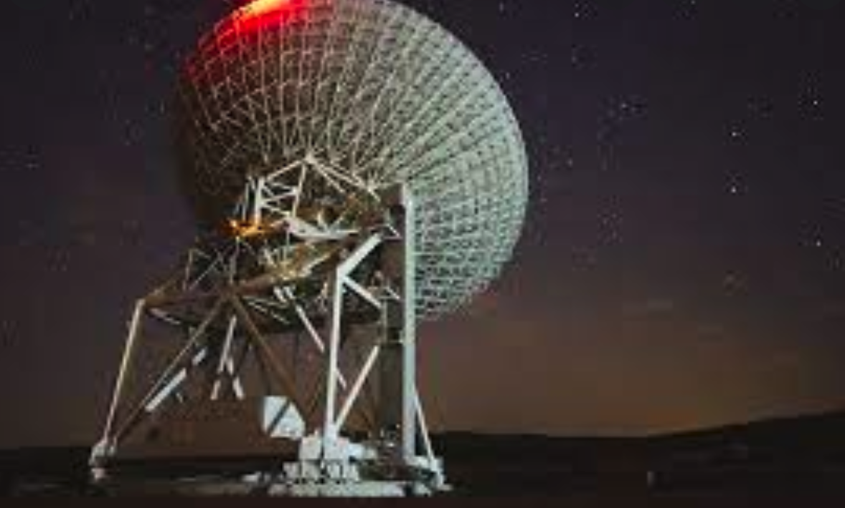
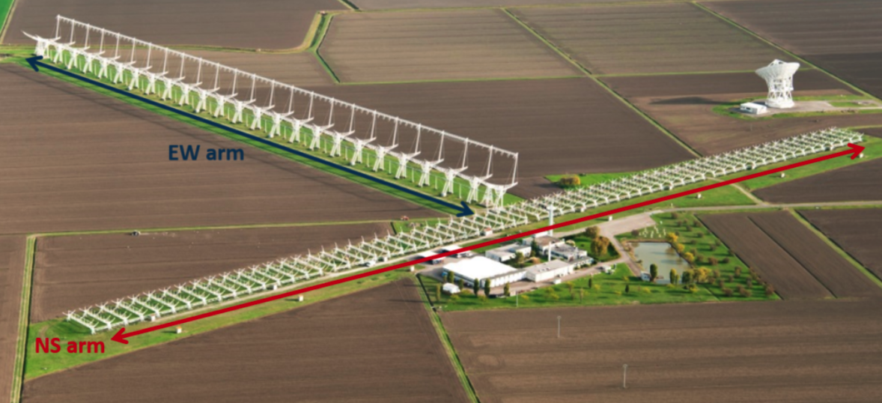
Major running investigations/instruments (by Italian teams)
SRT: 300 MHz, 1.4 GHz, 6 GHz
Northern Cross: 408 MHz

Slide 15
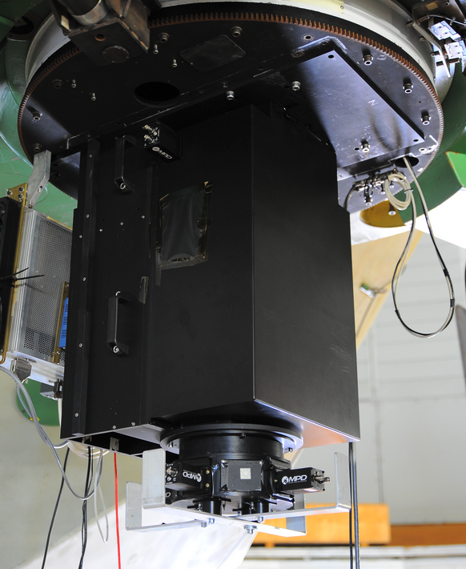
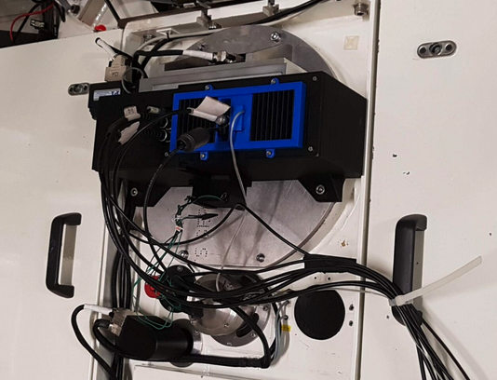
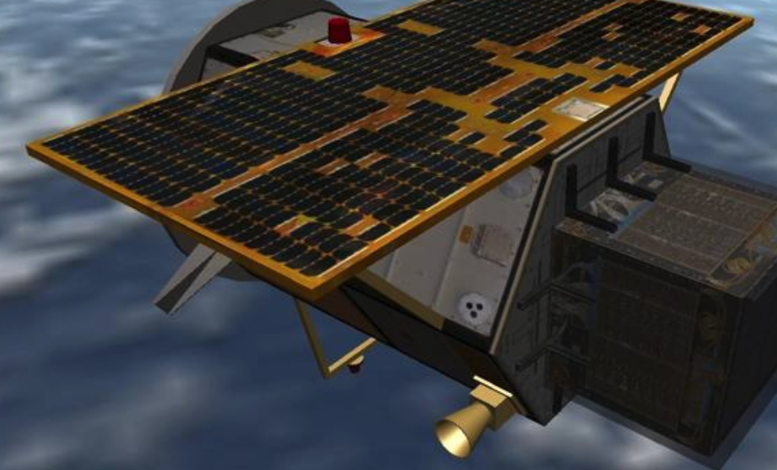
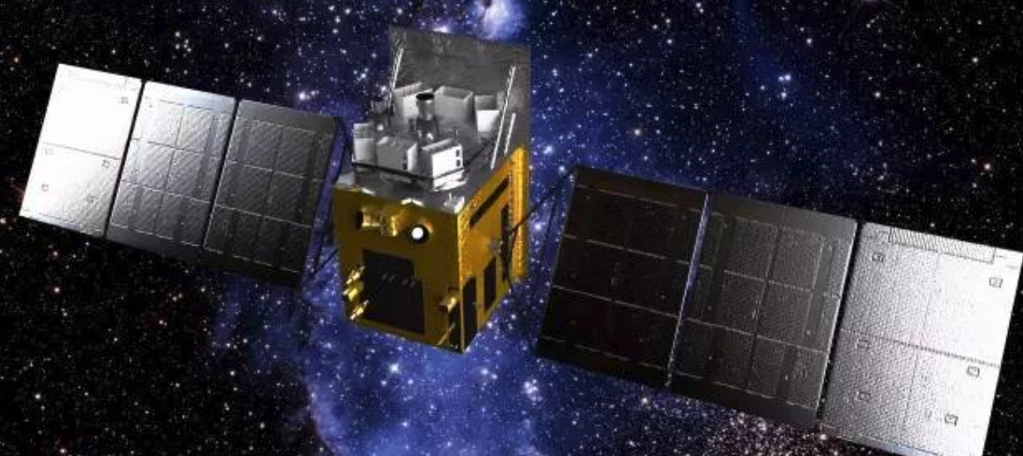
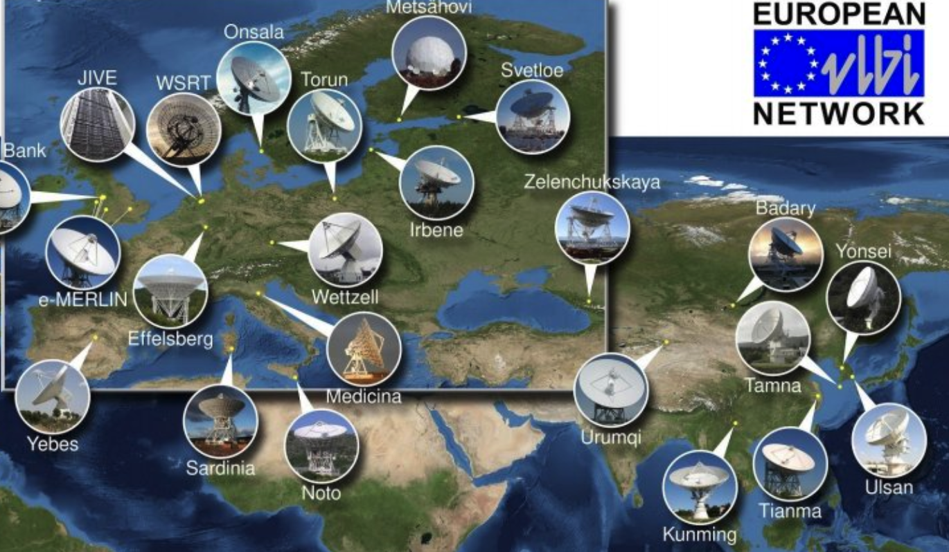
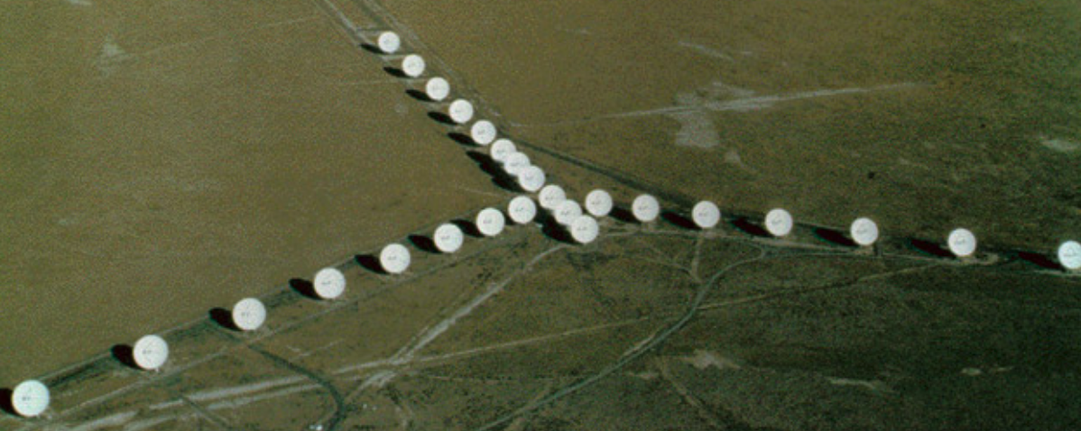
Major running investigations/instruments (by Italian teams)
SiFAP2@TBG, AQUEYE+@Copernicus: ultrafast optical photometers
HXMT, and all suite of X-ray and 𝝪-ray telescopes: study of (upper limits to) prompt and afterglow emission
Large MWL campaigns organized: ~ 50 people involved
[ e.g. Pilia et al 2020, Zampieri et al 2022, Trudu et al 2023 ]
VLA, EVN: radio localization and host characterization

Slide 16
Missione 4 • Istruzione e Ricerca
Missione 4 • Istruzione e Ricerca

