Slide 1
BUILDING A NEW DATA PROCESSING SYSTEM
Training Meeting
NG-Croce
Monday 12th May - Thursday 15th May
Medicina Radiotelescopes
IRA - Bologna
Giovanni Naldi

Slide 2
Outline
Review of the task’s purposes
Hardware components of the system:
Back-end boards
HPC Cluster
Contracts for development activities:
Firmware
Software
Other ongoing activities
Conclusions
Missione 4 • Istruzione e Ricerca
Missione 4 • Istruzione e Ricerca

Slide 3
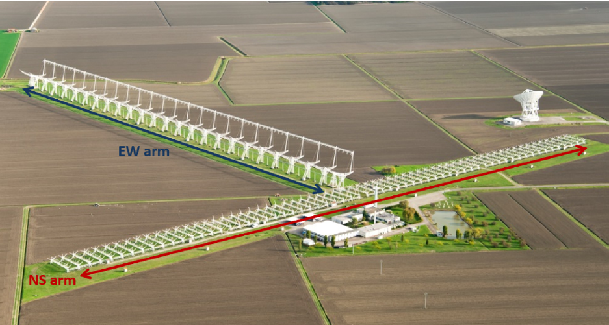
Goal of the Task
To equip the upgraded Northern Cross Radiotelescope with a new digital acquisition and processing system for data coming from both arms (North-South and East-West)
System components:
FPGA boards (digital backend)
High Performance Computing (HPC) cluster
Software/Firmware Development
Applications:
monitoring of LEO space objects
(space debris, SD)
detection of the Fast Radio Bursts (FRBs)
radio transients
Missione 4 • Istruzione e Ricerca
Missione 4 • Istruzione e Ricerca

Slide 4
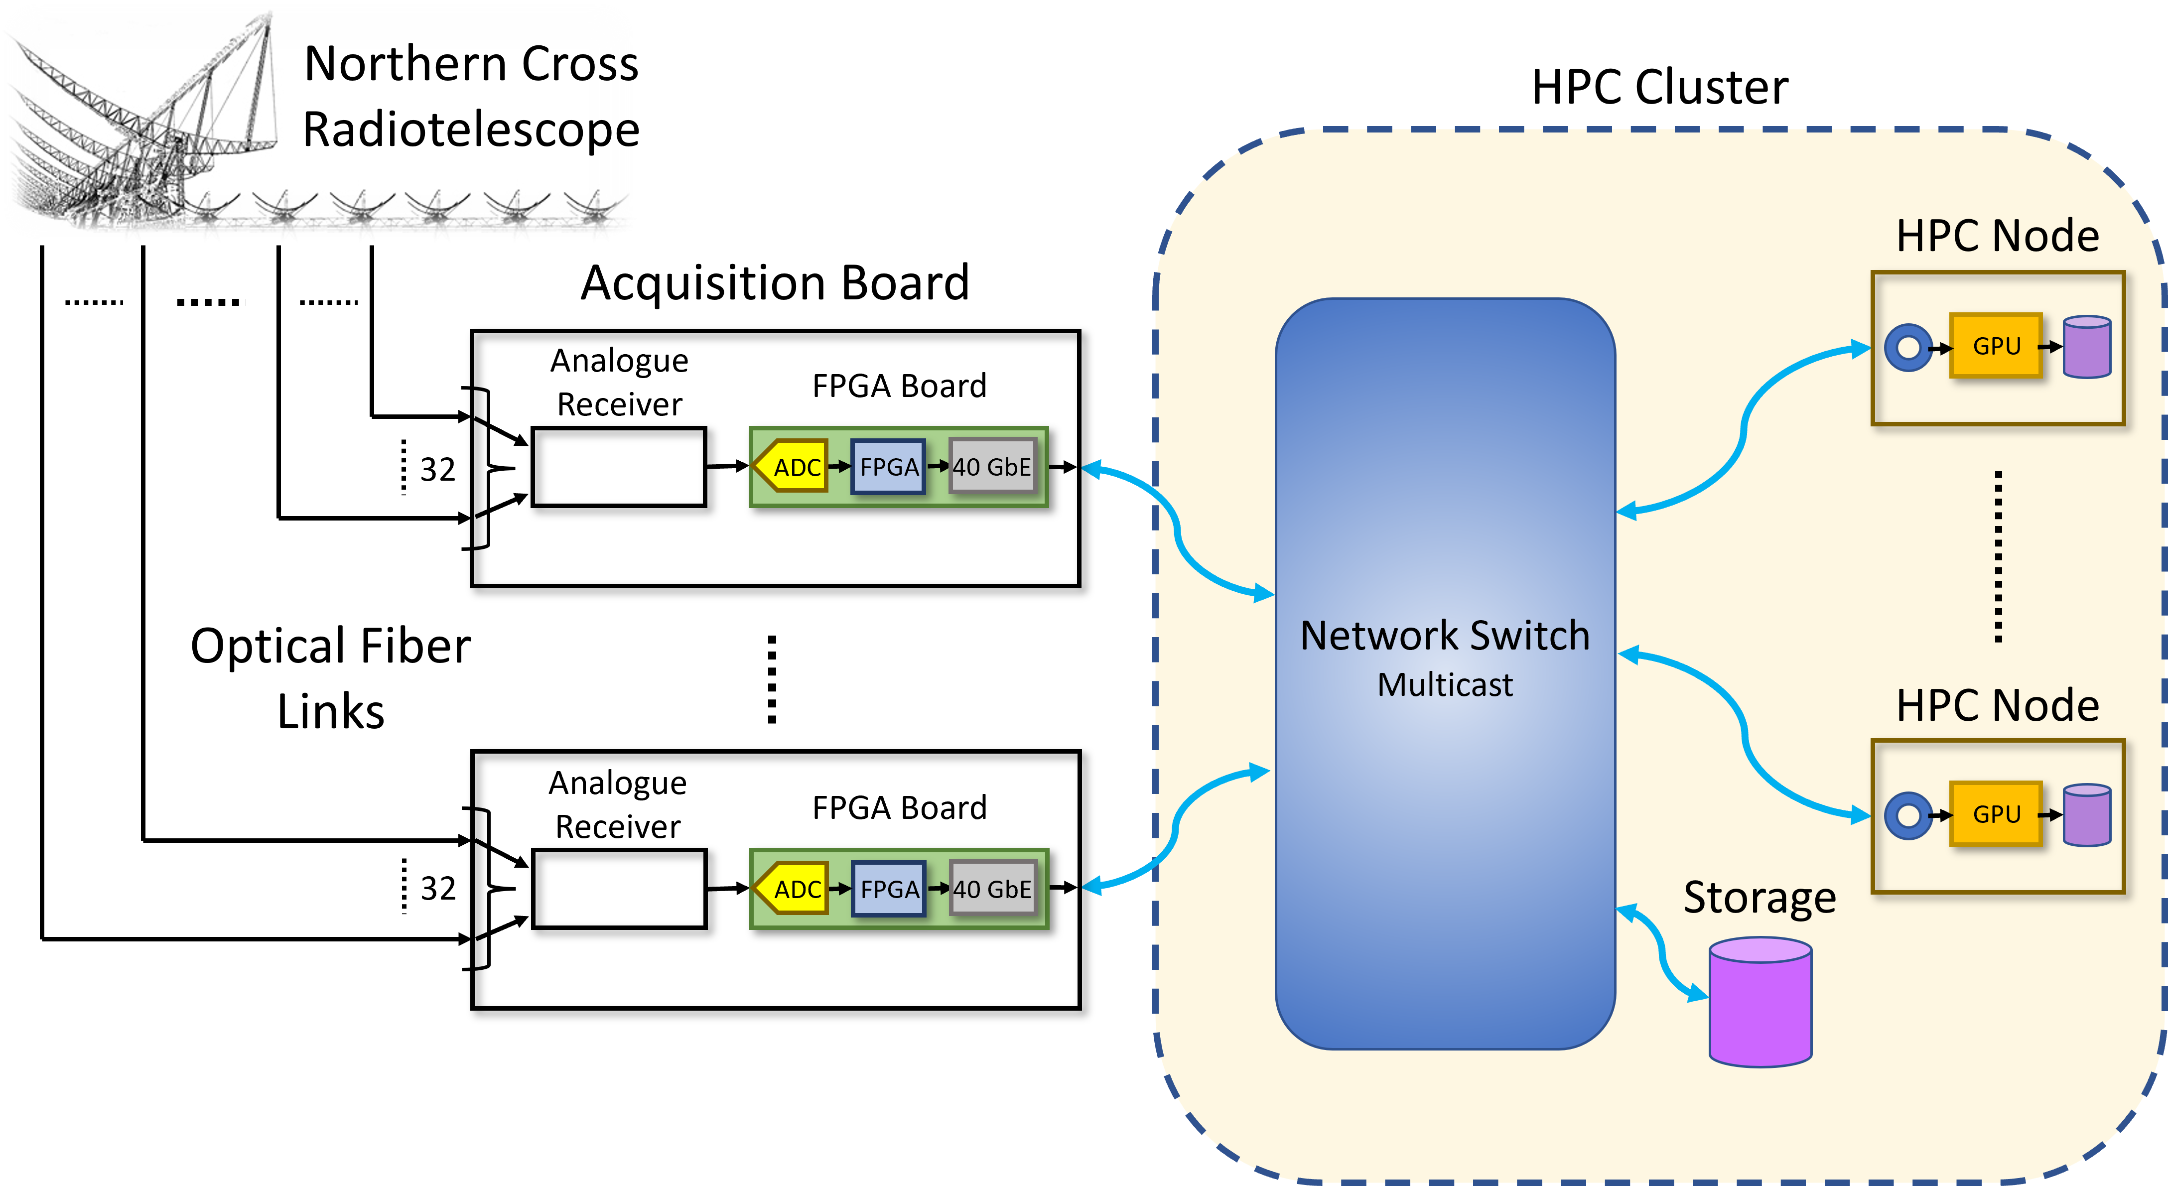
General Scheme
Missione 4 • Istruzione e Ricerca
Missione 4 • Istruzione e Ricerca

Slide 5
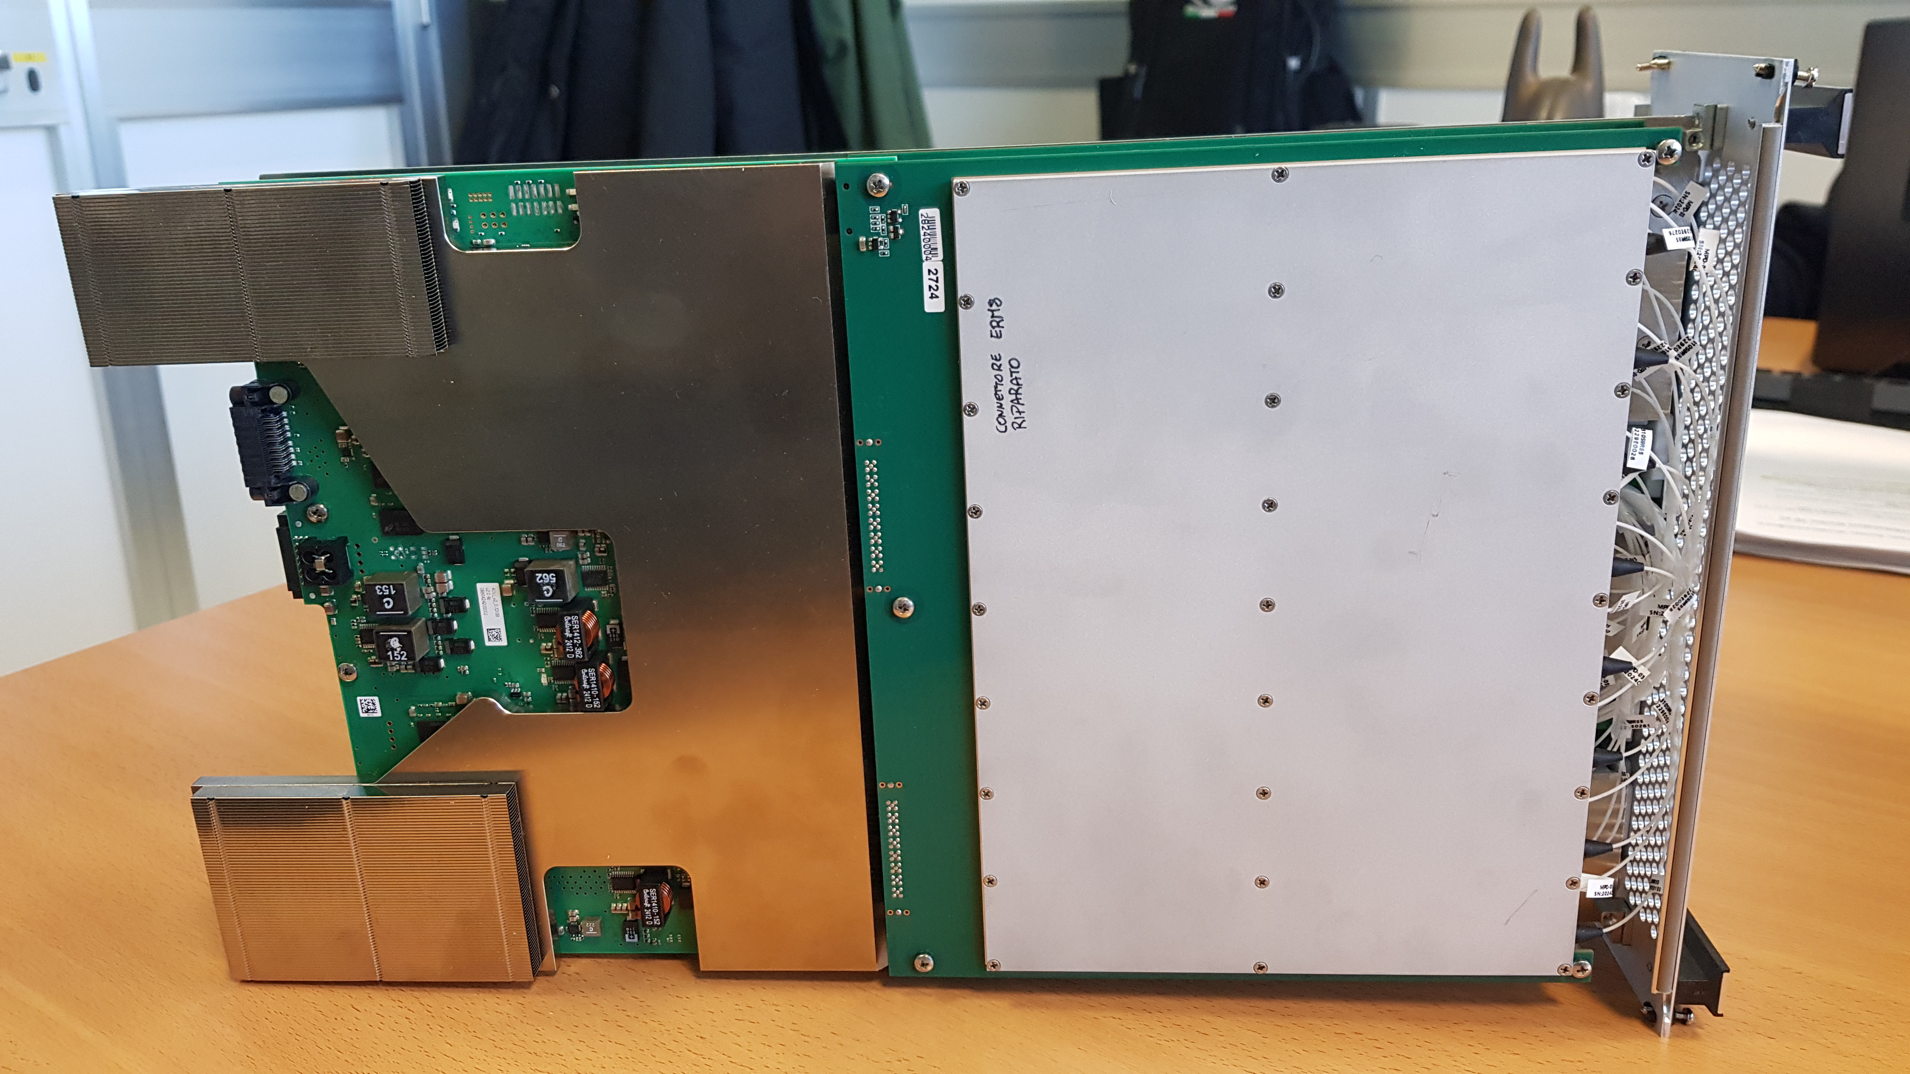
Hardware components: FPGA boards
21 FPGA boards arranged in 6 sub-racks
Main characteristics of the FPGA board:
Tile Processing Module
1x FPGA Board
2x Analogue Receivers
Dimension | 6U
Number of RF input signals | 32
Analog to Digital Converter | 16 dual, 14-bit ADCs
FPGA device | 2 Xilinx Ultrascale+
RAM memory | 32 GB
40 GbE interface | 2 QSFP (1 per FPGA)
Sub-rack
Status of the procedure:
Contract issued
Material delivered
Procedure about to be closed (next month)
Missione 4 • Istruzione e Ricerca
Missione 4 • Istruzione e Ricerca

Slide 6
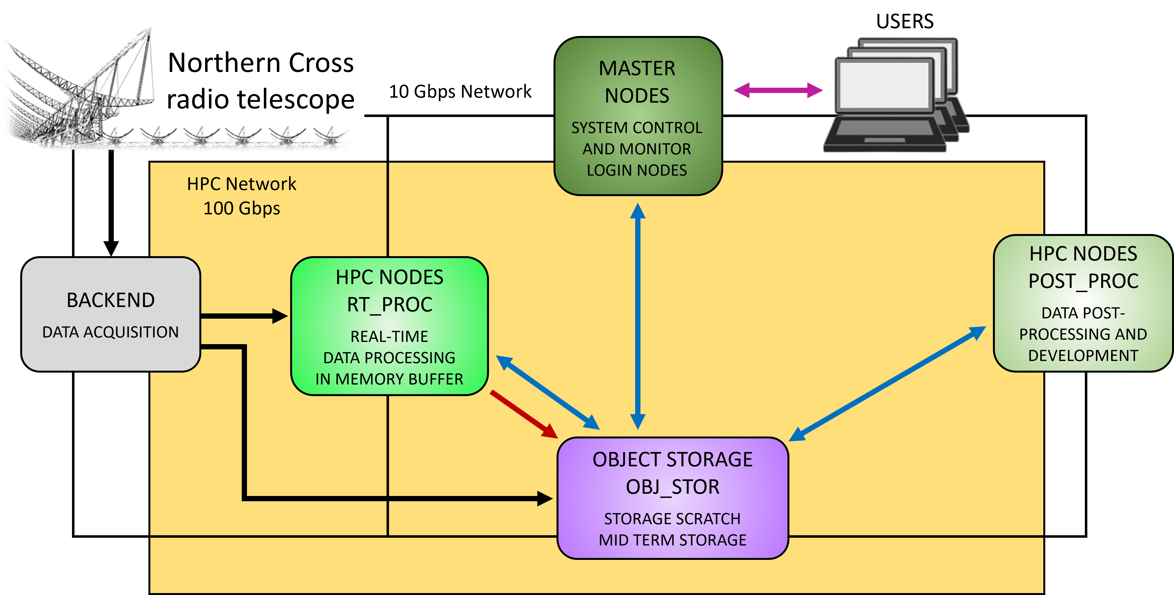
Hardware components: HPC Cluster
Missione 4 • Istruzione e Ricerca
Missione 4 • Istruzione e Ricerca

Slide 7
Hardware components: HPC Cluster
3x Master Nodes | 18x HPC Nodes | 9x Object Storage Nodes
System management (monitor and control) | Massive and parallel computing | Mid term storage for processed and reduced data
Login Nodes | Dual CPU (multi-core) | Raw data to be post-processed and post-analysed
 | 2x NVIDIA L40S GPU | 8 PB of total disk space
 | 2 TB RAM | 30GB/s writing; 45GB/s reading (aggregate)
 | 2x SSD (3 TB each)
 | 2x NIC (dual-port) 100Gb/s
Data center building
Status of the procedure:
Tender concluded
Supplier awarded
Contract about to be signed
Missione 4 • Istruzione e Ricerca
Missione 4 • Istruzione e Ricerca

Slide 8
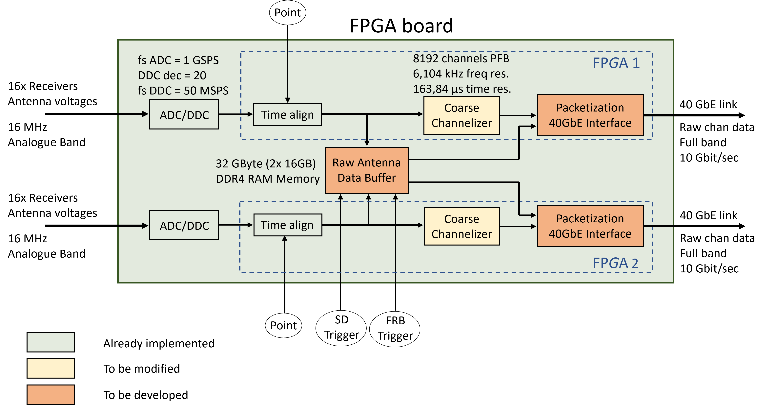
Firmware Development
Priority
Missione 4 • Istruzione e Ricerca

Slide 9
Firmware Development: Contract
The work must complete a design already started and in an advanced phase
Added the design for the Noto Radiotelescope (many common parts to be reused)
3 main Milestones:
Milestone | Description | Deadline
MS1 | Packetiser and 40 GbE interface included in the design for NCR | T₀+1month
MS2 | FW design for NCR completed | T₀+4months
MS3 | FW design for Noto Radiotelescope completed | T₀+6months
Status of the procedure:
SoW completed
Contract to be written and signed
Missione 4 • Istruzione e Ricerca

Slide 10
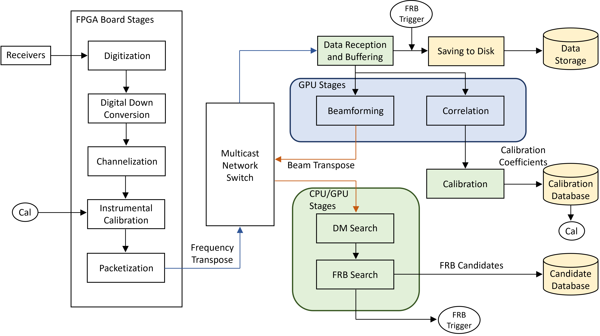
Software Development
See Alessio’s Talk…
Missione 4 • Istruzione e Ricerca

Slide 11
Software Development: Contract
Approach: building the system gradually, releasing step by step new features with respect to the system currently in use
4 main Milestones:
Milestone | Description | Deadline
MS1 | Initial Firmware and Software Tests | T₀+1month
MS2 | 64 (or 32) cylinders, 1 Beam, No Real-Time | T₀+3months
MS3 | 64 (or 32) cylinders, 1 Beam, Real-Time | T₀+6months
MS4 | 64 cylinders (or 32), Multi-Beam, Real-Time | T₀+8months
Status of the procedure:
SoW completed
Contract written
Contract to be signed
Missione 4 • Istruzione e Ricerca

Slide 12
Ongoing Activities
Efforts to make the currently used data analysis pipelines portable
Containerization (Docker, Podman) of:
FETCH (deep-learning based classifier)
FRB Baseband (pipeline to post-process the data of Noto RT)
Set up of a Gitlab server hosted in Medicina
Code repository (distributed revision control system)
Collaborative software development platform
Enable CI/CD automation
Mirroring in INAF Trieste (disaster recovery)
Missione 4 • Istruzione e Ricerca

Slide 13
Ongoing Activities
Set up of a secure remote access system to Medicina servers
Through VPN
Using isolated VLAN with access to the desired service
Software tools for the monitoring and control of:
Analogue receivers
Configuration set-up (DSA)
Power levels check
RFI monitoring
ADC clipping monitoring
Digital boards
Power on/off
FPGA programming
Temperature monitoring
Synchronization check
Missione 4 • Istruzione e Ricerca

Slide 14
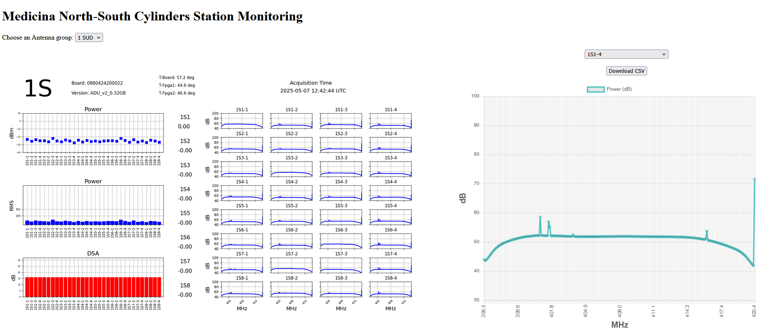
Receivers Monitor & Control
Courtesy: A. Mattana
Missione 4 • Istruzione e Ricerca

Slide 15
(Some) Criticalities and Strategies to Mitigate them
Tender for HPC Cluster: long and complex procedure
It could affect the development of other activities depending on it
Purchased a computing node with GPUs and a storage system
it will be used to deploy the system for 32 cylinders (first 2 milestones of SW development)
Difficulties in awarding contracts for FW/SW development
Some activities already started
Few people for many and complex tasks (with a tight timeline!)
Efforts to find additional manpower
Internship (5/6 months) for Master in HPC
PhD proposal (FRB search pipeline with HPC platforms)
Investigate possible synergies with CHORD?
Missione 4 • Istruzione e Ricerca

Slide 16
THANKS
FOR THE ATTENTION
Next Generation – Croce del Nord
IR0000026
Intervento finanziato nell’ambito del PNRR - Piano Nazionale di Ripresa e Resilienza
M4C2
Missione 4 - Istruzione e Ricerca Componente 2 - Dalla Ricerca alla Impresa
Linea di Investimento 3.1 - Rafforzamento e creazione di Infrastrutture di Ricerca
CUP C53C22000880006
Missione 4 • Istruzione e Ricerca
Missione 4 • Istruzione e Ricerca

