Slide 1


Orbit determination techniques for Resident Space Object catalog maintenance
Training Meeting
NG-Croce
Lunedì 12 Maggio - Giovedì 15 Maggio
Radiotelescopi di Medicina
IRA - Bologna
Mauro Massari

Slide 2
Outline
RSO Catalogs
Orbit determination problem
Typical measurements
Minimum set of measurements
Initial Orbit Determination
  Gauss’ method
  Effect of uncertainties
Precise Orbit Determination
  Least-square problem
  Kalman filter

Slide 3
Resident Space Objects Catalogs
A catalog of resident space objects (RSOs) typically includes detailed information about artificial objects orbiting Earth.
Common elements found in such a catalog:
Object Name: Common name or designation (e.g., Hubble Space Telescope, COSMOS 2251).
International Designator: A standardized code that includes the launch year, launch number, and piece identifier (e.g., 1998-067A).
NORAD Catalog Number: Unique number assigned by the North American Aerospace Defense Command.
Object Type: Classification such as satellite, rocket body, debris, or payload.
Owner/Operator: Country or organization responsible for the object.
Launch Date: Date the object was placed into orbit.
Launch Vehicle: The rocket used to deploy the object.
Orbit Type: General classification (e.g., LEO – Low Earth Orbit, MEO – Medium Earth Orbit, GEO – Geostationary Orbit, HEO – Highly Elliptical Orbit).
Current Status: Active, inactive, decayed, or unknown.
Radar Cross Section (RCS): Estimate of size or detectability by radar.
Decay Date: If applicable, the date the object re-entered Earth’s atmosphere.
Mission or Function: Intended use or mission purpose (e.g., communications, Earth observation, scientific research).
Tracking Information: Most recent TLE (Two-Line Element set) or ephemeris data for object tracking.

Slide 4
Resident Space Objects Catalogs
A catalog of resident space objects (RSOs) serves multiple critical functions in space operations, safety, and policy.
Collision Avoidance: Enables satellite operators to predict and prevent potential collisions (conjunctions) between satellites or with debris.
Orbital Traffic Management: Assists space agencies and private companies in planning satellite launches and maneuvers to avoid overcrowding or unsafe orbital paths.
Tracking Space Debris: Identifies and monitors debris objects to assess risks and develop mitigation strategies.
Re-entry Prediction: Supports the forecasting of when and where objects will re-enter Earth’s atmosphere, important for safety and risk assessment.
Anomaly Investigation: Helps investigate unexpected satellite behavior, such as loss of contact or damage, by analyzing nearby RSOs.
Research and Analysis: Provides data for scientific studies on orbital mechanics, long-term space sustainability, and debris population growth.
Historical Recordkeeping: Maintains a database of past and present objects for archival, forensic, and legal purposes.

Slide 5
Resident Space Objects Catalogs Maintenance
RSO Catalogs Are Updated:
Detection: Sensors detect new objects or movements (e.g., from launches, breakups, or maneuvers).
Identification: Analysts determine whether it's a new object, a known one with updated data, or a fragmentation/debris piece.
Orbit Determination: Orbital elements are calculated, often using the TLE (Two-Line Element) format for public distribution.
Tracking: Multiple observations are used to refine the orbit using radar, optical telescopes, and infrared sensors.
Catalog Entry or Update: The catalog is updated with the new object’s details, or the trajectory of an existing object is revised.

Slide 6
Resident Space Objects Catalogs Maintenance
RSO Catalogs Are Updated:
Detection: Sensors detect new objects or movements (e.g., from launches, breakups, or maneuvers).
Identification: Analysts determine whether it's a new object, a known one with updated data, or a fragmentation/debris piece.
Orbit Determination: Orbital elements are calculated, often using the TLE (Two-Line Element) format for public distribution.
Tracking: Multiple observations are used to refine the orbit using radar, optical telescopes, and infrared sensors.
Catalog Entry or Update: The catalog is updated with the new object’s details, or the trajectory of an existing object is revised.

Slide 7
Orbit Determination
Orbit determination problem

Slide 8
Orbit Determination Problem
8
Orbit determination consists in computing the state of an orbiting object at a given epoch starting from a set of measurements
  Compute the orbit of an newly discovered asteroid observed with a telescope
  Compute the position and velocity of a spacecraft using measurements obtained by Earth-based systems or on-board sensors

Slide 9

Orbit Determination Problem
9
Orbit determination consists in computing the state of an orbiting object at a given epoch starting from a set of measurements
  Compute the orbit of an newly discovered asteroid observed with a telescope
  Compute the position and velocity of a spacecraft using measurements obtained by Earth-based systems or on-board sensors
All missions require spacecraft navigation and orbit determination

Slide 10
Orbit Determination Problem
10
Do we actually know exactly where a spacecraft is?

Slide 11
Orbit Determination Problem
11
Do we actually know exactly where a spacecraft is?
No, there are many sources of error
  Modeling errors
  Launch errors
  Spacecraft performance
  Observation errors

Slide 12
Orbit Determination Problem
12
Do we actually know exactly where a spacecraft is?
No, there are many sources of error
  Modeling errors
  Launch errors
  Spacecraft performance
  Observation errors
  covariance
The set of possible positions of the spacecraft is usually described by the mean state and the covariance matrix C
  mean

Slide 13
Orbit Determination Problem
13
Orbit determination objective: estimating the mean and covariance describing the state of the object
  Be careful: mean and covariance are not always the best choice
  covariance
  mean

Slide 14
Orbit Determination Problem
14
Orbit determination objective: estimating the mean and covariance describing the state of the object
  Be careful: mean and covariance are not always the best choice
  covariance
  covariance
  mean
  mean

Slide 15
Orbit Determination Problem
15
What is the accuracy level we need on the knowledge of the spacecraft state?
For most situations in spacecraft navigation:
  Positions: meter level accuracy
  Velocities: m/s accuracy

Slide 16
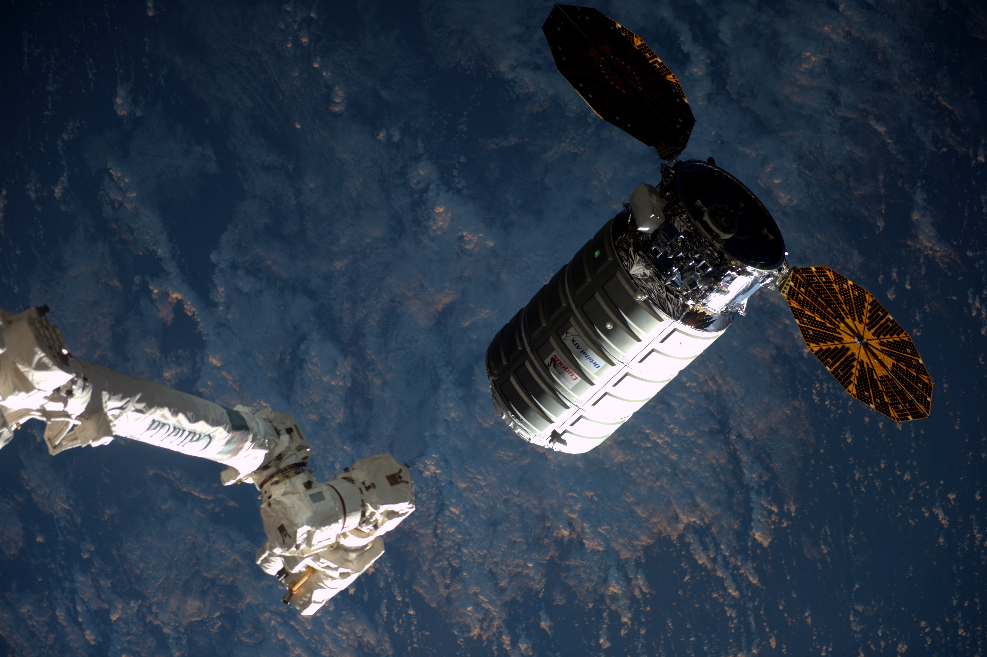
Orbit Determination Problem
16
What is the accuracy level we need on the knowledge of the spacecraft state?
For most situations in spacecraft navigation:
  Positions: meter level accuracy
  Velocities: m/s accuracy
For relative navigation:
  Positions: cm level accuracy
  Velocities: cm/s accuracy
Credits: NASA

Slide 17
Orbit Determination
Typical Measurements

Slide 18

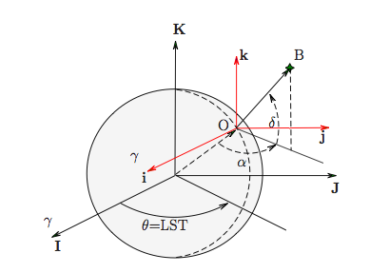
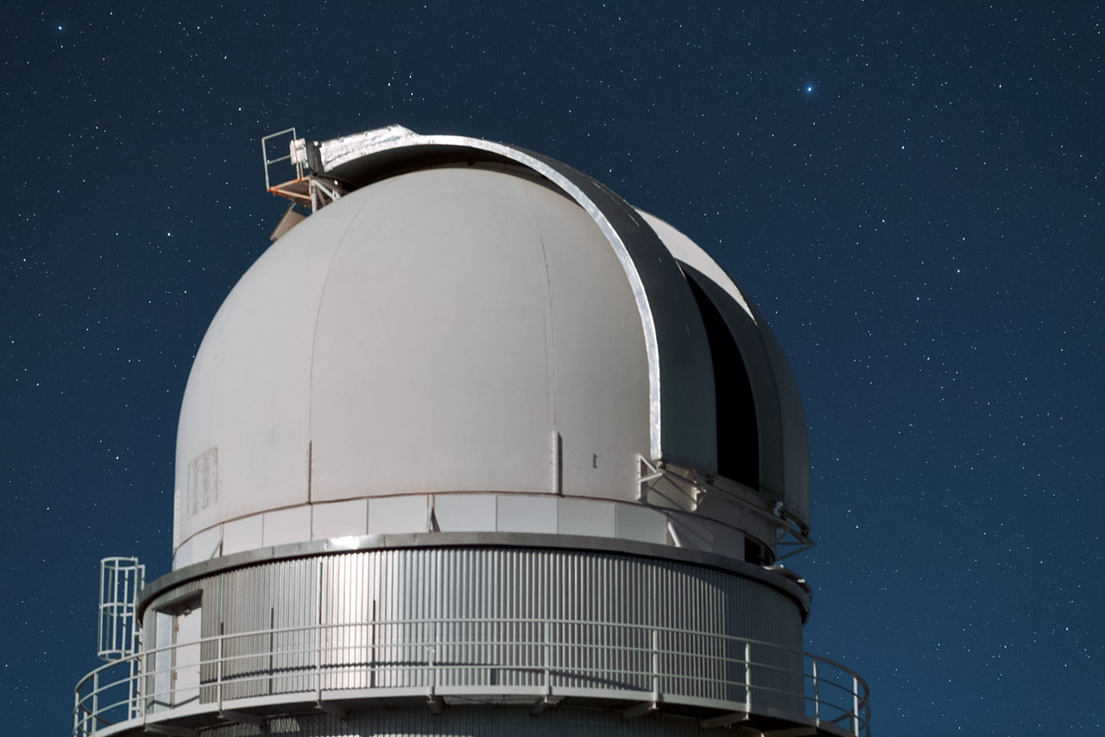
Typical Measurements
18
What are the possible measurements to estimate spacecraft position?
Ground measurements
Optical observations with telescopes:
  Right ascension
  Declination

Slide 19

Typical Measurements
19
Typical optical observation of an Earth-orbiting spacecraft

Slide 20
Typical Measurements
20
Typical optical observation of an Earth-orbiting spacecraft
  Identify the tracklet

Slide 21
Typical Measurements
21
Typical optical observation of an Earth-orbiting spacecraft
  Identify the tracklet
  Matches observed stars with catalogue

Slide 22
Typical Measurements
22
Typical optical observation of an Earth-orbiting spacecraft
  Identify the tracklet
  Matches observed stars with catalogue
  Retrieve observables of catalogued stars

Slide 23
Typical Measurements
23
Typical optical observation of an Earth-orbiting spacecraft
  Identify the tracklet
  Matches observed stars with catalogue
  Retrieve observables of catalogued stars
  Compute observables of the spacecraft w.r.t. catalogued stars

Slide 24
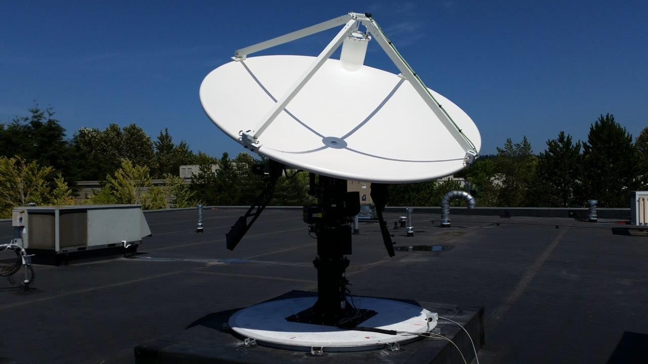



Typical Measurements
24
What are the possible measurements to estimate spacecraft position?
Ground measurements
Radar observations with radar antenna:
  Range
  Doppler shift
range rate

Slide 25
Typical Measurements
25
What are the possible measurements to estimate spacecraft position?
Ground measurements
Radar observations with radar antenna:
  Range
  Doppler shift
range rate

Slide 26
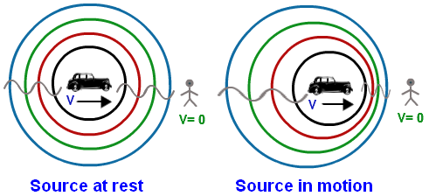
Typical Measurements
26
Typical radar observation of an Earth-orbiting spacecraft
  Range
  Doppler

Slide 27
Typical Measurements
27
Typical radar observation of an Earth-orbiting spacecraft
  Range
  Doppler

Slide 28
Typical Measurements
28
What are the possible measurements to estimate spacecraft position?
Ground measurements
deep-space spacecraft
Differential One-Way Ranging (DOR):

Slide 29

Typical Measurements
29
What are the possible measurements to estimate spacecraft position?
Ground measurements
deep-space spacecraft
Differential One-Way Ranging (DOR):

Slide 30
Typical Measurements
30
What are the possible measurements to estimate spacecraft position?
Ground measurements
deep-space spacecraft
Differential One-Way Ranging (DOR):
Delta-DOR: obtained by correcting DOR with simultaneous tracking of radio signals from a quasar

Slide 31
Typical Measurements
31
What are the possible measurements to estimate spacecraft position?
Onboard measurements
Accelerations

Slide 32
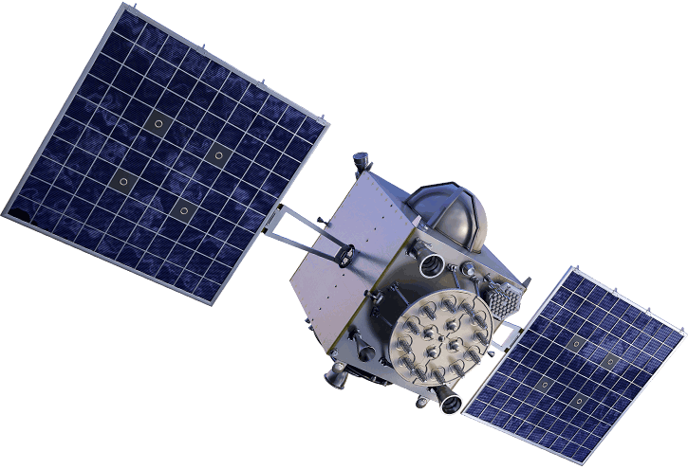
Typical Measurements
32
What are the possible measurements to estimate spacecraft position?
Onboard measurements
GPS-1
Accelerations
GPS
GPS-2
GPS-3
GPS-4

Slide 33
Typical Measurements
33
What are the possible measurements to estimate spacecraft position?
Onboard measurements
GPS-1
Accelerations
GPS
GPS-2
GPS-3
GPS-4

Slide 34
Typical Measurements
34
What are the possible measurements to estimate spacecraft position?
Onboard measurements
GPS-1
Accelerations
GPS
GPS-2
GPS-3
GPS-4

Slide 35
Typical Measurements
35
What are the possible measurements to estimate spacecraft position?
Onboard measurements
GPS-1
Accelerations
GPS
GPS-2
GPS-3
GPS-4

Slide 36
Typical Measurements
36
What are the possible measurements to estimate spacecraft position?
Onboard measurements
GPS-1
Accelerations
GPS
GPS-2
GPS-3
GPS-4

Slide 37
Orbit Determination
Minimum Set of Measurements

Slide 38



Minimum Set of Measurements
38
How many measurements do we need to estimate spacecraft state ?
Consider one optical observation: and
  given the position vector of the spacecraft
  w.r.t. the observer in the inertial reference
  frame

Slide 39

Minimum Set of Measurements
39
How many measurements do we need to estimate spacecraft state ?
Consider one optical observation: and
  given the position vector of the spacecraft
  w.r.t. the observer in the inertial reference
  frame
2 equations with
6 unknowns
cannot be solved

Slide 40

Minimum Set of Measurements
40
How many measurements do we need to estimate spacecraft state ?
Consider one radar observation: and
  given the position vector of the spacecraft
  w.r.t. the observer in the inertial reference
  frame

Slide 41
Minimum Set of Measurements
41
How many measurements do we need to estimate spacecraft state ?
Consider one radar observation: and
  given the position vector of the spacecraft
  w.r.t. the observer in the inertial reference
  frame
2 equations with
6 unknowns
cannot be solved

Slide 42
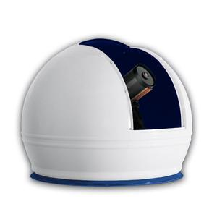
Minimum Set of Measurements
42
How many measurements do we need to estimate spacecraft state ?
  Idea: consider 3 optical observations at 3 different epochs

Slide 43

Minimum Set of Measurements
43
How many measurements do we need to estimate spacecraft state ?
  Idea: consider 3 optical observations at 3 different epochs
6 equations with
6 unknowns

Slide 44
Measurements
44
As the unknowns are 6 (position and velocity vectors) the problem could be:
  underdetermined if the number of linearly independent measurements is < 6
  well posed if the number of linearly independent measurements is = 6
  overdetermined if the number of linearly independent measurements is > 6

Slide 45
Measurements
45
As the unknowns are 6 (position and velocity vectors) the problem could be:
  underdetermined if the number of linearly independent measurements is < 6
  well posed if the number of linearly independent measurements is = 6
  overdetermined if the number of linearly independent measurements is > 6
Associated to each case we have:
  infinite solutions, i.e. the problem cannot be solved
  one solution (or multiple solutions that can be reduced to one)
  the solution is the best solution that better fits all the measurements (least square method)

Slide 46
Orbit Determination Sequence
46
Orbit determination is split in two phases
  Initial orbit determination: is the process of determining an initial orbit
    It is possible when the number of independent measurements is equal to the unknowns (i.e., 6)
    It requires the solution of a set of nonlinear equations (usually an iterative procedure as Newton’s method)
    It asks for an initial guess or a way to discern from different solutions

Slide 47
Orbit Determination Sequence
47
Orbit determination is split in two phases
  Initial orbit determination: is the process of determining an initial orbit
    It is possible when the number of independent measurements is equal to the unknowns (i.e., 6)
    It requires the solution of a set of nonlinear equations (usually an iterative procedure as Newton’s method)
    It asks for an initial guess or a way to discern from different solutions
  Orbit determination refinement: it is the process of updating the solution exploiting new measurements
    An initial orbit is necessary
    The best estimation is obtained by solving a least square problem
    The covariance on the measurements are mapped in the state vector space

Slide 48
Orbit Determination
Initial Orbit Determination

Slide 49
Initial Orbit Determination
49
Basic idea: given three observations and associated observables
  Find a first guess for the spacecraft state at one observation epoch
  Propagate the state to the epochs of the remaining observations
  Compute the predicted observables and the defects w.r.t. the true observables
  Correct the spacecraft state to cancel the defects

Slide 50
Initial Orbit Determination
50
Basic idea: given three observations and associated observables
  Find a first guess for the spacecraft state at one observation epoch
  Propagate the state to the epochs of the remaining observations
  Compute the predicted observables and the defects w.r.t. the true observables
  Correct the spacecraft state to cancel the defects

Slide 51
Initial Orbit Determination
51
Basic idea: given three observations and associated observables
  Find a first guess for the spacecraft state at one observation epoch
  Propagate the state to the epochs of the remaining observations
  Compute the predicted observables and the defects w.r.t. the true observables
  Correct the spacecraft state to cancel the defects

Slide 52
Initial Orbit Determination
52
Basic idea: given three observations and associated observables
  Find a first guess for the spacecraft state at one observation epoch
  Propagate the state to the epochs of the remaining observations
  Compute the predicted observables and the defects w.r.t. the true observables
  Correct the spacecraft state to cancel the defects

Slide 53
Initial Orbit Determination
53
Basic idea: given three observations and associated observables
  Find a first guess for the spacecraft state at one observation epoch
  Propagate the state to the epochs of the remaining observations
  Compute the predicted observables and the defects w.r.t. the true observables
  Correct the spacecraft state to cancel the defects
defect
defect

Slide 54
Initial Orbit Determination
54
Basic idea: given three observations and associated observables
  Find a first guess for the spacecraft state at one observation epoch
  Propagate the state to the epochs of the remaining observations
  Compute the predicted observables and the defects w.r.t. the true observables
  Correct the spacecraft state to cancel the defects

Slide 55
Initial Orbit Determination
55
Basic idea: given three observations and associated observables
  Find a first guess for the spacecraft state at one observation epoch
  Propagate the state to the epochs of the remaining observations
  Compute the predicted observables and the defects w.r.t. the true observables
  Correct the spacecraft state to cancel the defects
iterate

Slide 56

Dynamical Model
56
As the measurements are performed at different epochs a function to compute the evolution of the state vector is necessary
  Find the solution of a set of ordinary differential equations

Slide 57
Dynamical Model
57
As the measurements are performed at different epochs a function to compute the evolution of the state vector is necessary
  Find the solution of a set of ordinary differential equations
In the case of an Earth-orbiting spacecraft can include
  Earth’s gravitational harmonics
  atmospheric drag
  solar radiation pressure
  third-body effect
The solution can be found only using numerical integrators
In initial orbit determination a two-body approximation is considered

Slide 58
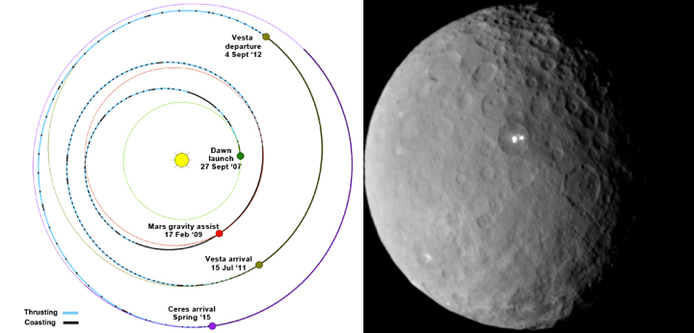
Gauss’s Method: Some History
58
Gauss’s method was derived for the "recovery" of the dwarf planet Ceres (1801):
  Ceres orbit is between Mars and Jupiter in the main asteroid belt
  Ceres was discovered by
  Father Giuseppe Piazzi 1801
  Initially classified as a planet
  and later demoted an asteroid
  Upgraded a dwarf planet in 2006,
  along with Pluto (downgraded)
Credits: NASA

Slide 59

Gauss’s Method: Facts
59
Gauss’s method:
  is a method for initial orbit determination when three observations with telescopes are available (3 sets of right ascensions and declinations)
  assumes two-body dynamics
  exploits truncated Lagrangian expansions to determine a first guess solution at the epoch of the second observation
  iterates using Kepler’s dynamics until the three sets of observations are exactly satisfied in the two-body framework
After more than 200 years it is the baseline for initial orbit determination of celestial bodies and spacecraft

Slide 60
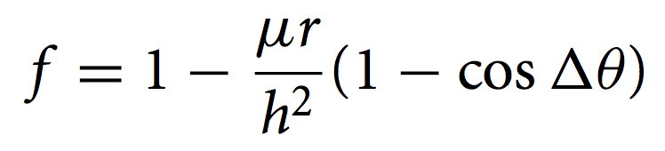
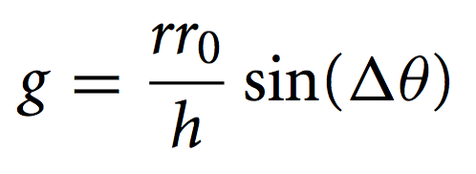
Lagrange Coefficient
60
Given an initial state and under Keplerian dynamics, the position at epoch can be obtained as:
with
Lagrange coefficients

Slide 61
Lagrange Coefficient
61
Given an initial state and under Keplerian dynamics, the position at epoch can be obtained as:
Given the first guess at , the positions at epochs and are
with
Lagrange coefficients

Slide 62

Observer's Inertial Location
62
Compute observer’s location w.r.t. Earth’s center in inertial frame:
Observation’s date is defined by year, month, day, and UT
Defining T₀ the centuries past J2000, Greenwich sidereal time at 0hr UT is
Greenwich sidereal time and that of the observer at observation epochs are

Slide 63
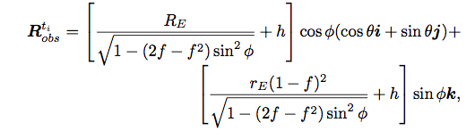
Observer's Inertial Location
63
Compute observer’s location w.r.t. Earth’s center in inertial frame:
Finally the observer’s inertial position wrt Earth’s center is

Slide 64
Observer's Inertial Location
64
Compute observer’s location w.r.t. Earth’s center in inertial frame:
Finally the observer’s inertial position wrt Earth’s center is
The unknown inertial positions of the object can be expressed as:
with

Slide 65

Observer's Inertial Location
65
Compute observer’s location w.r.t. Earth’s center in inertial frame:
Finally the observer’s inertial position wrt Earth’s center is
The unknown inertial positions of the object can be expressed as:
with
is unknown

Slide 66
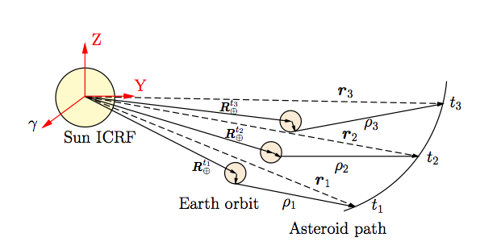
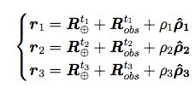

Object Inertial Locations
66
For the general case of interplanetary spacecraft:
The inertial position vector of the observer w.r.t. Sun is obtained by adding the inertial position vector of the Earth’s center
Earth’s position can be evaluated using JPL ephemeris
The unknown inertial positions of the object at observation epochs are:

Slide 67





Gauss’s Algorithm
67
Write the inertial position vector of the objects as
As we consider two-body problem (thus planar) we can write
or
Take the cross products
Thus
Use now the Lagrangian coefficients:
Obtain:
(1)
(2)

Slide 68

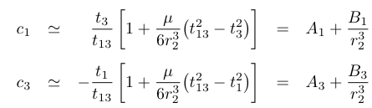

Gauss’s Algorithm
68
The expression of the c coefficients are
In the hypothesis of sufficiently close observations
Retaining terms up to the third-order in time
By substituting Eq. (1) in Eq. (2):
(3)
(4)

Slide 69





Gauss’s Algorithm
69
Rewrite in matrix form
Thus
Recalling that c₂ = -1
Substituting Eq. (5) in Eq. (7):
with
(5)
(6)
(7)
(8)

Slide 70


Gauss’s Algorithm
70
From Eq. (1) for the second observation:
Substitute Eq. (8) into Eq. (9)
which is a 8th order polynomial in r₂ that can be solved numerically
Once r₂ is computed, c₁ and c₃ are calculated from Eq (4) and ρ_{k} from Eq (6)
Finally the velocity at t₂ is computed as
Some considerations:
  In general we have 8 solutions for r₂, but only real solutions are feasible
  The matrix S must be invertible (s_{k} shall not be coplanar)
  The solution does not exactly satisfy the observations (due to truncation errors of the f and g series)
(9)
(10)

Slide 71
Gauss’s Algorithm
71
From Eq. (1) for the second observation:
Substitute Eq. (8) into Eq. (9)
which is a 8th order polynomial in r₂ that can be solved numerically
Once r₂ is computed, c₁ and c₃ are calculated from Eq (4) and ρ_{k} from Eq (6)
Finally the velocity at t₂ is computed as
Some considerations:
  In general we have 8 solutions for r₂, but only real solutions are feasible
  The matrix S must be invertible (s_{k} shall not be coplanar)
  The solution does not exactly satisfy the observations (due to truncation errors of the f and g series)
(9)
(10)

Slide 72
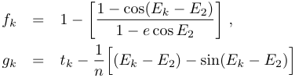
Iterative Correction
72
An iterative procedure is necessary to cancel errors w.r.t. observations
From r₂ and v₂ compute the orbital parameters of the object
Compute exact f and g coefficients
Compute c₁ and c₃ from Eq (3)
Compute G and Eq (5) and ρ_{k} with Eq (6)
Obtain r_{k} with Eq (1) and v₂ from Eq (10)
Note:
The iterative procedure can diverge if the observation are far in time (separation should be less than a radiant)
The matrix S must be invertible (s_{k} shall not be coplanar)
If the observations are too close S is ill-conditioned and the algorithm becomes unreliable

Slide 73

Effect of Uncertainties
73
When it converges the Gauss method delivers a solution that exactly fits the observations in the two-body approximation
  The observations are not exact, each measurement is affected by errors usually modeled with normal distributions
  Dynamical perturbations deviate the object’s path from two-body solution
Where is the star?

Slide 74
Effect of Uncertainties
74
When it converges the Gauss method delivers a solution that exactly fits the observations in the two-body approximation
  The observations are not exact, each measurement is affected by errors usually modeled with normal distributions
  Dynamical perturbations deviate the object’s path from two-body solution
estimated
exact

Slide 75
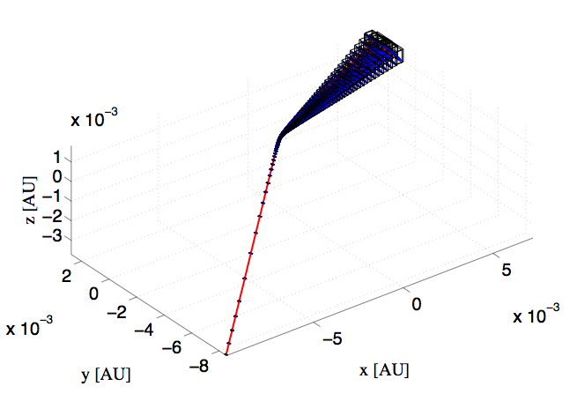



Effect of Uncertainties
75
Example: Apophis encounter with Earth in April 2029
Earth’s SoI
Earth

Slide 76
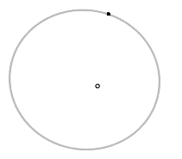
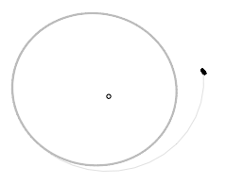
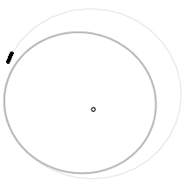
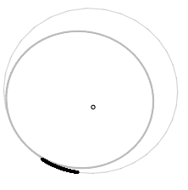
Effect of Uncertainties
76
Example: Apophis encounter with Earth in April 2029
18 Nov 2028
15 Sept 2029
Earth’s SoI
3 Apr 2030
8 Apr 2032

Slide 77
Orbit Determination
Precise Orbit Determination

Slide 78
Precise Orbit Determination
78
As time goes on, several measurements become available ( > 6 )

Slide 79
Precise Orbit Determination
79
As time goes on, several measurements become available ( > 6 )
The spacecraft state is found by fitting the measurements by solving a least-square problem

Slide 80

Least-square Problem
80
Problem statement: given
  Dynamics:
dynamics
unknown
  Measurements:
real
measurements
errors
measurement model

Slide 81
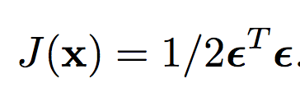
Least-square Problem
81
Problem statement: given
  Dynamics:
dynamics
unknown
  Measurements:
real
measurements
errors
measurement model
Find that minimises
vector of all errors

Slide 82
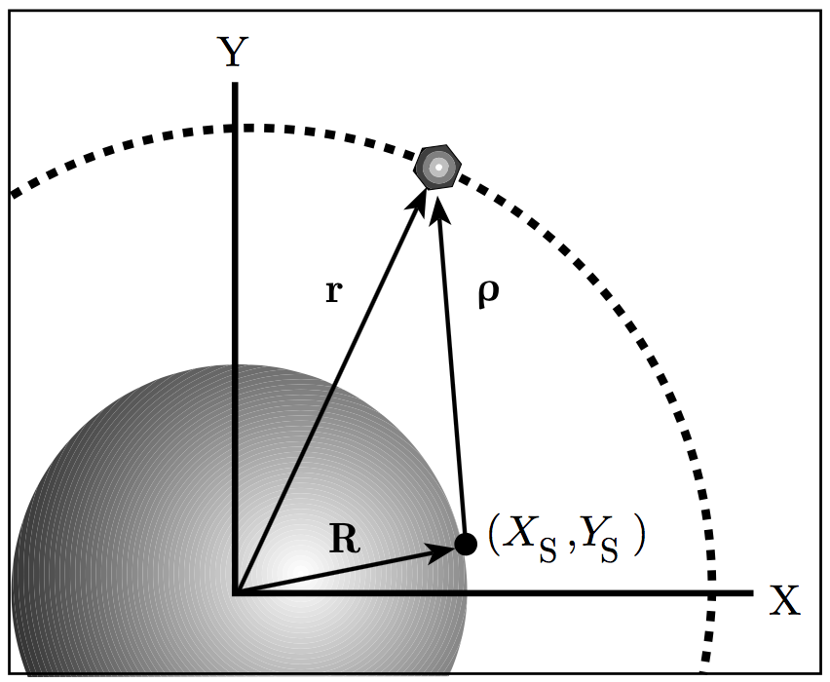
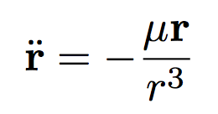
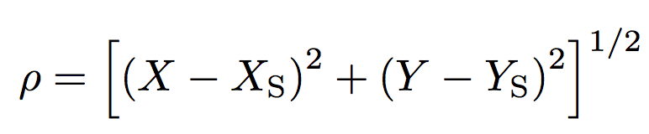
Least-square Problem
82
Problem statement: given
  Dynamics:
  Measurements:
Example:
  Dynamics:
  Measurements:

Slide 83
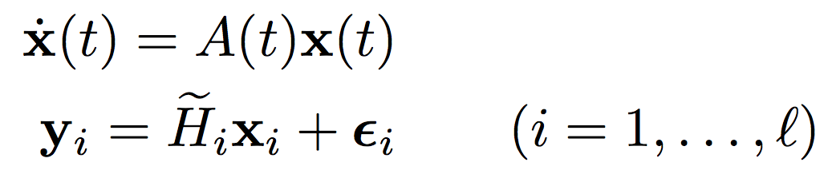
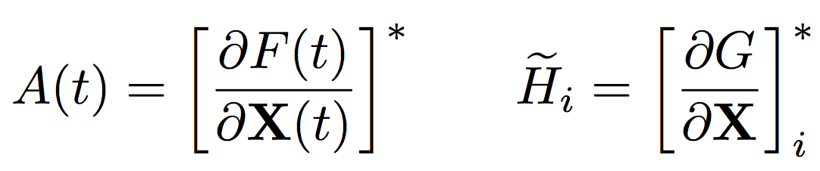
Least-square Problem
83
Linearize the equations
  Define the displacements:
with
  Manipulate the dynamics to relate equations to :

Slide 84
Least-square Problem
84
Linearize the equations
  Define the displacements:
with
  Manipulate the dynamics to relate equations to :
State Transition Matrix

Slide 85


Least-square Problem
85
State transition matrix computation
  Differentiate:
  Replace in
  Obtain the matrix equation:
  Integrate to obtain:
Note:
with
Note: can be found analytically in
specific cases

Slide 86
Least-square Problem
86
Let’s go back to the original problem:

Slide 87
Least-square Problem
87
Let’s go back to the original problem:

Slide 88
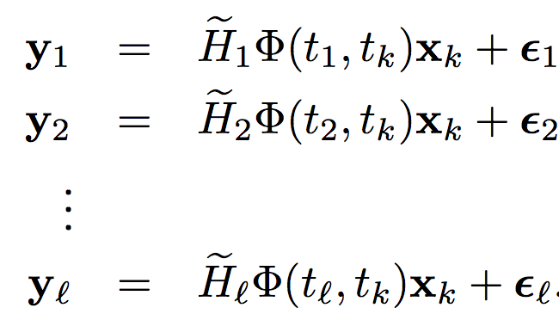
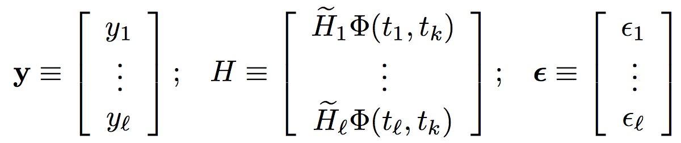
Least-square Problem
88
Let’s go back to the original problem:
Measurements equations are now:
Define:

Slide 89



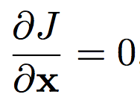

Least-square Problem
89
Rewrite measurements equations in matrix form:
(1)
We can now find that minimizes
From (1) we have
  Minimize
and
positive definite

Slide 90

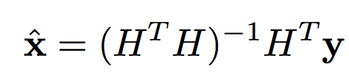
Least-square Problem
90
Thus, the best estimate of is:

Slide 91
Least-square Problem
91
Thus, the best estimate of is:
NOTE 1: An estimate of the uncertainty associated to can also be computed

Slide 92
Least-square Problem
92
Thus, the best estimate of is:
NOTE 1: An estimate of the uncertainty associated to can also be computed
NOTE 2 : The same procedure applies if we want to obtain the estimate at any measurement epoch
k

Slide 93
Least-square Problem
93
The previous procedure relies on the linearisation of the dynamics and of the measurements equation
  What if the system is nonlinear?

Slide 94

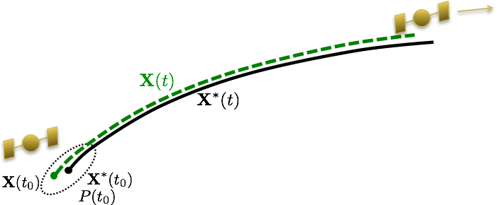
Least-square Problem
94
The previous procedure relies on the linearisation of the dynamics and of the measurements equation
  What if the system is nonlinear?
iterate
Credits: Brandon A. Jones

Slide 95
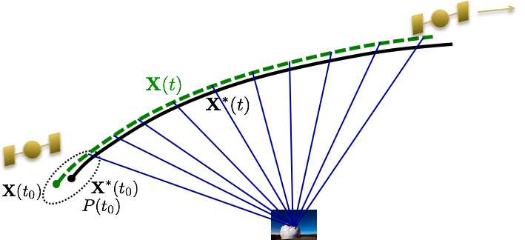
Least-square Problem
95
The previous procedure relies on the linearisation of the dynamics and of the measurements equation
  What if the system is nonlinear?
iterate
measurements
Credits: Brandon A. Jones

Slide 96
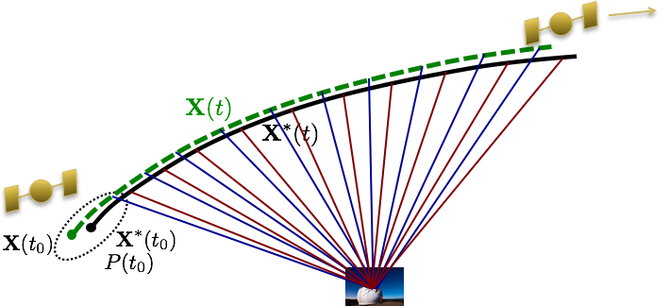
Least-square Problem
96
The previous procedure relies on the linearisation of the dynamics and of the measurements equation
  What if the system is nonlinear?
iterate
predicted measurements
Credits: Brandon A. Jones

Slide 97
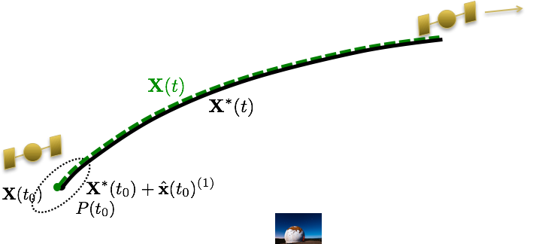
Least-square Problem
97
The previous procedure relies on the linearisation of the dynamics and of the measurements equation
  What if the system is nonlinear?
iterate
Credits: Brandon A. Jones

Slide 98
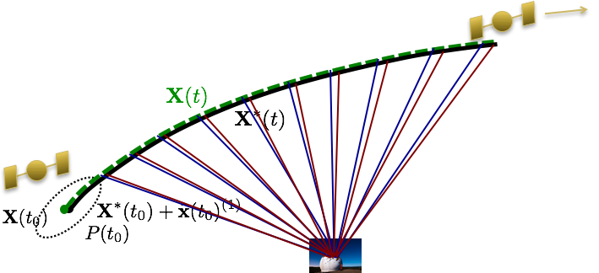
Least-square Problem
98
The previous procedure relies on the linearisation of the dynamics and of the measurements equation
  What if the system is nonlinear?
iterate
Credits: Brandon A. Jones

Slide 99
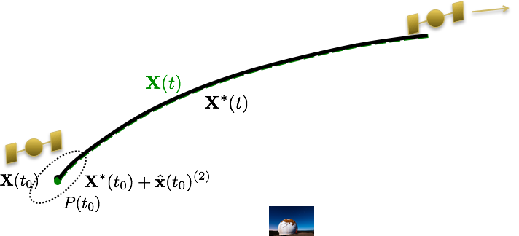
Least-square Problem
99
The previous procedure relies on the linearisation of the dynamics and of the measurements equation
  What if the system is nonlinear?
iterate
Credits: Brandon A. Jones

Slide 100
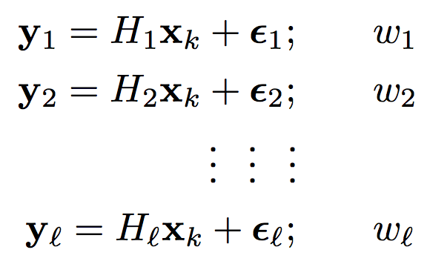
Least-square Problem
100
Weighted least-square:
  Sometimes we want to give “preference” among measurements
weights

Slide 101
Least-square Problem
101
Weighted least-square:
  Sometimes we want to give “preference” among measurements
weights

Slide 102
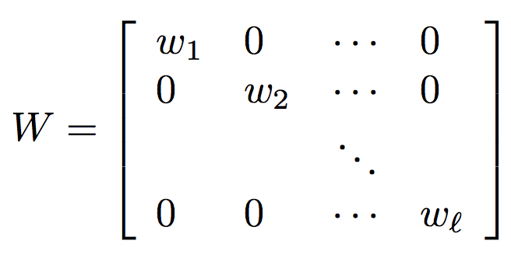



Least-square Problem
102
Weighted least-square:
  Sometimes we want to give “preference” among measurements
  Minimize:
  Results: the best estimate is
weights

Slide 103

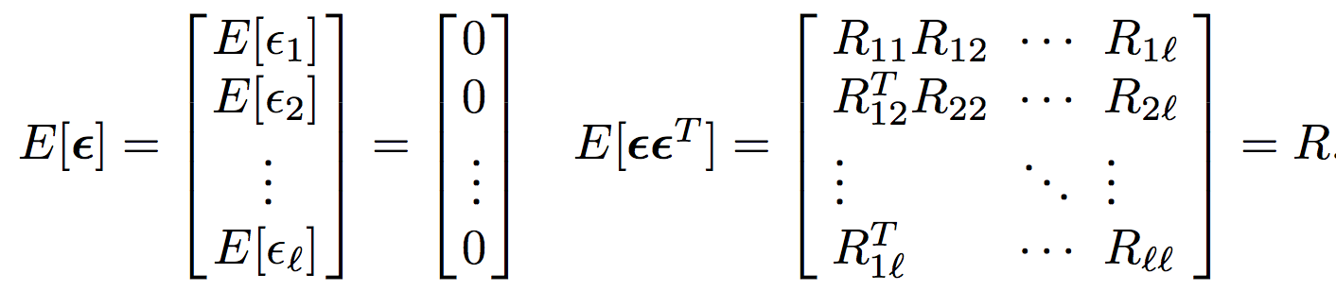

Least-square Problem
103
Minimum variance estimate:
  Statistical approach to identify estimated mean and covariance
  Given:
  With statistics:
  Find that minimizes the covariance matrix at :

Slide 104



Least-square Problem
104
Minimum variance estimate:
  Solution:

Slide 105
Kalman Filter
105
Assume we have an initial estimate of mean and covariance
  Kalman filter processes the measurements one by one as they arrive
E.g., consider the measurements acquired at
How can we updated the knowledge of the mean and covariance at ?

Slide 106
Kalman Filter
106
Assume we have an initial estimate of mean and covariance
  Kalman filter processes the measurements one by one as they arrive
E.g., consider the measurements acquired at
How can we updated the knowledge of the mean and covariance at ?

Slide 107
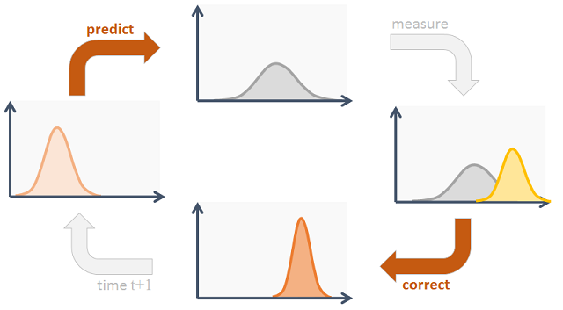
Kalman Filter
107
Real system

Slide 108
Kalman Filter
108
Real system
Prediction

Slide 109
Kalman Filter
109
Real system
Prediction

Slide 110
Kalman Filter
110
Real system
Prediction
Update

Slide 111
Kalman Filter
111
Real system
Prediction
Update

Slide 112
Kalman Filter
112
Real system
Prediction
Update
Kalman Filter

Slide 113
Kalman Filter
113
Prediction
Usually performed with linearised dynamics:

Slide 114

Kalman Filter
114
Prediction
Usually performed with linearised dynamics:
NOTE: Extended Kalman Filter perform new linearisation at each

Slide 115
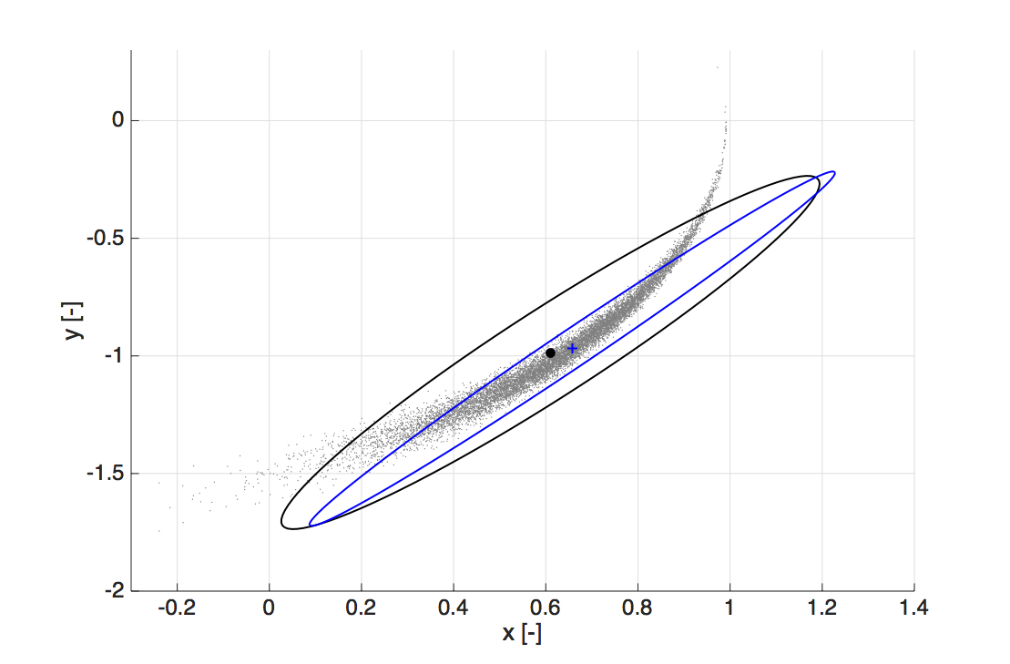
Kalman Filter
115
Prediction
Usually performed with linearised dynamics:
MC (10⁴ samples)
EKF - order 1
Not accurate for highly nonlinear
dynamics:
  Example: Kepler’s dynamics,
  eccentricity 0.5, after 0.8 orbits

Slide 116
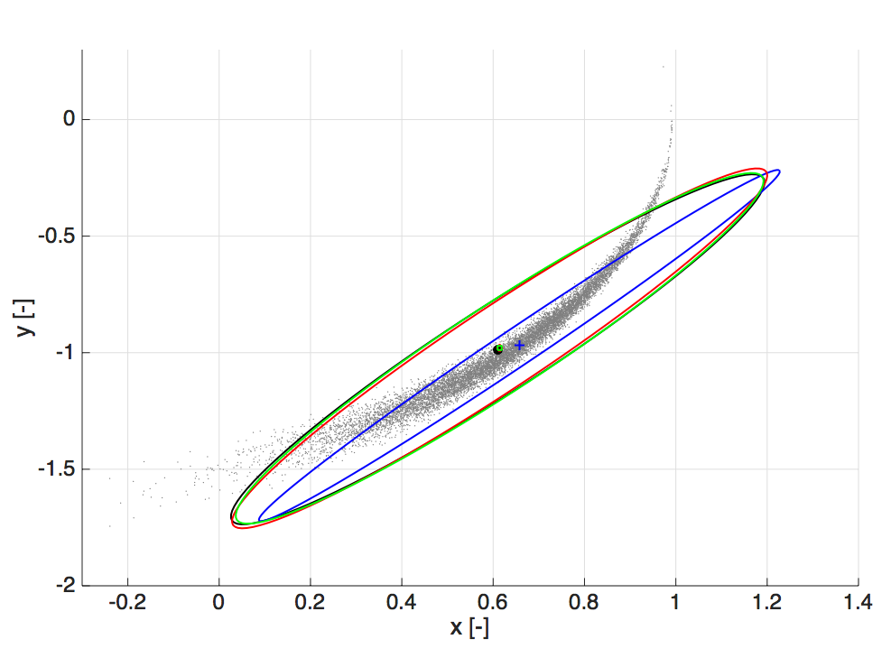
Kalman Filter
116
Prediction
high-order Taylor expansion
Using differential algebra we obtain:
MC (10⁴ samples)
EKF - order 1
EKF - order 2
EKF - order 3
Expectation are then computed on the monomials of the polynomial with Isserlis’ formula
  Example: Kepler’s dynamics,
  eccentricity 0.5, after 0.8 orbits

Slide 117
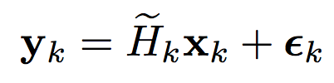
Kalman Filter
117
Update
Solved with a minimum variance approach:
  Given and the measurement noise

Slide 118



Kalman Filter
118
Update
Solved with a minimum variance approach:
  Given and the measurement noise
  Compute and with:

Slide 119
Orbit Determination
Conclusions

Slide 120
Conclusions
120
If no estimates are already available
Initial orbit determination

Slide 121
Conclusions
121
If no estimates are already available
Initial orbit determination
If an estimated state is already available
Least-squares method

Slide 122
Conclusions
122
If no estimates are already available
Initial orbit determination
If an estimated state is already available
Least-squares method
If an estimated mean and covariance is already available
Kalman filter

Slide 123
Orbit Determination
References

Slide 124
References
Schutz, Bob, Byron Tapley, and George H. Born. Statistical orbit determination. Elsevier, 2004
Milani, Andrea, and Giovanni Gronchi. Theory of orbit determination. Cambridge University Press, 2010
Crassidis, John L., and John L. Junkins. Optimal estimation of dynamic systems. CRC press, 2011
Beutler, Gerhard. Methods of celestial mechanics: volume I: physical, mathematical, and numerical principles. Springer Science & Business Media, 2004
Armellin, Roberto, and Pierluigi Di Lizia. "Probabilistic optical and radar initial orbit determination." Journal of Guidance, Control, and Dynamics 41.1 (2018): 101-118

