Slide 1
Evoluzione della popolazione satellitare e dei frammenti
Training Meeting
NG-Croce
Lunedì 12 Maggio - Giovedì 15 Maggio
Radiotelescopi di Medicina
IRA - Bologna
Alessandro Rossi

Slide 2
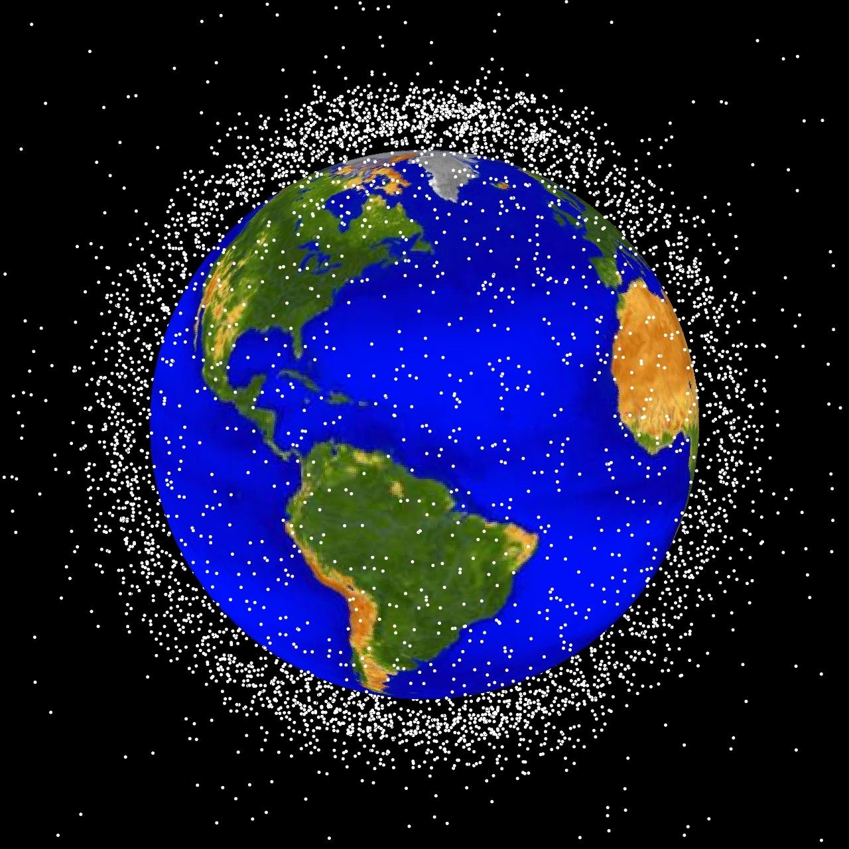
CURRENT DEBRIS POPULATION
Some numbers.
About 30 000 objects larger than 10 cm:
~ 44 % are active or defunct spacecraft
~ 56 % are spent rocket bodies and other types of debris
Missione 4 • Istruzione e Ricerca
Missione 4 • Istruzione e Ricerca

Slide 3
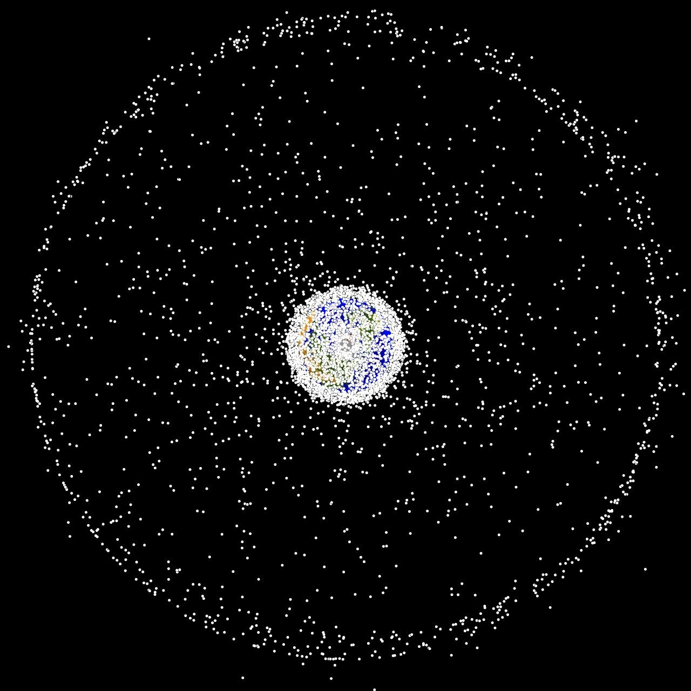
Estimates:
about 500,000 objects larger than 1 cm;
about 500 millions larger than 1 mm.
Most of the objects are in Low Earth Orbit
Missione 4 • Istruzione e Ricerca
Missione 4 • Istruzione e Ricerca

Slide 4
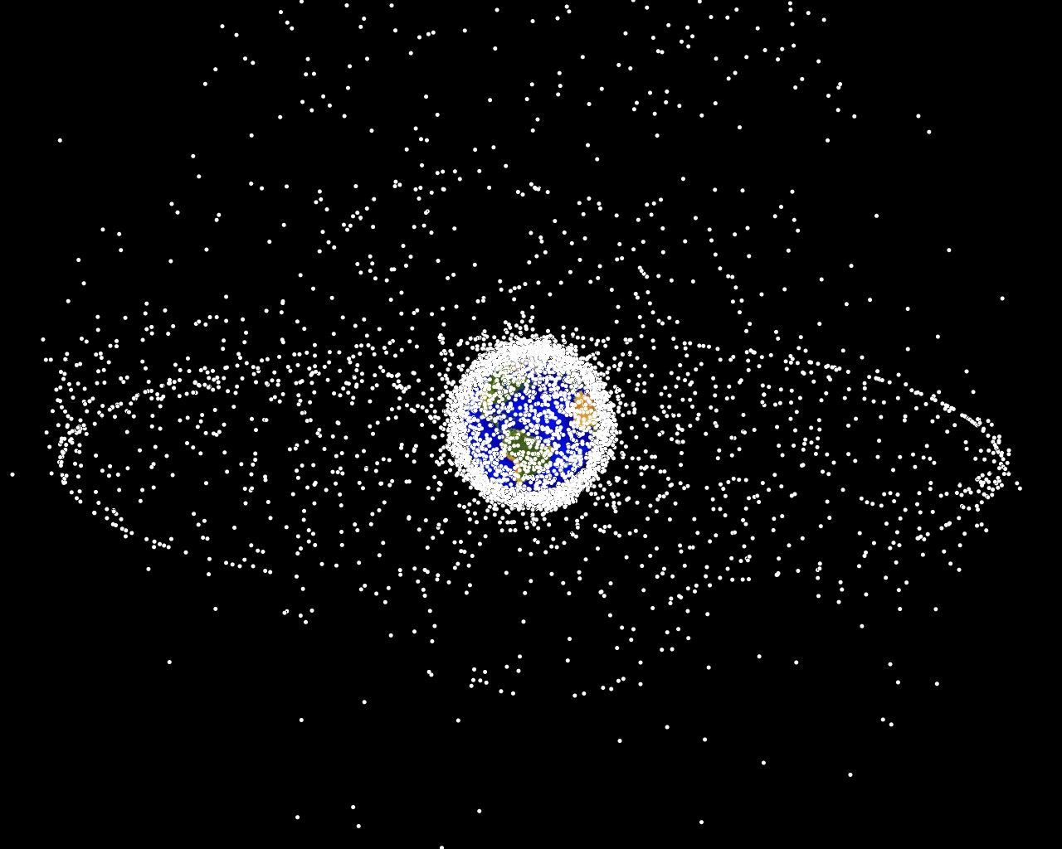
Estimates:
about 500,000 objects larger than 1 cm;
about 5 × 108 larger than 1 mm.
Most of the objects are in Low Earth Orbit
Missione 4 • Istruzione e Ricerca
Missione 4 • Istruzione e Ricerca

Slide 5
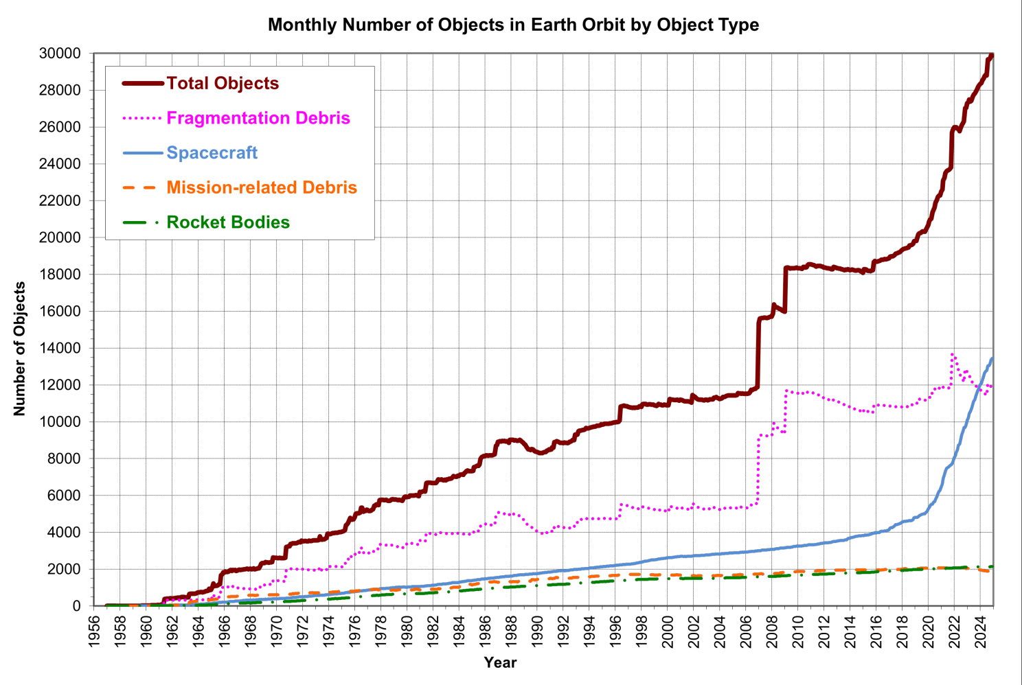
Image courtesy of: NASA ODQN
Missione 4 • Istruzione e Ricerca
Missione 4 • Istruzione e Ricerca

Slide 6
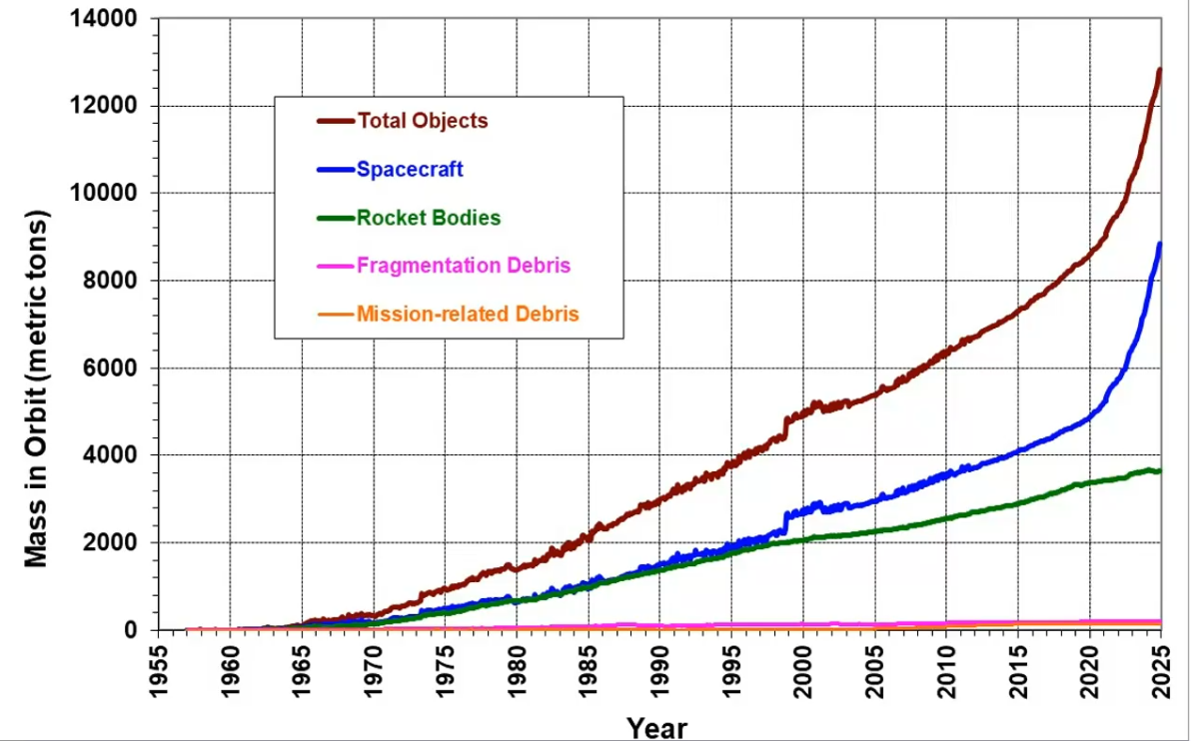
Image courtesy of: NASA JSC
Missione 4 • Istruzione e Ricerca
Missione 4 • Istruzione e Ricerca

Slide 7
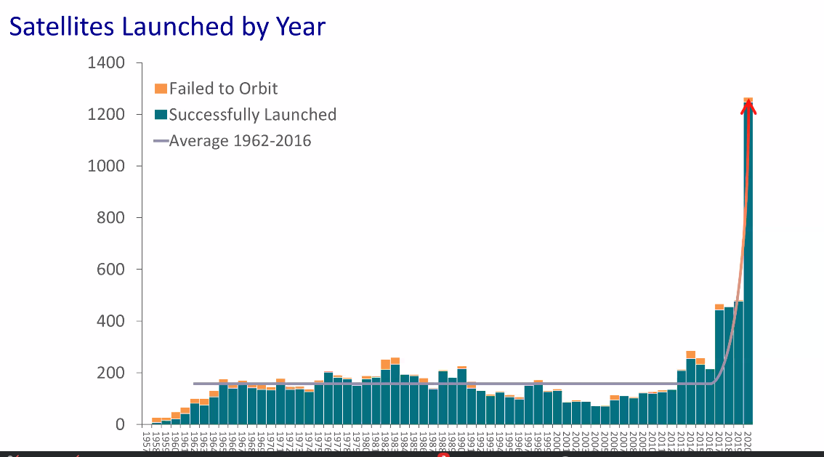
New actors
In 2019, 79 % of the 492 spacecraft launched into orbit were small satellites (below 600 kg)
From 2014 to 2019 more than 900 cubesats were launched

Slide 8
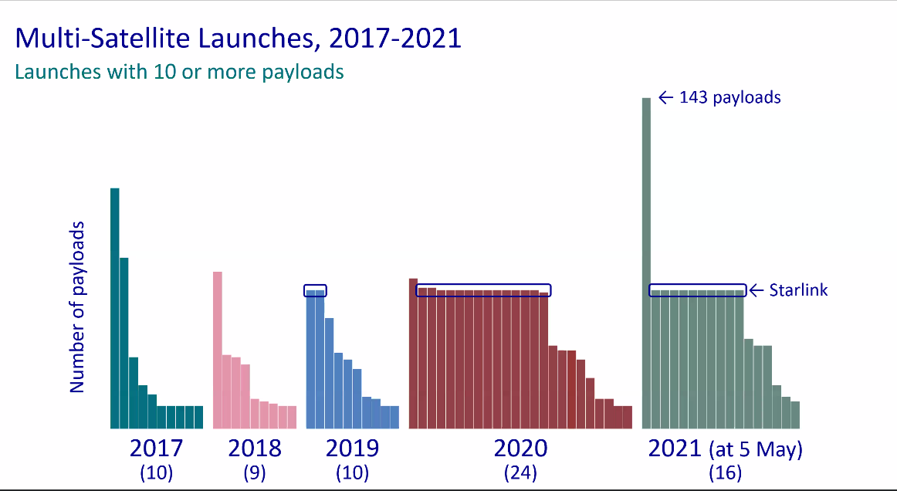
New actors

Slide 9
New actors
The space sector revenues increased steadily from $ 176 billion in 2005 to about $ 360 billion in 2019.
Most of the revenues of the satellite industry were realized on the satellites telecommunications (50 %) and navigation (48 %) value chains (with only 2 % on Earth observation).
As of today the vast majority of the revenue used to come from activities taking place in GEO and MEO.
This is changing…… with the advent of the LEO satellite internet constellations.
The US regulator had received license requests for more than 60,000 satellites as of March 2021…..
Euroconsult: the revenues of the commercial satellite industry could reach $ 485 billion by 2028
Goldman Sachs, Morgan Stanley and Bank of America Merril Lynch project the space economy in the 2040s at about $ 1 – 2.7 trillion.
Missione 4 • Istruzione e Ricerca
Missione 4 • Istruzione e Ricerca

Slide 10
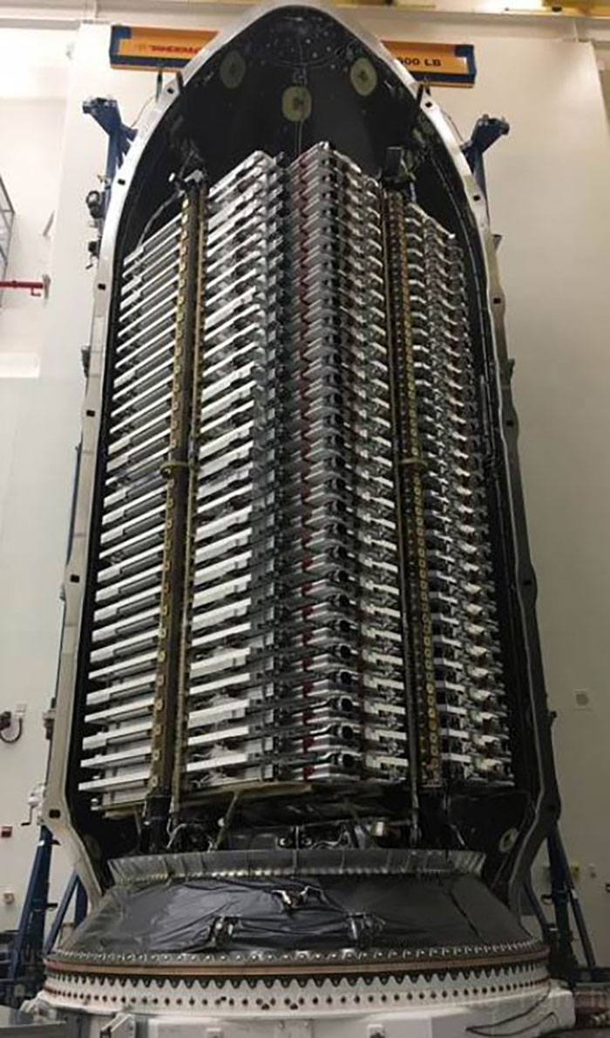
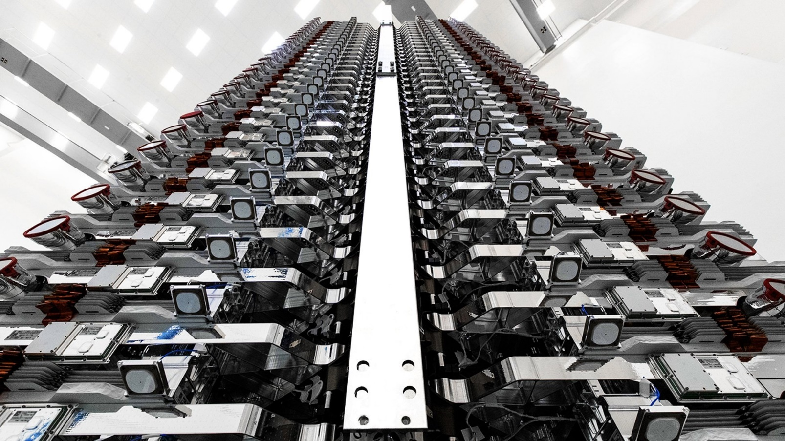
Starlink satellites inside the SpaceX Falcon 9

Slide 11
SOURCES OF SPACE DEBRIS
Explosions:
June 20 1961: explosion of the upper stage of the Transit 4A rocket.
It was the first of a series of hundreds of in-orbit explosions , partly accidental partly deliberate (about 30 %).
Explosions are still the major sources of catalogued fragments
Collisions:
Deliberate: ASAT tests
Accidental: Iridium – Cosmos,…..
Other (minor) sources:
RORSATs like events
Solid rocket motors exhausts (slag).
Missione 4 • Istruzione e Ricerca
Missione 4 • Istruzione e Ricerca

Slide 12
Missione 4 • Istruzione e Ricerca
Missione 4 • Istruzione e Ricerca

Slide 13
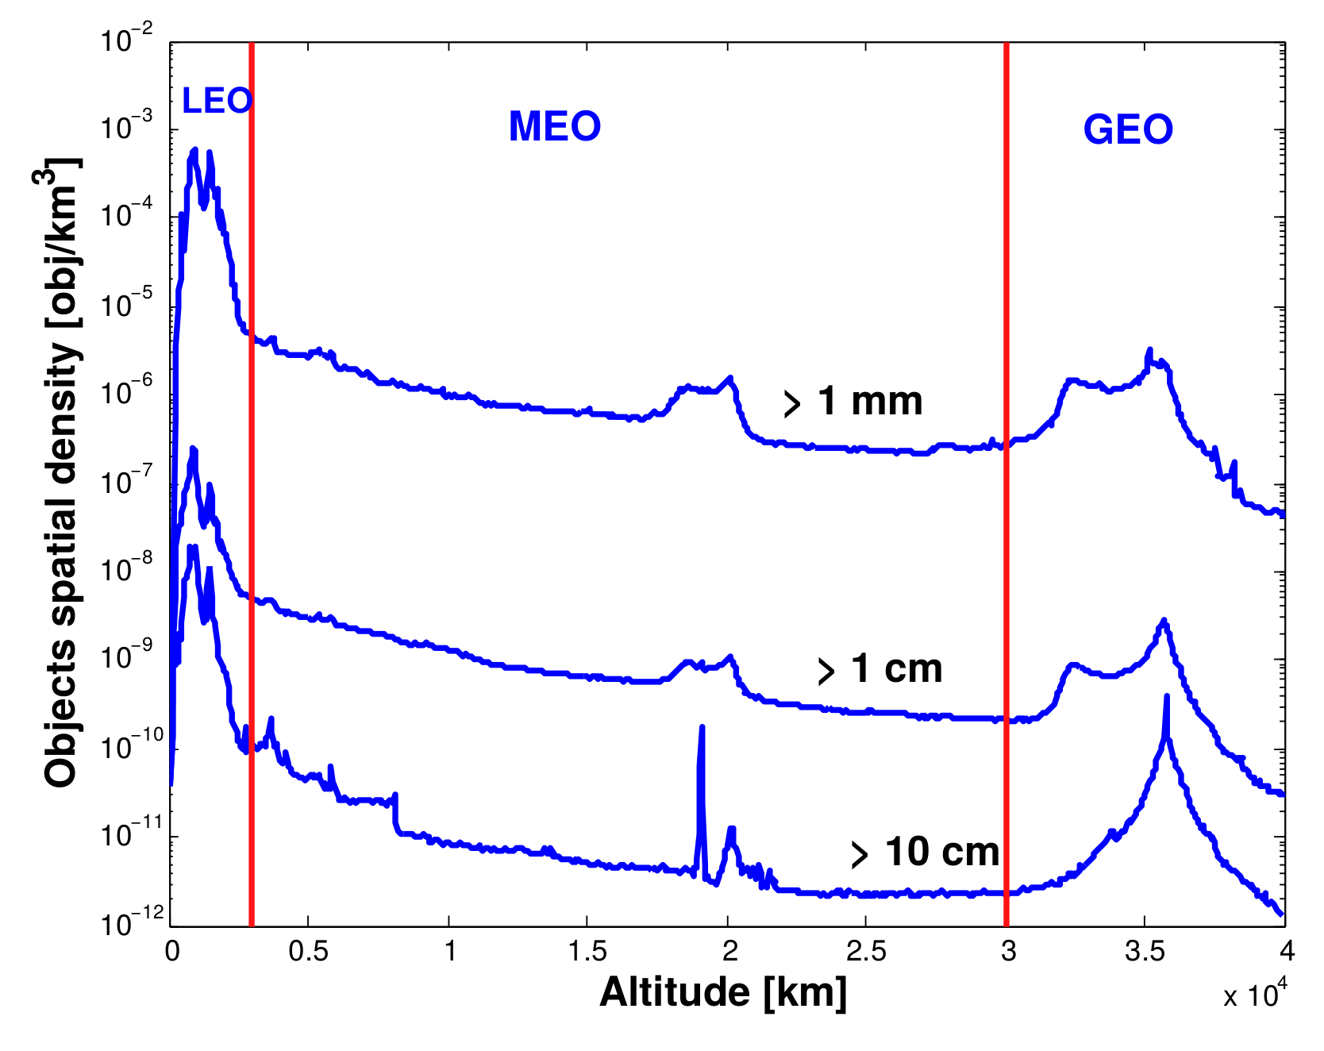
The majority of the objects are found in Low Eart Orbit (LEO)
Warning: The maximum of the spatial density reaches about ${10}^{−3}$ objects per cubic km

Slide 14
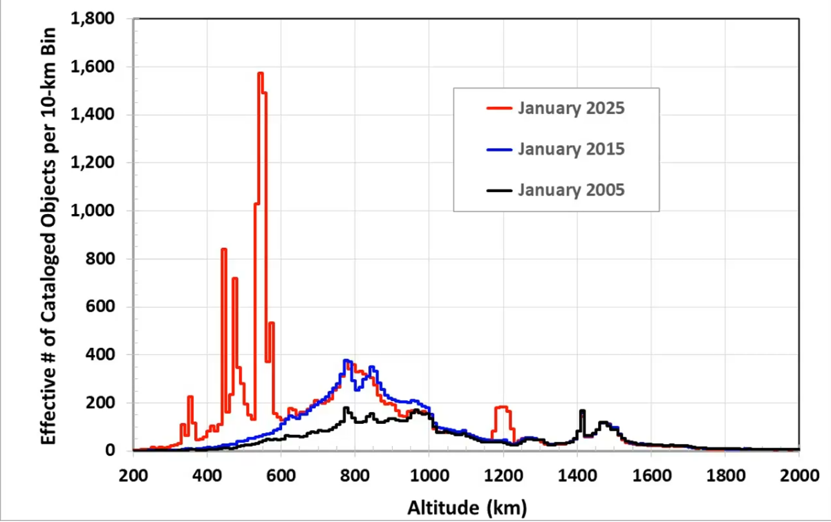
Image courtesy of: NASA JSC
Missione 4 • Istruzione e Ricerca
Missione 4 • Istruzione e Ricerca

Slide 15
Missione 4 • Istruzione e Ricerca
Missione 4 • Istruzione e Ricerca

Slide 16
Long term modeling: a Volterra-like model
Due popolazioni: detriti (proiettili), n e satelliti (bersagli), N.
A = tasso di crescita dei satelliti: oggetti lanciati - oggetti rientrati in atmosfera, per anno. si puo’ assumere un valore, per es., di circa 100.
x ∼ 3 × 10−10 : costante, tale che xnN rappresenta il numero di collisioni tra proiettili e bersagli. in tal modo xnN rappresenta anche il numero di satelliti distrutti dalle collisioni. il valore di x si puo’ calcolare con un modello particle-in-a-box
β ≃ 70: numero medio di frammenti primari, cioe’ generati da esplosioni o oggetti rilasciati nel corso della missione.
α ≃ 104: numero di frammenti prodotti in una collisione tipica.
Pertanto αxnN ci da’ il numero di oggetti prodotti in xnN collisioni.
Farinella & Cordelli , 1991

Slide 17
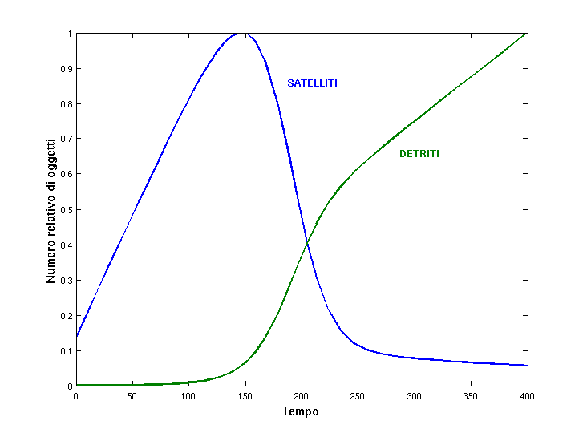
Using initial conditions such as in (Farinella & Cordelli, 1991)

Slide 18
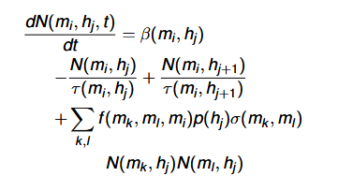
Long term modeling: increasing the complexity
From: Rossi, Cordelli and Farinella (JGR, 1994)

Slide 19
Long term modeling
SDM 5.0 space debris long term evolution model:
Starting from a given initial population, SDM allows the simulation of the full traffic of launches and disposal of space objects, including active and defunct satellites, spent rockets bodies and fragments, down to a given size threshold (e.g., 5 cm, 10 cm, ….).
Beside the “standard” launch traffic derived from the launch activities of the past decade, SDM allows the inclusion in the launch traffic of large constellations with their own specific traffic and maintenance procedures.
The collision probability (CUBE and/or Opik) and the related fragmentation in space are computed and simulated.

Slide 20
Long term modeling
SDM 5.0 space debris long term evolution model:
The orbits of all the objects are integrated by a fast high fidelity orbital propagator.
A number of mitigation and remediation measures can be simulated within SDM, e.g.:
The possibility to simulate the disposal at the end-of-life to an orbit (either circular or elliptic) with a given residual lifetime, by means of an impulsive or low-thrust manoeuver.
The Active Debris Removal (ADR) of spacecraft can be simulated too, as well as the re-fuelling of a given number of large satellites.
It is a statistical model, based on many Monte Carlo runs.

Slide 21
Long term modeling
SDM 5.0 space debris long term evolution model:
The orbits of all the objects are integrated by a fast high fidelity orbital propagator.
A number of mitigation and remediation measures can be simulated within SDM, e.g.:
The possibility to simulate the disposal at the end-of-life to an orbit (either circular or elliptic) with a given residual lifetime, by means of an impulsive or low-thrust manoeuver.
The Active Debris Removal (ADR) of spacecraft can be simulated too, as well as the re-fuelling of a given number of large satellites.
It is a statistical model, based on many Monte Carlo runs.

Slide 22
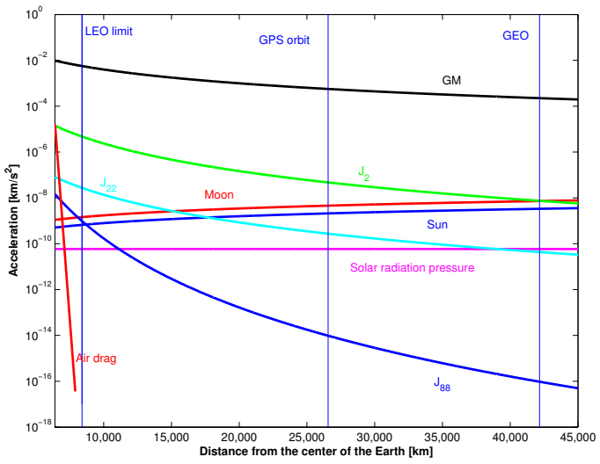
Gravitational perturbations:
Higher harmonics of the gravity potential
Lunisolar perturbations
Non-gravitational perturbations:
Air drag
Solar radiation pressure
Both proportional to the A/M of the object
Missione 4 • Istruzione e Ricerca
Missione 4 • Istruzione e Ricerca

Slide 23
Gravitational perturbations:
Higher harmonics of the gravity potential
Lunisolar perturbations
Non-gravitational perturbations:
Air drag
Solar radiation pressure
Both proportional to the A/M of the object
Most of the effect is related to J2, the quadrupole term of the gravity potential expansion in terms of spherical harmonics due to the Earth oblateness.
Are important mainly in changing the angular arguments of the satellite orbit.
The main effects of the geopotential perturbations are the secular regression of the orbital node (Ω) and the precession of the perigee argument ( ω)
Missione 4 • Istruzione e Ricerca
Missione 4 • Istruzione e Ricerca

Slide 24
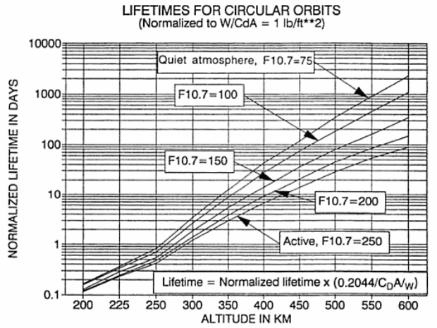
Gravitational perturbations:
Higher harmonics of the gravity potential
Lunisolar perturbations
Non-gravitational perturbations:
Air drag
Solar radiation pressure
Both proportional to the A/M of the object
Da: Chobotov, Orbital mechanics
Missione 4 • Istruzione e Ricerca
Missione 4 • Istruzione e Ricerca

Slide 25
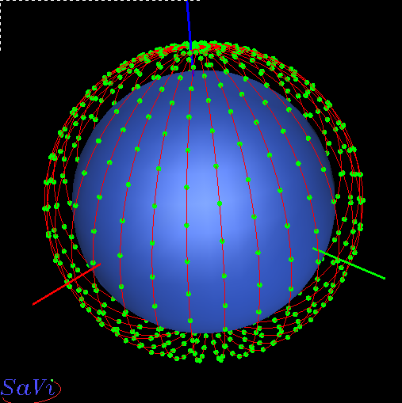
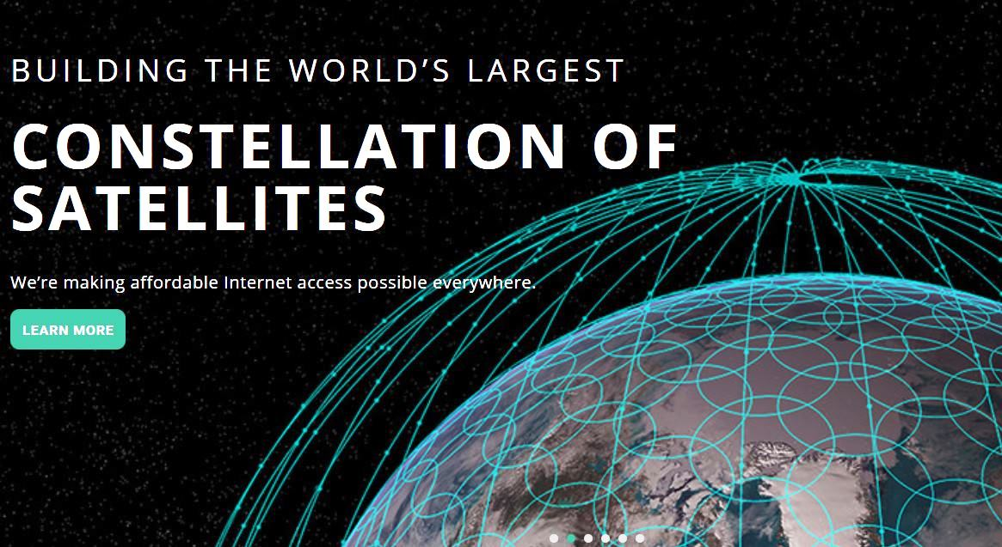
Mega constellations in LEO
Missione 4 • Istruzione e Ricerca
Missione 4 • Istruzione e Ricerca

Slide 26
Mega constellations in LEO
What is the impact of a (very large) mega constellation in (very) Low Earth Orbit?
Comparison between a “business-as-usual” case with no mega constellation in space and a scenario where a mega constellation is simulated.
19,500 satellites between 400 and 550 km of altitude, i = 50 deg , with the following configuration:
13 altitude shells spaced by 5 km, on 30 orbital planes separated by 0.5 deg
5-year lifetime for each satellite, with a total constellation lifetime of 50 years
Launch/dismissal of satellites at regular intervals: 250 satellites per launch (6 launches per shell, 5 planes per launch)
No de-orbiting of satellites at end-of-life, just natural reentry (due to the low altitude)
Perfect collision avoidance for constellation satellites while operational (i.e., no collision avoidance during the reentry phase)
The results are average of 100 Monte Carlo runs for each scenario.
Missione 4 • Istruzione e Ricerca
Missione 4 • Istruzione e Ricerca

Slide 27
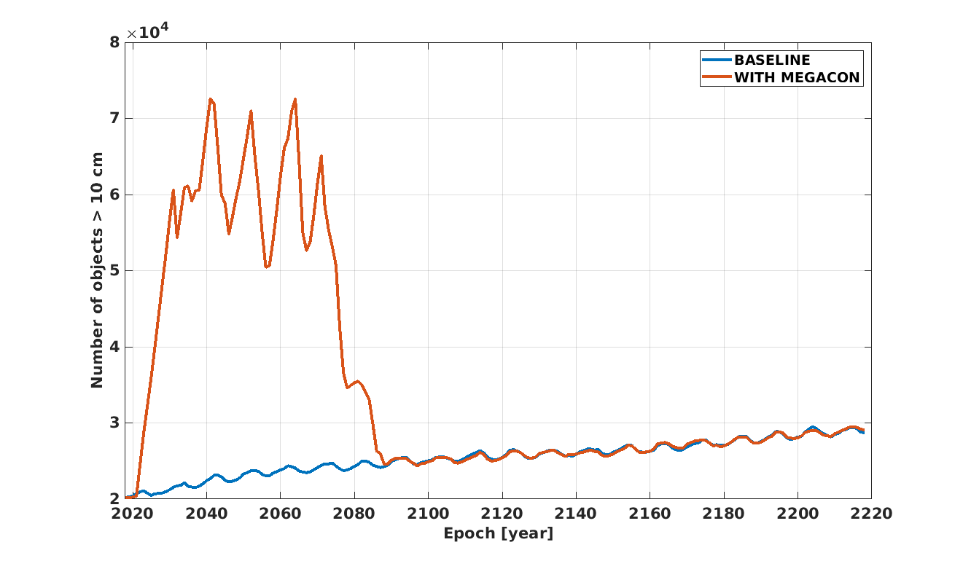
Number of objects > 10 cm
Missione 4 • Istruzione e Ricerca
Missione 4 • Istruzione e Ricerca

Slide 28
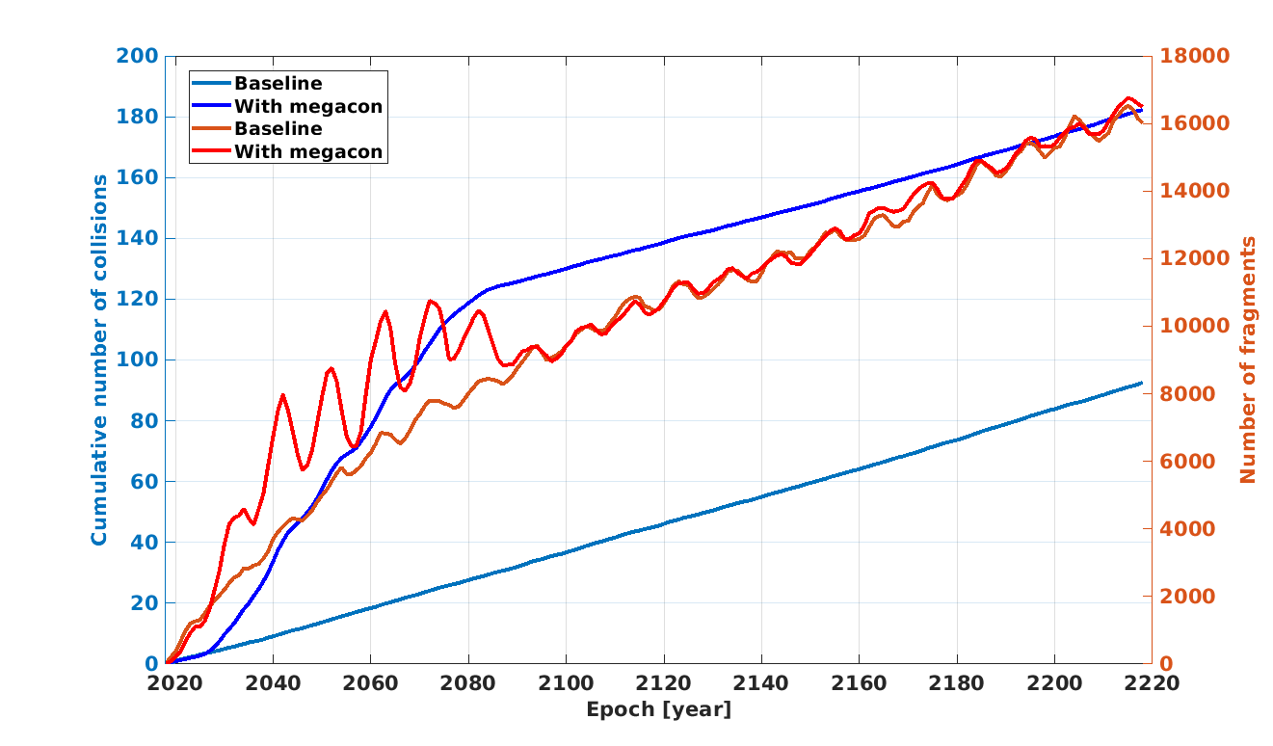
Number of collisions
Missione 4 • Istruzione e Ricerca
Missione 4 • Istruzione e Ricerca

Slide 29
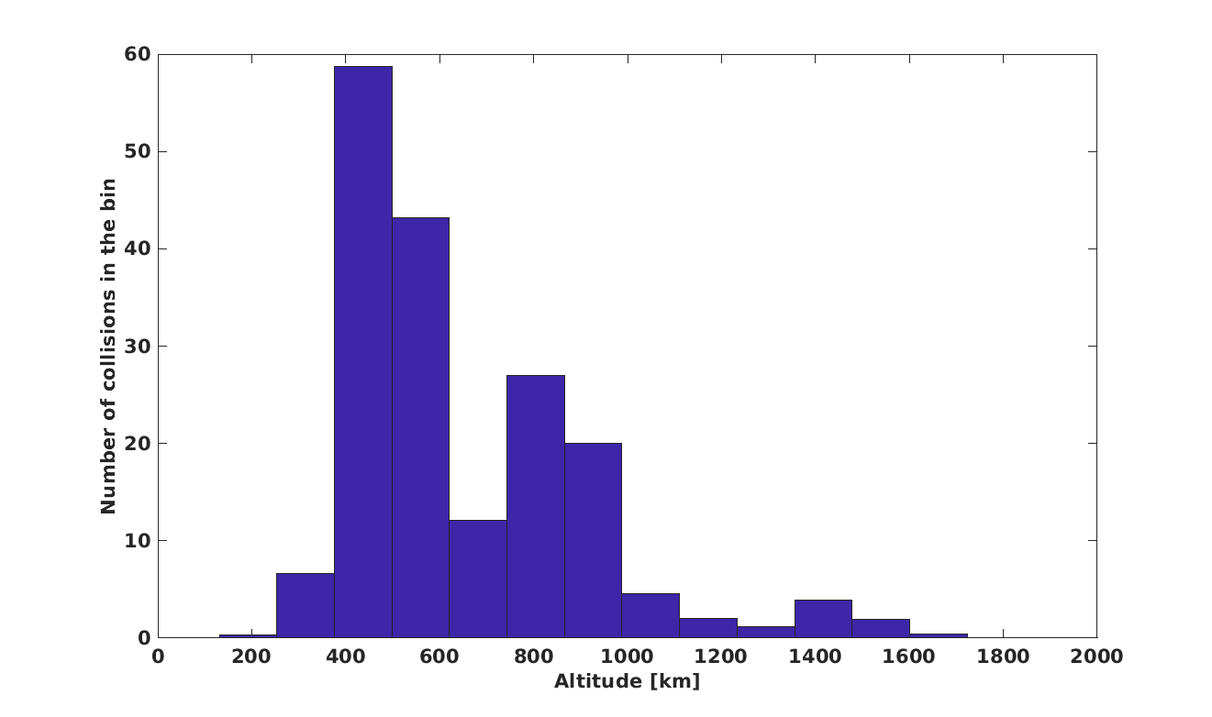
The majority of the collisions involve uncontrolled constellation satellites in the disposal phase
No long term accumulation of debris due to the air drag at low altitude
Missione 4 • Istruzione e Ricerca
Missione 4 • Istruzione e Ricerca

Slide 30
The majority of the collisions involve uncontrolled constellation satellites in the disposal phase
No long term accumulation of debris due to the air drag at low altitude
Manned spaceflight (ISS) zone interested
Missione 4 • Istruzione e Ricerca
Missione 4 • Istruzione e Ricerca

Slide 31
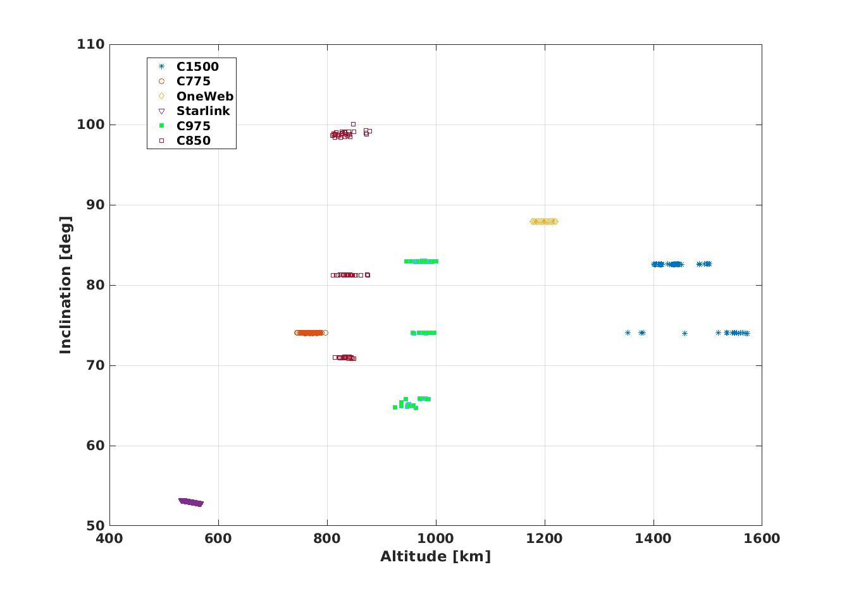
Clusters and constellations in LEO
Are mega-constellations the main drivers of the future debris evolution?
Center of the cluster (Span) [km] | # of objects and Cumulative Mass [kg] | Mass involved in typical collision | Trackable debris generated from collision (LNT))
775 (60) | 101 ~100,000 | ~1,600 – 2,800 | ~4,500 (~60,000)
850 (45) | 75 ~208,000 | ~6,000 – 18,000 | ~16,000 (~200,000)
975 (115) | 314 ~335,000 | ~1,600 – 2,800 | ~4,500 (~60,000)
1500 (400) | 73 ~96,000 | ~3,200-3,600 | ~9,000 (~120,000)
D. McKnight et al., Derelict Deposition Study, International Orbital Debris Conference, 2019.
A. Rossi , A. Petit, D. McKnight, Short-term space safety analysis of LEO constellations and clusters, Acta Astr., 2020
D. McKnight et al.,Identifying the 50 statistically-most-concerning derelict objects in LEO, Acta Astr., 2021

Slide 32
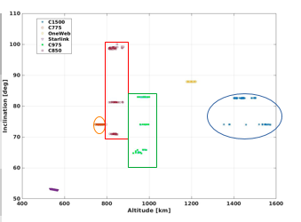
Clusters and constellations in LEO
Are mega-constellations the main drivers of the future debris evolution?
Center of the cluster (Span) [km] | # of objects and Cumulative Mass [kg] | Mass involved in typical collision | Trackable debris generated from collision (LNT))
775 (60) | 101 ~100,000 | ~1,600 – 2,800 | ~4,500 (~60,000)
850 (45) | 75 ~208,000 | ~6,000 – 18,000 | ~16,000 (~200,000)
975 (115) | 314 ~335,000 | ~1,600 – 2,800 | ~4,500 (~60,000)
1500 (400) | 73 ~96,000 | ~3,200-3,600 | ~9,000 (~120,000)
D. McKnight et al., Derelict Deposition Study, International Orbital Debris Conference, 2019.
A. Rossi , A. Petit, D. McKnight, Short-term space safety analysis of LEO constellations and clusters, Acta Astr., 2020
D. McKnight et al.,Identifying the 50 statistically-most-concerning derelict objects in LEO, Acta Astr., 2021

Slide 33
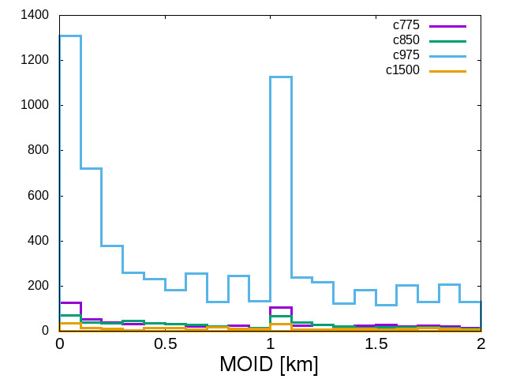
Computing the Minimum Orbital Intersection Distance (MOID) between each couple of objects inside the cluster.
Within C975 there are 159 couples of objects with MOID below 50 m and 265 couples of objects with MOID below 100 m.
The list of the objects with the lowest value of the median of the MOID is dominated by a significant number of the large SL-8 Rocket Body having a mass of about 1400 kg abandoned in very similar orbits.
Cluster | Mean [km] | Standard Deviation [km] | Median [km]
C750 | 34.1995 | 29.4394 | 24.2493
C850 | 14.4796 | 12.9333 | 10.7310
C975 | 16.3628 | 14.3297 | 12.6029
C1500 | 43.7074 | 35.2927 | 47.0672

Slide 34
Clusters and constellations in LEO
Computing the Minimum Orbital Intersection Distance (MOID) between each couple of objects inside the cluster (see G.F. Gronchi’s talk).
Within C975 there are 159 couples of objects with MOID below 50 m and 265 couples of objects with MOID below 100 m.
The list of the objects with the lowest value of the median of the MOID is dominated by a significant number of the large SL-8 Rocket Body having a mass of about 1400 kg abandoned in very similar orbits.
We can also evaluate the risk
using the Criticality of Spacecraft
Index (Rossi et al., 2015):
Cluster | Mean [km] | Standard Deviation [km] | Median [km]
C750 | 34.1995 | 29.4394 | 24.2493
C850 | 14.4796 | 12.9333 | 10.7310
C975 | 16.3628 | 14.3297 | 12.6029
C1500 | 43.7074 | 35.2927 | 47.0672
Cluster | Median
C750 | 0.0076
C850 | 0.0299
C975 | 0.0367
C1500 | 0.0294
$$Ξ=\frac{M}{M_{0}}\frac{ρ}{ρ_{0}}\frac{L}{L_{0}}f\left(i\right)$$

Slide 35
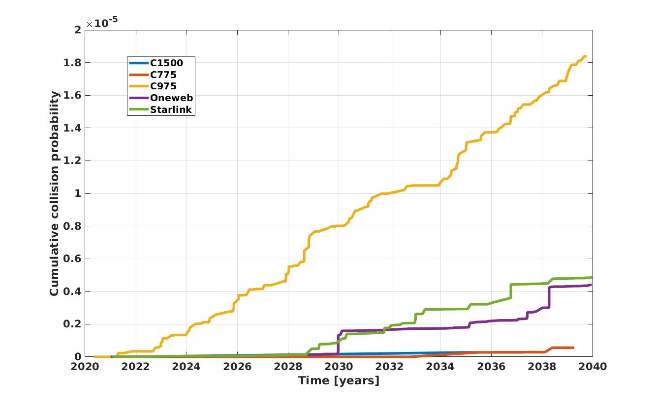
Clusters and constellations in LEO
The self-generated collision risk as a function of time related to the clusters
and to a few mega-constellations can be computed by means of SDM.
All the crossings between two controlled operational satellites
are considered “safe” and “avoided by design” (e.g., Reiland et al. 2021; Bombardelli et al., 2021), thus are not included in the cumulated quantity displayed in the plot.
We assumed that in each constellation 8 satellites fail every year.
Only the crossings involving at least one failed satellite are considered.
The cumulative collision probability for C975 is more than 3 times higher than for any of the other groups and is steadily growing due to the repeated orbital crossings and close approaches between the members of the cluster, with no natural disposal mechanism acting at that orbital altitude.

Slide 36
The failed uncontrolled satellites can represent a signiﬁcant risk for the large constellation, but this kind of risk can be mitigated by an eﬃcient management of these systems.
An operational service of accurate monitoring leading, when needed, to collision avoidance maneuvers can minimize the risk of collision against large trackable targets. In principle, if we assume a perfect collision avoidance service, most of the orbital crossings in the constellation cases should not enter in the cumulative collision probability computation but would “only” represent a nuisance for the constellation operation.
All the members of clusters considered in this analysis are stranded uncontrolled spacecraft for whom no maneuver would be possible
Even if a number of catastrophic collisions inside a constellation would pose an additional risk to the operational satellites, it is worth stressing that the satellites envisaged for the large LEO constellations tend to be comparatively small, thus leading, in case of fragmentation, to a limited number of debris limiting the long term consequences of this event.
The members of the clusters are usually very large spacecraft and upper stages (of the order a few tons). Any catastrophic fragmentation involving one of these giant objects would result in a massive cloud of fragments which would also be long lived due to the high orbital altitude, thus representing a signiﬁcant long term risk for the environment.
Missione 4 • Istruzione e Ricerca
Missione 4 • Istruzione e Ricerca

Slide 37
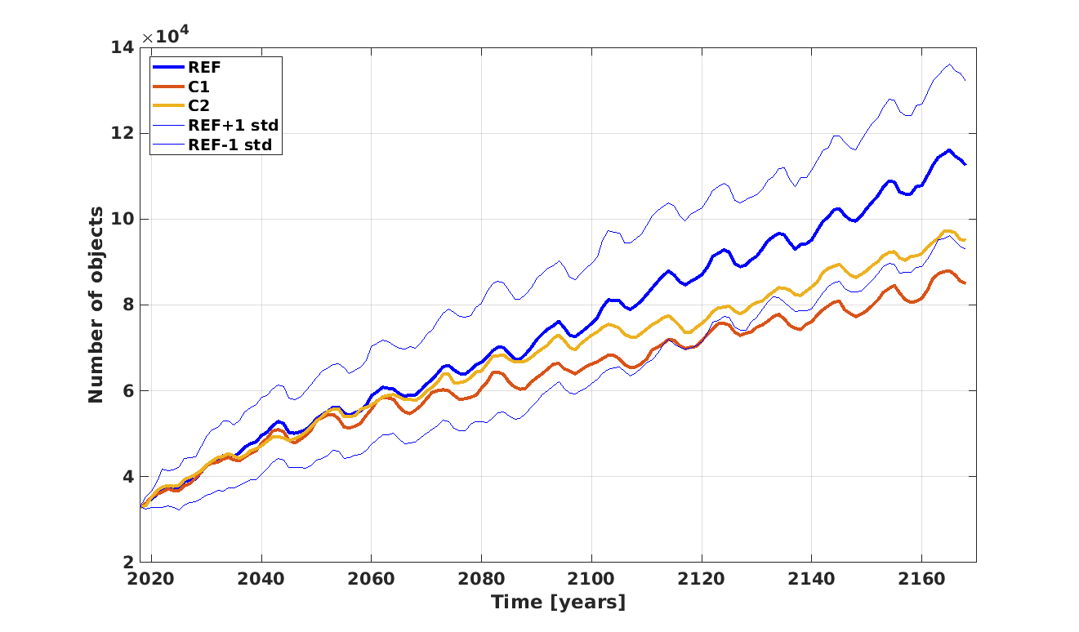
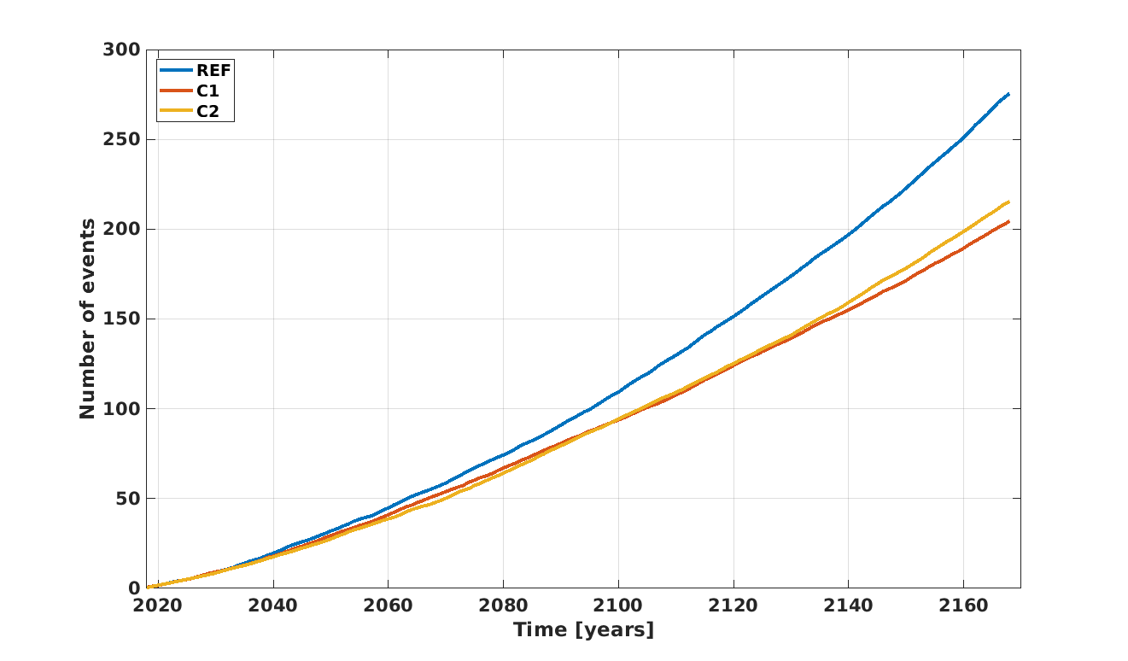
Effects of mitigation measures
REFERENCE: business as usual + 3 constellations, objects larger than 5 cm
C1: 25-year rule applied with a compliance of 80 % (w.r.t. to the 50 % of the Reference case), 70 % efficiency for the collision avoidance of standard satellites (w.r.t. to the 60 % of the Reference case)
C2: the residual lifetime in the Post Mission Disposal is changed from 25 years (25-year rule) to 5 years with a compliance of 60 %.
Number of objects in LEO larger than 5 cm
Number of collisions in LEO
C. Iacomino, A. Rossi, A. Saputo, Economic theory applied to space debris scenario, IAC 2021

Slide 38
Effects of mitigation measures
Improving the compliance to the 25-year rule from 50 to 80 % (along with a slightly better collision avoidance) reduces the number of objects larger than 5 cm by 25 % and the total number of collisions by about 26 %
importance of the full compliance of the currently adopted mitigation measures.
Comparing the cases C1 and C2: a more strict mitigation measure (a 5-year rule w.r.t. the 25-year rule) but with a lower compliance (60 % w.r.t. 80 %) leads to an increase of about 11 % in the number of objects and about 5% in the total number of collisions.
Initially, the C2 scenario appears comparable or even slightly better than the C1 scenario thanks to a larger compliance to a “softer” rule. Nonetheless, on the longer run, the accumulation of objects abandoned in space (due to the reduced compliance) starts to deteriorate the environment and to generate additional collisions.
Note: In all the three scenarios we assumed that the collision avoidance is effective for objects > 10 cm. Between 45 and 49 % of the collisions happen against objects smaller than 10 cm which are assumed to be non-trackable and therefore cannot be avoided importance of the improvement of the SST network.

Slide 39
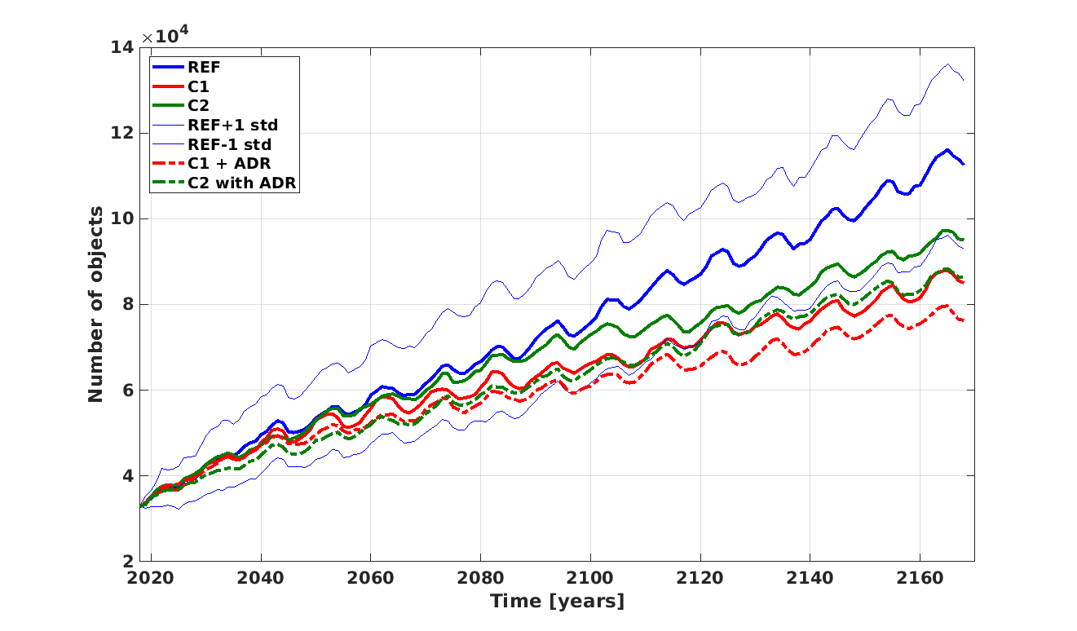
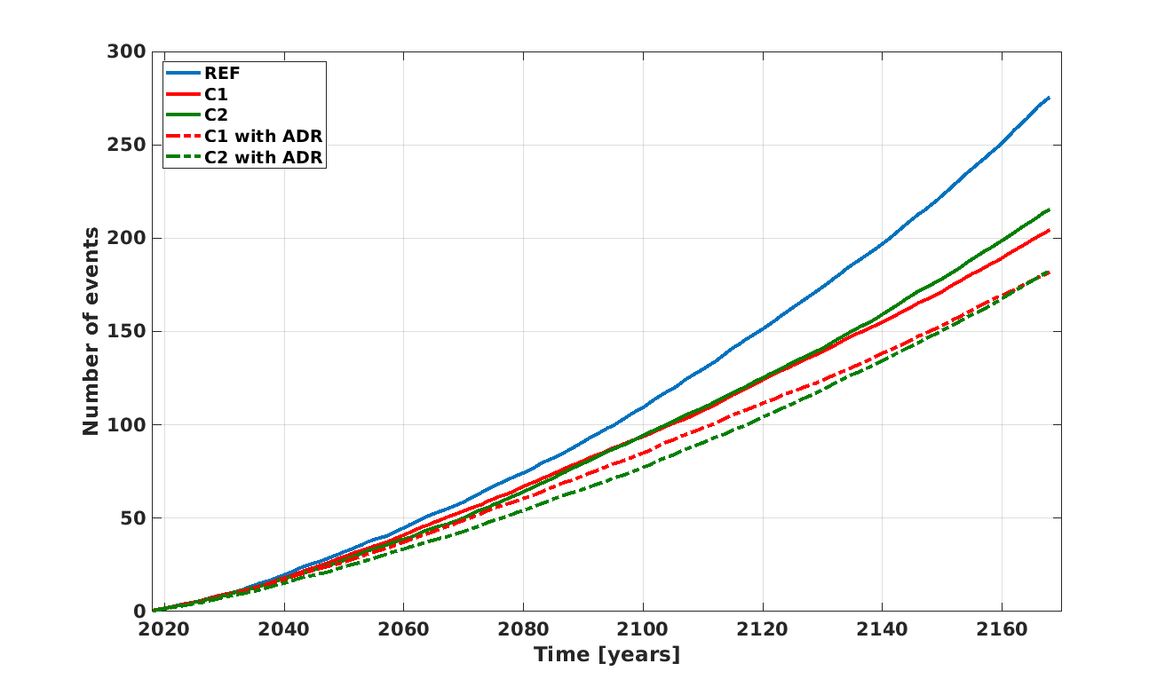
Effects of mitigation+remediation measures
C1 with ADR: the same as C1 + 4 ADR per year, starting in the year 2028. I.e., every year the 4 abandoned objects with the highest product (mass x collision probability) are removed from the simulation.
C2 with ADR: the same as C2 + 4 ADR per year, starting in the year 2028. I.e., every year the 4 abandoned objects with the highest product (mass x collision probability) are removed from the simulation.
Number of objects larger than 5 cm in LEO
Number of collisions in LEO

Slide 40
As expected, the ADR improves significantly the situation leading to:
an ~10 % reduction in the final number of objects larger than 5 cm in both C1_ADR and C2_ADR scenarios
an ~11 % reduction in the overall number of collisions for the C1_ADR case and of ~15 % for the C2_ADR case.
The final number of collisions is nearly equal in the C1_ADR and C2_ADR scenarios. Nonetheless, it is worth stressing that the growth pace (first derivative) of the C2_ADR is significantly steeper than for the C1_ADR case due, as already mentioned, to the accumulation of inactive spacecraft (i.e., collisional cross section) in the case where only 60 % of the spacecraft are disposed at the end-of-life (even if with a lower residual lifetime).
It is worth noting that the introduction of the ADR is extremely beneficial especially to the C2 case: remember that in this case more objects are abandoned (due to the lower compliance to the 5-year rule).
Missione 4 • Istruzione e Ricerca
Missione 4 • Istruzione e Ricerca

Slide 41
The mega constellations, if properly managed (and assisted by an efficient SST system) might not be detrimental to the space environment.
On the other hand, they can represent a de-facto violation of the Outer Space Treaty with the unregulated possession of specific orbital zones.
The long-standing problem of large derelict objects in space is still (after more than 30 decades of alarm) unresolved
The good ol’ 25-year rule can certainly be improved…. but it should be first properly applied!
ADR is certainly required but it is not THE solution.
Missione 4 • Istruzione e Ricerca
Missione 4 • Istruzione e Ricerca

Slide 42
The tragedy of the commons
In economic terms, space is considered a common-poll resource:
It is rivalrous: one’s use of a particular orbit prevents other space actors from using it (and, by abandoning a spacecraft at end-of-life, a user can reduce the benefits of new entrants on that particular orbit)
It is non-excludable: it is difficult and costly to exclude actors from enjoying the benefits of orbital space.
NOTE: the Trump administration officially declared that outer space should not be viewed as a global commons.
Missione 4 • Istruzione e Ricerca
Missione 4 • Istruzione e Ricerca

Slide 43
The tragedy of the commons
Common resources may be over-consumed, relative to the social optimum, because individuals have incentives to over-use them as long as marginal benefits (which are private) exceed marginal costs (which are shared with the community). Such over-exploitation may come at the expense of other users and of the resource sustainability (G. Hardin, 1968).
Ultimately all the space debris political/economic efforts are devoted to avoiding the tragedy of the commons.
Missione 4 • Istruzione e Ricerca
Missione 4 • Istruzione e Ricerca

Slide 44
The tragedy of the commons
Missione 4 • Istruzione e Ricerca
Missione 4 • Istruzione e Ricerca

Slide 45
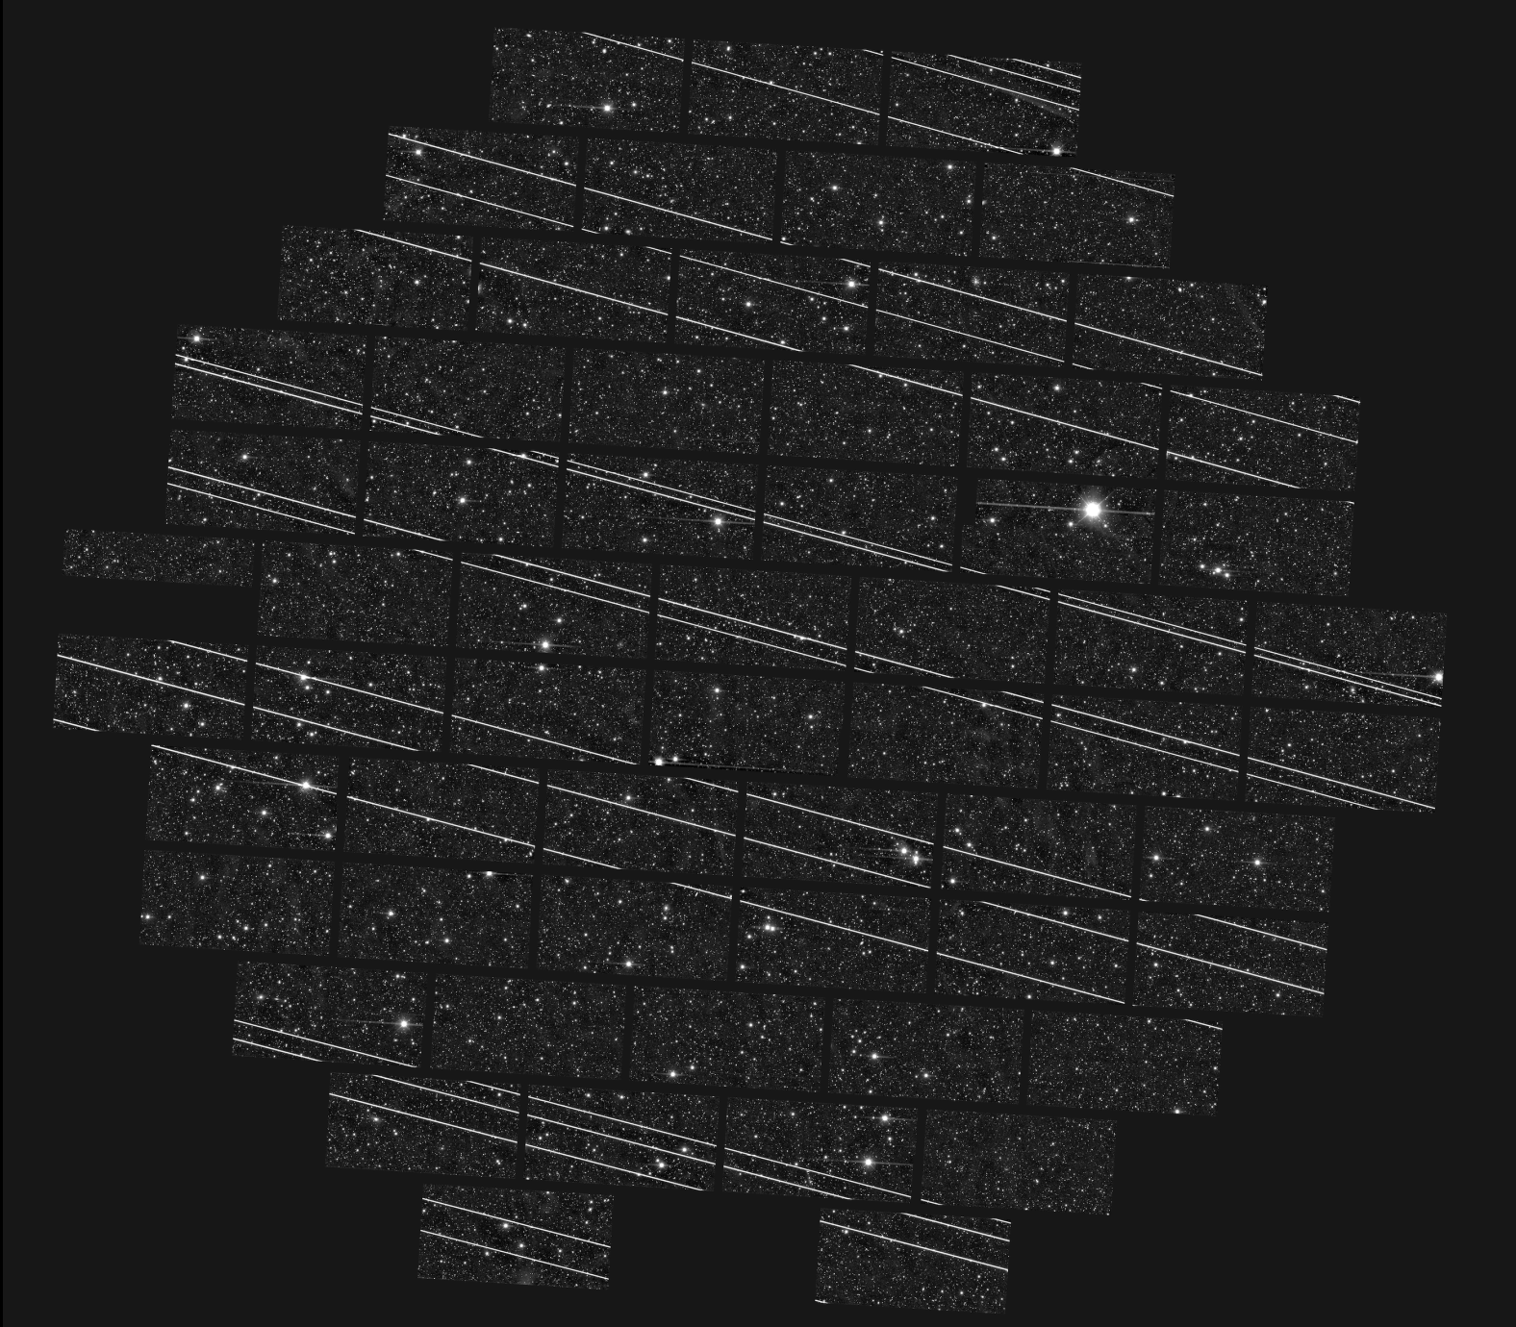
The tragedy of the commons
19 satelliti Starlink attraversano il campo di vista del telescopio NSF Blanco (4 metri) a Cerro Tololo in Cile l’11/11/2019
Circ ~4 sec per attraversare il campo di vista che è circa 4 volte il diametro della luna piena.
Immagine da: Patrick Seitzer, NAS Decadal Survey

Slide 46
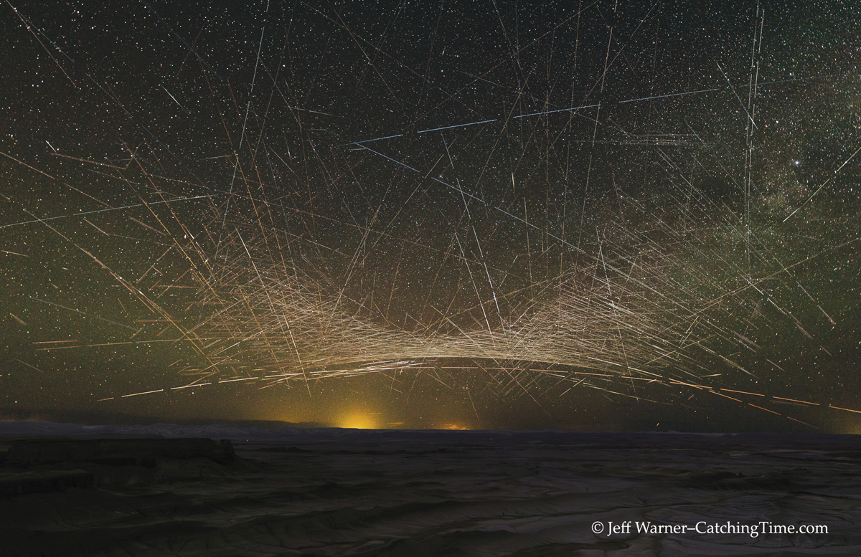
The tragedy of the commons
5.5 hours exposure image taken in Utah
Missione 4 • Istruzione e Ricerca
Missione 4 • Istruzione e Ricerca

Slide 47
The tragedy of the commons
The dark sky is (IMHO) a global common. It is a cultural heritage of all the life forms on the Earth.
The proliferation of bright satellites is endangering the optical astronomical observations, especially in the case of large field of view telescopes (e.g., Vera Rubin LSST)
Even small particles, if reflective enough, are able to scatter and reflect so much light to the ground that they significantly elevate the brightness of the sky background - a new variety of sky glow.
Missione 4 • Istruzione e Ricerca
Missione 4 • Istruzione e Ricerca

Slide 48
The tragedy of the commons
The dark sky is (IMHO) a global common. It is a cultural heritage of all the life forms on the Earth.
The proliferation of bright satellites is endangering the astronomical observations, especially in the case of large field of view telescopes (e.g., Vera Rubin LSST)
Missione 4 • Istruzione e Ricerca
Missione 4 • Istruzione e Ricerca

Slide 49
Problemi osservativi: simulazione della traccia di uno Starlink (V=5) su una CCD di LSST
Saturazione dei CCD anche per passaggi sui pixels per tempi di 1 ms
Perdita di informazioni nei pixels
Cross-talk nell’elettonica
Immagini “fantasma“
Soluzioni possibili dal lato osservativo:
Modifiche all’elettronica dei rivelatori ➔ costosi e non risolutivi
Algoritmi per “scansare” gli oggetti artificiali nel corso delle osservazioni ➔ estremamente penalizzanti per i tempi ottimizzati di osservazione e di scan di un telescopio moderno come LSST

Slide 50
The tragedy of the commons
The dark sky is (IMHO) a global common. It is a cultural heritage of all the life forms on the Earth.
The proliferation of bright satellites is endangering the optical astronomical observations, especially in the case of large field of view telescopes (e.g., Vera Rubin LSST)
Even small particles, if reflective enough, are able to scatter and reflect so much light to the ground that they significantly elevate the brightness of the sky background - a new variety of sky glow.
As commercial uses of the radio spectrum continue to ramp up, the radio skies grow louder. An increasing number of orbiting satellites with passive emission in protected bands and ones designed to communicate directly with mobile phones anywhere in the world threaten to undermine the efficacy of RQZs.
Missione 4 • Istruzione e Ricerca
Missione 4 • Istruzione e Ricerca

Slide 51
What is the cost of space debris?
The cost of the satellites varies and is generally decreasing:
Large GEO telecommunication satellites are worth 100s of millions of $
The costliest single satellite program in LEO is probably the Hubble Space Telescope: $ 4.7 billion at launch and ~$9.6 billion at its last servicing mission in 2009
The reported cost per OneWeb satellite was $ 1 million and launch cost around $ 2 million
Starling and SpaceX reduced further the overall cost (manufacturing + launches)
This has important consequences on the cost of space debris since for these manufacturers it is more convenient to self-insure by putting spares in orbit.
The overall economic impact of space debris is largely unknown due to a number of reasons:
Damage due to un-tracked objects in unreported
Operators are not transparent about the costs
There is a mix of civil-military budget in the Space Surveillance Systems
The current direct costs of space debris appears low because the perceived risk is too low to trigger active responses from operators.
Missione 4 • Istruzione e Ricerca
Missione 4 • Istruzione e Ricerca

Slide 52
Conclusions and open problems
Are we doing enough?
Missione 4 • Istruzione e Ricerca
Missione 4 • Istruzione e Ricerca

Slide 53
Conclusions and open problems
Are we doing enough? NO
Missione 4 • Istruzione e Ricerca
Missione 4 • Istruzione e Ricerca

Slide 54
Conclusions and open problems
Are we doing enough? NO
What should we do more?
The very small satellites should carry some kind of de-orbiting/maneuvering capability (remember, from 2014 to 2019 more than 900 cubesats were launched) e.g., solar sails, exploiting resonance “corridors” (Rossi et al., 2020) .
The new traffic must be regulated by a proper Space Traffic Management. This requires interaction and agreement between the different actors, e.g.:
ESA-SpaceX: Aeolus and Starlink 44 satellite
“mutual” collision avoidance between AI guided spacecraft: who’s going first?
…...
NOTE: only ~ 8 % of the trackable population is maneuverable
Missione 4 • Istruzione e Ricerca
Missione 4 • Istruzione e Ricerca

Slide 55
Are we doing enough? NO
What should we do more?
Apply existing rules:
57 % of the rocket bodies used in the past 10 years are still in orbit
For non-naturally compliant objects about 60 % of the payloads and 30 % of the rocket bodies do not even attempt to comply
Find and approve new rules (not necessarily the 25-year rule….)
Improve some technologies (de-orbiting, in-deorbit servicing, ADR, laser nudging of small debris, autonomous navigation & AI for collision avoidance, just in time collision avoidance,….)
Improve the SST system to lower the covariance and to detect smaller objects (LNT)

Slide 56
What should we do more?
Solve the legal/economic issues:
Liability:
the Liability Convention of 1971 “neither defines the fault nor establishes a standard of care for actors conducting space activities. The absence of precedent at both the international and domestic level leaves the ability of a victim to recover its losses uncertain”
As the liability regime is stronger for damage on the ground or in the air compared to in orbit, space actors are disincentivised to de-orbit their spacecraft design for demise (e.g., Rossi et al., Aerospace, 2018) (see next talk by Pardini & Anselmo!)
Missione 4 • Istruzione e Ricerca
Missione 4 • Istruzione e Ricerca

Slide 57
What should we do more?
Solve the legal/economic issues:
Insurance:
In the space domain, first-party insurance is more common than Third Party Liability (TPL)
Most of the insurance goes to LEOP and for GEO satellites
Only about 3 % of LEO satellites are covered by first-party insurance
The probability of collision is still too low (about 2 orders of magnitude smaller than the one of technical failure) to drive the premium rates
Insurers do not require compliance nor economically penalise operators for non-compliance to international guidelines.
Imposing the requirement for a TPL as long as a satellite is left in orbit would act as a kind of orbital fee and could incentivise operators to remove their assets from space to stop paying the fee.
Missione 4 • Istruzione e Ricerca
Missione 4 • Istruzione e Ricerca

Slide 58
Are we doing enough? NO
What should we do more?
Solve the legal/economic issues:
Active Debris Removal:
Who can remove what (states retain jurisdiction over their space objects)
Who is paying to remove derelict objects: various schemes have been proposed…..
……..etc etc
Missione 4 • Istruzione e Ricerca
Missione 4 • Istruzione e Ricerca

Slide 59
Are we doing enough? NO
What should we do more?
Solve the legal/economic issues:
Active Debris Removal:
Who can remove what (states retain jurisdiction over their space objects)
Who is paying to remove derelict objects: various schemes have been proposed…..
……..etc etc
The tyranny of small decisions
“…….a series of small, individually rational decisions, cumulatively result in a larger and significant outcome which is neither optimal nor desired and can negatively change the context of subsequent choices, even to the point where desired alternatives are irreversibly destroyed”
Alfred E. Kahn, 1966
Missione 4 • Istruzione e Ricerca
Missione 4 • Istruzione e Ricerca

Slide 60
Acknowledgment
Part of the work presented was supported by the Italian Space Agency (ASI) in the framework of the agreement “Detriti Spaziali - Supporto alle attivita’ IADC e SST 2023-2025”
Missione 4 • Istruzione e Ricerca
Missione 4 • Istruzione e Ricerca

