Slide 1
Tiered Object Storage platform sostenibile e con gestione semplificata
Trieste, 15 Aprile 2025
Ing. Matteo Gazzotti
Technical Presales Manager
Errevi System

Slide 2
ERREVI SYSTEM IN NUMERI
28
anni di presenza sul mercato
Esperienza
Interpretazione e gestione dei trend tecnologici
crescita media degli ultimi 5 anni
16%
Continua e costante crescita
Innovazione
35
MLN € fatturato 2024
Solida e affidabile
Struttura agile, operativa e flessibile
professionisti in staff
90
Più di 147 certificazioni
Competenze su tecnologie processi e persone
3
sedi a Reggio Emilia, Milano e Roma
Copertura di tutto il territorio nazionale
clienti attivi
400
Visione «trasversale» e per settore
Condivisione esperienze
Classificazione: documento confidenziale
Notes:
Per darvi un’idea più chiara del contesto aziendale vorrei presentarvi alcuni numeri.
Siamo presenti sul mercato da 28 anni, mi soffermo su questo dato per sottolineare che ora si parla di trasformazione digitale, ma noi non ci siamo improvvisati nel mestiere, dal 1997 ad oggi abbiamo saputo interpretare e gestire numerosi trend tecnologici e abbiamo guidato il percorso di tante aziende clienti supportandole in progetti digitali che fossero abilitanti per raggiungere i loro obiettivi di business.
A testimonianza del fatto che sappiamo come affrontare il mercato e i suoi cambiamenti e che sappiamo interpretare i trend tecnologici, vi riporto i dati della nostra crescita media che negli ultimi 5 anni è stata del 16%
Per darvi un’idea delle dimensioni aziendali, siamo 90 professionisti e nel 2024 abbiamo realizzato un fatturato di 35 milioni di €. È una dimensione aziendale che ci permette di esprimerci molto bene, possiamo contare su una struttura solida e affidabile ma al contempo anche agile e reattiva e in grado di adeguarsi molto rapidamente ai cambiamenti di mercato anche anticipandoli. Abbiamo sempre investito molto sul valore delle nostre persone e possiamo contare su oltre 147 certificazioni tecniche a testimonianza di competenze specialistiche di prim’ordine.
Il nostro HQ è storicamente a Reggio Emilia in una posizione centrale e strategica per servire agevolmente l’intero territorio italiano abbiamo inoltre presidi sul territorio in Lombardia e Lazio.
Lavoriamo con più di 400 clienti attivi che ci forniscono una visione molto completa dei diversi mercati.

Slide 3
Archives and Data Management Systems
in the Big Data Era

Slide 4
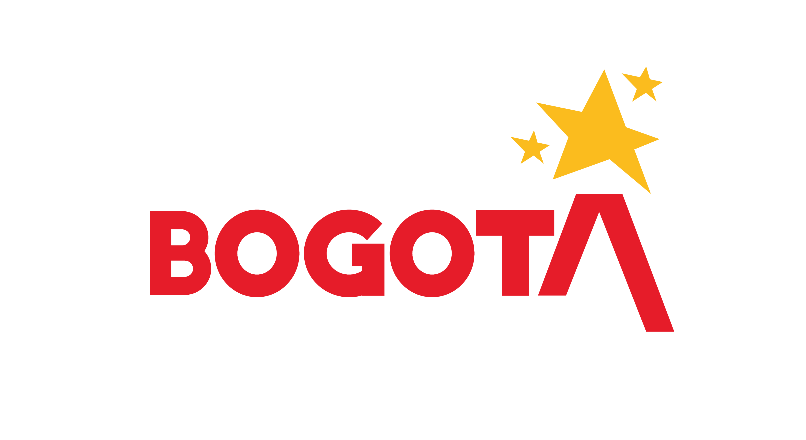
Quantum Customers Include…
5 of 5
Largest US Broadcasters
4 of 5
Largest US Public Transit Systems
5 of 5
Largest Hyperscalers
The Largest
Media Companies
6 of Top 10
Hotel, Casino, Resort Companies
6 of Top 10
Largest Financial Institutions
The Most Recognized
Brands
10 of the World’s
Highest-Volume Airports
17 of 18
US Intelligence Agencies
13 of 30 MLB Teams
15 of 32 NFL Teams
100+
Universities
14 of 17
National Labs

Slide 5
ActiveScale

Slide 6
Quantum ActiveScale® Simplicity, performance, and efficiency at any scale, so you can focus on value creation
Scalable, multi-class object storage for affordable, durable access across the data lifecycle
Simplicity
Performance
Durability
Lowest TCO
Address massive data growth from terabytes to exabytes with effortless expansion, management, and protection.
Achieve best-in-class performance at any scale across storage classes for AI pipelines and data-intensive workflows.
Maintain secure, available, and durable access throughout data's life from years to decades.
Deploy analytics, data lakes and storage clouds optimized across flash, disk and tape with easy-to-predict costs.

Slide 7
ActiveScale – Logical Tiering
HOT
active data
multiple workloads
multi-protocol
low latency
intelligent
easy to manage
HOLD
massive, long-term
online and accessible
S3 addressable
resilient
economical
built-in cold tier

Slide 8
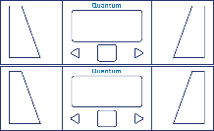
ActiveScale Object Storage Optimized architecture for seamless scalability and efficiency
Scale-out architecture
Seamless expansion of network, compute, and storage
Data-in-place upgrades and decommissioning
Single namespace across flash, disk and tape
Metadata: NVMe
Active data: NVMe or HDD
Cold data: Tape
Unlimited, independent scaling
Active and Cold storage classes
Dynamic allocation of NVMe in all-flash configs
Built for enterprise scale
Built-in availability, data durability, strong consistency and performance
S3-Enabled Apps and Workflows
S3 Standard
S3 Glacier
Lifecycle Policies
Client network
Metadata - NVMe
Active - NVMe or HDD
Cold - Tape
Quantum ActiveScale®
The industry’s 1st and only object store
architected for active and cold data

Slide 9
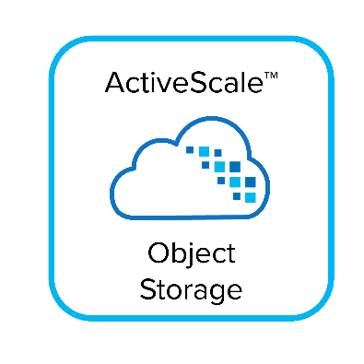
ActiveScale Object Storage Platform Portfolio Flexible deployment and purchase vehicles from terabytes to exabytes and beyond
Appliances
P200
X200
Z200 All-Flash
Min Raw Raw
648 TB
1.08 PB
460 TB
Max Active Raw Raw
Unlimited Active Data
Max Cold Raw
Unlimited Cold Data
Objects
Unlimited Objects
Non-Disruptive Expansion with NO Rebalancing Required
Notes:
P200
Lowest cost entry point
Best HDD performance
Incremental growth
X200
Highest density
Best price/performance
Z200
Highest throughput and transactional performance
Massive object counts

Slide 10
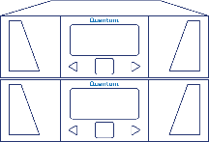
ActiveScale Cold Storage Deployment Examples Single site, 3-Geo geospreading, and replication across storage classes
Single
site
Uni & bidirectional
replication
Between and across active and cold storage classes
Site 1
Site 2
3-Geo geospreading
Replicate to hub
GEO1
GEO2
Between and across active and cold storage classes
GEO3
Hybrid
replication
To any supported storage class
and other S3 targets

Slide 11
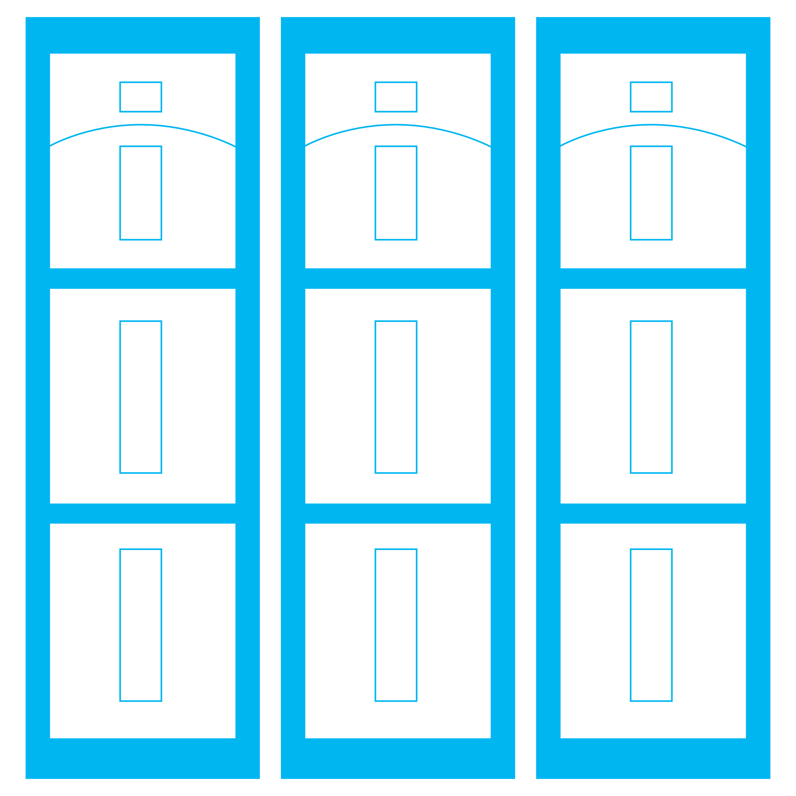
ActiveScale Cold Storage Innovations Simultaneously maximizes access performance, data durability, and storage efficiency
Object on Tape Management
Quantum RAIL
Patented* 2D Erasure Coding
2 D
1 D
Redundant Array of Independent Libraries
Integrated staging to disk
No handling of tape media
Intelligent, programmatic use
Architected for long reads/writes
Scale-out architecture
Designed for RAS
Modular, flexible footprint
Multi-site protection
Single tape read data access
Fully protects against tape and library failures
Overhead as low as 15%
Durability up to 19 9’s
*U.S. Patent #11,216,196

Slide 12
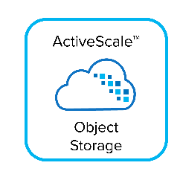
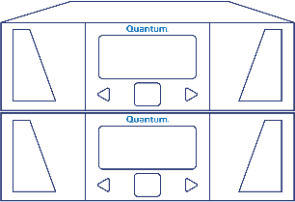
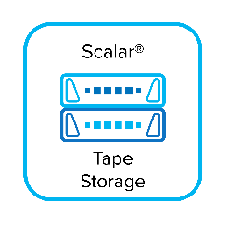
ActiveScale Object Storage: Cold Storage Class Less storage overhead & better durability
Quantum RAIL with 7x Scalar i6 Tape Libraries
Patented 2-dimensional Erasure Coding (18+3)
Protect across 21 tapes but read from SINGLE TAPE
Protect from up to 3 simultaneous tape failures or 1 tape library going down (e.g. robot failure)
Overhead = 1.25x (75PB usable capacity system only requires 91PB raw capacity)
75PB usable capacity systems | Legacy Tape 1-Copy | Legacy Tape 2-Copy | ASCS 2D EC | Legacy Tape 3-Copy | ASCS 3-Geo 2D EC (6+3)
LTO-9 Tapes | 4,167 | 8,334 | 5,243 | 12,501 | 6,741
Durability | 3 Nines | 6 Nines | 15 Nines | 9 Nines | 17 Nines
Objects Lost Per Year with 1B Objects | 603,000 | 363 | 0.0000003 (one every 3M yrs) | 0.22 (one every 4.6 yrs) | 0.00000001 (one every 100M yrs)

Slide 13
ActiveScale – Built for Data Protection Data Security and Data Recoverability
Authentication & Role-based Access Users have exclusive access to their data
Inflight & At Rest Encryption System-wide and object-based encryption
Immutability Object locking protects an object from being deleted or changed
Object Versioning Preserve multiple versions of an object for easy recovery
Bucket Replication Copy a bucket of objects to S3-compatible storage over distance
Notes:
Separation of concerns – role based access. Different roles can be set up within the system so that the people doing the system administration don’t need to be the once that manage the data but that these also don’t need to be the same as those generating and using the data. This allows so set up workflows that protect against fat-fingering, malicious deletes, etc.
ActiveScale Object Storage software and architecture is built on top of the concepts of immutability. Internally that concept is used a lot. Externally this is mostly visible by how objects are overwritten. An object is never modified in place, but a newer version of the object is created on top of that. If versioning is enabled on a bucket, the older versions stay available until they are deleted either by the role managing the data or by a set policy.
Again this protects against fat-fingering and malicous deletes. But it also protects against Ransomware. We will go into detail about that in the next slide.
For extremely safe environments Object Lock aka WORM can be added to the workflow. By placing a lock on object nobody, not even the system admin can delete that object.
ActiveScale also supports bucket replication. This allows specific buckets to be replicated to another bucket in either another ActiveScale system or in bucket on AWS S3.
Last notable feature on the Data Security Section is support for inflight and At REST encryption. When enabled data is encrypted as soon as it hits the system and stay in that state untill the very last moment before it leaves the system. People getting access to a single drive or listening in on a single connection are never able to read the data this way. Protecting against theft of data from drives that leave the system or people evesdropping on single connections.

Slide 14
Conclusioni
Vantaggi della soluzione Quantum Active Scale

Slide 15
Vantaggi della soluzione Quantum Active Scale:
Efficienza parity distribuita «2D patented»
Affidabilità Erasure Coding su dischi e nastri: si può perdere un intero sito senza impatto sul servizio
Sicurezza ogni oggetto è unico by design, con ObjectLock il dato è protetto contro ransomware
Espandibilità e flessibilità si può crescere sia sul layer nodi che su quello tapes
Costo: €85/TB con proiezione a 5 Anni, 5 PB (1HOT+4 COLD), 3GEO
Site 2
Site 1
Site 3
Unico NameSpace

Slide 16
StorNext NAS
ActiveScale integrable

Slide 17
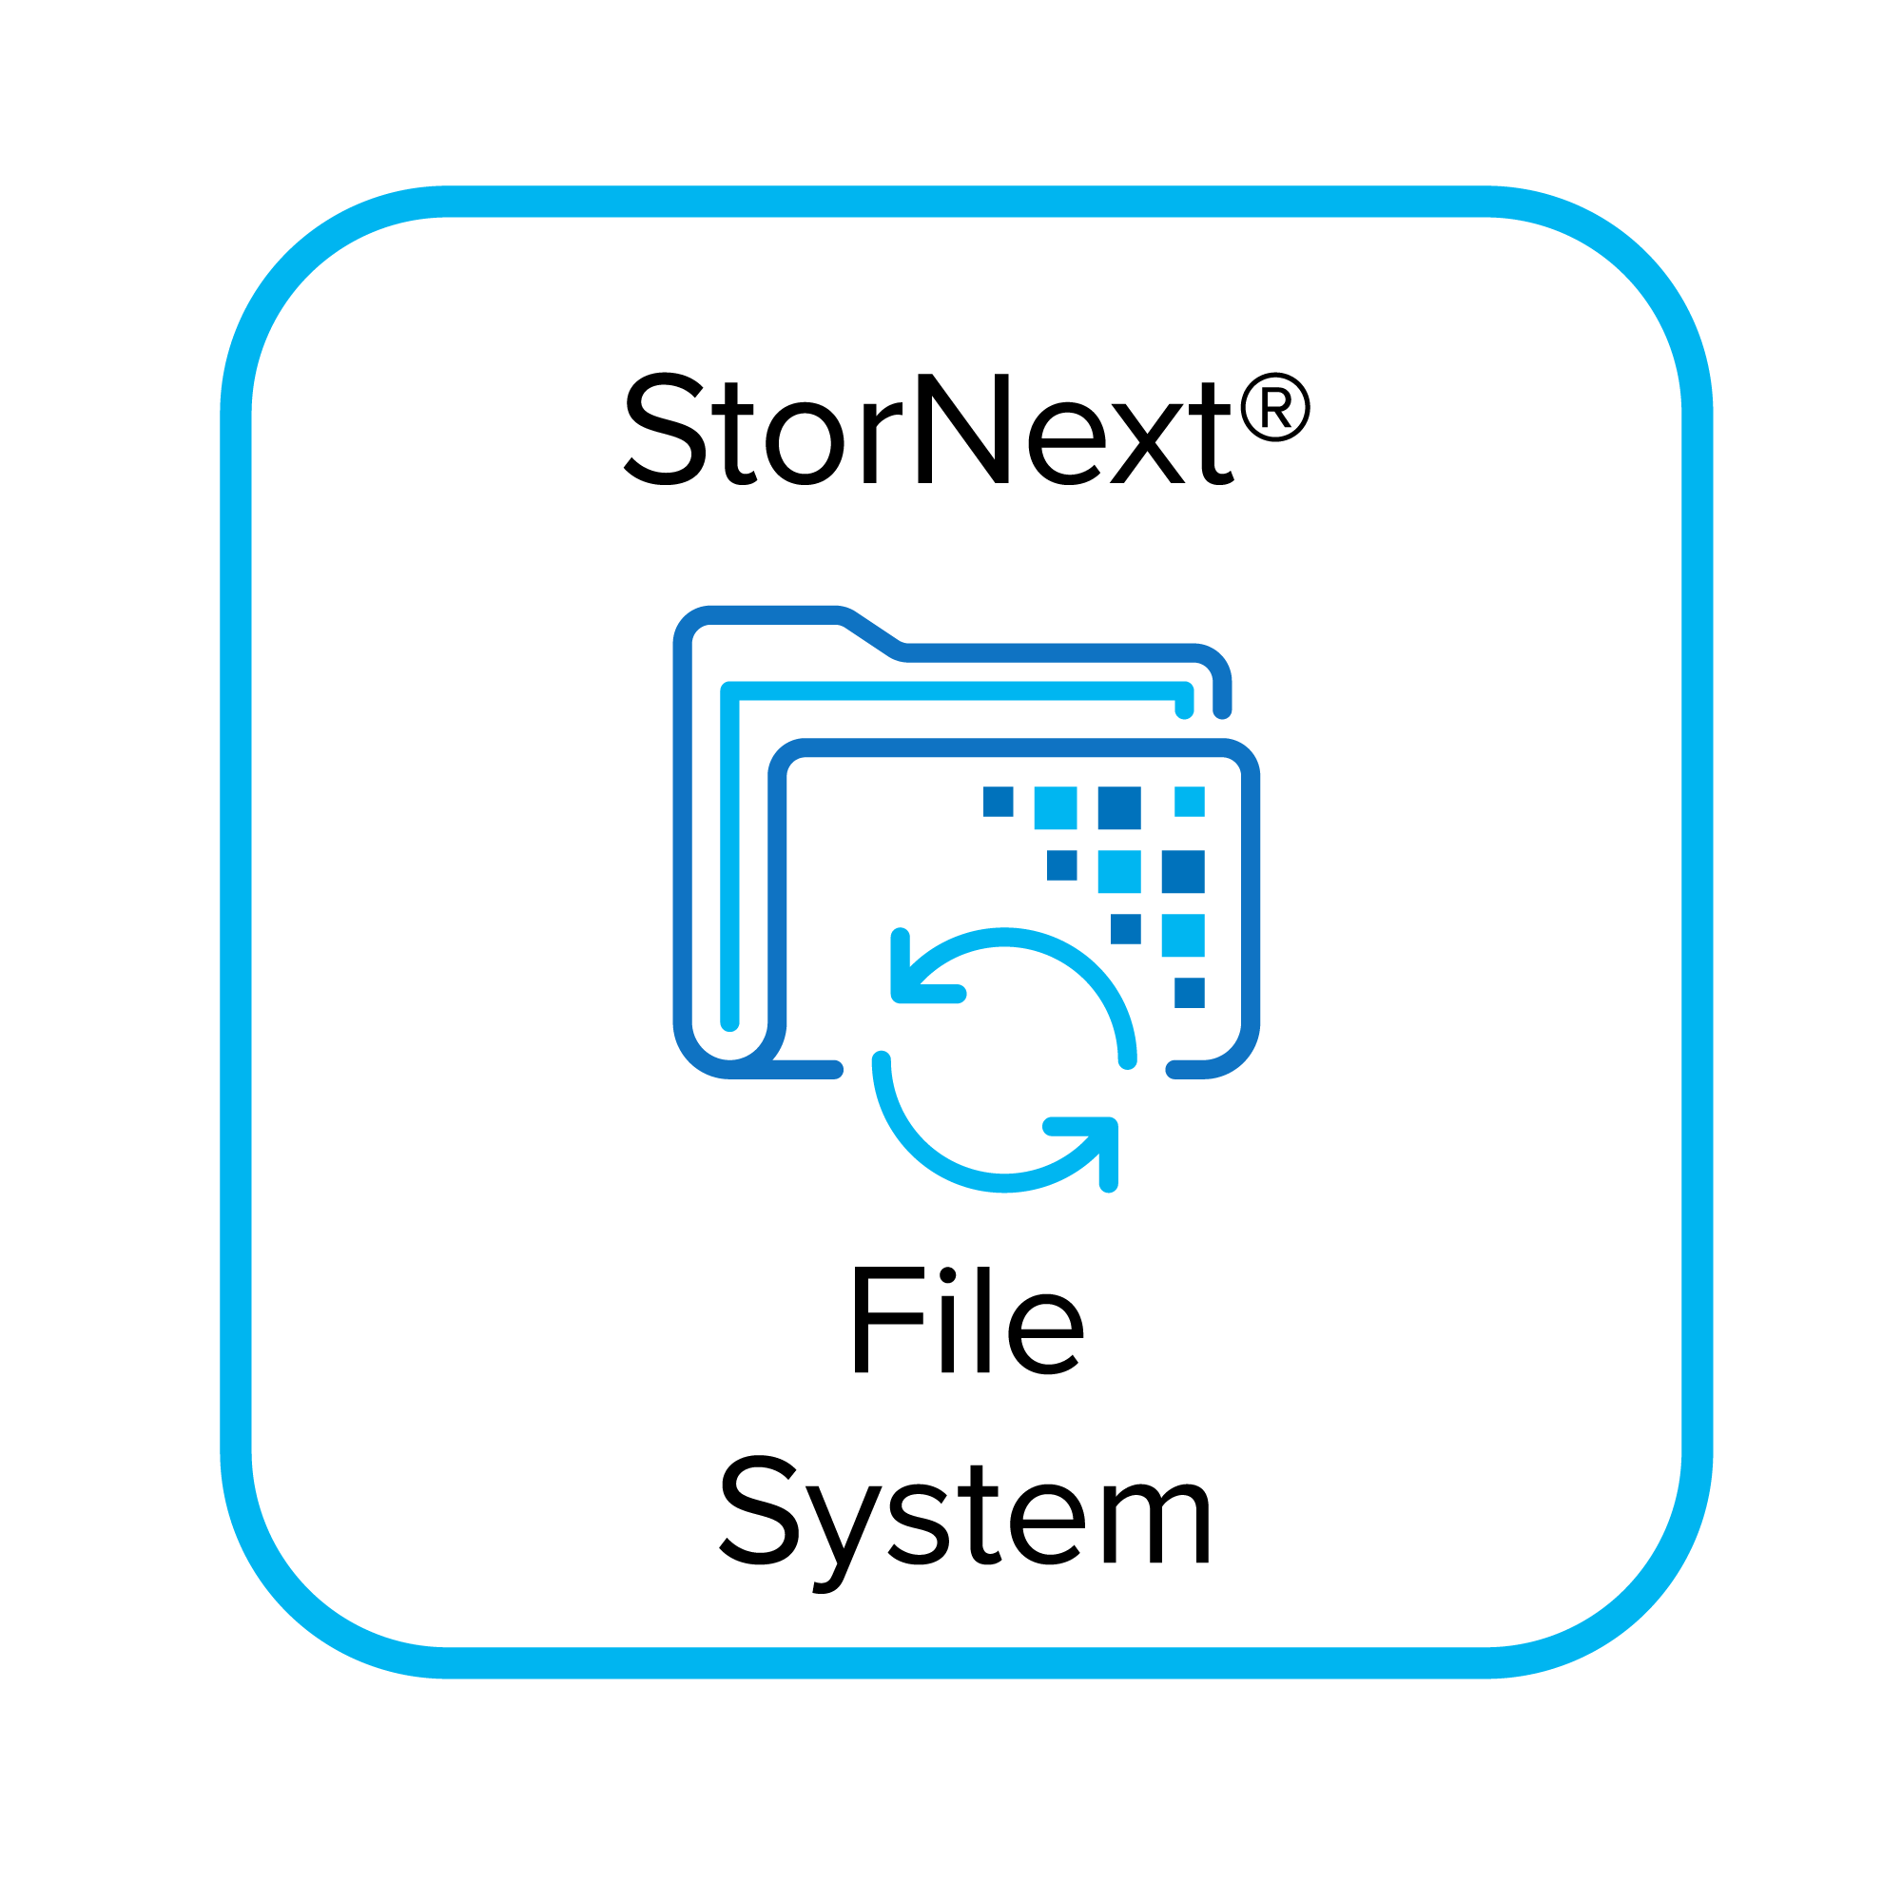
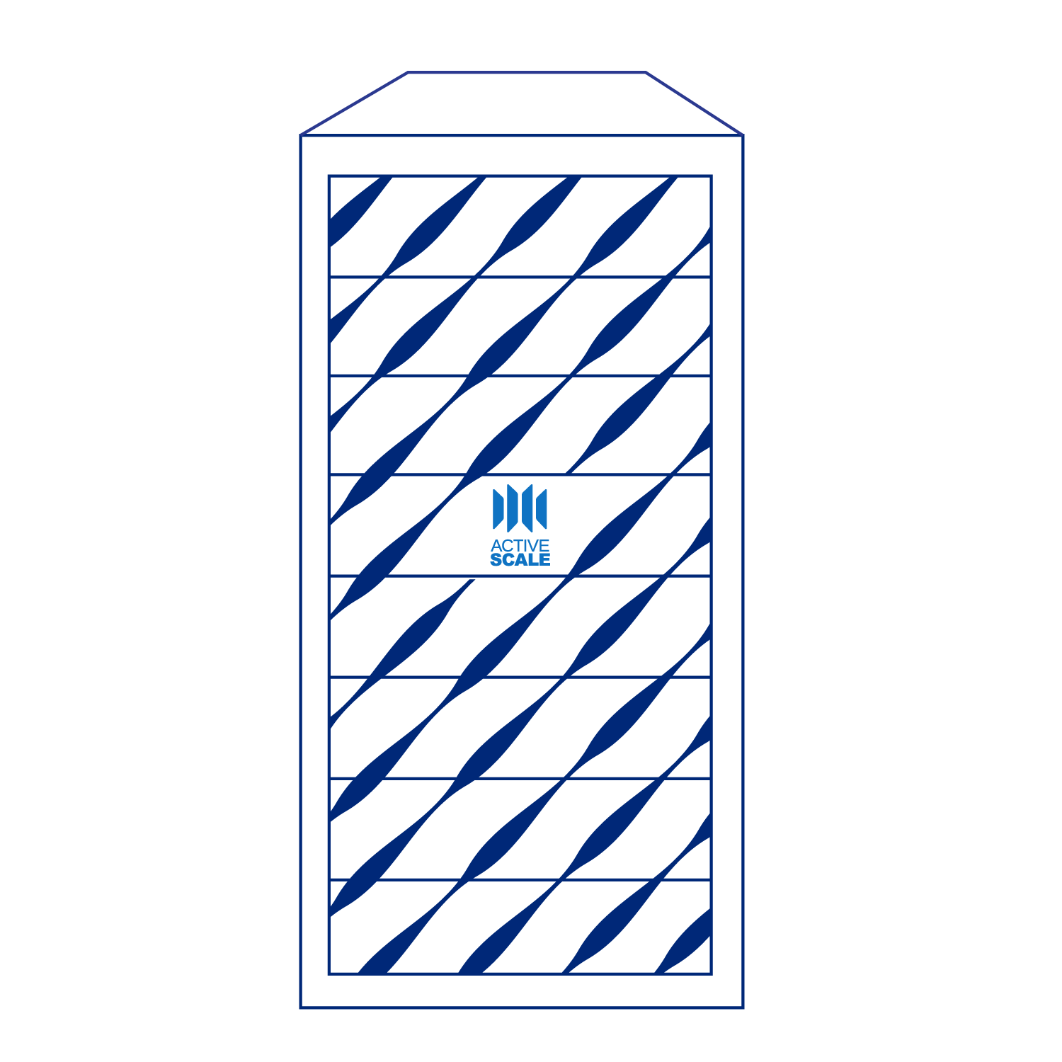
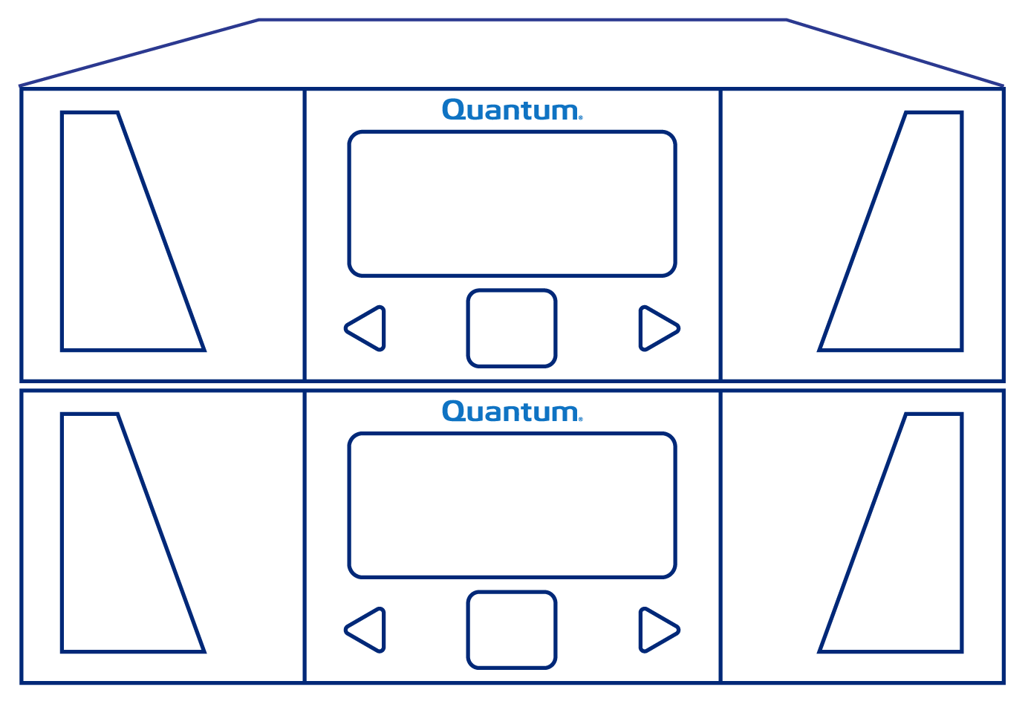
End-to-End Data Management Workflows on Quantum
StorNext policy-based data management and APIs
StorNext File System
High speed ingest and archive
On NVMe, SSD, HDD storage
Apps
ActiveScale Object Storage
Large scale active archives
Clients
NFS, SMB, S3
Backup software
Digital Tape Archive
Lowest cost, offline storage
Digital Pathology
Notes:
At the heart of these collaboratitve workflows is StorNext…. Clients access af full speed, highest performance and lowest latencies… and storage supporting those critical workflows can be tuned for performance, capacity…. And tieed and managed and moved to object, tape cloud …

Slide 18
Backup solutions
ActiveScale integrabili

Slide 19
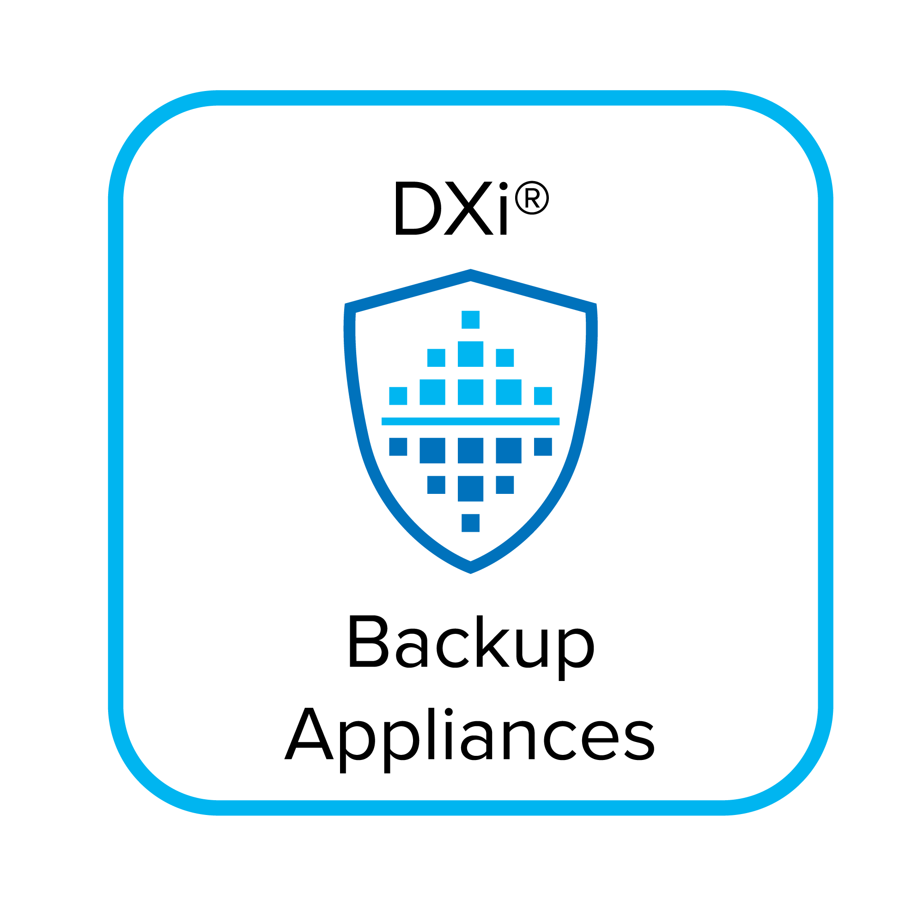
Addressing Business Requirements for Data Protection, Compliance, Retention As part of 3-2-1-1 Data Protection Infrastructure
Ensure business continuance
Meet any RPO and RTO
Protect against system issues, disasters, and ransomware
Avoid public cloud egress charges
ActiveScale Object Storage
Long-term archive storage
DXi Backup Appliances
All Flash NVMe High-Speed Backup, Instant Recovery
Scalar Tape Storage
Offline copy to protect against ransomware

Slide 20
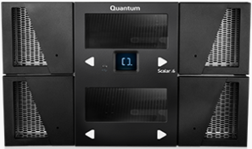
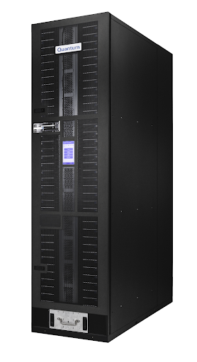
ActiveScale vision: 100-year multi-generational archive
single persistent name space / management domain
migration
Quantum RAIL
Single namespace
Single management domain
Single pane of glass
One-click migration
One-click hardware decommission

Slide 21
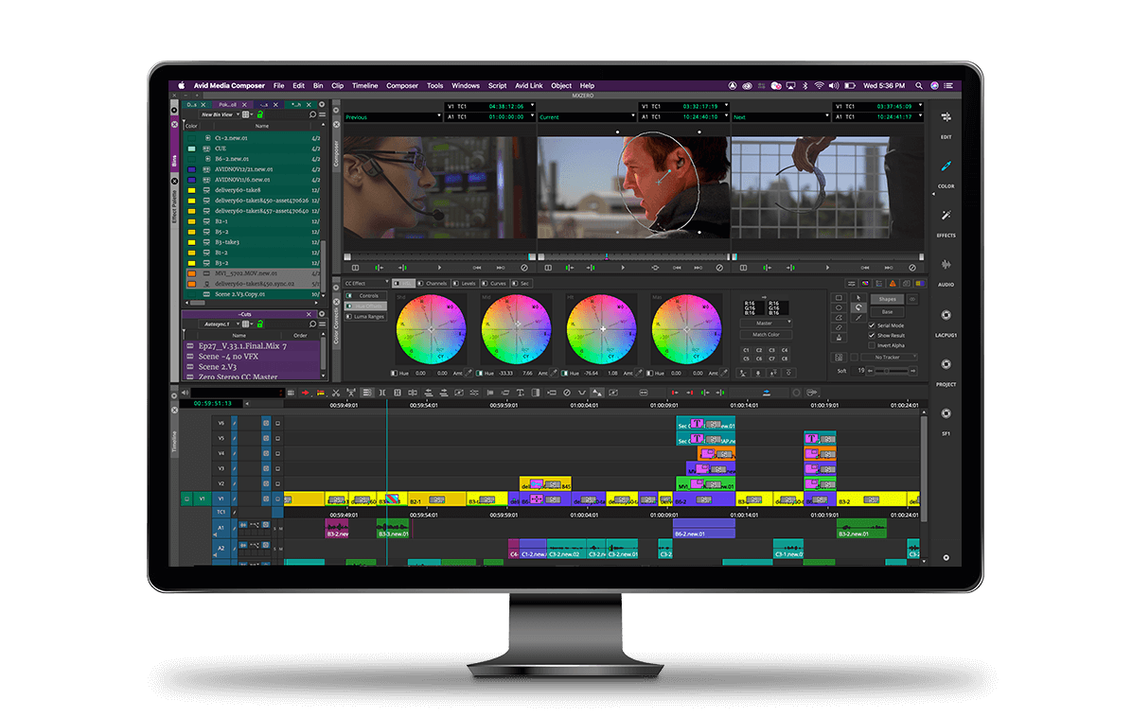
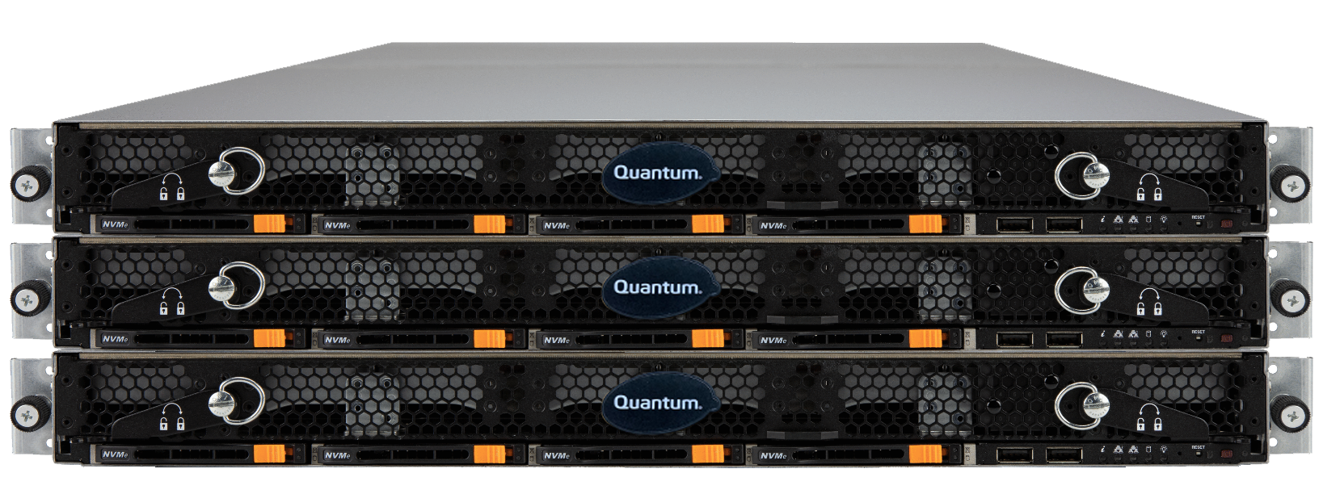
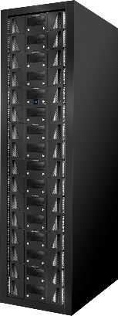
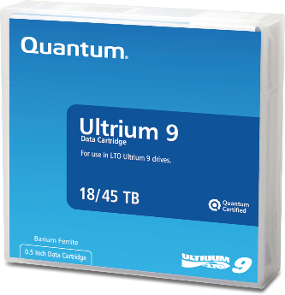
LTO generational migration
State-of-the-art
ActiveScale Cold Storage
Client
myfile → tape=B00006 LBA=8
Client
myfile → tape=A00001 LBA=7
myfile → bucket=media object=my-object
ActiveScale
my-object → tape=A00001 LBA=7
my-object → tape=B00006 LBA=8
Automatic Throttled
Background Process
LTO 9
LTO 11
LTO 9
LTO 11

Slide 22
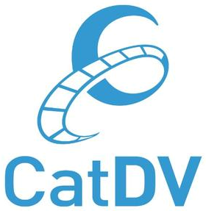
Building an End-to-End Architecture
Added
Object Storage
Added data catalog, workflow orchestration
First private cloud with S3 Glacier tier
All-Flash File and Object Storage
2020
2021
2022
2024
#1 in hyperscale tape archives
Added solutions for video surveillance
AI enrichment for video, audio, images

Slide 23
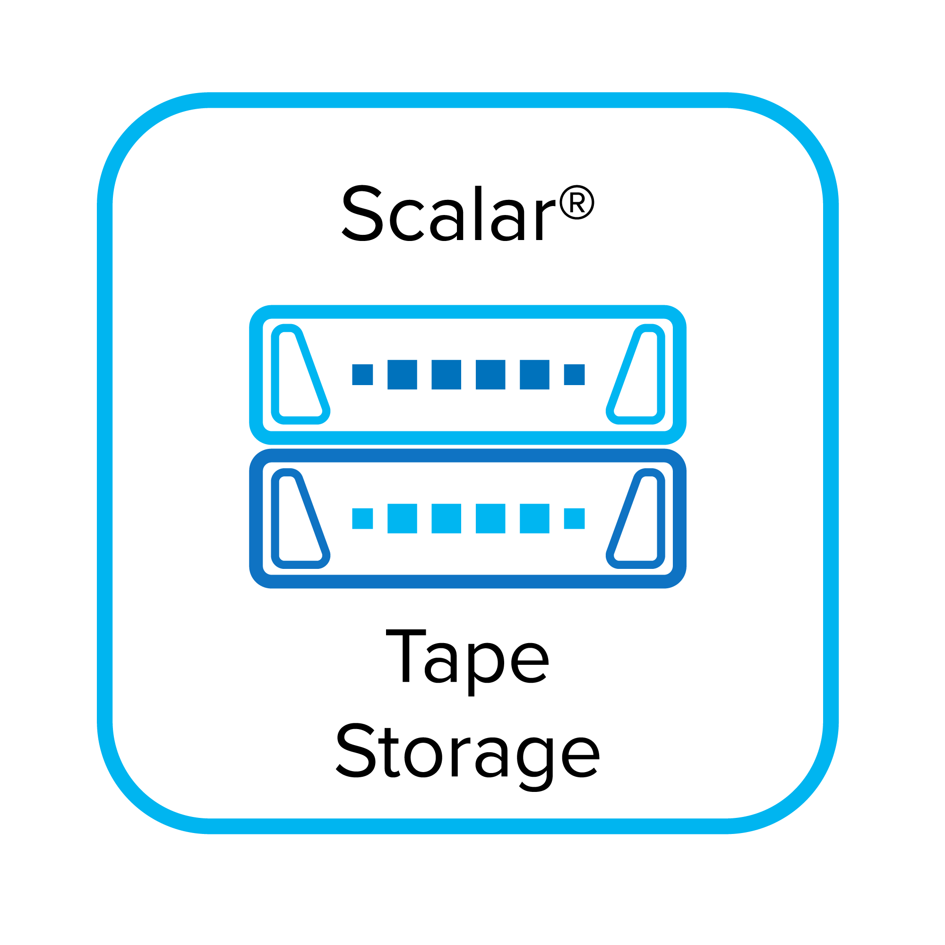
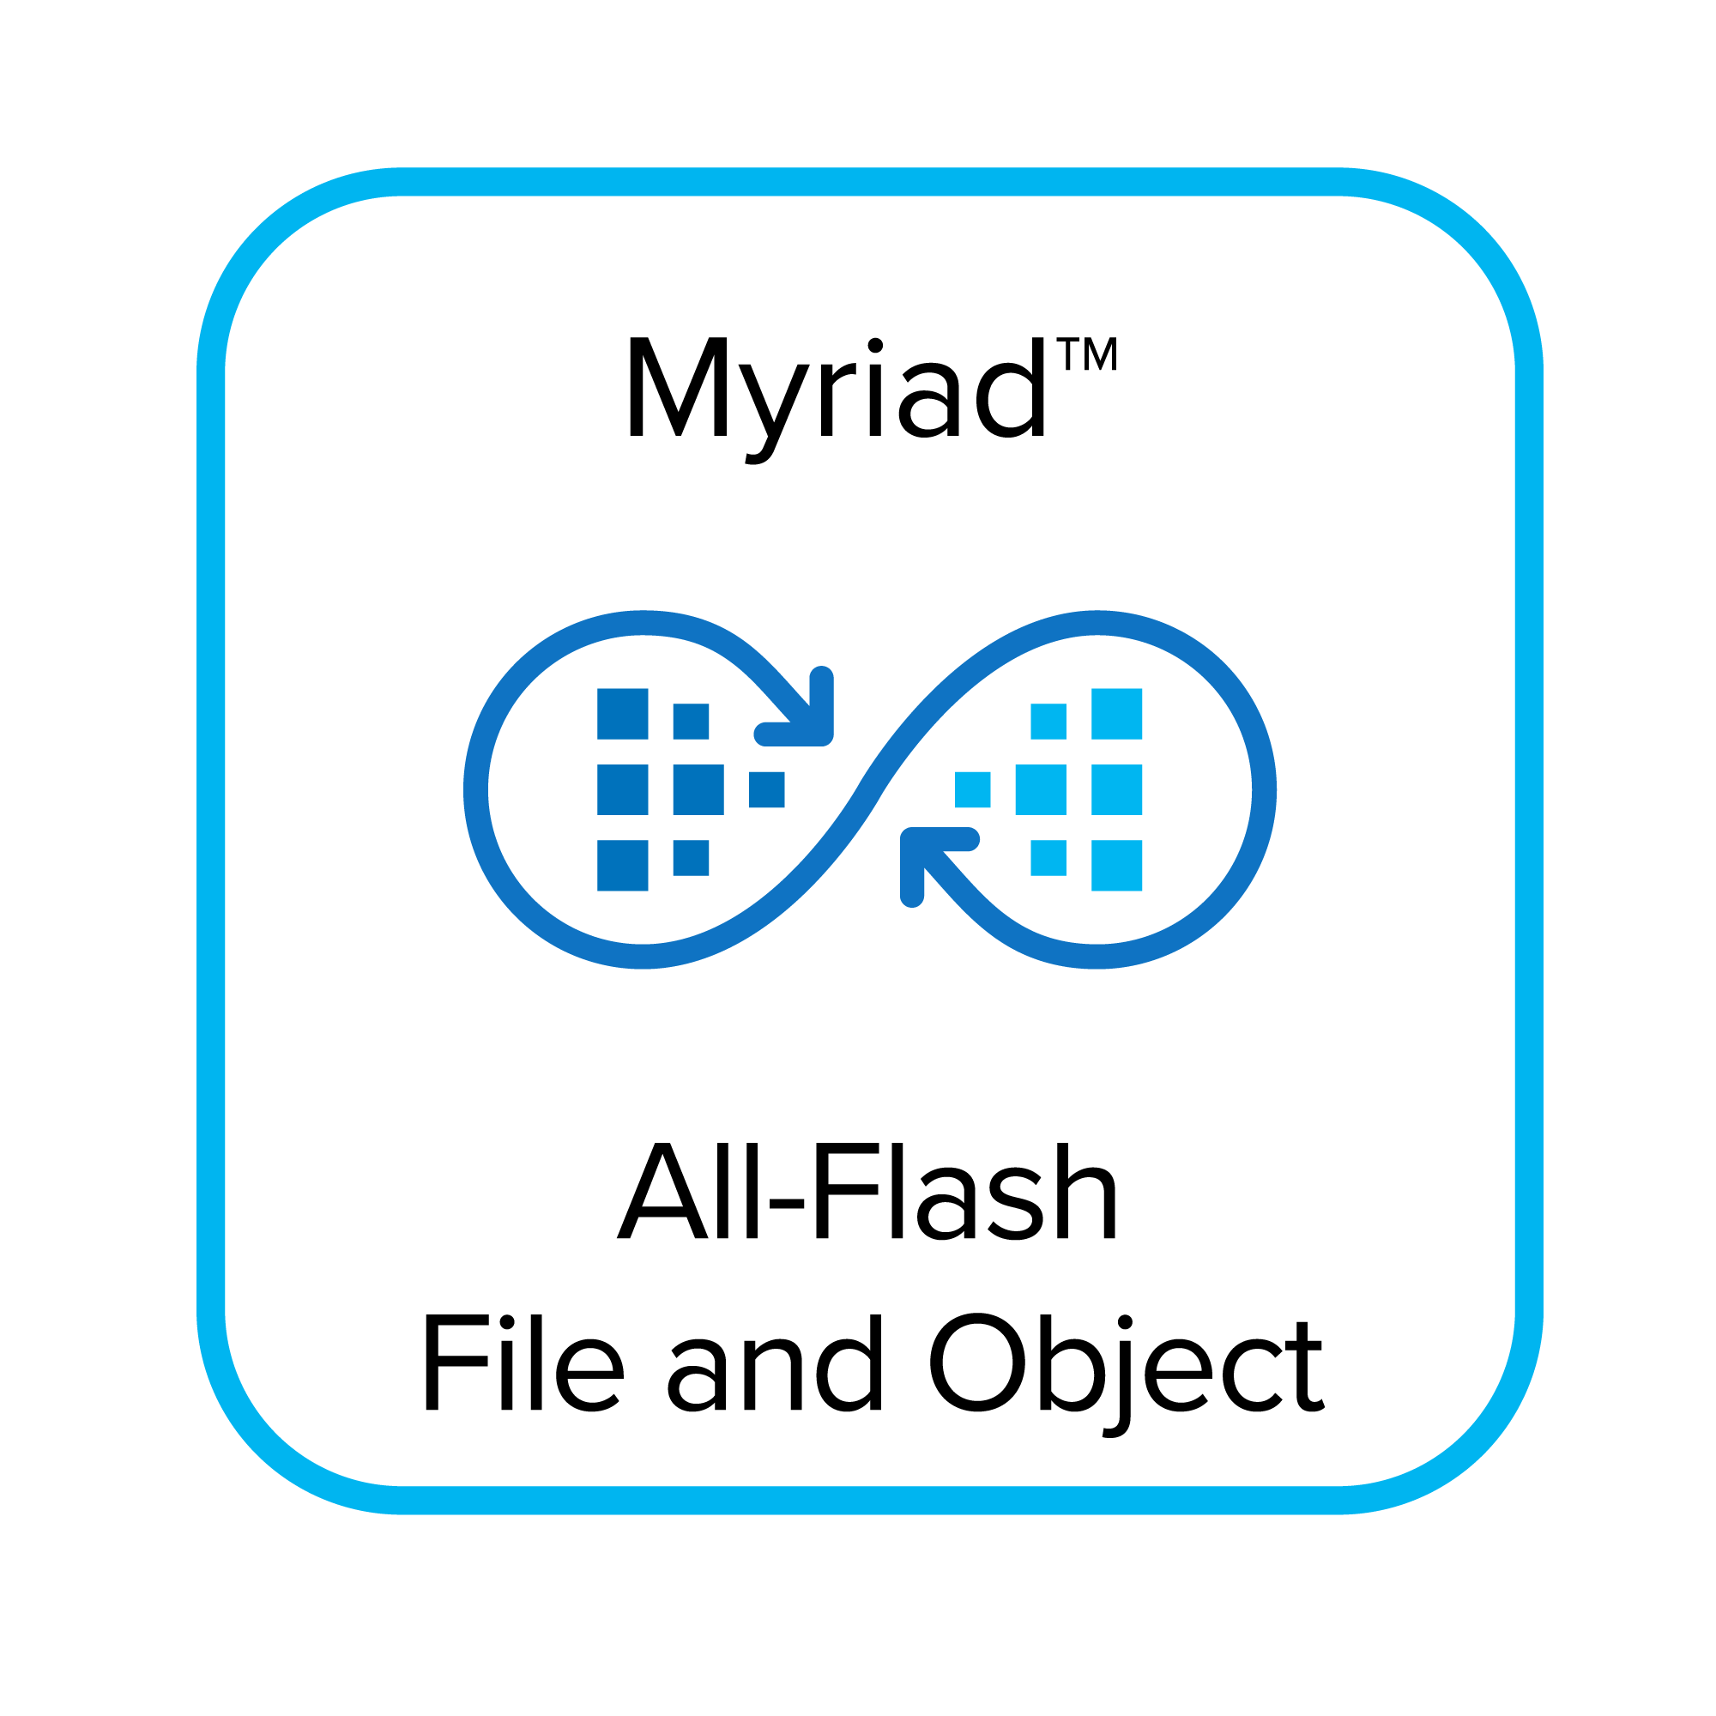
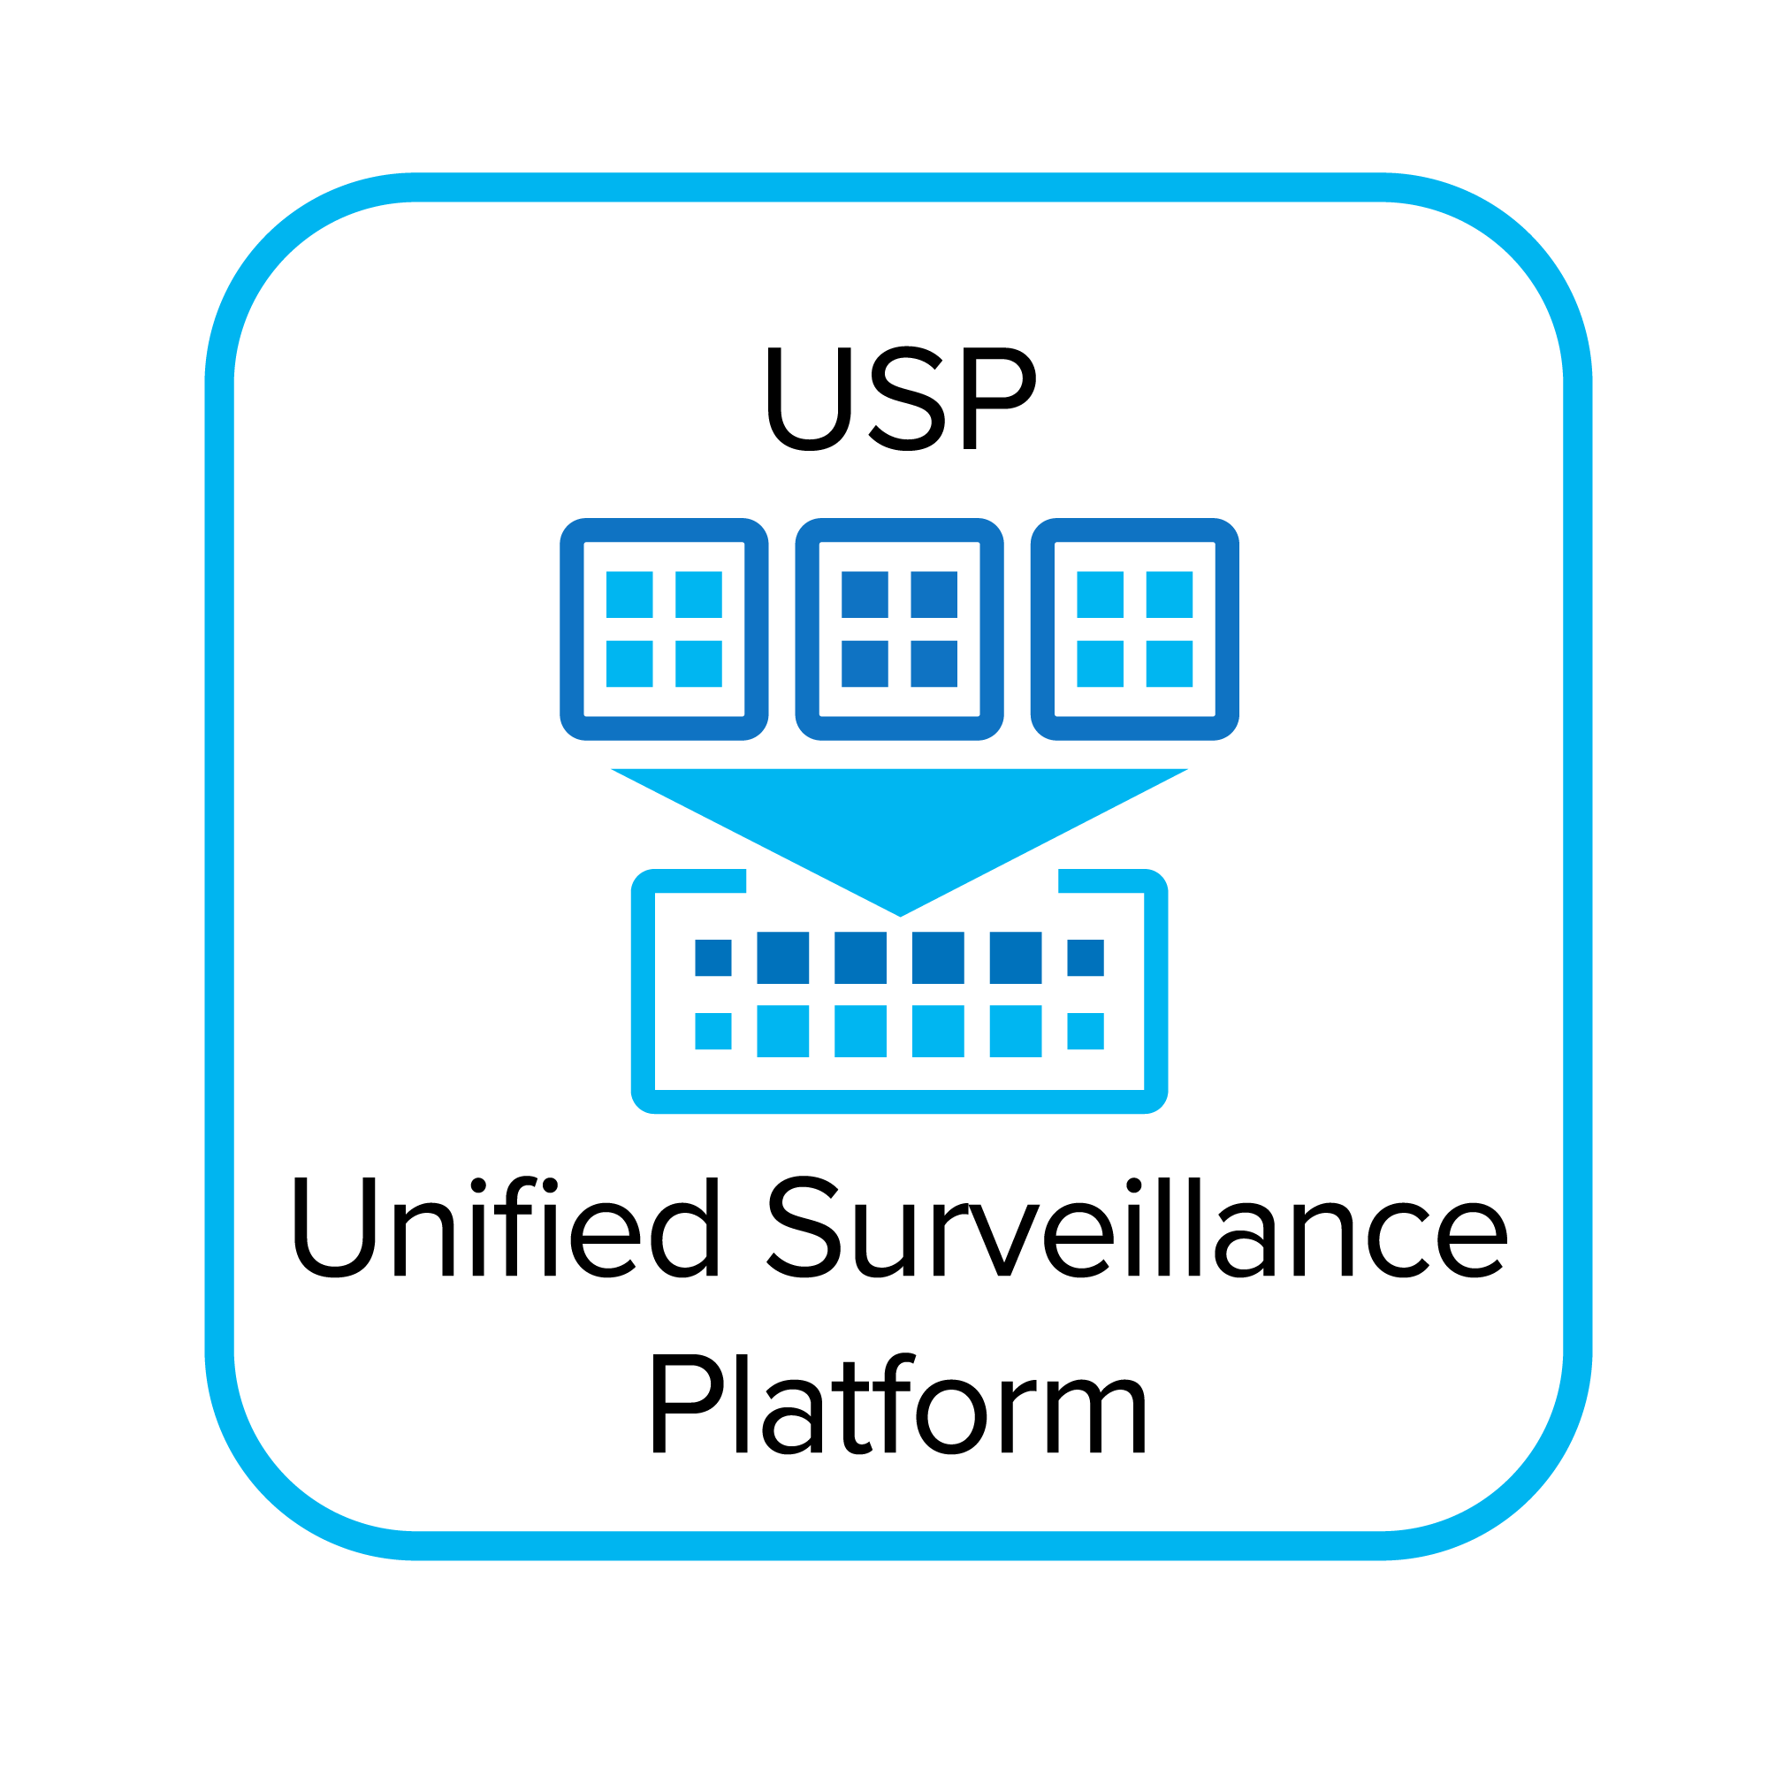
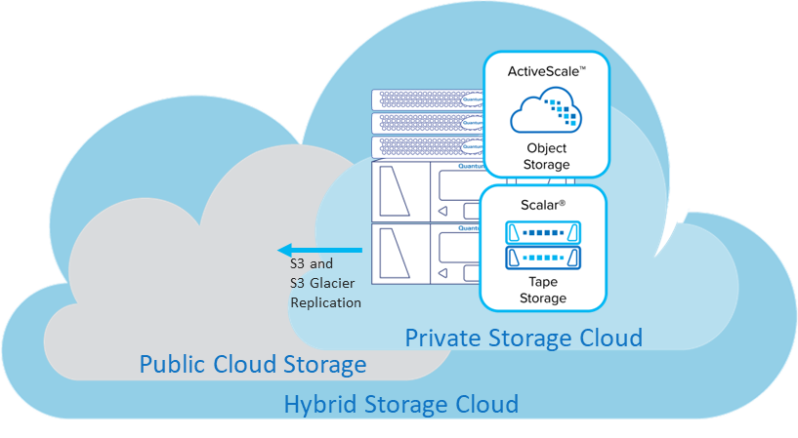
Quantum Portfolio Integration with ActiveScale ActiveScale forms the basis for private and hybrid enterprise storage clouds
FlexSync
FlexTier
Cloud Share
V5000 Cloud Replication Target
Tiger Surveillance

Slide 24
ActiveScale Feature-Rich Software Built-in data durability, security, availability, performance and cost-efficiency
ActiveScale Object Storage Software
Data Access
S3 (Standard Storage Class, Glacier Storage Class, …)
NFS
Management & Monitoring
Web UI
CLI
API
Cloud Monitoring
Prometheus
Email
SNMP
Syslog
Data Services
Versioning
Replication
Object Locking
Quotas
IAM
Lifecycle Policies
Encryption
Object Notification
The ActiveScale Architecture
Wide-Stripe
Erasure Coding
Dynamic Data
Placement
Dynamic
Data Repair
Strong
Consistency
End-to-End
Security
Geospreading
Object Size Optimization
Two-Dimensional Erasure Coding
Active & Cold Storage Classes
Hardware Platforms
GEO 1
GEO 2
GEO 3
HDD /
NVMe
HDD /
NVMe
HDD /
NVMe
NVMe
NVMe
HDD /
NVMe
NVMe
HDD /
NVMe
Meta
Active
Cold
Meta
Active
Cold
Meta
Active
Cold
Unlimited Scalability

Slide 25
Classificazione: documento confidenziale

