Slide 1

VSP ONE
Archives and Data Management Systems in the Big Data Era
Cristian Magro
Solution Architect
Trieste 15/04/2025

Slide 2



VSP 360
Redefine the Data Platform for the AI Factory.
Fleet Management
Intelligent Protection
Clear Sight Observability
Data Governance
Integrated Systems
IaC
VSP One
Block
File
Object

Slide 3
Virtual Storage Platform Enable Data Agility
Index Engines
Pentaho
Innovate with Data
Store
Enrich
Automate
Monetize
Data Fabric
Cyber Security
Classification
PII Discovery
Hitachi iQ
Data Services
Control Plane
VSP 360
Data Management Platform
API
Terraform
VSP One
Ansible
Data Plane
API
Block | File | Object | Mainframe
ServiceNow
Notes:
Hitachi Vantara is a data company with the best IP, domain expertise, and data-driven technology and systems that Hitachi has to offer to help you manage your data management challenges and maximize your data ROI:
We’ve combined our rich domain experience in operational technology and information technology with advanced analytics, machine learning, artificial intelligence, and professional services to create the data stairway to value, which we believe will be the path to intelligent innovation and maximize the return in data at every step of this stairway, This means bringing together unique capabilities, skillsets, industry knowledge, and technologies from Hitachi Vantara and other Hitachi companies to deliver data-driven solutions to data-driven innovators.
Infrastructure Agility: Offering a comprehensive line of data infrastructure products to efficiently store, protect and manage your data to meet the agility, security, service levels and costs requirements.
Data Agility: Hitachi delivers a DataOps platform, architecture, and software applications to properly extract (profile, discover, glossary) new insights and innovation with your data.
Business Agility: Automate data insights to optimize data placement, performance and cost objectives that creates new application value for the business.

Slide 4
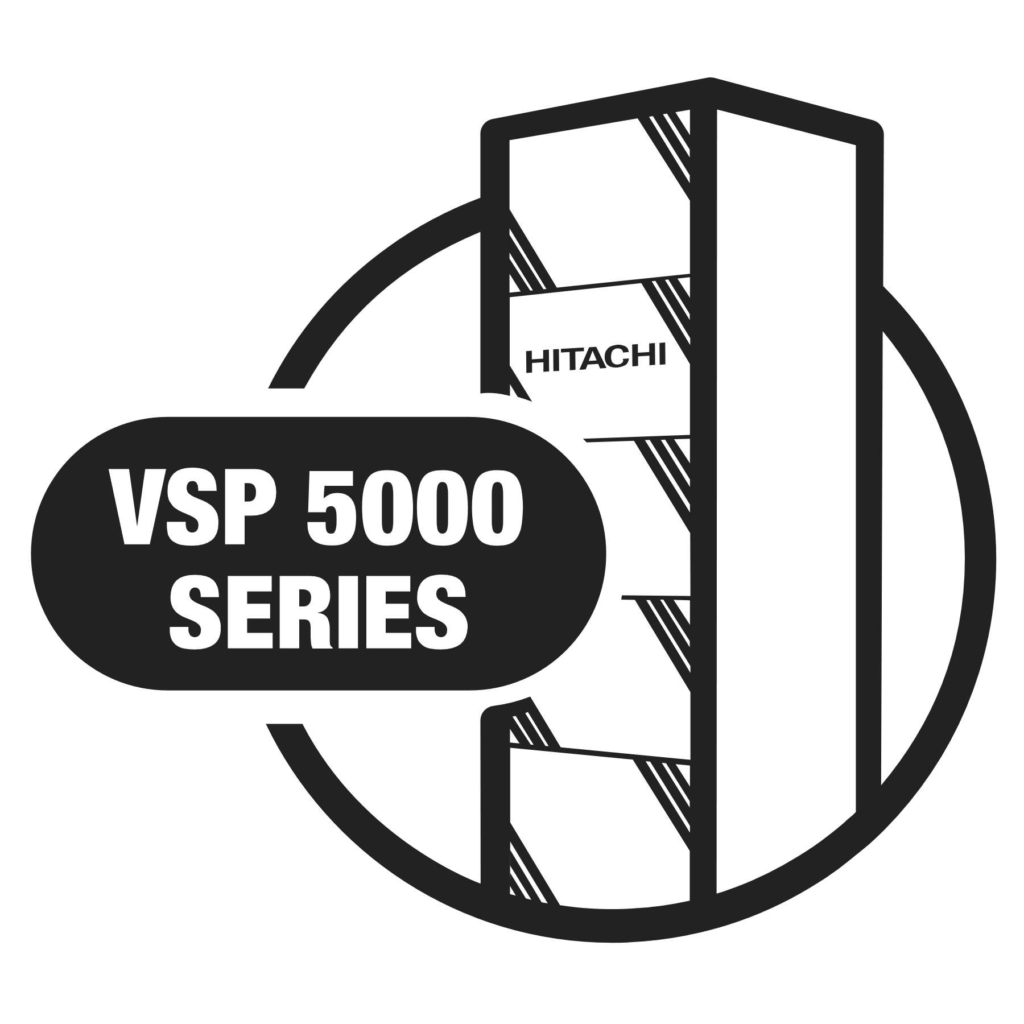
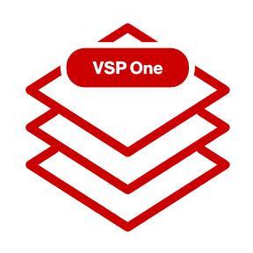
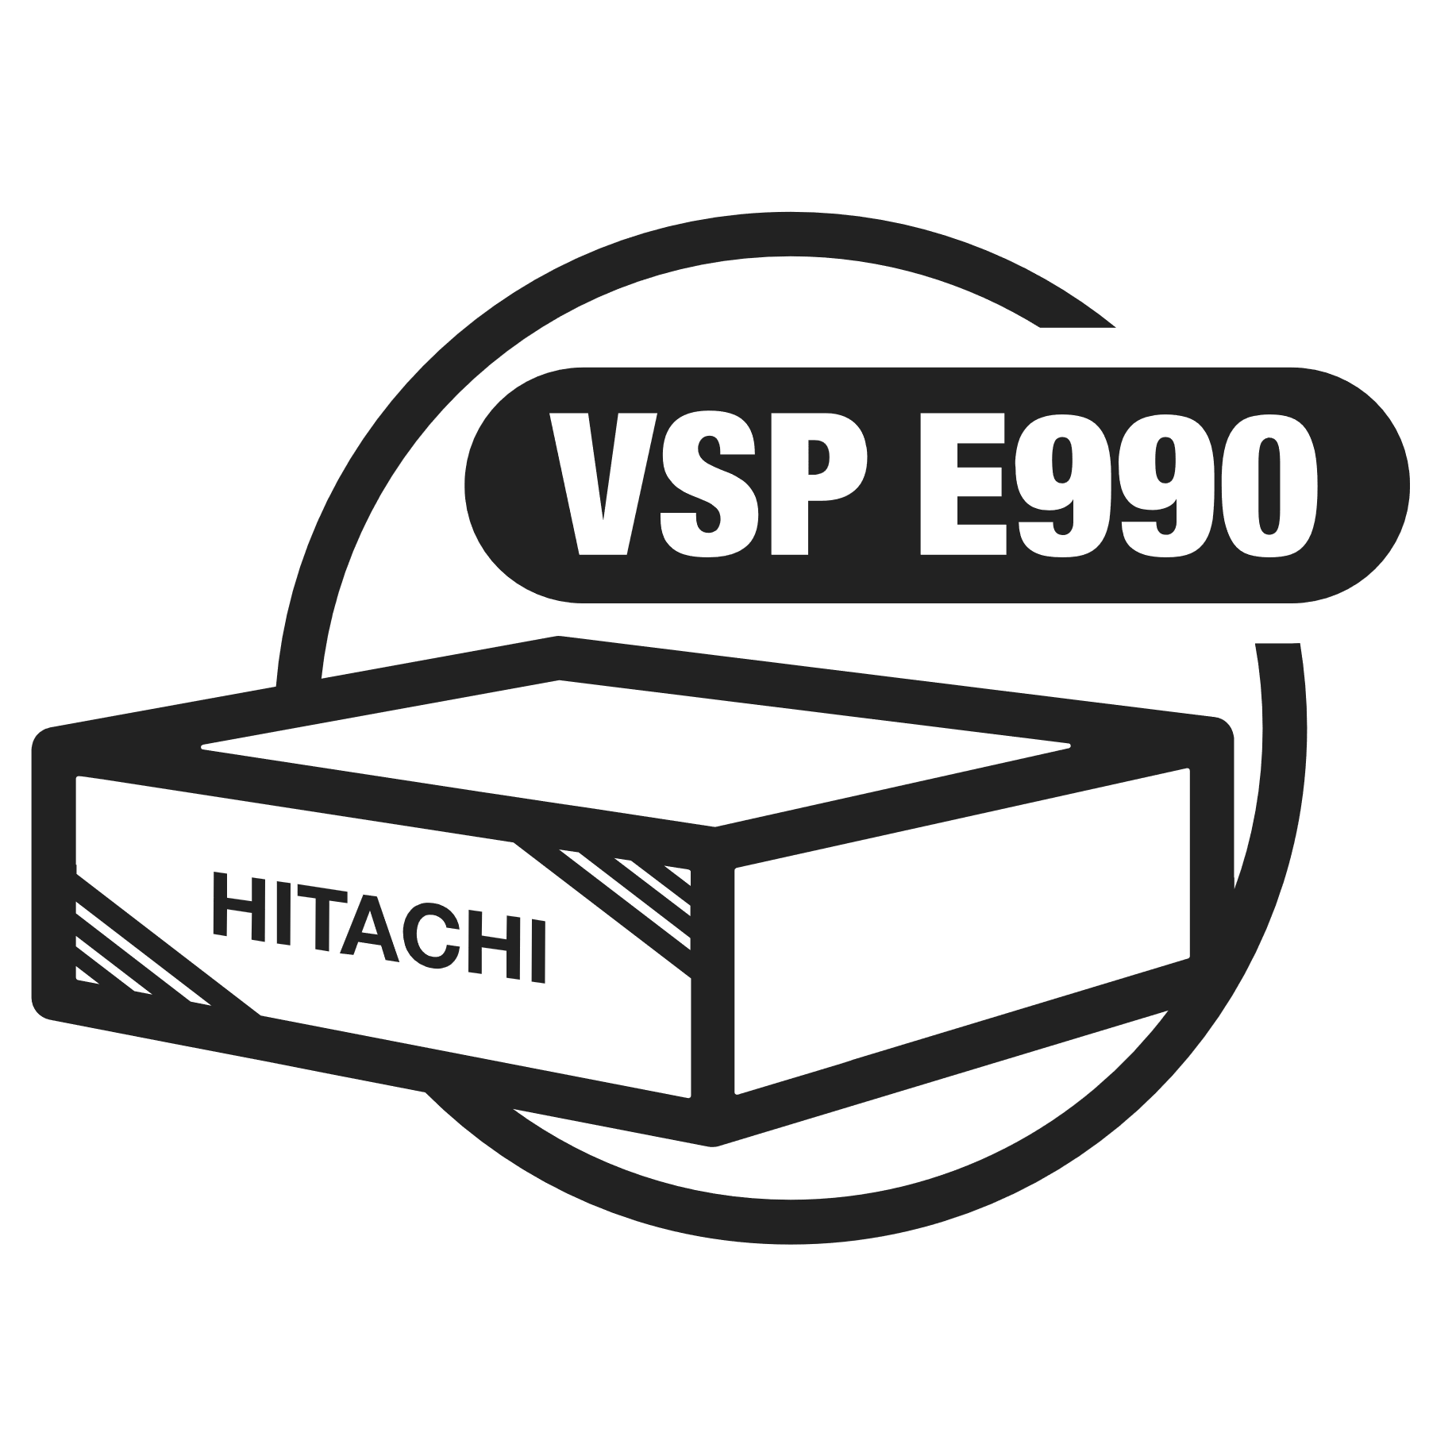







Agility with Simplification, Transform the Experience
One Hybrid Cloud Data Platform. No Hassles. No Silos. No Limits.
SVOS DNA
Block
100% Data Availability Guarantee
Effective Capacity Guarantee
Modern
Storage Assurance
Clear Sight
Fleet management
in the cloud
360
Intelligent automation integrated AIOps software
EverFlex
As-a-service for infrastructure consumption
File
Object
SDS
Performance & Resiliency
OS
Trusted
Experienced
Evolution/Revolution
Notes:
Revenue of $67B in FY23 using the currency conversion rate on 3/31/2024 (with news release at investor relations day on June 11, 2024)
SOURCE FY23 Financial Statement
https://www.hitachi.com/New/cnews/month/2024/04/240426/2023_An.pdf
Left Box Sources
$2.4 B R&D: Source per 2022_Ansup.pdf: 316.2 B Yen = $2.4B USD (FY22 = $2.4B. As of June 2024, FY2023 amount not yet received from Hitachi Global)
Another Source: Hitachi Global Company Overview Presentation: Hitachi New Corporate Presentation.pptx (sharepoint.com)
$3.7B investment in AI & Digital
Source: Financial Times: Hitachi has set aside ¥500bn ($3.7bn) to invest in its digital strategy for the three years through March 2025 and plans to hire 30,000 people to work in that area
$18B revenue from IT sector (actual is $17.9B in Digital Systems and Services sector per FY23 financial statement https://www.hitachi.com/New/cnews/month/2024/04/240426/2023_An.pdf (2,598 Yen = $17.9 USD using currency conversion rate on 3/31/2024)
182,000 global patents as of April 2022: Source: Hitachi Global Corporate Presentation received Jan2024 slide 10 (as of June 2024, updated presentation and number not yet received from Hitachi Global)
Right Smaller Boxes
Fortune 500 top 11 tech company by revenue (2023 report): https://en.wikipedia.org/wiki/List_of_largest_technology_companies_by_revenue
All data in the Wikipedia table is from the Global Fortune 500 2023 report for technology sector companies
19 Customer co-creation centers (Source Unconfirmed: Hitachi Global Corporate Presentation received Jan2024 does not include exact number (as of June 2024, updated presentation and number not yet received from Hitachi Global)
VC funds: Press release on April 20, 2023: Hitachi Establishes the Third Corporate Venture Capital Fund for Innovation in the Digital Domain ($300M to start with)
Source: https://globalventuring.com/corporate/asia/hitachi-raises-300m-ai-and-web3-fund/#:~:text=Hitachi%20Ventures%20has%20raised%20a%20new%20%24300m%20fund%2C,technologies%20for%20the%20new%20fund%20to%20focus%20on.
Top 100 Global Innovators by Clarivate - In the 2024 report, Hitachi is listed as #19 of 100. Hitachi has been on the Top 100 Global Innovators for 13 consecutive years, since the reports inception in 2012.
Clarivate (formerly CPA Global) was formerly the Intellectual Property and Science division of Thomson Reuters. In 2016, Thomson Reuters struck a $3.55 billion deal in which they spun it off as an independent company and sold it to private equity firms.
Source: https://clarivate.com/top-100-innovators/the-top-100/?clv-award-year=2023&utm_campaign=Top_100_Global_Innovators_Report_LeadGen_IPG_Global_2023&utm_source=earned_coverage&utm_medium=press
268K employees per annual report https://www.hitachi.com/New/cnews/month/2024/04/240426/2023_An.pdf
NOTE: HV # of employees is 5,840 (nearly 6000)
$67B consolidated revenue per annual report https://www.hitachi.com/New/cnews/month/2024/04/240426/2023_An.pdf
Additional Talking Points
Hitachi is a large conglomerate with businesses across several industry sectors, with 573 subsidiary companies (and 369 equity-method associates and joint ventures), 268,655 employees and roughly $67B in annual revenue last fiscal year reported 3/31/2024 (depending on exchange rates)
Overall revenue FY21 – FY22 went from 10,264 Byen (FY21) to 10,881 Byen (FY22) up +6% to 9,728 Byen (FY23) down -11%
NOTE: Decrease in revenue due to major business unit Hitachi Astemo becoming an equity-method associate of the company in FY23 (similar to Hitachi Construction Machinery and Hitachi Metals in the previous FY22).

Slide 5



Expanding the Unbreakable Core
Extending trusted guarantees across the entire data plane
Modern Storage Assurance
Future-proof VSP One solution technology without data migrations.
100% Data Availability Guarantee
Meet service level agreements with continuous access to VSP One data. Guaranteed.
Effective Capacity Guarantee
Lower storage costs by increasing capacity while protecting performance.
NEW
NEW
Cyber Resiliency Guarantee
Immutable data retention with SafeSnap and Intelligent restore with Validated Recovery Point
Sustainability Guarantee
Lower storage power consumption and CO2 production to meet ESG goals

Slide 6




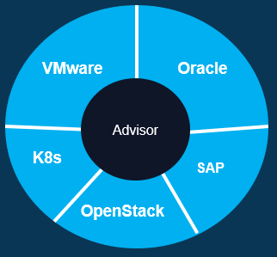
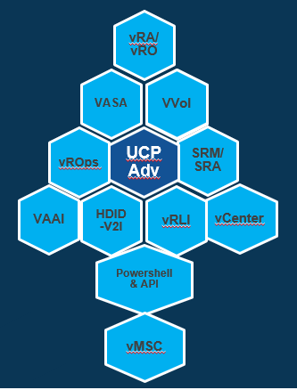
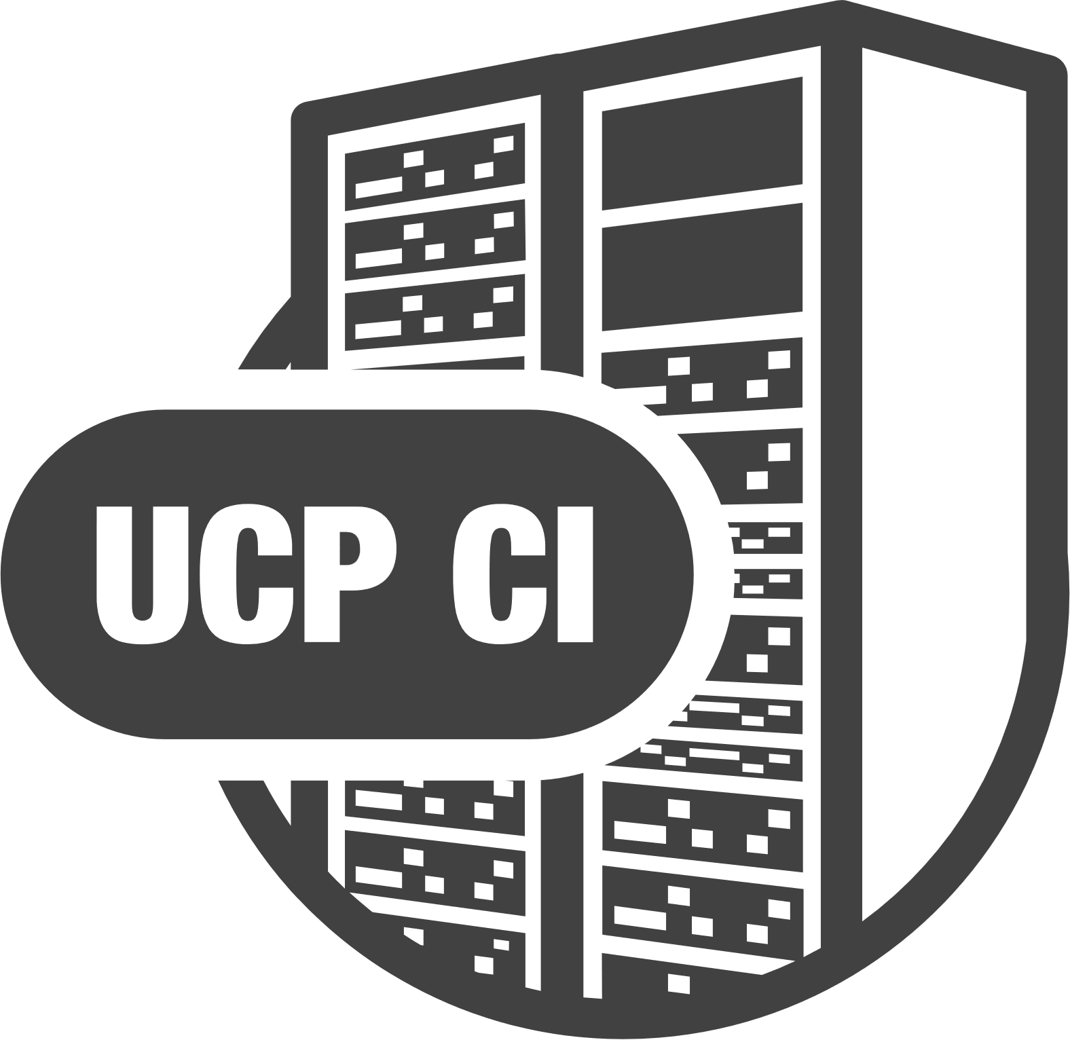

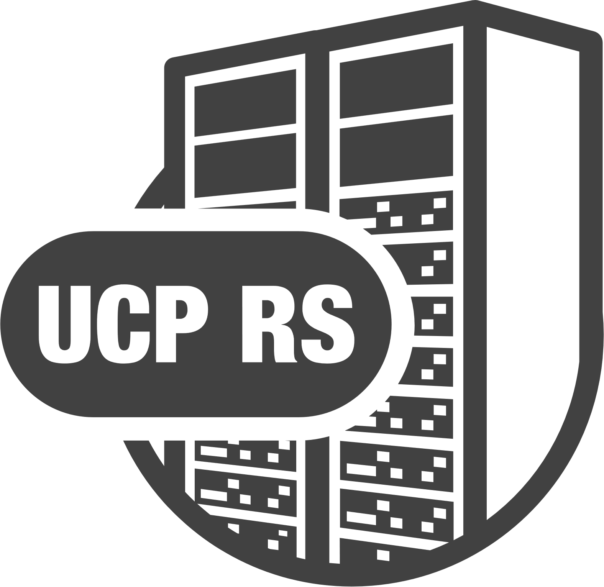




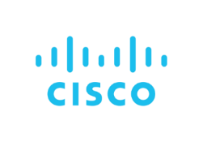















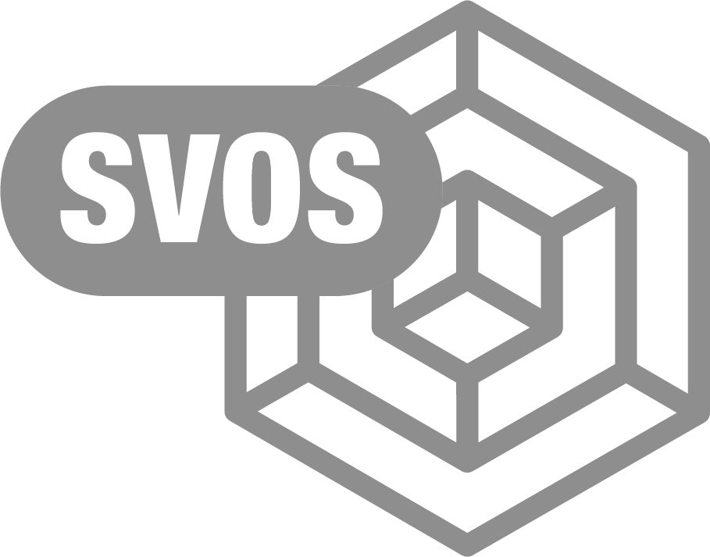
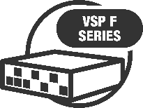
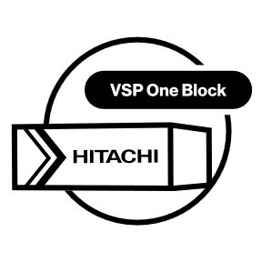
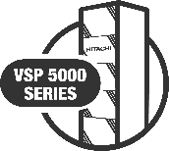
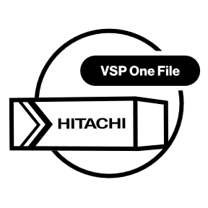
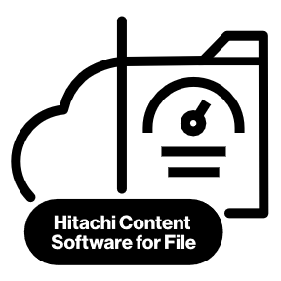
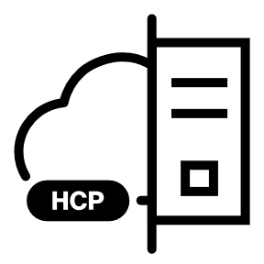
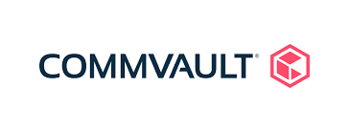

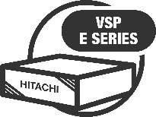
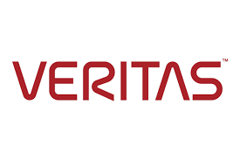

Hitachi Vantara Data Infrastructure Portfolio
Solutions
Hybrid/Multi Cloud
Private Cloud
Mission Critical Apps
Big Data / Analytics
Workloads
Hitachi UCP Advisor
Infrastructure
Automation
Ecosystems
Integrations
Infrastructure Management
& Automation
CONVERGED
Unified Compute Platform CI
HYPERCONVERGED
Unified Compute Platform HC
RACK SCALE
Unified Compute Platform RS
Cisco and Hitachi Adaptive Solutions for CI
Simplified Consumption
Rack Servers
Scalable Modular Servers
Compute / Networking / Acceleration
Ops Center
Administrator
Analyzer
Analyzer
Viewpoint
Automator
Storage Management & Orchestration
DATA PROTECTION
BLOCK
FILE
OBJECT
Scalable File
High
Performance
Hitachi Content Platform
Storage Portfolio
Notes:
Hitachi UCP provides the horsepower for Digital innovation for your customers bringing together flexible, high performance storage, network and compute offered through pre-packaged and pre-validated converged and hyperconverged solutions.
Hitachi UCP solutions brings in these components integrating closely with partner technologies such as VMware, Red Hat, Cisco, etc. through best practices and Reference Architecture.
Your customers can deploy wide spectrum of workloads from general purpose to virtualization to container, from packaged applications to home grown Big Data to AI/ML workloads.
Your customers can leverage Automation enabled through UCP Advisor to increase the velocity to roll out the applications
Your customers can reduce operational cost with consistent management of Converged and Hyper-converged infrastructure through the same tool

Slide 7


The Portfolio
Block Storage
Virtual Storage Platform One
Notes:
GenAI is unstoppable. More people, from tech to non-tech industries, from enterprises to consumers – are boarding the GenAI express on the promise of doing more in less time.*
Cloud is making it even easier to experiment with emerging tech. As-a-service, cloud is the ideal environment to crash test and deploy AI applications at lower costs and risk.
Everyone has the tools to innovate now more than ever, especially with data. Digital innovation is being democratized, even the disruptors can be disrupted.
Today we are at a new precipice. Whether you’re innovating to meet current market demands or create demand – advancing innovation is a matter of survival.
The question is, how can you thrive, not just survive, in this era of rapid change?
*IDC predicts $ 1T productivity gains by 2026 for enterprises leveraging GenAI & automation technologies.
*Competition became irrelevant when iPhone arrived in 2007. Innovate not just to compete but to delight customers with something they didn’t know they needed.
* Digital Innovation - Application and adoption of digital technologies to improve business, products/services, enhance customer experience

Slide 8



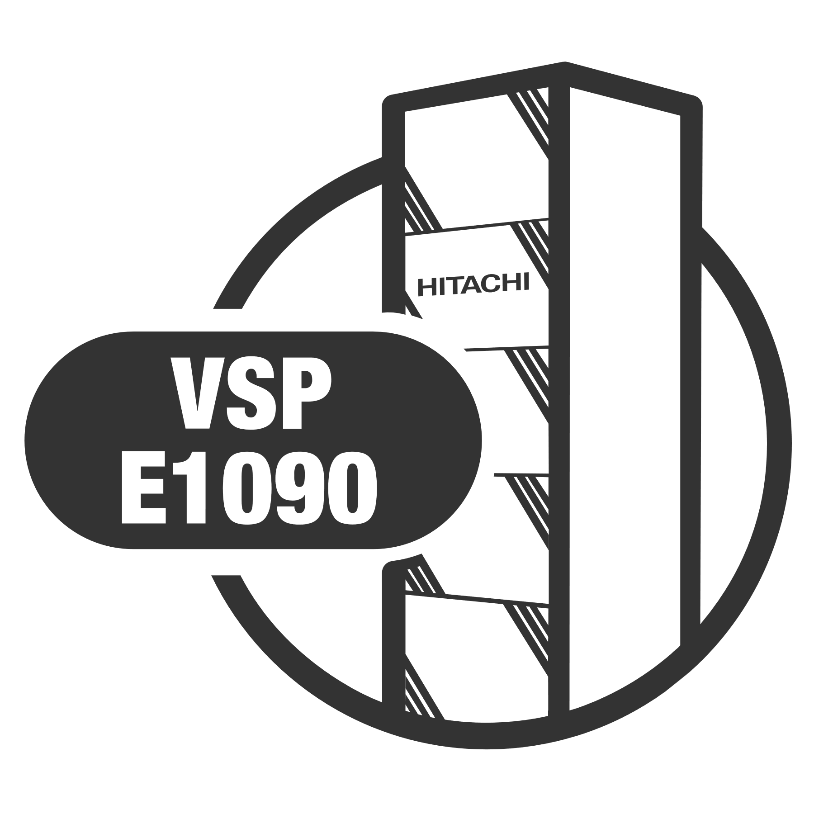
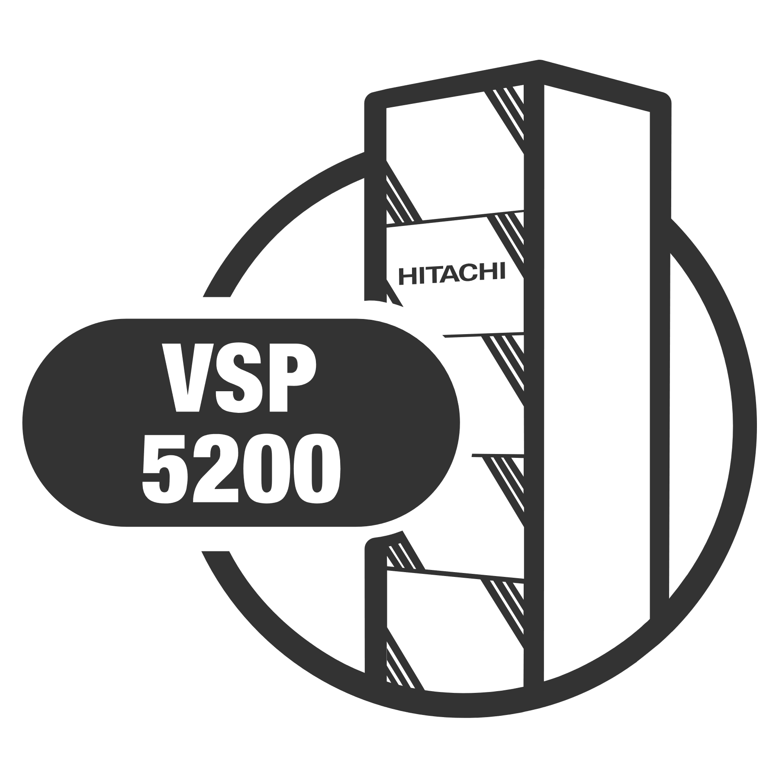
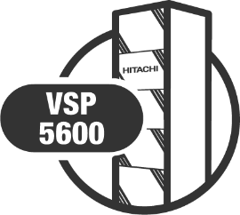
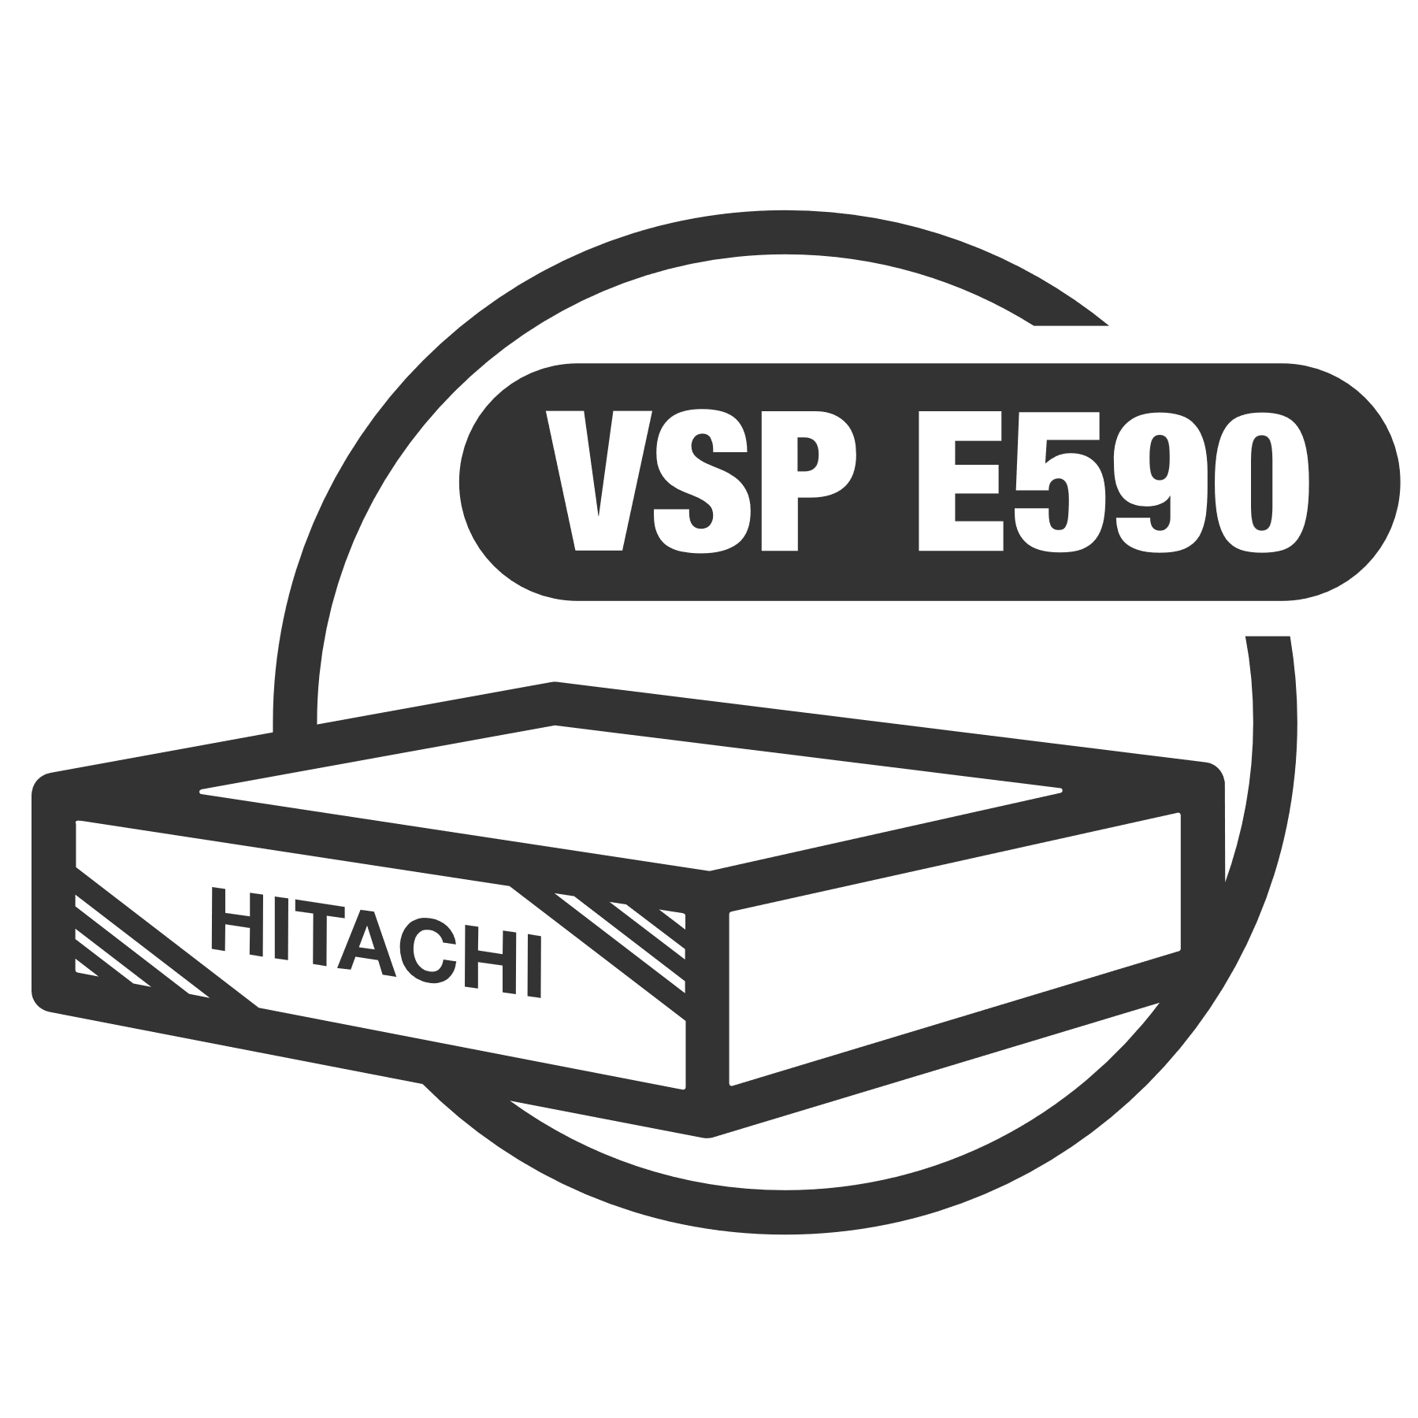
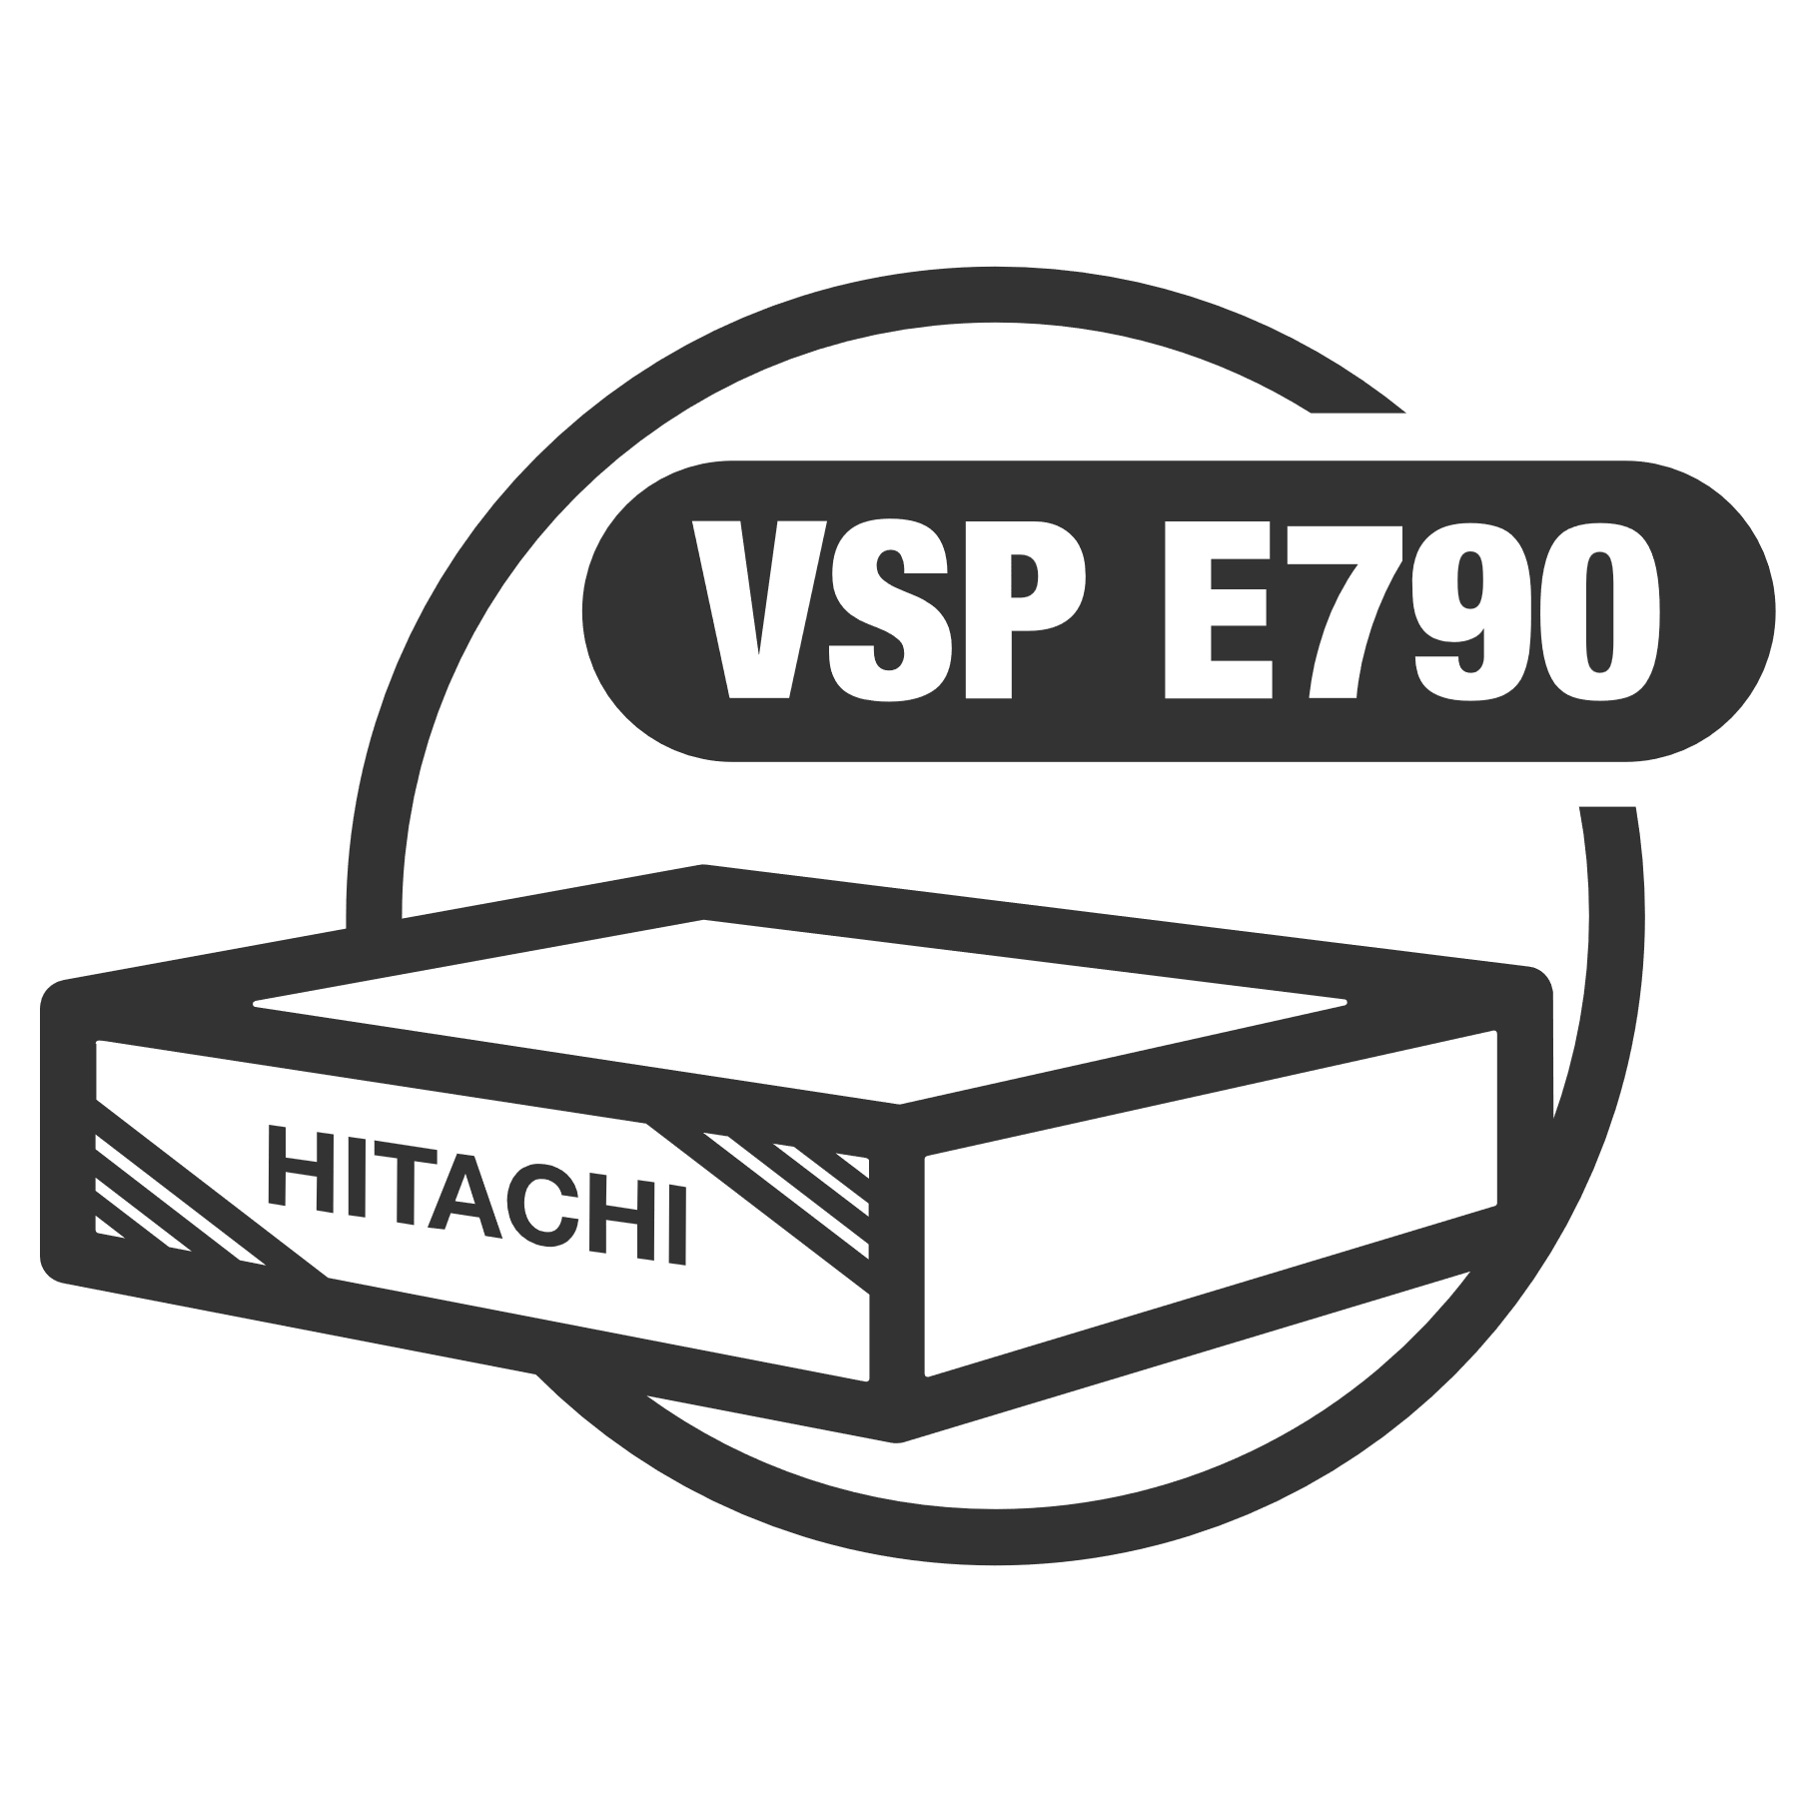
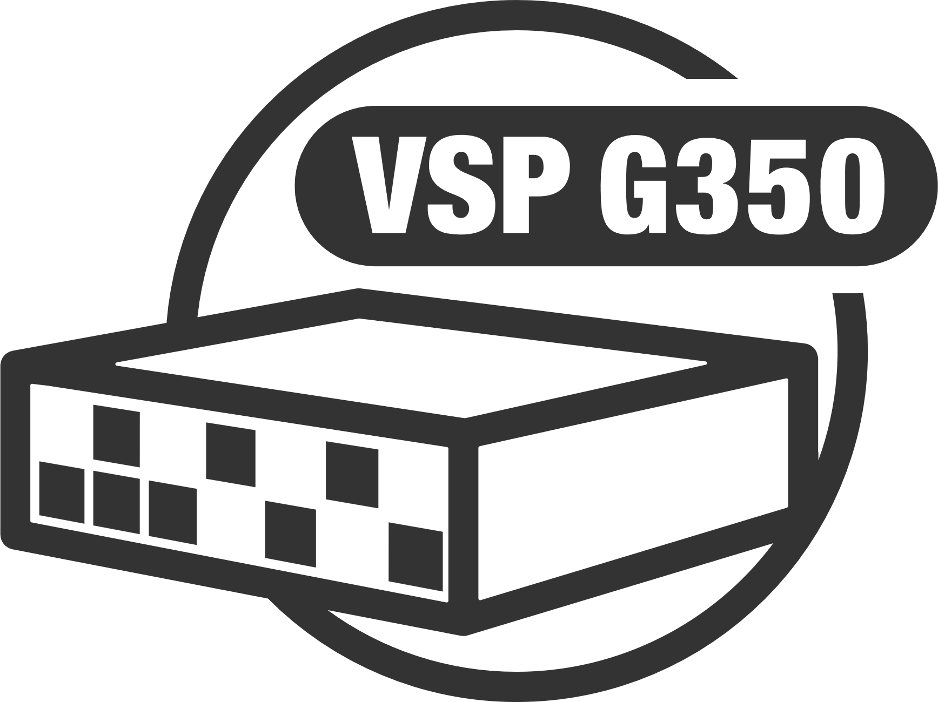
Portfolio Overview
Common Operating System
Common Ops Center Management Suite
3.6M IOPS
24 Cores
256 GB Cache
5.1M IOPS
24 Cores
768 GB Cache
9.1M IOPS
64 Cores
1’024 GB Cache
8.4M IOPS
64 Cores
1’024 GB Cache
25.9PB MAX RAW
4U Form Factor
5.1M IOPS
40 Cores
1’024 GB Cache
23.1PB MAX. RAW 18U Form Factor
33M IOPS
240 Cores
6’144 GB Cache
69PB MAX. RAW 18U Form Factor
600K IOPS
12 Cores
128 GB Cache
4M IOPS
24 Cores
768 GB Cache
6.8M IOPS
64 Cores
768 GB Cache

Slide 9


SVOS | Hitachi Vantara Availability
Ranked #1
Reliability, Availability and Serviceability for +5 consecutive years!!
Controller A
Controller B
VSP
Active/Active Controllers/Nodes
Workload is distributed across the controllers
Automatically and Manually

Slide 10
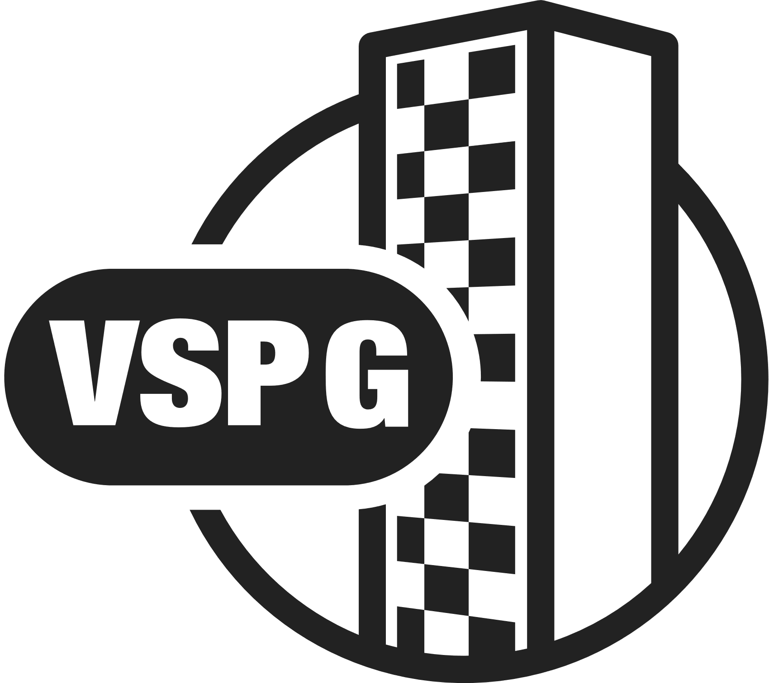

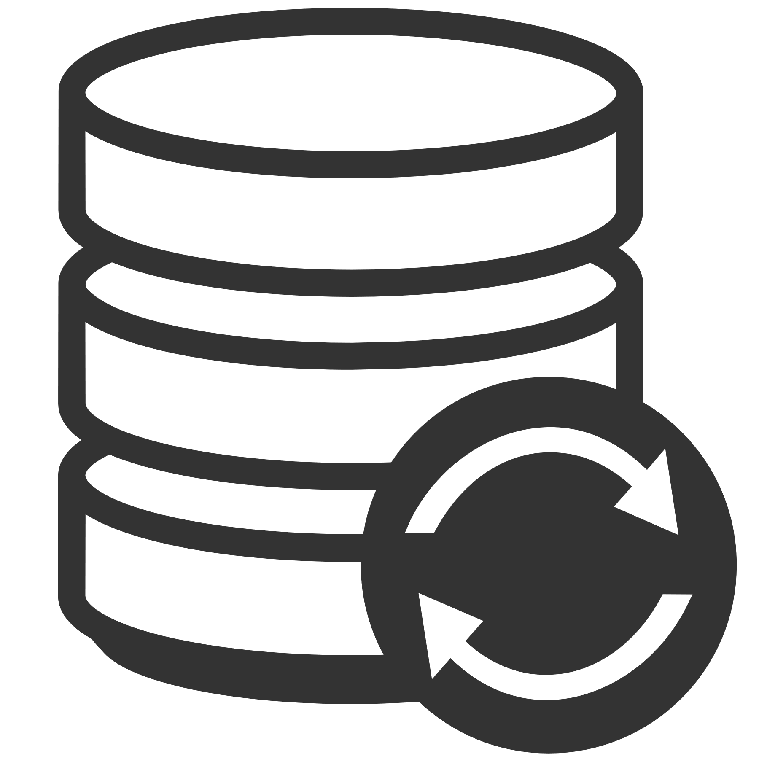

SVOS | Hitachi Vantara Availability
Business Continuity
VMWARE | MICROSOFT | ORACLE | SAP
Zero Recovery Point&Time
NO Appliance architecture
NO Scripts
Active/Active data access
Zero management overhead
100% agnostic
100% microcode
COMPUTE
COMPUTE
GAD
Active/Active
Geo Redundancy Storage Service
GAD Quorum
HUR
Asyncronous Continuos
HUR
Delta Resync

Slide 11

SVOS | 3DC Multisite Continuity
Cascade
Production
Local
Remote
Benefits of Remote Replication
  High Availability and Business Continuity:
    GAD – Global Active Device
    TC – True Copy
  Disaster Recovery with HUR – Hitachi Universal Replication
  Air Gapped Ransomware Solution with HTIA
  Data governance & regulatory compliance (e.g., DORA, GPDR etc.)
Sync
Async
Multi-Target
Multi-Target with Active-Active
Production
Local
Production 1
Production 2
Sync
GAD
Async
Async
Delta Resync
Delta Resync
Remote
Remote

Slide 12
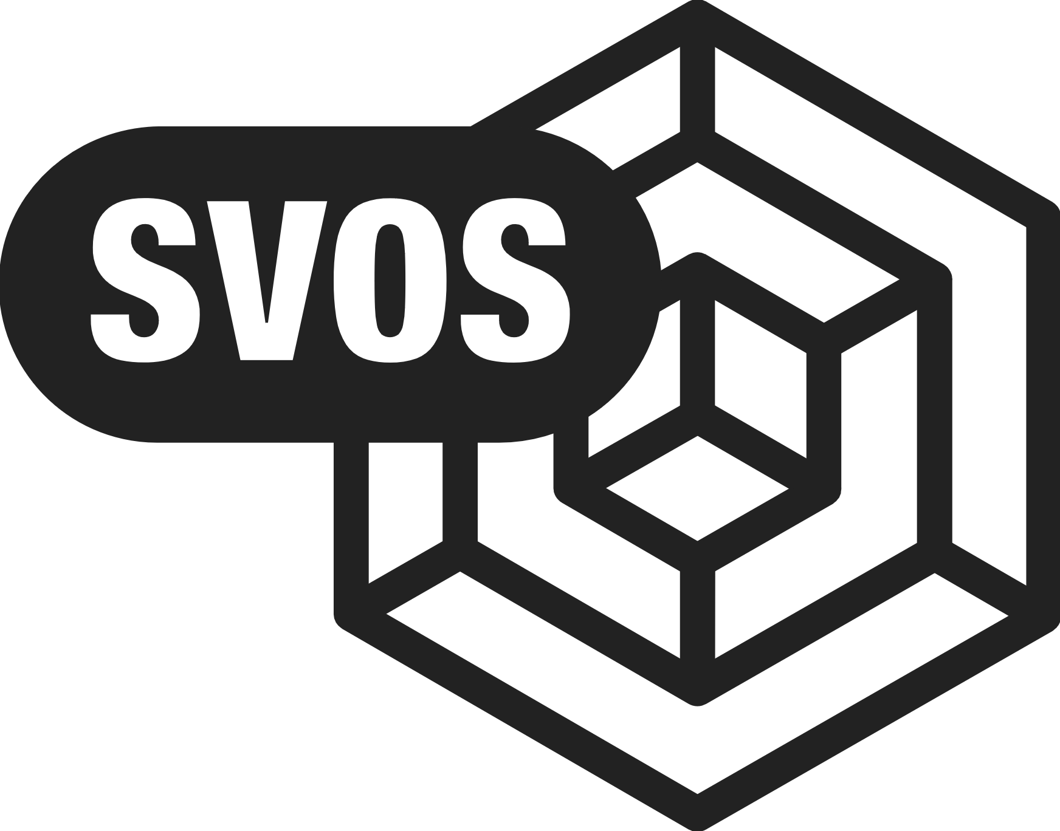
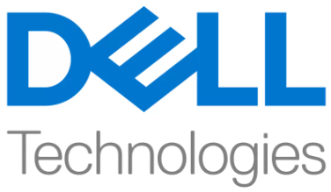


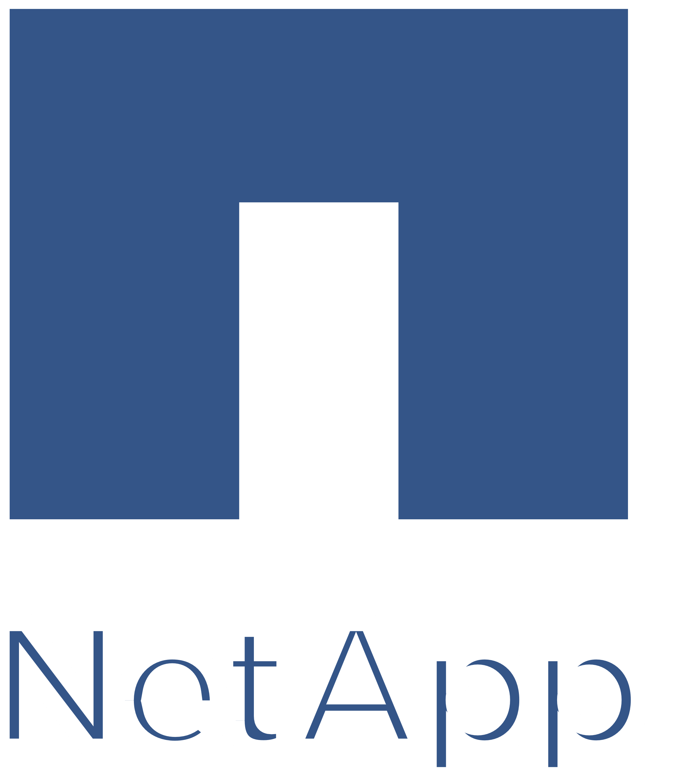

SVOS | Hitachi Storage Virtualization
Native SVOS function
NO appliance
All vendors, 100+ validated models
Non disruptive and easy data migration
Cost optimization and asset reutilization
Simplified administration with unified management
Functionality reuse
…..

Slide 13
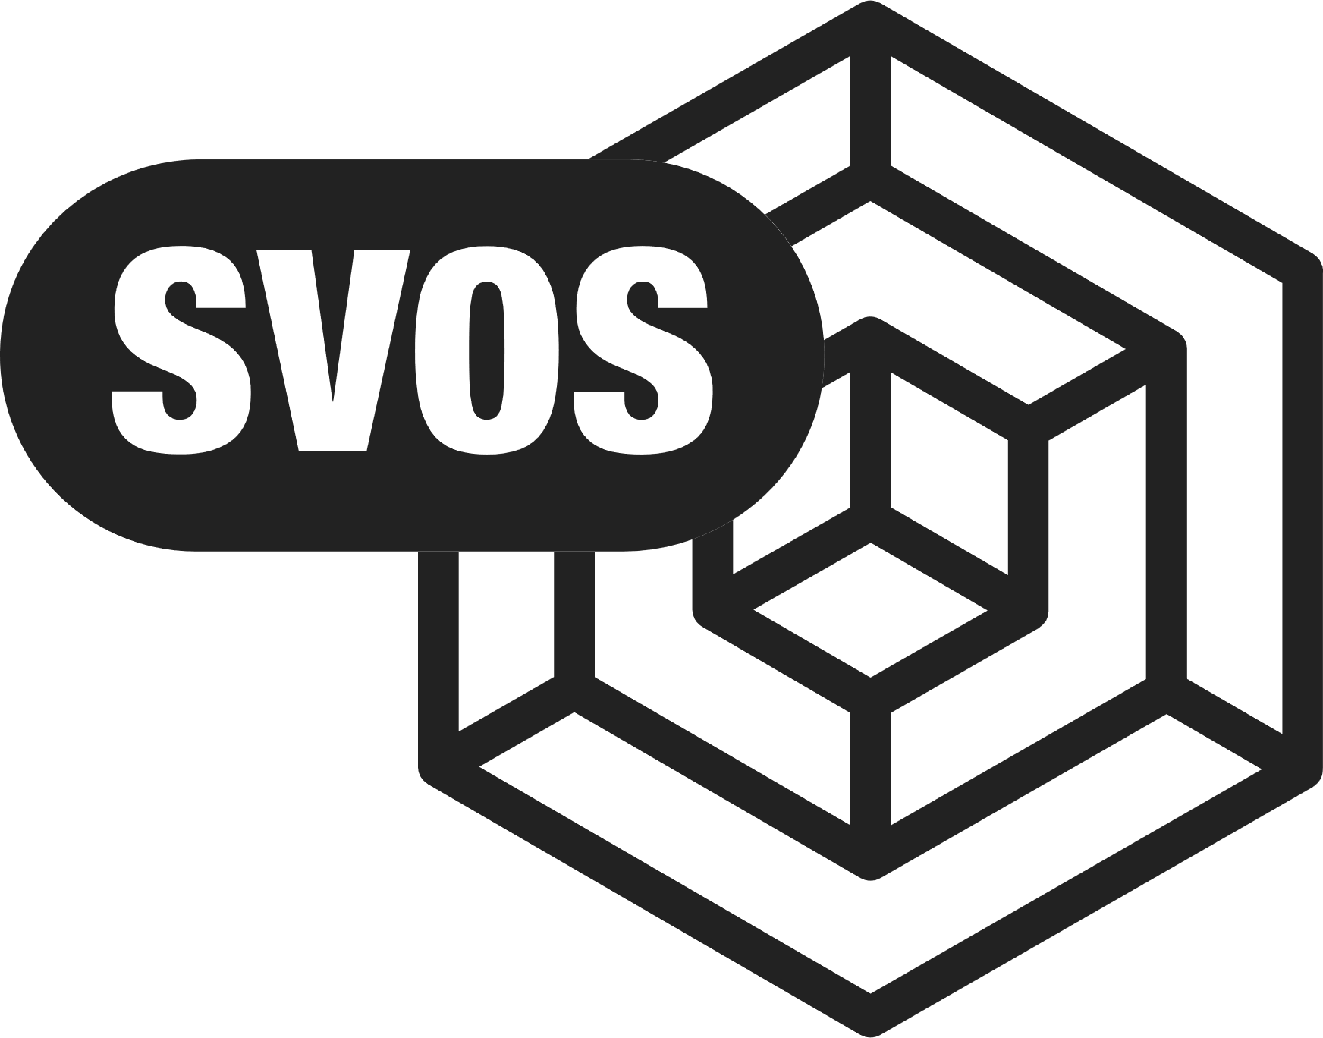



75%
SVOS | Hitachi Data Retention Utility
By 2025
Of companies will be
a victim of Ransomware*
Undo damage by ransomware attacks in seconds
Fully integrated component of all VSP arrays
Locks down copies of production data for a defined period of time
Data cannot be deleted, edited or encrypted during the retention period
Production
Production Volume
Snapshots / Clones
V1
V2
Time-Locked Copy Volumes
* Gartner’s prediction for ransomware attacks

Slide 14



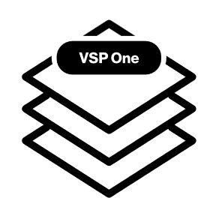


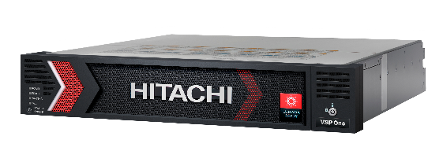


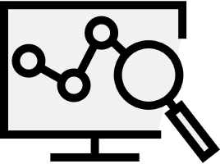
Data Foundation for Hybrid Cloud
Storage Efficiencies from public cloud integration with Hyperscalers
Primary
Remote
Performance & Scale
VSP One
SDS Cloud
Cyber Resilience
Workload mobility enables data anywhere
DevOps Flexibility
Common API for cloud consumption
Designed for distributed applications
Expand common data services into the public cloud with AWS /Azure
Deploy VSP One on AWS/ Azure Marketplace
with correct capacity and cost
Snapshot data locally and set
SDS migration target within AWS/Azure
Clear Sight Cloud Observability
Insights and management
Ops Center Data Management
Common Control Plane
Notes:
Hitachi’s Virtual Storage Platform family has a common management framework and a common operating system that expands across the entire portfolio. That means a simplified user experience no matter which platform is right for your business needs. Today, tomorrow or next year.
The VSP E series is a midrange storage family that delivers enterprise class features, performance and resilience along with the simplicity and price that meets the needs of midsized enterprises.
The VSP 5000 series is the most powerful enterprise class platform available today, delivering industry leading performance and scalability.
VSP systems support flexible drive options for all workloads at all stages.

Slide 15
The Portfolio
File Storage
Virtual Storage Platform One File
Notes:
GenAI is unstoppable. More people, from tech to non-tech industries, from enterprises to consumers – are boarding the GenAI express on the promise of doing more in less time.*
Cloud is making it even easier to experiment with emerging tech. As-a-service, cloud is the ideal environment to crash test and deploy AI applications at lower costs and risk.
Everyone has the tools to innovate now more than ever, especially with data. Digital innovation is being democratized, even the disruptors can be disrupted.
Today we are at a new precipice. Whether you’re innovating to meet current market demands or create demand – advancing innovation is a matter of survival.
The question is, how can you thrive, not just survive, in this era of rapid change?
*IDC predicts $ 1T productivity gains by 2026 for enterprises leveraging GenAI & automation technologies.
*Competition became irrelevant when iPhone arrived in 2007. Innovate not just to compete but to delight customers with something they didn’t know they needed.
* Digital Innovation - Application and adoption of digital technologies to improve business, products/services, enhance customer experience

Slide 16






Hitachi Vantara File Offerings
VSP One File
Content Software for File
HCP Anywhere Enterprise
Scale-up/Scale-Out Central Clustered File System
Scale-Out Clustered Parallel File System
Scale-up/Scale-out Distributed File System
  Specialized HPC, AI, ML
  Generative AI
  Complex Image & Streaming Analytics
  Digital Twin Simulations
  3D Modeling & Visualization
  Computer-Vision Applications
  Natural Language Processing
  Large Scale Inference Models
  Real-Time Transactional
  Collaborative Workloads
  End-User Productivity Systems
  Enterprise Content Management
  Desktop & Mobile File Sharing
  Departmental File Sharing & Distribution
  IOT Edge to Core Capture
  Extended Data Operations
  Traditional Data Center Centric Workloads
  Batch Systems
  Decision Support
  Local File Consolidation
  Database on File Deployments
  Central Home Directories
  Virtual Machines
  Backup & Recovery
Consolidated
Dedicated
Distributed

Slide 17
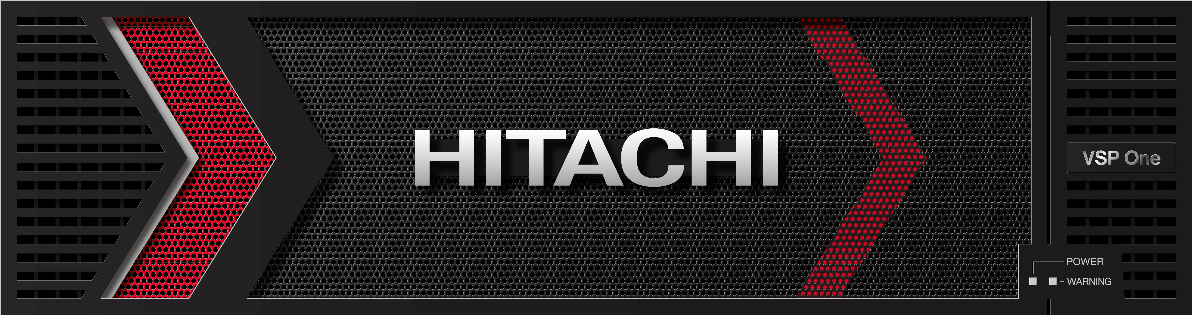



VSP One File
Delivering Flexibility without Complexity
FPU HW Accelerated file system enables large scale parallelization for scalability & performance
Simplified management with VSP integration and Clearsight SaaS based fleet management
Enhanced real-time analytics and troubleshooting
Scale up and Scale out capabilities for capacity or performance
Performance and Scale
Cyber Resiliency - Immutability, Denial of service attack protection
Enhanced Security features - MFA, SSO, NFS 4.1, and Privileges access management w. CyberArk vaulting
Ransomware detection with key partners (Splunk / CyberArc)
Full Enterprise Feature set - Dedup, Tiering, Snapshot, Clone, MetroCluster, Virtual file server, WORM
Trusted
Hybrid Cloud Enabled with Native Cloud tiering
Network flexibility 10/25/100GbE & near-cloud extension options
Multi-protocols with secure NFS VMware datastore and Metro cluster support
Hybrid Enabled
Notes:
Slide 34: VSP One: File
In Q1 we will be launching our next generation File capabilities with VSP One File
These are built with our next generation FPU HW accelerated file system….
…… The easy analogy here is what GPU’s are for Analytics, these are for file system and protocol processing
- Enabling massive parallelization resulting in performance and scalability
- And these solutions live up to that… with up to 6x performance increase
Also new simplified management including integration with VSP and Clearsight
---------------------------------
Integrated Cyber Resiliency capabilities with immutability and DOS protection
- and a whole host if enhanced security features
- as well as ransomware protection with integration into key partners such as Splunk and CyberArc
------------------------------------
- They deliver enhanced network flexibility with 10/25/100GbEthernet connectivity with
native cloud teiring capabilities
- As well as near-cloud extension options

Slide 18
VSP One File Advantage
Gateway Architecture
Hitachi - Independent Scaling
Competitor
Gateway Focus
Storage Focus
Shared Resources
File IOPS
Network (IPv4/IPv6)
Protocol Stack
File System
Copy Management
Block IOPS
Storage IO
Data Reduction
EC/RAID
Network
Protocols
File System
Snapshot/Replication
Storage IO
Data Reduction
EC/RAID
VS

Slide 19
VSP One File Advantage
FPGA Performance
Hitachi Distributed Processing
Competitor
CPU
FPGA
CPU
Shared Processor
Shared Memory
Serialized I/O Channel
Shared Bus
Distributed Processing
Multiple Tasks per Clock Cycle
Distributed Memory
Dedicated I/O Channels
Shared Processor
Shared Memory
Serialized I/O Channel
Shared Bus
VS
18 billion tasks per second by CPUs vs 125 trillion tasks per second by FPGAs

Slide 20
Common Enterprise NAS OS and Management Across Models
100% Data Availability Guarantee
VSP One Model 38
New
VSP One Model 34
PERFORMANCE
New
VSP One Model 32
Hitachi NAS 5300
New
Hitachi NAS 5200
CAPACITY

Slide 21
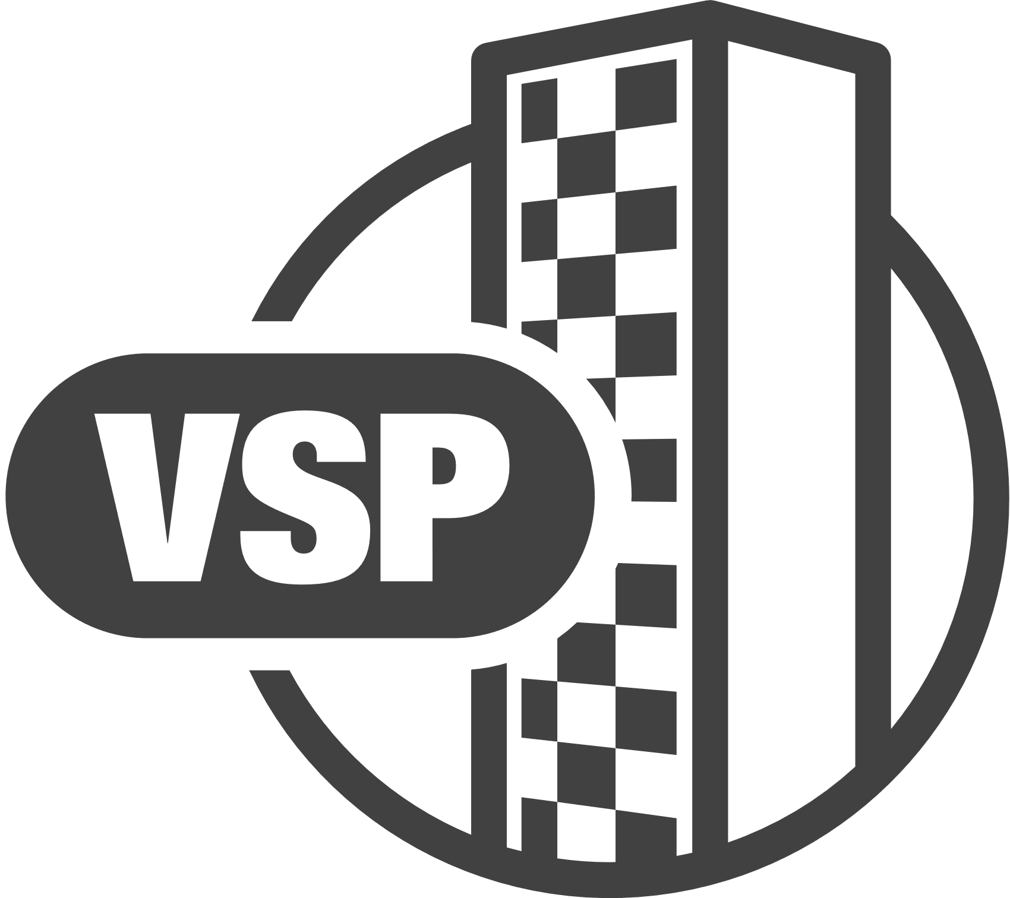
Hitachi NAS Gateway Stretched Cluster
With GAD
SMU Quorum
Provides an HA copy of the data using VSP with global-active devices (GAD)
The cluster can be stretched over two locations, although it doesn’t need to be
Problems with one of the two nodes will be handled by the existing cluster mechanism providing high availability
Problems with storage availability are handled by the global-active device mechanism of VSP, providing high availability at the storage layer
NVRAM
NVRAM
Global-Active Device
Virtual LDEVs:
10:01
10:02
10:01
10:02
20:01
20:02
Quorum

Slide 22
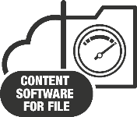
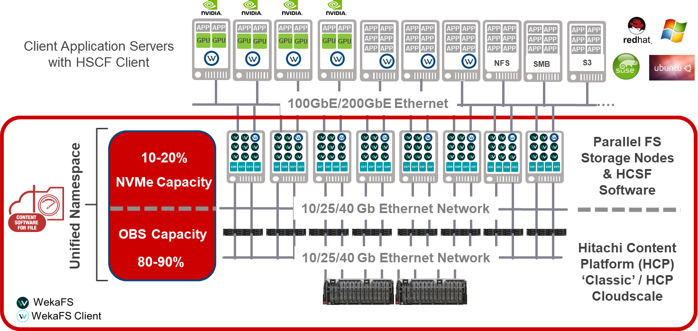

The Ultimate Data Platform for High-Performance Data Analytics
Hitachi Content Software for File
Faster Access to More Data at a Lower Cost
High-performance file-based storage solution
highly scalable and easy to deploy, configure, manage, and expand
1
2
World’s fastest shared file system
3
Integrated cloud tiering to the Hitachi Content platform (HCP) and HCP for Cloud Scale
Powered by
What’s not
  Hitachi Content Software for File is not a general-purpose NAS solution or any other “traditional” storage solution.
Notes:
Hitachi Content Software for File (HCSF) is a high-performance file-based storage solution that is highly scalable and comes as an appliance with all software and hardware pre-installed.
It comes with integrated cloud tiering to the Hitachi Content platform (HCP) and HCP for Cloud Scale.
It is the world’s fastest shared file system and comes with zero performance tuning to support small and large files simultaneously
What’s not
HCSF is not a general-purpose NAS solution or any other “traditional” storage solution.

Slide 23
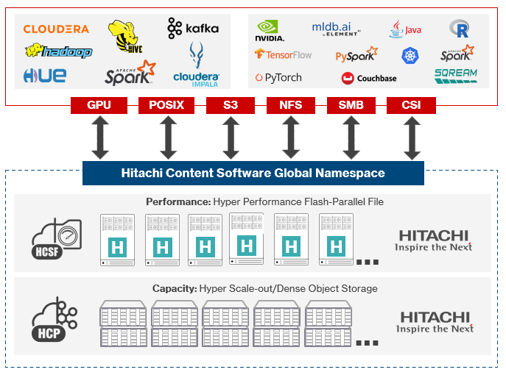
The Ultimate Data Platform for High-Performance Data Analytics
“If a client is looking for a beast of a platform that can really outperform anything else in the industry, that's what Hitachi Content Software for File solution is. I absolutely would recommend it. It is the elite high-powered,
high-velocity sports car.”
William Nelson, T-Systems

Slide 24
HCSF is Much Faster at IOPS and Deep Learning
The Faster the IOPS, the Faster the Training
HCSF has 7.5X – 225X superior IOPs performance swamps all other systems on Deep Learning AI workloads
HCSF
Server
Vendor Stated Read IOP Performance Numbers

Slide 25
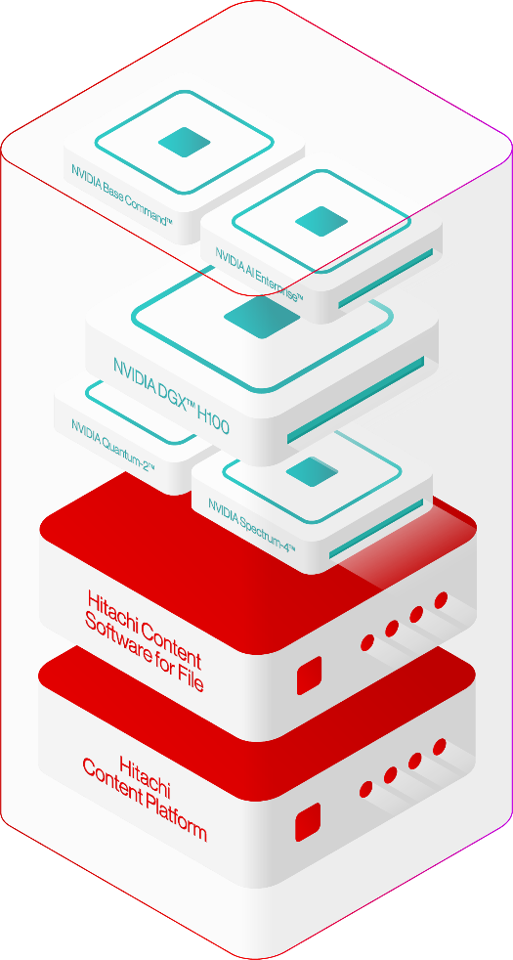
Hitachi iQ AI-Ready Infrastructure with NVIDIA DGX
AI Software Stack
Enterprise-class platform for AI training
End-to-End software for accelerated AI pipelines
Production grade pretrained AI models
Accelerated Compute
Fully integrated hardware and software solution on which to build your AI Center of Excellence
Proven reference architectures for AI infrastructure delivered with Hitachi's leading storage technology
Switching
400Gb Ethernet & NDR InfiniBand Connectivity
Highly scalable & self-healing network capabilities
High-speed, extremely low-latency, and scalable networking
High-Performance Parallel Filesystem
Accelerated filesystem to match the mixed AI workload
Modern consumption improving AI workloads (NVIDIA GPUDirect®, POSIX, S3)
Latest generation platform to support the highest concentrated workloads
Native data offloading capabilities to support better economics at scale
Scale-out Object Storage Tier
Object storage density to provide best storage economics at density
Erasure coding protection designed for large scale volumes of data
Data reduction & compression for ultimate capacity efficiency
Notes:
Link to AI Enterprise details: NVIDIA AI Software Platform for Enterprise
automatically manages tiering of data between high-performance, NVMe-based storage, and low-cost object storage

Slide 26
The Portfolio
Object Storage
Virtual Storage Platform One
Notes:
GenAI is unstoppable. More people, from tech to non-tech industries, from enterprises to consumers – are boarding the GenAI express on the promise of doing more in less time.*
Cloud is making it even easier to experiment with emerging tech. As-a-service, cloud is the ideal environment to crash test and deploy AI applications at lower costs and risk.
Everyone has the tools to innovate now more than ever, especially with data. Digital innovation is being democratized, even the disruptors can be disrupted.
Today we are at a new precipice. Whether you’re innovating to meet current market demands or create demand – advancing innovation is a matter of survival.
The question is, how can you thrive, not just survive, in this era of rapid change?
*IDC predicts $ 1T productivity gains by 2026 for enterprises leveraging GenAI & automation technologies.
*Competition became irrelevant when iPhone arrived in 2007. Innovate not just to compete but to delight customers with something they didn’t know they needed.
* Digital Innovation - Application and adoption of digital technologies to improve business, products/services, enhance customer experience

Slide 27
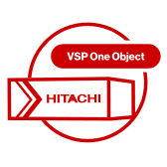



















Top 3 Use Cases for VSP One Object
DATA LAKE LAKEHOUSE
AI/ML & ANALYTICS
BACKUP & DATA PROTECTION
Data Warehouse
Big Data & Analytics
AI / ML
NPL
AI / ML
GenAI
Ransomware Protection
Data Protection & Security
Backup to Object
VSP ONE OBJECT
VSP ONE OBJECT
VSP ONE OBJECT

Slide 28











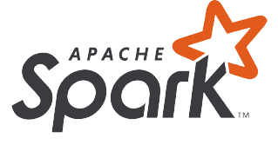



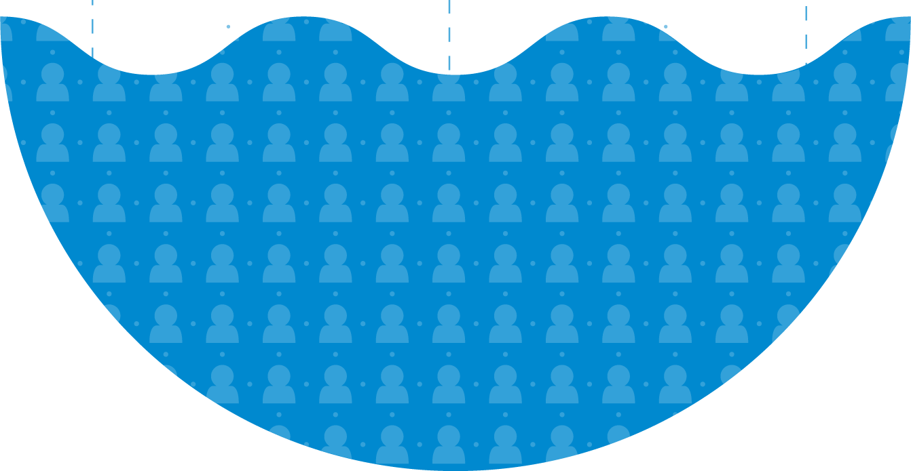


Hitachi VSP One Object | Platform Advantages
S3 Native Analytics
BigData Optimizations
Intelligent Data Services
High Performance S3
01
02
03
04
Custom
App
Prepare Data
100% S3 Compatible
Connects data with analytics solutions
Data Lake
S3
Event Notification
VSP One Object
Metadata Orchestration for
Standard Single Source of Truth
Stores, secure and protects data with
Infinite Scalability
Hybrid-Cloud Workflow
Optimize Compute
Notes:
VSP One Object Advantage: Shifting the Focus to Data Services and Applications
The VSP One Object Advantage is all about redefining how we think about storage. Instead of just focusing on the storage infrastructure itself, we’re shifting our attention to what really matters—the data services and applications that drive business value.
By prioritizing data services, we enable advanced capabilities like data analytics, AI-driven insights, and seamless data management

Slide 29


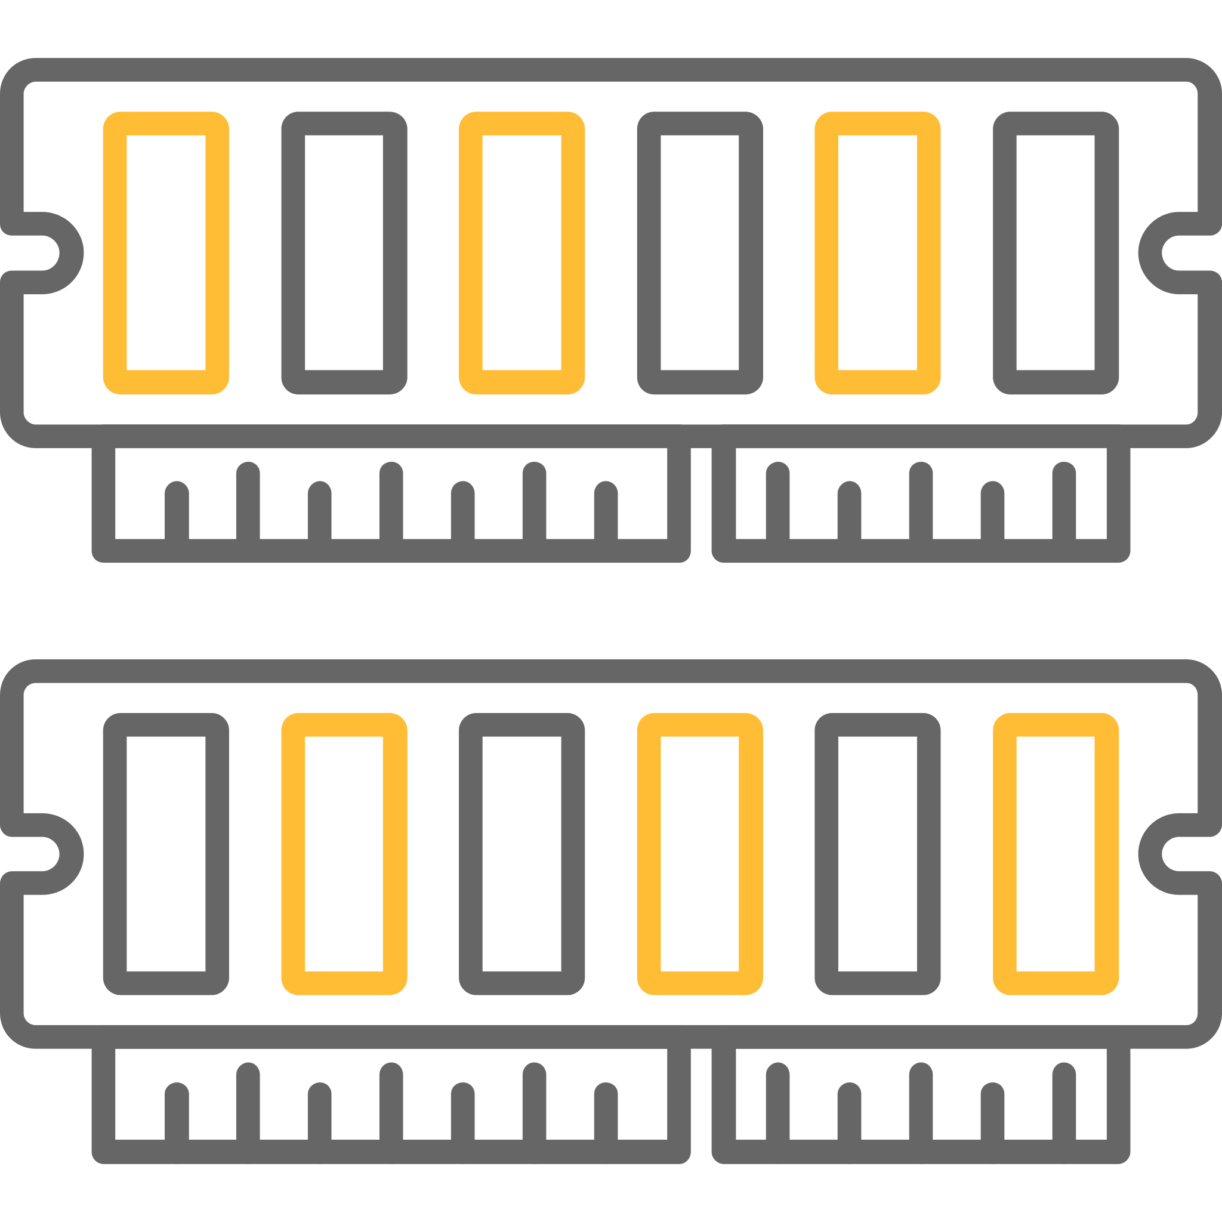

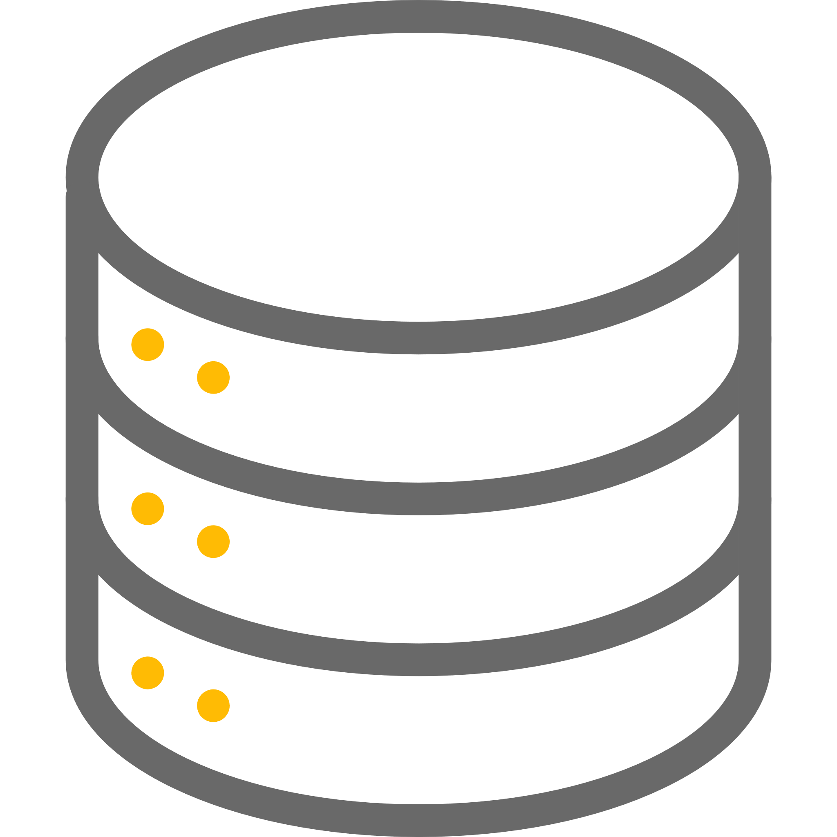

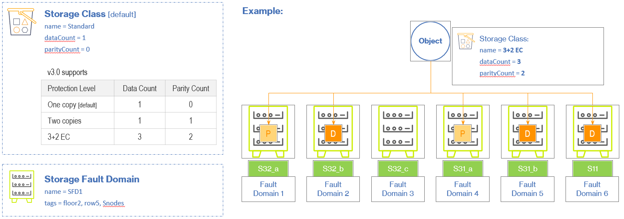




Virtual Storage Platform One Object | Gen 3
Object
Compute & Storage Options
Replication Services
hyperconverged
(with on-board storage)*
+
disaggregated storage*
disaggregated storage
hyperconverged
(with on-board storage) *
Replication for
Disaster Recovery
Replication for
Business Continuity*
Storage Services
Core Services
compatibility
regulatory compliance
data retention and lifecycle
Data-at-rest encryption (DARE)
future: encrypt metadata
v1
v2
v3
versioning
v4
v5
v6
* v3.1 Release Dependent
Notes:
In essence, we’re moving beyond just storing data—

Slide 30



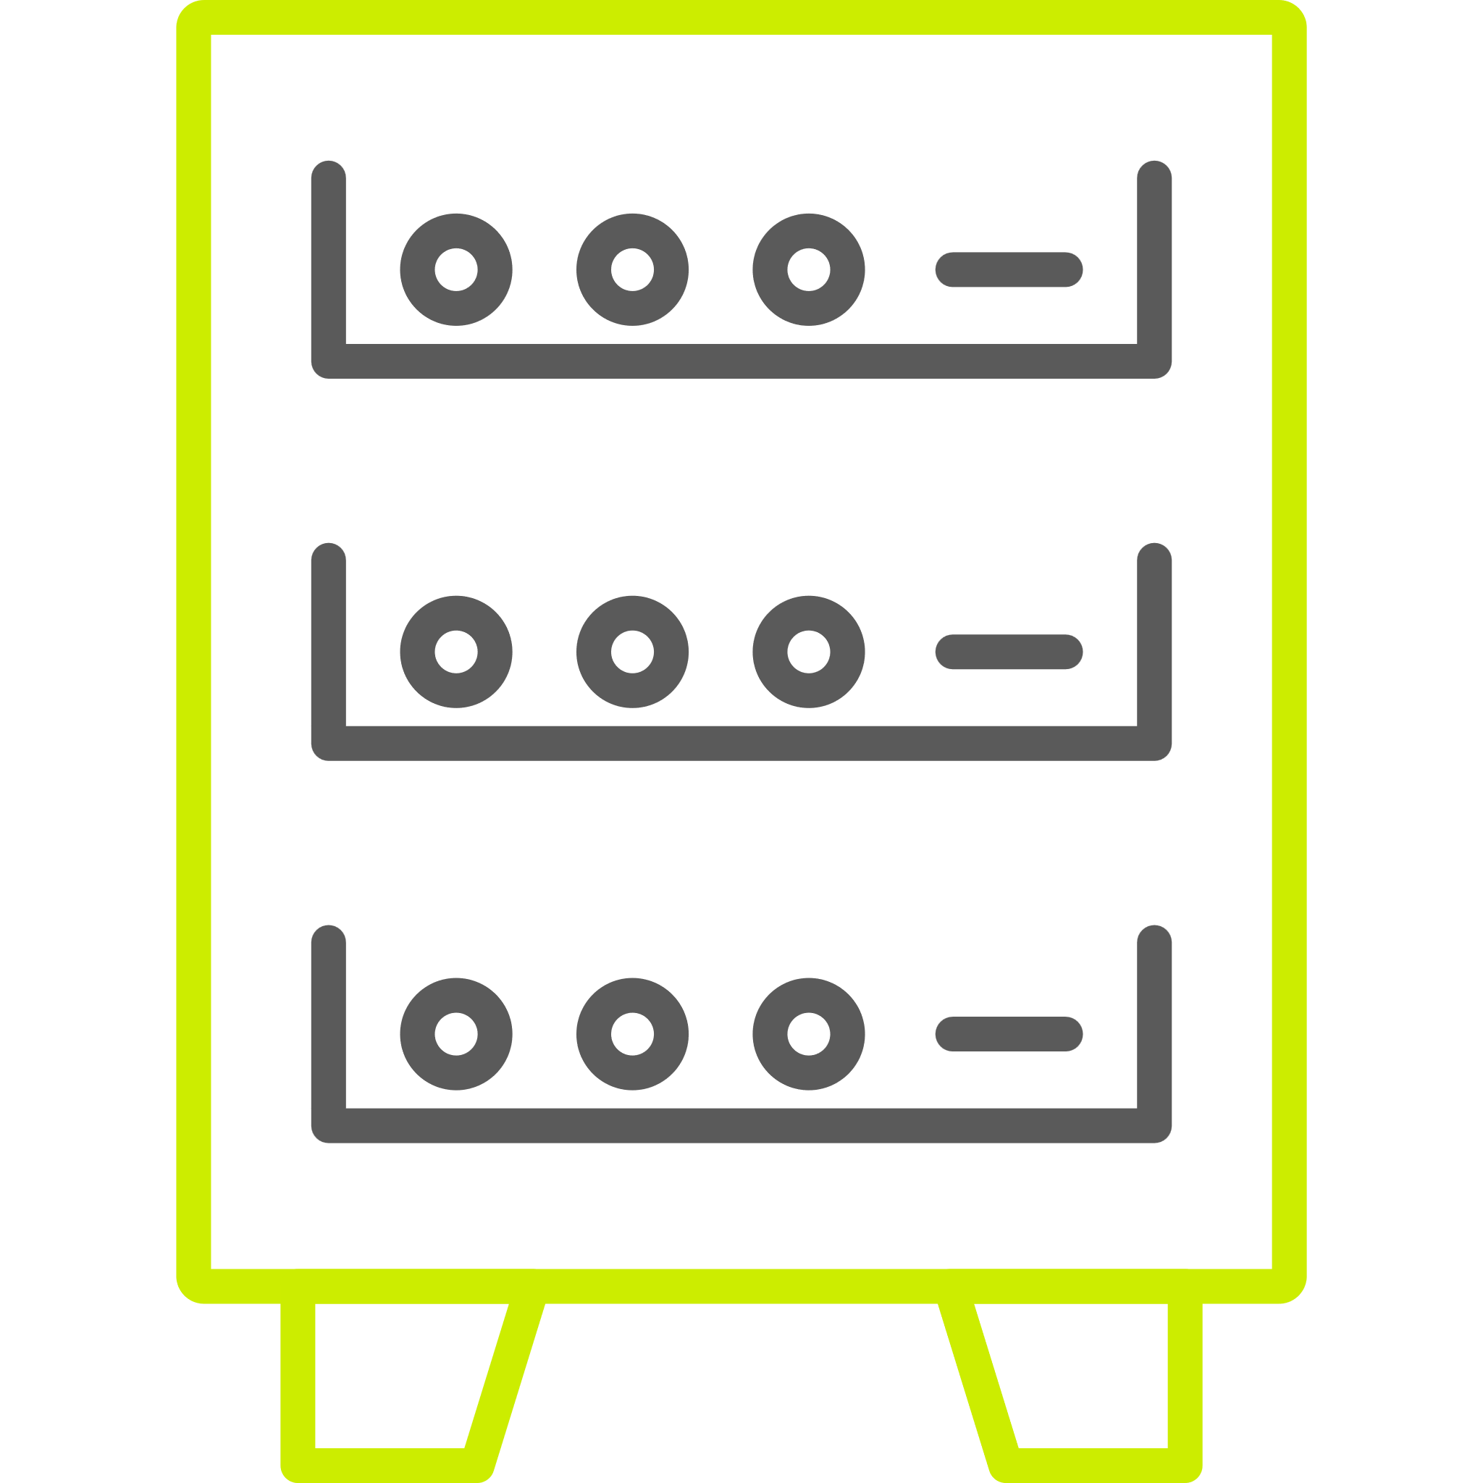
Storage Services | Concepts
New!
Storage Class
defines how data is protected
select from one of the following protection levels
  Single copy (default)
  Two copies
  Erasure coded (specify data & parity)
specify storage class with
  optional header: x-amz-storage-class
  without header, writes to default storage class
  PUT Object, POST Object, Create MPU
1
n
Storage Component
stores data
hyperconverged with on-board storage
disaggregated storage:
  VSP One Object S-series
  VSP One Block arrays
1
Storage Fault Domain
defines where data is protected
improve resilience with physically dispersed data
ensure data availability if there is a disruption
Notes:
Flexible Protection Options.

Slide 31
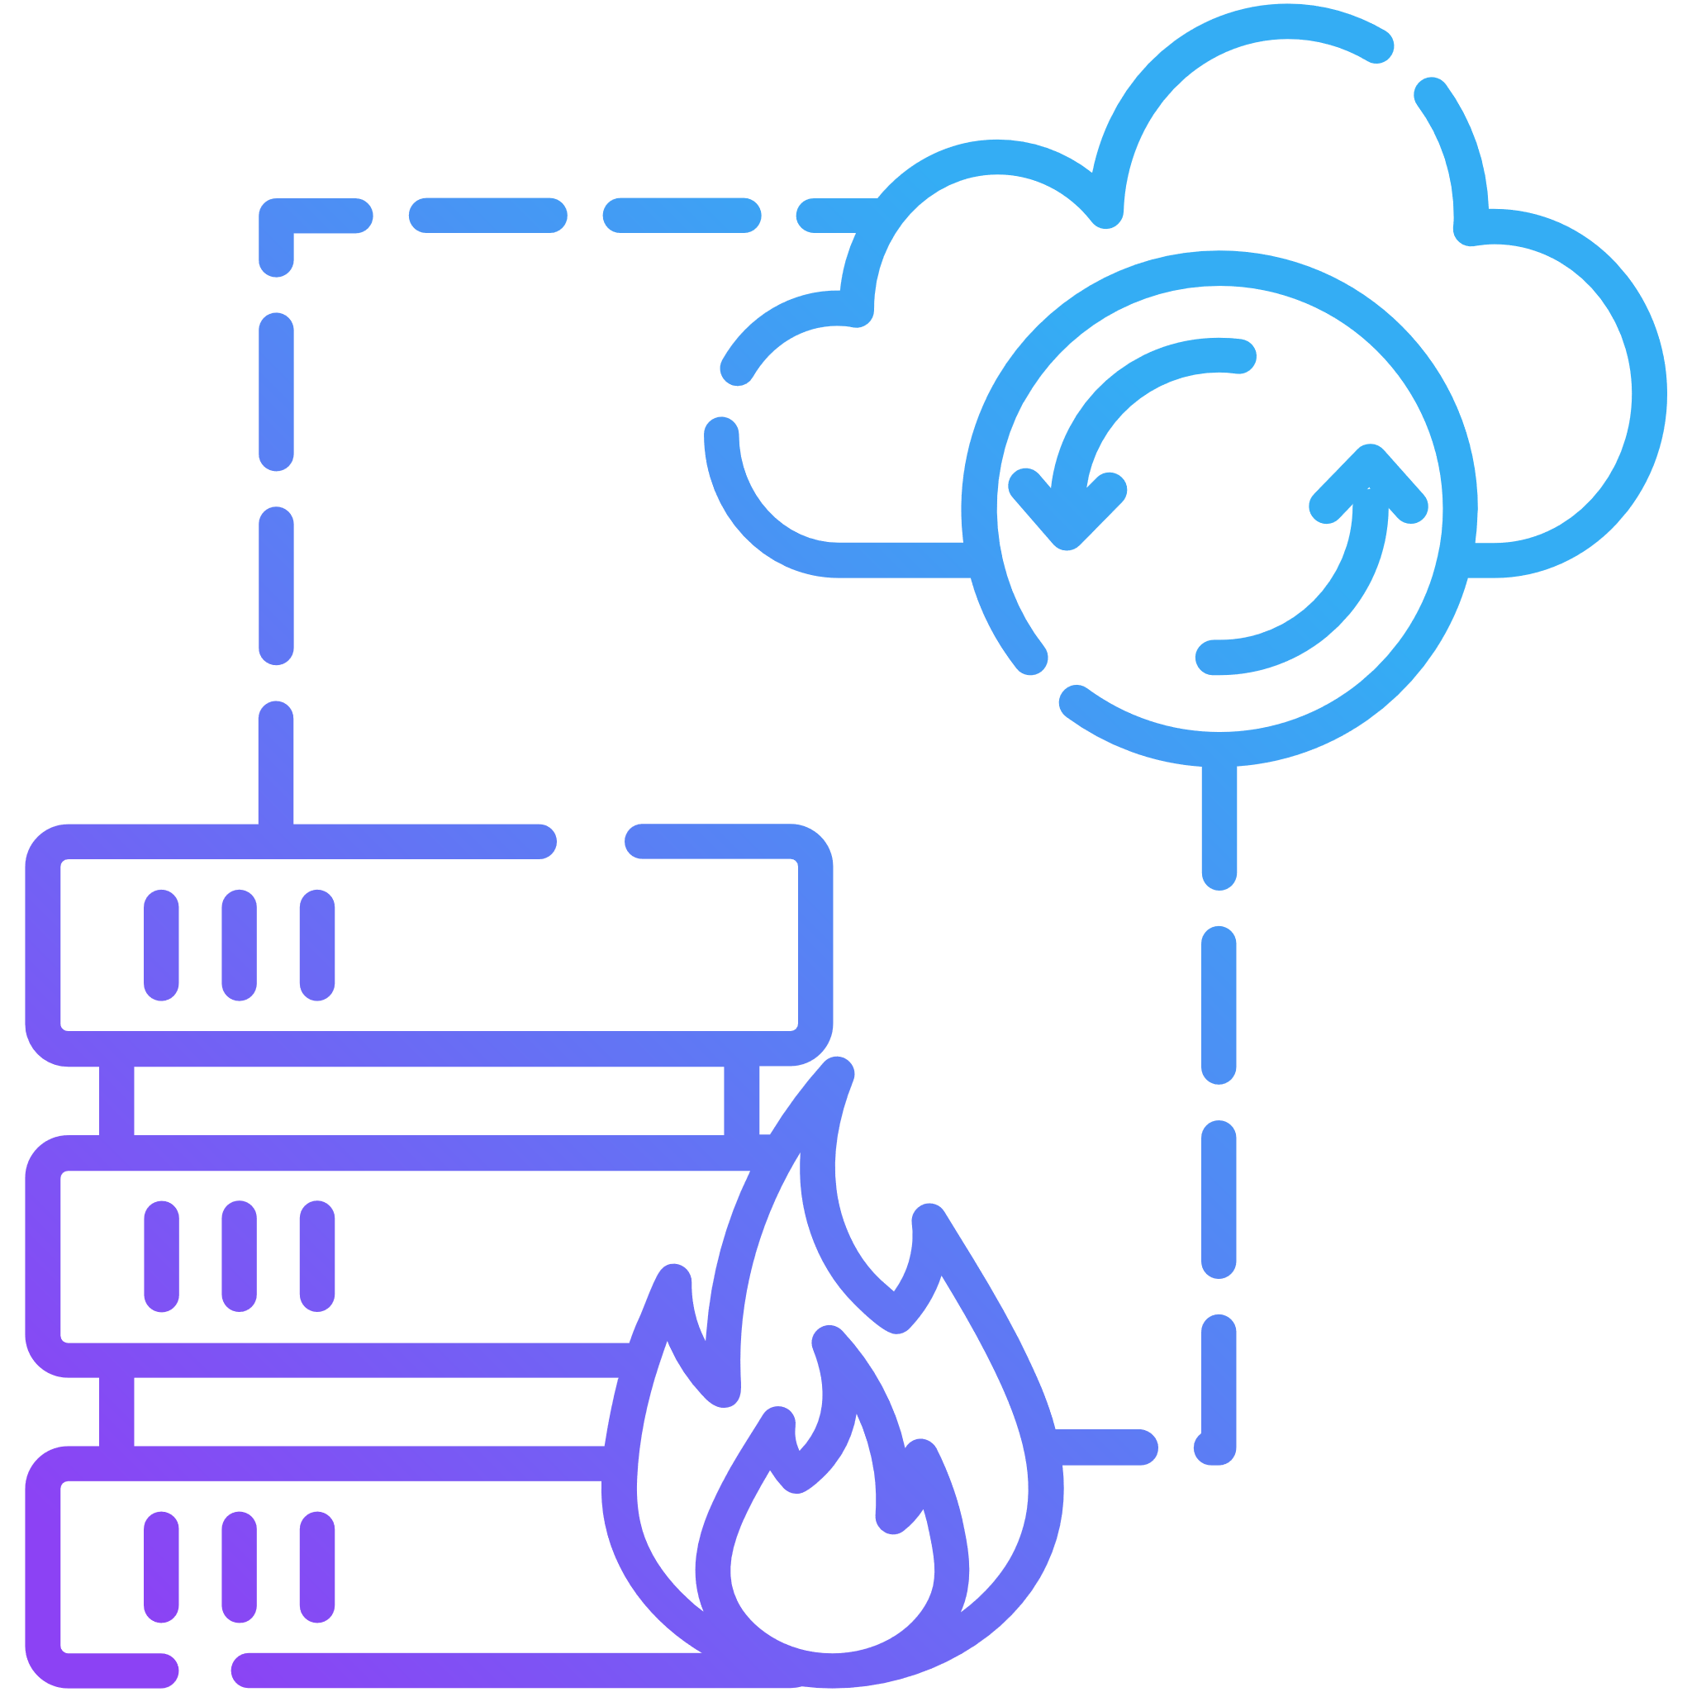



VSP One Object | Replication overview
Replication for BCDR
Replication for
Disaster Recovery
Replication for
Business Continuity
ensuring continuous operations*
v3.0
Replicate & protect critical data across multiple regions
Asynchronous replication optimized for long distances (dependent on customer network)
Configurations & metadata are protected to recover from a natural disaster or other business disruption
v3.1
Automated failover & failback for continuous operations
Seamless access to buckets across regions during a disruption
Allow replication of existing buckets to new buckets (eg, after a disaster)
Additional replication functionality
* like GAD for VSP

Slide 32
VSP One Object Models | O42 & O44
VSP One Object System
Packaged Offering – SW + HW
Full (8) node cluster in a 4u rack – Sustainability
Pre-packaged configuration – Reduce risk, simple
(8) Nodes with (6) NVME SED slots each
  5 nodes (Workers)
  3 nodes (Management)
  512 GB RAM
  1 NVMe slot / worker node reserved for Metadata
Options
  Local NVMe Storage: 7.68TB, 15TB, 30TB
  External Storage: S-Node, VSP One Block (v3.1)
  Network: 25 GbE, 100GbE
  Compute: 32 Core, 32/64 Core, 64 Core
*Object Rack Density: +263%
*Storage Rack Density: +466%
*Note: Compared to HCP
CONFIDENTIAL – For use by Hitachi Vantara employees and other audiences under NDA only.
Notes:
7.68TB x 5 x 5 = 192TB Raw Data
15 x 5 x 5 = 375TB Raw Data
10GbE BaseT for Management and Service

Slide 33

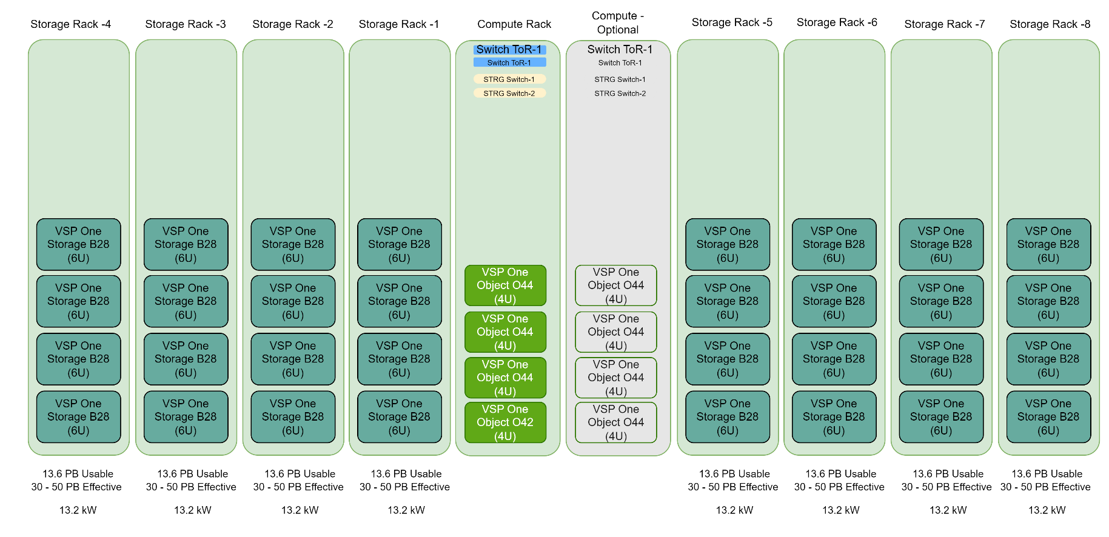
100+ PB Environment

Slide 34
Hitachi iQ AI-Ready Infrastructure with NVIDIA DGX or HGX
AI Software Stack
NVIDIA AI Enterprise
Enterprise-class platform for AI training
End-to-End software for accelerated AI pipelines
Production grade pretrained AI models
Accelerated Compute
Fully integrated hardware and software solution on which to build your AI Center of Excellence
Proven reference architectures for AI infrastructure delivered with Hitachi's leading storage technology
Switching
400Gb Ethernet & NDR InfiniBand Connectivity
Highly scalable & self-healing network capabilities
High-speed, extremely low-latency, and scalable networking
High-Performance Parallel Filesystem
Accelerated filesystem to match the mixed AI workload
Modern consumption improving AI workloads (NVIDIA GPUDirect®, POSIX, S3)
Latest generation platform to support the highest concentrated workloads
Native data offloading capabilities to support better economics at scale
Scale-out Object Storage Tier
Object storage density to provide best storage economics at density
Erasure coding protection designed for large scale volumes of data
Data reduction & compression for ultimate capacity efficiency
Notes:
Link to AI Enterprise details: NVIDIA AI Software Platform for Enterprise
automatically manages tiering of data between high-performance, NVMe-based storage, and low-cost object storage

Slide 35
Virtual Storage Platform One Object
FAIR Ready
Object
Findable
Accessible
VSP One Object assigns globally unique identifiers to each object and includes rich metadata, making it easier to locate and retrieve data
VSP One Object ensures data is accessible through standard protocols and APIs, allowing seamless access and integration.
Interoperable
Reusable
VSP One Object supports standardized formats and vocabularies, ensuring data can be used across different systems and applications.
VSP One Object includes detailed metadata and clear usage licenses, facilitating data reuse in various contexts.
Notes:
In essence, we’re moving beyond just storing data—

Slide 36
Thank You

