Slide 1
Intro to SL SWG
Massimo Meneghetti (INAF-OAS)

Slide 2
The SL SWG
Coordinators: Ben Metcalf (UniBO) 🇮🇹, Fred Courbin (ICCUB), Rafael Gavazzi (LAM)
Wiki on redmine: https://euclid.roe.ac.uk/projects/slswg/wiki/Wiki
Slack channels:
swg-strong-lens
swg-strong-lens-*: citizen science, lens detection, discussion, modeling, simulations
dr1-kp-sl-*: 1-ml-search, 1-gg-exploitation, 2-qsolensing, 4-clusters
General telecon every Wednesday at 16:00 (CET/CEST)
Other focused telecons happening during the week

Slide 3
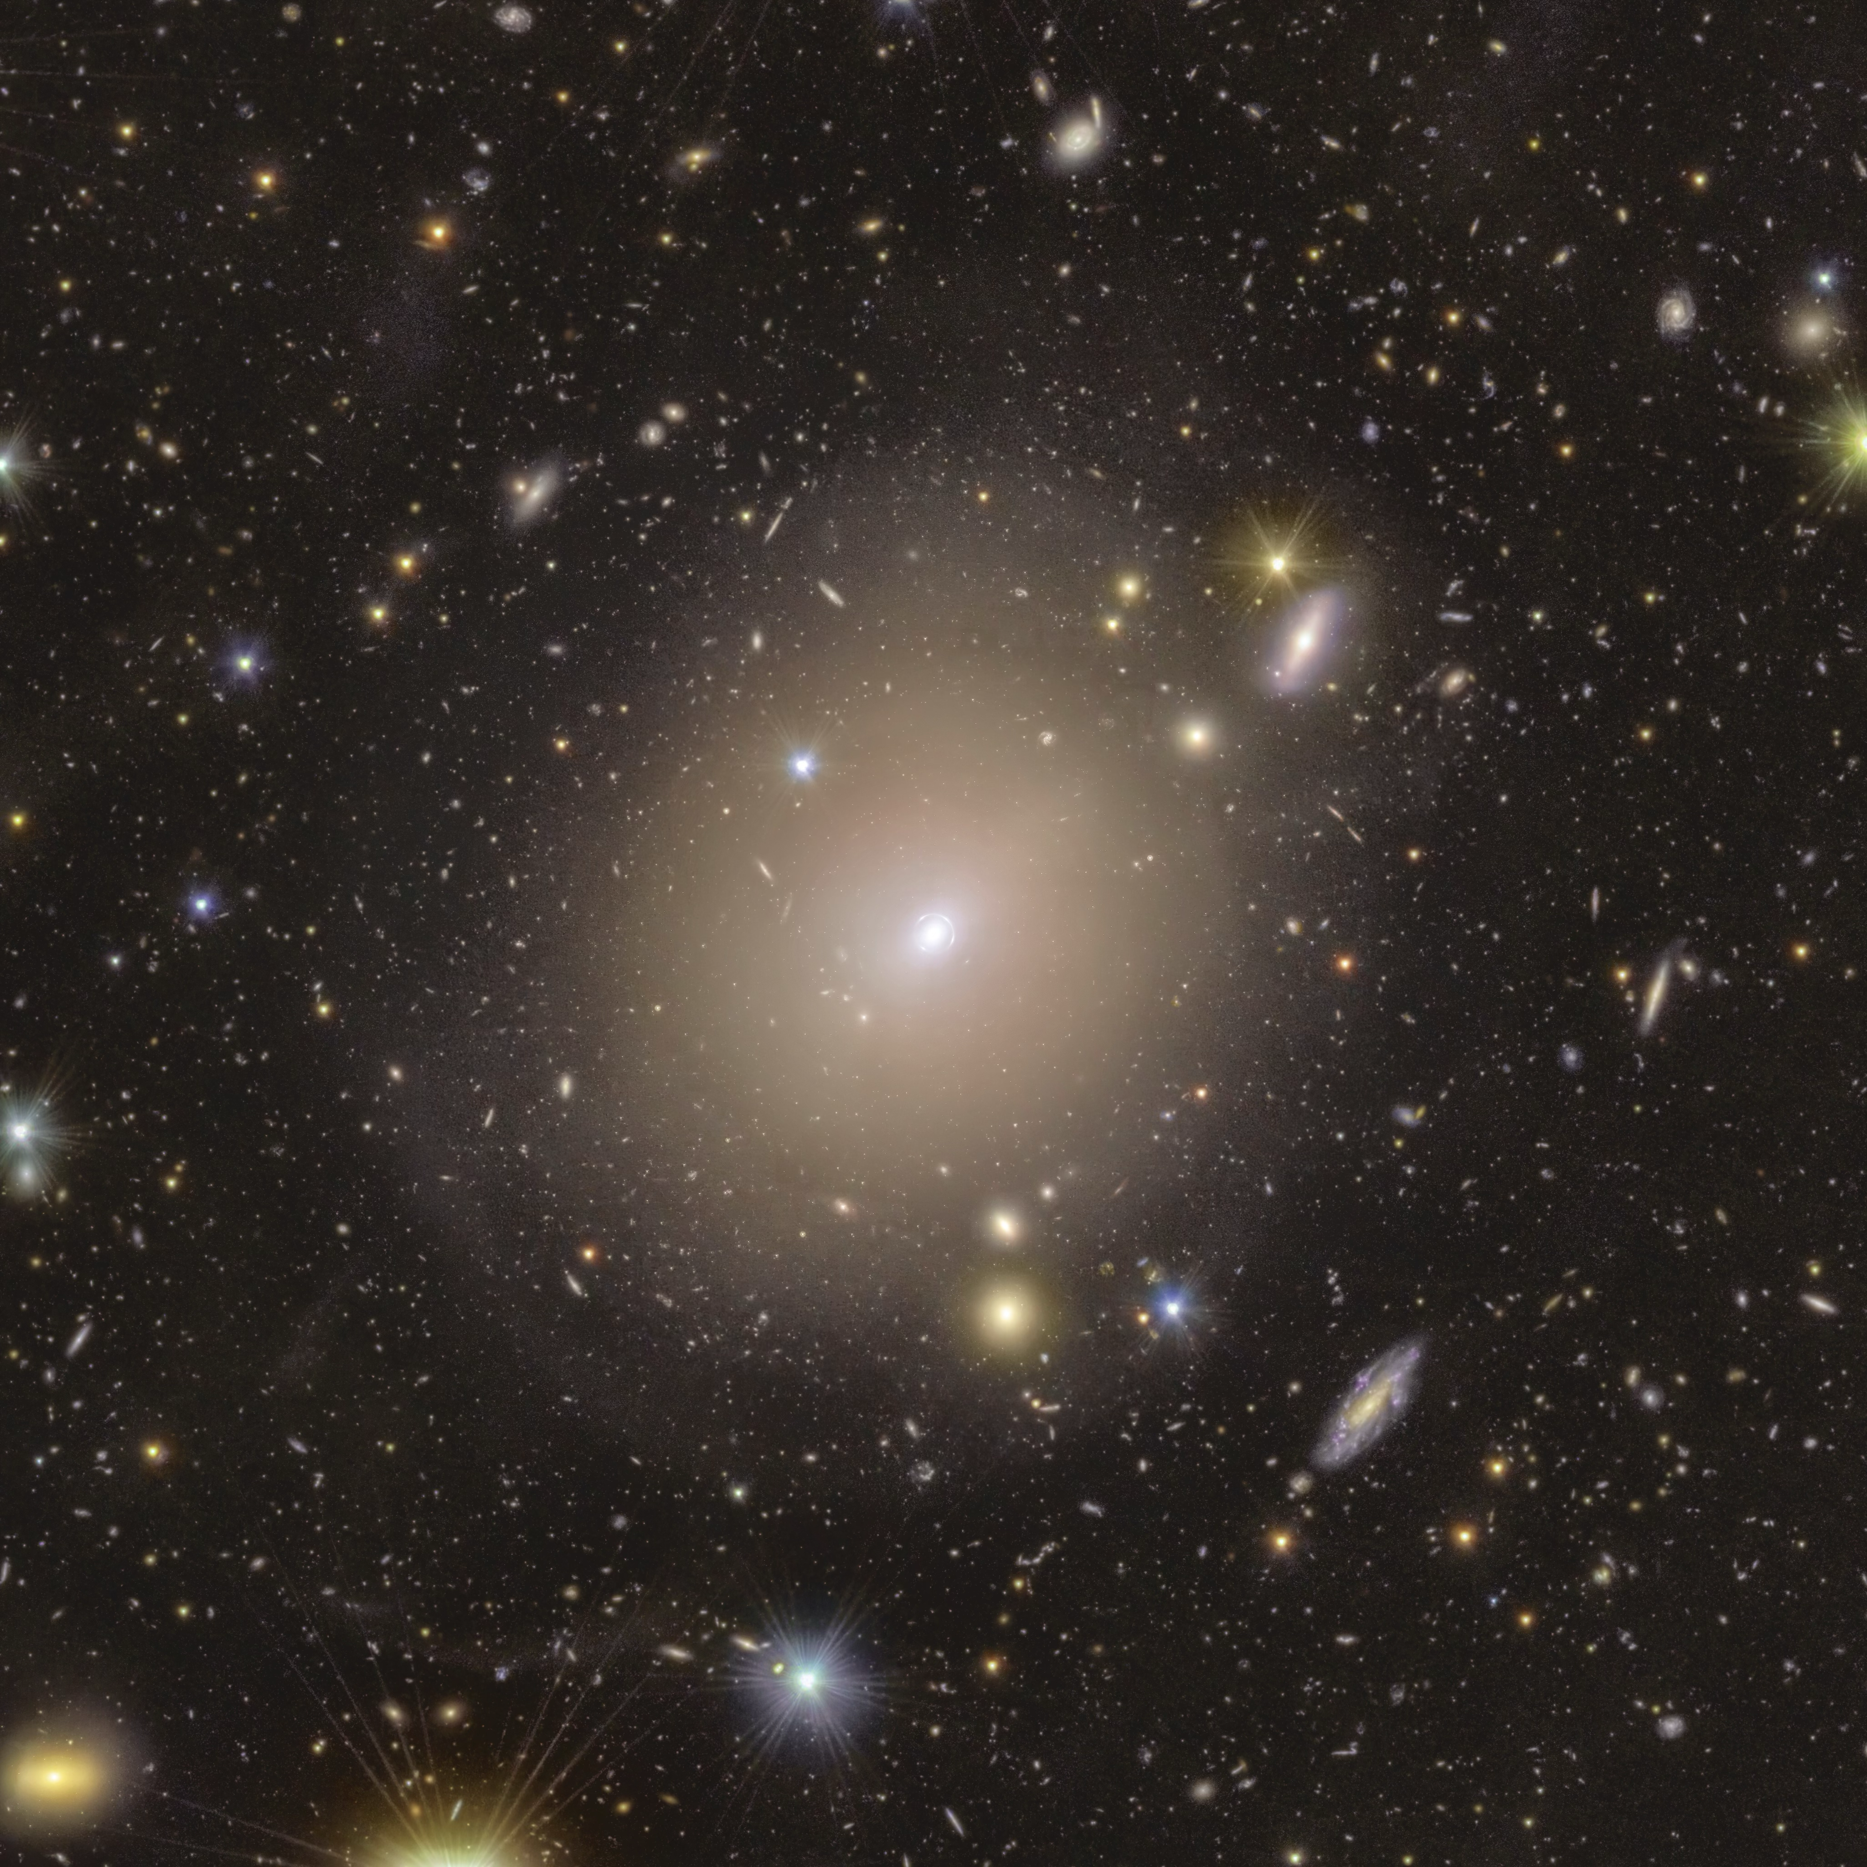
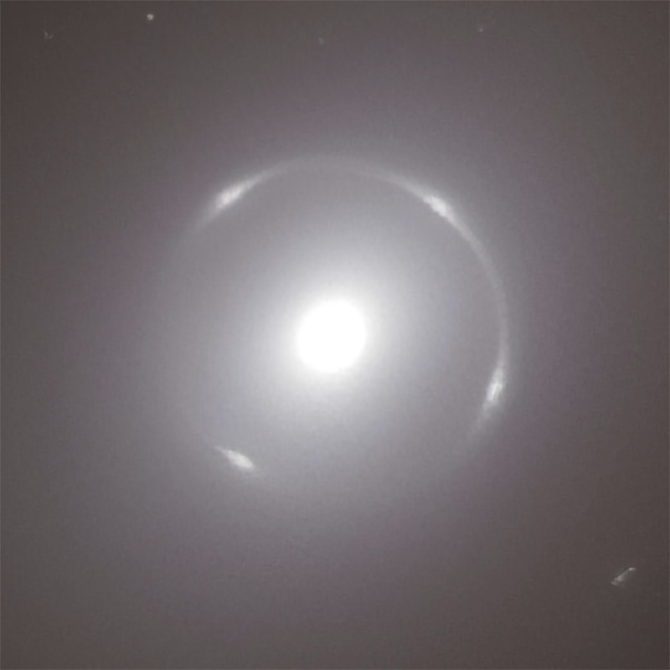
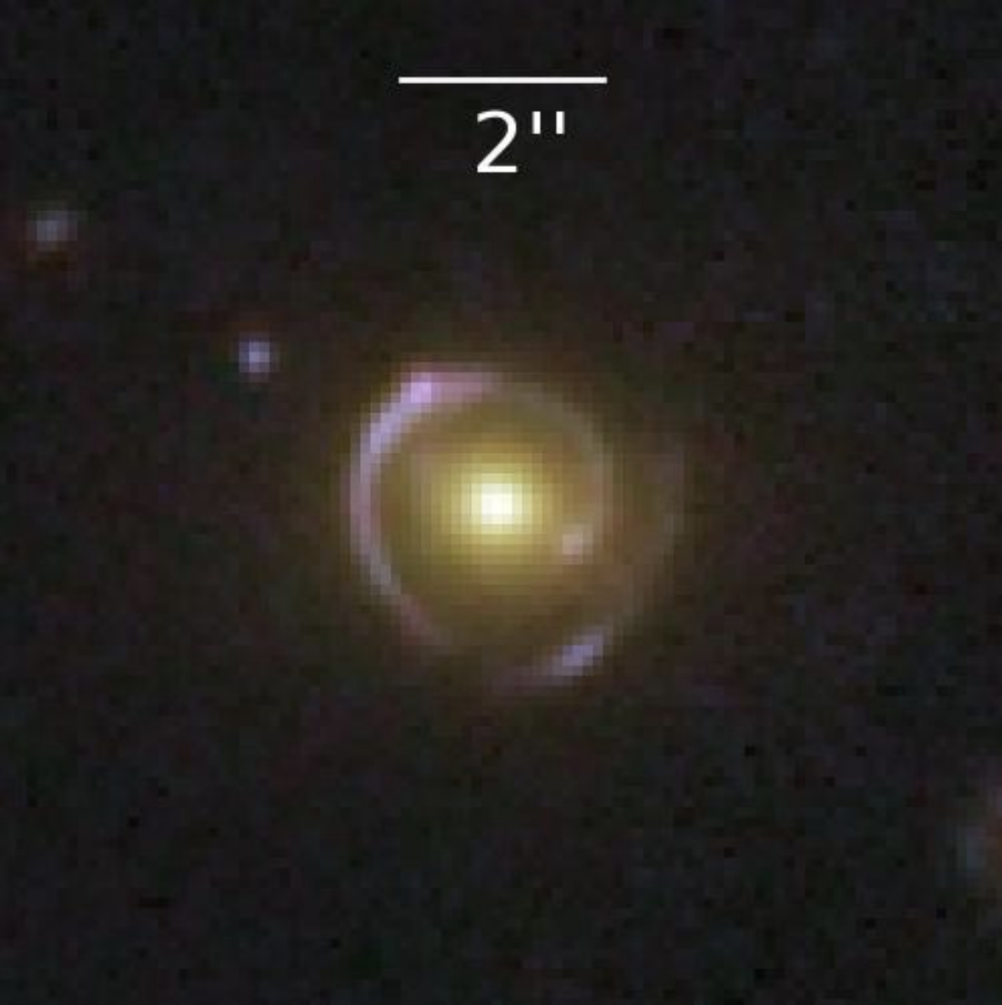
Goals
Finding strong lenses:
~100000 galaxy-galaxy, galaxy-QSO
~10000 groups, and clusters
Exploiting the lenses:
Dark vs baryonic matter: the nature of dark matter, galaxy formation and evolution
SL cosmography: distance ratios, time delays (dark energy, H0)
Cosmic telescopes (super-magnified sources, super-lenses)
Methods:
Machine learning
Citizen science, visual inspection
Mass inversion (requires redshifts)
Lens statistics
NGC6505 (O’Riordan et al. 2025)
Snail lens (EC, Li et al al. Q1)
Abell 2390: Abriola et al. 2025

Slide 4
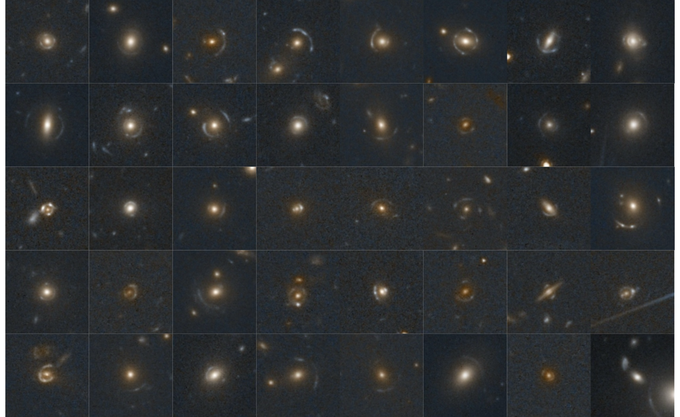
Euclid
40 random lenses discovered by the SL Discovery Engine in Q1

Slide 5
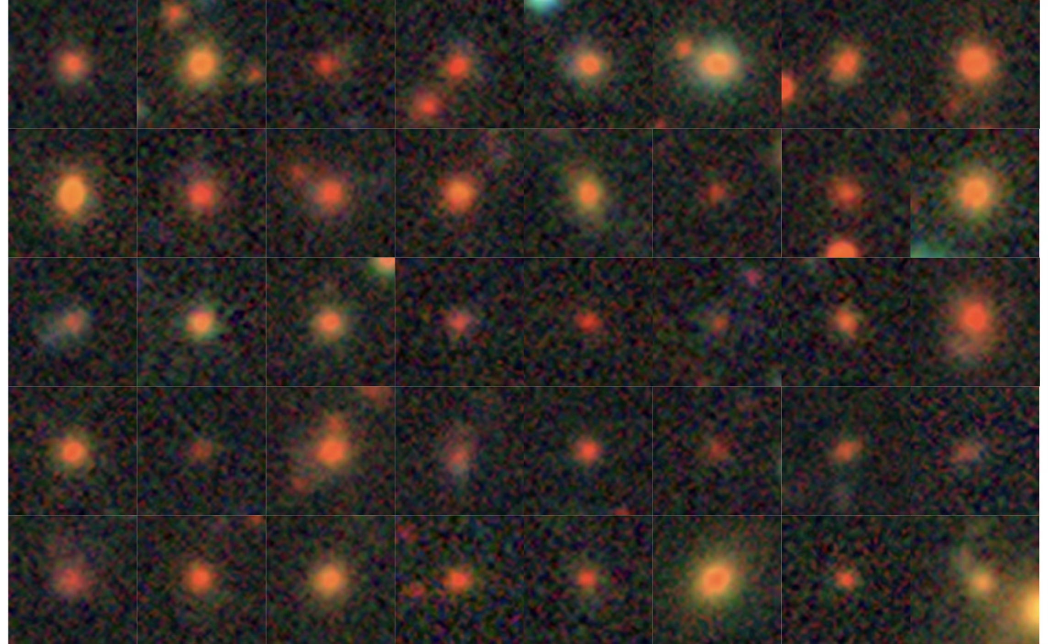
DES
40 random lenses discovered by the SL Discovery Engine in Q1

Slide 6
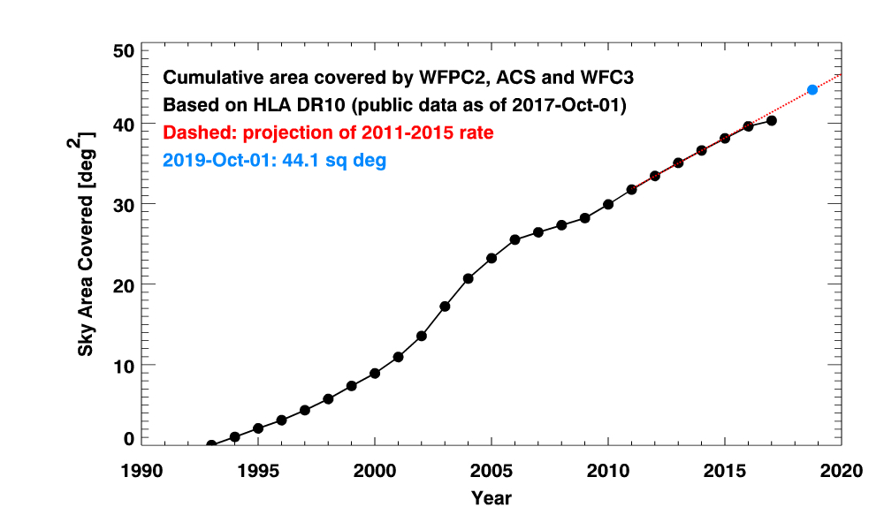
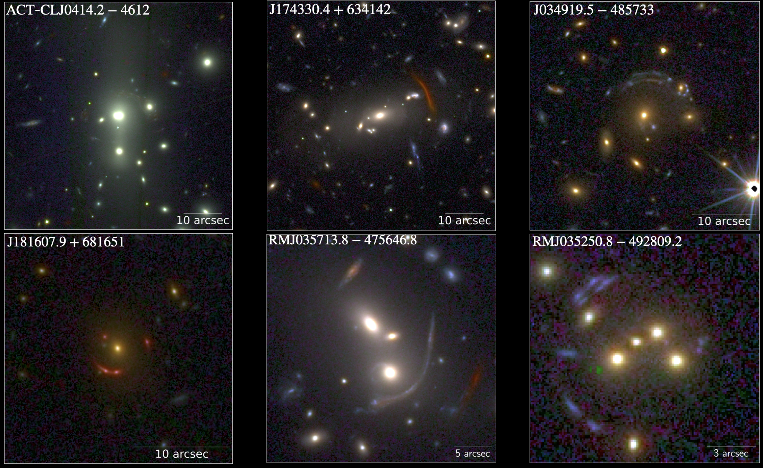
Q1 results:
~500 GGSL candidates
Small ERs ($θ_{E}>0.5”)$
Nearby lenses (NGC6505)
Edge-on galaxies
Double-Source-Plane Lenses
~80 SL clusters
Giant arcs
~80 GGSLs in galaxy clusters
SL merging clusters
40 random lenses discovered by the SL Discovery Engine in Q1

Slide 7
SL Projects (Q1/DR1)
Q1/DR1 Key projects :
DR1-KP-SL-1: First catalogs of galaxy-scale strong lenses in Q1/DR1 (Giulia Despali🇮🇹, Stefan Schuldt🇮🇹, Thomas Collett)
DR1-KP-SL-2(-3): First Catalogs of lensed and lensing quasars in Q1/DR1 (Dominique Sluse, Eric Slezak)
DR1-KP-SL-4: Validating the strong lensing cluster analysis with Q1/DR1 data (Pietro Bergamini🇮🇹, Ana Acebron, Massimo Meneghetti🇮🇹)
DR1-KP-SL-5: Characterizing gravitationally lensed sub-mm galaxies in Q1/DR1 (Stephen Serjeant)
Joint KP :
DR1-KP-JC-3: Halo mass profiles from combined strong and weak lensing (Raphael Gavazzi, Mauro Sereno🇮🇹)

Slide 8
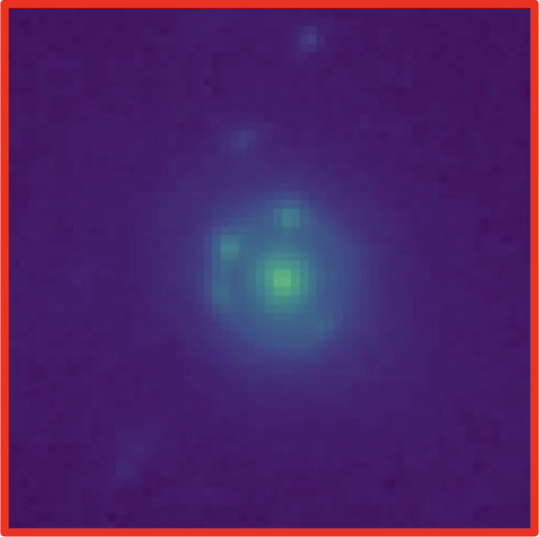
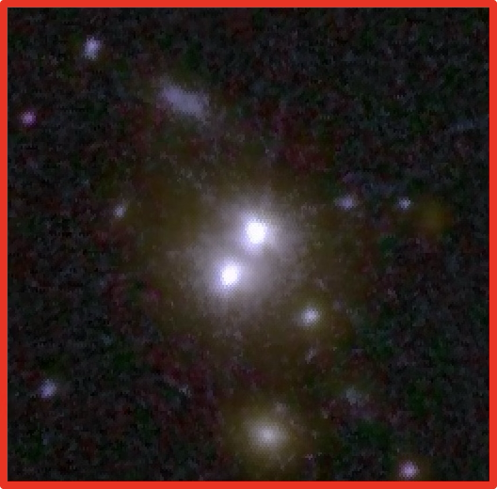
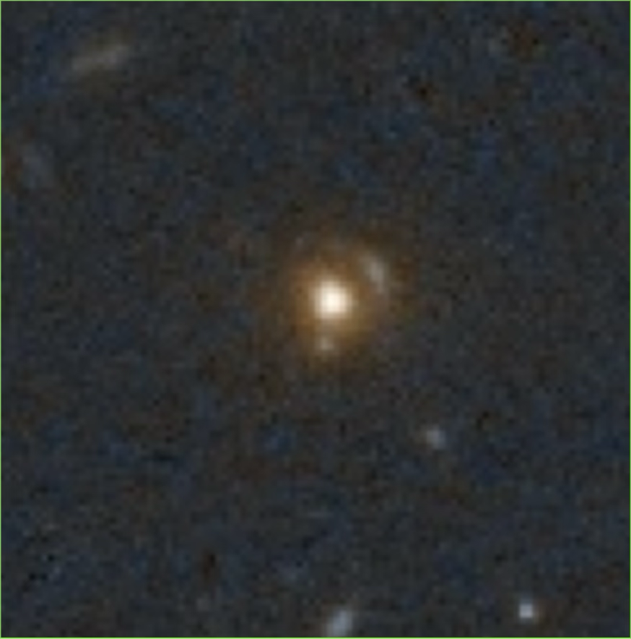
DR1-KP-SL-2(-3): SL QSOs
Goal: Catalog of lensed AGNs and lensing by AGN
 | Pixel level | Catalog level | Hybrid
Methods | Convolutional Neural Networks (CNN) | Extremely randomized trees (ERT) + Falor & Schechter ellipses | - Citizen science - Astrometric shift w. λ - 2D Euclid Spectra - (Chan + 2022 method)
Teams | L. Ulivi🇮🇹 , I. Andika, N.Lines, K. Rojas, E. Slezak | L. Delchambre, D. Sluse, E. Slezak | Knud Jahnke, J. Acevedo Barroso, N. Jackson, L. Moustakas
Inputs | Quasars candidates from GAE and/or MER + image cutouts | Point source positions and fluxes possibly filtered w. QSO candidates. | Image cutouts (fits) and possibly filtered w. QSO candidates
Systems | Doubles, quads, and dual AGNs | Quads | Doubles, quads, lensing BY QSOs, (dual AGNs)

Slide 9
DR1-KP-SL-5: lensed sub-mm gals
Goal: Catalog of lensed sub-mm galaxies
Visual inspection (through Zooniverse) of Euclid cutouts with Herschel overlaps

Slide 10
Other synergies
Collaboration projects:
Lensed Transients: collab. with the Transients WG (Sherry Suyu)
Visual inspection of clusters fields (CLSWG)
With the SGS:
OU-SHE (pipeline, Hubert Degaudenzi, Benjamin Clement)
Spectroscopy of SLs (Ben Granett 🇮🇹, Marco Scodeggio 🇮🇹, Marco Fumana 🇮🇹, the ELSA team)
Photo-z of SLs (Andrea Enia 🇮🇹, Micol Bolzonella 🇮🇹)

