Slide 1
EUCLID +
Since the original proposal it was clear than one of the biggest benefits from Euclid data was to be able to carry multi wavelength studies on large areas.
Mostly for Legacy but also for Cosmology, e.g. X ray clusters and XCMB).
A quantum leap especially for the NIR and morphology

Slide 2
There are several possibilities for multi wavelength studies etc.
those enabling for the main goal of the mission (ground based photometry for photoz, spectra, Spitzer in the deep fields)
using Euclid data (still proprietary) with other public data
using Euclid data (still proprietary) with other proprietary data
over the years there have been several programs which have started/completed by members of EC community, often involving people outside the EC

Slide 3
For the Italian community therefore it is useful to know
what is ongoing/planned
where
why
how many people are involved
POLL
PLEASE
fill it !!

Slide 4
There are several possibilities for multi wavelength studies etc.
those enabling for the main goal of the mission (ground based photometry for photoz, spectra, Spitzer in the deep fields)
using Euclid data (still proprietary) with other public data
using Euclid data (still proprietary) with other proprietary data
What to do
can use when public or can make a proposal for a specific collaboration
can list your project and accept other EC members if they want to collaborate
cases:
other data property of other EC members only: same as case 1
other data property also of few other people: they can become special members, limited to the particular project(s)
other data property also of other large collaborations: you can have a MoU between EC and other collaboration

Slide 5
Just a reminder about DR1 data:
a few passes on deep fields
planned visits on auxiliary (photoz) fields
big areas on the wide
a fill in program done early in the mission during the PSF stabilisation periods: a proto EMDS (medium deep survey)

Slide 6
Euclid Medium Deep Survey [EMDS]
R. Scaramella & R. Vavrek (ESA) & B. Granett (INAF) & many others
Rationale
Most/all large astronomical surveys have a wedding cake shape with three levels of area x depth:
wide (large area, small depth)
medium (…)
deep (small area, large depth)
In this way one can effectively sample different parts of the discovery space
In his baseline Euclid had the wide (main goal) and the deep parts (also for sample characterisation), so it lacked a medium part by design.
Notwithstanding, the idea was studied in the past (2018+) but it could not fit easily in the base plan and ESA did not want to touch yet the unallocated time. But ECSURV studied what/where could have been observable with N repeats in the unallocated time periods

Slide 7
Sesto Meeting on Euclid Survey(s)
Last week of June 2019
DONE
Fantastic place, relaxed & fruitful atmosphere
Get in touch to participate
discuss problems and NEW ideas
Euclid Medium??!?!?!
USUAL WEDDING CAKE:
it is “missing” an area
mag+1, ~300 sq deg

Slide 8
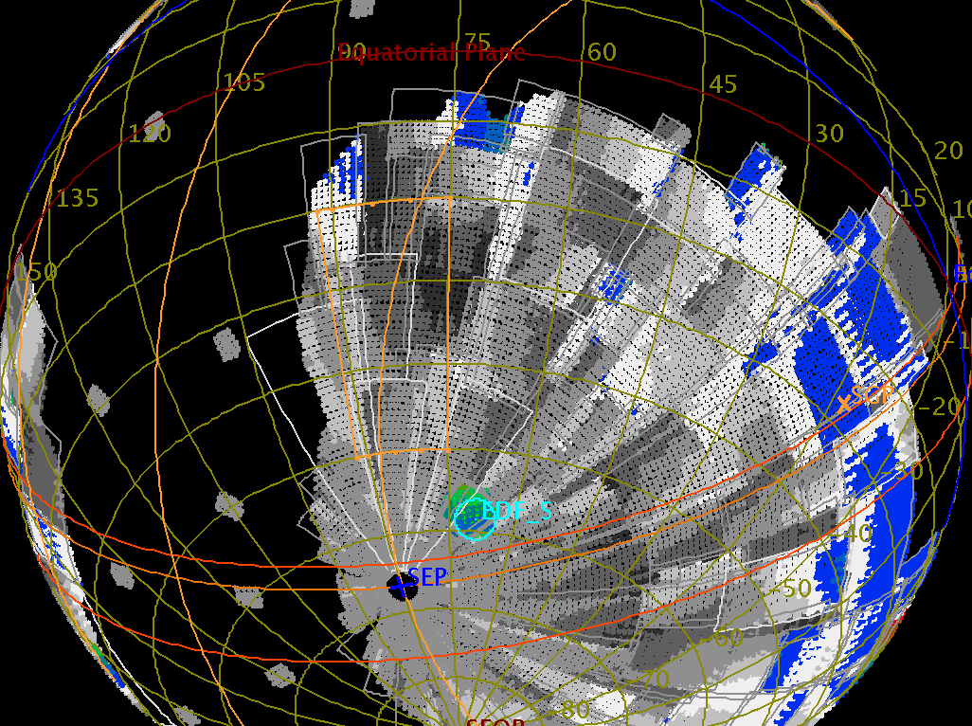
Bonn meeting: an interesting idea to explore (with some drawbacks)
We have 10⁴ degrees observed once + 40 sq degs 2 mags deeper
RA 75 deg to 92 deg
DEC -20 deg to -50 deg
It is missing a medium-deep field of ~few 10² square degrees observed 1 mag deeper
Use unallocated time at the late phases (~150 days) & not observe the worse regions (~1–2 10³ sq degs) so to add 5 passes -once per year (?)- to a wide field contiguous area of 200–400 sq degs. Problem: need deeper ground based photom but LSST would cover this area. All this has to be still looked into

Slide 9
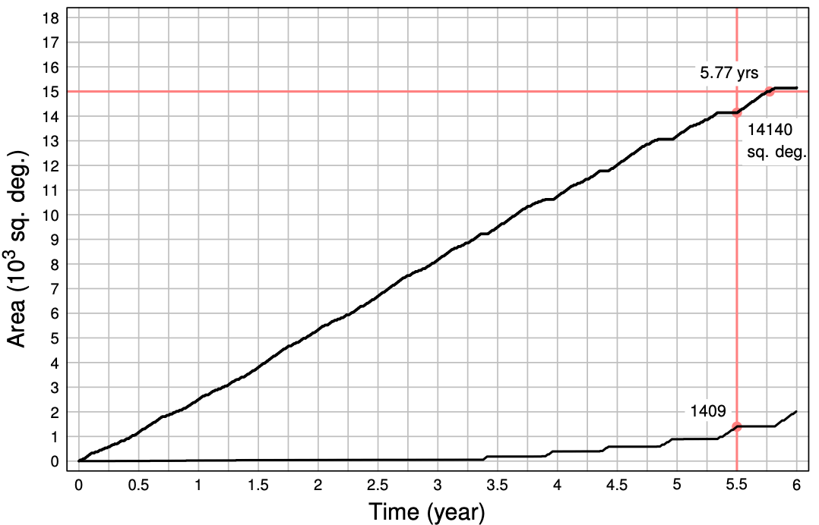
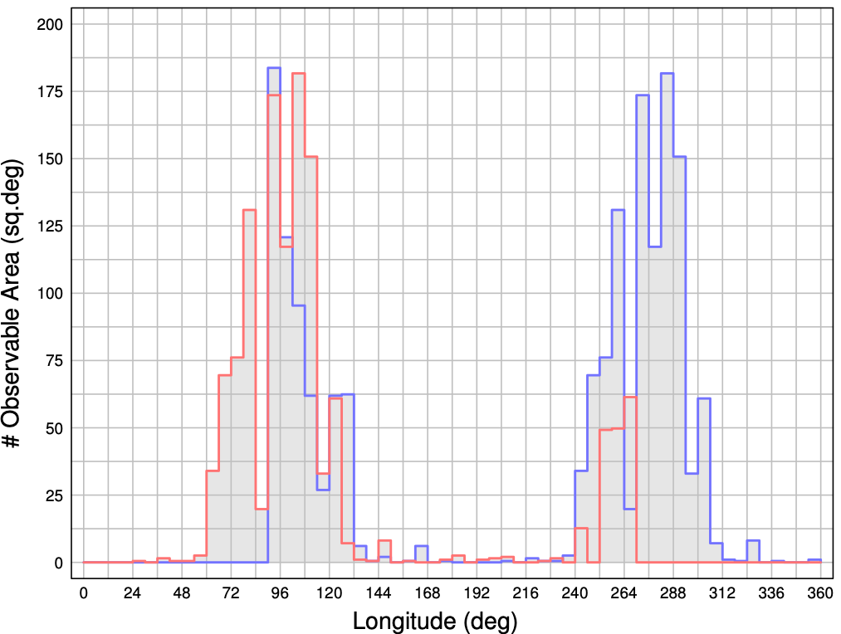
OLD
Unallocated time: ideally, if one was to be able to point everywhere, this would mean to add 5 visits over 300 sq degs: need ~ 1500 sq deg
Helsinki Survey: equivalent unallocated area ~2000 sq deg (+ ~2 months from reduction of std cycle= +600 sq degs). Total ~2500 sq deg [ ~8 months] to be used
This maps to ecliptic -3 +20 degrees at ecliptic equator, then grows at Δ/cos(|β|)
Check if this can be used to get an overall better and more reliable mission
with just 1 mo can complete CPCN to EDFN depth
Cumulate vs ecliptic longitude (SAA=90)
Leading and trailing

Slide 10
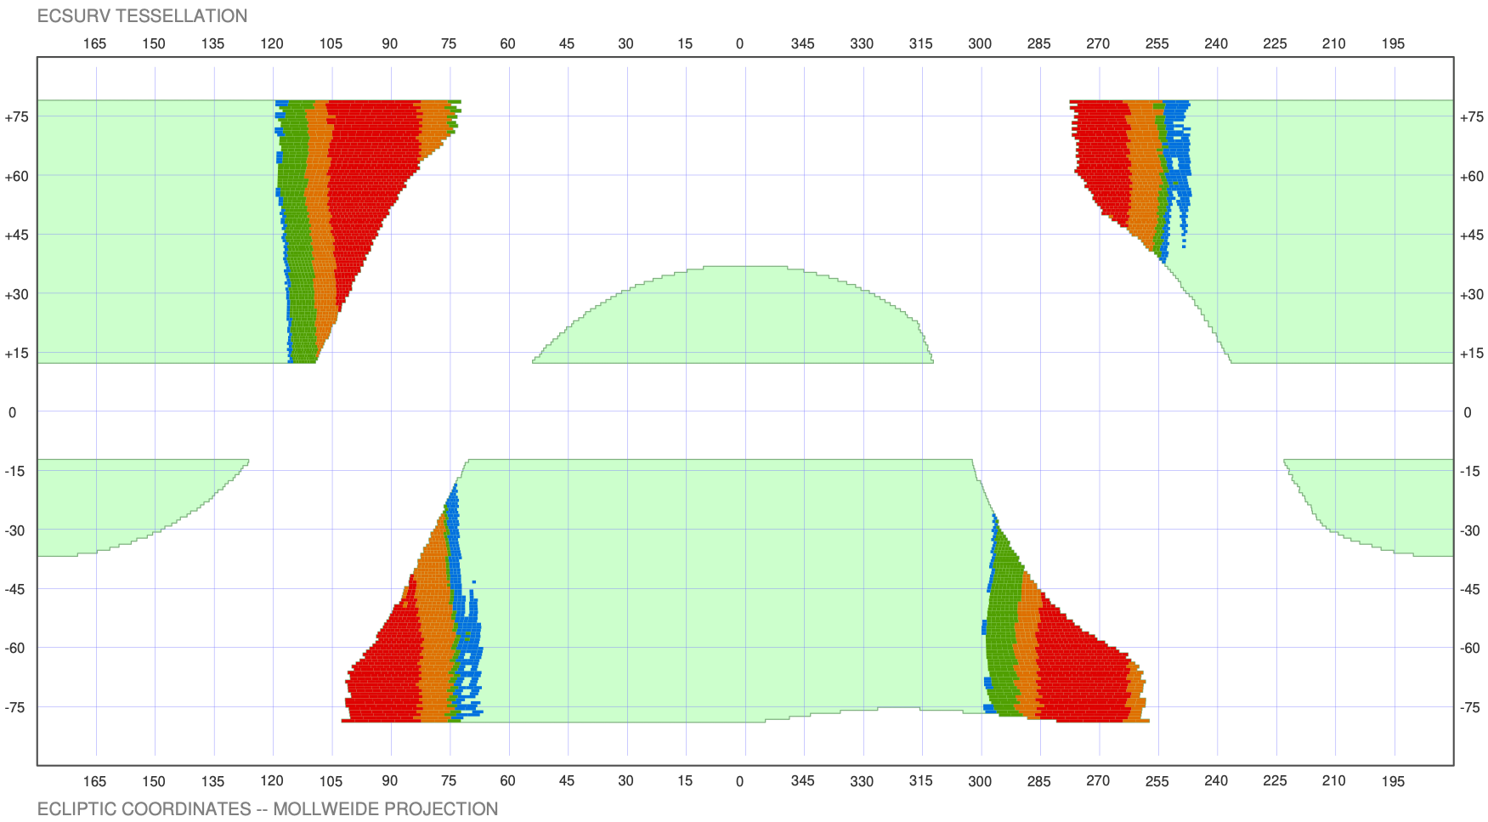
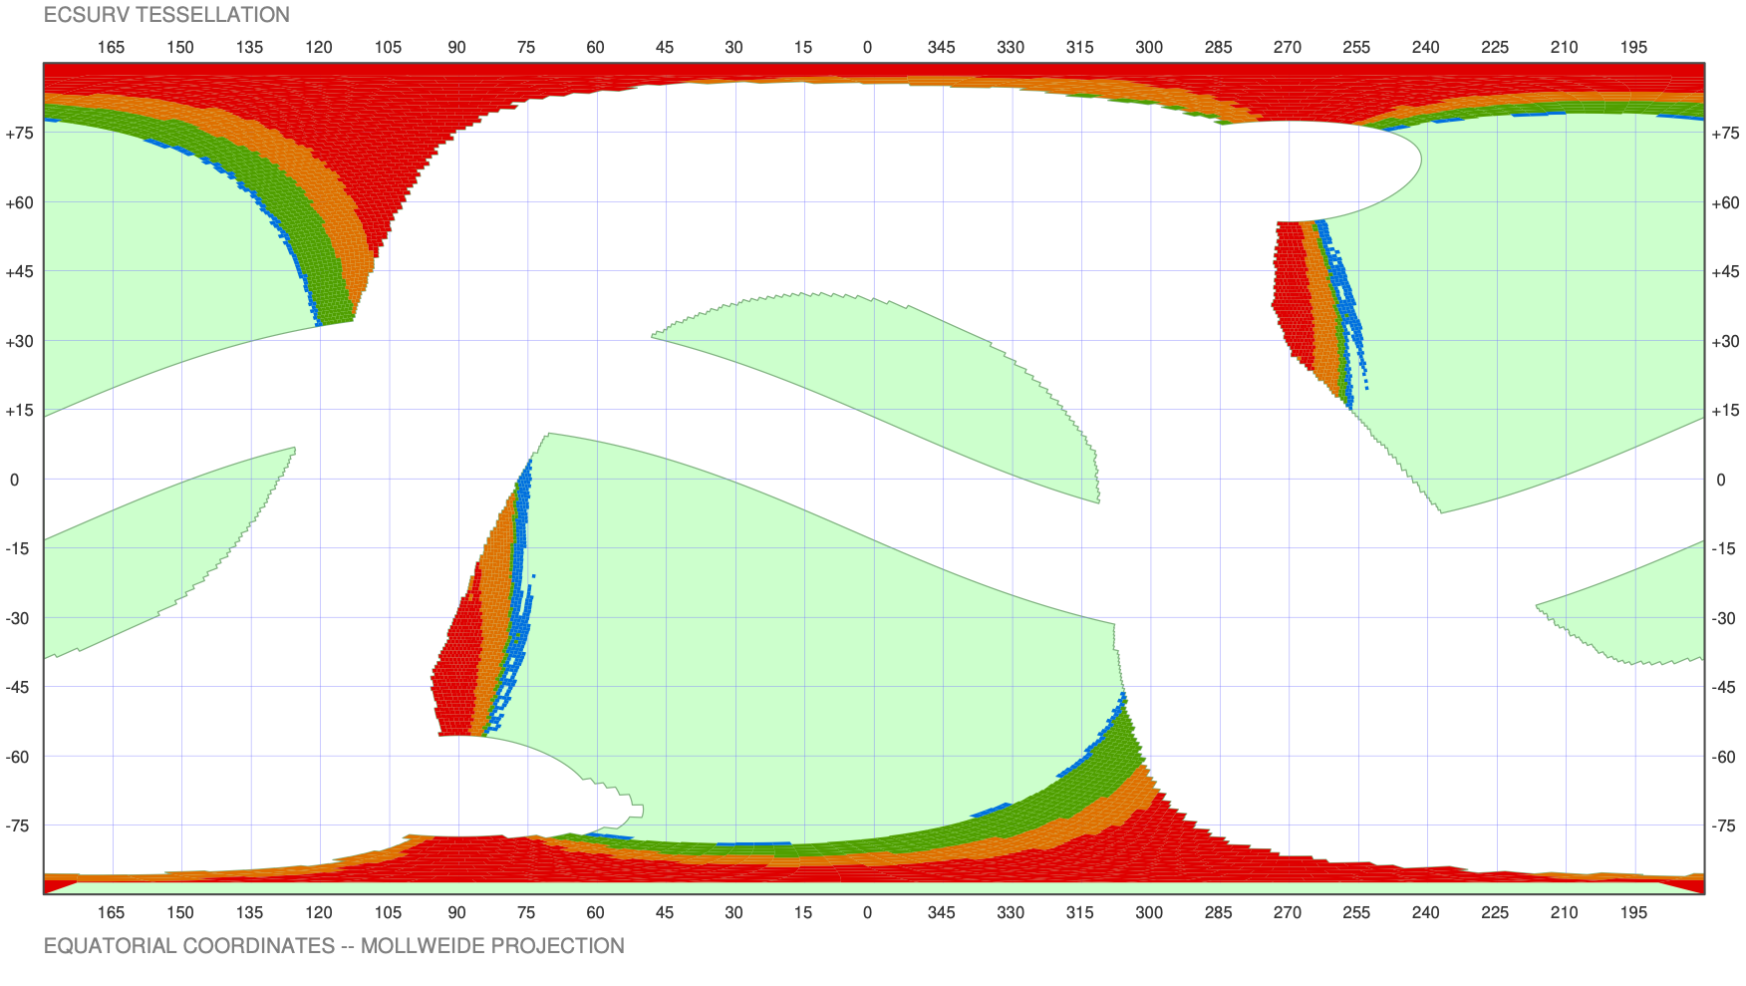
Different colors:
visibility for additional visits
(total here from 4 -green- to 7 -red-)
J. Dinis

Slide 11
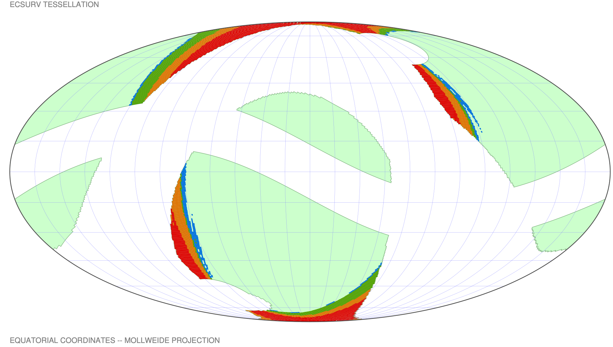
J. Dinis
Different colors:
visibility for additional visits
(total here from 4 -green- to 7 -red-)

Slide 12
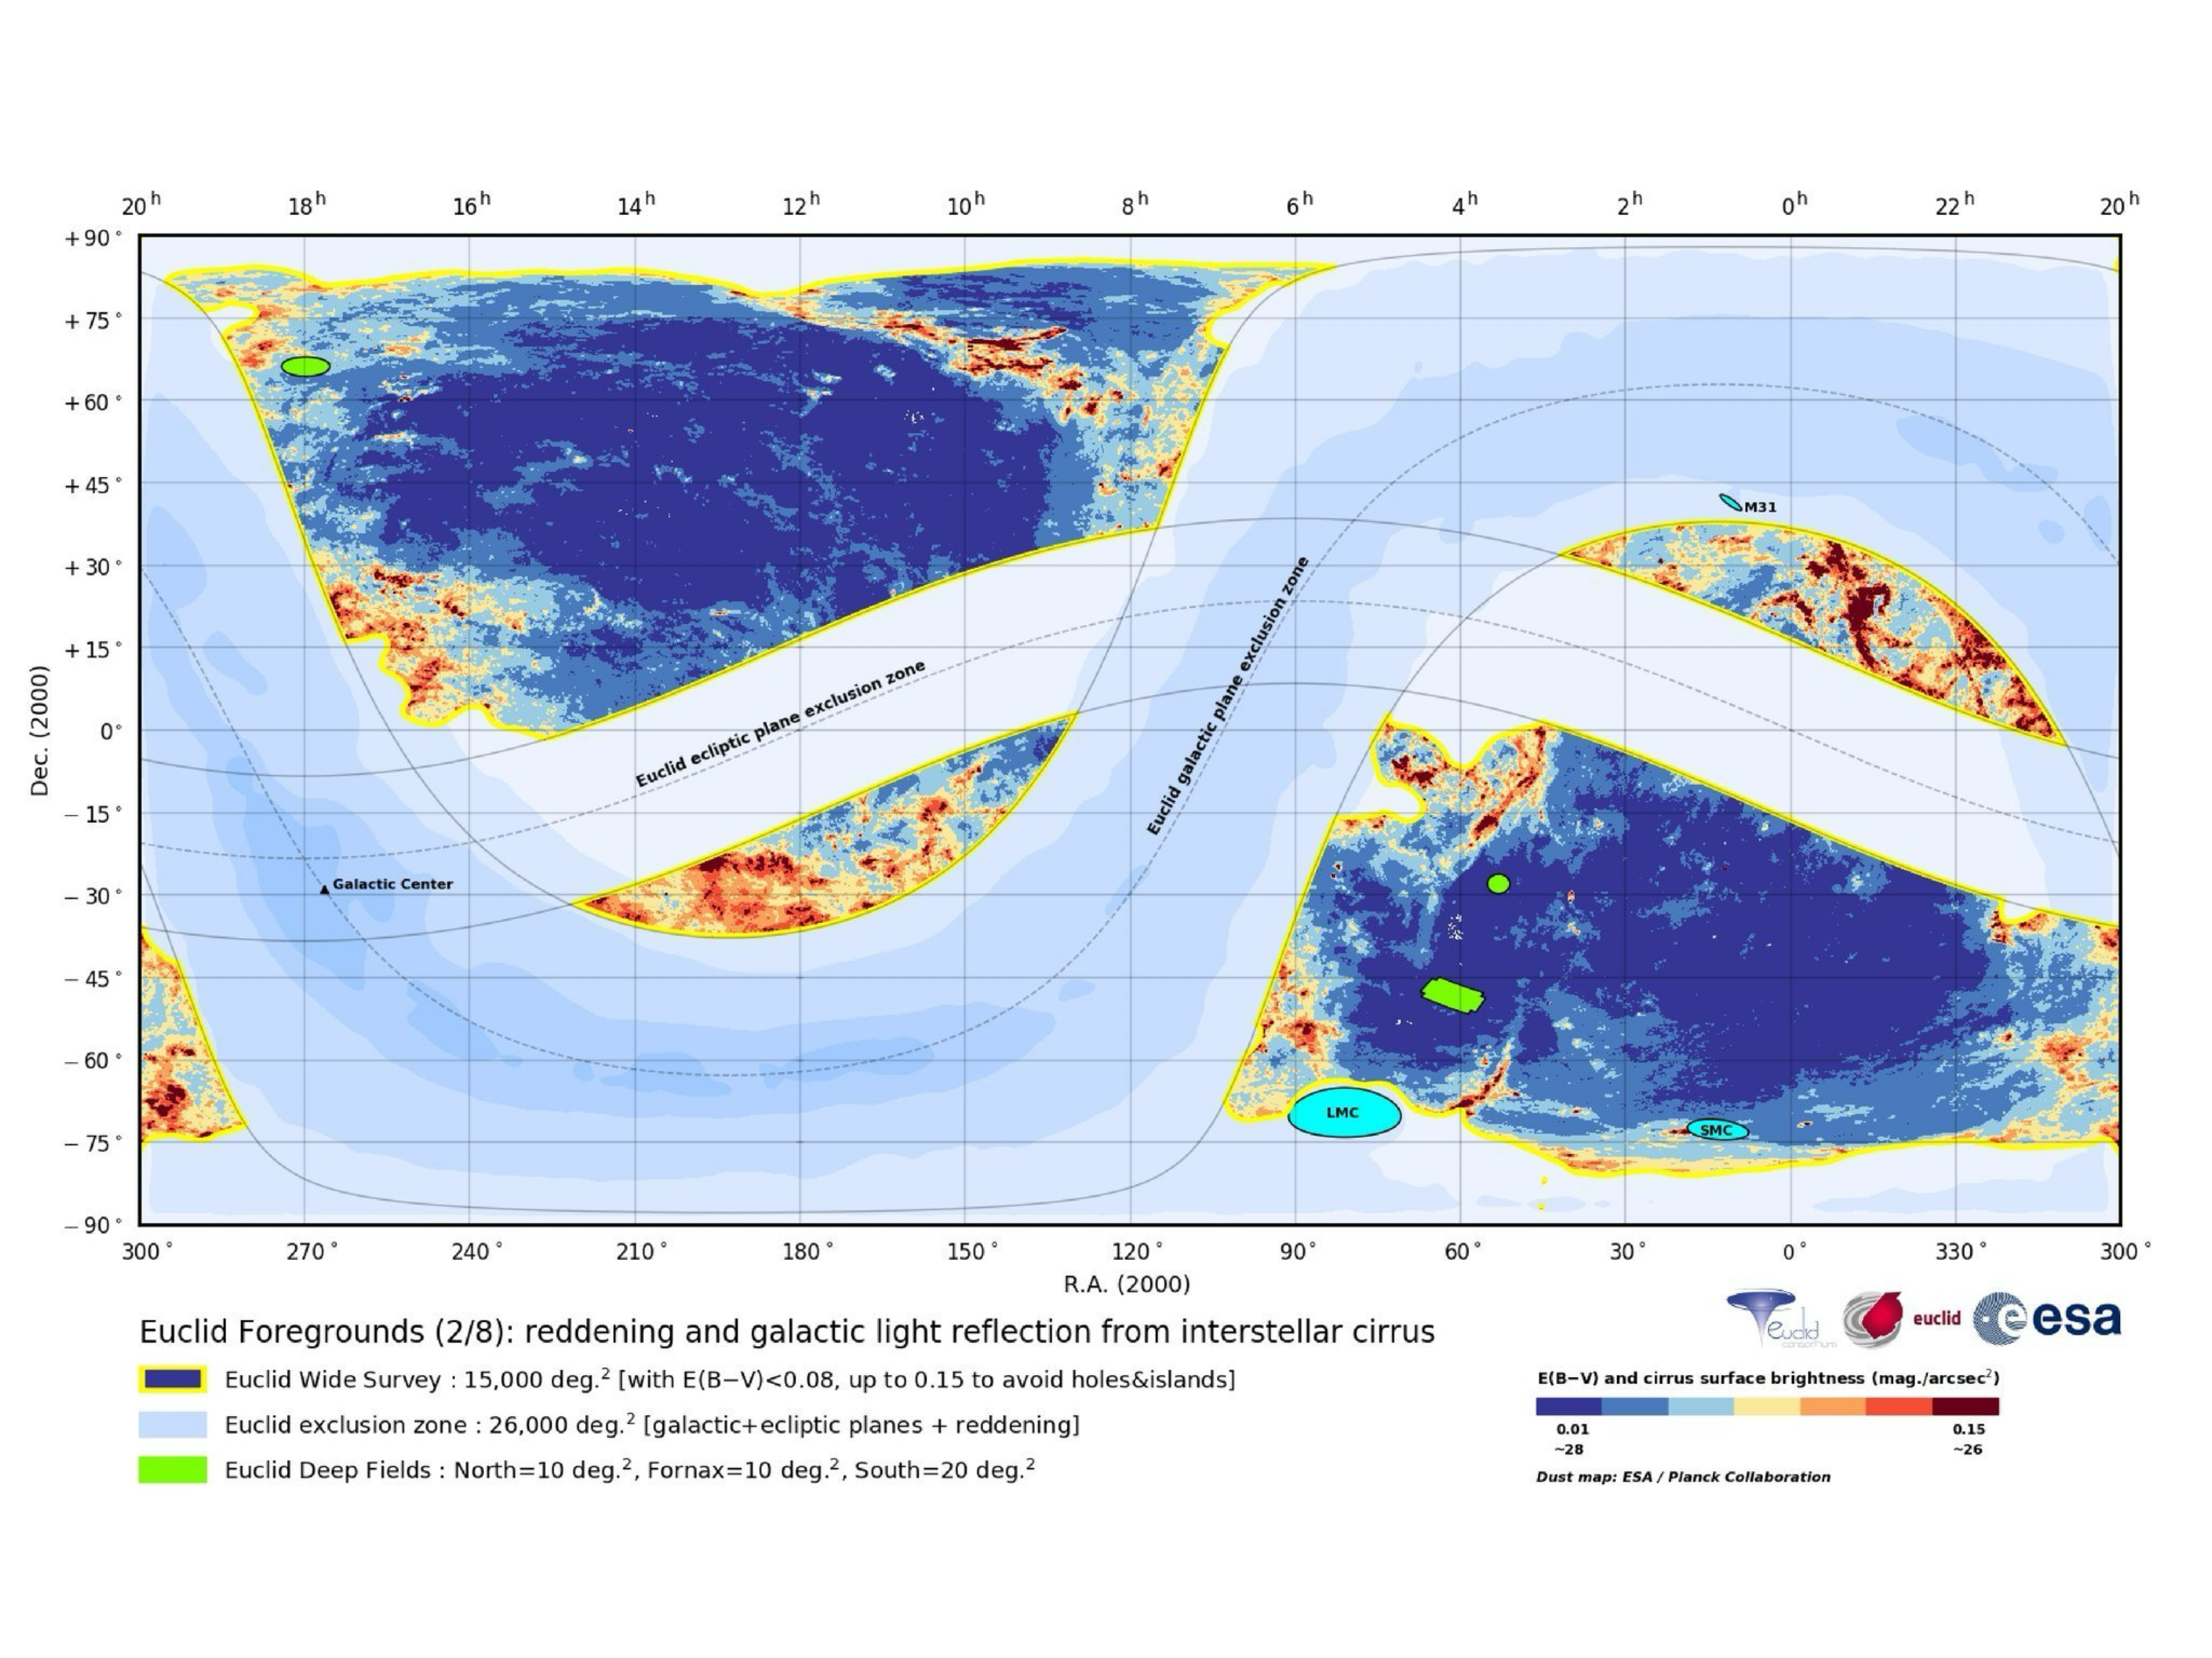
Lots of bad regions in this time window
EMDF
Foregrounds: reddening
Need to check feasibility (EMDF not in scale)

Slide 13
Need to check feasibility (EMDF not in scale)
EMDF
Lots of bad regions in this time window
Foregrounds: reddening
EMDF

Slide 14
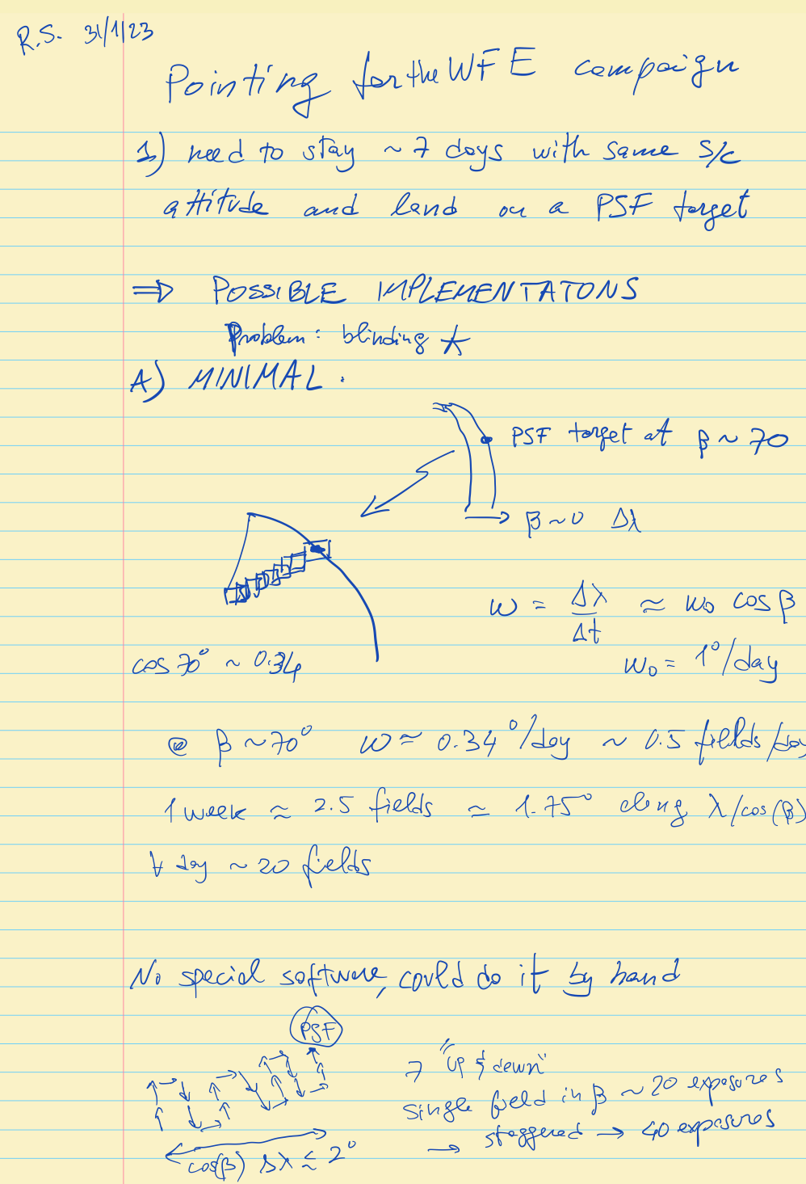
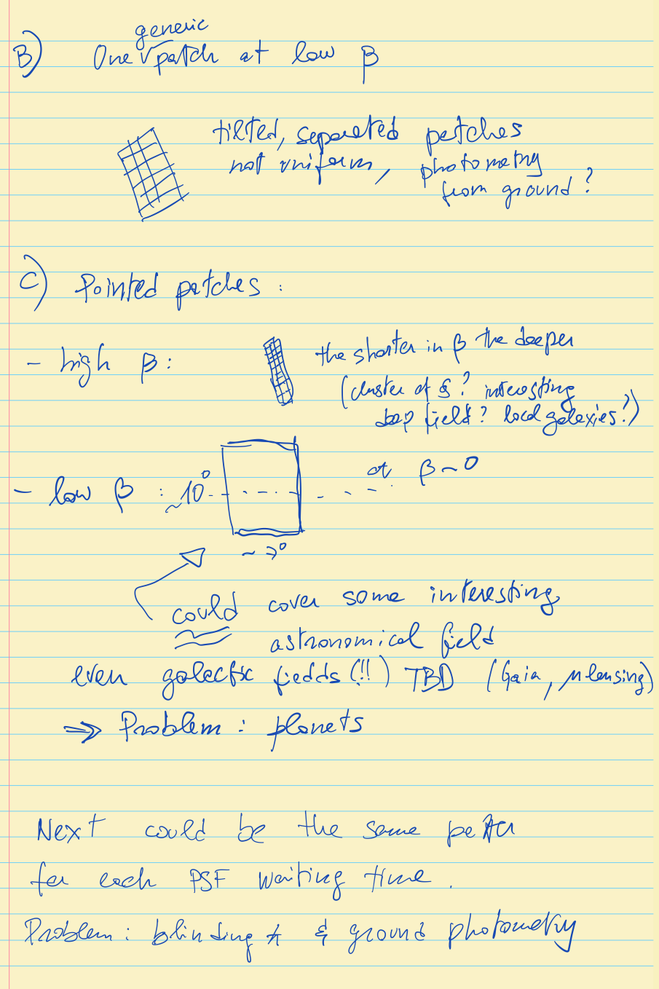
Early 2023: what to do during PDC waiting times? (pointing extremely restricted)
Will be done by SOC
IF (best effort) will be done by SOST

Slide 15
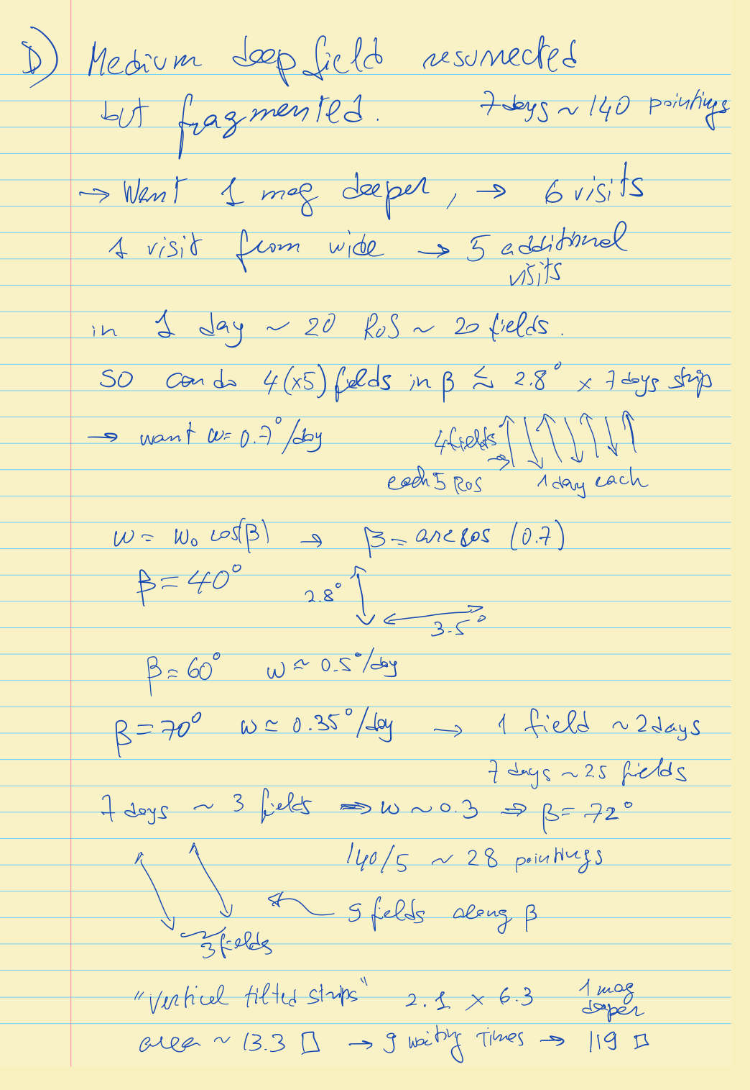
Simple to implement
and useful:
medium depth field
resurrected (but split)
+ 1 mag, ~120 sq deg

Slide 16
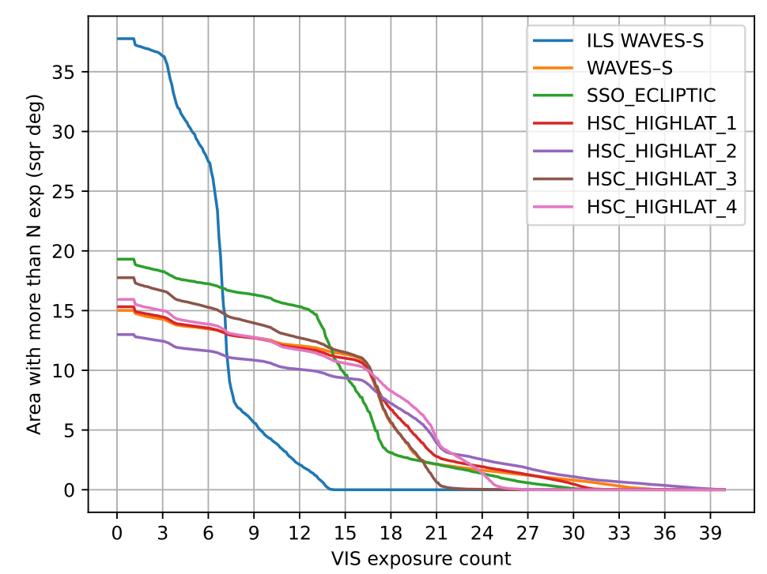
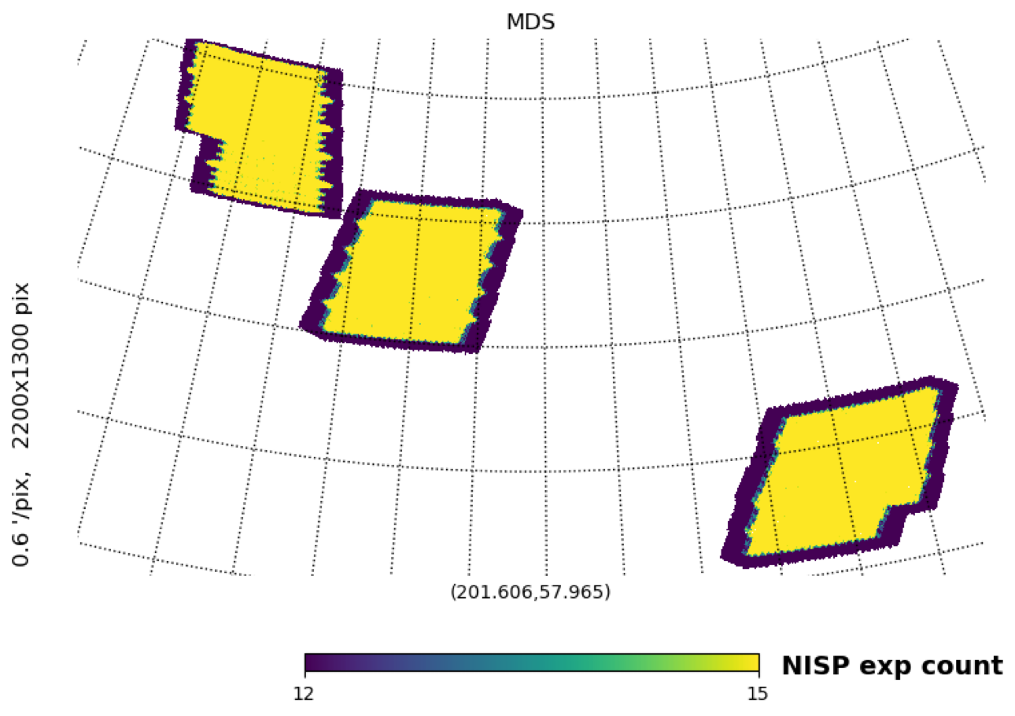
Euclid Medium Deep Survey [EMDS]
Ongoing
R. Scaramellla & R. Vavrek (ESA) & B. Granett (INAF) & many others
Idea: because of complex PSF calibrations during the Phase Diversity/PSF calibration time need to wait ~1 week with practically no degrees of freedom for telcos pointing, use that no-pointing periods to cover x (few) exposures some patches on the sky. Ideally 4 times (2x SNR) —> 6 repeats (+1 mag); within the RoI, so that one more pass will be given by the std wide observations. Quite useful for a variety of checks and for science. Problem is to get adequate photometry from the ground. If lucky, by chance can point areas with known data. Proposal approved by ECL, ECB, EST, ESA
So far ~20 sq deg (TBC) at 4 exposures. Add one visit from the std wide and get 5 passes wrt the iniital aim of 5. Not bad at all, given all the heavy constraints. Pity lack of NISP in some fields
Subaru HSC + Waves fields

Slide 17
EMDS two fold goal:
Repeats on large areas and before the start of the main survey will help a lot to quantify internal errors and spot early possible problems. Extremely important and useful so to early “debug” the system
Scientifically useful for a variety of topics, which will use the additional 53 sq deg from the deep so to beat down cosmic variance.
In addition, could (?) complete and extend in future during the unallocated time or mission extensions (on a competition basis)
Notes:
Not all PDC waiting time was allocated to EMDS (other programs done)
Unfortunately, only “vertical” movements allowed (—> less efficient in multiple coverage)
Unfortunately, only partial NISP coverage because of thermal stability requirements
Observations ended before the start of the wide survey
Reduction is heavy for GS
[TBD!!] Public release for Q2? Aim for internal release to be the same as for DR1 data

Slide 18
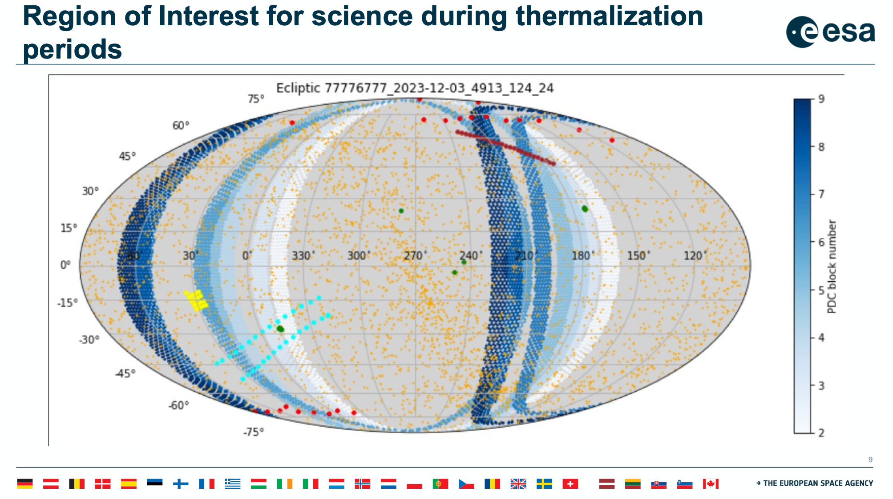
R. Vavrek
Visible strips
3 programs done during PDC waiting times:
Solar System Objects
Independent Legacy Scientists
Euclid Medium Deep Survey
Fields optimised for position, cadence, area, other available data
P. Gomez

Slide 19
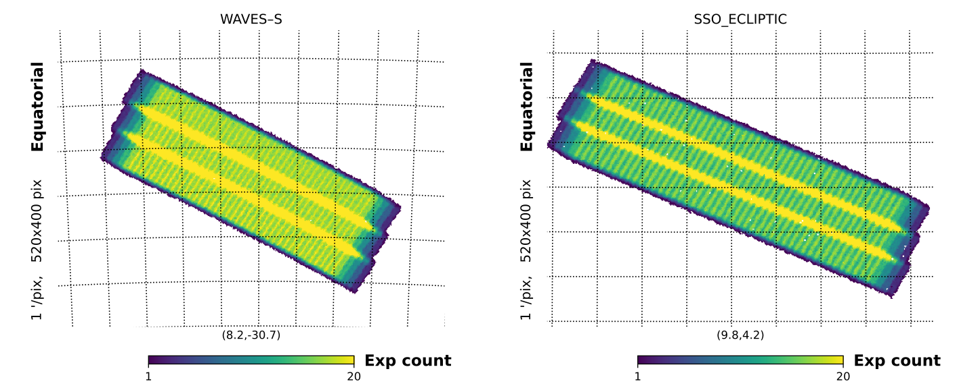
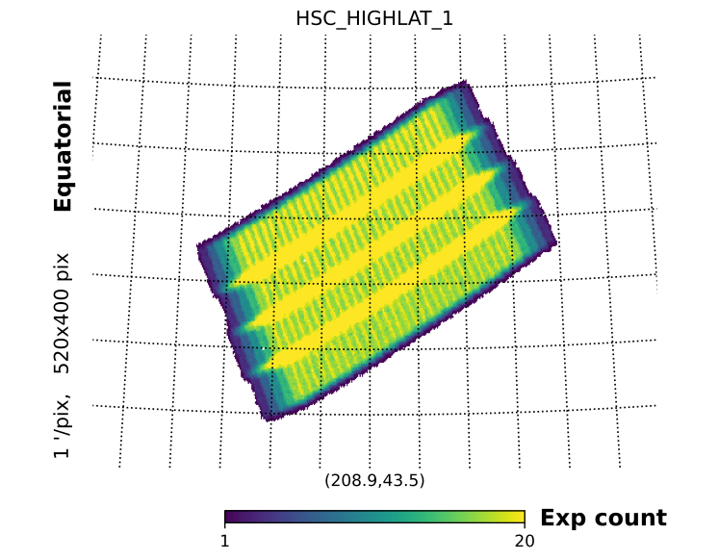
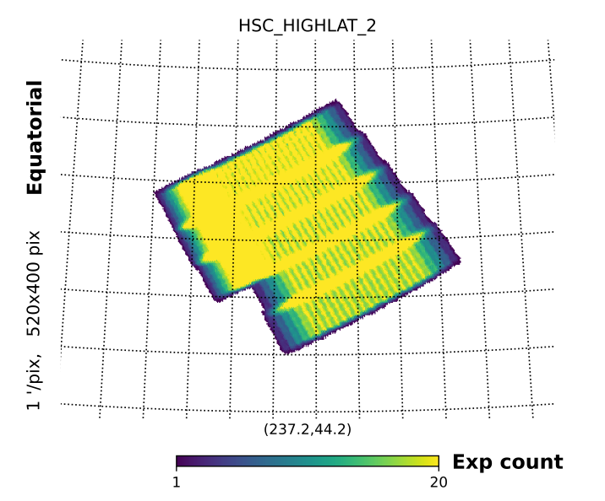
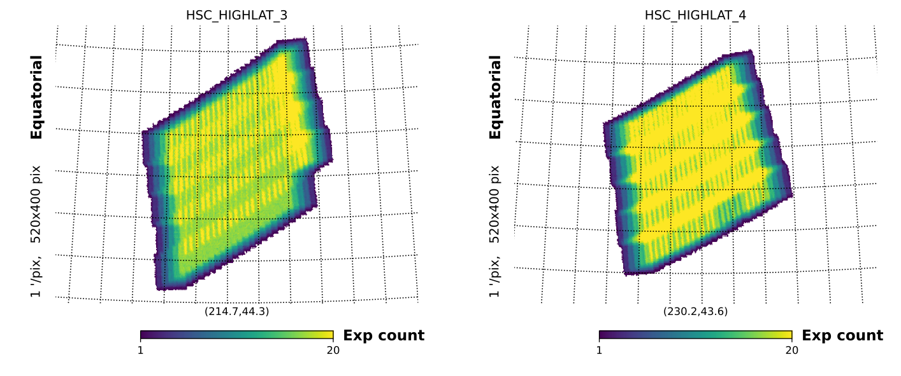
Footprint of the PDC fields
B. Granett
Need to avoid blinding stars

Slide 20
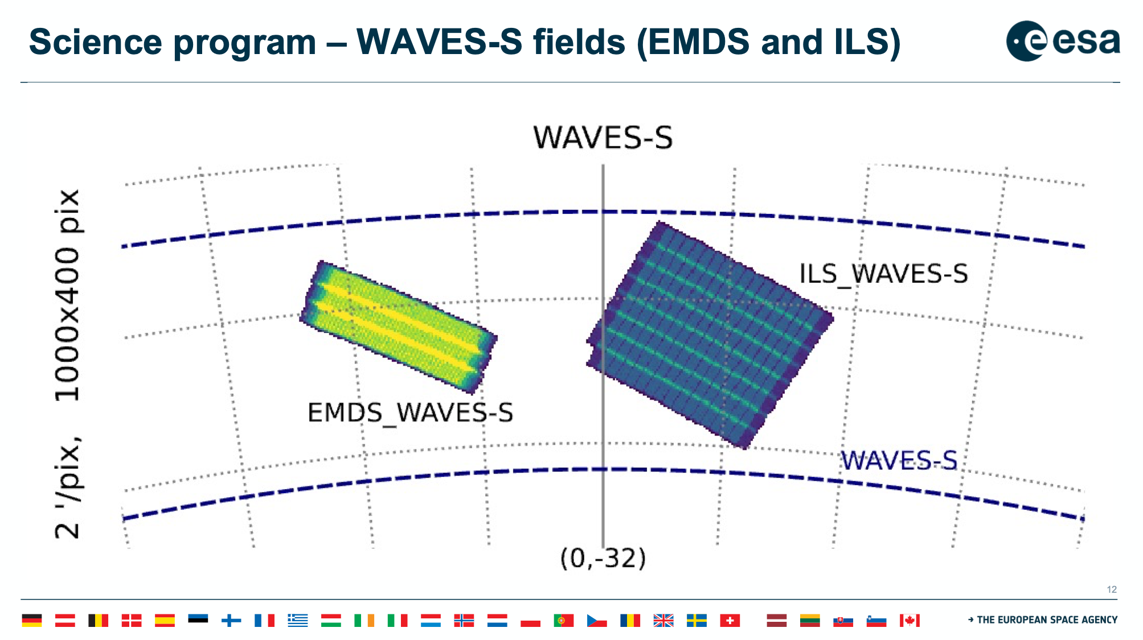
Solar System Objects
Independent Legacy Scientists
B. Granett

Slide 21
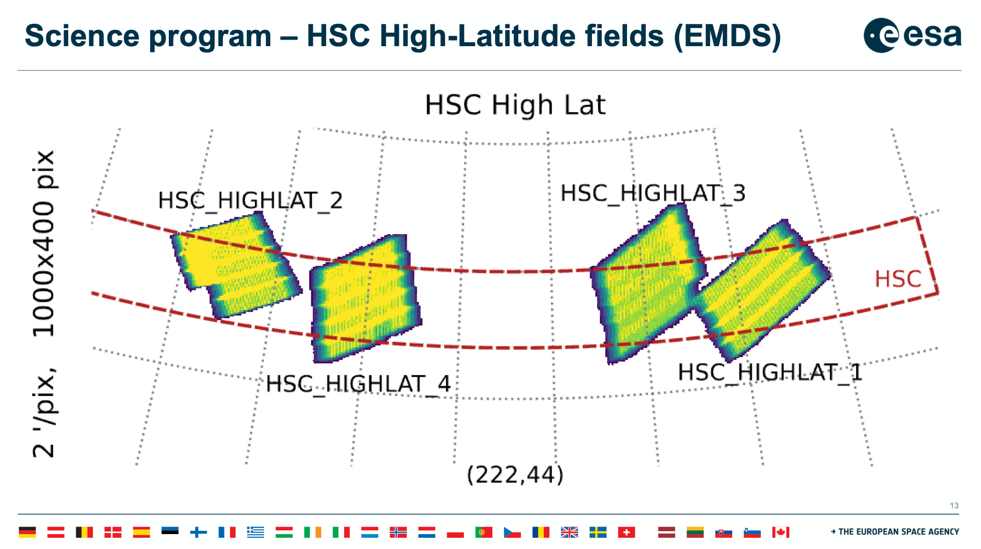
B. Granett
Need to avoid blinding stars
Subaru High Supreme Cam strip gives deep photometry

Slide 22
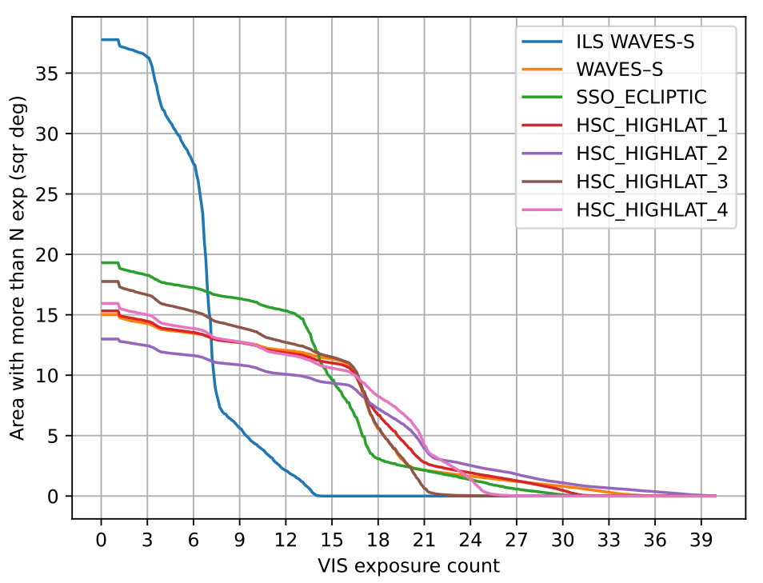
SUMMARY
1x
4x
Each wide-like visit has 4 VIS exposures
who | what | Area ≥1x [sq deg] | median # passes | area ≥ 4x [sq deg] VIS/NISP
ILS | GAMA+stars | 32/32 | 1.7
SSO | asteroids | 17.6 | 1
EMDS | repeated wide | 70/30.2 | ≥ 4.2 | 52.3/21.4
Total |  | ~120/60

Slide 23
B. Granett
who | what | Area ≥1x [sq deg] | median # passes | area ≥ 4x [sq deg] VIS/NISP
ILS | GAMA+stars | 32 | 1.7
SSO | asteroids | 17.6 | 1
EMDS | repeated wide | 70 | 4.4 | 52.3/21.4
Total |  | ~120

