Slide 1
GAEV WP 3:
GALAXY EVOLUTION
AS A FUNCTION OF ENVIRONMENT
Coordinators: Manuela Magliocchetti & Jenny Sorce

Slide 2
Some info on WP3
134 members and counting
In charge of PLKP 3.1 on Algorithms for Density Reconstruction
and PLKP3.2 on Environmental Dependencies of Galaxy Physical Properties
Expected about 8-10 papers. 3 submitted to ECEB (Malavasi+25; Kraljic+25;
Parmar+25 submitted within CG SWG), one circulated within WP3
(Sarron+25), 2 almost ready (Papini+25; Cleland+25a)
In charge of Q1 splashes (March and October). 3 papers submitted in March
(Laigle+25; Gouin+25; Cleland+25) and 4 expected in October (Kang+25;
Fabricius+25; Scott+25; Gentile+25)

Slide 3
Some info on WP3
3 DR1 KPs directly connected with WP3 plus a number of papers in other WPs
(everything can be done as a function of environment ;) )
DR1-KP-GEV-5 – Galaxy Evolution in Extreme Environments
(KP coordinators: Cleland, Bardelli, Stanford)
DR1-KP-GEV-1 – The Cosmic Web
(KP coordinators to be appointed. Call recently closed)
A. Cimatti official coordinator
M.Magliocchetti & J. Sorce acting coordinators
DR1-KP-GEV-6 – Galaxy Evolution through clustering analysis
(KP coordinators to be appointed. Call recently closed)
A. Cimatti official coordinator
M.Magliocchetti & J. Sorce acting coordinators
Starting passage of papers from WP3 to relevant KPs

Slide 4
Some nice results!!
mostly Cosmic Web and overdensities
since detection of proto-clusters and high-z
clusters although also followed in WP3
appear as CG SWG WP11 papers

Slide 5
PLKP3.1:KRALJIC+2025 – submitted to ECEB – replying to ref. report

Slide 6
PLKP3.1:MALAVASI+2025 – submitted to ECEB – replying to ref report
2D reconstruction of the Cosmic Web in the Euclid Wide Survey
with the Euclid photometric sample

Slide 7
PLKP3.2:Papini+2025 – Advanced Stage

Slide 8
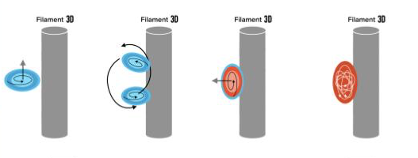
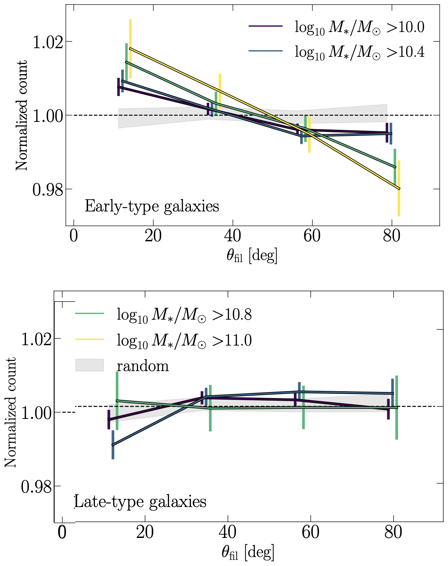
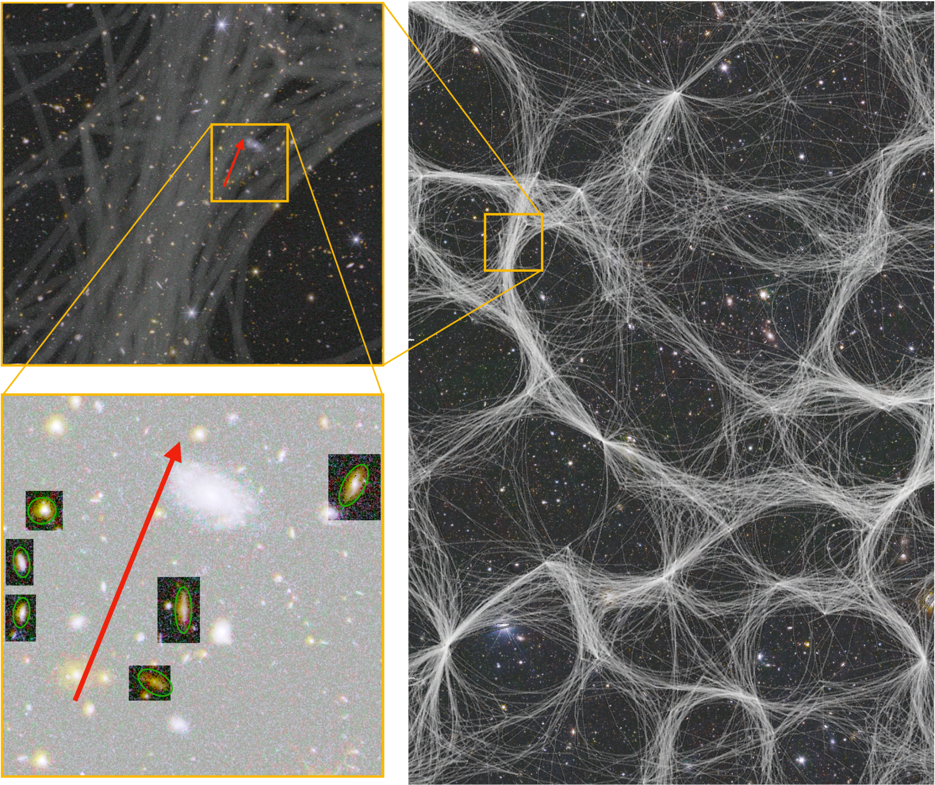
LAIGLE+2025 – submitted within March Q1 splash
REAL DATA!
Alignment of galaxies with cosmic filaments
- CW reconstruction on 0.5<z<0.9
- Early-type galaxies closer to
filaments and elongated along filaments
- Signal stronger at larger masses

Slide 9
GOUIN+2025 – submitted within March Q1 splash
REAL DATA!

Slide 10
REAL DATA!
CLELAND+2025 – submitted within March Q1 splash
High-mass
galaxies all ET
Paper on simulations also about to be published as PLKP3.2

Slide 11
KANG+2025 – to submitted within October Q1 splash
REAL DATA!
Angular Clustering of Euclid Galaxies
M*
M*
Problematic issue of producing photometric mask finally solved

Slide 12
KANG+2025 – to submitted within October Q1 splash
REAL DATA!
Angular Clustering of Euclid Galaxies
M*
M*
Results as a function of stellar mass and redshift

Slide 13
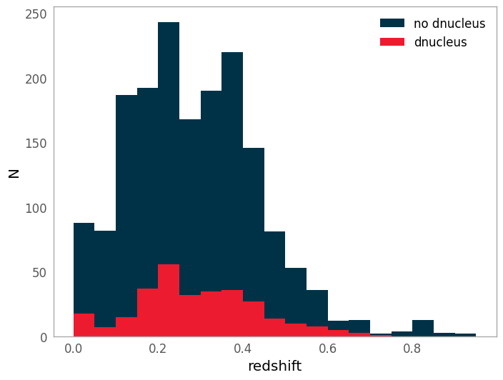
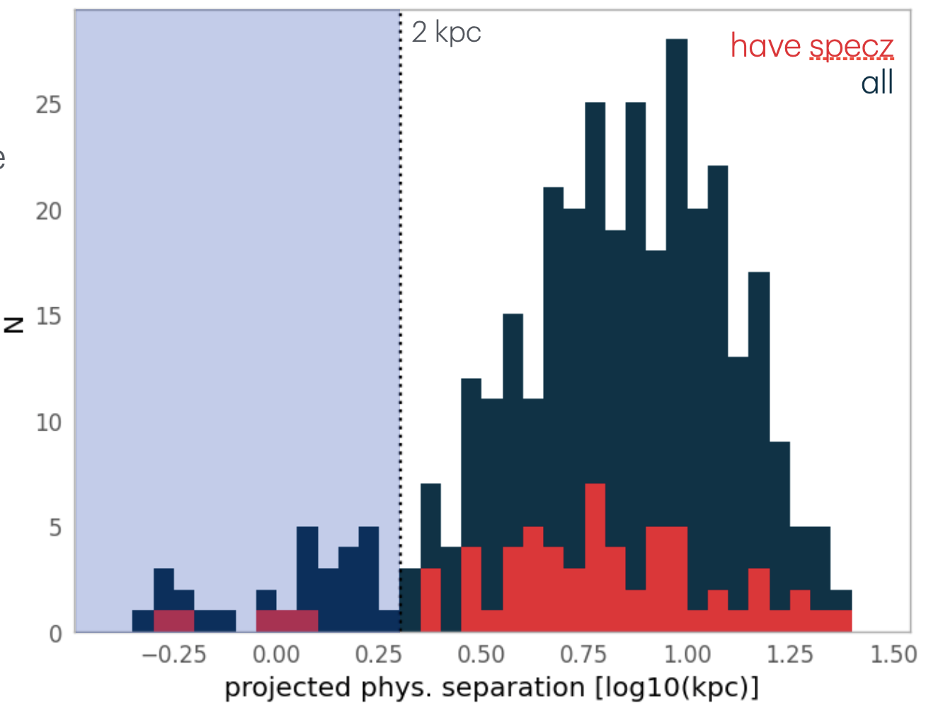
FABRICIUS+2025 – to submitted within October Q1 splash
Multiple Nuclei in Early Type Galaxies
REAL DATA!
~9% of Euclid’s ETGs exhibit secondary components
30 systems host double nucleus within 2 kpc
Using Q1 to train
CNN for DR1
Examples of the < 2 kpc separation double nuclei discovered in Euclid’s Q1 dataset.

Slide 14
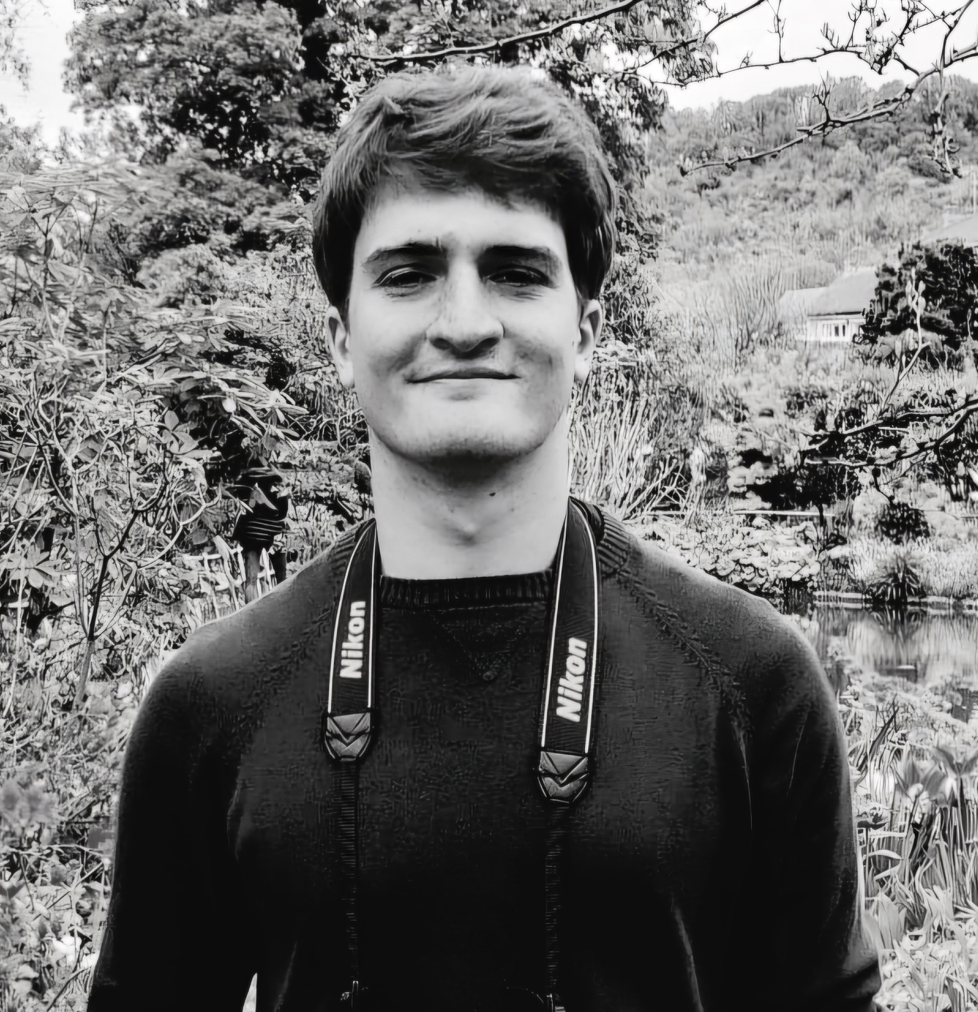
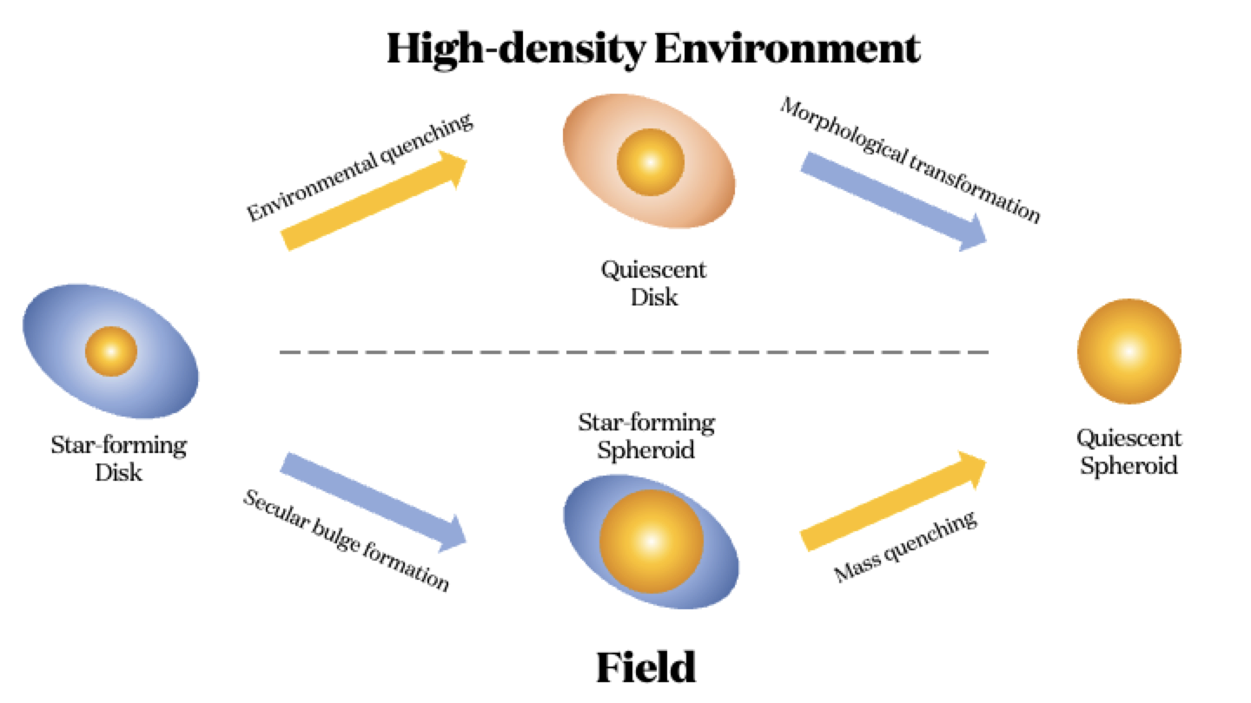
Gentile+2025 – to submitted within October Q1 splash
Quenching and morphological transformation in different environments
REAL DATA!
Main questions:
What is the interplay between quenching and morphological transformation? How are these processes impacted by different environments?
"ELSA: Euclid Legacy Science Advanced analysis tools" (Grant Agreement no. 101135203) is funded by the European Union. Views and opinions expressed are however those of the author(s) only and do not necessarily reflect those of the European Union or Innovate UK. Neither the European Union nor the granting authority can be held responsible for them.
Main result:
In the field the morphological transformation precedes the galaxy quenching, while follows it in over-dense environments

