Slide 1
Euclid It EDU
Sandro Bardelli
INAF-OAS, Bologna
(on behalf of the Euclid It EDU Group)
Notes:
https://drive.google.com/drive/u/0/folders/1lEyyl50zXNKJRRrl8ZhAtEShQbYkNopG

Slide 2
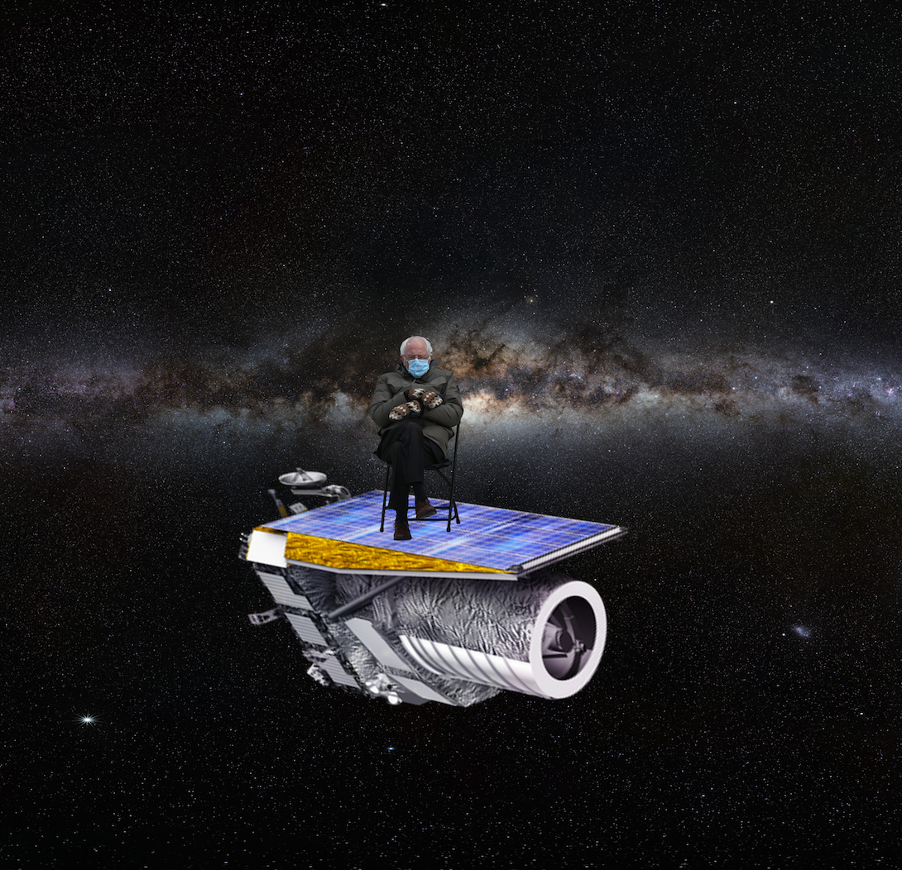
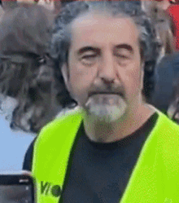
TASSE TASSE
TASSE
COSMOLOGY
MICROLENSING
CLUSTERS
POWER SPECTRUM
BARYON ACUSTIC OSCILLATIONS
GROWTH OF STUCTURES

Slide 3
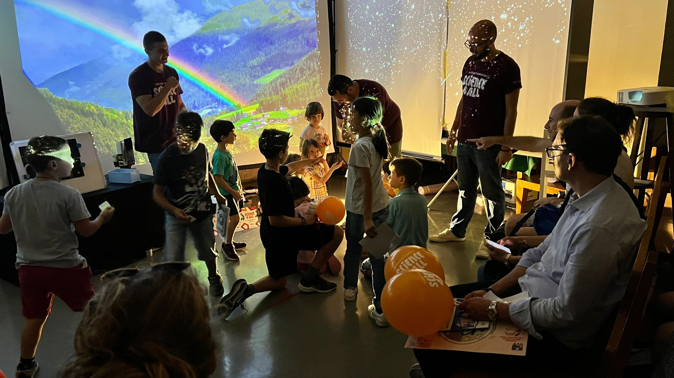
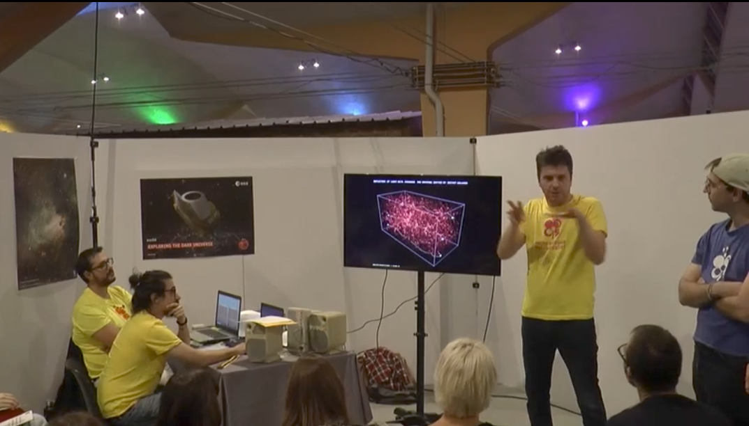
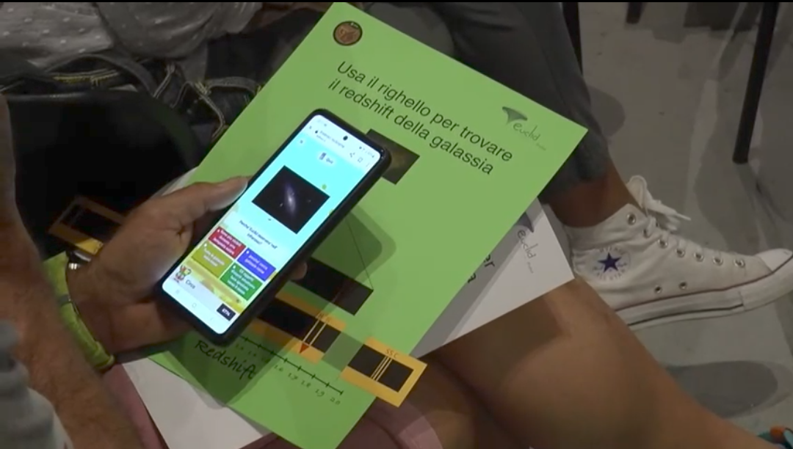
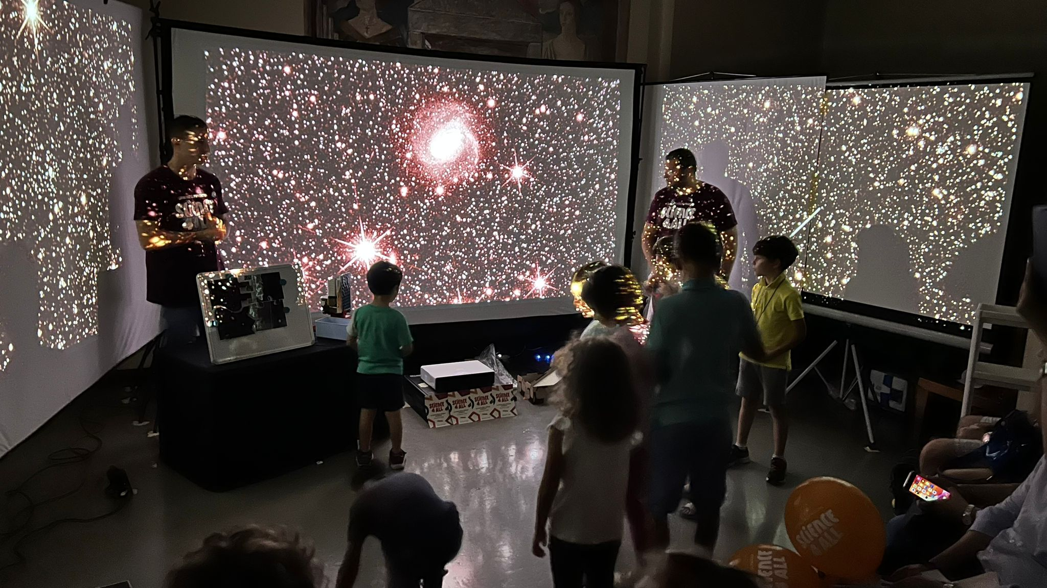
Euclid escape room
(C. Sirignano, Padua Group)
Euclid Challenge @NdR
(Bologna Group)
Notes:
https://drive.google.com/drive/u/0/folders/1lEyyl50zXNKJRRrl8ZhAtEShQbYkNopG

Slide 4
Euclid goes to School

Slide 5
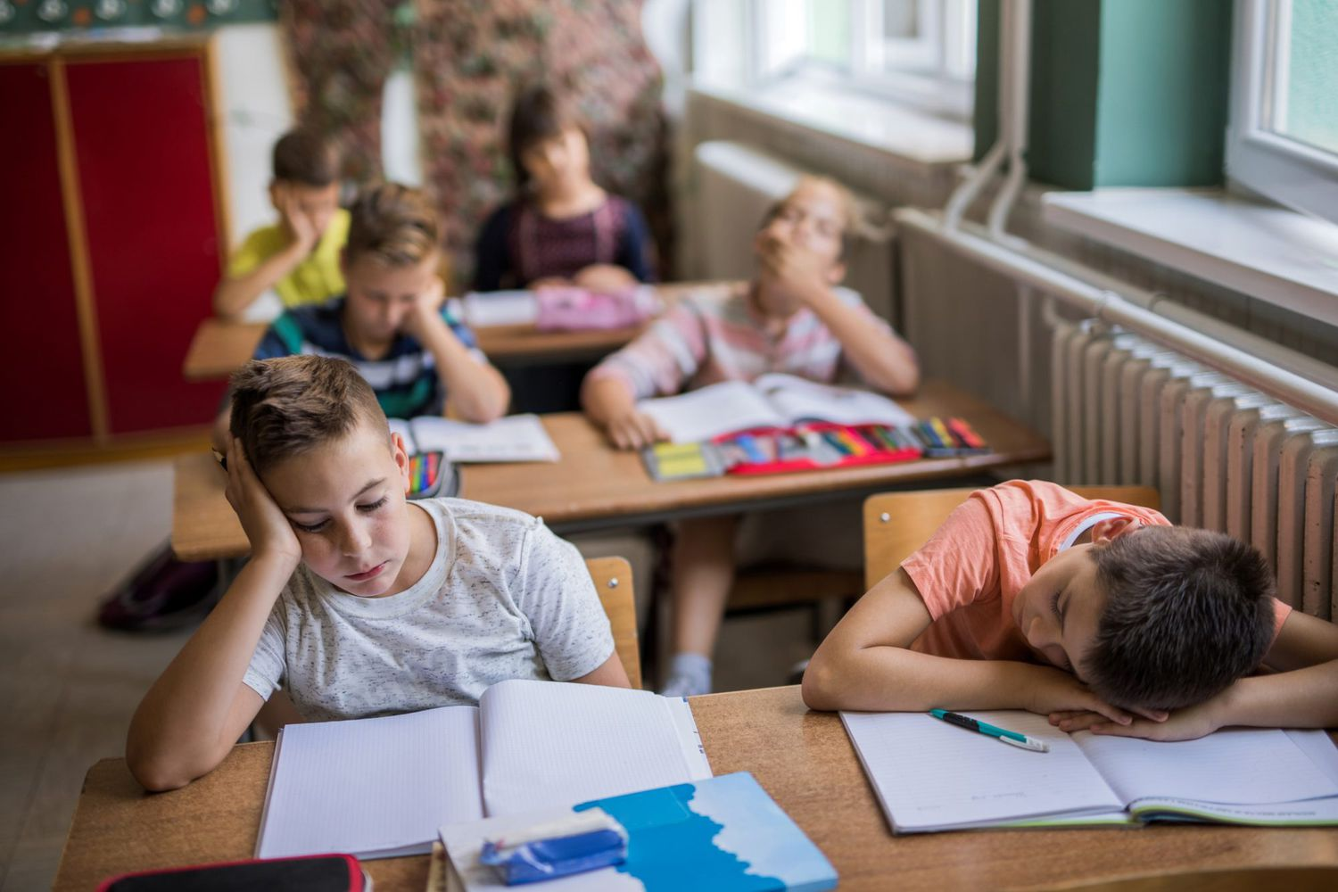
Indicazioni nazionali per il curricolo?
Euclid is difficult for EDU
Notes:
https://drive.google.com/drive/u/0/folders/1lEyyl50zXNKJRRrl8ZhAtEShQbYkNopG

Slide 6
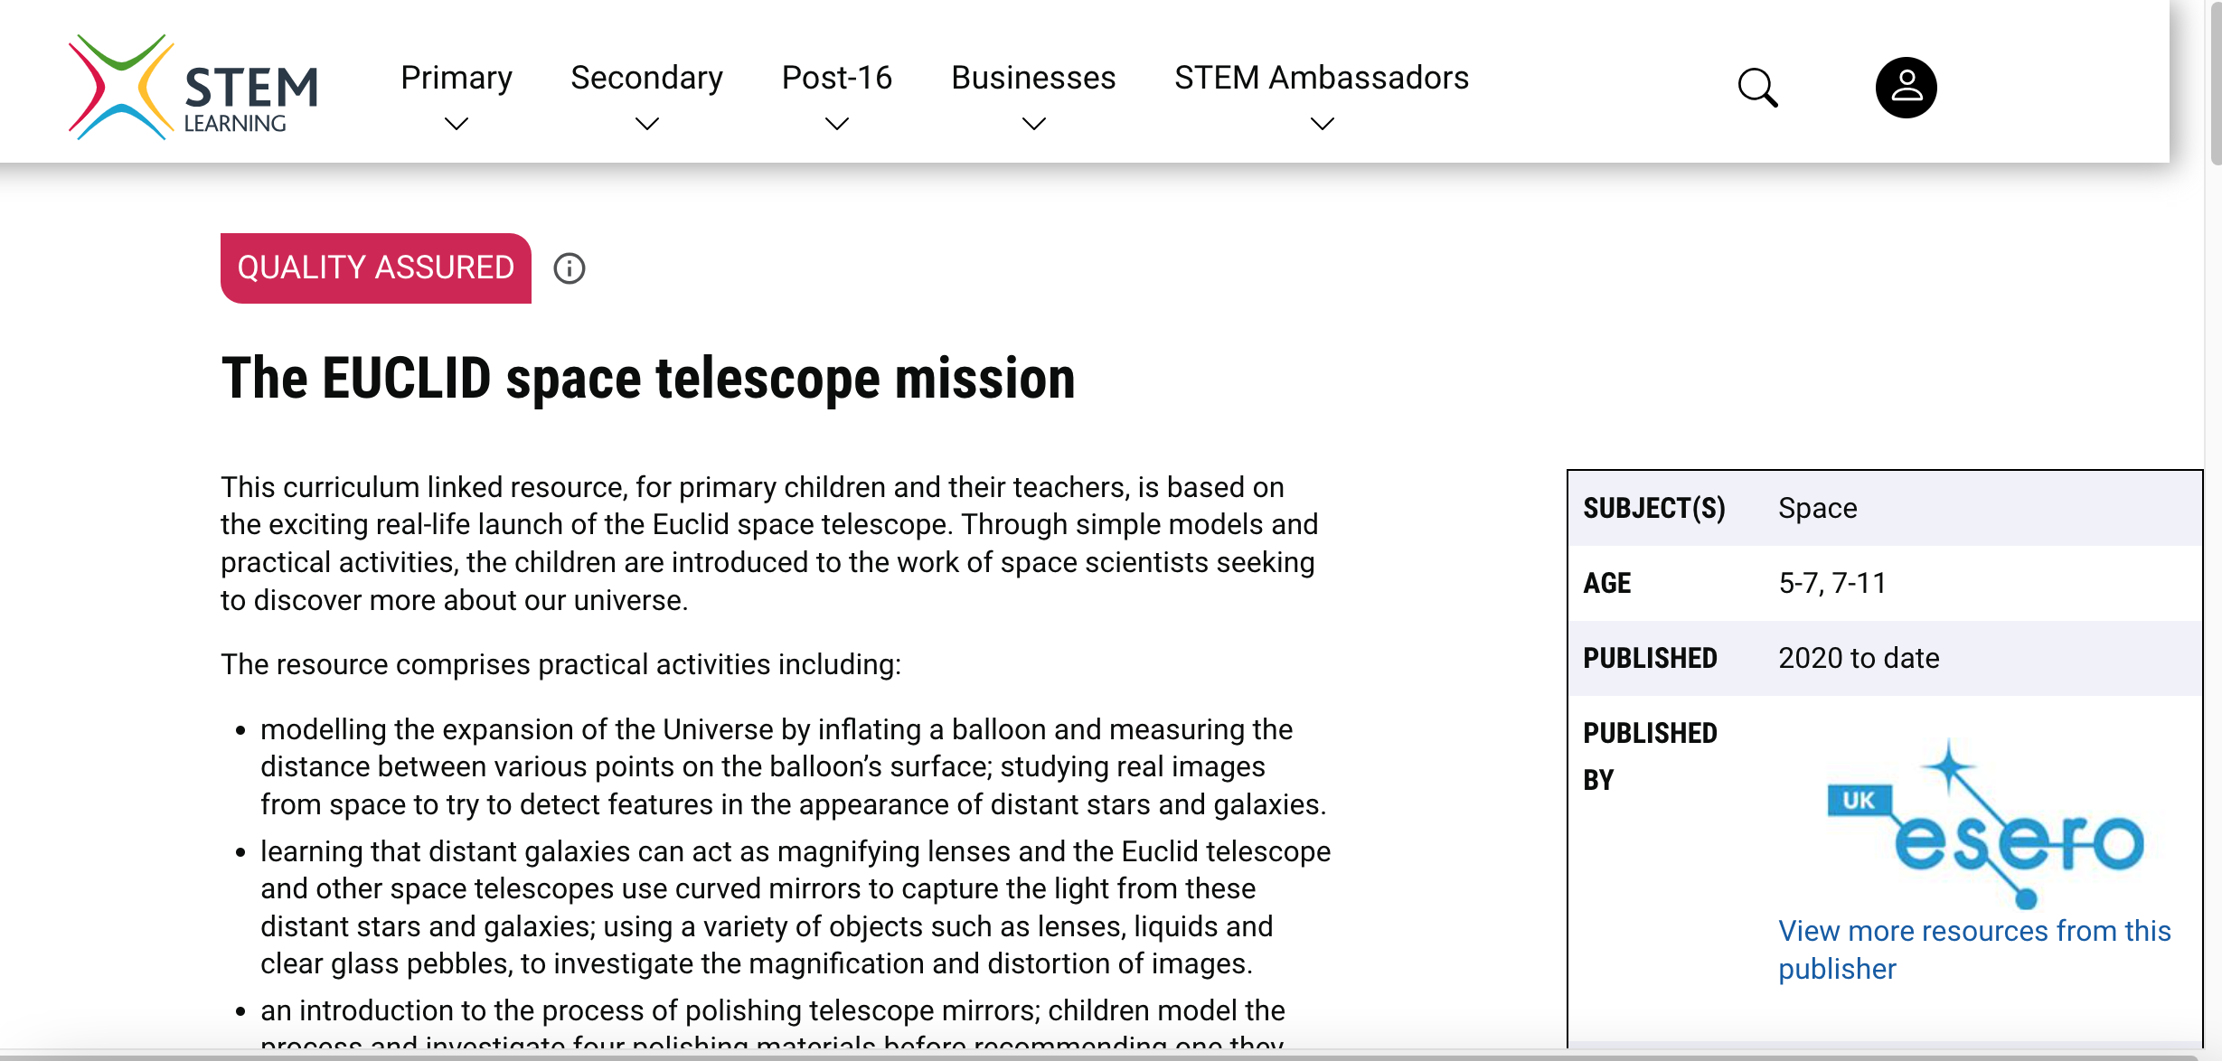
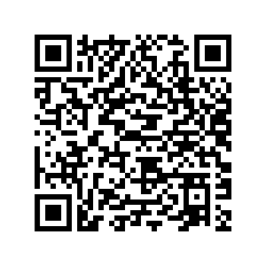
Educational materials
Work in progress towards Dark Matter Day (31 Oct 2025)
In collaboration with ESERO Italia
Working on educational resources
for teachers
for researchers visiting schools
Activities and games about:
cosmic expansion
redshift
Adapting materials developed by ESERO UK
Special thanks to the Euclid EDU WG: Sandro Bardelli, Francesca Cavallotti, Veronica Ceruti, Petra Dell'Arme, Anna Di Giorgio, Germana Galoforo, Silvano Tosi, Annalisa Veneto, Lorenza Vianello, Elena Zucca

Slide 7
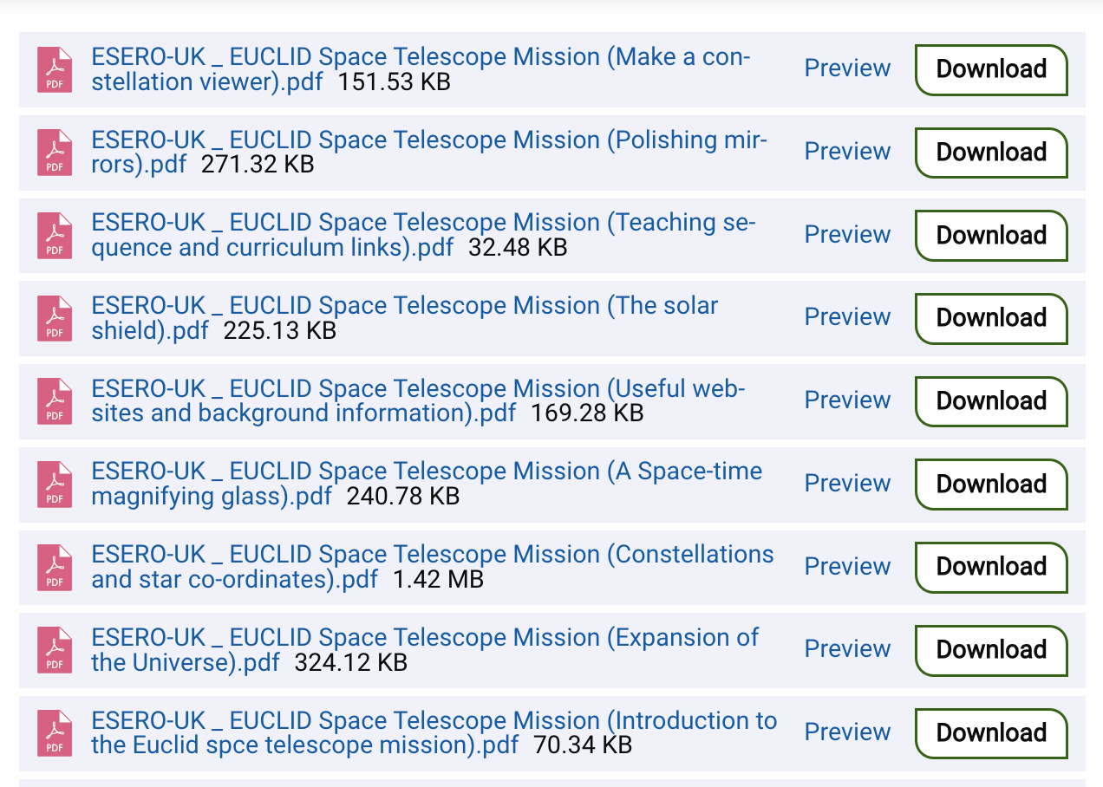
Notes:
https://drive.google.com/drive/u/0/folders/1lEyyl50zXNKJRRrl8ZhAtEShQbYkNopG

Slide 8
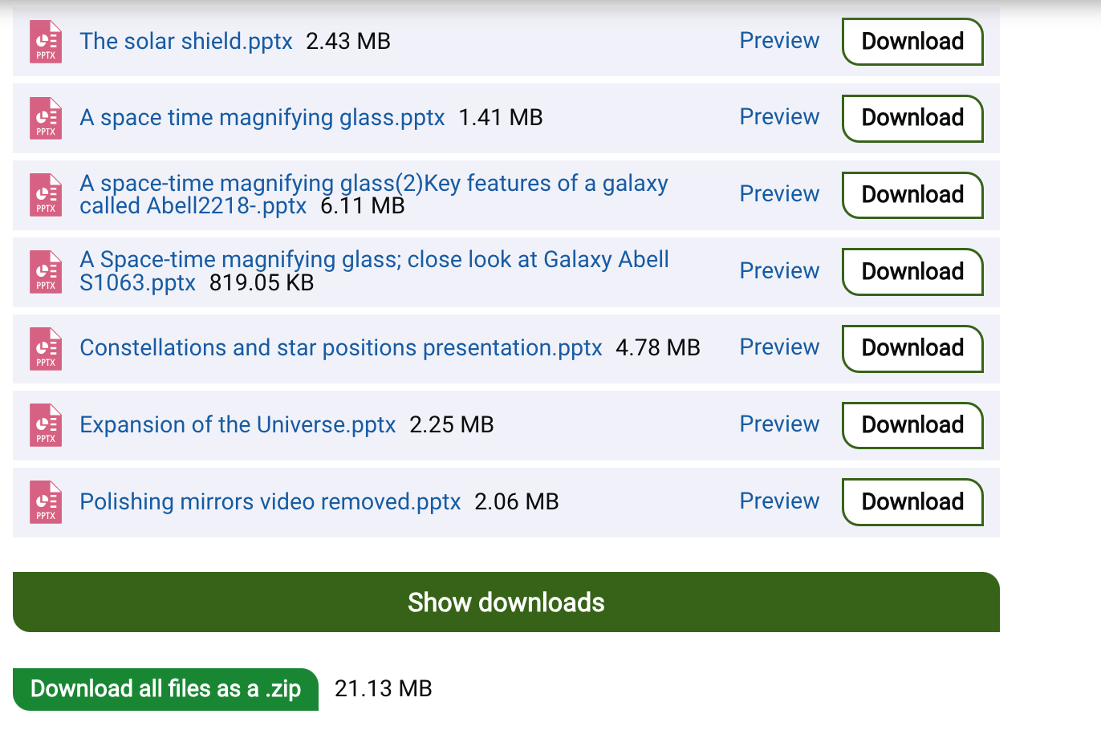
Notes:
https://drive.google.com/drive/u/0/folders/1lEyyl50zXNKJRRrl8ZhAtEShQbYkNopG

Slide 9
COLLABORATION WITH
www.esero.it
Notes:
https://drive.google.com/drive/u/0/folders/1lEyyl50zXNKJRRrl8ZhAtEShQbYkNopG

Slide 10
Euclid EDU WG (alphabetical order)
Sandro Bardelli, Francesca Cavallotti, Veronica Ceruti,
Petra Dell'Arme, Chiara del Balio, Anna Di Giorgio, Germana Galoforo, Camilla Linnemann, Claudia Mignone, Fabiana Paravani, Chiara Sirignano, Silvano Tosi, Annalisa Veneto, Lorenza Vianello, Elena Zucca
Notes:
andro Bardelli <sandro.bardelli@inaf.it>, Petra Dell'Arme <petra.dellarme@inaf.it>, chiara.sirignano@unipd.it, Anna Maria Di Giorgio <anna.digiorgio@inaf.it>, francesca.cavallotti@gmail.com, silvano.tosi@ge.infn.it, linnemann@museoscienza.it, germana.galoforo@asi.it, lorenza.vianello@unibo.it, fabiana.paravani@asi.it

Slide 11
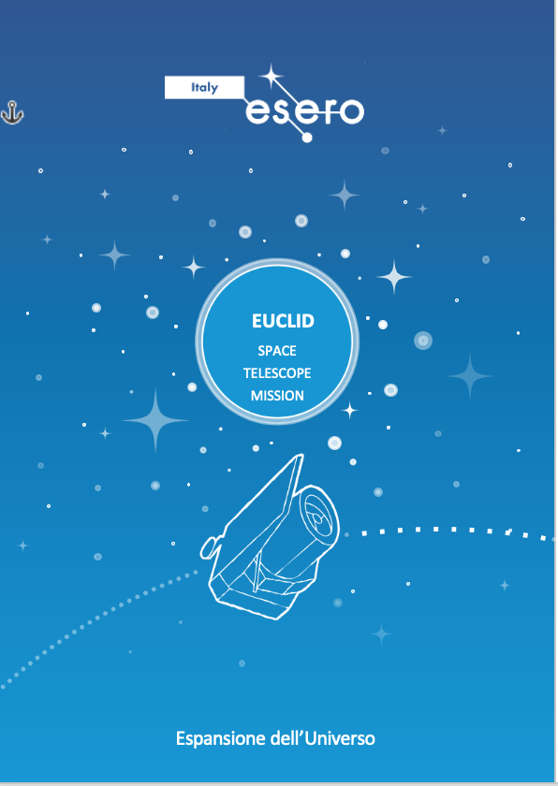
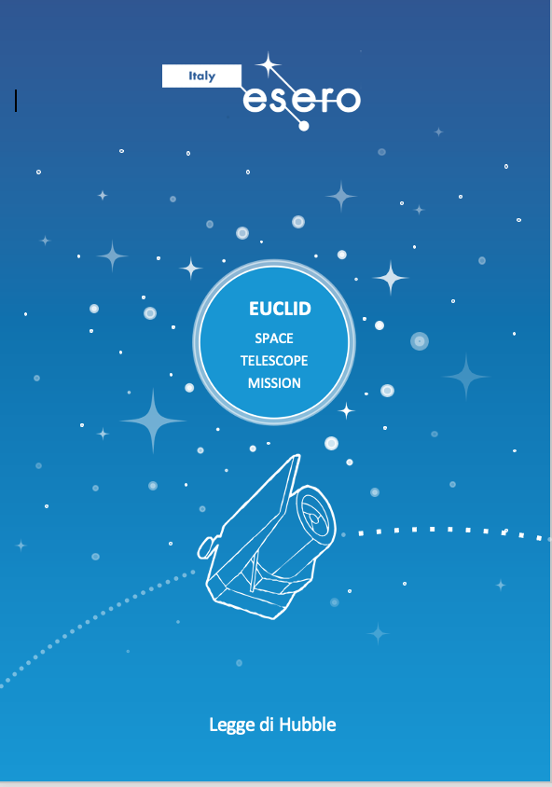
Notes:
https://drive.google.com/drive/u/0/folders/1lEyyl50zXNKJRRrl8ZhAtEShQbYkNopG

Slide 12
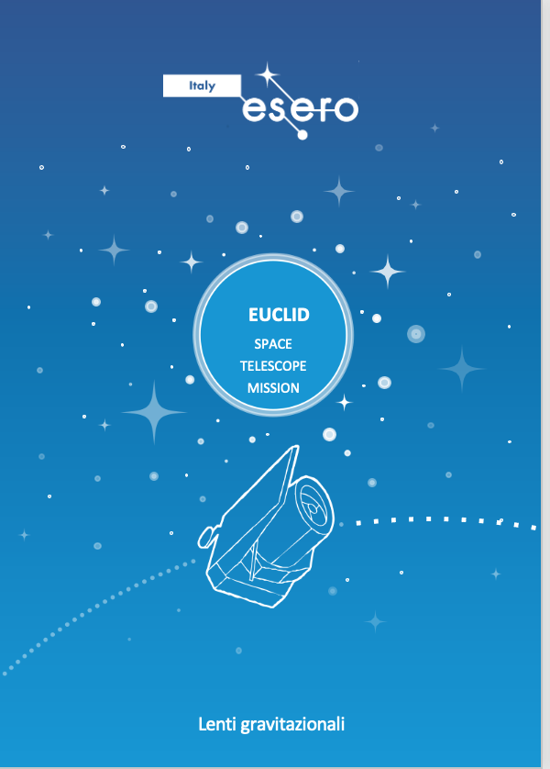
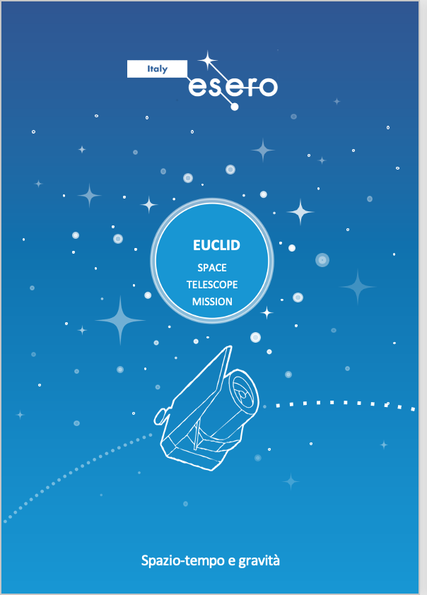
Notes:
https://drive.google.com/drive/u/0/folders/1lEyyl50zXNKJRRrl8ZhAtEShQbYkNopG

Slide 13
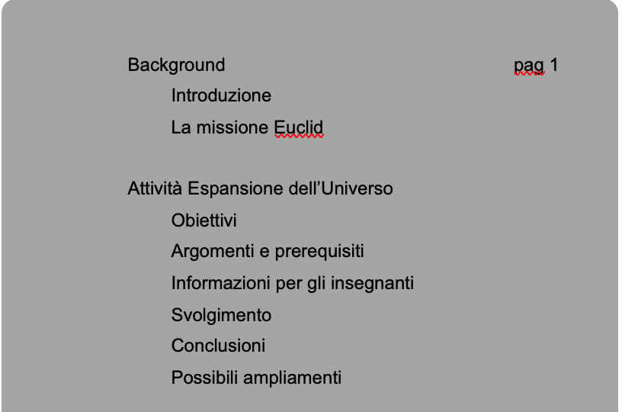
COSA E`UNA RISORSA DIDATTICA?
What is an educational resource?
Notes:
https://drive.google.com/drive/u/0/folders/1lEyyl50zXNKJRRrl8ZhAtEShQbYkNopG

Slide 14
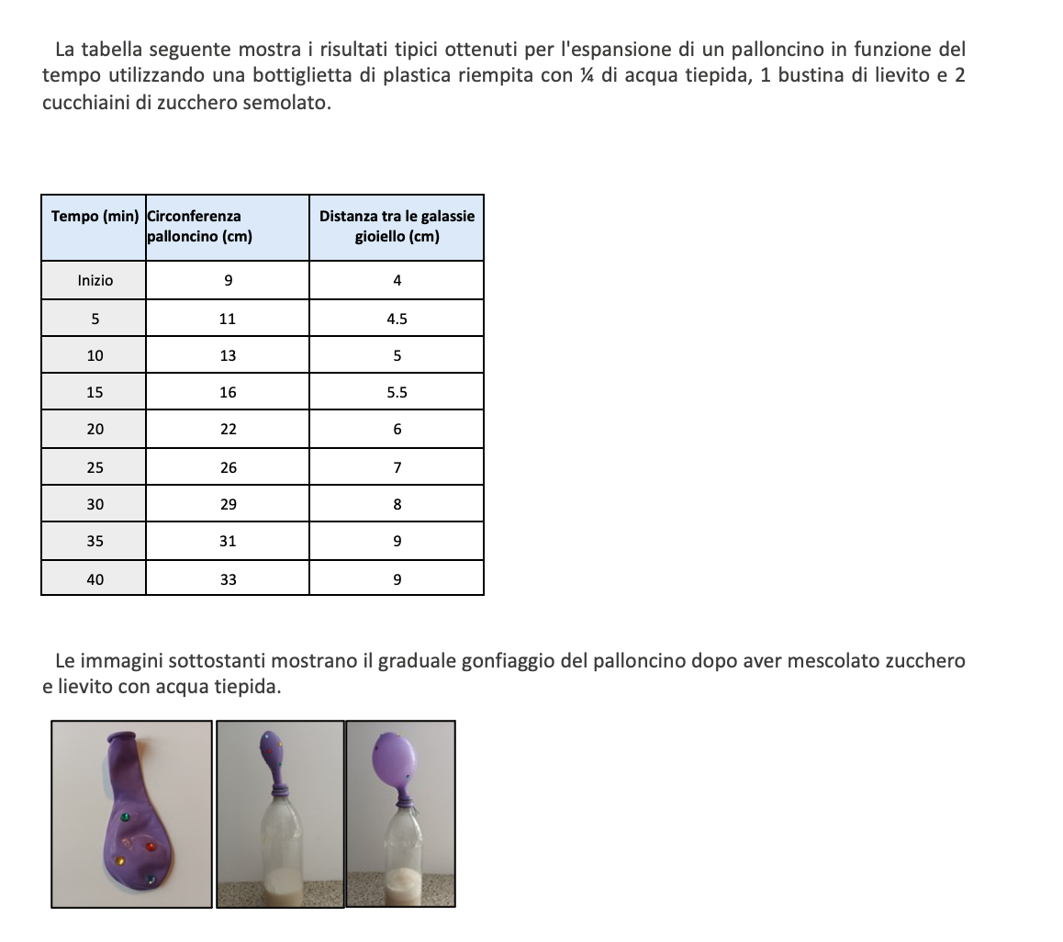
COSA E`UNA RISORSA DIDATTICA?
What is an educational resource?
Notes:
https://drive.google.com/drive/u/0/folders/1lEyyl50zXNKJRRrl8ZhAtEShQbYkNopG

Slide 15
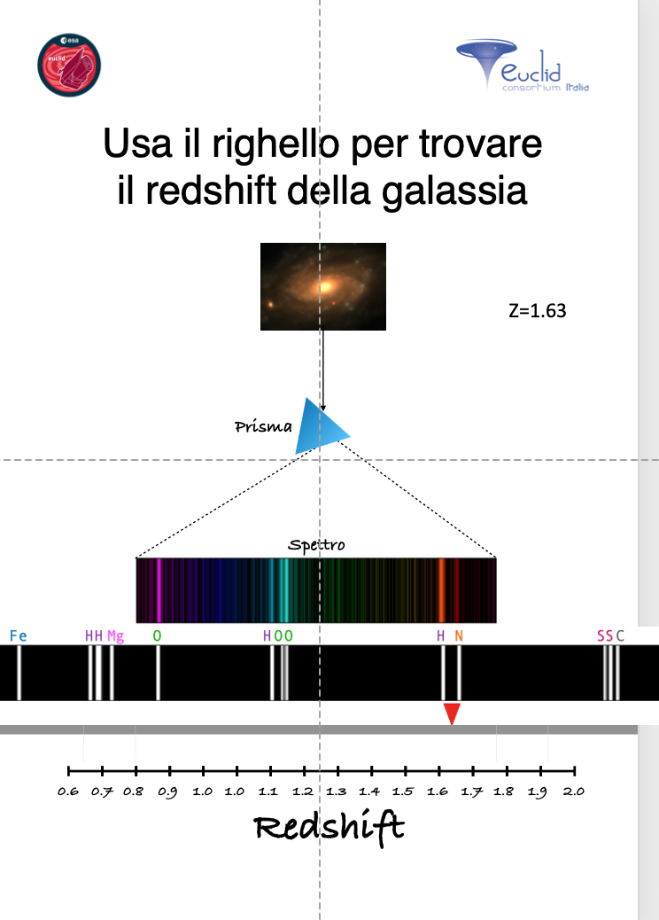
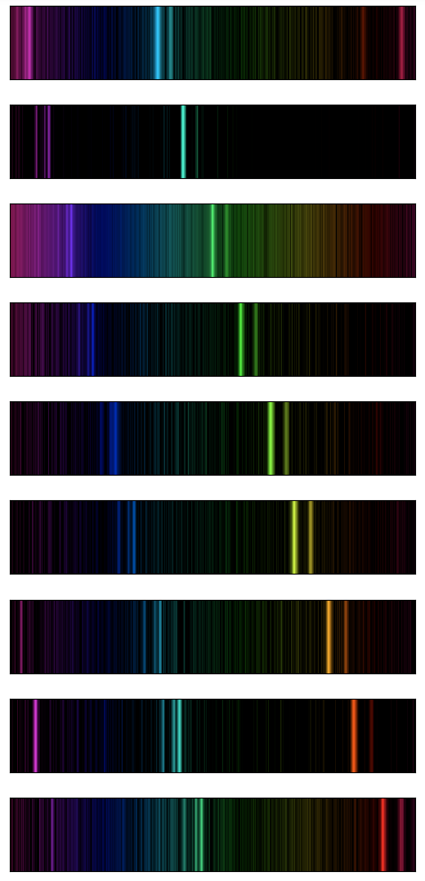
COSA E`UNA RISORSA DIDATTICA?
z=0.93
z=1.03
z=1.13
z=1.23
z=1.33
z=1.43
z=1.53
z=1.63
z=.173
Euclid It-EDU WG
+
S. Quai
M. Roncarelli
M.TaliaM
Notes:
https://drive.google.com/drive/u/0/folders/1lEyyl50zXNKJRRrl8ZhAtEShQbYkNopG

Slide 16
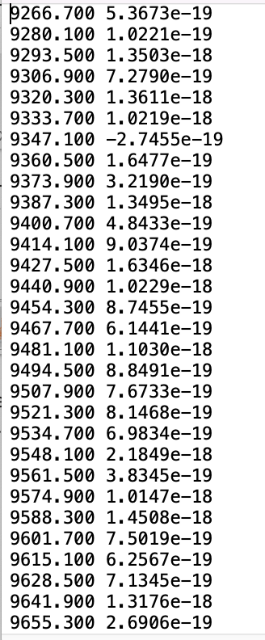
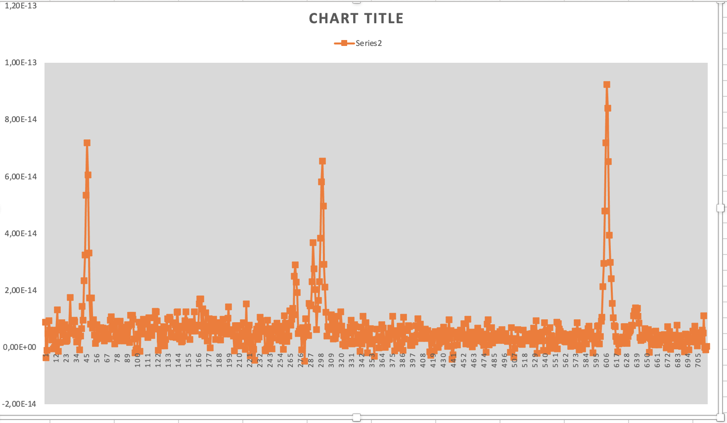
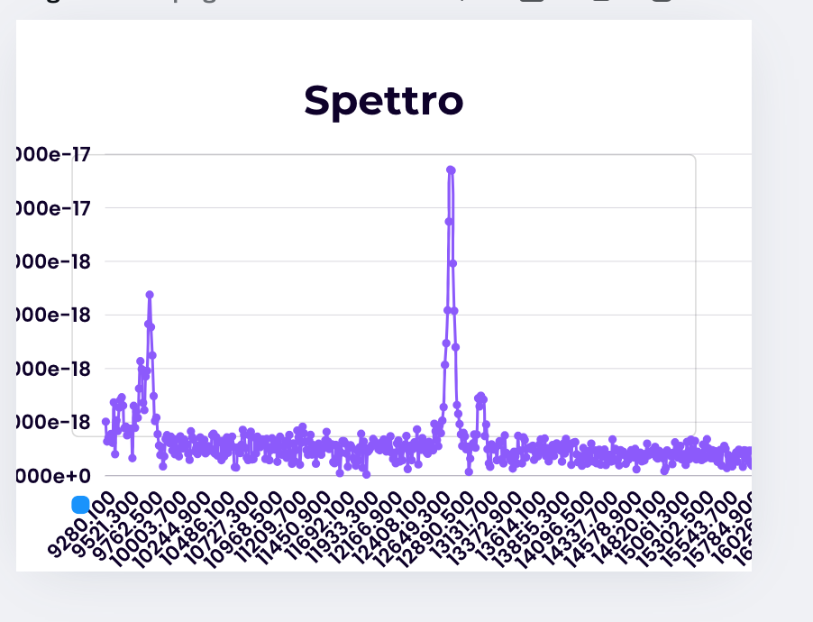
Euclid It-EDU WG
+
S. Quai
M. Roncarelli
M.TaliaM
Notes:
https://drive.google.com/drive/u/0/folders/1lEyyl50zXNKJRRrl8ZhAtEShQbYkNopG

Slide 17
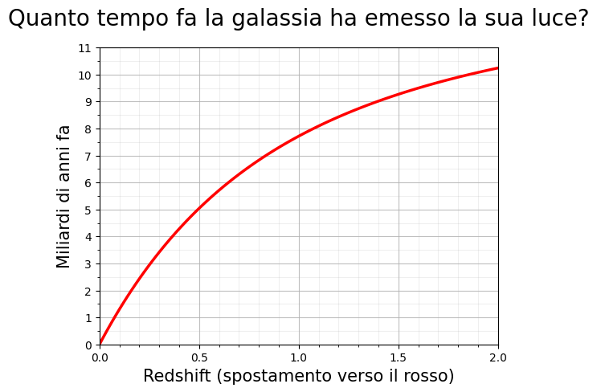

Slide 18
Educational materials
Educational resources
Who will use them?
School Teachers
Euclid researchers visiting schools

Slide 19
October 31st
Notes:
https://drive.google.com/drive/u/0/folders/1lEyyl50zXNKJRRrl8ZhAtEShQbYkNopG

Slide 20
Dark Matter/Euclid week for the schools
The idea is to offer activities for students presented by Euclid researchers visiting schools
during the week 27-31 October 2025
?
Notes:
https://drive.google.com/drive/u/0/folders/1lEyyl50zXNKJRRrl8ZhAtEShQbYkNopG

Slide 21
Dark Matter/Euclid week for the schools
Educational resources will be made available
on the Italian Euclid web page
https://www.euclid-italia.org/it/home/
Each Euclid site will contact schools
to propose the activities, which will be
offered on the basis of available researchers
?
Notes:
https://drive.google.com/drive/u/0/folders/1lEyyl50zXNKJRRrl8ZhAtEShQbYkNopG

Slide 22
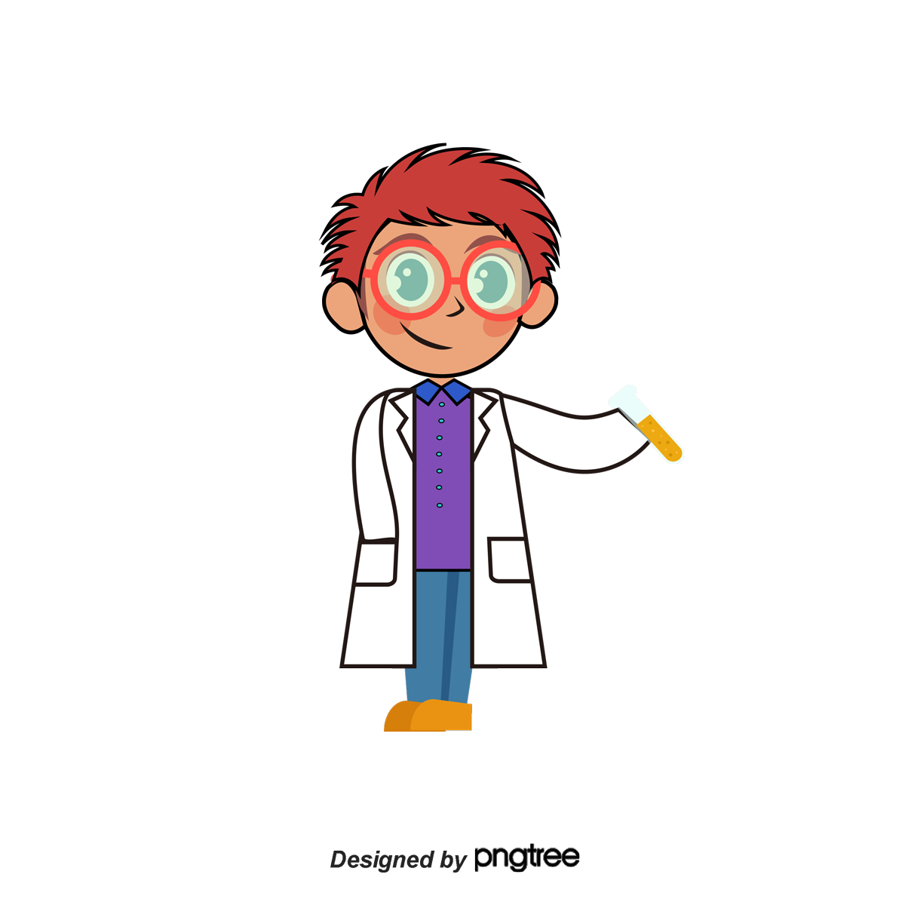
You are all invited
to bring Euclid to school!
Euclid goes to School

Slide 24
https://wittman.physics.ucdavis.edu/Animations/RotationCurve/GalacticRotation.html
https://plancksatellite.org.uk/cmb-sim/
https://gravitational-lensing.explored.info/?fbclid=IwY2xjawE2hEZleHRuA2FlbQIxMQABHUhaRz-xNFLx1hOxp3r9Tht3fdzGy9cRXJzaEoqiGYGWD7KVkanfHe-61g_aem_tTTA7tV_3CLolpGtr2ScqA&sfnsn=scwspmo
https://gravitational-lensing.explored.info/?fbclid=IwY2xjawE2hEZleHRuA2FlbQIxMQABHUhaRz-xNFLx1hOxp3r9Tht3fdzGy9cRXJzaEoqiGYGWD7KVkanfHe-61g_aem_tTTA7tV_3CLolpGtr2ScqA&sfnsn=scwspmo
https://wittman.physics.ucdavis.edu/Animations/CosmicExpansion/index.html
http://astro.unl.edu/mobile/Galaxies/GalaxiesStable.html

