Slide 1
OU-LE3 STATUS Focus on: Galaxy Clustering and Clusters of Galaxies.
Enzo Branchini. University of Genova
Emiliano Munari. OATS-INAF

Slide 2
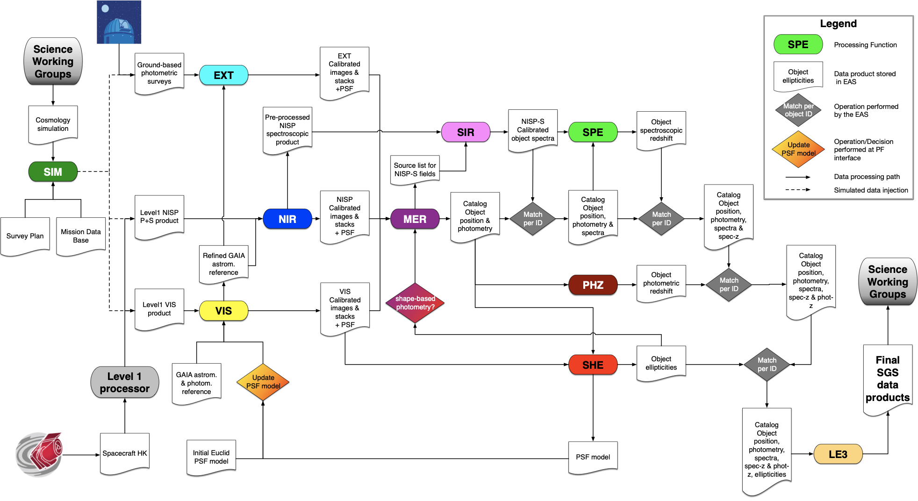

Slide 3
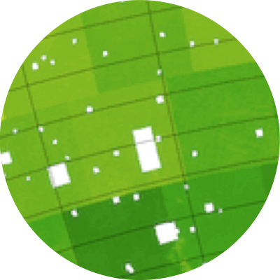
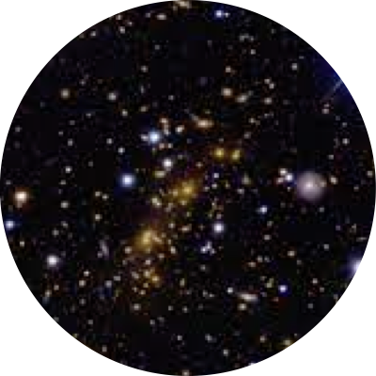
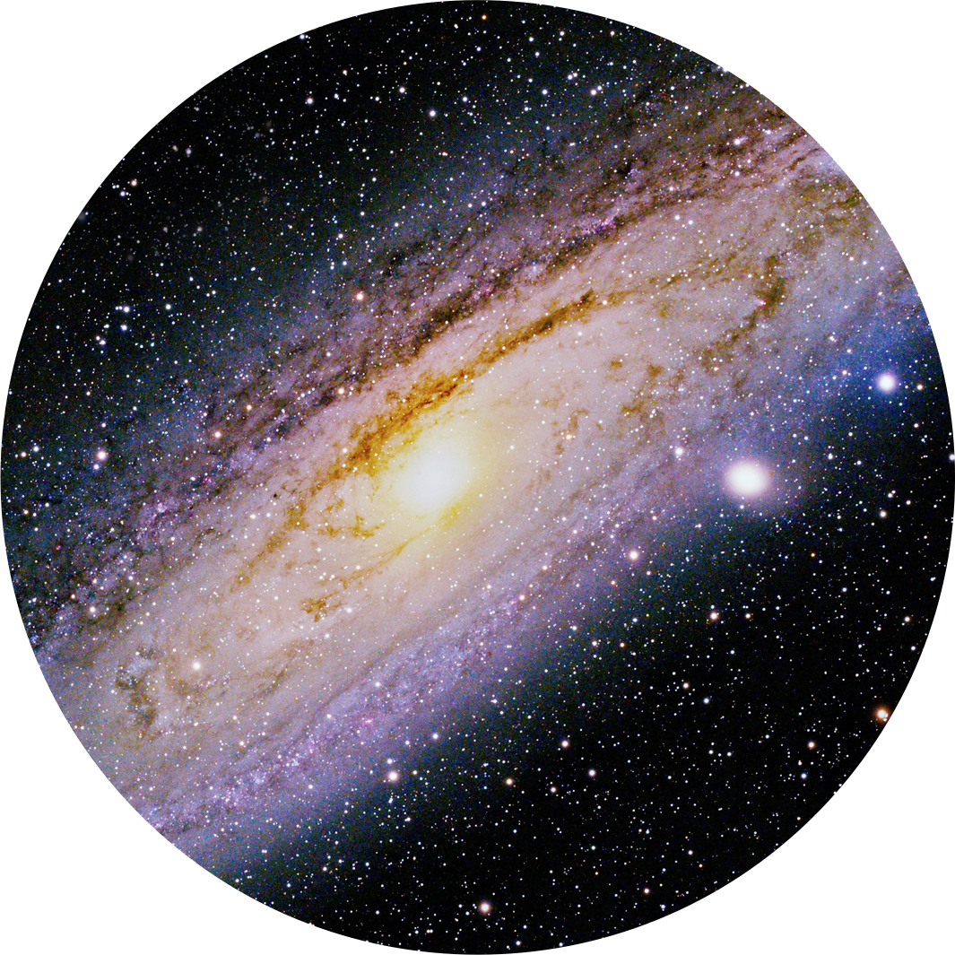
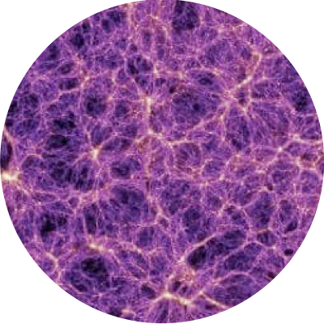
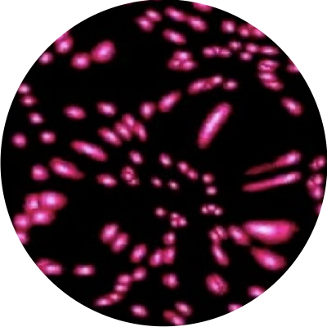
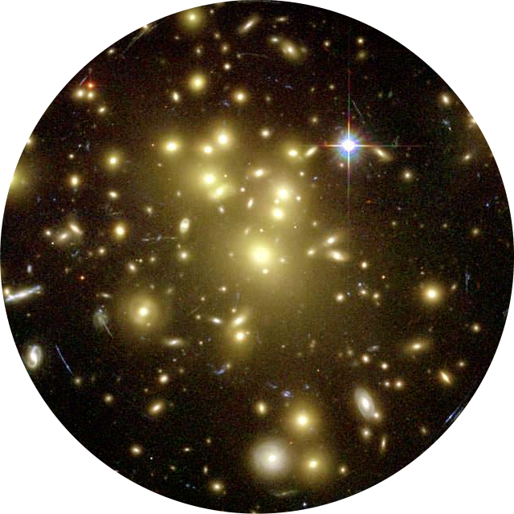
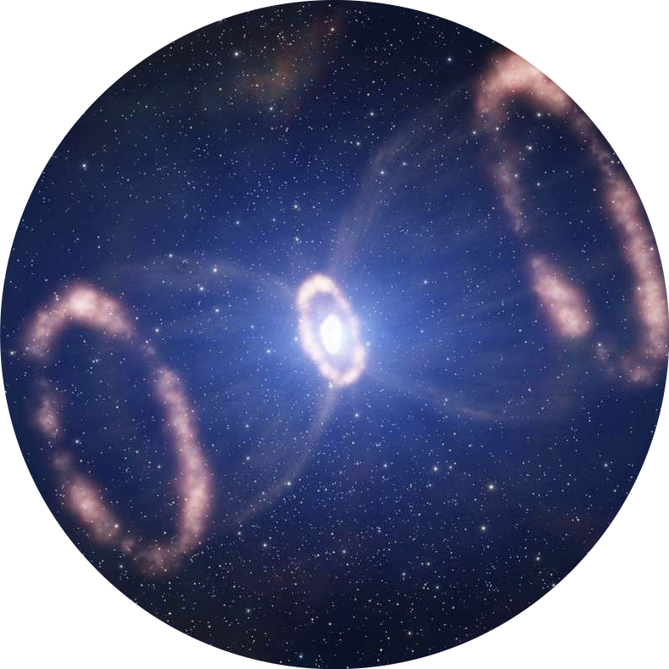
Internal Data
External Data
ID
ED
47 Processing Functions (PFs) in total
MWNG
GC
WL
CL
TD
Milky Way and Nearby Galaxies
Galaxy Clustering
Weak Lensing
Clusters of Galaxies
Time Domain

Slide 4
Internal Data
ID
GC
Galaxy Clustering

Slide 5
Internal Data
ID
2 Processing Functions
GC
Galaxy Clustering
6 Processing Functions

Slide 7
PF | ML STATUS* | DATA STATUS | INTEGRATION STATUS
2PCF-GC | ML3A+83% | On DPS (EDF-N) | Done (CCB 26/2/25)
3PCF-GC | ML3A+85% | On DPS (EDF-N) | Done (CCB 26/2/25)
PK-GC | ML3A+79% | On DPS (EDF-N) | Done (CCB 26/2/25)
BK-GC | ML3B | On DPS (EDF-N) | Done (CCB 26/2/25)
CM-2PCF-GC | ML3A+50% | SC8 mocks | Done (CCB 26/2/25)
CM-PK-GC | ML3A+60% | SC8 mocks | Done (CCB 26/2/25)
VMSP-ID** | ML3B | On DPS (EDF-N) | Done (7/8/24). Update soon
SEL-ID** | ML3B | On DPS (EDF-N) | Done (7/8/24). Update soon
* Score fluctuates when the code is updated/modified. They’ve all reached ML3B in the past.

Slide 8
Generates the Euclid Spectroscopic Galaxy Catalog from which it extracts all the subsamples that will be used for clustering analyses and cosmological inference.
Estimates the Selection Function of the spectroscopic catalog and all its subsamples. It will take the form of a catalog of synthetic objects uniformly distributed across the survey volume (a.k.a. the Random Catalogs)

Slide 9
The LE2-spectroscopic pipeline for DR1 has not been
frozen yet. A final reference datasets has not been generated yet. The very selection criteria of the survey are yet to be defined.
As a result:
1- The current VMSP-SEL pipeline can and will generate a Q1-like spectroscopic catalog (and random) for DR1.
2- An updated version of VMSP-SEL will have to be issued to generate spectroscopic catalogs (and random) suitable for cosmological analysis.
This is work in progress and is where most of the pressure on LE3-GC currently is.

Slide 10
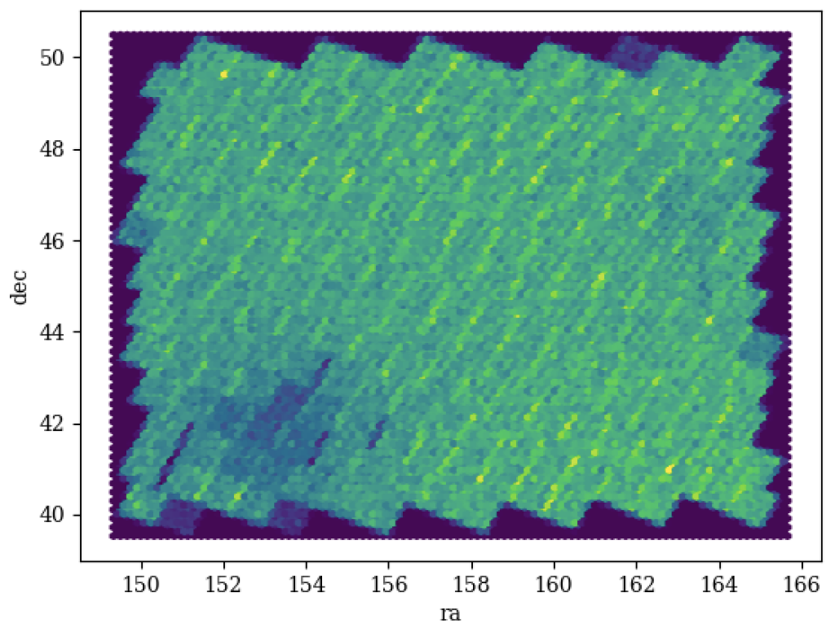
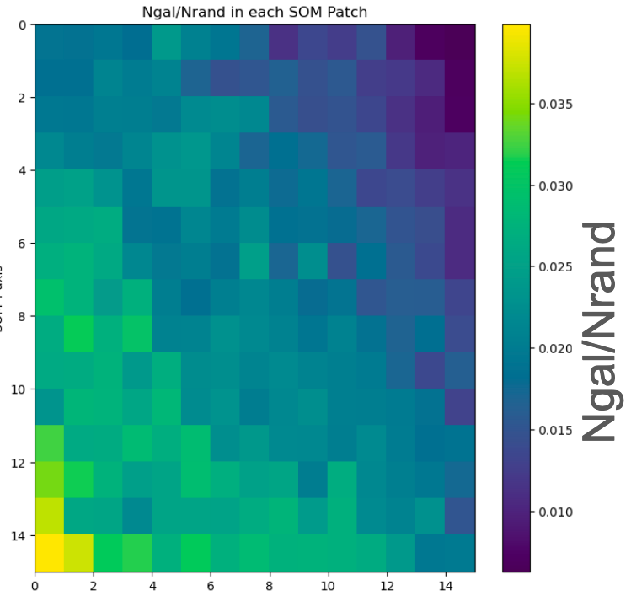
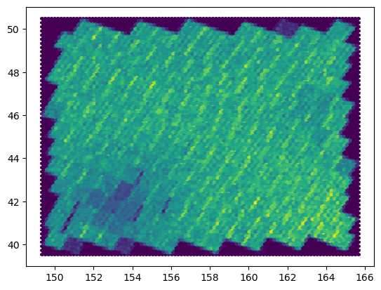
A reference galaxy catalog is needed to estimate the survey selection function. Our baseline strategy uses a forward modelling approach the relies on the Euclid Deep Fields [EDFs]. However, EDFs will not reach their full depths by DR1. An alternative approach is required. A. Farina and B. Granett have implemented one based on the Self Organizing Map tool.
List galaxy properties (N-dimensional space) and project to a 2D Self Organizing Map.
Sample the 2D map with a set of “random” objects taken i.e. from the Flagship.
Evaluate statistical weights and assign probability to random objects
Baseline
Alternative
This SOM-based method is being validated and implemented, as an alternative option,
in the official VMSP-code. To be integrated in the Euclid pipeline this fall.

Slide 11
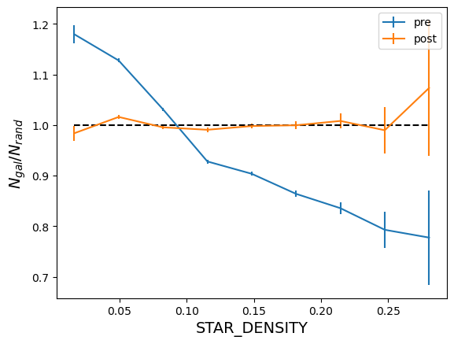
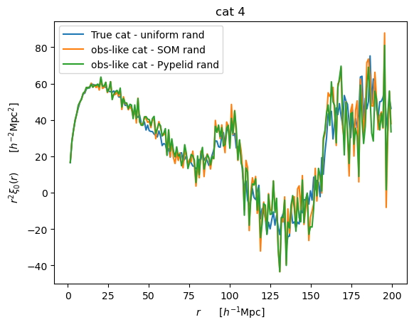
Validation tests on real and simulated EUCLID DATA [RR2 fields]
Real data
Simulated data
After SOM correction
SOM correction
Before SOM correction
Perfect correction
A. Farina
True
A. Farina

Slide 12
GC-PFs are being thoroughly validated with simulated Euclid data. Huge efforts to quantify window function effects in Fourier space.
GC PFs are being continuously upgraded. A newer 2PCF code that reduced the CPU time by a factor 2
is now ready to be implemented.
GC PFs are and will be updated to meet SWG requests (i.e. use of FKP weights in the estimate of the 2PCF)

Slide 13
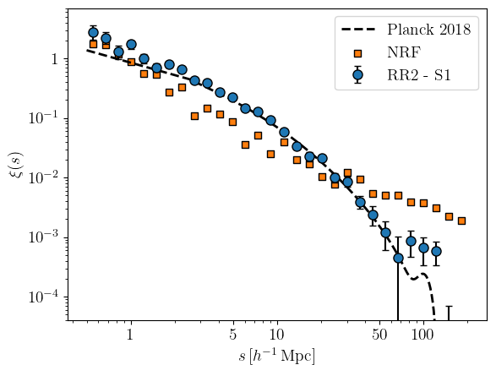
GC-PFs are being thoroughly validated with simulated Euclid data. Huge efforts to quantify window function effects in Fourier space.
2PCF-GC and PK-GC have been successfully applied to the available Euclid Data.
GC PFs are being continuously upgraded. A newer 2PCF code that reduced the CPU time by a factor 2
is now ready to be implemented.
NEW !!!!!
GC PFs are and will be updated to meet SWG requests (i.e. use of FKP weights in the estimate of the 2PCF)
A. Farina, I. Risso, A. Veropalumbo

Slide 14
All of this is a reflection of the joint effort contributed by OU-LE3, SDC-IT, and SWG-GC, with the Italian community's contribution being the most significant..
Thanks to (an incomplete list of the IT-based contributors):
S. Bardelli,Y. Elkhashab, A. Farina, P. Ganeshaiah, B. Granett, M. Karcher, E. Maragliano, F. Marulli, P. Monaco, C. Oliveri, I. Risso, F. Rizzo, E. Sarpa, E. Sefusatti, J. Salvalaggio, A. Veropalumbo, M. Viel, E. Zucca
See you at the OU-LE3 Meeting in Bologna. 27-30 January 2026

Slide 15
LE3 CL:
Getting ready for DR1 and plans for the future
E. Munari - Results and images from the whole team

Slide 16
LE3 CL: DR1 pipelines
15 pipelines that can be ideally divided in 3 groups:
Characterized cluster catalog
Detections with richness estimates, photometric membership, and refined redshift estimate (spec-z)
Additional characterization
Tangential reduced shear profile, cov matrices, mass from WL, luminosity and stellar mass functions
CL clustering
Subsample, random, 2PCF, CM-2PCF
+ Selection Function as special guest!

Slide 17
LE3 CL: DR1 pipelines
Main issues
Not very effective organization: actions have been already taken
Only recently we’ve had a significant dataset (some tens of deg²) of Euclid data on which to test our codes and pipelines

Slide 18
Q1 paper
S. Bhargava et al. (replying to the referee), “Euclid Quick Data Release (Q1) - First detections from the Euclid galaxy cluster workflow”
349 have at least 1 known counterpart
426 high-SNR detections
with z=[0.2, 1.5]
77 new candidates (visually inspected - 8 have spec-z estimate)
15 high-SNR detections with z = [1.5, 2.0] - clear visual overdensities in Euclid and external imaging data

Slide 19
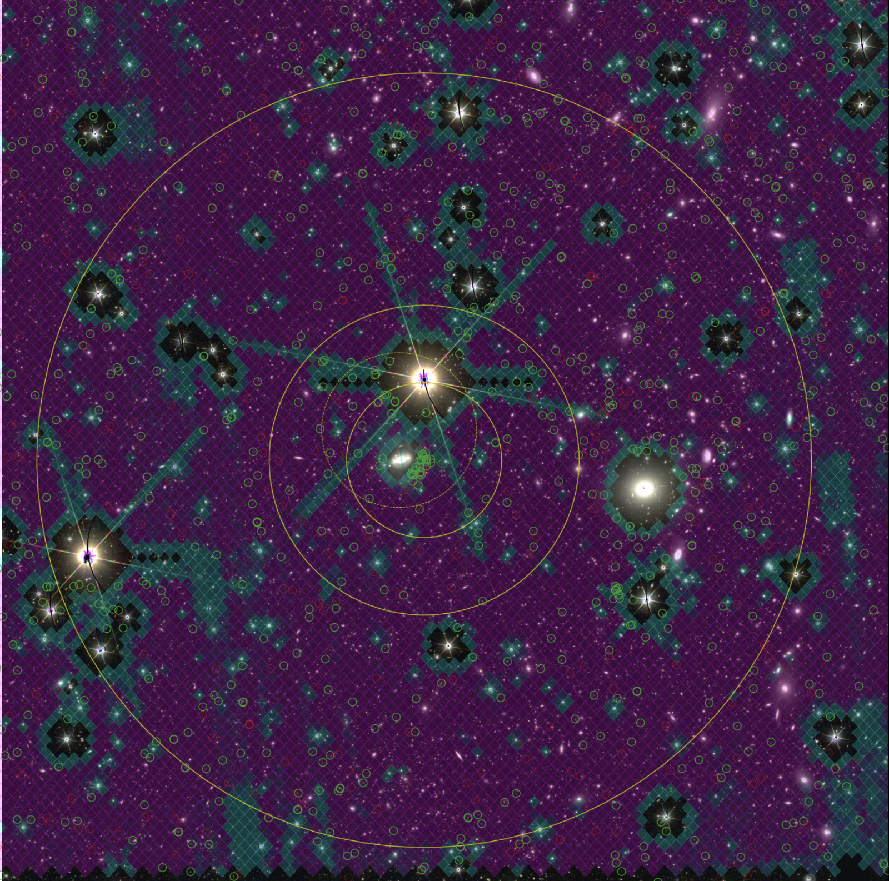
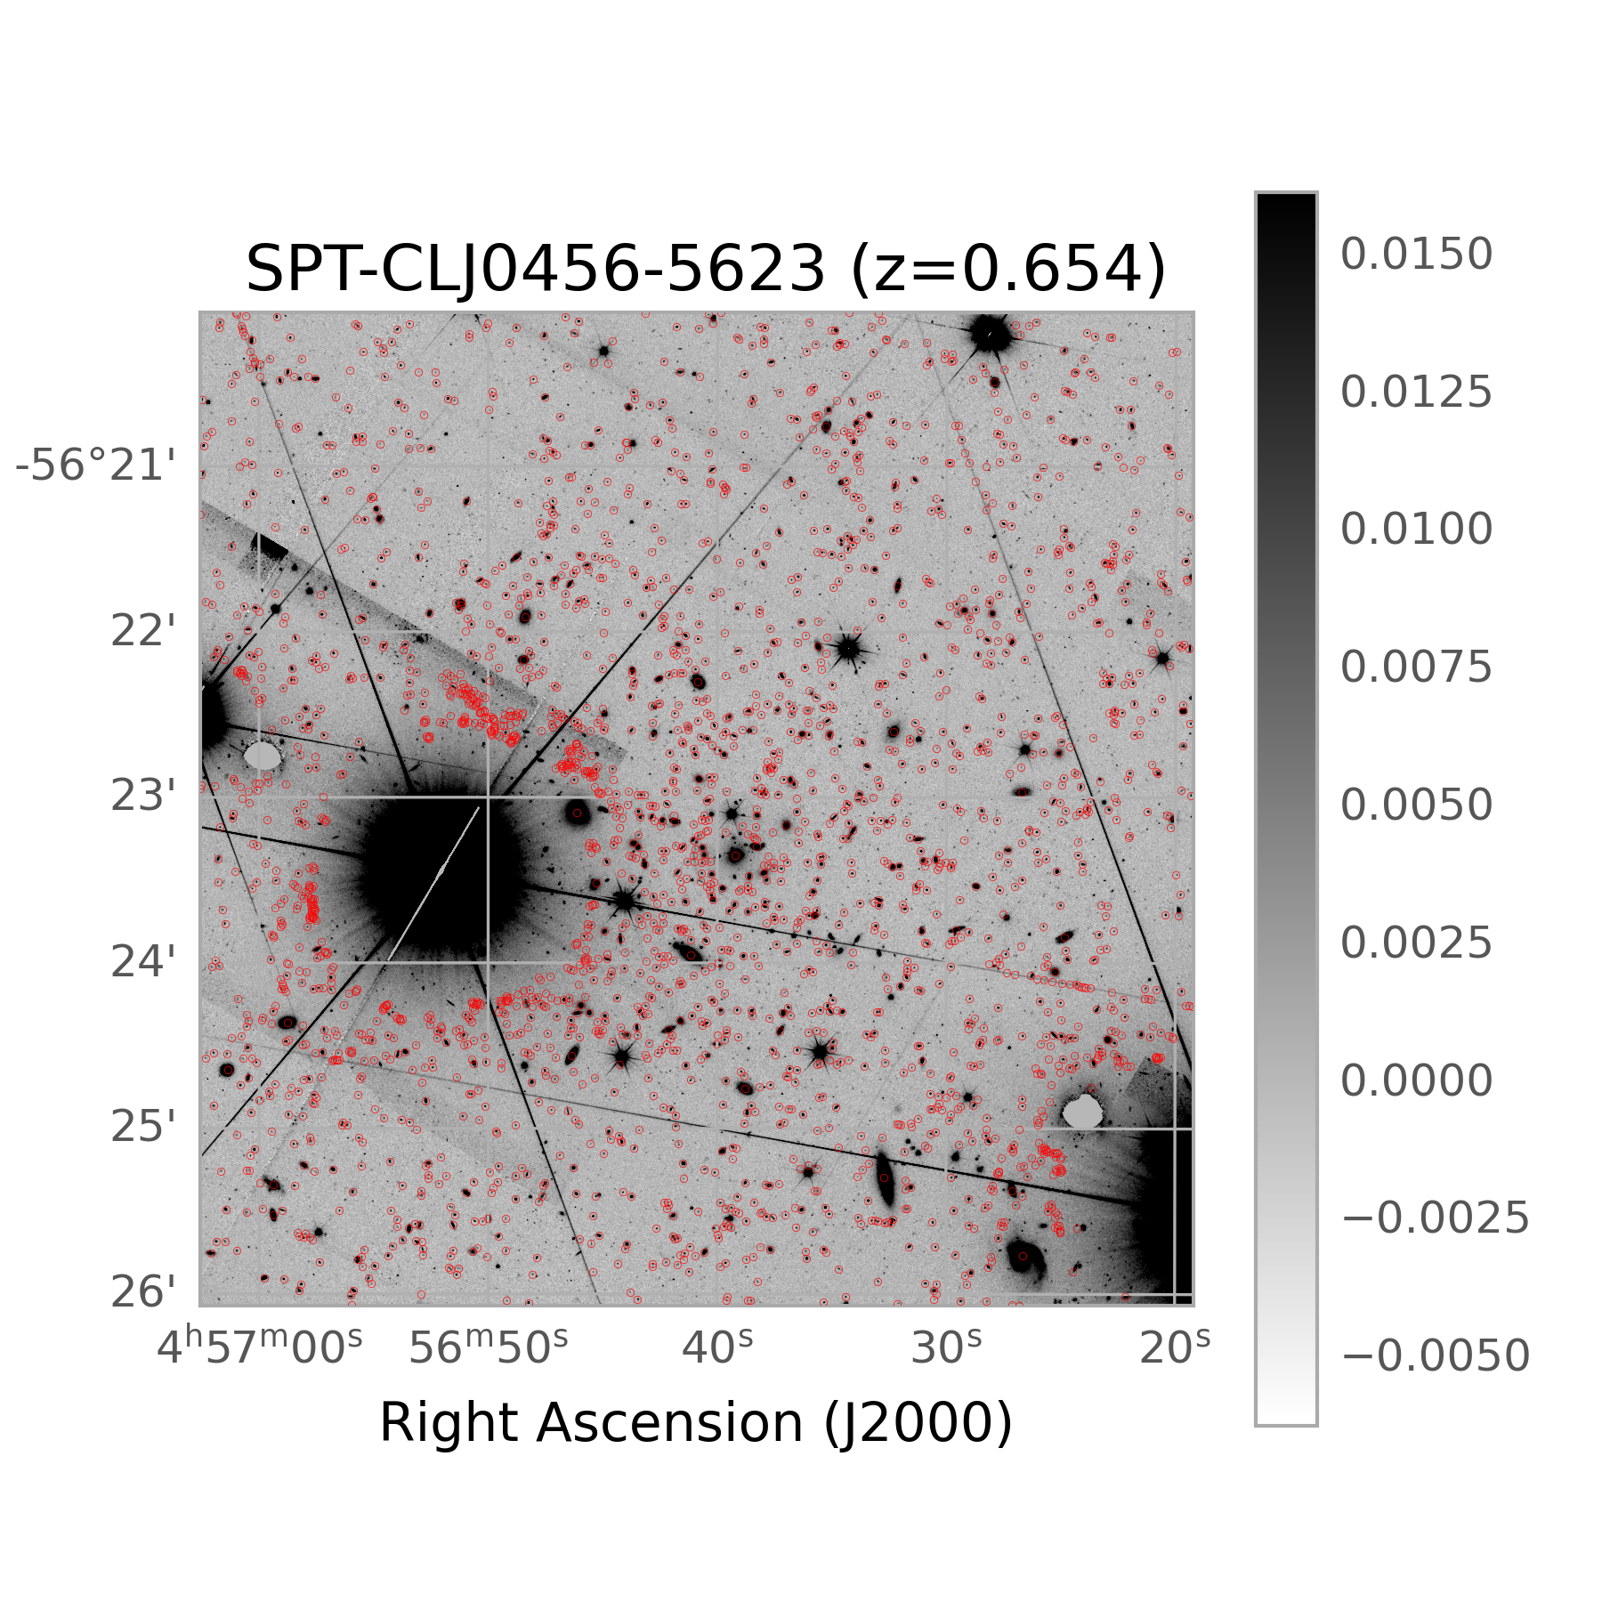
Visual inspection tool by M. Aguena: https://gitlab.euclid-sgs.uk/aguena/overlay_images
Analysis on data
Masks: need of widened masks around bright stars and extended sources to remove artifacts

Slide 20
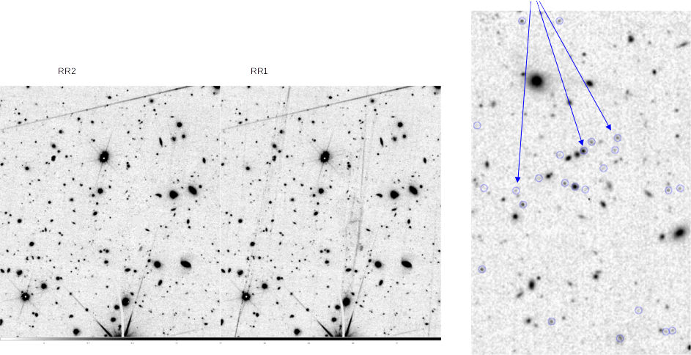
Analysis on data
NIR-only detections are circled (and nice)
Galaxy selection: so far galaxies detected in VIS (because of the persistence). Refinement of selection criteria currently ongoing
Improved persistence treatment

Slide 21
Analysis on data
Photo-z:
We will use PHZ_MODE_1 or PHZ_MEDIAN plus the percentiles, not the full P(z)
New regularization term to cope with possible ‘peakiness’ of P(z), minimum error set to:
sigma_z = sigma_0 * (1+z)
sigma_0 = polynomial (coeff_z, z) * polynomial (coeff_H, H)

Slide 22
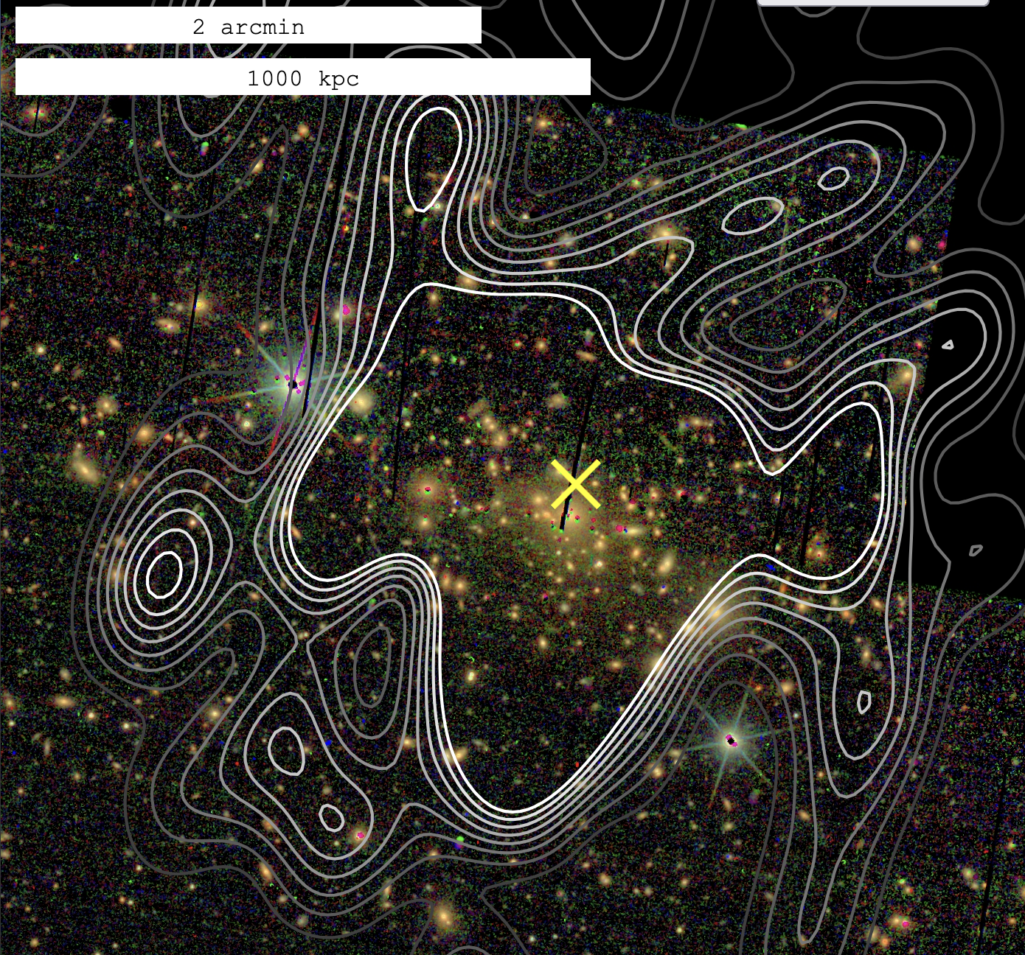
High SNR Cluster Detection Example in RR2
YJH images, eROSITA contours
RR2
Northern region : 85 deg² - no EXT, so no PHZ/SHE
South 1: 329 deg²
South 2: 73 deg²
We have run tiling (no HR yet, still fixing issues), DET, and merged the results in a single product.
Soon we’ll rerun DET with the new regularization of the P(z)
z=0.57 SNR=34.5
Viewer by Matthias Kluge

Slide 23
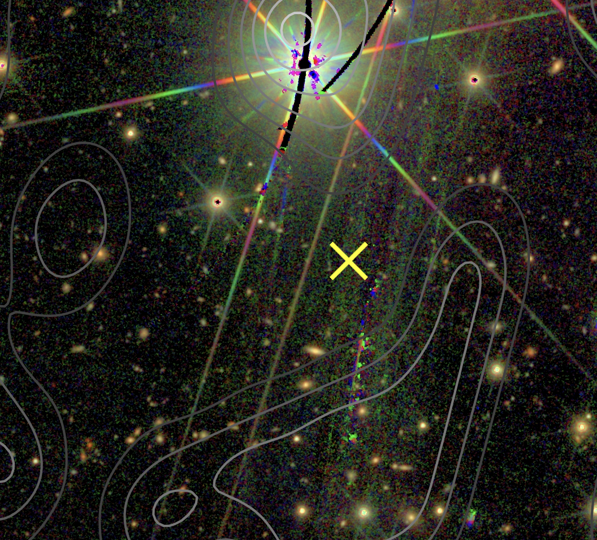
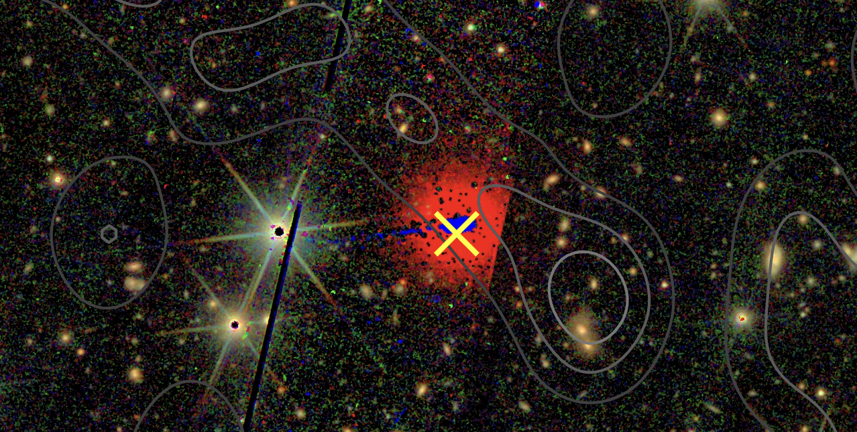
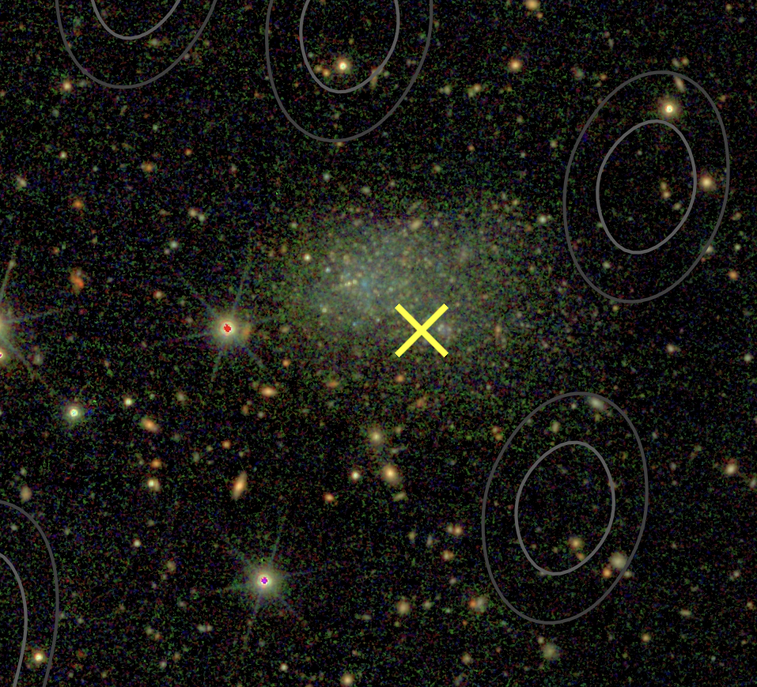
RR2
Remaining sources of contamination
Stars
Unmasked Artifacts & Edges
Extended Sources
Viewer by Matthias Kluge

Slide 24
LE3 CL: after DR1
After DR1 we plan to implement the following
Additional characterization
Radial profile of clusters, velocity dispersion of member galaxies
Selection function
This will be run outside the pipelines for DR1. For DR2 it will be integrated in the pipelines
Additional CL clustering
PK, CM-PK and maybe 3PCF, BK

Slide 25
LE3 CL: lessons learned so far
The group is enthusiastic and responsive, e.g. good attendance to the weekly coffee meeting

Slide 26
LE3 CL: lessons learned so far
We’ve got tools that are effective for an efficient team work (Gitlab, Redmine, Slack, Dockeen, Jenkins, …, and the support from the respective “help desks”), although we are not fully exploiting them (e.g. Redmine issues) and not everyone is using them (e.g. DPS)

Slide 27
LE3 CL: lessons learned so far
We missed a common data repository, but now most of us have access to cc-in2p3

Slide 28
LE3 CL: lessons learned so far
Lack of formal and structured coordination (e.g. no periodic meetings with PF leads, no periodic schedule check)

Slide 29
LE3 CL: lessons learned so far
Lack of person power for code integration

Slide 30
LE3 CL: lessons learned so far
Limited time to understand data, although this should not have hindered the integration and testing (e.g. use mocks to integrate codes instead of waiting for the proper catalogs and masks)

Slide 31
Thanks for your attention!
Supported by the PRIN 2022 project "EMC2 - Euclid Mission Cluster Cosmology: unlock the full cosmological utility of the Euclid photometric cluster catalog", funded by the European Union - NextGenerationEU, Mission 4, Component 2, Investment 1.1 - CUP C53D23001140006, project code: 2022KCS97B

