Slide 1
OU-NIR
Status and Future Developments
Matteo Correnti
On behalf of all the OU-NIR Team

Slide 2
Outline
DR1 Data Validation
DR1 Photometric Calibration and zero-point stability
DR1 improvements
NIR PF Features for DR2

Slide 3
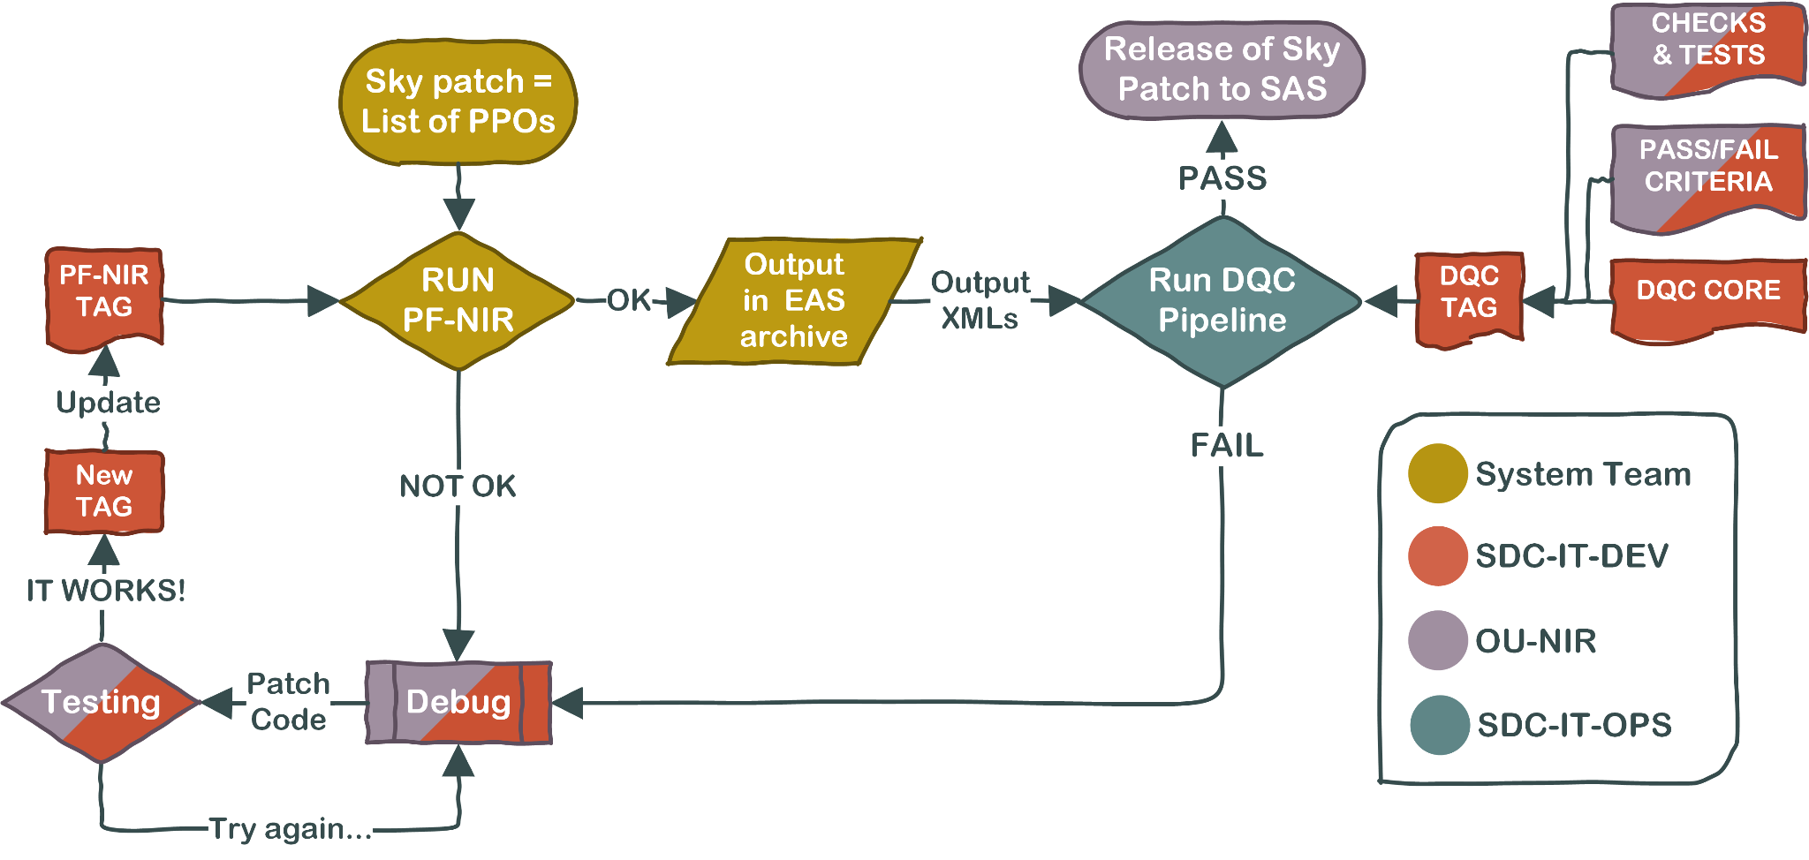
DR1 — Data Validation
DR1 data validation ongoing
For Q1 we validated images through DQC pipeline and visual inspection (total calibrated images: 1620).
Approach is not sustainable for DR1 —> need fast turnaround, hence need to rely almost exclusively on DQC pipeline
Improved DQC pipeline to:
a) include further additional check (i.e., ellipticity, comparison with GAIA, etc)
b) tweak the parameters to have more meaningful number of FAIL and WARN in the various test performed (i.e., change thresholds, etc)

Slide 4
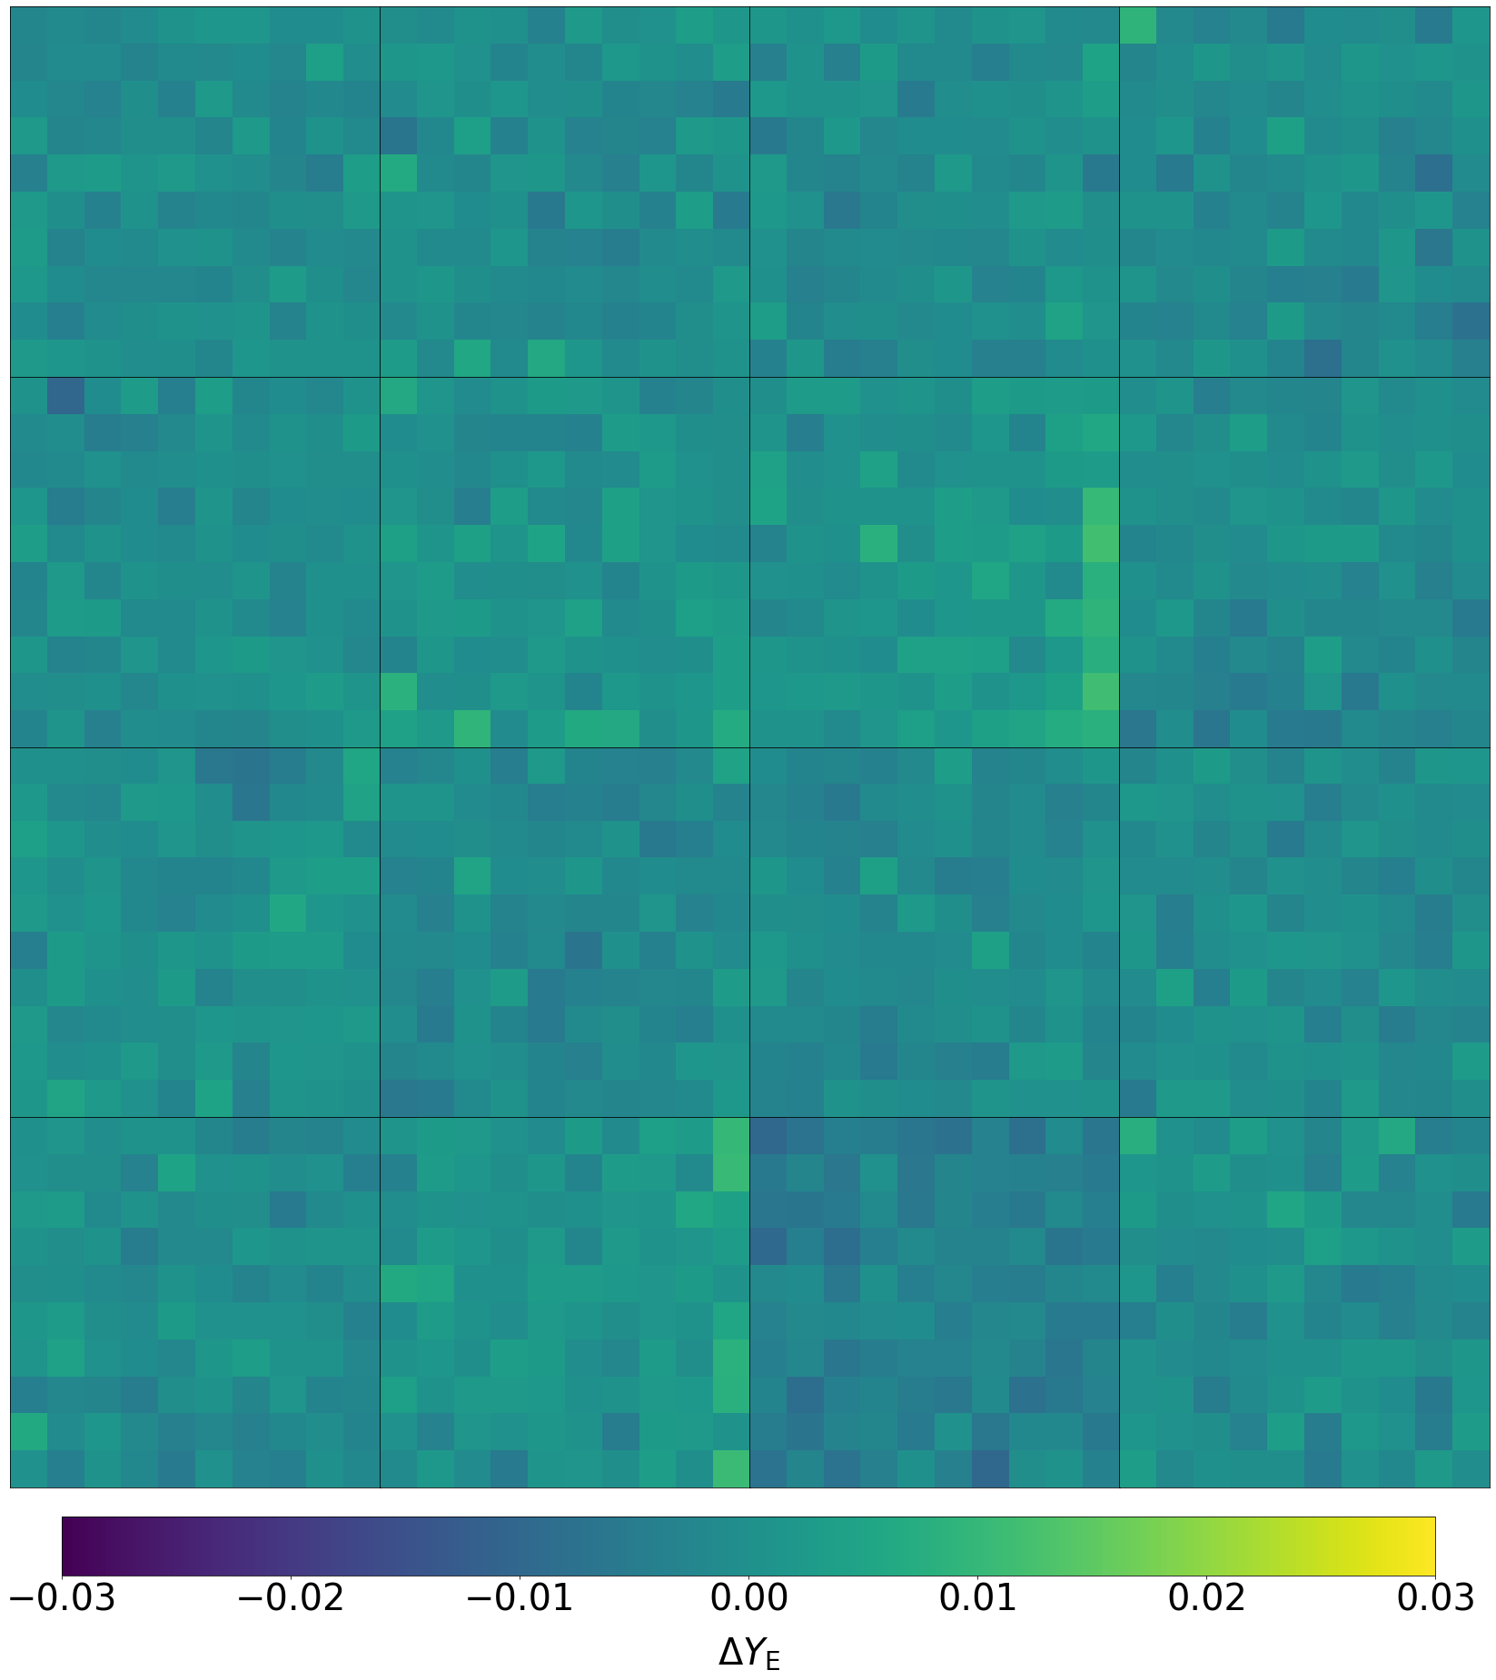
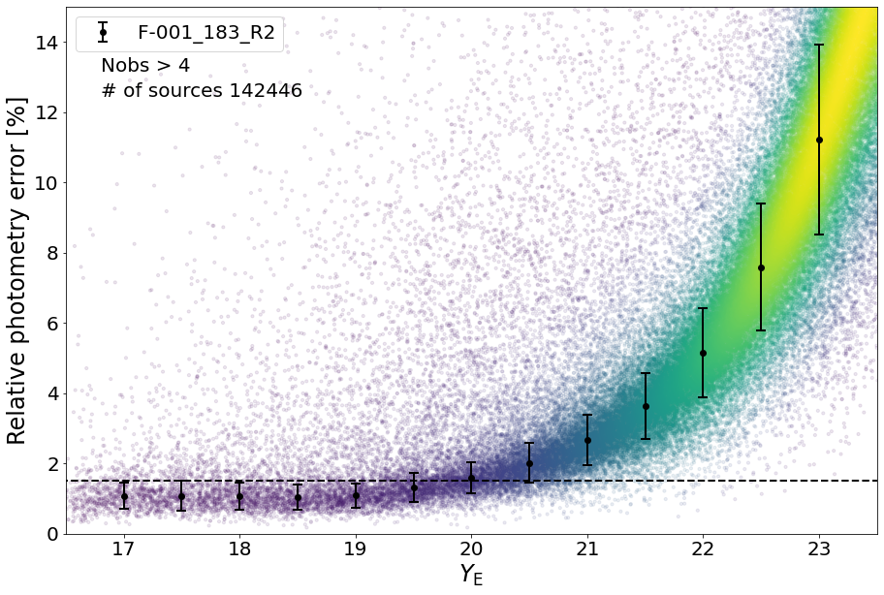
DR1 — Photometric Calibration
Routine photometric calibration performed exploiting monthly self-cal field observations
Relative photometry error < 1%
Photometric accuracy has no major spatial dependence

Slide 5
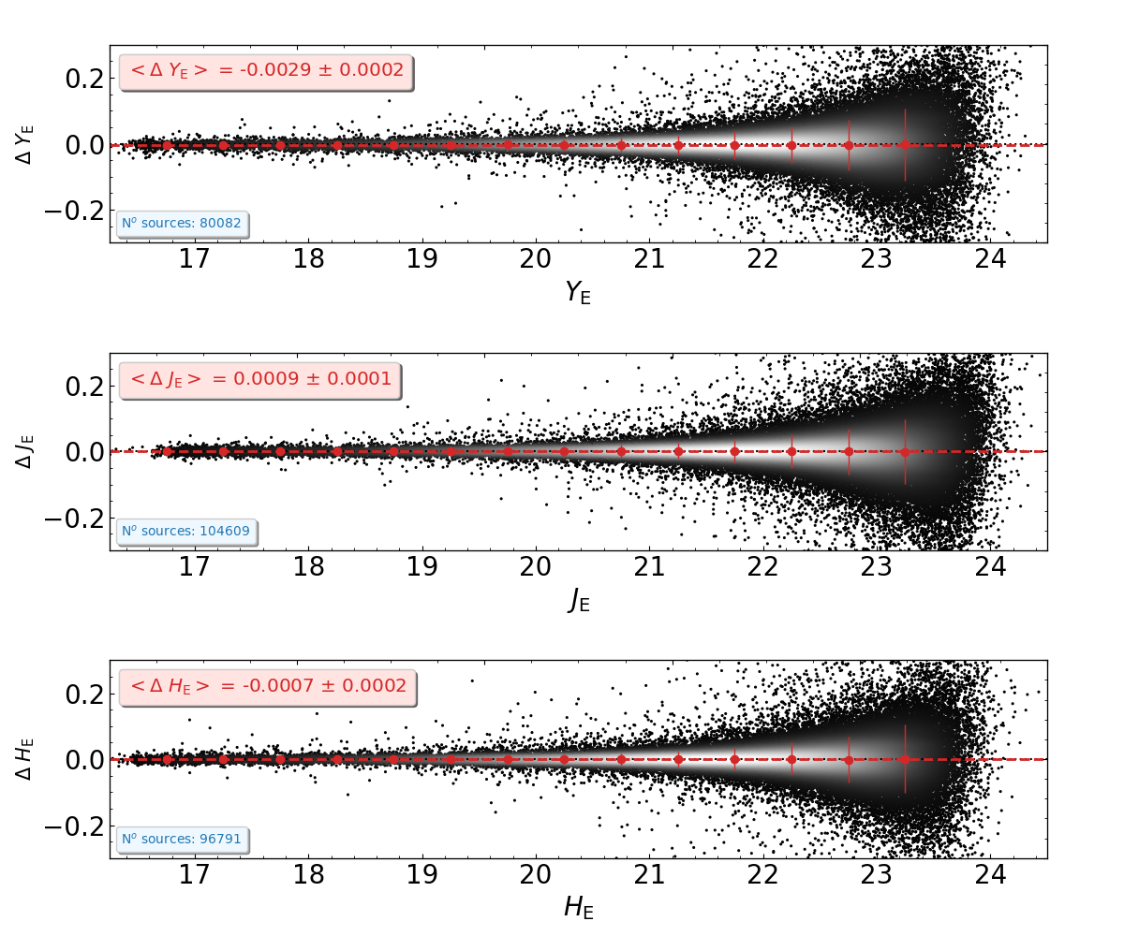
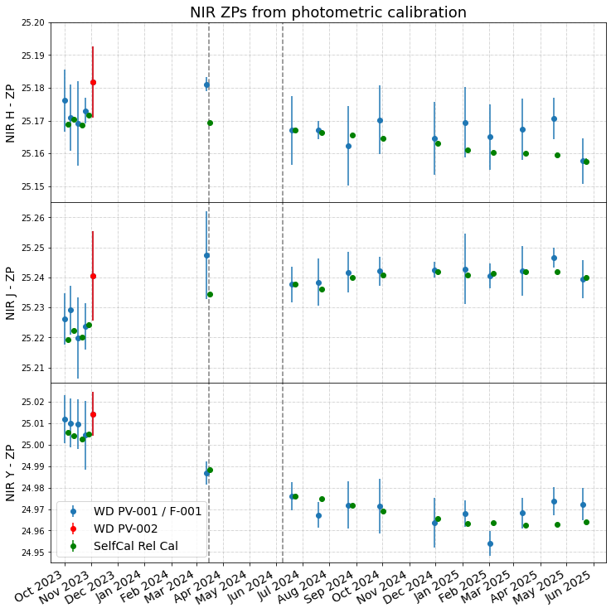
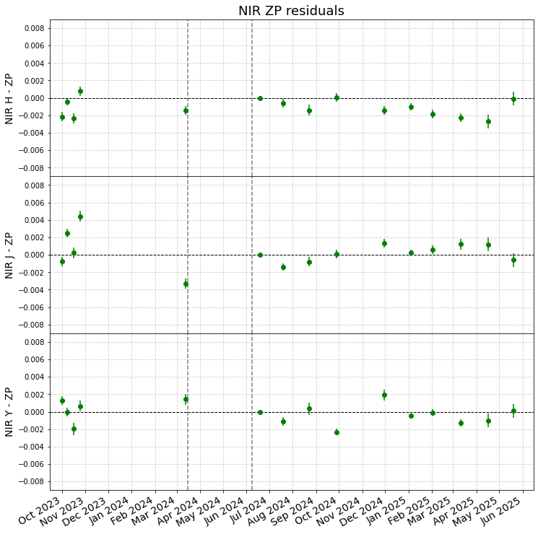
DR1 — Photometric Calibration
Photometry stability better than 0.3% ~ few mmag
Photometric differences between July and August observations of the self-calibration field
Courtesy of G. Polenta

Slide 6
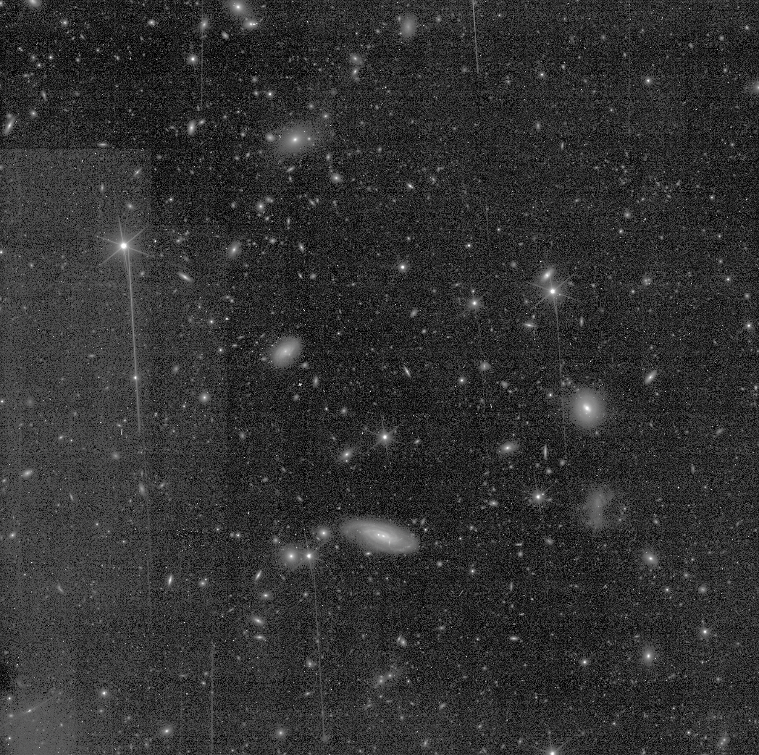
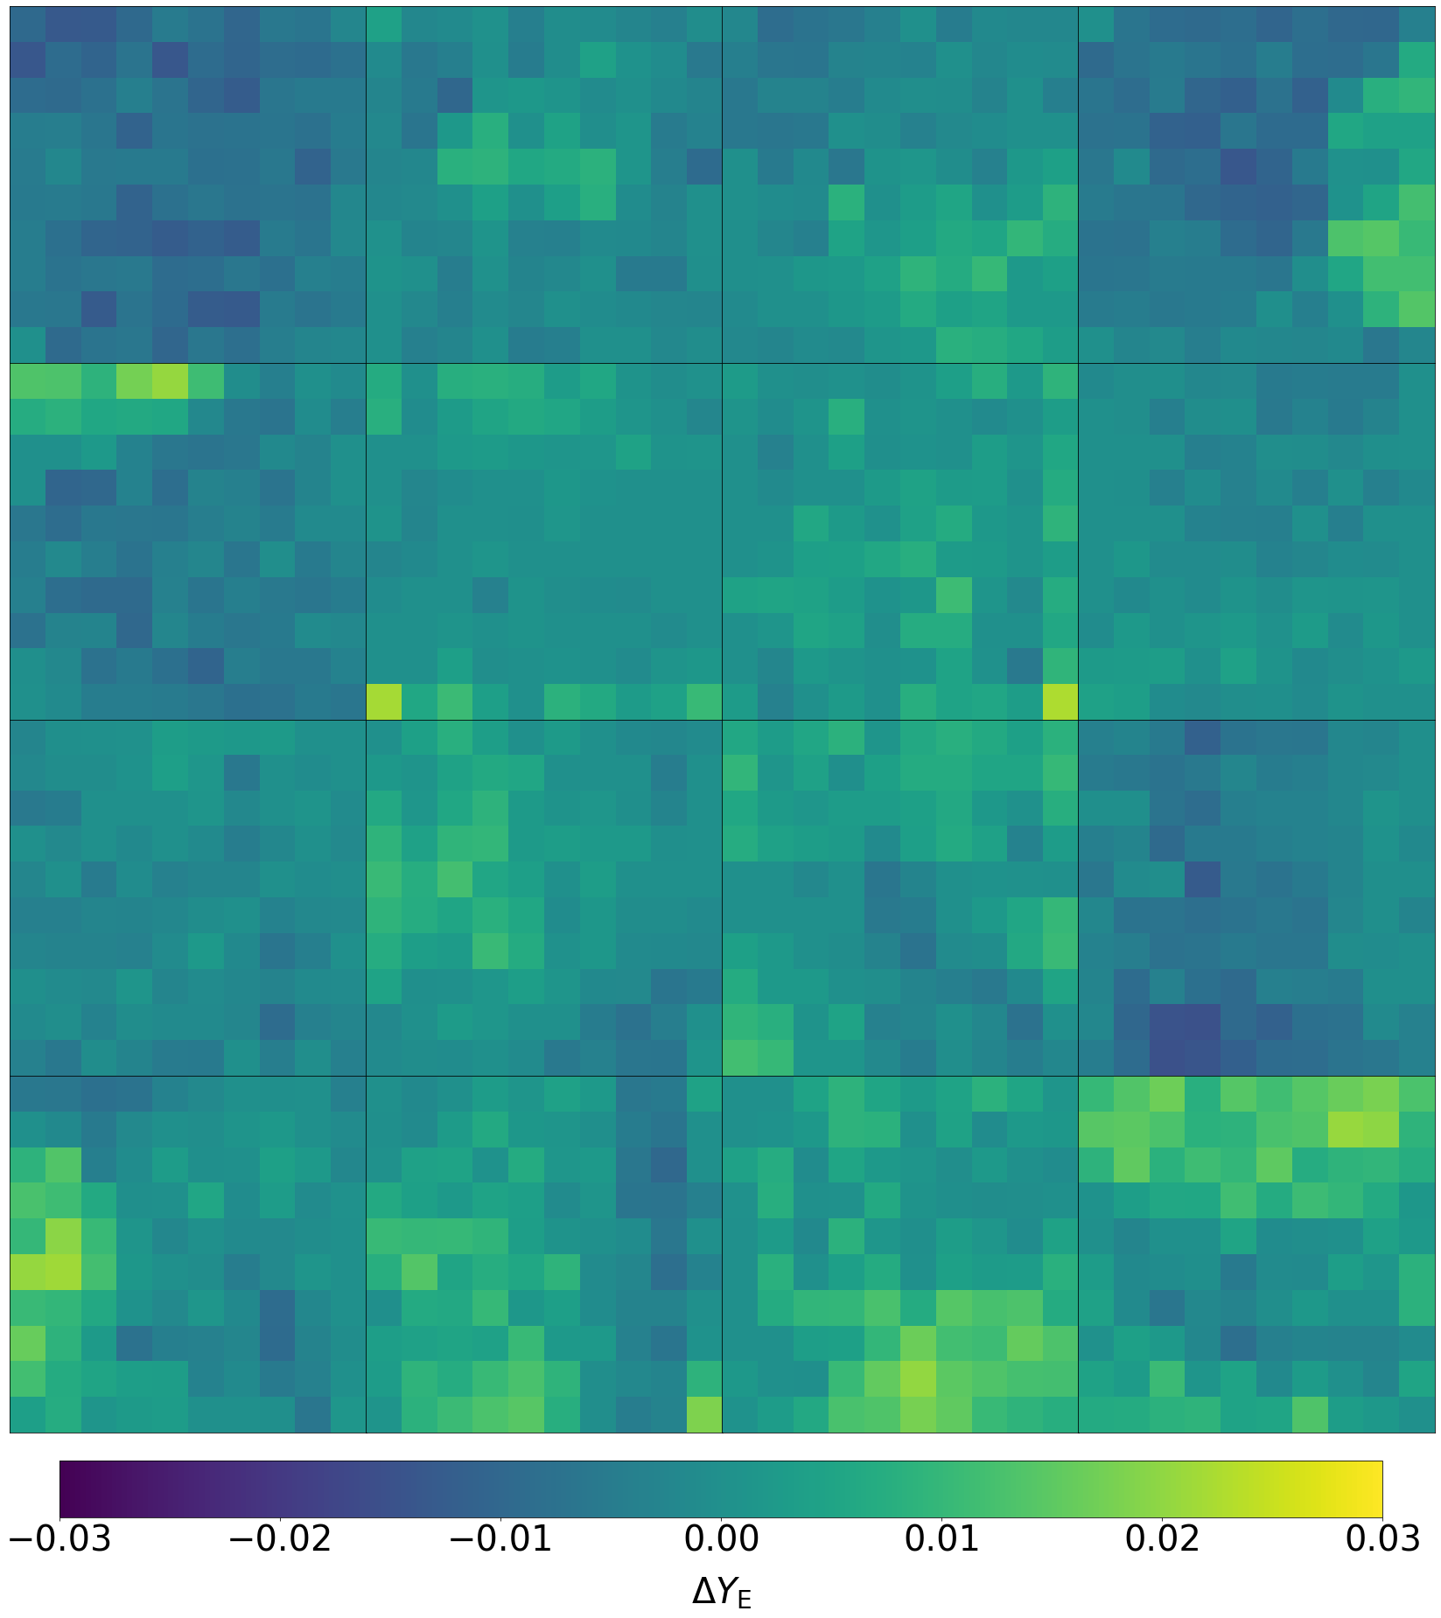
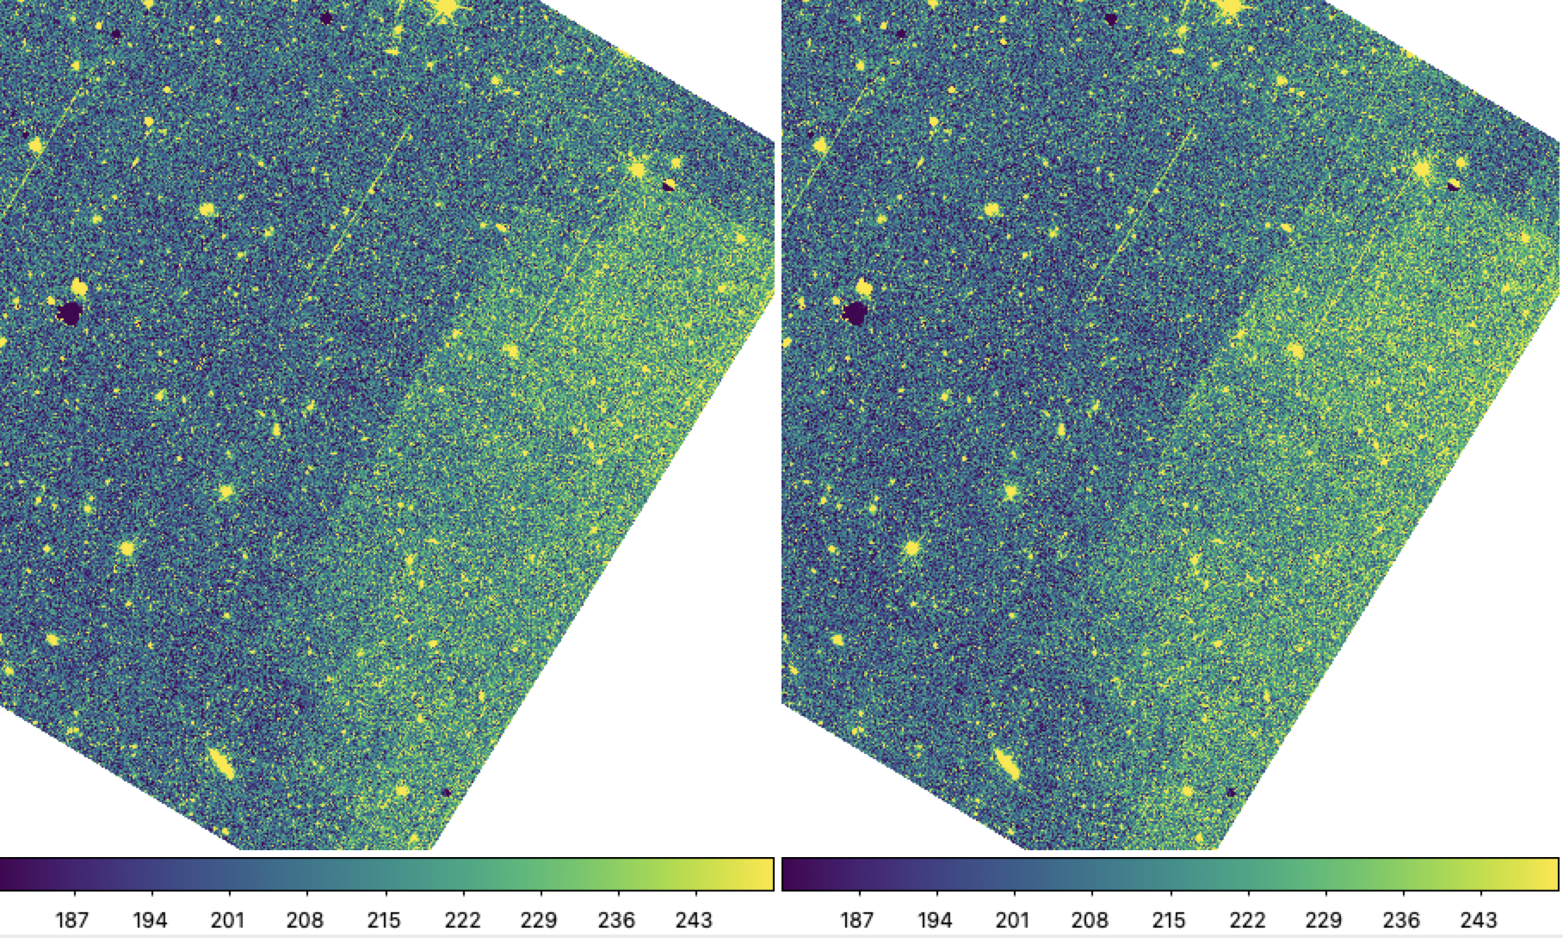
DR1 — Validation of PDC campaign data
PDC thermal stabilisation campaigns data show some diffuse features.
Independent on the LSF used in the processing.
Observations close to the ecliptic plane —> higher zodi level which possibly result in higher persistence in the bkg with different scaling in the high and low persistence regions.
Relative photometry on single dataset is > 1.5%. Note that when stacking images creating the tiles the final photometry value is the mean value from sources in different positions in the detectors (I.e., lower rms).
Work in progress to quantify impact on photometry

Slide 7
DR1 improvements
Persistence: improved masking routines.
PSF model: in Q1 offset between aperture and PSF photometry with slight dependence on magnitude. For DR1, improved PSF models derived from observations of self-calibration field through a dedicated pipeline, extending the model to larger radii and providing better characterisation of the extended PSF wings.
Background estimation: positive correlation between estimate bkg signal and position of bright objects —> over-subtraction in the outskirts of extended objects. In DR1, different background algorithm estimate (NoiseChisel).
Calibration products: majority of calibrated products used for Q1 based on in-flight data, few products based on ground calibration will be superseded by in-flight data in DR1.
Calibrated catalogs: single aperture photometry. For DR1, inclusion of multi-aperture photometry.

Slide 8
DR1 — Persistence Masking
Effective model from ground calibration
Single spectroscopic observation
Power-law model based on flight data
5 hours history of spectroscopic observations
5 hours history of imaging observations implemented but not used in the current pipeline —> DR2
Courtesy of B. Kubik

Slide 9
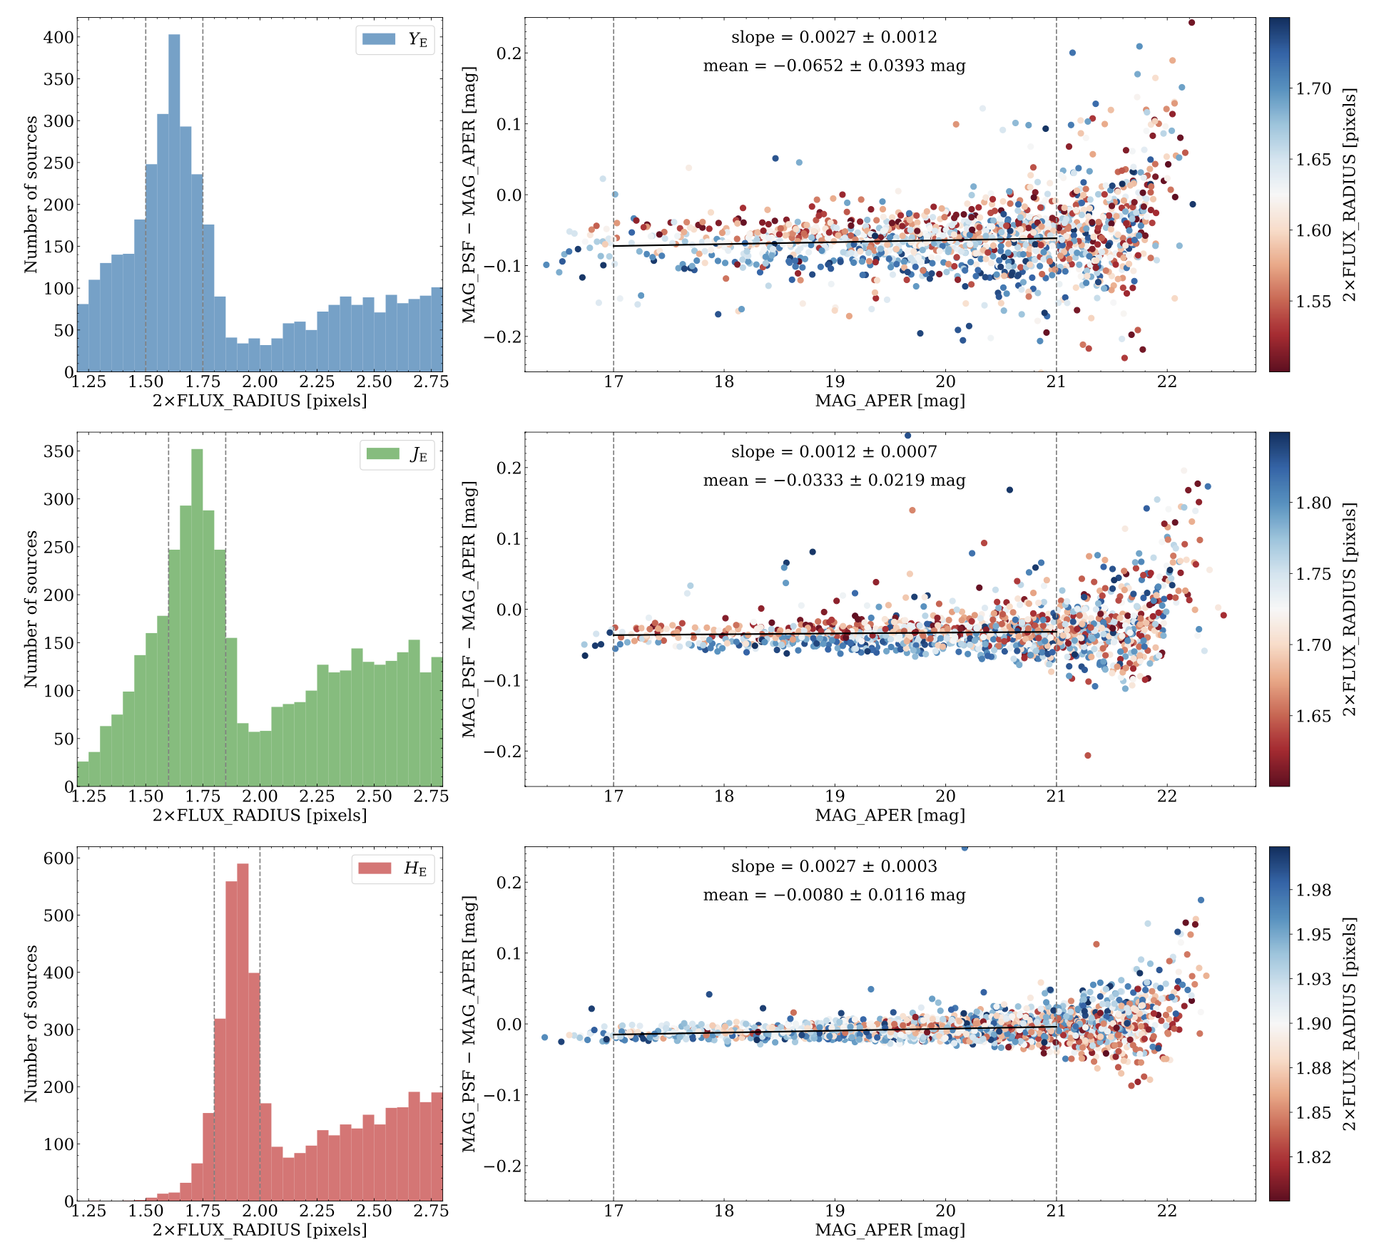
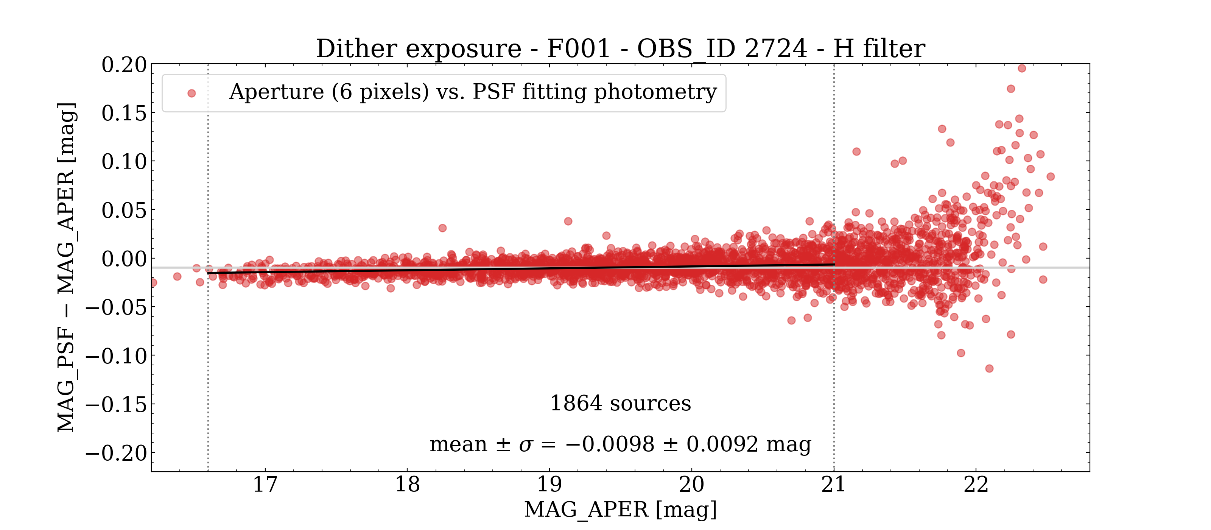
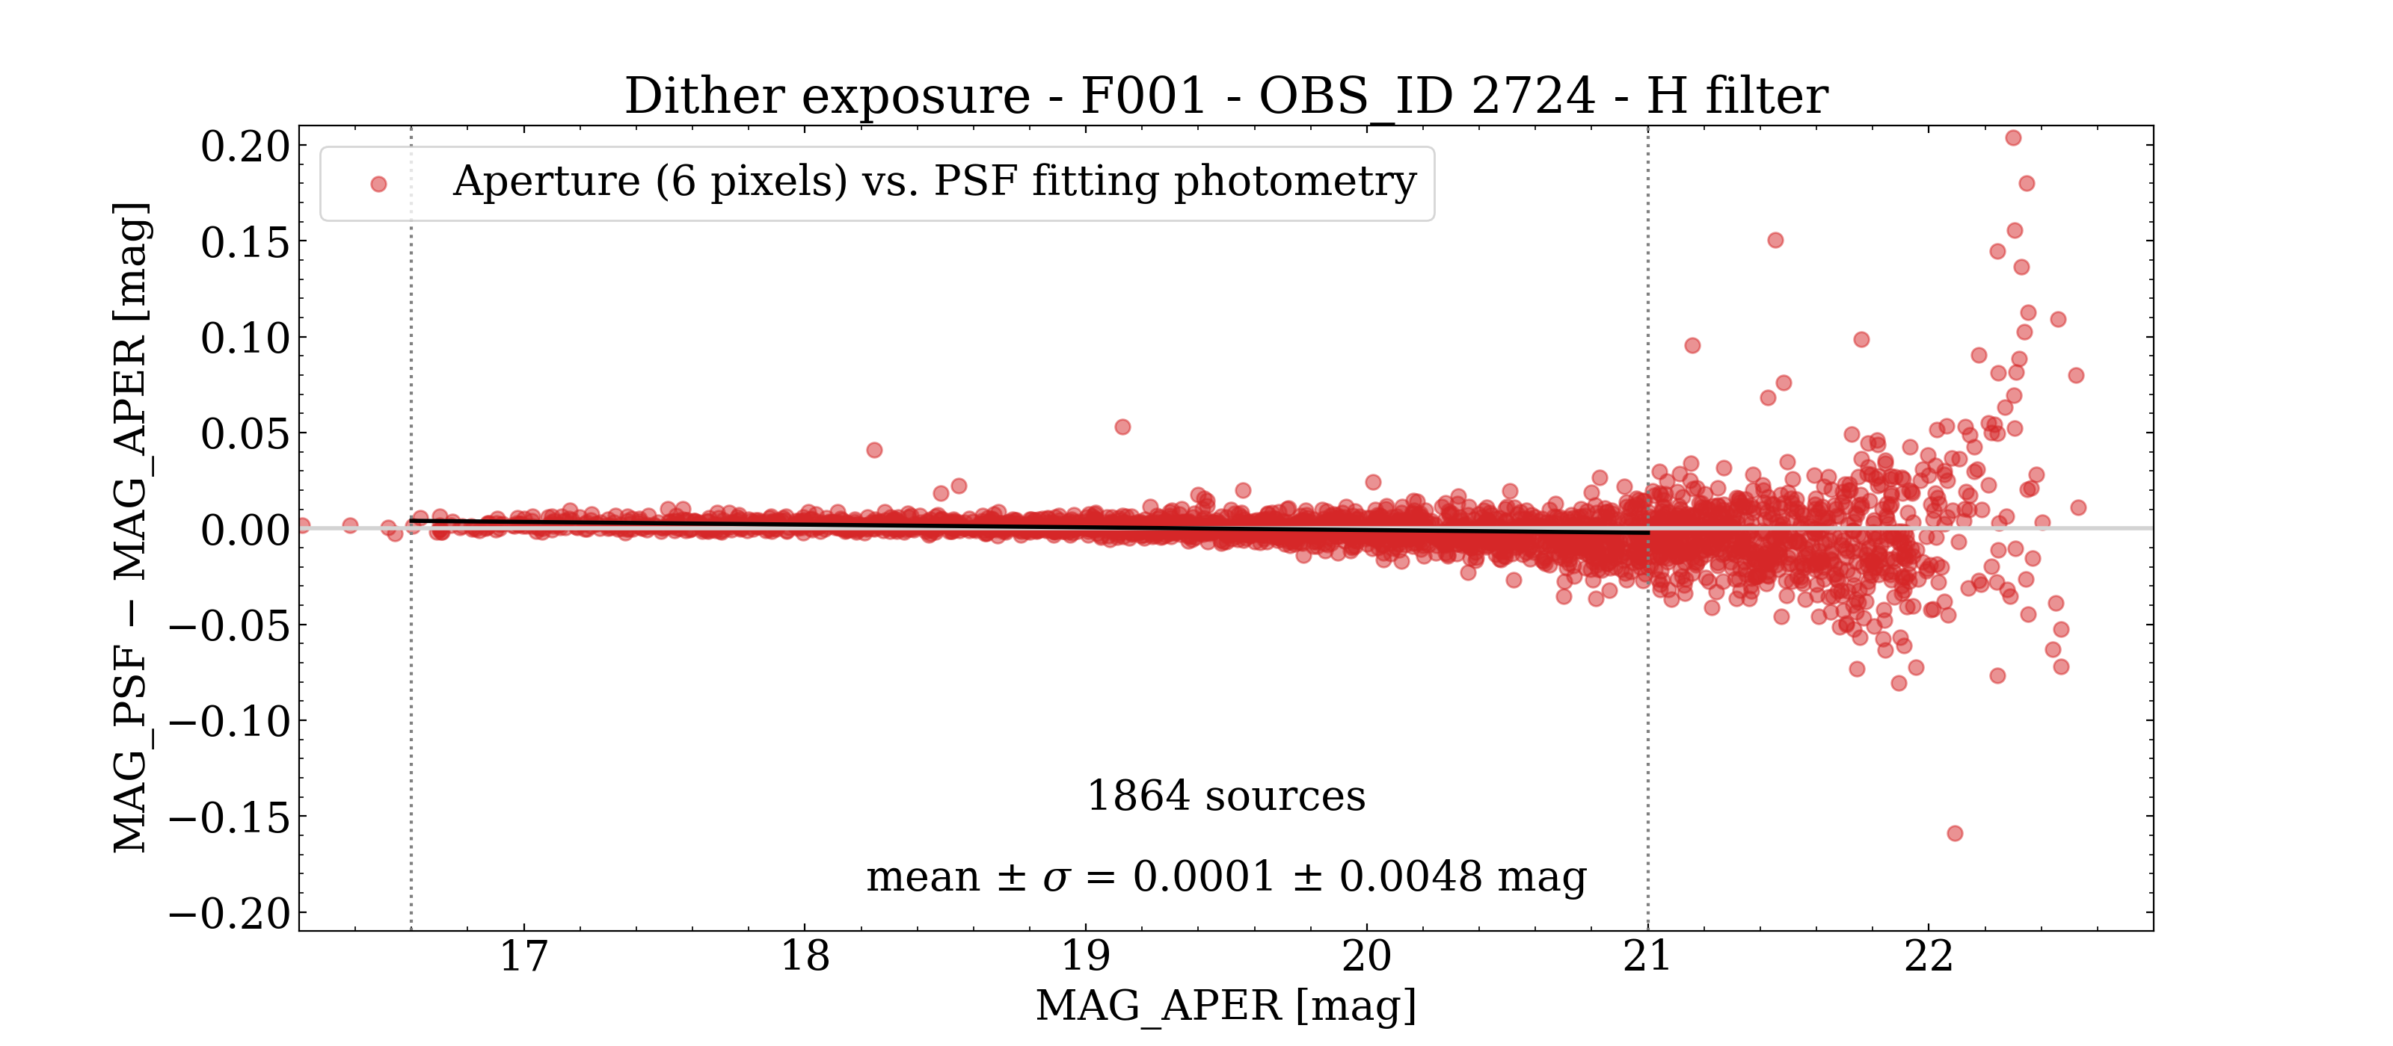
DR1 — Point Spread Function
Model derived from self-calibration observations (more point sources)
Larger number of basis vectors (hundreds instead of tens)
7” x &” stamps instead of 3” x 3” for each source
OLD
NEW
Comparison between PSF and Aperture Photometry for Q1 data
Courtesy of R. Da Silva

Slide 10
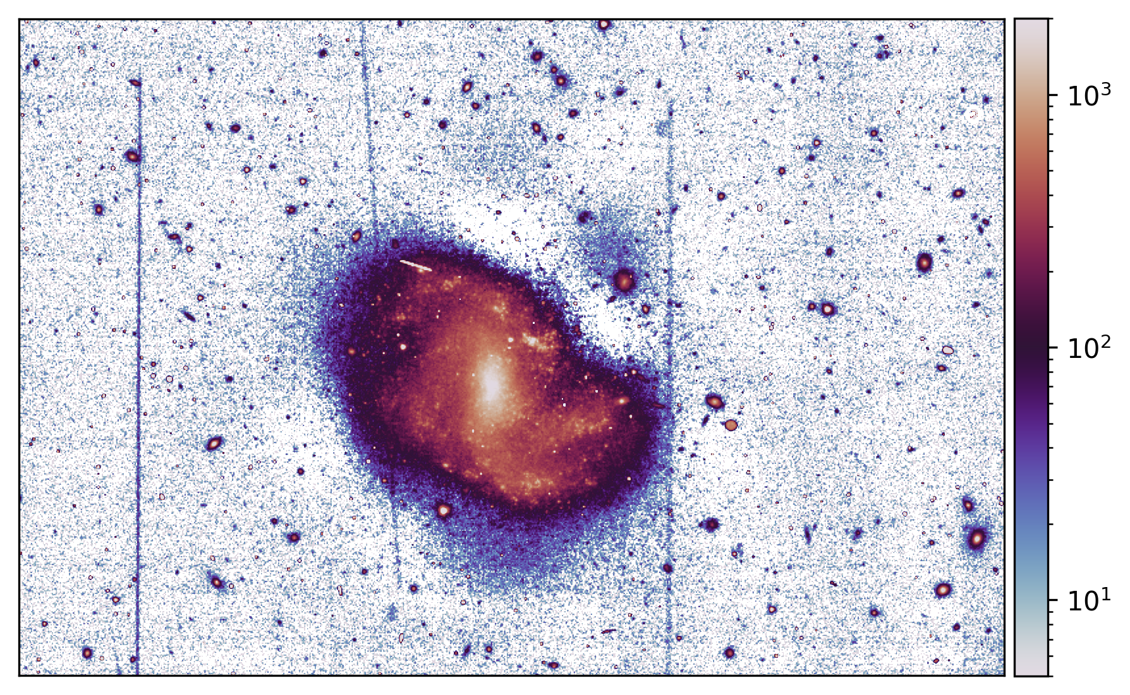
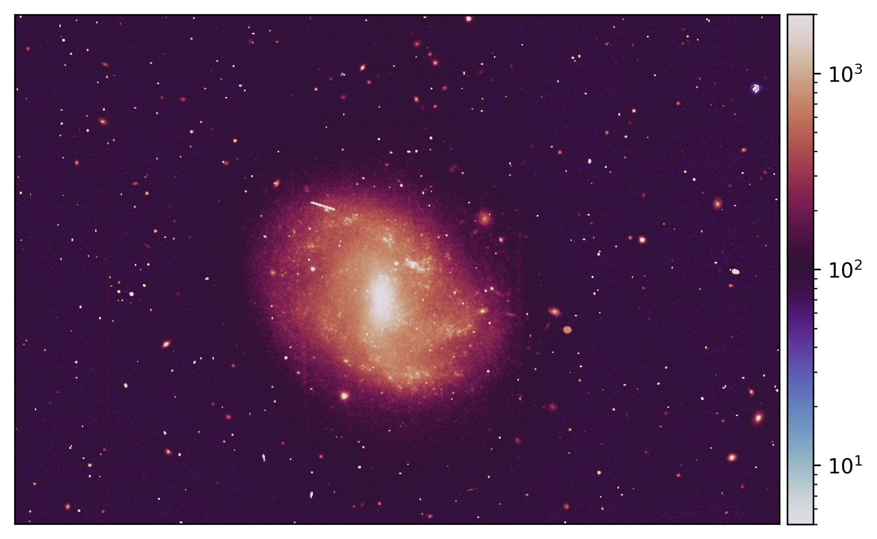
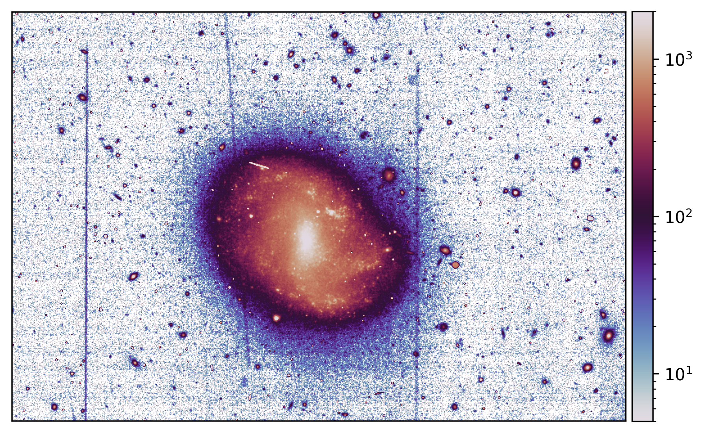
DR1 —Background
Bkg using SourceExtractor (Q1)
Bkg subtracted image
Example for 1 image in 1 detector from Q1 data
Original Image
Bkg using NoiseChisel (DR1)
Bkg subtracted image
Courtesy of P. Awad

Slide 11
Planned NIR PF features for DR2
1/f noise correction: removal of horizontal stripes due to 1/f noise.
Persistence masking: improving persistence masking using photo+spectro history (requires tuning of the threshold).
Relative Calibration from Self-cal: creation of a calibration pipeline to compute the relative calibration factor between different self-cal visits.
Superflat: Calibration pipeline to build a super flat from NISP photometric exposures (Alternative approach to the LSF computation — based on bkg, i.e. low fluxes, vs LSF based on sources, i.e. high fluxes).
Non-linearity model: use of additional data at the highest fluency for non-saturating pixels.
Absolute photometric calibration: use of additional sources to improve the absolute photometric calibration.
Persistence correction: adopting a correction for persistence vs masking.
Calibrated catalogs: improvement in rejections of spurious detections (masking from photo history + bright stars masking).

Slide 12
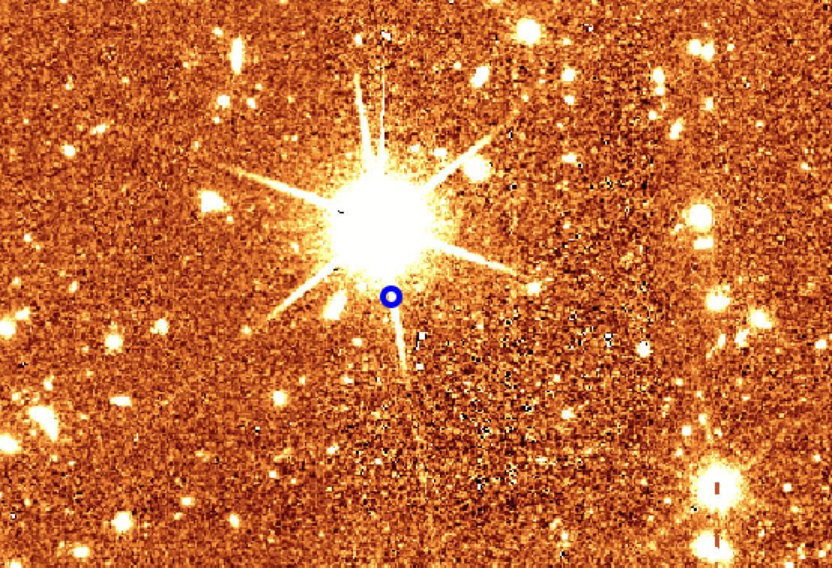
Improving source catalogs
Two identified different classes of spurious sources:
Photo-to-photo persistence (faint end)
Bright star spike (bright end)
Masking procedure will be implemented for bright stars, in order to avoid spurious detections due to the star spikes.
Test performed with the new persistence mask that take into account also the photo history show improvements in the stacked image (i.e., 10% of spurious detections vs ~ 20% without new mask).
Work in progress to understand the residual fraction of spurious sources at faint magnitudes

Slide 13
Removal of 1/f noise
Example of correction by rows x amplifier
1/f noise is a correlated noise introduced in the images when detectors are read out. The noise presents as horizontal (and vertical) striping patterns that vary from row to row (and columns to columns)
Summary of the main steps for 1/f noise correction:
Create initial mask to identify and mask pixels that should not be used (from DQ flags, negative, etc.).
Estimate and subtract simple background that detects and removes remaining large-scale variations in the image
Mask source in the image
Estimate the stripe patterns (median along rows, rows x amp, columns)
Validate the correction (compare old vs new bkg rms)
Developed and integrated in the pipeline. Need to be tested on OTF processing.
Example of correction by rows and columns
Courtesy of P. Awad & M. Correnti

Slide 14
Persistence Correction

Slide 15
Conclusions
DR1 reprocessing proceeding as expected, need to work on PDC data to better understand origin of diffuse features
Improvements in DR1 data for what concerns persistence, bkg estimation, calibration products
Planned work for DR2 to further improve quality of images and catalogs

