Slide 1
NISP-IOT: NISP Data Trend Analysis
Evandro Balbi (evandro.balbi@ge.infn.it) on behalf of NISP-IOT
Notes:
Good

Slide 2
Outline:
HKTM and QLA daily monitoring
Cosmic Detection On Slew Dark
Flat-field (F-007) Detectors Analysis
Persistence Detection On Slew Dark Using Autoencoders
Work In Progress

Slide 3
HKTM and QLA daily monitoring
Developed an automatic pipeline:
Checking for data on database
HKTM & QLA data Retrieving
Converting in a root file/day
Uploading on NISP website
Creating plots
http://nisp01.oas.inaf.it:20080/
Daily health checks and long-term monitoring of:
HKTM
QLA
Temperatures, voltages, current, power for:
Mechanical Assembly (OMA – e.g. FWA and GWA)
Warm Electronics (ICU, DPUs)
Baseline
Saturated pixels
Number of px/s with cosmics
Number of sources
Number of spectra
PSF
Chi2
Spectrum Angle
SCI px statistics
REF px statistics

Slide 4
Daily Plot
Weekly Plot
Monthly Plot

Slide 5
Cosmic Detection On Slew Dark: Developed Pipeline
NIR Bad pixel map
Dark fits file
Bad pixel dict
Science Data dict
Data Quality dict
Bad px replaced with median of the background
Cosmic Detection and Removal with Astroscrappy
Cleaned Image
Cosmic Mask
Single px clustering & clusters statistics
Analysis statistics
Root File
Notes:
With the aim of a continue and ever more accurate monitoring of NISP and of its products, we developed also a pipeline to detect and remove cosmic rays on slew dark.

Slide 6
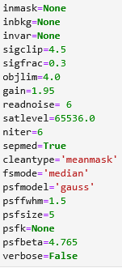
Astroscrappy
Improvement of L.A.Cosmic: python-based algorithm that uses Laplacian to detect cosmic rays (van Dokkum 2001)
Key speedups lies in the application of a separable median filter instead of the original LA Cosmic median filter. Filters are not identical but produce comparable results and the separable version is much faster (factor of 28).
Numerous successful tests have been conducted on synthetic products and on real acquisition to verify the performance of the algorithm
Input parameters of Astroscrappy were progressively tuned to achieve the most suitable set up for NISP slew dark products.
Notes:
Il Laplaciano è un operatore matematico usato nell’elaborazione di immagini per evidenziare bordi netti o discontinuità. L.A.Cosmic lo usa perché i raggi cosmici tendono a generare picchi molto ripidi e isolati nei pixel, che si distinguono bene dai bordi naturali degli oggetti astronomici.

Slide 7
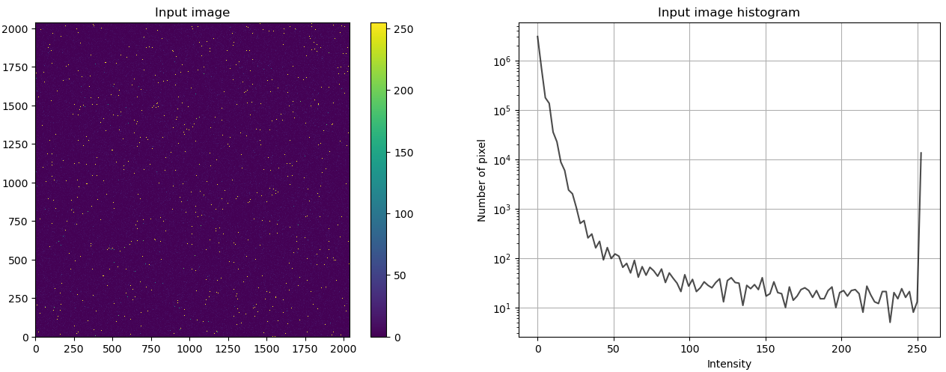
In the case of macc_sim_4_16_4_rpFalse.fits the n° of simulated cosmics (chi2>49) is 15 849
Chi2 (macc_sim_4_16_4_rpFalse.fits )
Distribution of Chi2
Astroscrappy flagged 15 562 px as cosmics, the goodness of the analysis can be derived by:
$\frac{True Positive}{True positive + False positive}$ = $\frac{14 418}{14 418+1 431}$ = $0.91$
Tests on simulations proved the capability of the pipeline to detect pixels affected by cosmics with high precision (>90%)
Notes:
If a px flagged as cosmic has also a bad quality factor (Chi2=1) it is a True Positive. False Positive are px flagged as cosmics that have a good quality factor (Chi = 0). The comparison is calculated as:

Slide 8
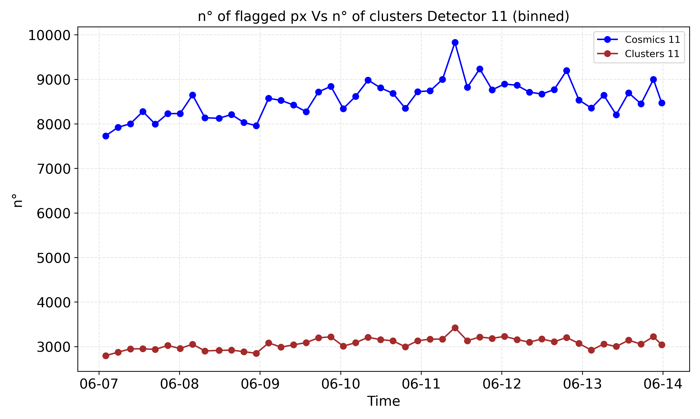
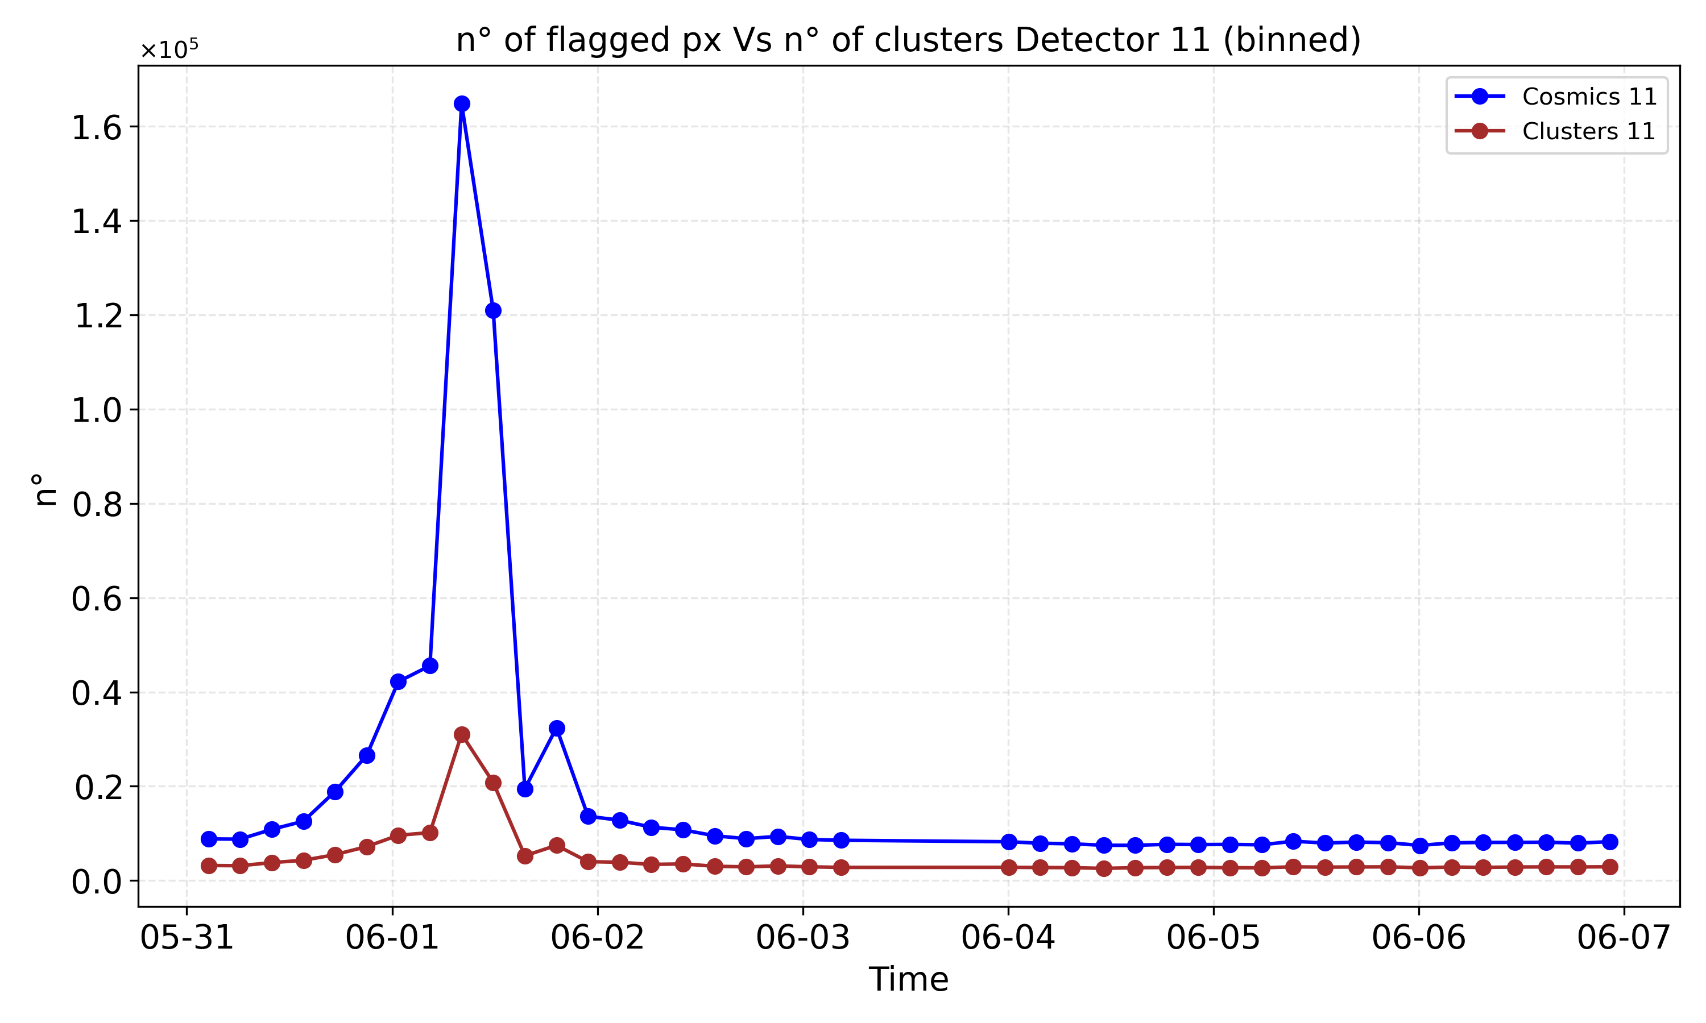
Results
Astroscrappy provides the n° of flagged pixels. For each px coordinates (x, y) and intensity are derived
Neighbouring pixels flagged as cosmics are grouped into clusters. For each cluster centroid position (x, y), shape, n° of px, total intensity (sum) are derived

Slide 9
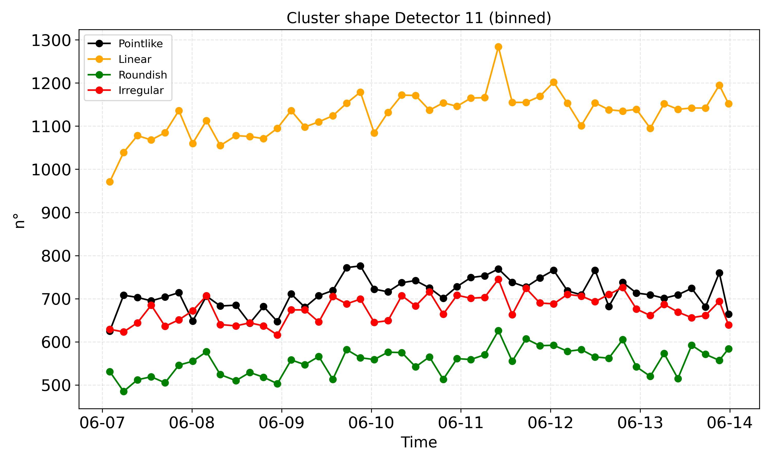
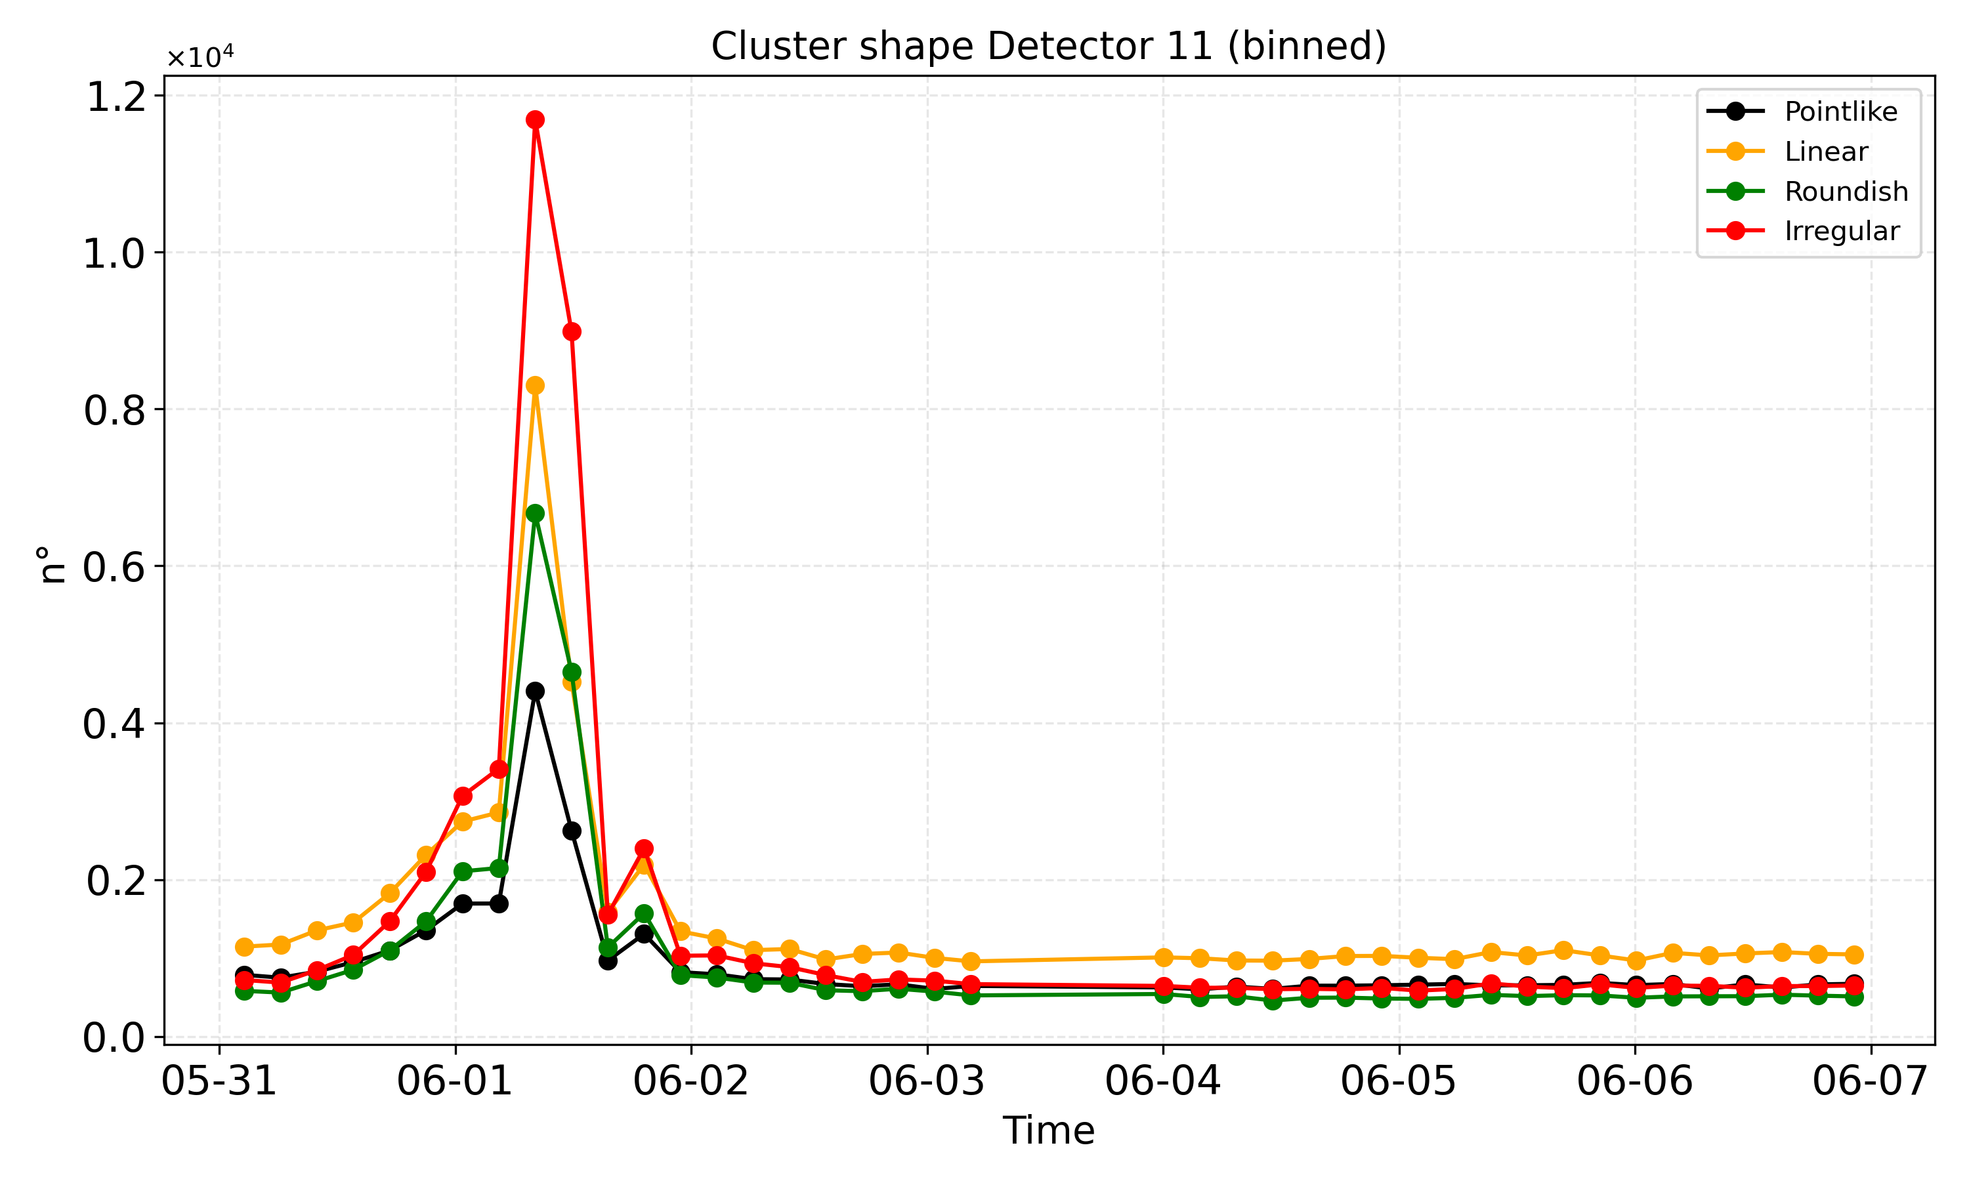
Increasing in the n° of clusters with >1 px (pointlike clusters are less numerous during the peak)
High solar activity leads to different topology in energy deposit

Slide 10
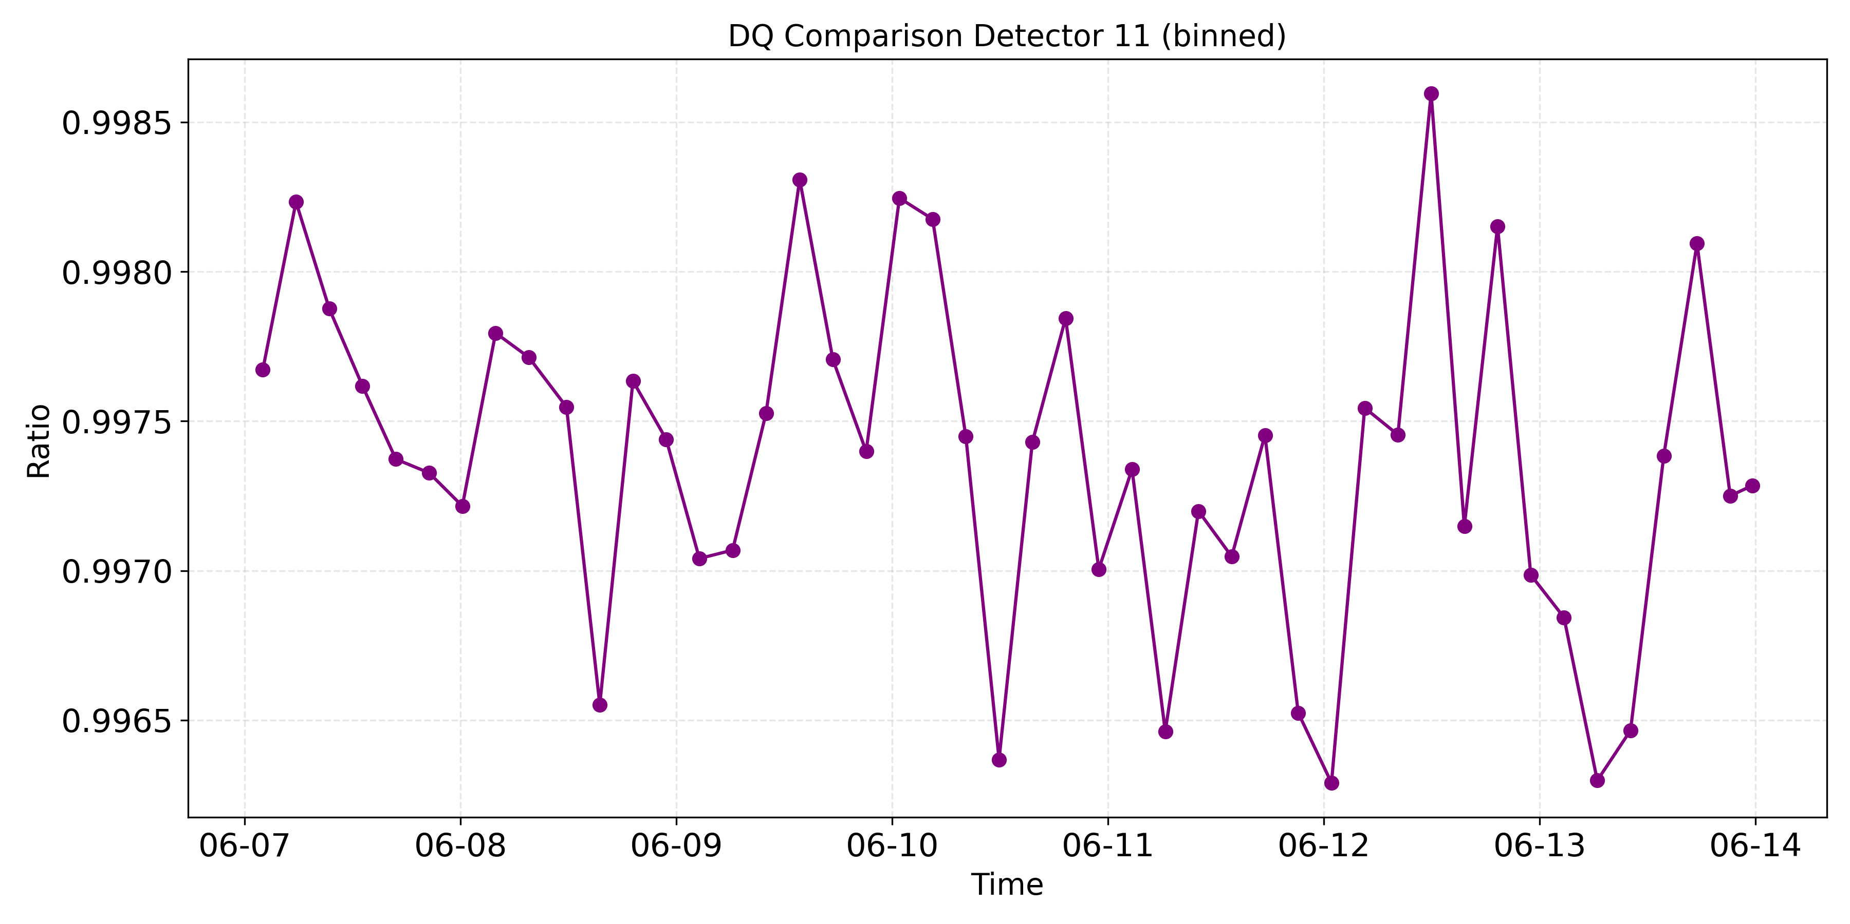
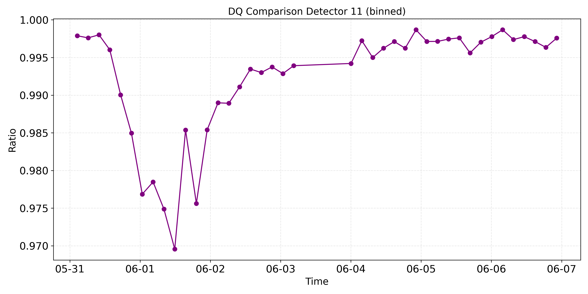
We compared the number of pixels flagged as cosmics with the number of pixels flagged as bad DQ by the OnBoardSoftware
$$\frac{True Positive}{True positive + False positive}$$
During high solar activity the metric decreases but remains >95% strengthening the reliability of the pipeline

Slide 11
Original Image 01/06/2025 (corresponding to the peak)
EUC_LE1_NISP-08033-1-W_20250601T090351.000000Z_01_05_01.00.fits
DET 11

Slide 12
Cleaned Image 01/06/2025
EUC_LE1_NISP-08033-1-W_20250601T090351.000000Z_01_05_01.00.fits
DET 11

Slide 13
Cosmic Mask 01/06/2025
EUC_LE1_NISP-08033-1-W_20250601T090351.000000Z_01_05_01.00.fits
DET 11

Slide 14
Flat-field (F-007) Detectors Analysis
Mean and median signal values for each LED provide a comprehensive view of the detector's response uniformity and consistency
Variations in signal strength (e.g., outliers) between different LEDs are critical to understand detector's performance under various illumination conditions
Consistent mean and median values suggest stable performance
Plotted trends allow us to compare the behavior of LEDs A through E, emphasizing the importance of cross-calibration for reliable data acquisition
Use these insights to refine calibration pipelines or flag detectors needing additional analysis, ensuring robust data quality for scientific use.
Median
Mean
For details: poster Chegeni et al., ‘‘Monitoring of NISP Flat-Field Stability using Monthly Calibrations"
Notes:
1. This slide presents the mean and median signal values across all detectors for each LED (we have 5 LEDs that emit uniform light with different wavelengths) , providing a comprehensive view of the detector's response uniformity and consistency. 2. The data highlights variations in signal strength in e/s between different LEDs, which is critical for understanding the detector's performance under various illumination conditions. Note any outliers or detectors with significantly higher or lower signals, as these may indicate potential calibration issues or hardware anomalies. 3. Consistent mean and median values across detectors suggest stable performance, while discrepancies may warrant further investigation into flat-field corrections or detector health. 4. The plotted trends allow us to compare the behavior of LEDs A through E, emphasizing the importance of cross-calibration for reliable data acquisition. 5. Use these insights to refine calibration pipelines or flag detectors needing additional analysis, ensuring robust data quality for scientific use.

Slide 15
Persistence Decay in Dark Images (F-007)
Impact of persistence correction on dark exposures (mean about the 27 dark exposures at the end of F-007)
Persistence is modeled as a power-law decay (from ground segment) and after subtracting it from the original signal (orange line) we have the calibrated/corrected signal (blue line)
Plot quantifies how persistence subtraction improves detector signal consistency, particularly in dark exposures compared to master dark threshold
Model will be refined to be applied to remove persistence on slew dark data
Notes:
La power law è quella del ground segment e, come visto ieri, non è proprio ottimale da utilizzare per i dati F-007.
Slide 7 SX 1. This shows evaluating the impact of persistence correction on dark exposures (In Calblock F-007 data we have 150 photometry data from LED A to E and at the end of this data acquisition we have 27 darkspectro and my mean about dark exposures are these 27 darkspectro data). Recall that persistence is modeled as a power-law decay and after subtracting from the original signal (orange line)we have this calibrated signal (blue line). 2. This slide quantifies how persistence subtraction improves detector signal consistency, particularly in dark exposures compared to masterdark threshold. Slide 8 (Zoomed Results) --- just zoom the plot in slide 7 around masterdark threshold DX 1. we observe the mean signal (in e⁻/s) across all detectors (SCS11–SCS44) after subtracting persistence effects. The uniformity of values post-correction suggests successful mitigation of residual artifacts. 2. Detectors like SCS13 and SCS23 (example) show particularly stable signals, aligning with expectations for well-corrected dark frames.The absence of outliers reinforces that the persistence model and masking strategy effectively addressed prior exposures' persistence effects. 3. These results validate the pipeline's persistence correction process

Slide 16
Persistence Detection On Slew Dark Using Autoencoders
Patches flagged by Gaussian Mixture Model are mapped to detector coordinates. Clusters like C2 may correlate with persistence, given their spatial coherence and intensity profiles.
To verify patches found by ML are persistence, we compared them with the "RGS180 and Tilt 0" exposure
Notes:
we recently tried to find persistence effects in slewdark using Autoencoders
Slide 27: 1. Here, we see the practical outcome of clustering: patches flagged by GMM are mapped back to detector coordinates. Clusters like C2 may correlate with persistence, given their spatial coherence and intensity profiles. To verify that patches found by machine are persistent, we show the "RGS180 and Tilt 0" exposure and when comparing these two we should see the persistence feature in both of them.

Slide 17
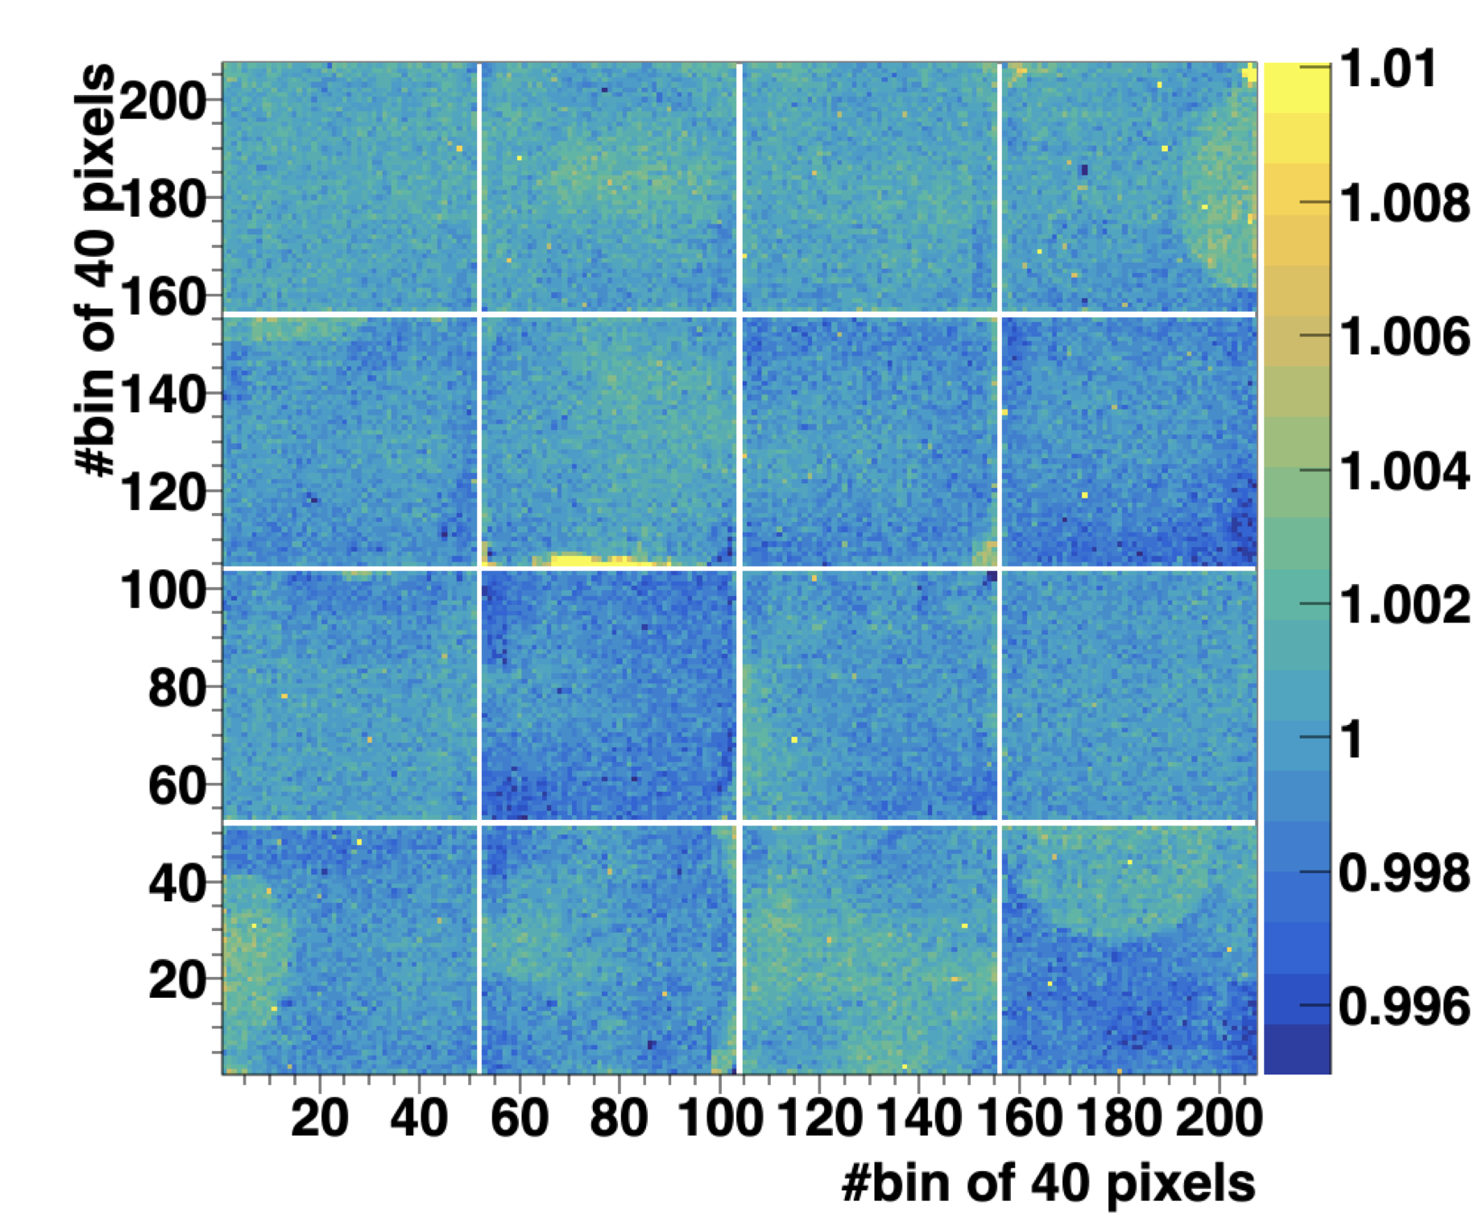
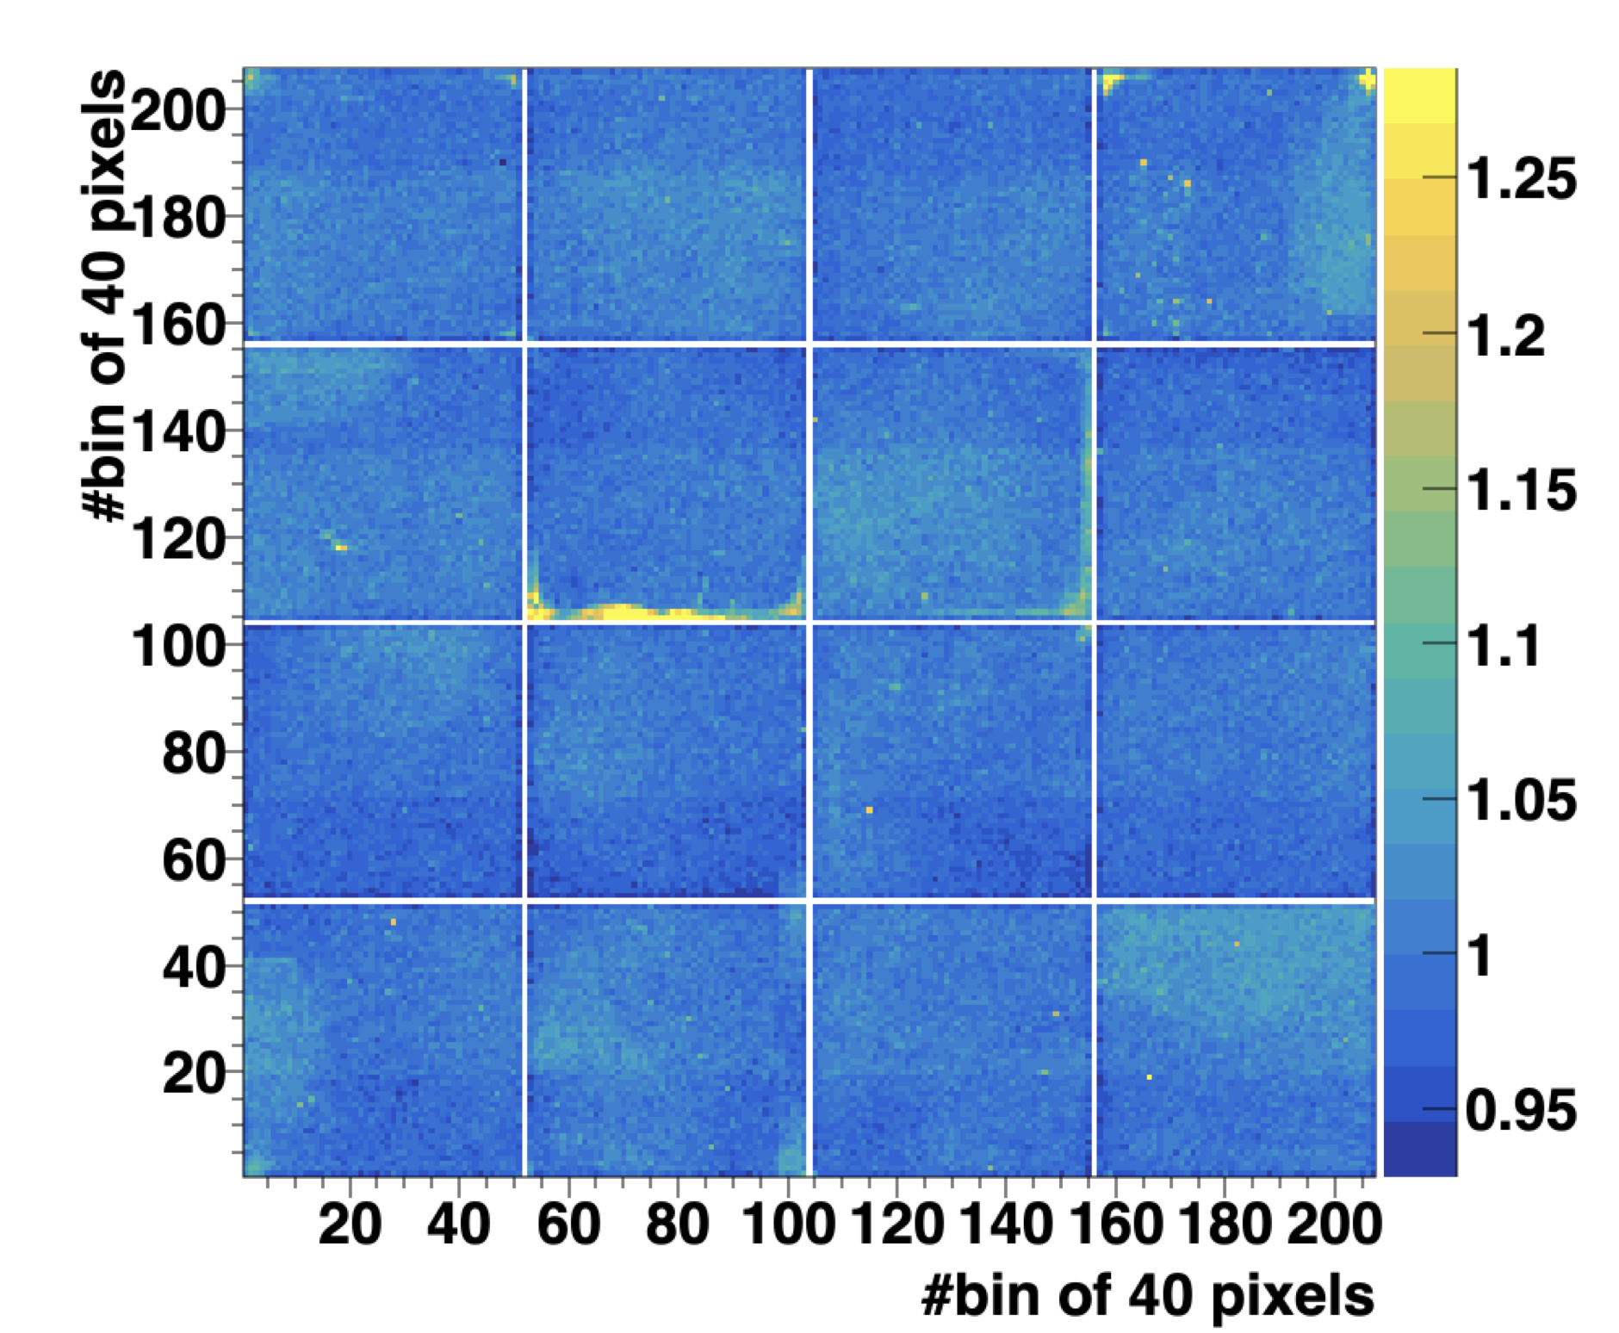
Work In Progress…
Study of NISP uniformity response using NIR Calibrated Catalog
Galaxies are randomly distributed on the NISP focal plane (flat distribution of any feature of the NIR catalog)
Differences in the mean values relates to a non-uniform response of NISP instrument, calibration, reconstruction
Using NIR Calibrated Catalog - REGREPROC2_R1 we can verify the uniformity at % level over area of 40x40 pixels
Mag / (median Mag)
Ellipticity / (median Ellipticity)
“Flower Pixels”
41 | 42 | 43 | 44
31 | 32 | 33 | 34
21 | 22 | 23 | 24
11 | 12 | 13 | 14
For details see poster from Dusini et al., ‘‘Measure the uniformity of NISP instrument using NIR calibrated catalogue’’
Notes:
"We have developed a new technique to evaluate the uniformity of NISP instrument using NIR calibrated Catalog. Because the galaxies observed during the wide survey are randomly distributed on the focal plane, we should see a flat distribution of any feature in the NIR Catalog. Deviations are due systematic effect of the instrument or of the calibration.
The nice thing of this technique is that with two month wide survey data we can measure non uniformity smaller the 1%.
For more details there is poster... "
Galaxies observed by NISP during the Wide Survey are randomly distributed on the NISP focal plane.
Each area of the NISP FPA will see the same distribution of sources.
If we see differences in the mean value of any feature of the NIR catalog this is due to a non-uniform rensonce of the NISP instrument, calibration and reconstruction. EFFETTI SISTEMATICI. LEGATI A TUTTA LA «CATENA», CALIBRATED CATALOG INGLOBA TUTTI INSIEME GLI EFFETTI (STRUMENTALI, CALIBRAZIONE, RICOSTRUZIONE). VANTAGGIO perché GUAROD RISULTATO FINALE, SVANTAGGIO perché NON SO DOVE GUARDARE.
Using NIR Calibrated Catalog - REGREPROC2_R1 we can verify the uniformity at % level over area of 40x40 pixels

Slide 18
DPU-ASWv1.4 new release (September 2025)
Two minor issues fixed:
NISP status undefined (because is reset before changing state) once every six months (per DPU) for few milliseconds while HKTM is prepared. This did not cause scientific data loss.
During Calblock-F009 (non-linearity) a LED illumination configuration leads to a very small size of the NISP data product. This exception was not correctly handled by the functions transferring the data internally in the DPU. A work-around was defined (disabling the compression) and the Calblock-F009 was successfully completed.
Notes:
Two minor issues are fixed in the new version.
Once every six months (per DPU) the NISP status is undefined (because is reset before changing state) for few miliseconds while housekeeping is prepared. This problem do not cause scientific data loss. when the housekeeping is prepared.

Slide 19
Thank you for your attention!

Slide 21
Backup

Slide 22
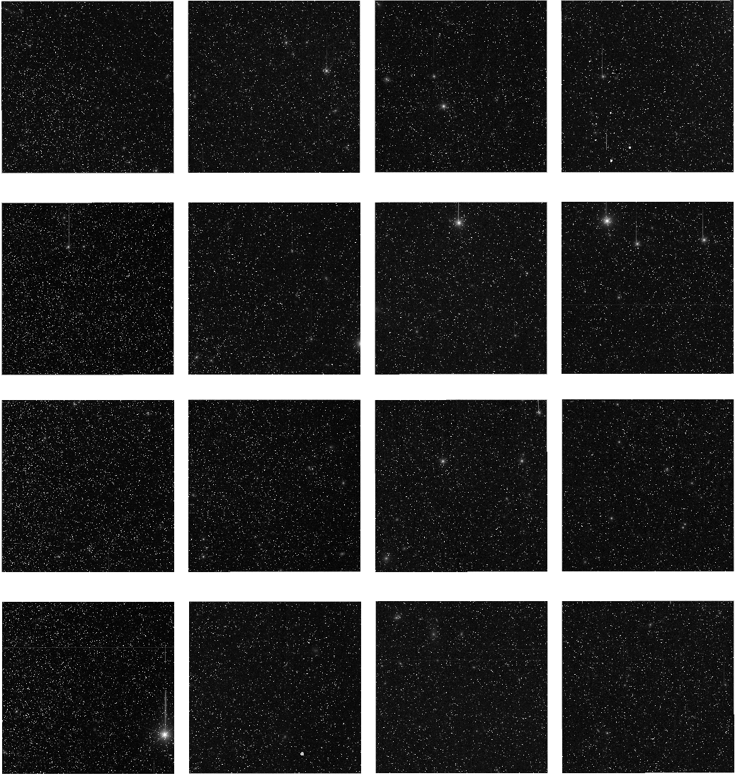
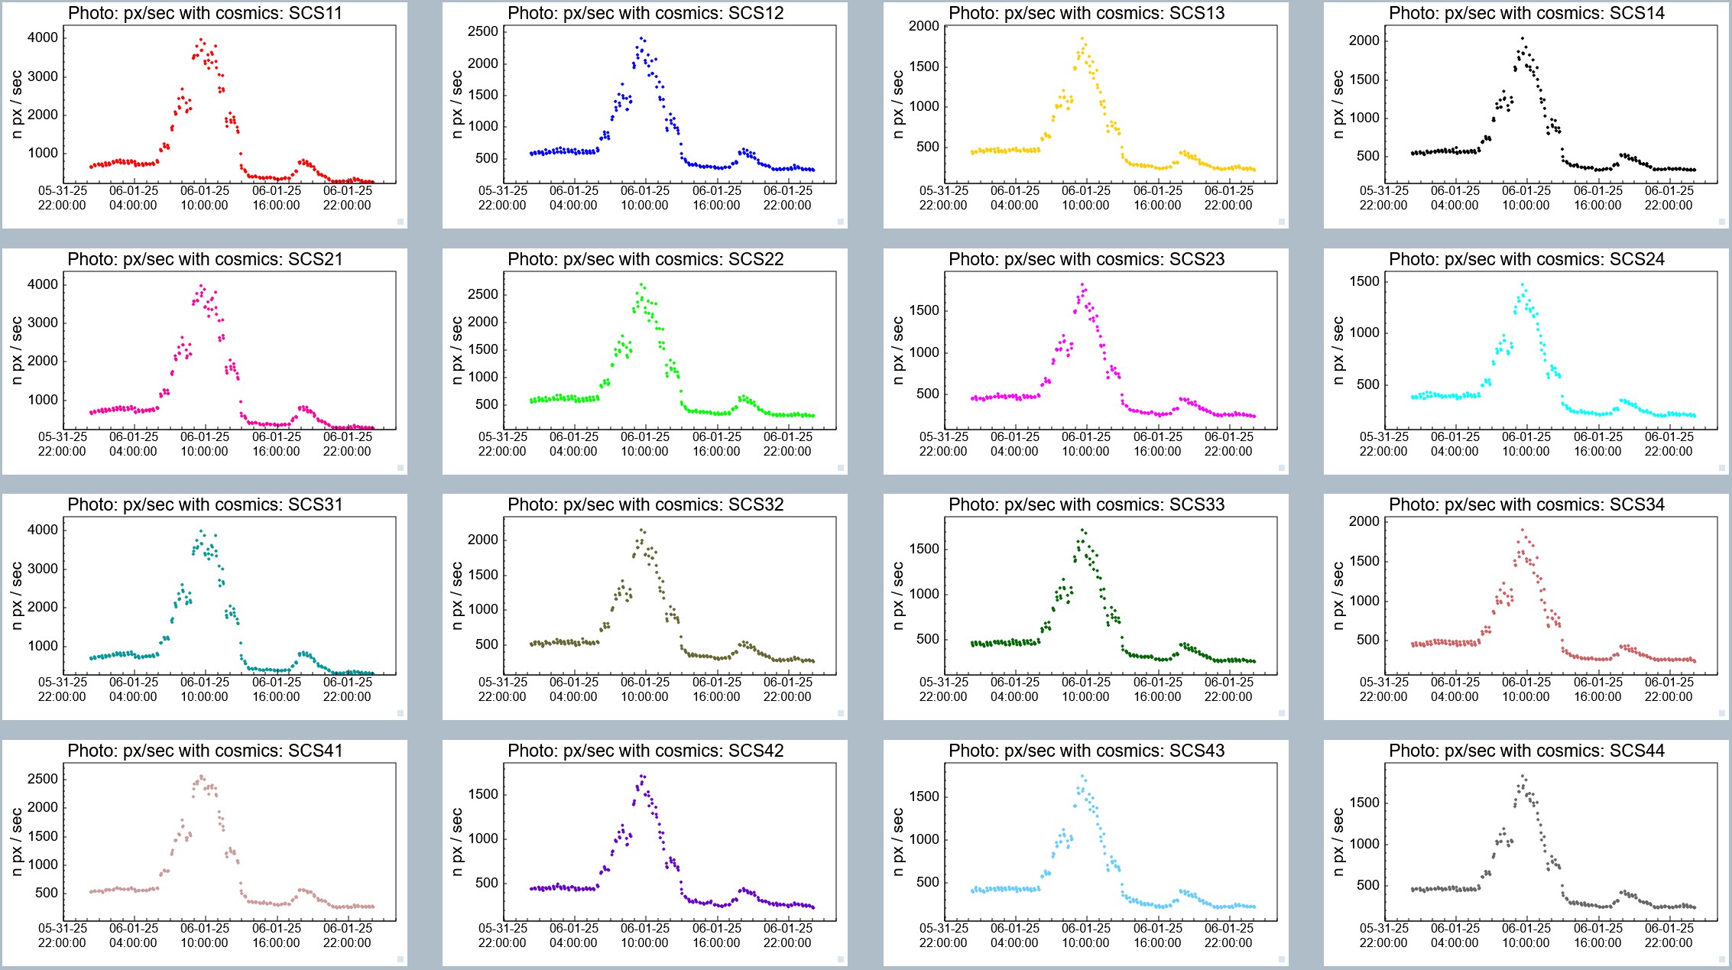
Daily

Slide 23
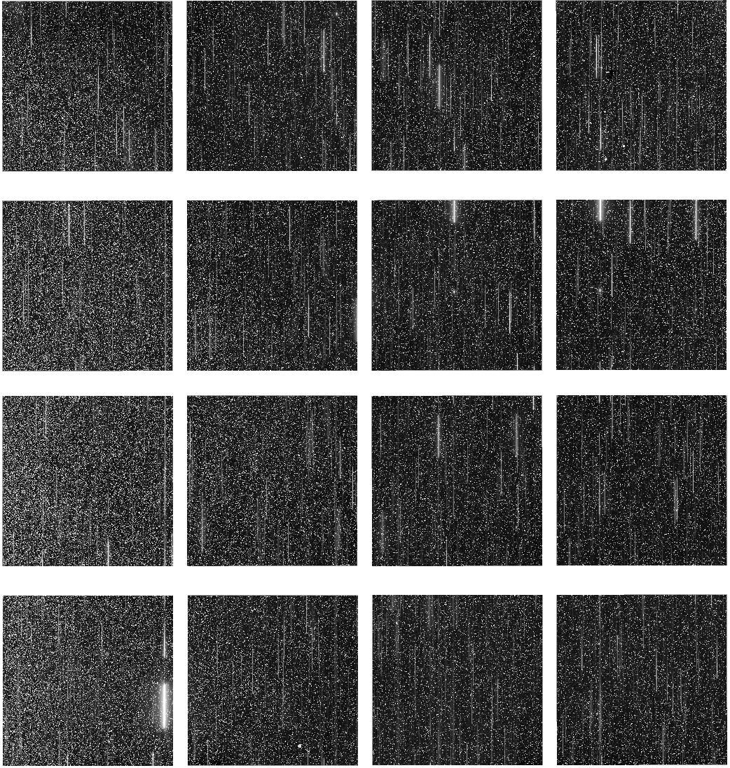
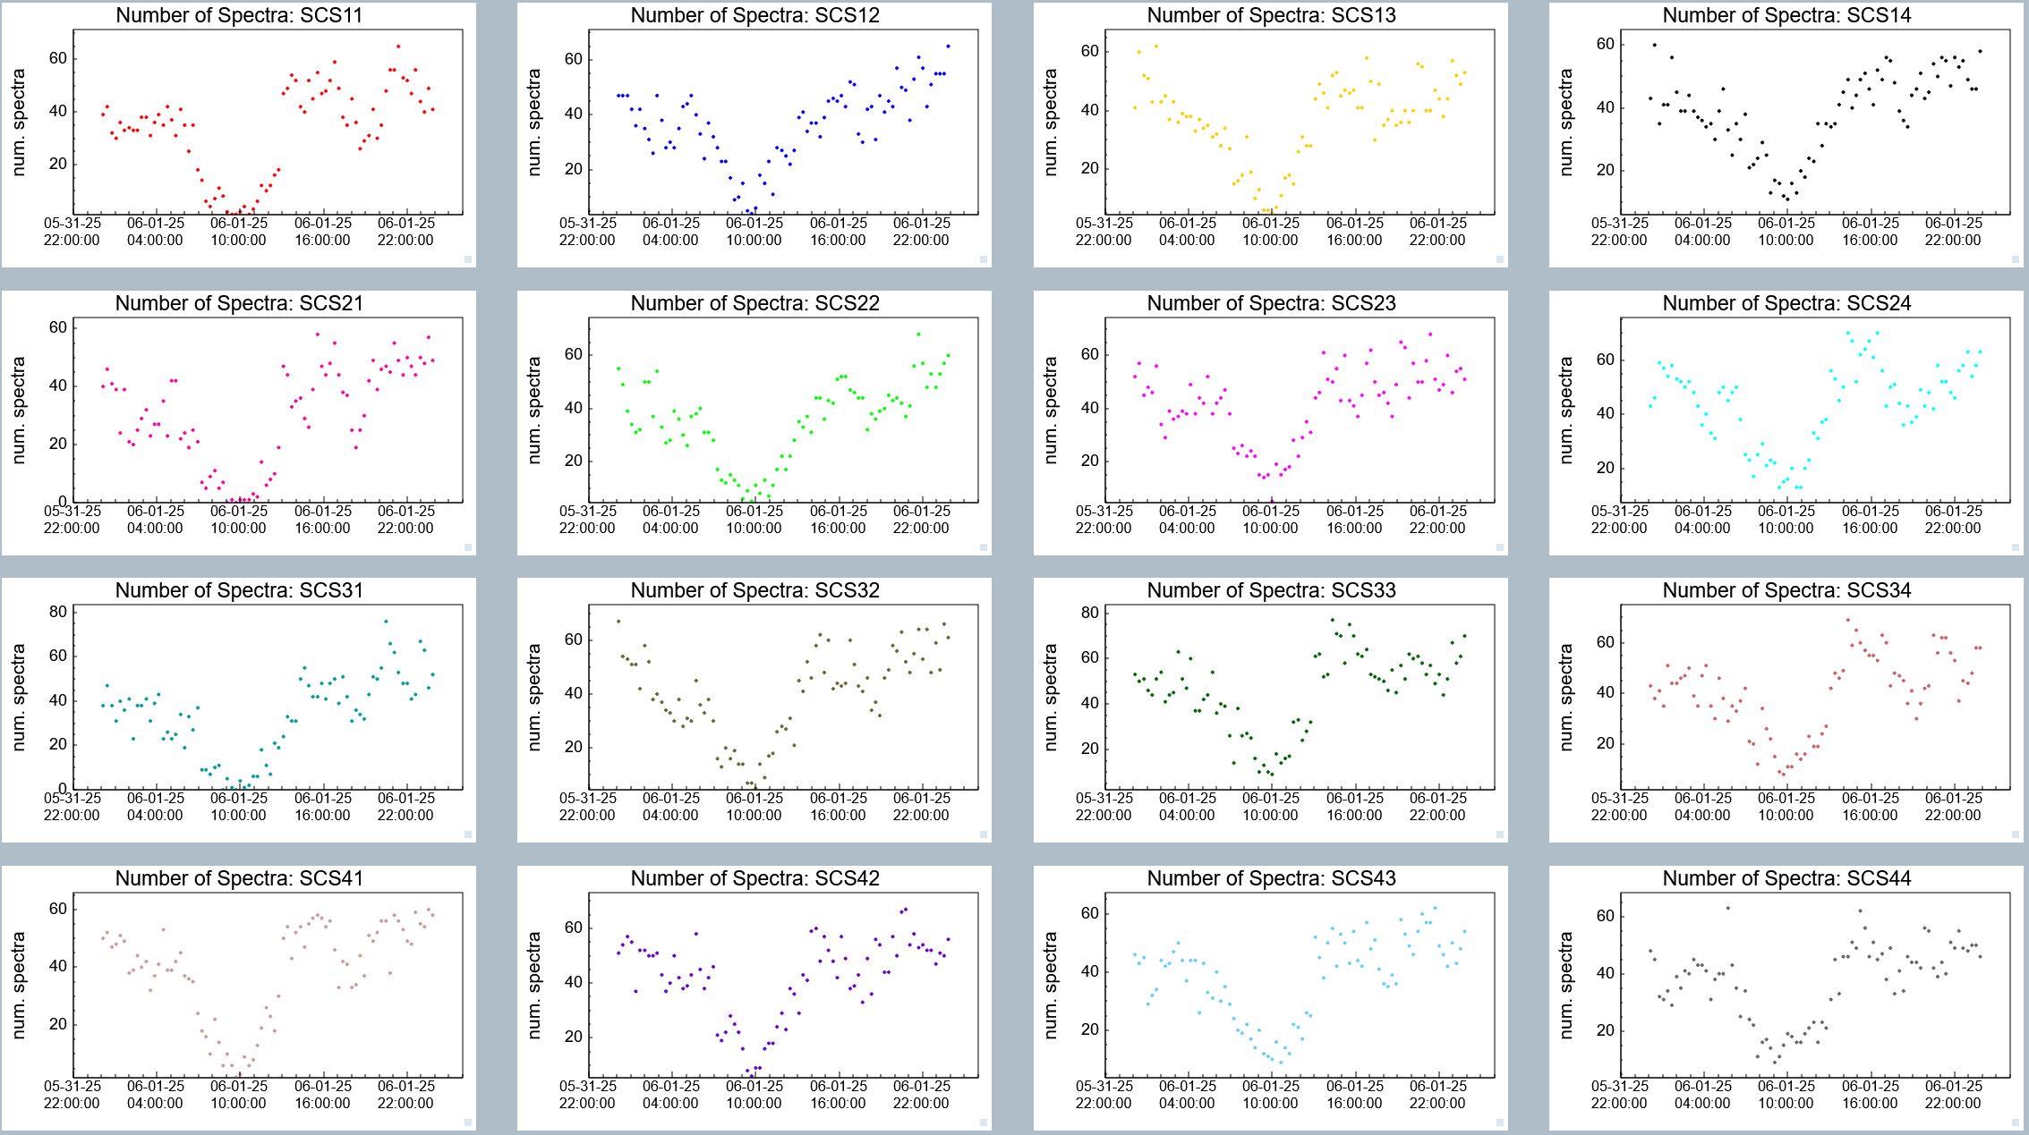
Daily

Slide 24
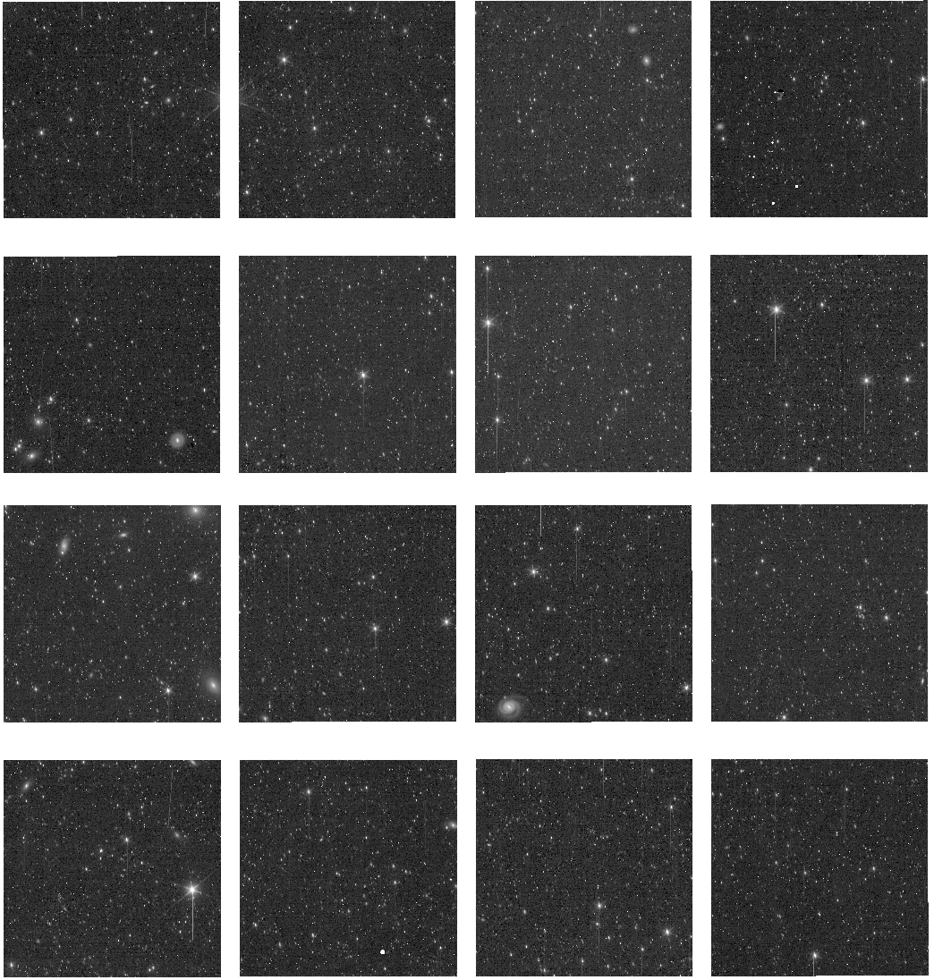
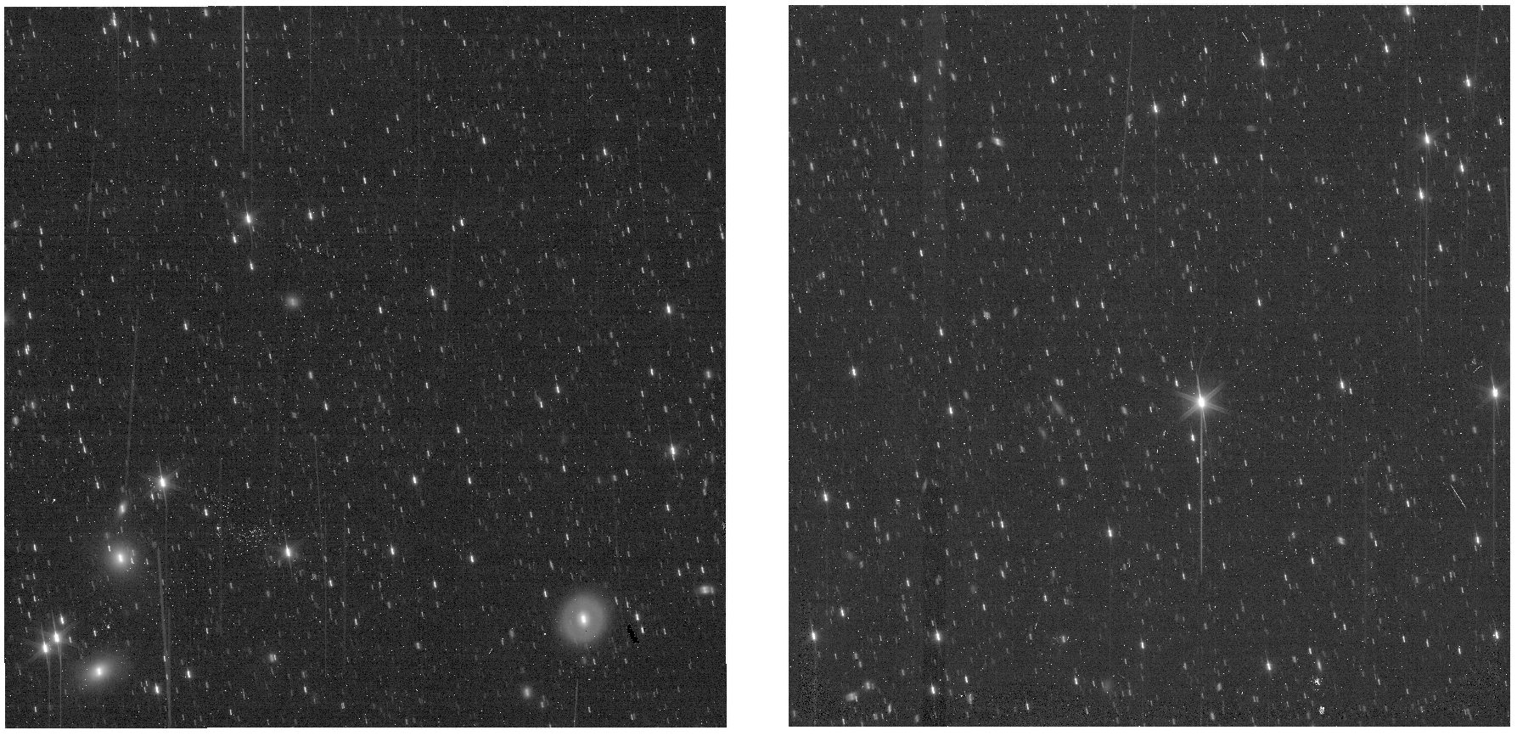
Daily
31
32
PLAN ID 1211426433

Slide 25
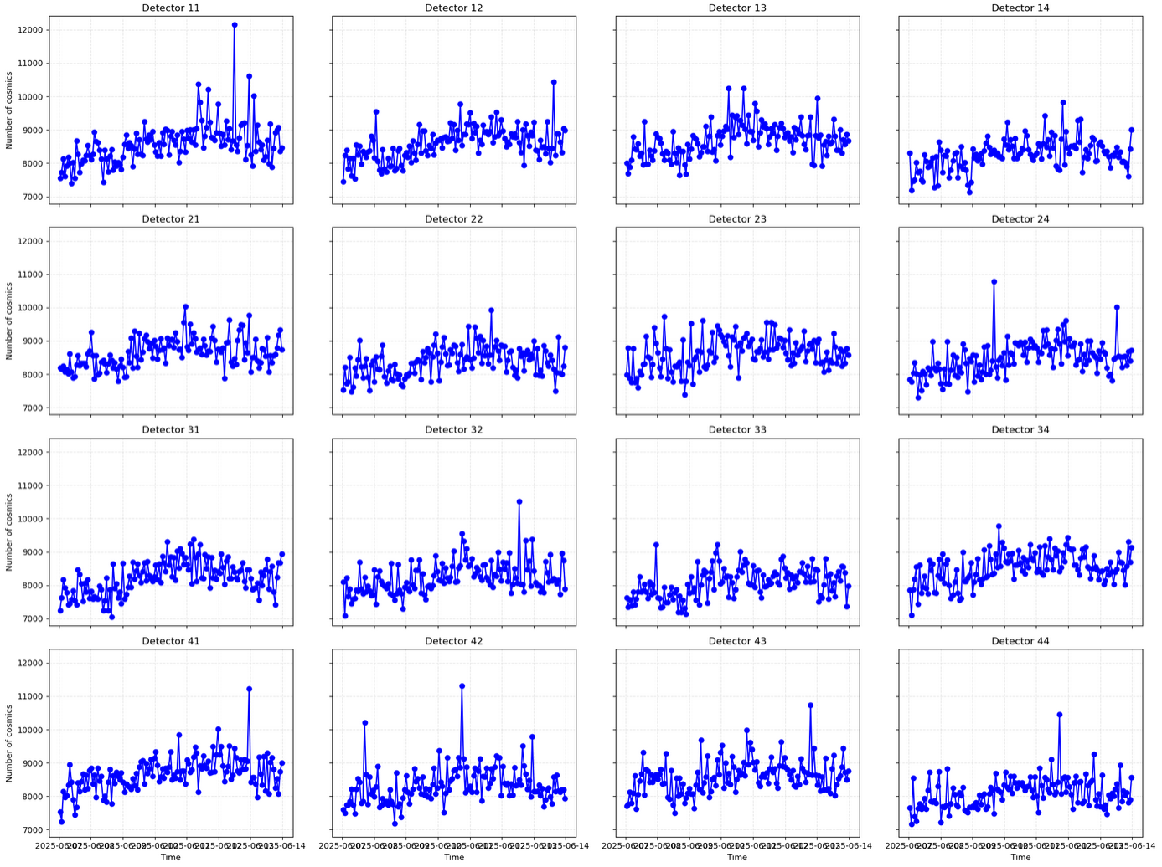

Slide 26
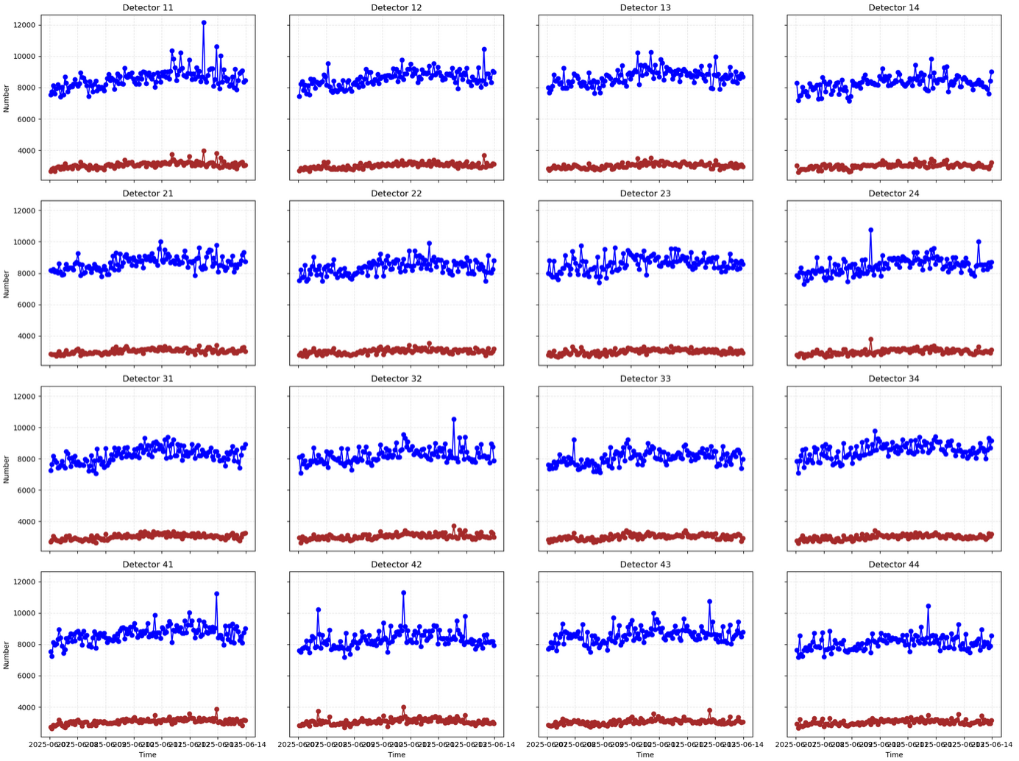

Slide 27
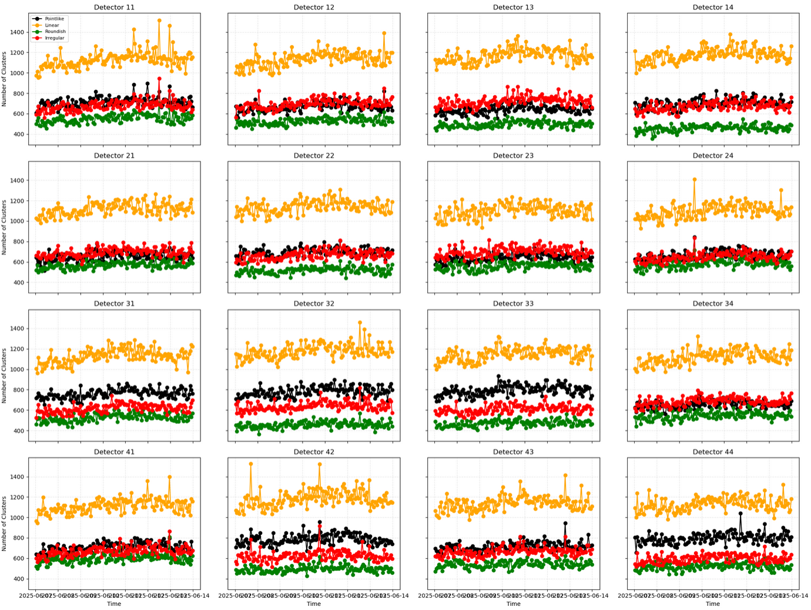

Slide 28
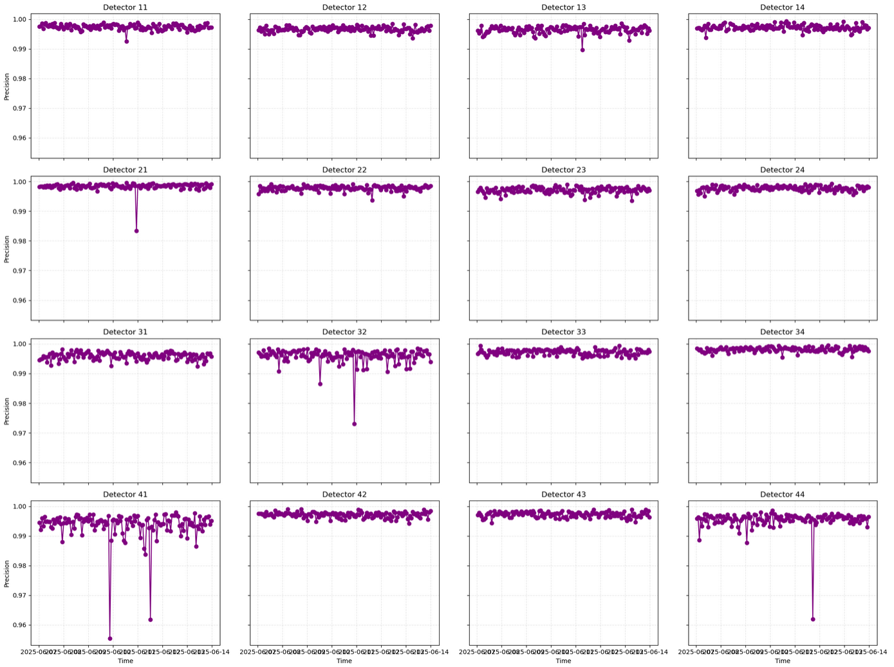

Slide 29
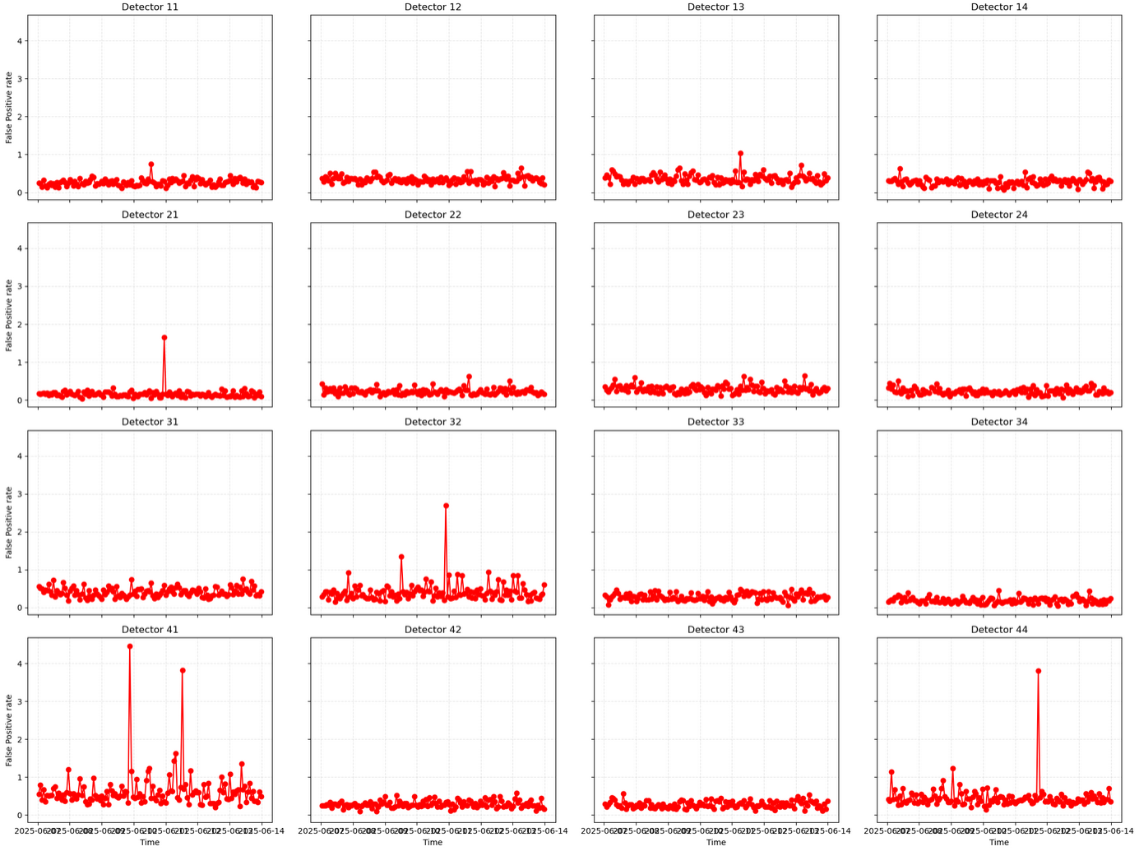

Slide 30
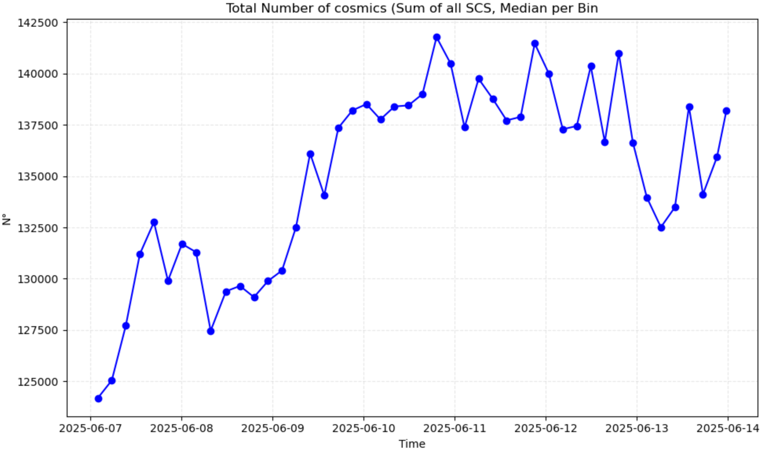
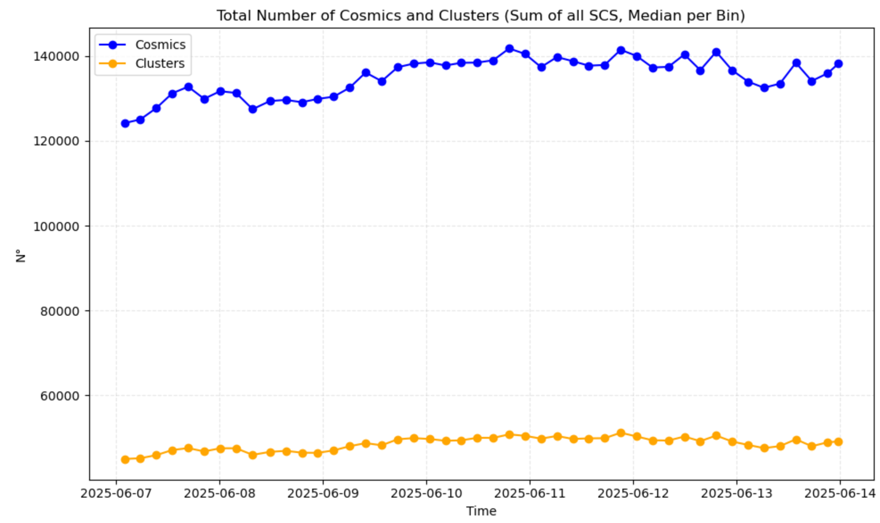
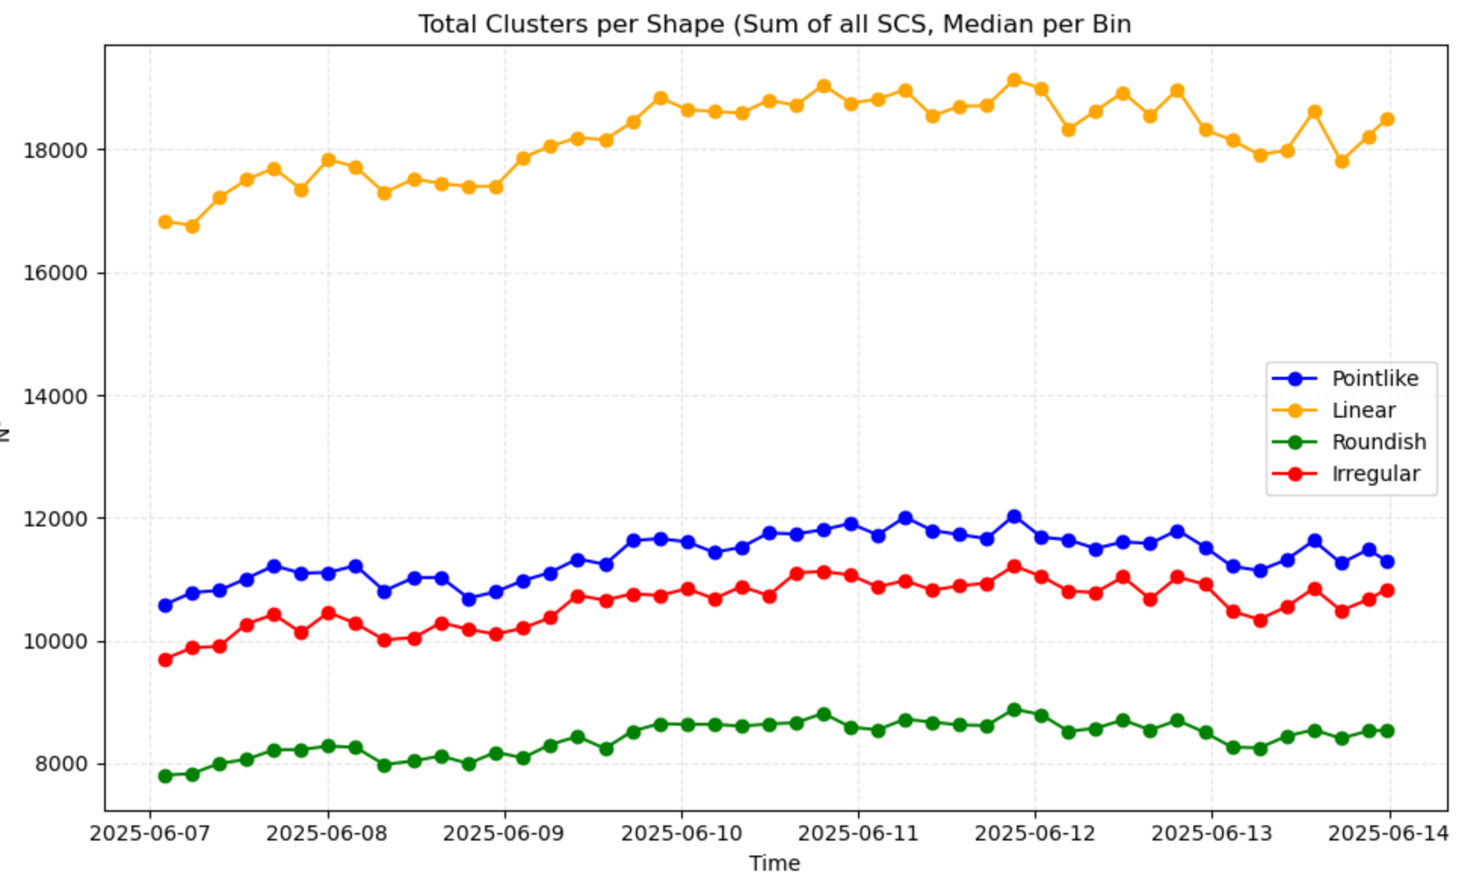

Slide 31
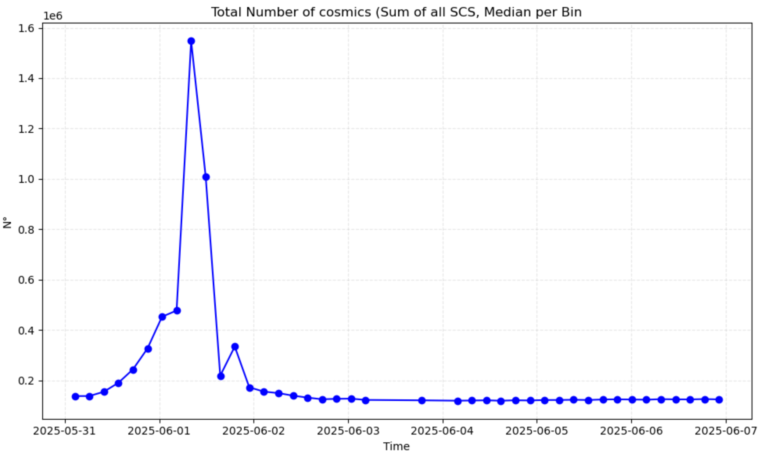
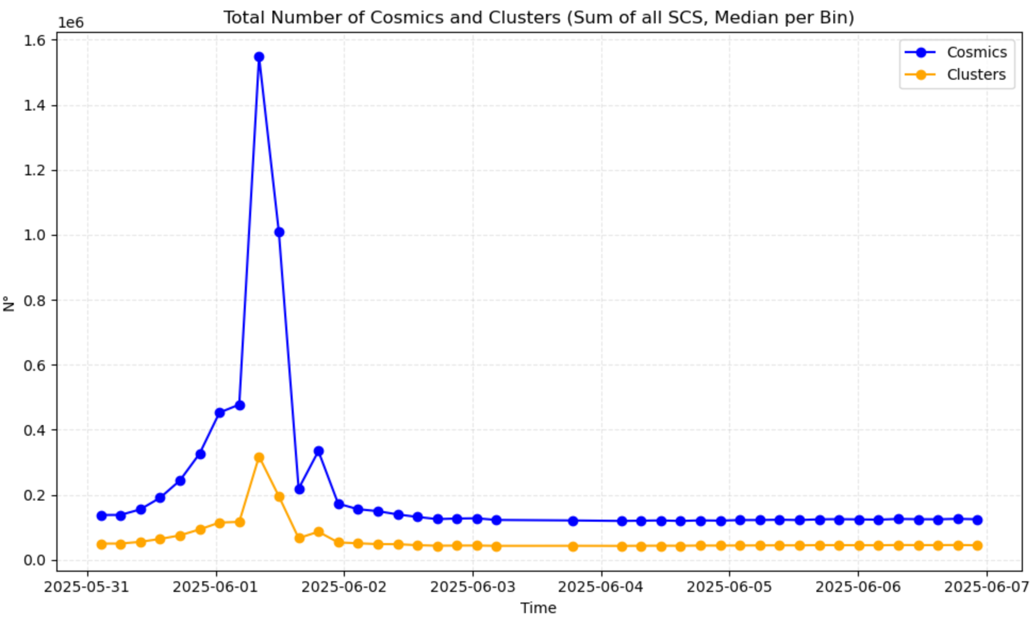
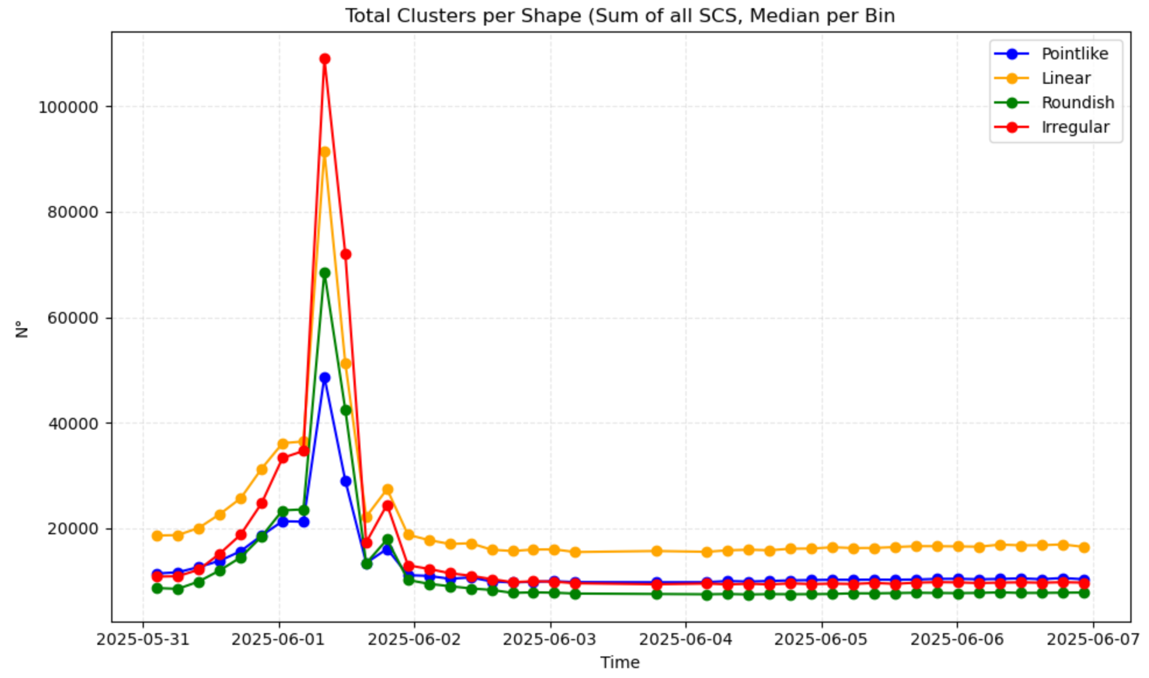
Weekly/History plots

Slide 32
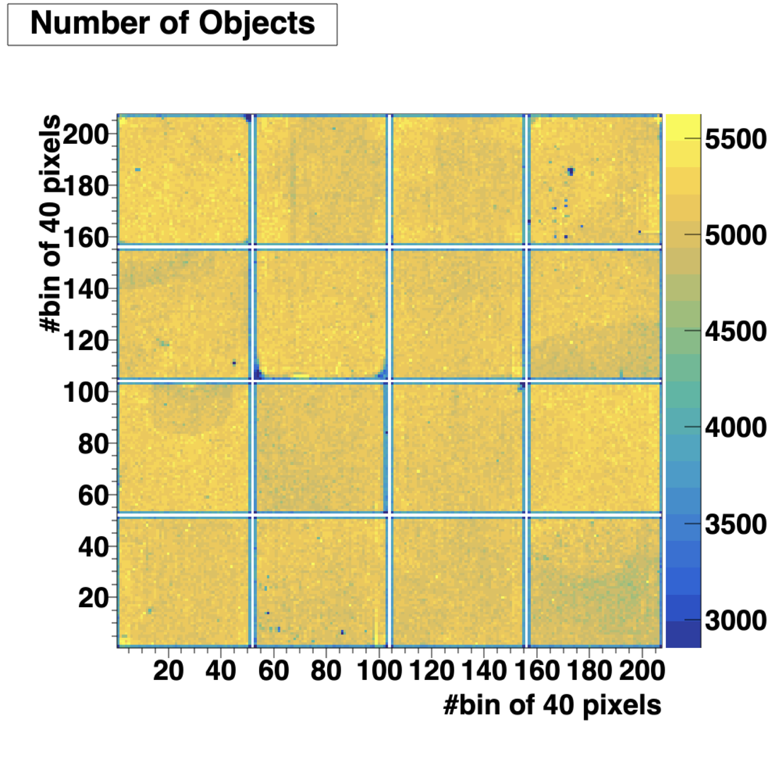
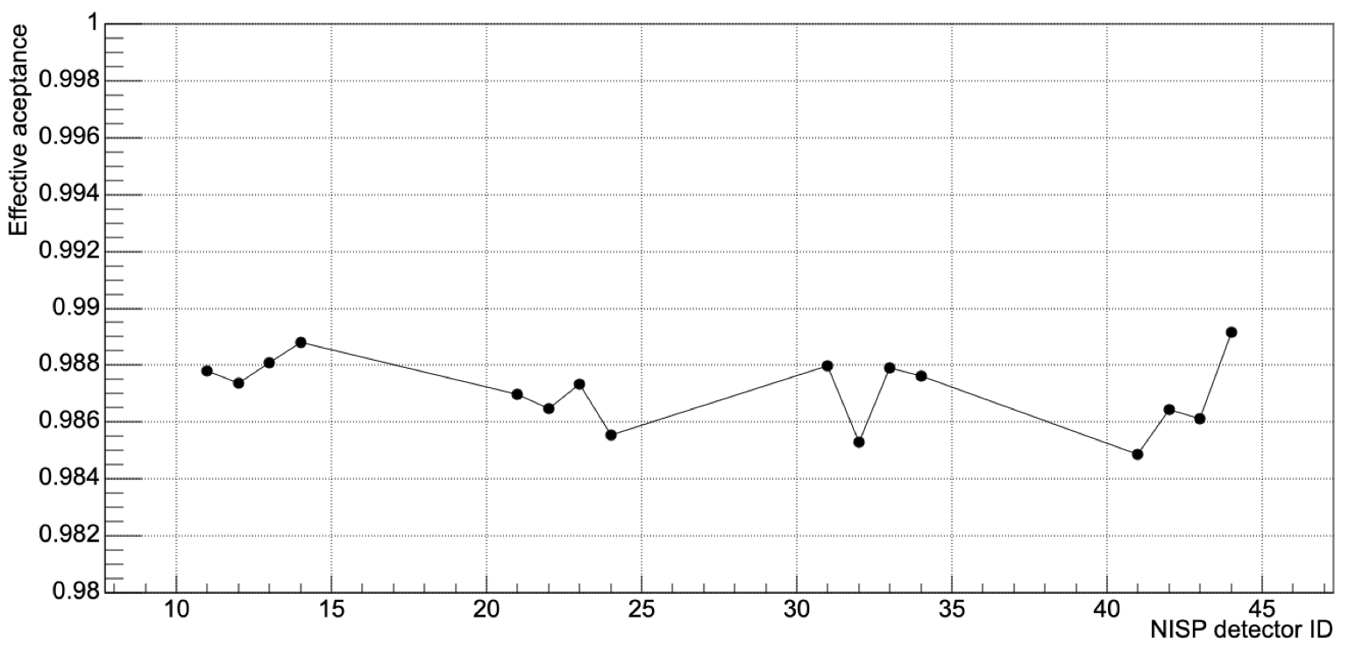
Less sources are reconstructed close to detector border.
NIR effective detector area detector acceptance (area) ~98.7 %

Slide 33
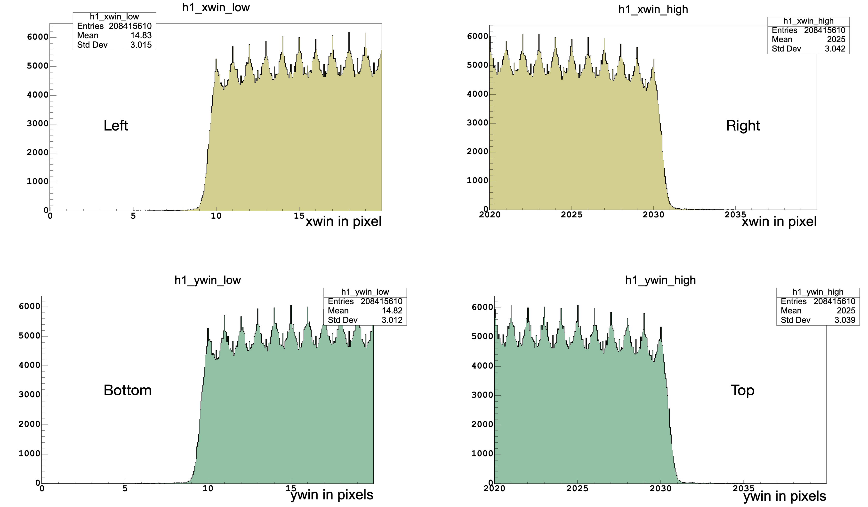

Slide 34
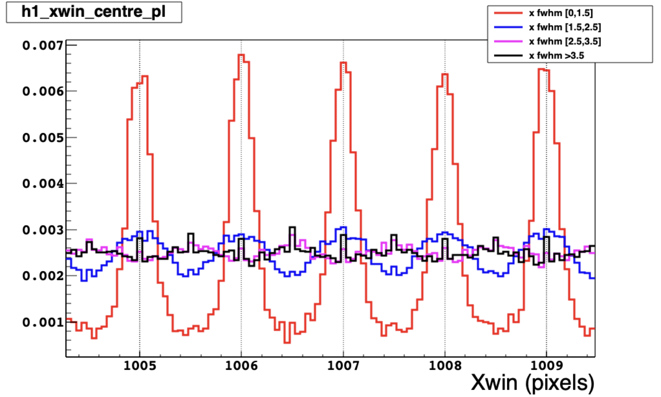
The strong “resonance” in the (x,y) coordinate of the reconstructed sources in the NIR catalog are due to point like sources which are reconstructed in the centre of the pixel.

Slide 35
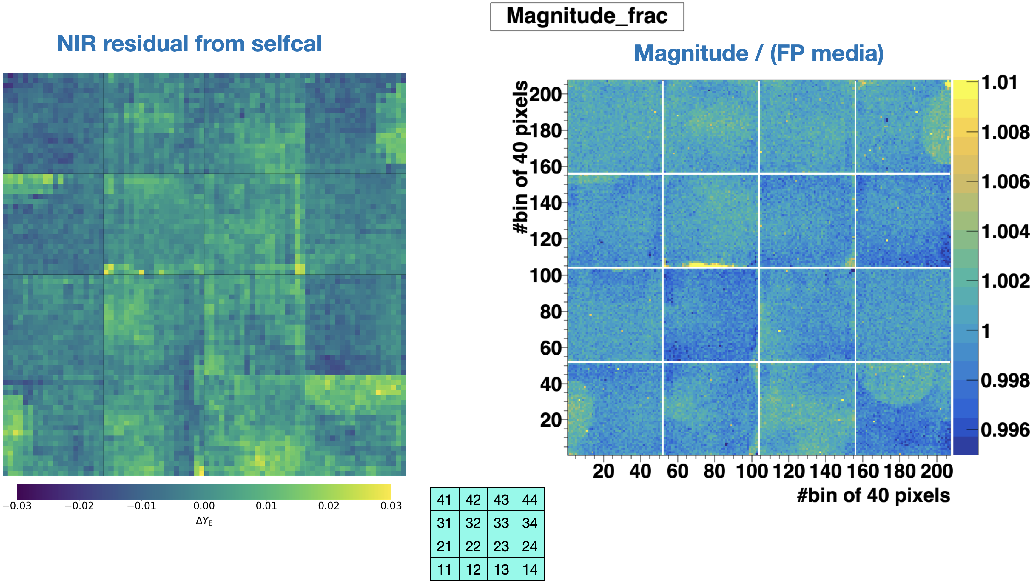

Slide 36
Indat Input data array
inmask=None Boolean mask with px to be avoided for the analysis (e.g., bad px, saturated px,…) [OPTIONAL]
inbkg=None Mask with pre-determined background values to be subtracted from the input image [OPTIONAL]
invar=None Mask with pre-determined variance per px (i.e., noise squared) [OPTIONAL]
sigclip=4.5 Laplacian-to-noise limit for cosmic ray detection (i.e., ratio between px and neighboring intensities). Influence the most FP. [range: 3 - 6]
sigfrac=0.3 Fractional detection limit for neighboring pixels. For cosmic ray neighbor pixels, a lapacian-to-noise detection limit of sigfrac * sigclip is applied [range: 0.2 - 0.5 )]
objlim=4.0 Minimum contrast between Laplacian image and the fine structure image. [range: 1 to 500]
gain=1.95 Gain of the image (electrons / ADU). [form header]
readnoise= 6 Read noise of the image (electrons) [from header]
satlevel=65536.0 Saturation level. Default 65536 for 16bit images
niter=6 Number of iterations

Slide 37
sepmed=True True: used a seprable median filter rather than a full median filter. Faster and with the same efficiency.
cleantype='meanmask’ Cleaning algorithm: ‘median’: An umasked 5x5 median filter; ‘medmask’: A masked 5x5 median filter; ‘meanmask’: A masked 5x5 mean filter; ‘idw’: A masked 5x5 inverse distance weighted interpolation.
fsmode='median' Methodo to rebuild the fine structure image. "median": standard median filter of LACosmic. "convolve" convolution bu using the psf kernel. Default: median
psfmodel='gauss' Model used to generate pdf kernel if smode = ‘convolve’ e psfk = None. Options: "gauss" or "moffat" producing circular kernels. "gaussx" o "gaussy" producing gaussian kernel on x o y. Default: gauss
psffwhm=1.5 Length at mid height (Full Width Half Maximum) of psf to generate kernel. Default: 2.5
psfsize=5 Dimension of the kernel (psfsize x psfsize). Default: 7 (other values 3, 5, 7, 9)
psfk=None pdf kernel array to be used for the fine structure image if fsmode = "convolve". If psfk=None and fsmode=convolve, psf kernel calculated wuth psfmodel
psfbeta=4.765 Moffat beta parameter. Used if fsmode = convolve and psfmodel=moffat. Defalut: 4.765
verbose=True If true print processing information

Slide 38
FLAT-FIELD (F-007) DETECTORS ANALYSIS
Notes:
1. This slide presents the mean and median signal values across all detectors for each LED (we have 5 LEDs that emit uniform light with different wavelengths) , providing a comprehensive view of the detector's response uniformity and consistency. 2. The data highlights variations in signal strength in e/s between different LEDs, which is critical for understanding the detector's performance under various illumination conditions. Note any outliers or detectors with significantly higher or lower signals, as these may indicate potential calibration issues or hardware anomalies. 3. Consistent mean and median values across detectors suggest stable performance, while discrepancies may warrant further investigation into flat-field corrections or detector health. 4. The plotted trends allow us to compare the behavior of LEDs A through E, emphasizing the importance of cross-calibration for reliable data acquisition. 5. Use these insights to refine calibration pipelines or flag detectors needing additional analysis, ensuring robust data quality for scientific use.

Slide 39
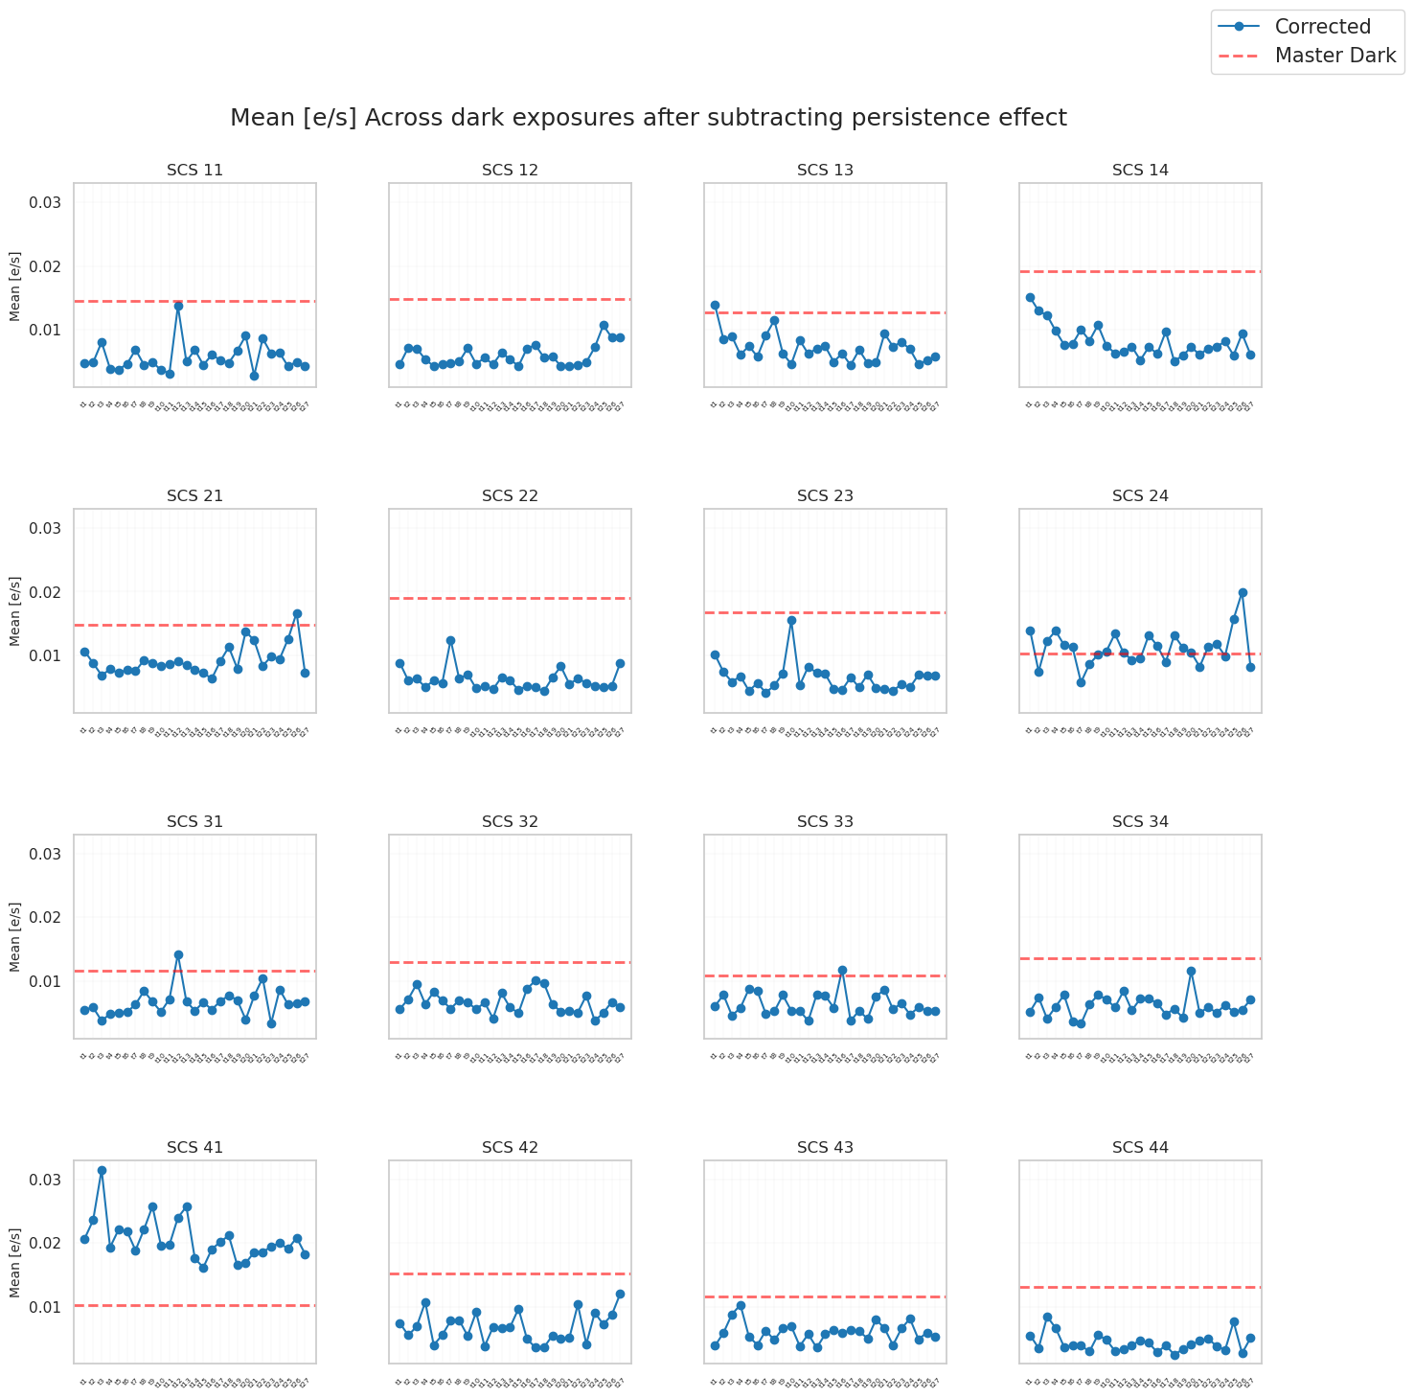
Persistence Decay in Dark Images (F-007)
zoomed
Notes:
Slide 7 SX 1. This shows evaluating the impact of persistence correction on dark exposures (In Calblock F-007 data we have 150 photometry data from LED A to E and at the end of this data acquisition we have 27 darkspectro and my mean about dark exposures are these 27 darkspectro data). Recall that persistence is modeled as a power-law decay and after subtracting from the original signal (orange line)we have this calibrated signal (blue line). 2. This slide quantifies how persistence subtraction improves detector signal consistency, particularly in dark exposures compared to masterdark threshold. Slide 8 (Zoomed Results) --- just zoom the plot in slide 7 around masterdark threshold DX 1. we observe the mean signal (in e⁻/s) across all detectors (SCS11–SCS44) after subtracting persistence effects. The uniformity of values post-correction suggests successful mitigation of residual artifacts. 2. Detectors like SCS13 and SCS23 (example) show particularly stable signals, aligning with expectations for well-corrected dark frames.The absence of outliers reinforces that the persistence model and masking strategy effectively addressed prior exposures' persistence effects. 3. These results validate the pipeline's persistence correction process

Slide 40
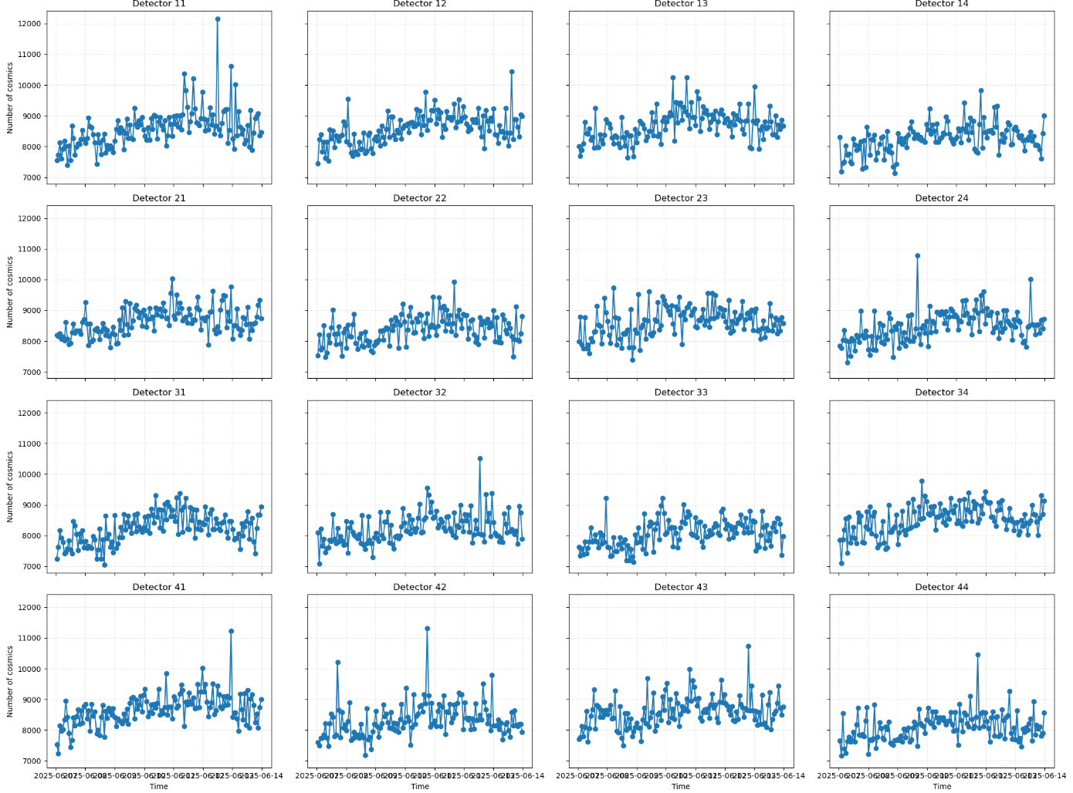
Week 07/06 - 13/06/2025 (No solar events)
Notes:
Solo o 2 detector come esempio, il resto focal plane in the back up slides

Slide 41
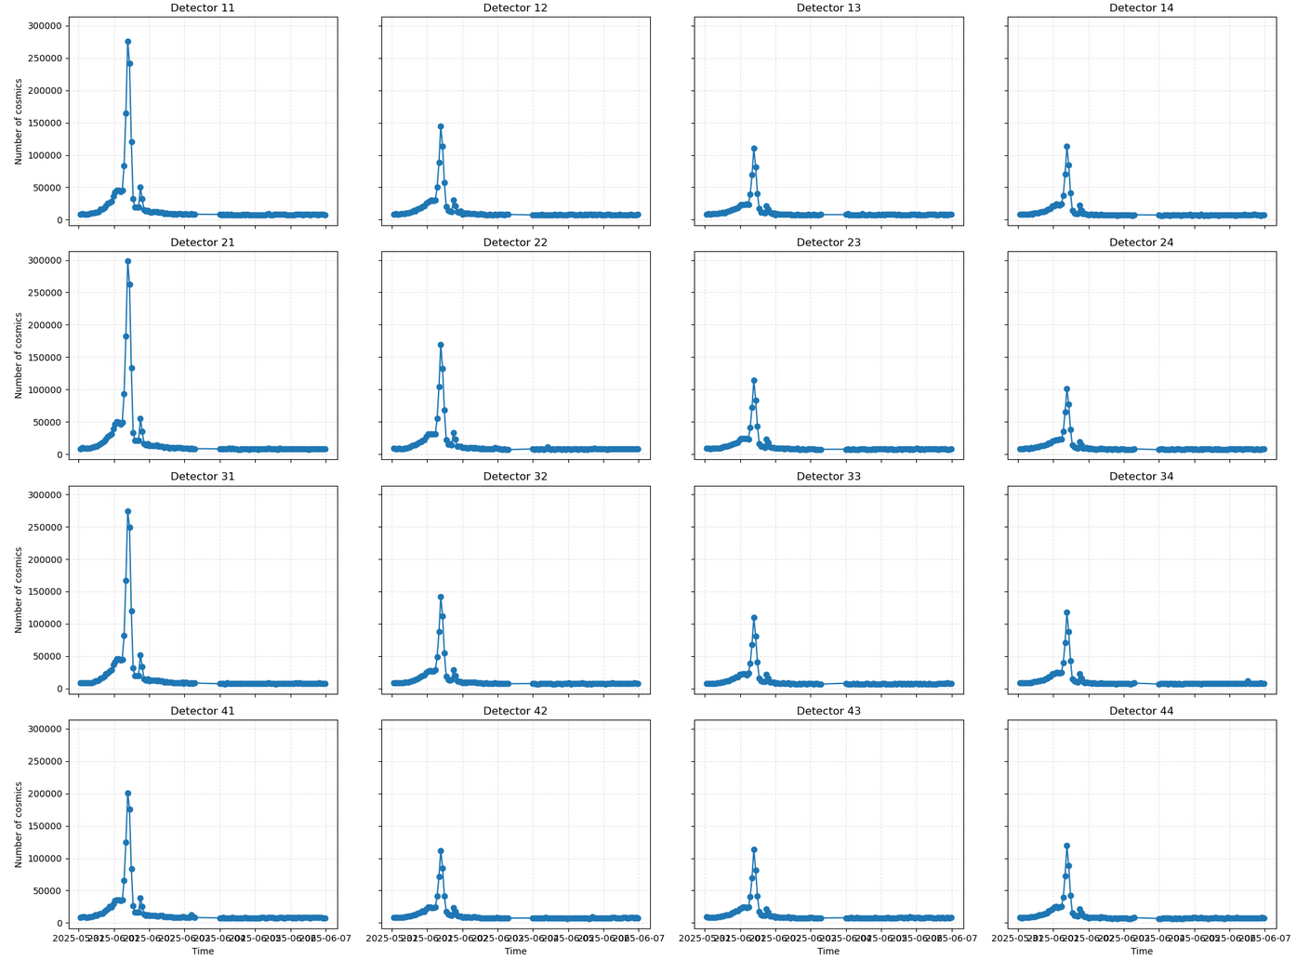
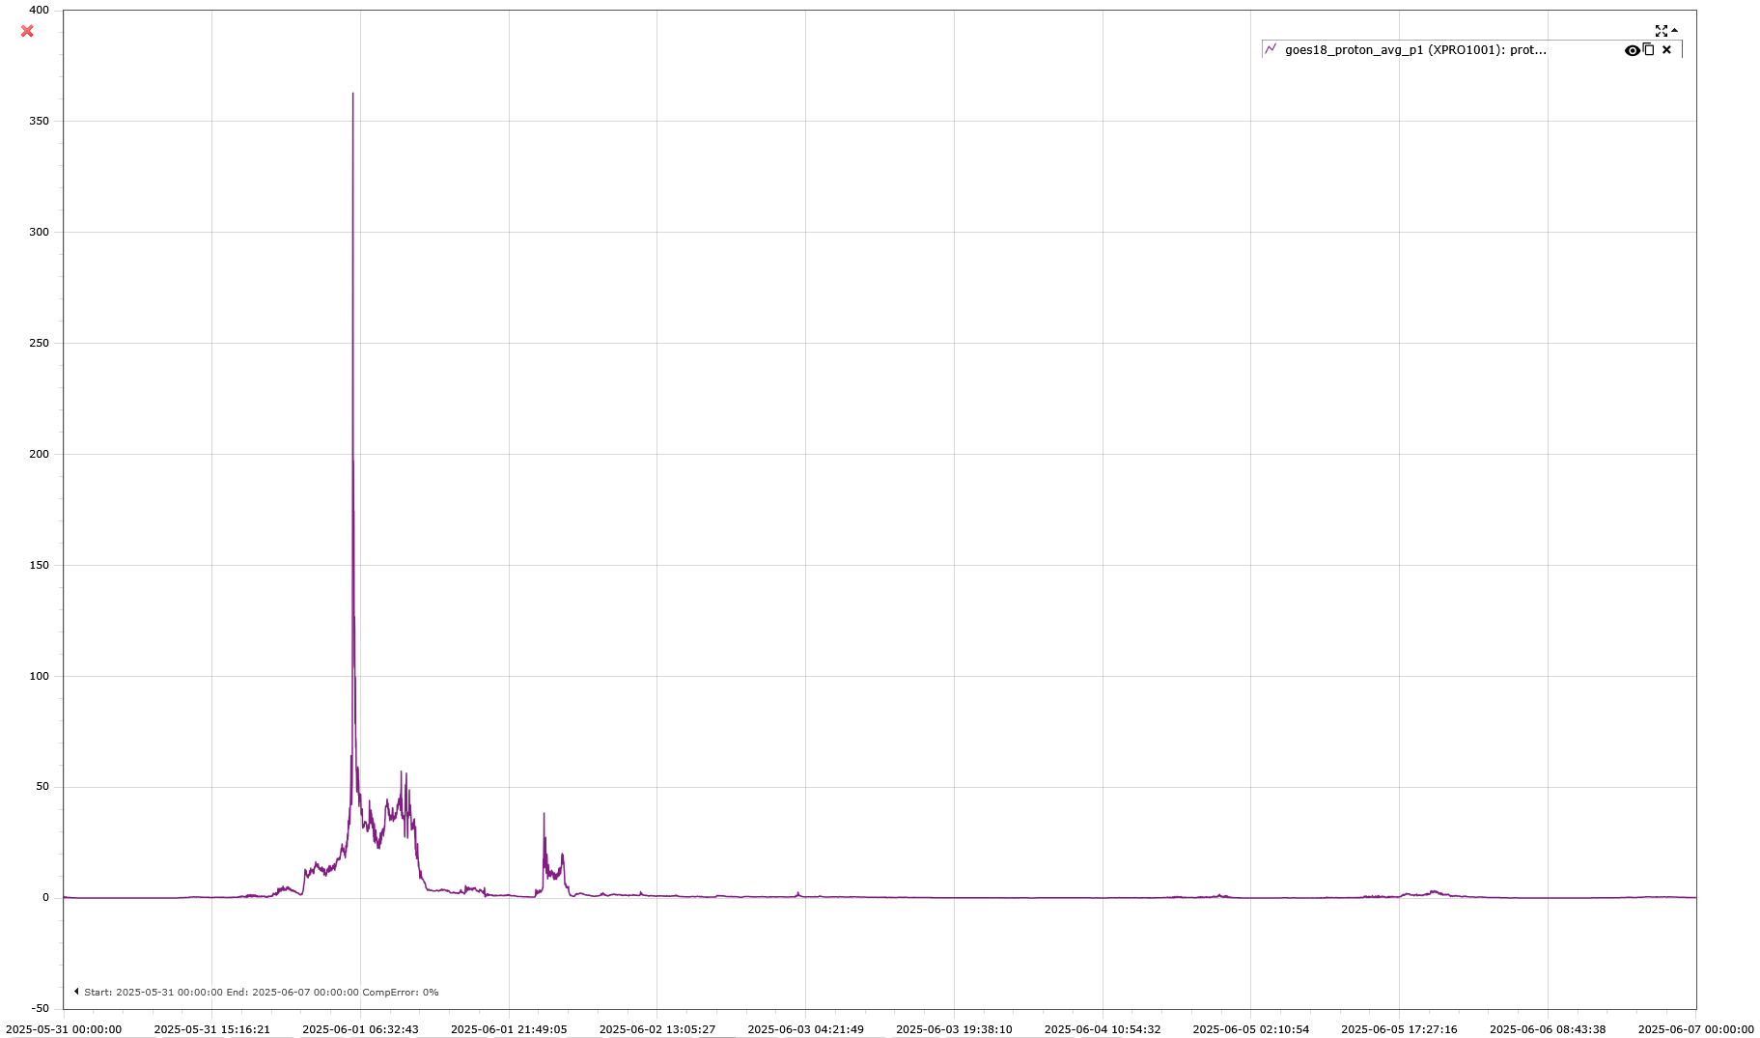
Week 31/05 - 06/06/2025
Solar flare 31/05 - 01/06
n° of px flagged as cosmic per detector
GOES proton flux

Slide 42
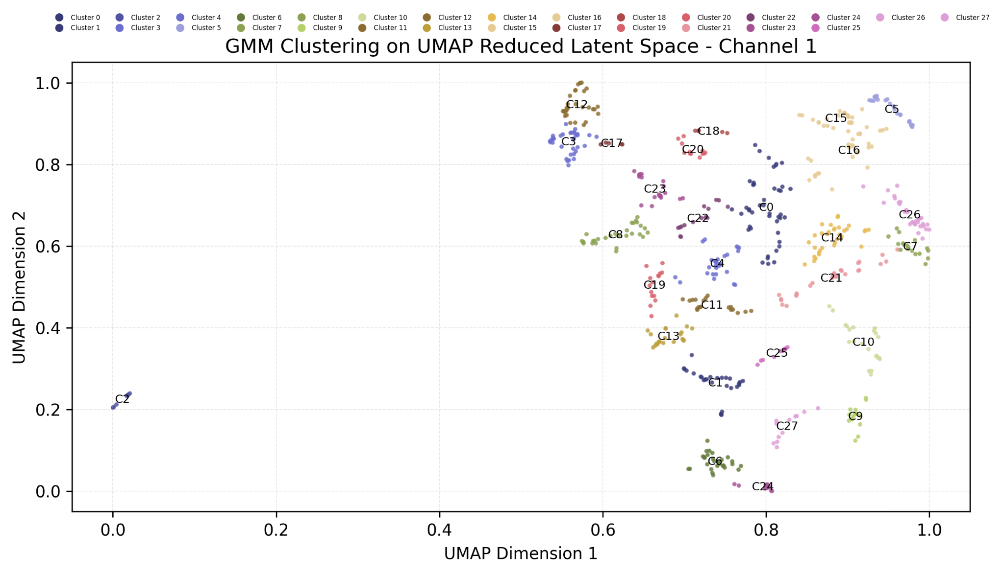
PERSISTENCE DETECTION ON SLEW DARK USING AUTOENCODERS
Channel 1 Latent Space Analysis
2. UMAP's ability to preserve local and global structures helps us identify meaningful groupings. Here, we used GMM with 28 clusters (optimal per AIC/BIC) to capture the diversity of features in Channel 1.
Notes:
slide 26: 1. This slide showcases the UMAP-reduced latent space of Channel 1 (top area of detector-you can see the channel divisions in slide 25), where high-dimensional autoencoder features are projected into 2D for interpretability. Each point represents a patch (i used 34*34 shape patches you can see the different size of patches in slides number 4 and 5) of detector data, and colors denote clusters identified by Gaussian Mixture Models (GMM). The separation of cluster C2 suggests distinct patterns in the data, which may correspond to persistence artifacts. 2. UMAP's ability to preserve local and global structures helps us identify meaningful groupings. Here, we used GMM with 28 clusters (optimal per AIC/BIC) to capture the diversity of features in Channel 1.

Slide 43
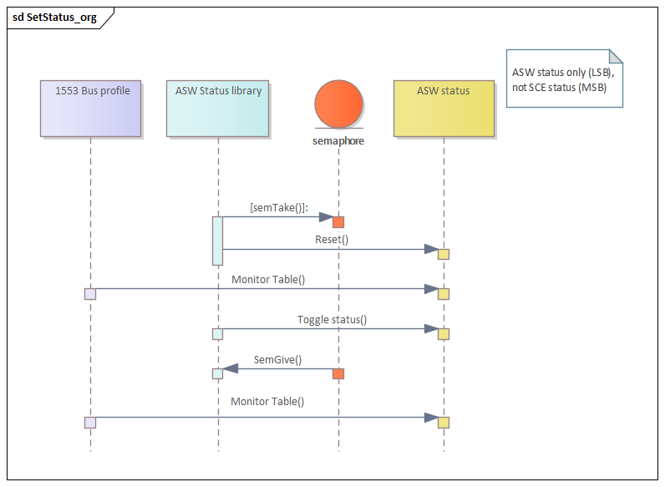
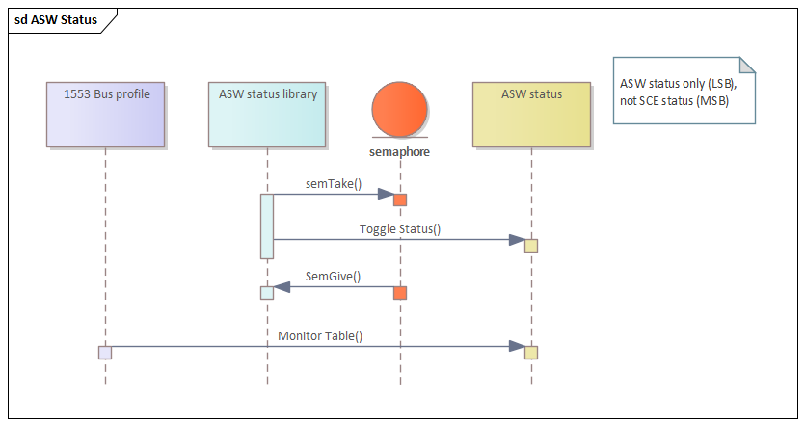
DPU-ASWv1.4 new release (September 2025)
Two minor issues fixed:
NISP status undefined (because is reset before changing state) once every six months (per DPU) for few milliseconds while HKTM is prepared. This did not cause scientific data loss.
error condition
proposed fix
Notes:
Two minor issues are fixed in the new version.
Once every six months (per DPU) the NISP status is undefined (because is reset before changing state) for few miliseconds while housekeeping is prepared. This problem do not cause scientific data loss. when the housekeeping is prepared.

Slide 44
During Calblock-F009 (non-linearity) a LED illumination configuration leads to a very small size of the NISP data product.
This exception was not correctly handled by the functions transferring the data internally in the DPU.
A work-around was defined (disabling the compression) and the Calblock-F009 was successfully completed.
critical size
Data product sizes from PV data
(for the same type of calibration PV-18)
Data product sizes during CalBlock-F009
(causing the internal error)
Notes:
During Calblock-F009 (non-linearity) a LED illumination configuration (requested for the first time in-flight) lead to a very small size of the NISP data product. This exception was not correctly handled by the functions transferring the data internally in the DPU. A work-around was defined (disabling the compression) and the Calblock-F009 was successfully completed.

Slide 45
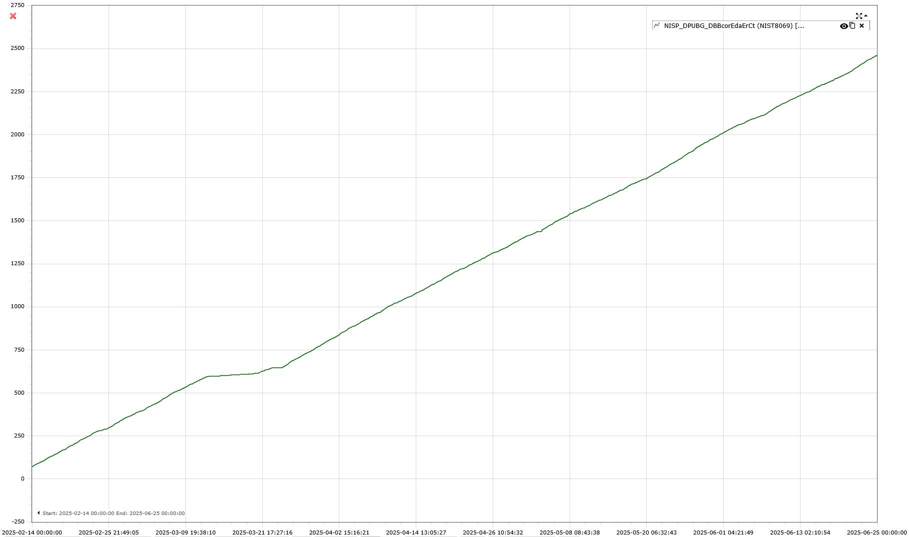
DPU hardware: on-going investigation
Since February 2025, the mass memory (Data Buffer Board - DBB) of the DPU2 signals continuously a single bit error corrected by the EDAC algorithm
A single EDAC (1 bit corrupted) is generated every $\sim$20 days (i.e., 1 every ROS), specifically 1 every 4 spectrometric acquisitions → In every ROS we have a single bit corrupted but fully recovered
A correction procedure will be tested this summer
February 14th
June 25
Notes:
a possible cause could be damage from CR which is was foresee as one of the aging effects over the instrument.
Since February 2025 the mass memory (Data Buffer Board - DBB) of the DPU2 signals continuously a single bit error corrected by the EDAC algorithm -Fig. 1.
The EDAC algorithm is a defensive mechanism implemented against data corruption and is implemented in the 6GByte DBB. It is able to correct a single bit upset (of a 16bit register) that could modified due to a Cosmic Ray (bit swap) or due to a hardware issue (stuck-bit). An EDAC occurrence indicates data correctly recovered.
Frequency: we identified that area of the memory generating a single EDAC (1 bit corrupted) by correlating it with the data acquired. The frequency of the EDAC is 1 every ~20 day i.e., 1 every ROS, specifically 1 every 4 spectrometric acquisitions → in every ROS we have a single bit corrupted but fully recovered

