Slide 1



A new underground seismic-isolation facility at LNGS
Coordinating Institutions: GSSI & INFN – LNGS
Collaborators & Technical Advisors
Tomislav Andric (GSSI), Carlo Bucci (INFN), Ilaria Caravella (GSSI), Daniele Cortis (INFN), Nicola D’Ambrosio (INFN), Massimiliano De Deo (INFN), Marco D’Incecco (INFN), Antonio Di Ludovico (INFN), Oliver Gerberding (University of Hamburg), Jan Harms (PI; GSSI), Jeff Kissel (LIGO Hanford), Alessandro Lalli (INFN), Brian Lantz (Stanford University), Laura Leonzi (INFN), Carla Macolino (Università di L’Aquila), Rich Mittleman (MIT), Conor Mow-Lowry (VU Amsterdam), Donato Orlandi (INFN), Stefano Pirro (INFN), Marco Ricci (Università di Roma La Sapienza), Jamie Rollins (Caltech), Jim Warner (LIGO Hanford)
Ilaria
Tomislav
https://arxiv.org/abs/2509.04730

Slide 2
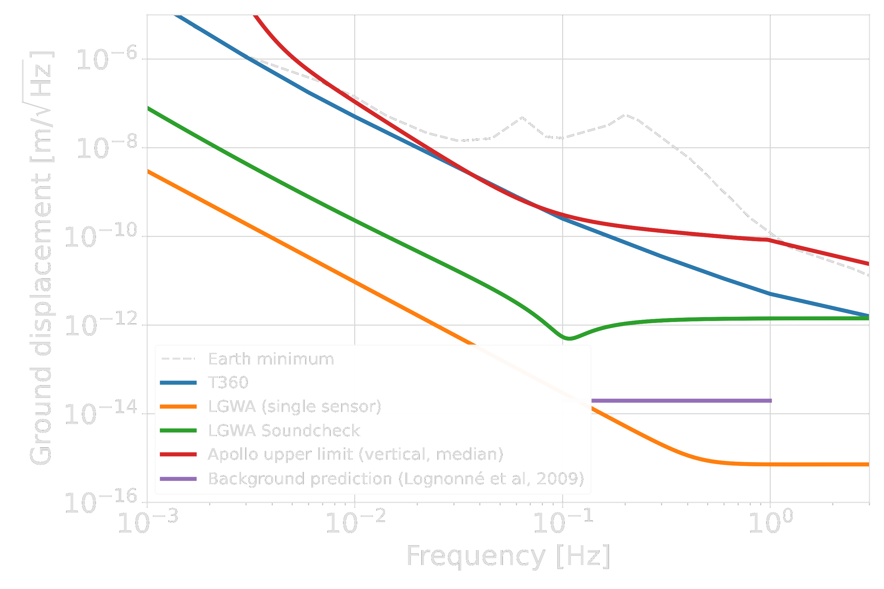
GEMINI – A Moon Emulator
Test high-performance, cryo-temperature lunar seismometers for LGWA
Common-mode subtraction / Wiener filtering
Targeted GEMINI platform residual motion
LGWA sensor performance target

Slide 3


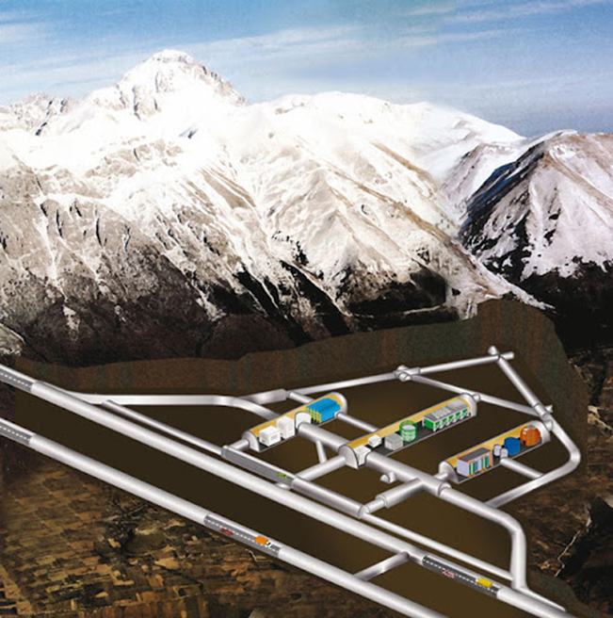
Location of GEMINI
GEMINI site is 1.4km underground
GIGS

Slide 4
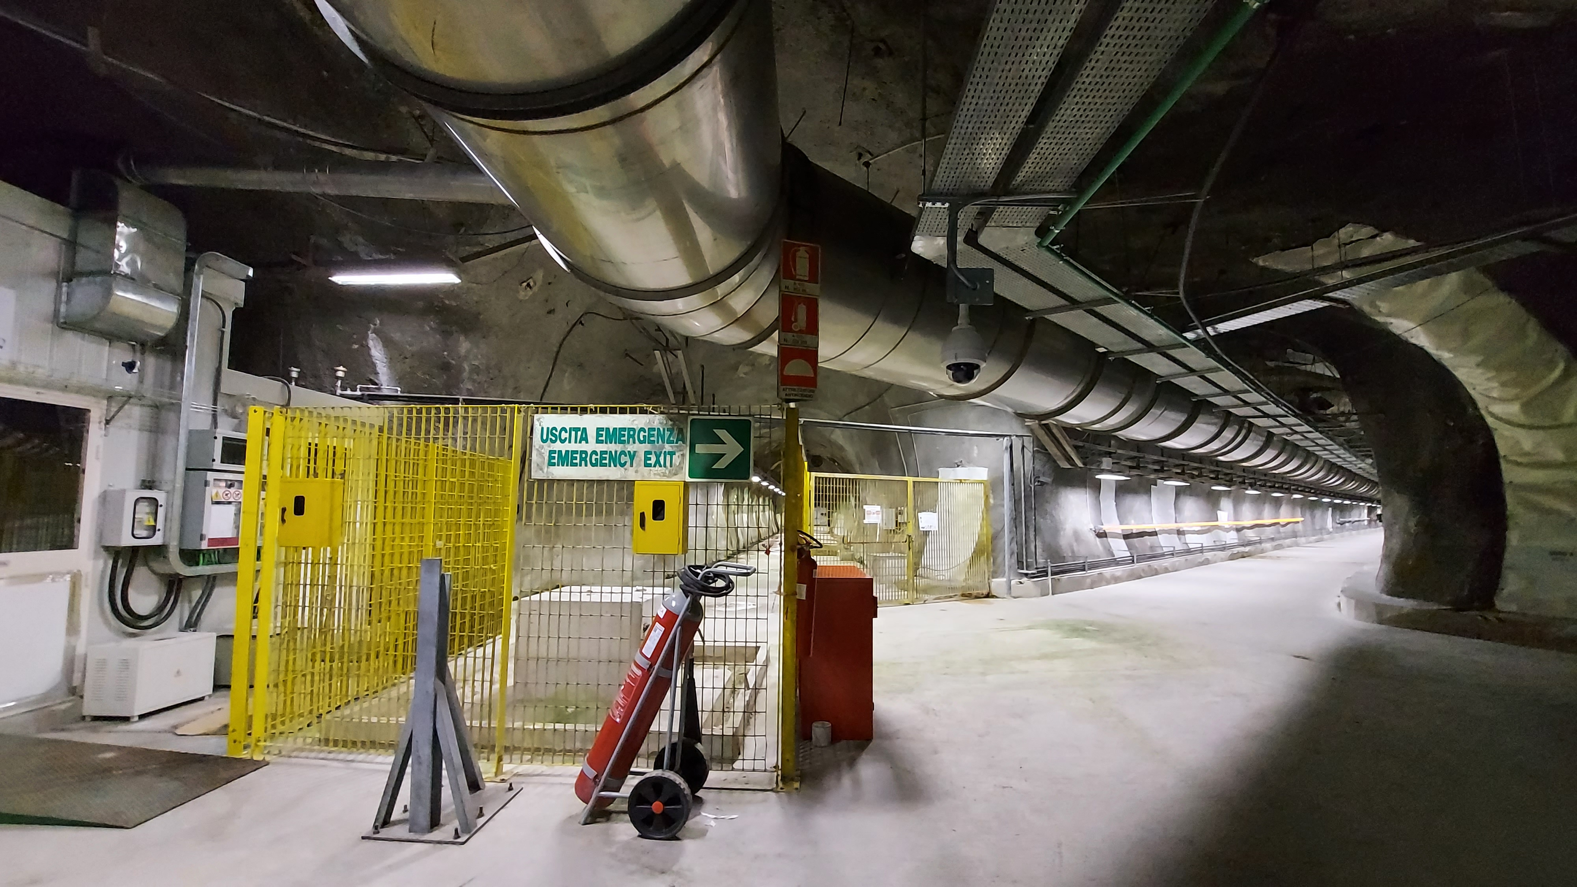
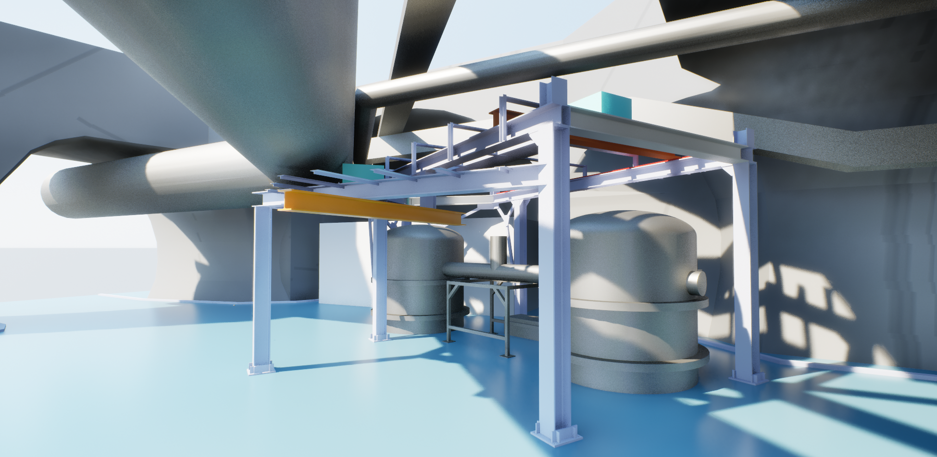
Underground Laboratory
Water management
Floor treatment
Laminar-flow enclosure
Lifting device
Access to cooling water, pressured air, electricity, network/timing signal

Slide 5
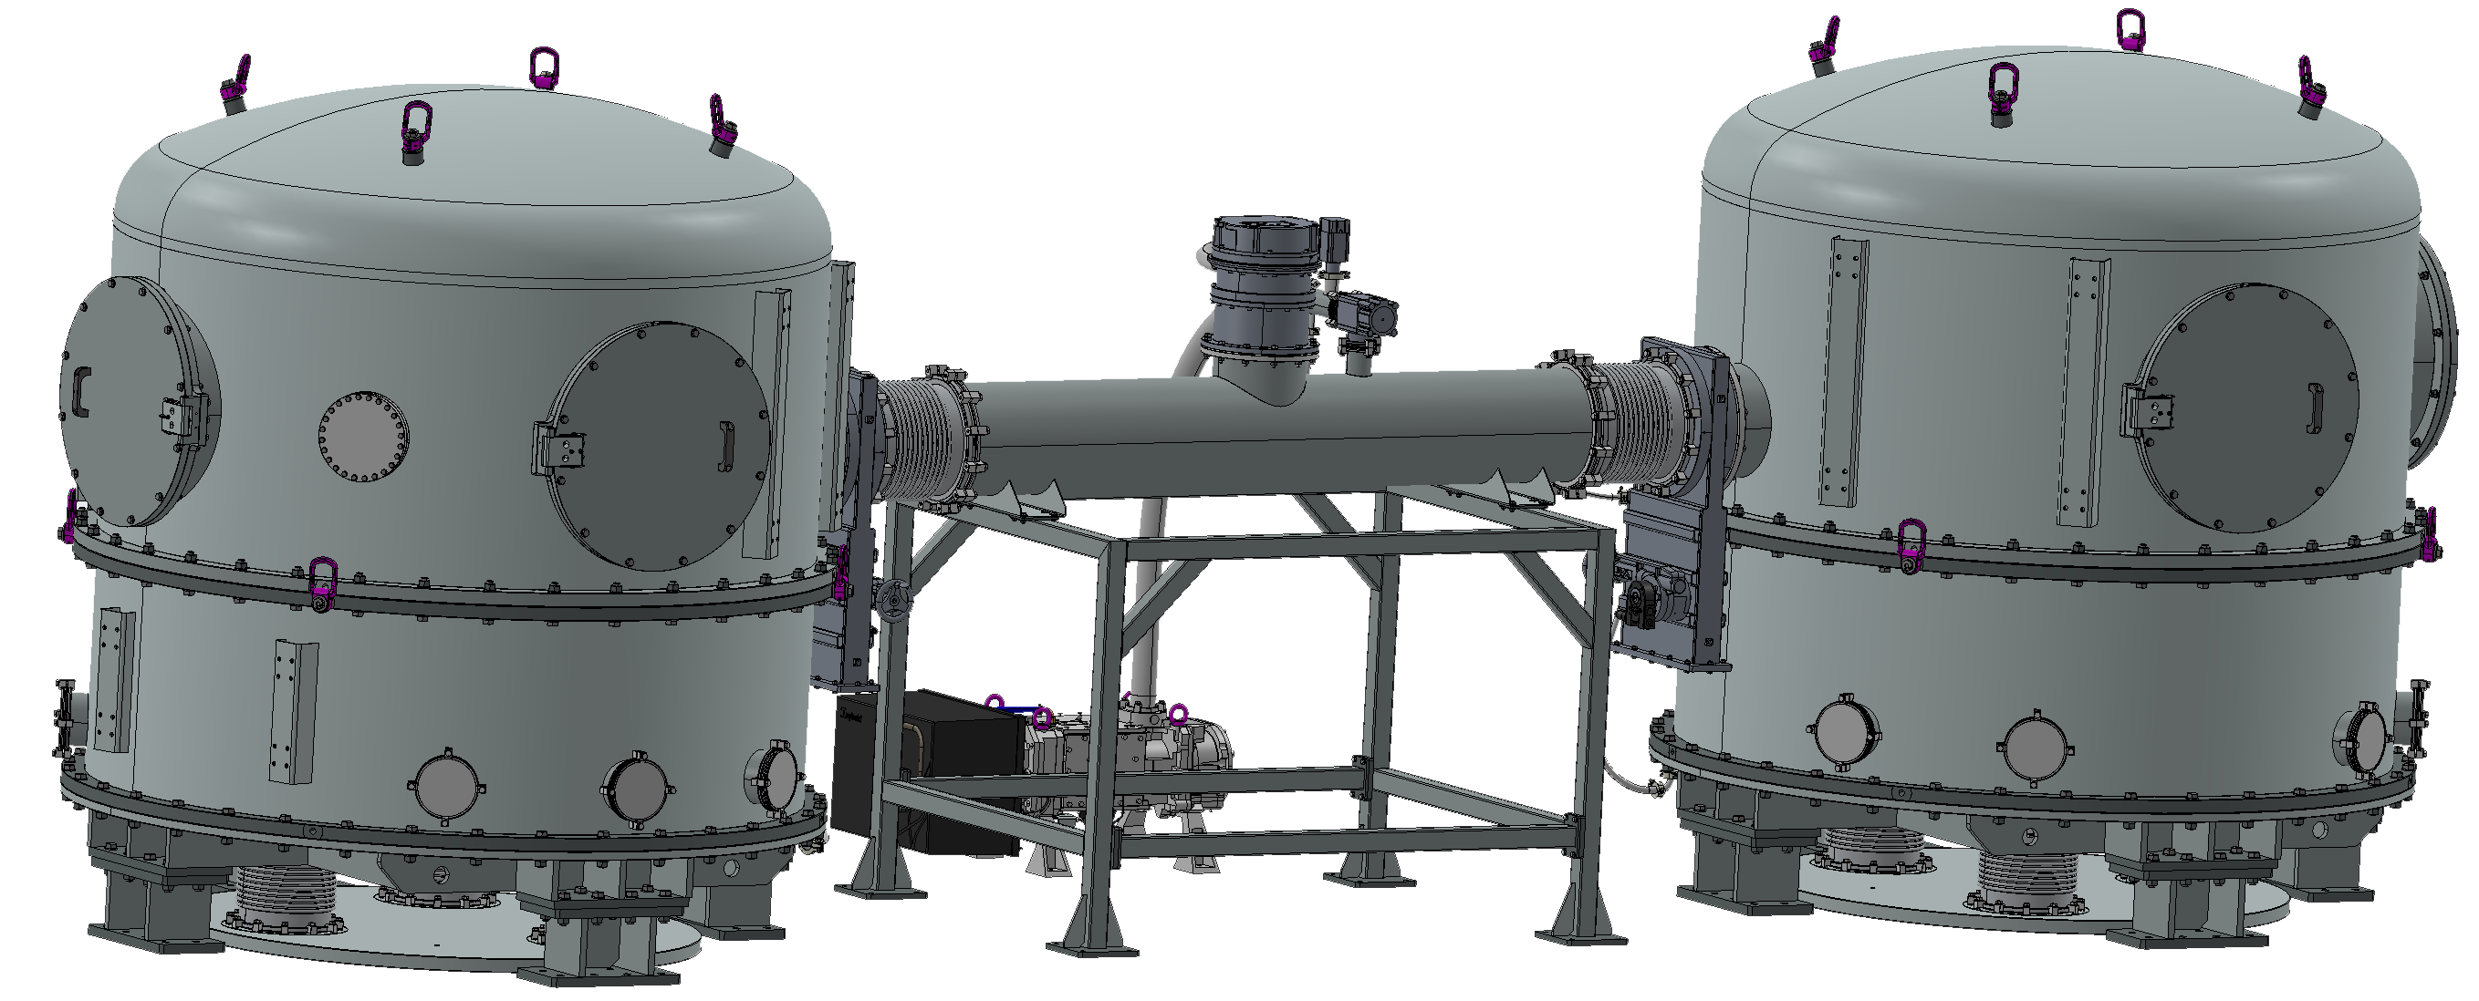
Vacuum System
Two chambers connected by vacuum pipe.
Tunnel entrance dimensions put strong limitations on chamber geometry.

Slide 6
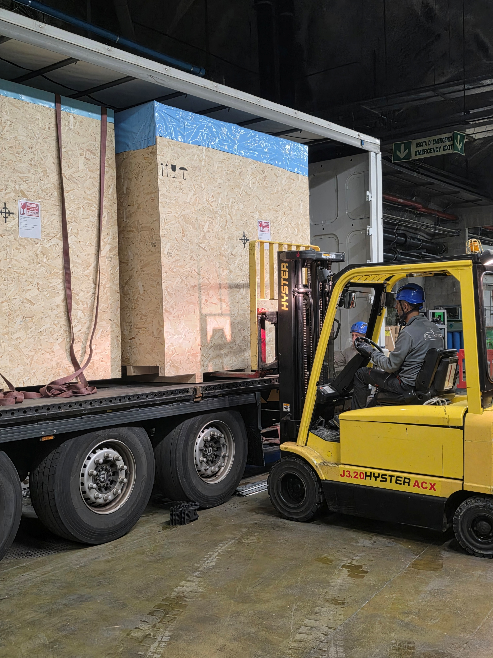
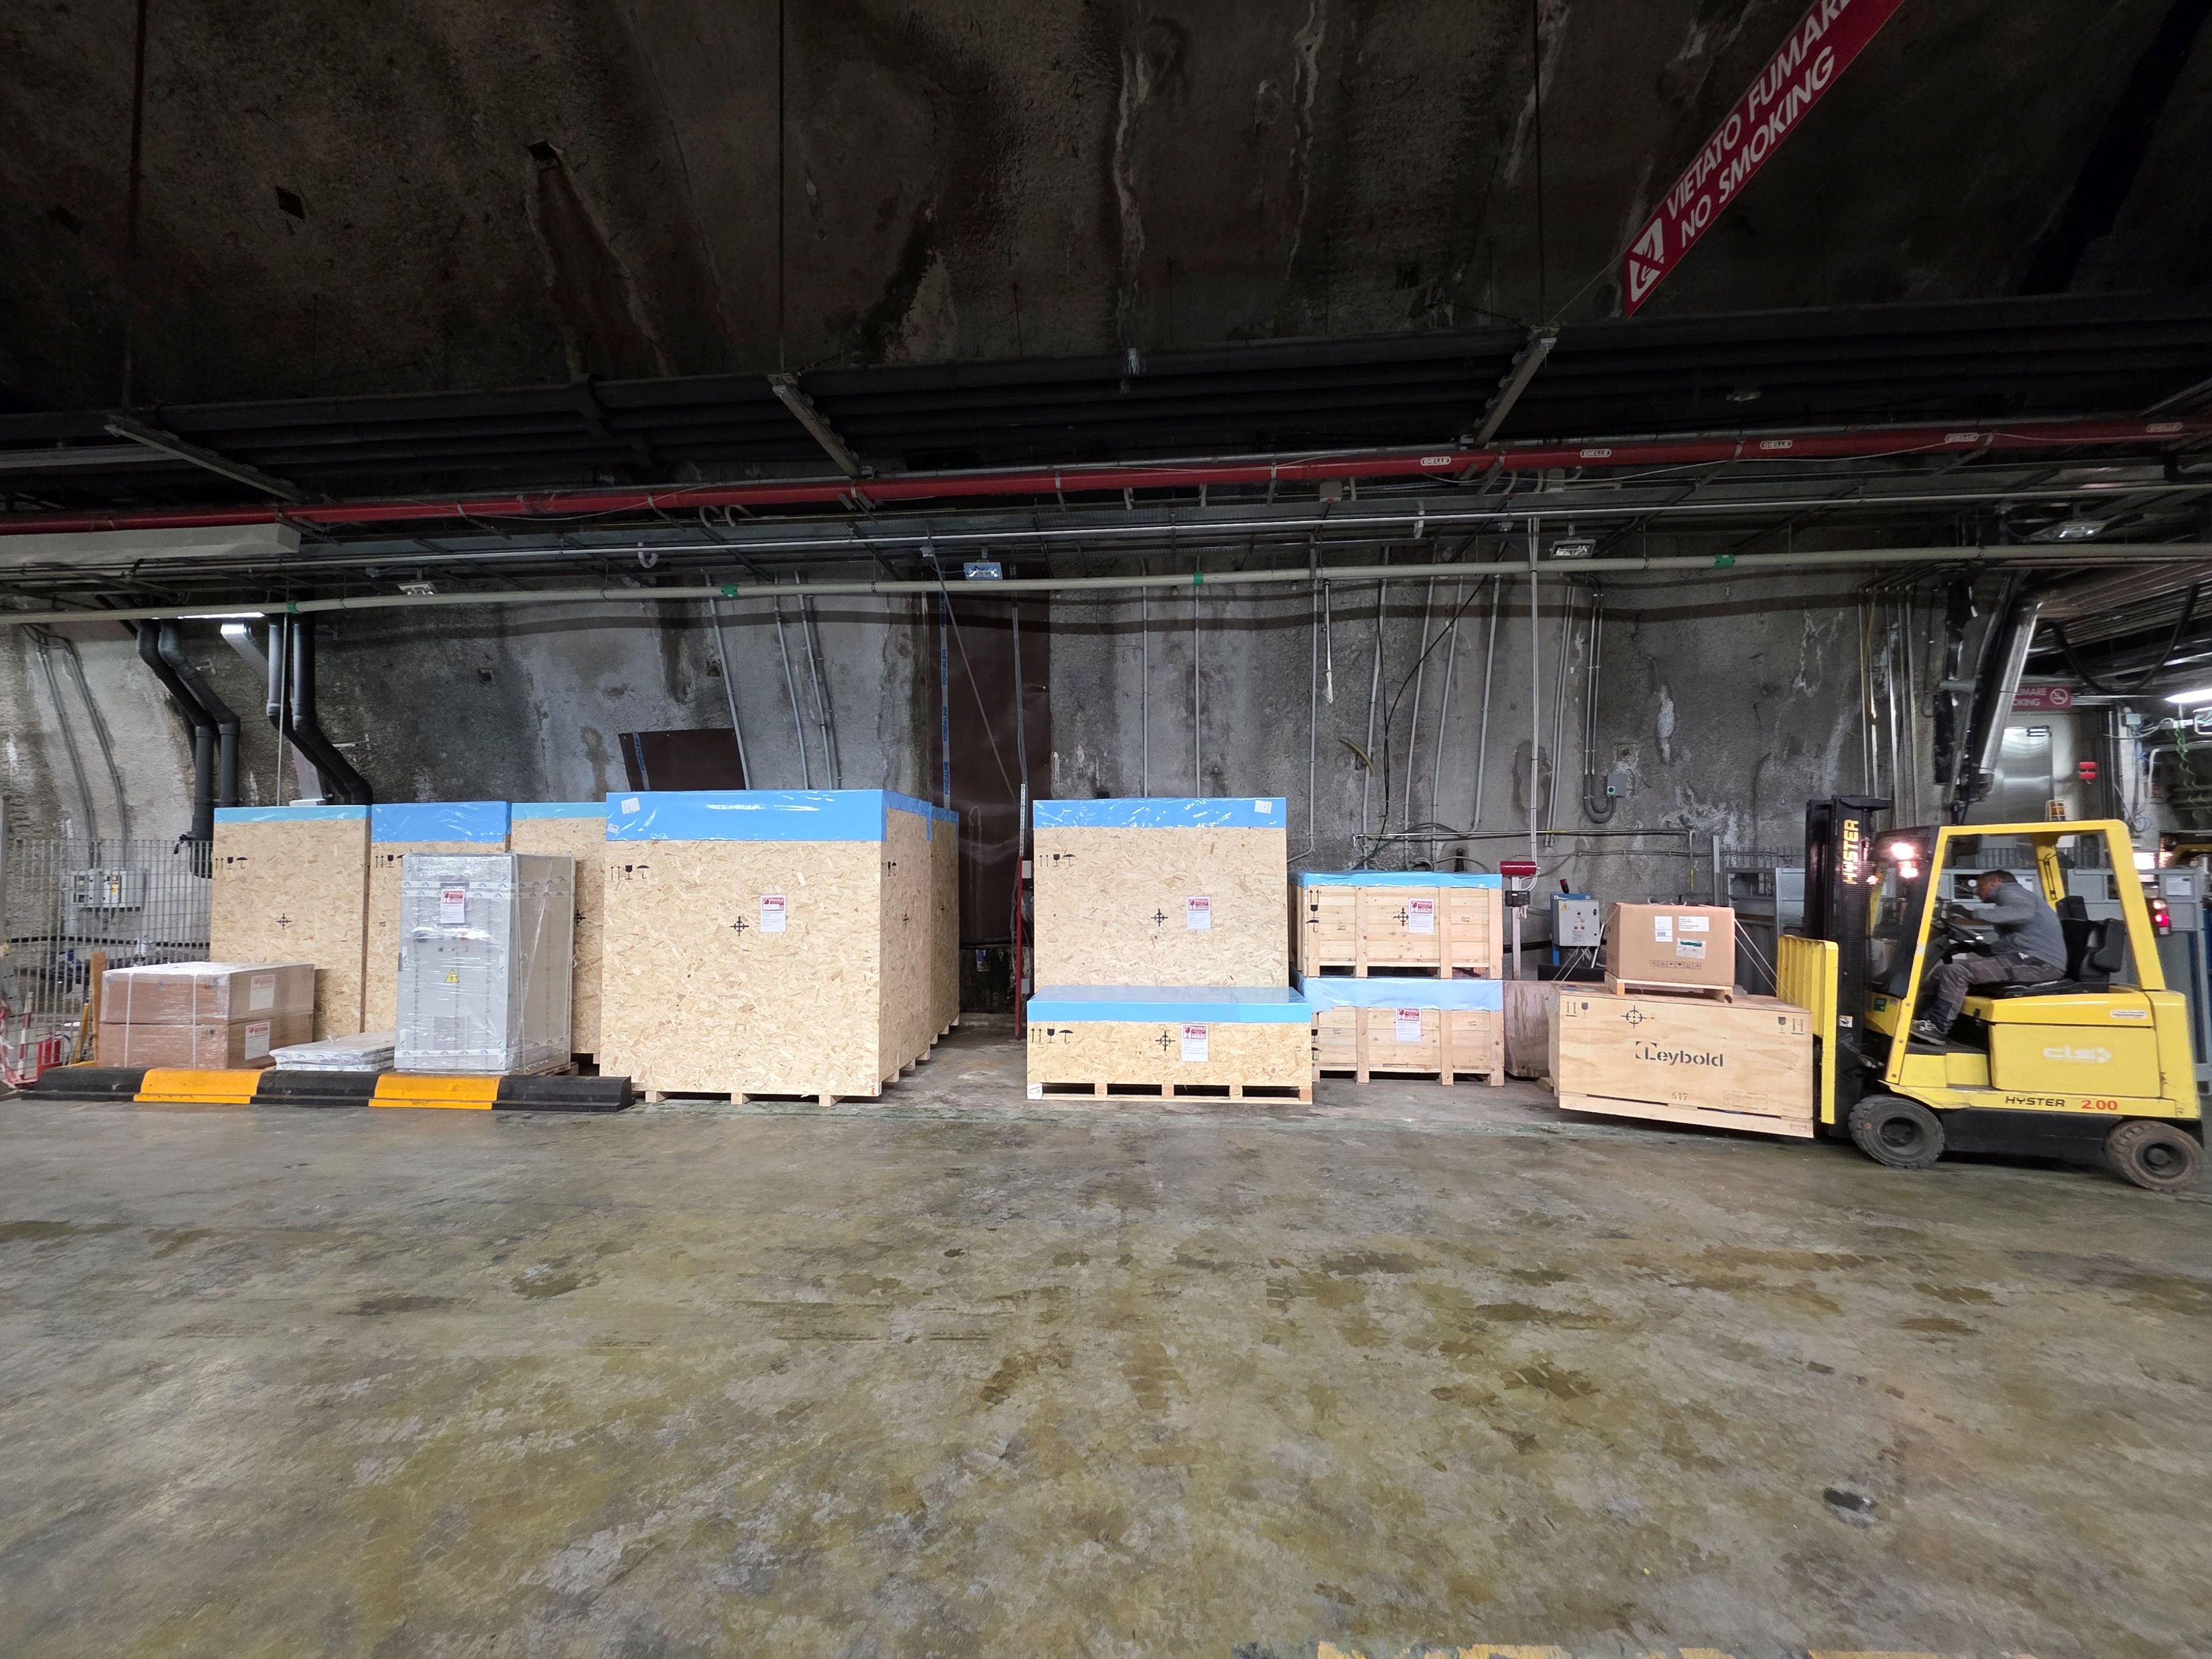
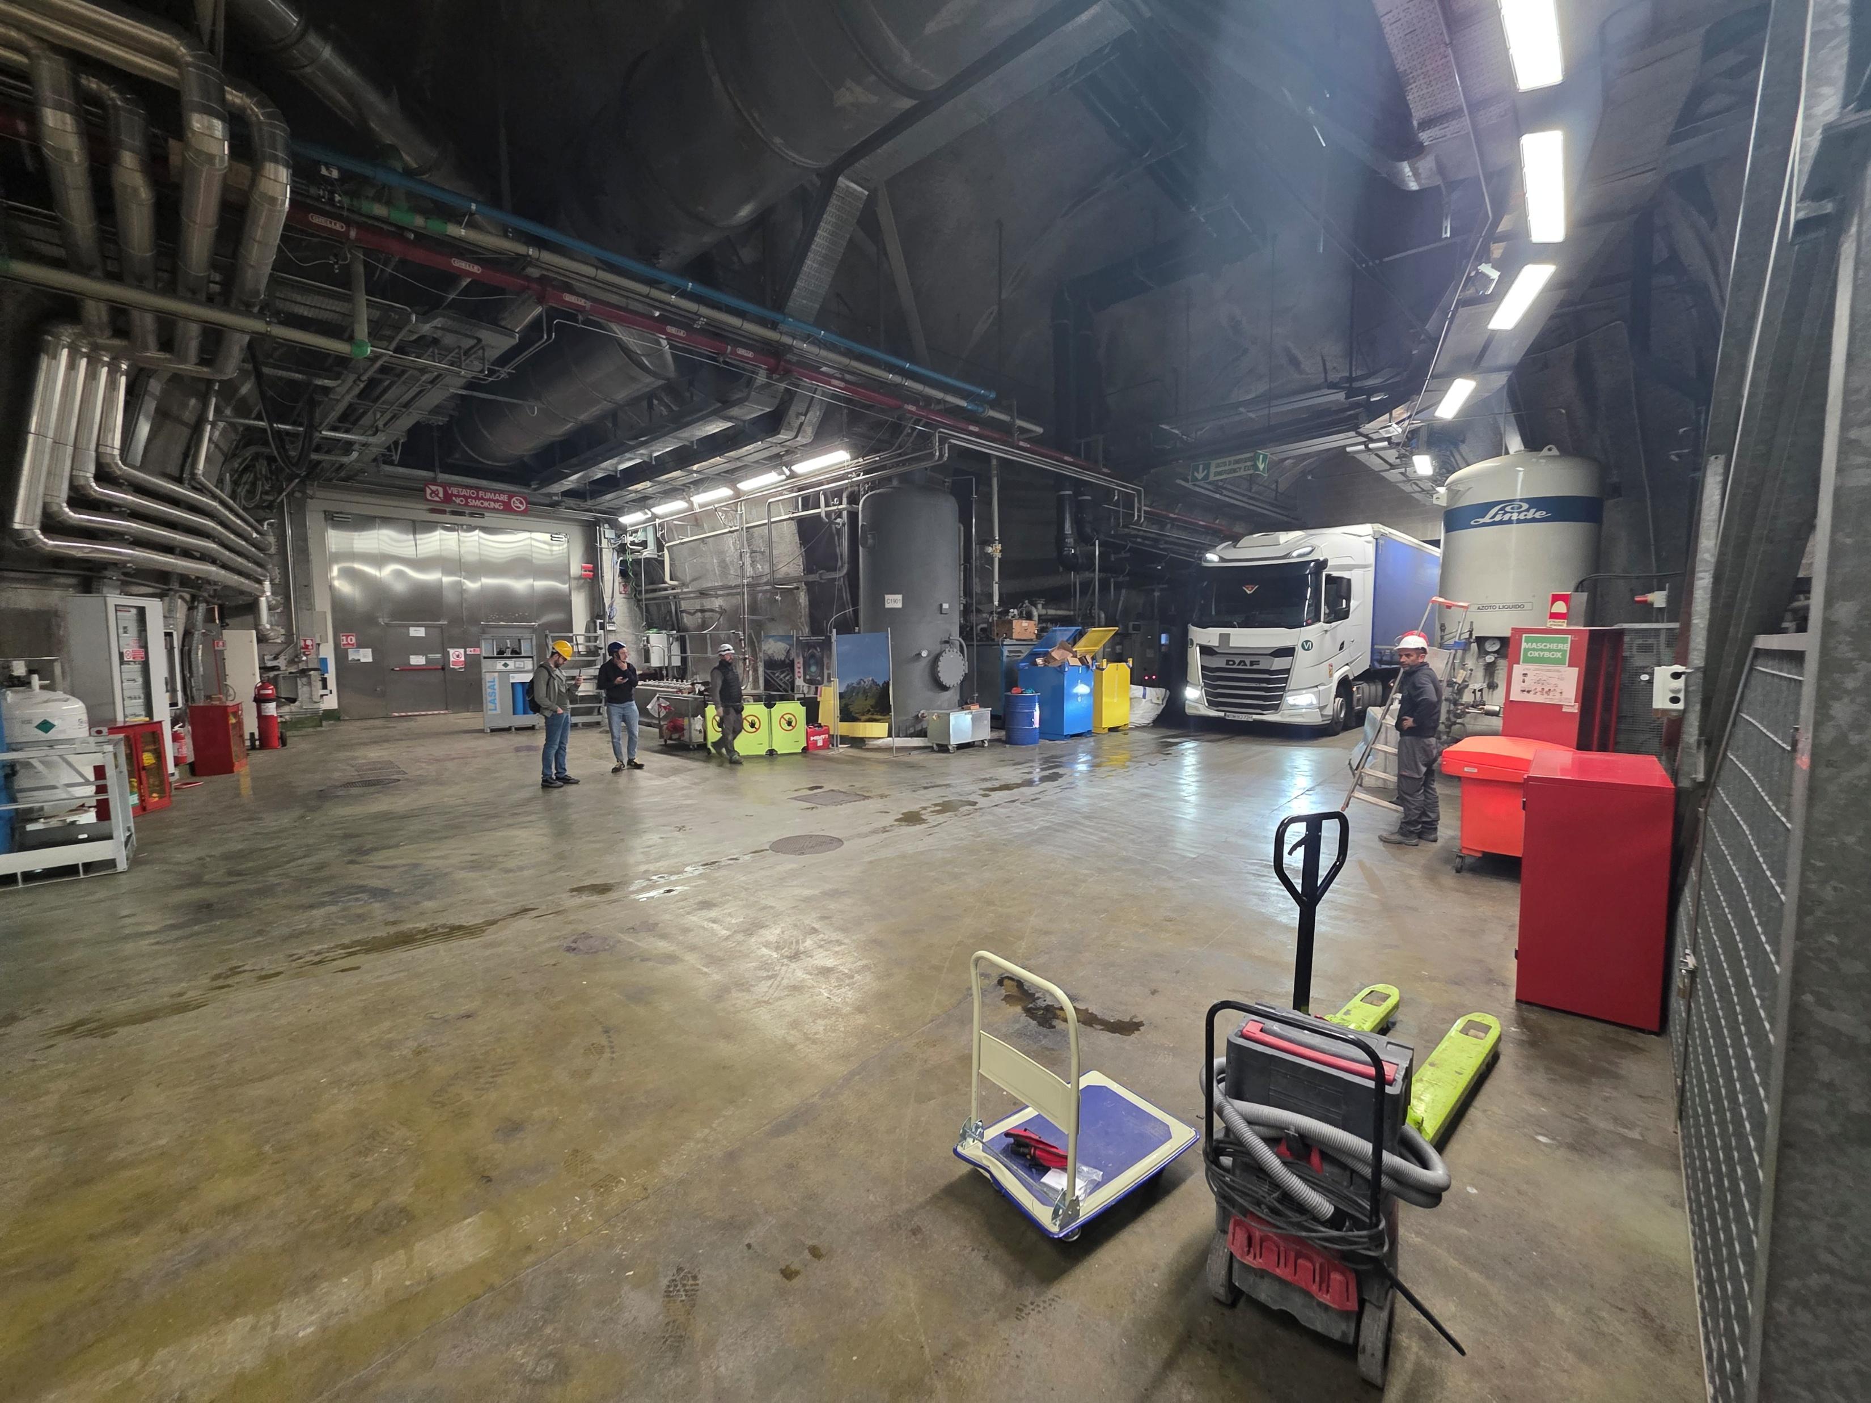
Delivery in July

Slide 7
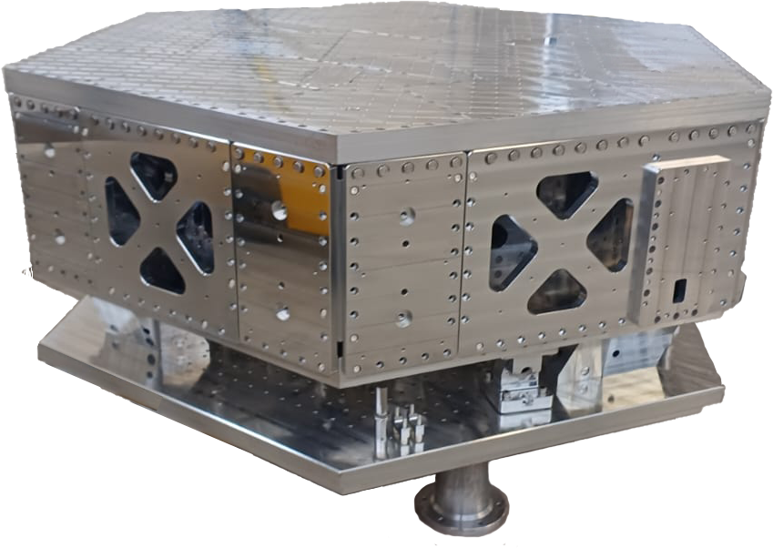
GEM-VCP
GEMINI Vibration-control Platform
Starting point of the design: LIGO HAM-ISI
Design modifications, vibration analysis, and executive drawings produced by LNGS mechanical engineers

Slide 8
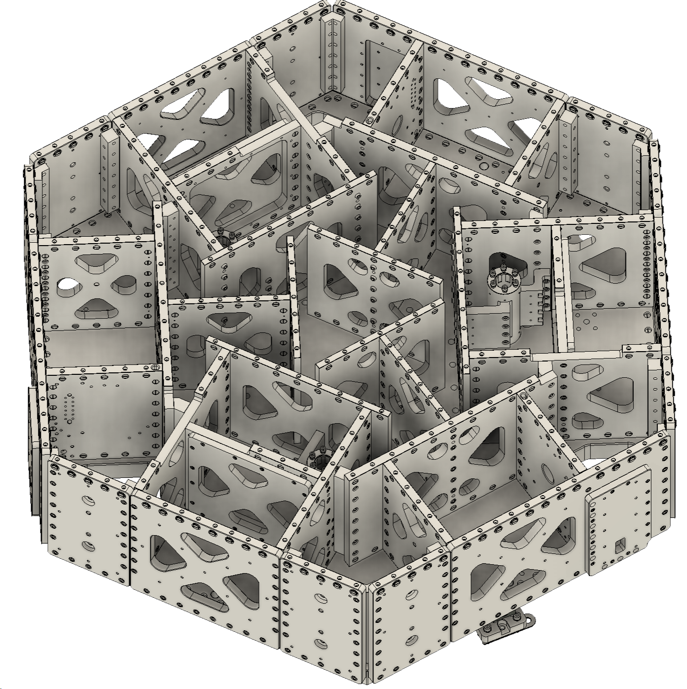
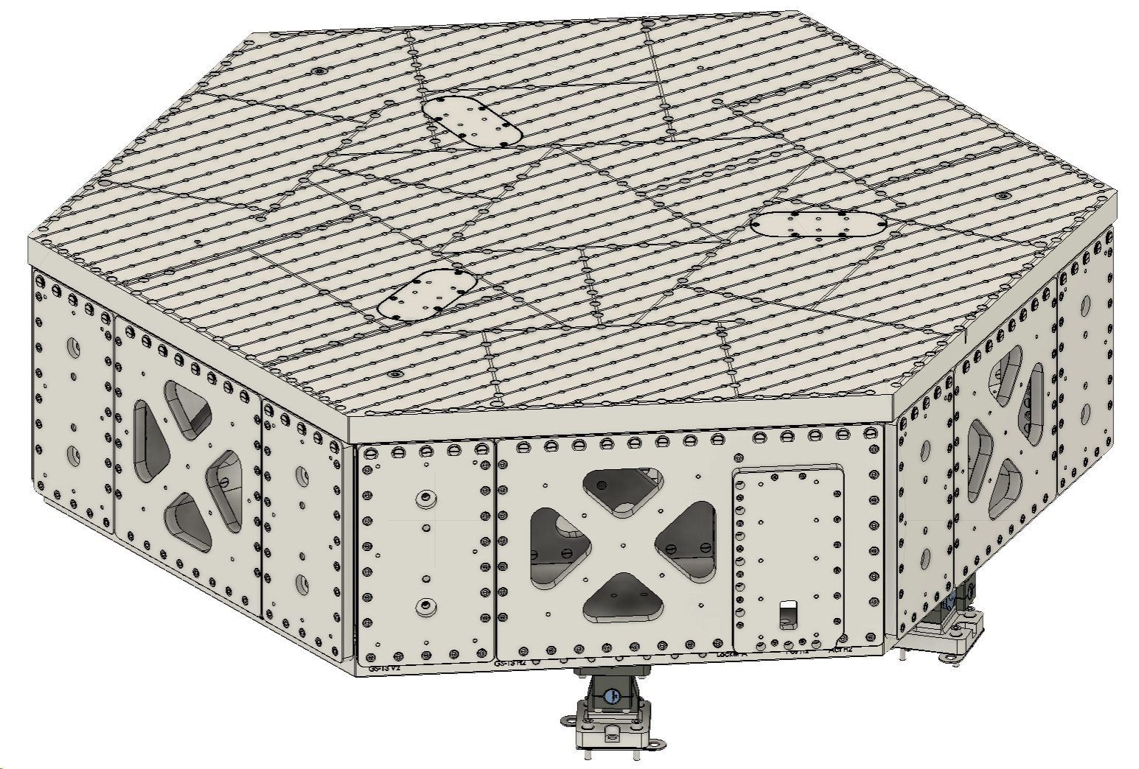
GEM-VCP: Stage 1
Pillar compartments
2m diameter
T360 compartments
Stoppers mounted to stage-0 and stage-1

Slide 9
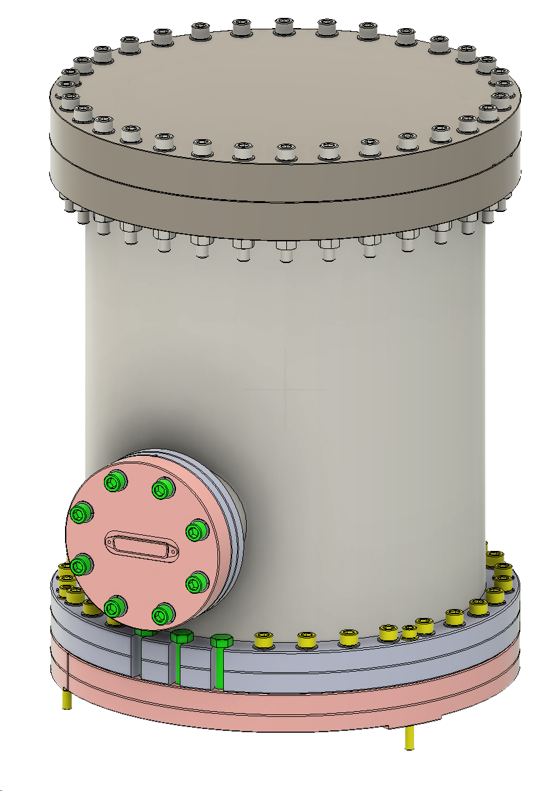
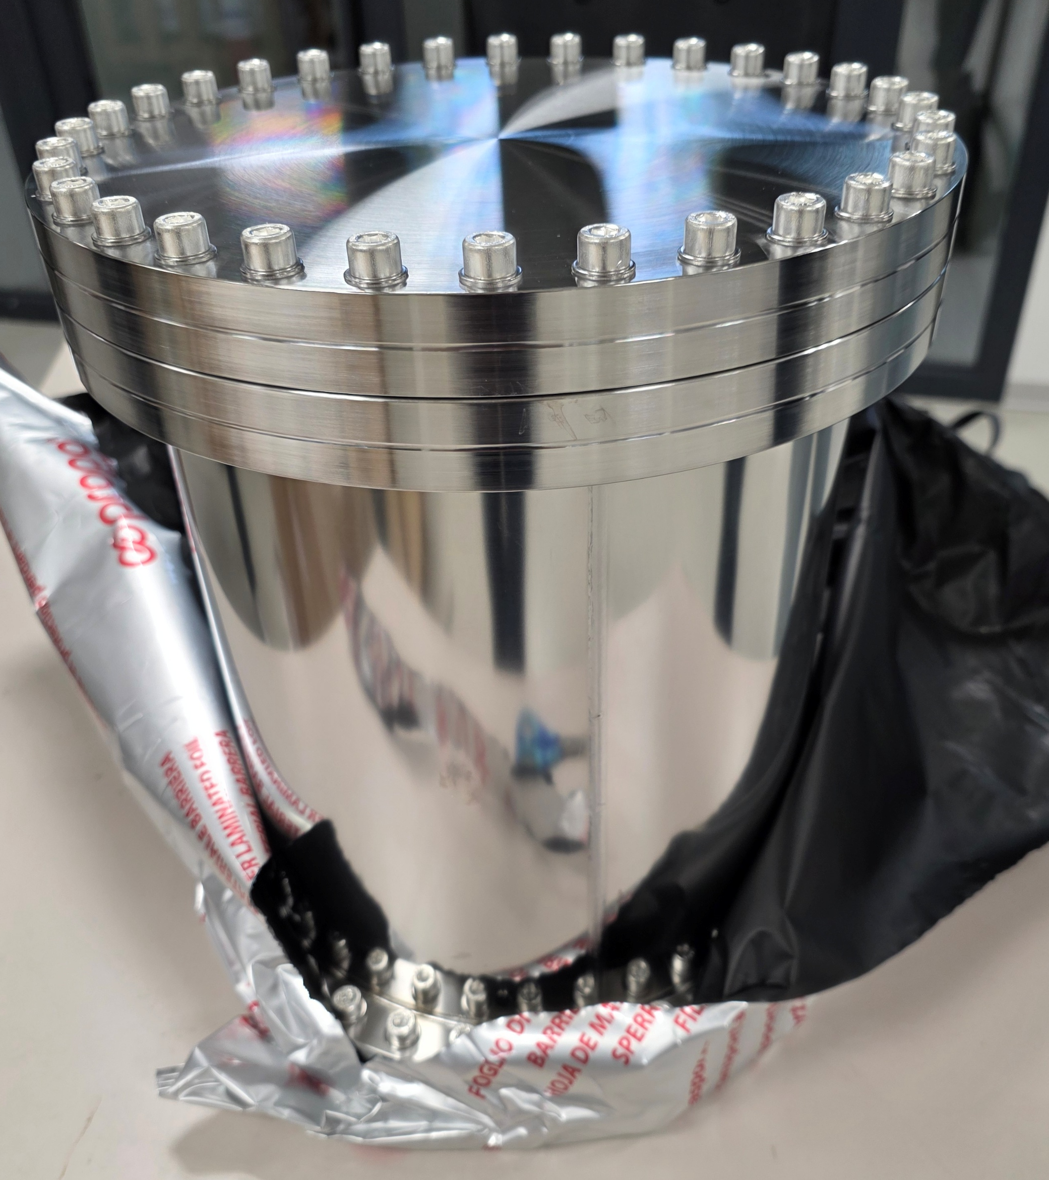
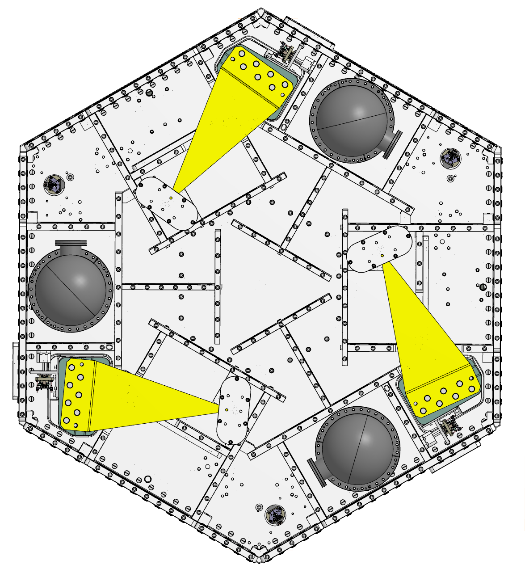
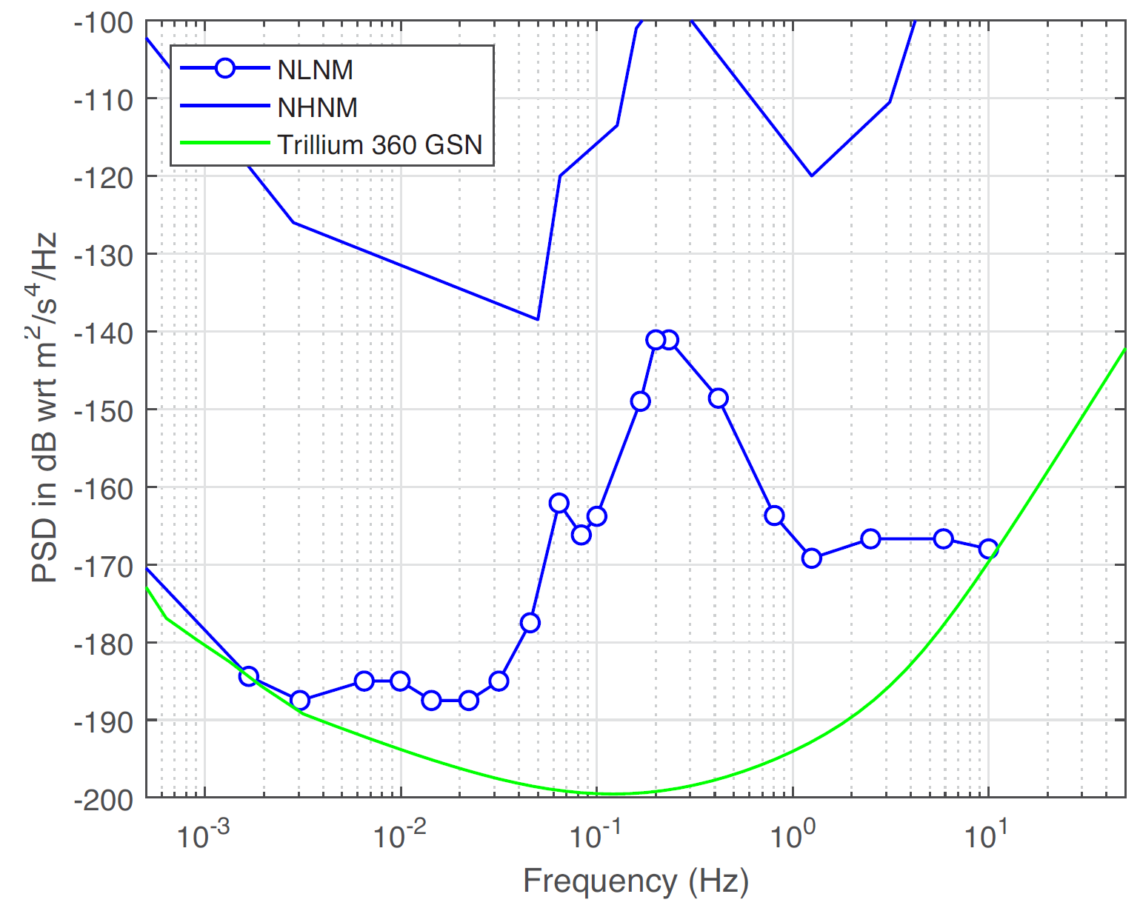
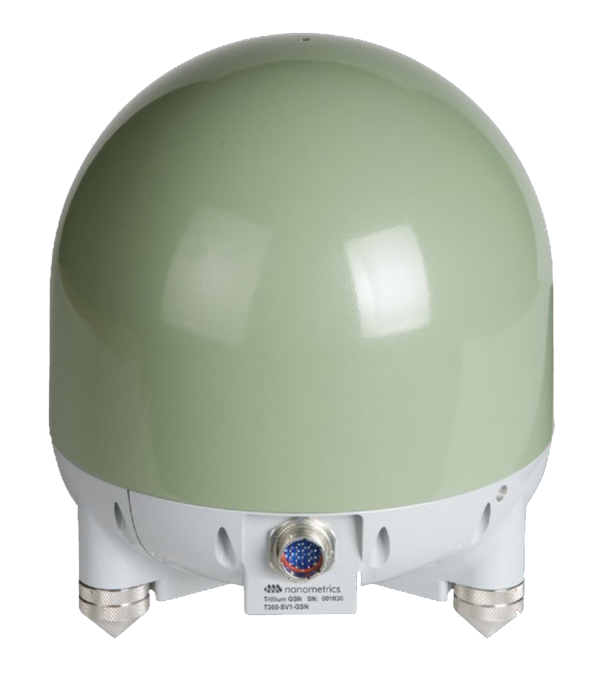
Inertial Sensing
Vacuum pods
Nanometrics T360 GSN Vault
(3 per platform, 3 channels each)
Integration in GEM-VCP

Slide 10
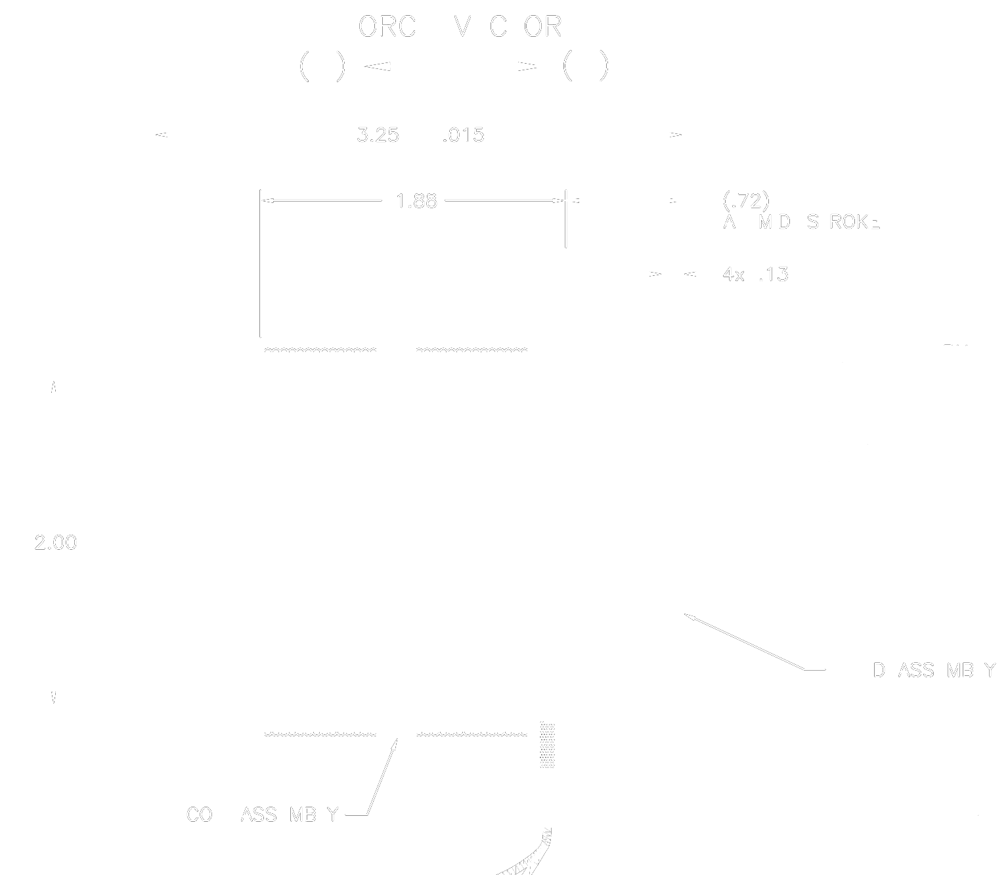
Voice-coil Actuators
Sensata - BEI Kimco LA18-32-000A
Total Stroke 12.7 mm
Continuous Stall Force 43.15 N
Peak Force 142.34 N
Actuator Constant 9.03 N/√W
Modification: low outgassing for vacuum compatibility

Slide 11
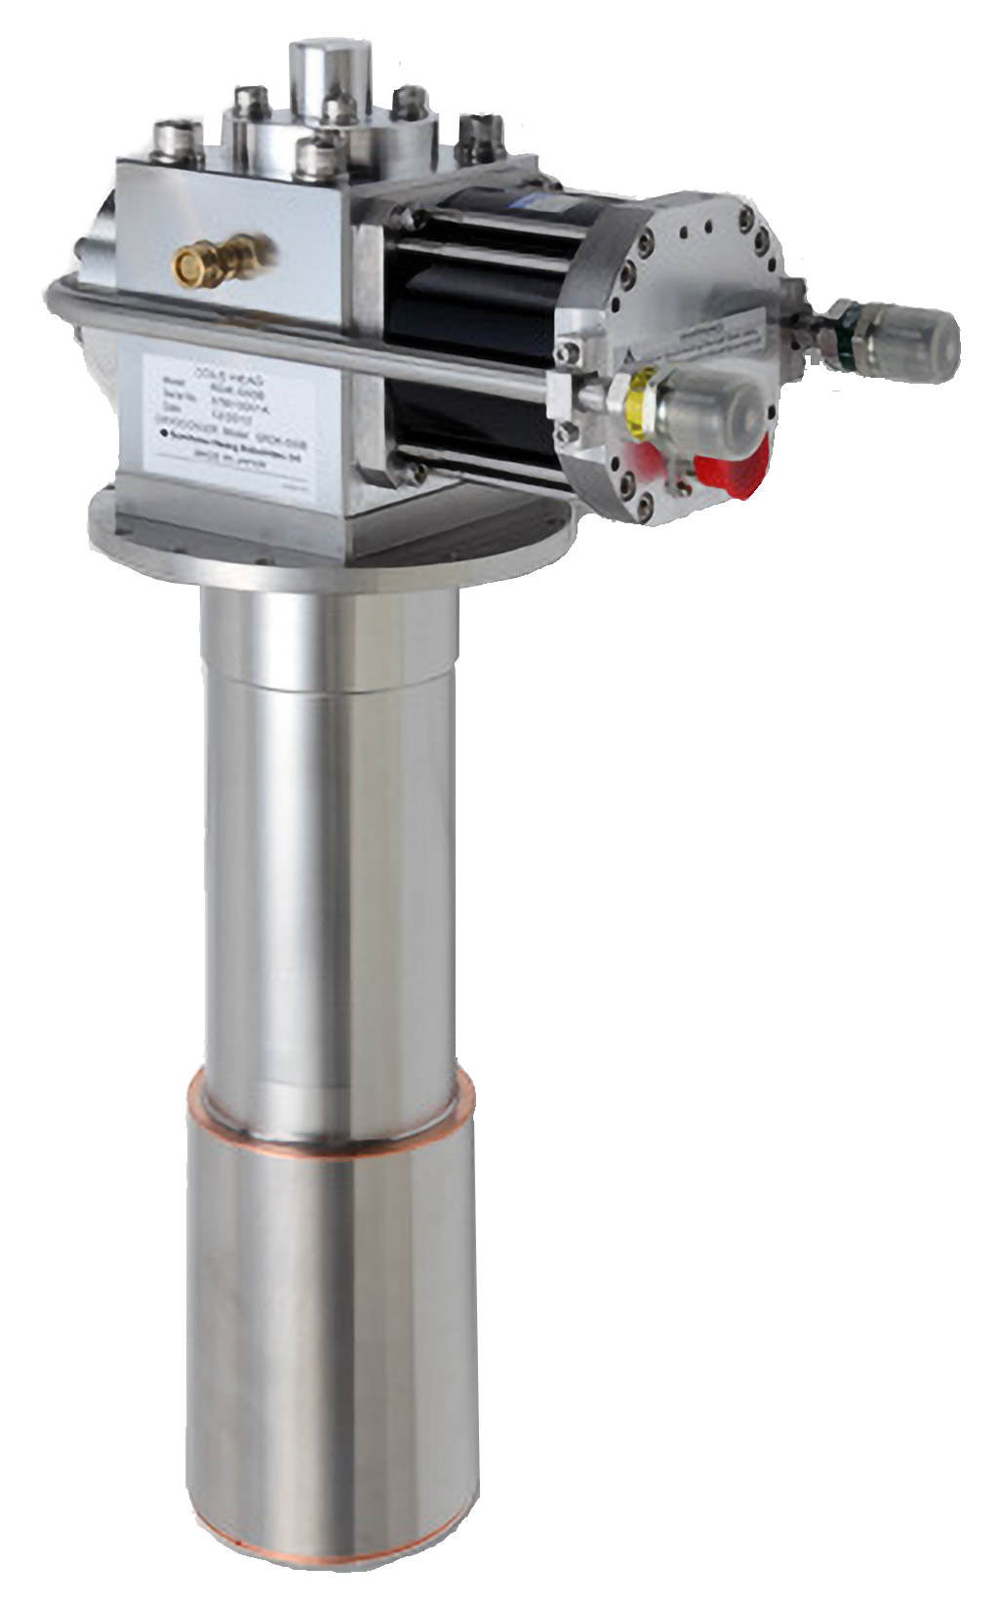
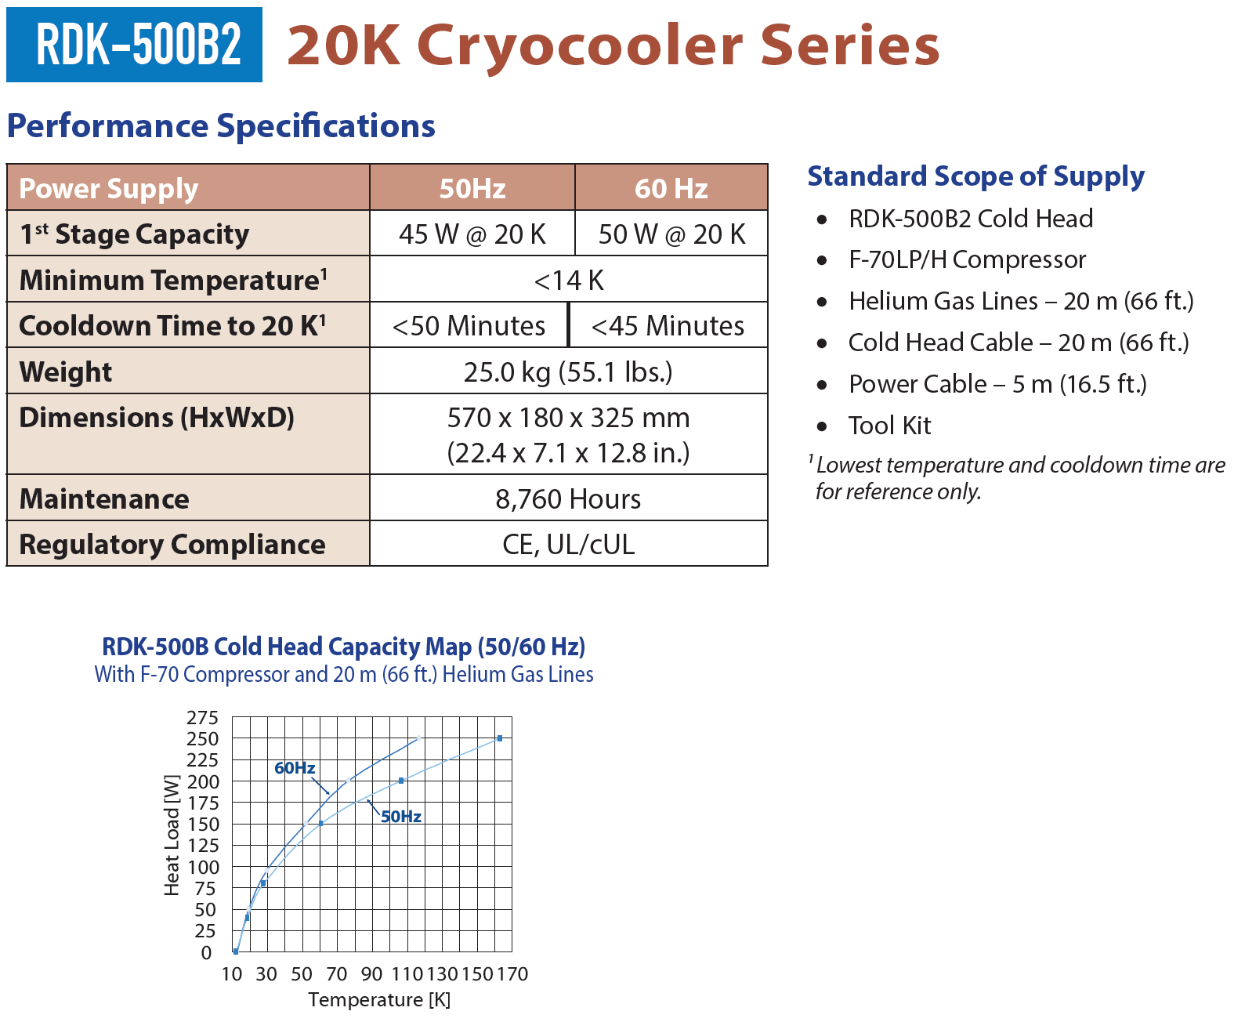
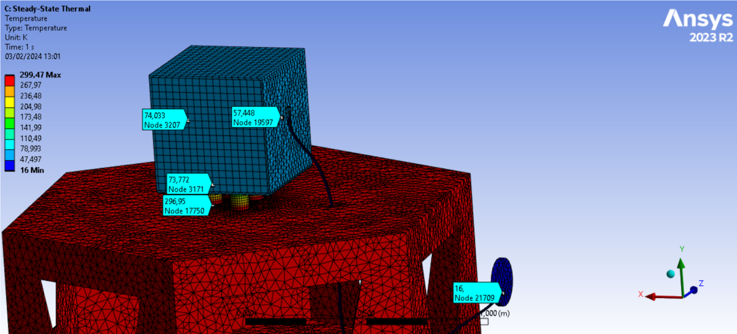
Cryo-box
Emulate 40k environment for lunar PSR payloads
Thermal link will not be as shown in this simulation

Slide 12
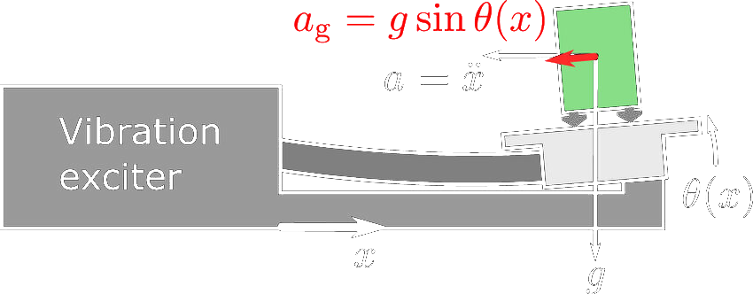
Tilt-to-horizontal Coupling
Platform tilt – either produced by the seismic input or by the platform control creates a «fake» horizontal signal in the inertial sensor.
For seismic isolation, you need a tiltmeter to disentangle the tilt contribution from the true horizontal motion.

Slide 13
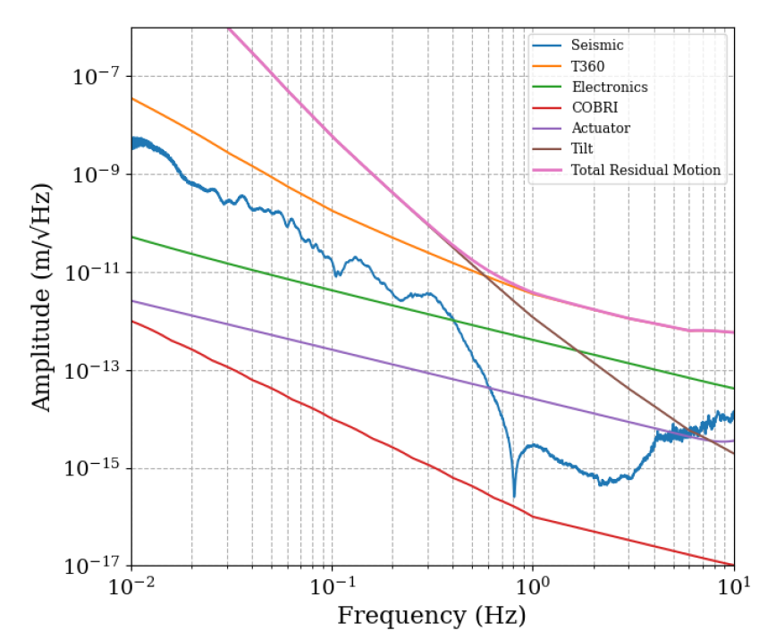
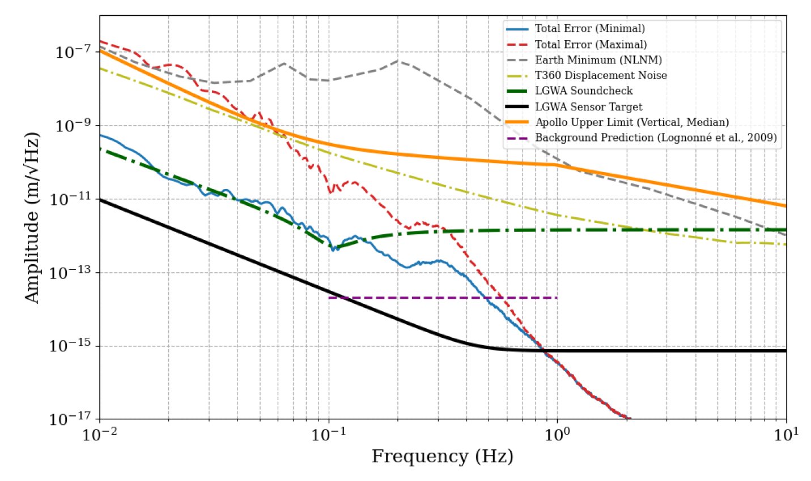
Performance Models
“Seismic-isolation mode”
“Error-signal minimization mode”

