Slide 1



Digging Deeper:
VIPER and the Foundations toward Lunar Sustainability
Dr. Caitlin Ahrens
CRESST-II/UMD
NASA Goddard Space Flight Center
ASCE Aerospace Technical Committee
Disclaimer: Presenter is not funded by VIPER, all materials public knowledge

Slide 2

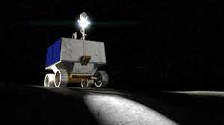
Volatiles Investigating Polar Exploration Rover

Slide 3
Mobility advancements
Neutron Spectrometer System
TRIDENT
MSolo - Camera
Near Infrared Volatiles Spec System (NIRVSS)
Mass Spec

Slide 4
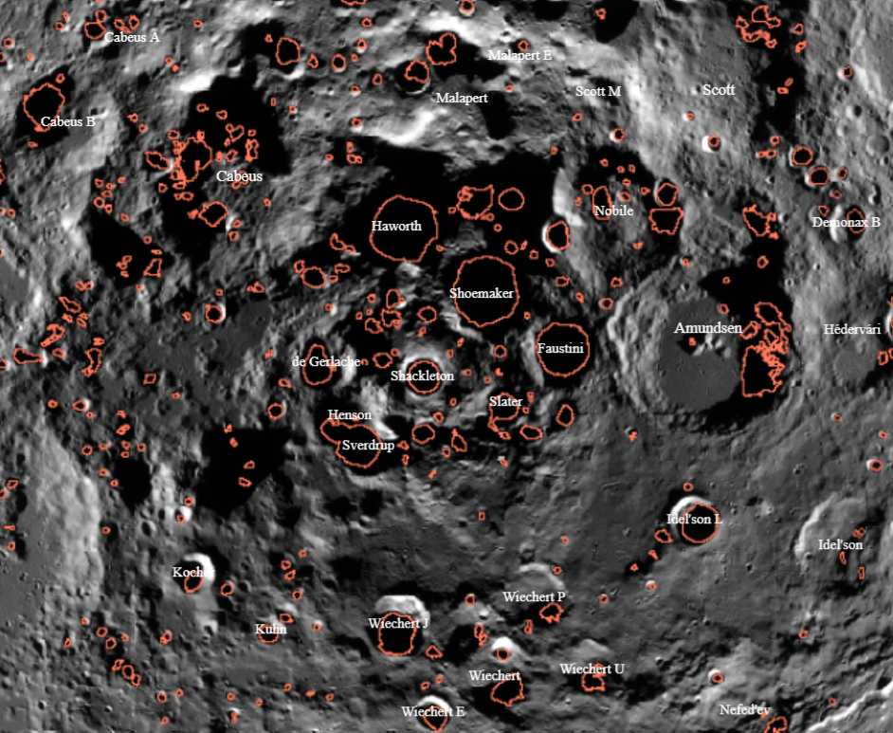
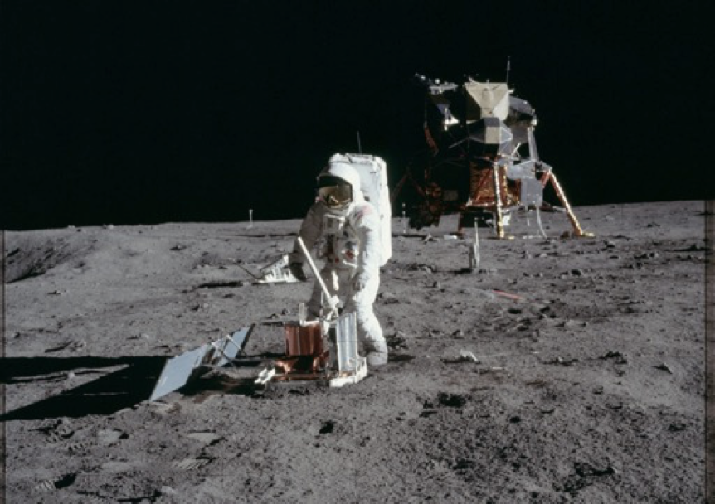
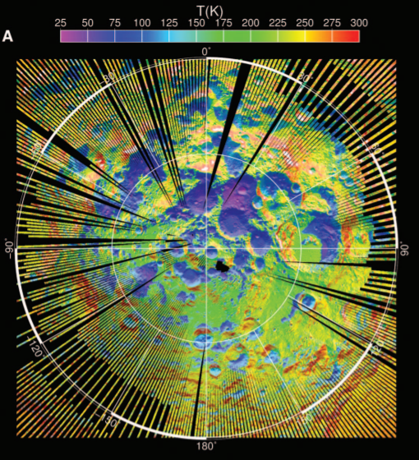
Science Themes
?
Notes:
Theme 1- we’re going back! But where specifically?
Theme 2- water water everywhere? Learning about the environment
Theme 3- how to study it? And safety!

Slide 5
Science Themes
?
THEME 1:
Environmental aspects
Site planning
THEME 2:
Where is the water?!
Environmental learning
THEME 3:
Ok we found it,
now what?!
Sampling and Construction
Notes:
Theme 1- we’re going back! But where specifically?
Theme 2- water water everywhere? Learning about the environment
Theme 3- how to study it? And safety!

Slide 6
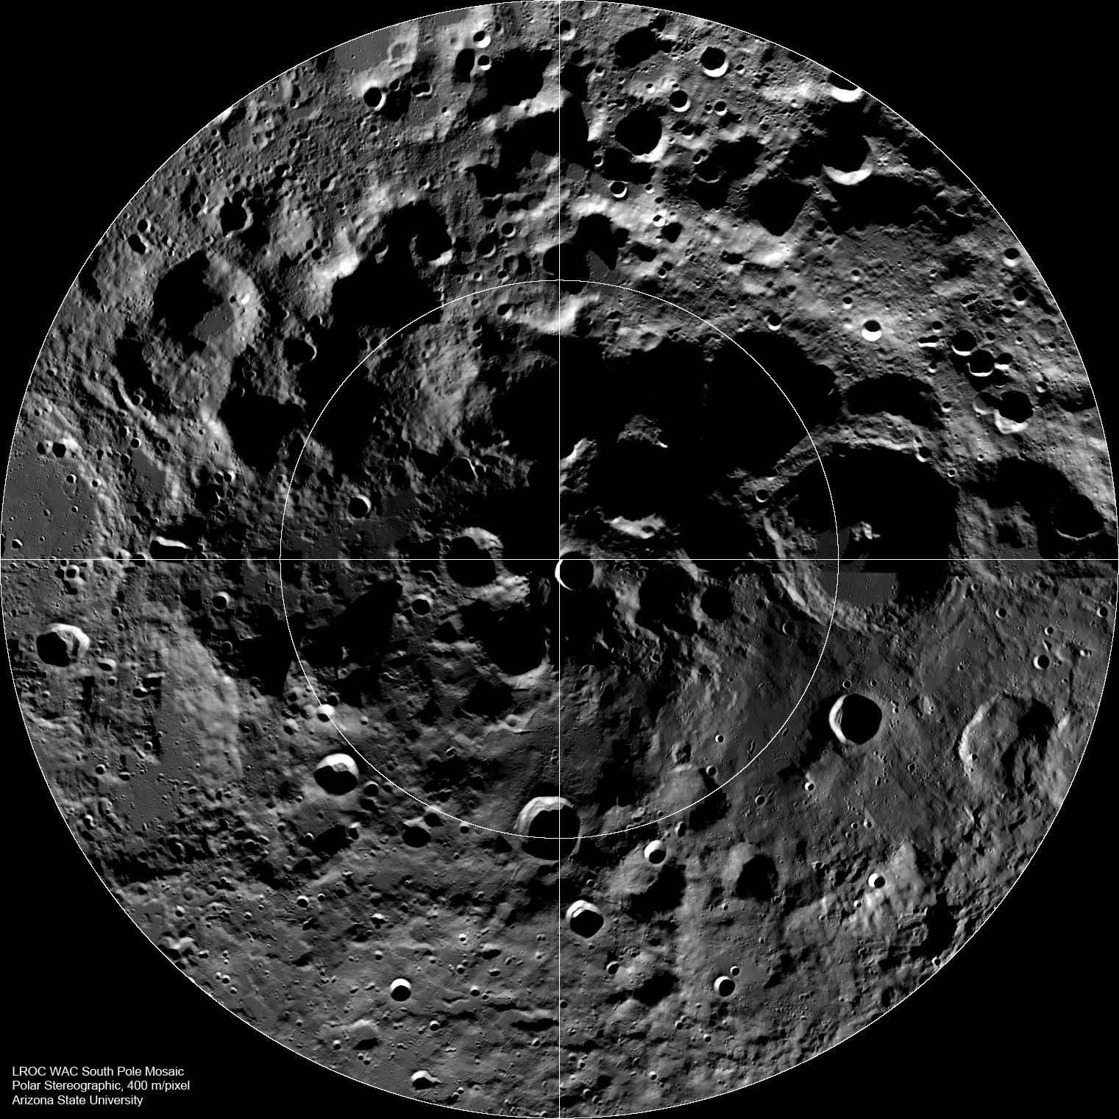

Slide 7
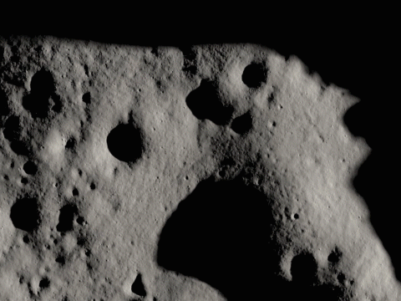

Slide 8
Quick overview of PSRs
Permanently shadowed regions
characterized by the variations in seasonal temperatures
PSRs are typically found at surfaces < 110 K, capable of cold trapping water over ~1 Gyr

Slide 9
Quick overview of PSRs
Permanently shadowed regions
characterized by the variations in seasonal temperatures
PSRs are typically found at surfaces < -163°C, capable of cold trapping water over ~1 Gyr
Due to this temperature variability, there are likely to variations in their stability

Slide 11
Water
Sulfur
CO₂
Sodium
Methanol
Ammonia
Hydrogen Sulfide
Sulfur Dioxide

Slide 12
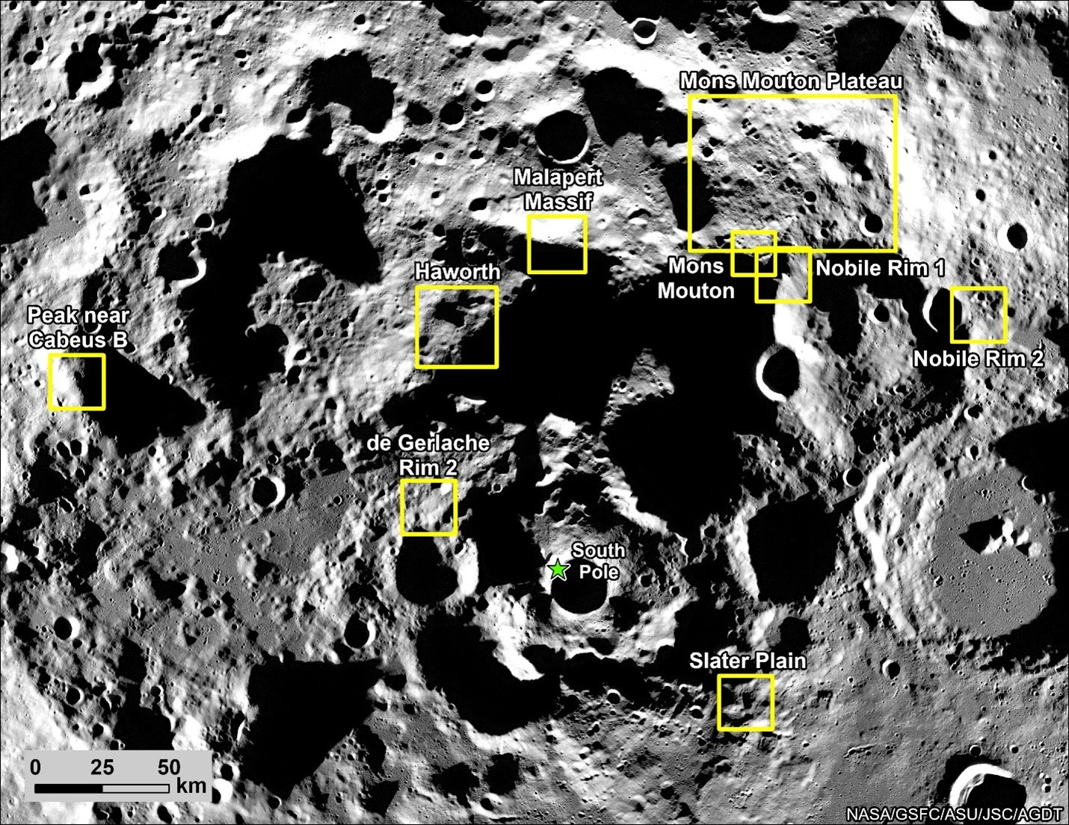

Slide 14
Open Questions on Geotechnical Information

Slide 15
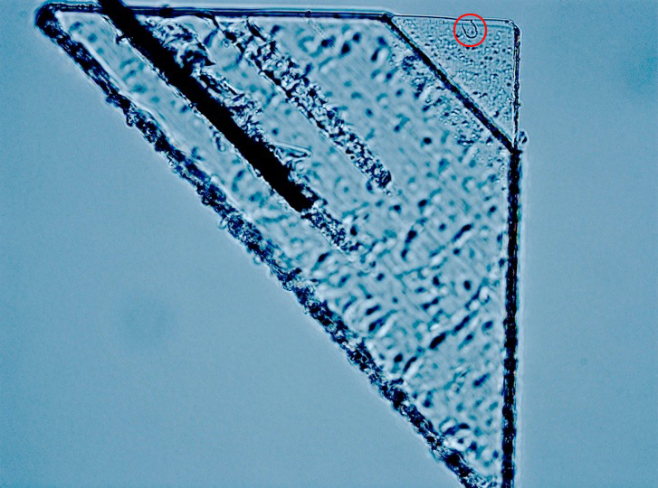
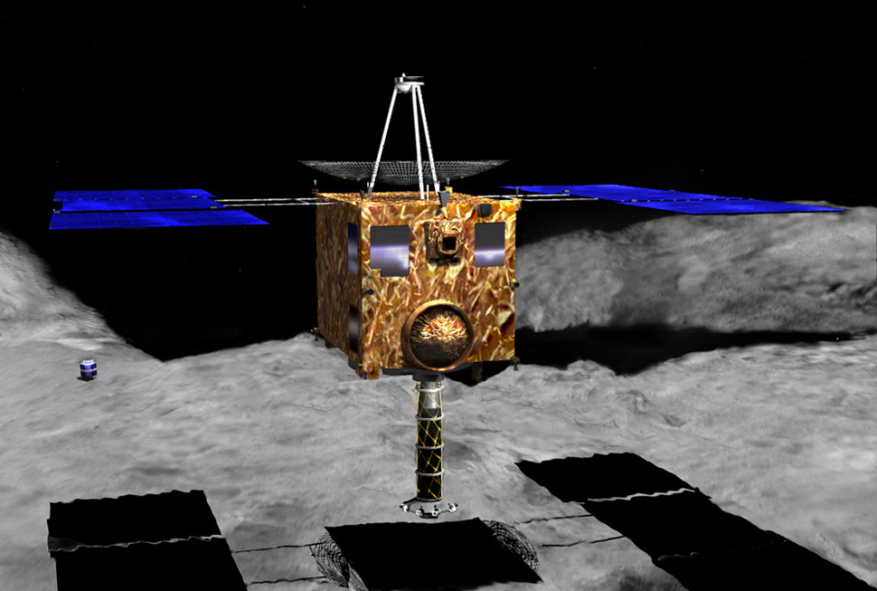
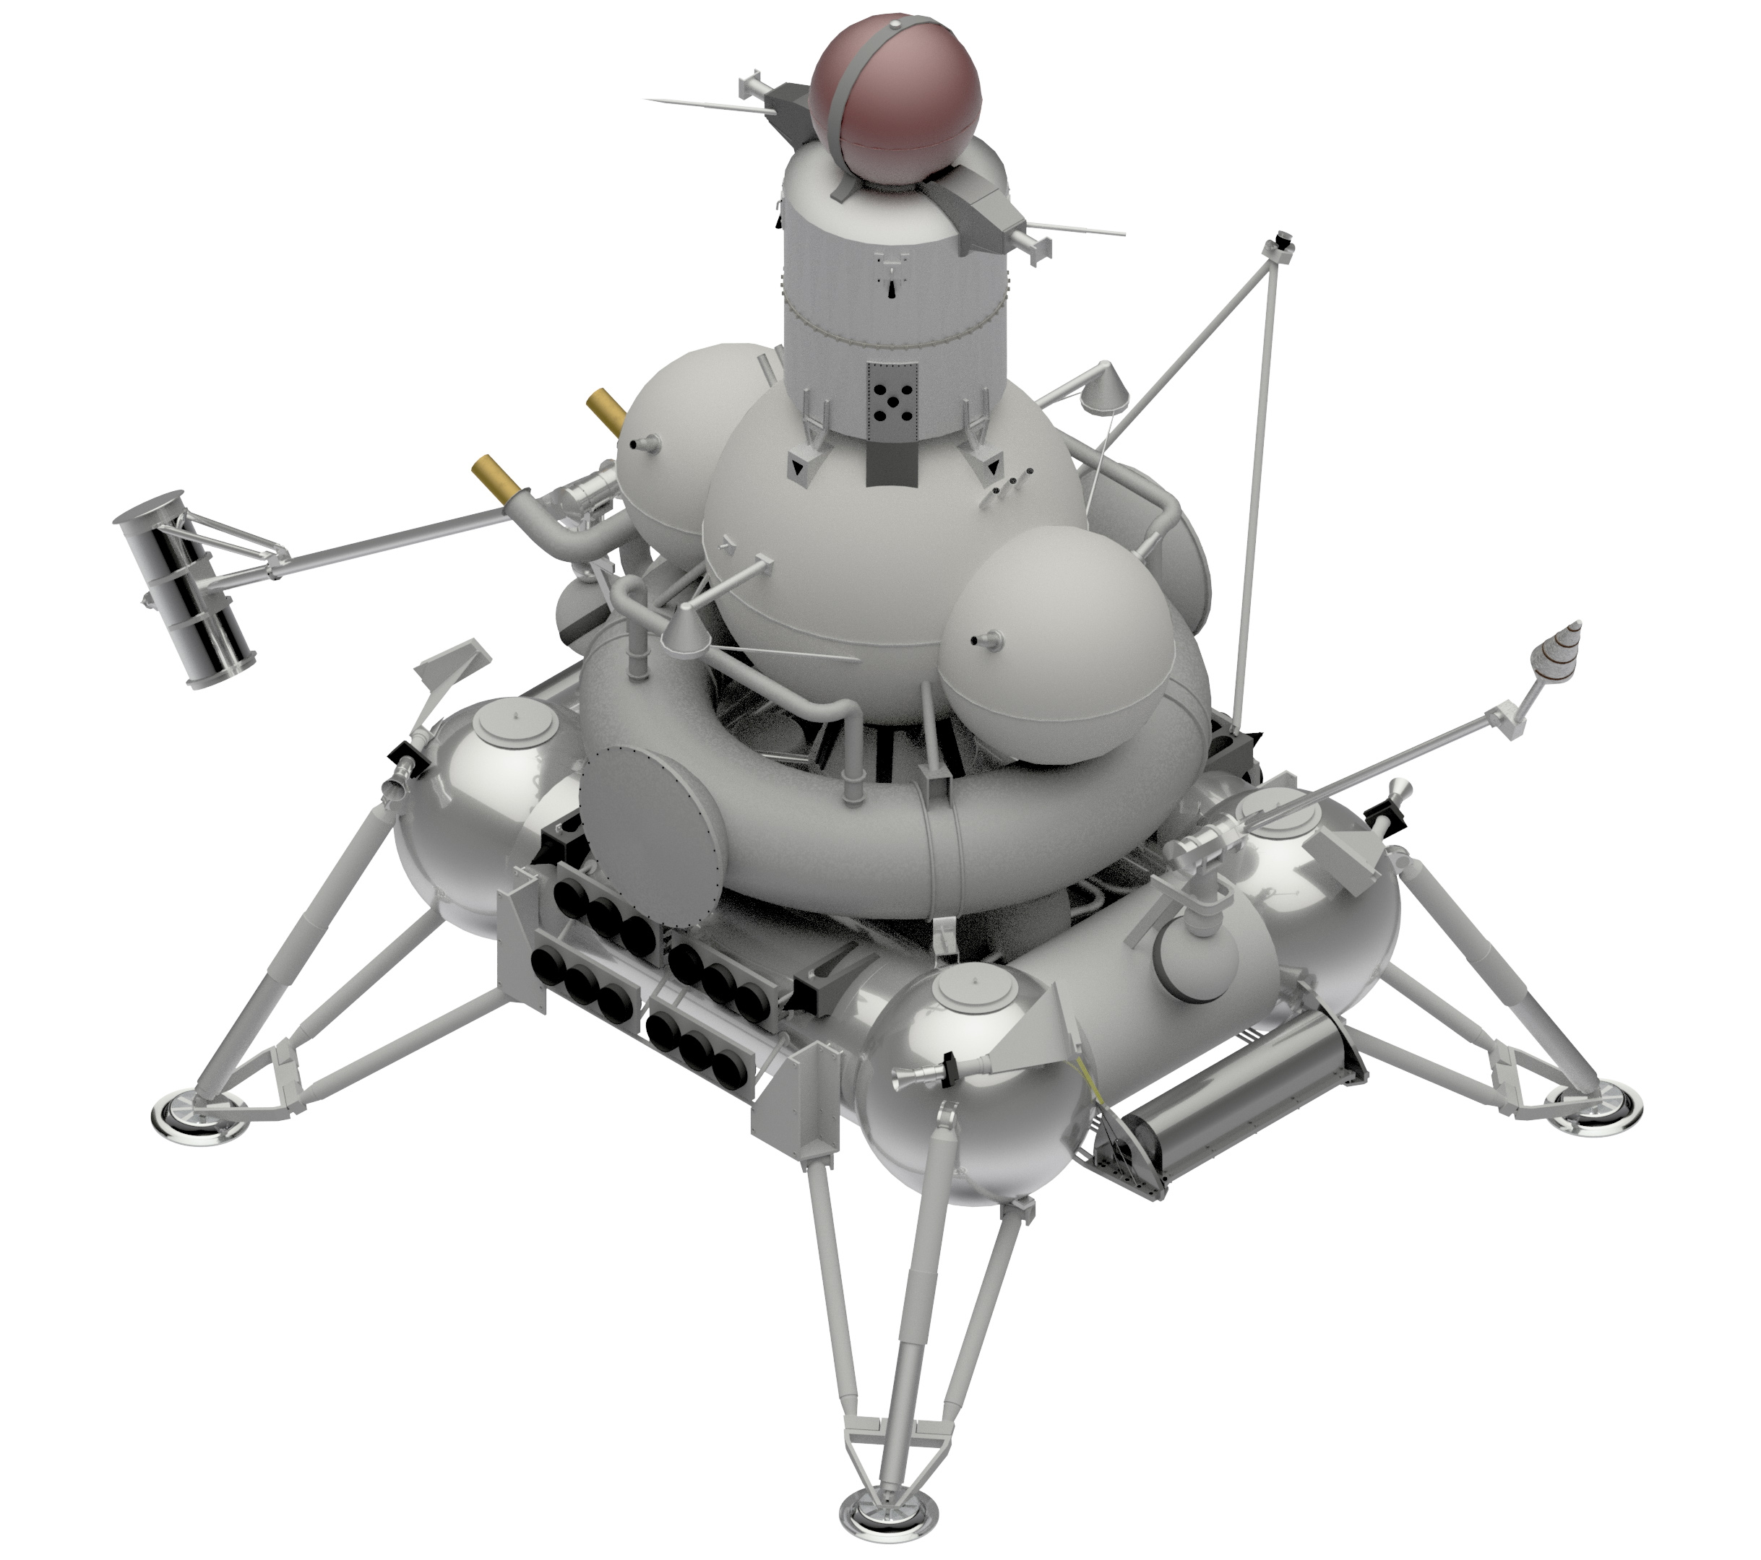
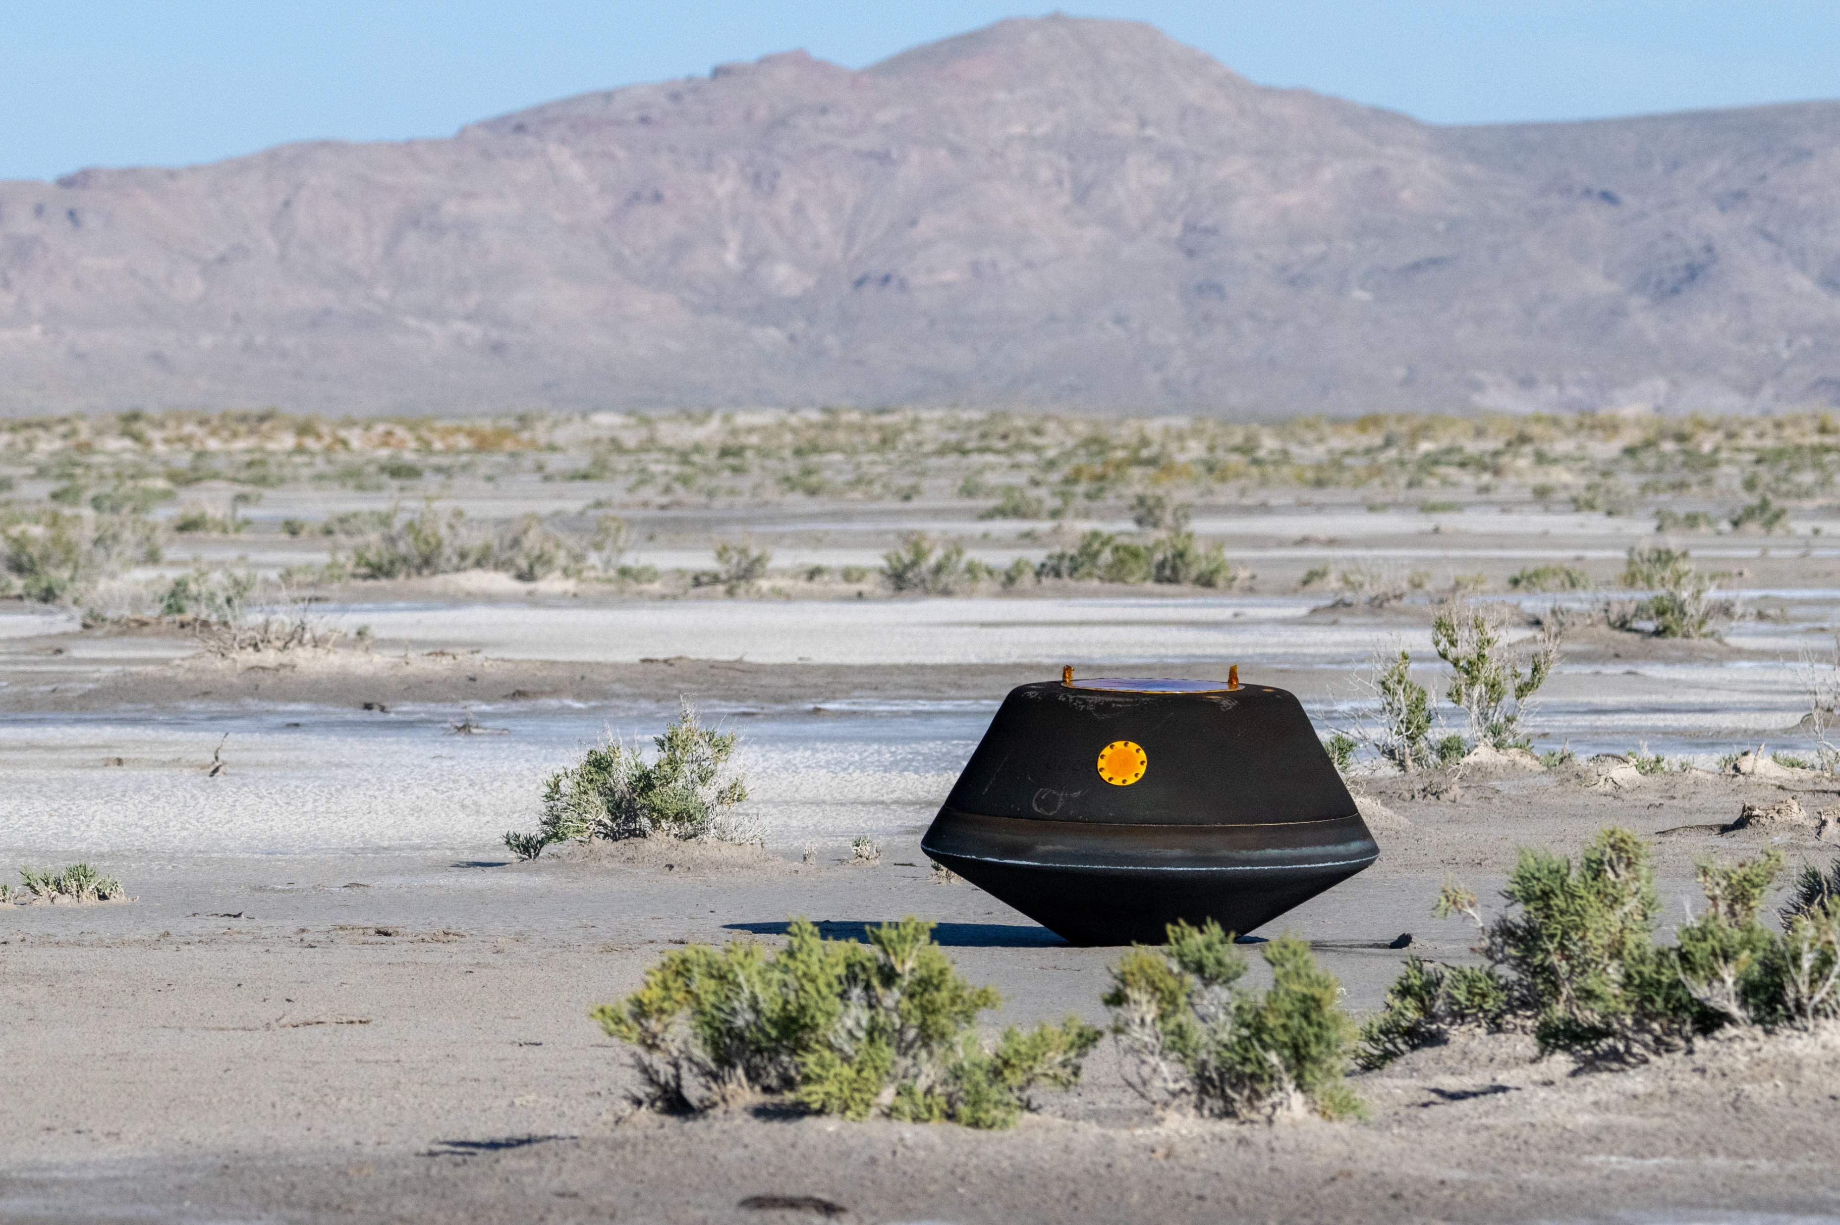
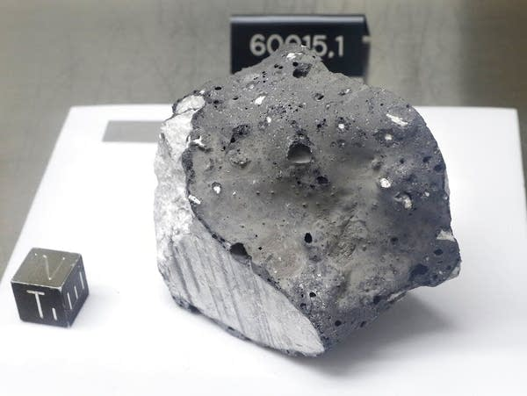
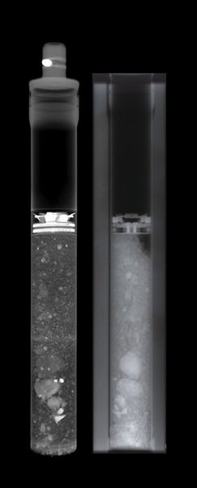

Slide 16
Open Questions (not limited...)
How might volatiles be retained or depleted during construction?
How might thermal variations to different construction materials influence fatigue and loading properties?
Dust buildup, abrasion, and adhesion may cause thermal and mechanical failures over time?
How might heat waste interact with the lunar regolith?
How might the natural lunar environment interact (moonquakes, micrometeroids, etc.)?

Slide 17
There are hazards...

Slide 18
Hazards: Natural –vs – Induced

Slide 19
Hazards: Natural –vs – Induced
Natural Hazards
  Dust
  Radiation/Plasma
  Illumination/shadows
  Temperature
  Moonquakes, seismic weaknesses
  Micrometeoroids

Slide 20
Hazards: Natural –vs – Induced
Induced Hazards
  Astronaut activity
  Rover/lander activity
  Tools
  Power and batteries
  Leaks
  Astronaut suits

Slide 21
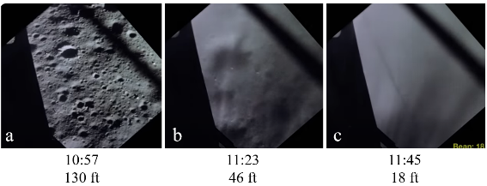
Apollo 12

Slide 22
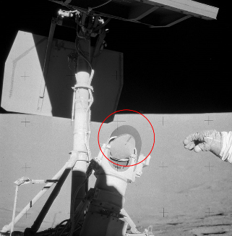
155 m away!
Apollo 12

Slide 23
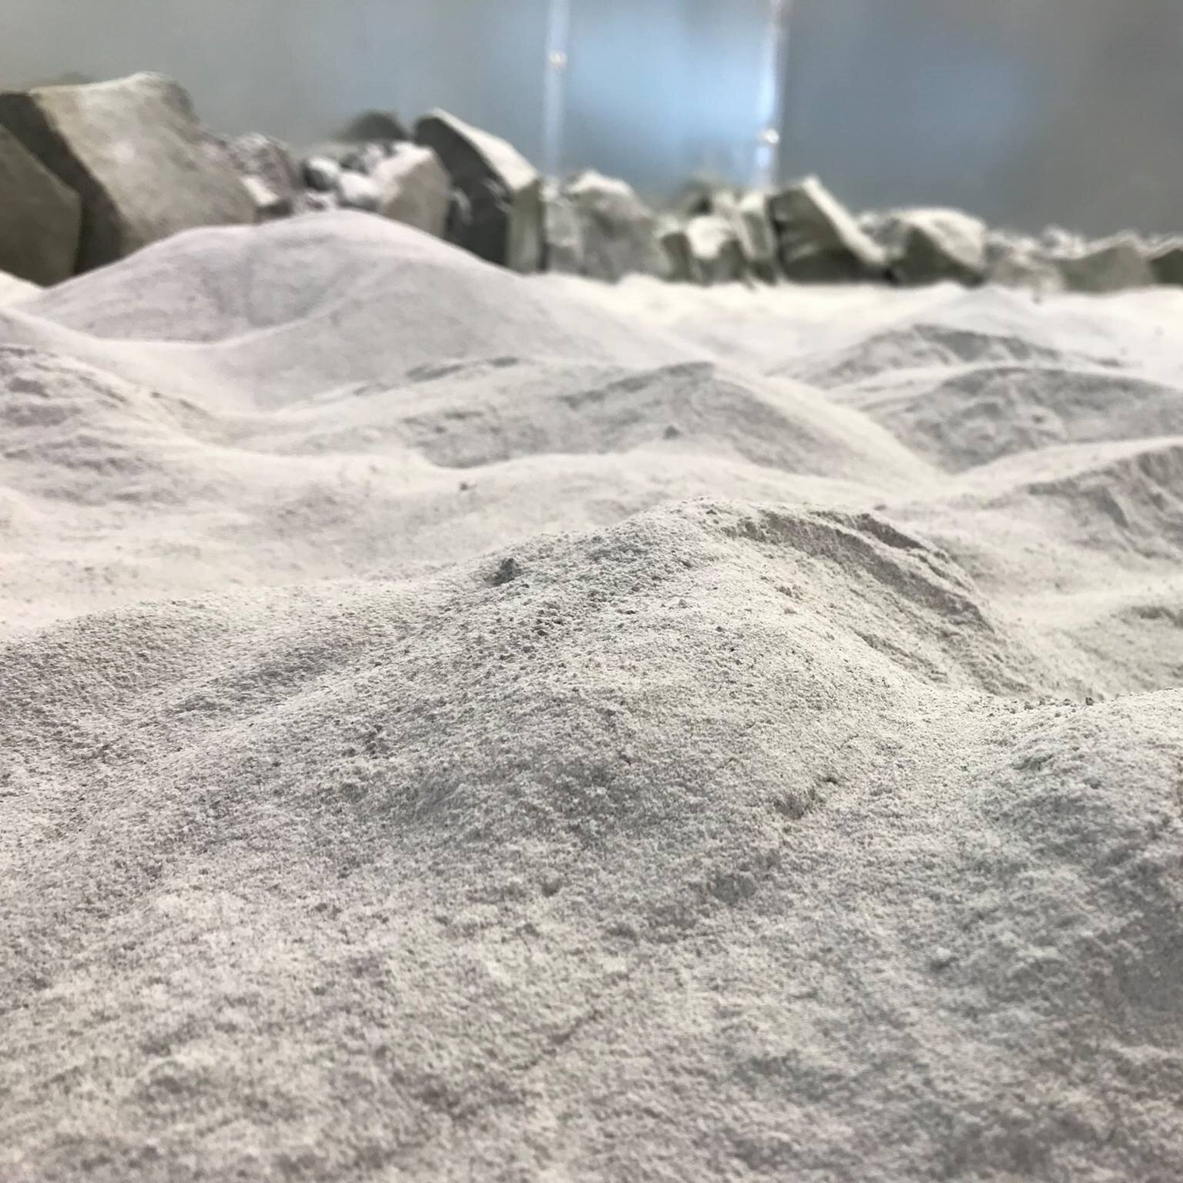
Lunar architecture
Using “native” materials
Simulant helps test equipment!
3D printing??
Launch/landing pads wear and tear...
Different types of buildings?

Slide 24
Mobility advancements
Neutron Spectrometer System
TRIDENT
MSolo - Camera
Near Infrared Volatiles Spec System (NIRVSS)
Mass Spec

Slide 25
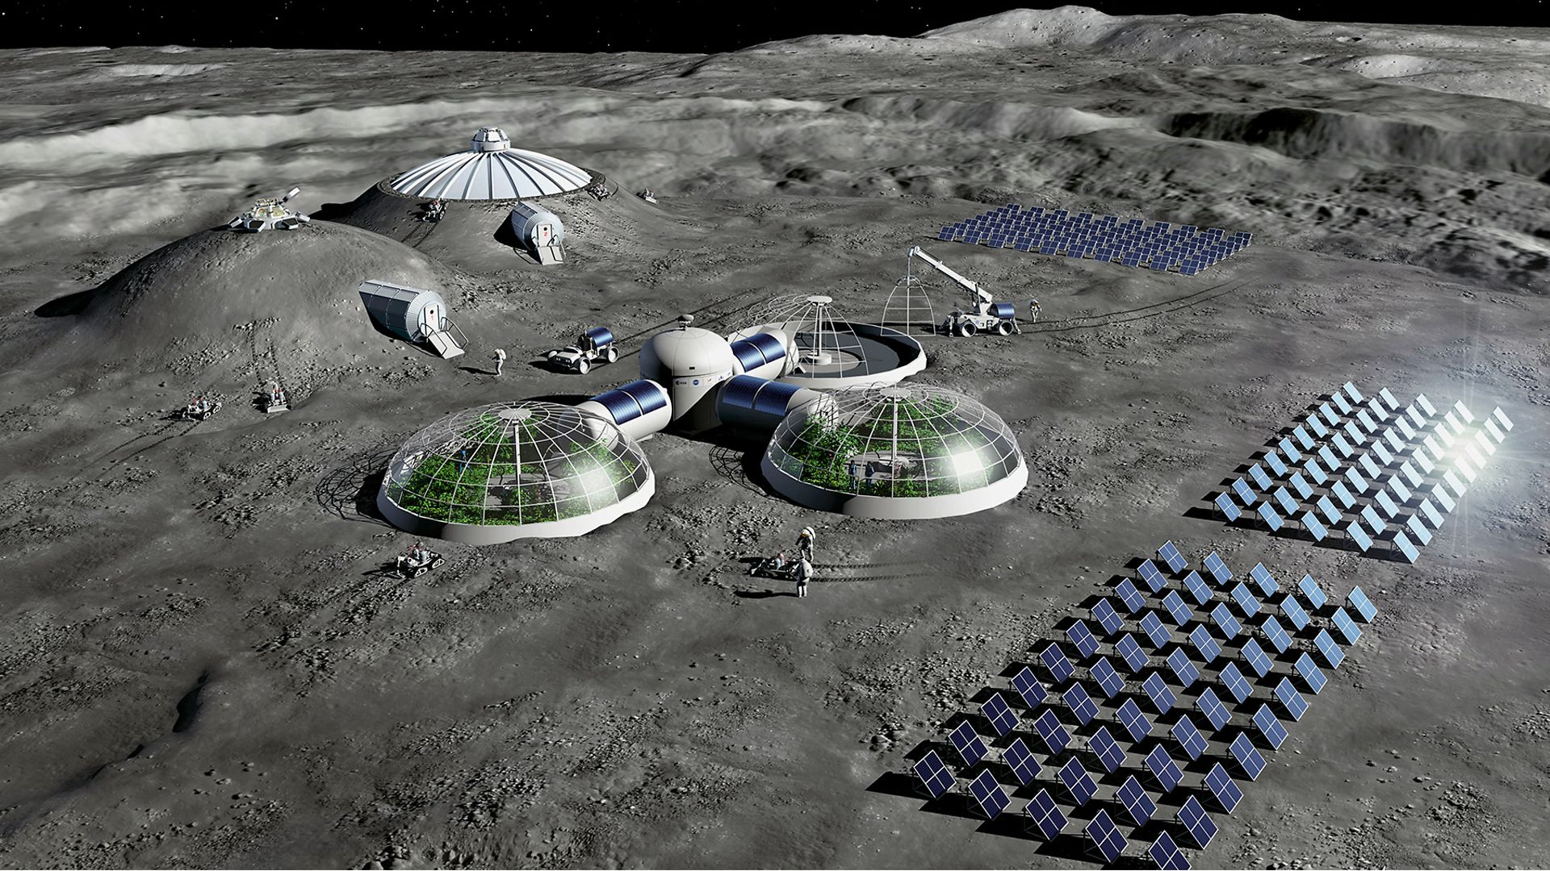
Mobility advancements
Neutron Spectrometer System
TRIDENT
MSolo - Camera
Near Infrared Volatiles Spec System (NIRVSS)
Mass Spec

Slide 26
What does “sustainability” mean?

Slide 27
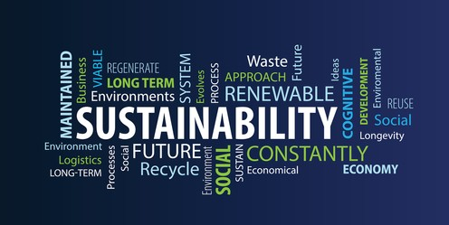
“Sustainability”

Slide 28
“Sustainability”

Slide 29
“Sustainability”

Slide 30
“Sustainability”

Slide 31
“Sustainability”

Slide 32
Where does LGWA fit into this?
What geotechnical info can be used for gravity wave research?
How might VIPER-like instrumentation help facilitate the construction of LGWA?
Might natural and robotic – induced hazards help guide LGWA site planning and deployment?

Slide 33
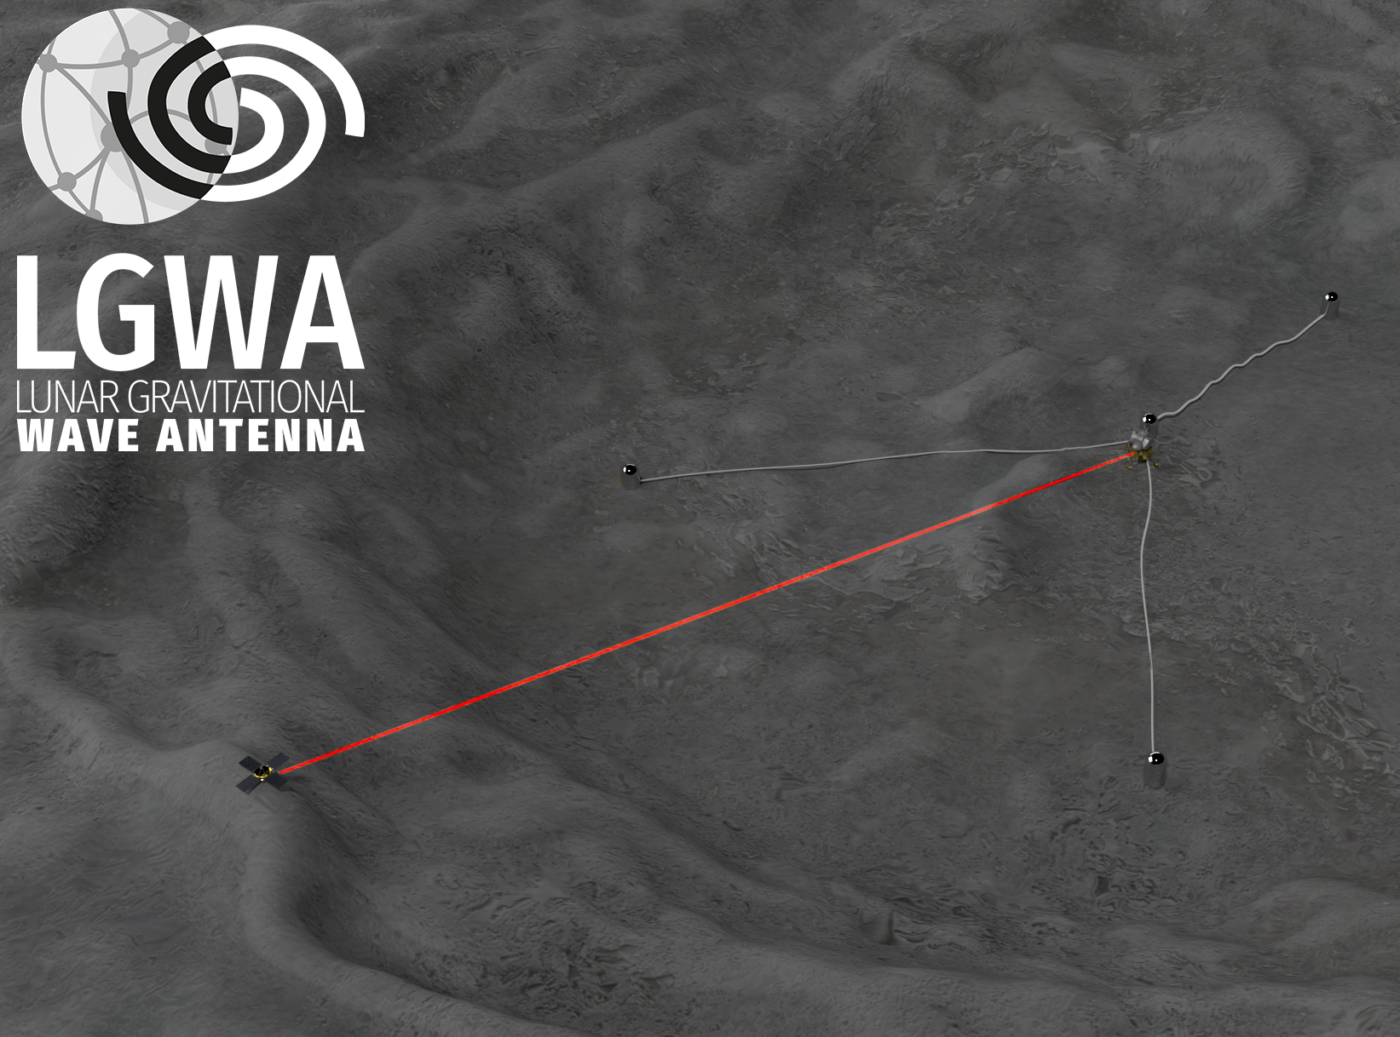

Slide 34
Human/robotic-made hazards
Need to know regolith properties for deployment
Dust electrostatics regulated/insulated
Slope hazards
Illumination of the site
Lunar seismicity hazards
Diurnal and seasonal thermal effects
Outgassing regulations from cryocoolers and heat waste management

Slide 35
Human/robotic-made hazards
Need to know regolith properties for deployment
Dust electrostatics regulated/insulated
Slope hazards
Illumination of the site
Lunar seismicity hazards
Diurnal and seasonal thermal effects
Outgassing regulations from cryocoolers and heat waste management

Slide 36
Thanks!
Grazie!
cahrens@umd.edu

