Slide 1


Gravitational counterparts of Tidal Disruption Events by IMBHs with LGWA
International Workshop
Lunar Gravitational Wave Antenna 2025
San Benedetto del Tronto, 15 - 19 September 2025
Elisabeth – A. Keppler
SISSA (Trieste)
ekeppler@sissa.it

Slide 2
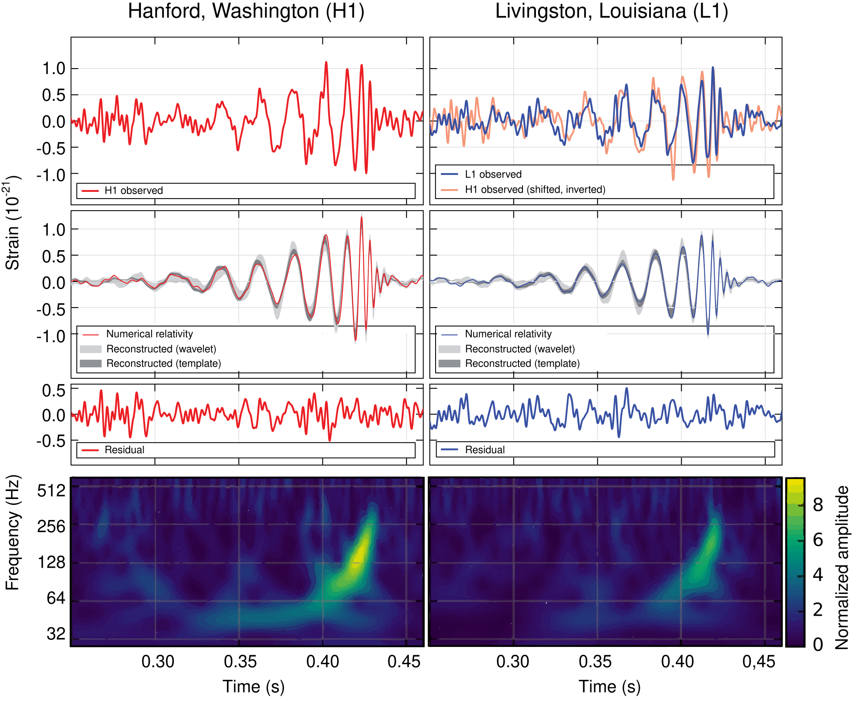
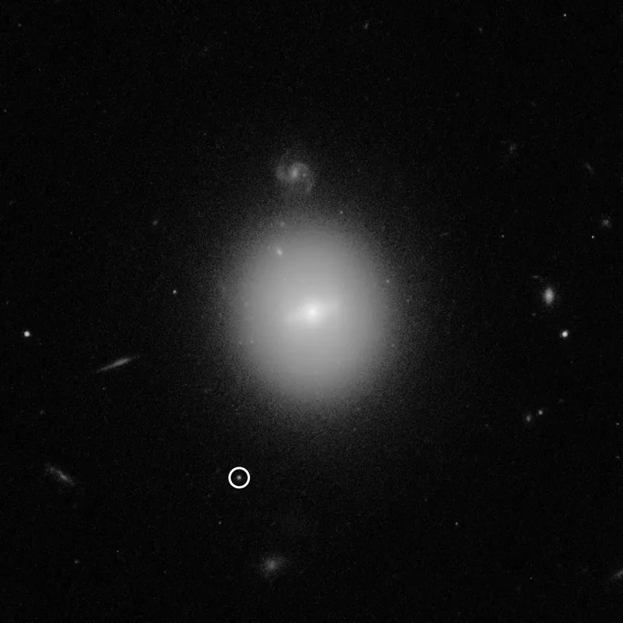
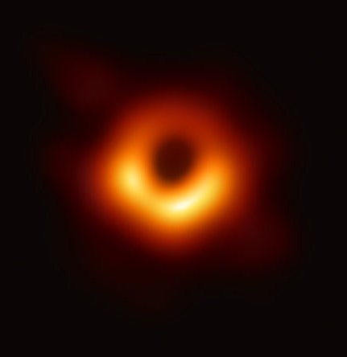
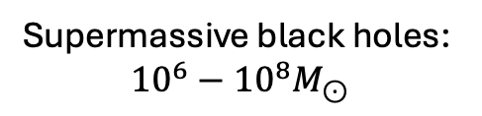
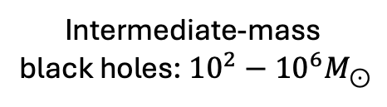

BH classification
NASA, ESA and D. Lin (Univ. of New Hampshire)
EHT Collaboration
  Abbott+16
Intermediate-mass
black holes: ${10}^{2}−{10}^{6}M_{⊙}$
Supermassive black holes:
$${10}^{6}−{10}^{8}M_{⊙}$$
Stellar-mass black holes: $4−{10}^{2}M_{⊙}$

Slide 3
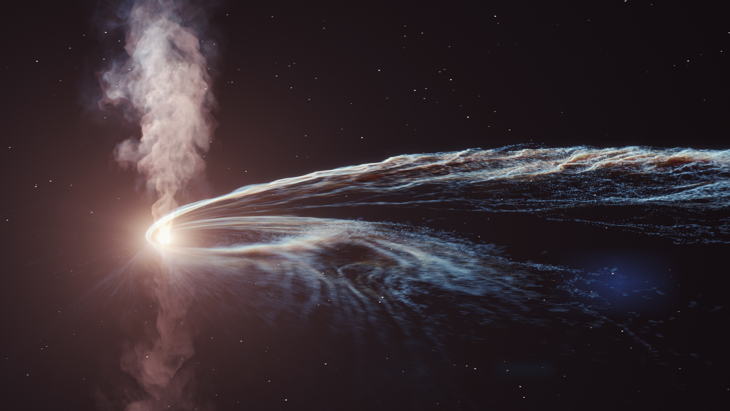
What are TDEs?
TDEs (Tidal Disruption Events) are astrophysical transients that occur when a star orbits sufficiently close to a Black Hole (BH), resulting in the star being torn apart by the tidal forces of the BH.
Credit: DESY Science Communication Lab
Notes:
La variabilità è grandissima…

Slide 4
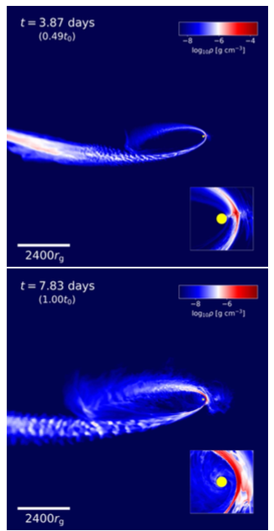
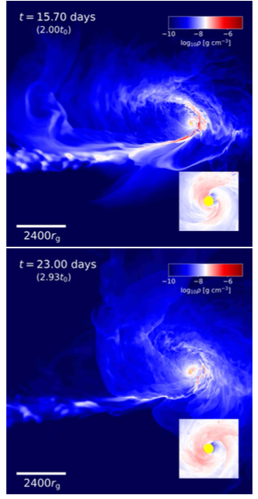
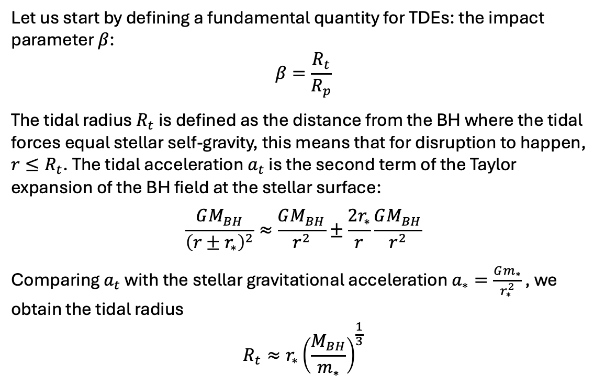
Impact parameter and tidal radius
Let us start by defining a fundamental quantity for TDEs: the impact parameter $β$:
$$β=\frac{R_{t}}{R_{p}}$$
The tidal radius $R_{t}$ is defined as the distance from the BH where the tidal forces equal stellar self-gravity, this means that for disruption to happen, $r≤R_{t}$. The tidal acceleration $a_{t}$ is the second term of the Taylor expansion of the BH field at the stellar surface:
$$\frac{GM_{BH}}{{\left(r±r_{∗}\right)}^{2}}≈\frac{GM_{BH}}{r^{2}}±\frac{2r_{∗}}{r}\frac{GM_{BH}}{r^{2}}$$
Comparing $a_{t}$ with the stellar gravitational acceleration $a_{∗}=\frac{Gm_{∗}}{r_{∗}^{2}}$ , we obtain the tidal radius
$$R_{t}≈r_{∗}{\left(\frac{M_{BH}}{m_{∗}}\right)}^{\frac{1}{3}}$$
Ryu+23
Notes:
Minimo valore per avere TD: beta Maggiore di 1. più è grande beta, più è forte la disgregazione. Esiste un massimo, che avviene quando la stella incorre in direct plunge (caduta senza disgregazione)

Slide 5
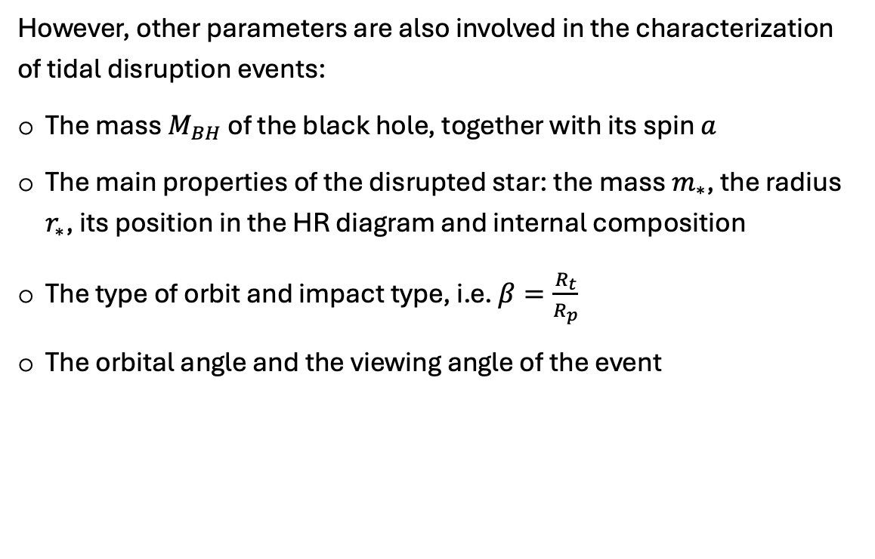
How do we characterize a TDE?
However, other parameters are also involved in the characterization of tidal disruption events:
The mass $M_{BH}$ of the black hole, together with its spin $a$
The main properties of the disrupted star: the mass $m_{∗}$, the radius $r_{∗}$, its position in the HR diagram and internal composition
The type of orbit and impact type, i.e. $β=\frac{R_{t}}{R_{p}}$
The orbital angle and the viewing angle of the event
Ryu+23

Slide 6
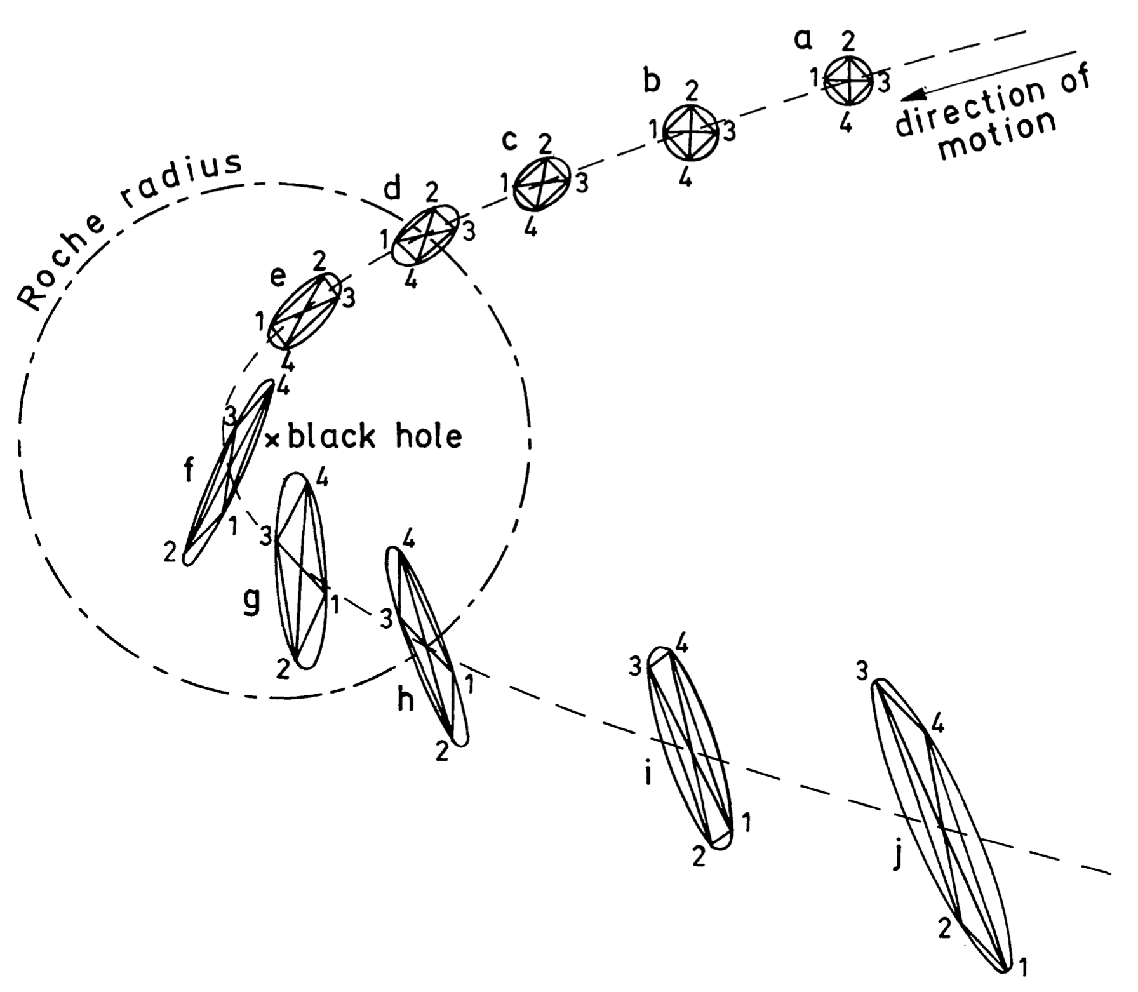
Semi-analytical models
One of the first analytical models of TDEs is the affine star model, first presented by Carter-Luminet in 1983. In a parabolic approximation of the stellar orbit, the following phases are identified:
Approximate equilibrium
The free-fall regime
The bounce
The free rebound and ejection
Carter&Luminet, 1986

Slide 7
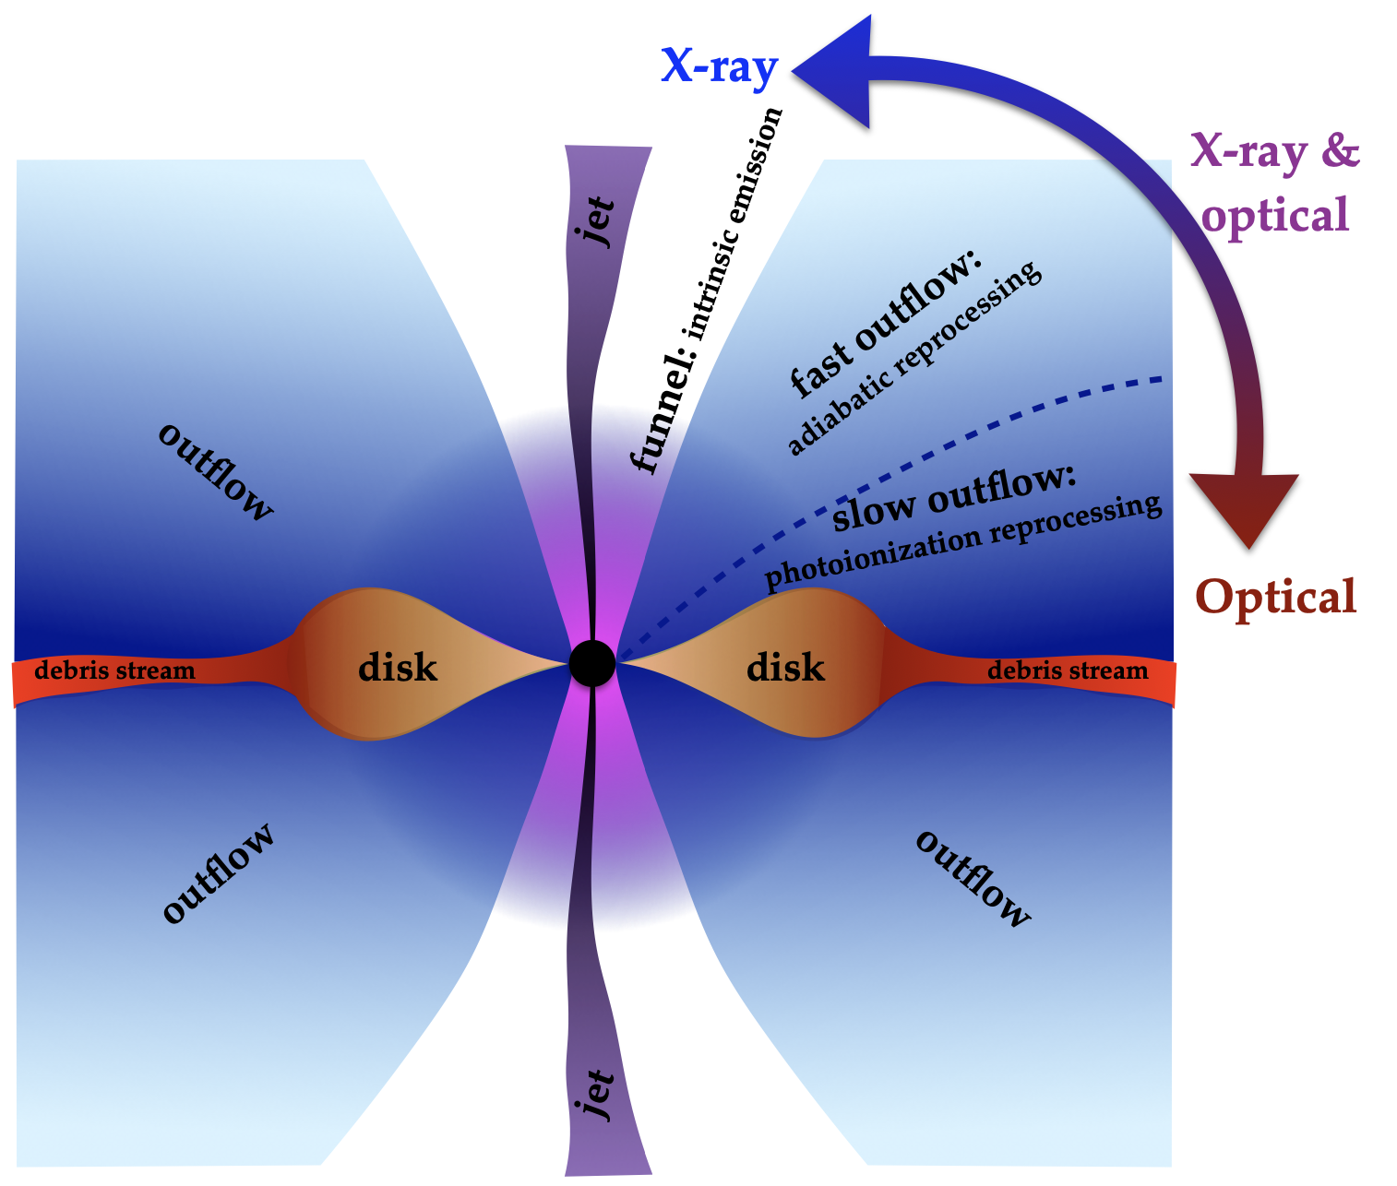
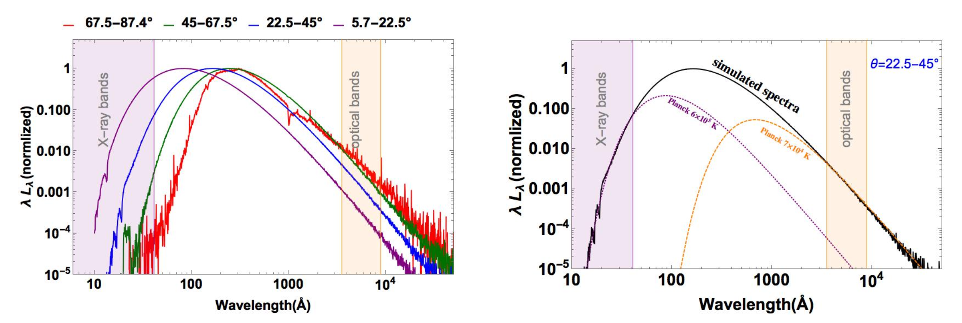
Electromagnetic emission models of TDEs
The results of the simulation (3D GRMHD code with radiative transfer setup) (Dai+18) describe the different emission types that have been observed in TDEs (soft X rather than UV/optical):
  Montecarlo simulations return the spectrum type with respect to the angle of emission, which track the propagation of photons in 3D
  Depending on the angular position of the debris, we find two different reprocessing mechanisms of the radiation
  At great angles (with respect to the mid-plane), we observe a high ionization and low absorption of the radiation
  At low angles (close to the midplane), radiation is absorbed through photo-ionization and remitted as UV and optical radiation through electron recombination
  Shift in the spectrum towards the X-ray bands at increasing angle (with respect to the mid-plane)
  Dai+18
Notes:
Possiamo simulare tde! e non solo il movimento dei pacchetti individuali, come faremo in seguito per le controparti gravitazionali, ma anche Montecarlo

Slide 8
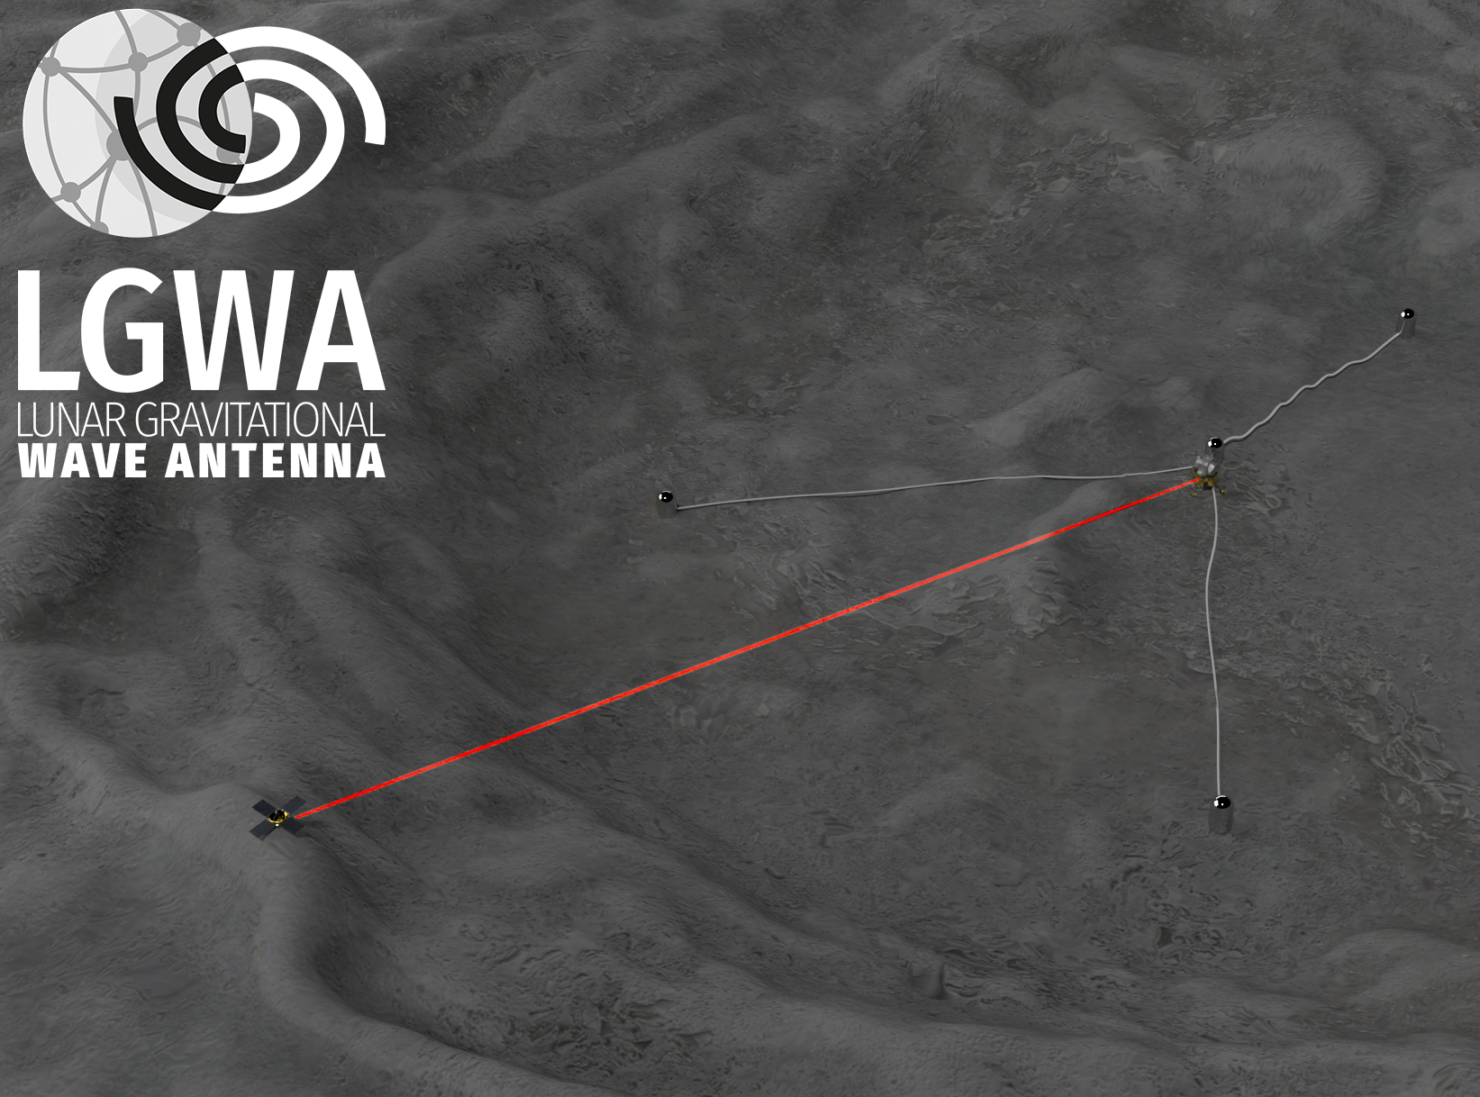
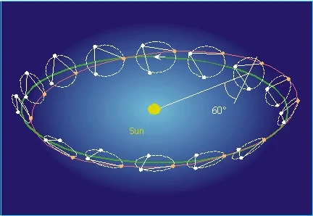
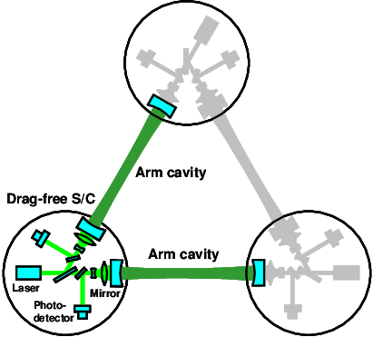
Space-based GW detectors
LGWA
ESA
Kawamura+06
LGWA crater representation
LISA orbit representation
DECIGO detector setup

Slide 9
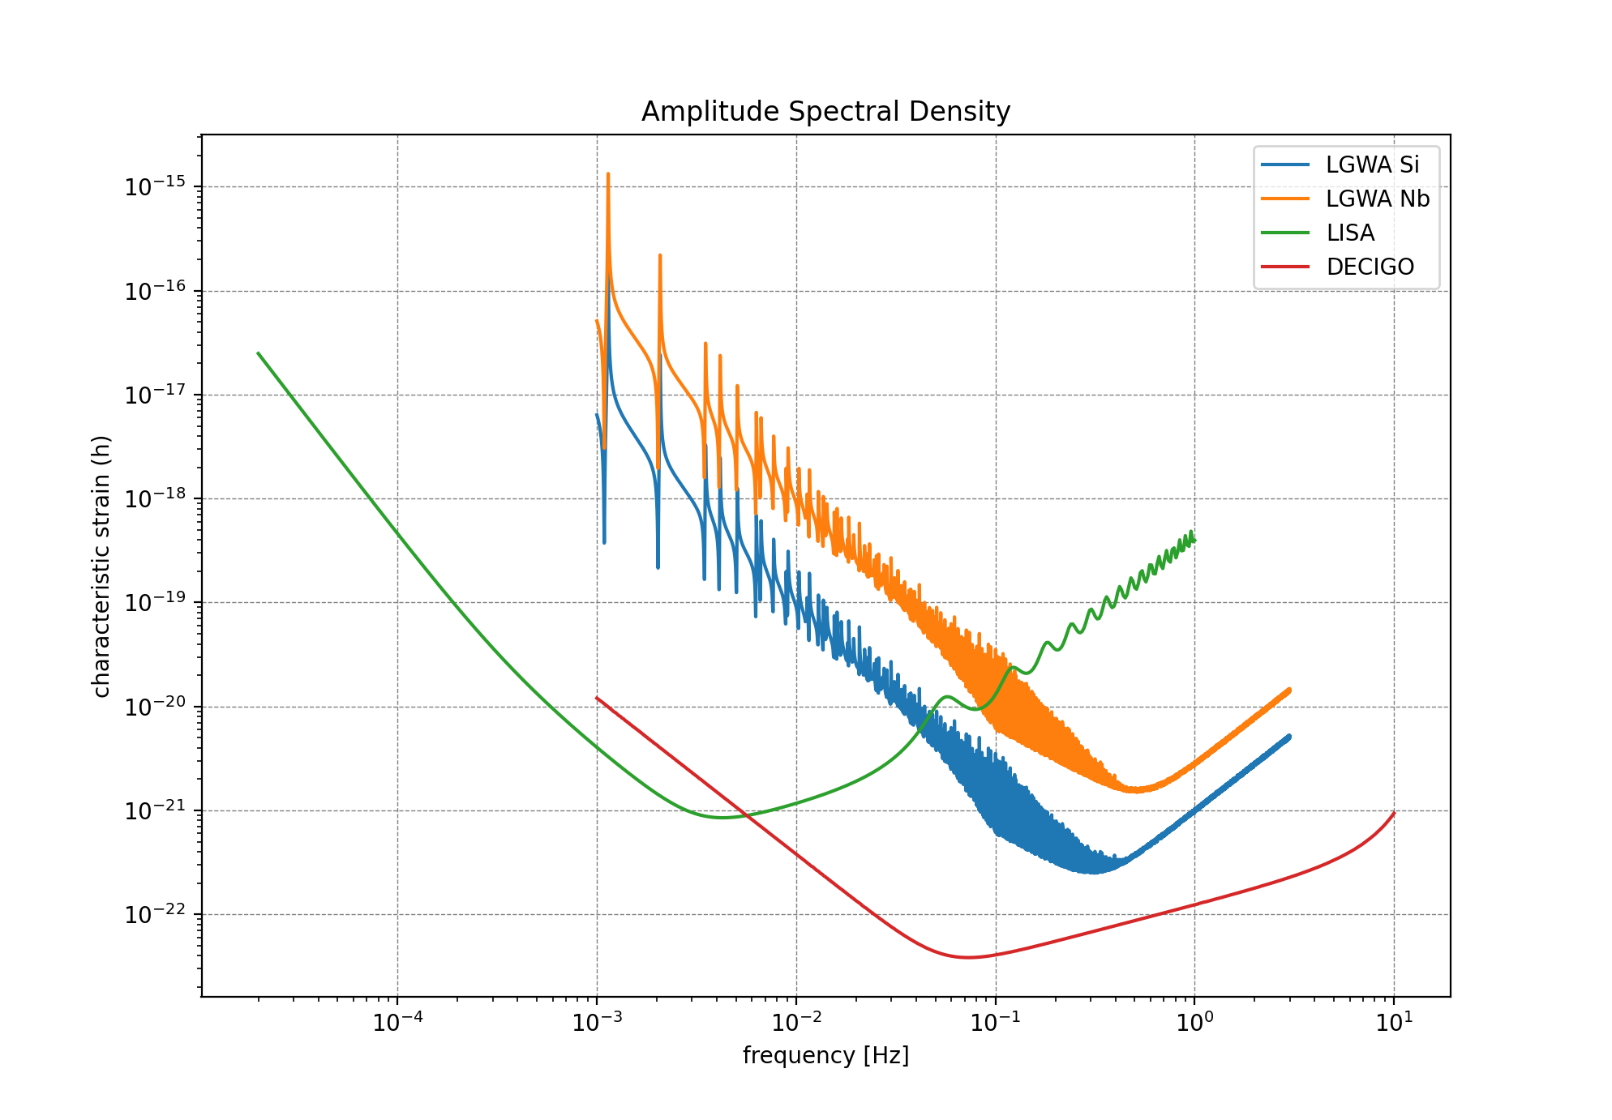
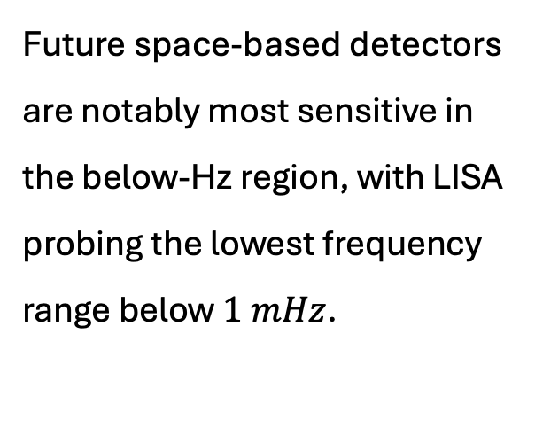
Space-based GW detectors: sensitivity
Future space-based detectors are notably most sensitive in the below-Hz region, with LISA probing the lowest frequency range below $1 mHz$.

Slide 10
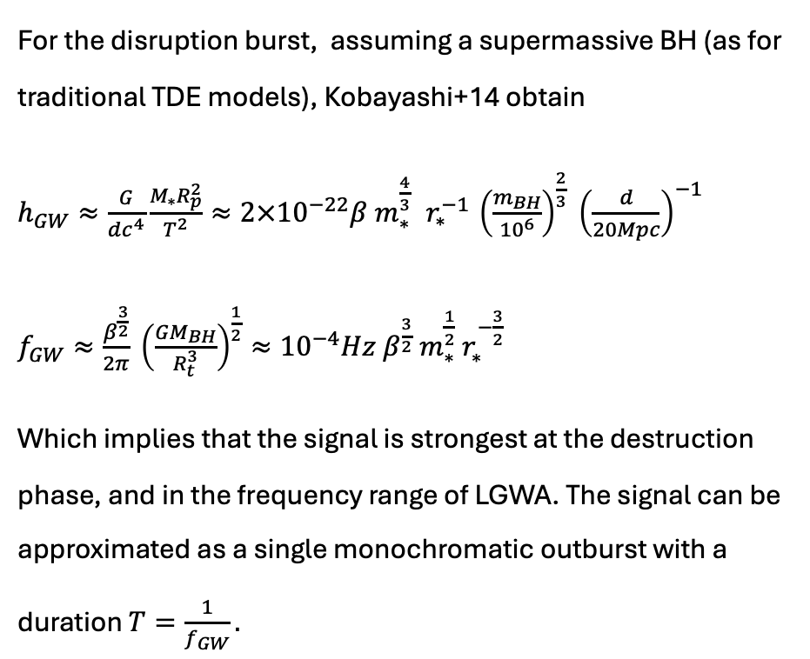
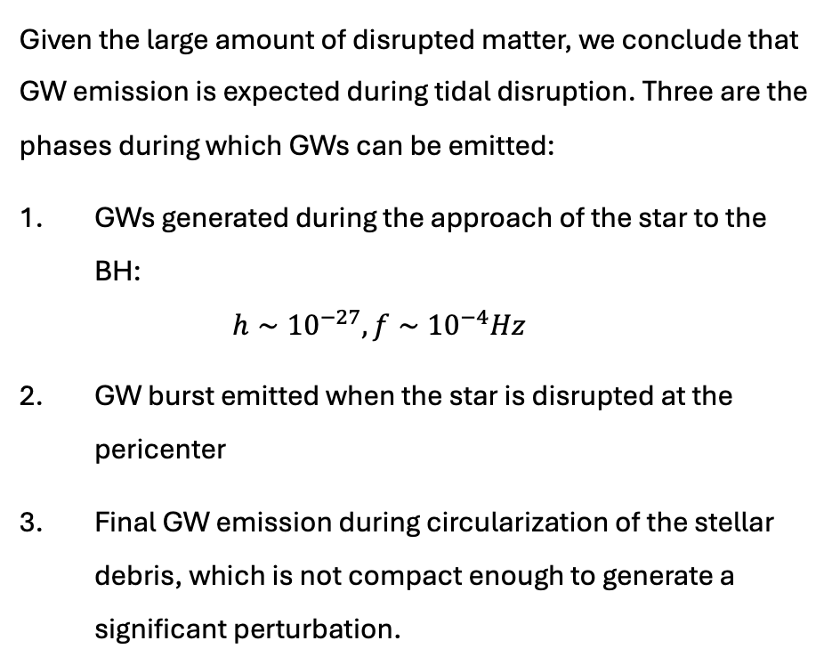
Analytical approach of GW counterparts of TDEs
Given the large amount of disrupted matter, we conclude that GW emission is expected during tidal disruption. Three are the phases during which GWs can be emitted:
GWs generated during the approach of the star to the BH:
$h∼{10}^{−27}, f∼{10}^{−4}Hz$
GW burst emitted when the star is disrupted at the pericenter
Final GW emission during circularization of the stellar debris, which is not compact enough to generate a significant perturbation.
For the disruption burst, assuming a supermassive BH (as for traditional TDE models), Kobayashi+14 obtain
$h_{GW}≈\frac{G}{dc^{4}}\frac{M_{∗}R_{p}^{2}}{T^{2}}≈2×{10}^{−22}β m_{∗}^{\frac{4}{3}} { r}_{∗}^{−1} {\left(\frac{m_{BH}}{{10}^{6}}\right)}^{\frac{2}{3}} {\left(\frac{d}{20Mpc}\right)}^{−1}$
$f_{GW}≈\frac{β^{\frac{3}{2}}}{2π} {\left(\frac{GM_{BH}}{R_{t}^{3}}\right)}^{\frac{1}{2}}≈{10}^{−4}Hz β^{\frac{3}{2}} m_{∗}^{\frac{1}{2}} r_{∗}^{−\frac{3}{2}}$
Which implies that the signal is strongest at the destruction phase, and in the frequency range of LGWA. The signal can be approximated as a single monochromatic outburst with a duration $T=\frac{1}{f_{GW}}.$

Slide 11
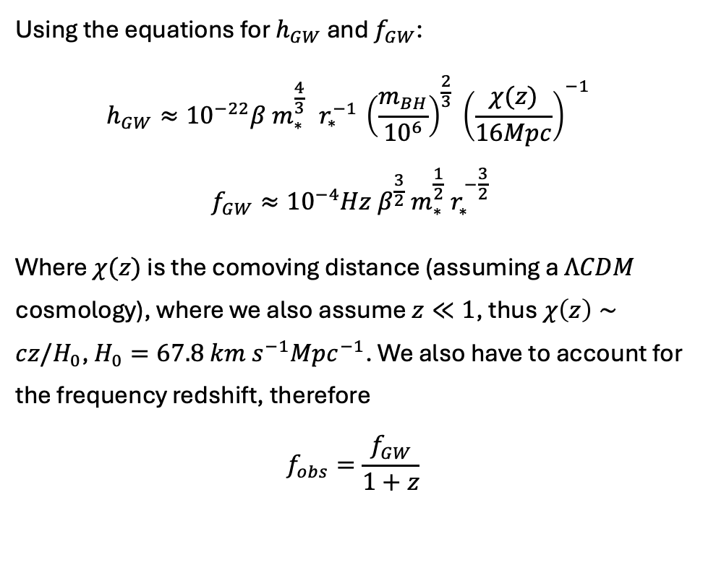
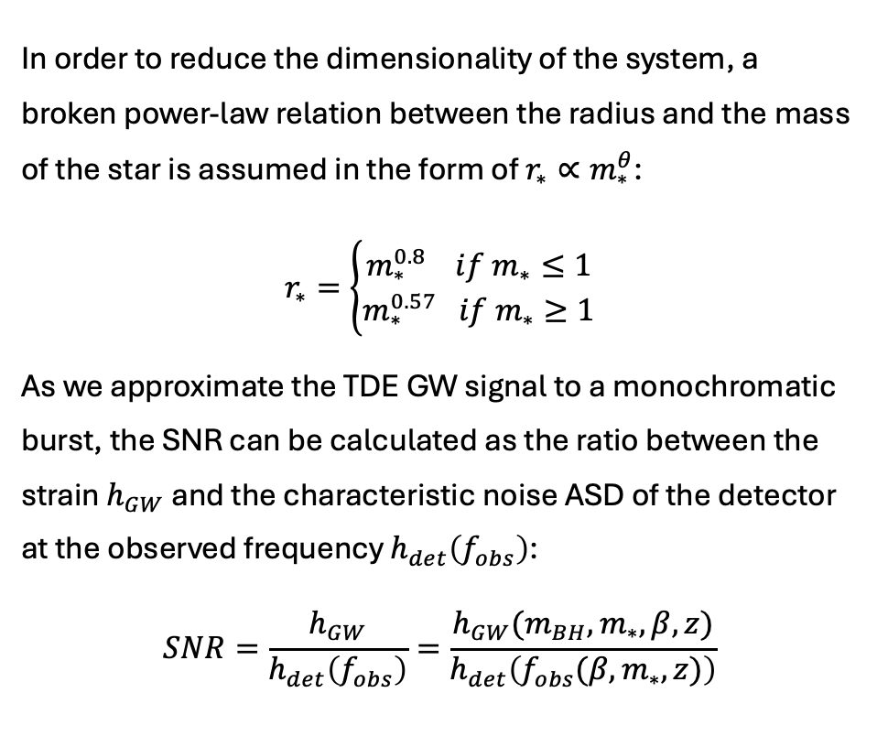
Signal-to-Noise Ratio
Using the equations for $h_{GW}$ and $f_{GW}$:
$$h_{GW}≈{10}^{−22}β m_{∗}^{\frac{4}{3}} { r}_{∗}^{−1} {\left(\frac{m_{BH}}{{10}^{6}}\right)}^{\frac{2}{3}} {\left(\frac{χ(z)}{16Mpc}\right)}^{−1}$$
$$f_{GW}≈{10}^{−4}Hz β^{\frac{3}{2}} m_{∗}^{\frac{1}{2}} r_{∗}^{−\frac{3}{2}}$$
Where $χ(z)$ is the comoving distance (assuming a $ΛCDM$ cosmology), where we also assume $z≪1$, thus $χ\left(z\right)∼cz/H_{0}$, $H_{0}=67.8 km s^{−1}Mpc^{−1}$. We also have to account for the frequency redshift, therefore
$$f_{obs}=\frac{f_{GW}}{1+z}$$
In order to reduce the dimensionality of the system, a broken power-law relation between the radius and the mass of the star is assumed in the form of $r_{∗}∝m_{∗}^{θ}$:
$$r_{∗}=\left\{\begin{aligned}m_{∗}^{0.8} if m_{∗}≤1 \\ m_{∗}^{0.57} if m_{∗}≥1\end{aligned}\right.$$
As we approximate the TDE GW signal to a monochromatic burst, the SNR can be calculated as the ratio between the strain $h_{GW}$ and the characteristic noise ASD of the detector at the observed frequency $h_{det}\left(f_{obs}\right)$:
$$SNR=\frac{h_{GW}}{h_{det}\left(f_{obs}\right)}=\frac{h_{GW}(m_{BH},m_{∗},β,z)}{h_{det}\left(f_{obs}(β, m_{∗},z)\right)}$$
Notes:
A voce solo SNR.
Come primo attempt lo facciamo solo analitico, anche se ci rendiamo conto che questa descrizione ha poche equazioni e molte variabili, dunque il sistema è degenere. Ciononostante è utile come primo approccio

Slide 12
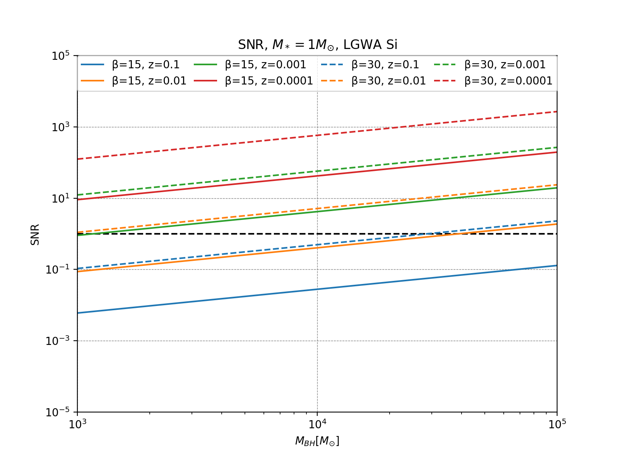
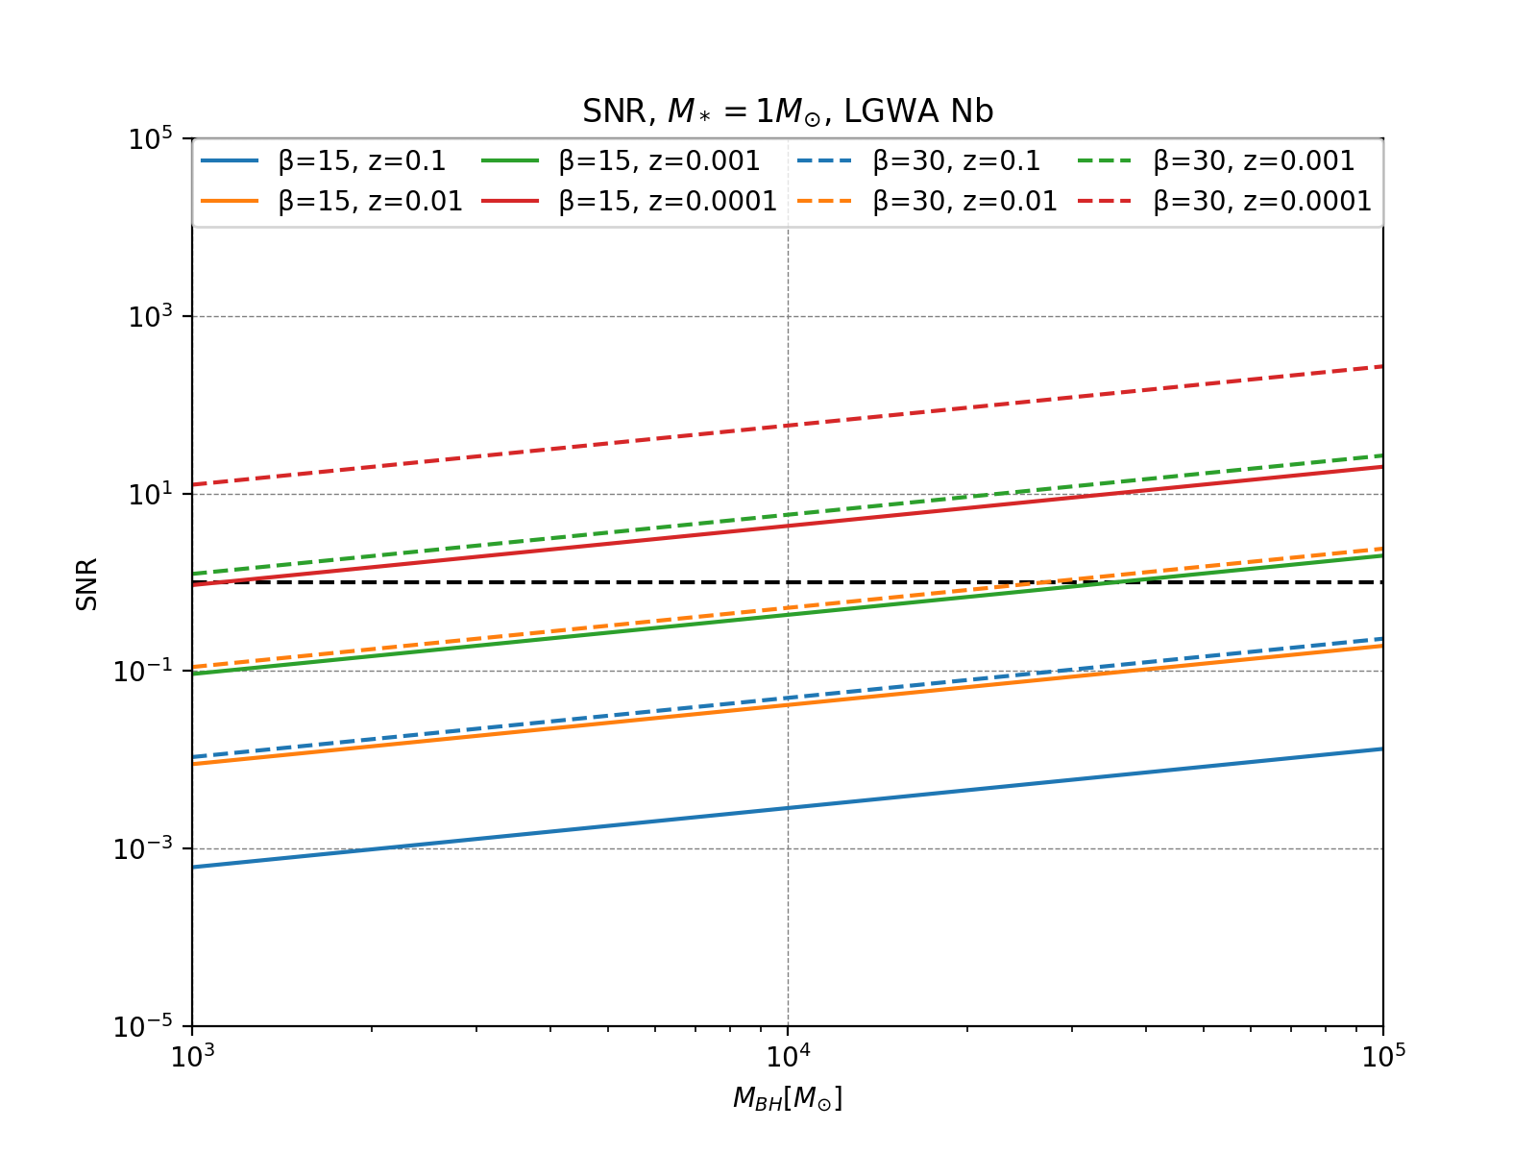
Analytical SNR estimate (M_{BH})
Analytical estimate of the SNR of all the detectors considered, in order LGWA Si and LGWA Nb. $m_{∗}=1 M_{⊙}$ is fixed, while different values of $β$ and $z$ are represented in color and line style. On the x-axis we find $M_{BH}$.

Slide 13
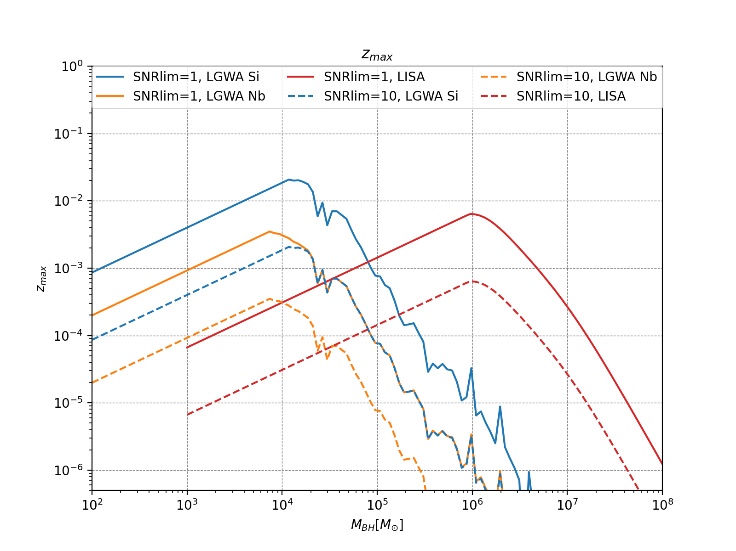
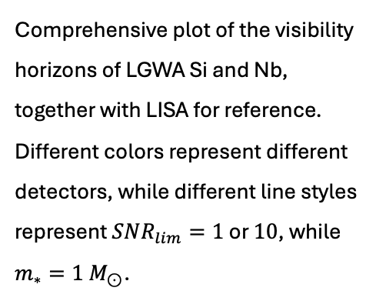
Visibility horizons
Comprehensive plot of the visibility horizons of LGWA Si and Nb, together with LISA for reference. Different colors represent different detectors, while different line styles represent $SNR_{lim}=1$ or $10$, while $m_{∗}=1 M_{⊙}$.
Notes:
Complementarietà LISA+LGWA (non competitor ma alternativi)

Slide 14
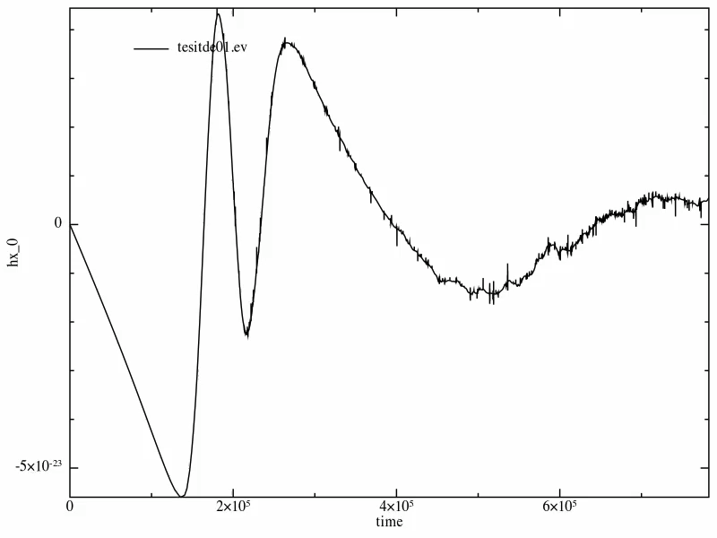
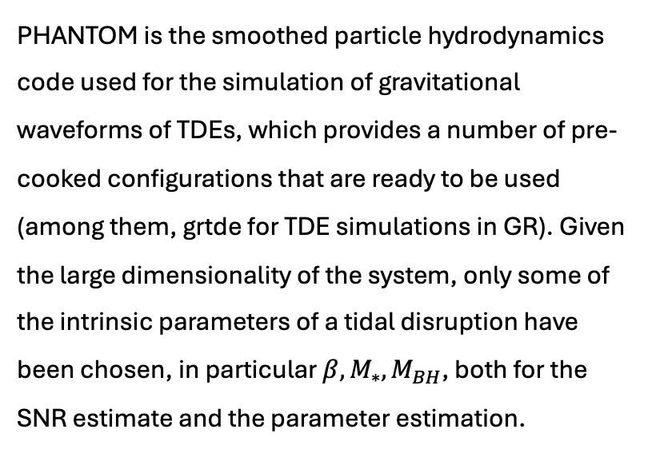
Numerical waveform simulations
PHANTOM is the smoothed particle hydrodynamics code used for the simulation of gravitational waveforms of TDEs, which provides a number of pre-cooked configurations that are ready to be used (among them, grtde for TDE simulations in GR). Given the large dimensionality of the system, only some of the intrinsic parameters of a tidal disruption have been chosen, in particular $β,M_{∗},M_{BH}$, both for the SNR estimate and the parameter estimation.

Slide 15
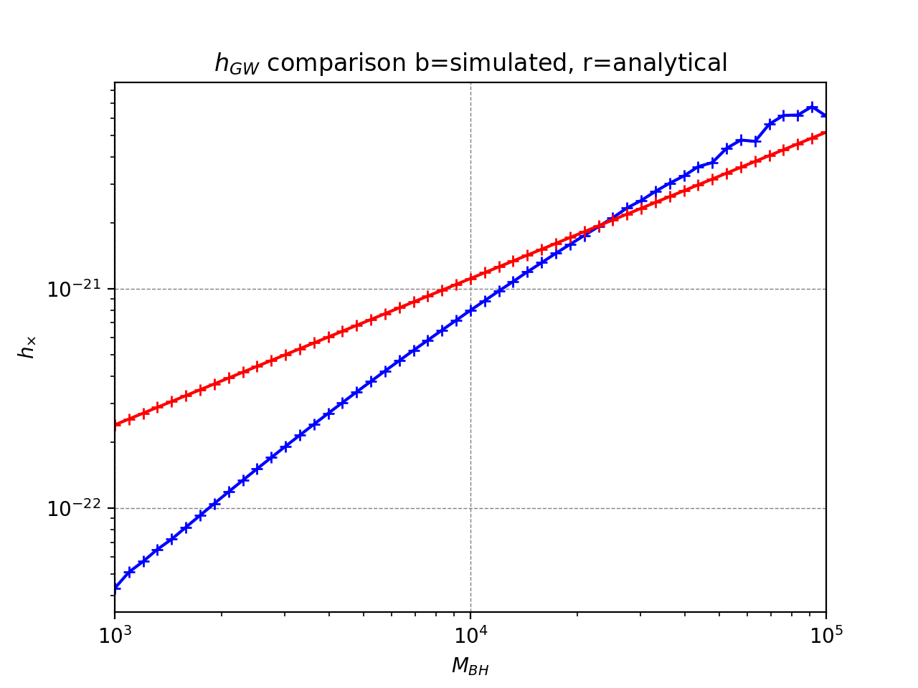
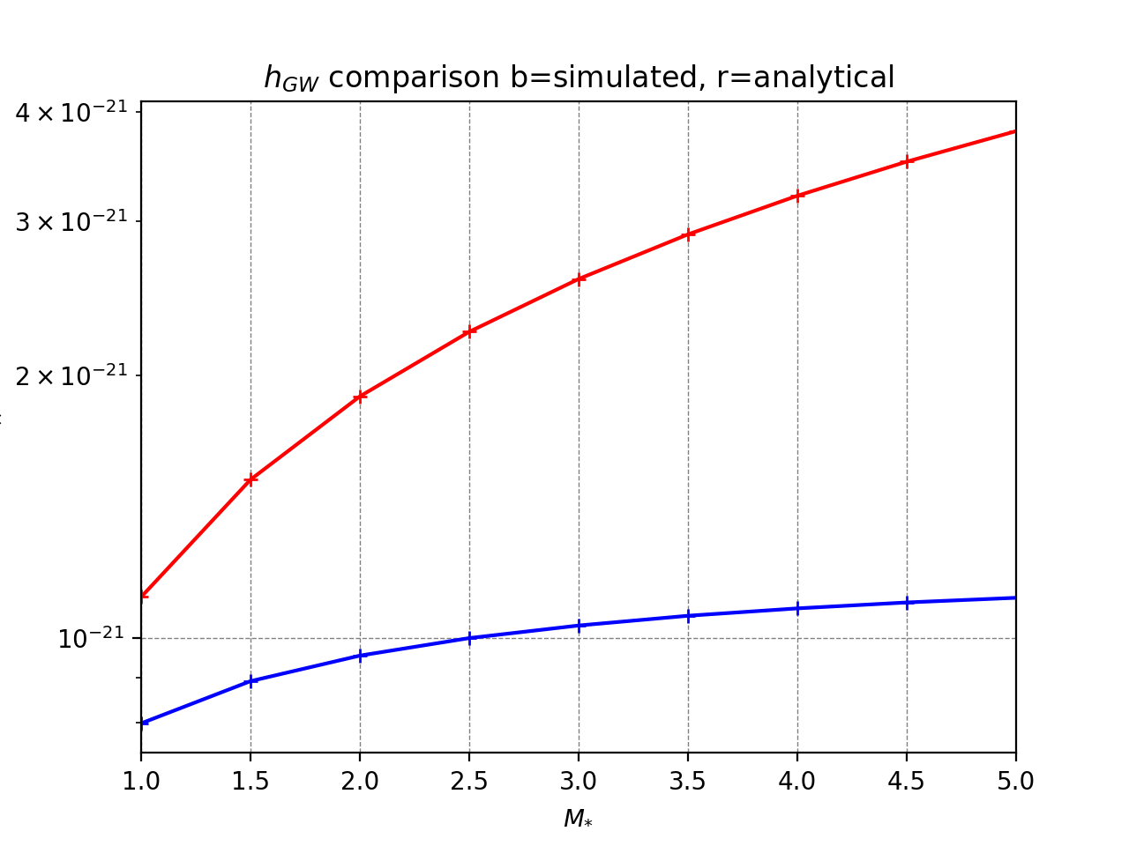
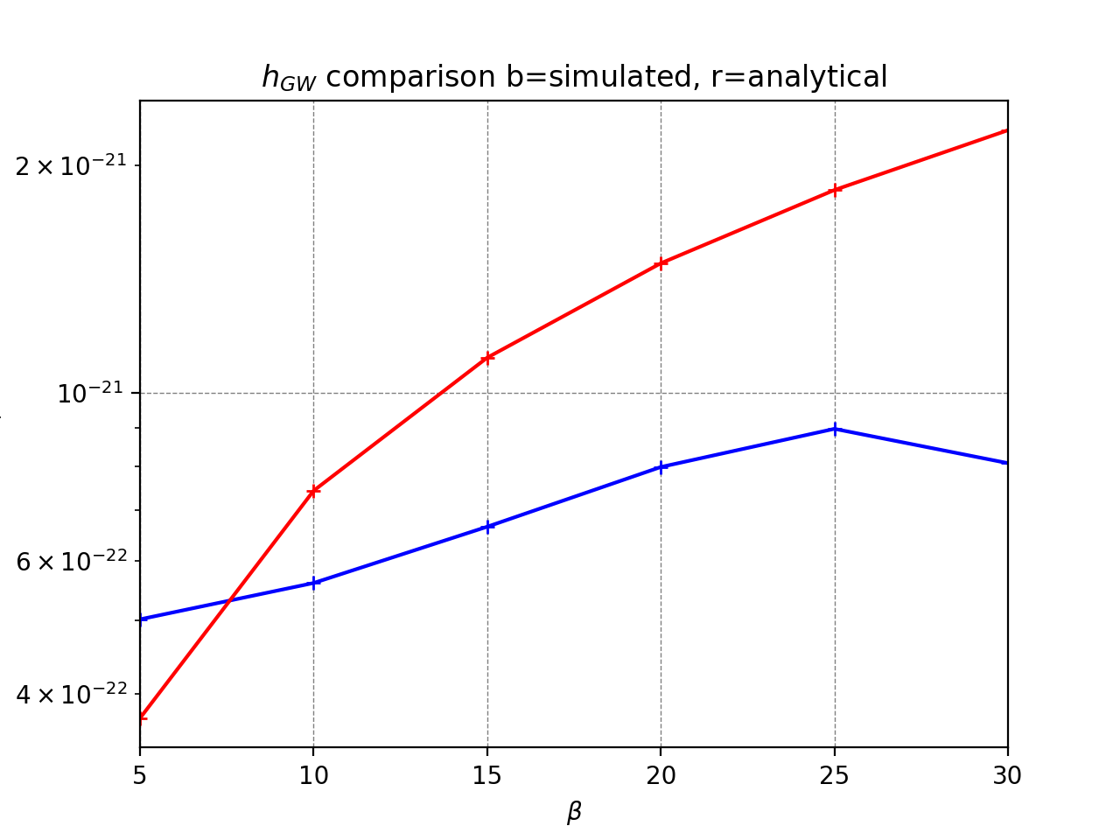
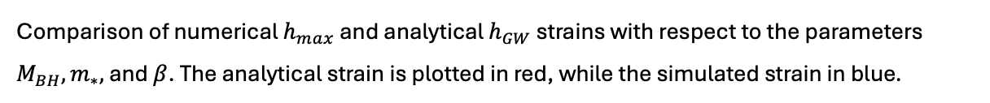
Analytical and numerical strain comparison
Comparison of numerical $h_{max}$ and analytical $h_{GW}$ strains with respect to the parameters $M_{BH},m_{∗},$ and $β$. The analytical strain is plotted in red, while the simulated strain in blue.

Slide 16
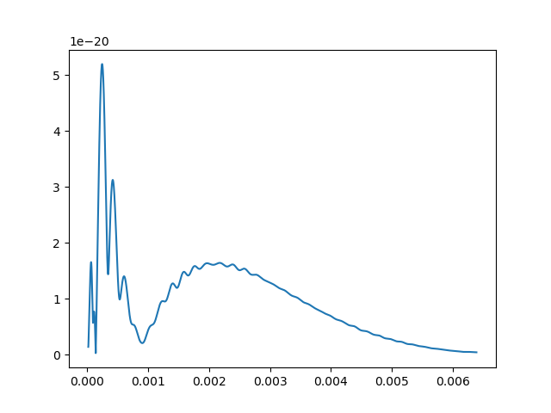

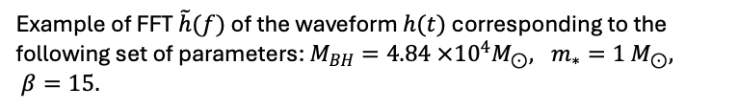

Signal-to-Noise Ratio
Given a detector output, the objective is to extract a signal: a well-known solution to this problem is matched filtering. By knowing a priori the form of the signal $\tilde{h}(f)$, the Signal-to-Noise Ratio is defined as
$$ρ^{2}=\int_{0}^{+∞}{df\frac{4{\left|\tilde{h}\left(f\right)\right|}^{2}}{S_{n}(f)}}=\left(\tilde{h}\left(f\right)|\tilde{h}\left(f\right)\right)$$
Where the Fourier transform is calculated with the Fast Fourier Transform (FFT) algorithm.
FFT of the waveform
$\tilde{h}$(f)
f
Example of FFT $\tilde{h}(f)$ of the waveform $h(t)$ corresponding to the following set of parameters: $M_{BH}=4.84 ×{10}^{4}M_{⊙}, m_{∗}=1 M_{⊙}, β=15.$

Slide 17
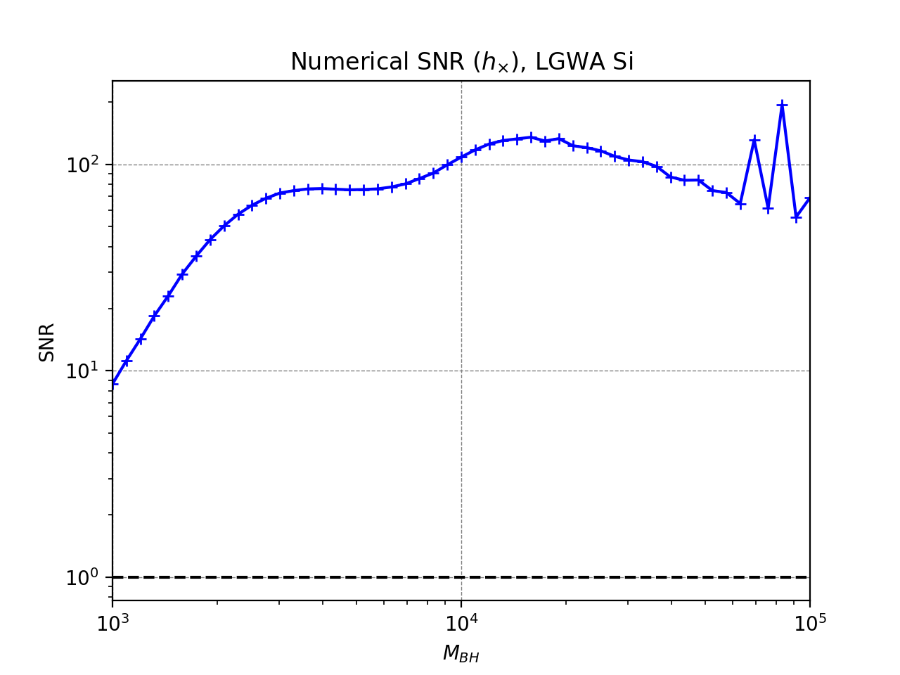
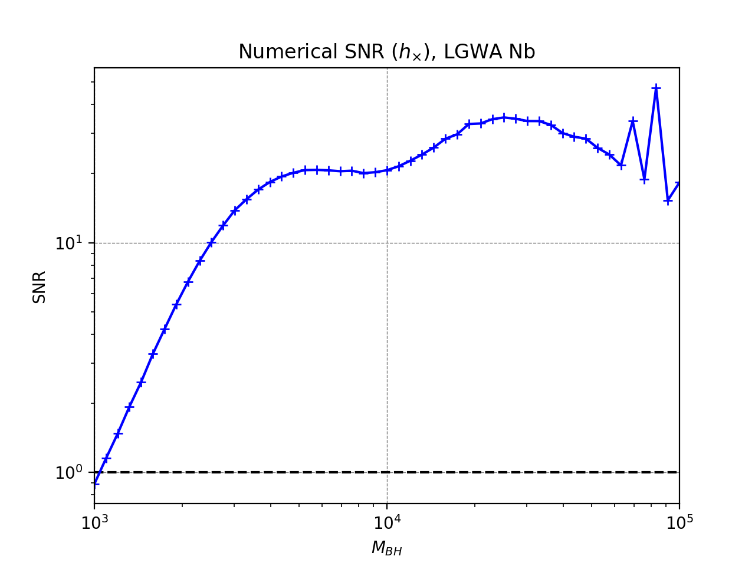
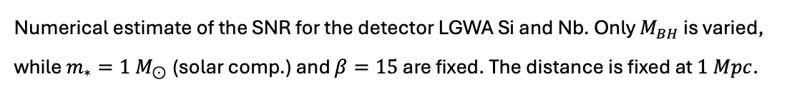
Numerical SNR estimate – LGWA
Numerical estimate of the SNR for the detector LGWA Si and Nb. Only $M_{BH}$ is varied, while $m_{∗}=1 M_{⊙}$(solar comp.) and $β=15$ are fixed. The distance is fixed at $1 Mpc$.

Slide 18
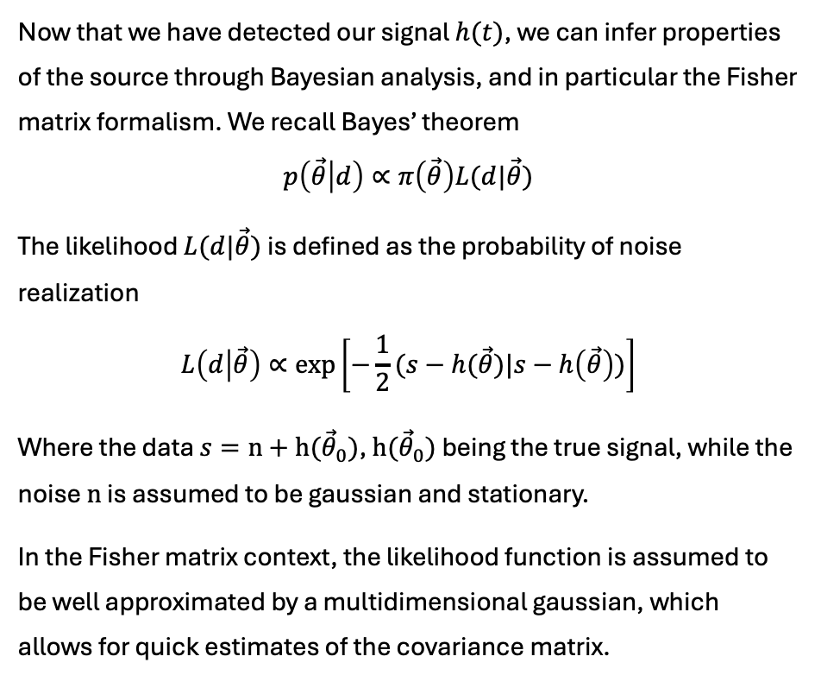
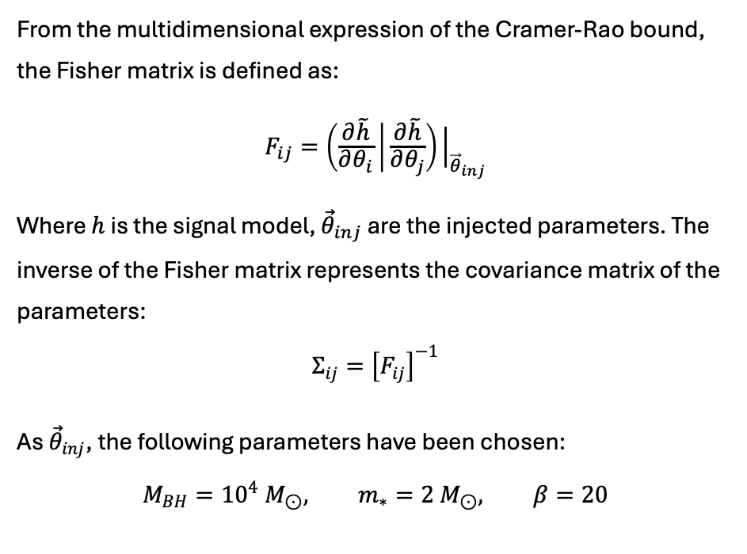
Parameter estimation
Now that we have detected our signal $h(t)$, we can infer properties of the source through Bayesian analysis, and in particular the Fisher matrix formalism. We recall Bayes’ theorem
$$p\left(\vec{θ} | d\right)∝π\left(\vec{θ}\right)L(d|\vec{θ})$$
The likelihood $L(d|\vec{θ})$ is defined as the probability of noise realization
$$L\left(d | \vec{θ}\right)∝\exp\left[−\frac{1}{2}(s−h(\vec{θ})|s−h\left(\vec{θ}\right))\right]$$
Where the data $s=n+h({\vec{θ}}_{0})$, $h({\vec{θ}}_{0})$ being the true signal, while the noise $n$ is assumed to be gaussian and stationary.
In the Fisher matrix context, the likelihood function is assumed to be well approximated by a multidimensional gaussian, which allows for quick estimates of the covariance matrix.
From the multidimensional expression of the Cramer-Rao bound, the Fisher matrix is defined as:
$$F_{ij}=\left(\frac{∂\tilde{h}}{∂θ_{i}} | \frac{∂\tilde{h}}{∂θ_{j}}\right){\left.​\right|}_{{\vec{θ}}_{inj}}$$
Where $h$ is the signal model, ${\vec{θ}}_{inj}$ are the injected parameters. The inverse of the Fisher matrix represents the covariance matrix of the parameters:
$$Σ_{ij}={\left[F_{ij}\right]}^{−1}$$
As ${\vec{θ}}_{inj}$, the following parameters have been chosen:
$$M_{BH}={10}^{4}{ M}_{⊙}, m_{∗}=2 M_{⊙}, β=20$$
Notes:
Approssimazione guassiana -> fisher

Slide 19
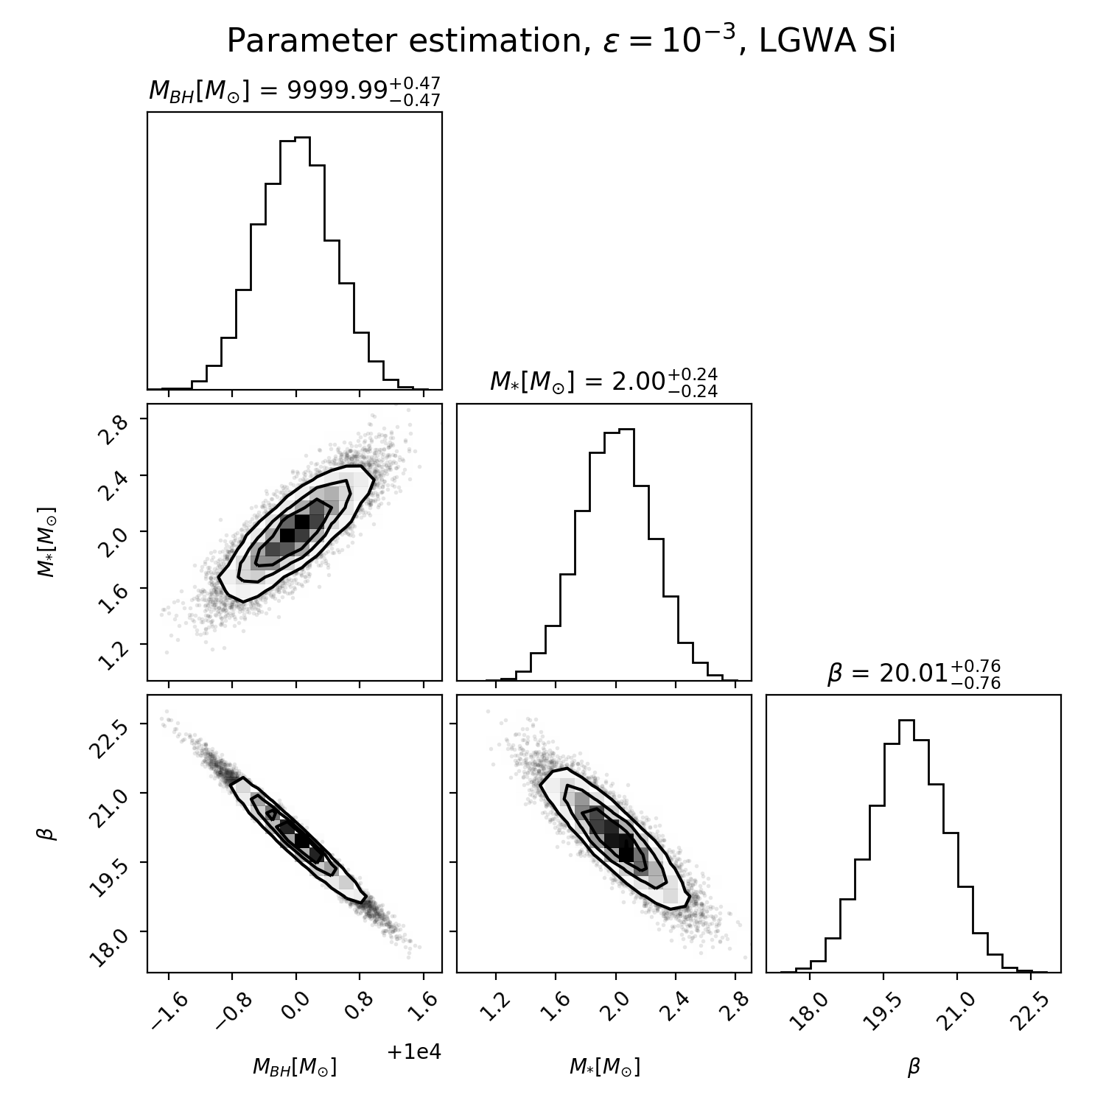
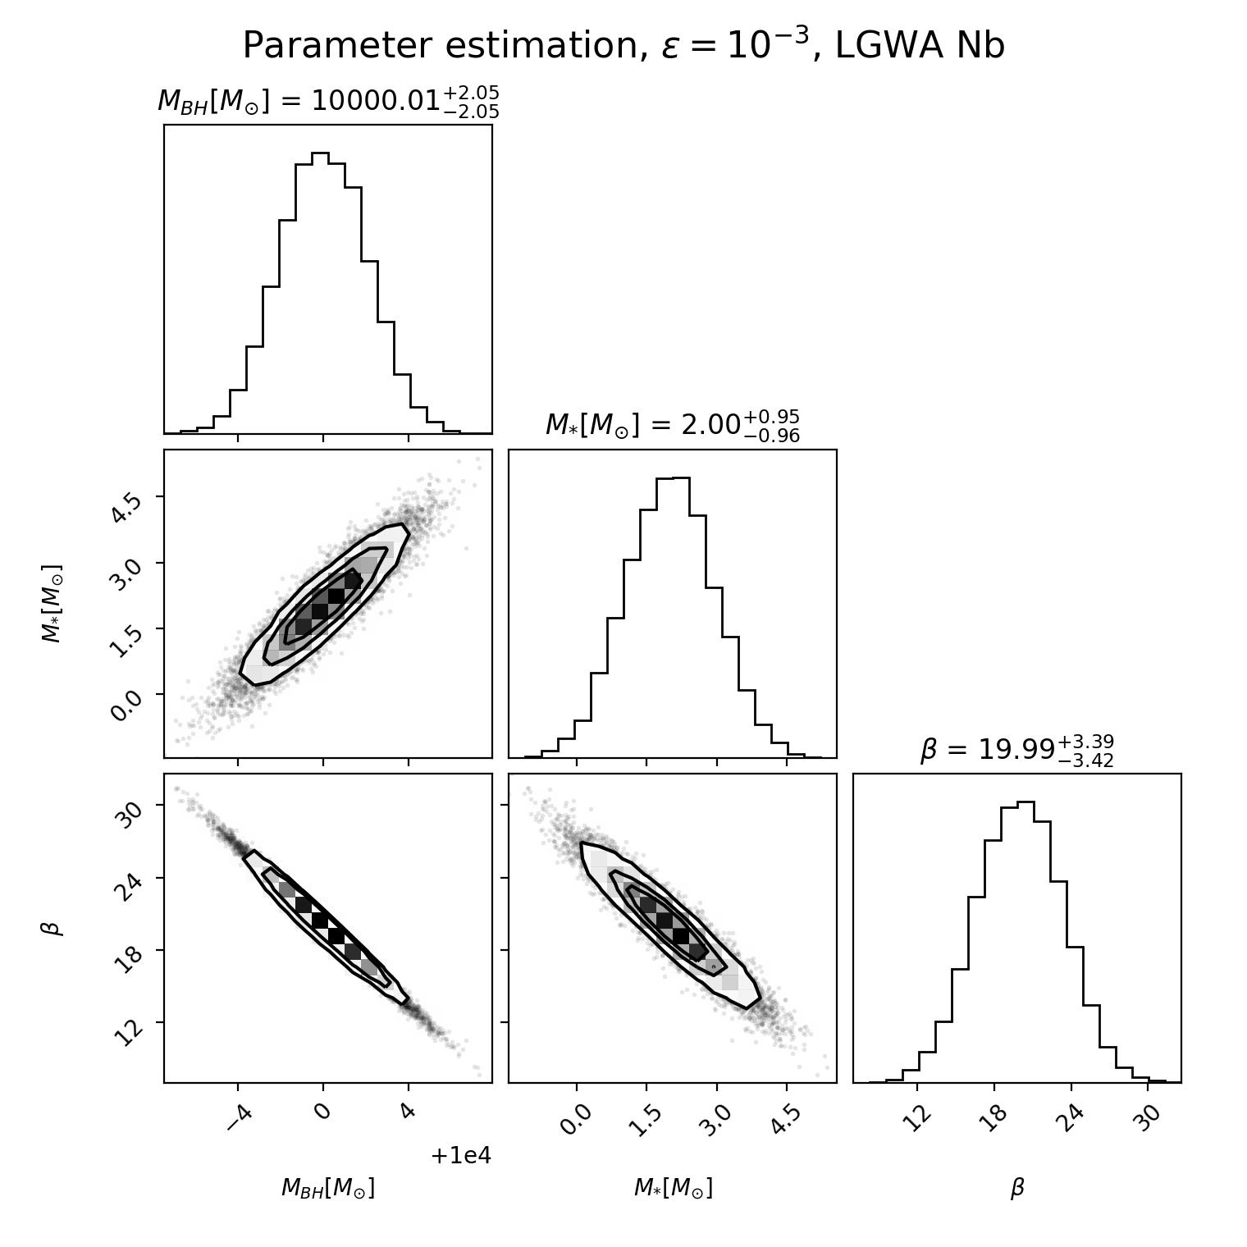
Parameter estimation
Corner plots resulting from the parameter estimation for LGWA Si and Nb.
Notes:
Final message esplorazione dello spazio dei parameteri

Slide 20
Backup slides

Slide 21
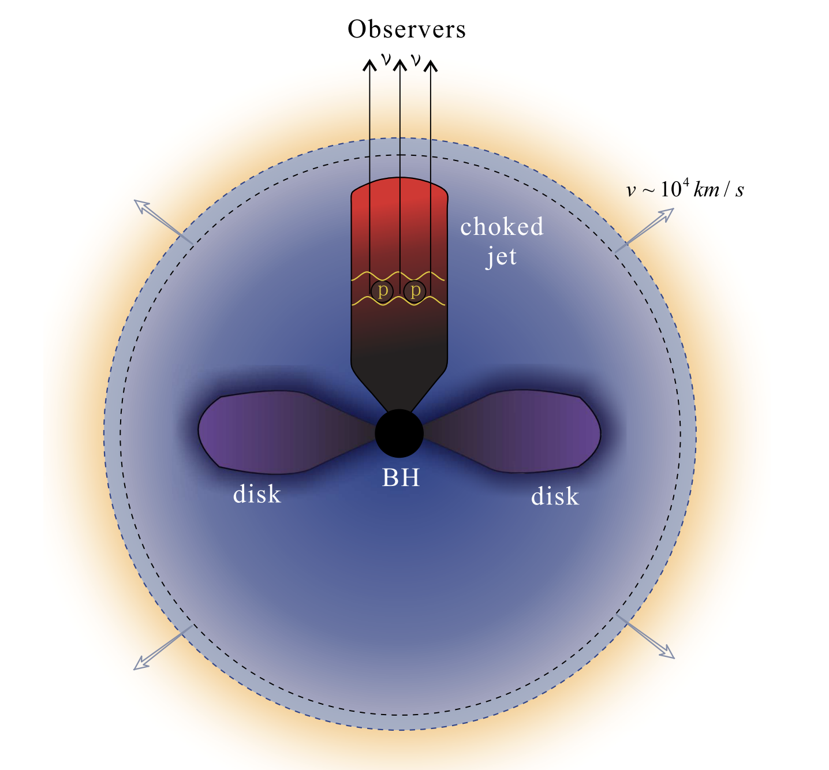
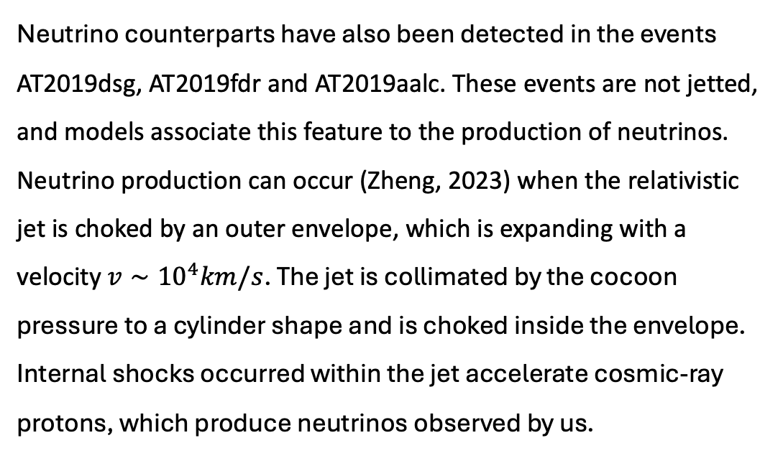
Neutrino counterparts of TDEs
Neutrino counterparts have also been detected in the events AT2019dsg, AT2019fdr and AT2019aalc. These events are not jetted, and models associate this feature to the production of neutrinos. Neutrino production can occur (Zheng, 2023) when the relativistic jet is choked by an outer envelope, which is expanding with a velocity $v∼{10}^{4}km/s$. The jet is collimated by the cocoon pressure to a cylinder shape and is choked inside the envelope. Internal shocks occurred within the jet accelerate cosmic-ray protons, which produce neutrinos observed by us.
  Zheng+23

Slide 22
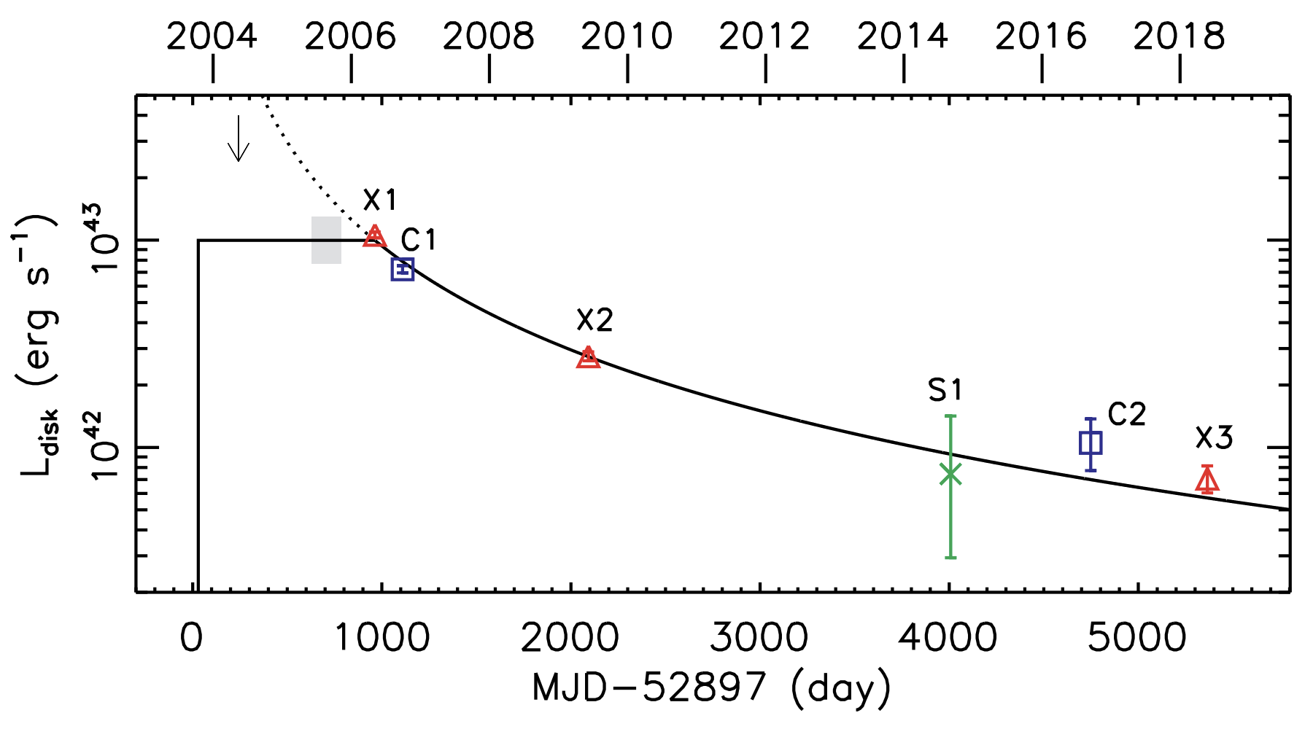
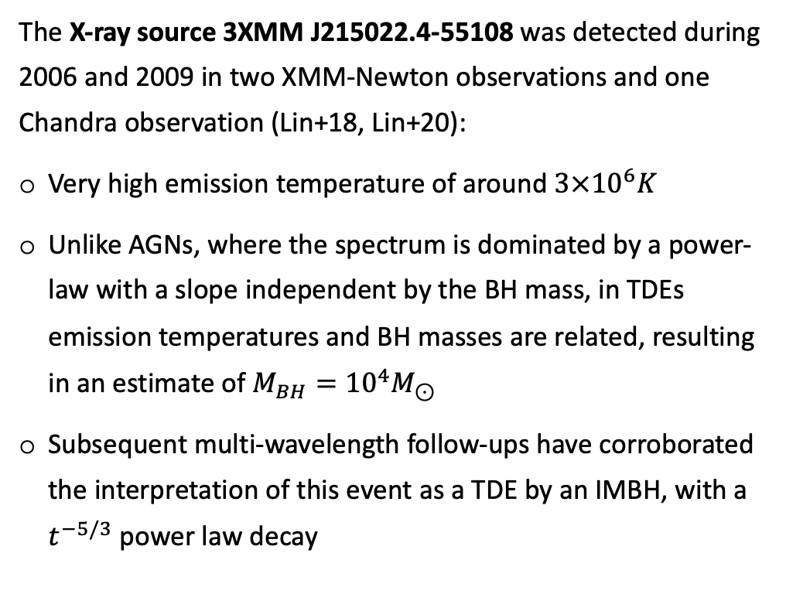
A TDE by an Intermediate-mass BH
The X-ray source 3XMM J215022.4-55108 was detected during 2006 and 2009 in two XMM-Newton observations and one Chandra observation (Lin+18, Lin+20):
Very high emission temperature of around $3×{10}^{6}K$
Unlike AGNs, where the spectrum is dominated by a power-law with a slope independent by the BH mass, in TDEs emission temperatures and BH masses are related, resulting in an estimate of $M_{BH}={10}^{4}M_{⊙}$
Subsequent multi-wavelength follow-ups have corroborated the interpretation of this event as a TDE by an IMBH, with a $t^{−5/3}$ power law decay
Lin+20

Slide 23
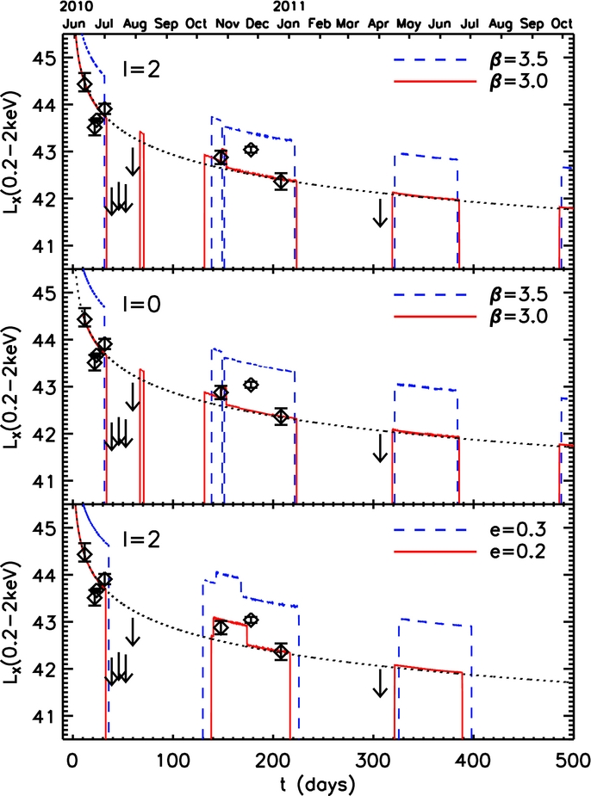
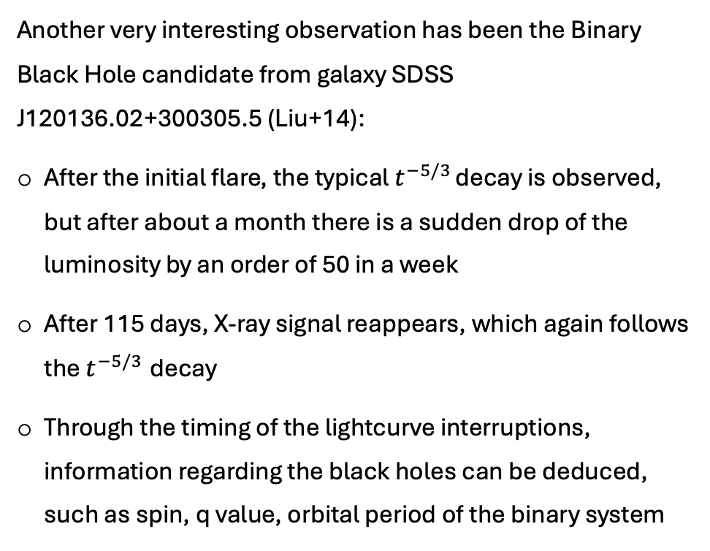
A TDE by a Supermassive BH binary
Another very interesting observation has been the Binary Black Hole candidate from galaxy SDSS J120136.02+300305.5 (Liu+14):
After the initial flare, the typical $t^{−5/3}$ decay is observed, but after about a month there is a sudden drop of the luminosity by an order of 50 in a week
After 115 days, X-ray signal reappears, which again follows the $t^{−5/3}$ decay
Through the timing of the lightcurve interruptions, information regarding the black holes can be deduced, such as spin, q value, orbital period of the binary system
  Liu+14

Slide 24
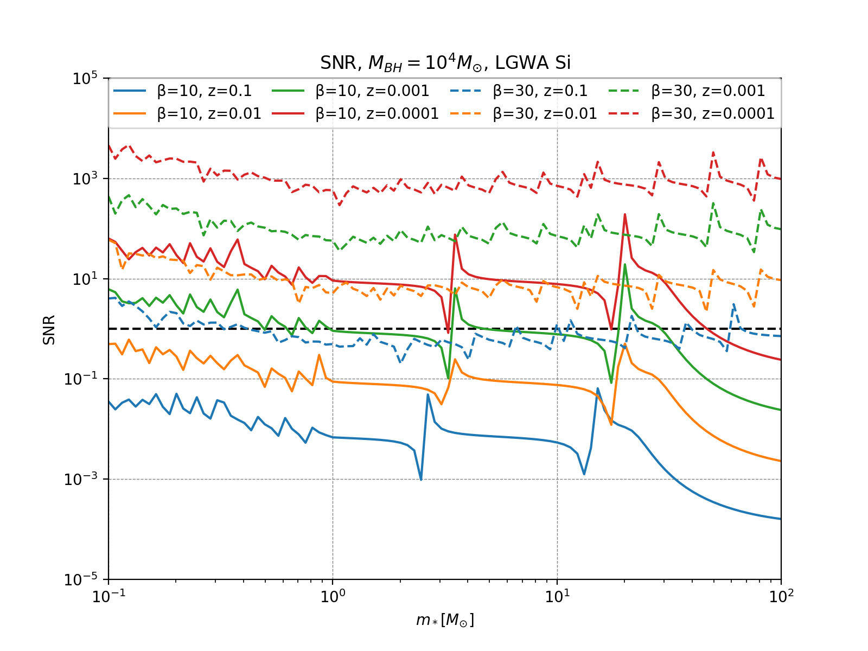
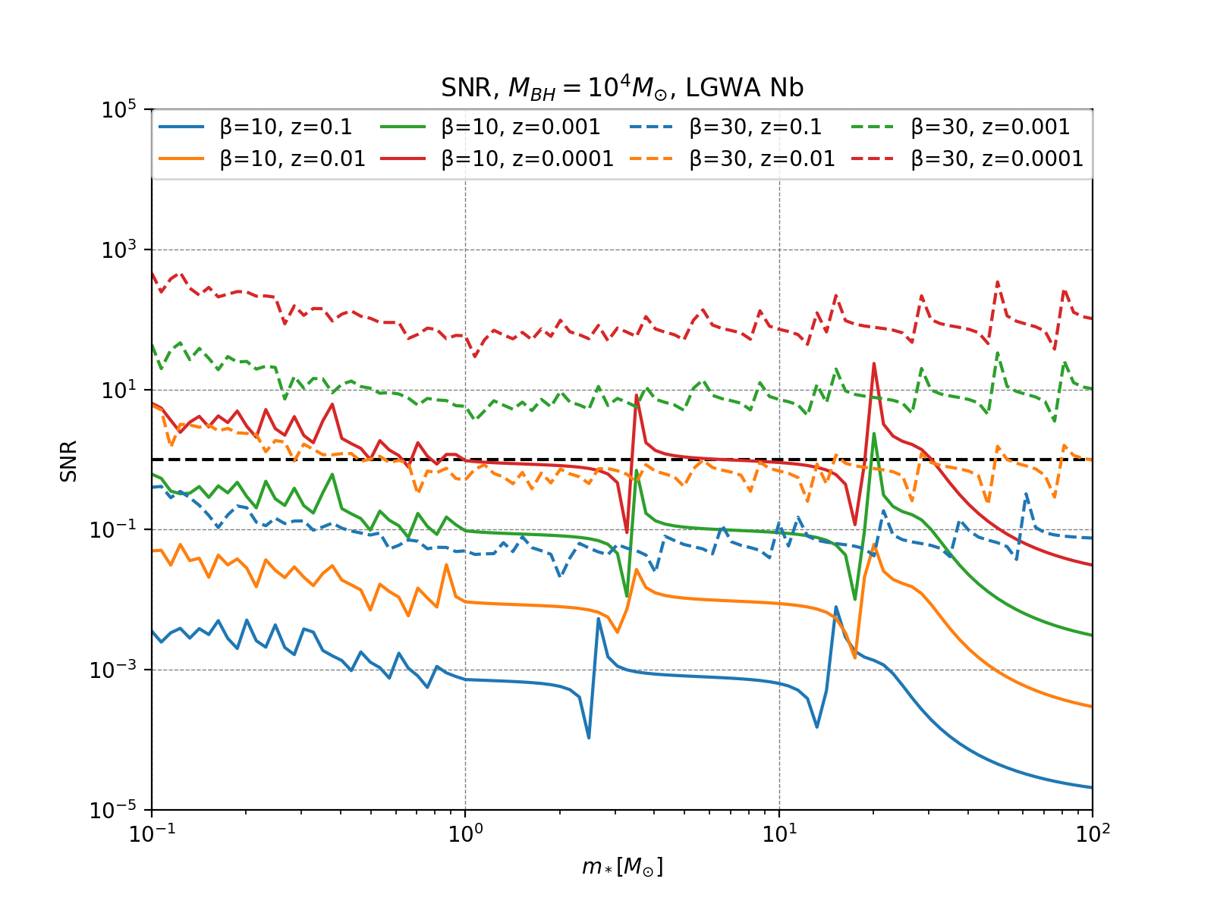

Analytical SNR estimate
Analytical estimate of the SNR for LGWA Si and Nb. $M_{BH}={10}^{4}M_{⊙}$ is fixed, while different values of $β$ and $z$ are represented in color and line style. On the x-axis we find $m_{∗}$.
Notes:
Dividere in due slide

Slide 25


Visibility horizon estimate
Now that we obtained the SNR, if we fix a certain threshold on the SNR value $SNR_{lim}$ we can invert the previous equation for a distance $z (z≪1)$:
$$z∝\frac{m_{∗}m_{BH}^{2/3}}{SNR}\frac{f_{GW}^{2/3}}{h_{det}(f_{GW})}$$
In order to obtain visibility horizons, however, we need to maximize $β$, from the definition:
$$β≤β_{max}=\frac{24}{κ}m_{∗}^{−1/3}r_{∗}{\left(\frac{m_{BH}}{{10}^{6}}\right)}^{−2/3}$$
Where $κ$ represents the critical radius for direct plunge in units of $r_{Sch}$, where a factor $κ∼2$ reproduces the correct relativistic rates and is the value chosen.
From these two values $β_{max}$ and $κ$, the final result for $z_{max}$ is:
$z_{max}=\frac{0.01m_{∗}}{SNR_{lim}}$ ${\left(\frac{m_{BH}}{{10}^{6}}\right)}^{−2/3}{\left(\frac{f_{∗}}{{10}^{−2}Hz}\right)}^{2/3}{\left(\frac{h_{det}\left(f_{∗}\right)}{{10}^{−21}}\right)}^{−1}$
Where
$$f_{∗}=\min\left({4⋅{10}^{−3}Hz{\left(\frac{κ}{2}\right)}^{−3/2}\left(\frac{m_{BH}}{{10}^{6}}\right)}^{−1},f_{opt}\right)$$
Introducing $f_{opt}$ the optimal frequency of the detector, given the U-shape of the ASD, we have two outcomes in order to calculate $z_{max}$:
If $h_{det}$ is a steep function of f, and $f_{GW,max}≥f_{opt}$, then there exists $β$ for which $h_{det}\left(f_{GW}\right)=h_{opt}$, and $z_{max}$ is calculated in $h_{opt}$
If $f_{GW,max}≤f_{opt}$, $z_{max}$ is obtained for $f_{GW,max}$
Notes:
Ricordarsi di dire perché qui non è possibile la parameter estimation

Slide 26



Numerical SNR estimate – LGWA
Numerical estimate of the SNR for the detector LGWA Si and Nb. Only $M_{∗}$ is varied, while $M_{BH}={10}^{4} M_{⊙}$and $β=15$ are fixed. The distance is fixed at $1 Mpc$.

Slide 27



Numerical SNR estimate – LGWA
Numerical estimate of the SNR for the detector LGWA Si and Nb. Only $β$ is varied, while $M_{BH}={10}^{4} M_{⊙}$and $m_{∗}=1 M_{⊙}$ are fixed. The distance is fixed at $1 Mpc$.

Slide 28

Parameter estimation
In order to obtain the derivatives of the strain, a finite difference approach has been adopted:
$$f^{′}\left(x\right)=\frac{f\left(x+h\right)−f(x−h)}{2h}+o(h^{2})$$
In our specific case, a value $ε$ is chosen, and the derivative is calculated as:
$$\frac{∂\tilde{h}}{∂θ_{i}}{\left.​\right|}_{{\vec{θ}}_{inj}}=\frac{\tilde{h}\left(θ_{i,inj}⋅\left(1+ε\right)\right){\left.​\right|}_{{\vec{θ}}_{inj}}−\tilde{h}\left(θ_{i,inj}⋅\left(1−ε\right)\right){\left.​\right|}_{{\vec{θ}}_{inj}}}{2θ_{i,inj}⋅ε}$$
Where $ε$ has been set to $ε={10}^{−3}$.
As ${\vec{θ}}_{inj}$, the following parameters have been chosen:
$$M_{BH}={10}^{4}{ M}_{⊙}, m_{∗}=2 M_{⊙}, β=20$$
Notes:
Central difference with first-order accuracy

