Slide 1
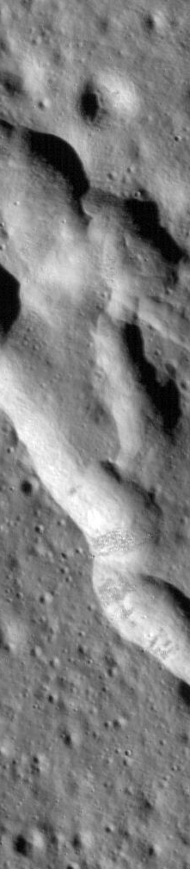




Observing, characterizing, and inverting lunar ground motions for near-surface structure
Heiner Igel¹, Sabrina Keil^{1,4}, Felix Bernauer¹, Fabian Lindner¹, Martin Schimmel⁴, Dmitriy Shutin², Ban-Sok Shin², Kai Nierula², Philipp Reiss³, Rok Sesko³
¹ Ludwig-Maximilians-Universität München, Germany
² German Aerospace Center (DLR), Oberpfaffenhofen, Germany
³ Technische Universität München, Germany
⁴ Geosciences Barcelona - CSIC, Barcelona, Spain
NASA(LRO)
mps.mpg.de
Notes:
Project initated by AeroSpace Center
Re-analysis of Apollo17 data
How best to use lunar noise for imaging?
Strategies for near surface exploration

Slide 2
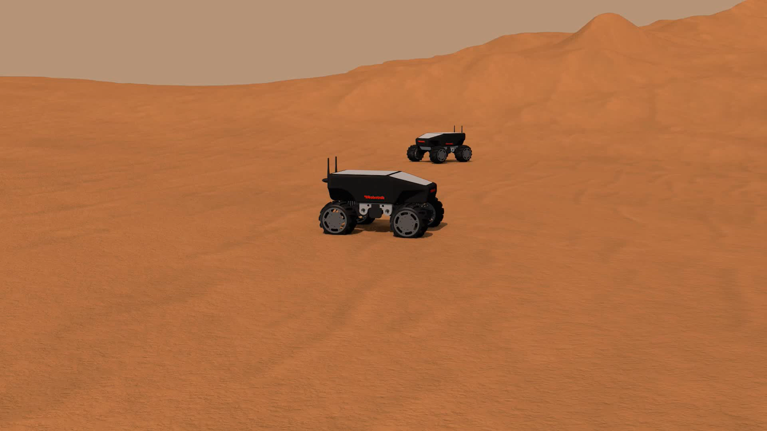

Near-Surface Seismic Exploration of Planetary BOdies with Adaptive NetworkS
https://www.nepos-project.com
NASA(LRO)
mps.mpg.de
Notes:
YES the moon is grey
Payload restrictions go
Potential for multi-seismic station networks
Strong need to find ice and cavities
Revolution in seismic instrumentation (nodes, rotation sensing 6 DoF, distributed acoustic sensing)
Explore strategies for autonomous robotic exploration
Agents are: sources, receivers, computers, navigators
Experiment optimization (optimal moves w.r.t. Question posed)
New approaches interrogation theory
Passive and active experiments

Slide 3
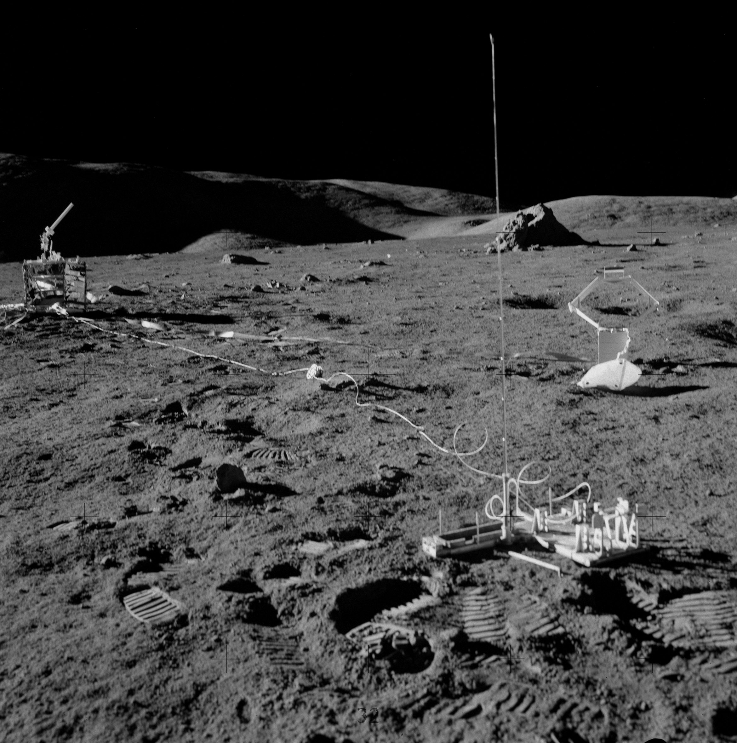
Research Questions
What can we learn about lunar noise from the Apollo17 data?
Under what conditions can we use lunar noise for seismic interferometry?
What „time of day“ is optimal for imaging?
How long should we observe to get best information return? How far apart?
How does scattering affect imaging results?
Can we develop a realistic Digital Twin for lunar wavefields?
NASA(LRO)
mps.mpg.de

Slide 4
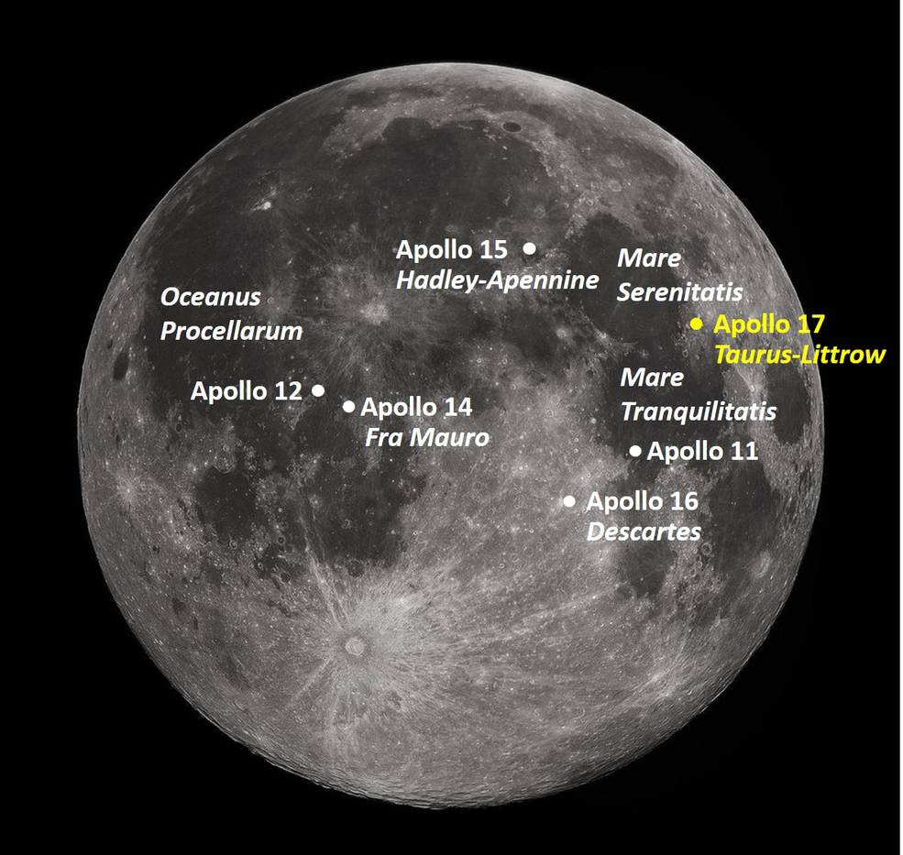
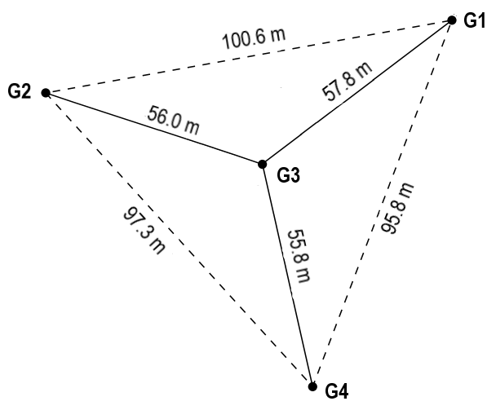
Apollo 17 - seismic experiment
8 month of continuous recordings between 1976 – 1977
4 geophones with usable frequency range of 3-30Hz
Only vertical component
NASA(LRO)
mps.mpg.de

Slide 5
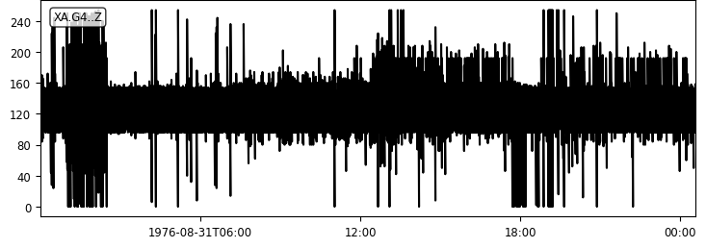
Apollo 17 - noise analysis
Previous studies on lunar data:
Larose et al. (2005)
Tanimoto et al. (2008)
Sens-Schönfelder & Larose (2008)
Sens-Schönfelder & Larose (2010)
→ Noise on the Moon = Thermal Moonquakes
NASA(LRO)
mps.mpg.de
Notes:
7 bit resolution

Slide 6
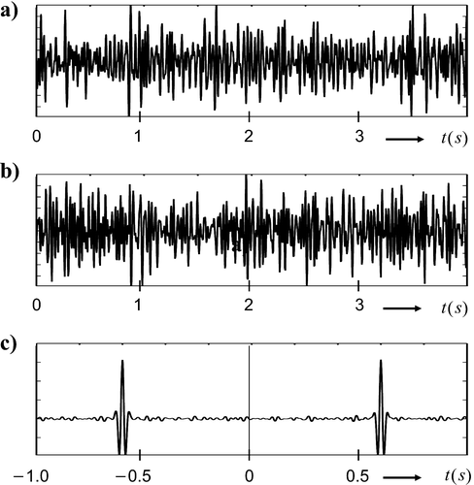
What is noise interferometry?
A
B
Record ambient noise on two stations for some time
Cross-correlate multiple (overlapping) time windows, stack them
A „Green‘s function“ emerges after sufficient stacking
No active sources, passive imaging
Coherent (surface) wave energy interfere constructively
What is the frequency range of noise?
NASA(LRO)
Wapenaar et al. (2010)
mps.mpg.de
Notes:
2005 noise interferometry for seismology emerged
First applications in helio seismology

Slide 7
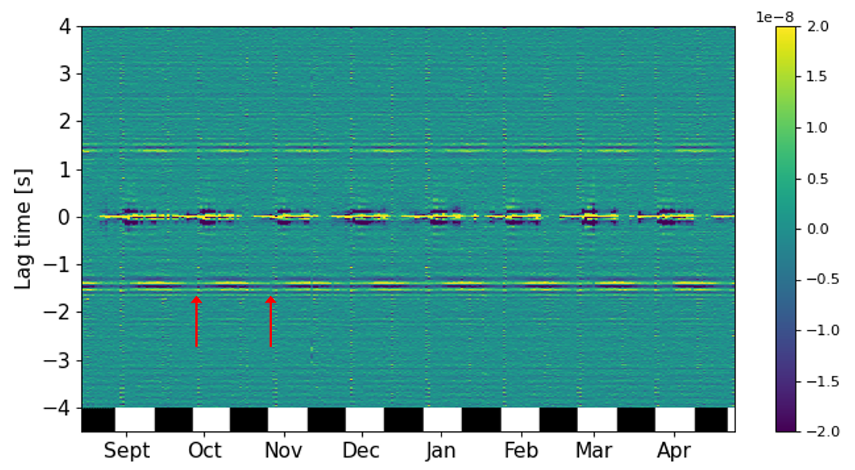
Lunar seismic interferometry
Station pair G3 – G4
Keil et al. (2024)
NASA(LRO)
mps.mpg.de
Notes:
Central blob
Electromagnetic
Below station
extern

Slide 8
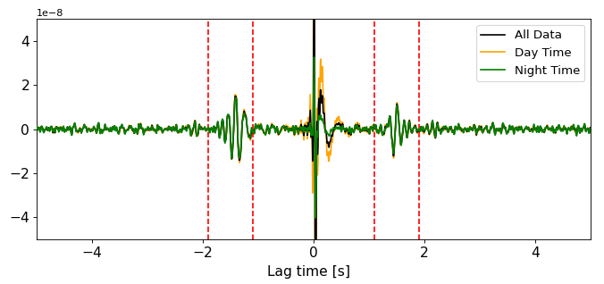
Lunar seismic interferometry
Reference stack G3-G4
Stable Rayleigh wave peak for all three reference stacks
Amplitude difference between negative and positive lag time peak
NASA(LRO)
mps.mpg.de
Notes:
2005 noise interferometry for seismology emerged
First applications in helio seismology

Slide 9
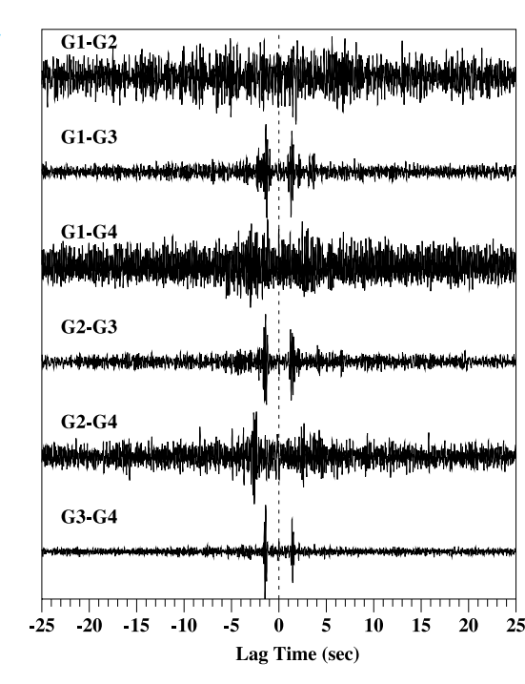
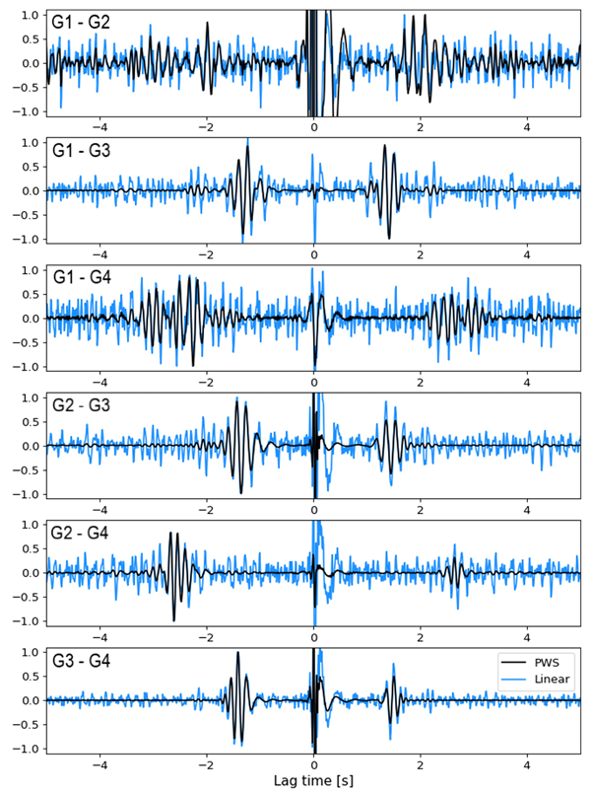
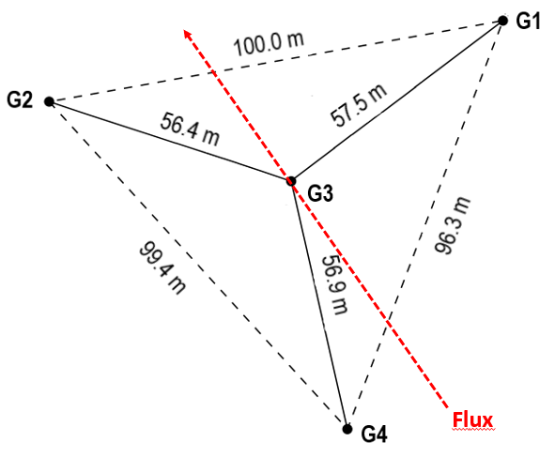
Lunar seismic interferometry
ts-PWS after Ventosa et al. 2017
Correlation for all station pairs
Tanimoto et al. 2008
Keil et al. (2024)
NASA(LRO)
mps.mpg.de
Notes:
Pws ...cohärente Phasen werden mehr hervorgehoben, inkohärente gecancelt
- Increased S/N

Slide 10

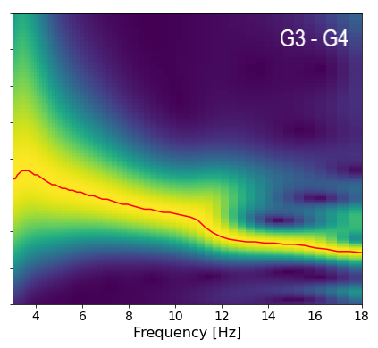
Surface wave inversion
Dispersion curve extraction using continuous wavelet transform
Keil et al. (2024)
NASA(LRO)
mps.mpg.de
Notes:
2005 noise interferometry for seismology emerged
First applications in helio seismology

Slide 11
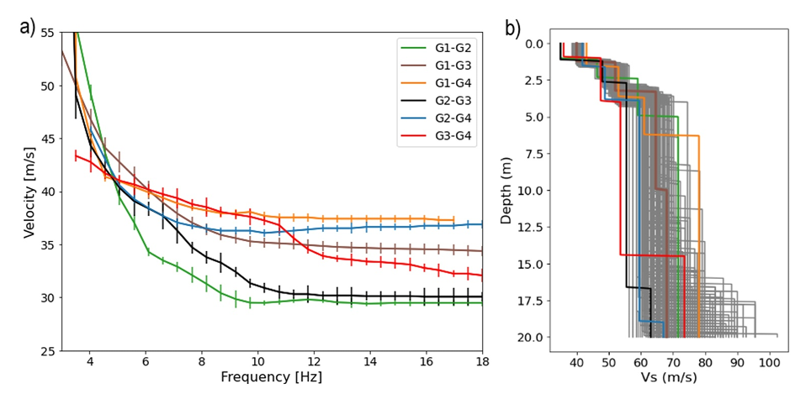
Surface wave inversion
Invert dispersion curves for 1D velocity profiles
Keil et al. (2024)
NASA(LRO)
mps.mpg.de
Notes:
Topography not used
Distances corrected, no correct
Grey scale are models for one of the profiles

Slide 12
How long to converge ... when?
Day time Night time
... during day ... better wait for the lunar afternoon ...
NASA(LRO)
mps.mpg.de
Notes:
Thermal moonquakes dominat after lunchtime

Slide 13
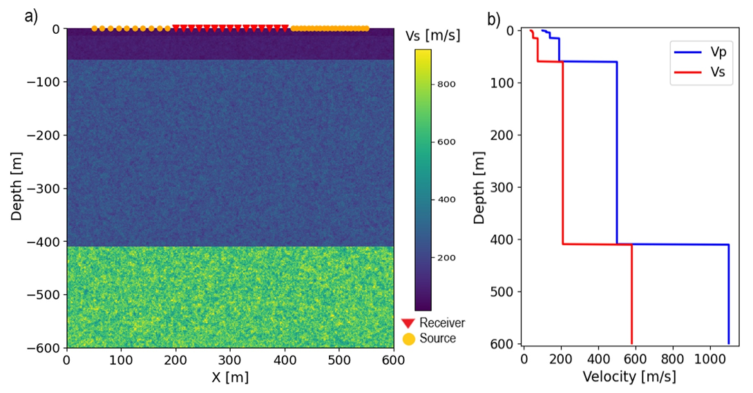
Can we reproduce this with seismic modeling?
2D
Scattering media: (von Karman random media)
NASA(LRO)
Keil et al. (2024)
mps.mpg.de
Notes:
2005 noise interferometry for seismology emerged
First applications in helio seismology

Slide 14

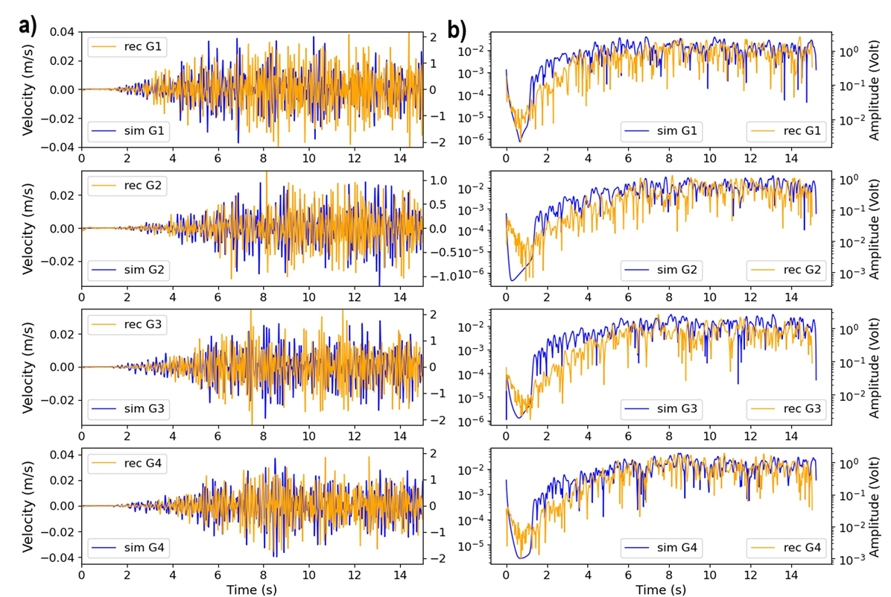
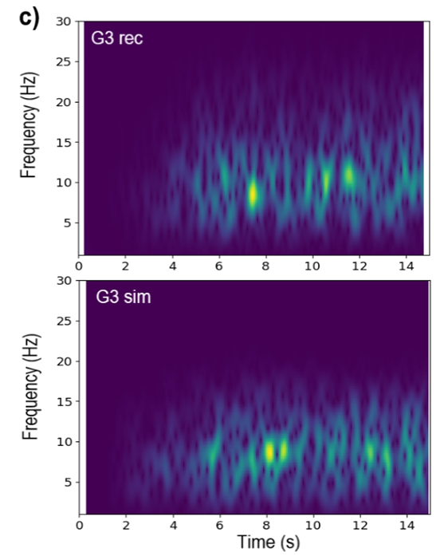
Simulation vs. Observation
Model parameters:
Correlation length = 10m
Velocity fluctuation= 70%
NASA(LRO)
Keil et al. (2024)
mps.mpg.de
Notes:
2005 noise interferometry for seismology emerged
First applications in helio seismology

Slide 15
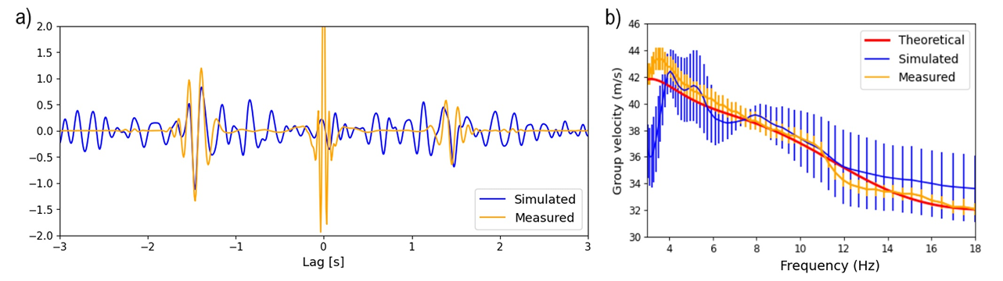
Simulation vs. Observation
Numerical simulation
Real data (Apollo 17)
NASA(LRO)
mps.mpg.de
Notes:
only 10 min noise ... More stacking improves S/N

Slide 16
Synthetic lunar seismic interferometry (homogeneous)
NASA(LRO)
mps.mpg.de
Notes:
2005 noise interferometry for seismology emerged
First applications in helio seismology

Slide 17
Synthetic lunar seismic interferometry (scattering)
NASA(LRO)
mps.mpg.de
Notes:
2005 noise interferometry for seismology emerged
First applications in helio seismology

Slide 18
Conclusions
Seismic interferometry is possible with Moon data
In the best case only 1.5 hours of data needed
depends on several factors:
Time during lunar cycle
Distribution of noise sources
Station-pair distance (not larger than 60 m)
Variations in the shallow velocity structure
Simulations give comparable results to measured data
scattering influences Green´s function retrieval
First step to build digital twin for the shallow subsurface structure of the Moon
NASA(LRO)
mps.mpg.de
Notes:
2005 noise interferometry for seismology emerged
First applications in helio seismology

Slide 19
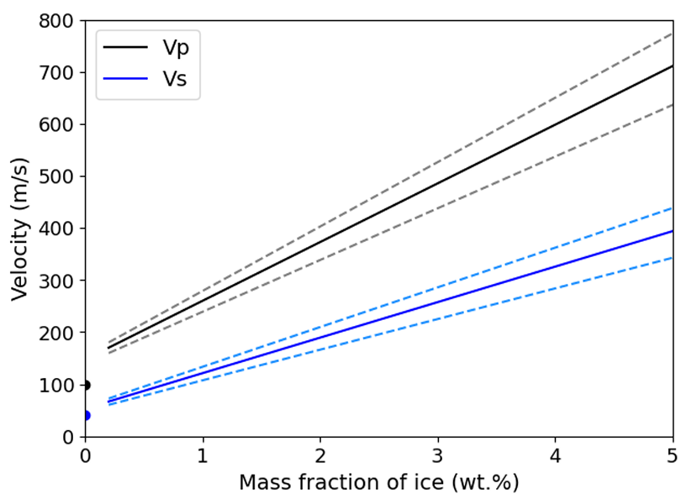
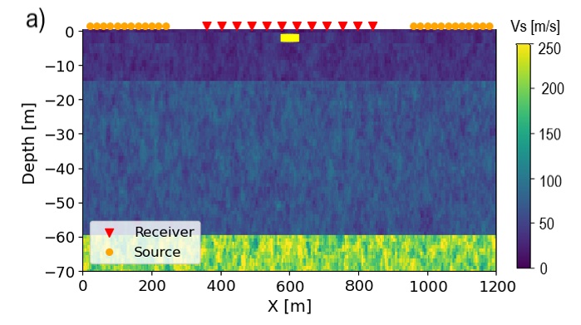
Outlook
Ice bearing rocks
Searching for ice (simulation)
NASA(LRO)
mps.mpg.de
Notes:
2005 noise interferometry for seismology emerged
First applications in helio seismology

Slide 20
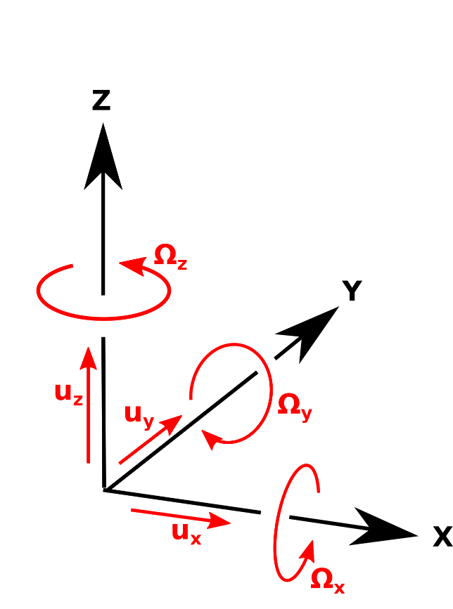
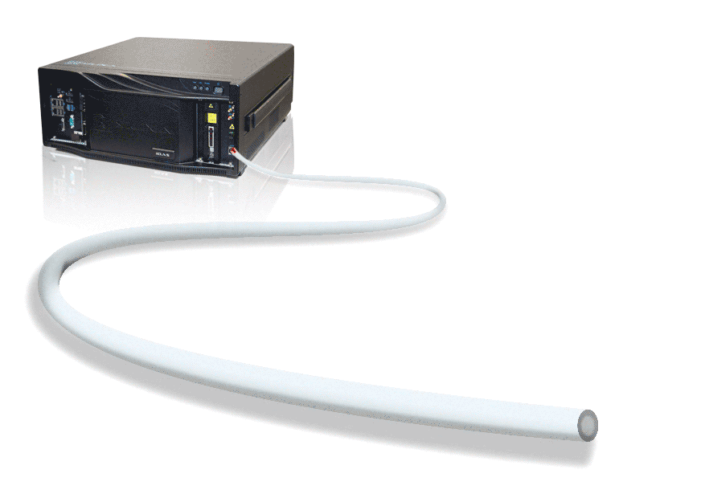
Outlook
6 DoF sensing
Distributed Acoustic Sensing
NASA(LRO)
mps.mpg.de
Notes:
2005 noise interferometry for seismology emerged
First applications in helio seismology

Slide 21
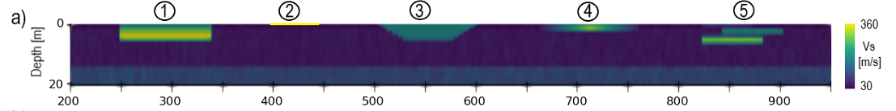
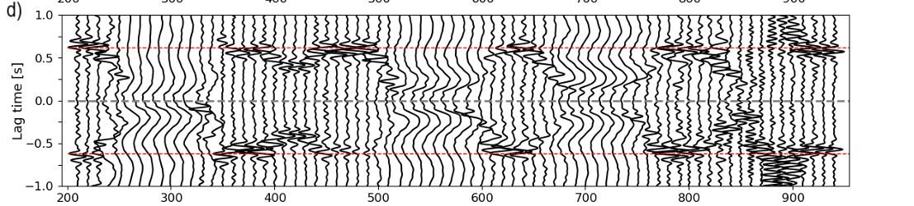
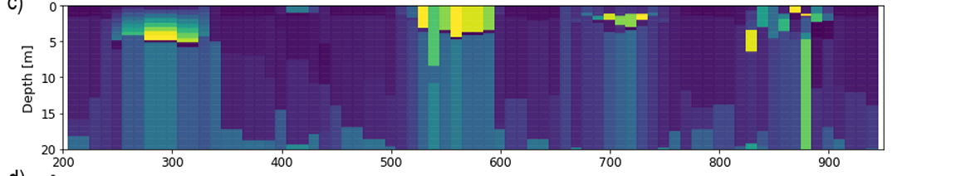
Outlook
Scenario
Correlations
Inversion
mps.mpg.de
NASA(LRO)
Distance [m]
Notes:
Alle 5 m
Cor alle 30 m
30 m experiment across surface

Slide 22
Outlook
True
H/V
Interferometry
DAS
6 DoF
6 DoF + H/V
mps.mpg.de
NASA(LRO)
Notes:
Effects transition to ice
DAS dispersiuon curves uncertain

Slide 23
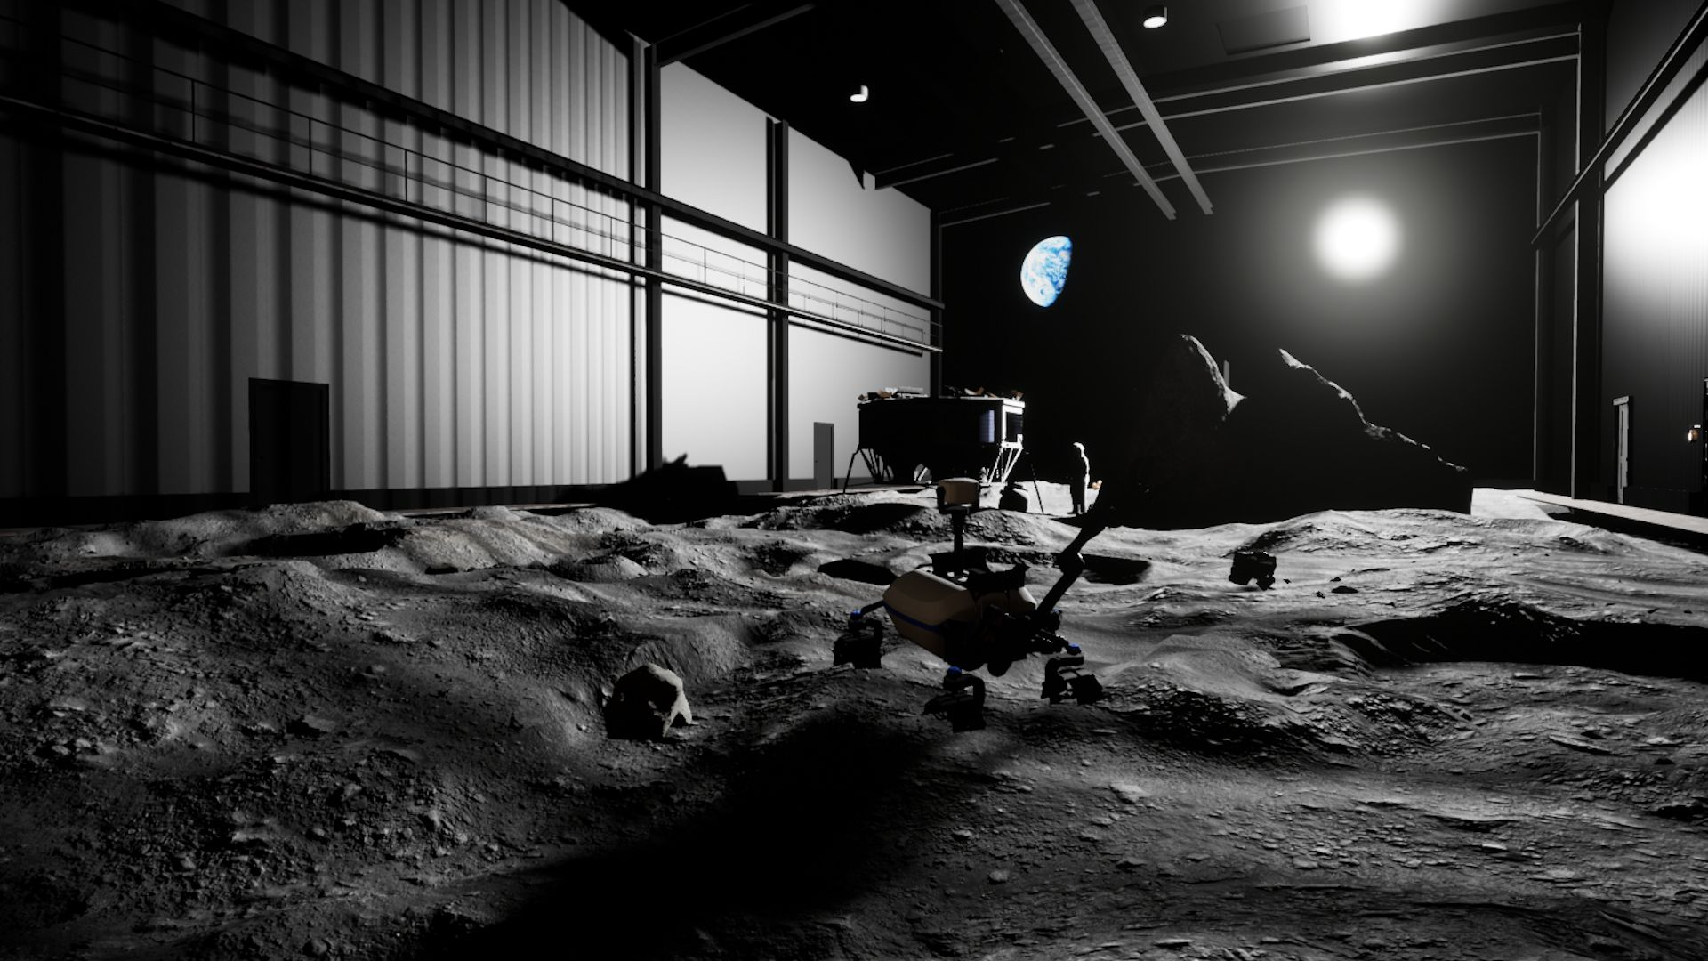
6 DoF Experiments LUNA Hall
November 2025
mps.mpg.de
NASA(LRO)
Notes:
2005 noise interferometry for seismology emerged
First applications in helio seismology

Slide 24
Literature
NEPOS Project:
Keil, S., Igel, H., Schimmel, M., Lindner, F., & Bernauer, F. (2024). Investigating subsurface properties of the shallow lunar crust using seismic interferometry on synthetic and recorded data. Earth and Space Science, 11(10), e2024EA003742.
Keil, S., Schimmel, M., & Igel, H. (2025). Evaluating Seismic Ambient Noise Techniques for Detecting Ice-Bearing Rocks on the Moon. Earth and Space Science, in print.
Keil, S., Schimmel, M., & Igel, H. (2025). Seismic detecting of cavities on the Moon: Theoretical study. In preparation..
Others:
Blanchette-Guertin, J. F. (2014). Seismic energy propagation in highly scattering environments and constraints on lunar interior structure from the scattered signals of the Apollo passive seismic experiment (Doctoral dissertation, University of British Columbia).
Garcia, R. F., Khan, A., Drilleau, M., Margerin, L., Kawamura, T., Sun, D., ... & Zhu, P. (2019). Lunar seismology: An update on interior structure models. Space Science Reviews, 215, 1-47.
Larose, E., Campillo, M., Khan, A., & Nakamura, Y. (2005). Lunar subsurface investigated from correlation of seismic noise. Geophysical Research Letters, 32, L16201.
Nunn, C., Garcia, R. F., Nakamura, Y., Marusiak, A. G., Kawamura, T., Sun, D., ... & Zhu, P. (2020). Lunar seismology: A data and instrumentation review. Space Science Reviews, 216(5), 89.
Prieto Lazaro, A. (2024). Analysis of candidate sites for seismic imaging of lunar subsurface ice (Master Thesis). Technical University of Munich.
Schorghofer, N., & Williams, J.-P. (2020). Mapping of ice storage processes on the Moon with time-dependent temperatures. The Planetary Science Journal, 1(3), 54. https://doi.org/10.3847/PSJ/abb6ff
Sens-Schönfelder, C., & Larose, E. (2010). Lunar noise correlation, imaging and monitoring. Earthquake Science, 23, 519-530.
Sens-Schönfelder, C., & Larose, E. (2008). Temporal changes in the lunar soil from correlation of diffuse vibrations. Physical Review E, 78(4), 045601.
Tanimoto, T., Eitzel, M., & Yano, T. (2008). The noise cross‐correlation approach for Apollo 17 LSPE data: Diurnal change in seismic parameters in shallow lunar crust. Journal of Geophysical Research: Planets, 113(E8).
Wapenaar, K., Draganov, D., Snieder, R., Campman, X., & Verdel, A. (2010). Tutorial on seismic interferometry: Part 1—Basic principles and applications. Geophysics, 75(5), 75A195-75A209.
mps.mpg.de
NASA(LRO)
Notes:
2005 noise interferometry for seismology emerged
First applications in helio seismology

