Slide 1
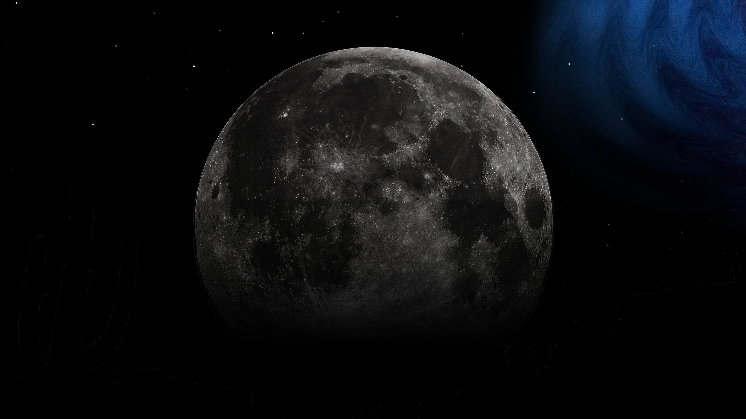

Cosmology in the dHz: opportunities from single sources and stochastic backgrounds
Francesco Iacovelli — 16/09/2025 — LGWA workshop - San Benedetto del Tronto

Slide 2

Overview
Introduction to current GW observations and GW cosmology
Gravitational-wave standard sirens
Key concepts
Standard sirens at LGWA
Stochastic gravitational-wave backgrounds
Introduction
Detection prospects at LGWA

Slide 3
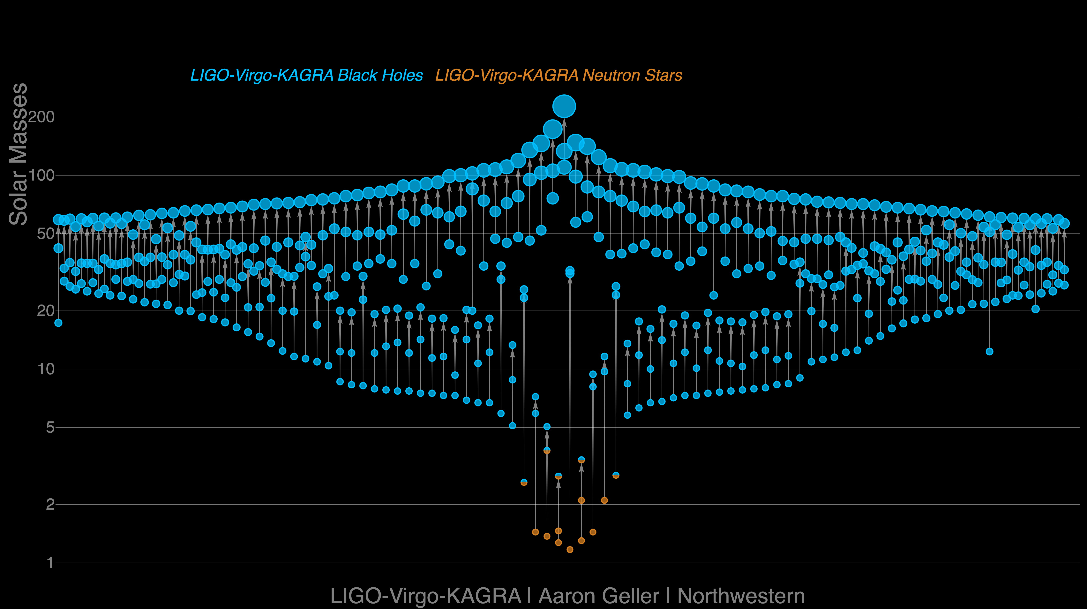


State of the art at 2G detectors
First detection!
237 significant candidates in O4 for the moment!
First BNS event, and first multi-messenger!

Slide 4
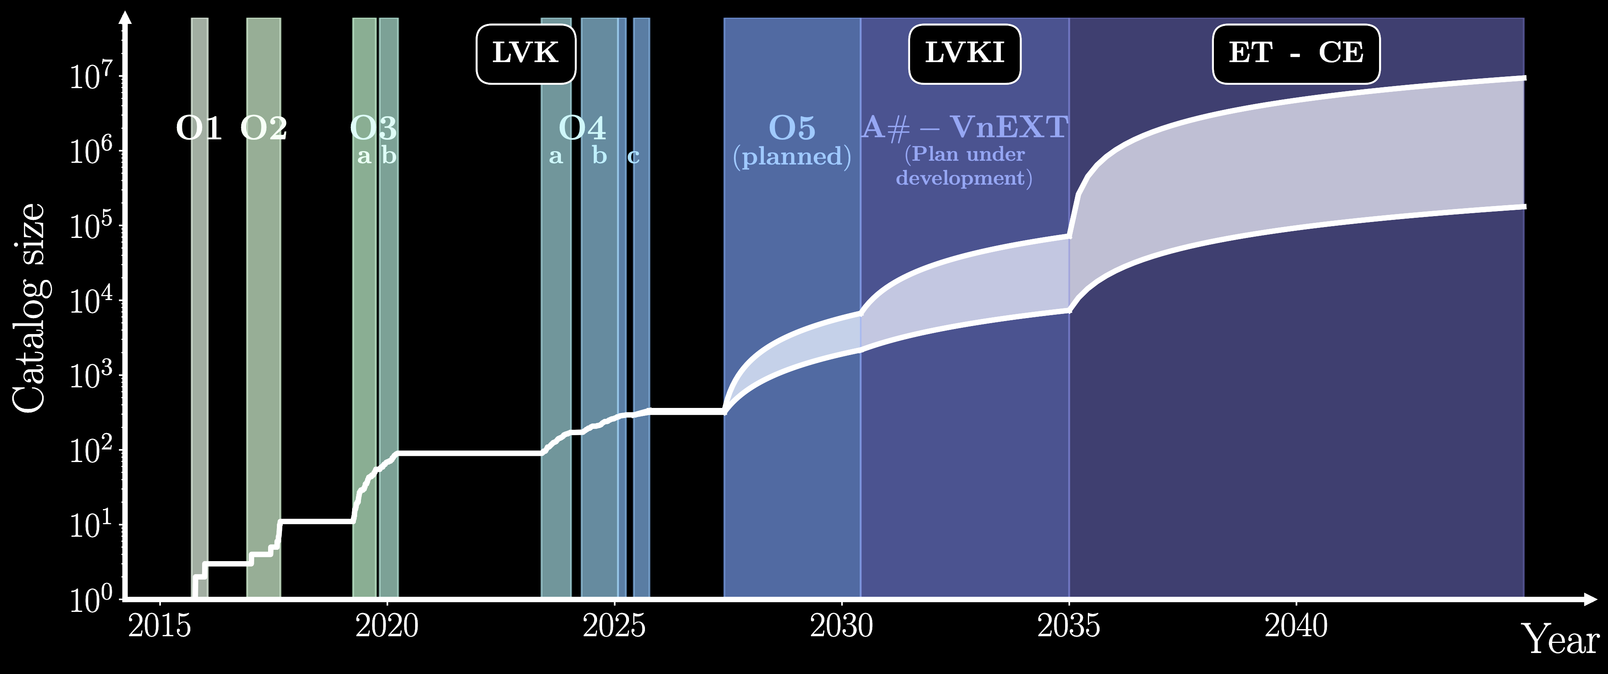
Prospects at 2G detectors
Already at 2G detectors, thanks to future advancements, in the coming years the number of detections is expected to quickly raise
© Michele Mancarella

Slide 5

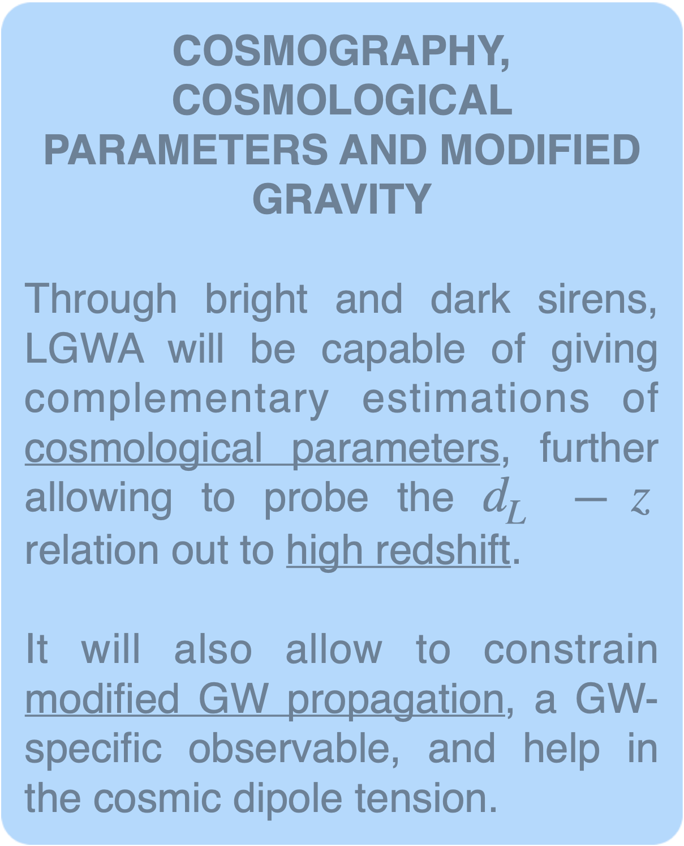
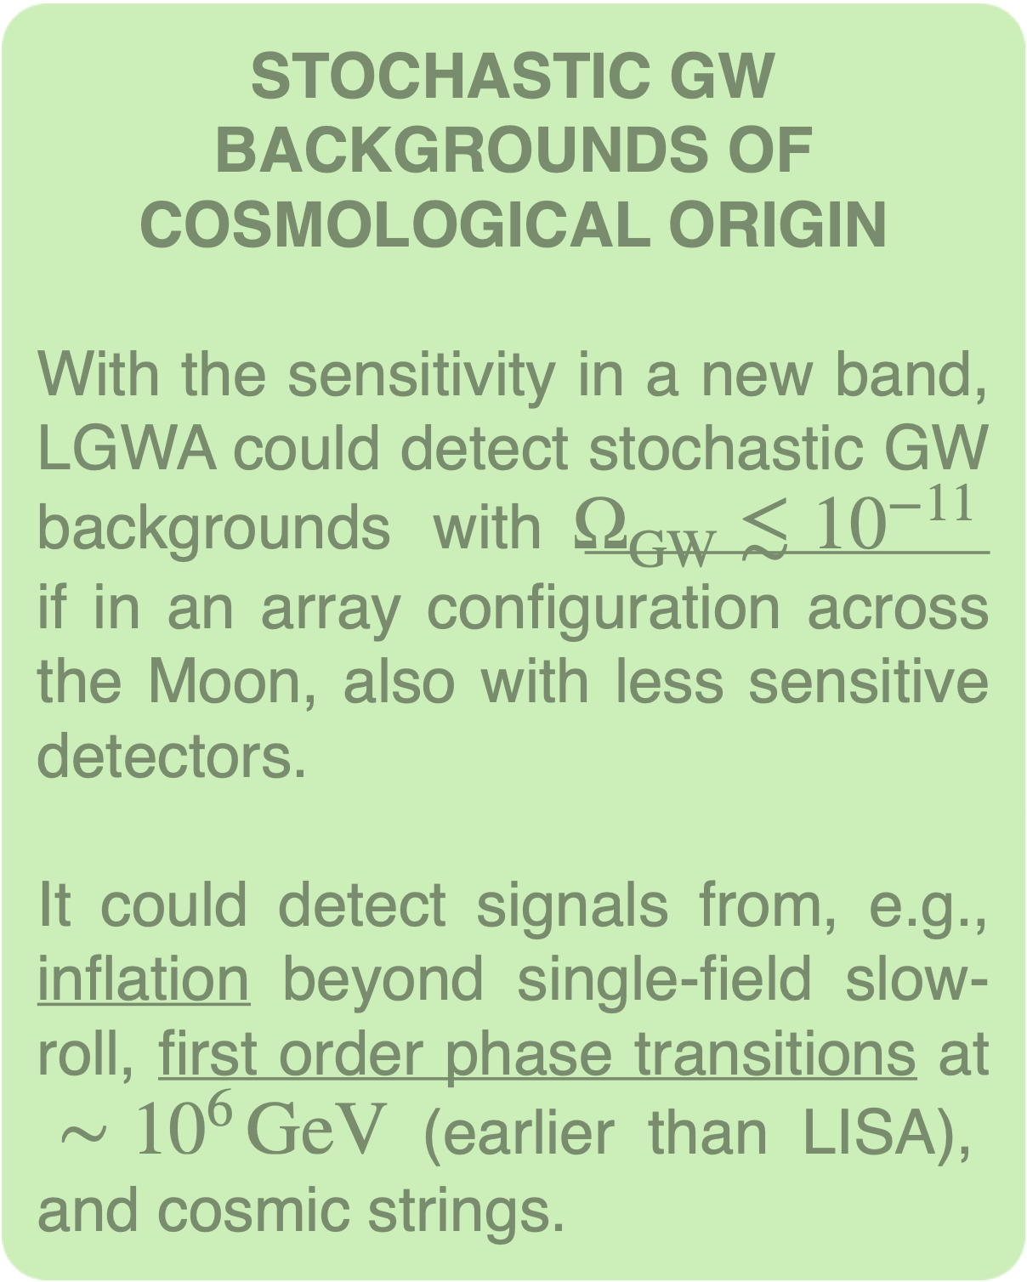
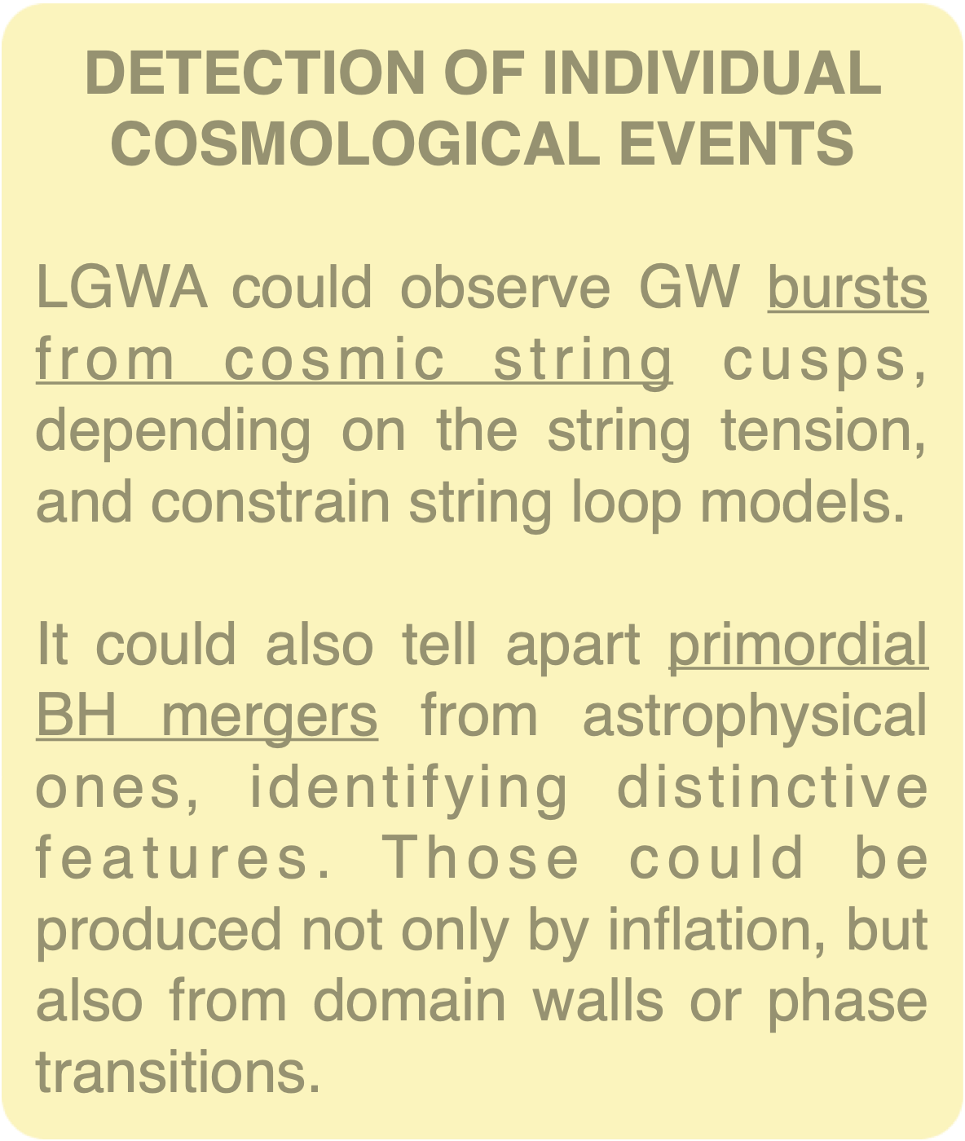
Cosmology at LGWA
LGWA can contribute to cosmology along the following main lines

Slide 6
Overview
Introduction to current GW observations and GW cosmology
Gravitational-wave standard sirens
Key concepts
Standard sirens at LGWA
Stochastic gravitational-wave backgrounds
Introduction
Detection prospects at LGWA

Slide 7










Gravitational-wave standard sirens
GW sources from binaries are self-calibrating distance indicators:
all compact binaries are standard, you “just” have to work out the equations!
Keitel+ (2016)
GW150914

Slide 8
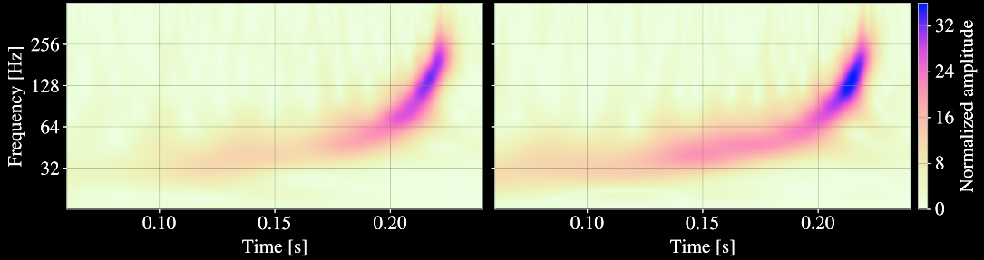
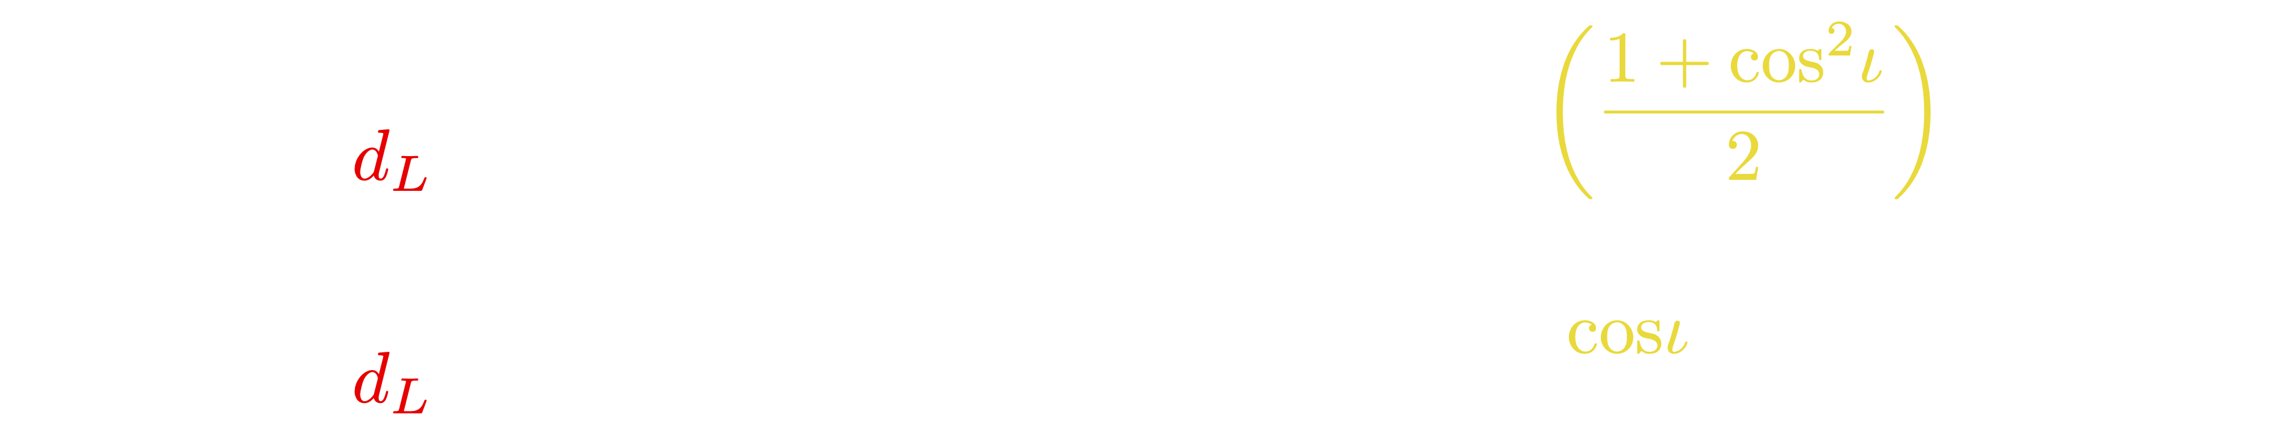
Gravitational-wave standard sirens
GW sources from binaries are self-calibrating distance indicators:
all compact binaries are standard, you “just” have to work out the equations!
Time-frequency evolution, amplitude, arrival times…
but a strong correlation with the inclination remains for face-on/off systems
Schutz (1986)
Holz-Hughes (2005)
The wavelength of gravitational radiation is typically $≳$ the size of the source. GWs cannot form an image, they can be best thought of as to sound

Slide 9

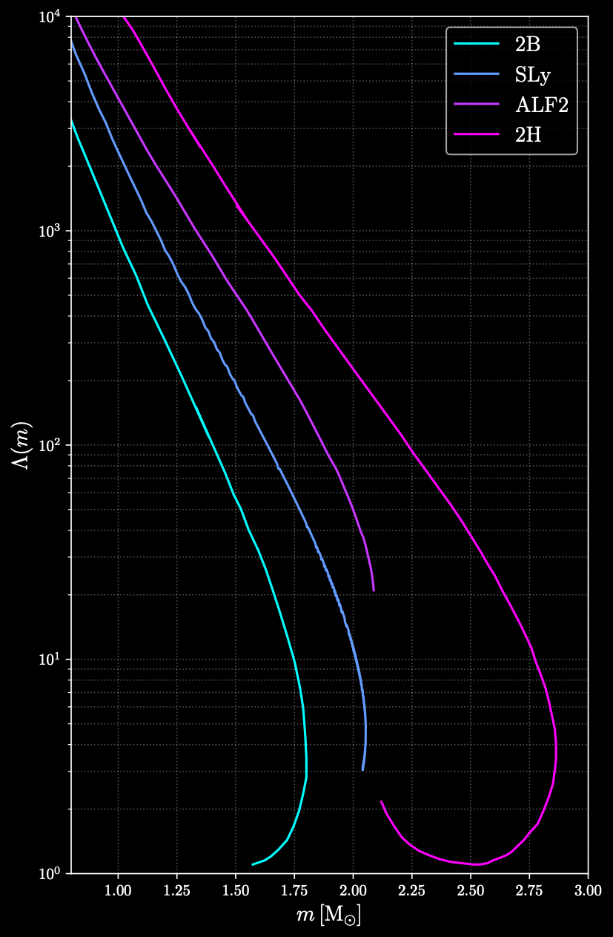
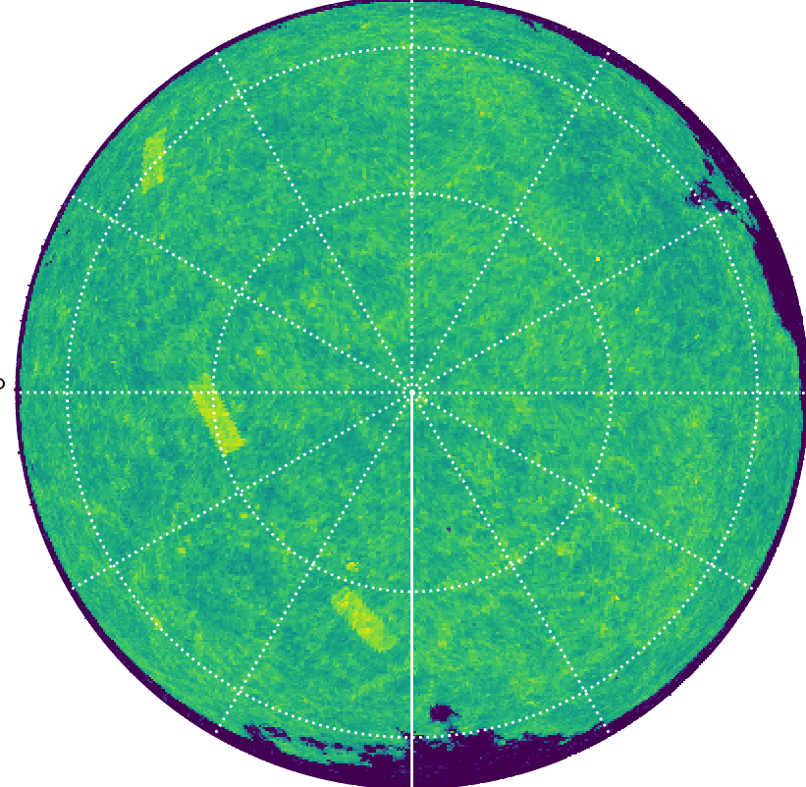
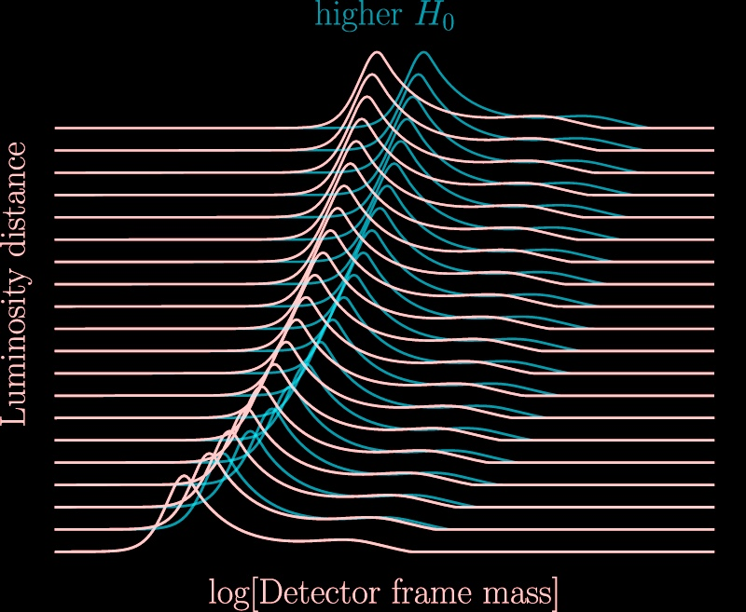
Gravitational-wave standard sirens
Given our extremely valuable estimation of the luminosity distance, we still miss something to infer cosmological parameters, $z$!
We can do it either from GWs alone or using complementary measurements
2402.03120
GLADE+
1710.05833

Slide 10


Bright sirens: the case of GW170817
The most “straightforward” case is bright sirens from multimessenger events
1710.05835
1710.05833
$d_{L}$ and $z$
© Alberto Colombo

Slide 11
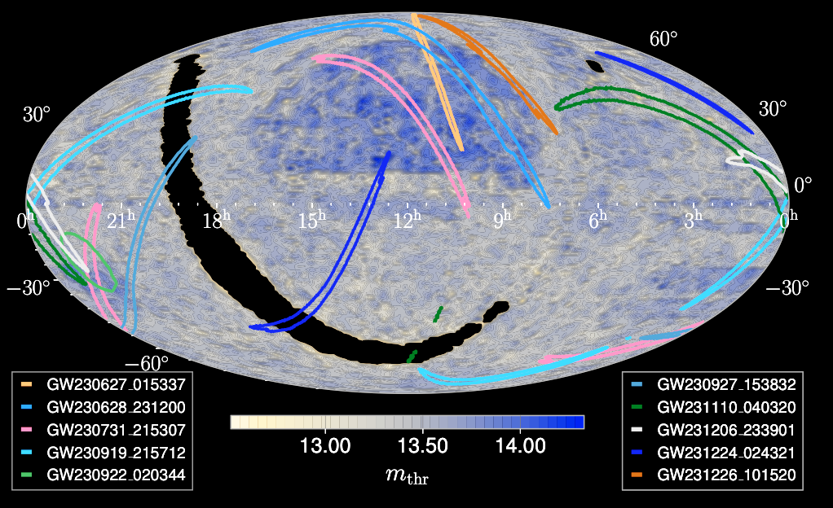
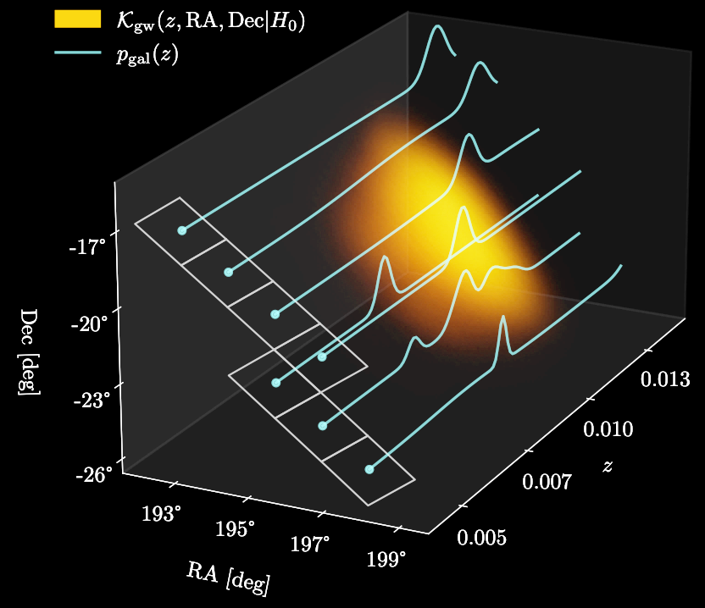
Dark sirens: GWs + galaxy catalogs
In absence of a counterpart, we can resort to statistical techniques
One that is commonly considered is the statistical host identification using a galaxy catalog
2509.04348
2312.05302

Slide 12



GWs spectral sirens
Alternatively, one can input some knowledge of the mass distribution of compact binaries, and sharp features will help
What we directly measure in GW astronomy is indeed the detector-frame masses of a binary source, linked to the source-frame ones by
Changes in the expansion rate of the Universe would then apparently modify the mass distribution
2402.03120

Slide 13
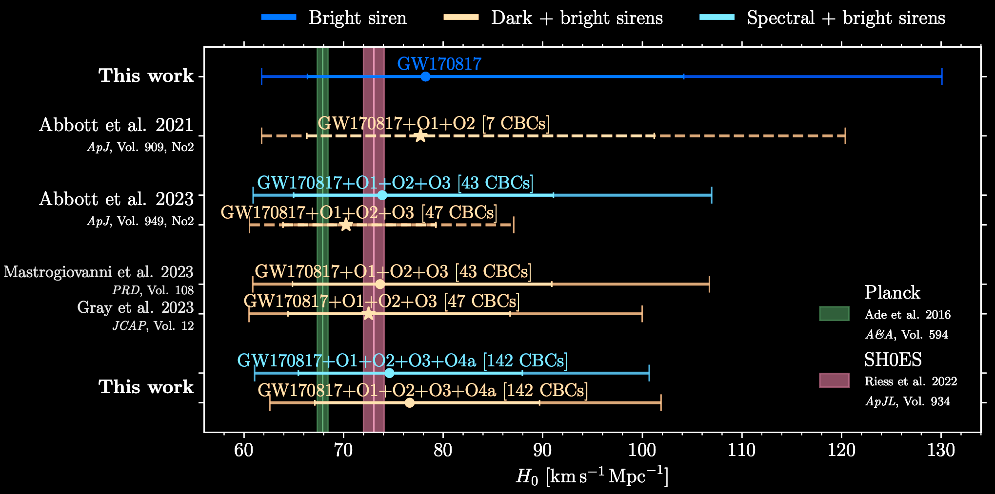
GW standard sirens today
The key aspects for GW standard sirens are thus localization and number of detections.
For the moment the best constraint is from bright sirens, but the dark side will catch up as observations accumulate. LGWA can help in both directions!
2509.04348

Slide 14
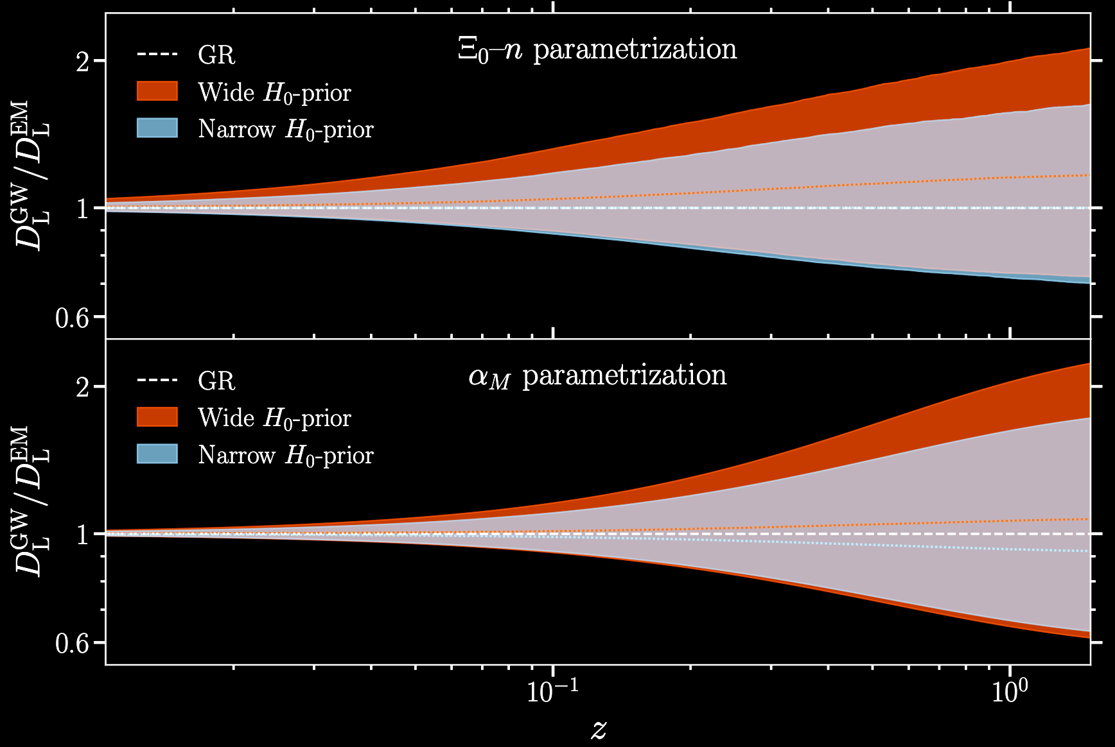




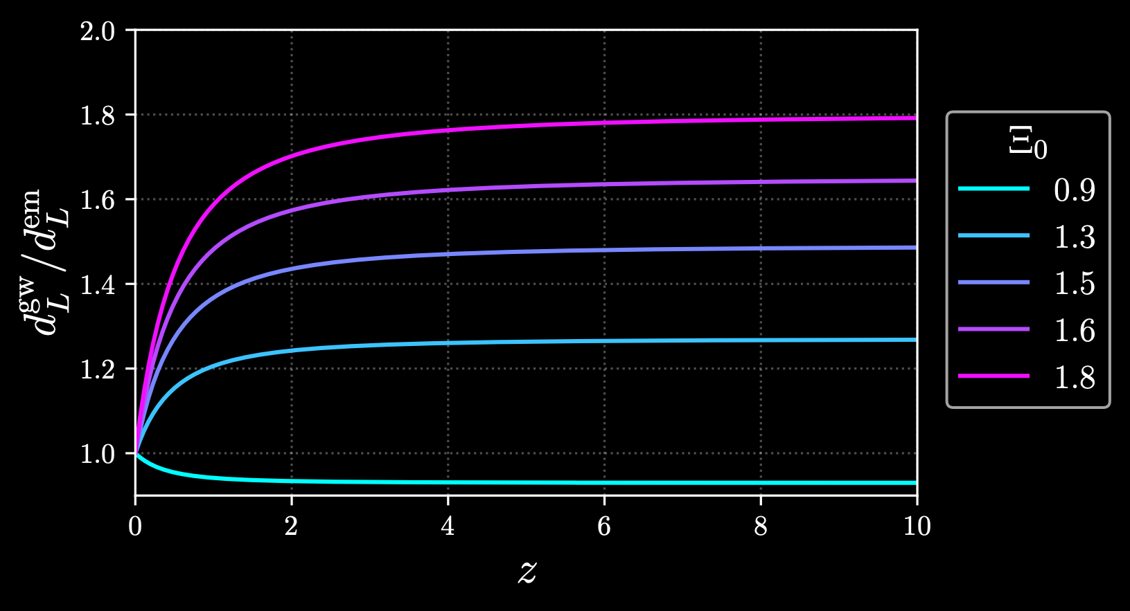


Modified GW propagation
Other than $Λ$CDM parameters and dark energy, another interesting observable accessible through GWs is modified GW propagation
2509.04348
See e.g. 2001.07619

Slide 15
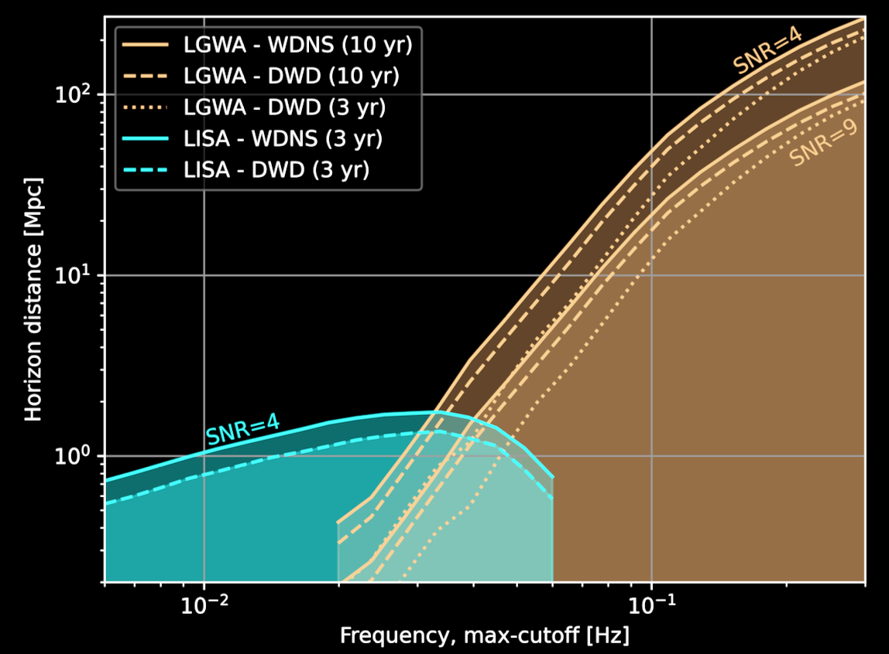
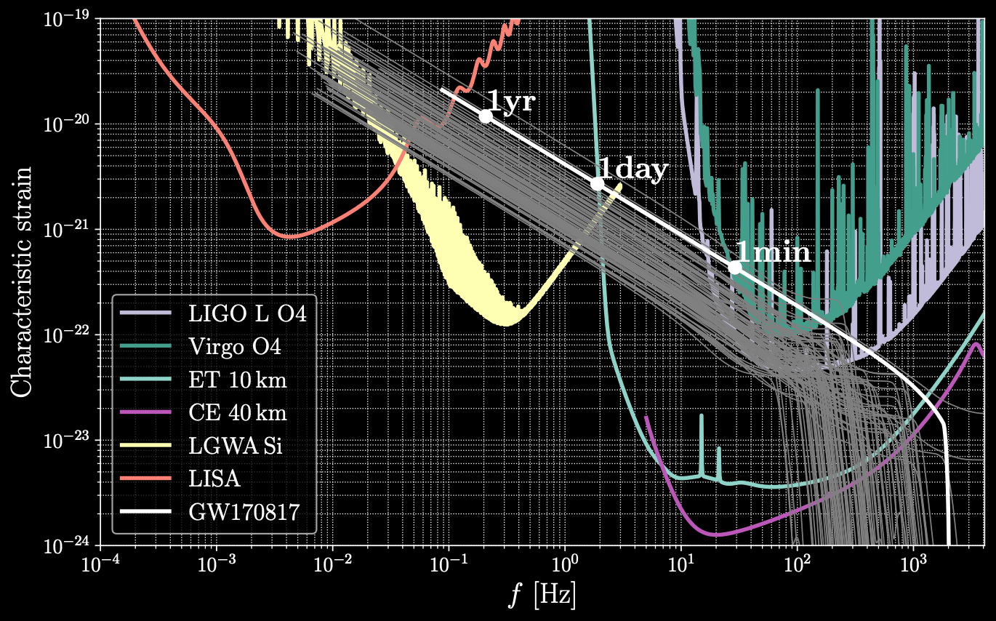
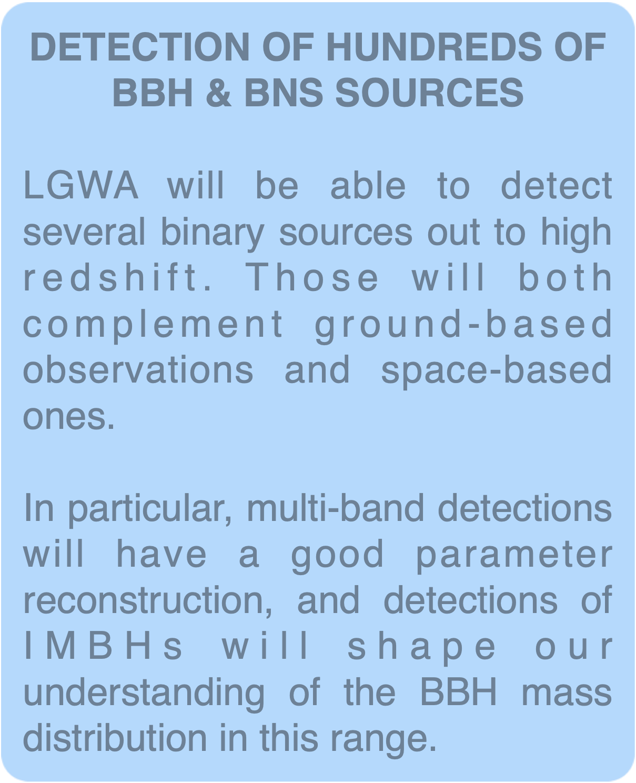
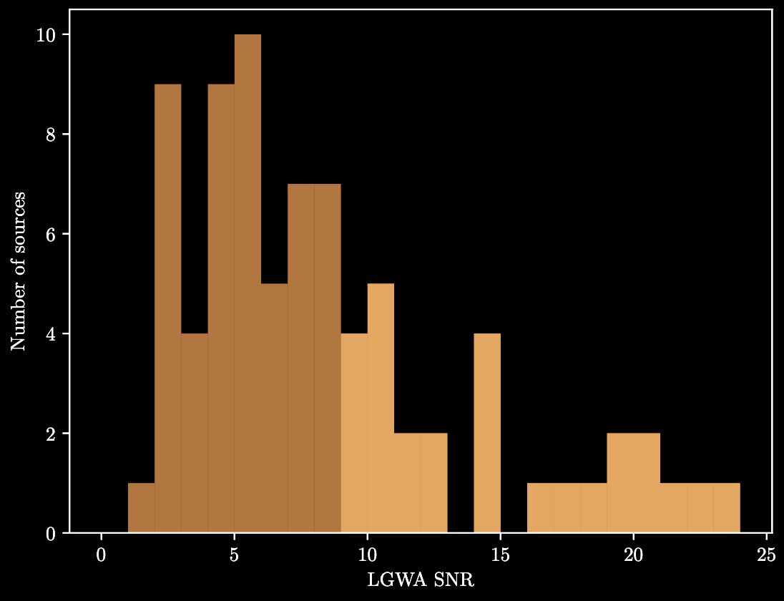
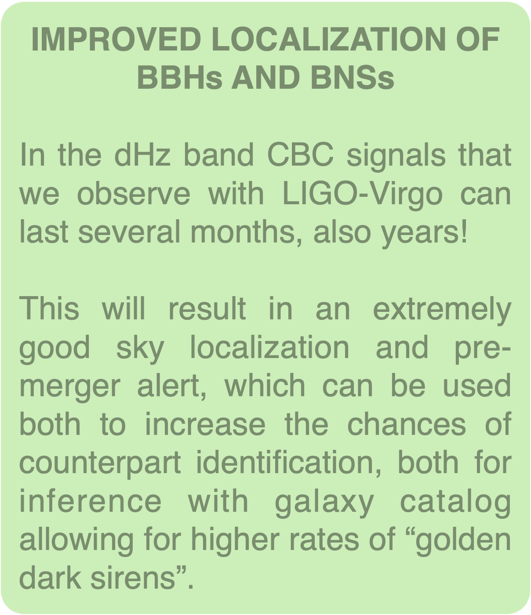
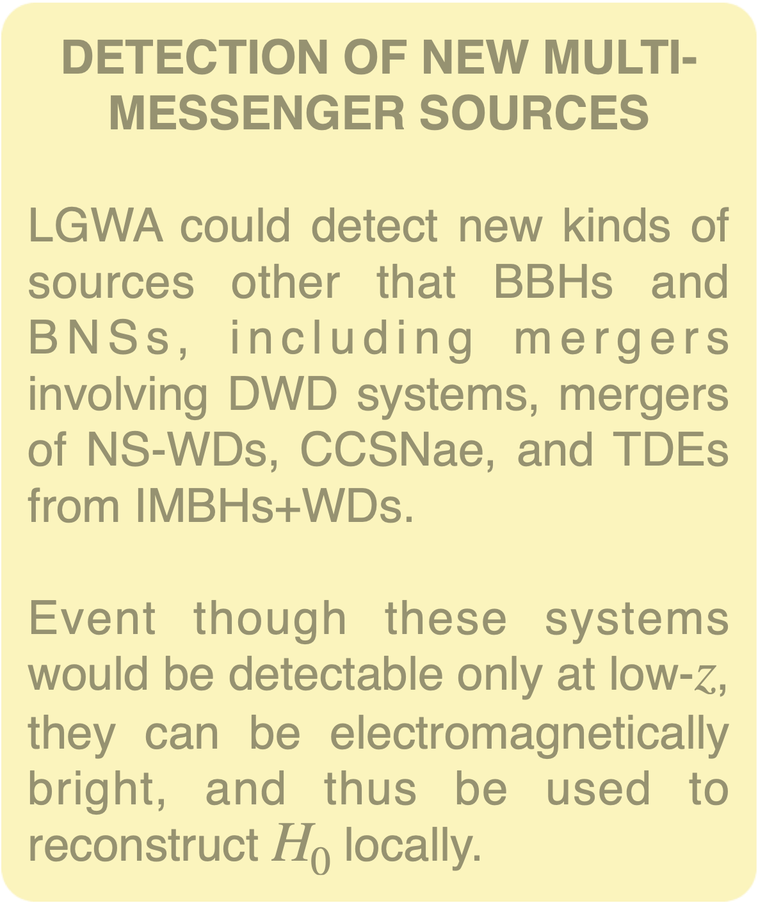
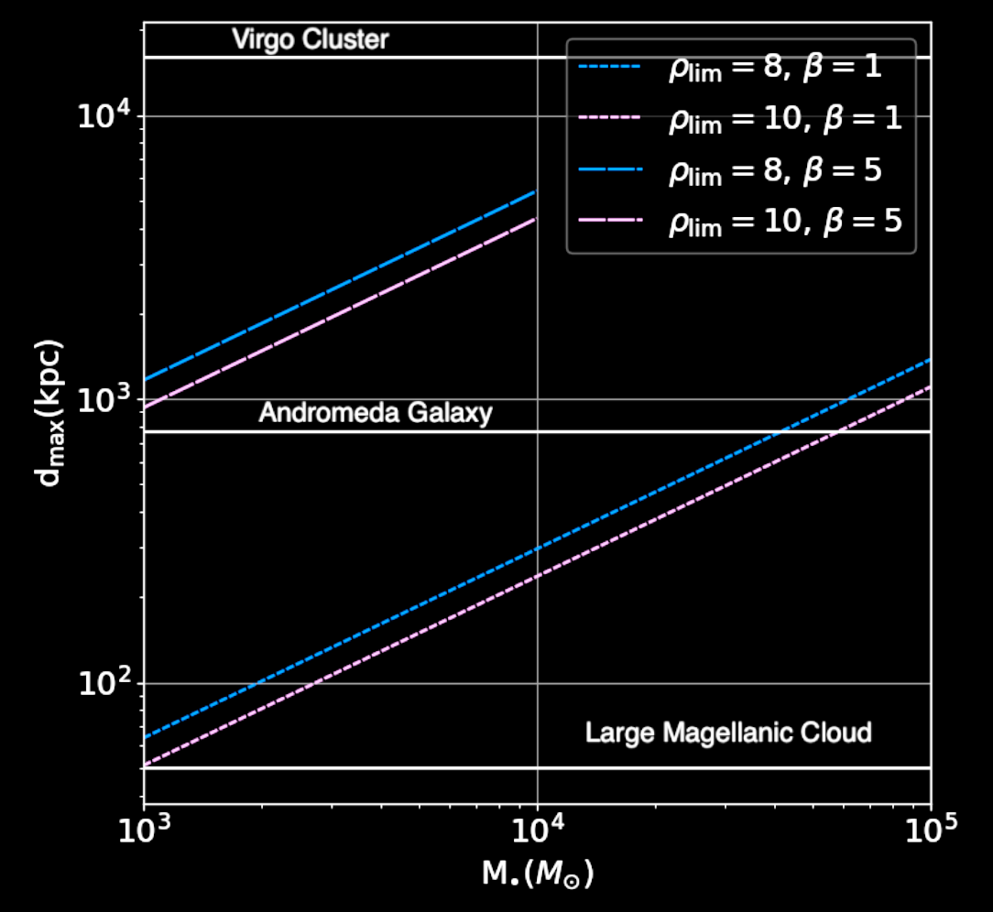
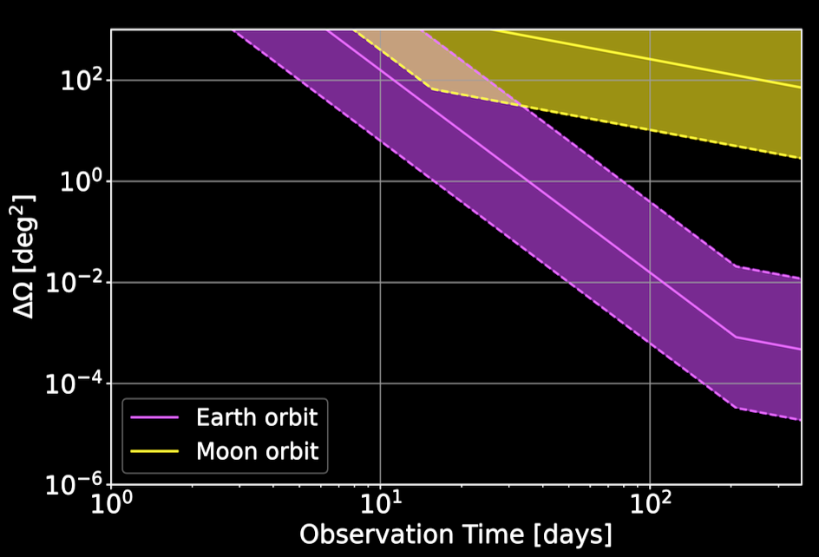
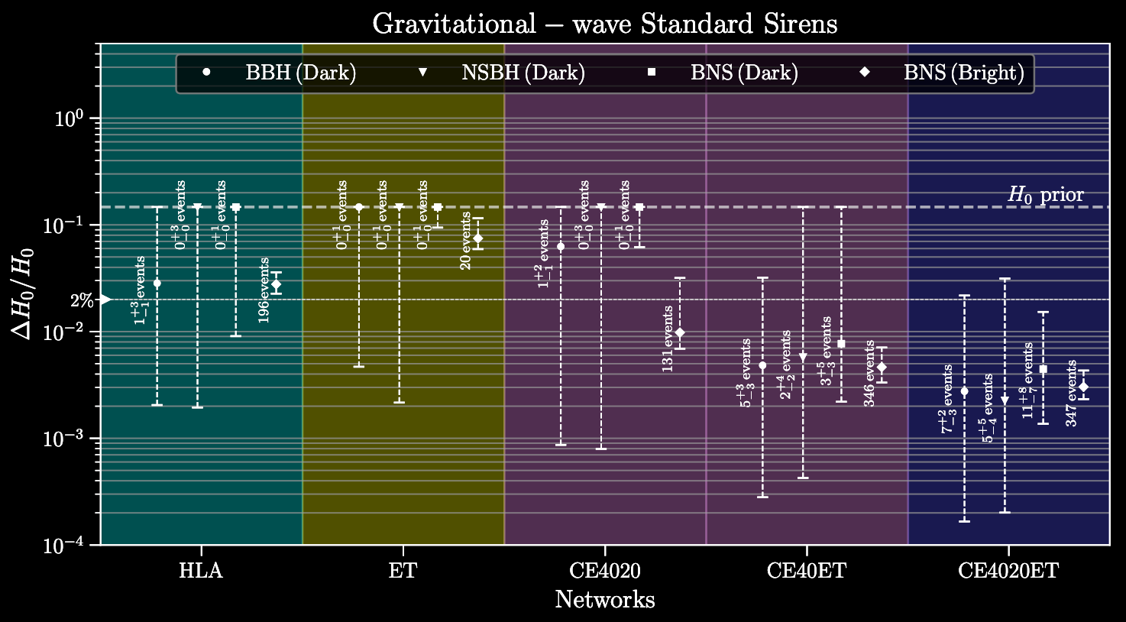
GW standard sirens at LGWA

Slide 16
Summary
GWs are an extremely powerful tool for cosmology, as they allow to put tight constraints on $Λ$CDM parameters, dark energy, and modified gravity
Several techniques can be used to infer the expansion history of the Universe, including systems with and without a counterpart, with the crucial requirements being localization accuracy and number of detections
LGWA can largely contribute to GW cosmology, thanks to its localization capabilities, access to new EM-bright sources, and exploration of the high-mass end of the BBH mass distribution

Slide 17
Overview
Introduction to current GW observations and GW cosmology
Gravitational-wave standard sirens
Key concepts
Standard sirens at LGWA
Stochastic gravitational-wave backgrounds
Introduction
Detection prospects at LGWA

Slide 18
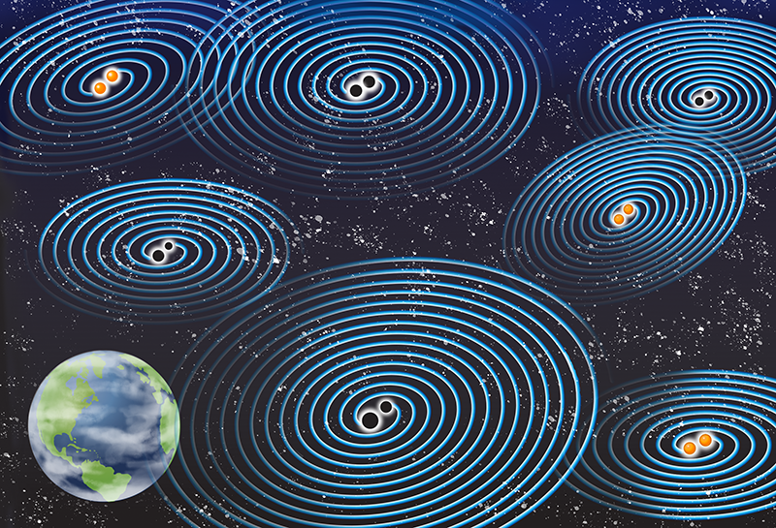
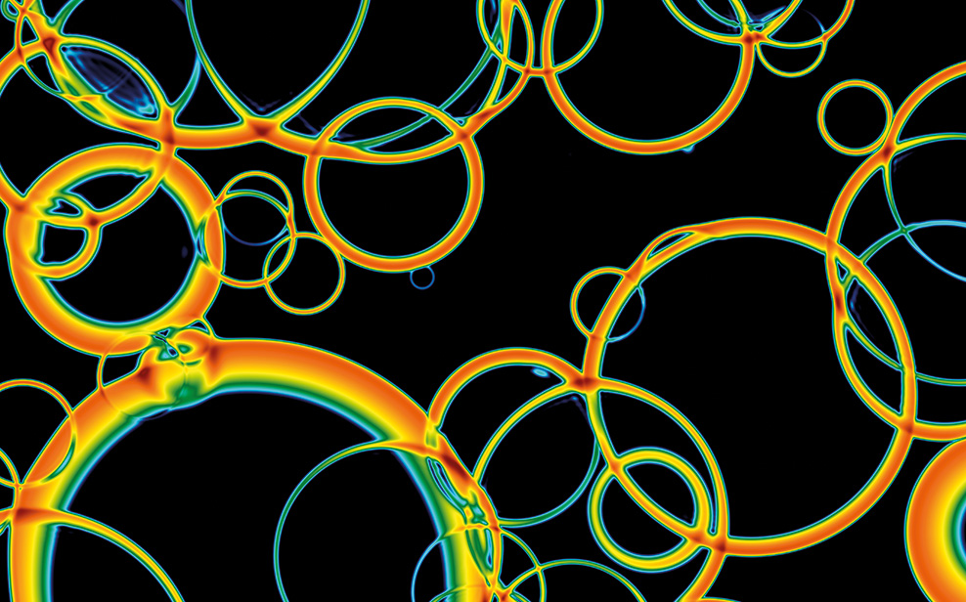
Stochastic GW backgrounds
The stochastic GW background is formed by the incoherent superposition of signals emitted by different GW sources in our Universe:
the AGWB is made of the superposition of all GWs emitted by different populations of astrophysical sources, from the onset of stellar activity until the present epoch
The CGWB are tensor modes produced by different processes in the early universe such as inflation, reheating, phase transitions, cosmic strings, or primordial black holes
©APS/Carin Cain
©D Weir/U Helsinki

Slide 19
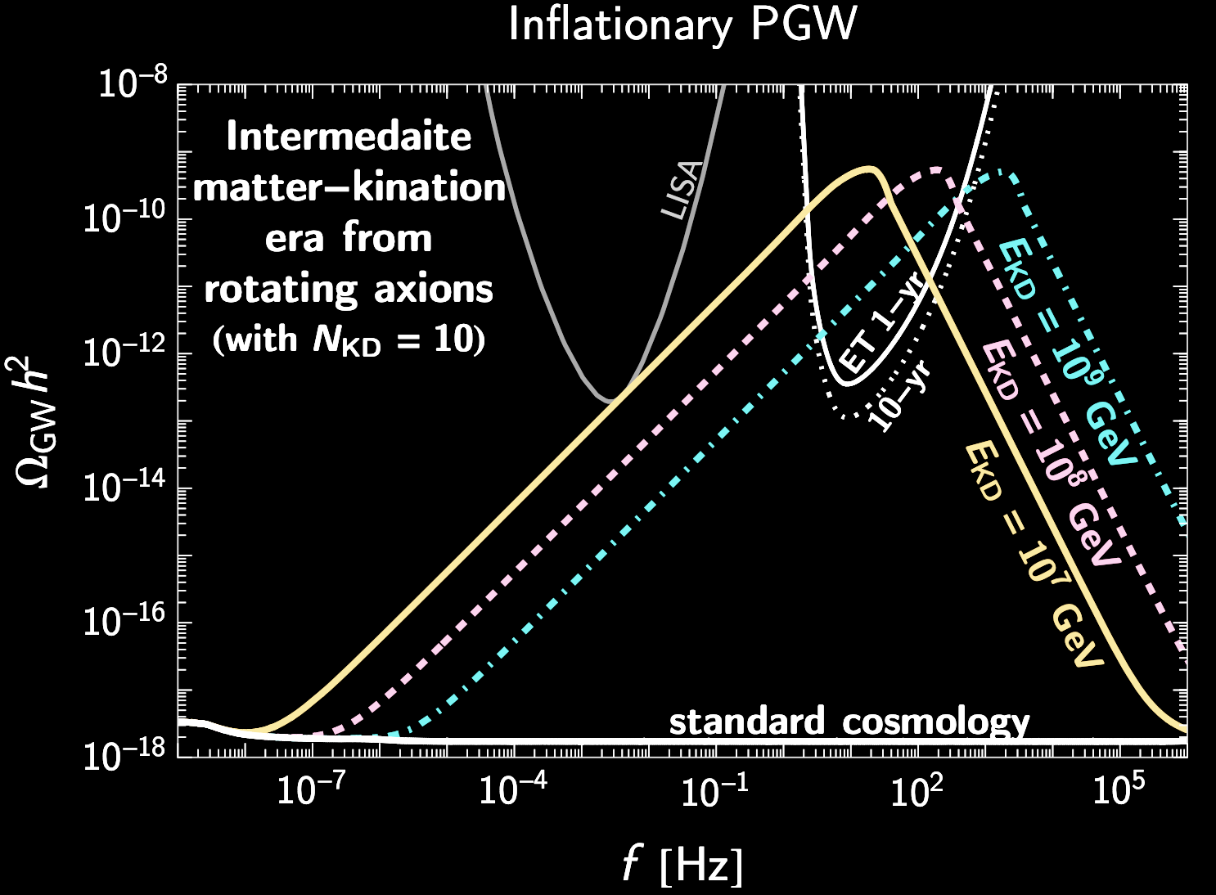
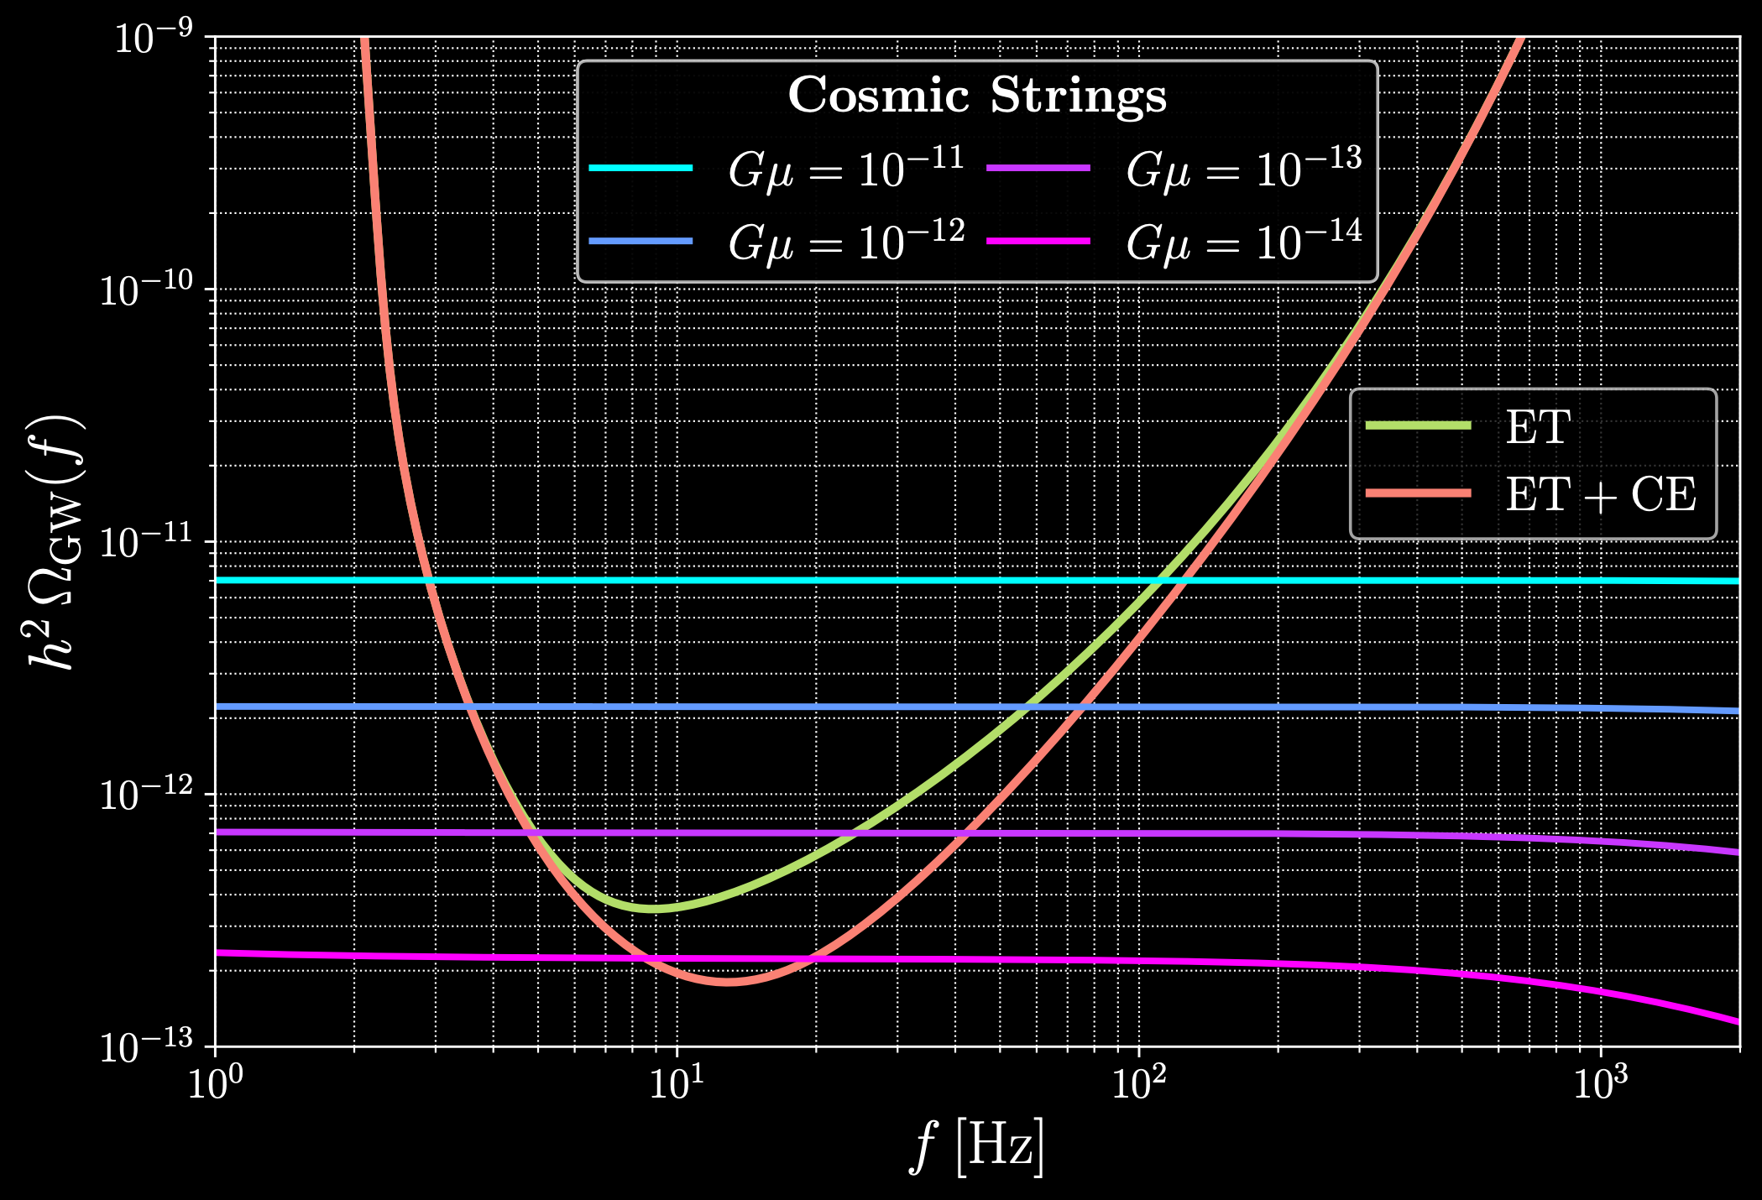
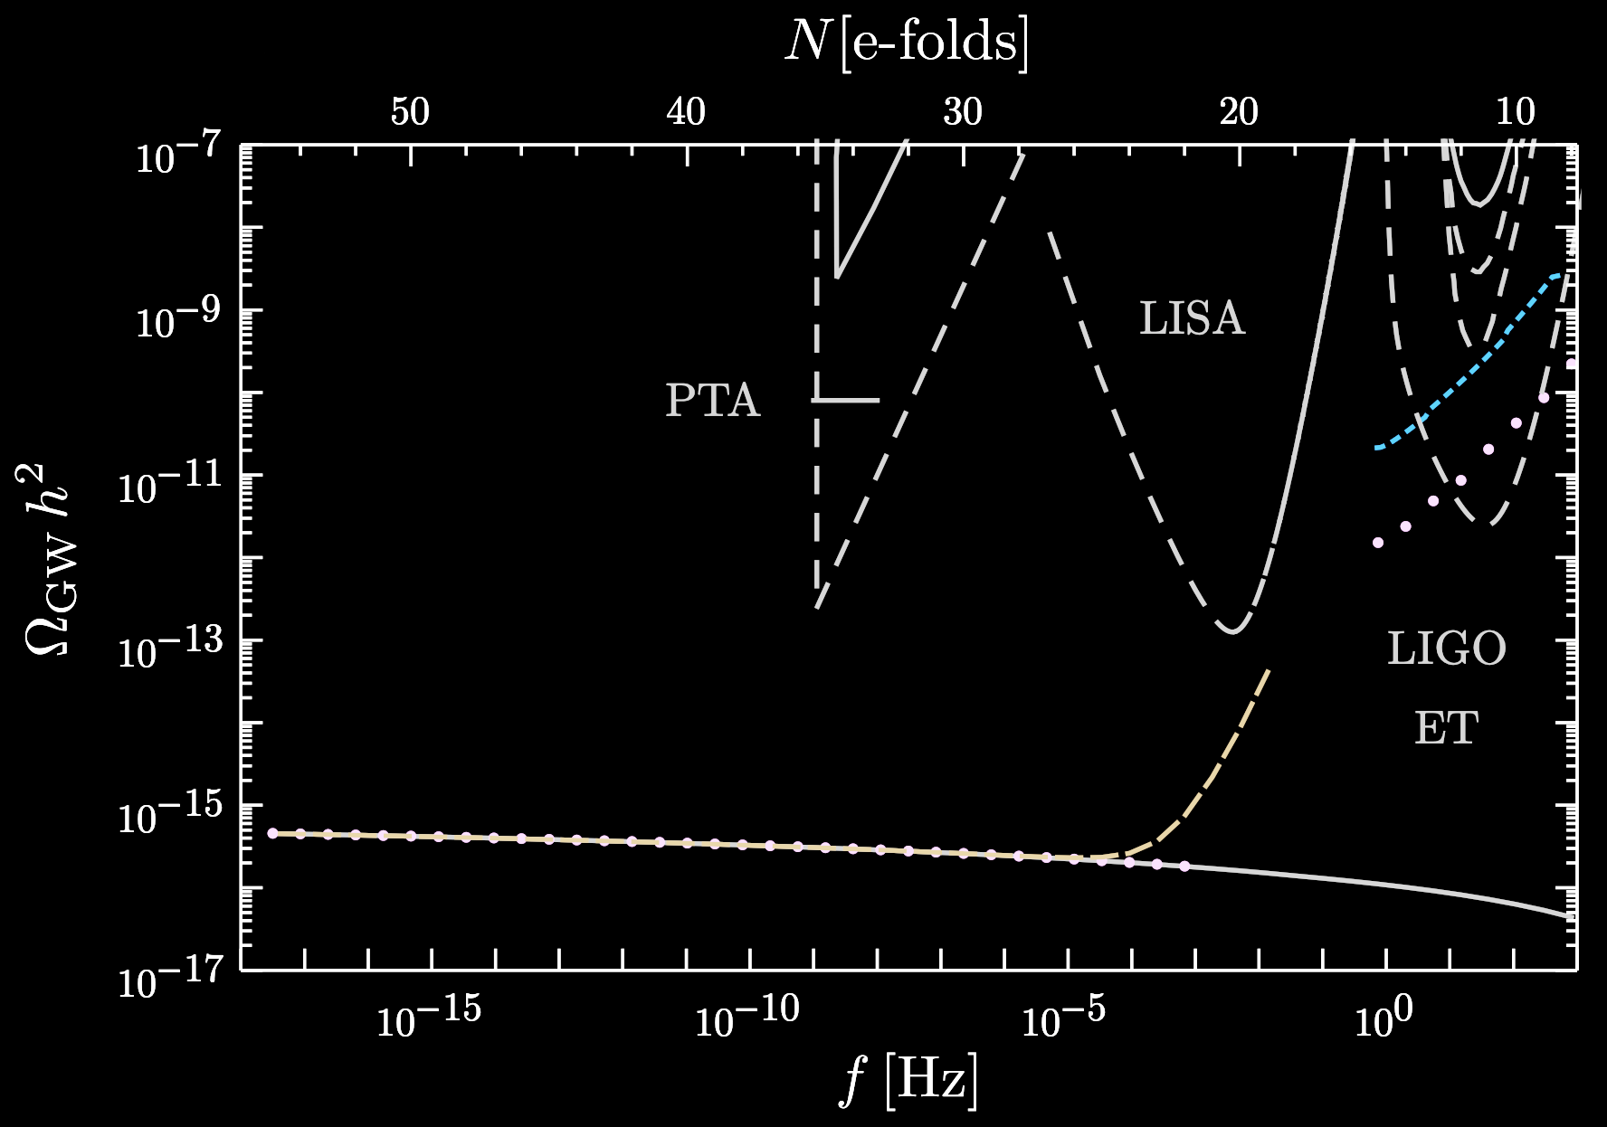
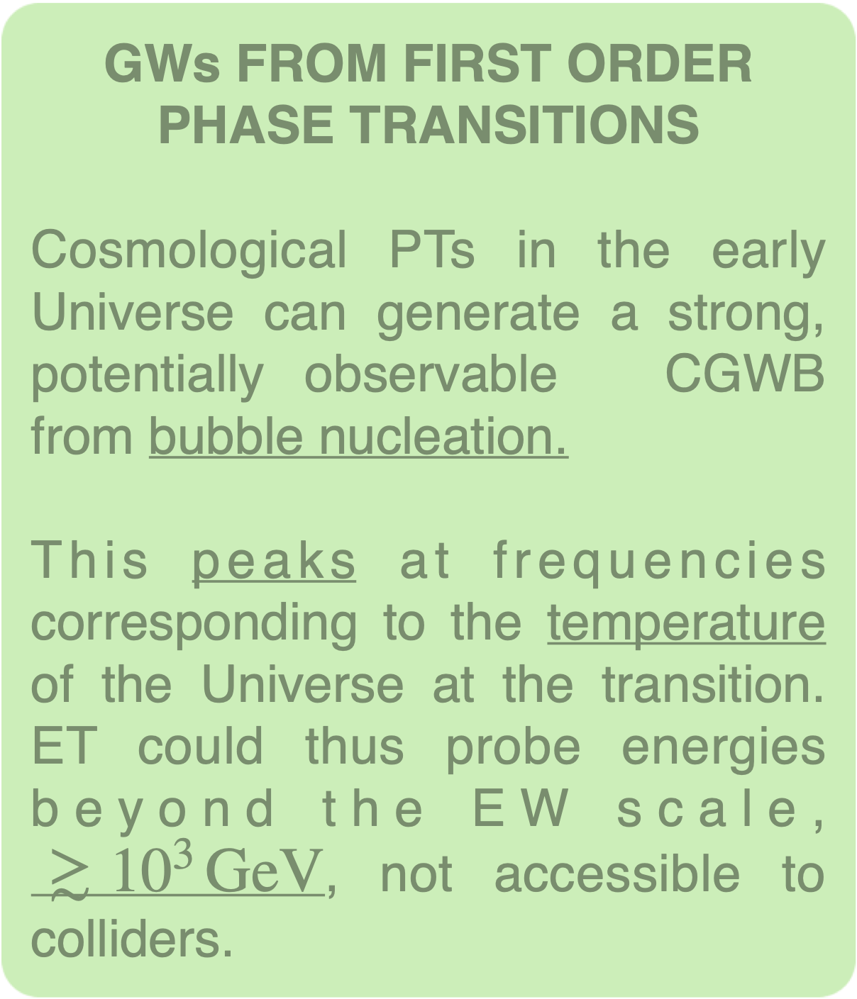
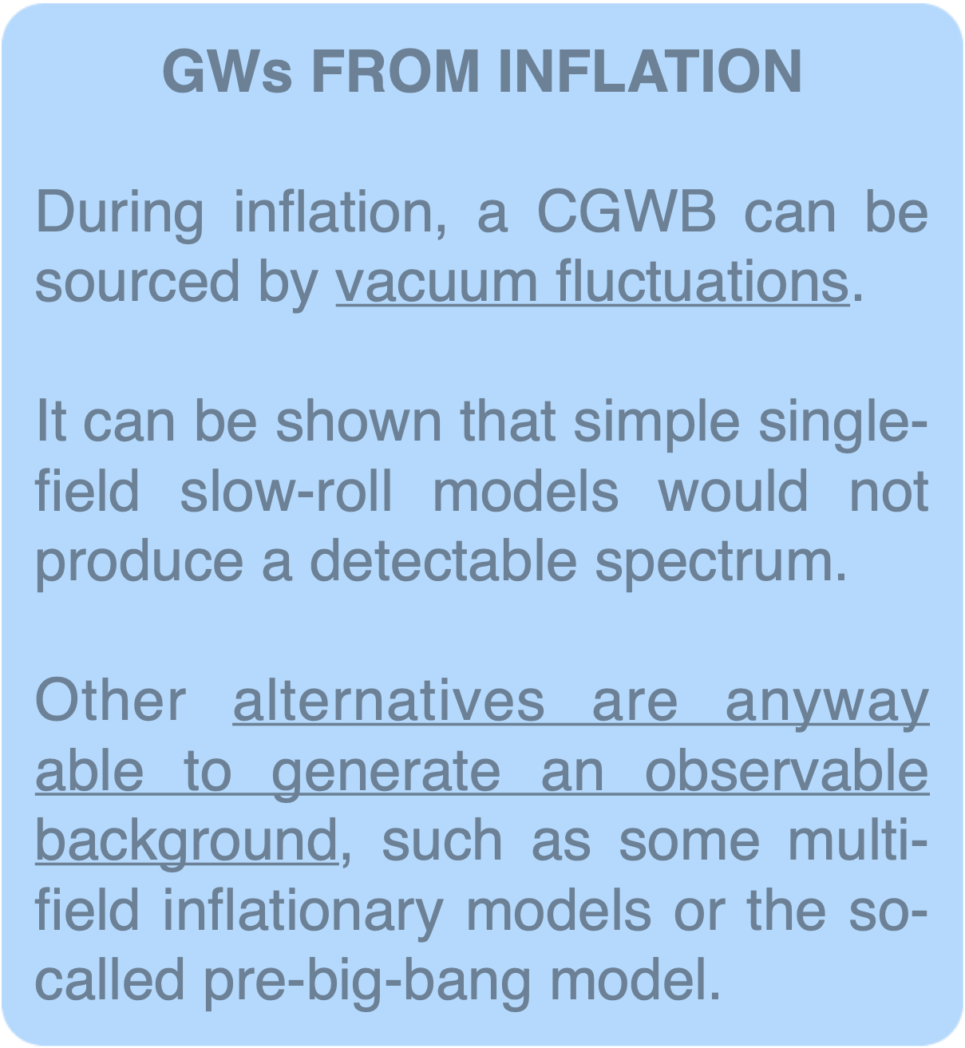
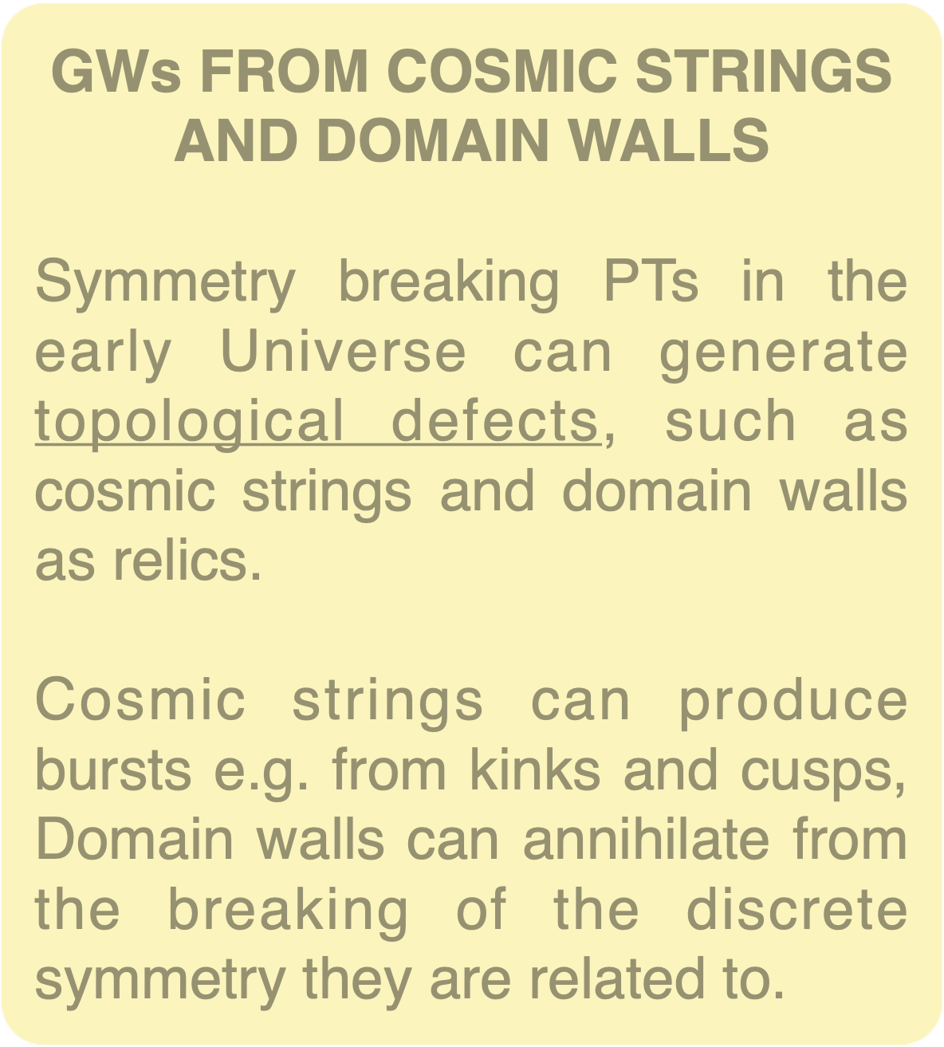
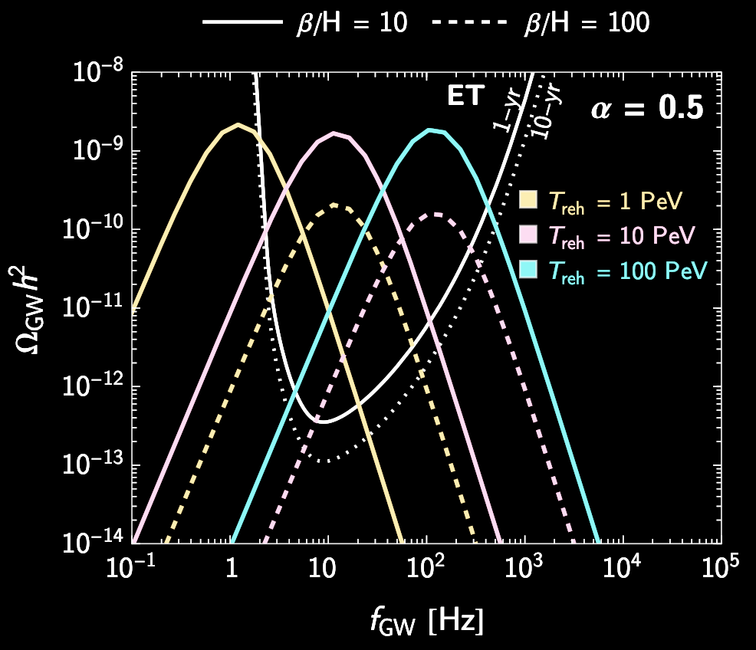
Cosmological GW backgrounds
Several processes in the early Universe can produce a CGWB
multi-field
single-field
1807.03358
2002.01079

Slide 20

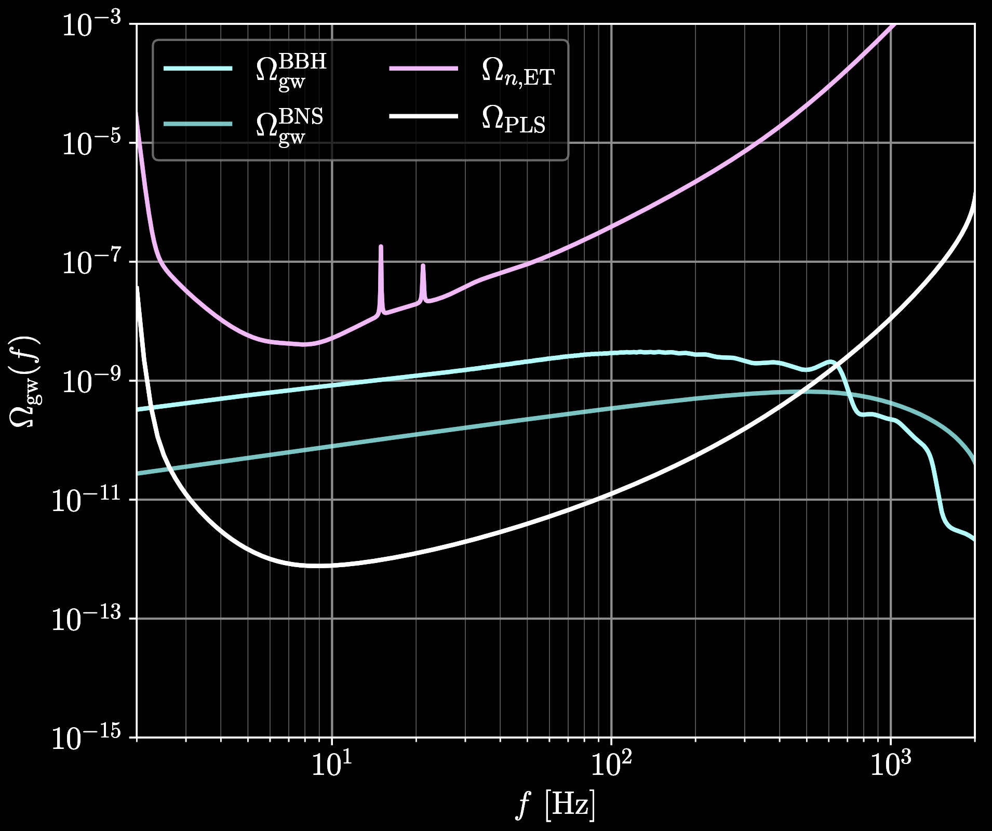


The astrophysical GW background
1 yr
The superposition of unresolved signals from CBCs and other astrophysical sources constitutes another GW background, potentially louder than a cosmological one

Slide 21






Search for a SGWB
Having a network of GW detectors, the search for a SGWB can be performed correlating the output of the instruments
filter
One then maximizes the signal-to-noise ratio, defined as

Slide 22
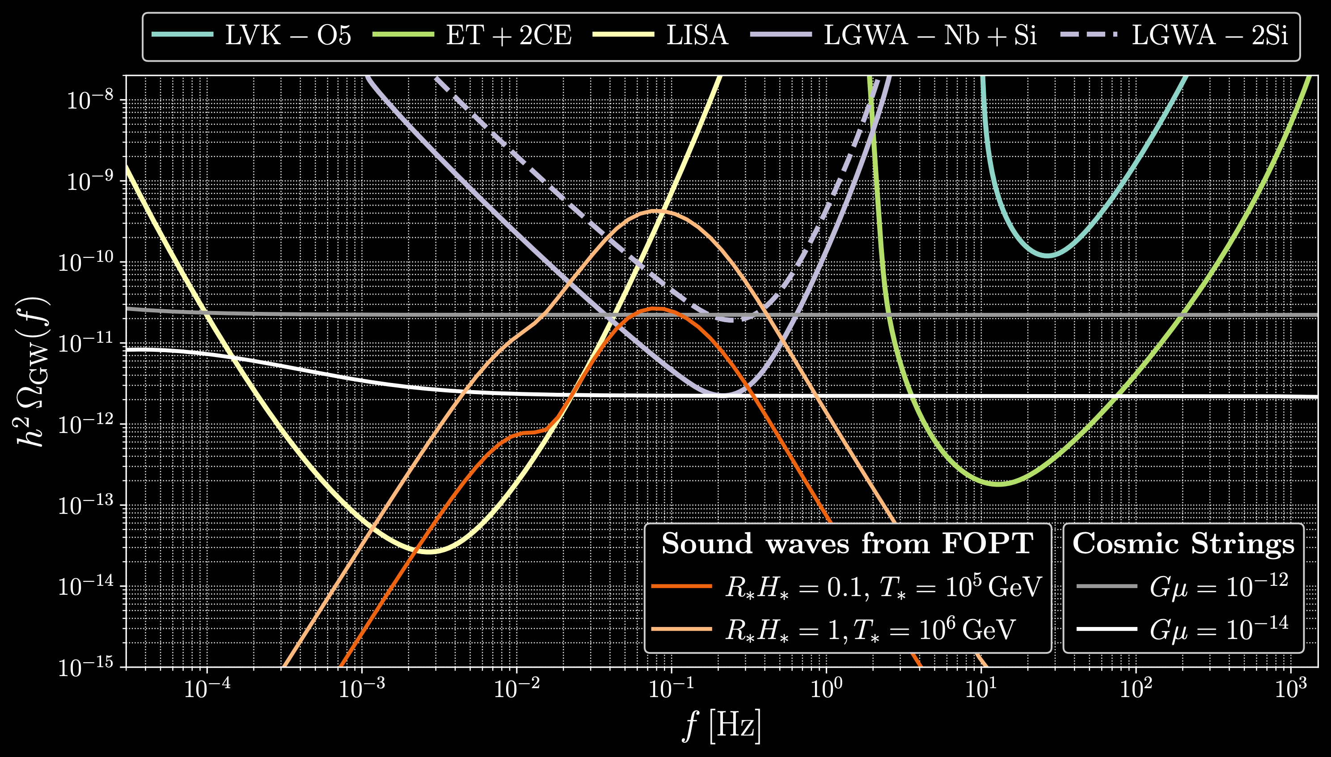

Search for a SGWB: the PLS
From this one can define the power-law integrated sensitivity, which is commonly used to assess the detectability of a SGWB spectrum
1310.5300

Slide 23
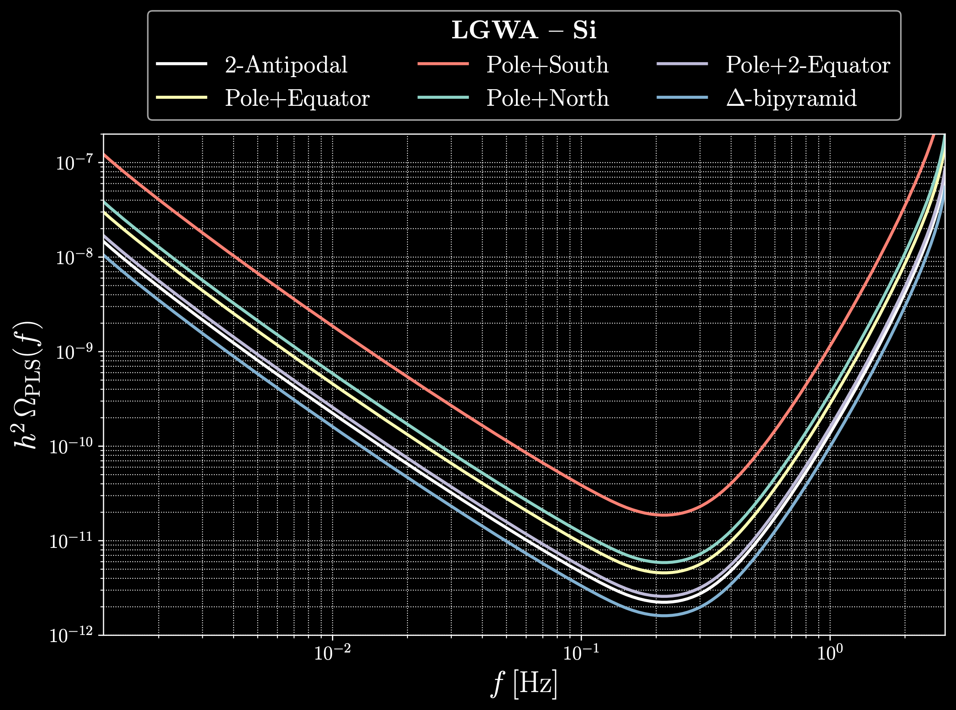
Search for a SGWB: the PLS
From this one can define the power-law integrated sensitivity, which is commonly used to assess the detectability of a SGWB spectrum
1310.5300

Slide 24
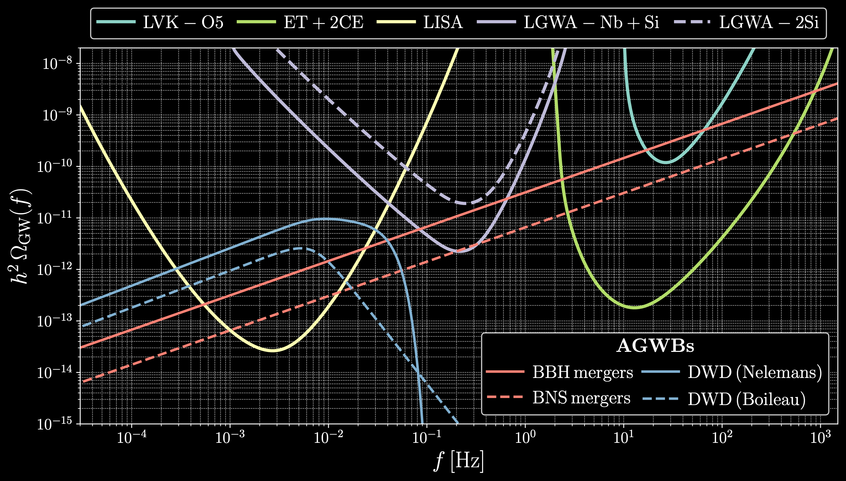
Search for a SGWB: AGWB in the dHz
The LGWA band is particularly favorable to search for CGWB:
The galactic and extragalactic DWD background, which is un unbeatable source of noise in LISA, is not expected to be loud enough for LGWA
The AGWB from compact binaries can be reduced by subtracting signals, also in conjunction with future experiments (ET and CE) which will observe most of the BBHs in the Universe
© Luca Reali

Slide 25

Summary
SGWBs are among the most interesting observables for GW instruments, representing a new powerful probe of the early Universe
LGWA will open a new window to observe CGWBs, both specific to the dHz band and spanning different orders in frequency
The impact of the AGWB in the LGWA band is expected to be less relevant than in other bands
An array of detectors (also at a reduced sensitivity) will however be needed

Slide 26



