Slide 1
HPC, Big Data and AI for Astrophysics in the Age of Computing
CLAUDIO GHELLER
INAF – INSTITUTE OF RADIO ASTRONOMY BOLOGNA
(on behalf of all contributors to the National Centre for HPC, Big Data and QC)
ICSC Italian Research Center on High-Performance Computing, Big Data and Quantum Computing
Missione 4 • Istruzione e Ricerca

Slide 2
The Age of Computing
Entering the
Age of Computing
Credits: Torsten Hoefler - ETHZ

Slide 3
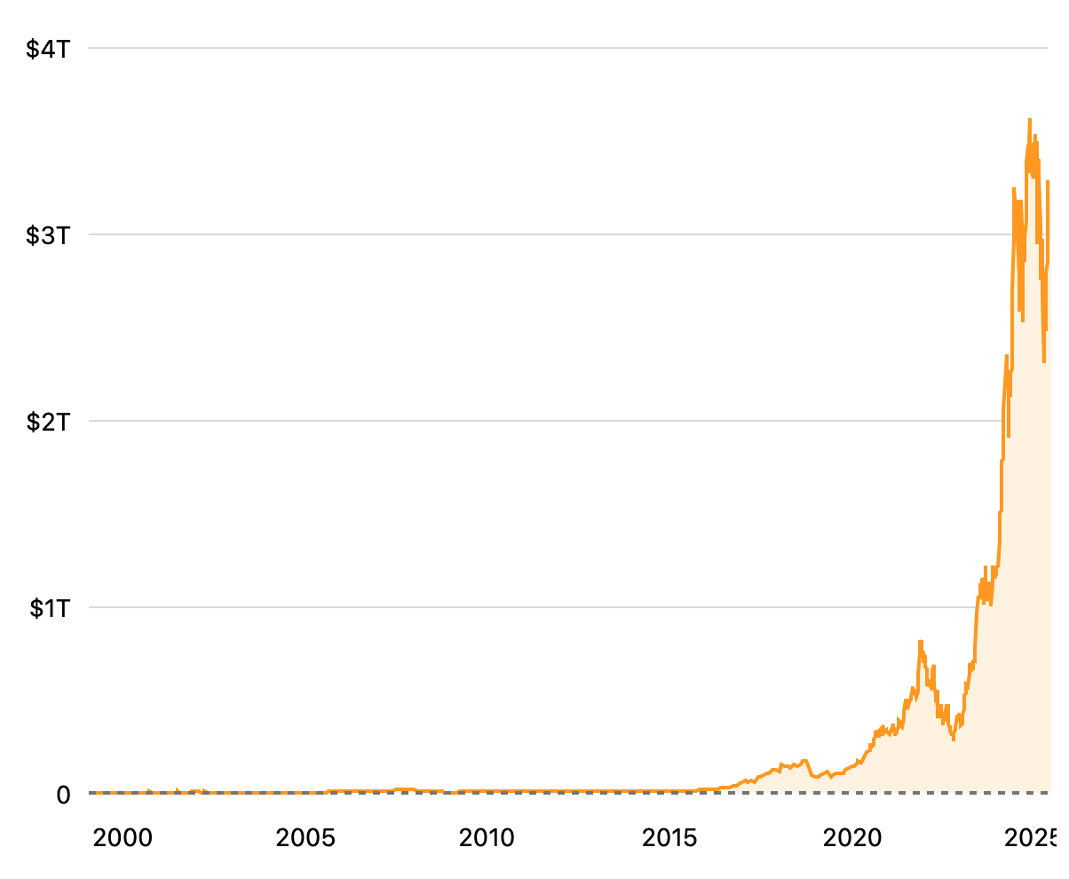
The age of Computing
Market cap history of NVIDIA from 1999 to 2025
AI DRIVEN
Processors
Network
Software

Slide 4
Do we need AI?
Radio interferometric data segmentation
Identify low surface brightness emission
LOFAR HBA observation
(Govoni et al. 2019)

Slide 5
Do we need AI?
Transformer based network to perform the segmentation of radio images
Trained to detect faint, diffuse sources
LOFAR HBA observation

Slide 6
Do we need AI?
Segmentation mask superimposed to the A399-A401 data at 80’’ resolution
(Sanvitale et al. 2025)

Slide 7
Do we need AI?
Large Language Models (ChatGPT, DeepSeek, Gemini, Llama…)

Slide 8
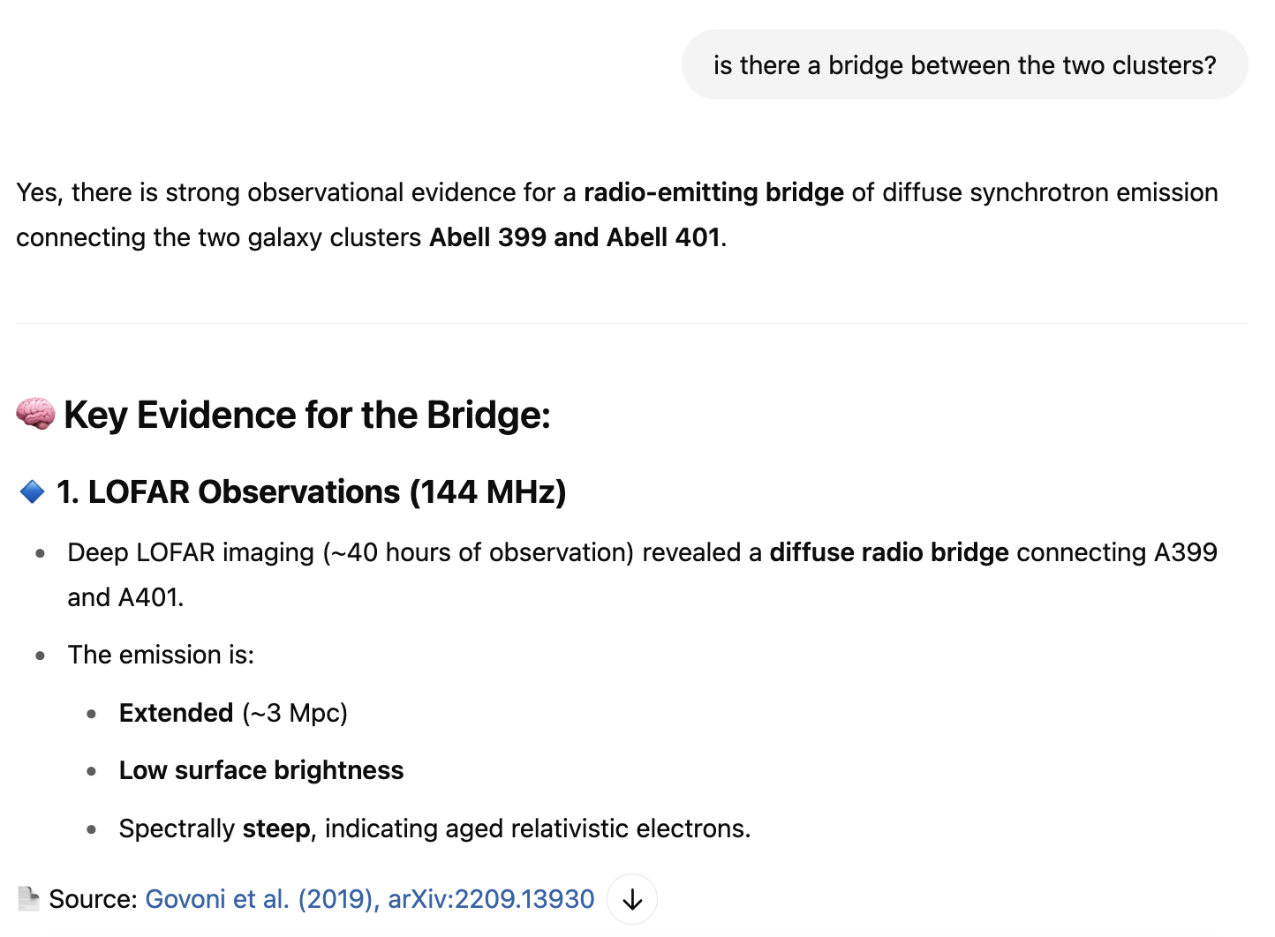
Do we need AI?
Large Language Models (ChatGPT, DeepSeek, Gemini, Llama…)

Slide 9
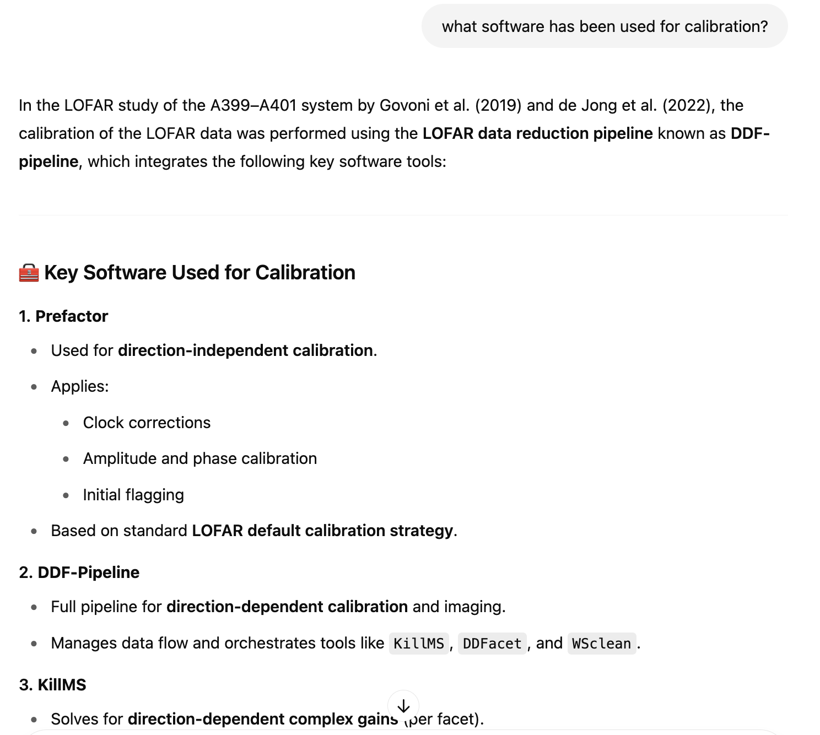
Do we need AI?
Large Language Models (ChatGPT, DeepSeek, Gemini, Llama…)

Slide 10
Guess if…
We could specialize the LLM to astrophysics vocabulary and to astronomy data archives → FINE TUNING
We could retrieve up-to-date information (e.g. day before arXiv) with fonts and references without retraining → Retrieval Augmented Generation (RAG)
We could combine LLM and classification/regression functionalities on heterogeneous data → Multimodal Foundation Models
We could have more powerful algorithms → e.g. DeepSeek

Slide 11
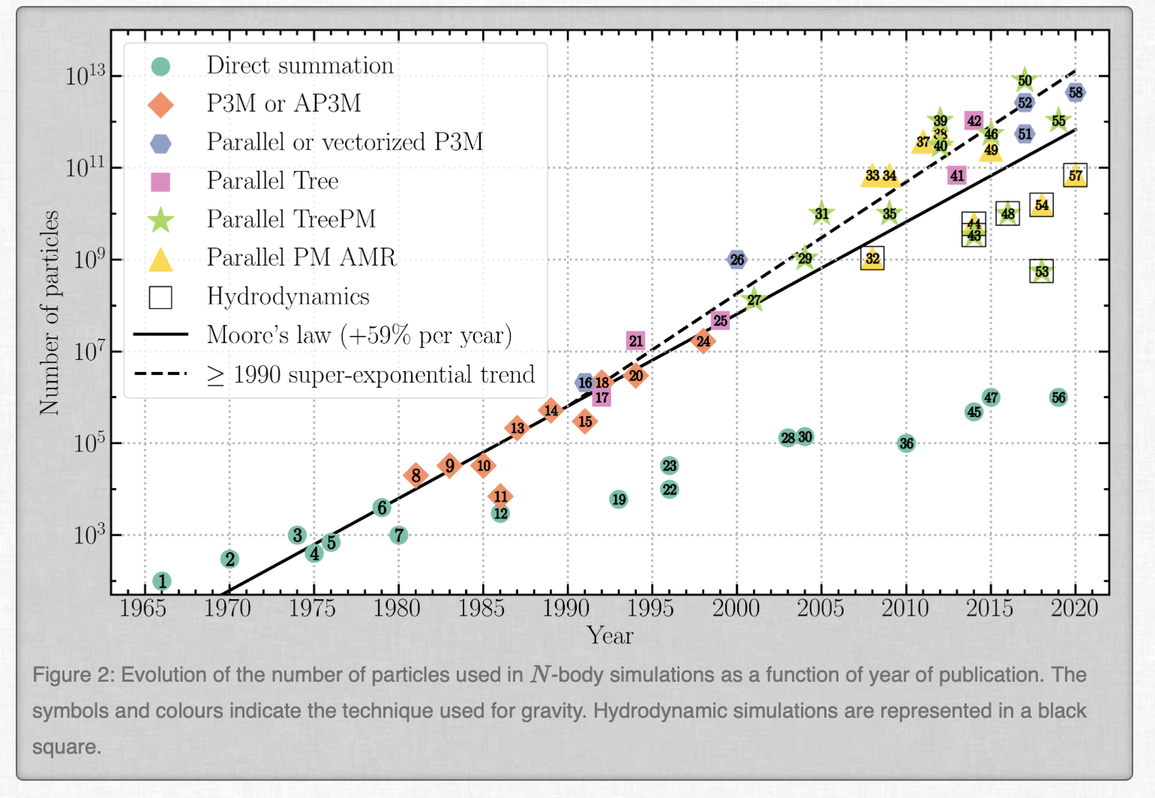
(of course…) it is not only AI
Numerical models and simulations, data processing and analysis
https://www.florent-leclercq.eu/blog.php?page=2

Slide 12
Past...
INSTRUMENT
SCIENCE
DATA
COMPUTING

Slide 13
Present
INSTRUMENT
DATA
SCIENCE
DATA
DATA
DATA
COMPUTING

Slide 14
Future: the computational inflation
DATA
DATA
INSTRUMENT
DATA
COMPUTING
SCIENCE
COMPUTING

Slide 15
Riding the wave
The National Centre for HPC, Big Data and Quantum Computing (ICSC)
Born in 2022 with PNRR funds (320 Meuros)
Mission: “The activities of the ICSC will focus on maintenance and upgrade of the Italian HPC and Big Data infrastructure, as well as on the development of advanced methods and numerical applications and software tools to integrate computing, simulation, collection, and analysis of data of interest for research, manufacturing, and society, also through cloud and distributed approaches”.
https://www.supercomputing-icsc.it

Slide 16
INAF is a founding member, involved in 4 Spokes (sub-projects)
Spoke 3: Astrophysics & Cosmos Observations (Spoke leader)
Spoke 2: Fundamental Research & Space Economy (Spoke co-leader)
Spoke 1: Future HPC & Big Data
Spoke 10: Quantum Computing
~ 40 scientific/technological research activities carried on only in Spoke 3 in:
HPC code development: parallelization, optimization
Code acceleration
AI and advanced statistical solutions development
Data management and archiving
Training the new generation of computational astronomers
> 30 researchers gravitating in the National Centre on astro topics
INAF as a main player in ICSC

Slide 17
Getting ready for the challenges of the next decade(s)
Currently working for the final consolidation and establishment of the National Centre, beyond the PNRR
Funds already made available by the Italian Government for 2027-2028
Integrated in the EU HPC (EuroHPC) and Data (EOSC) ecosystem
Outstanding infrastructure to exploit for all the computing and data demanding tasks of future missions, telescopes, satellites…
Preparing the new generations of computational astrophysicists

Slide 18
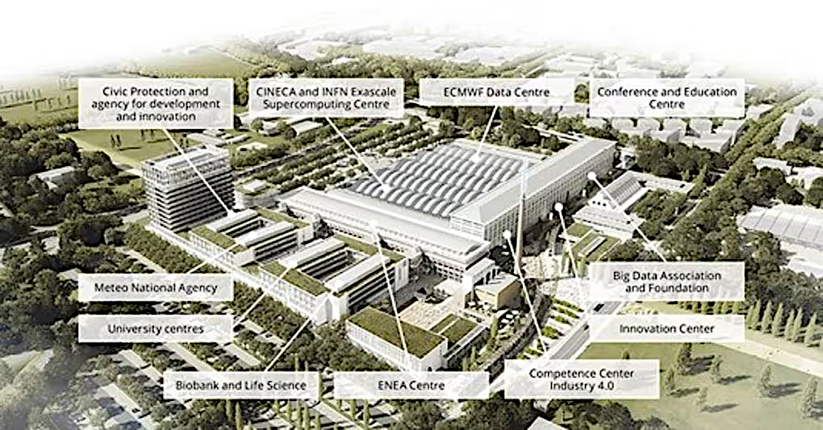
Tecnopolo in Bologna: the main ICSC site
Where: Bologna Technopole
When: Operational from end 2025 – Beginning 2026
What (INAF dedicated resources):
Dedicated 2 PF hybrid computing system
Multi-GPU nodes
Fat CPU nodes (> 1TB RAM)
On-line storage > 5 PB
Long term storage > 11 PB
> 100 Gb/s geographic network
Direct connection with: Tier 1 (Marco Polo) > 15 PF Leonardo and successors
INAF facilities

