Slide 1
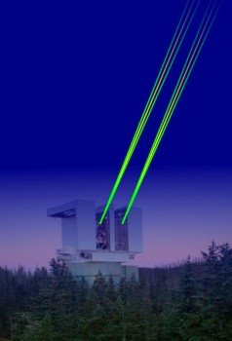
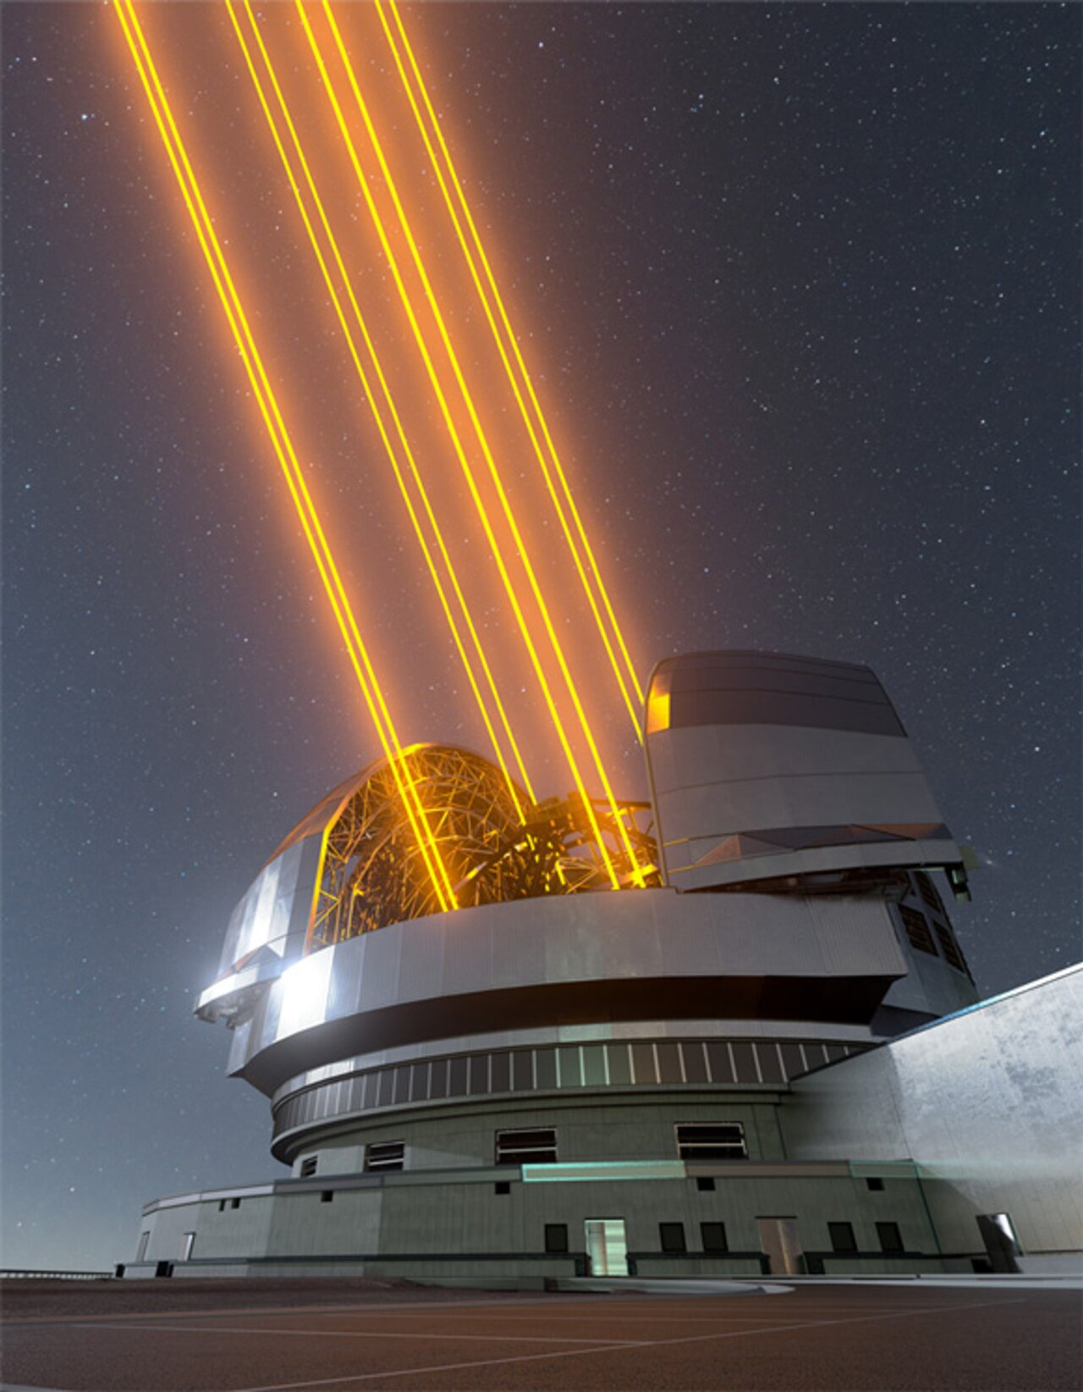
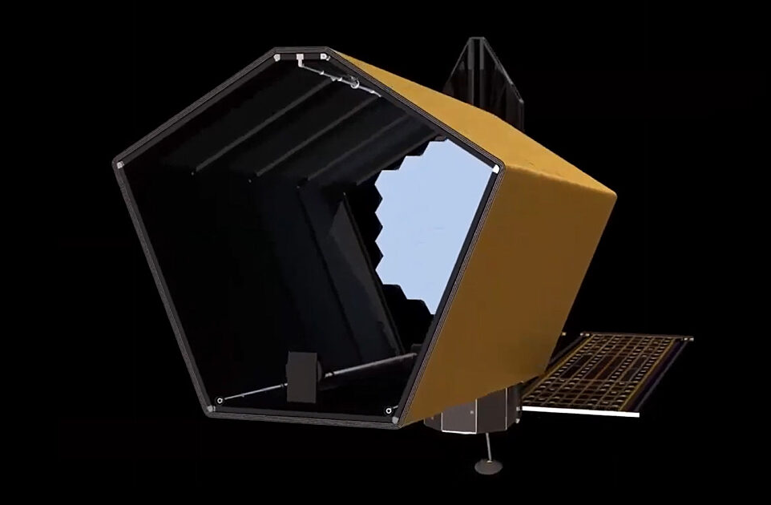
S.S.-QE-DETECTOR parade today tomorrow
Fernando Pedichini INAF OAR

Slide 2
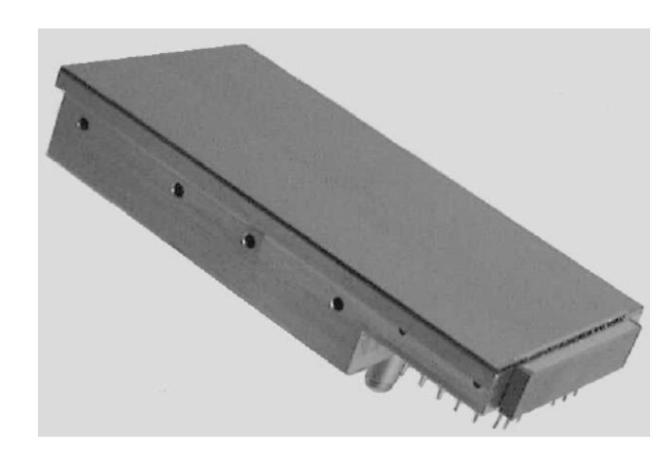
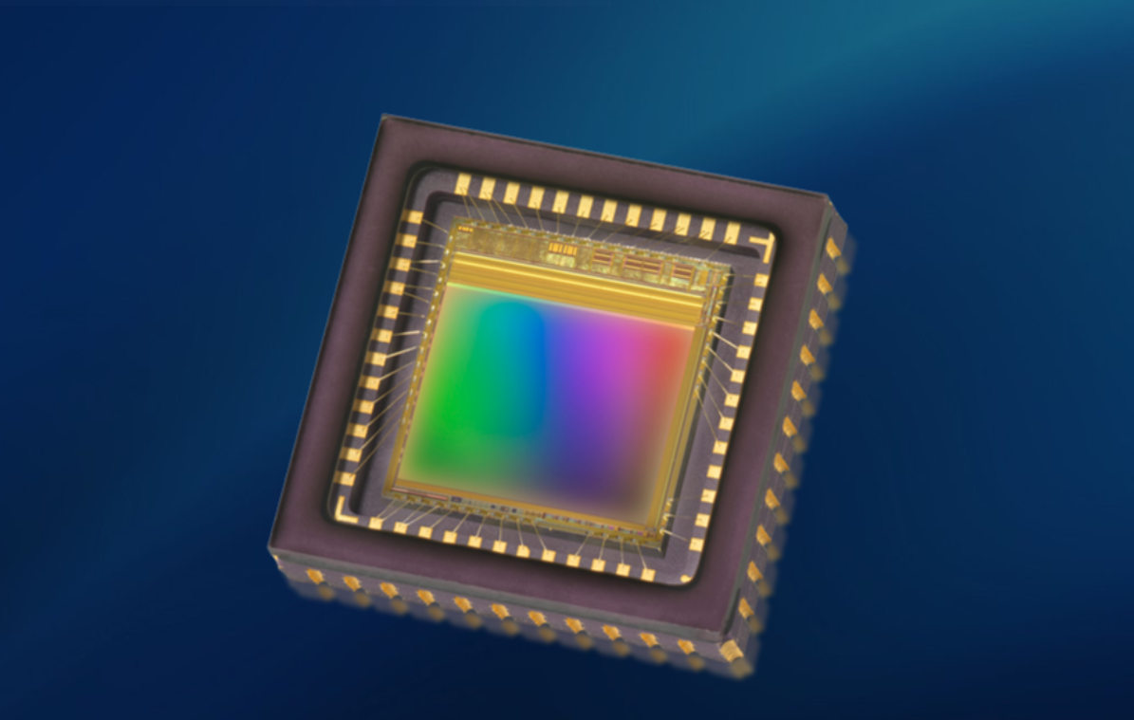
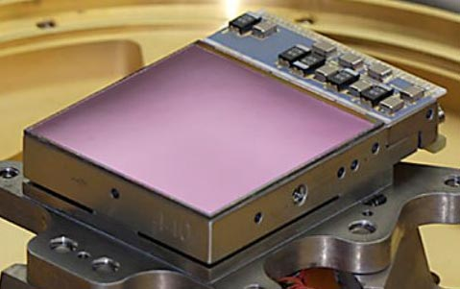
families of standard DETECTOR
CCD (slow)
Large pixels
Megapixels
High Dark Current
3-5e- RON
Binning
High far-red QE
Complex control
Radiation weak
Mechanical shutter (most)
CMOS (fast)
Small pixels
Megapixels++
Low Dark Current
1-2e- RON
Binning only a few
BI and Microlens
Simple control
Radiation Good
Electronic shutter
HYBRID (CMOS)
Wavelength [μm] 0.3 – 14+
Megapixels
Cryogenics
2-4e- RON
Sub-Window readout
Expensive and critical
Very complex control
Are in Space!
Electronic Shutter

Slide 3
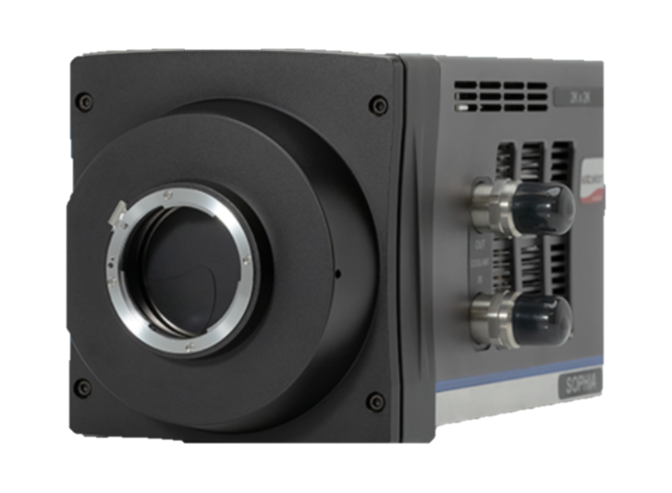
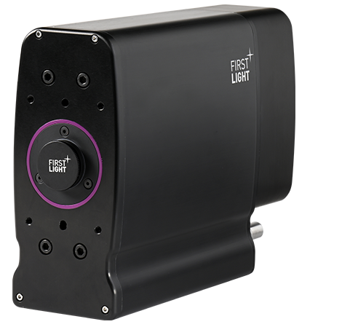
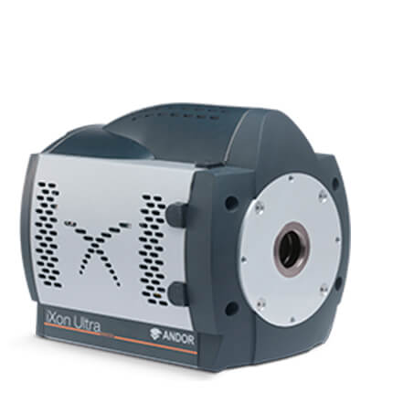
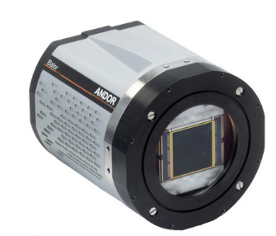
CCDs @ the shelf (ANDOR & Teledyne-E2V)
AO ccd 220
iXon serie
CCD & EM-CCD
0.2-0.3 e- RON
1Mpix El. Shutter
CCD 36Mpix
monolithic
EM-CCD low dynamic
0.2-0.3 e- RON
2kFps

Slide 4
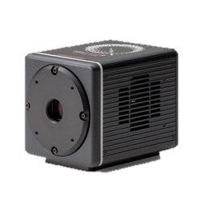
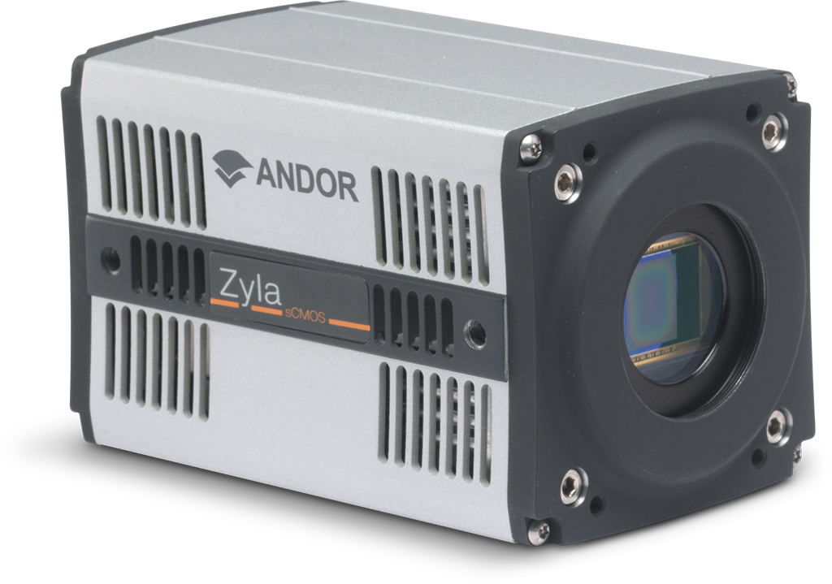
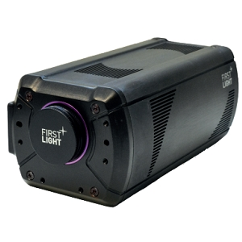
CMOS @ the shelf
qMOS
sCMOS
qORCA HAMAMATSU
8Mpix
0.25e- RON
1kFps
photon counting mode
4Mpix
1e- RON
1kFps

Slide 5
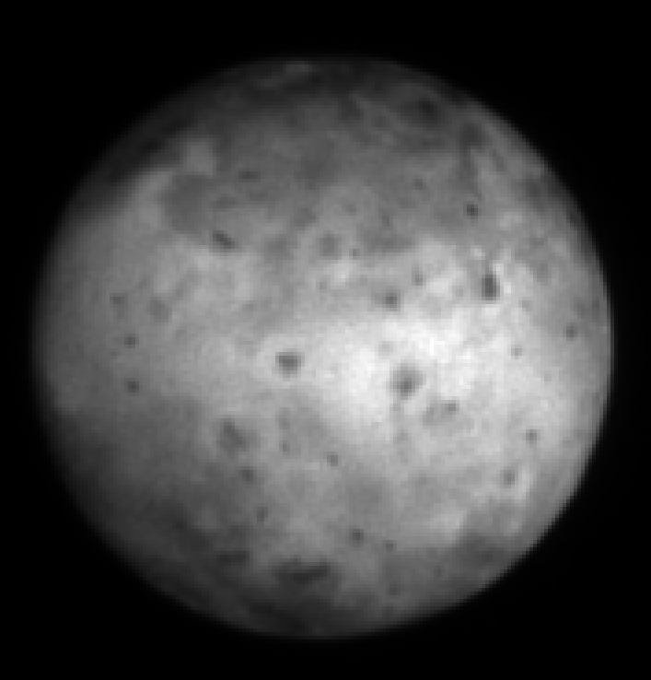
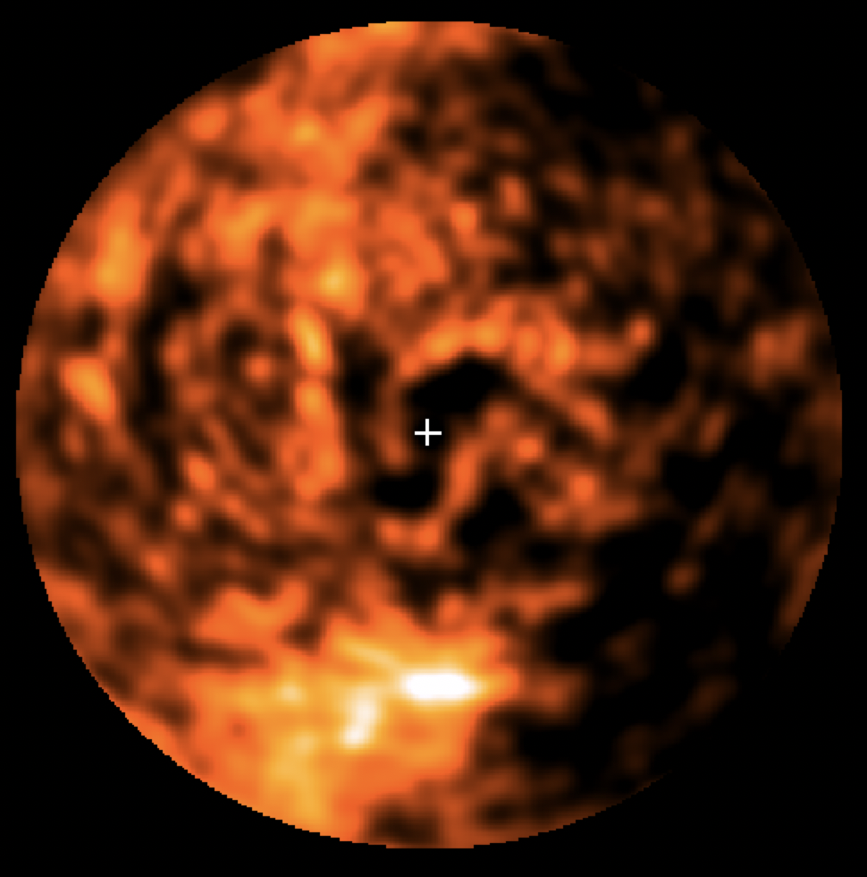
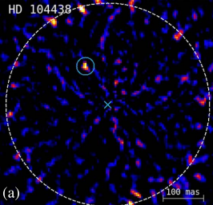
CMOS @ the shelf
SHARK-VIS experience
IO R band
VESTA
AB Aurigae Halpha
2e-4 @107mas

Slide 6
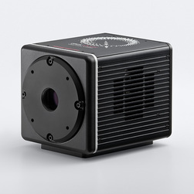
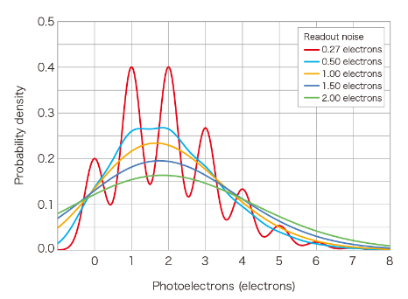
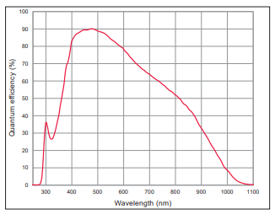
CMOS @ the shelf qORCA HAMAMATSU
0 : 4 γ/pix
(0.8 γ/pix)
0.25 e- RON

Slide 7
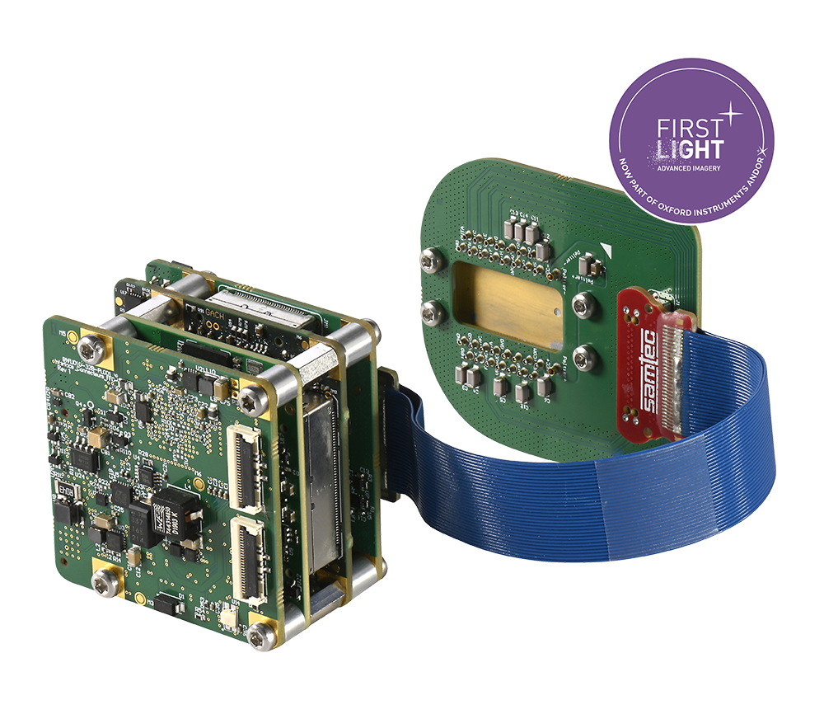
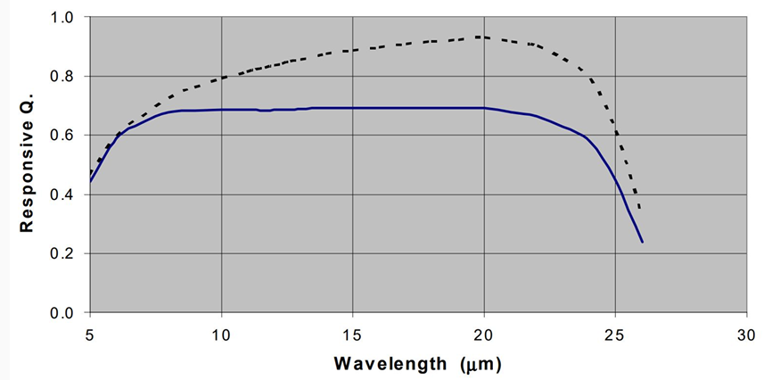
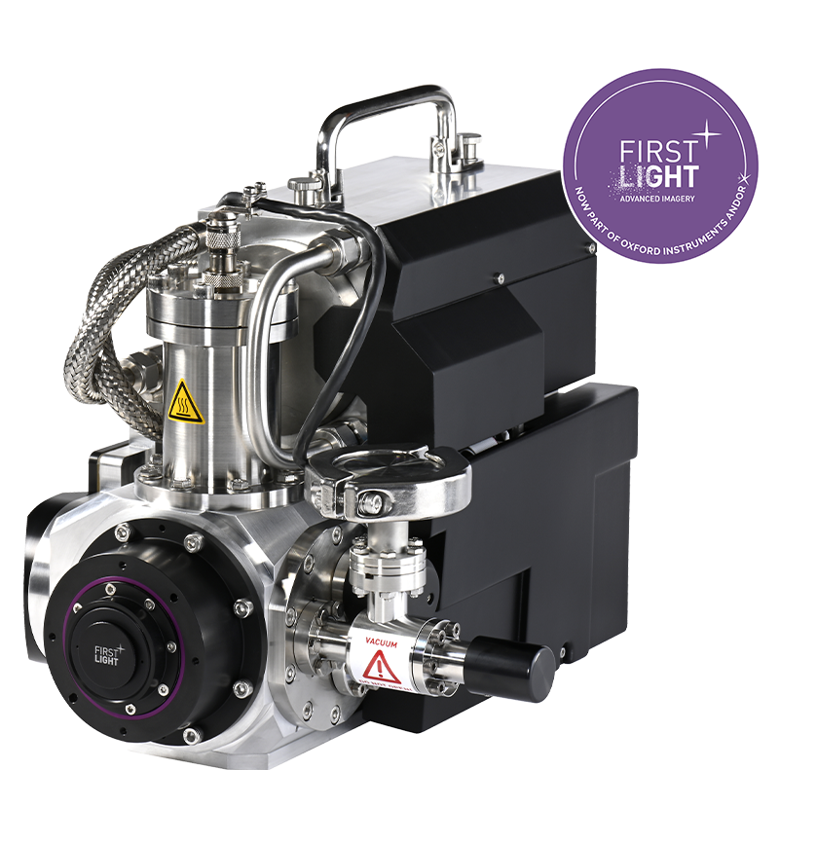
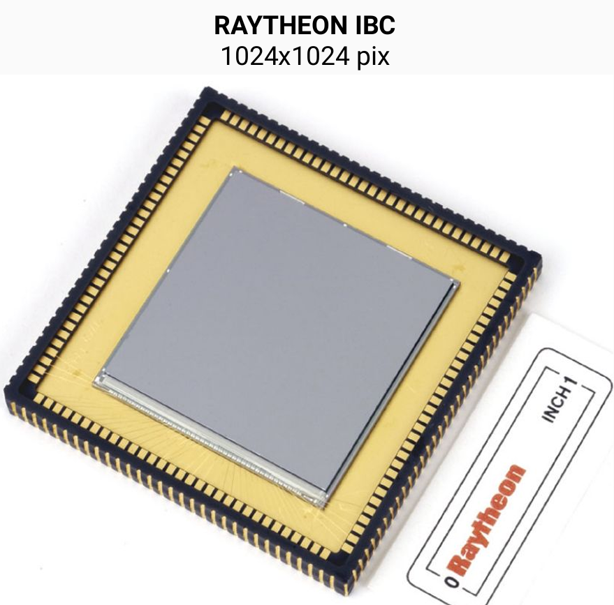
HYBRID @ the shelf
MIR
FIR
NIR
320 x 256 e-APD MCT
24 μm pixel pitch
SWIR 0.8 - 2.43 μm
70% QE, wavelength from 0.9 to 1.7 μm
Up to 3500 fps full frame
Subelectron readout noise

Slide 8
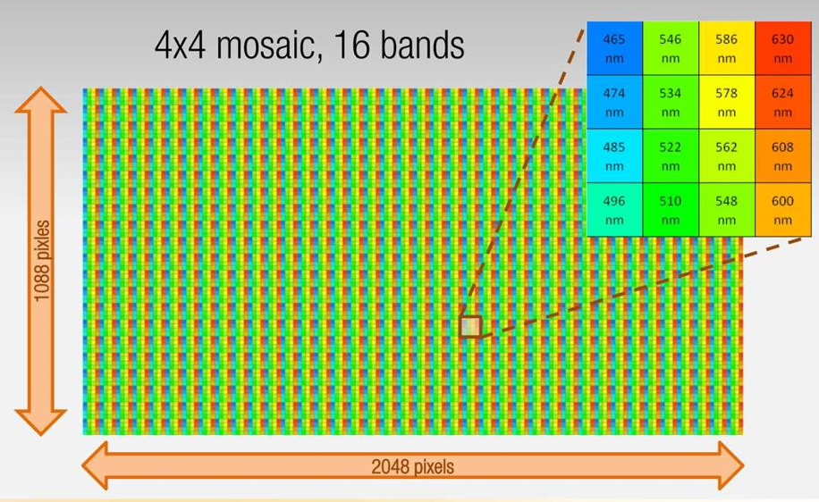
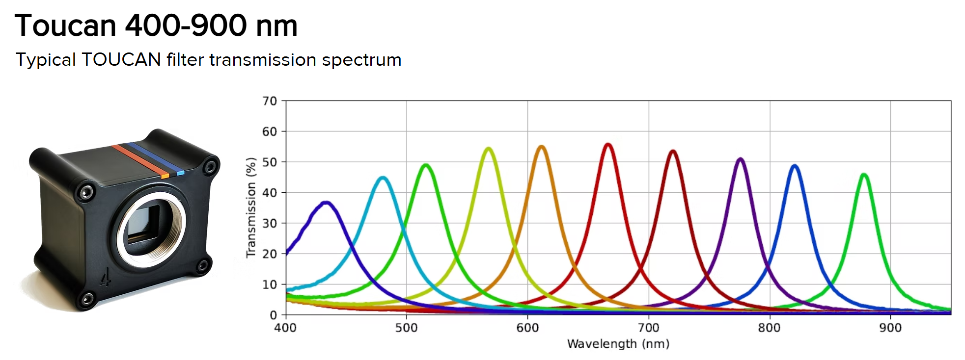
SILIOS / XIMEA hyperspectral filters
CMOS
4Mpixel
2.4 μm pixel pitch
Fully customizable chip and filters
SPACE ready

Slide 9
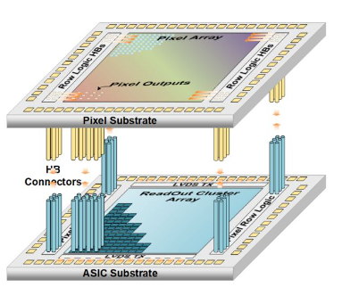
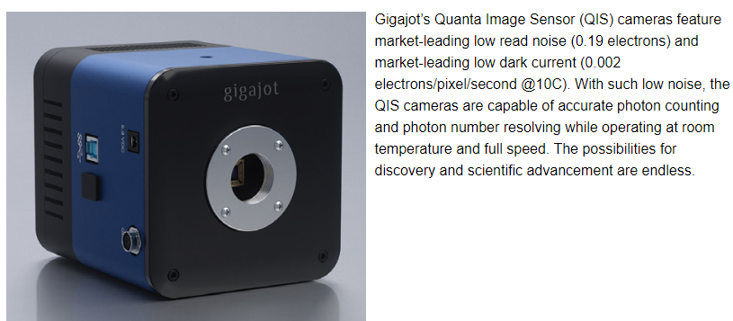
CMOS gigajot
1µm x 1µm pixel
64 Mpix (8x8)
Dynamic: a few photon/pix
Dark: 0.002 e-/pix @ room temp
Spatial & Time binning of fast exposures
Image after post-processing

Slide 10
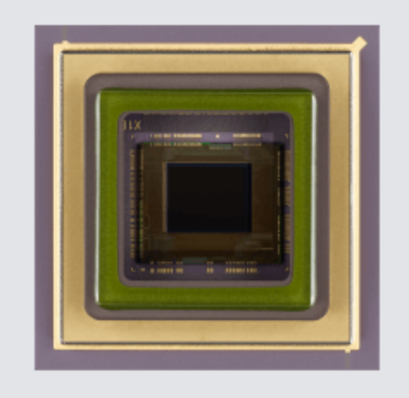
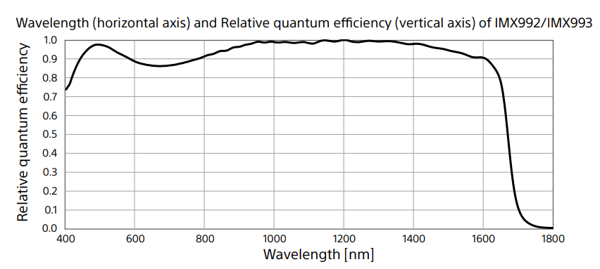
CMOS
SONY IMX 990-1-2-3
Up to 5.3 Mpix
Cooler embedded
Avg QE ≈ 75%
RON ≈10e- (tbd)

Slide 11
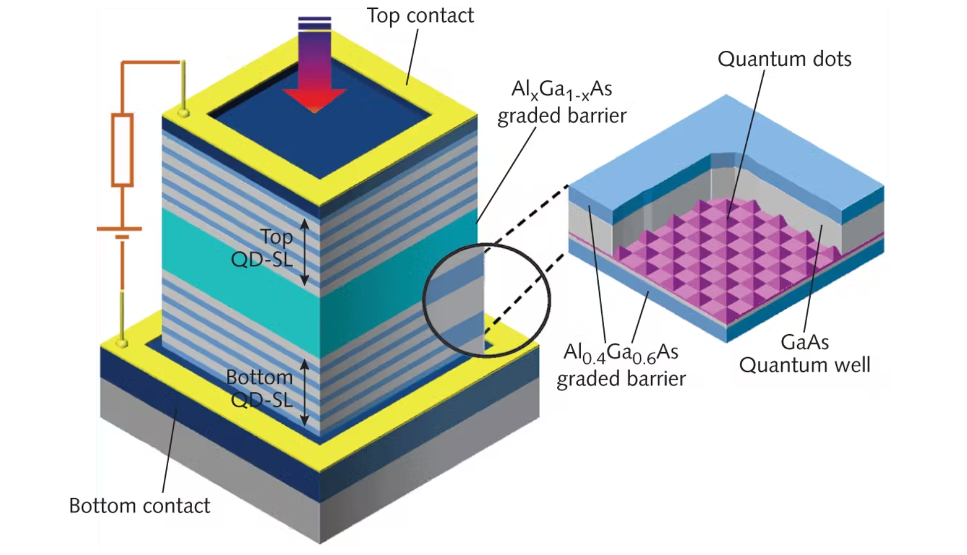
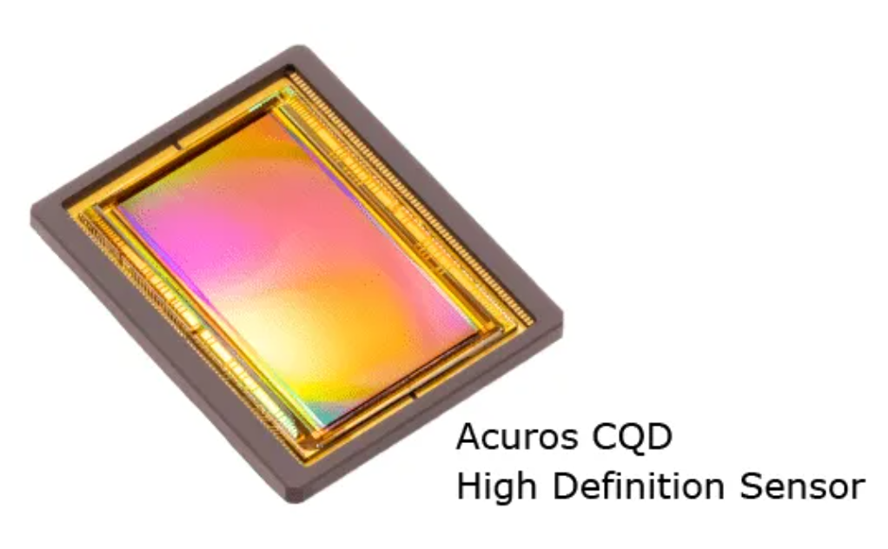
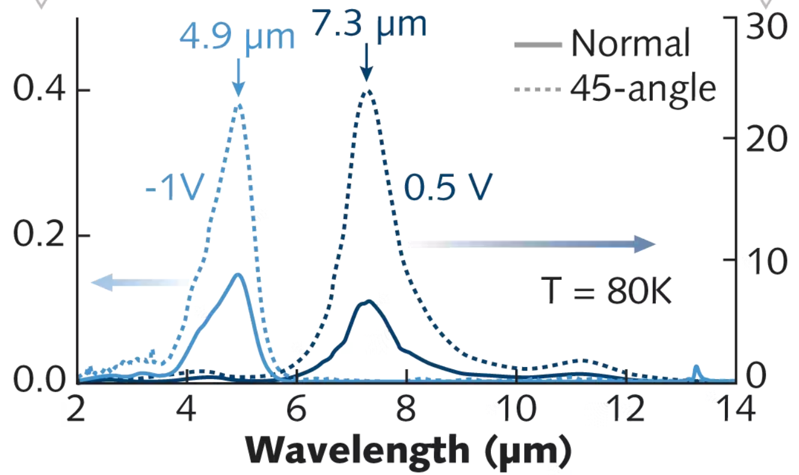
HYBRID
qDOT
Up to 4 Mpix
Good for SWIR-MIR
will be color tuned by
control electronic

Slide 12
VISION-I (photons are expensive)
X-SHOOTER / MUSE / SPHERE-IFS / ALES
$$N_{pix}≥N_{spax}∙1.5∙{FWHM}_{pix}^{2}∙Δλ∙\frac{R\left(λ_{c}\right)}{λ_{c}}$$
LENSLET SLICER
$$N_{pix}≥{N_{s}∙S}_{pix}∙{FWHM}_{pix}^{1}∙Δλ∙\frac{R(λ_{c})}{λ_{c}}$$
SLIT SLICER
$$Δλ=500 \left(400nm−900nm\right)$$
$R(λ_{c})$= 650 ($λ_{res}=1nm)$
500

Slide 13
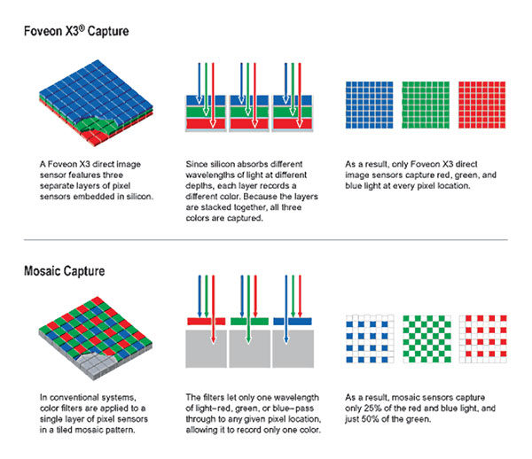
CMOS
FOVEON
15 x 3 Mpix
3 levels R, G, B stack
Detection depth: deeper for longer wavelengths
Photometry Compatible
see: Pedichini+ SDW 2006, ASSL

Slide 14
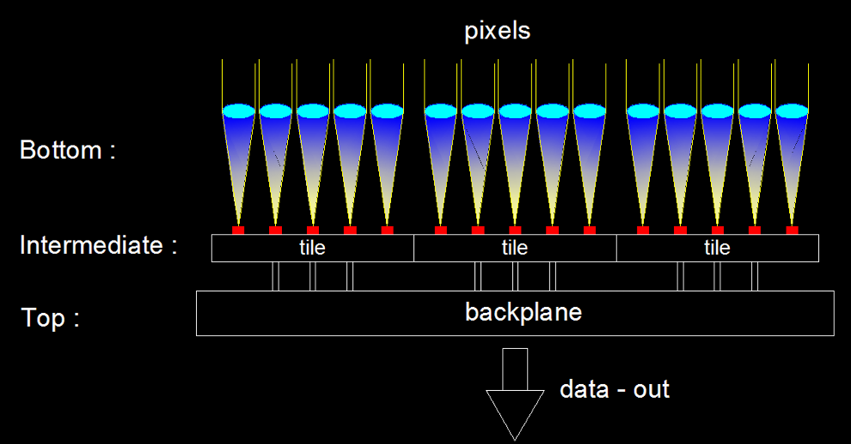
CMOS
PIXEL-ONE
Microlenses allow to use only a small area of your pixel for detection
Lot of space for amplifier, A/D converter and logics
Automatic RESET and ADD of bright pixels >> Infinite dynamic range
No need for shutter
Always running
SONY is working on this technology
see: Pedichini+ SPIE 2010

Slide 15
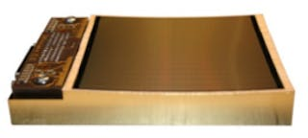
VISION-II going to the 4th dimension (X,Y,E and t)
Bruno Keller Foundation
TOF detector
SPAD array
“NDA”
Curved Detectors
simplify and speed-up
optical design

Slide 16
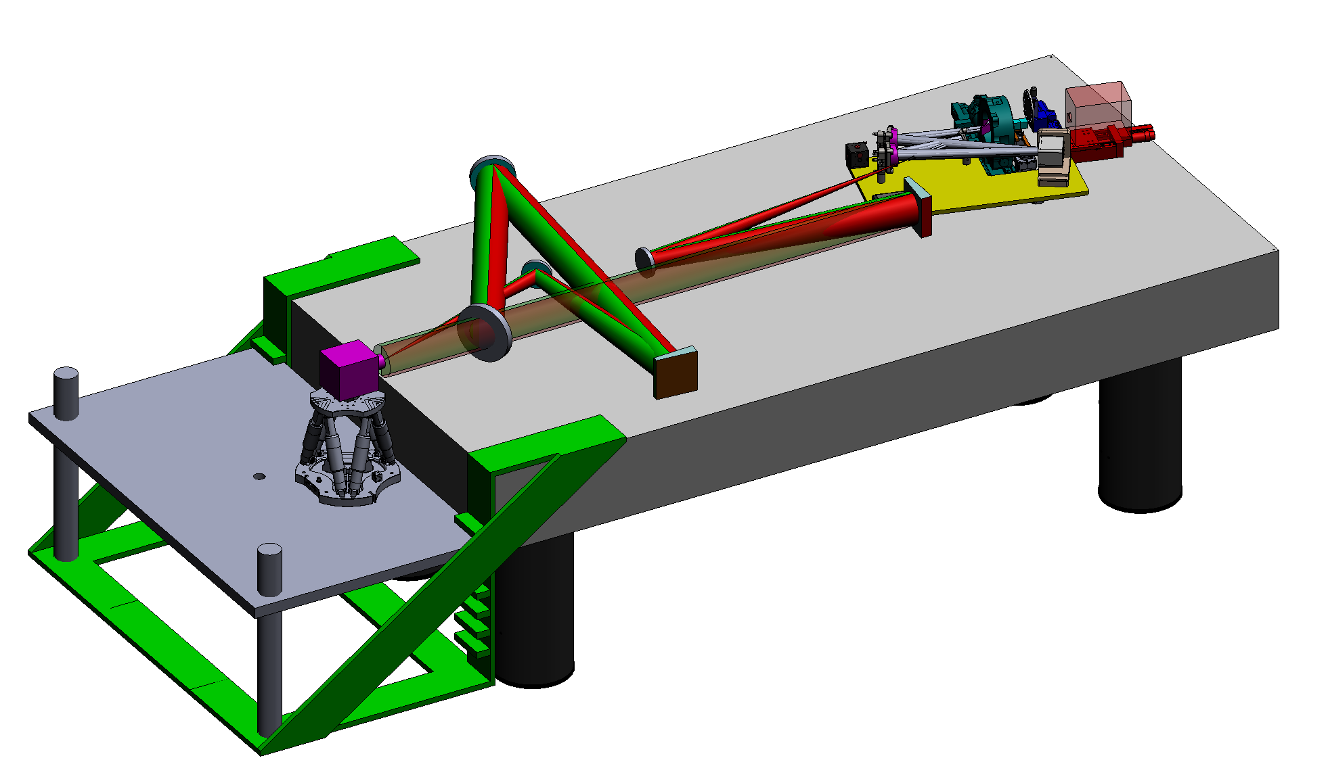
DATT @ OAR PNRR STILES WP 5401 (Pedichini OAR)
Detector Advanced Test Track
Hexapod positioner
Fully automated
Super-K source
Spectral engine
Fully Acromatic
Turbulence injector
Astro sources DLP projector
High contrast targets

Slide 17
circa 30-35 anni fà la performance dei sensori CCD era ancora limitata e si discuteva se mai avessero soppiantato le emulsioni fotografiche e riguardo ai primi CMOS poi non se ne poteva neppure parlare.
Oggi i detector “strani” ed innovativi superano già di gran lunga i primi CCD usati in Astrofisica… basta lavorare e saremo pronti nel 2040!
GRAZIE per la VOSTRA
ATTENZIONE

