Slide 1
Kilometer Baseline Interferometer (KBI) and Time Domain Telescope (TDT), a general overview
Expanding Horizons in Italy
15-16 May Rome

Slide 2
Disclaimer
Not expert of KBI
Not Expert of Time Domain Astronomy
The kid of the sandwiches

Slide 3
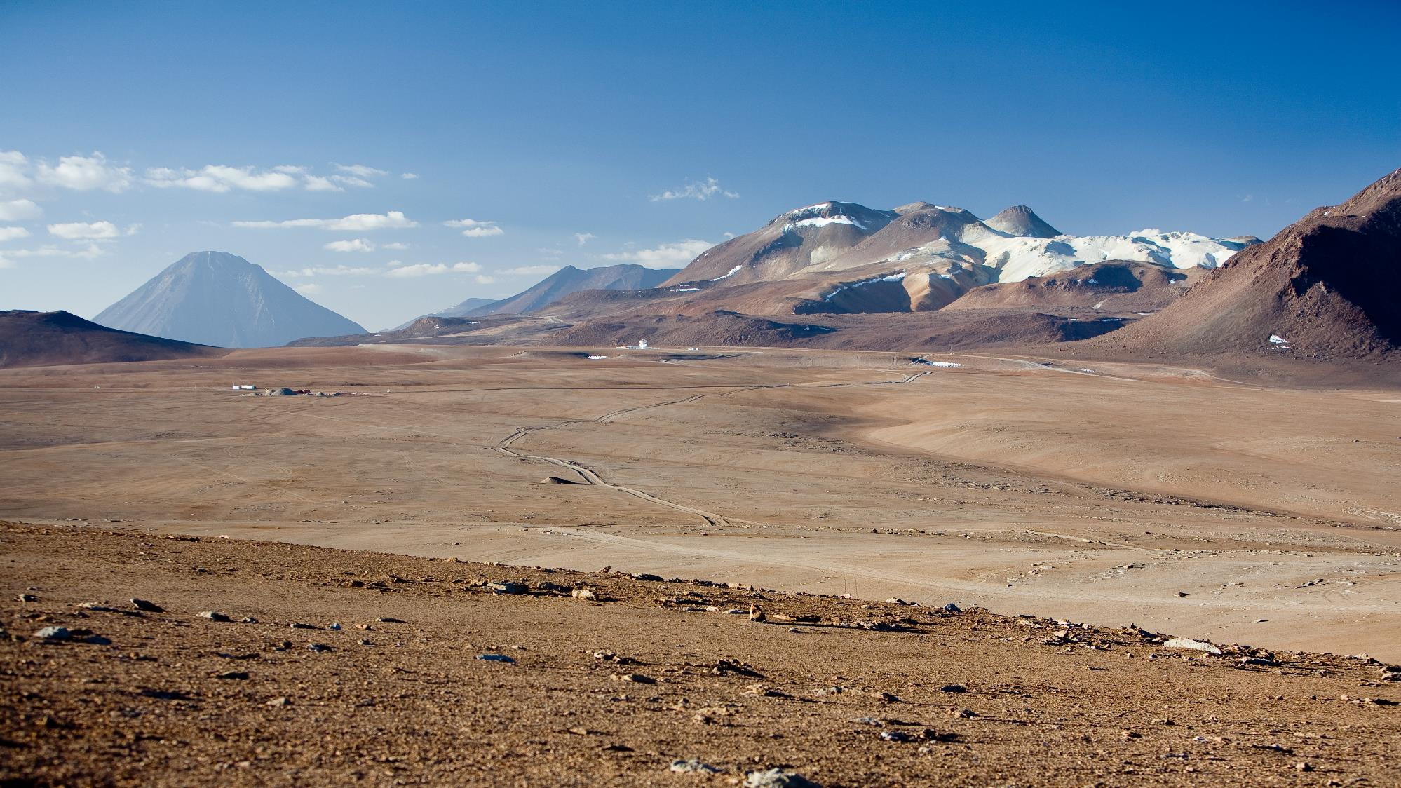
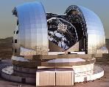
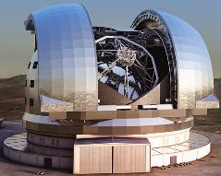
Ten-Kilometer Baselines - Thousands m2 Collecting Area: Optical / IR
Credits: Horizons of Optical Long Baseline Interferometry, Meudon, France, 27—30 January 2025

Slide 4
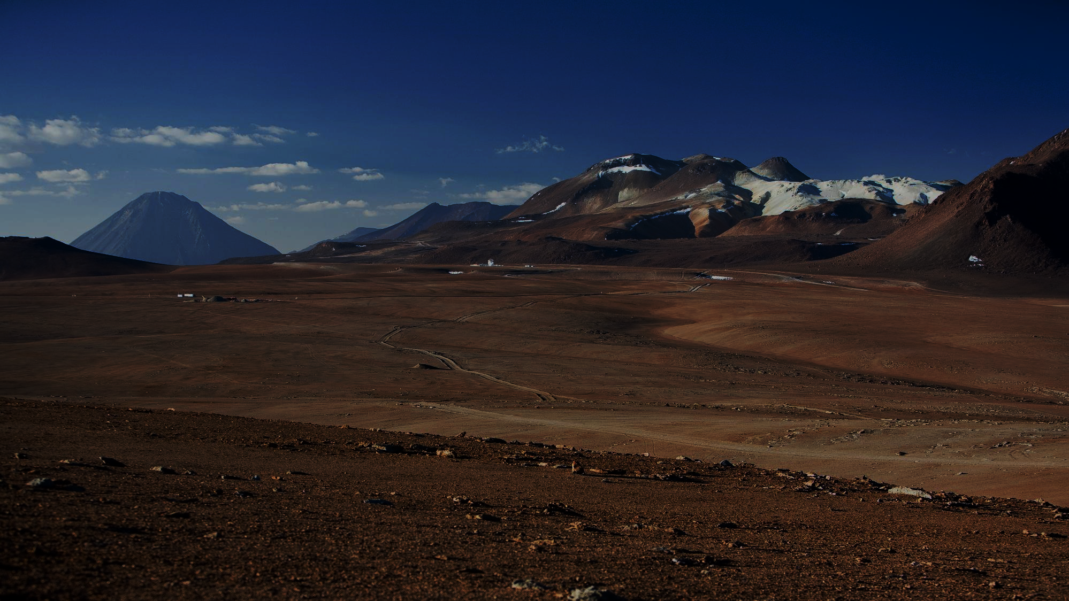
Ten-Kilometer Baselines
Thousands m² Collecting Area
Optical / IR
Resolution~ λ/B = 10 µas
Sensitivity ~ ELT ~ 28 (23) mag_{AB}
Point Source Imaging (Spectroscopy)
Astrometry ~ 0.1 µas

Slide 5
From GRAVITY(+) Towards a Kilometers Baseline, Large Telescope Interferometer
Ringberg Workshop
June 2024
10 µs angular resolution
Fundamental Physics
Cosmology
For more info follow Filippo Mannucci Talk tomorrow
>1 Gpc
1/10 pc SN1987A
Galaxies
100 Mpc
1000 AU TDEs
Black Holes
1 Mpc
10 AU Saturn Orbit
Stars/-formation
10 kpc
0.1 AU = 1 Schwarzschild R.
Exoplanets
10 pc
Earth
150 km
astrometry
1 pc
1500 km Greenland
15 km

Slide 6
How to Arrive at KBI ?
Feasibility Demonstrated
Large Telescopes
Adaptive Optics and Laser Guide Stars
Beam Combination
Fringe tracking and Phase-referencing
What‘s missing ?
Demonstration of Kilometer Baselines
Technology Tradeoff for Cost Reduction

Slide 7
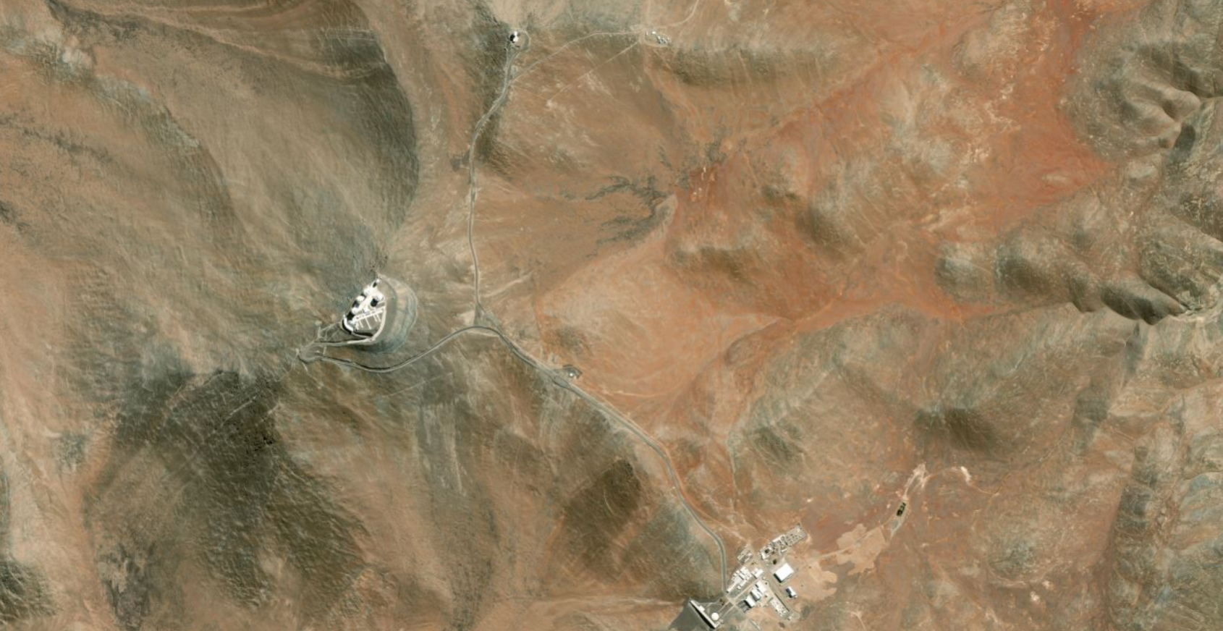
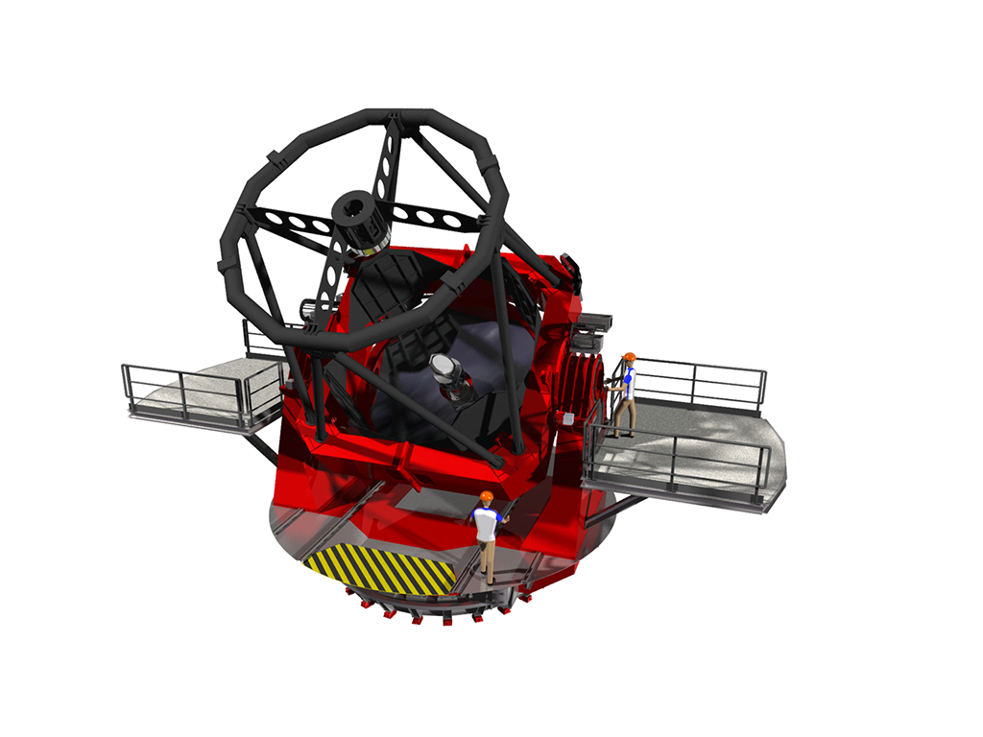
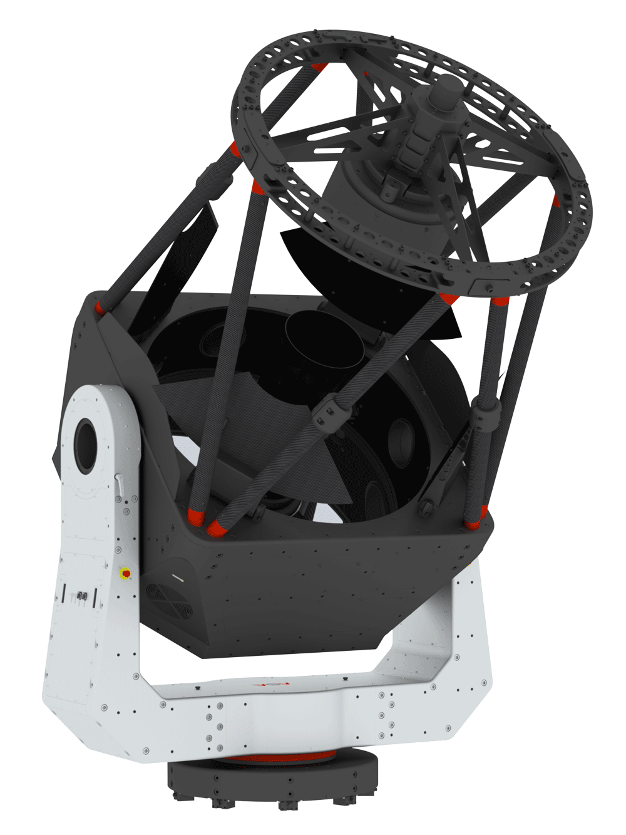
Kilometer Baseline Demonstrator
Outrigger Telescope on VISTA peak
Member State Initiative & Partner Institutes
Commercial 2-4m Telescope
Credit: Bing Maps

Slide 8
Extended VLT(I)
$$λ/{2B}=100 µas$$
Technology Tradeoff Studies
Credit: Bing Maps

Slide 9
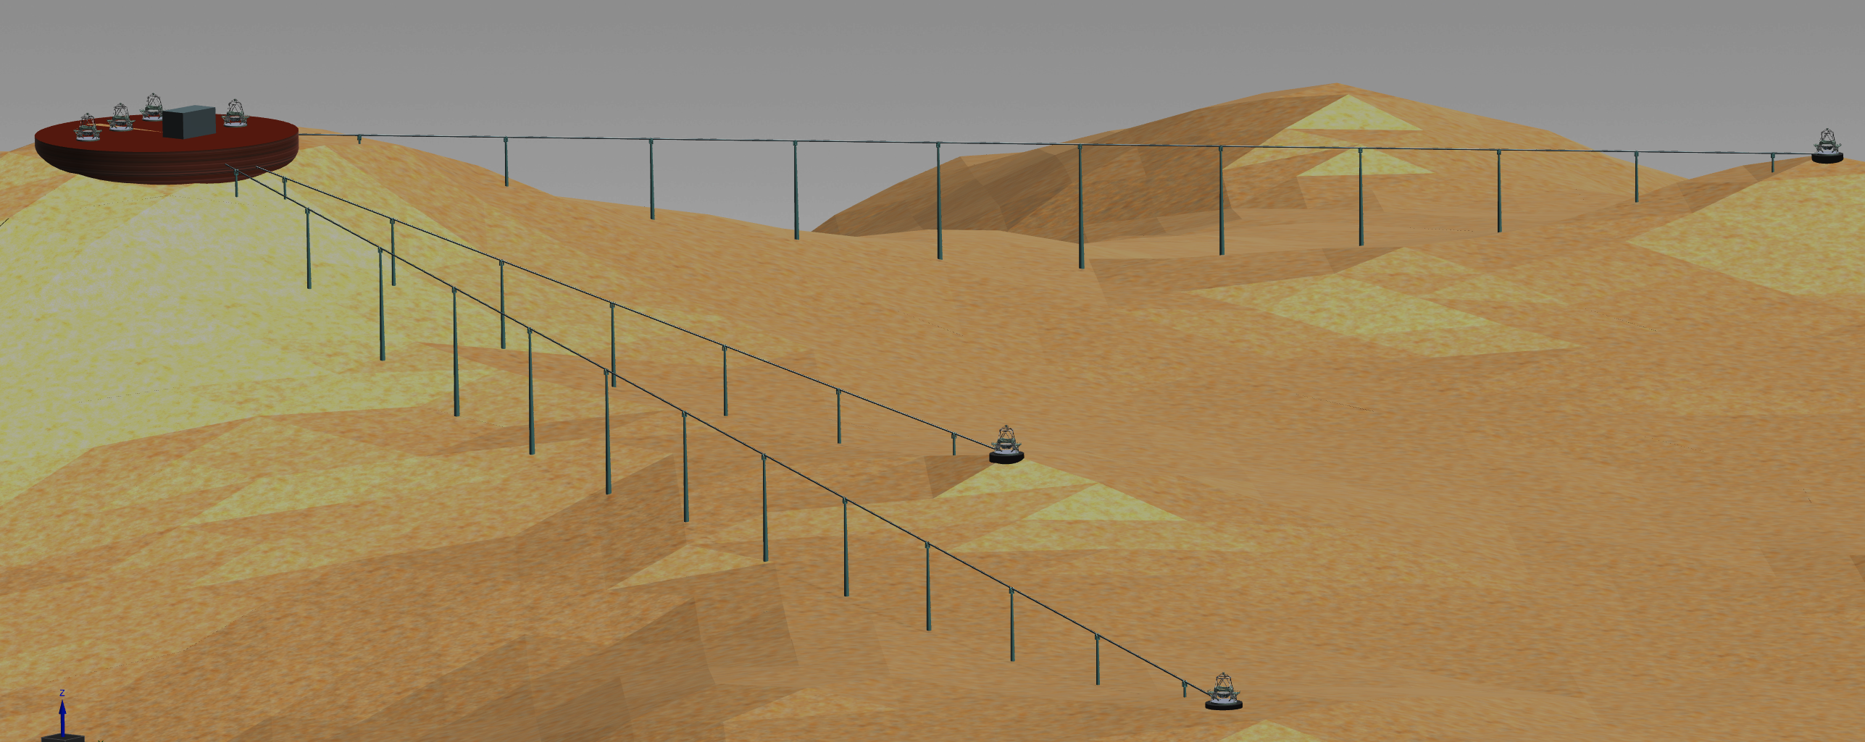
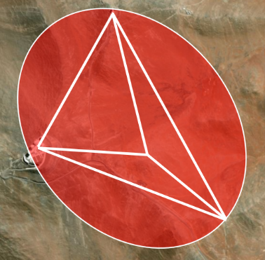
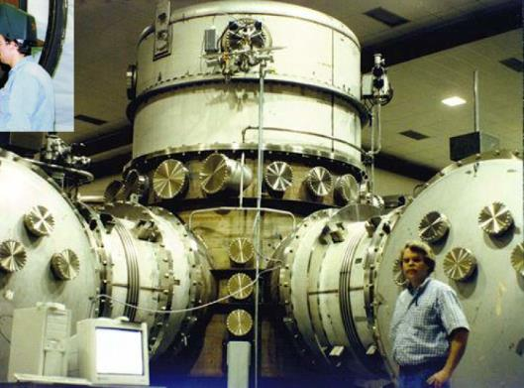
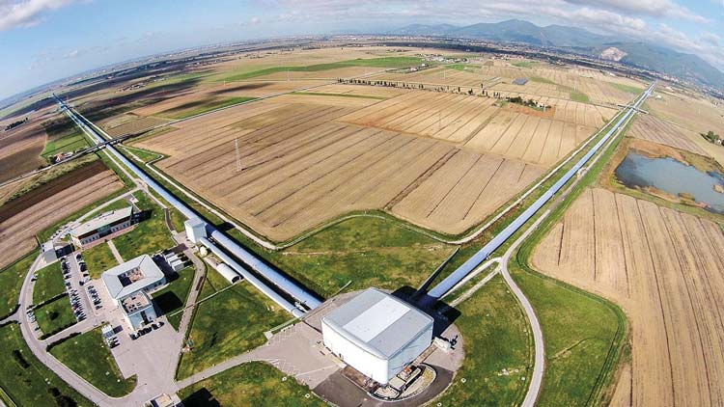
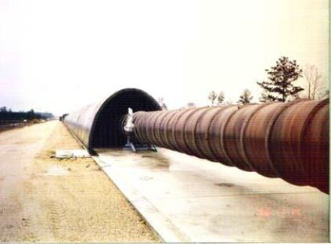
Beam Transport in Vacuum Tubes
Technology Tradeoff Studies
Extensive Experience in Gravitational Wave and Particle Physics

Slide 10
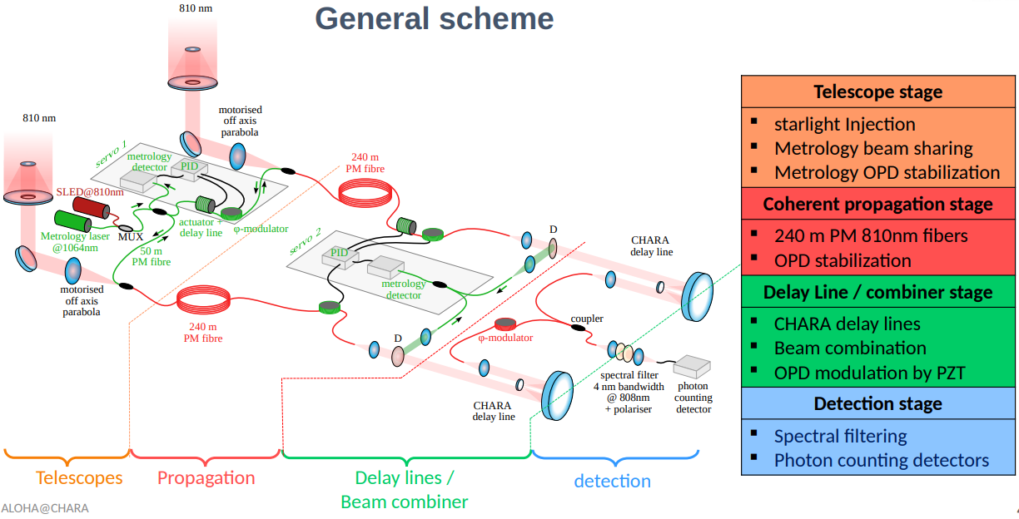
Beam Transport by Fibers
Perrin+24
J. MAGRI, F. REYNAUD

Slide 11
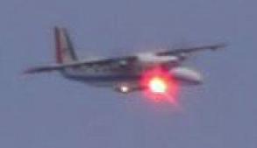
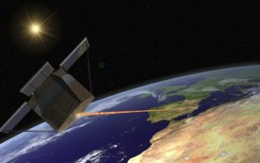
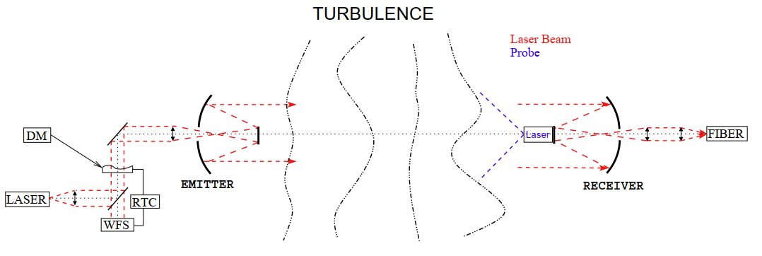
Beam Transport by Horizontal Adaptive Optics
Legacy from Optical Communication
Schwartz+09

Slide 12
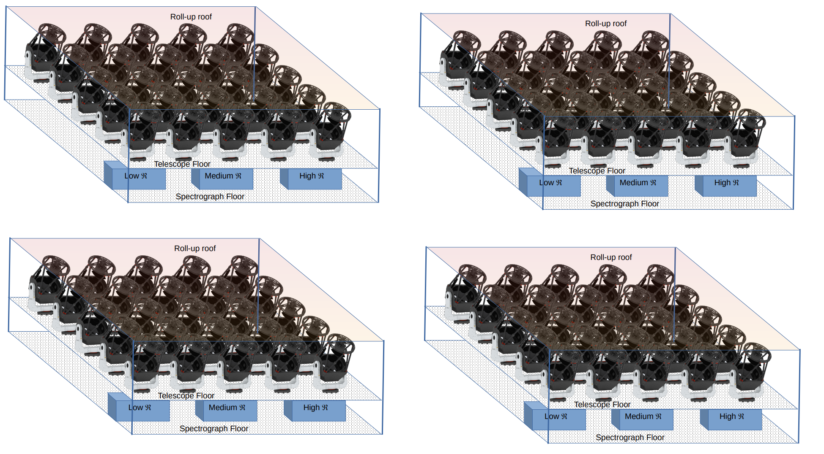
The TDT: Time Domain Telescope: Building on several current initiatives: MAST, MARVEL, MEDUSA....
Credits: TDT Kick-Off Meeting; December 11, 2024, The Hague, NL

Slide 13
Basic features
100 x 2m telescopes: Dequiv = 20m
4 clusters of 25 telescopes
Connected by fibers per cluster
Wavelength range: 0.3 – 1.8 μm
Three spectrographs per cluster: low (10^3), medium (10^4), high (10^5)
Each telescope also high-speed (>>1Hz) optical/NIR photometry
Flexible configuration: 100x1, 25x4, 24x4+4, 1x100, 1x98+2, etc.
Located at La Silla (available space, new lease on life) ?
Total budget: ~350 M€
Timeline: post-ELT (2035?)

Slide 14
Science Case:
Asteroseismology
Exoplanet cosmography from radial velocity variations
Stellar/Binary evolution and populations
Physics of explosive transients and stellar end-points
Multi-messenger astrophysics
Cosmology with time-variable phenomena
For more info follow Sergio Campana Talk tomorrow

Slide 15
Unit telescope (conceptual design only!)
Off-the-shelf 2m telescope with ~5’x5’ fov
→ (Or mix of multiple aperture units?)
Fully steerable
Single instrument unit:
Combined acquisition camera + OIR high-speed camera
Fiber unit for feed into low/medium/high-resolution spectograph

Slide 16
Unit telescope (conceptual design only!)

Slide 17
Cluster of telescopes (conceptual!)
Per cluster 25 telescopes in a 5x5 grid
Fibers of each telescopes feeding a low/medium/high res spectrograph
Housed in low-squat building, with retractable roof.

Slide 18
Four Clusters for full TDT

Slide 19
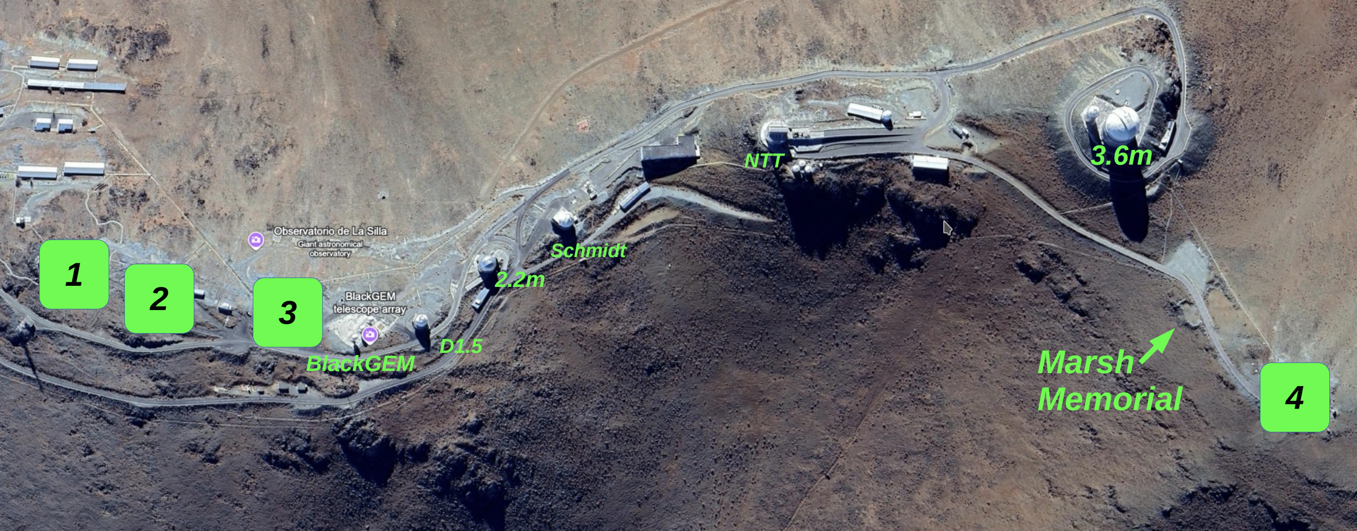
The TDT: Time Domain Telescope @ La Silla?

Slide 20
The TDT: status and Next steps
Feasibility Study/ White paper
Science Case
Transients
Variables/Asteroseismology/Stellar structure and evolution
Exoplanets
Solar System
Telescope/Instrumentation feasibility study
Unit aperture vs. number of units; mix of different apertures?
Tip-tilt correctors from improved input psf?
Fiber coupling
Detectors
Spectrographs & Fast-imagers
Operations and Maintenance modes
Outrigger clusters around the world? N/S, 24/7
Kick off meeting: December 11, 2024, The Hague, NL

Slide 21
Some comments

Slide 22
Thank you very much!

Slide 23
backup

Slide 25
https://horizons-olbin.sciencesconf.org/file/1181660

