Slide 1
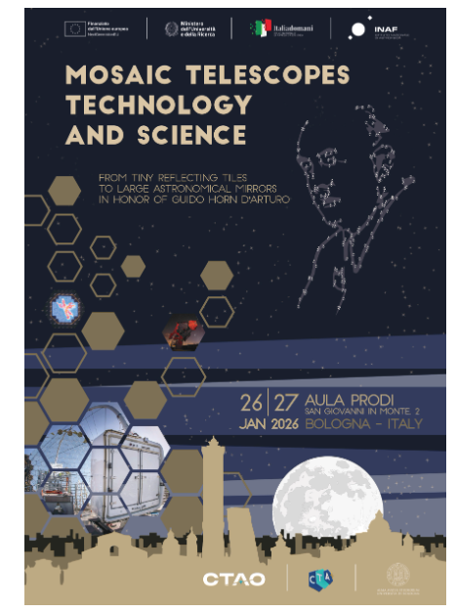
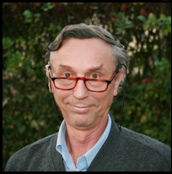
Piero Salinari and the advancements of telescope technology
Presented by: S. Esposito, 26 gennaio 2026, Bologna

Slide 2
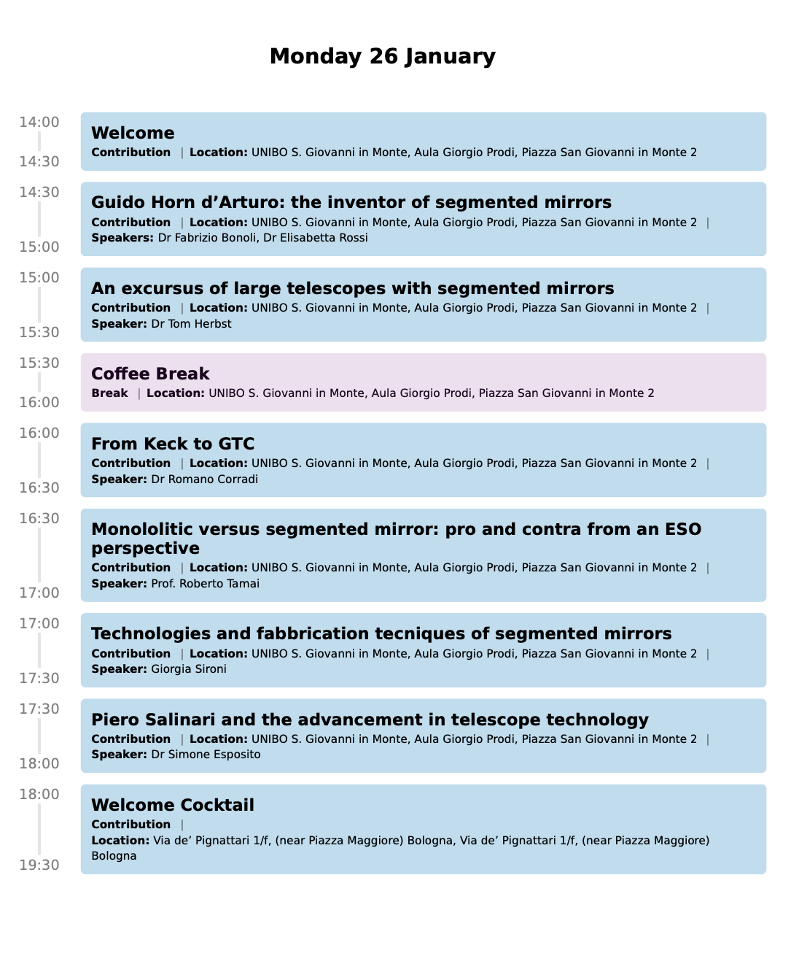
Acknowledgements to:
The Workshop Organizers...
The main contributors...
F. Mannucci
A. Riccardi
R. Briguglio
E. Pinna
L. Busoni
R. Stanga
R. Biasi
P. Vettolani
G. Pareschi

Slide 3
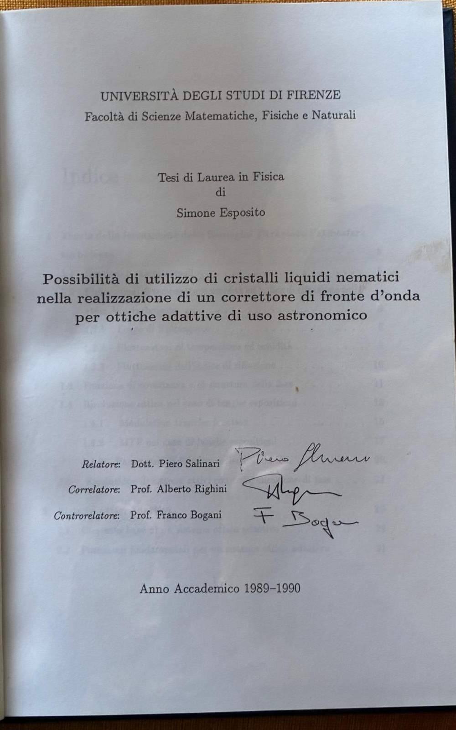
Disclaimer
a personal reconstruction.....
from a former graduate student
.....and I like to believe a friend of Piero

Slide 4
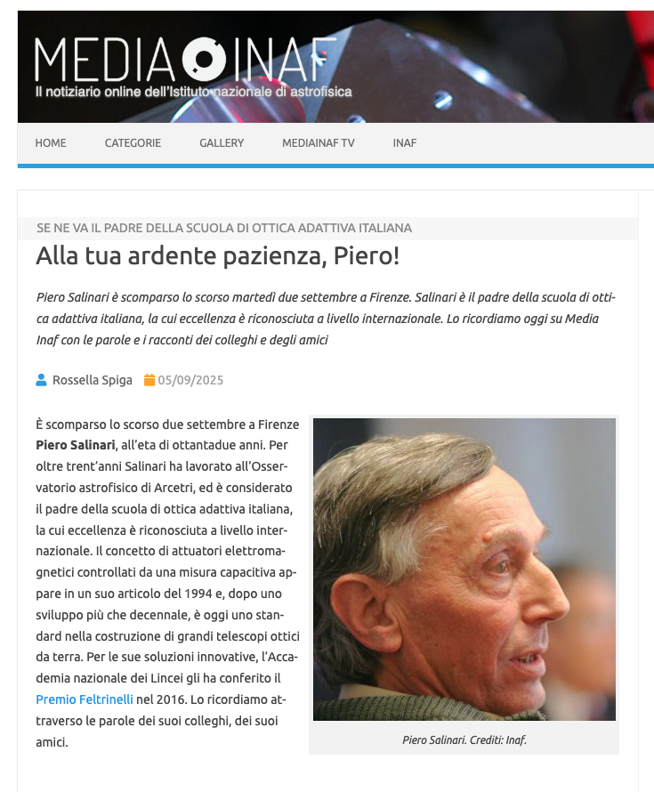
Piero Salinari and the advances of telescope technology

Slide 5
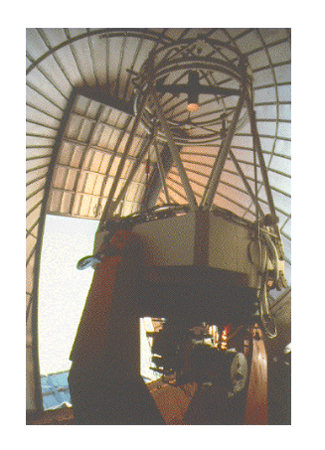
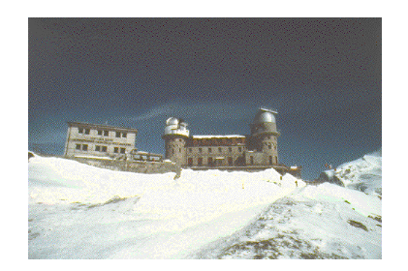
Tirgo telescope 1981-1987
From O. Citterio CV: «a national Working Group was set up in 1973 coordinated by Prof. C. Dilworth for the implementation of the TIRGO project to which the candidate was invited to take part as vice-coordinator of the project. The Observatory became operative since 1981, under the management of the Center for IR Astronomy of the CNR (it was decommissioned just in 2009)».

Slide 6
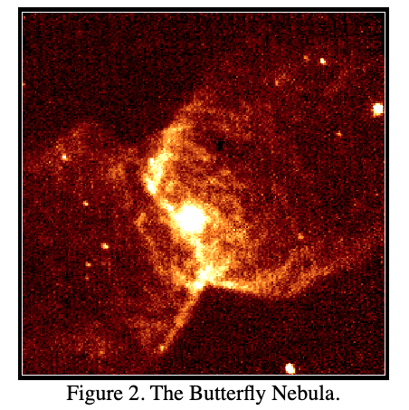
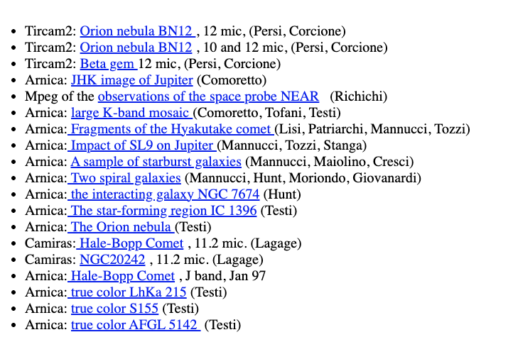
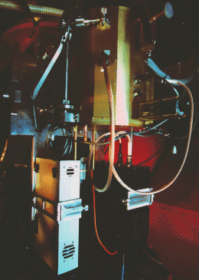
A few images...
From R. Stanga: «Piero ha portato l'astronomia IR ad Arcetri, ha costruito i fotometri IR, e poi le prime camere IR (all'epoca erano 16x16, e poi siamo arrivati a 128x128 se ricordo bene, con Franco Lisi e Don Hartill). ...Questo e’ successo fra 1981-1987».
ARNICA camera
NICMOS 3 (256x256, 40um)

Slide 7
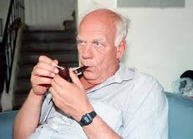
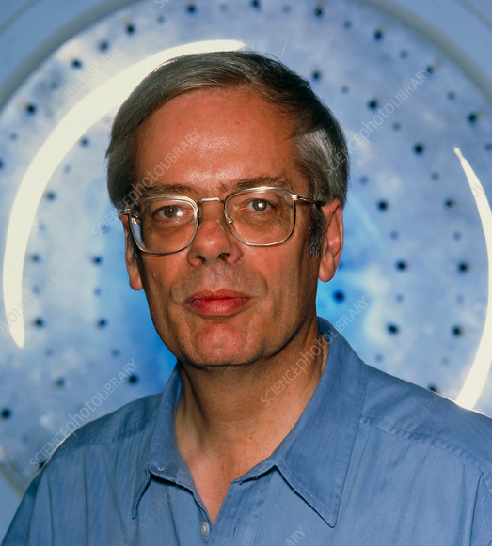
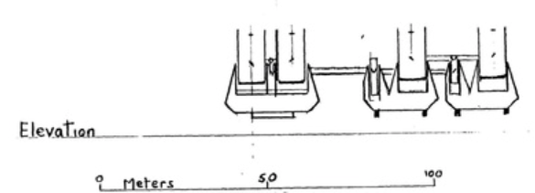
1988, Franco Pacini, Piero Salinari, Roger Angel
Il progetto del telescopio columbus iniziato alla fine degli anni 80 da R. Angel UoA (AZ)

Slide 8
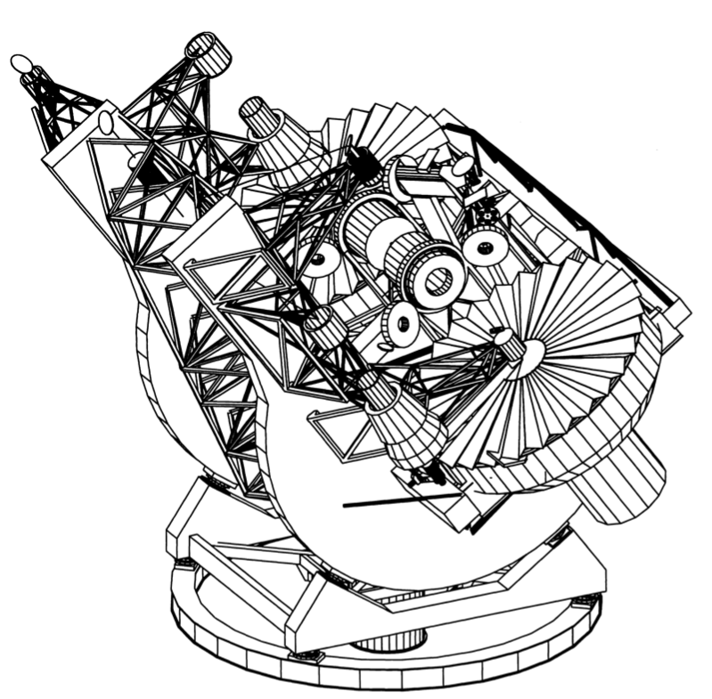
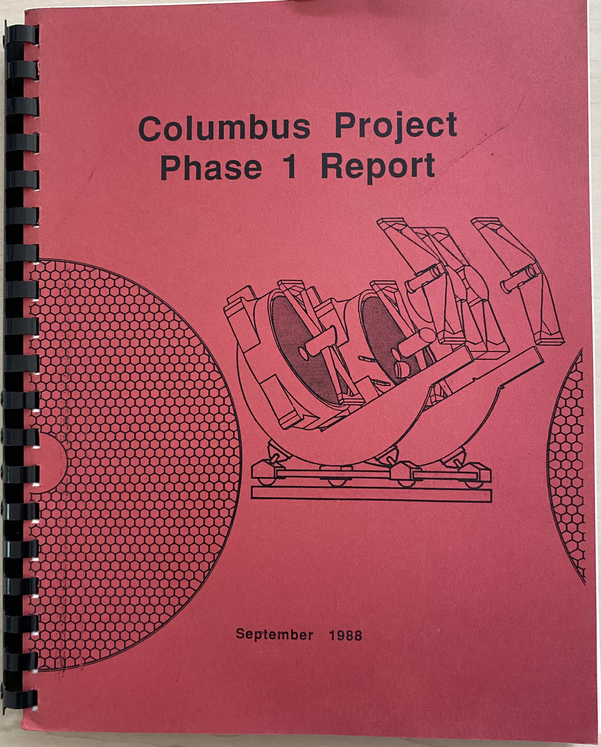
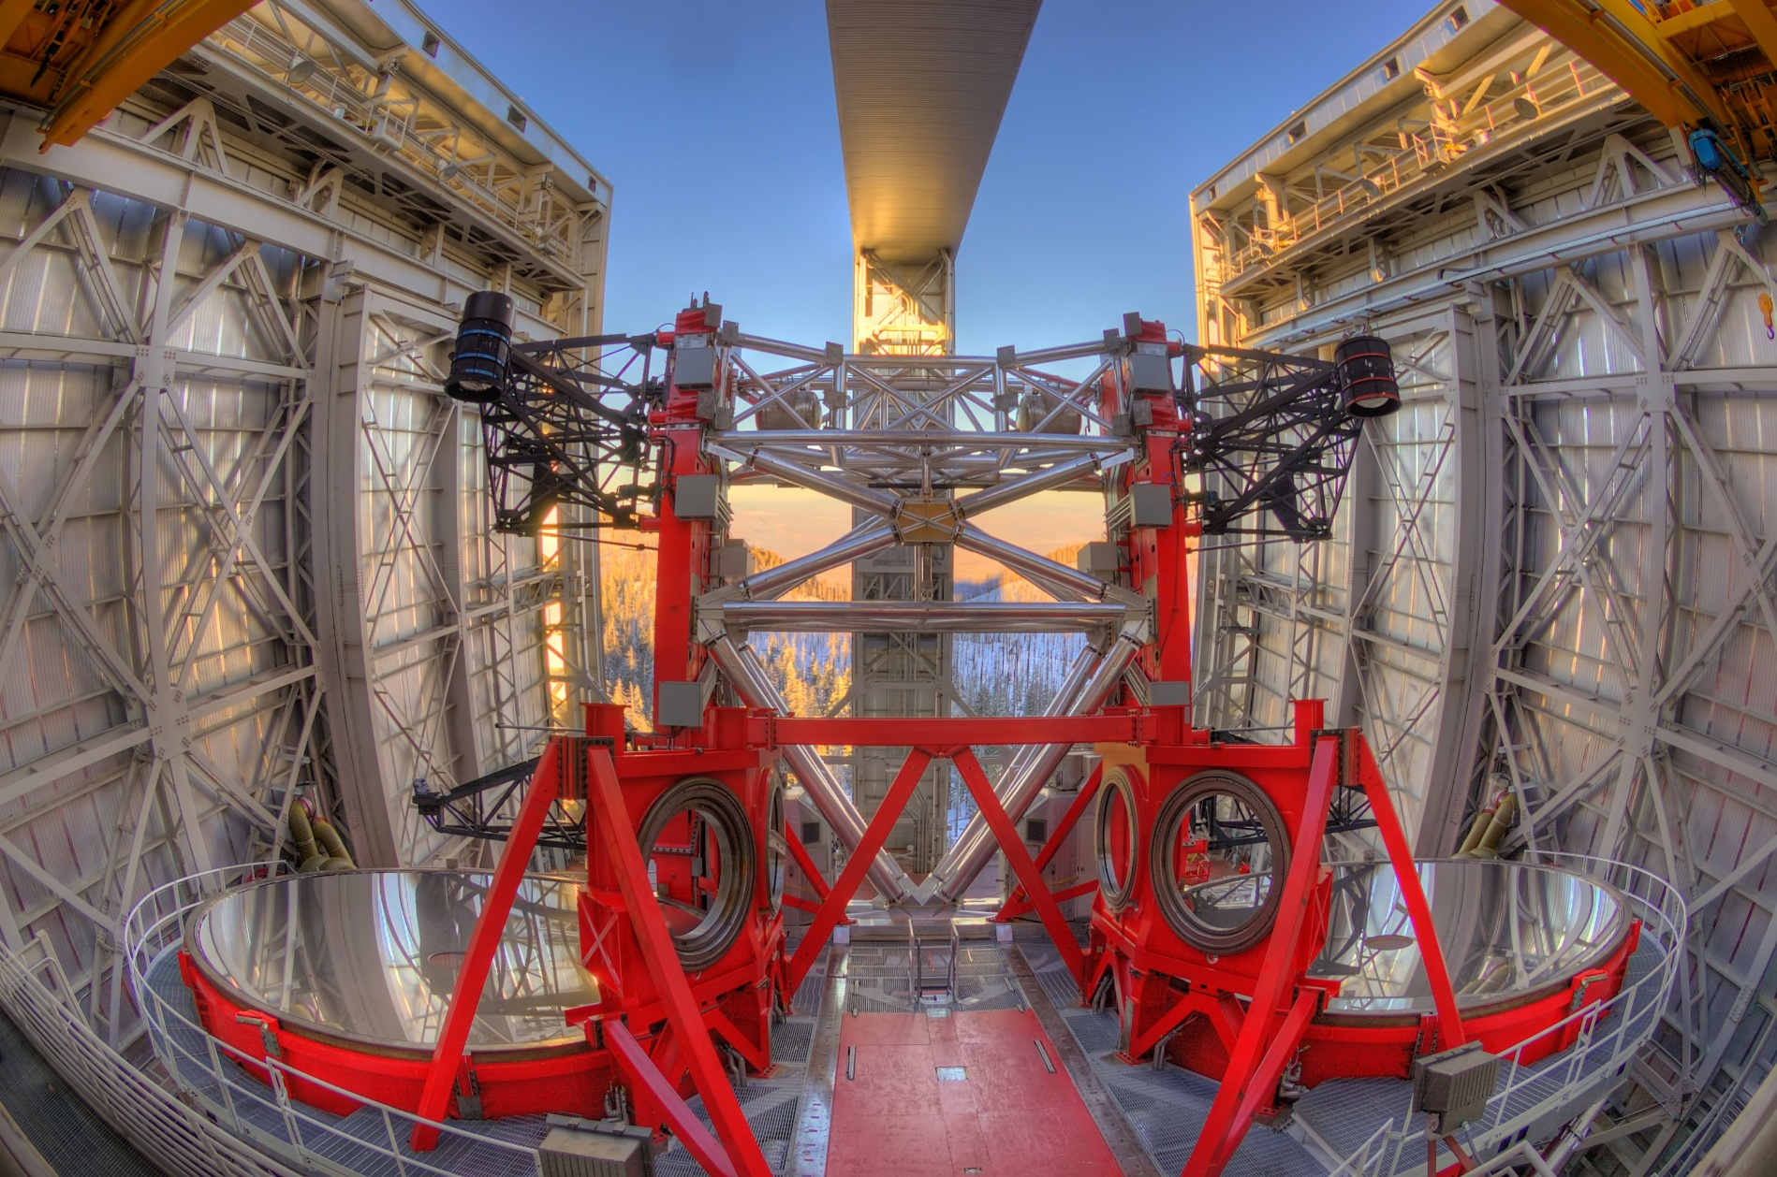
1988, Columbus/LBT telescope
Un telescopio binoculare interferometrico con 2 specchi da 8.4 m su una singola montatura che funziona come un interferometro, un telescopio da 23m di diametro.
Senza ottica adattiva un simile telescopio NON FUNZIONA!!!!!

Slide 9
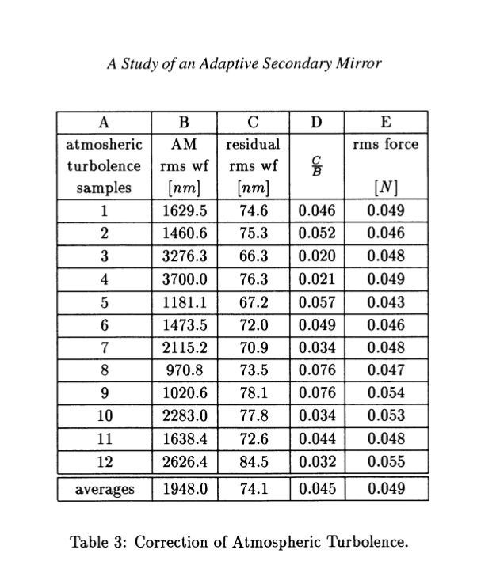
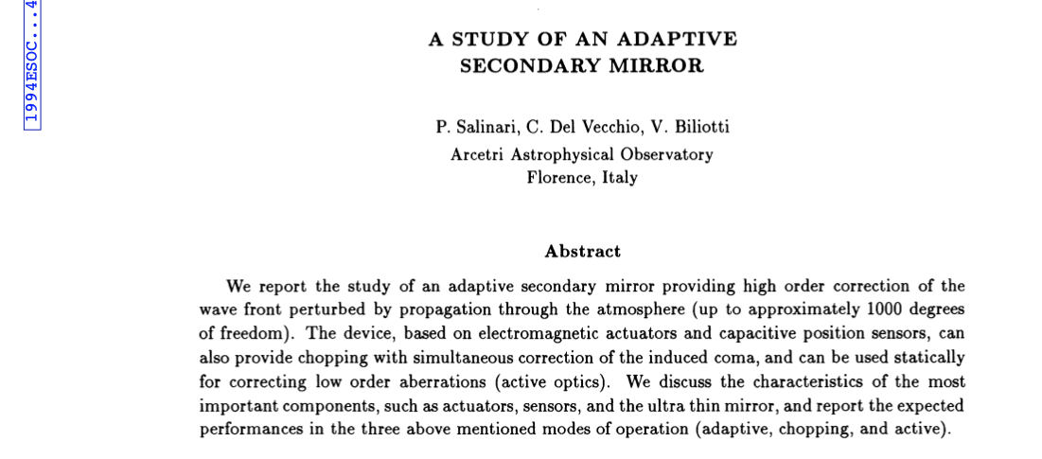
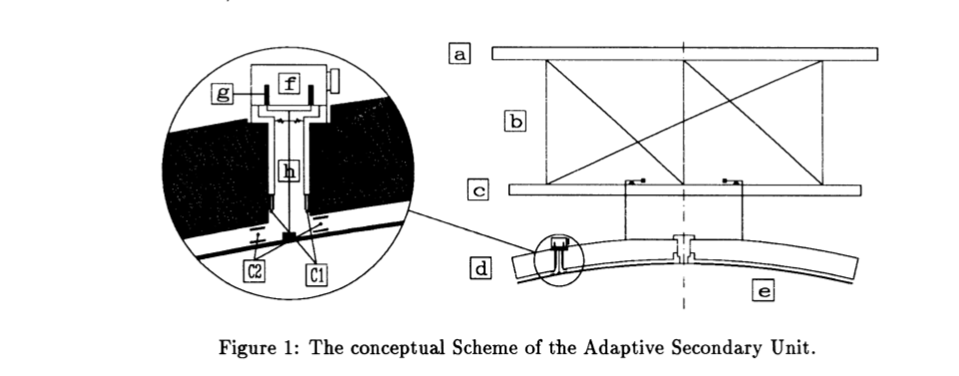
1994, Il secondario adattivo

Slide 10
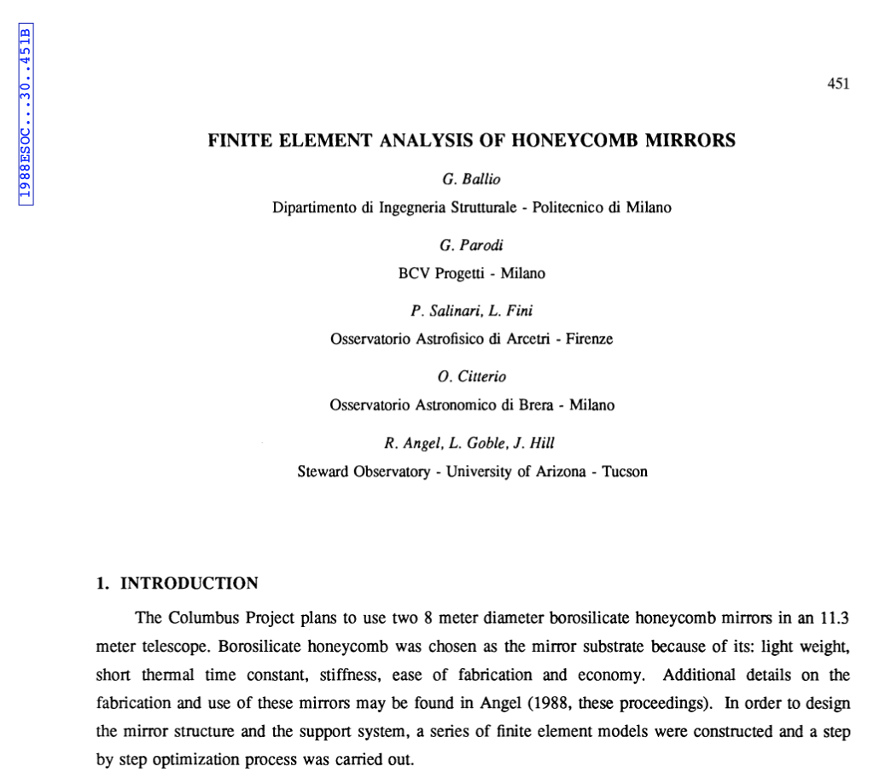
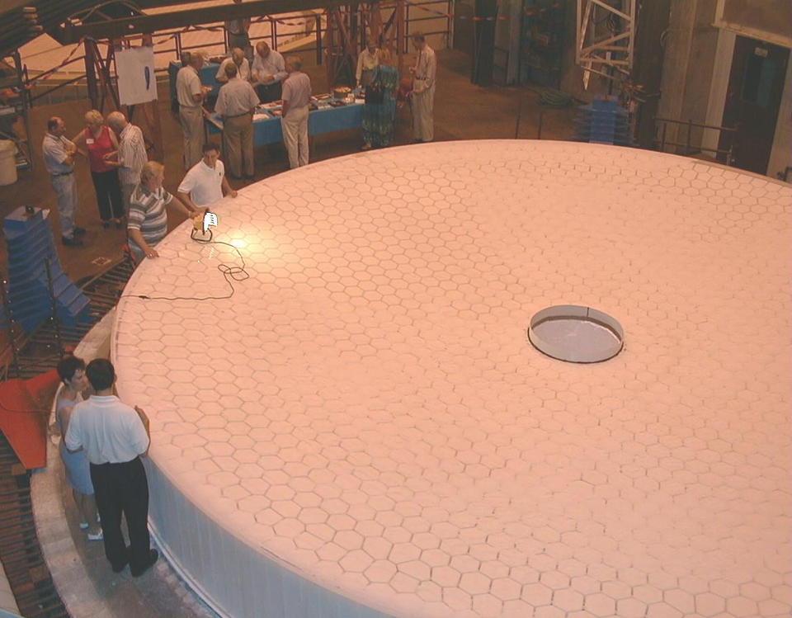
1998: specchi primari da 8.4m
Lo specchio honeycomb !!!
Mirrror Lab, Tucson, AZ, 1998

Slide 11
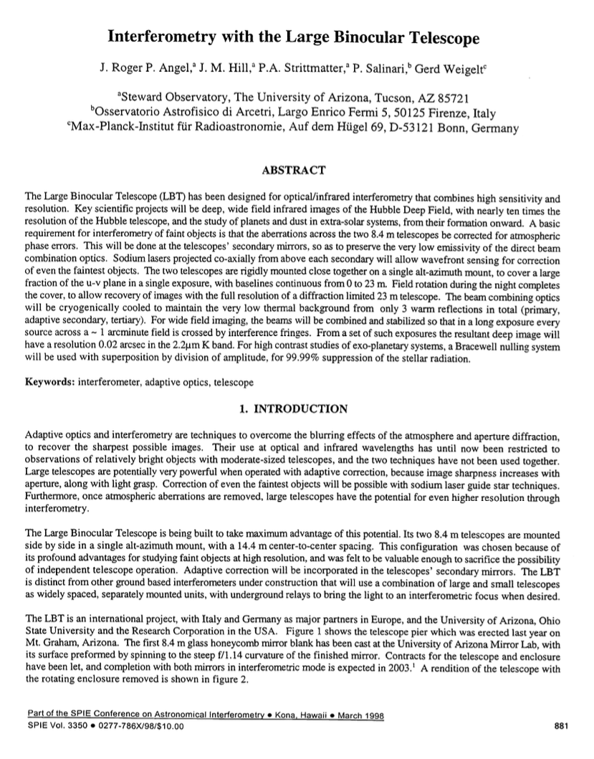
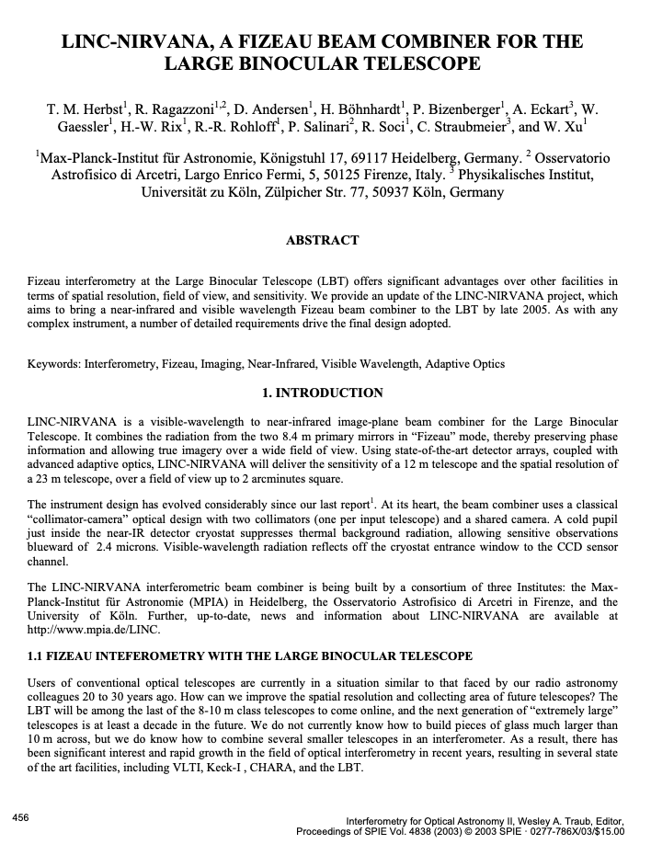
Fizeau Interferometry at LBT
SPIE 2002
SPIE 1998

Slide 12
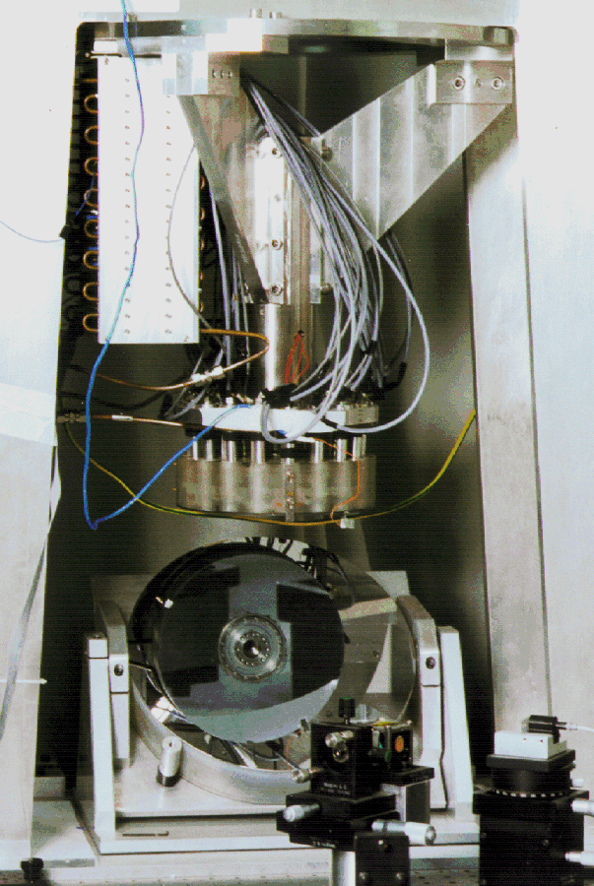
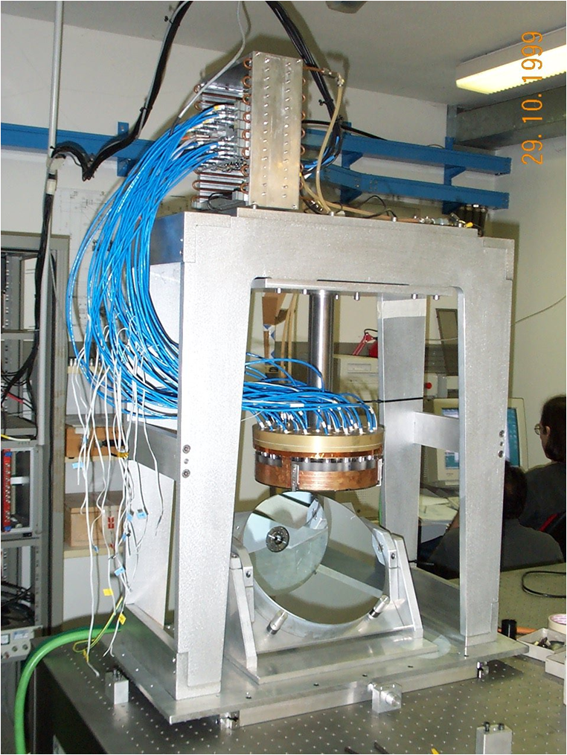
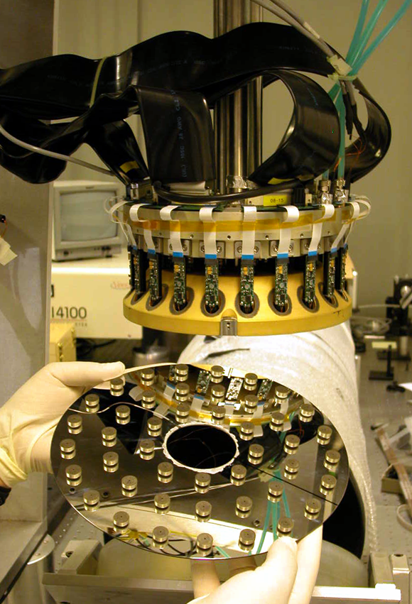
1997-2003, i prototipi
Brusa, Riccardi, Biliotti, MG, ADS
1997
1999
2003
30 attuatori
24cm diametro
36 attuatori
45 attuatori

Slide 13
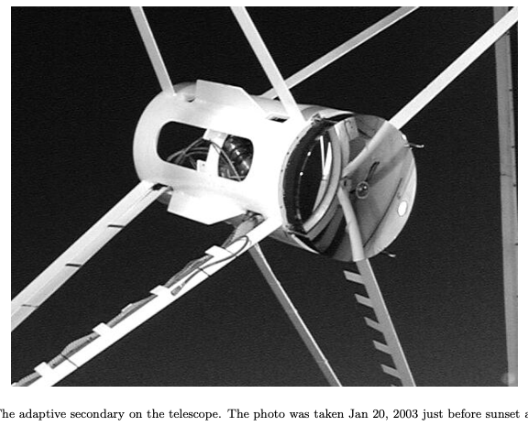
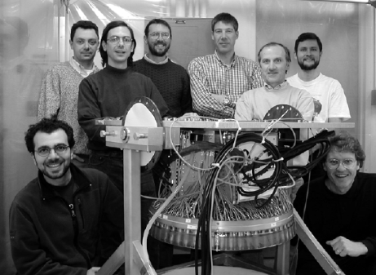
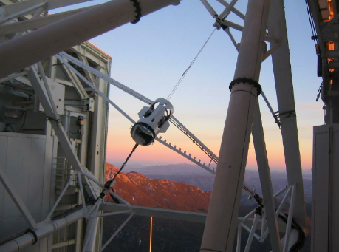
MMT 2003

Slide 14
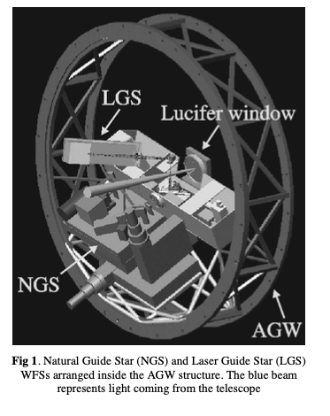
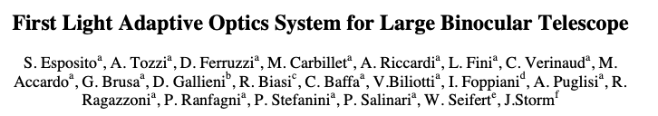
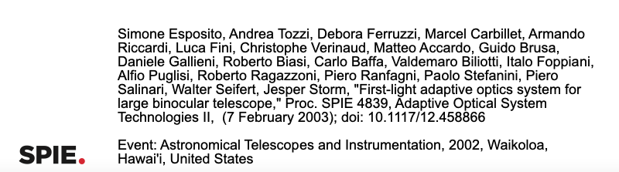
2002, Hawaii....
The First Ligth AO system for LBT chiamato FLAO viene presentato per la prima volta allo SPIE 2002

Slide 15
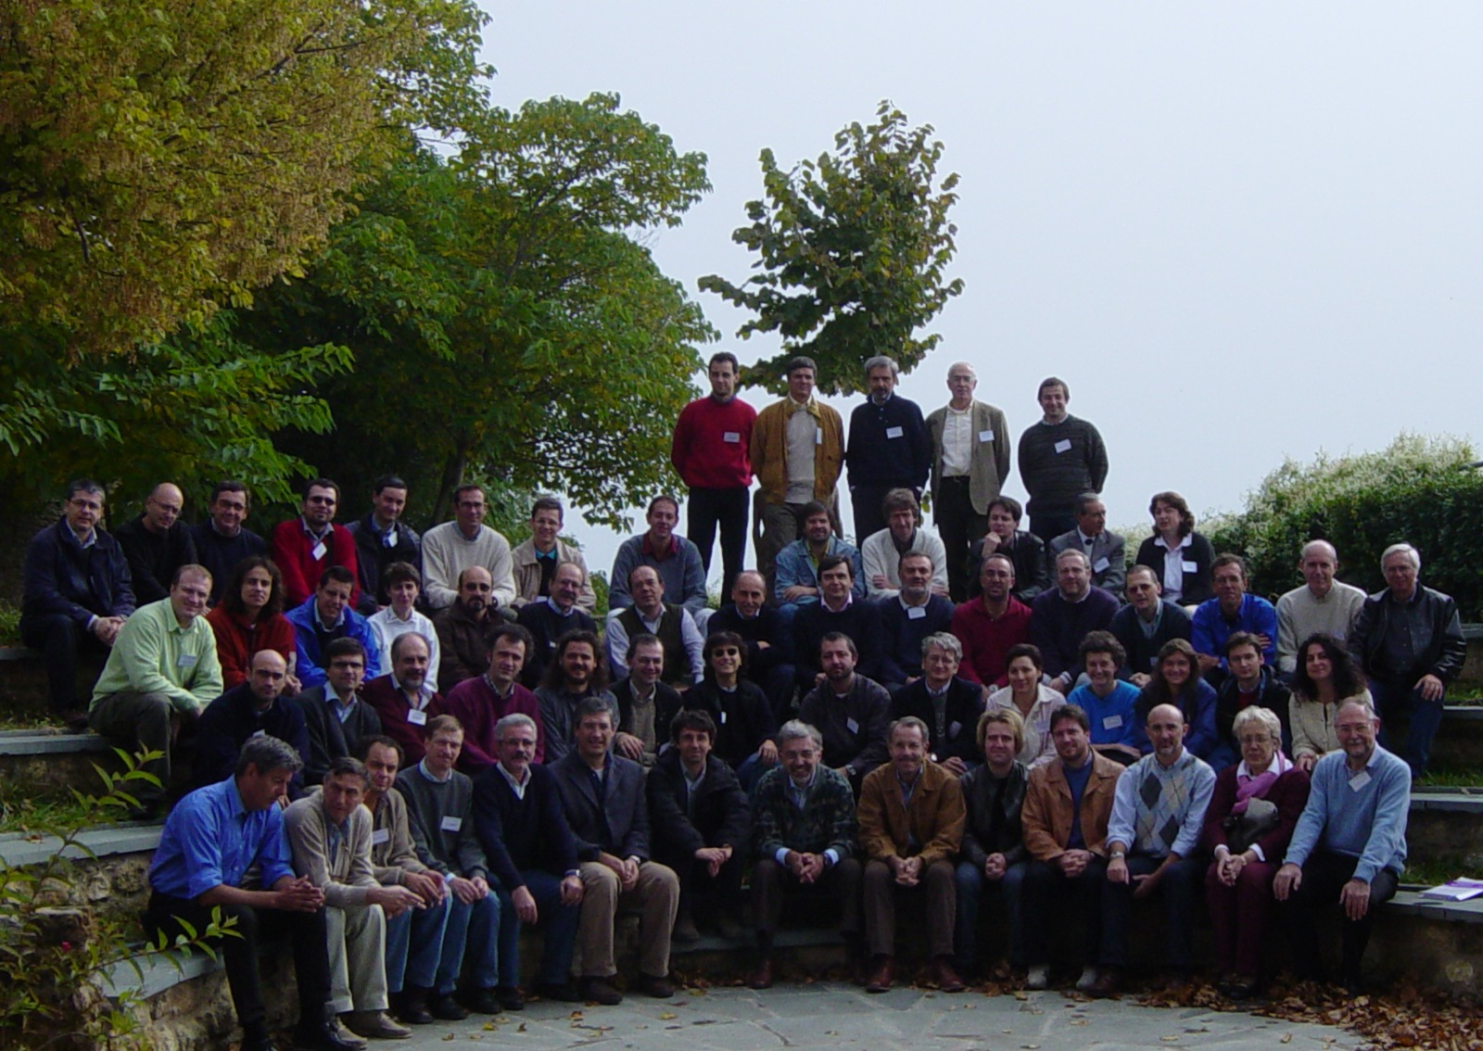
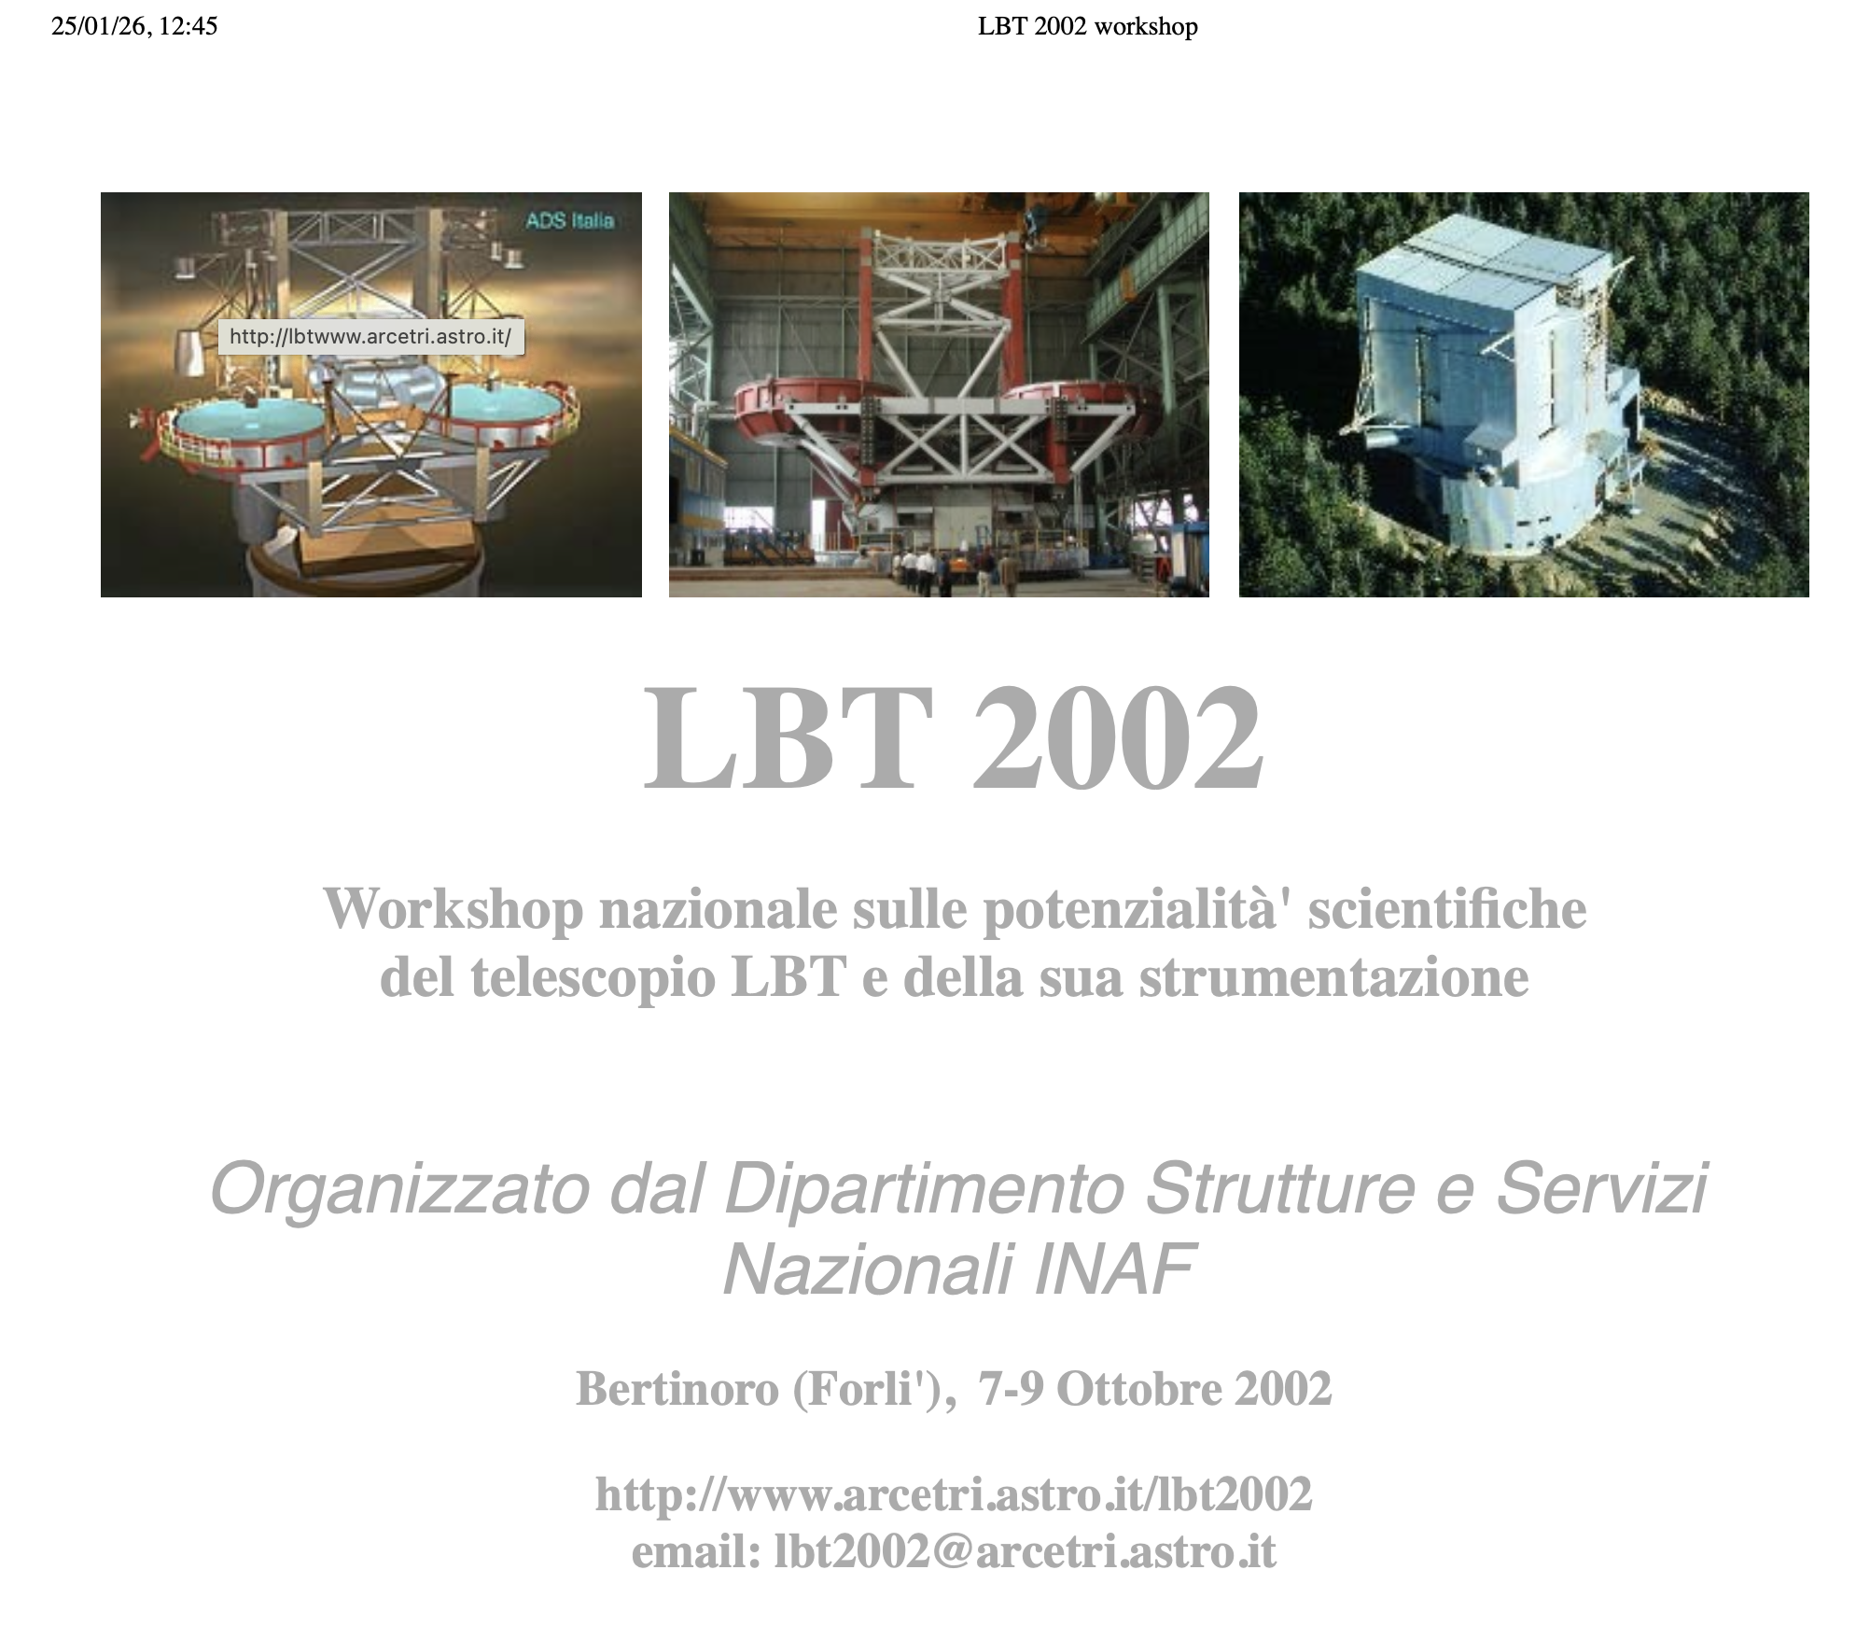
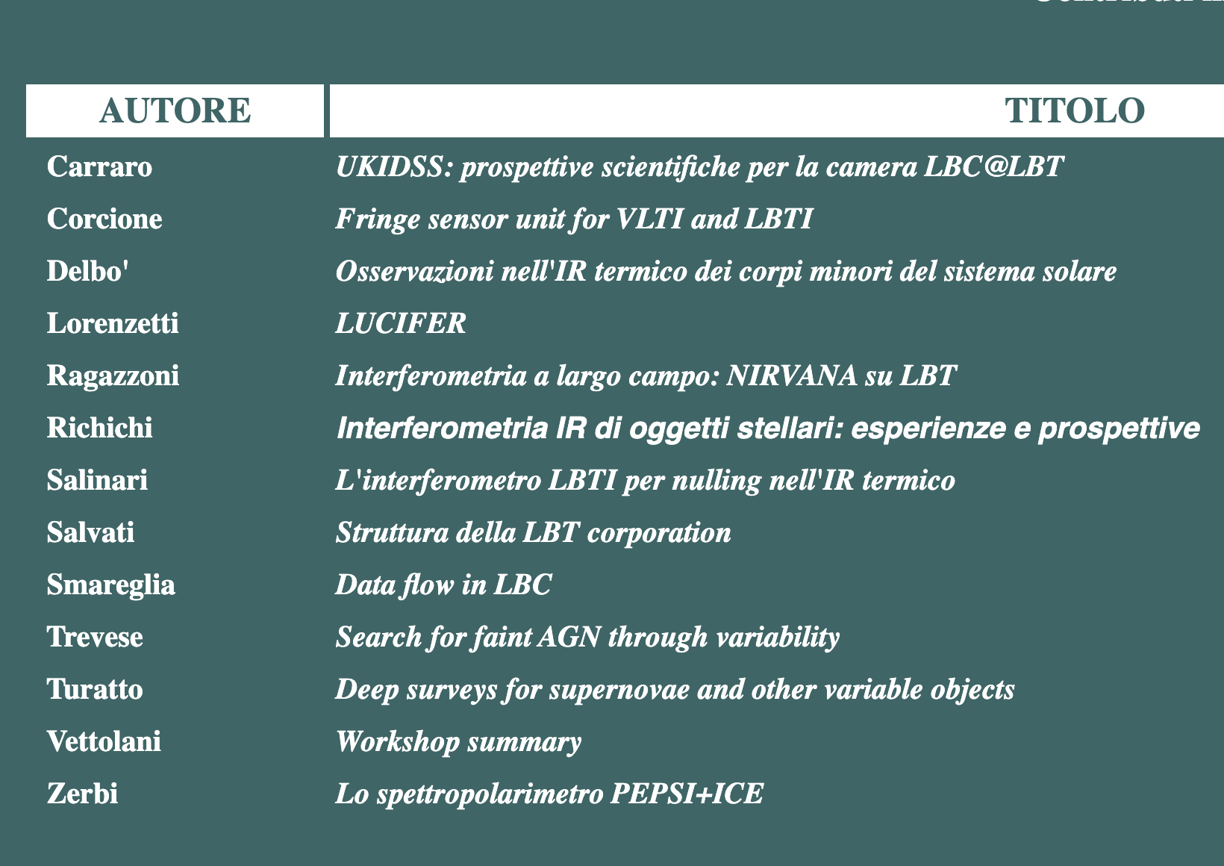
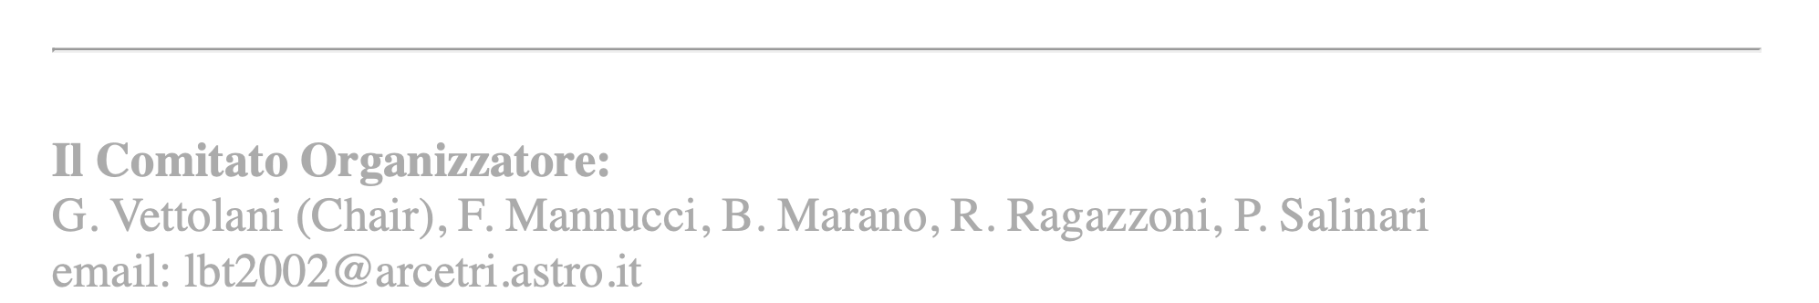
2002: LBT in Bertinoro

Slide 16
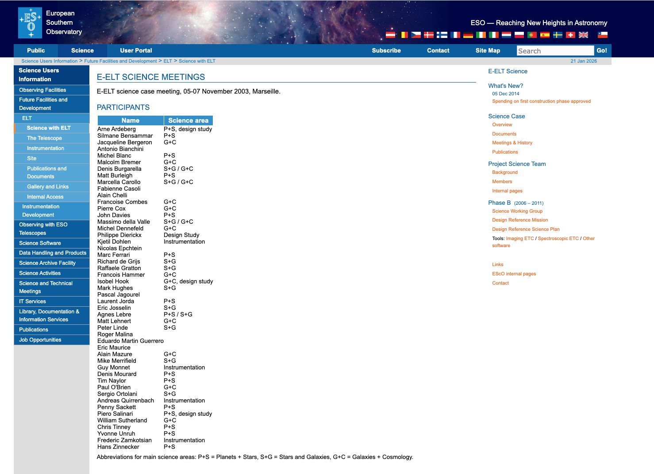
ELT-2003

Slide 17
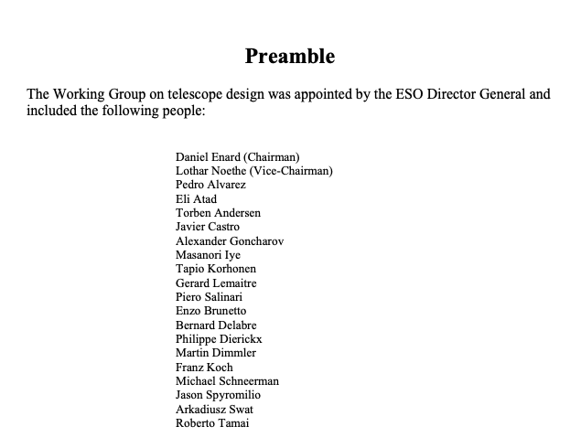
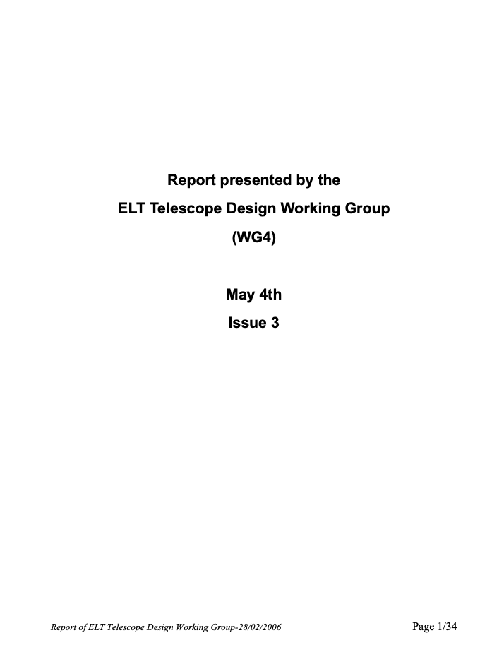
ELT, 2004-2006
Report presented on May 2006

Slide 18
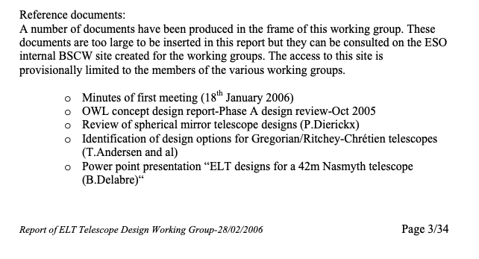
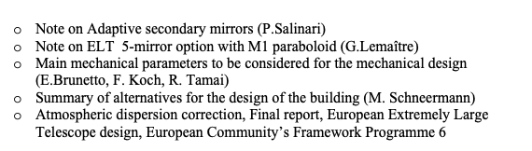
Adaptive primaries?!

Slide 19
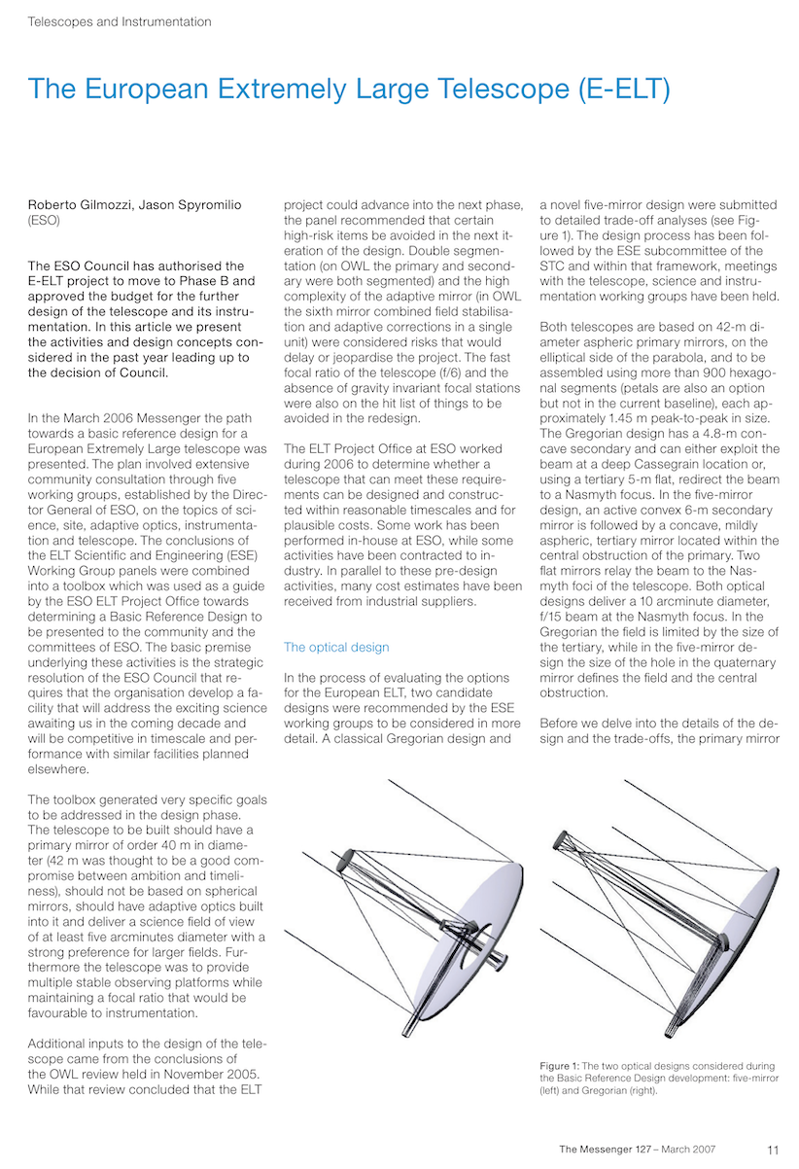

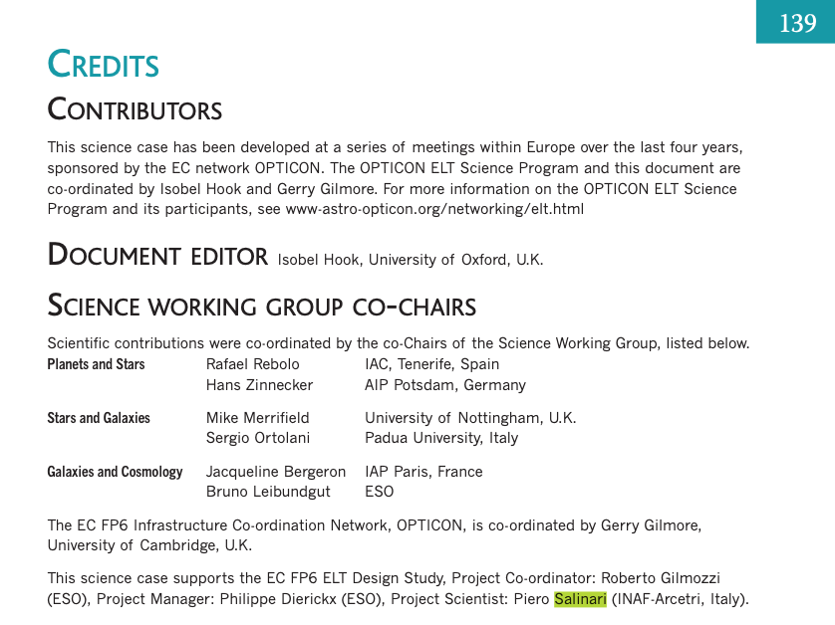
E-ELT Science Book

Slide 20
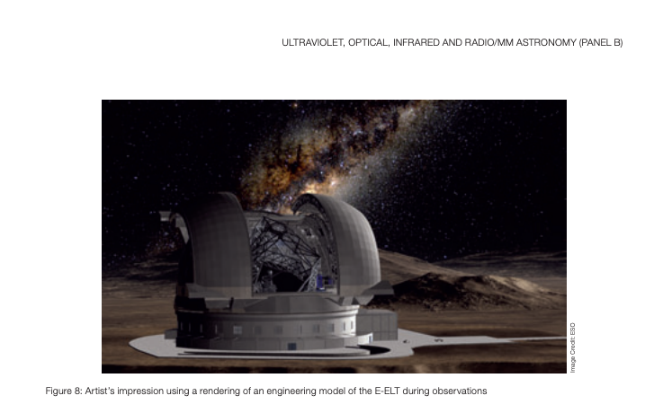

E-ELT 2007-2008, 42m telescope

Slide 21
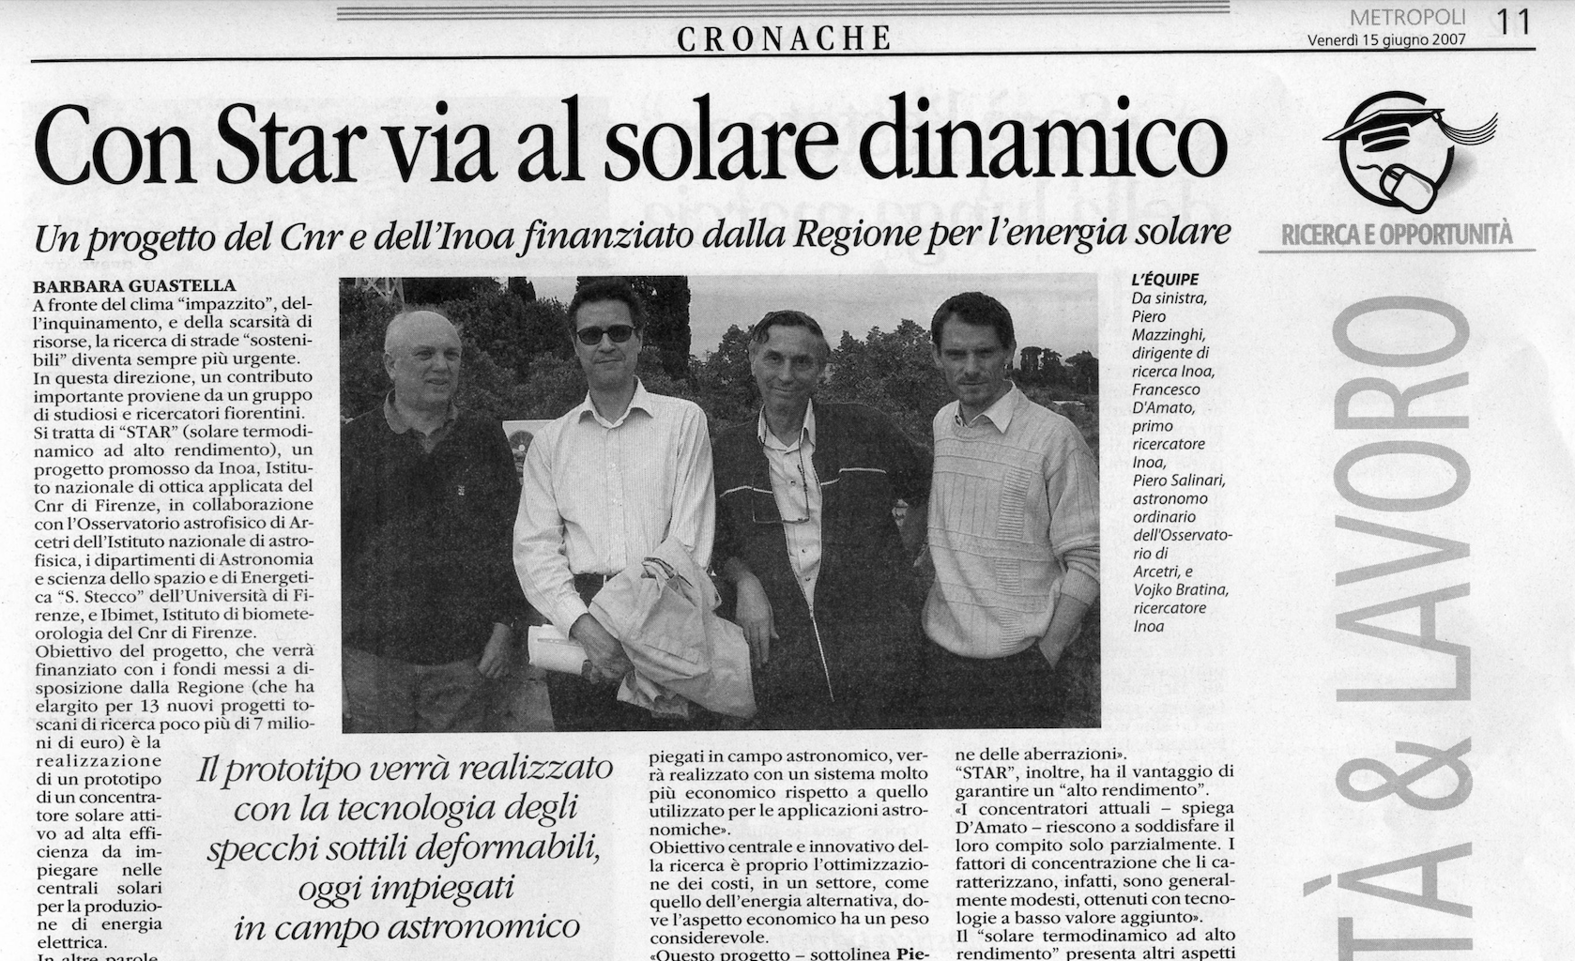
Termodynamic solar plant 2007
a solar thermodynamic plant—also known as a concentrating solar power (CSP) plant, or a solar thermal power plant—is a type of power plant that uses solar radiation as its primary energy source. By concentrating sunlight, it stores the captured energy in the form of heat and then converts it into electricity by means of a steam turbine.

Slide 22
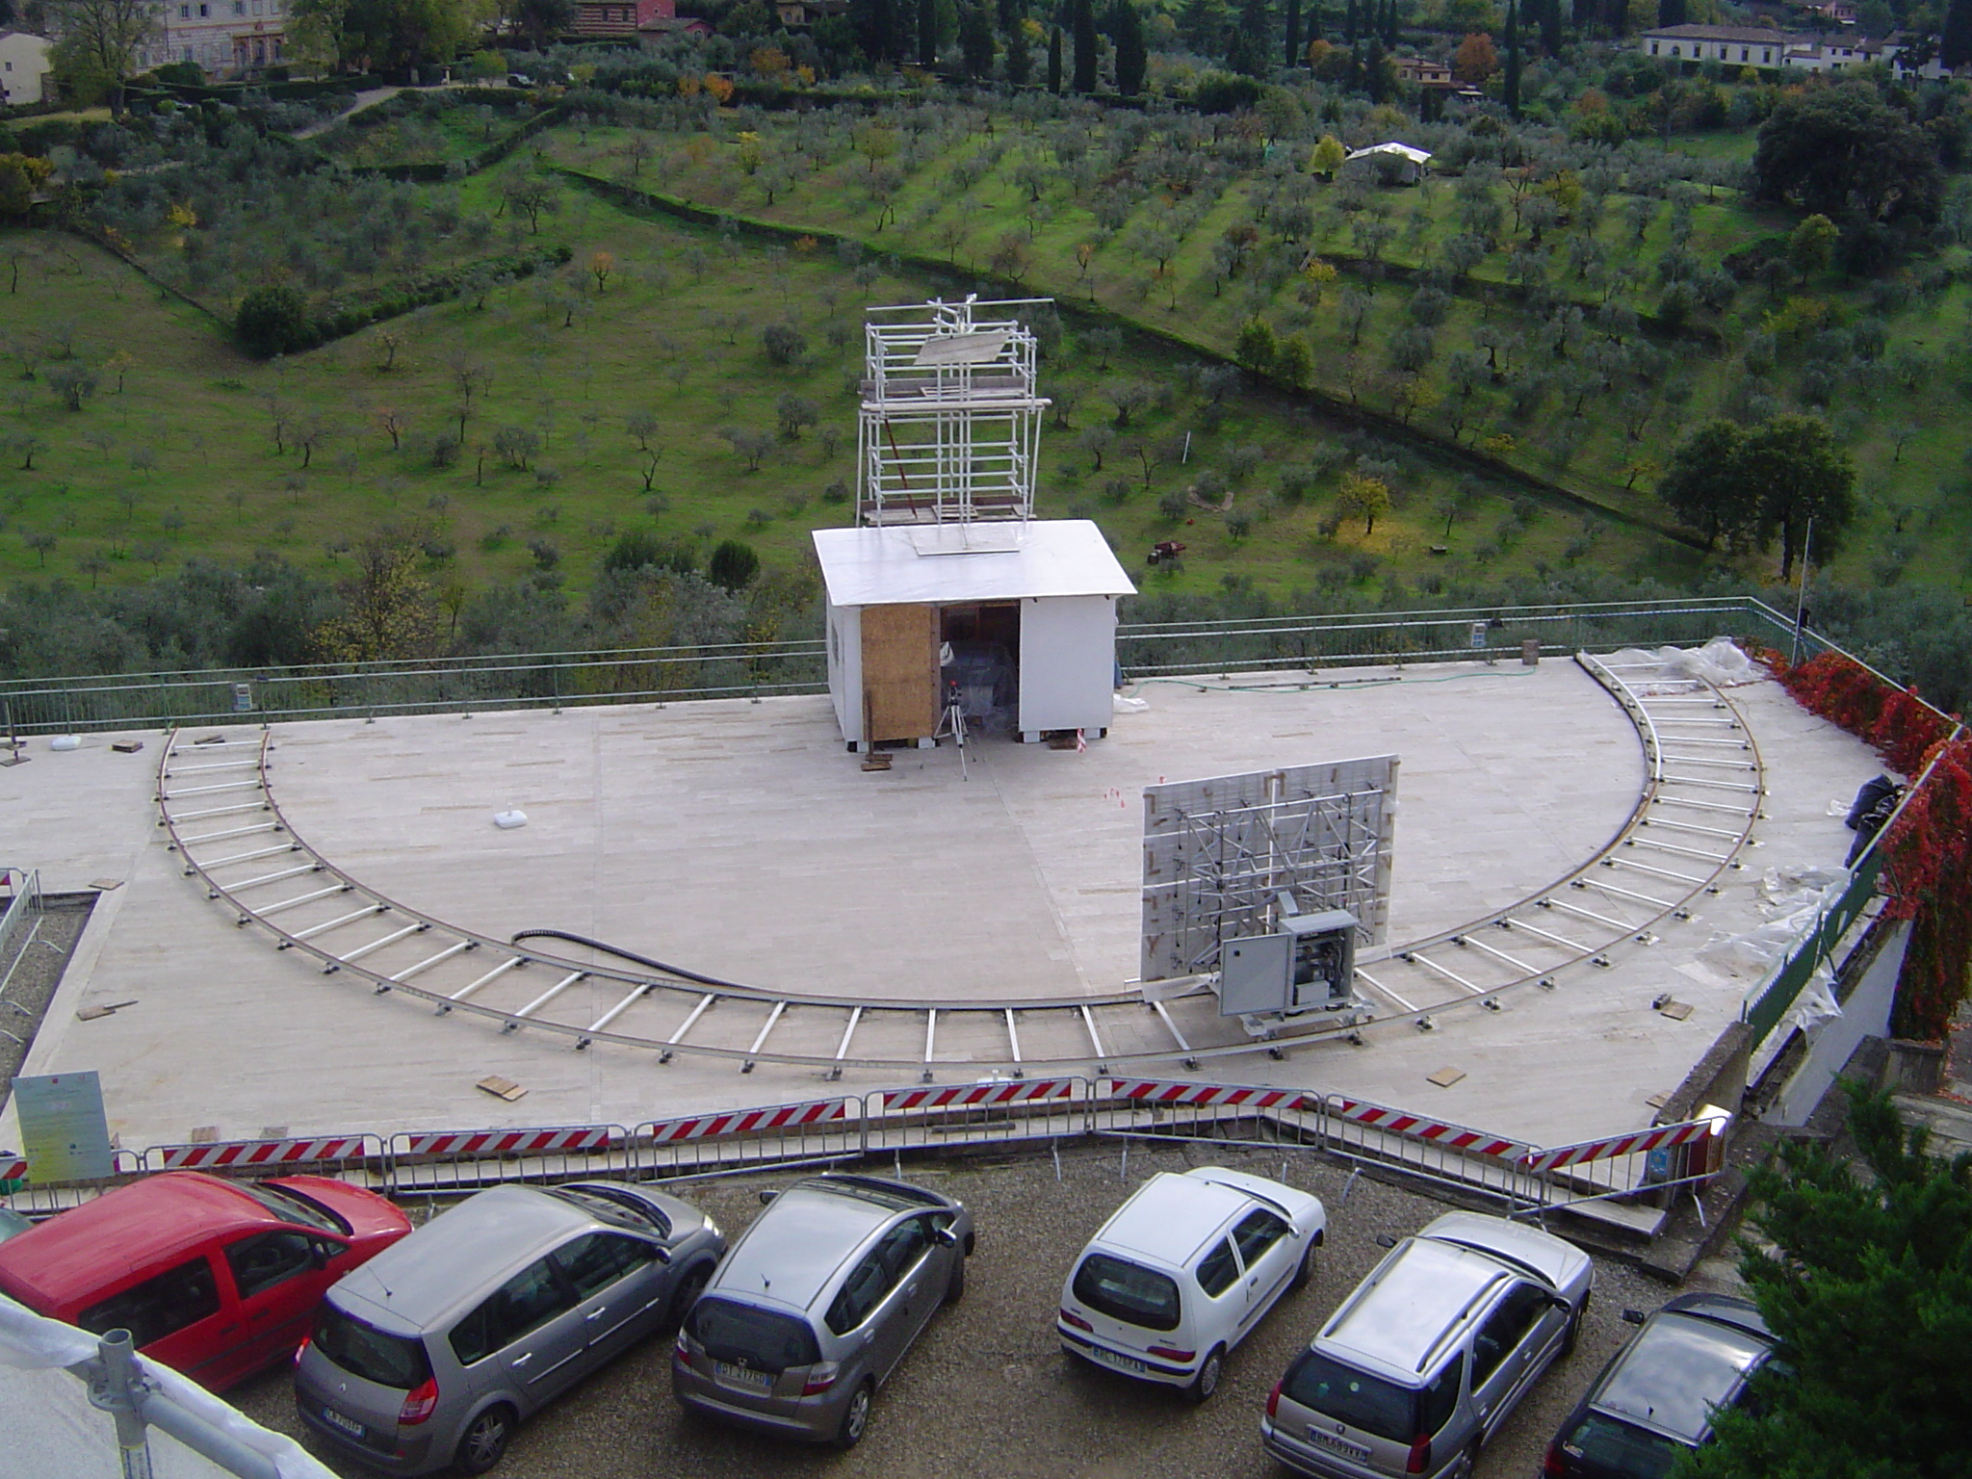
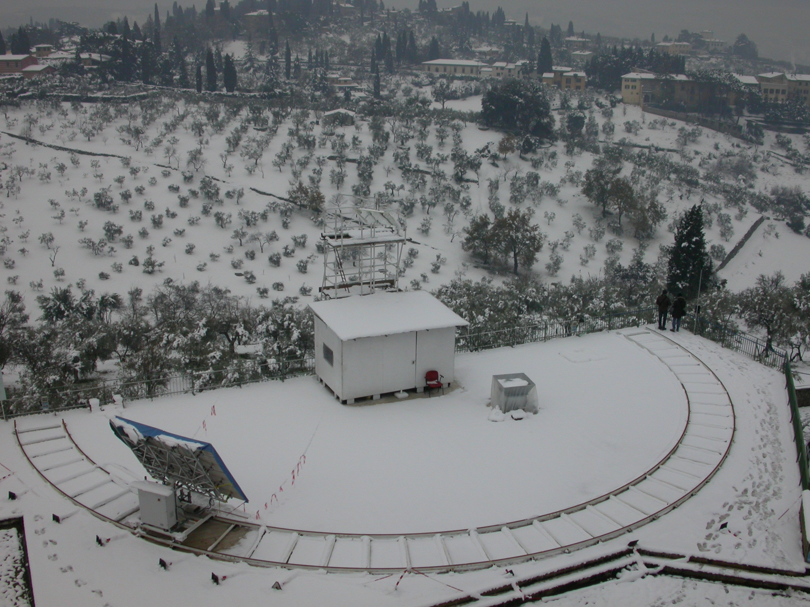
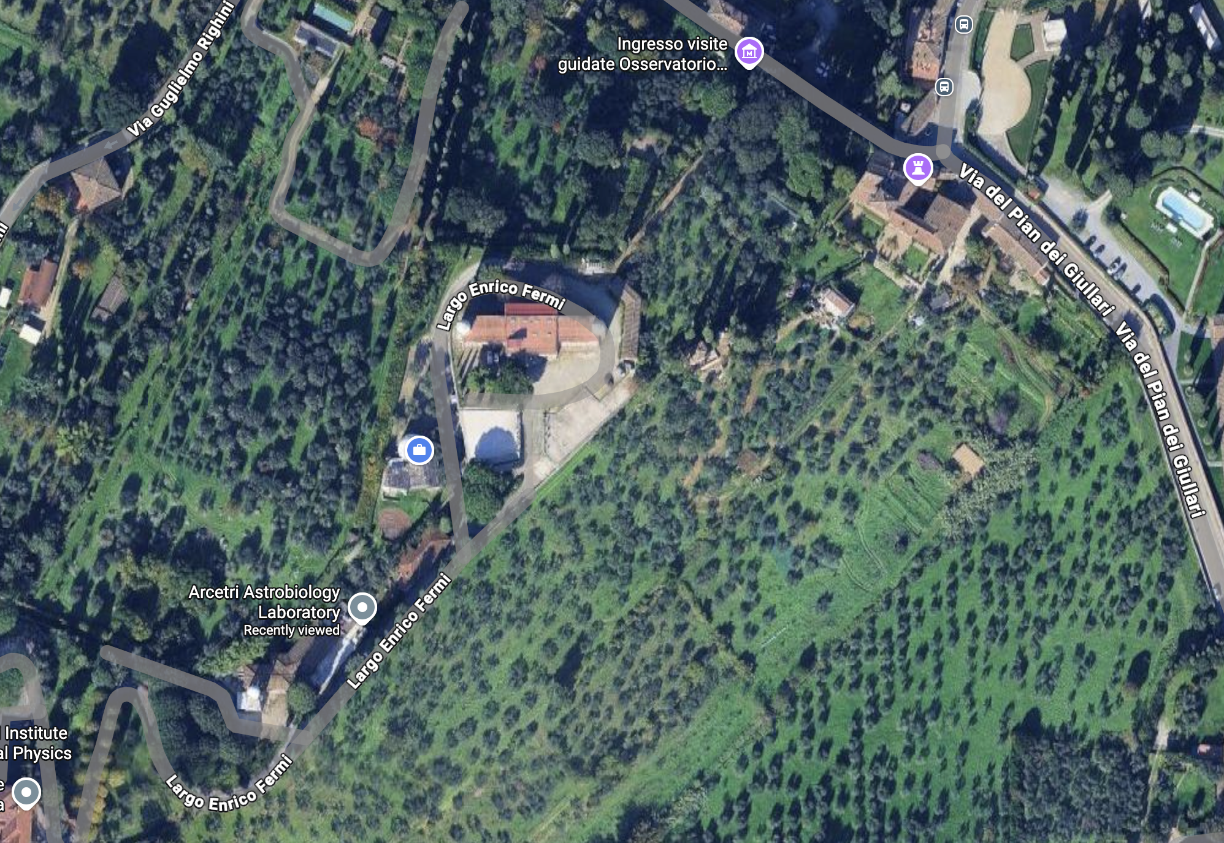
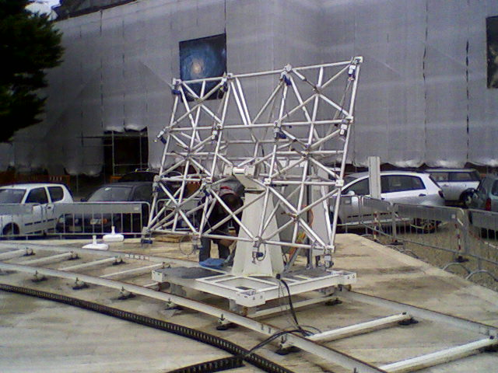

Slide 23
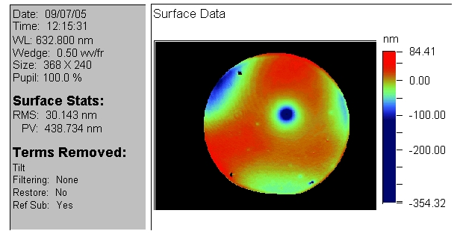
2007: Specchi con tecnologia slumping

Slide 24




2008: Stripping of LBT672a reference body gold deposition using the «Piragna»
P. Salinari
Piragna solution: Acqua ossigenata + acido solforico
According to R. Briguglio

Slide 25

2010....

Slide 26

FLAO system installation at LBT....

Slide 27


FLAO system installation at LBT
February 9th --March 17th 2010

Slide 28


FLAO system installation @ LBT
February 9th --March 17th 2010
February 9th --March 17th .
SPIE, Optics+Photonics Conf., 21 - 25 August 2011, USA

Slide 29


FLAO system installation at LBT
February 9th --March 17th 2010
February 9th --March 17th .
SPIE, Optics+Photonics Conf., 21 - 25 August 2011, USA

Slide 30

2010, Results ?? RESULTS !!!!

Slide 31


High SR images..(H band)
H band SR 80%
8 rings visible
The reference: HD175658, R =6.5, H=2.5
The atmosphere: seeing 0.9 arcsec V band
FLAO parameters: 1KHz, 30x30 subaps, 400 corrected modes
SPIE, Optics+Photonics Conf., 21 - 25 August 2011, USA

Slide 32




The Globular cluster M92
~15’’
10’’
HST WFPC3, H band, 20min
LBT FLAO, H band, 8min
HST WFPC3, H band, 20 min
LBT+FLAO, H band, 8 min
Main data: Rmag 11.5, 0.7’’ seeing,
AO settings: 0.5KHz, 15x15 subaps, 153 corrected modes
HST/WFPC3, H band 21min
LBT J band, 6min
LBT K band, 3min
HST WFPC3, H band, 20min
LBT+FLAO, H band, 8min
Main data: Rmag 12.0, 0.9’’ seeing
AO settings: 0.5KHz, 15x15 subaps, 153 corrected modes
SPIE, Optics+Photonics Conf., 21 - 25 August 2011, USA

Slide 33

2011: Piero’s fest foto.

Slide 34

2016:

Slide 35






Slide 36










2011: Piero’s idea is adult and walks on its legs
VLT-UT4: 1stLight Oct 2016
Convex, 2mm thick
1120mm diam
1170 acts, 29mm/act
Proj. on M1: 21cm/act
σ_{fit} = 66nm rms WFE
(0.8as seeing@V)
SUBARU: GLAO
Convex, 2mm thick
1260mm diam
924 acts
in production

Slide 37


Slide 38




Adaptive Telescope Mirrors on ELTs
ELT (39m)
GMT (25m)
5352 actuators
2.5m diam
7x672 act segments (tot:4700)
1.05m diam per seg. (tot: 3.17m)

Slide 39


Slide 40

5352 actuators, 2.4m diameter

Slide 41
And then?
Visible interferometry ?
Adaptive primaries ?
Now, its's easy to imagine what Piero would say about at least one of the open points above:
5352 actuators on M4? No. One actuator (DoF) per photons received. Let’s change the ELT primary design to an adaptive M1 (798 segments each of 1.2m size with 10cm actuator pitch or 113 act). Its sum up to 90174 actuators. We still have a couple of years..

Slide 42
Piero’s contribution to telescope technologies
I presented a list of main items, I assume I surely have forgotten some, or I am not aware of some!! My apologizes to you and Piero for these errors!!
Piero’s contribution is impressive/essential, adaptive secondary and their technology shaped the ELTs design, the largest optical facilities for the next (?) >30 years. Adaptive secondaries are currently the state of the art for AO on bests 8m class telescope like VLTs.
Piero, thank you for everything you did for me over the past 20 years, and for never once letting me doubt that we would make it right in the end.

Slide 43
Thanks you very much for your attention....

Slide 44

2007 at ESO, HOT experiment
SR della piramide calcolati da Markus Kasper > 100% ☺

Slide 45




FLAO system installation at LBT
15mm
February 9th --March 17th 2010

Slide 46


FLAO system installation at LBT
February 9th --March 17th 2010
February 9th --March 17th .
February 9th --March 17th 2010

Slide 47


FLAO system installation @ LBT
February 9th --March 17th 2010
February 9th --March 17th 2010

Slide 48


May2010: first on sky results, a 40mas separation binary
Star companion
FLAO parameters
30x30 subaps
400 corrected modes
1Khz frame rate
Image data
H band
4s exposure time
SR > 60% (no correction for 2nd star flux)
SPIE, Optics+Photonics Conf., 21 - 25 August 2011, USA

