Slide 1
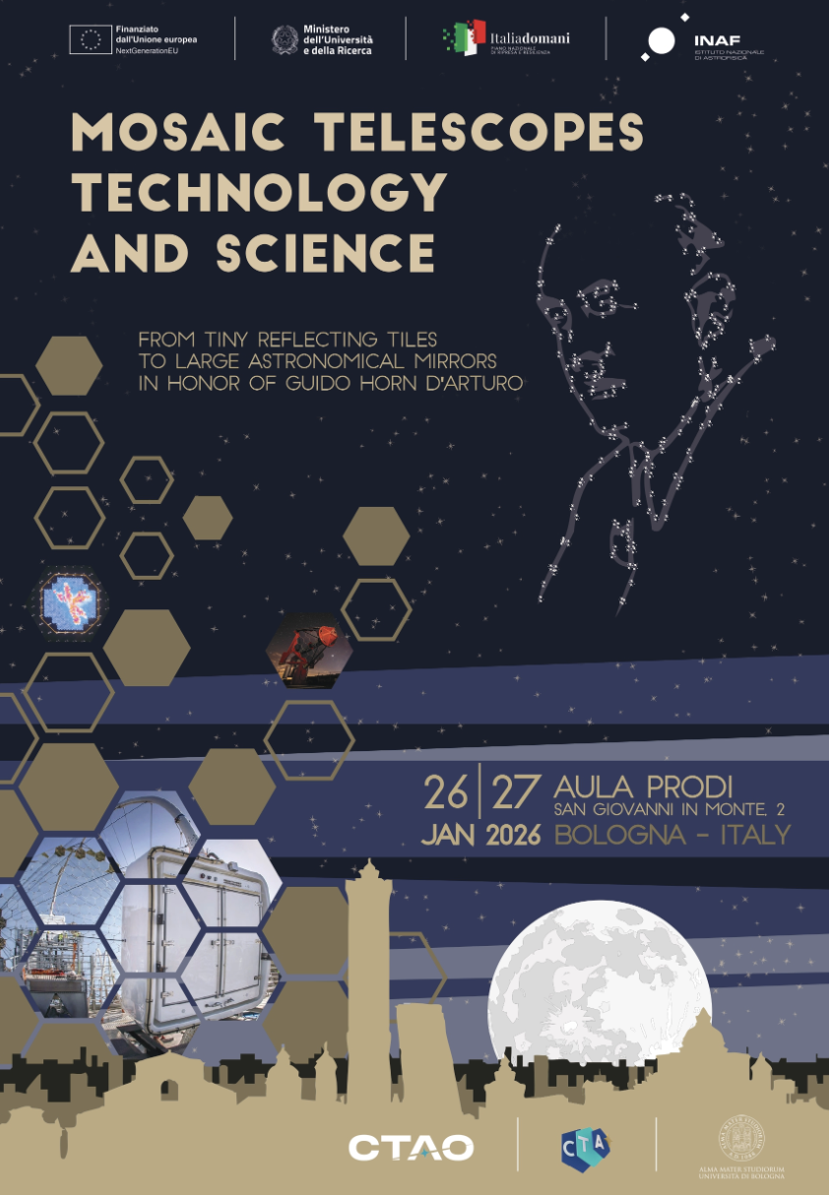
Some concluding remarks
Giovanni Pareschi
INAF / Osservatorio Astronomico di Brera

Slide 2
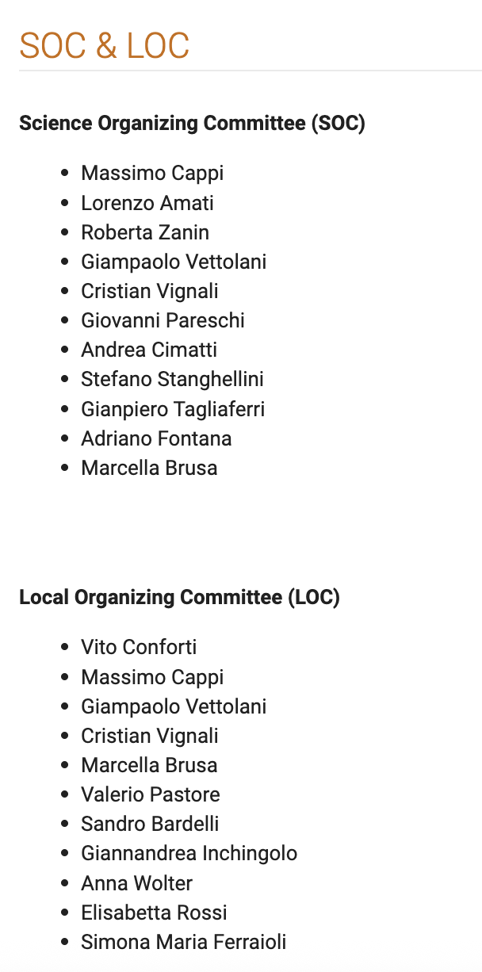

Slide 3
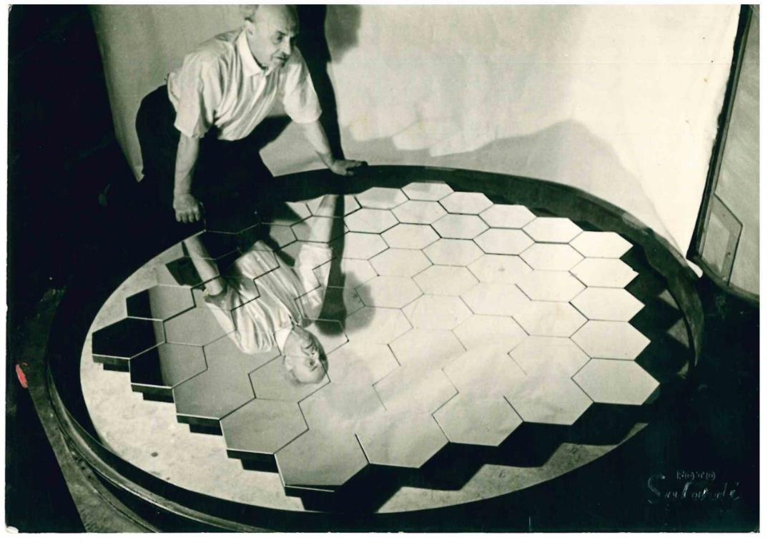
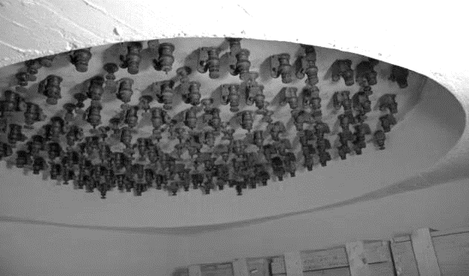
Completion of the first telescope based on segmented mirror
1952 – 61 tiles – diameter 1,80 m
Adjusting time
~ 45 minutes
183 screws for actuation
Credits: F. Bonoli, 2018

Slide 4
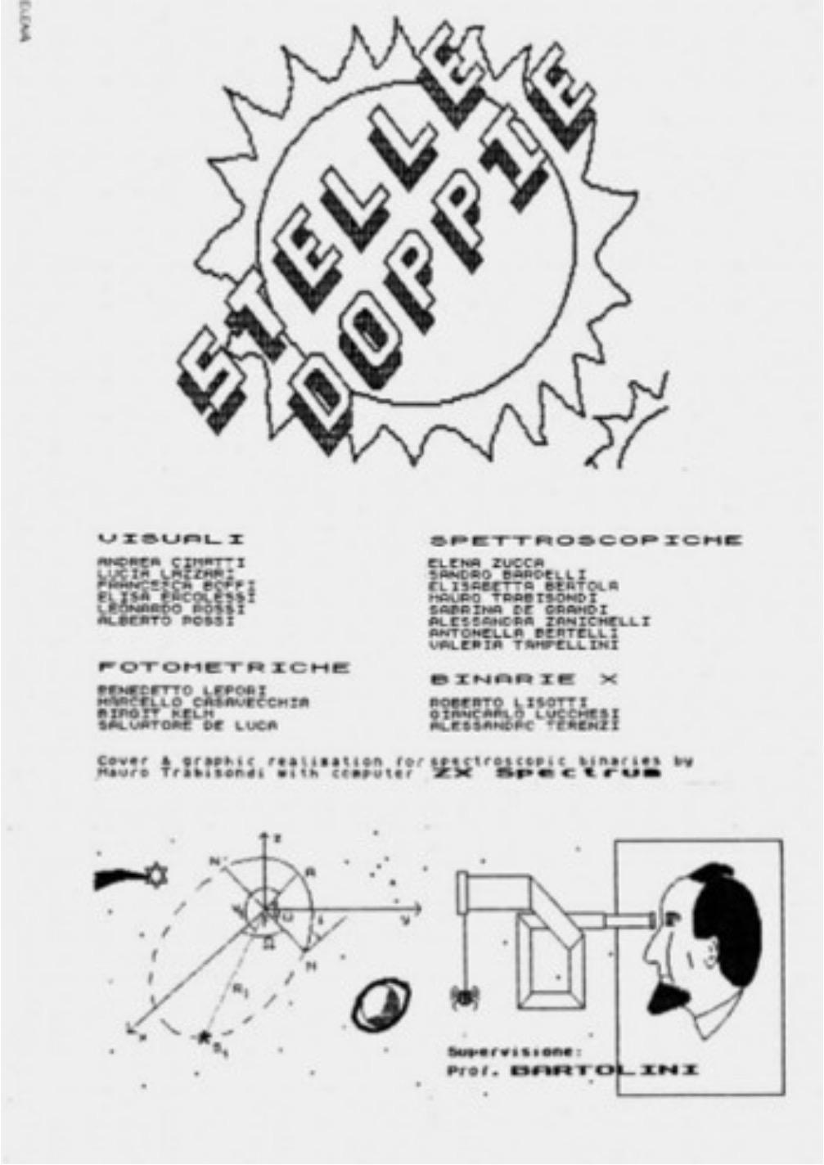
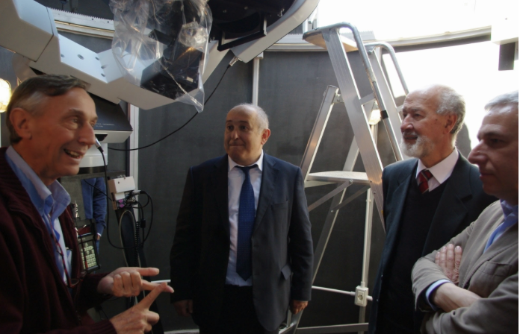
Astronomia Generale
First course of the in Astronomy Laurea curriculum at the Bologna University
Prof Corrado Bartolini
Corrado Bartolini
Piero Salinari

Slide 5
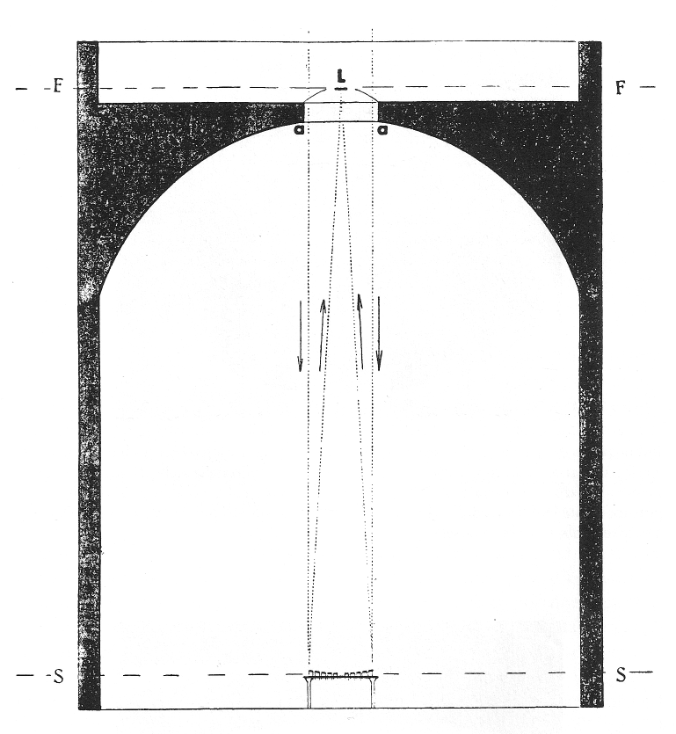
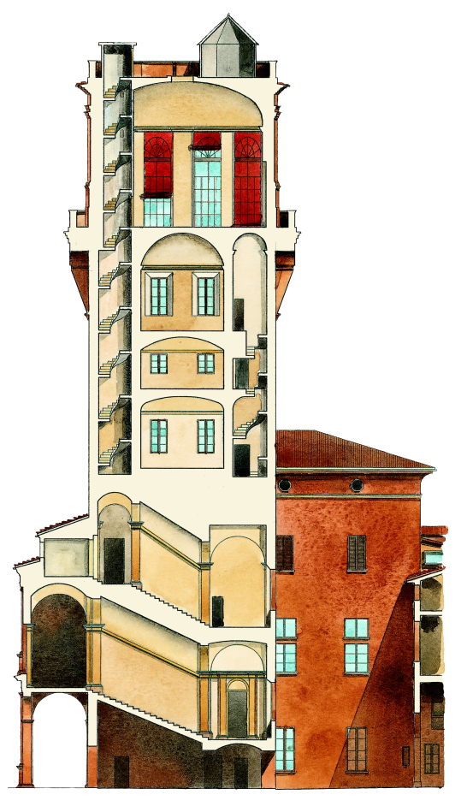
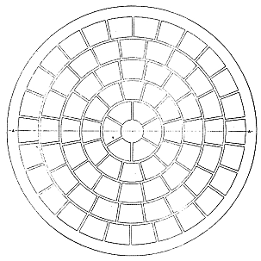

Mosaic mirror(s) in the Bologna specola
Classroom for the lessons for Astronomy Laurea (from about 1975 to amout 2010)
h = f = 10,4 m
Credits: F. Bonoli, 2018

Slide 6
International Holocaust Remembrance Day
27 January

Slide 7
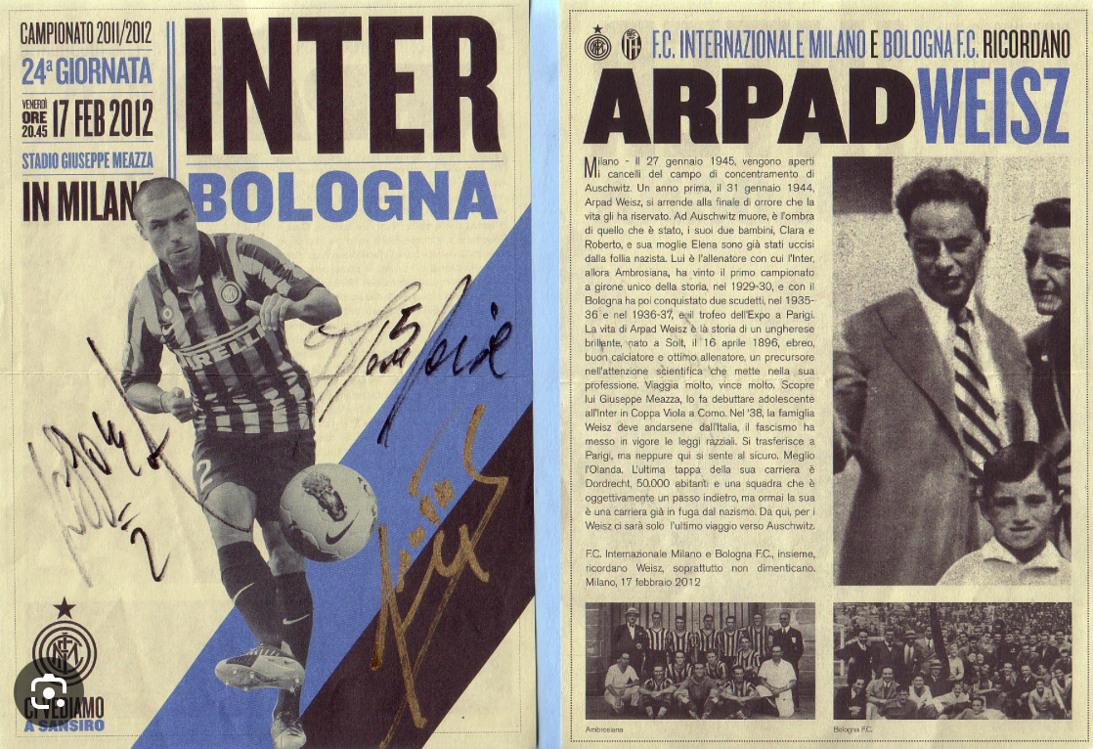

Slide 8
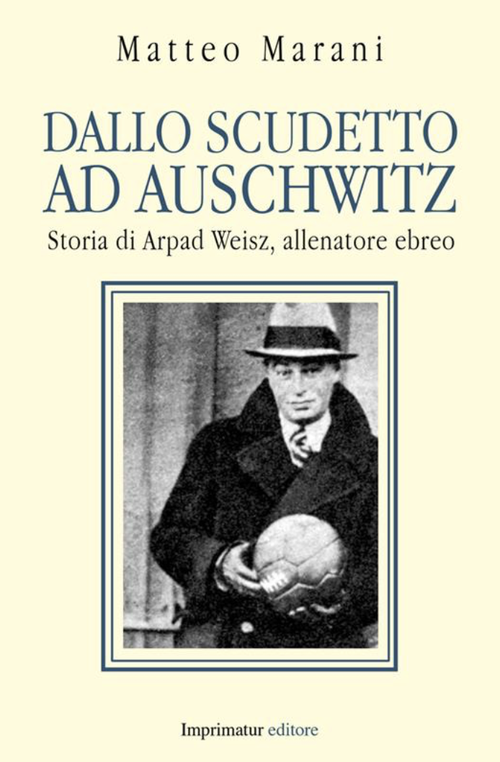
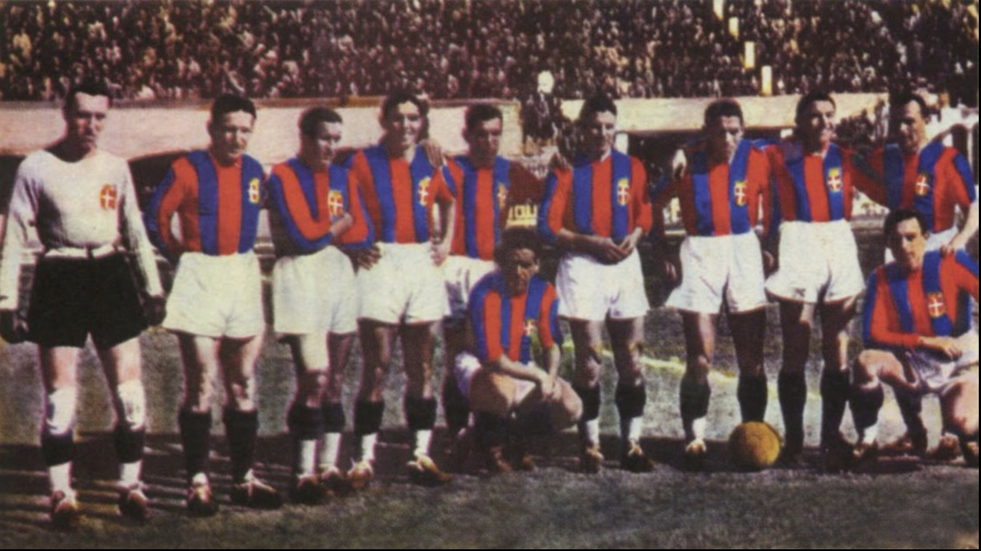
Inter Milano: : winner of the Italian Championship 1929-30
Bologna: winner of the Italian Championship 1935-36 & 1936-38
Winner in Paris of the EXPO Trophy (vs Chelsea, 1937, score 4-1)
Inventor of the “sistema” zone tactic

Slide 9
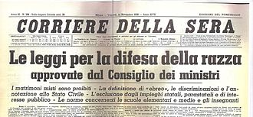
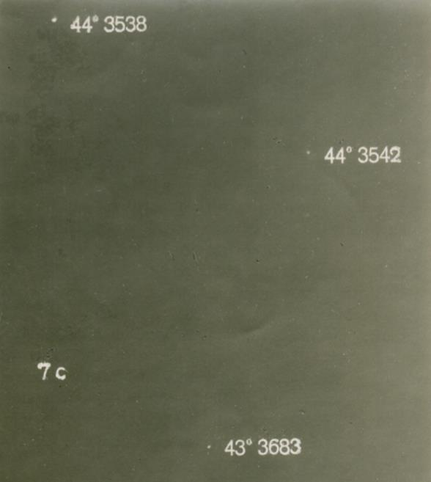

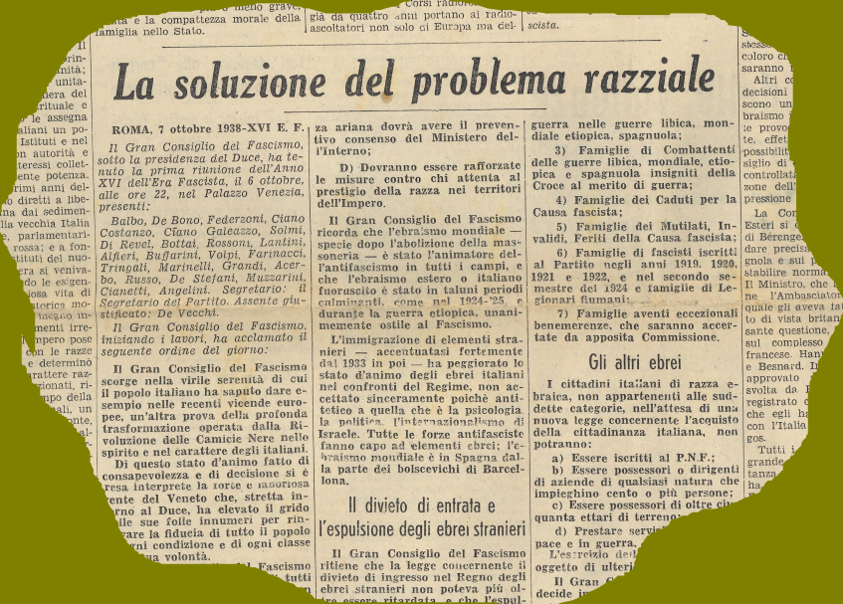
The first prototype shows very promising results but…
1938 – for 7 years Horn’s activity is interrupted (from 1938-1945 years) because of the racial laws by the fascist goverment in Italy (Horn is Jewish!)
Credits: F. Bonoli, 2018

Slide 10
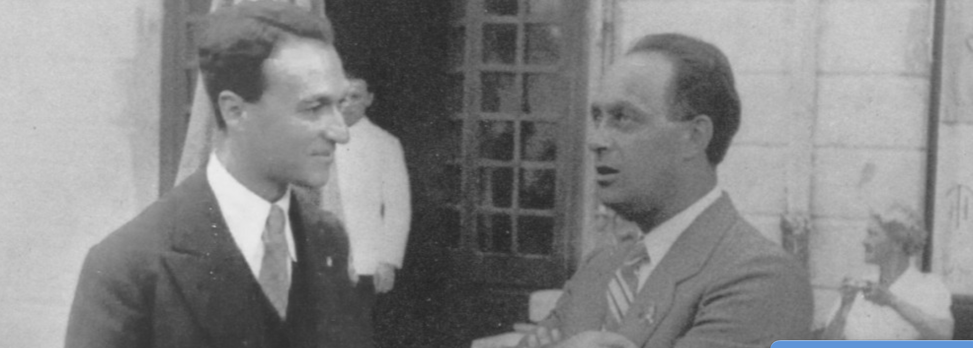
1938: Rossi and Fermi emigrated to USA

Slide 11
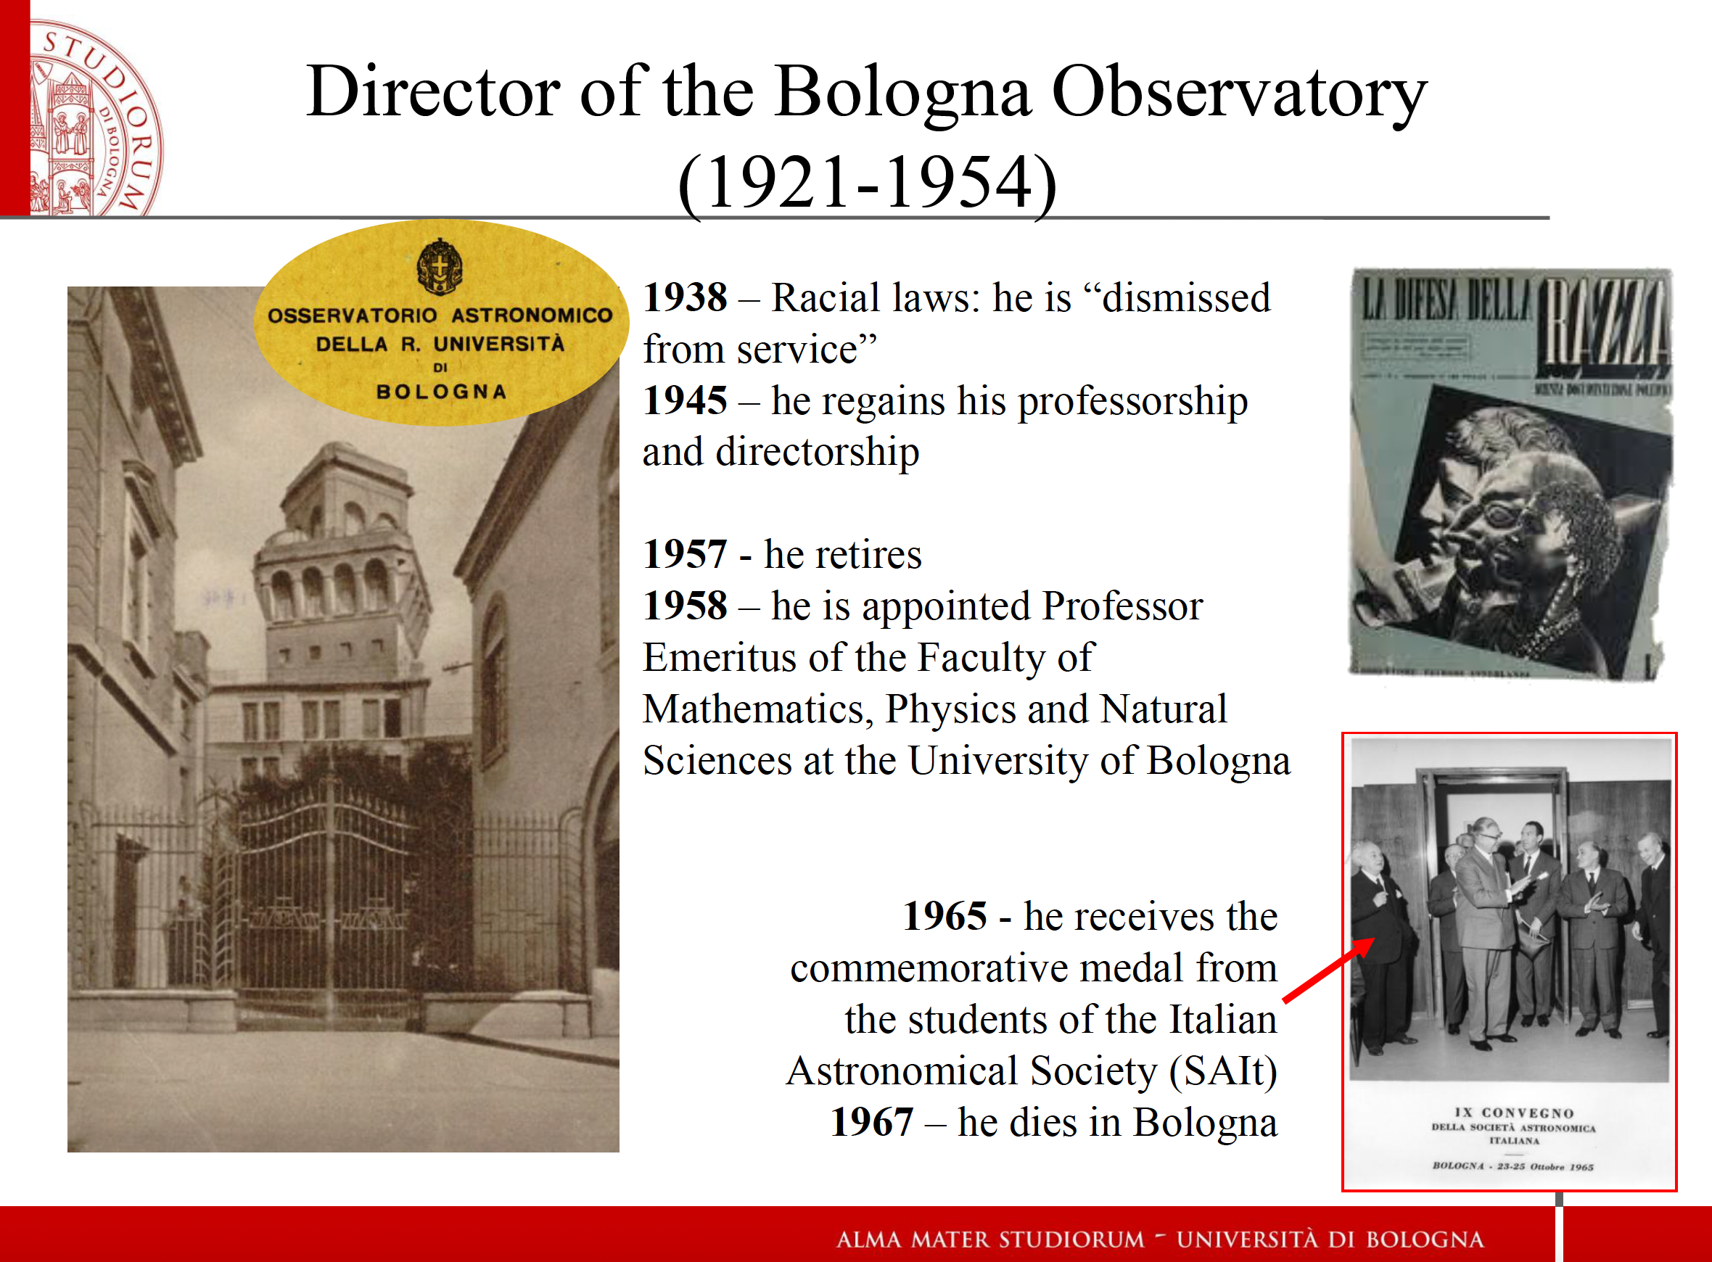
CREDITS: E. Rossi

Slide 12
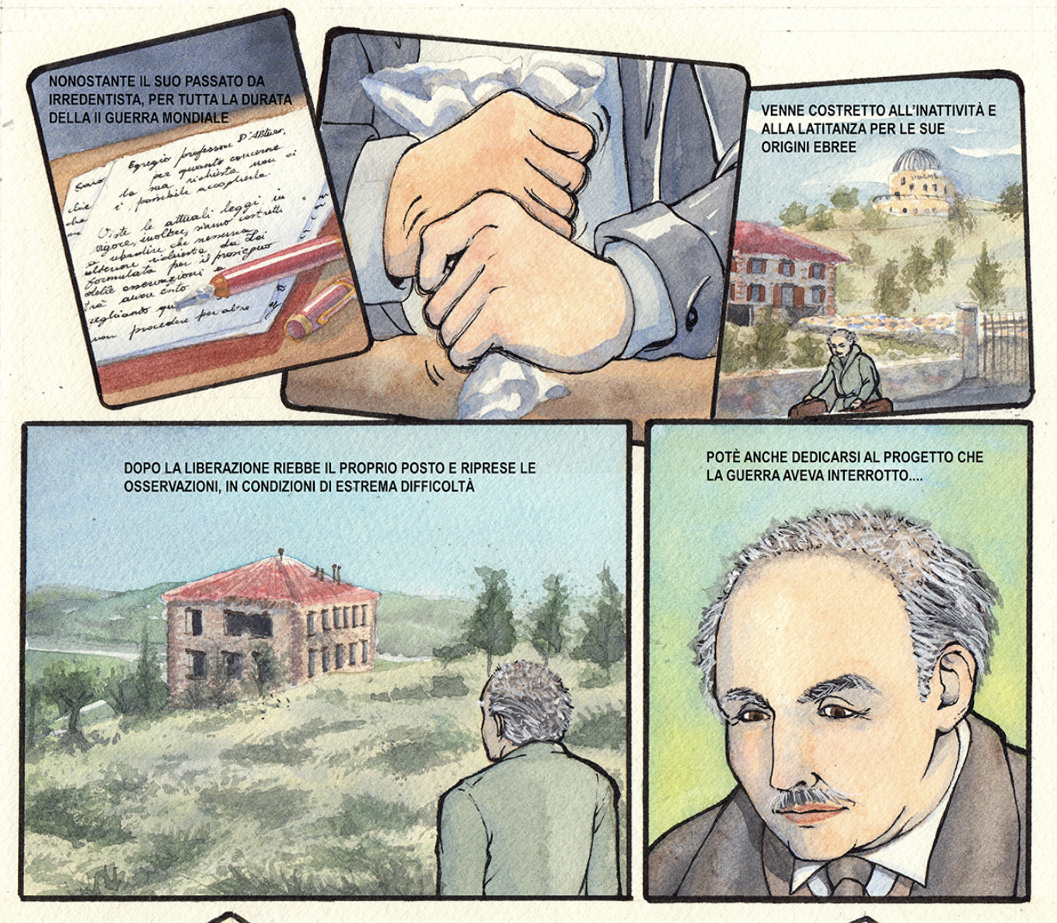
CREDITS: L. Zarantonello, R. Rampazzo, V. Zanini

Slide 13
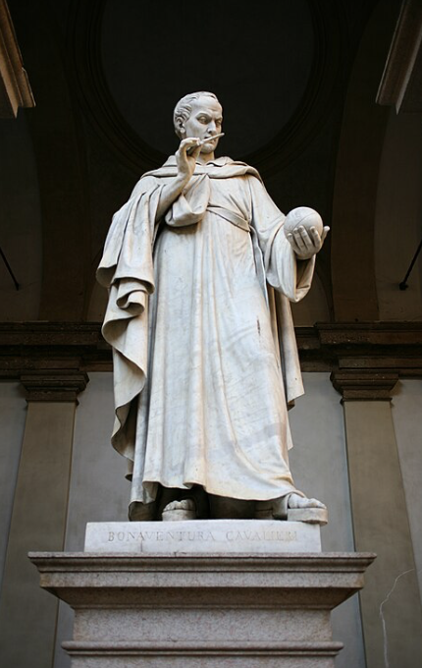
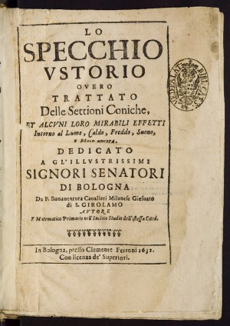
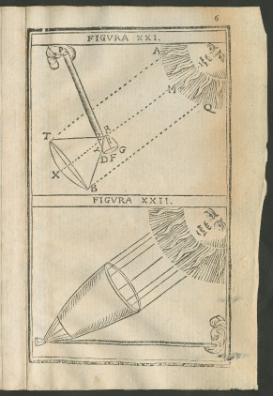
Normal vs grazing incidence
Bonaventura Cavalieri (1598 – 1647)
Professor at the Univ. of Bologna (since 1629)

Slide 14
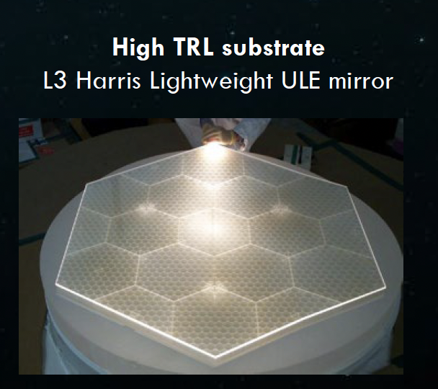
Why segments?
The mirror itself can be very stiff because of its smaller size (scales non-linearly), and the backplane can be stiffened through increased depth
The mount architecture, coarse actuator, wavefront sensing and control, error budgeting, alignment, gravity approach, segment metrology, and system-level verification of the telescope leverage JWST experience
The JWST AMSD mirror was made of ULE and reached TRL5, and a mount design was also developed. Zerodur and ULE are both options.
CREDITS, Feiunberg 2023

Slide 15
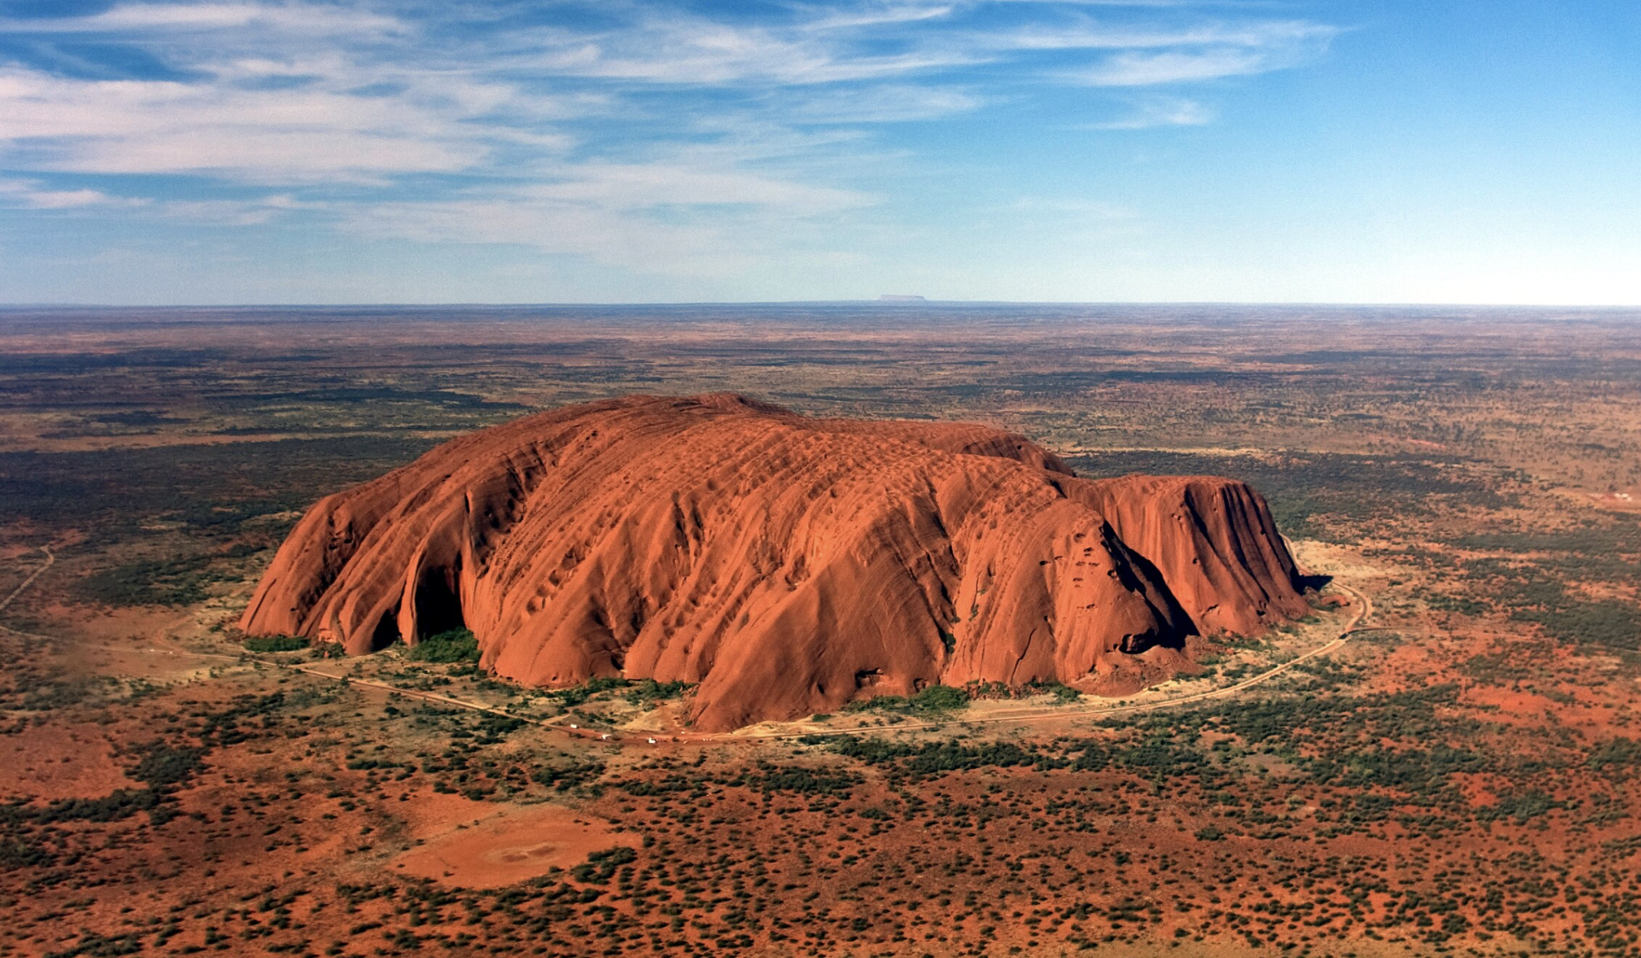
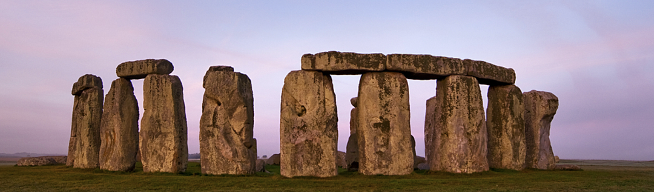
Monolithic & Segmented
What is the most convenient solution?
VS

Slide 16
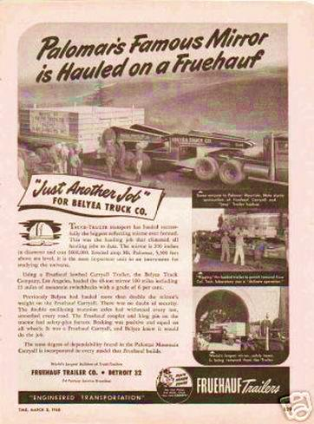
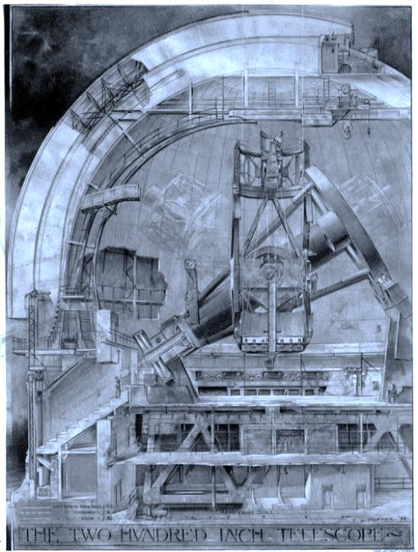
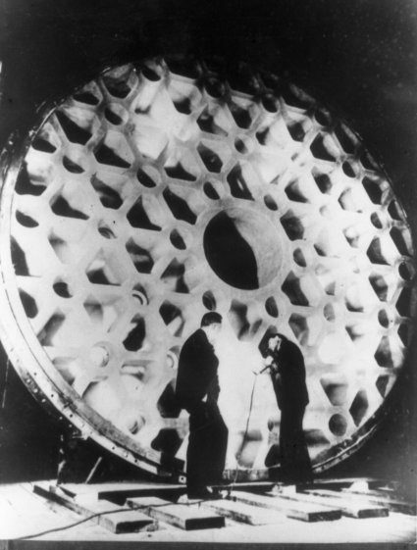
The fact that triggered Horn
1928
la Rockefeller Foundation ➔ 6 M$
for the 200” Palomar telescope
Credits: F. Bonoli, 2018

Slide 17
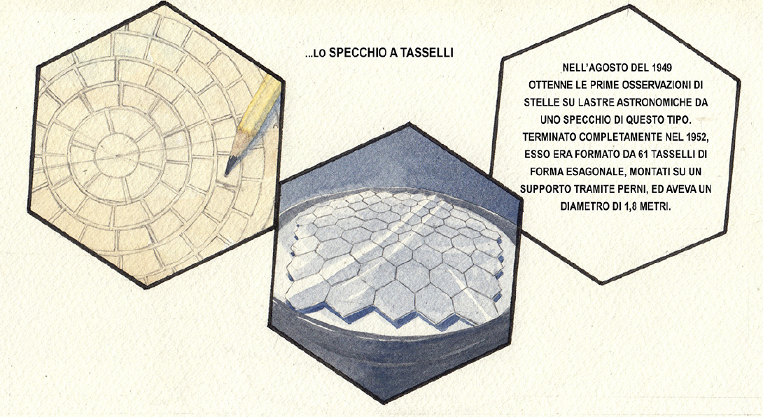
CREDITS: L. Zarantonello, R. Rampazzo, V. Zanini

Slide 18
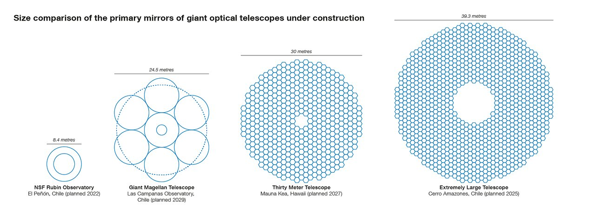
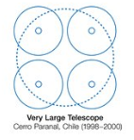
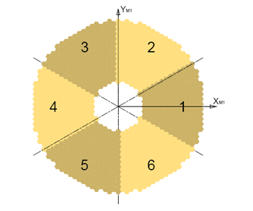
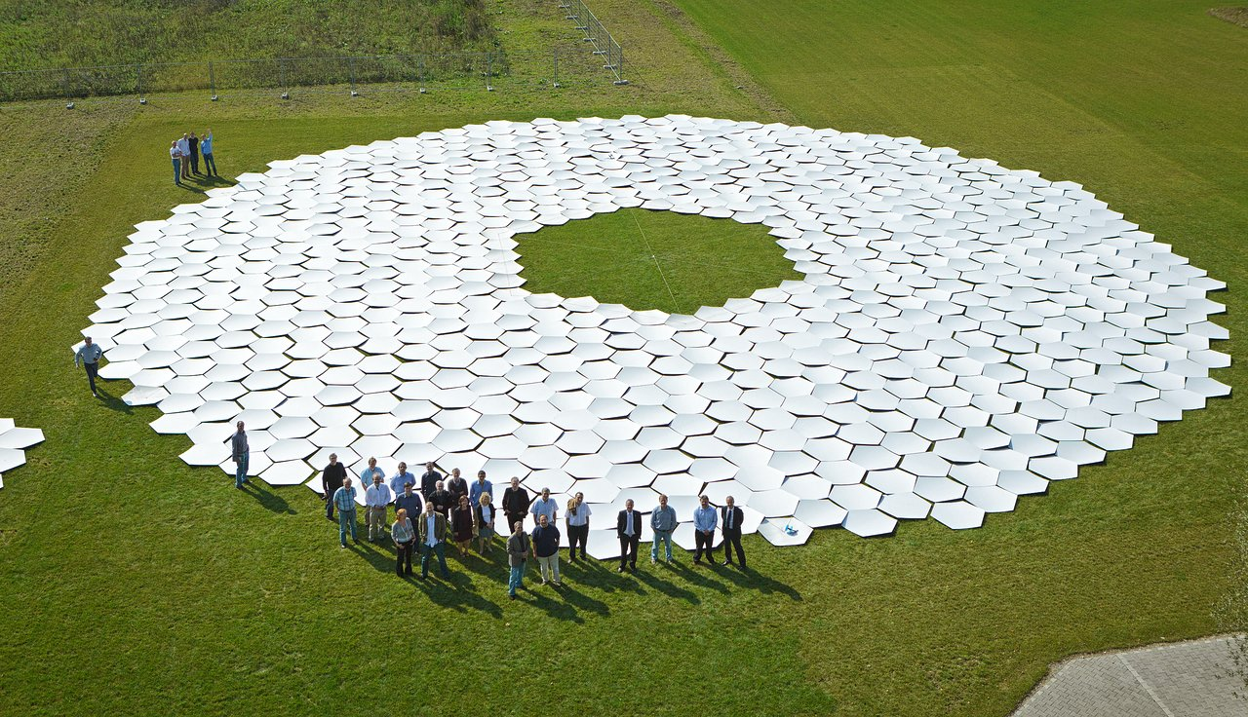
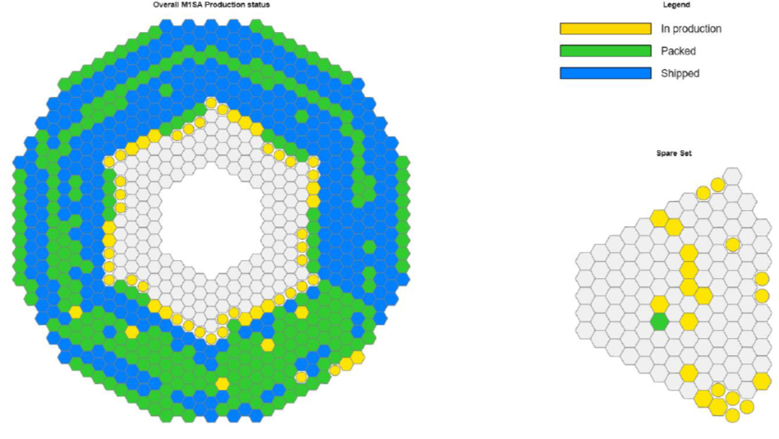
M1 “diameter”: 39-m
Segments diagonal: 1.4m
Amount: 6 x 133 segments
1 x 133 spare segments
Total: 931 segments
M1 Mirror
Outer diameter (mm) | 39146.0
Inner diameter (mm) | 9418.4
M1 Optical Prescription
Radius of curvature (mm) | 68685
Conic constant | -0.996473

Slide 19
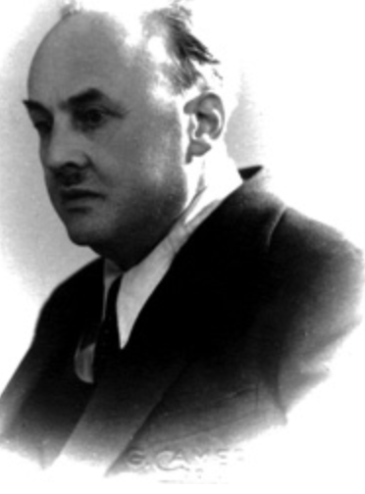
Horn and mosaic space telescopes (60 years beffore…)
«The impossibility of obtaining better-defined images, as long as one remains within the atmosphere, pushes the astronomer to take the optical means outside the atmosphere... one ends up resorting to the relatively light-tiled mirror.»
G. Horn d’Arturo: Coelum, dic. 1966,
Translation from Italian

Slide 20
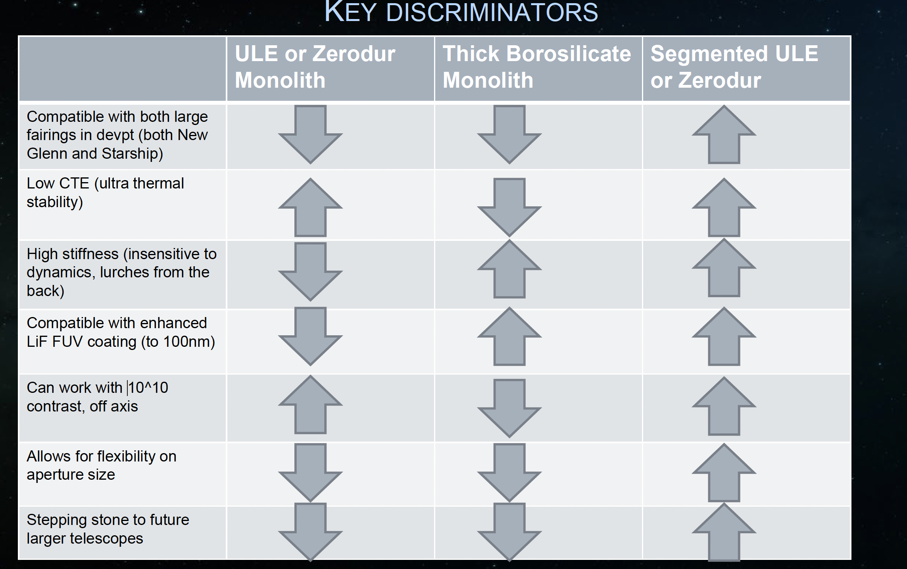
HWO Trade off
CREDITS, Feiunberg 2023

Slide 21
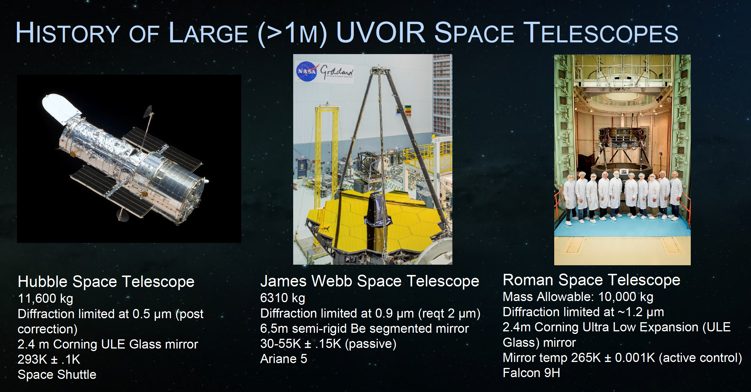
CREDITS, Feiunberg 2023

Slide 22
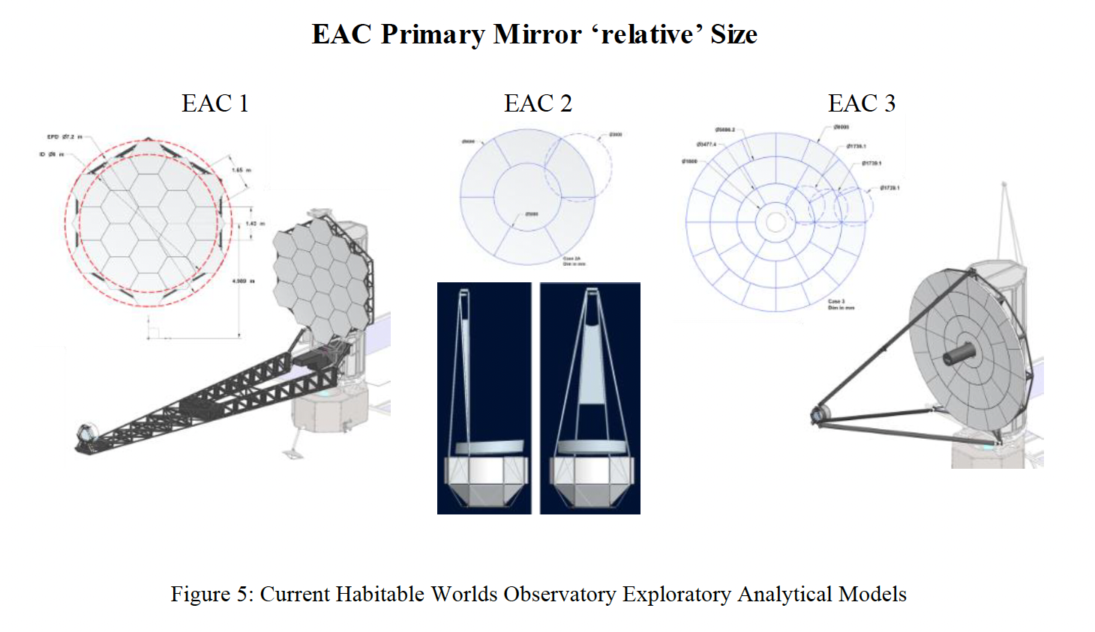
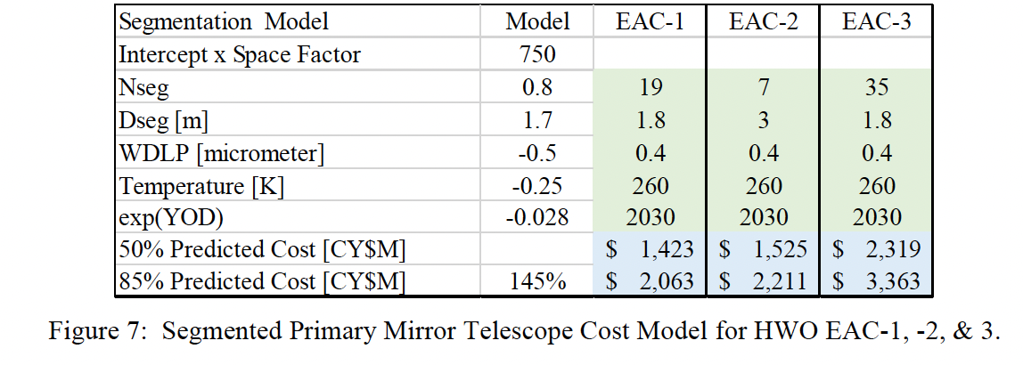
HWO optics cost model
(merely the reflecting surface)
H. Ph. Stahl, Variations of Parametric Cost Models
for Ground and Space Telescopes, SPIE Proc, 2024
»NASA Marshall model»

Slide 23
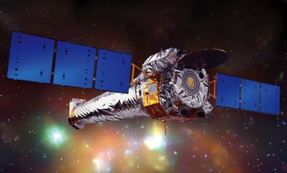
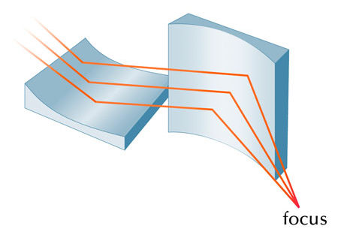
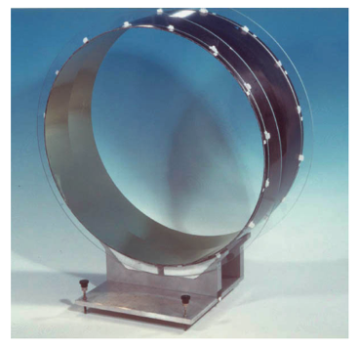
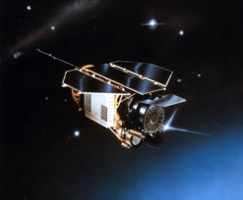
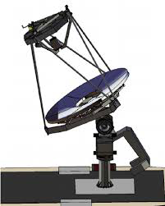
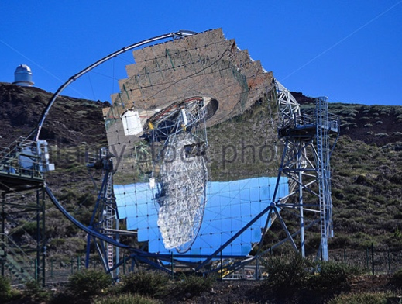
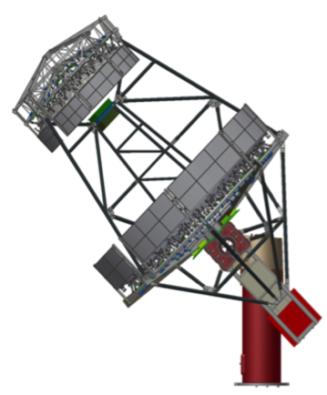
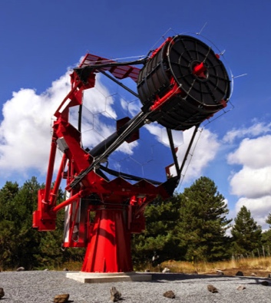
X-ray and Cherenkov telescoscopes vs SC configuration
We recalled the evolution of Schwarzschild-like solution designing X-ray and ground based Cherenkov telescopes, finding some analogies in their development pattern.
Specific requirement
First empirical
focalization
Analytical solution
RT Polynomial optimization
94.0%
86.9%
High Energy
Grazing Incidence
Kirkpatrick - Baez
CHANDRA
WFXT
ROSAT
Wolter &
Wolter-Schwarzschild
84.0%
80.4%
88.1%
85.4%
Few fast pulses
Large Area
Davies- Cotton
ASTRI
Schwarzschild-Couder:
pSCT & Gate
Credits: Giorgia Sironi
23
Notes:
23-48-52-92
52-2007-
Inizia su wolter

Slide 24
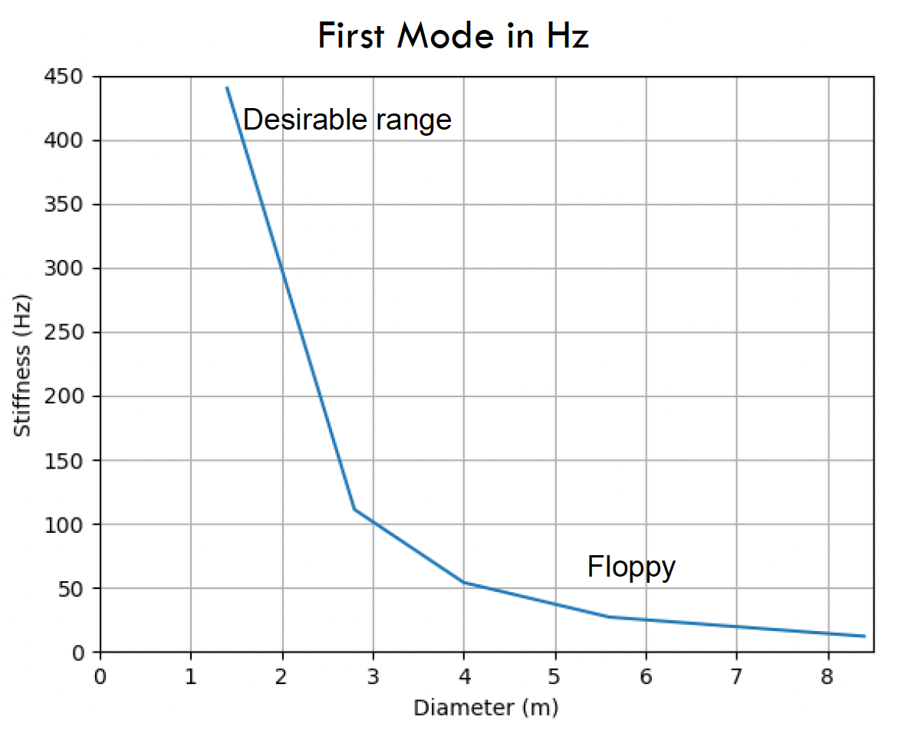
MIRROR STIFFNESS SCALES WITH DIAMETER
A stiffer mirror is highly desirable to prevent deformation caused by dynamic inputs or strain from the back.
An example based on a 15 kg/m2 areal density shows that this depends on the mirror's construction, making it a notional figure.
You can produce a thicker, stiffer mirror; however, mirror manufacturing with ULE and Zerodur materials limits the thickness and, therefore, the stiffness.
Borosilicate can be made thicker depending on the mass, but it would exceed what is feasible for New Glenn.
CREDITS, Feiunberg 2023

Slide 25
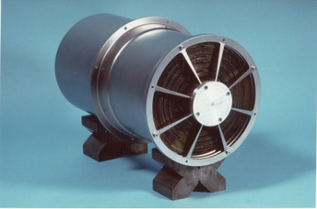
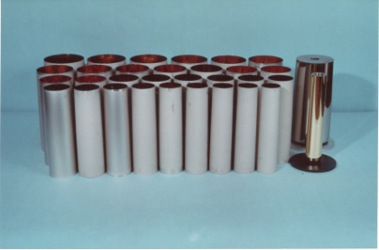
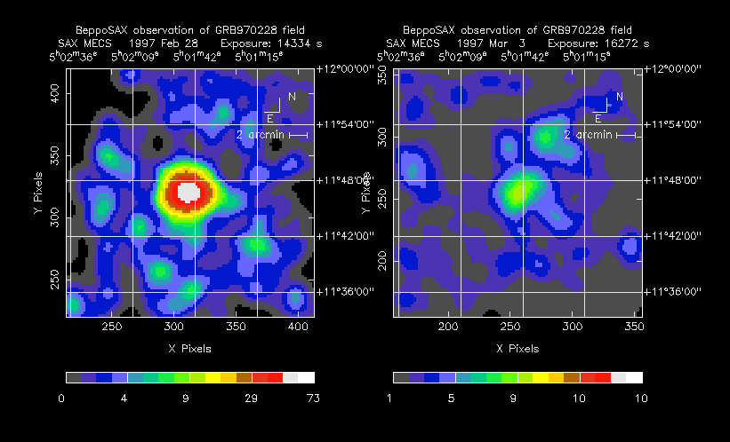


From BeppoSAX to XMM-Newton
BeppoSAX
ESA credits
Jet-X/Swift
XMM-Newton

Slide 26



lo specchio a tasselli: 1932
Credits: F. Bonoli, 2018
nasce il progetto dello specchio a tasselli
80 specchi trapezoidali
con sezione di curvatura sferica
per 1m di diametro complessivo
in montatura azimutale fissa
~ 10x10 cm
CREDITS, Bonoli 2017
3 viti per movimentare ogni tassello:
farli convergere nello stesso fuoco,
eliminare alcune aberrazioni
OTTICA ATTIVA

Slide 27



NewAthena:
Modular Optics for efficient and cost-effective production
Credits: Marcos Bavdaz, ESAc

Slide 28





Present Astronomical optics technologies:
HEW Vs Mass/geometrical area
Nustar
New Configuration

Slide 29

Horn and Cherenkov telescopes
Horn wrote in Coelum (1966) as it is reported in the book “Guido Horn d’Arturo e lo specchio a tasselli”-Authors M. Zuccoli e F. Bonoli ed Clueb: pag 92:
“ Finally, we read in the Sky and Telescope (June 1966 pag 538) that the Smithsonian Astrophysical Observatory, Cambridge (Mass) chose the top of Mount Hopkins for its new facilities*. And it is planning the construction of a 15 meter diameter Reflector, formed by concave segments; it will serve for the study of atmospheric luminosity dependent on gamma rays coming from celestial sources.”
*NB: the quoted concept will evolve into the WHIPPLE telescope, that will make the first detection of the Crab nebula in the TeV energy region at the end of the ‘80-ies

Slide 30

Credits: R. Mirzoyan

Slide 31

CREDITS, R. Mirzoyan
Credits: R. Mirzoyan

Slide 32


Adventure started with MAGIC II (2006)
Principal Inventor: Oberto Citterio
INAF + Media Lario

Slide 33



Segmented reflecting surface
Credits: NASA
JWST, reflecting surface cost: ➔ a few MEuro/m²
ASTRI, reflecting surface cost:
➔ A few KEuro/m²
33
33

Slide 34






INAF past experiences with lightweight optics
Cherenkov LST/CTAO mirror
(core of Al hexacell)
Space foamed Optics, 380 mm
Aereal Density 10 kg/m², rms figure 50 nm

Slide 35

ASTRI-1, Tenerife, Xmas 2025

Slide 36



ASTRI Prototype: PSF across the field of view
FoV position (deg) | D80 (mm)
4.5 | 6.72
3.0 | 6.32
1.5 | 7.28
0.0 | 6.86
-1.5 | 6.32
-3.0 | 5.50
-4.5 | 6.90
SiPM pixel linear dimension: 7 mm → 11.2 arcmin

Slide 38

The Scientific Legacy of Guido Horn d’Arturo
Catania (IT), Novembre 9-10, 2018
Translation of the Horn’s papers in English
https://www.memsait.it/volumi/Vol.%2089%20n.%204,%202018/2018MmSAI..89..446I.pdf

Slide 39





Il telescopio a Serra La Nave
S. Scuderi – Gli ASTRI di Horn – Catania, 9 Nov 2018

Slide 40


10 Nov 2018

Slide 41

2026: Museum at the Bologna Specola/UNIBO

Slide 42

CREDITS: L. Zarantonello, R. Rampazzo, V. Zanini

Slide 43
Is it not time to dedicate a large facility based on a mosaic configuration to Guido Horn d’Arturo?
An appeal to ESO, ESA, NASA, CTAO, IAC…

