Slide 1
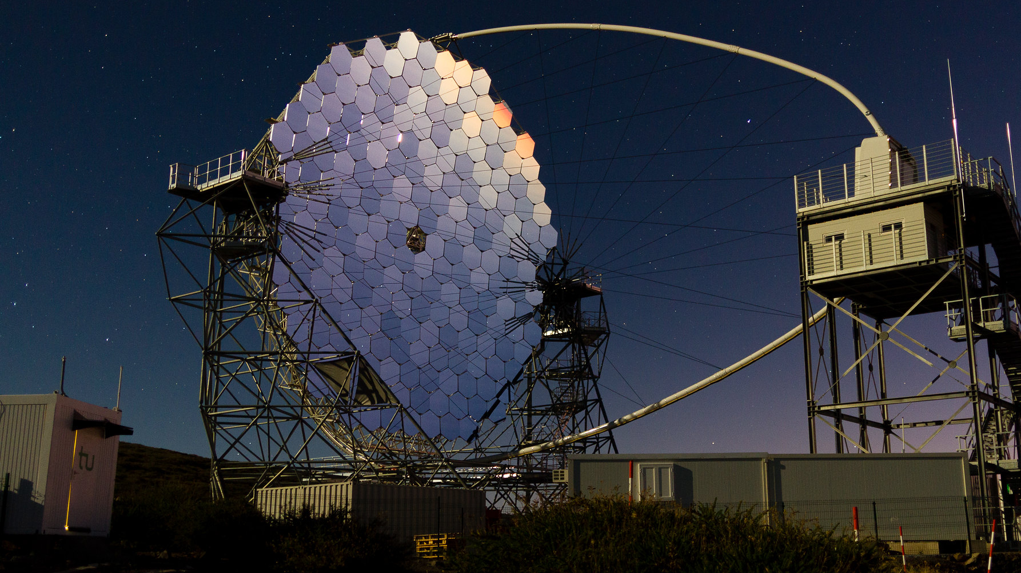
Imaging Cherenkov Telescopes: A New Window into the Universe Made Possible by Segmented Mirrors W. Hofmann, MPIK
Apologies for some overlap with
Giorgia’s talk yesterday
Very High Energy Gamma-Ray Astronomy
at Teraelectronvolt Energies

Slide 2
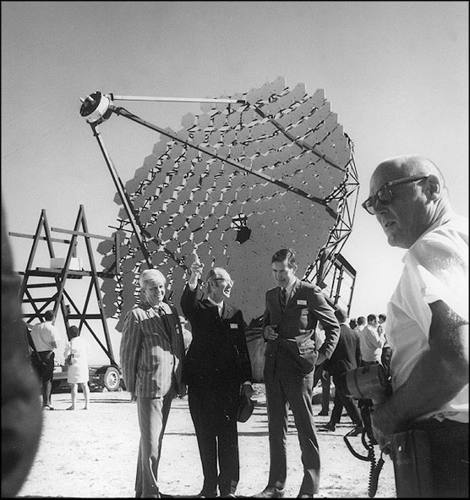
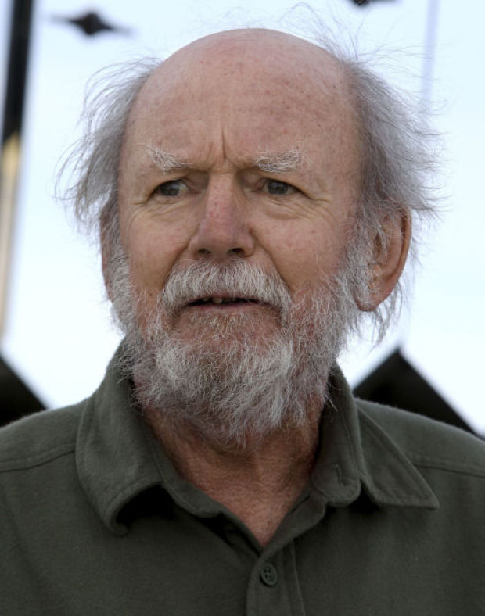
Birth of very high energy (TeV) gamma ray astronomy: WHIPPLE telescope 1989
Trevor
Weekes
ƚ 2014
Whipple Telescope 1968

Slide 3
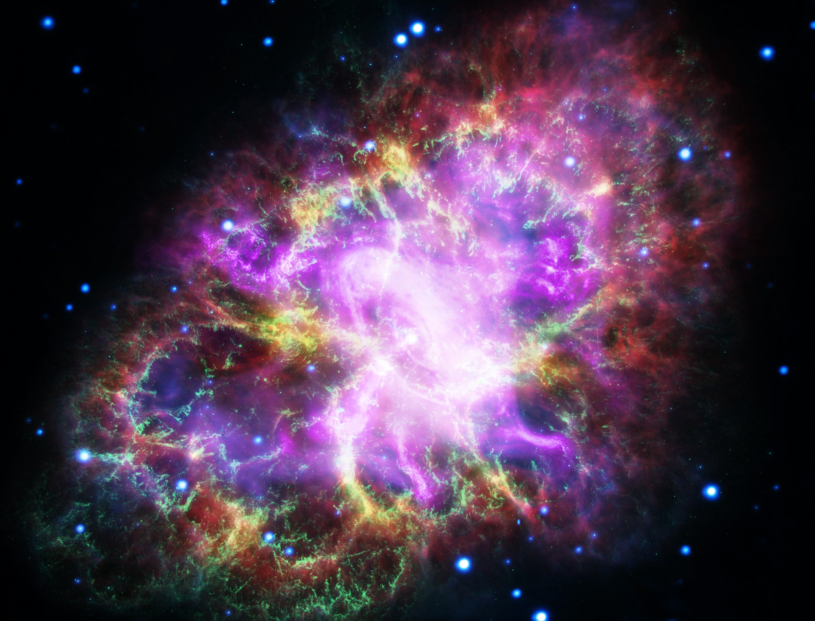
Birth of very high energy (TEV) gamma ray astronomy: WHIPPLE telescope 1989
Whipple Telescope 1968
Credit: G. Dubner (IAFE, CONICET-University of Buenos Aires) et al.; NRAO/AUI/NSF; A. Loll et al.; T. Temim et al.; F. Seward et al.; Chandra/CXC; Spitzer/JPL-Caltech; XMM-Newton/ESA; and Hubble/STScI

Slide 4
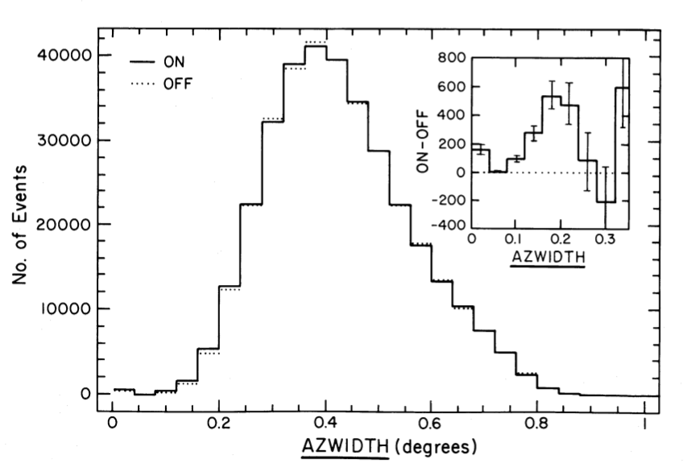
Birth of very high energy (TEV) gamma ray astronomy: WHIPPLE telescope 1989
T. Weekes et al., ApJ 342 (1989) 379
“Observation of TeV Gamma Rays from the Crab Nebula using the Atmospheric Cerenkov Imaging Technique”
about 90 h of data
Whipple Telescope 1968

Slide 5
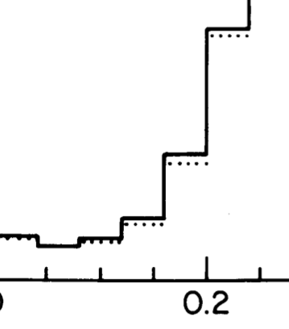
Birth of very high energy (TEV) gamma ray astronomy: WHIPPLE telescope 1989
T. Weekes et al., ApJ 342 (1989) 379
“Observation of TeV Gamma Rays from the Crab Nebula using the Atmospheric Cerenkov Imaging Technique”
about 90 h of data
On source
Off source
Whipple Telescope 1968

Slide 6
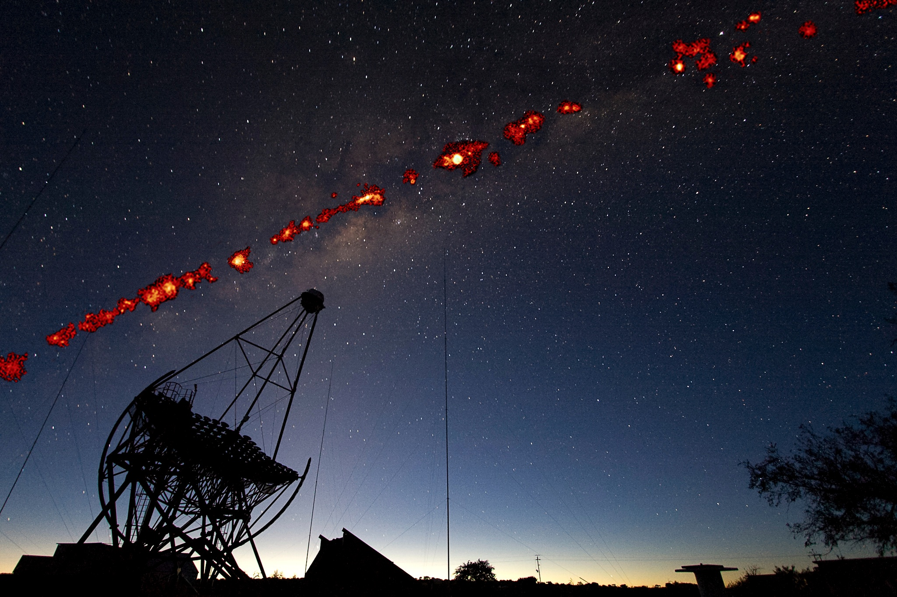
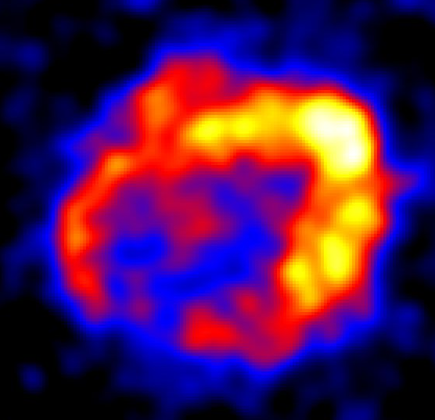
The teV southern sky
In the whole sky, over 200 sources
Supernova remnants
Pulsars and pulsar wind nebulae
Stellar clusters
Binary systems
Novae
Microquasars
Superbubbles
Starburst galaxies
Blazars
FSRQs
…
Sky maps with few arc-min resolution
Energy spectra over 3 decades in energy
Light curves on all scales from minutes to years

Slide 7
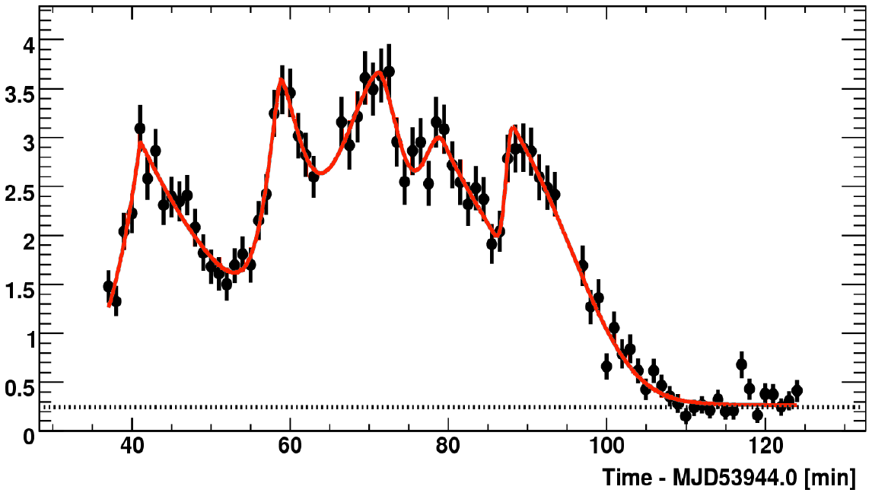
The teV southern sky
In the whole sky, over 200 sources
Supernova remnants
Pulsars and pulsar wind nebulae
Stellar clusters
Binary systems
Novae
Microquasars
Superbubbles
Staburst galaxies
Blazars
FSRQs
…
Sky maps with few arc-min resolution
Energy spectra over 3 decades in energy
Light curves on all scales from minutes to years
PKS 2155-304
2-3 min variability

Slide 8
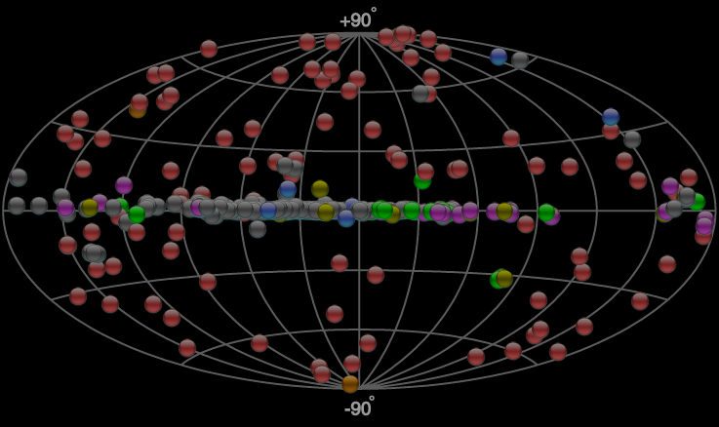
What have we learned
Gamma rays are produced when high-energy particles interact ➜ Gamma rays trace cosmic particle accelerators
Particle acceleration is ubiquitous – every object with fast (1000 km/s) outflows
Particle acceleration is efficient – often 10% or more of the kinetic energy is converted into relativistic particles
Feedback of particles is relevant for dynamics both on small and large scales
The detailed physics of particle acceleration and particle propagation is quite complex and not well understood
Field for more than 2 decades driven by Cherenkov telescopes
Since then
Explosion in # of sources
Driven by IACTS
Real astronomy
Extreme objects

Slide 9
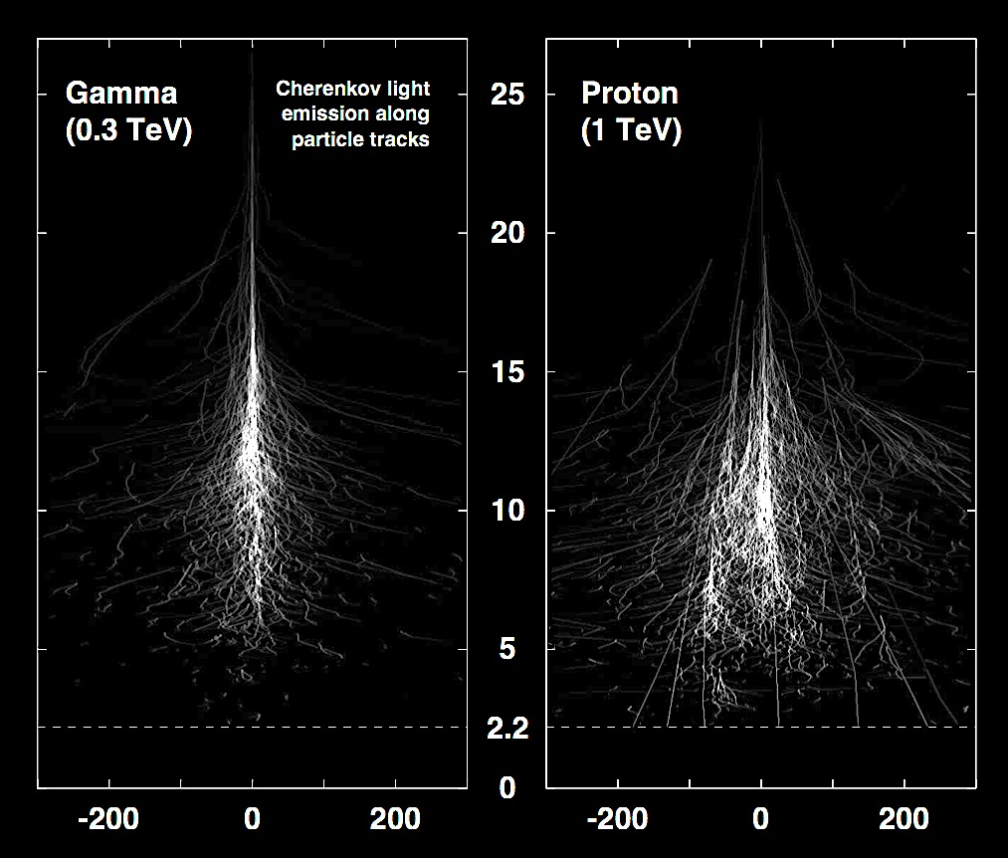
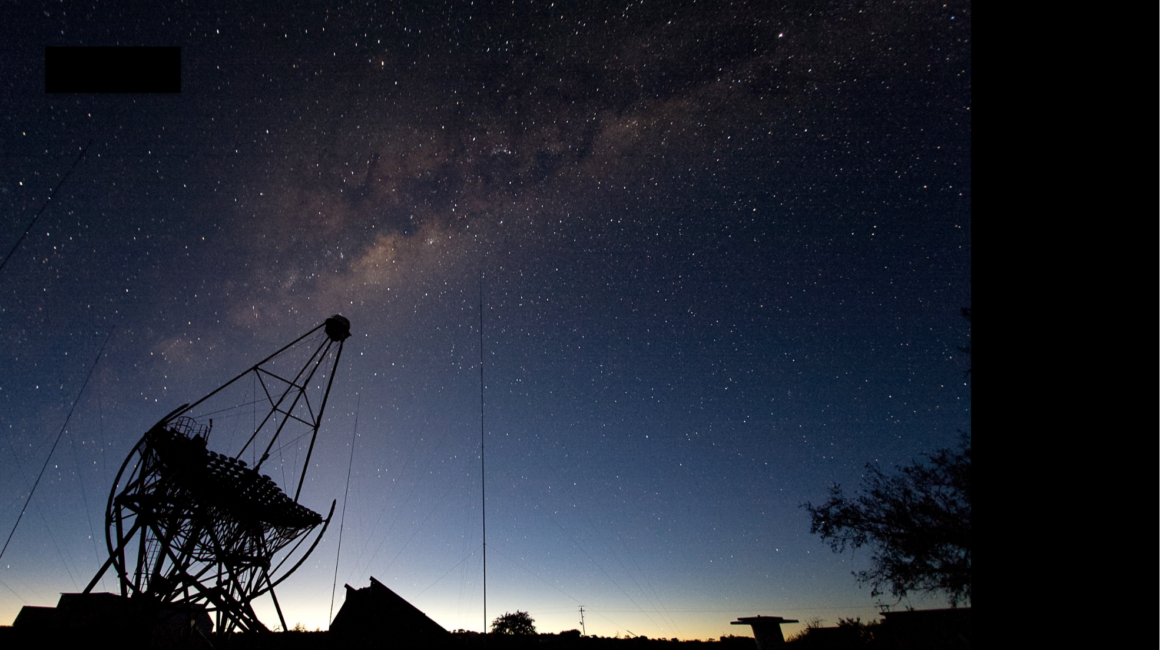
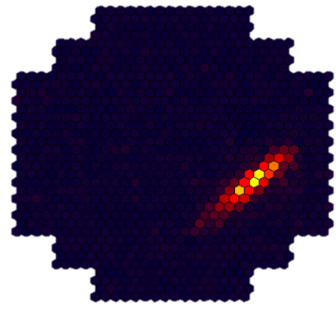
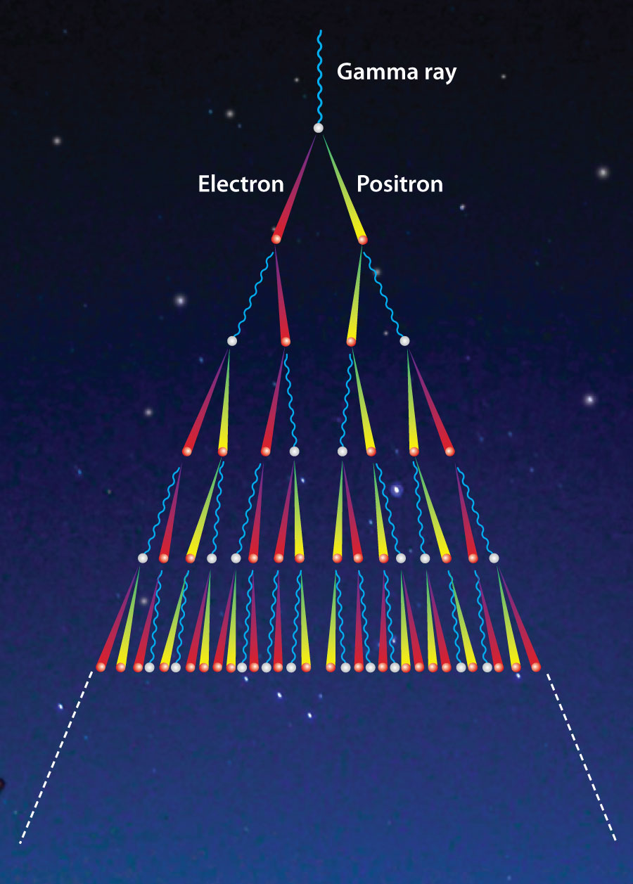
Use the Earth’s atmosphere
as detector medium
Cherenkov
telescopes
A bit like a meteor track, but
very faint (few photons per m²)
very short-lived (some 10⁻⁹ seconds)
Multiple telescopes
provide stereoscopic
views of the cascade
300 m ∅ “light pool”, 10⁵ m²

Slide 10
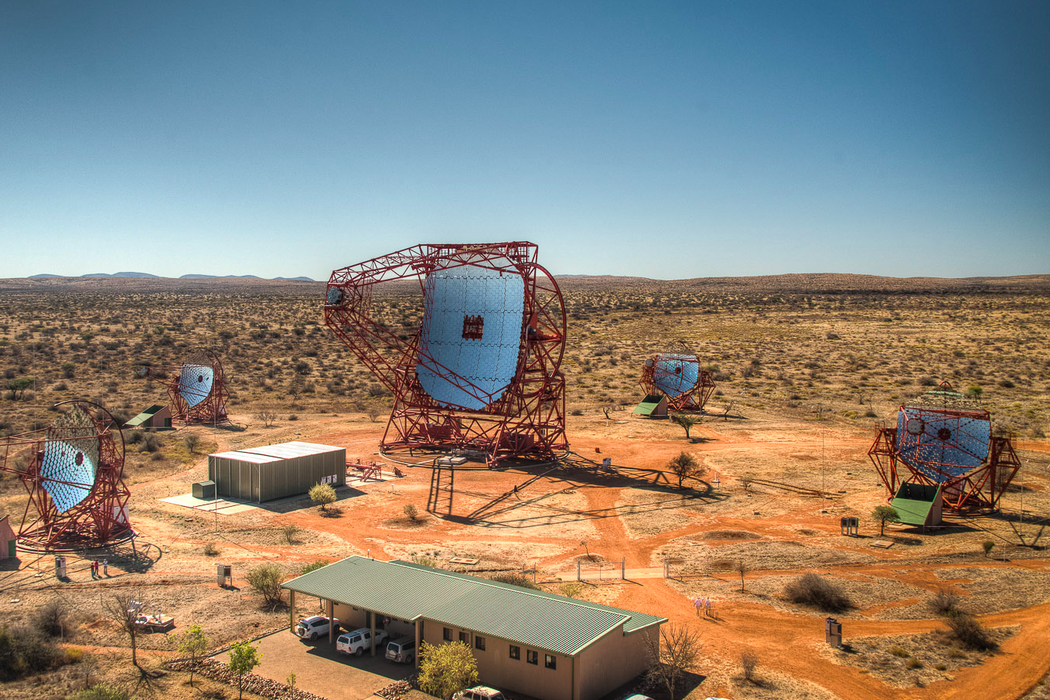
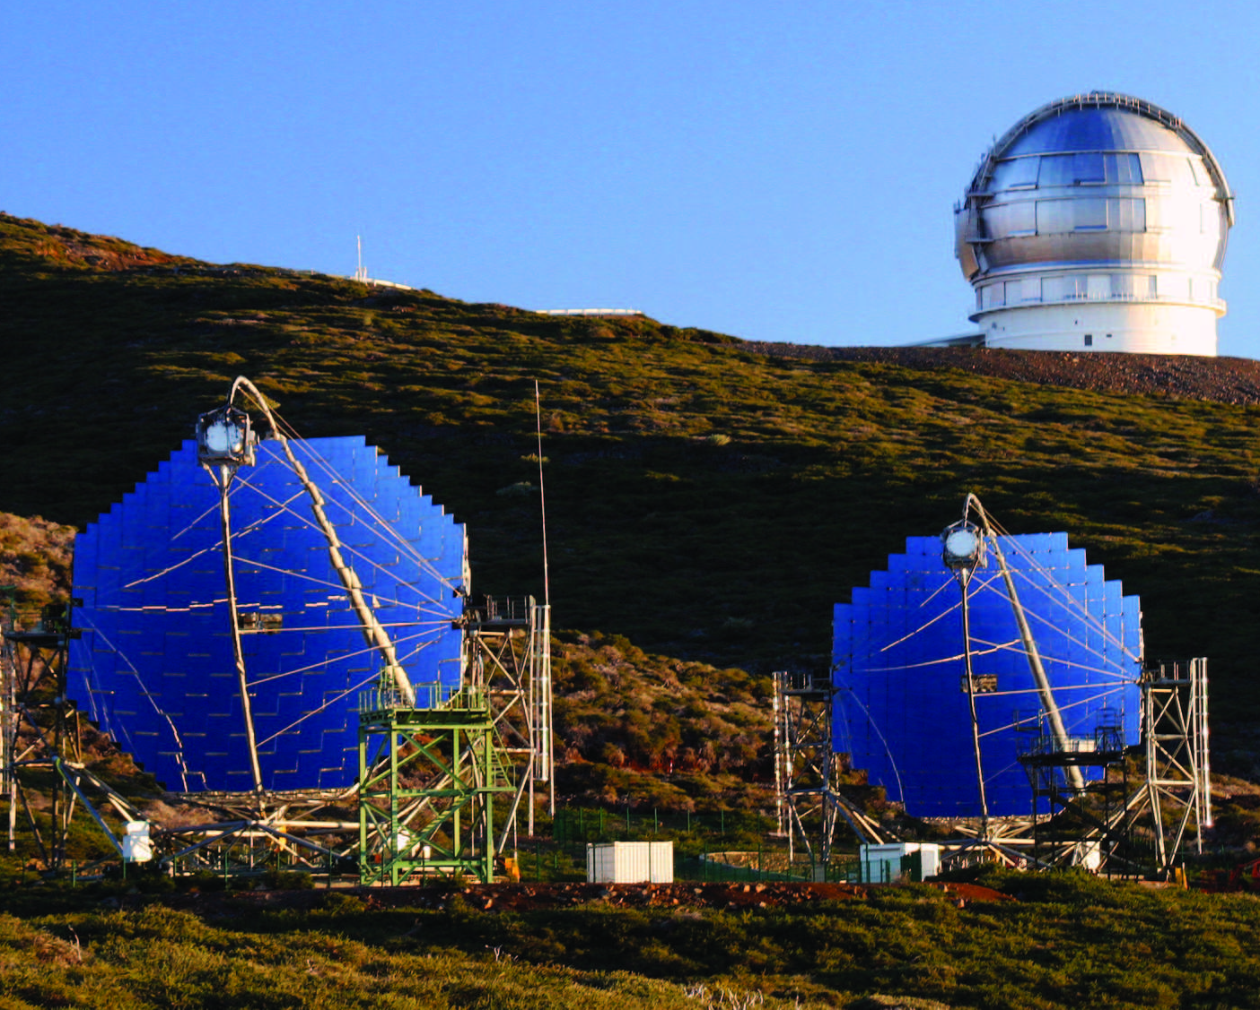
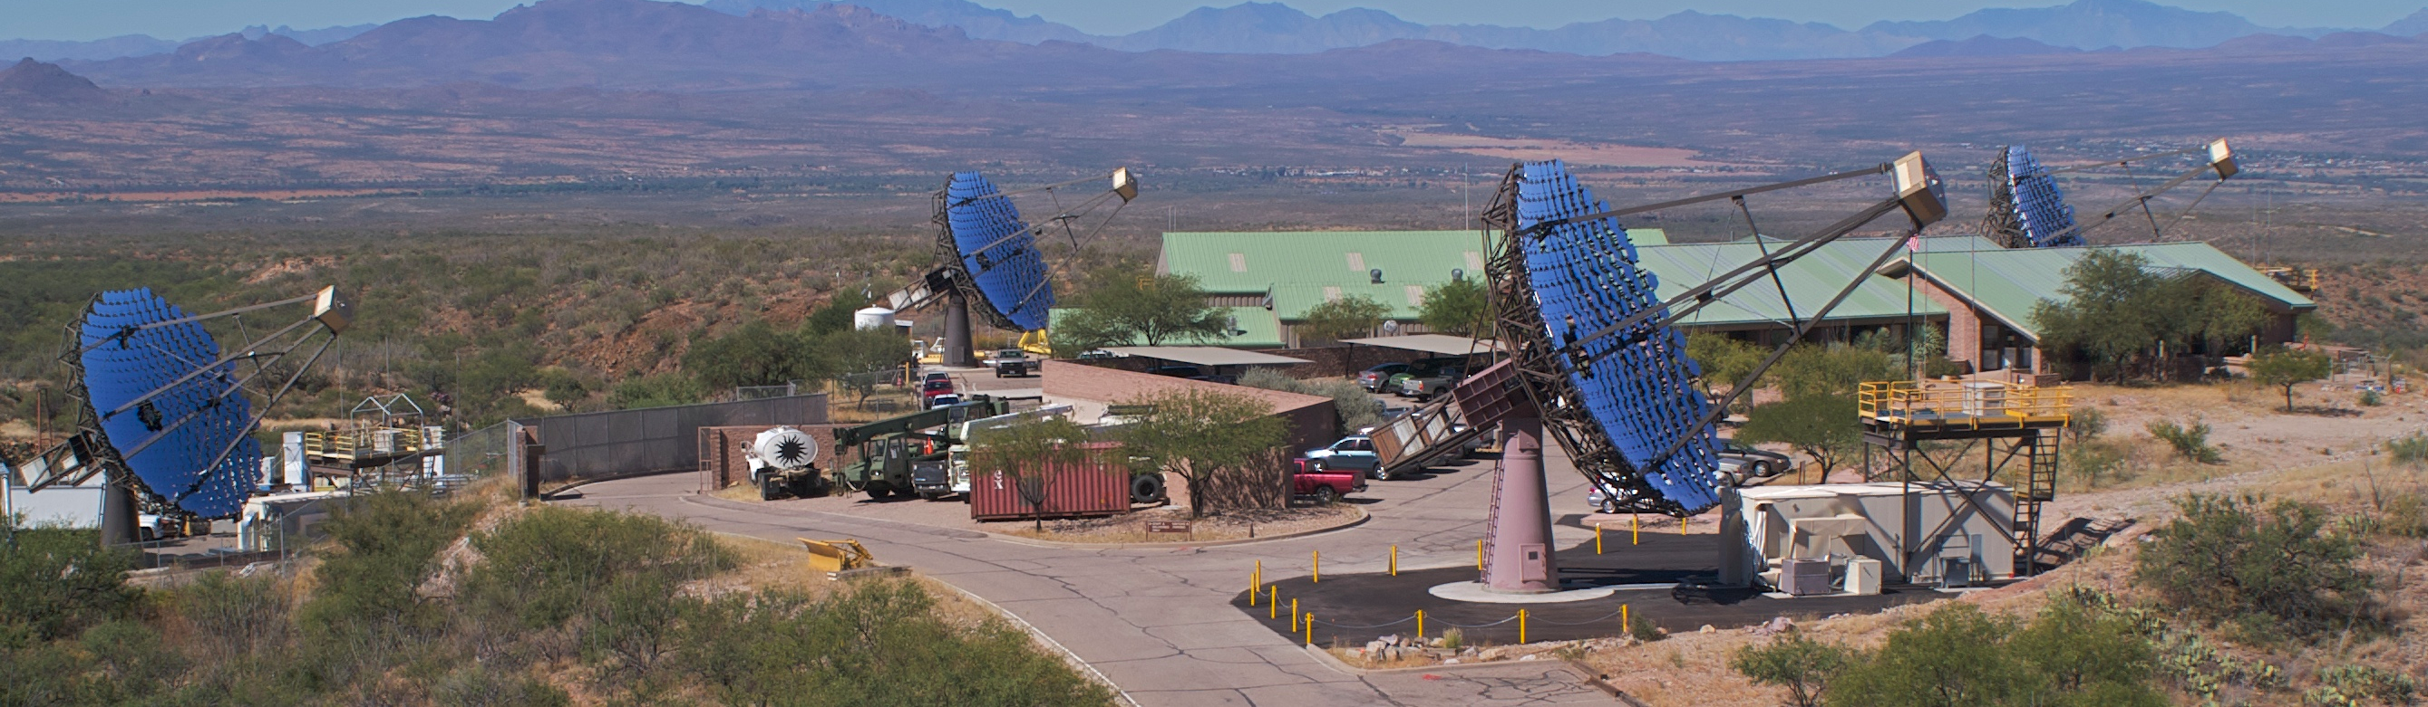
H.E.S.S., Namibia
MAGIC, La Palma
VERITAS, Arizona
Stereoscopic systems of
Imaging Atmospheric
Cherenkov Telescopes
currently in operation

Slide 11
Cascade starts at 20-30 km
Maximum at ∼10 km
Length of image ∼1º
Stochastic process, strong
fluctuations from one cascade
to the next
Transverse scale of cascade: few 10 m,
corresponding to ∼0.1º in the image
Cherenkov light peaks in the blue, 300-500 nm;
Nanosecond flash with ∼1 (detected) photon /m² at 1 TeV
300 m ∅ “light pool”, 10⁵ m²

Slide 12
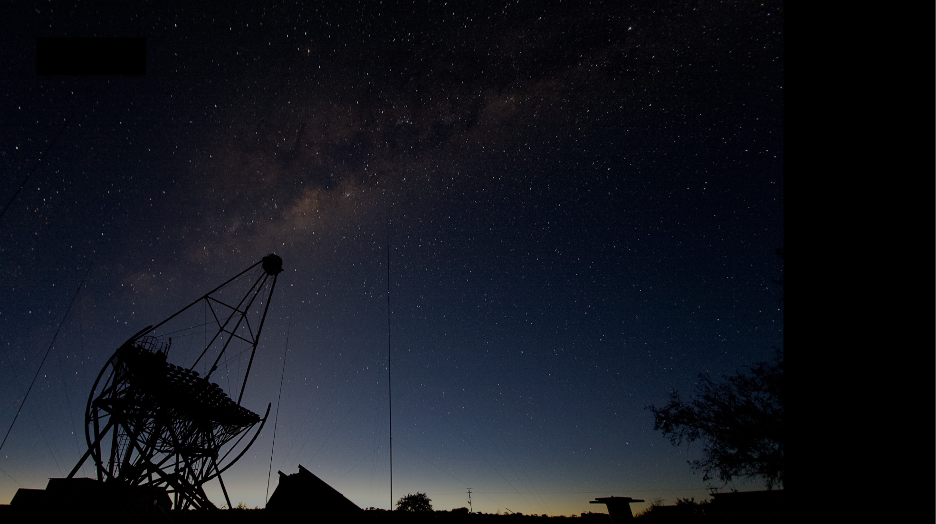
Requirements on mirror
Very inexpensive compared to astronomical instruments of same size
Robust over years, when exposed to weather (cannot afford enclosure)
Length of image ∼1º
Useful field of view of (at least) few degrees
Transverse scale of cascade: few 10 m,
corresponding to ∼0.1º in the image
PSF ≲ 0.1º
Cherenkov light peaks in the blue, 300-500 nm;
Nanosecond flash with ∼1 (detected) photon /m² at 1 TeV
Large area, O(100 m²)
Time dispersion ≲ few ns
High reflectivity at 300 – 500 nm

Slide 13
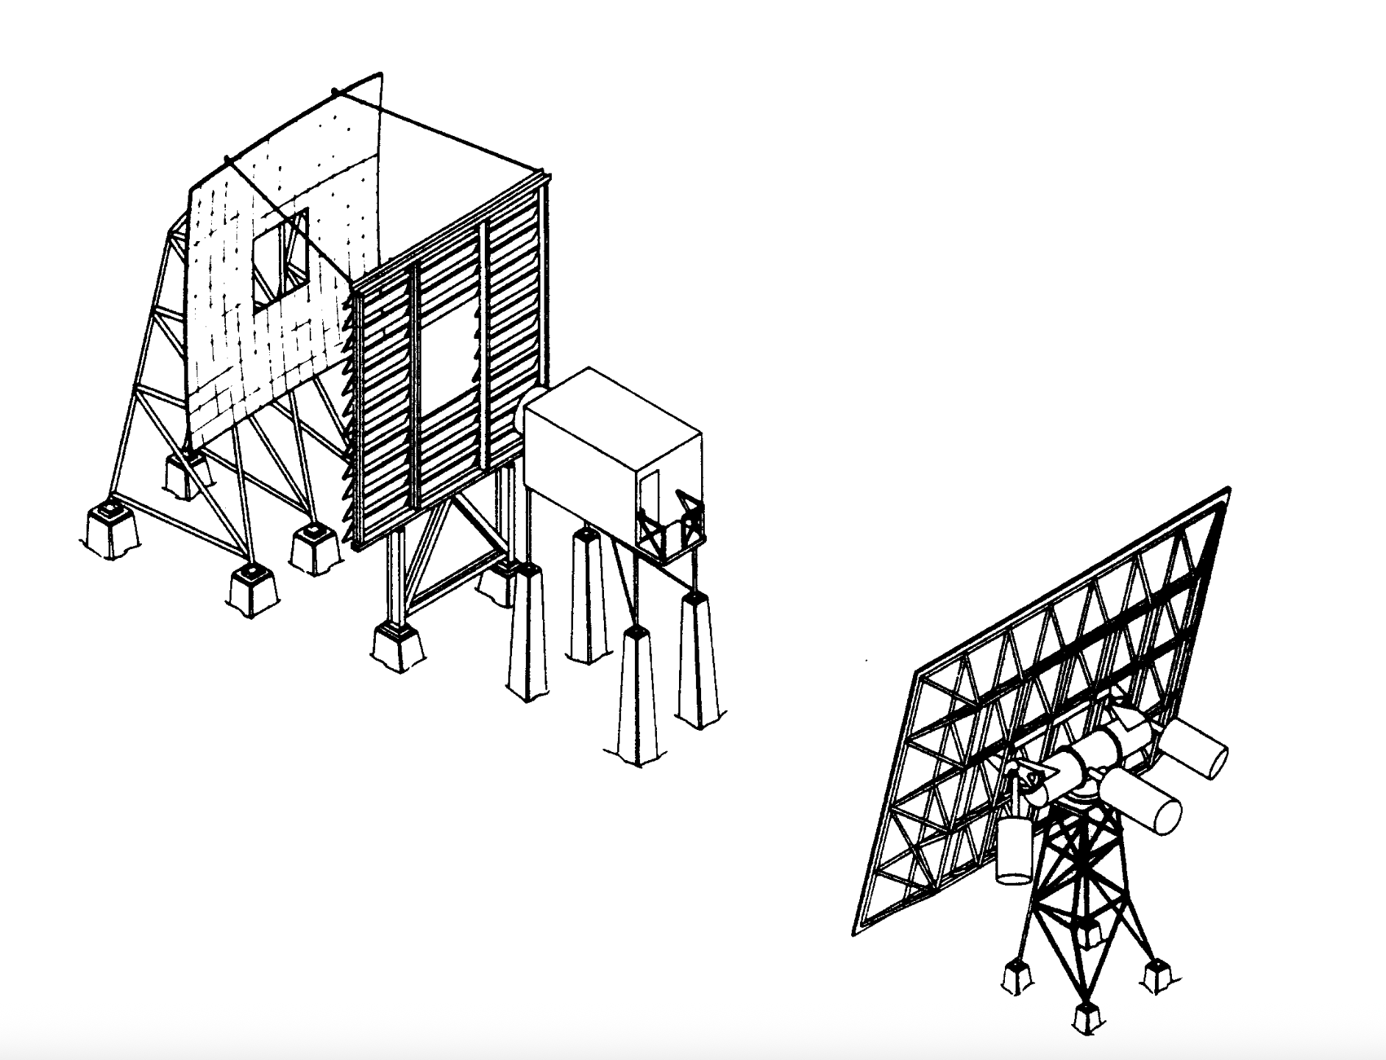
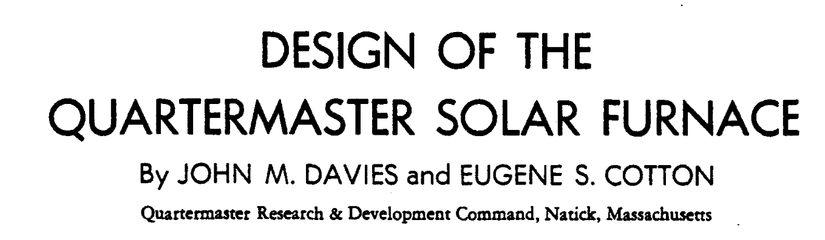
INSPIRATION: optical telescopes & Solar concentrators
Solar Energy, vol. 1, 1957

Slide 14
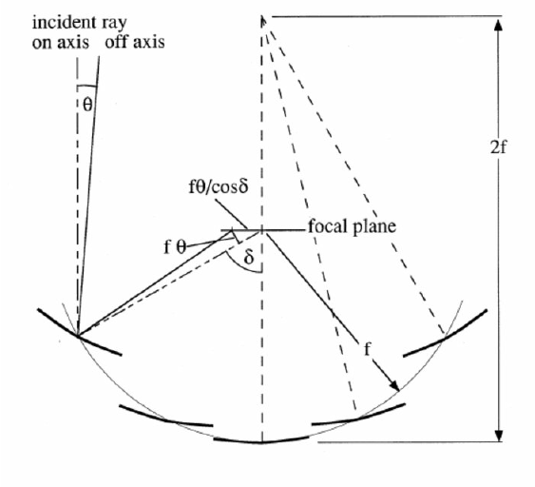
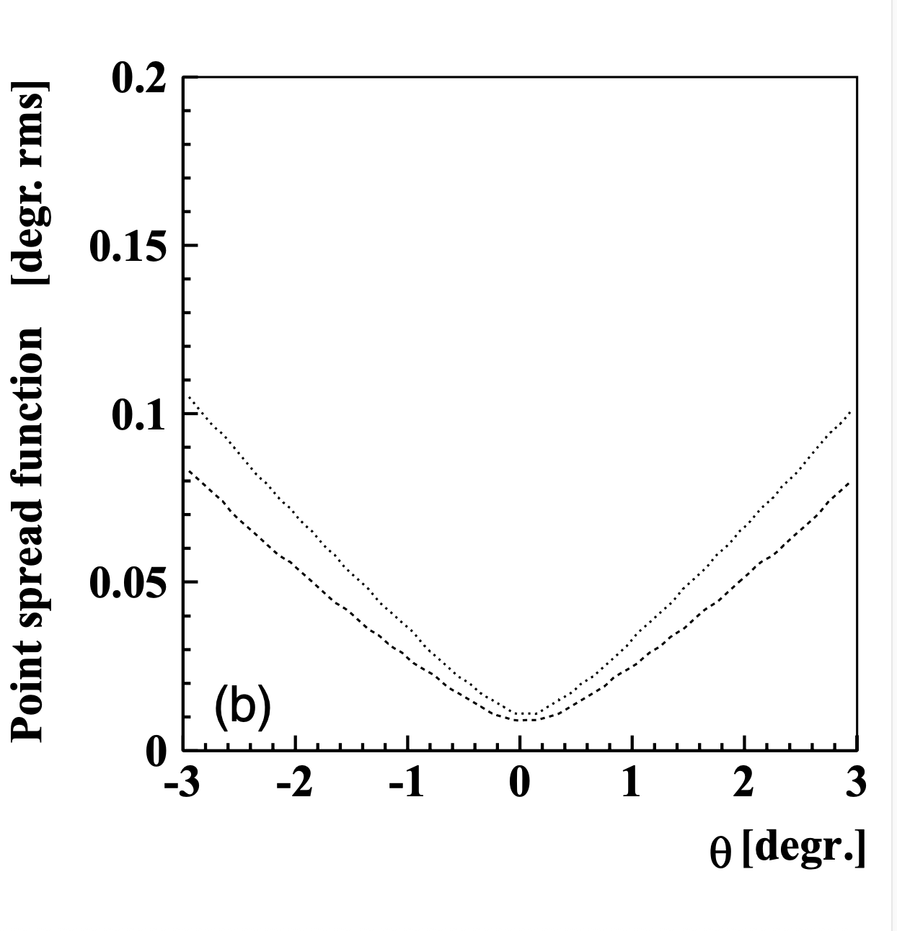
DAVIES-COTTON optics
Single mirror composed of
identical facets of focal length f arranged on a sphere of radius f (rather than 2f)
f/d = 1.2
Parabolic
DC
Off-axis angle

Slide 15
DAVIES-COTTON optics
Single mirror composed of
identical facets of focal length f arranged on a sphere of radius f (rather than 2f)
f/d = 1.2
Parabolic
Quality of facets and of facet alignment
DC

Slide 16
DAVIES-COTTON optics
Single mirror composed of
identical facets of focal length f arranged on a sphere of radius f (rather than 2f)
f/d = 1.2
Slope ∼(d/f)²
Parabolic
Quality of facets and of facet alignment
DC
Time dispersion ∼0.1 ns per m mirror diameter

Slide 17
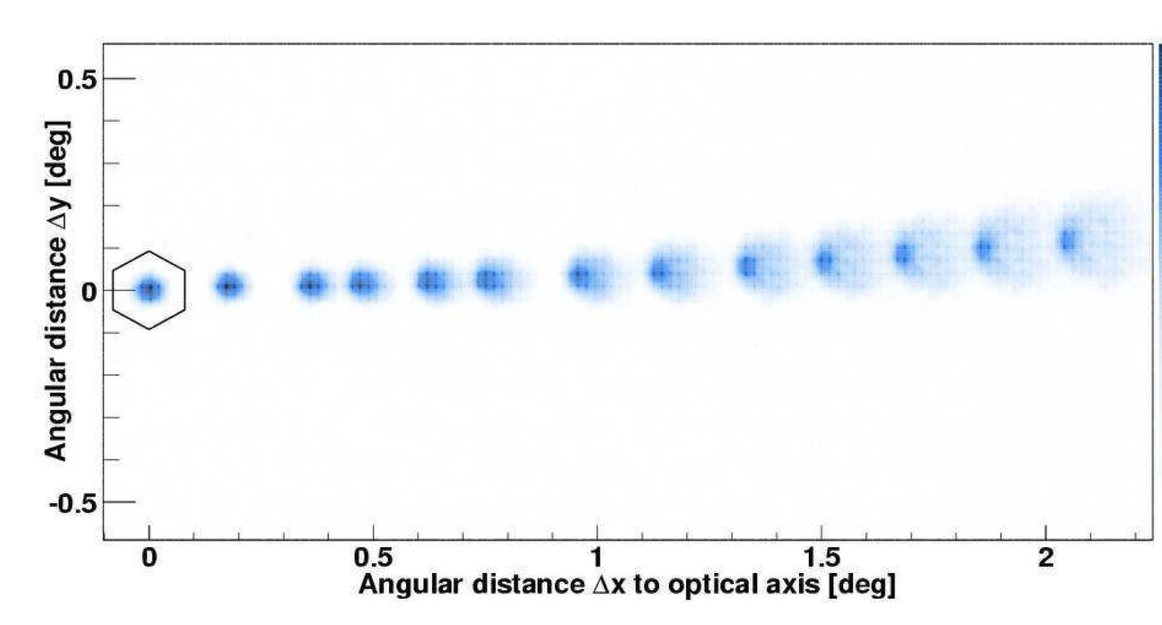
DAVIES-COTTON optics
Single mirror composed of
identical facets of focal length f arranged on a sphere of radius f (rather than 2f)
Image of a star at
different off-axis angles (H.E.S.S.)
f/d = 1.2
Slope ∼(d/f)²
Parabolic
Quality of facets and of facet alignment
DC

Slide 18
DAVIES-COTTON optics
Single mirror composed of
identical facets of focal length f arranged on a sphere of radius f (rather than 2f)
Not isochronous
ΔT_{rms} ≃ 0.1 D_{m} [ns]
f/d = 1.2
Parabolic
Ok for mirrors up to ∼10 m;
larger mirrors are parabolic
DC

Slide 19
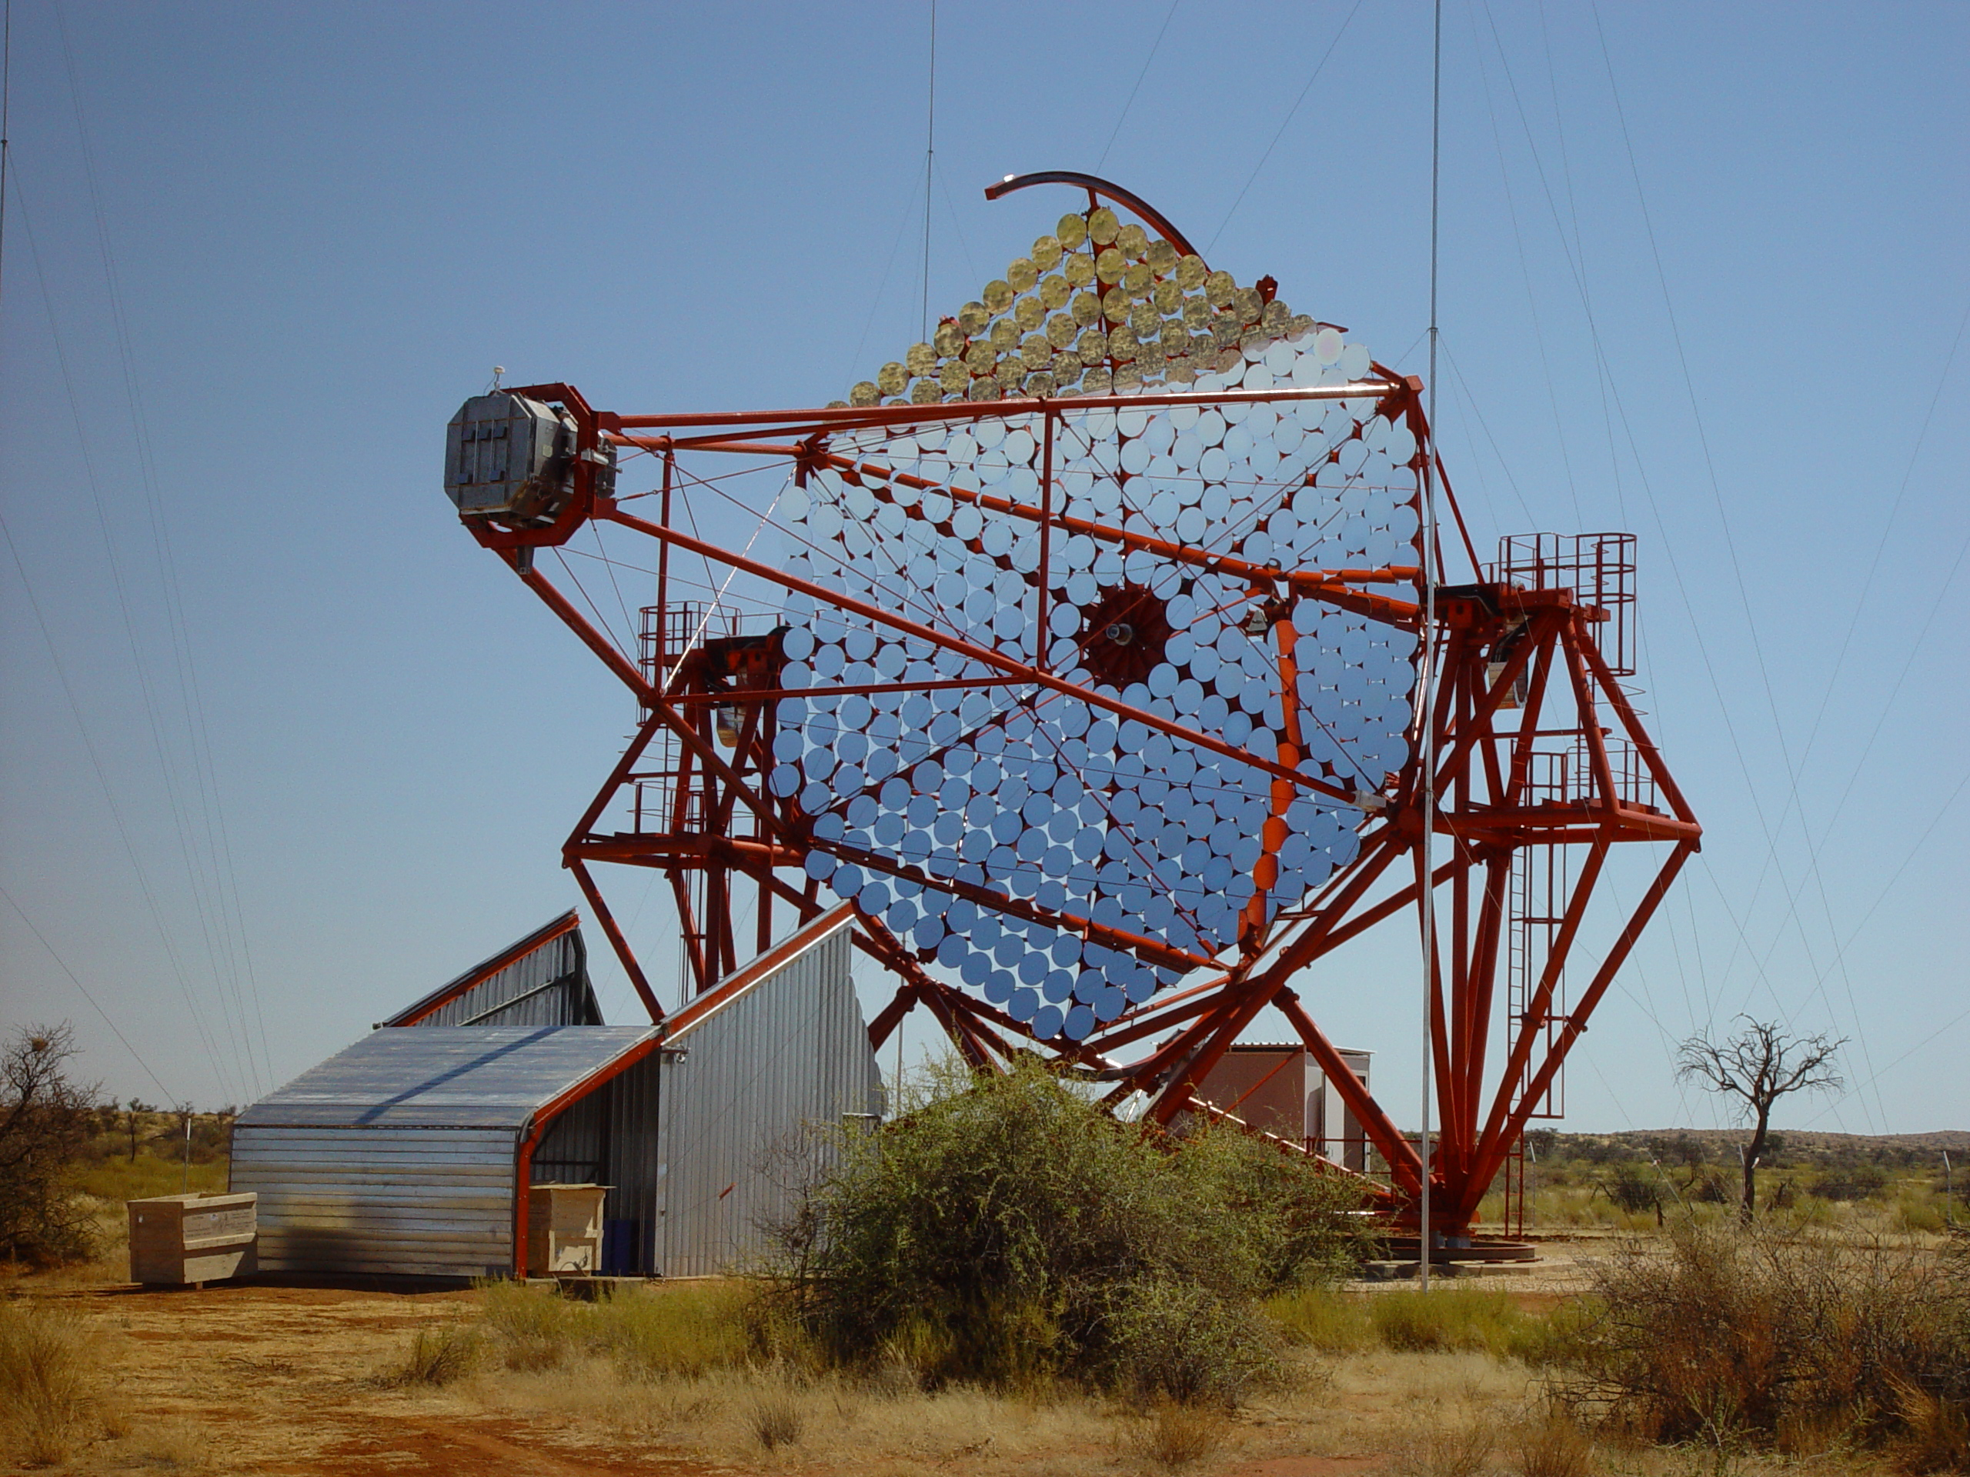

Four 12-m telescopes

Slide 20
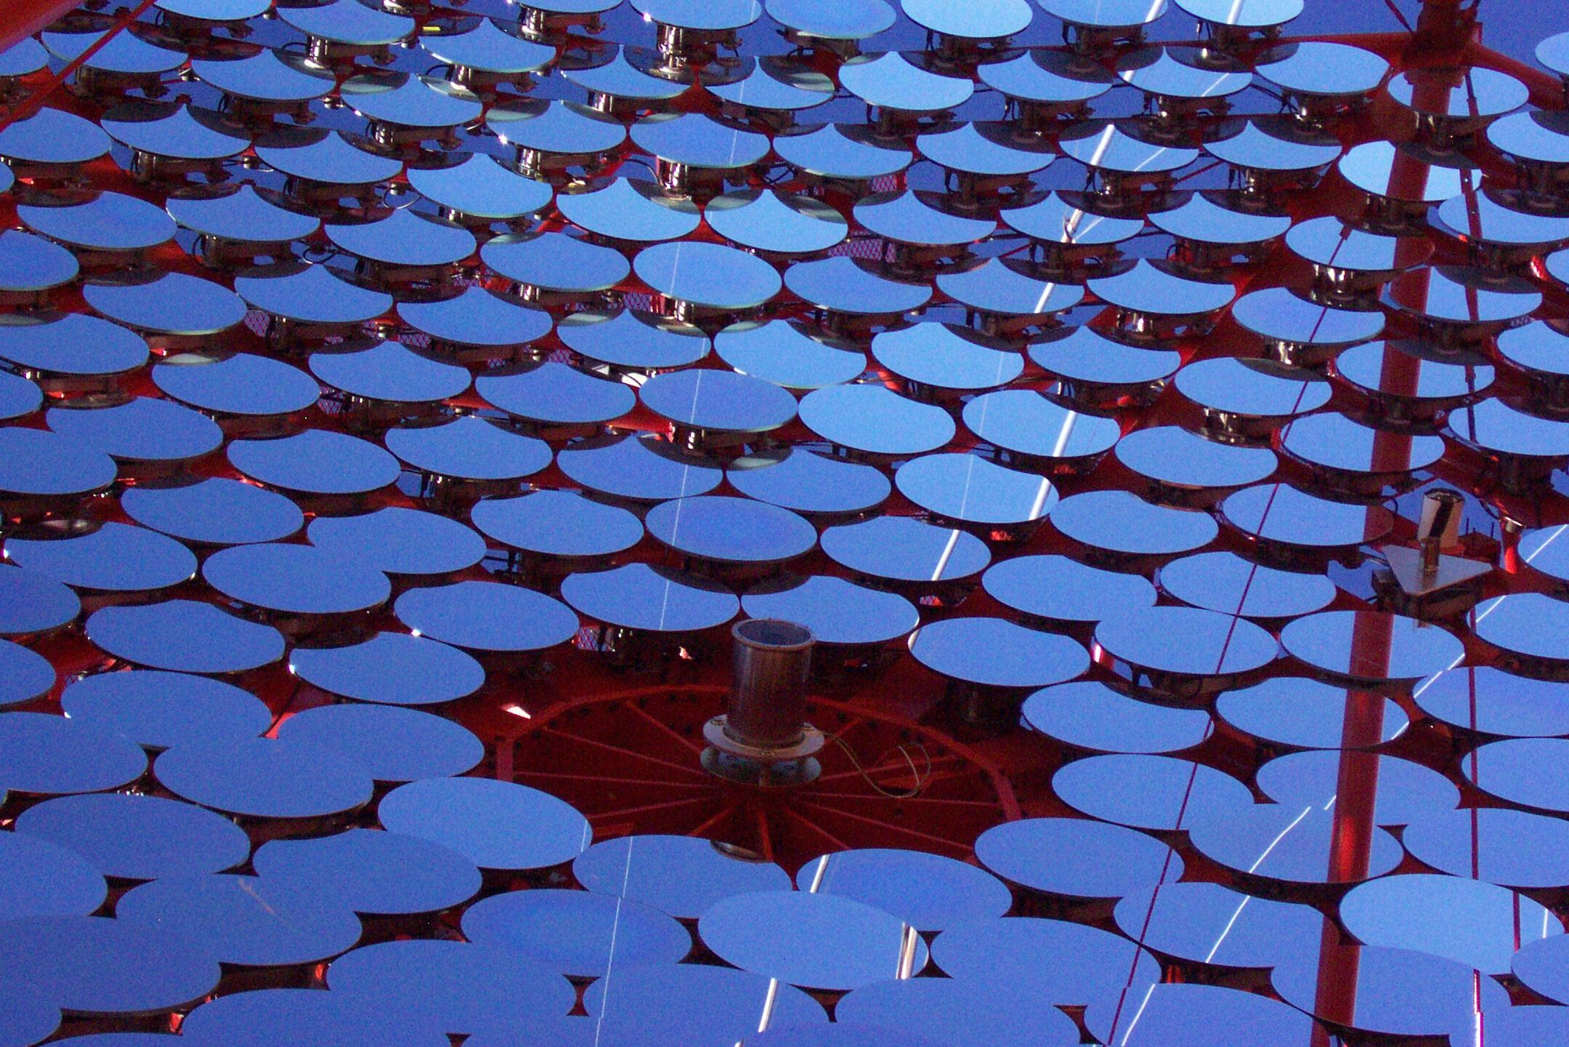

Slide 21
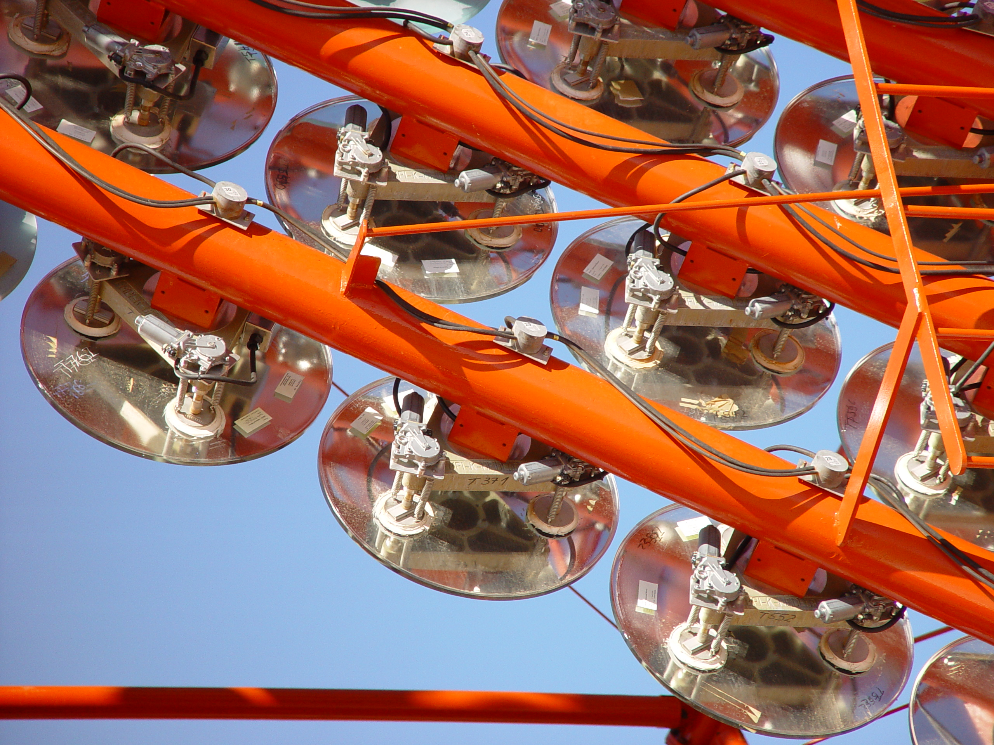

Slide 22
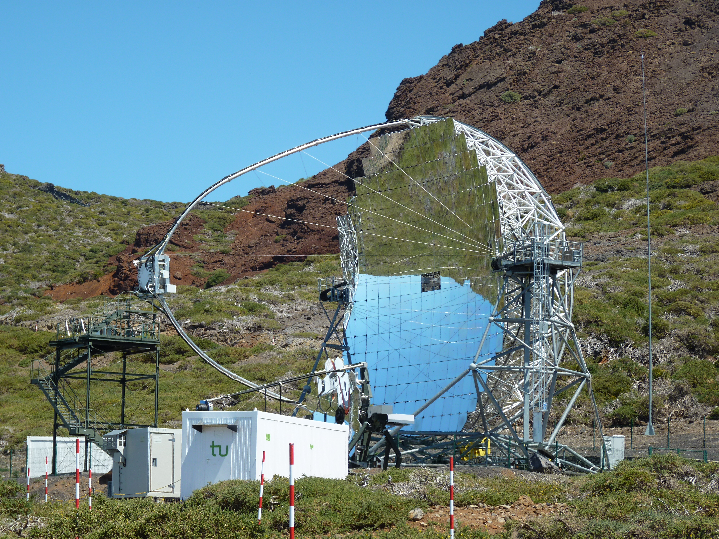

Two 17-m
Telescopes on
La Palma
Parabolic,
continuous
active mirror
alignment

Slide 23
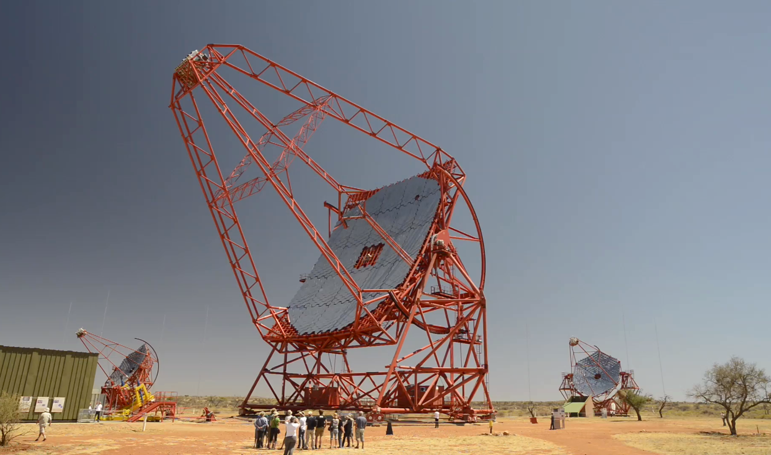
H.E.S.S. CT5 (2012)
600 m² parabolic mirror
28 m diameter
36 m focal length

Slide 24
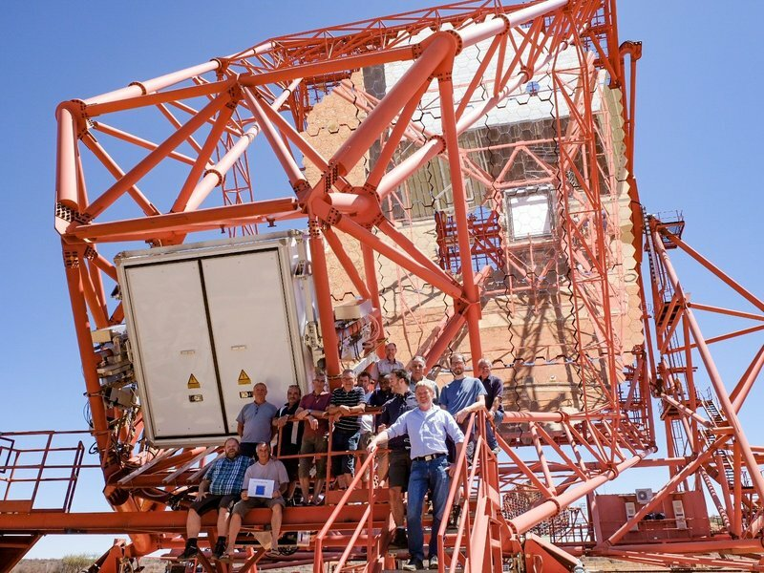
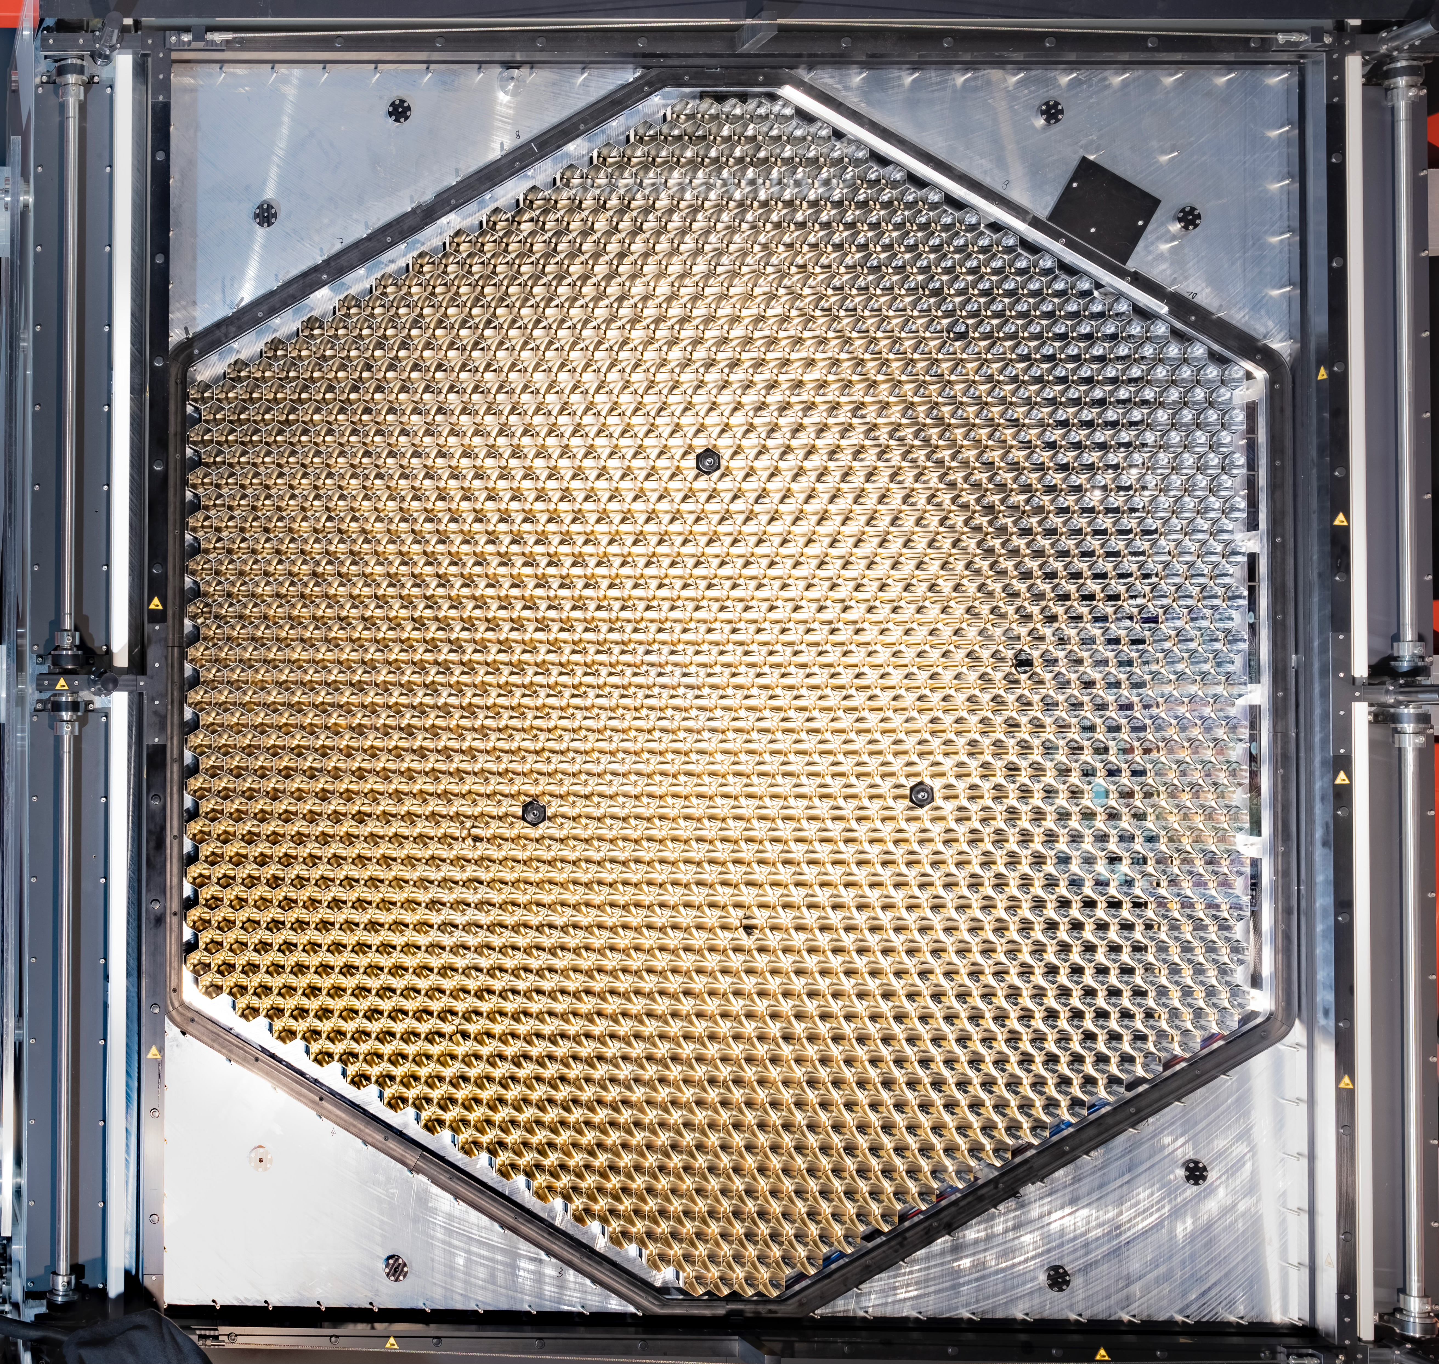
Cherenkov “camera”
1000 – 2000 pixels of ∼0.1º size
Record air shower ”movies” at GHz frame rate
Select and save “interesting” frames

Slide 25
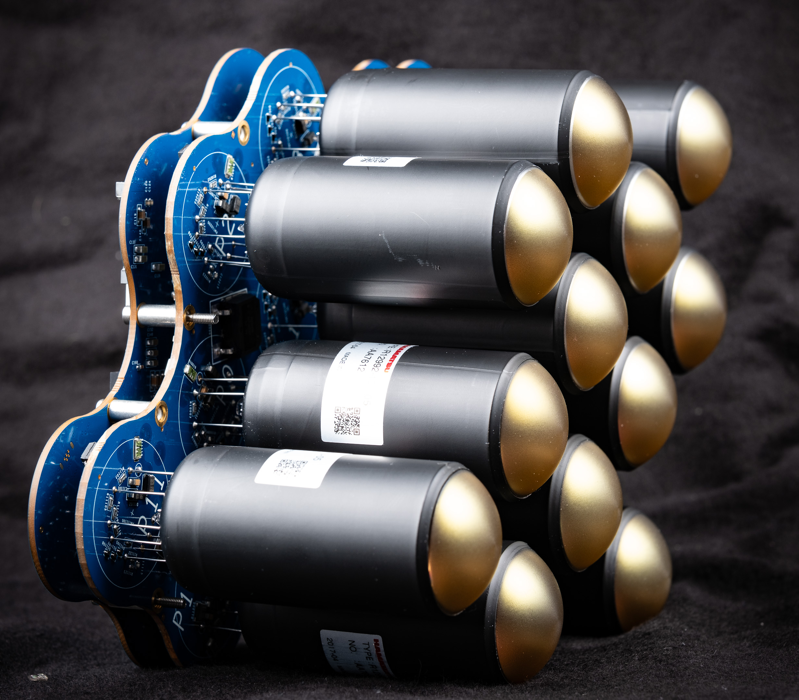
Cherenkov “camera”
1000 – 2000 pixels of ∼0.1º size
Record air shower ”movies” at GHz frame rate
Select and save “interesting” frames

Slide 26
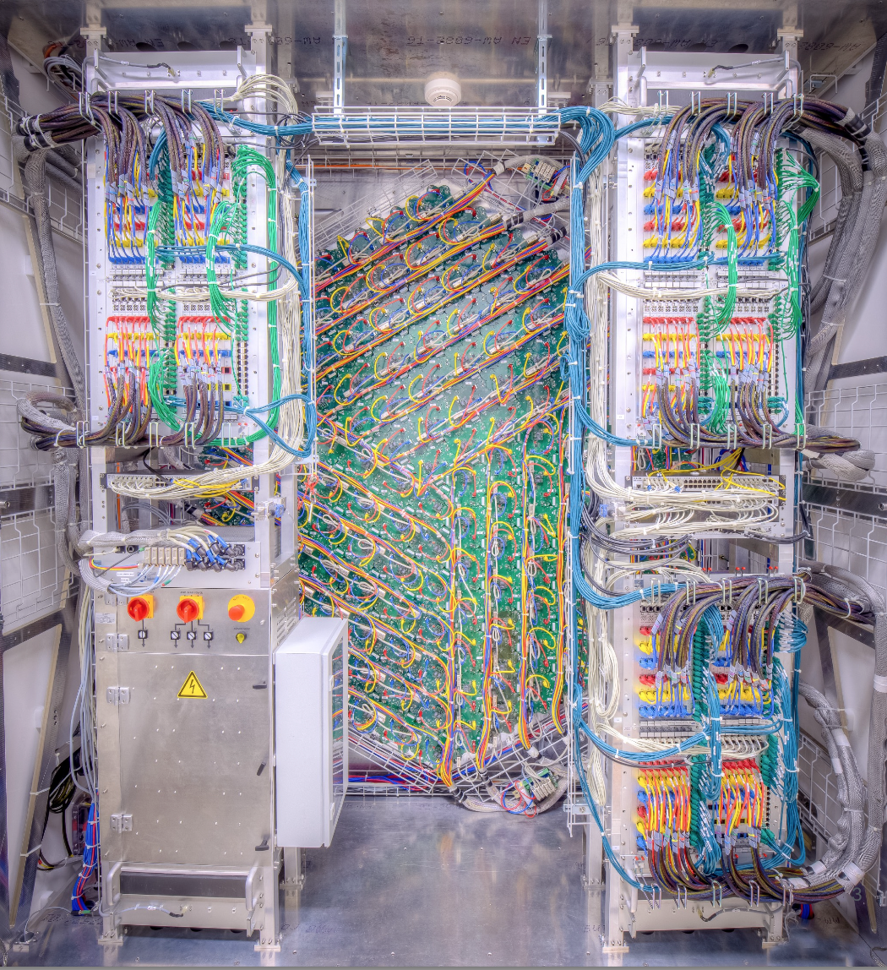
Cherenkov “camera”
1000 – 2000 pixels of ∼0.1º size
Record air shower ”movies” at GHz frame rate
Select and save “interesting” frames

Slide 27
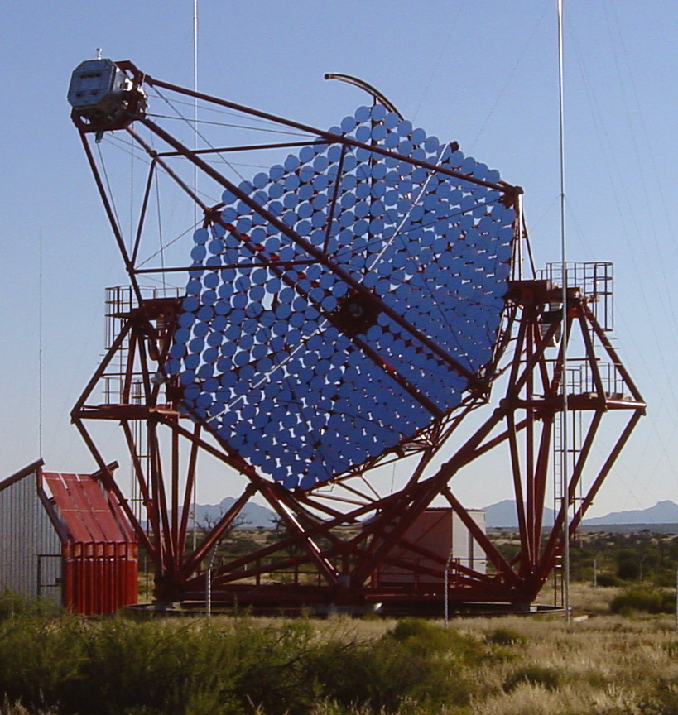
1989 VS TODAY

Slide 28
1989 VS TODAY
Crab detection in 90 h
1% Crab in < 10 h

Slide 29
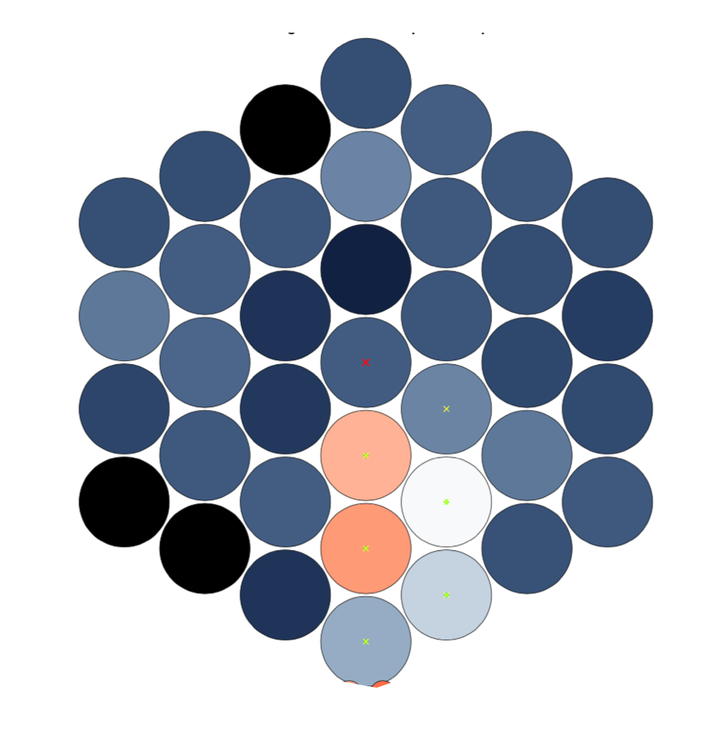
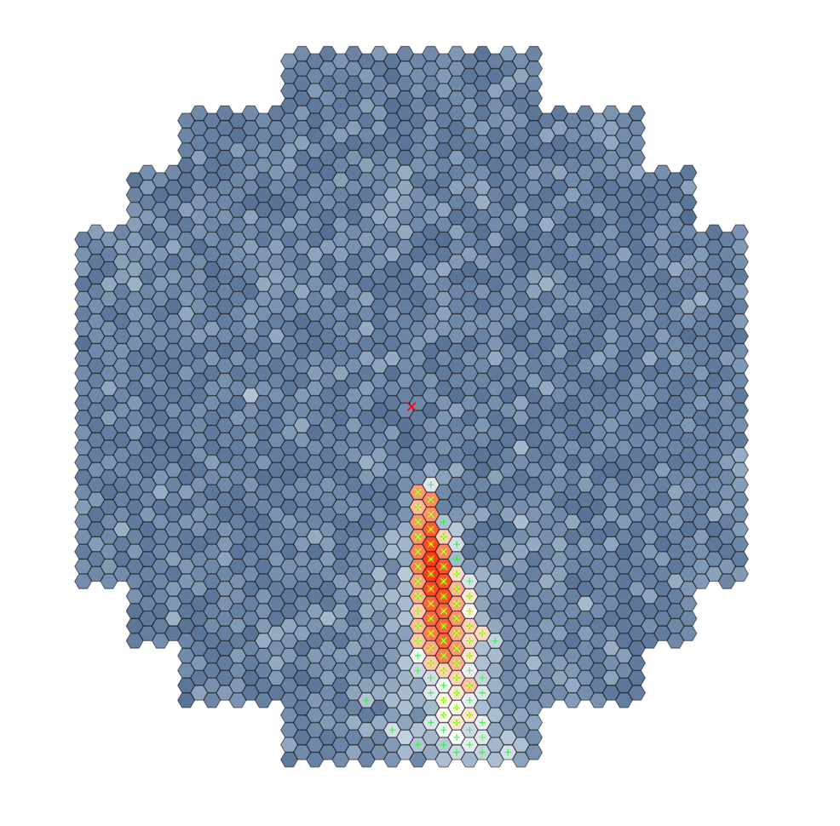
1989 VS TODAY
Whipple 1989 shower image
Modern camera

Slide 30
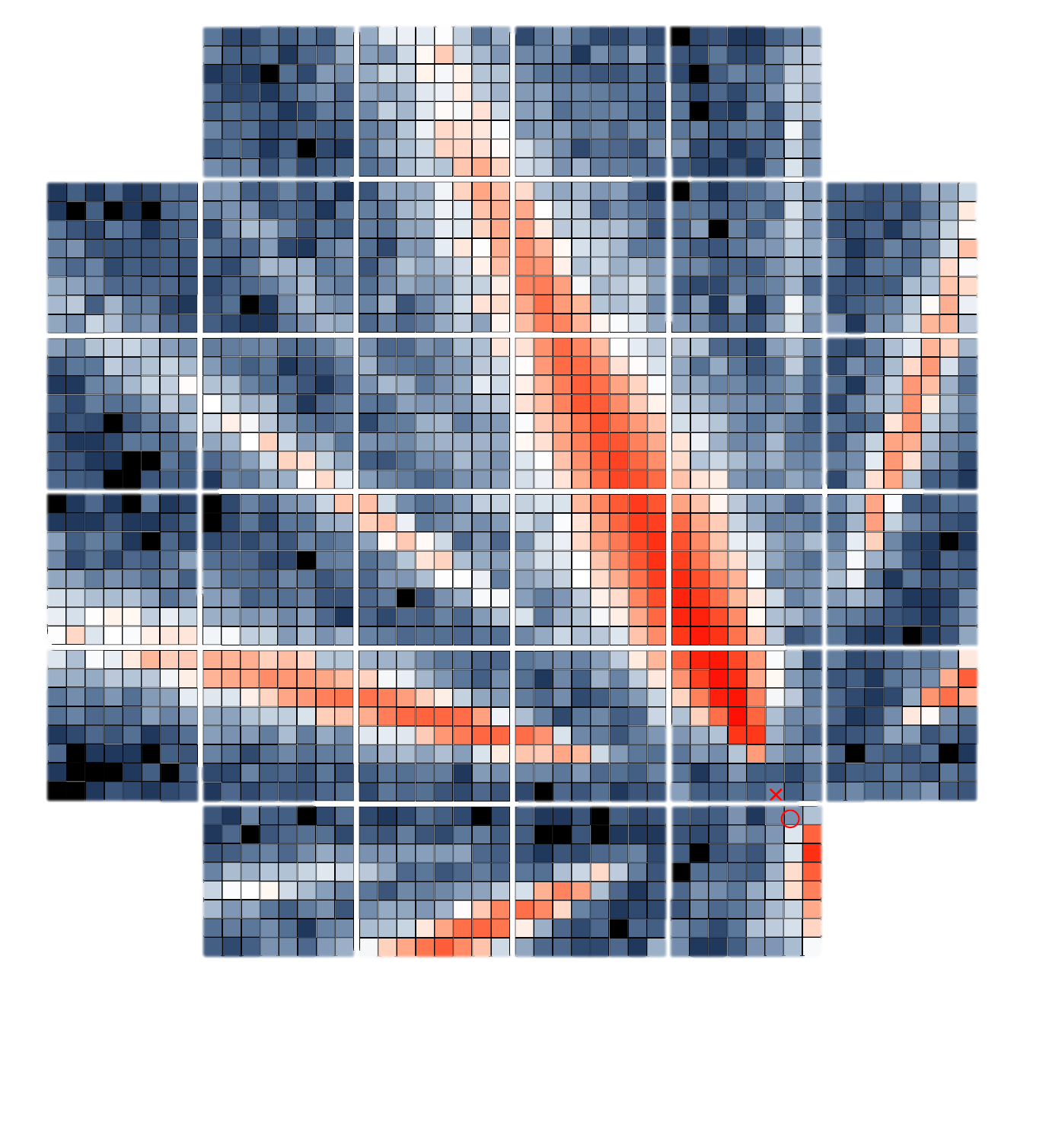
1989 VS TODAY
Whipple 1989 shower image
Modern array
Modern array

Slide 31
 | Whipple | HESS I | MAGIC I | VERITAS | MAGIC II | HESS II | CTAO LST | CTAO SST/ASTRI | CTAO MST
1st operation | 1968 | 2002 | 2003 | 2005 | 2009 | 2012 | 2018 | 2025 | 2026
Area | 75 m² | 108 m² | 236 m² | 110 m² | 240 m² | 614 m² | 370 m² | 5 m² | 88 m²
Diameter | 10 m | 12 m | 17 m | 12 m | 17 m | 28 m | 23 m | 4.3 m | 11.5 m
Focal length | 7.3 m | 15 m | 17 m | 12 m | 17 m | 36 m | 28 m | 2.25 m | 16 m
f/D | 0.7 | 1.3 | 1.0 | 1.0 | 1.0 | 1.3 | 1.2 | 0.5 | 1.4
Field of view
Optics | DC | DC | Parab. | DC | Parab. | Parab. | Parab. | SC’ | DC’
# facets | 248 | 382 | 964 | 350 | 247 | 875 | 198 | 18 (M1) | 86
Facet shape | hex | round | square | hex | square | hex | hex | hex | hex
Facet size | 61 cm | 60 cm | 50 m | 61 cm | 100 cm | 90 cm | 151 cm | 85 cm | 120 cm
Facet material | Glass | Glass | Diamond-milled aluminum sandw. | Glass | Milled aluminum & Cold-slumped glass sandw. | Glass | Cold-slumped glass sandw. | Cold-slumped glass sandw | Cold-slumped glass sandw.
Reflector | Alum. | Alum. | Alum. | Alum. | Alum. | Alum. | Alum. | Alum. | Alum.
Protection | Anodized | Quartz-coating | Quartz-coating | Anodized | Quartz-coating | Quartz-coating | Multilayer coating | Multilayer coating | Multilayer coating

Slide 32
 | Whipple | HESS I | MAGIC I | VERITAS | MAGIC II | HESS II | CTAO LST | CTAO SST/ASTRI | CTAO MST
1st operation | 1968 | 2002 | 2003 | 2005 | 2009 | 2012 | 2018 | 2025 | 2026
Area | 75 m² | 108 m² | 236 m² | 110 m² | 240 m² | 614 m² | 370 m² | 5 m² | 88 m²
Diameter | 10 m | 12 m | 17 m | 12 m | 17 m | 28 m | 23 m | 4.3 m | 11.5 m
Focal length | 7.3 m | 15 m | 17 m | 12 m | 17 m | 36 m | 28 m | 2.25 m | 16 m
f/D | 0.7 | 1.3 | 1.0 | 1.0 | 1.0 | 1.3 | 1.2 | 0.5 | 1.4
Field of view
Optics | DC | DC | Parab. | DC | Parab. | Parab. | Parab. | SC’ | DC’
# facets | 248 | 382 | 964 | 350 | 247 | 875 | 198 | 18 (M1) | 86
Facet shape | hex | round | square | hex | square | hex | hex | hex | hex
Facet size | 61 cm | 60 cm | 50 m | 61 cm | 100 cm | 90 cm | 151 cm | 85 cm | 120 cm
Facet material | Glass | Glass | Diamond-milled aluminum sandw. | Glass | Milled aluminum & Cold-slumped glass sandw. | Glass | Cold-slumped glass sandw. | Cold-slumped glass sandw | Cold-slumped glass sandw.
Reflector | Alum. | Alum. | Alum. | Alum. | Alum. | Alum. | Alum. | Alum. | Alum.
Protection | Anodized | Quartz-coating | Quartz-coating | Anodized | Quartz-coating | Quartz-coating | Multilayer coating | Multilayer coating | Multilayer coating
Time
^{from Whipple to CTAO}

Slide 33
 | Whipple | HESS I | MAGIC I | VERITAS | MAGIC II | HESS II | CTAO LST | CTAO SST/ASTRI | CTAO MST
1st operation | 1968 | 2002 | 2003 | 2005 | 2009 | 2012 | 2018 | 2025 | 2026
Area | 75 m² | 108 m² | 236 m² | 110 m² | 240 m² | 614 m² | 370 m² | 5 m² | 88 m²
Diameter | 10 m | 12 m | 17 m | 12 m | 17 m | 28 m | 23 m | 4.3 m | 11.5 m
Focal length | 7.3 m | 15 m | 17 m | 12 m | 17 m | 36 m | 28 m | 2.25 m | 16 m
f/D | 0.7 | 1.3 | 1.0 | 1.0 | 1.0 | 1.3 | 1.2 | 0.5 | 1.4
Field of view
Optics | DC | DC | Parab. | DC | Parab. | Parab. | Parab. | SC’ | DC’
# facets | 248 | 382 | 964 | 350 | 247 | 875 | 198 | 18 (M1) | 86
Facet shape | hex | round | square | hex | square | hex | hex | hex | hex
Facet size | 61 cm | 60 cm | 50 m | 61 cm | 100 cm | 90 cm | 151 cm | 85 cm | 120 cm
Facet material | Glass | Glass | Diamond-milled aluminum sandw. | Glass | Milled aluminum & Cold-slumped glass sandw. | Glass | Cold-slumped glass sandw. | Cold-slumped glass sandw | Cold-slumped glass sandw.
Reflector | Alum. | Alum. | Alum. | Alum. | Alum. | Alum. | Alum. | Alum. | Alum.
Protection | Anodized | Quartz-coating | Quartz-coating | Anodized | Quartz-coating | Quartz-coating | Multilayer coating | Multilayer coating | Multilayer coating
Facets get larger – 0.3 m² to 2 m²

Slide 34
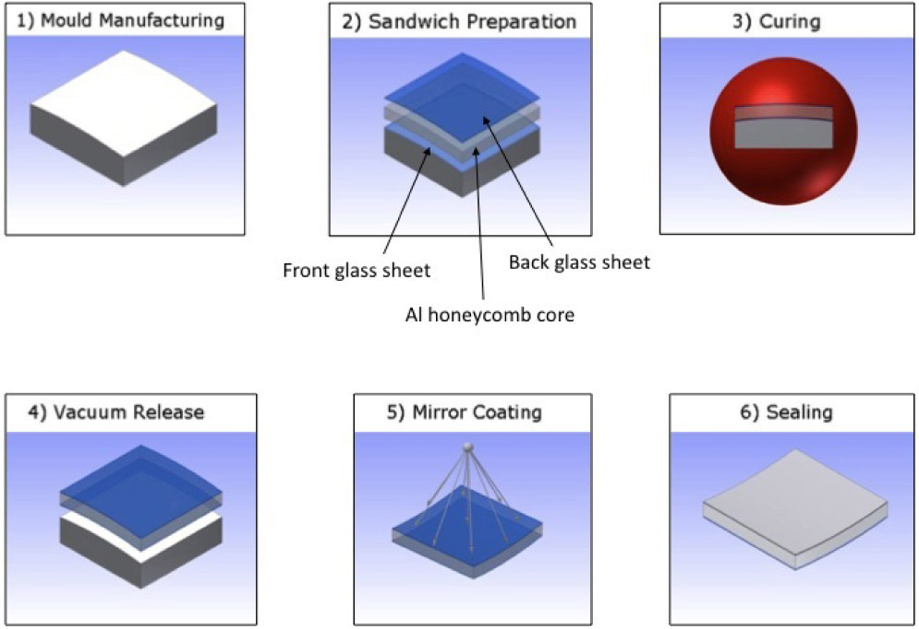
 | Whipple | HESS I | MAGIC I | VERITAS | MAGIC II | HESS II | CTAO LST | CTAO SST/ASTRI | CTAO MST
1st operation | 1968 | 2002 | 2003 | 2005 | 2009 | 2012 | 2018 | 2025 | 2026
Area | 75 m² | 108 m² | 236 m² | 110 m² | 240 m² | 614 m² | 370 m² | 5 m² | 88 m²
Diameter | 10 m | 12 m | 17 m | 12 m | 17 m | 28 m | 23 m | 4.3 m | 11.5 m
Focal length | 7.3 m | 15 m | 17 m | 12 m | 17 m | 36 m | 28 m | 2.25 m | 16 m
f/D | 0.7 | 1.3 | 1.0 | 1.0 | 1.0 | 1.3 | 1.2 | 0.5 | 1.4
Field of view
Optics | DC | DC | Parab. | DC | Parab. | Parab. | Parab. | SC’ | DC’
# facets | 248 | 382 | 964 | 350 | 247 | 875 | 198 | 18 (M1) | 86
Facet shape | hex | round | square | hex | square | hex | hex | hex | hex
Facet size | 61 cm | 60 cm | 50 m | 61 cm | 100 cm | 90 cm | 151 cm | 85 cm | 120 cm
Facet material | Glass | Glass | Diamond-milled aluminum sandw. | Glass | Milled aluminum & Cold-slumped glass sandw. | Glass | Cold-slumped glass sandw. | Cold-slumped glass sandw | Cold-slumped glass sandw.
Reflector | Alum. | Alum. | Alum. | Alum. | Alum. | Alum. | Alum. | Alum. | Alum.
Protection | Anodized | Quartz-coating | Quartz-coating | Anodized | Quartz-coating | Quartz-coating | Multilayer coating | Multilayer coating | Multilayer coating
Ground solid glass ➜ cold-slumped glass sandwich mirrors
D. Vernani et al.,
Proc. of SPIE Vol. 7018
Larger
Less expensive
Suitable for mass production

Slide 35
 | Whipple | HESS I | MAGIC I | VERITAS | MAGIC II | HESS II | CTAO LST | CTAO SST/ASTRI | CTAO MST
1st operation | 1968 | 2002 | 2003 | 2005 | 2009 | 2012 | 2018 | 2025 | 2026
Area | 75 m² | 108 m² | 236 m² | 110 m² | 240 m² | 614 m² | 370 m² | 5 m² | 88 m²
Diameter | 10 m | 12 m | 17 m | 12 m | 17 m | 28 m | 23 m | 4.3 m | 11.5 m
Focal length | 7.3 m | 15 m | 17 m | 12 m | 17 m | 36 m | 28 m | 2.25 m | 16 m
f/D | 0.7 | 1.3 | 1.0 | 1.0 | 1.0 | 1.3 | 1.2 | 0.5 | 1.4
Field of view
Optics | DC | DC | Parab. | DC | Parab. | Parab. | Parab. | SC’ | DC’
# facets | 248 | 382 | 964 | 350 | 247 | 875 | 198 | 18 (M1) | 86
Facet shape | hex | round | square | hex | square | hex | hex | hex | hex
Facet size | 61 cm | 60 cm | 50 m | 61 cm | 100 cm | 90 cm | 151 cm | 85 cm | 120 cm
Facet material | Glass | Glass | Diamond-milled aluminum sandw. | Glass | Milled aluminum & Cold-slumped glass sandw. | Glass | Cold-slumped glass sandw. | Cold-slumped glass sandw | Cold-slumped glass sandw.
Reflector | Alum. | Alum. | Alum. | Alum. | Alum. | Alum. | Alum. | Alum. | Alum.
Protection | Anodized | Quartz-coating | Quartz-coating | Anodized | Quartz-coating | Quartz-coating | Multilayer coating | Multilayer coating | Multilayer coating
Simple al/quartz coatings ➜
multilayer coatings

Slide 36
 | Whipple | HESS I | MAGIC I | VERITAS | MAGIC II | HESS II | CTAO LST | CTAO SST/ASTRI | CTAO MST
1st operation | 1968 | 2002 | 2003 | 2005 | 2009 | 2012 | 2018 | 2025 | 2026
Area | 75 m² | 108 m² | 236 m² | 110 m² | 240 m² | 614 m² | 370 m² | 5 m² | 88 m²
Diameter | 10 m | 12 m | 17 m | 12 m | 17 m | 28 m | 23 m | 4.3 m | 11.5 m
Focal length | 7.3 m | 15 m | 17 m | 12 m | 17 m | 36 m | 28 m | 2.25 m | 16 m
f/D | 0.7 | 1.3 | 1.0 | 1.0 | 1.0 | 1.3 | 1.2 | 0.5 | 1.4
Field of view
Optics | DC | DC | Parab. | DC | Parab. | Parab. | Parab. | SC’ | DC’
# facets | 248 | 382 | 964 | 350 | 247 | 875 | 198 | 18 (M1) | 86
Facet shape | hex | round | square | hex | square | hex | hex | hex | hex
Facet size | 61 cm | 60 cm | 50 m | 61 cm | 100 cm | 90 cm | 151 cm | 85 cm | 120 cm
Facet material | Glass | Glass | Diamond-milled aluminum sandw. | Glass | Milled aluminum & Cold-slumped glass sandw. | Glass | Cold-slumped glass sandw. | Cold-slumped glass sandw | Cold-slumped glass sandw.
Reflector | Alum. | Alum. | Alum. | Alum. | Alum. | Alum. | Alum. | Alum. | Alum.
Protection | Anodized | Quartz-coating | Quartz-coating | Anodized | Quartz-coating | Quartz-coating | Multilayer coating | Multilayer coating | Multilayer coating
Increasing fields of view
3º ➜ 10º

Slide 37
 | Whipple | HESS I | MAGIC I | VERITAS | MAGIC II | HESS II | CTAO LST | CTAO SST/ASTRI | CTAO MST
1st operation | 1968 | 2002 | 2003 | 2005 | 2009 | 2012 | 2018 | 2025 | 2026
Area | 75 m² | 108 m² | 236 m² | 110 m² | 240 m² | 614 m² | 370 m² | 5 m² | 88 m²
Diameter | 10 m | 12 m | 17 m | 12 m | 17 m | 28 m | 23 m | 4.3 m | 11.5 m
Focal length | 7.3 m | 15 m | 17 m | 12 m | 17 m | 36 m | 28 m | 2.25 m | 16 m
f/D | 0.7 | 1.3 | 1.0 | 1.0 | 1.0 | 1.3 | 1.2 | 0.5 | 1.4
Field of view
Optics | DC | DC | Parab. | DC | Parab. | Parab. | Parab. | SC’ | DC’
# facets | 248 | 382 | 964 | 350 | 247 | 875 | 198 | 18 (M1) | 86
Facet shape | hex | round | square | hex | square | hex | hex | hex | hex
Facet size | 61 cm | 60 cm | 50 m | 61 cm | 100 cm | 90 cm | 151 cm | 85 cm | 120 cm
Facet material | Glass | Glass | Diamond-milled aluminum sandw. | Glass | Milled aluminum & Cold-slumped glass sandw. | Glass | Cold-slumped glass sandw. | Cold-slumped glass sandw | Cold-slumped glass sandw.
Reflector | Alum. | Alum. | Alum. | Alum. | Alum. | Alum. | Alum. | Alum. | Alum.
Protection | Anodized | Quartz-coating | Quartz-coating | Anodized | Quartz-coating | Quartz-coating | Multilayer coating | Multilayer coating | Multilayer coating
Dual mirror telescopes
appear (Schwarzschild-Couder)

Slide 38
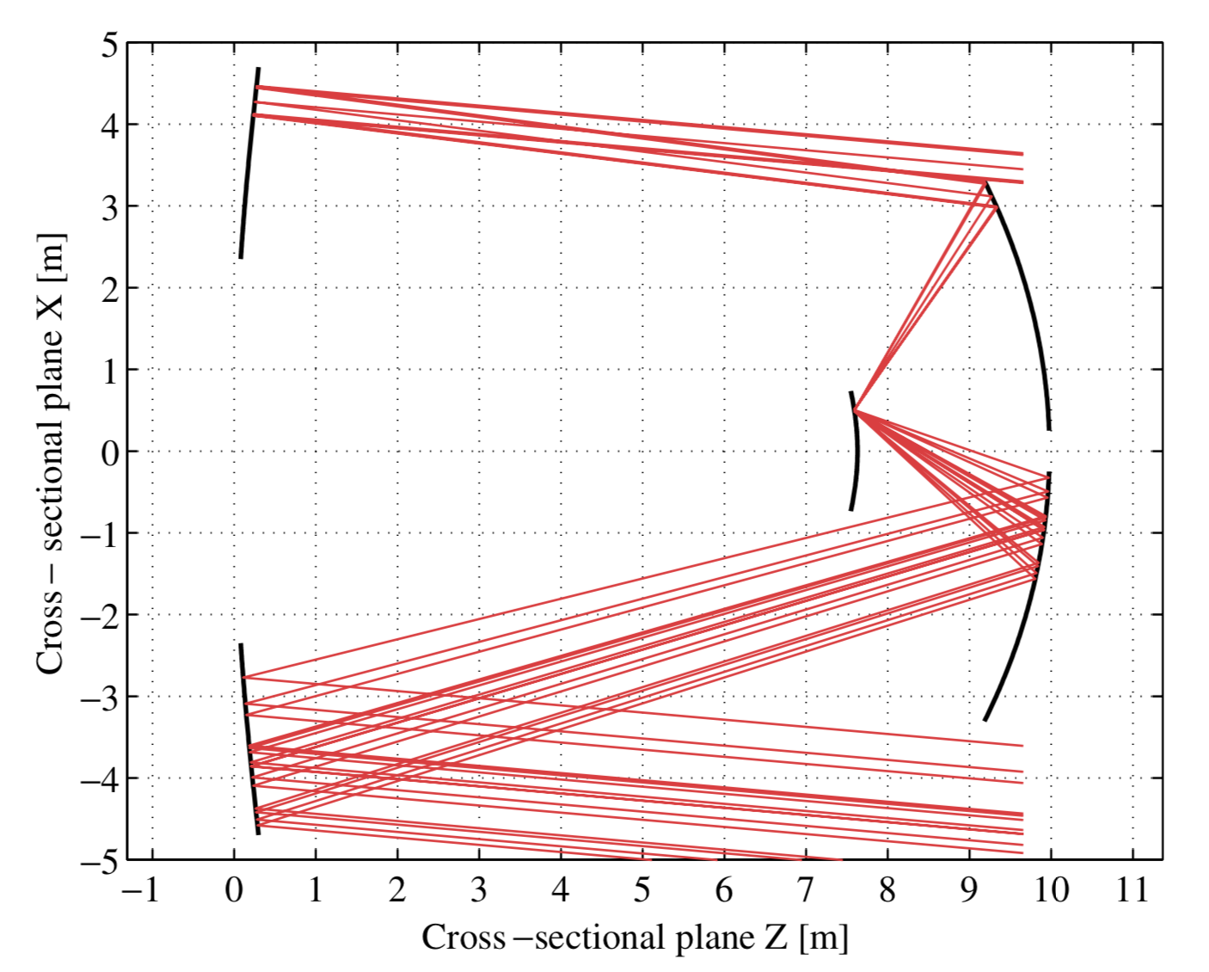
Secondary
Primary
Compact
focal plane
V. Vassiliev et al.
Astroparticle Physics
28 (2007) 10
Benefits:
Improved PSF over large FoV
Compact focal plane

Slide 39
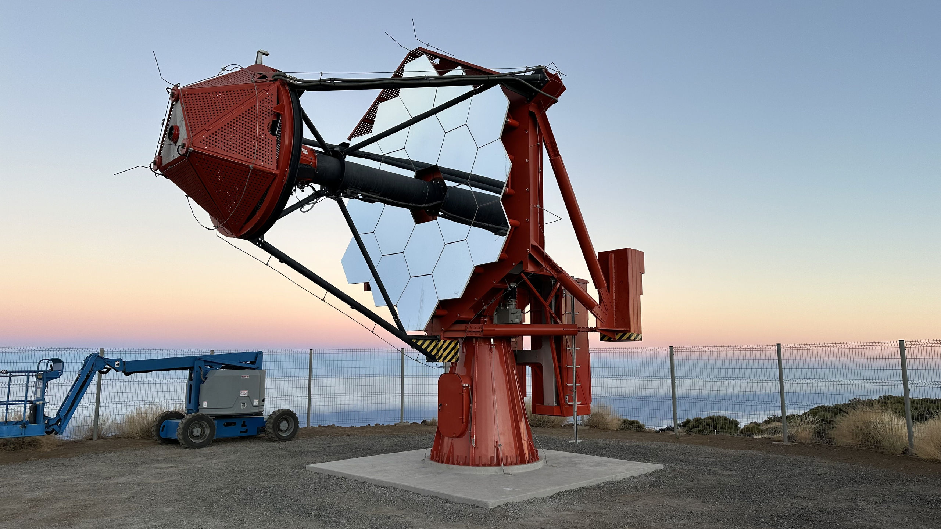
Secondary
Primary
Compact
focal plane
V. Vassiliev et al.
Astroparticle Physics
28 (2007) 10
Benefits:
Improved PSF over large FoV
Compact focal plane
ASTRI ARRAY
Source: ASTRI

Slide 40
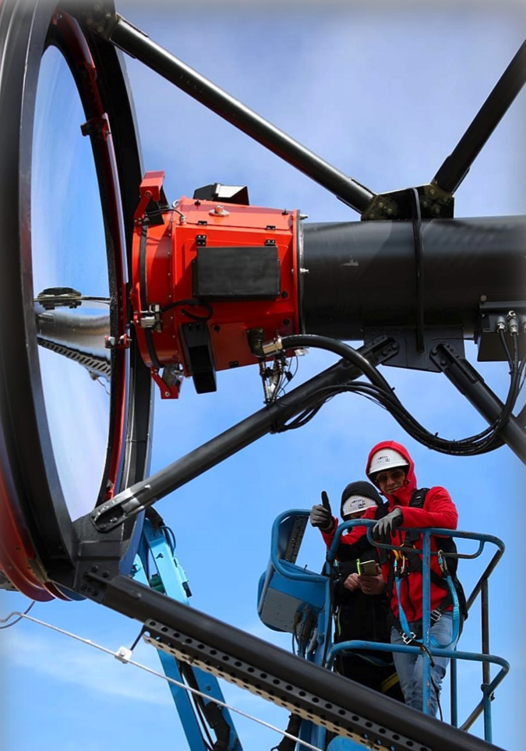
Secondary
Primary
Compact
focal plane
V. Vassiliev et al.
Astroparticle Physics
28 (2007) 10
Benefits:
Improved PSF over large FoV
Compact focal plane
ASTRI ARRAY

Slide 41
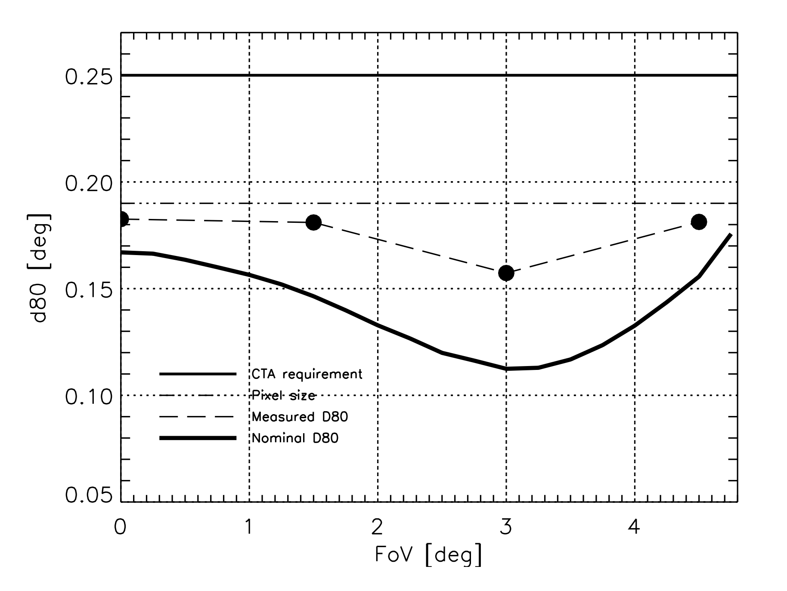
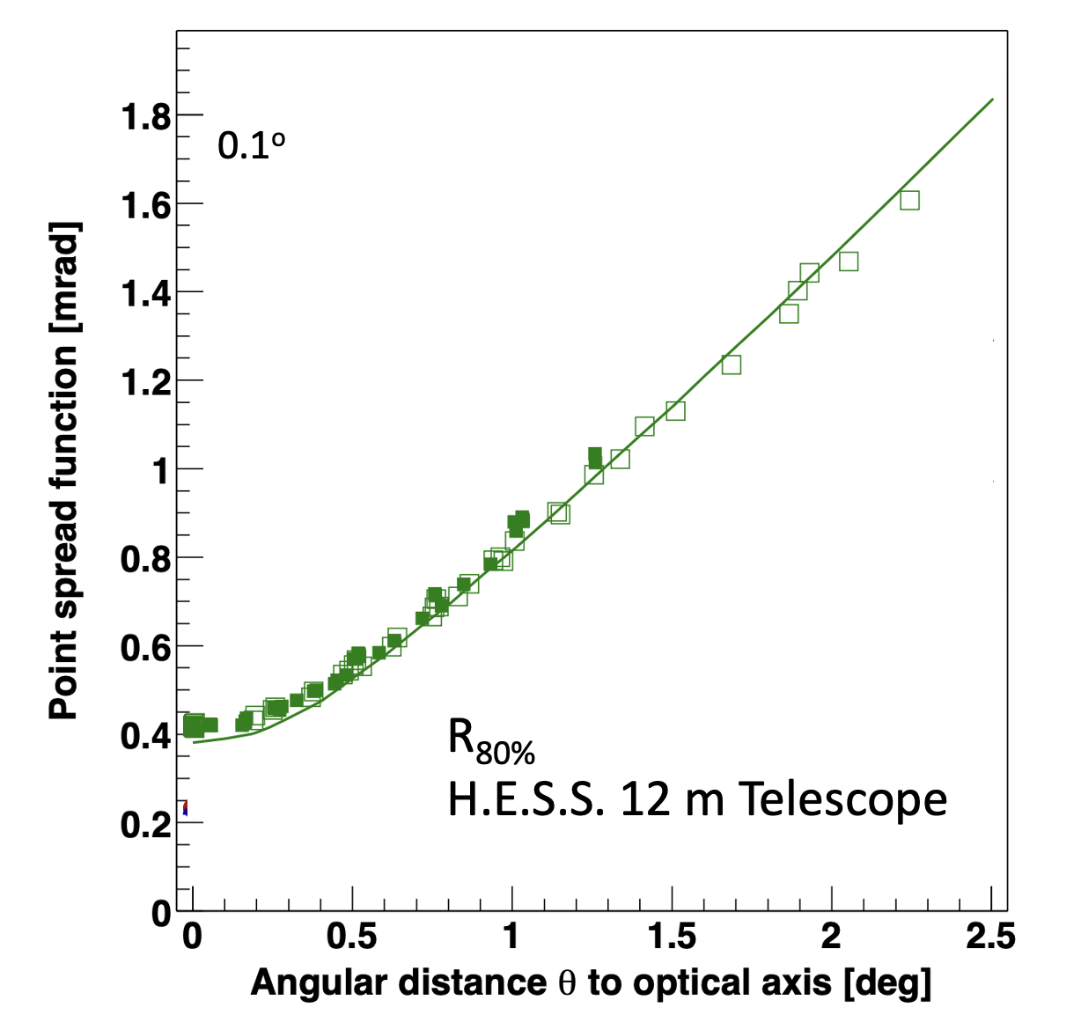
First optical validation of a Schwarzschild Couder telescope: the ASTRI SST-2M Cherenkov telescope
E. Giro et al., arXiv:1709.08418 (2017)
ASTRI ARRAY

Slide 42
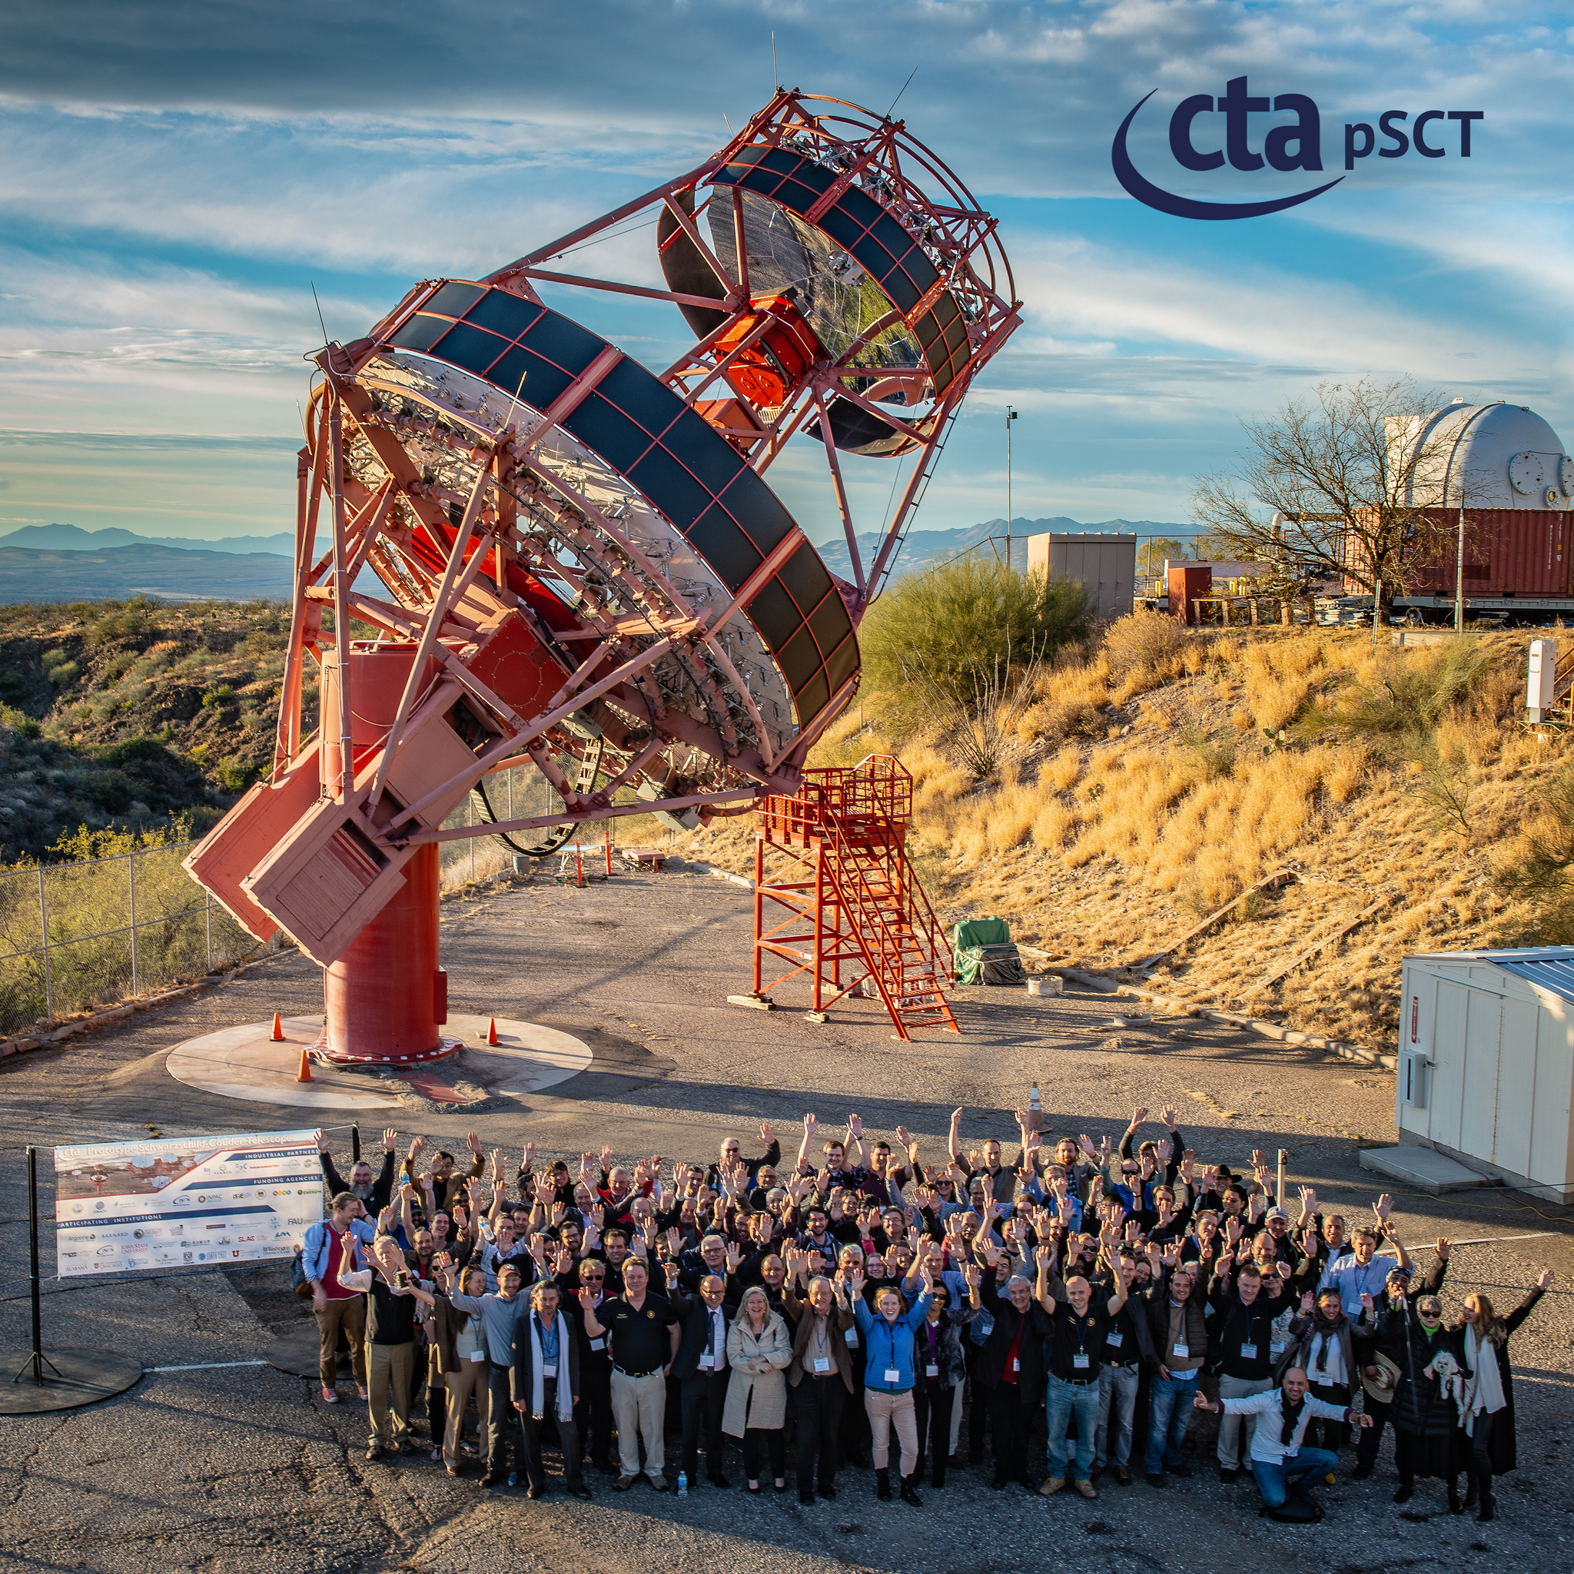
Inauguration
Schwarzschild-Couder Prototype Telescope (pSCT)
Whipple Observatory, 2019

Slide 43
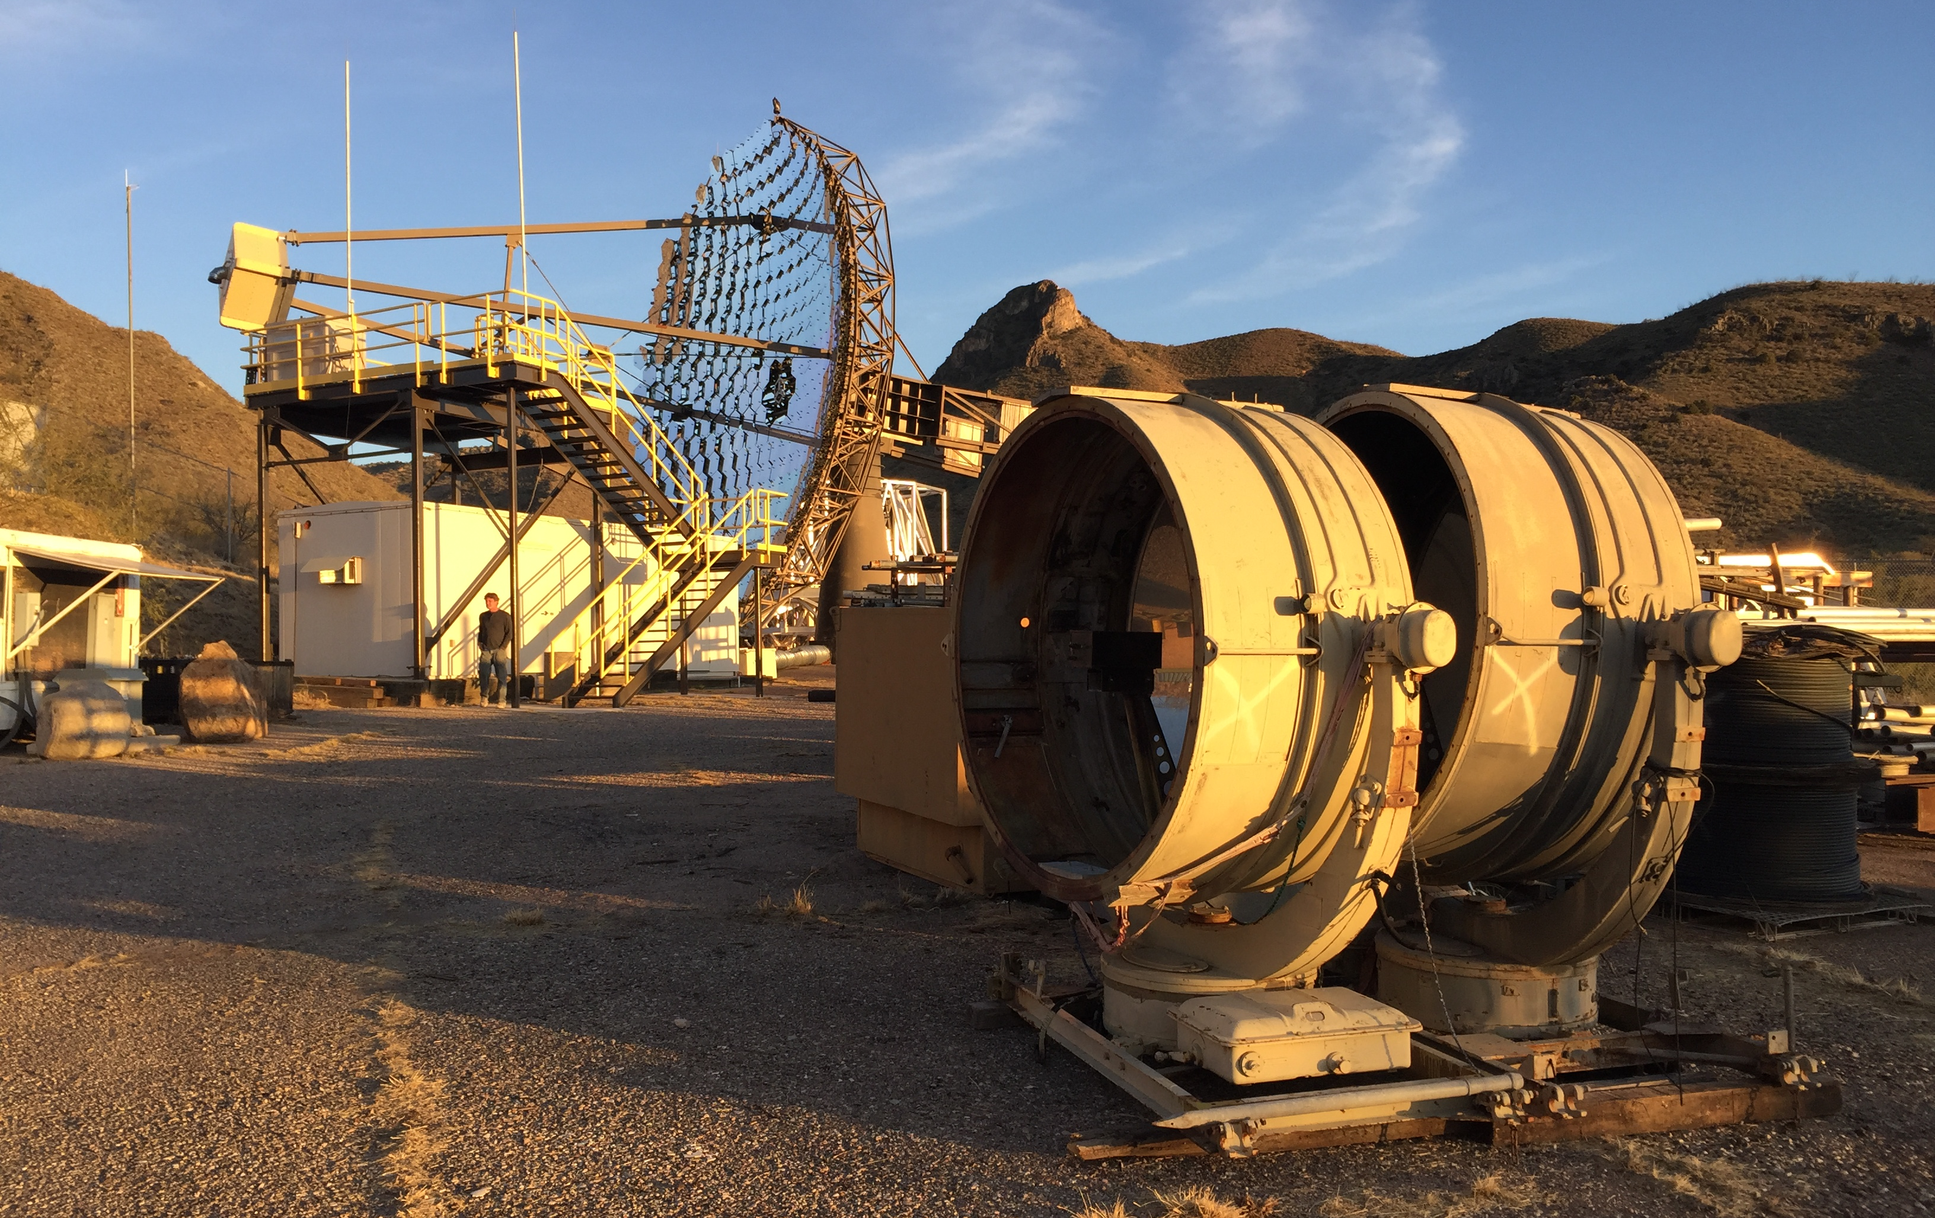
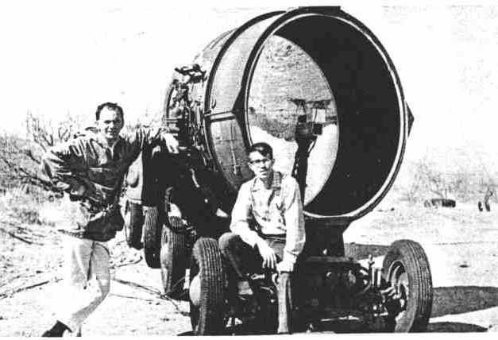
Weekes and Rieke
1967, at the site of
the present Whipple Observatory

Slide 44
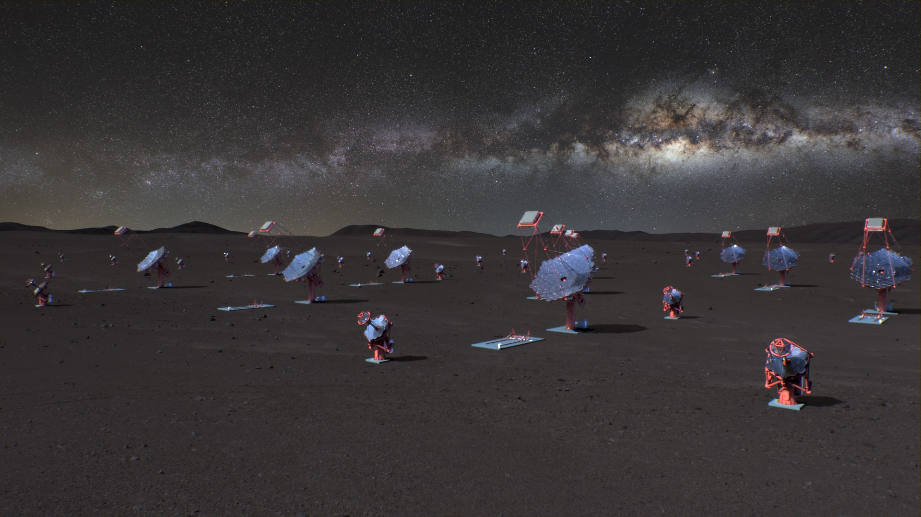

The next big step:
The Cherenkov Telescope Array Observatory

Slide 49
Higher statistics of
detected gamma rays
Higher quality of
detected gamma rays

Slide 50
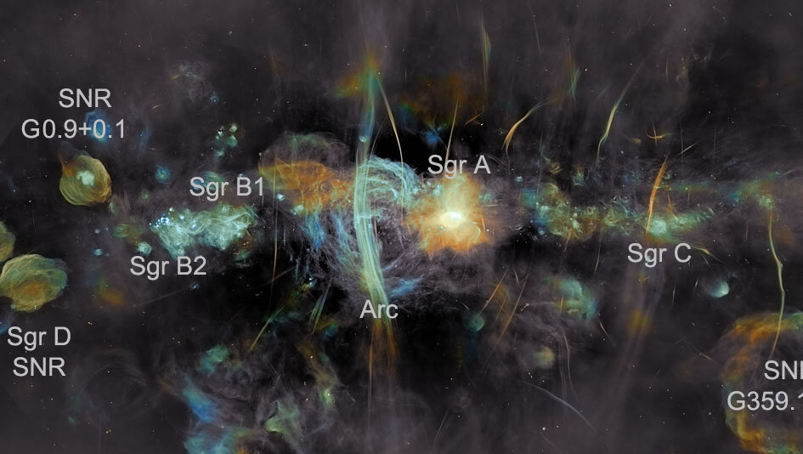
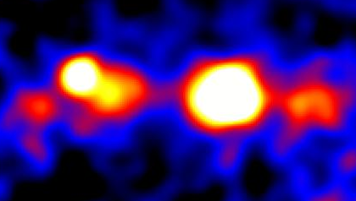
HESS γ-ray PSF
CTAO γ-ray PSF
G0.9
Galactic center seen
with Meerkat
Sgr B2 Sgr A*
HESS
50

Slide 53
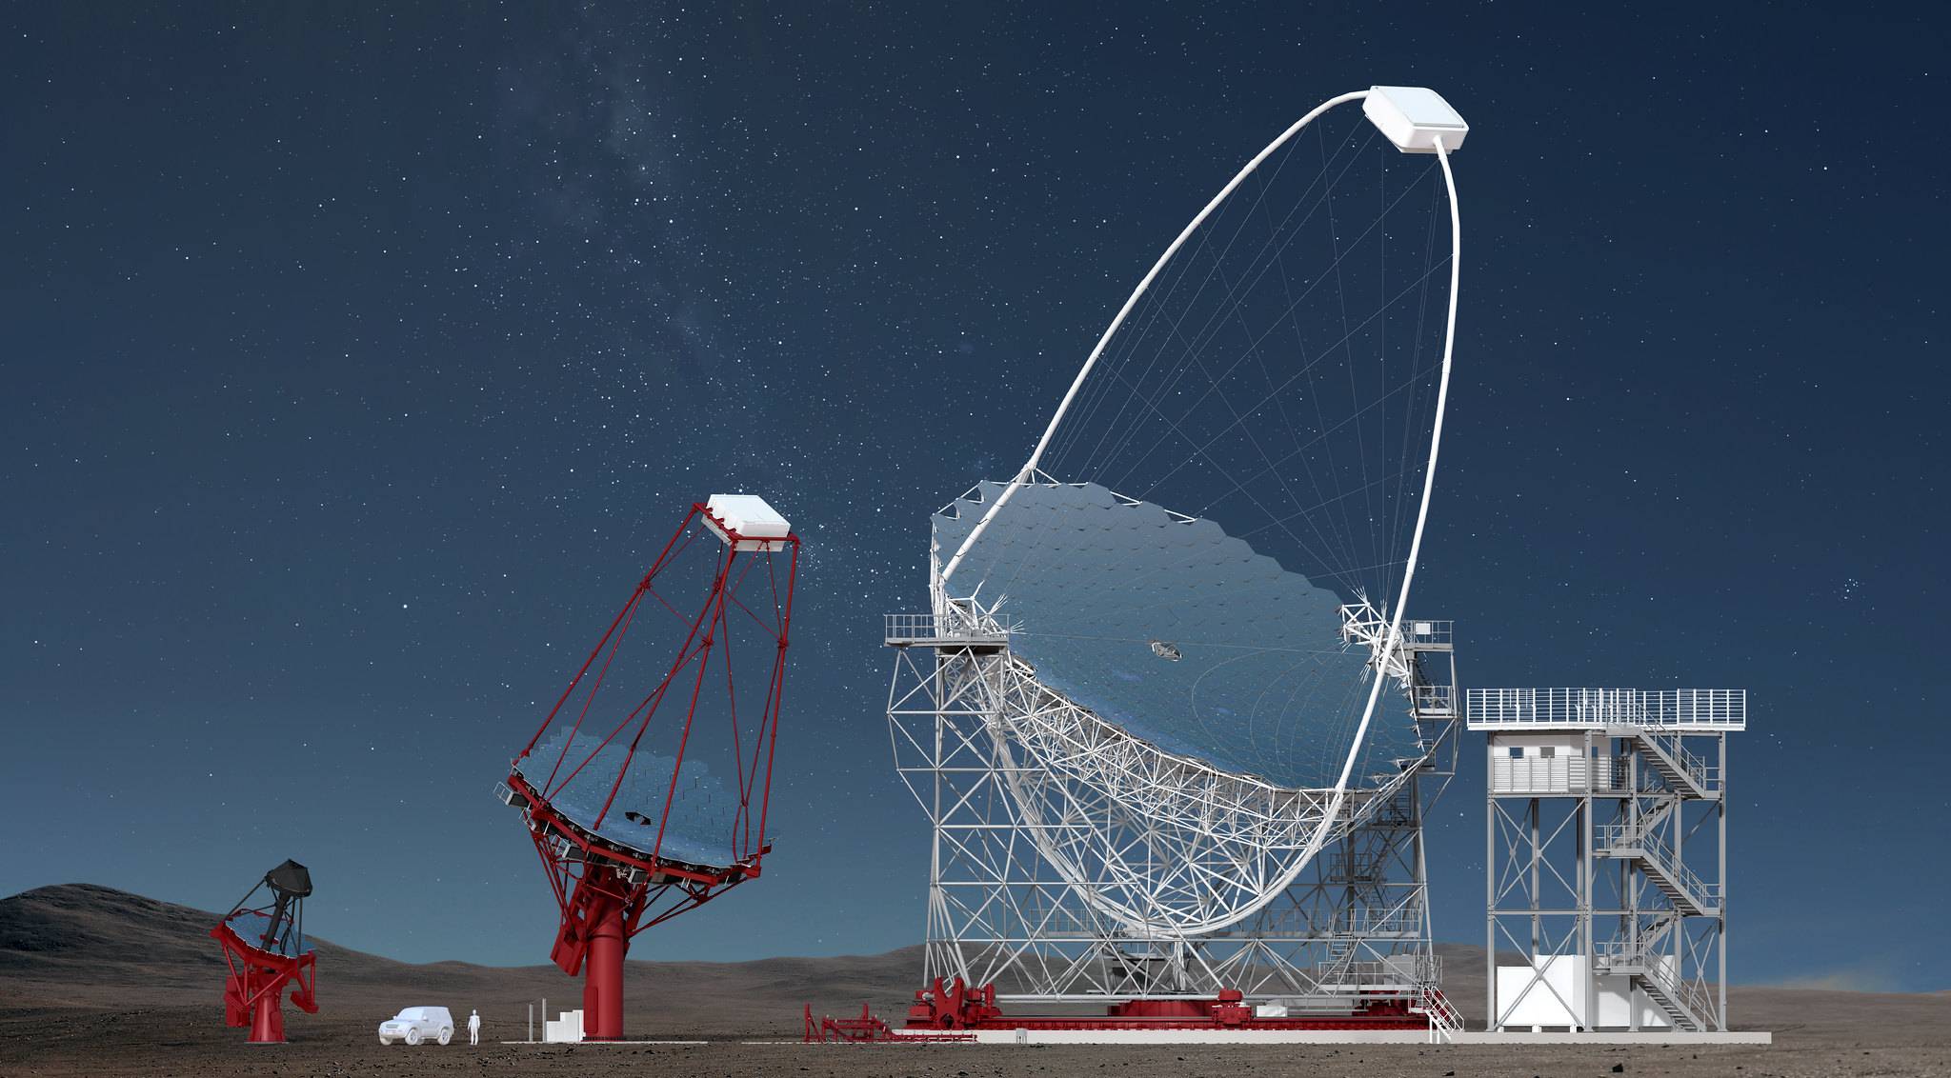

Slide 54
500 GeV
50 GeV
SST
MST
LST
Gamma ray flux decreases with increasing energy
Detection area increases
➜ Huge dynamic range

Slide 55
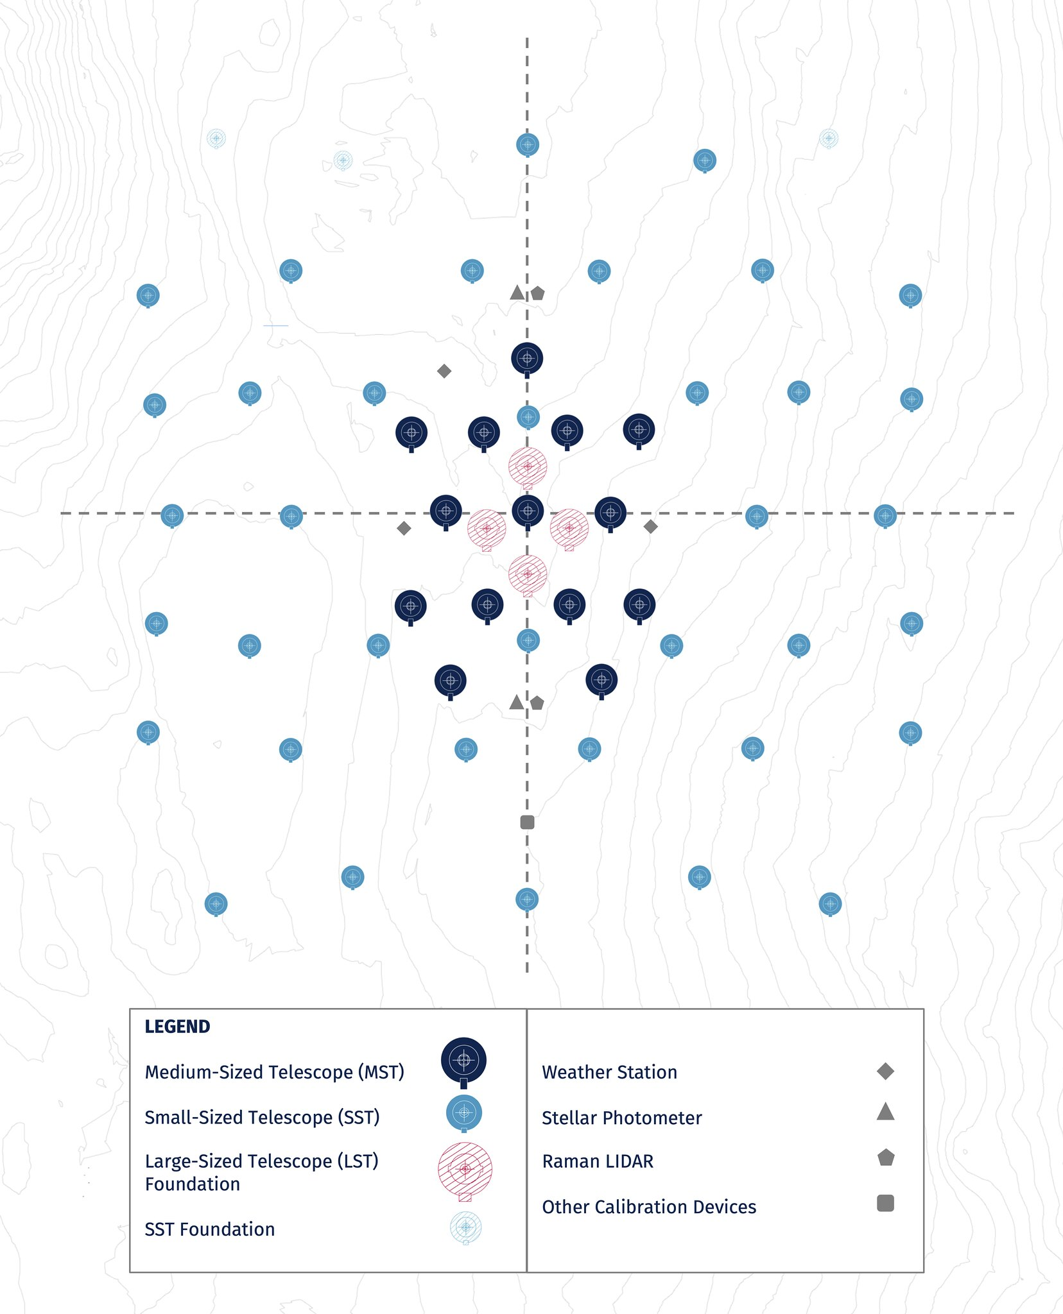


CTAO South
(Chile)
Bologna
Headquarters
SDMC @ DESY
CTAO North
(La Palma)
Source: CTAO

Slide 56


Large Telescopes (LST) at
CTAO North
Dec. 17
Groundbreaking
CTAO South
Source: CTAO

Slide 57

Theme 1: Cosmic Particle Acceleration
How and where are particles accelerated?
How do they propagate?
What is their impact on the environment?
Theme 2: Probing Extreme Environments
Processes close to neutron stars and black holes?
Characteristics of relativistic jets, winds and explosions?
Cosmic voids: their radiation fields and magnetic fields
Theme 3: Physics Frontiers
What is the nature of Dark Matter?
Is the speed of light a constant?
Do axion-like particles exist?

Slide 58


Dark matter at the galactic center
H.E.S.S. Coll.
arXiv:2207.10471
Weakly Interacting
Dark Matter Particles
95% CL upper limits
W⁺
W⁻
CTAO
Annihilation
cross section
“known” from
Dark Matter
abundance
Spectral signature
known from particle physics

Slide 60

A New Window into the Universe Made Possible by Segmented Mirrors

