Slide 1


Technologies and fabrication techniques of segmented mirrors for Cherenkov Telescopes
Giorgia Sironi
INAF-Osservatorio Astronomico di Brera

Slide 2
Summary
Imaging Atmospheric Cherenkov Telescopes
Segmentation and design
Segmentation and manufacturing
Segmentation and alignment
Segmentation and defocusing
Conclusions
Giorgia Sironi – Bologna, 25 Jan 2026

Slide 3
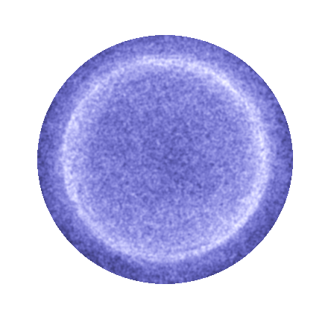
Imaging Atmospheric Cherenkov Telescopes
Understanding the origin and the role of CRs
Probing extreme enviroments (jets/winds/explosions – NS/BH))
Primary Gamma-ray
Very High Energy γ-rays (E > 20GeV) are generated by a variety of cosmic sources.
γ-rays interact with the atmosphere generating a particle cascade which produces detectable light by means of the Cherenkov effect:
Origin at about 10 km
Cone angle about 1°;
Illuminating radius about 100 m;
Light wave-front about 1 ns
Light density about 10 ph/m²
(NSB about 10⁸ ph/m²/s)
~ 1°
~ 10 μs
~ 10 km
~ 1 ns
~ 100 m
Giorgia Sironi – Bologna, 25 Jan 2026
Notes:
Con nichel ad angolo critico e 3.5 nm fa 54

Slide 4
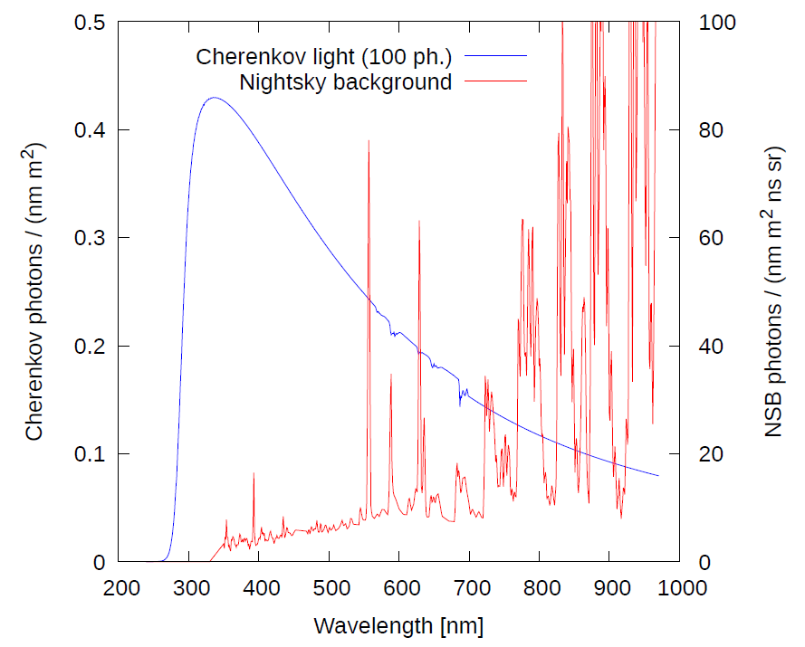
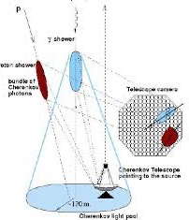
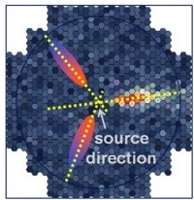
Imaging Atmospheric Cherenkov Telescopes
Key-concept
separate gamma signal by the cosmic background
Detect the nanoseconds scale Cherenkov signal drowned in in the continuous background
Retrieve the signal image incoming direction by the geometry of the image
Naumann et al. 2012
Giorgia Sironi – Bologna, 25 Jan 2026
Notes:
Con nichel ad angolo critico e 3.5 nm fa 54

Slide 5
Imaging Atmospheric Cherenkov Telescopes
A
Collect enaugh time correlated photons
To “see” the flashes
Isocronicity
Large effective area
Large geometrical area
Good reflectivity
Giorgia Sironi – Bologna, 25 Jan 2026
Notes:
Con nichel ad angolo critico e 3.5 nm fa 54

Slide 6
Imaging Atmospheric Cherenkov Telescopes
Good resolution on a large FOV
Have resolution to reconstruct the incoming direction of the “gamma” flashes
FOV requirement
PSF requirement
B
Naumann et al. 2012
Naumann et al. 2012
+ POINTING
Geometrical area
Isocronicity
PSF
FOV
Giorgia Sironi – Bologna, 25 Jan 2026
Notes:
Con nichel ad angolo critico e 3.5 nm fa 54

Slide 7
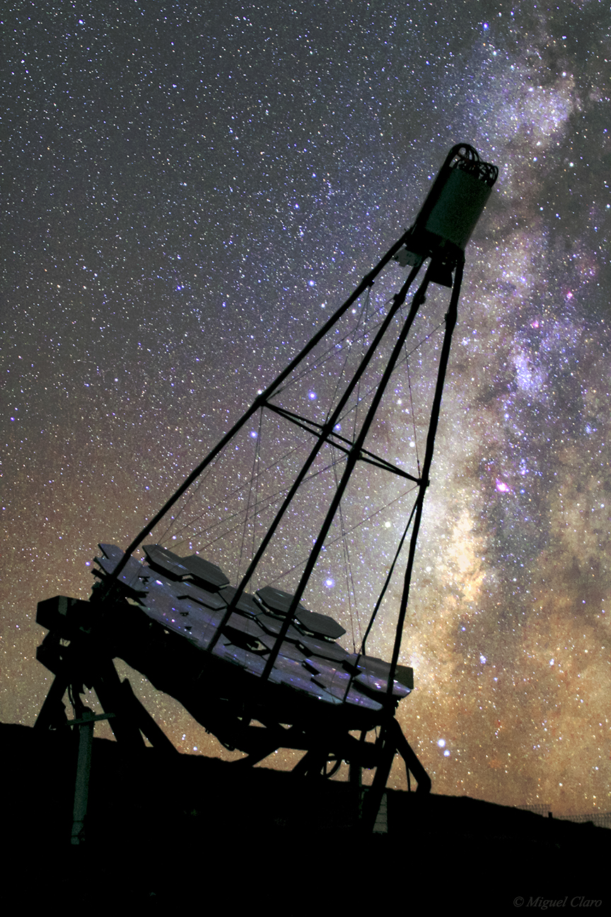
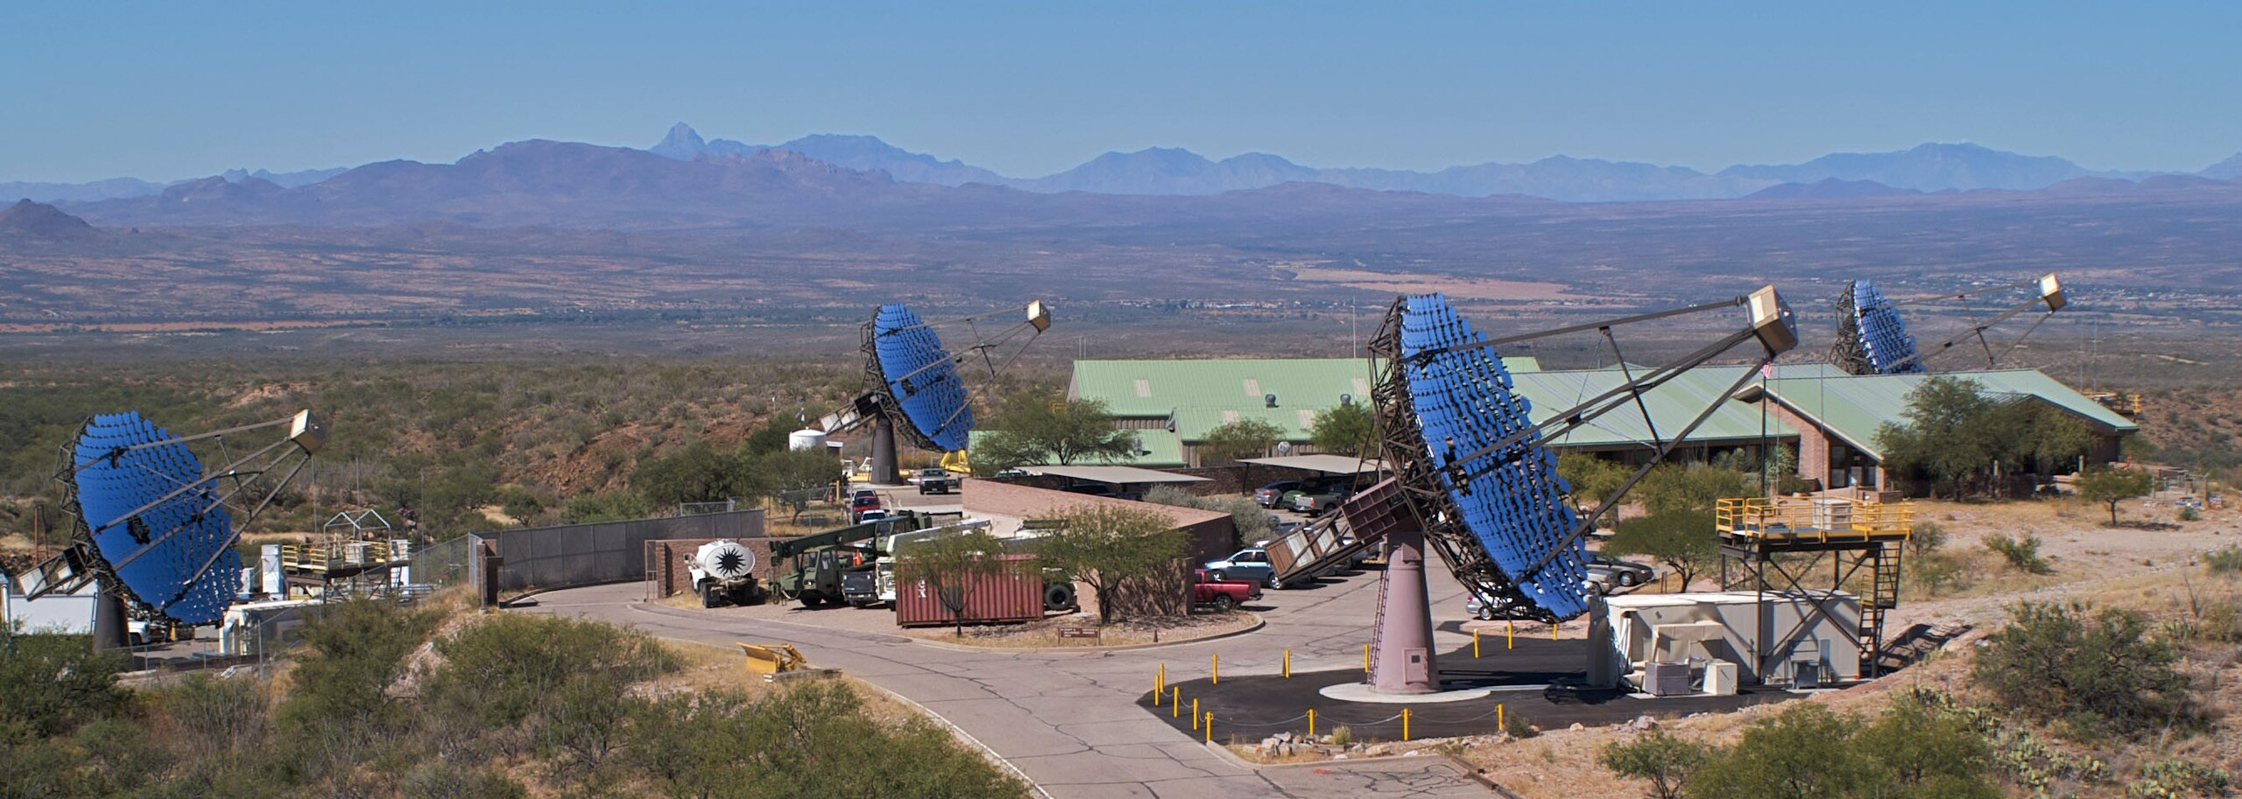
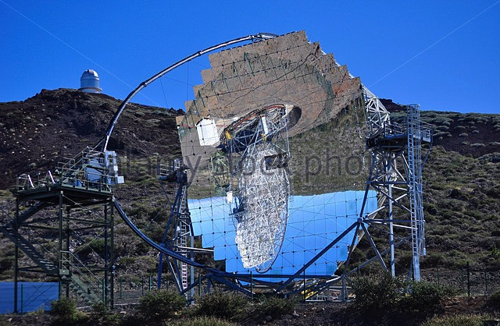
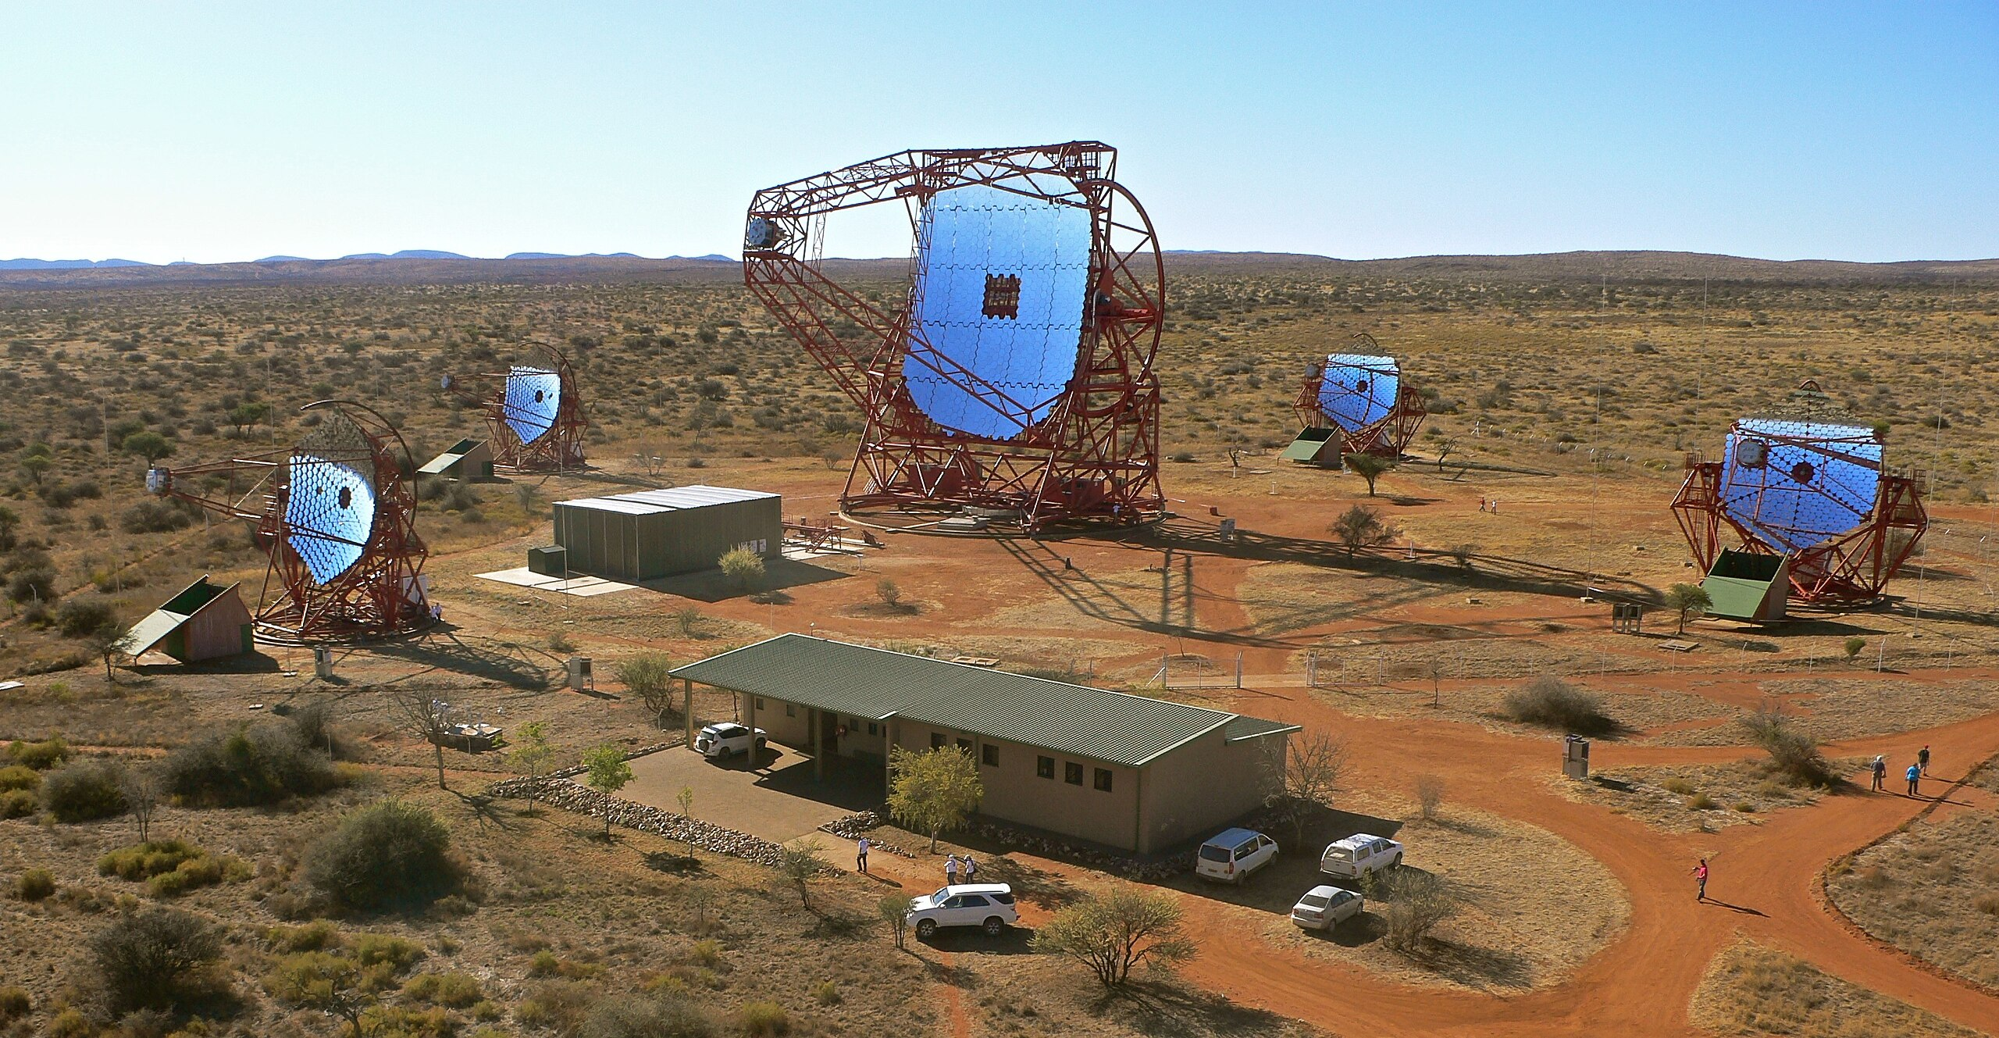
Imaging Atmospheric Cherenkov Telescopes
Geometrical area
Large tessellated optics
VERITAS 4 telescopes with diameter 12 m
FACT 4 m dimeter
MAGIC 2 telescopes with dimeter 17 m
H.E.S.S. 4 telescopes 12 m+ 1 telescope 28 m
Giorgia Sironi – Bologna, 25 Jan 2026
Notes:
Con nichel ad angolo critico e 3.5 nm fa 54

Slide 8
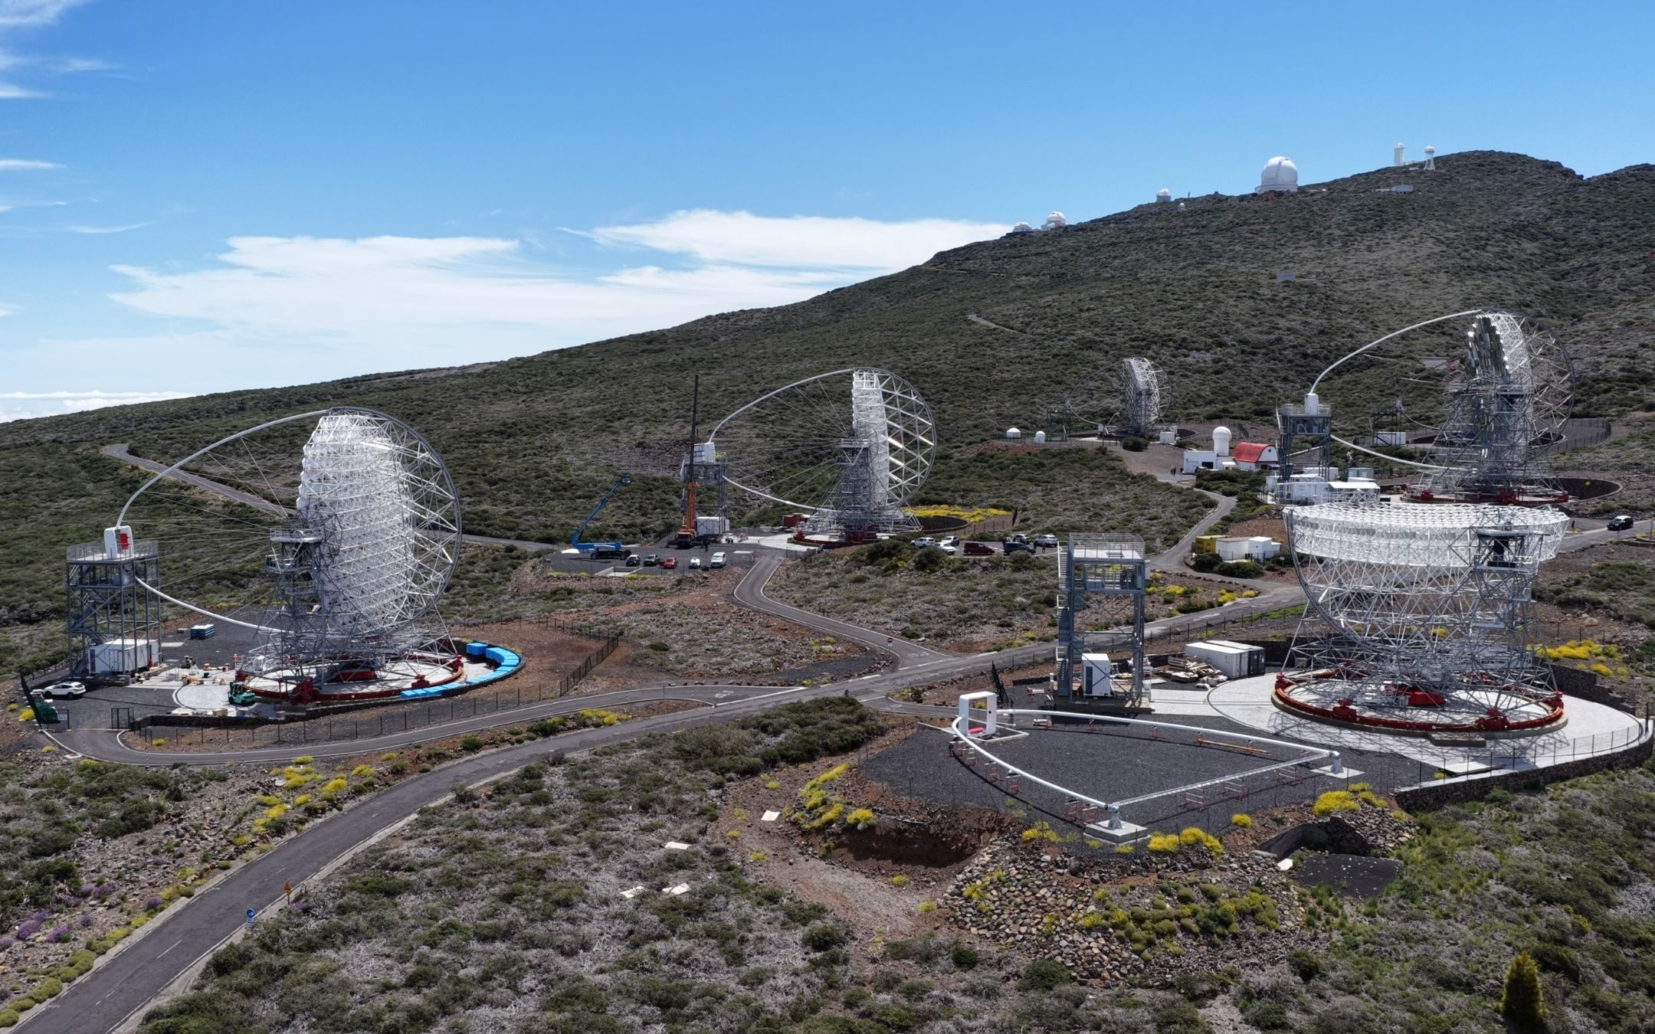
Imaging Atmospheric Cherenkov Telescopes
Geometrical area
Large tessellated optics
VERITAS 4 telescopes with diameter 12 m
FACT 4 m dimeter
CTAO-N LST 23 m
MAGIC 2 telescopes with dimeter 17 m
H.E.S.S. 4 telescopes 12 m+ 1 telescope 28 m
Giorgia Sironi – Bologna, 25 Jan 2026
Notes:
Con nichel ad angolo critico e 3.5 nm fa 54

Slide 9
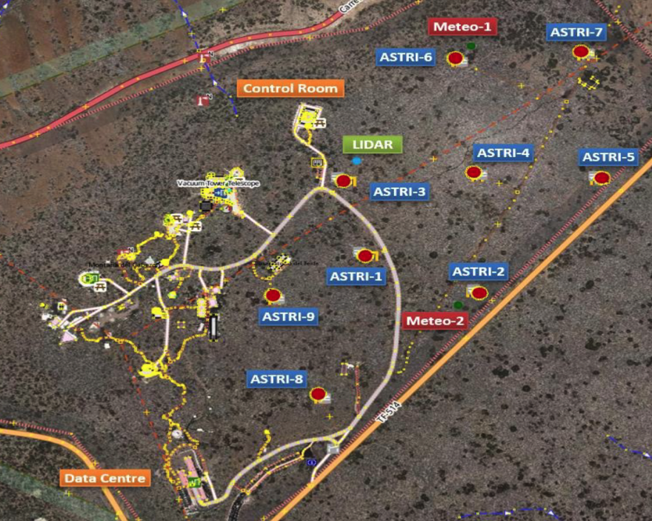
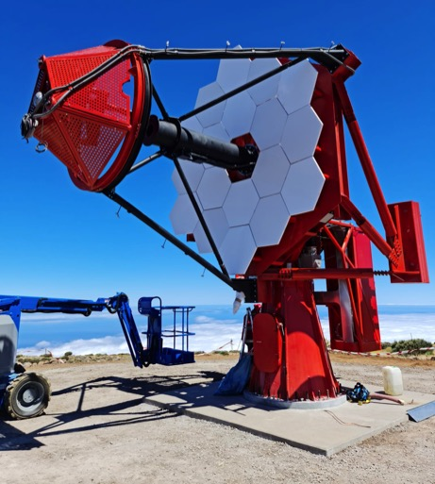
Imaging Atmospheric Cherenkov Telescopes
ASTRI Mini Array
9 Telescopes CTA-SST like in Tenerife
ASTRI-MINI telescopes are now (2026) in AIV phase
Giorgia Sironi – Bologna, 25 Jan 2026

Slide 10
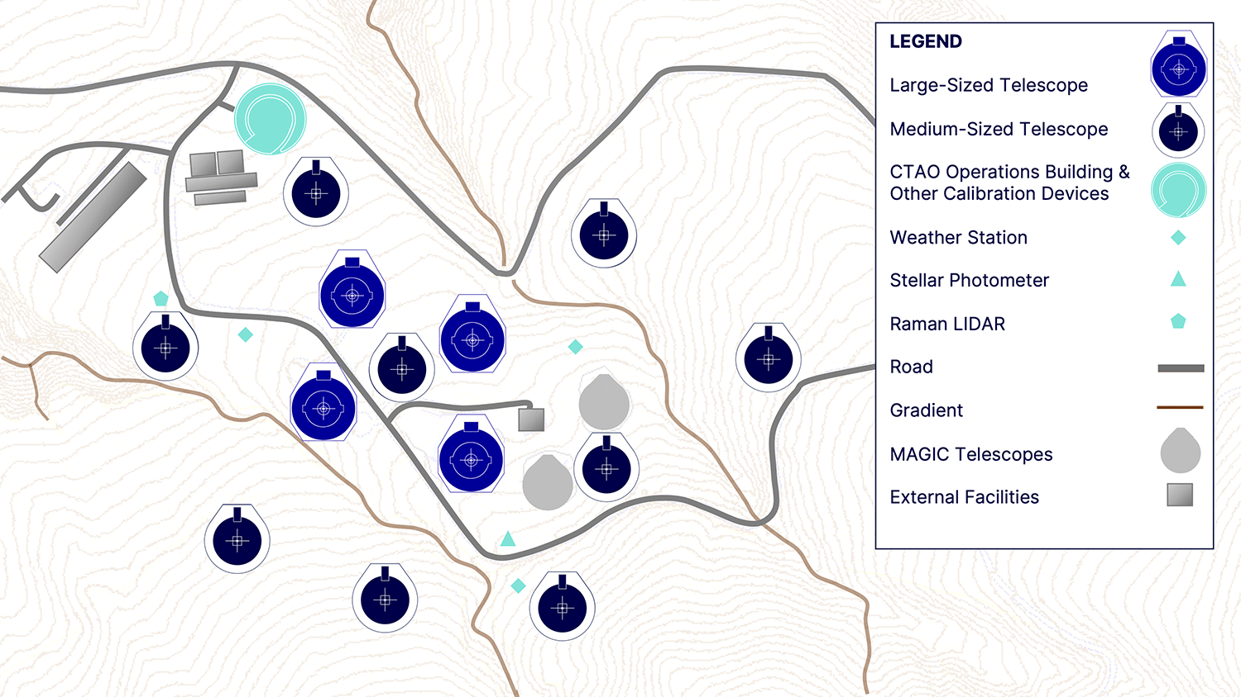
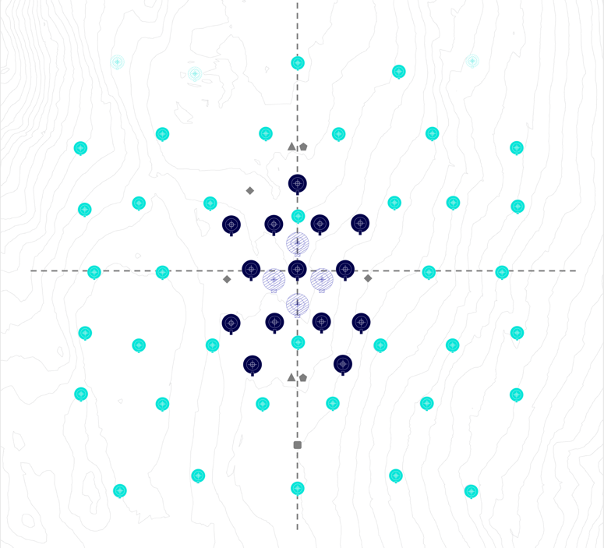
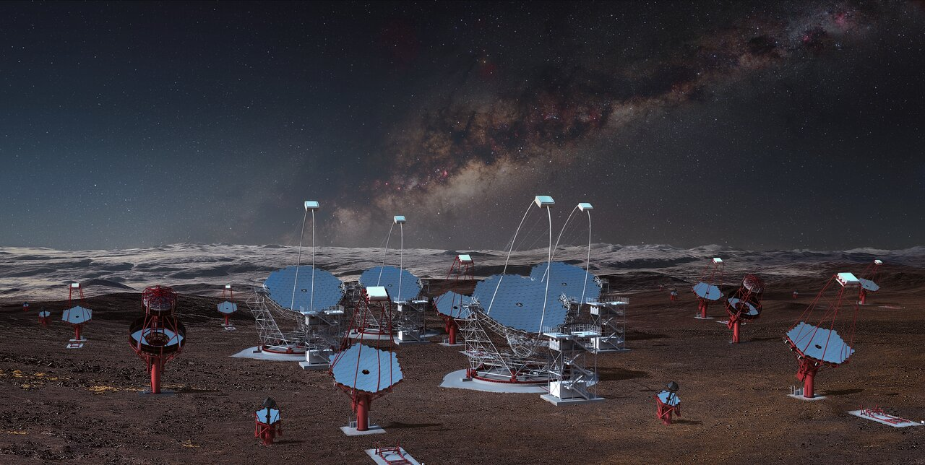
Imaging Atmospheric Cherenkov Telescopes
CTAO
Southern array
Northern array
300 TeV
SST MST LST
5 TeV
200 GeV
20 GeV
Giorgia Sironi – Bologna, 25 Jan 2026

Slide 11
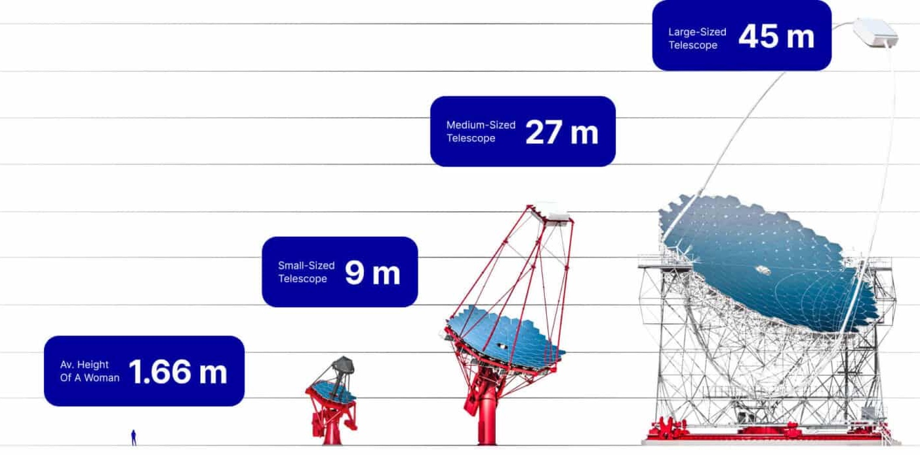
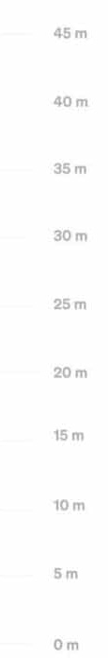
Segmentation and design
Geometrical area
A > 5.5-300 m2
Isocronicity
Dt < 2 -6 ns
PSF
D80 < 0.25 -0.1 deg
FOV
> 9.9 - 4.3 deg
CTAO TELESCOPES
300 TeV
SST MST LST
5 TeV
200 GeV
20 GeV
Giorgia Sironi – Bologna, 25 Jan 2026
Notes:
Con nichel ad angolo critico e 3.5 nm fa 54

Slide 12
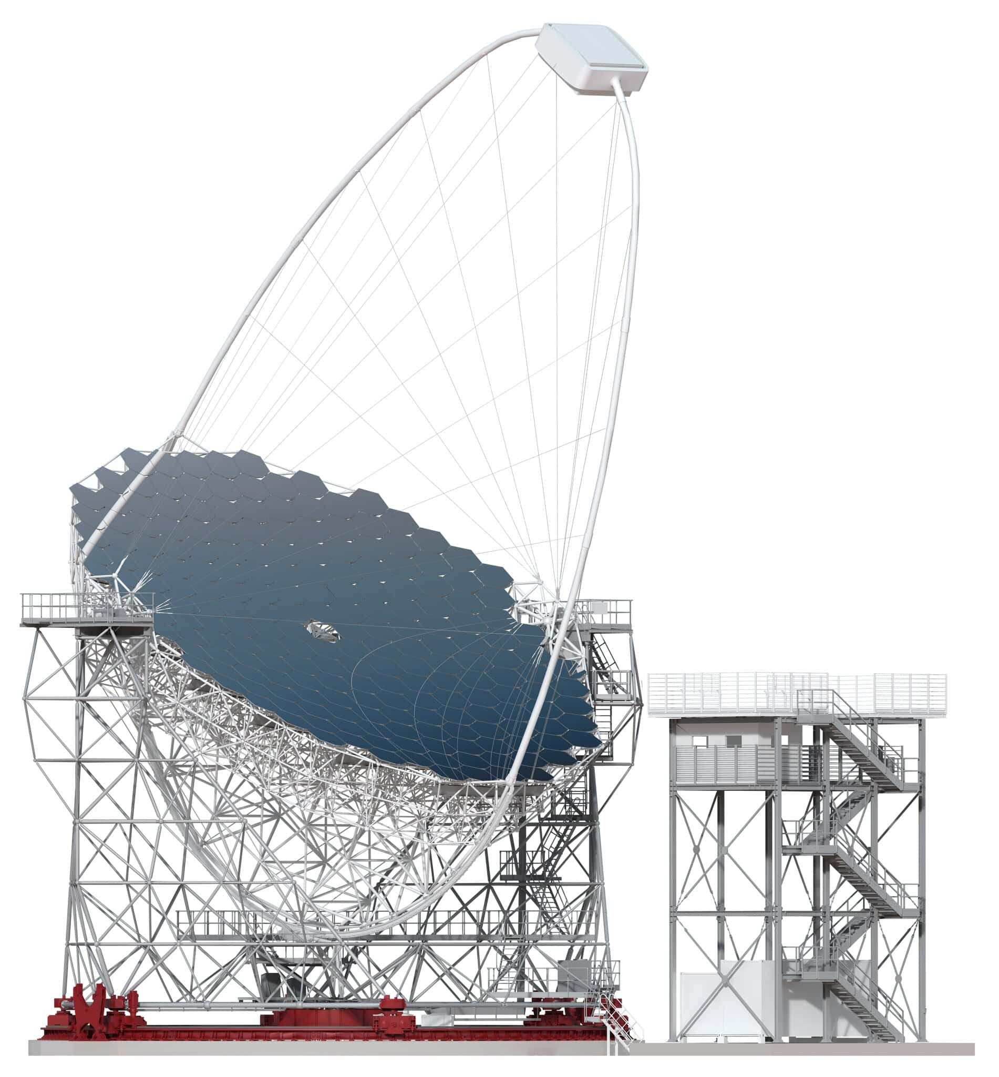
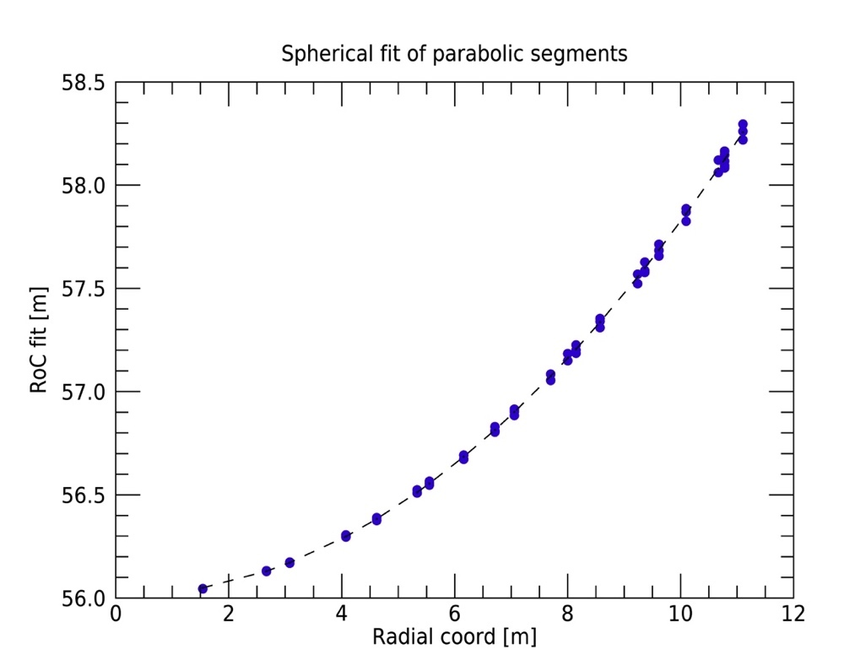
Segmentation and design
Geometrical area
Isocronicity
PSF
FOV
Ex 1: CTA-LST Parabolic approximation
Parabolic Dish (D=23 m)
198 spherical mirrors (side-to-side=1.5 m)
Segments rotated to approximate the parabolic response
Giorgia Sironi – Bologna, 25 Jan 2026
Notes:
Con nichel ad angolo critico e 3.5 nm fa 54

Slide 13
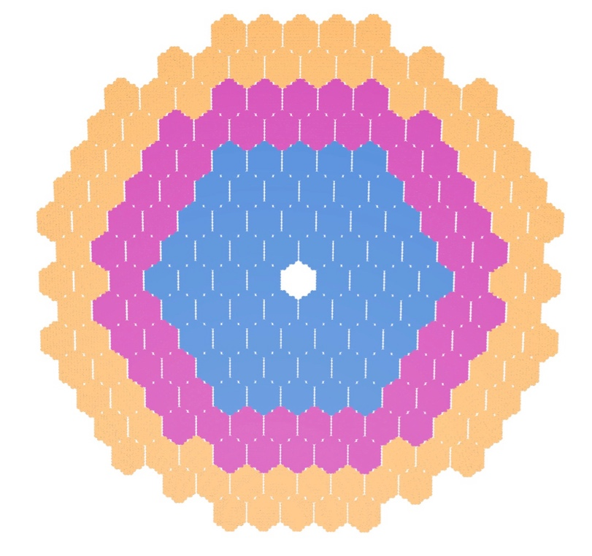
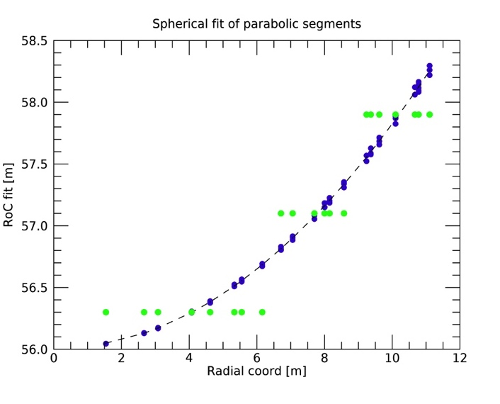
Segmentation and design
Geometrical area
Isocronicity
PSF
FOV
Ex 1: CTA-LST Parabolic approximation
Parabolic Dish (D=23 m)
198 spherical mirrors (side-to-side=1.5 m)
Segments rotated to approximate the parabolic response
RoC [m] | # of segments
56.3 | 60
57.1 | 60
57.9 | 78
Giorgia Sironi – Bologna, 25 Jan 2026
Notes:
Con nichel ad angolo critico e 3.5 nm fa 54

Slide 14
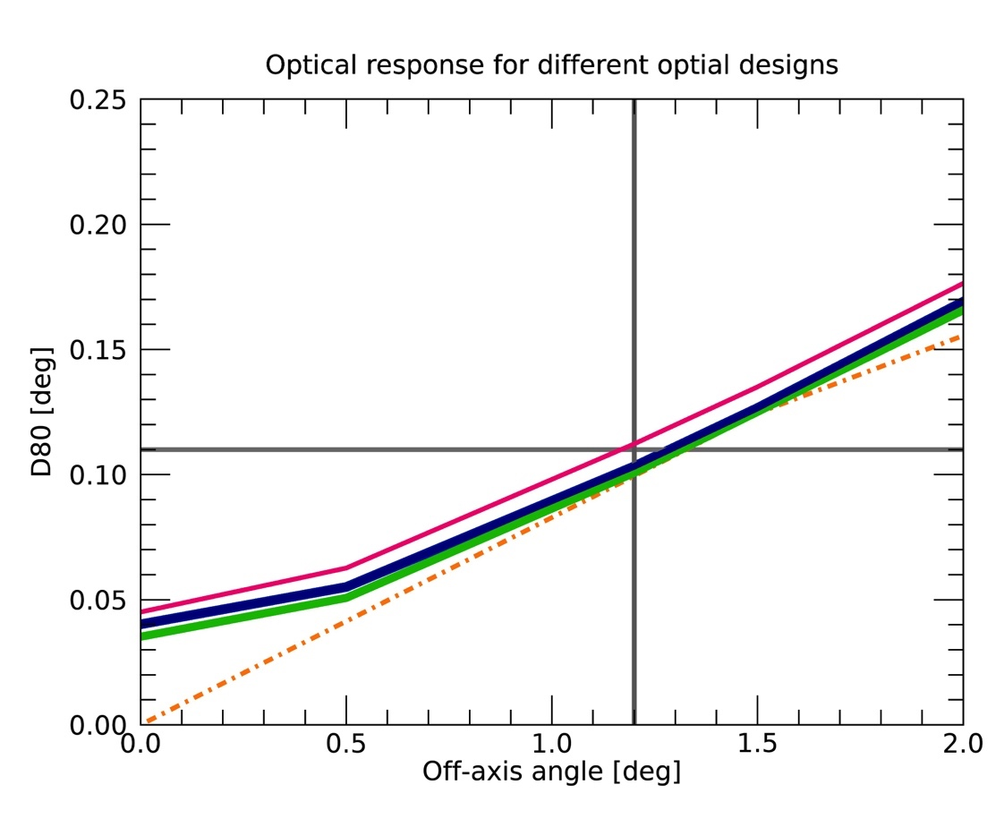
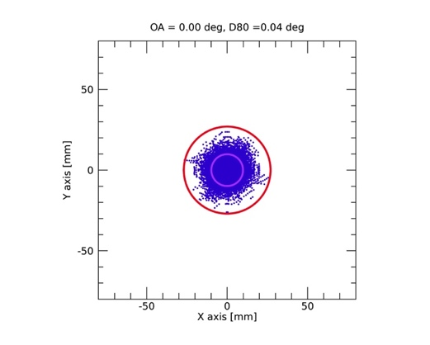
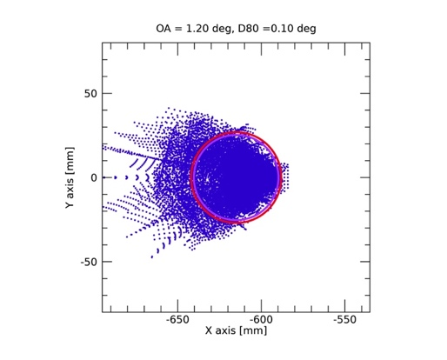
Segmentation and design
Geometrical area
Isocronicity
PSF
FOV
Ex 1: CTA-LST Parabolic approximation
Parabolic Dish (D=23 m)
198 spherical mirrors (side-to-side=1.5 m)
Segments rotated to approximate the parabolic response
Yellow dashed line: parabolic mirror
Green: continuous RoC distribution
Blue: proposed solution with 3 coronae
Pink: all mirrors with the same RoC
Tessellation allowed to obtain parabolic response by spherical mirrors
Giorgia Sironi – Bologna, 25 Jan 2026
Notes:
Con nichel ad angolo critico e 3.5 nm fa 54

Slide 15
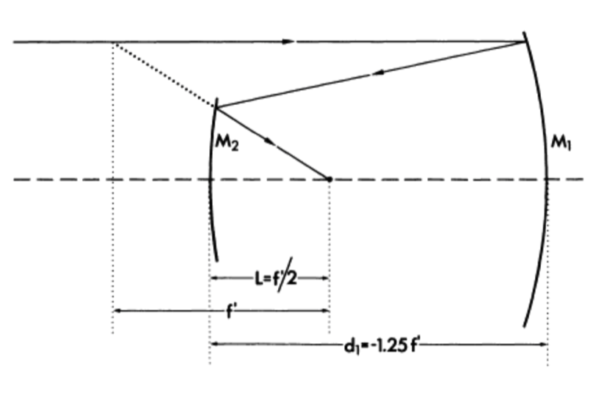
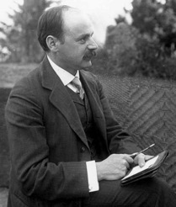
Segmentation and design
Geometrical area
Isocronicity
PSF
FOV
Ex 2: ASTRI and pSCT and the strong asphericity
1905: Karl Schwarzschild solved the Seidel optical equations for spherical aberration and coma find relation between parameters capable to make a telescope aplanatic.
“For any geometry, 2 aspheric mirrors allow the correction of SI and SII to give an aplanatic telescope”
Schwarzschild telescope
b_{S1}= Hyperbola
b_{S2}= Spheroid
FoV: 2.8 deg
RMS_{edge}~12’’
Technological obstacle: Aspherical Optics manufacturing
Giorgia Sironi – Bologna, 25 Jan 2026
Notes:
Con nichel ad angolo critico e 3.5 nm fa 54

Slide 16
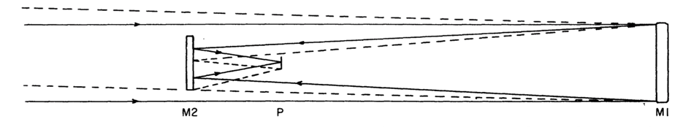
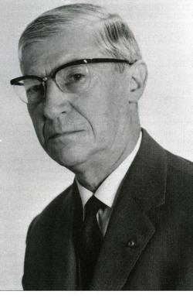
Segmentation and design
Geometrical area
Isocronicity
PSF
FOV
Ex 2: ASTRI and pSCT and the strong asphericity
1926: Couder solved the Seidel equation removing the flat field condition obtaining aplanatic anastigmatic telescope and a generalization of Schwarzschild theorem:
“N aspheric optics allow correcting N Seidel aberrations”
Spheric
Coma
Astigmatism
Couder telescope
b_{S1}= Hyperbola
b_{S2}= Spheroid
FoV:3.0 deg
RMS_{edge}~1’’
Technological obstacle: Aspherical Optics manufacturing
Giorgia Sironi – Bologna, 25 Jan 2026
Notes:
Con nichel ad angolo critico e 3.5 nm fa 54

Slide 17
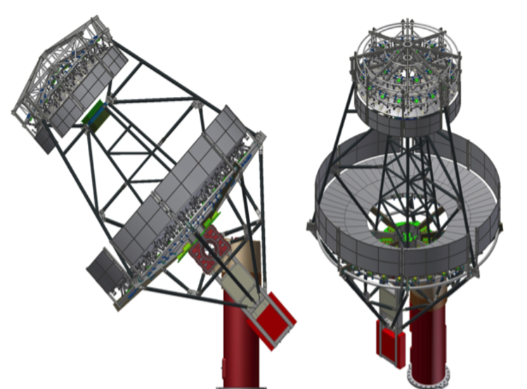
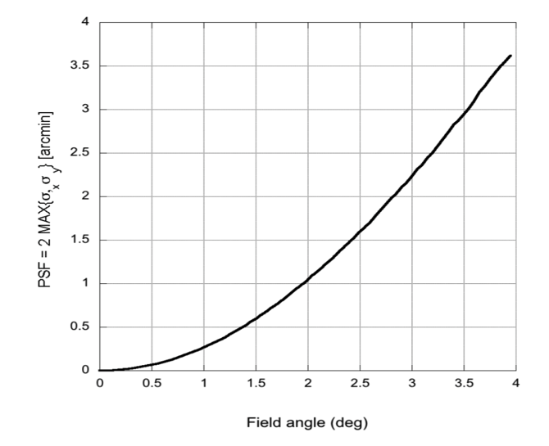
Segmentation and design
Geometrical area
Isocronicity
PSF
FOV
Ex 2: ASTRI and pSCT and the strong asphericity
V. Vassiliev proposed to apply the Schwarzschild-Couder solution to Cherenkov telescopes (2007).
SC design for CTA Medium Size class Telescope
Better resolution off-axis
Smaller plate scale →smaller camera
Aspheric mirrors manufacturing
Alignment
Giorgia Sironi – Bologna, 25 Jan 2026
Notes:
Con nichel ad angolo critico e 3.5 nm fa 54

Slide 18
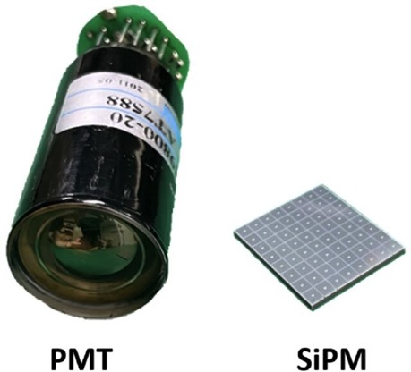
Segmentation and design
Geometrical area
Isocronicity
PSF
FOV
Ex 2: ASTRI and pSCT and the strong asphericity
V. Vassiliev proposed to apply the Schwarzschild-Couder solution to Cherenkov telescopes (2007).
SC design for CTA Medium Size class Telescope
Better resolution off-axis
Smaller plate scale →smaller camera
Aspheric mirrors manufacturing
Alignment
Giorgia Sironi – Bologna, 25 Jan 2026
Notes:
Con nichel ad angolo critico e 3.5 nm fa 54

Slide 19
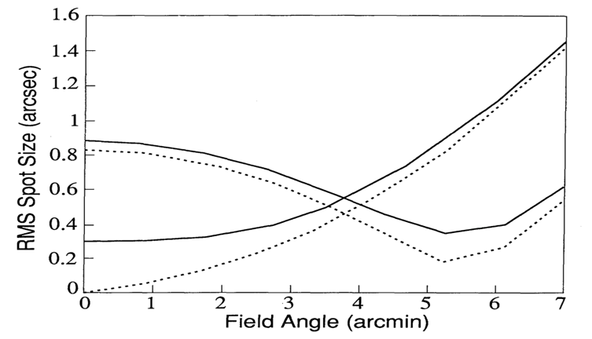
Segmentation and design
Geometrical area
Isocronicity
PSF
FOV
Ex 2: ASTRI and pSCT and the strong asphericity
CHANDRA
In 1992 Burrow, Burgs and Giacconi proposed to modify the X-ray telescope (CHANDRA) design with Schwarzschild-like polynomial solution
Defines the surface profile allowing higher order polynomials admitted
Optimization of the imagery quality is on the FoV
Burrows, C. J., Burg, R., & Giacconi, R. 1992, ApJ, 392, 760
Ray-tracing optimization
On the FoV
Giorgia Sironi – Bologna, 25 Jan 2026
Notes:
Con nichel ad angolo critico e 3.5 nm fa 54

Slide 20

Segmentation and design
Geometrical area
Isocronicity
PSF
FOV
Ex 2: ASTRI and pSCT and the strong asphericity
86.9%
Polynomial solutions can be generalized for all purposes
RMS value should be chosen according specification
Minimum is at ~ θ_{max} /2^{1/2}
Real angular resolution is never perfect!!
On-axis value can be equal to the typical manufacturing and alignment errors can be
CHANDRA upgrade, Burrows et al. 1992
Giorgia Sironi – Bologna, 25 Jan 2026
Notes:
Con nichel ad angolo critico e 3.5 nm fa 54

Slide 21
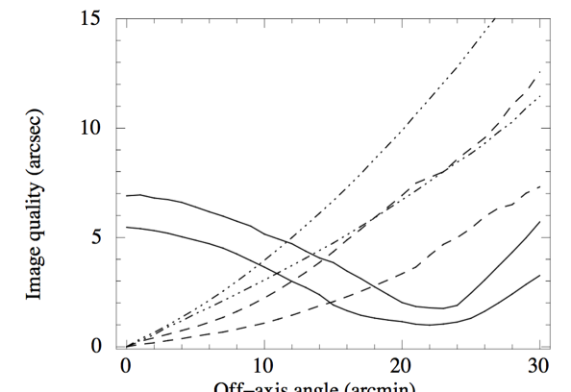
Segmentation and design
Geometrical area
Isocronicity
PSF
FOV
Ex 2: ASTRI and pSCT and the strong asphericity
86.9%
Polynomial solutions can be generalized for all purposes
RMS value should be chosen according specification
Minimum is at ~ θ_{max} /2^{1/2}
Real angular resolution is never perfect!!
On-axis value can be equal to the typical manufacturing and alignment errors can be
CHANDRA upgrade, Burrows et al. 1992
WFXT, Conconi et al. 2010
85.4%
Giorgia Sironi – Bologna, 25 Jan 2026
Notes:
Con nichel ad angolo critico e 3.5 nm fa 54

Slide 22
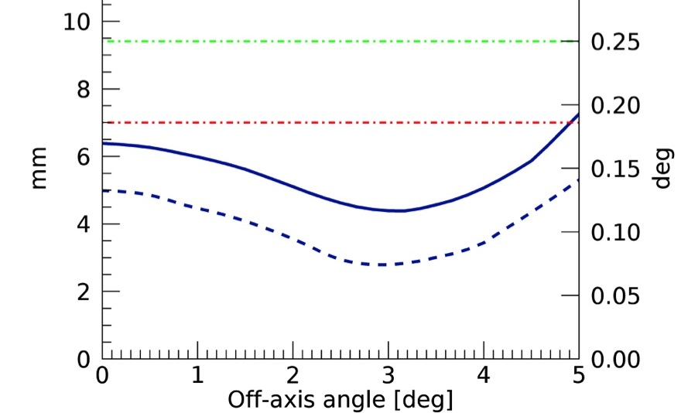
Segmentation and design
Geometrical area
Isocronicity
PSF
FOV
Ex 2: ASTRI and pSCT and the strong asphericity
86.9%
Polynomial solutions can be generalized for all purposes
RMS value should be chosen according specification
Minimum is at ~ θ_{max} /2^{1/2}
Real angular resolution is never perfect!!
On-axis value can be equal to the typical manufacturing and alignment errors can be
CHANDRA upgrade, Burrows et al. 1992
ASTRI Optical response
WFXT, Conconi et al. 2010
85.4%
Giorgia Sironi – Bologna, 25 Jan 2026
Notes:
Con nichel ad angolo critico e 3.5 nm fa 54

Slide 23
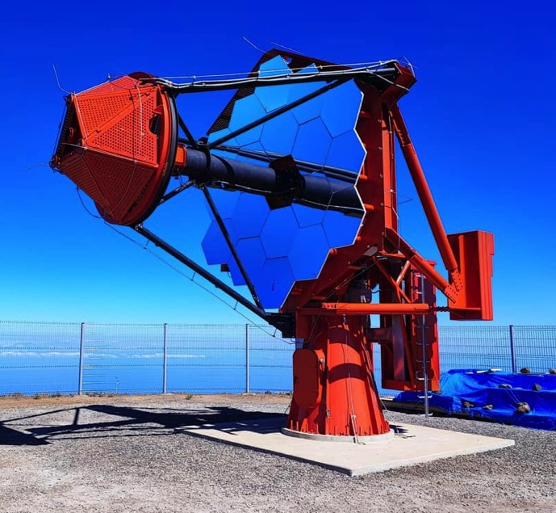
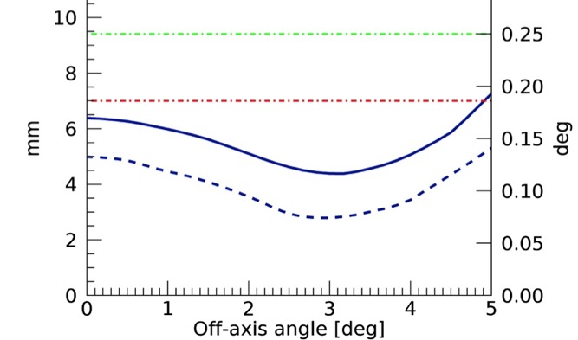
Segmentation and design
Geometrical area
Isocronicity
PSF
FOV
Ex 2: ASTRI and pSCT and the strong asphericity
In 2011 P. Conconi proposed to apply the polynomial optimization to the Schwazschild-Coude design to ASTRI Cherenkov telescopes.
ASTRI/CTA-SST telescope:
Very fast optics
Flat off-axis angular resolution
Very aspheric optics
Alignment
Giorgia Sironi – Bologna, 25 Jan 2026
Notes:
Con nichel ad angolo critico e 3.5 nm fa 54

Slide 24
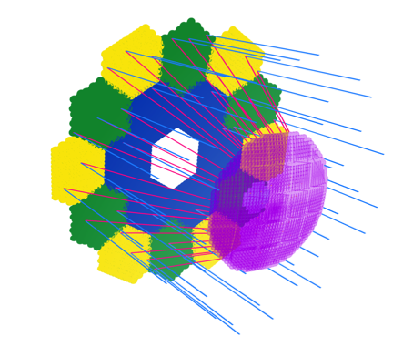
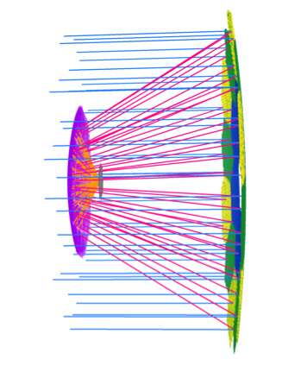
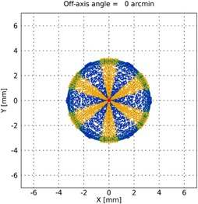
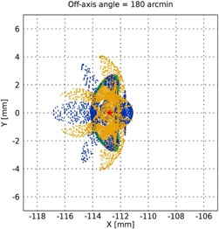
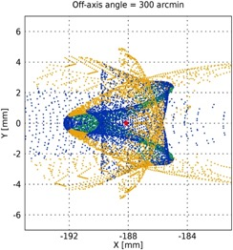
Segmentation and design
Geometrical area
Isocronicity
PSF
FOV
Ex 2: ASTRI and pSCT and the strong asphericity
In 2011 P. Conconi proposed to apply the polynomial optimization to the Schwazschild-Coude design to ASTRI Cherenkov telescopes.
ASTRI/CTA-SST telescope:
Very fast optics
Flat off-axis angular resolution
Very aspheric optics
Alignment
Giorgia Sironi – Bologna, 25 Jan 2026
Notes:
Con nichel ad angolo critico e 3.5 nm fa 54

Slide 25
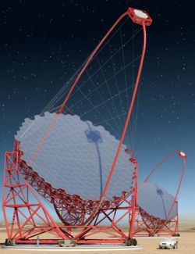
Segmentation and design
Geometrical area
Isocronicity
PSF
FOV
Ex 2: ASTRI and pSCT and the strong asphericity
In 2011 P. Conconi proposed to apply the polynomial optimization to the Schwazschild-Coude design to ASTRI Cherenkov telescopes.
ASTRI/CTA-SST telescope:
Very fast optics
Flat off-axis angular resolution
Very aspheric optic
Alignment
 | ASTRI | SSt-1M | LST
Diameter M1 | 4 m | 4 m | 23 m
Focal lenght | 2.15 m | 5.6 m | 28 m
Spostamento sul piano focale | 3.6 mm/0.1° | 6 mm/0.08° | 51 mm/0.1°
FOV | 9.6 deg | 9.1 deg | 4.5 deg
Camera Side | 35 cm | 88 cm | 2.5 m
Camera weight | 55 kg | 186 kg | 2000 kg
LST
Giorgia Sironi – Bologna, 25 Jan 2026
Long focal
Large camera
Defined FOV
Notes:
Con nichel ad angolo critico e 3.5 nm fa 54

Slide 26
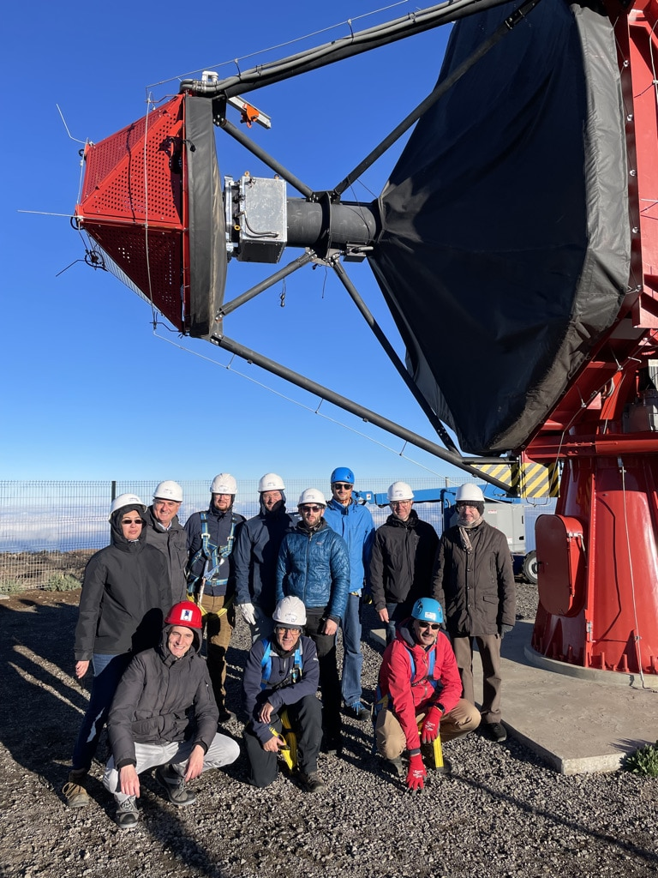
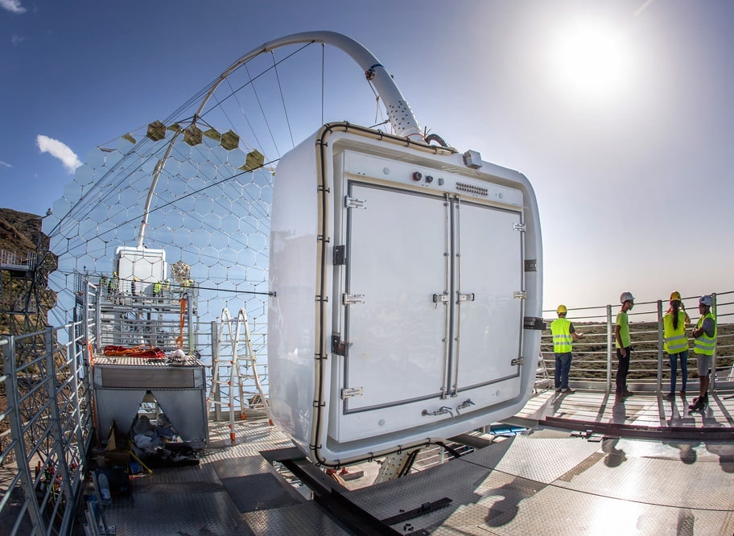
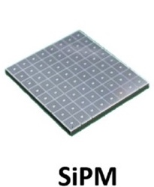
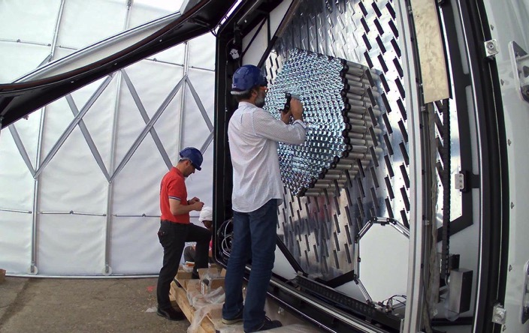
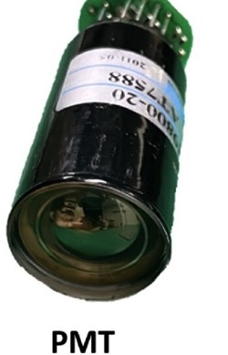
Segmentation and design
Geometrical area
Isocronicity
PSF
FOV
Ex 2: ASTRI and pSCT and the strong asphericity
LST
Long focal
Large camera
Giorgia Sironi – Bologna, 25 Jan 2026
Defined FOV
Long focal
Large camera
Defined FOV
Notes:
Con nichel ad angolo critico e 3.5 nm fa 54

Slide 27
Segmentation and manufacturing
Giorgia Sironi – Bologna, 25 Jan 2026

Slide 28
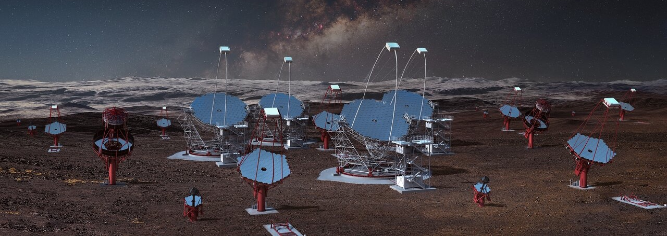
Segmentation and manufacturing
IACTs are large, uncovered, fast moving collectors
Segmented optics
Light weight
Cost-effective
Enormous number of mirrors to be produced
 | # Telescope @CTA-N | # Mirrors/ Telescope | # Mirrors @CTA-N
LST | 4 | 198 | 792
MST | 9 | 86 | 774
 | # Telescope @CTA-S | # Mirrors/ Telescope | # Mirrors @CTA-S
LST | 2 | 198 | 396
MST | 14 | 86 | 1204
SST | 37(42) | 18 | 666 (756)
# Telescope @ASTRI -MA | # Mirrors/ Telescope | # Mirrors @ASTRI-MA
9 (10) | 18 | 162 (180)
Giorgia Sironi – Bologna, 25 Jan 2026

Slide 29
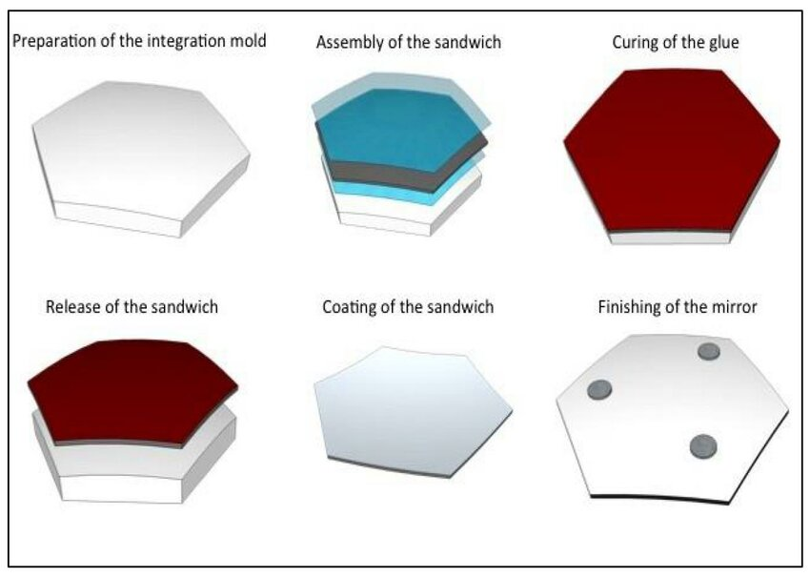
Segmentation and manufacturing
IACTs are large, uncovered, fast moving collectors
Segmented optics
Light weight
Cost-effective
Glass cold-slumping developed by INAF-Osservatorio Astronomico di brera and Media Lario
Giorgia Sironi – Bologna, 25 Jan 2026

Slide 30
Segmentation and manufacturing
IACTs are large, uncovered, fast moving collectors
Segmented optics
Light weight
Cost-effective
Glass cold-slumping developed by INAF-Osservatorio Astronomico di brera and Media Lario
Replica on few moulds: optical polishing of a small number of workpieces
ASTRI
CTA-LST
18 segments
3 aspherical moulds
198 segments
3 spherical moulds
Capable to mimic the parabolic response thanks to segmentation
Giorgia Sironi – Bologna, 25 Jan 2026

Slide 31
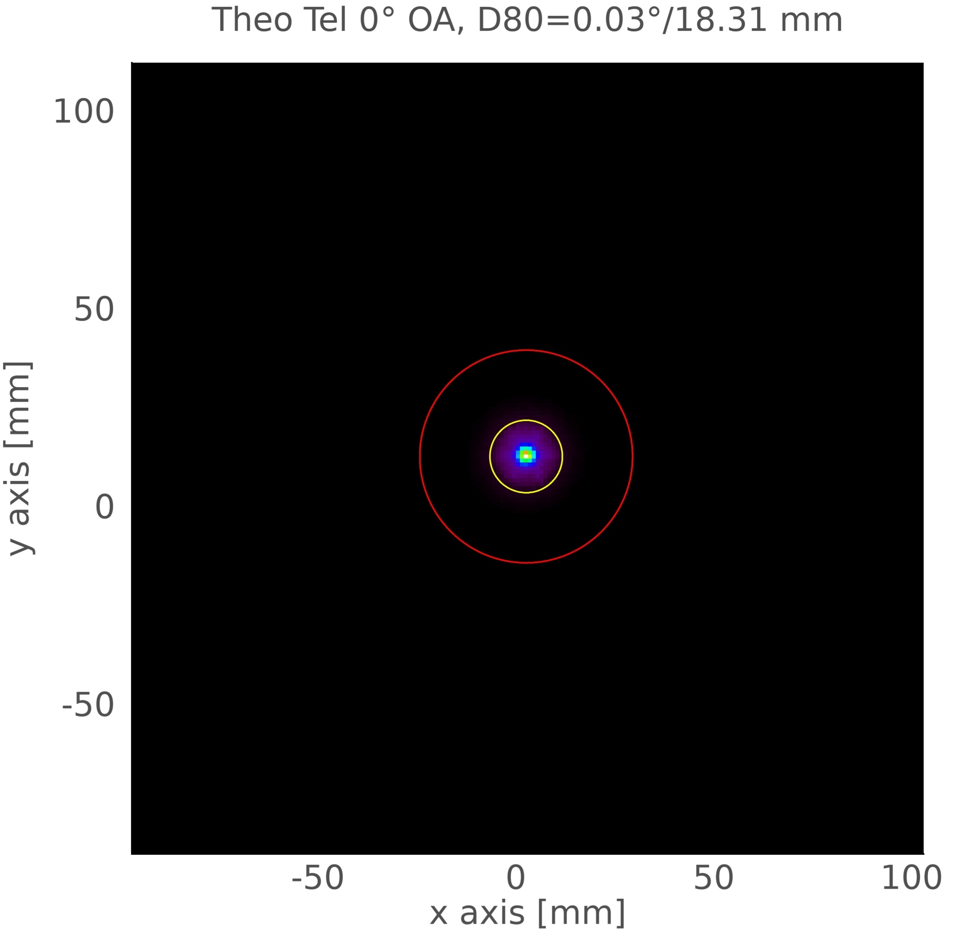
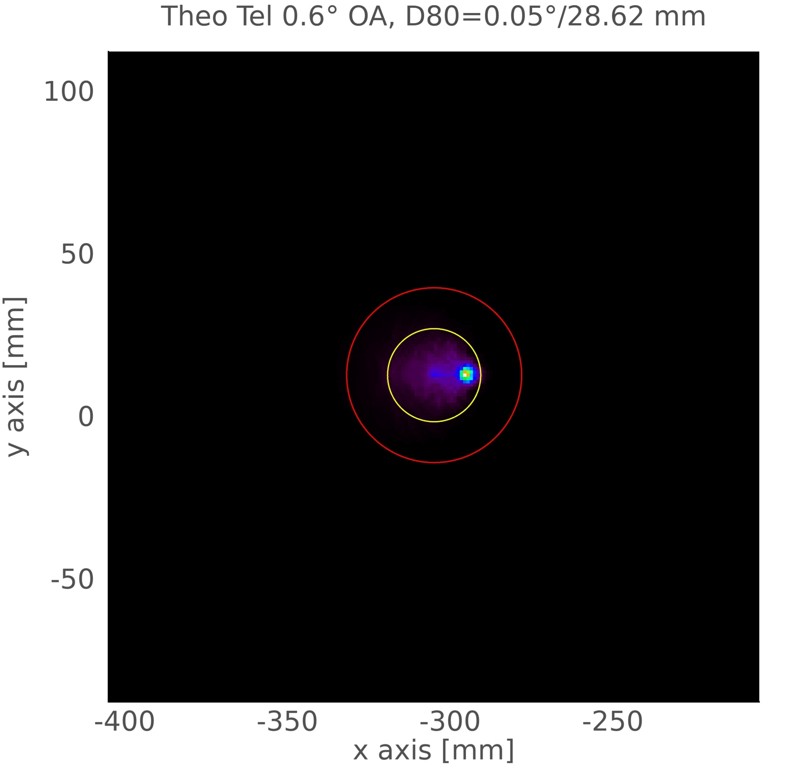




Segmentation and manufacturing
IACTs are large, uncovered, fast moving collectors
Segmented optics
Light weight
Cost-effective
Glass cold-slumping developed by INAF-Osservatorio Astronomico di brera and Media Lario
Replica on few moulds: fine lavoration of a small number of workpieces
Maintain the glass native roughness – no additional scattering
CTA-LST
Theoretical response
CTA-LST
Theoretical response
+ 30’’ roughness
Giorgia Sironi – Bologna, 25 Jan 2026

Slide 32


Segmentation and manufacturing
IACTs are large, uncovered, fast moving collectors
Segmented optics
Light weight
Cost-effective
2011 – Progetto Bandiera ASTRI – INAF started the end-to-end production of ASTRI-Horn
Giorgia Sironi – Bologna, 25 Jan 2026

Slide 33






Segmentation and manufacturing
ASTRI mirrors brought cold slumping technology to the limit:
Height/dimension ratio is very strong (12 mm/900mm)
RoC in the range 9-11 m
Corona 1
Corona 2
Corona 3
Corona 1
Focus at 7154mm
Corona 2
Focus at 7612mm
Corona 3
Focus at 7901mm
~ 8.5 cm
~ 50 cm
~ 100 cm
PV 4.5 mm - Rms 800 µm
PV 2.8 mm – Rms 670 µm
PV 5.7 mm – Rms 972 µm
849 mm
980 mm
Not accurate enough to be measured with CGH interferometry (100-200 µm PV)
Too big to be measured by means of a single point profiler with a spatial resolution in the millimeter scale in a cost-effective time
12 mm
Giorgia Sironi – Bologna, 25 Jan 2026

Slide 34




Segmentation and manufacturing
ASTRI mirrors required specific metrology to fast verify the shape error with high resolution
Deflectometry lab: just TV+camera …. and a lot of analysis
Giorgia Sironi – Bologna, 25 Jan 2026

Slide 35
Segmentation and alignment
Giorgia Sironi – Bologna, 25 Jan 2026

Slide 36





Segmentation and alignment
Segments have to be co-focused at focal plane
Number of involved segments
Shape of the involved segments
CTA-LST
198 segments to be moved in tip/tilt
Spherical shape → aligned in a common point on-axis
Giorgia Sironi – Bologna, 25 Jan 2026

Slide 37

Segmentation and alignment
Segments have to be co-focused at focal plane
Number of involved segments
Shape of the involved segments
ASTRI/CTA-SST
18 segments to be moved
Aspherical shape → aligned to form a specific image in-axis
Giorgia Sironi – Bologna, 25 Jan 2026

Slide 38
Segmentation and alignment
Segments have to be co-focused at focal plane
Number of involved segments
Shape of the involved segments
ASTRI/CTA-SST
18 segments to be moved
Aspherical shape → aligned to form a specific image in-axis
Giorgia Sironi – Bologna, 25 Jan 2026

Slide 39






Segmentation and alignment
Segments have to be co-focused at focal plane
Number of involved segments
Shape of the involved segments
Corona1 – 1 mirror
Corona2 – 1 mirror
Corona3 – 1 mirror
89.7%
91.2%
90.1%
Corona1 – 6 mirror
Corona2 – 6 mirrors
Corona3 - mirrors
ASTRI/CTA-SST
18 segments to be moved
Aspherical shape → aligned to form a specific image in-axis
92.2%
85.6%
91.6%
Giorgia Sironi – Bologna, 25 Jan 2026

Slide 40


Segmentation and alignment
Segments have to be co-focused at focal plane
Number of involved segments
Shape of the involved segments
Final alignment check and D80 across the FOV for ATRI-Horn telescope
E. Giro, R. Canestrari, G. Sironi et al, A&A Volume 608, December 2017 https://doi.org/10.1051/0004-6361/201731602)
ASTRI/CTA-SST
18 segments to be moved
Aspherical shape → aligned to form a specific image in-axis
Giorgia Sironi – Bologna, 25 Jan 2026

Slide 41
Segmentation and defocusing
Giorgia Sironi – Bologna, 25 Jan 2026

Slide 42
Maximum Solar Concentration Telescopes
Segmentation and defocusing
IACTs are light concentrators with no domes
fire accident is a real issue
Maximum Solar Concentration Telescopes should never concentrate sun light to power densities above a defined limit…Areas and times at which excess of power densities occur must be identified and clearly documented by telescope providers
For a single parking position mirrors will be illuminated by sunlight for a certain period
LST geometrical area is very large
Solar concentration shall be studied in terms of power density and involved areas
Giorgia Sironi – Bologna, 25 Jan 2026

Slide 43


Considering the Sun path at CTA South site
Segmentation and defocusing
IACTs are light concentrators with no domes
fire accident is a real issue
Parking position is toward the pole
From equinox to winter solstice the Sun illuminates LST dish at dawn and sunset
Worst case is December
https://www.sunearthtools.com/dp/tools/pos_sun.php?lang=it
Giorgia Sironi – Bologna, 25 Jan 2026

Slide 44



Segmentation and defocusing
IACTs are light concentrators with no domes
fire accident is a real issue
Simulation od pawer densities obtained by Ray-tracing
Hot area close to the dish
Hot spots on air 7-8 a.m.
Hot spots on ground 8-9 a.m.
21 December
Time | Elevation | Azimuth | Power [kW]
07:00:00 | 14.01 | 109.67 | 73.4
08:00:00 | 27.02 | 104.93 | 71.3
09:00:00 | 40.32 | 100.68 | 56.4
Hot spots on air
Concentration area on the ground
Giorgia Sironi – 2nd CTAO Summer School, La Palma, 21 June 2025

Slide 45




Segmentation and defocusing
IACTs are light concentrators with no domes
fire accident is a real issue
Possible solution
Change the parking position during the year: the camera parking support structure will be complicated
Use segmentation to defocus the mirrors
Each mirror can be tip/tilted to avoid solar concentration
Giorgia Sironi – Bologna, 25 Jan 2026

Slide 46
Conclusions
Giorgia Sironi – Bologna, 25 Jan 2026

Slide 47
The beauty of science
Tessellation enabled technological solutions in
Optical design
Manufacturing Technologies
Metrological solutions
Validation and operative procedures
Giorgia Sironi – Bologna, 25 Jan 2026

Slide 48

The beauty of science
ASTRI-Horn mirrors surrounding Ebe by Antonio Canova (1804) at Palazzo Citterio-Grande Brera
Giorgia Sironi – Bologna, 25 Jan 2026

