Slide 1
Serial Code Porting on HPC & Quantum Computing
D. Caputo – R. Nembrini – M. Innocenti – A. Ballarin
Spoke 3 III Technical Workshop, Perugia 26-29 Maggio, 2025
ICSC Italian Research Center on High-Performance Computing, Big Data and Quantum Computing
Missione 4 • Istruzione e Ricerca
Notes:
Cover

Slide 2
Scientific Rationale
Implementation of Machine Learning (ML) Algorithms available in Open Source versions in languages suitable for:
High-Performance Computing (HPC)
Quantum Computing
The objective is the development of systems based on ML algorithms for the purpose of cyber attack prediction (KeepCalm Project).
HPC and Quantum Computing environments would enable faster response times to cyber attacks, thereby enhancing reactive capabilities—an essential aspect in the field of cybersecurity.
ICSC Italian Research Center on High-Performance Computing, Big Data and Quantum Computing
Missione 4 • Istruzione e Ricerca
Notes:
Template e guide lines

Slide 3
Technical Objectives, Methodologies and Solutions
Development of an environment to support the prediction and early identification of cyber threats:
Near real-time response
Increased resilience against individual threats
Design of a Methodological Framework to guide the porting of traditionally serial code to High-Performance Platforms
Efforts will also focus on identifying and unifying the development phases shared between HPC and Quantum Computing architectures. The aim is to streamline workflows, reduce redundancy, and promote a coherent approach to hybrid computing system development.
ICSC Italian Research Center on High-Performance Computing, Big Data and Quantum Computing
Missione 4 • Istruzione e Ricerca
Notes:
Template e guide lines

Slide 4
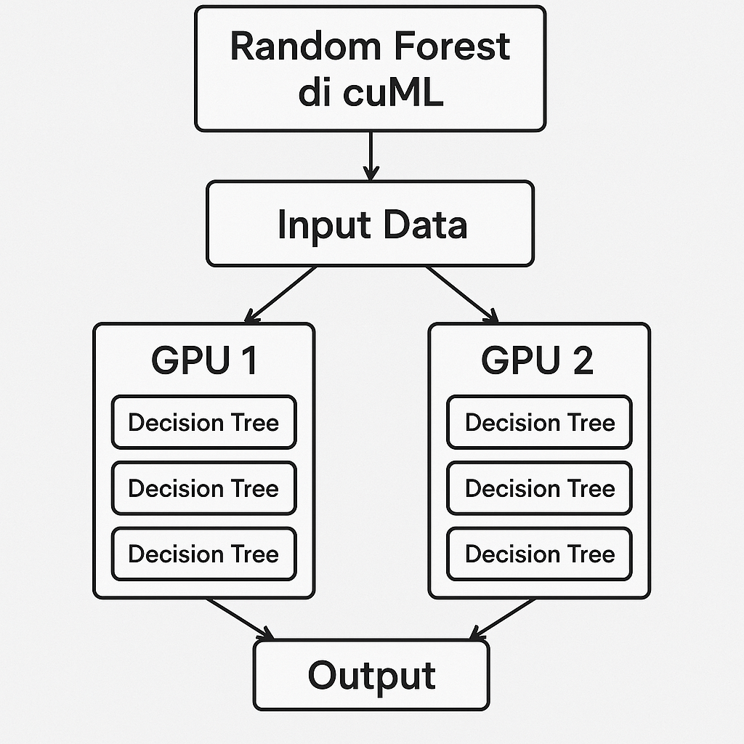
Random Forest with 2 GPU
🔁 The Working Flow
Input: GPU data is loaded and prepared with the open source library cuDF.
Distribution: cuML (CUDA Machine Learning) assigns half of the trees to each GPU.
Parallel: Each GPU indipendently builds its own trees.
Ensemble: Predictions are aggregate → majority vote (classification) or average (regression).
Final Output Combined result is sent to the client
✅ Natively parallel approach: no synchronization during tree building, only at the end.
ICSC Italian Research Center on High-Performance Computing, Big Data and Quantum Computing
Missione 4 • Istruzione e Ricerca
Notes:
Template e guide lines

Slide 5
cuML Random Forest – Model Performance per Attack Type
Attack category | Train time (Seconds) | Test time (Seconds) | accuracy | F1 malicious | Precision malicious | Recall malicious
All-category | 5.42 | 2.593 | 0.99413 | 0.97648 | 0.98061 | 0.97238
dos | 1.17 | 1.6265 | 0.99868 | 0.98616 | 0.98369 | 0.98865
fuzzers | 1.32 | 1.7736 | 0.98927 | 0.89854 | 0.81744 | 0.9975
exploits | 1.96 | 1.9215 | 0.99846 | 0.98391 | 0.98039 | 0.98745
generic | 5.3 | 2.4506 | 0.99973 | 0.99854 | 0.99955 | 0.99752
reconnaissance | 1.1 | 1.7782 | 0.99931 | 0.99274 | 0.99147 | 0.99401
analysis | 0.89 | 1.5837 | 0.99875 | 0.98704 | 0.97442 | 1.0
shellcode | 0.64 | 1.1003 | 0.99917 | 0.99138 | 0.98291 | 1.0
backdoor | 0.73 | 1.741 | 0.99919 | 0.99155 | 0.98876 | 0.99435

Slide 6
XGBOOST – Model Performance per Attack Type
Attack category | Train time (Seconds) | Test time (Seconds) | accuracy | F1 malicious | Precision malicious | Recall malicious
All-category | 29.16 | 0.9556 | 0.99454 | 0.97803 | 0.98647 | 0.96974
dos | 3.8 | 0.2118 | 0.99892 | 0.98866 | 0.98742 | 0.98991
fuzzers | 4.83 | 0.2369 | 0.98991 | 0.90149 | 0.84246 | 0.96942
exploits | 9.75 | 0.3844 | 0.99876 | 0.98695 | 0.98662 | 0.98728
generic | 27.57 | 0.9453 | 0.99988 | 0.99933 | 0.99961 | 0.99904
reconnaissance | 3.53 | 0.2029 | 0.99953 | 0.99508 | 0.99572 | 0.99444
analysis | 0.75 | 0.1151 | 0.9983 | 0.98212 | 0.98095 | 0.98329
shellcode | 0.44 | 0.0999 | 0.99938 | 0.99352 | 0.98712 | 1.0
backdoor | 0.63 | 0.1085 | 0.99946 | 0.99437 | 0.99157 | 0.99718

Slide 7
Stochastic Gradient Descent – Model Performance per Attack Type
Attack category | Train time (Seconds) | Test time (Seconds) | accuracy | F1 malicious | Precision malicious | Recall malicious
All-category | 36.35 | 1.2183 | 0.98842 | 0.9545 | 0.94046 | 0.96897
dos | 4.95 | 0.0024 | 0.99634 | 0.96112 | 0.97165 | 0.95082
fuzzers | 5.33 | 0.0028 | 0.98869 | 0.89331 | 0.8111 | 0.99407
exploits | 11.41 | 0.0072 | 0.9951 | 0.94892 | 0.94195 | 0.95598
generic | 33.9 | 0.0224 | 0.99908 | 0.99492 | 0.99784 | 0.99203
reconnaissance | 4.54 | 0.0021 | 0.99467 | 0.94587 | 0.91523 | 0.97862
analysis | 3.79 | 0.0018 | 0.99795 | 0.97872 | 0.96956 | 0.98807
shellcode | 3.38 | 0.0014 | 0.9971 | 0.97046 | 0.94262 | 1.0
backdoor | 3.36 | 0.0014 | 0.99651 | 0.96328 | 0.96328 | 0.96328

Slide 8
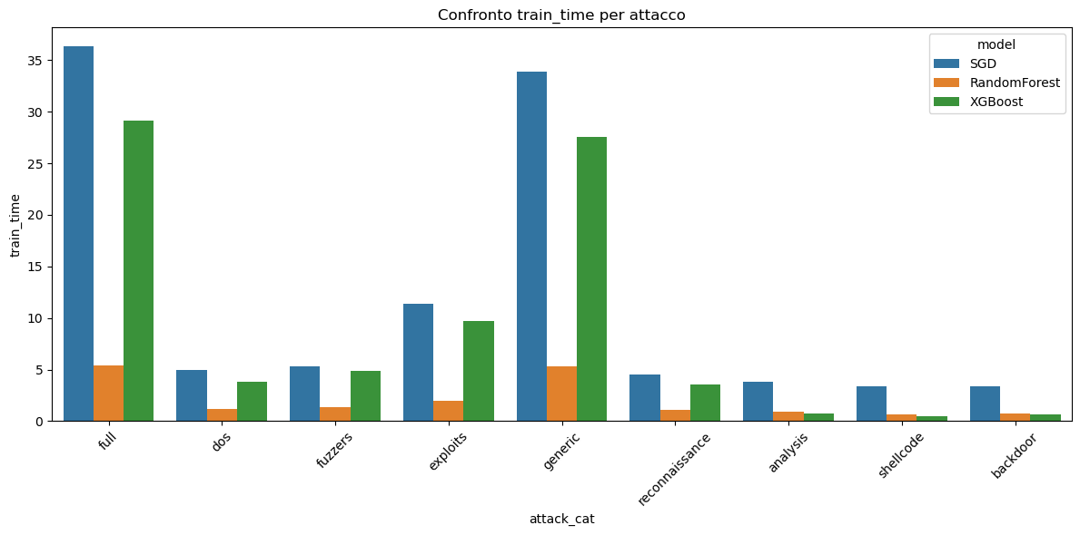
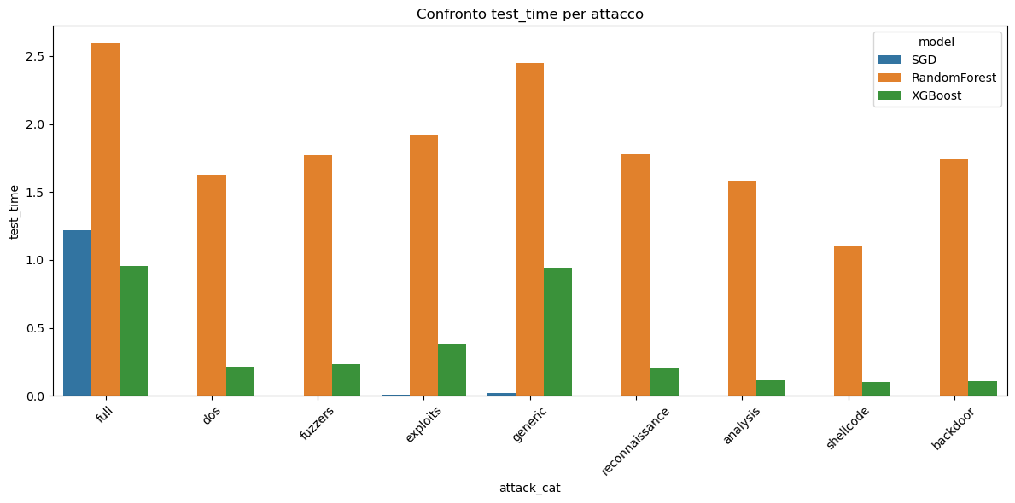
Result Comparison per Attack Type - Timing

Slide 9
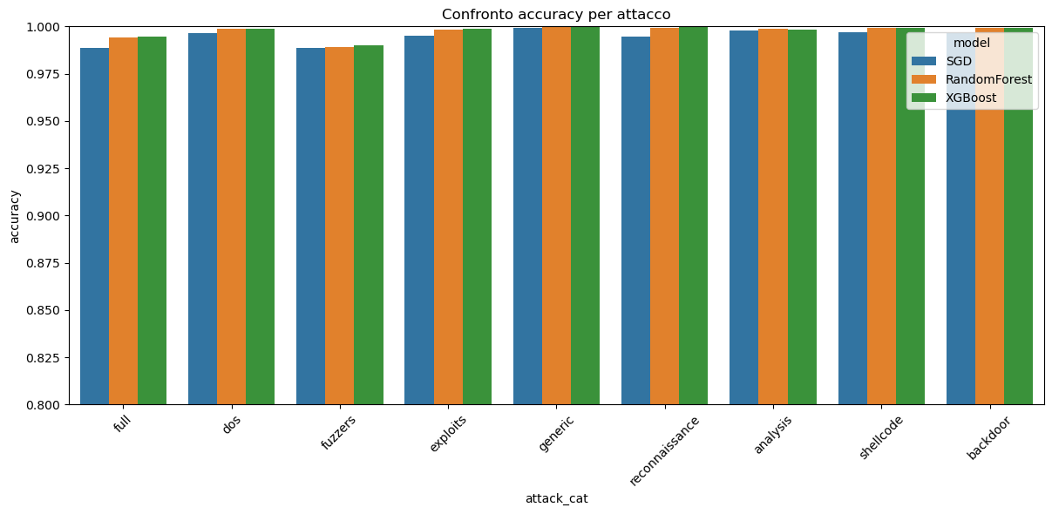
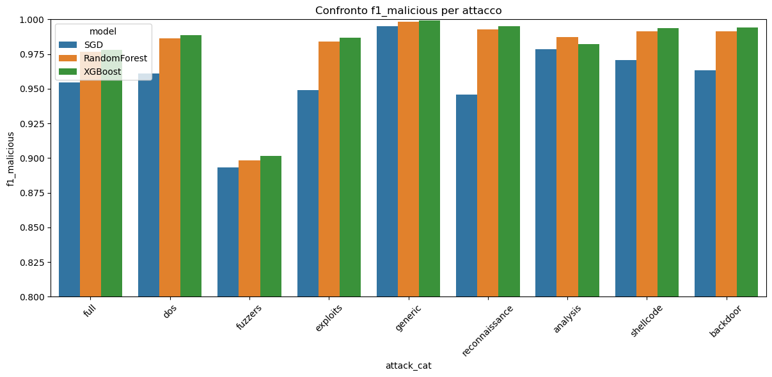
Result Comparison per Attack Type - Metrics

Slide 10
GNN (E-Graph Sage) – Distributed GNN Graph vs Dataset partitioning
In the distributed scenario, two approaches were employed for dataset loading:
The first involves partitioning the graph into two subgraphs, each allocated to a separate GPU.
The second entails dividing the dataset into two segments, with a distinct graph generated for each segment.

Slide 11
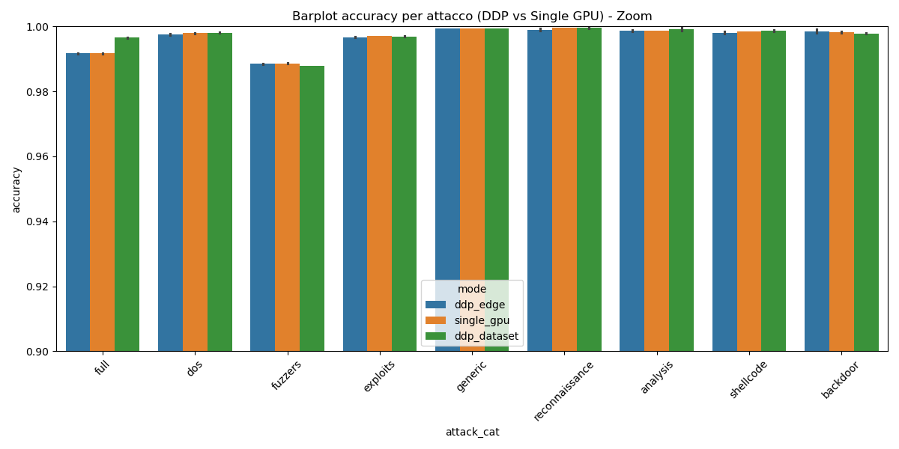
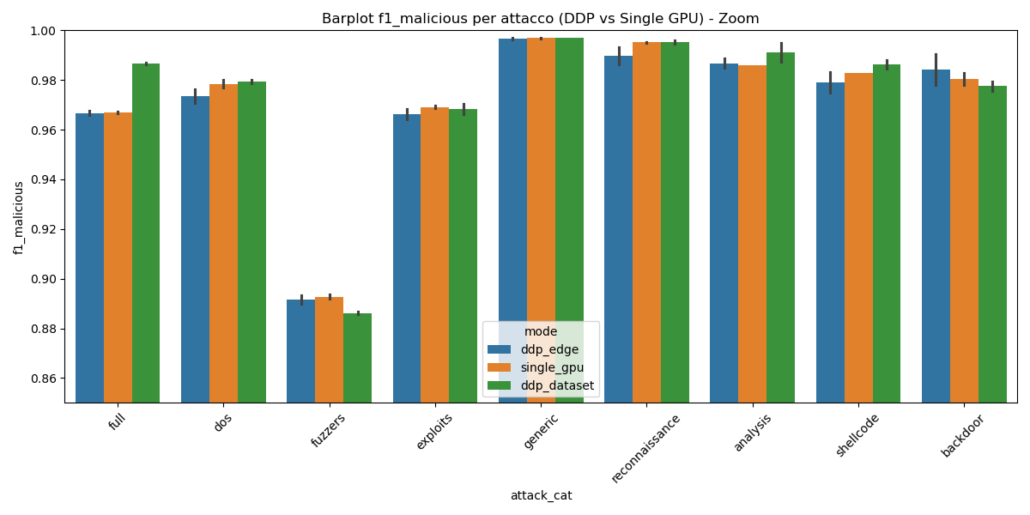
GNN (E-Graph Sage) – Average of results over 5 runs with distinct initializations
Attack category | mode | accuracy | F1 malicious | Precision malicious | Recall malicious | Train time (seconds) | Test time (seconds) | Peak memory (Megabyte)
full | ddp_edge | 0.9917 | 0.9668 | 0.9694 | 0.9642 | 68.5 | 0.5823 | 10728.87
full | ddp_data | 0.9966 | 0.9866 | 0.9778 | 0.9956 | 58.426 | 0.5103 | 8801.92
full | single_gpu | 0.9917 | 0.9669 | 0.9666 | 0.9671 | 102.406 | 0.6376 | 16139.82

Slide 12
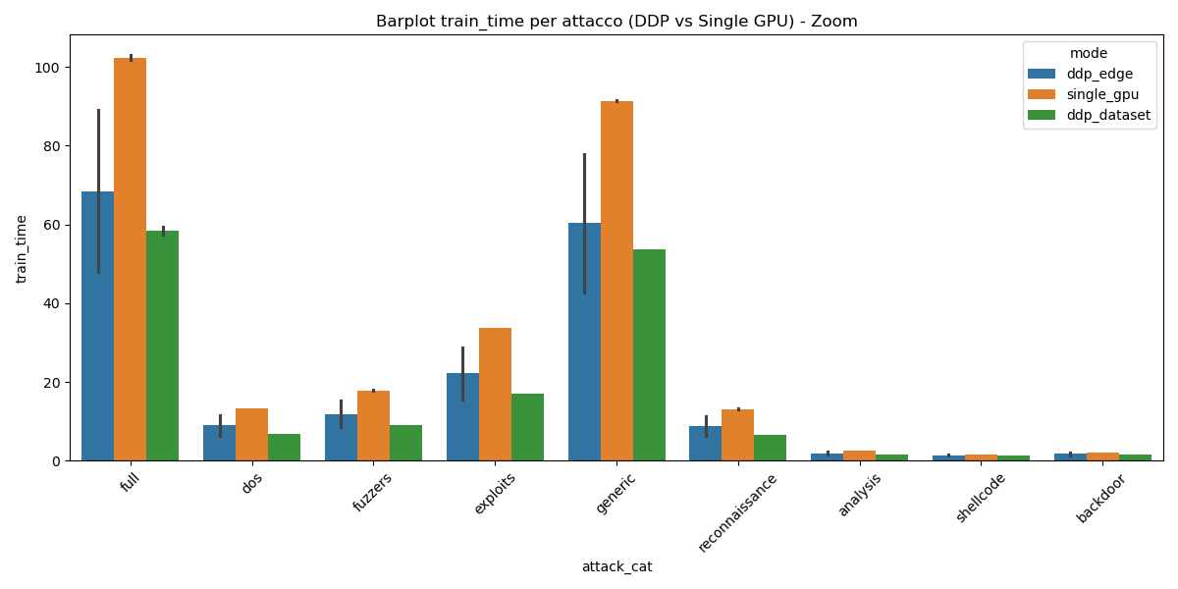
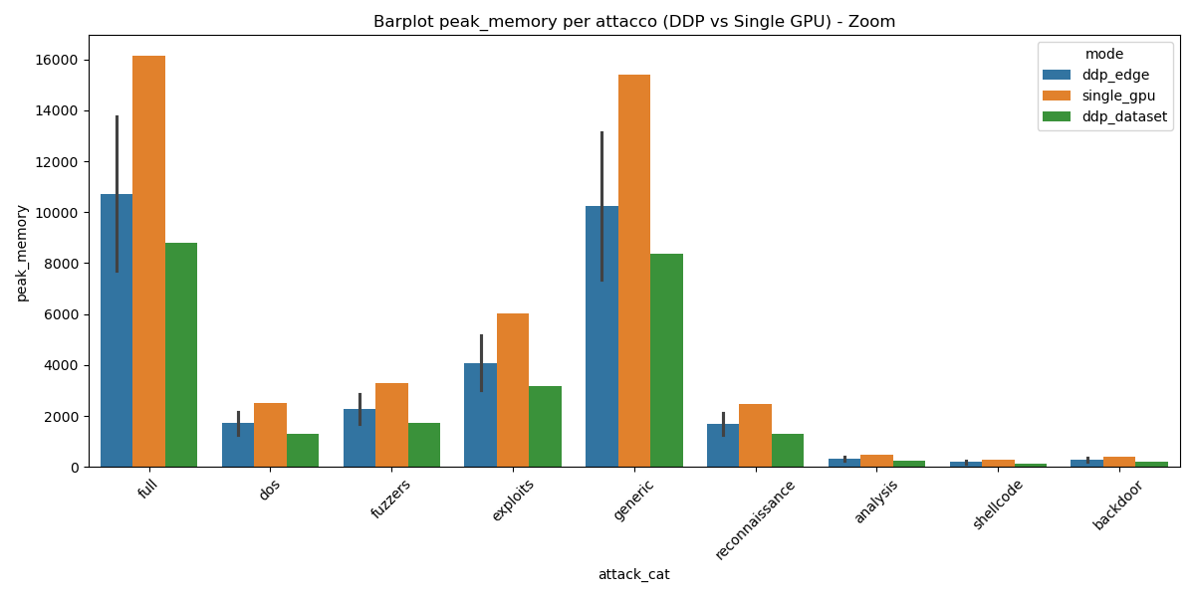
TRAINING TIME (sec)
Single gpu, distributed graph and dataset partitioning
MEMORY ALLOCATION (MB) Single gpu, distributed graph and dataset partitioning

Slide 13
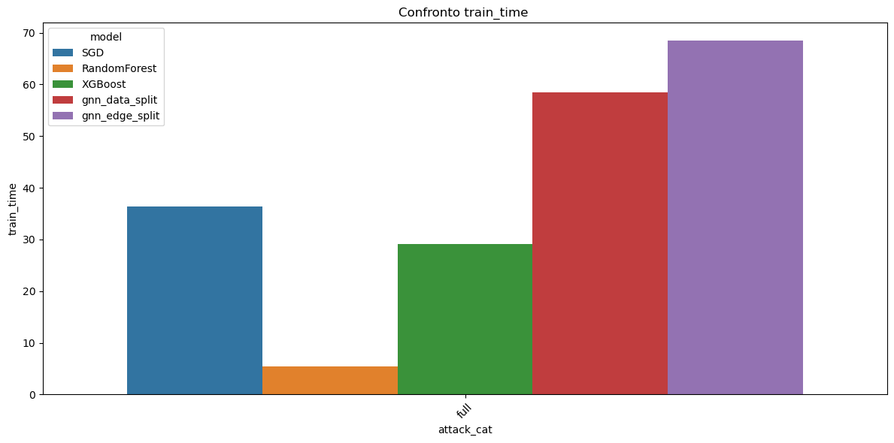
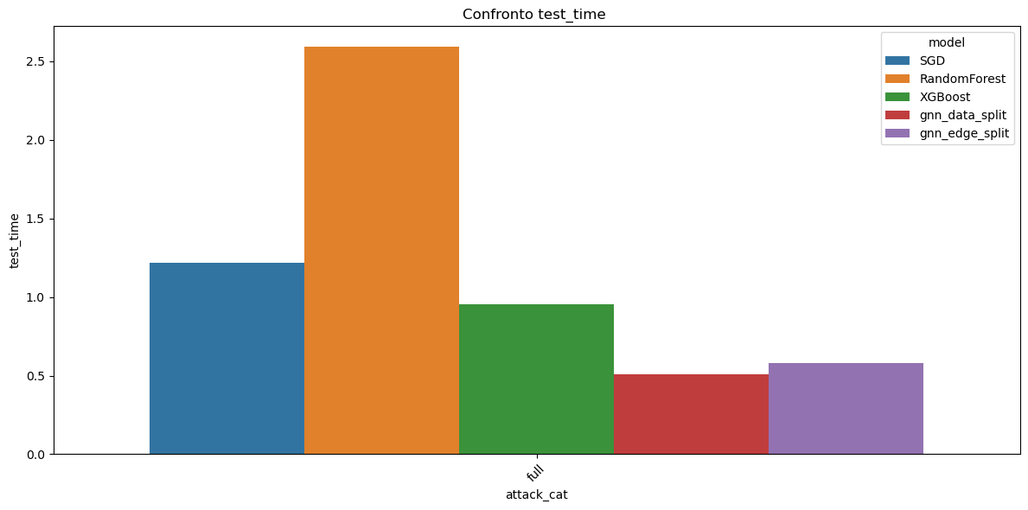
A comparison among the five models - Timing

Slide 14
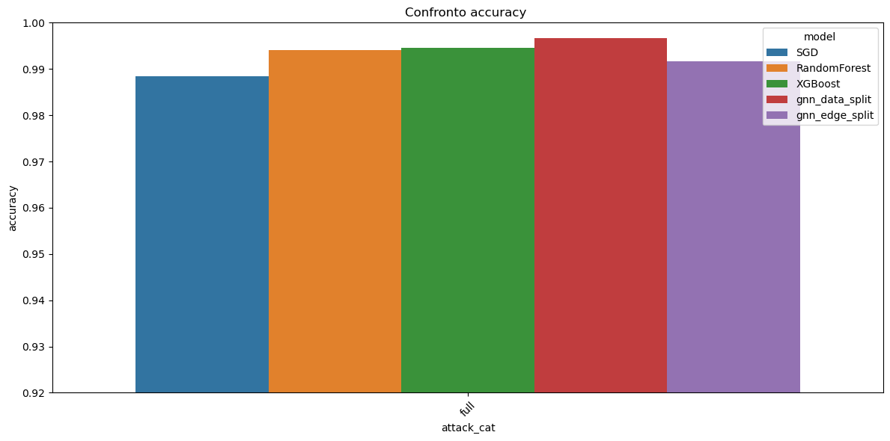
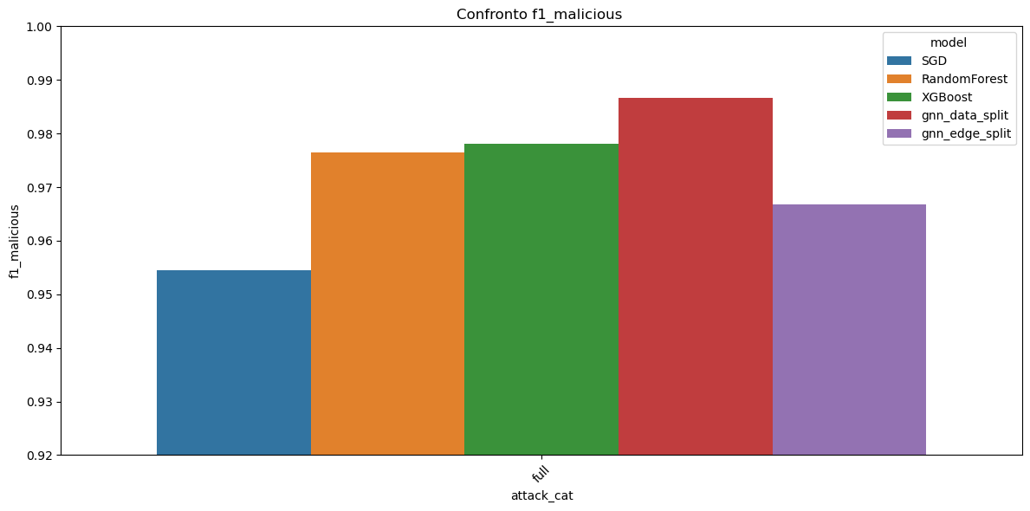
A comparison among the five models - Metrics

Slide 15
The Quantum Computation Approach
Quantum Computing (QC) as a Support to Classical Computation
- An acceleration tool for computations, similar to High Performance Computing (HPC)
- The porting of an algorithm cannot be performed in the same way: QC introduces a computational and programming paradigm that is fundamentally different from classical and parallel approaches.
Quantum Annealing (QA) for Solving Combinatorial Optimization Problems
- Formulate the problem as a Quadratic Unconstrained Binary Optimization (QUBO)
- Map the logical problem to the quantum hardware
- Solve the problem (typical solution time ≈ 20μs)

Slide 16
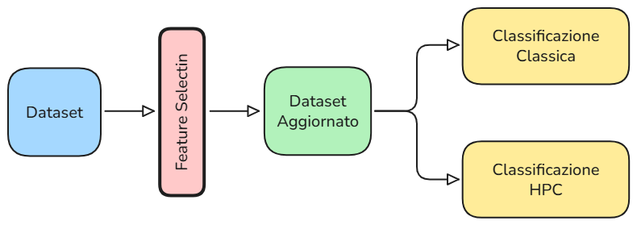
The Quantum Annealing Way
Quantum Annealing (QA) for Feature Selection (FS) in Classification Tasks Feature selection can assist in identifying the most relevant features, improving the efficiency and performance of model training.

Slide 17
The Quantum Annealing Way
Feature Selection via Quantum Annealing Using Three Models [1]:
MIQUBO, based on Mutual Information
Maximize the MI between selected features $f$ and the target variable $y$ as well as the conditional MI between a feature and the target, given other selected features
QUBO Correlation, based on Pearson Correlation
Maximize the correlation between the selected features and the target variable, as well as minimize the correlation between selected features.
QUBO Boosting, based on Support Vector Classifiers
Estimation of the information content of a feature based on the predictions computed by a classifier using only that feature. Selection is based on correlation between predicted label $h$ and target variable.
Preliminary experiments underway on the dataset using Simulated Annealing
[1] Maurizio Ferrari Dacrema, Fabio Moroni, Riccardo Nembrini, Nicola Ferro, Guglielmo Faggioli, and Paolo Cremonesi. 2022.
Towards Feature Selection for Ranking and Classification Exploiting Quantum Annealers.

