Slide 1
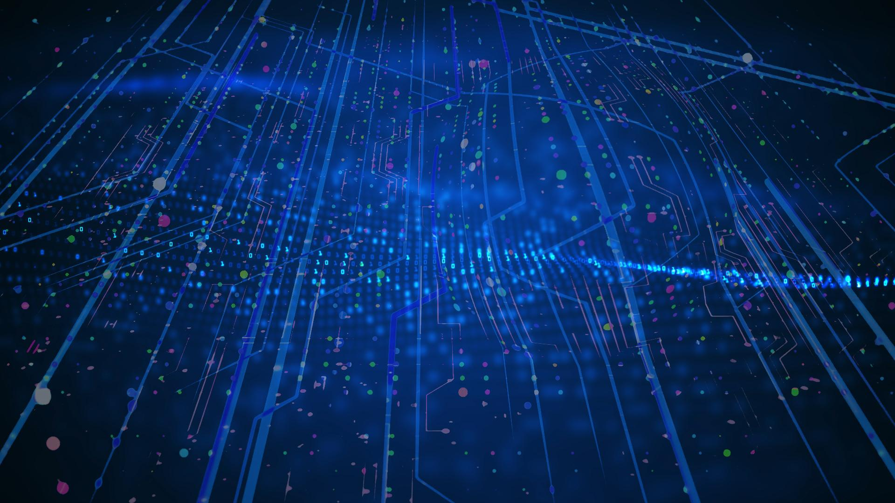

Implementation of Machine Learning algorithms on low power real time hardware devices for future space missions
A. Abba, V. Arosio, F. Caponio, S. Carsi, A. Giannini
Spoke: F. Gargano, F. Cuna, M. Bossa
Spoke 3 III Technical Workshop, Perugia 26-29 Maggio, 2025
ICSC Italian Research Center on High-Performance Computing, Big Data and Quantum Computing
Missione 4 • Istruzione e Ricerca
Notes:
Cover

Slide 2
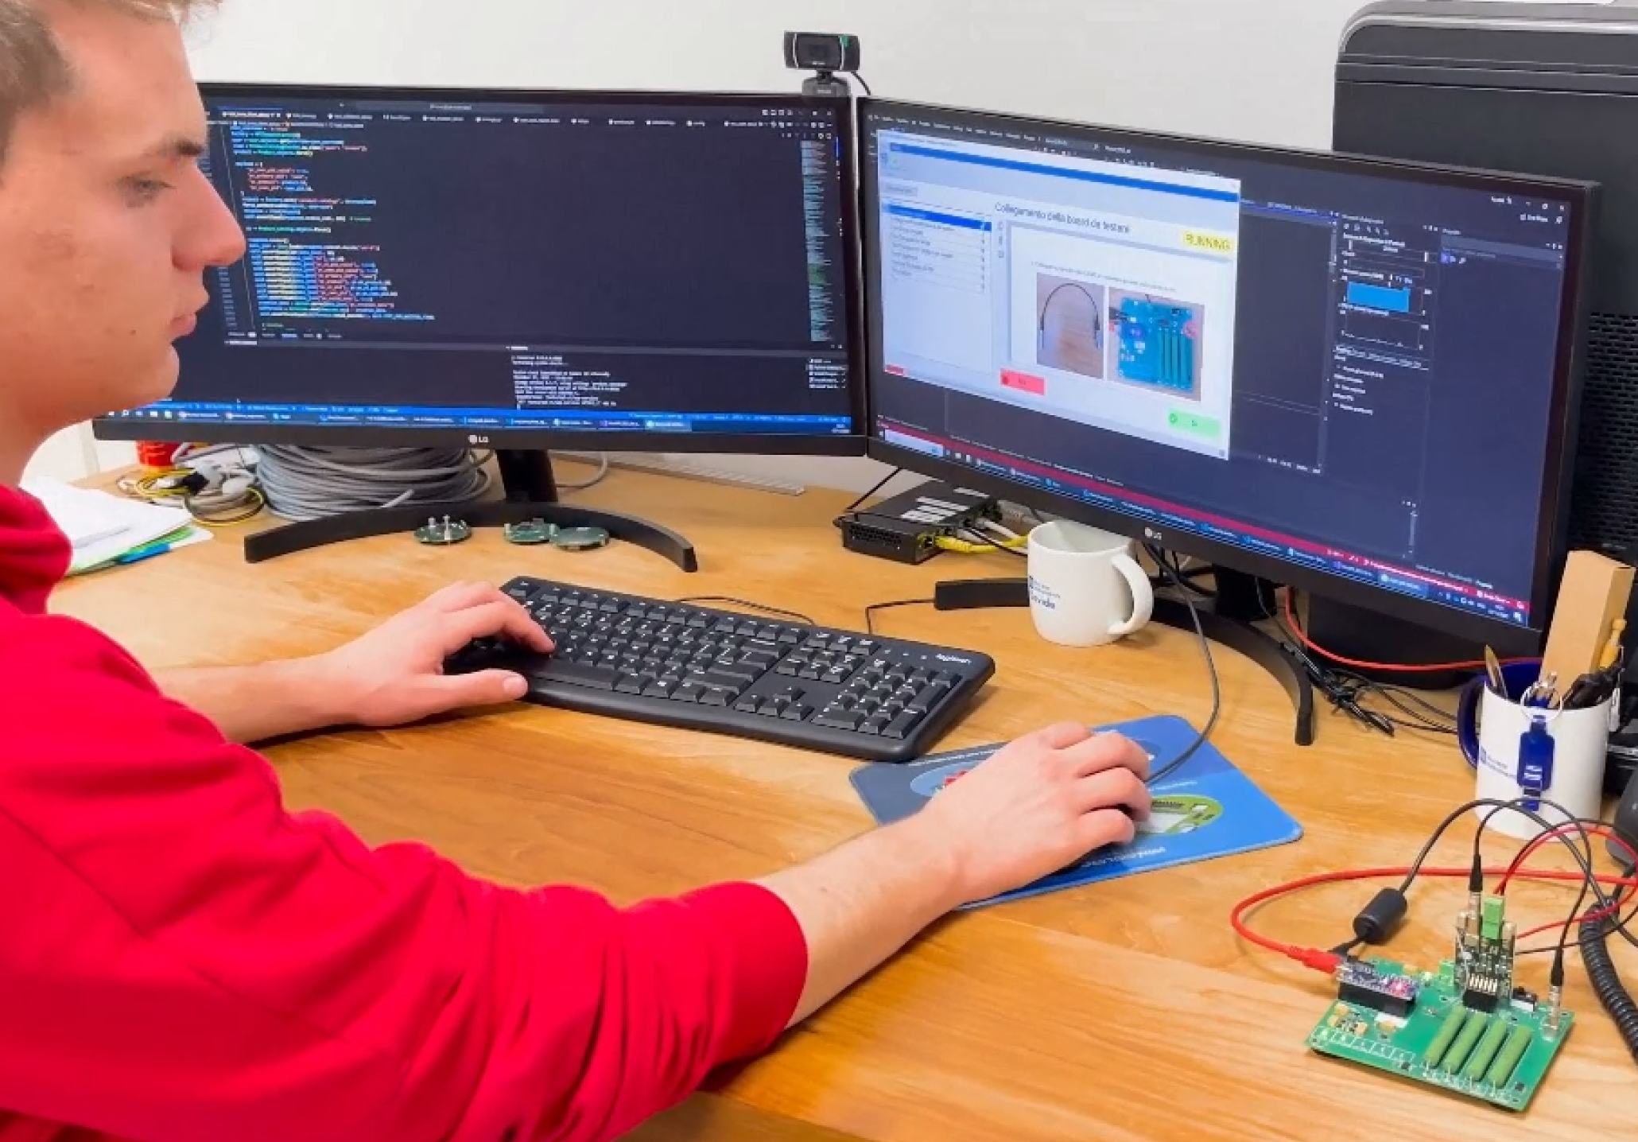

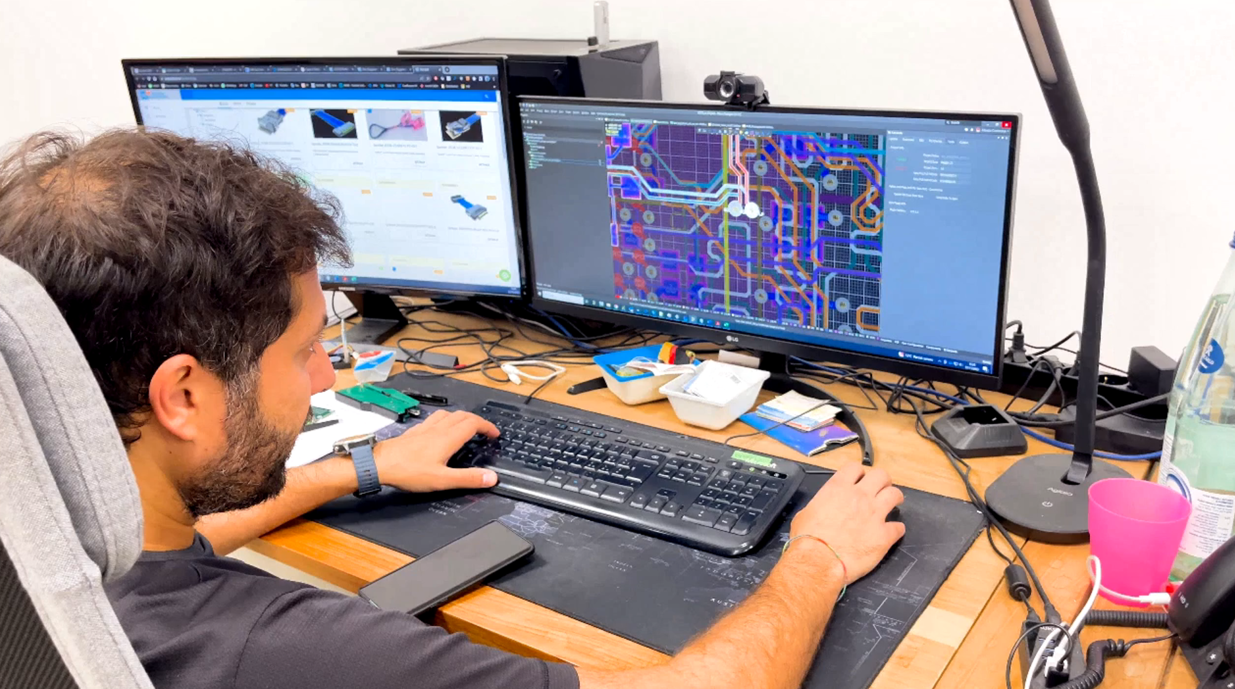
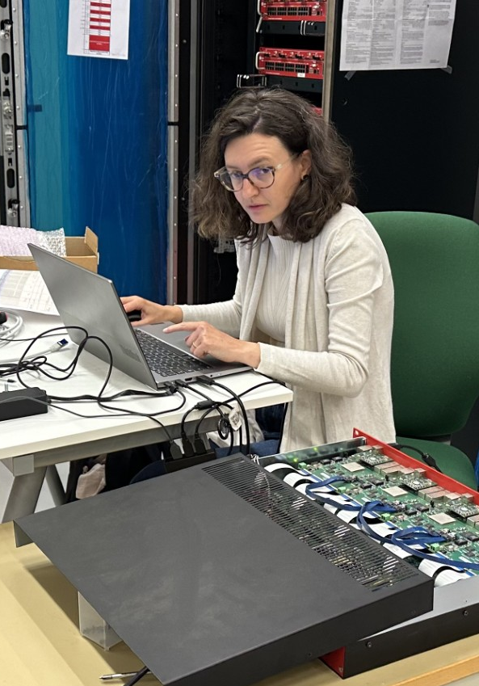
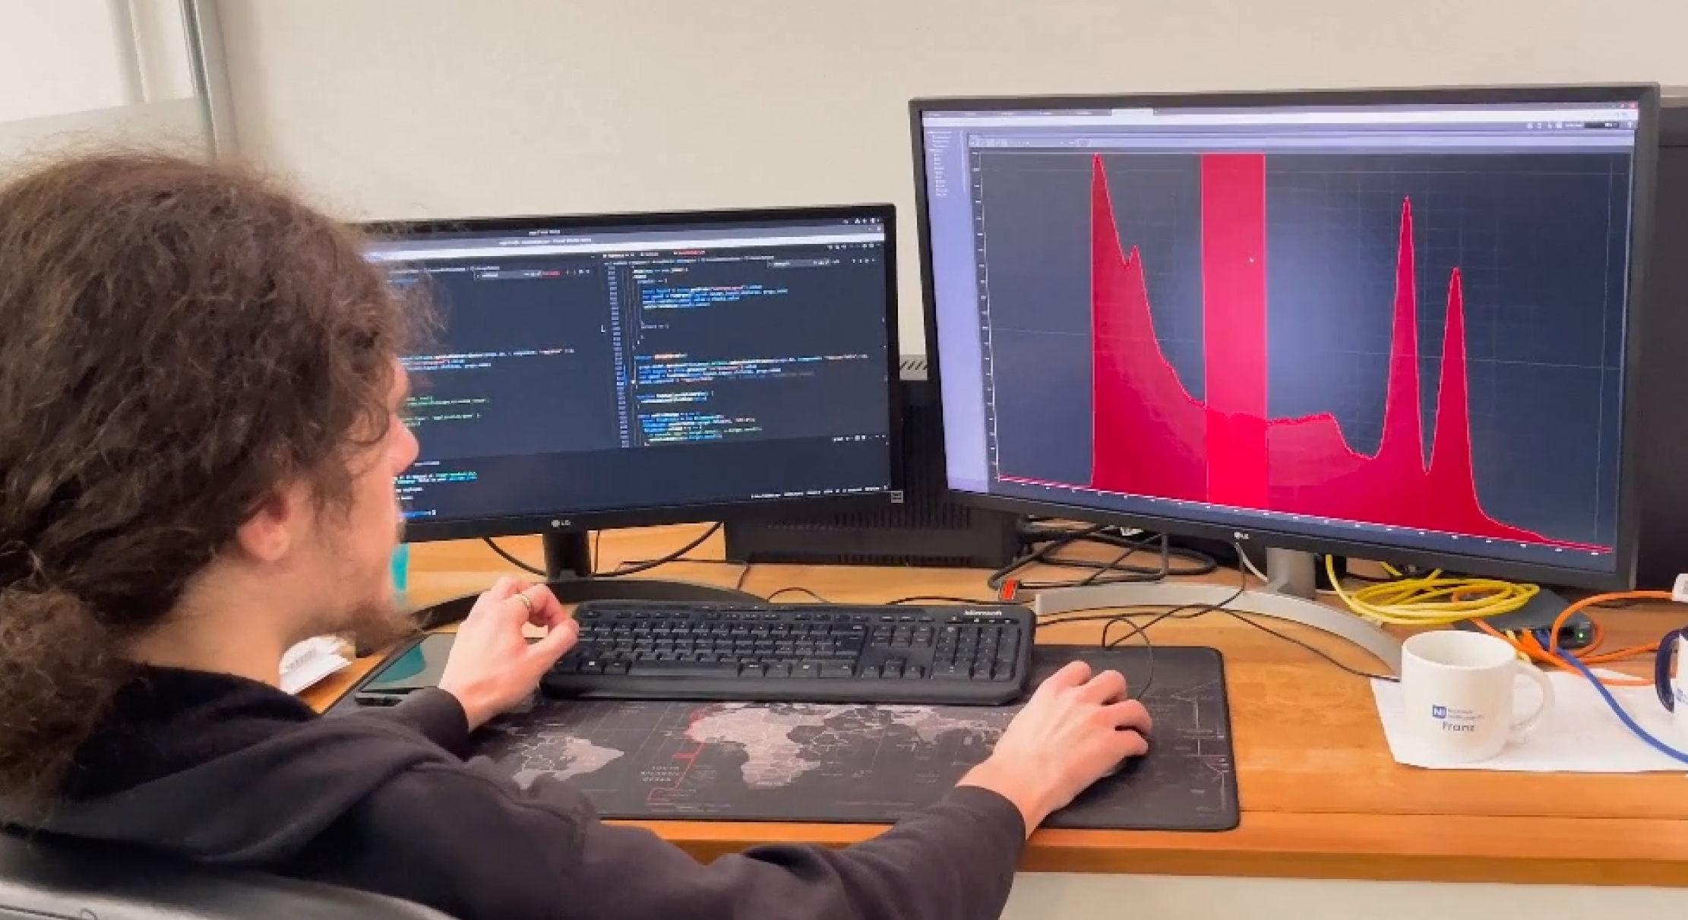
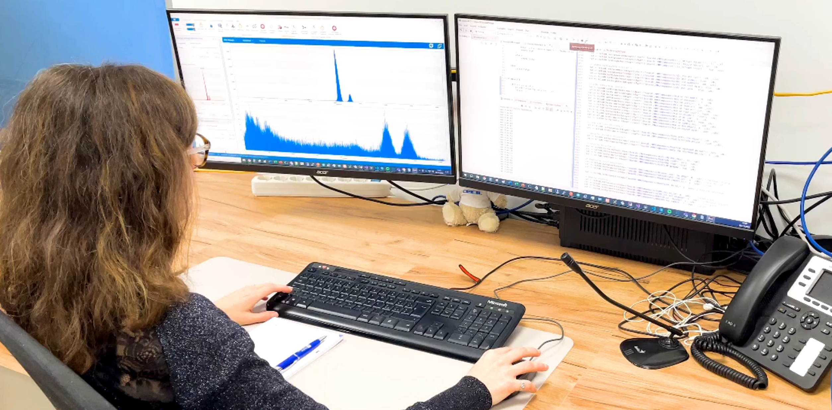
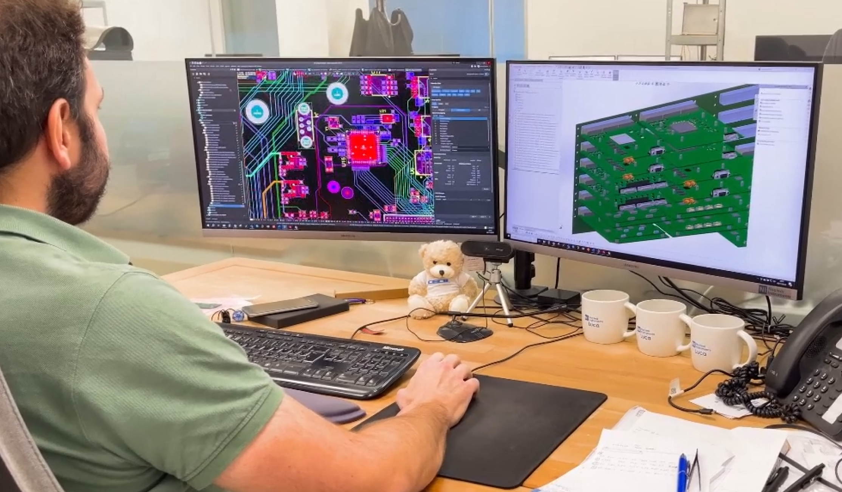
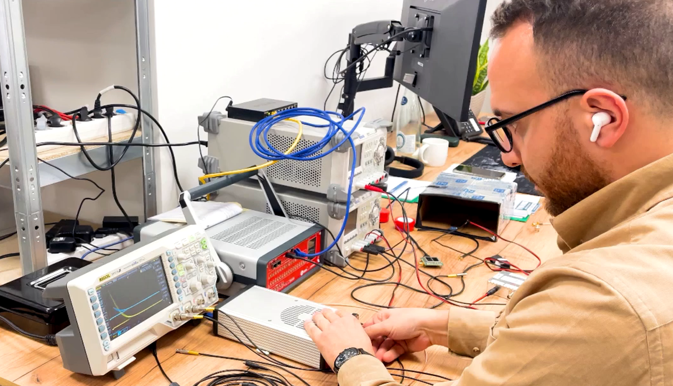

Nuclear Instruments
Who we are
an outstanding Italian company
  Team of highly qualified young engineers, physicists, and computer scientists (22 people)
Our mission
Design and develop advanced electronic solutions
Support cutting-edge scientific experiments
Research areas
Study of matter’s structure in large colliders
Astrophysics
Aerospace
Nuclear Medicine
Operating model
Function as a true research laboratory
Strong focus on innovation
Collaborations
Partnerships with leading scientific institutions worldwide
Contributing expertise to advance science and technology in strategic, pioneering fields
ICSC Italian Research Center on High-Performance Computing, Big Data and Quantum Computing
Missione 4 • Istruzione e Ricerca
Notes:
Template e guide lines

Slide 3
Projects in charge of Nuclear Instruments
SPARTAN: SPace pARTicle trAcking with Neural-networks
Development of a real-time particle tracker for space applications using machine learning and FPGA technology. The project aims to reconstruct particle trajectories with high precision and low energy consumption, enabling operation in dense event environments like cosmic radiation detectors.
LEGIMaC: Low-Energy Gamma Imaging via Machine Learning in Calorimeters
Creation of ML algorithms for detecting ultra-low energy gamma events in space calorimeters. The focus is on distinguishing scintillation signals from dark noise and resolving event pileup, even at high rates, through pulse shape analysis on GPUs and FPGAs
ICSC Italian Research Center on High-Performance Computing, Big Data and Quantum Computing
Missione 4 • Istruzione e Ricerca
Notes:
Template e guide lines

Slide 4
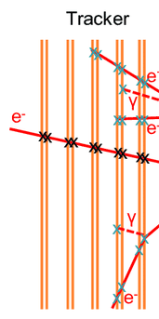
SPARTAN: What is Particle Tracking?
Particle tracking is the process of reconstructing the trajectories of charged particles as they pass through a detector.
It allows physicists to determine key properties of particles, such as momentum, charge, and origin, by analyzing their paths.
Charged particles interact with detector materials, leaving signals (hits) that are used to map their curved paths, especially within magnetic fields.
ICSC Italian Research Center on High-Performance Computing, Big Data and Quantum Computing
Missione 4 • Istruzione e Ricerca
Notes:
Template e guide lines

Slide 5
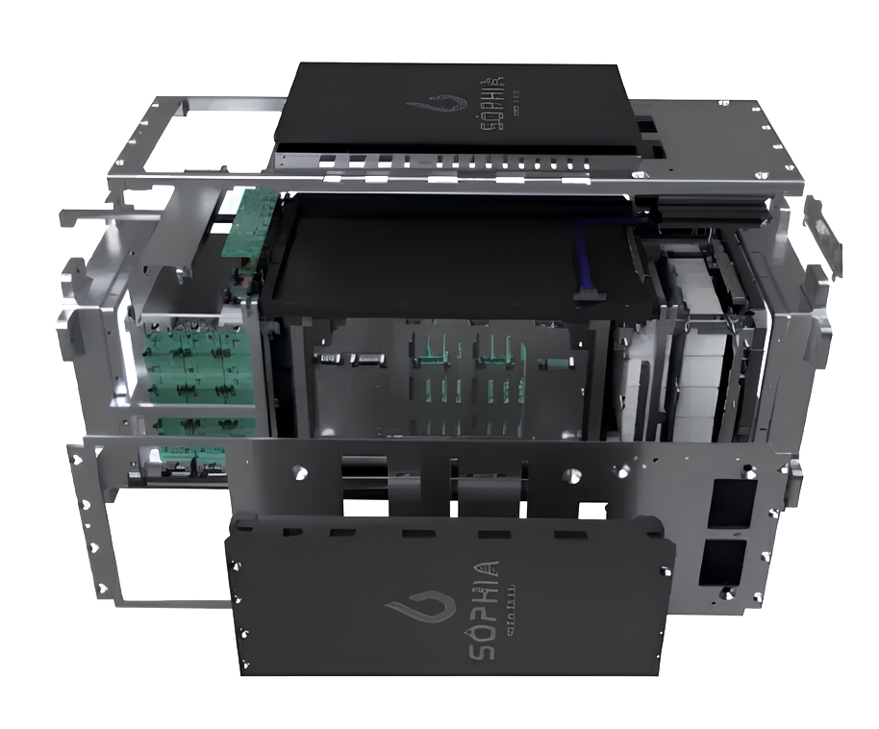
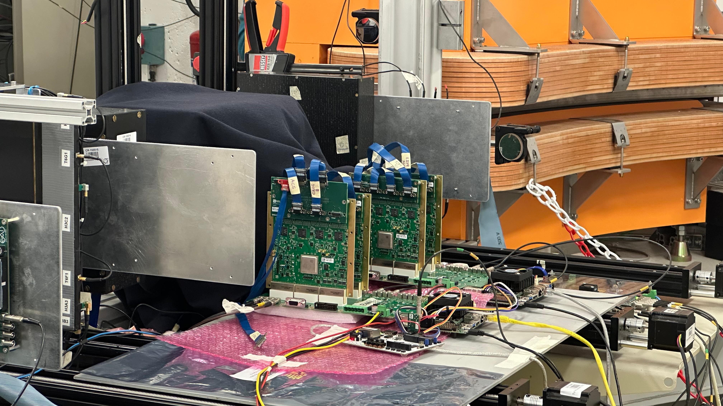
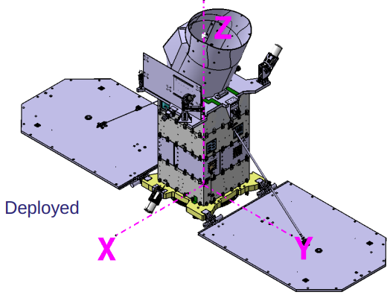
Zire payload on Nuses Satellite
3D model of the satellite and of Zirè payload
ICSC Italian Research Center on High-Performance Computing, Big Data and Quantum Computing
Missione 4 • Istruzione e Ricerca
Notes:
Template e guide lines

Slide 6
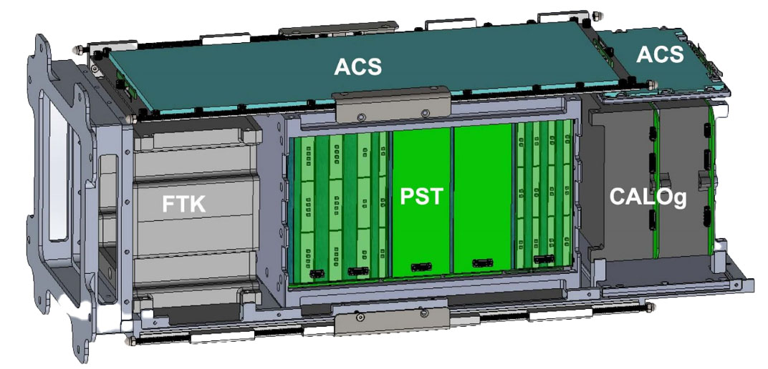
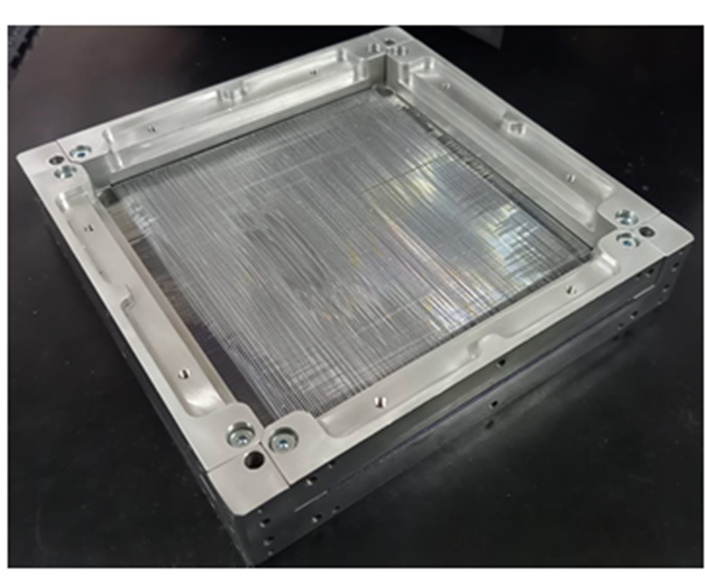
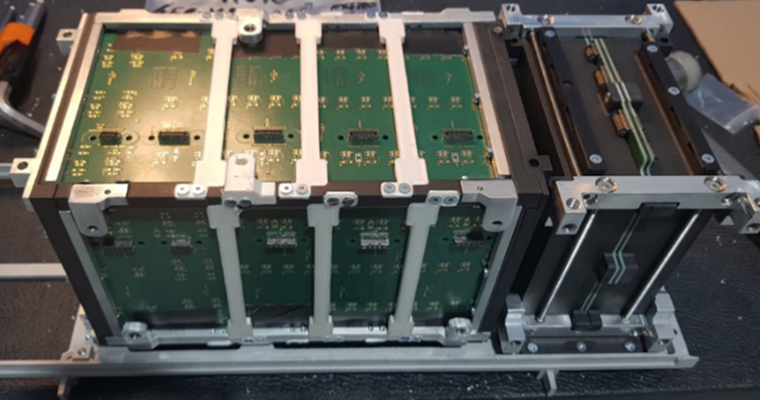
Zire payload on Nuses Satellite
FTK Fiber Tracker
M.N. Mazziotta, F.Gargano, R.Pillera, G. Panzarini,
L. Lorusso, A. Liguori
ICSC Italian Research Center on High-Performance Computing, Big Data and Quantum Computing
Missione 4 • Istruzione e Ricerca
Notes:
Template e guide lines

Slide 7
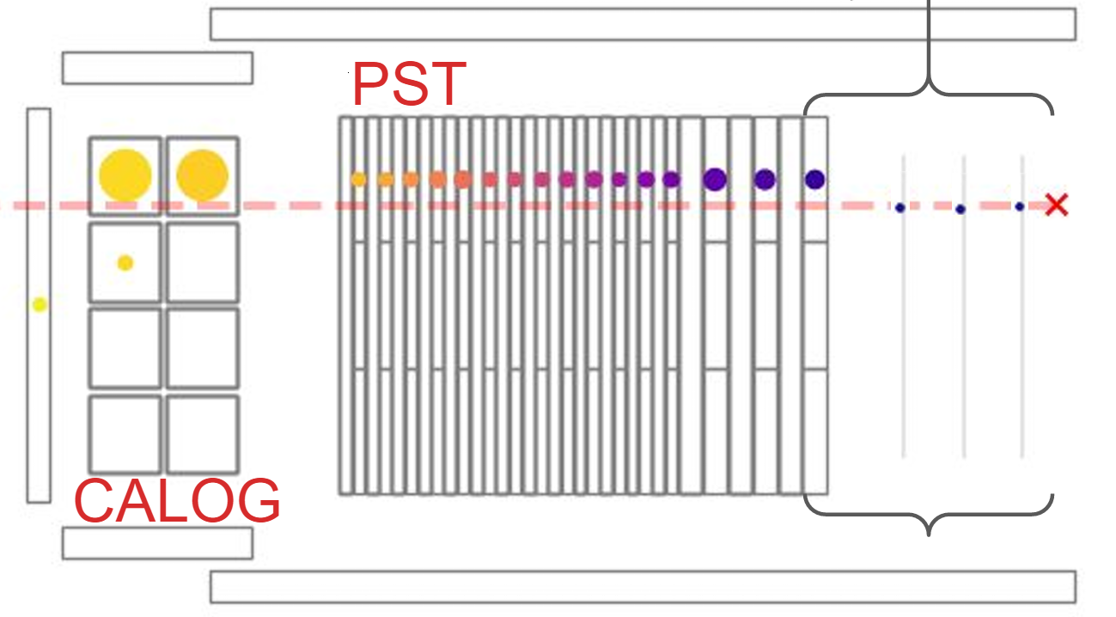
Zire payload on Nuses Satellite
Fiber tracker → recostruction with ML
Low power solutions → less than 10W
FTK
ICSC Italian Research Center on High-Performance Computing, Big Data and Quantum Computing
Missione 4 • Istruzione e Ricerca
Notes:
Template e guide lines

Slide 8
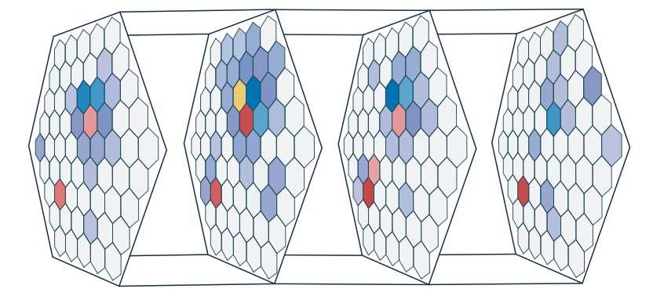
How Neural Networks Identify Particle Tracks
Input: Detector Hits
Charged particles traversing a detector leave behind signals, or "hits," in various detector layers.
These hits are recorded as spatial coordinates, representing the particle's interaction points.
Graph Construction
Each hit is represented as a node in a graph.
Edges are established between nodes based on spatial proximity, forming potential track segments.
Detector Input with possible tracks
ICSC Italian Research Center on High-Performance Computing, Big Data and Quantum Computing
Missione 4 • Istruzione e Ricerca
Notes:
Template e guide lines

Slide 9
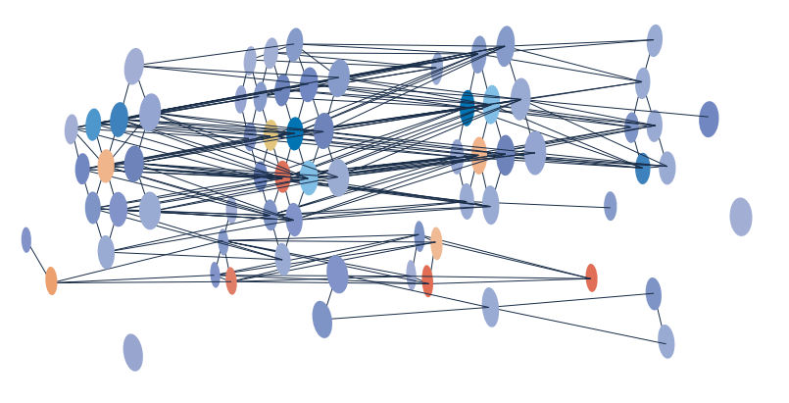
How Neural Networks Identify Particle Tracks
Graph Neural Network (GNN) Processing
A Graph Neural Network analyzes the constructed graph to evaluate the likelihood that connected nodes (hits) belong to the same particle trajectory.
Through iterative message passing between nodes, the GNN learns to identify patterns consistent with particle tracks.
Track Reconstruction
Nodes with high confidence scores are selected to assemble complete particle trajectories.
The network effectively filters out noise and resolves overlapping tracks, even in dense environment
Edge connected each other and possible tracks reconstructed by the GNN
ICSC Italian Research Center on High-Performance Computing, Big Data and Quantum Computing
Missione 4 • Istruzione e Ricerca
Notes:
Template e guide lines

Slide 10
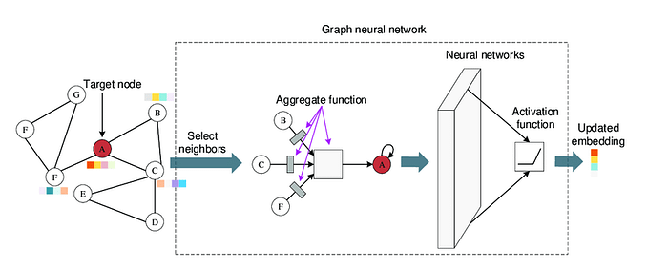
SageCONV Layers
How GNN Works
Message Passing: Each node collects ("receives messages from") its neighbors.
Aggregation: The received messages are combined using a function (e.g., mean, sum).
Update: The node’s feature is updated using the aggregated information and its own features.
SAGEConv is a GNN layer introduced by GraphSAGE that enables inductive learning: SAGEConv learns a transferable aggregation function, enabling it to make accurate predictions on nodes and graphs never seen during training.
Neighbor Sampling: Selects a fixed-size set of neighbors for each node → scalable to large graphs.
Aggregation Functions:
  Mean (default): Simple average of neighbor features
  Max, LSTM, or even learned functions for richer modeling
Update Rule: Combines the node’s own features with the aggregated neighborhood representation
ICSC Italian Research Center on High-Performance Computing, Big Data and Quantum Computing
Missione 4 • Istruzione e Ricerca
Notes:
https://medium.com/@sheikh.sahil12299/exploring-sageconv-a-powerful-graph-neural-network-architecture-44b7974b1fe0
Spiegazione in dettaglio:
"Unseen nodes":
Si riferisce a nodi che non erano presenti nei dati di training. Ad esempio, in un grafo sociale, un nuovo utente.
"Unseen graphs":
Si riferisce a interi nuovi grafi (nuove strutture, ad esempio nuove reti o eventi sperimentali) che non facevano parte del training set.
🧠 Perché è importante?
I modelli GNN classici (come GCN) sono transductive: imparano solo a fare inferenze su nodi già presenti nel grafo di training.
SAGEConv è inductive: impara una funzione di aggiornamento generalizzabile che può essere applicata a:
Nuovi nodi
Nuove connessioni
Grafi completamente diversi
📌 Esempio concreto:
Supponiamo che tu abbia addestrato una rete su eventi di particelle da un tipo di esperimento, e poi la usi su eventi diversi, o nuovi layer del detector:
Una GCN standard non funzionerebbe bene.
Una rete con SAGEConv, invece, può adattarsi e funzionare, perché ha imparato come combinare le informazioni locali, non dipende dal grafo globale.

Slide 11
How Neural Networks Identify Particle Tracks
Aspect | Convolutional Neural Networks (CNNs) | Graph Neural Networks (GNNs)
Data Structure | Operate on regular, grid-like data structures (e.g., images), where spatial relationships are fixed. | Operate on graph-structured data, accommodating arbitrary sizes and complex topologies, ideal for irregular detector geometries.
Application in Particle Tracking | Transform detector hits into 2D or 3D images; apply convolutional filters to detect patterns corresponding to particle trajectories. | Model detector hits as nodes in a graph; use message passing to aggregate information from neighboring nodes, capturing complex spatial relationships.
Advantages | - Well-established architectures with extensive tooling and support. - Efficient for data with regular spatial structures. | - Naturally handle irregular and sparse data. - Adaptable to complex detector geometries. - Capture intricate relationships between hits.
Limitations | - May struggle with sparse data and complex topologies. | - Potentially higher computational complexity. - May require more sophisticated training and tuning.
ICSC Italian Research Center on High-Performance Computing, Big Data and Quantum Computing
Missione 4 • Istruzione e Ricerca
Notes:
Template e guide lines

Slide 12


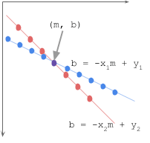
Data Preprocessing Pipeline for Particle Tracking
X layers
Pre-Processing
Inference
Clusters
Nodes
Edges
Track Fitting
Y layers
Pre-Processing
Inference
Clusters
Nodes
Edges
ICSC Italian Research Center on High-Performance Computing, Big Data and Quantum Computing
Missione 4 • Istruzione e Ricerca
Notes:
Template e guide lines

Slide 13
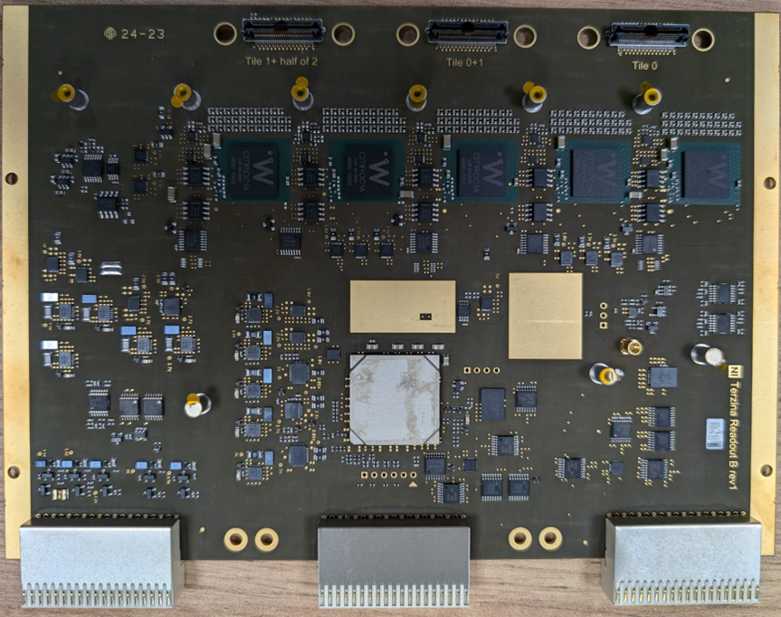
Data Preprocessing Pipeline for Particle Tracking
DATA CLEANING
NODE FEATURES
EDGE CONSTRUCTION
Remove events with insufficient layer coverage (less than 4 layers).
Drop rows with missing values
Hit positions
Uncertainties
Energy deposition
Layer information
Create edges by connecting hits in consecutive layers
Calculate edge features such as angular differences between hits
DATA
SOURCE
Store data on file
ICSC Italian Research Center on High-Performance Computing, Big Data and Quantum Computing
Missione 4 • Istruzione e Ricerca
Notes:
Template e guide lines

Slide 14
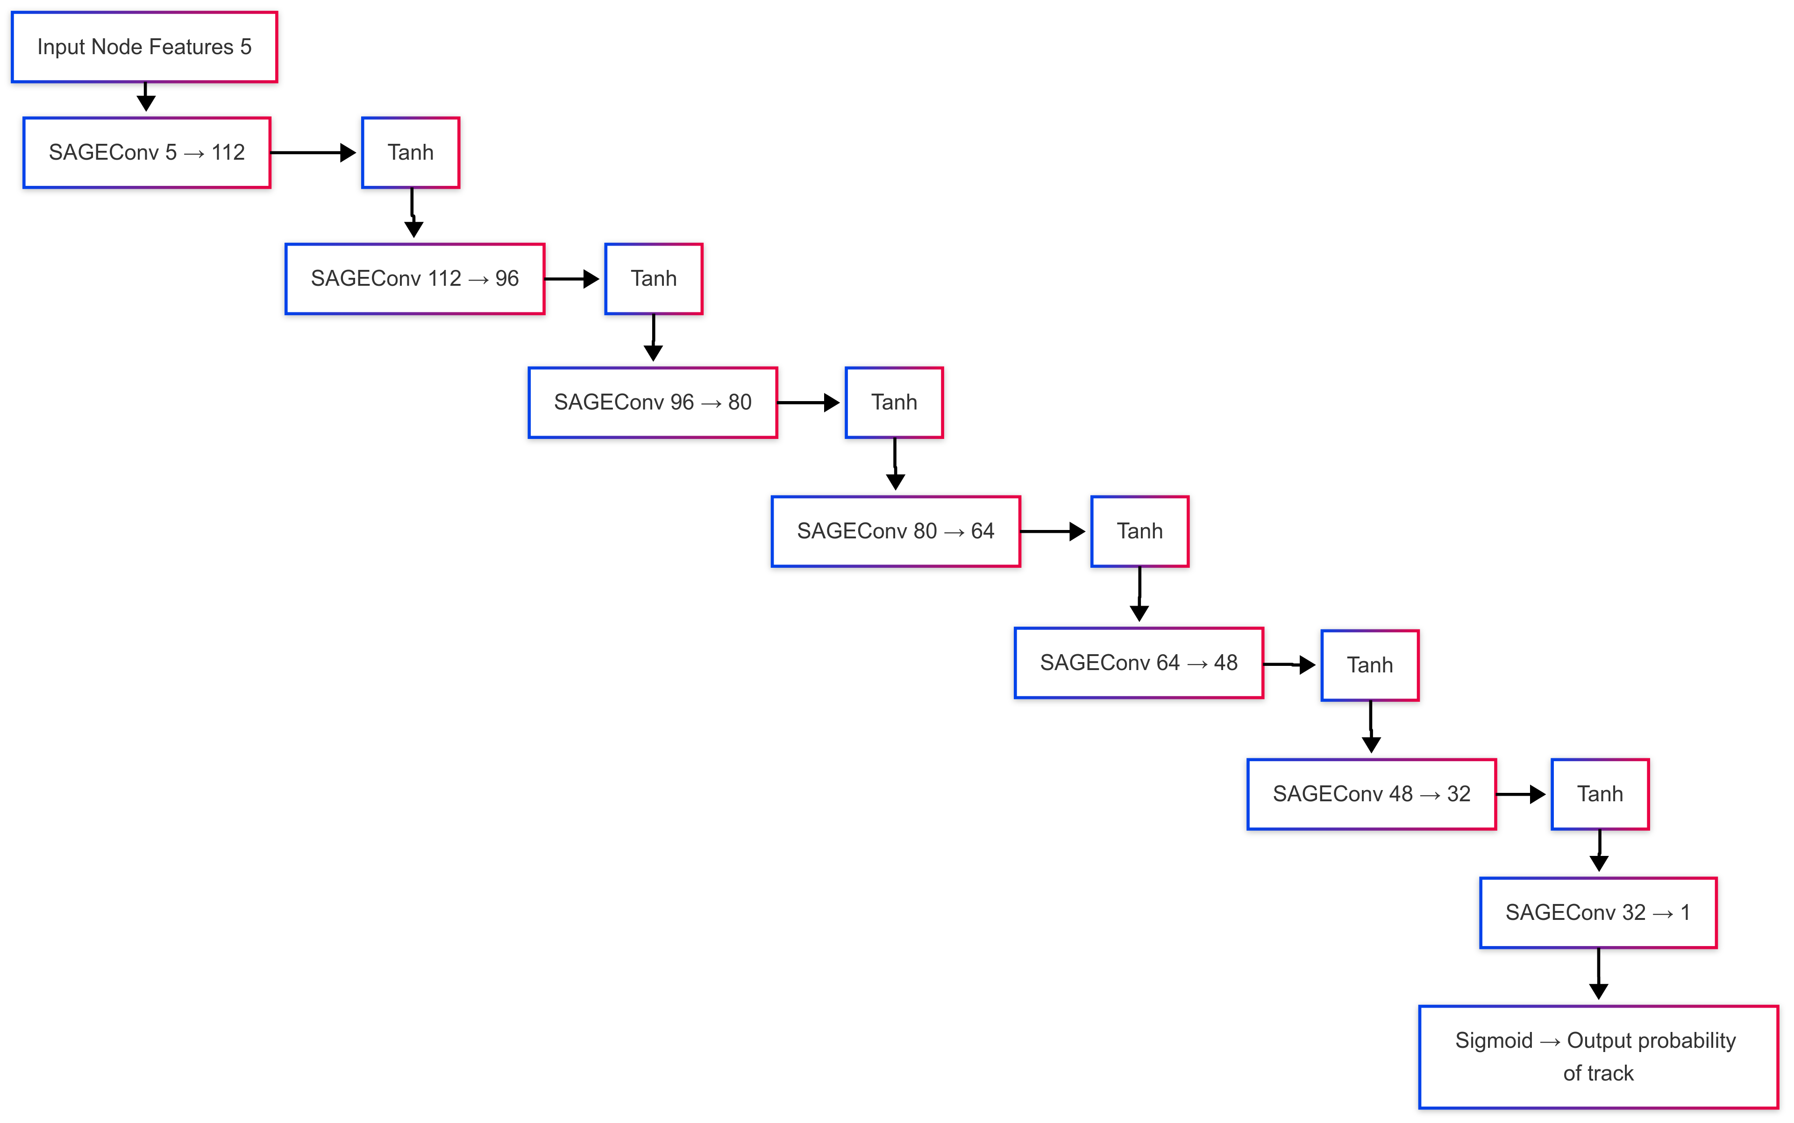
Inference using SageCONV
The SageConv model is a scalable GNN architecture built using GraphSAGE convolution layers, specifically designed to process particle hit graphs across multiple detector layers.
Parameter | Value
Input Features | 5 per node (e.g., x, z, PE, uncertainty, layer)
Output | 1 (binary classification: node on track or not)
Hidden Size | 112 neurons (initial layer)
Number of Layers | 7 SAGEConv layers
Feature Reduction | 16 units per layer
ICSC Italian Research Center on High-Performance Computing, Big Data and Quantum Computing
Missione 4 • Istruzione e Ricerca
Notes:
Template e guide lines

Slide 15
Input Graph
How it works
Input Graph
  Each node corresponds to a hit.
  Edges connect hits between consecutive detector layers.
  The graph includes geometric and signal-based features.
Layer Stack (7x SAGEConv)
  The first SAGEConv maps 5 input features → 112 hidden units.
  Each following layer reduces the hidden dimension by 16 units:
    Layer 2: 112 → 96
    Layer 3: 96 → 80
    …
    Layer 7: 32 → 1 output
Activation Functions
  All layers (except the last) apply Tanh to introduce non-linearity.
  Final layer uses Sigmoid to output a value ∈ [0, 1] = track probability.
Edge
ICSC Italian Research Center on High-Performance Computing, Big Data and Quantum Computing
Missione 4 • Istruzione e Ricerca
Notes:
Template e guide lines

Slide 16
Why SAGEConv
It aggregates neighbor features efficiently using mean or learned functions.
Perfect for graphs with irregular topology, like sparse particle events.
Works in inductive mode, so it can generalize to unseen graphs.
After training, each node's output represents the probability of belonging to a particle track.
ICSC Italian Research Center on High-Performance Computing, Big Data and Quantum Computing
Missione 4 • Istruzione e Ricerca
Notes:
Template e guide lines

Slide 17
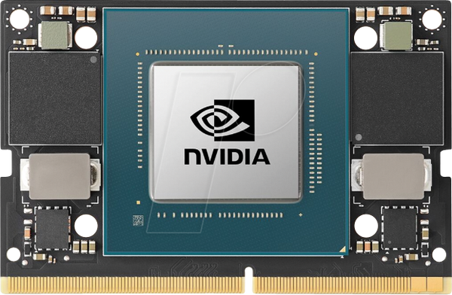
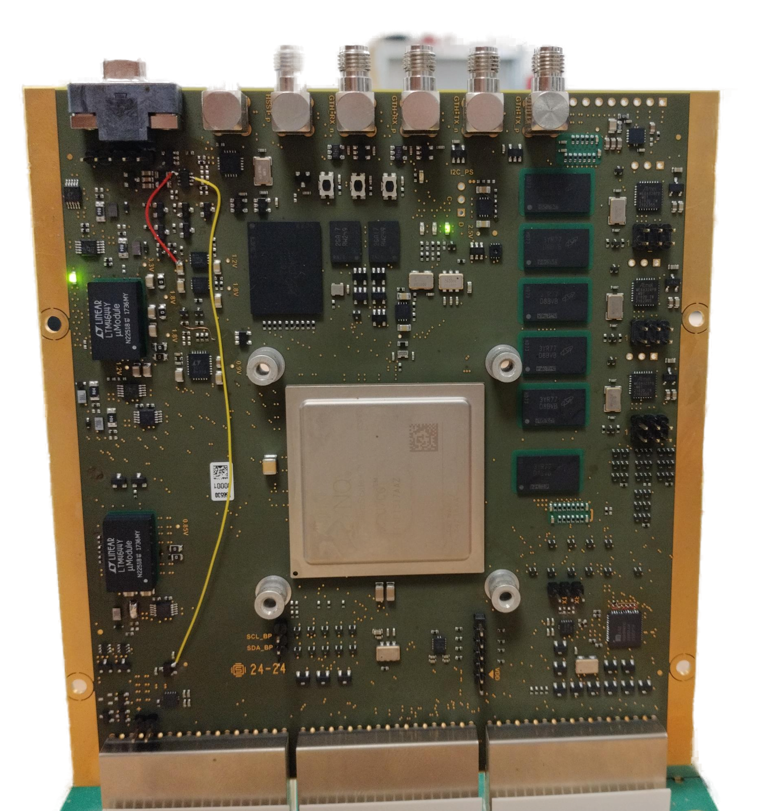
Hardware Implementation Strategy
System Architecture
Hybrid Solution: FPGA + NPU
A mixed architecture combines a Xilinx Zynq Ultrascale+ FPGA with an NVIDIA Jetson Orin Nano to optimize the execution of the GNN model.
Functional Roles:
  FPGA (Zynq Ultrascale+) handles:
    Front-end data acquisition
    Preprocessing (e.g., cluster building, filtering)
    Real-time data preparation and formatting
  NPU (Jetson Orin Nano) performs:
    GNN inference (GraphSAGE model)
    Track reconstruction
    Data packaging for acquisition PC
Detector
NPU/GPU
Front end board
Concentrator
PLMM
ICSC Italian Research Center on High-Performance Computing, Big Data and Quantum Computing
Missione 4 • Istruzione e Ricerca
Notes:
Template e guide lines

Slide 18
Challenges in Full GNN Implementation on FPGA
Architectural Constraints
      Non-pipelined Design: The structure of the SAGEConv-based GNN is not easily pipelined, making it unsuitable for direct implementation on pure FPGA without significant performance penalties.
      Resource Usage: The complexity of Graph Neural Networks requires a large number of logic gates and memory blocks, which scales poorly with the number of nodes and channels in the graph
      Performance Bottlenecks
      Sequential Computation
      Unlike CNNs, GNNs require message passing and aggregation steps that are inherently sequential, limiting the effectiveness of parallel execution on FPGA.
      Edge Feature Handling
      The GNN model processes not only node features but also edge features—an added challenge for logic-based hardware without large shared memory and flexible control logic.
ICSC Italian Research Center on High-Performance Computing, Big Data and Quantum Computing
Missione 4 • Istruzione e Ricerca
Notes:
Template e guide lines

Slide 19
Challenges in Full GNN Implementation on FPGA
      Toolchain Limitations
      Existing tools like Vitis AI and hls4ml are not fully optimized for implementing complex GNN layers, especially when dynamic graph structures and attention mechanisms are involved
Due to the limitations above, a hybrid architecture was chosen: FPGA (Zynq Ultrascale+) for preprocessing, and NPU (Jetson Orin Nano) for inference, achieving high throughput and low power consumption
ICSC Italian Research Center on High-Performance Computing, Big Data and Quantum Computing
Missione 4 • Istruzione e Ricerca
Notes:
Template e guide lines

Slide 20
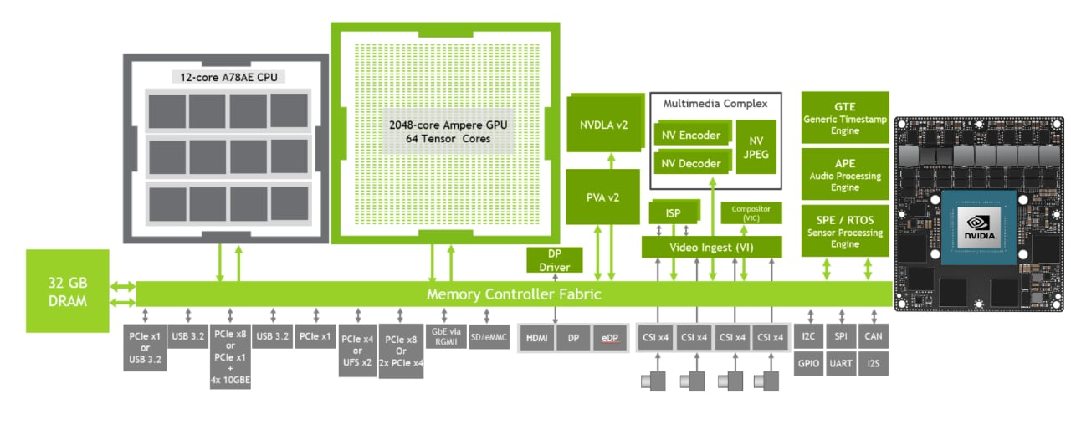
NVIDIA Jetson Orin Architecture
ICSC Italian Research Center on High-Performance Computing, Big Data and Quantum Computing
Missione 4 • Istruzione e Ricerca
Notes:
Template e guide lines

Slide 21
Inference system: Performance
5W
7W
Zynq UP
Node/Edge calculation
Jetson Orin
Inference
Storage server
(emulating satellite PLMM)
ZeroMQ
Flatbuffers
ZeroMQ
Flatbuffers
Simulation output file
5k pre-processing/sec
10k inference/sec
ICSC Italian Research Center on High-Performance Computing, Big Data and Quantum Computing
Missione 4 • Istruzione e Ricerca
Notes:
Template e guide lines

Slide 22
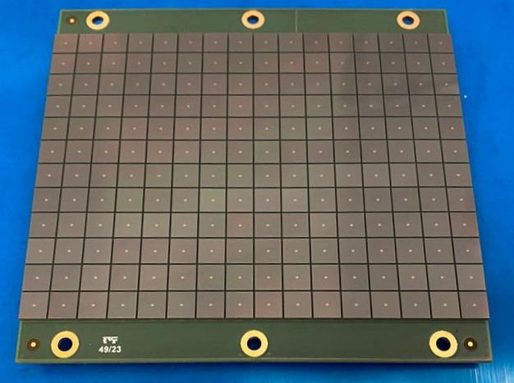
Alternative Architecture – 2D CNN for Particle Tracking
Concept:
Replace the graph-based approach with a 2D convolutional neural network (CNN) that processes detector data as image-like arrays.
Each detector layer is treated as a 2D plane of pixels: (N x N) matrix.
Input Representation:
A 4-channel image, where each channel corresponds to one detector layer.
Active pixels represent either:
  Advantages:
  Compatible with HLS4ML, allowing direct synthesis on FPGA.
  Standard CNN architectures are simpler to deploy and optimize on embedded systems.
Fiber intersection over threshold, or
        Actual pixel hits (in pixelated detectors).
ICSC Italian Research Center on High-Performance Computing, Big Data and Quantum Computing
Missione 4 • Istruzione e Ricerca
Notes:
Template e guide lines

Slide 23
Input 4x32x32
2D CNN for Particle Tracking
CNN Structure Description
The CNN is designed to process 4 detector layers simultaneously, each treated as a 32×32 pixel image.
The model follows a U-shaped encoder-decoder pattern (though shallow), typical of segmentation tasks:
Encoder:
Conv2D (4 → 16 channels)
Captures local patterns across each layer.
ReLU Activation
Conv2D (16 → 32 channels)
Learns higher-level features combining all layers.
ReLU Activation
Decoder:
Conv2D (32 → 16 channels)
Begins reconstruction to match the input resolution.
ReLU Activation
Conv2D (16 → 4 channels)
Output: 4-channel mask with sigmoid-activated values indicating track probabilities.
Conv2D 4→16
ReLU
Conv2D 16→32
ReLU
Conv2D 4→16
ReLU
Conv2D 16→32
Sigmoid
Output 4x32x32
ICSC Italian Research Center on High-Performance Computing, Big Data and Quantum Computing
Missione 4 • Istruzione e Ricerca
Notes:
“Questa CNN2D riceve in input i quattro piani del nostro rivelatore come immagini 32x32. L’encoder estrae pattern locali e globali, mentre il decoder ricostruisce le probabilità che ogni pixel sia parte di una traccia. Alla fine otteniamo 4 mappe di probabilità, una per piano. Il modello è compatto, adatto all’hardware, e facilmente sintetizzabile in FPGA.”
Input
Forma dell'input: [batch_size, 4, 32, 32]
Significato:
4 = numero di piani del rivelatore (quattro layer)
Ogni piano è una griglia 32×32
Il valore in ciascun pixel rappresenta un segnale: può essere 0 (vuoto), vicino a 1 (segno di traccia) o un valore casuale (rumore)
🧠 Struttura della rete
Encoder: estrae caratteristiche rilevanti
Conv2d(4 → 16)
Ogni pixel "vede" i suoi vicini grazie al filtro 3×3
Impara a riconoscere piccoli pattern come allineamenti verticali/diagonali
ReLU()
Funzione non lineare: mantiene i valori positivi e annulla quelli negativi
Conv2d(16 → 32)
Aumenta la profondità dell'informazione: ora la rete ha 32 canali astratti che descrivono combinazioni complesse di attivazioni
ReLU()
Introduce ulteriore non linearità per migliorare la capacità di modellare il comportamento complesso delle tracce
Decoder: ricostruisce una mappa dei pixel attivi
Conv2d(32 → 16)
Riduce il numero di canali per tornare a uno spazio più semplice, iniziando a “ricostruire” l’immagine della traccia
ReLU()
Conv2d(16 → 4)
Ultimo livello: genera una mappa per ciascun piano del rivelatore
Il valore in ogni pixel rappresenta la probabilità che quel pixel faccia parte della traccia
Sigmoid()
Converte i valori finali tra 0 e 1: possono essere interpretati come probabilità
🎯 Output
Forma dell’output: [batch_size, 4, 32, 32]
Per ogni pixel della griglia, la rete stima un valore fra 0 e 1: più è vicino a 1, più è probabile che quel punto appartenga a una traccia vera.
✅ Perché è efficace?
Le CNN sono eccellenti nel riconoscere pattern spaziali: anche se le tracce sono oblique o hanno un po' di rumore, la rete può apprendere la coerenza geometrica tipica dei passaggi di particelle.
In questo caso, l’uso di filtri convoluzionali condivisi su tutti i piani permette di generalizzare bene anche se la forma esatta della traccia cambia leggermente da evento a evento.
Matematicamente, la funzione sigmoid è definita come:
σ(x)=11+e−x\sigma(x) = \frac{1}{1 + e^{-x}}σ(x)=1+e−x1​ Se x è molto positivo, sigmoid(x) ≈ 1
Se x è molto negativo, sigmoid(x) ≈ 0
Se x = 0, sigmoid(x) = 0.5
🧠 Nel contesto della tua CNN:
La rete produce, per ogni pixel e per ogni piano, un valore continuo.
Questo valore passa attraverso la Sigmoid, che lo “schiaccia” tra 0 e 1.
Il risultato rappresenta la probabilità che quel pixel appartenga a una traccia.
📌 Perché serve qui:
Il tuo modello è pixel-wise binary classification: decide, per ogni pixel, se c’è traccia (1) o no (0).
La Sigmoid permette di applicare una funzione di perdita binaria (es. BCELoss) durante l’allenamento.
Durante l’inferenza, puoi fissare una soglia (es. 0.5): se l’output è > 0.5 → traccia, altrimenti no.

Slide 24
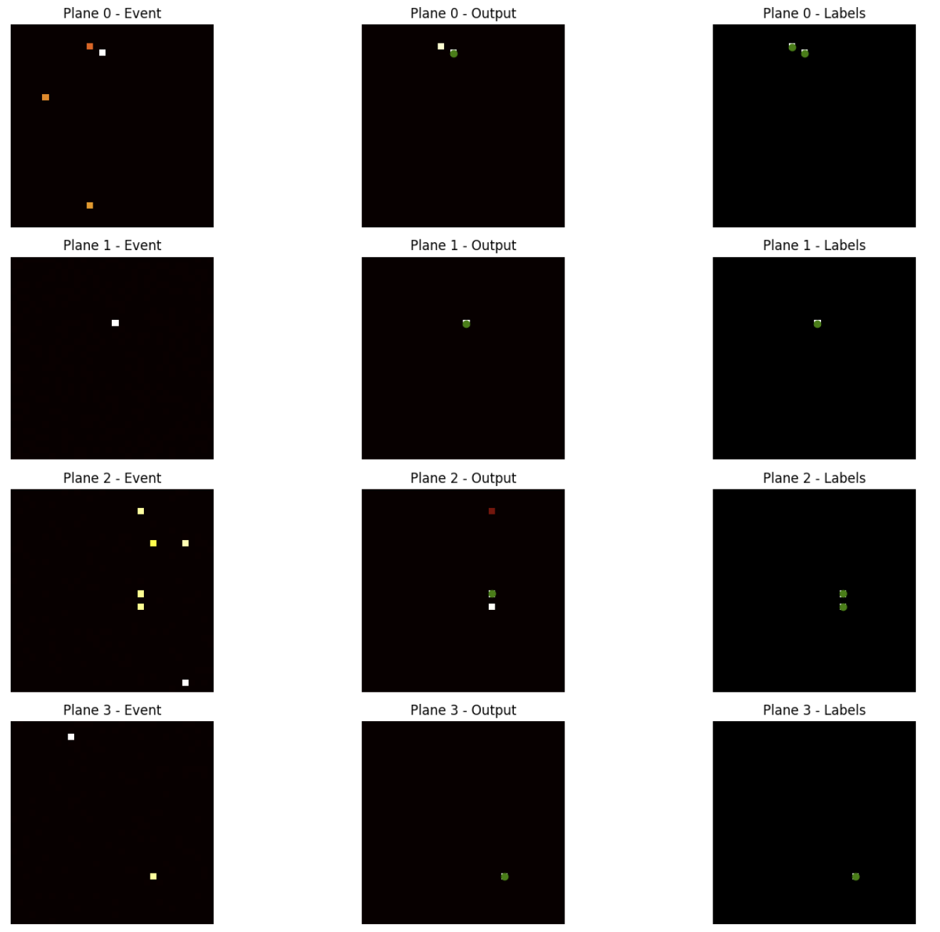
Alternative Architecture – 2D CNN for Particle Tracking
ICSC Italian Research Center on High-Performance Computing, Big Data and Quantum Computing
Missione 4 • Istruzione e Ricerca

Slide 25
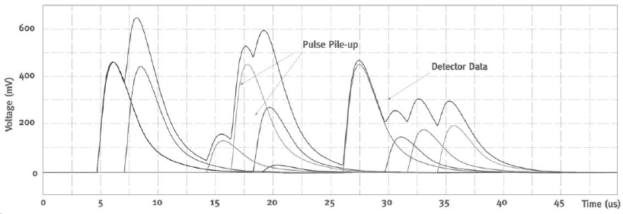
LEGIMAC: What is Pile-up
Pile-up occurs when multiple events happen too close in time for the detector to resolve them as separate.
Instead of recording distinct pulses, the system sees a single distorted or merged signal.
Challenge | Effect
Energy reconstruction | The total signal is not a linear sum of the two → energy is overestimated
Timing resolution | The peak shifts → wrong estimation of arrival time
Counting accuracy | You may count one event instead of two, especially if one is low energy
Pulse shape distortion | Makes it harder to distinguish real signals from noise or background
ICSC Italian Research Center on High-Performance Computing, Big Data and Quantum Computing
Missione 4 • Istruzione e Ricerca
Notes:
Template e guide lines

Slide 26
LEGIMAC: What is Pile-up
LEGIMaC aims to detect ultra-low energy gamma events in space.
These are frequent and closely spaced, especially during bursts or cosmic showers.
Pile-up dramatically reduces: Detection sensitivity, Spectral resolution, Trigger efficiency
Use machine learning, especially neural networks, to:
Deconvolve overlapping signals
Identify and separate individual events
Reconstruct true amplitude and timing of each pulse
ICSC Italian Research Center on High-Performance Computing, Big Data and Quantum Computing
Missione 4 • Istruzione e Ricerca
Notes:
Template e guide lines

Slide 27
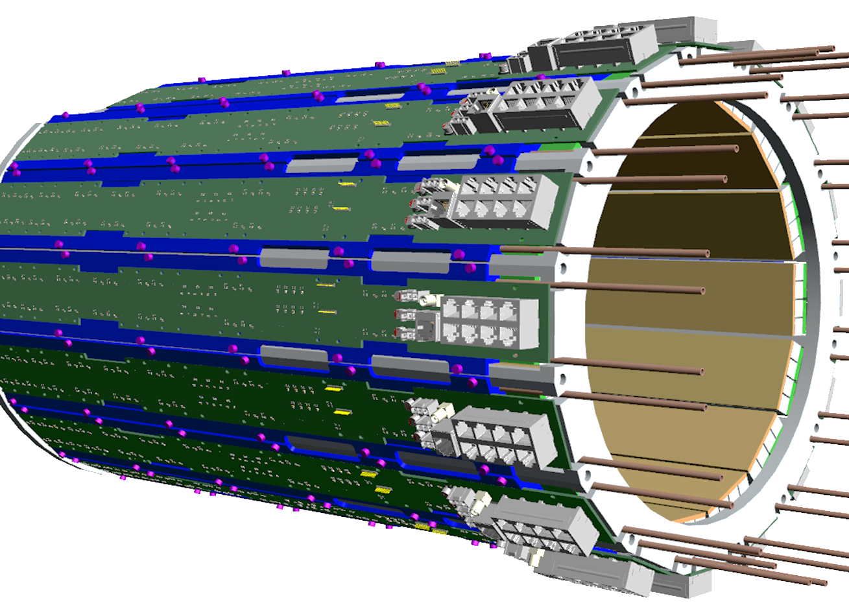
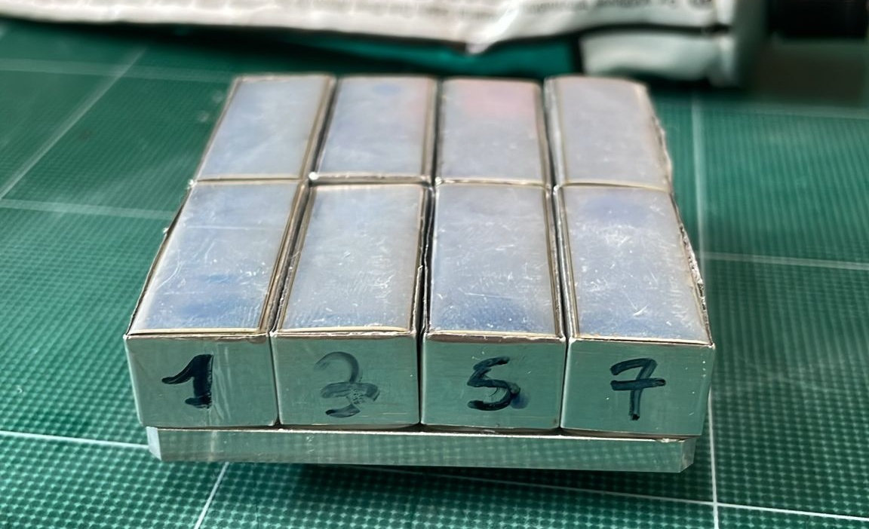
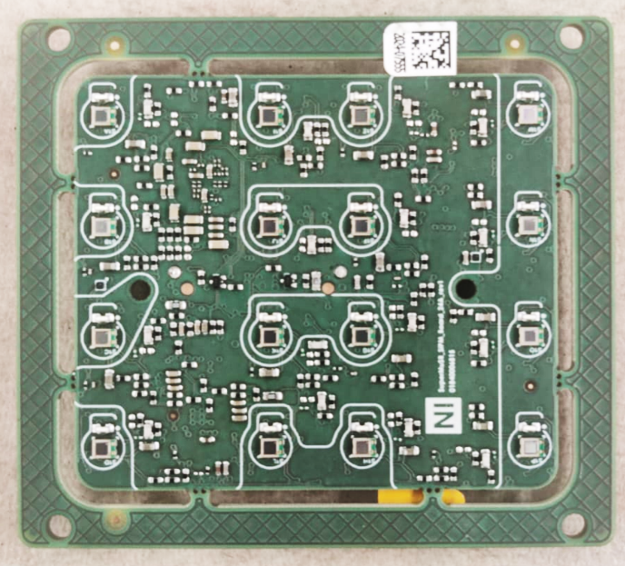
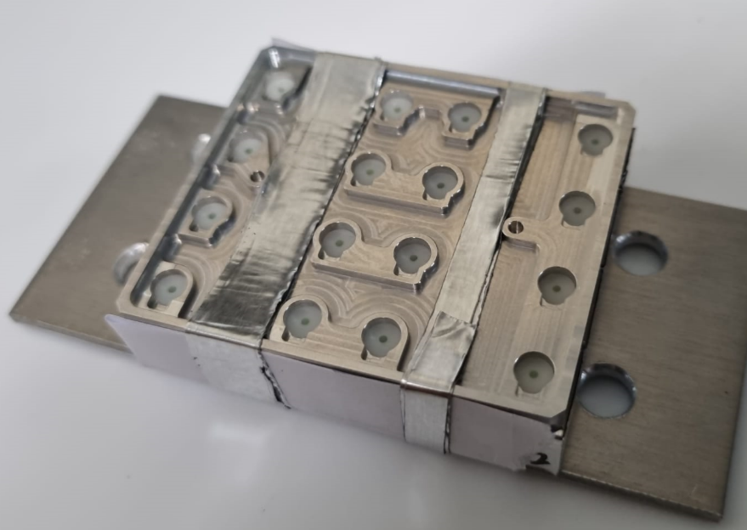
SuperMuSR Detector at ISIS
We use data from the SuperMuSR experiment as a realistic benchmark:
Setup: Muon spectrometer at the ISIS pulsed neutron and muon source.
Detector: Fast scintillators coupled to SiPMs (Silicon Photomultipliers).
Environment: Muons arrive in well-defined bursts (up to MHz), producing rapid chains of interactions in the sample.
Why it’s relevant:
Mimics the burst-like, impulsive nature of space radiation LEGIMaC targets.
Provides a rich dataset with real pile-up cases to train and validate algorithms.
ICSC Italian Research Center on High-Performance Computing, Big Data and Quantum Computing
Missione 4 • Istruzione e Ricerca
Notes:
Template e guide lines

Slide 28
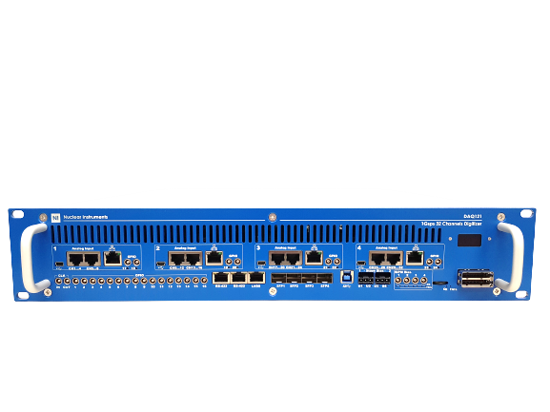
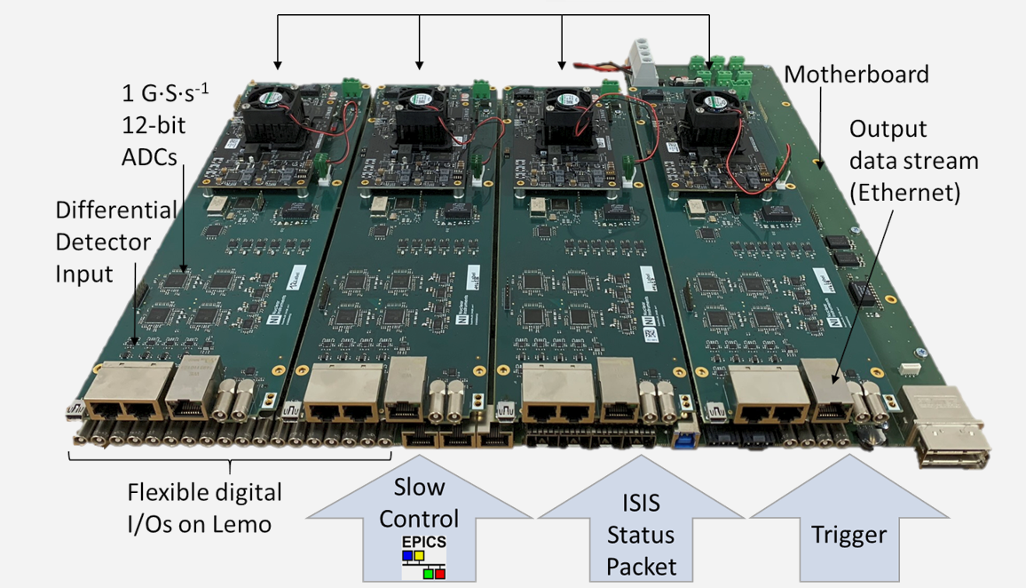
Hardware platform
Digitizer: Nuclear Instruments DAQ121
4x FPGA: Zynq Ultrascale + XCZU7EV
Operating clock frequency: 250 MHz
Operating sample rate: 1 GSPS
Channels per digitizer: 32
Integrated 4x4 cores ARM64 CPU with EPICS and Kafka directly running on the device
4 Gbps connectivity on copper
10 Gbps on fiber
32 + 4 LVDS
24 x TTL Lemo I/O
Integrated LV generator
Integrated BIAS generator up to 80V
ICSC Italian Research Center on High-Performance Computing, Big Data and Quantum Computing
Missione 4 • Istruzione e Ricerca
Notes:
Template e guide lines

Slide 29
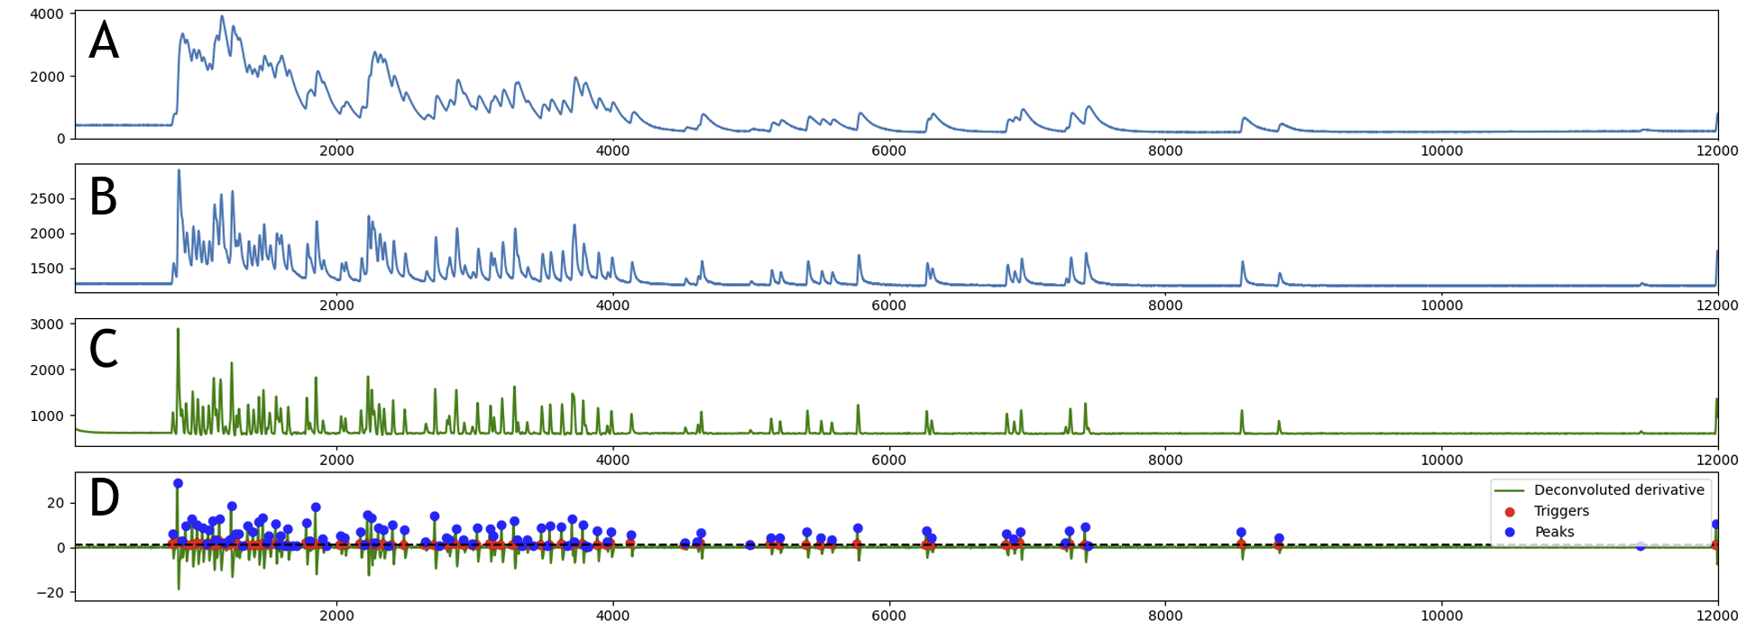
Deconvolution algorithm
ICSC Italian Research Center on High-Performance Computing, Big Data and Quantum Computing
Missione 4 • Istruzione e Ricerca
Notes:
Template e guide lines

Slide 30
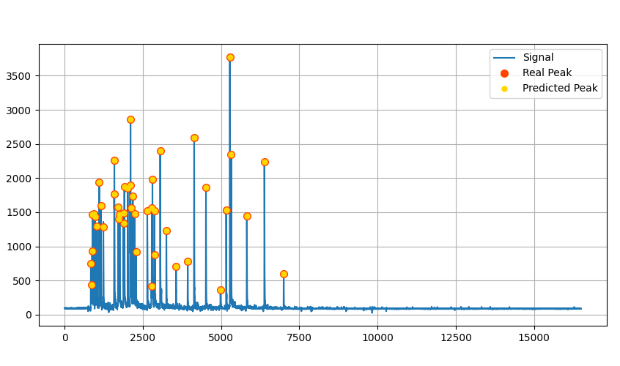
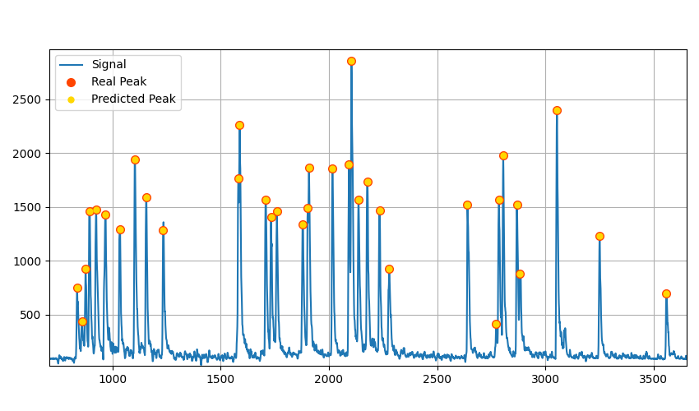
CNN-1D
ICSC Italian Research Center on High-Performance Computing, Big Data and Quantum Computing
Missione 4 • Istruzione e Ricerca
Notes:
Template e guide lines

Slide 31
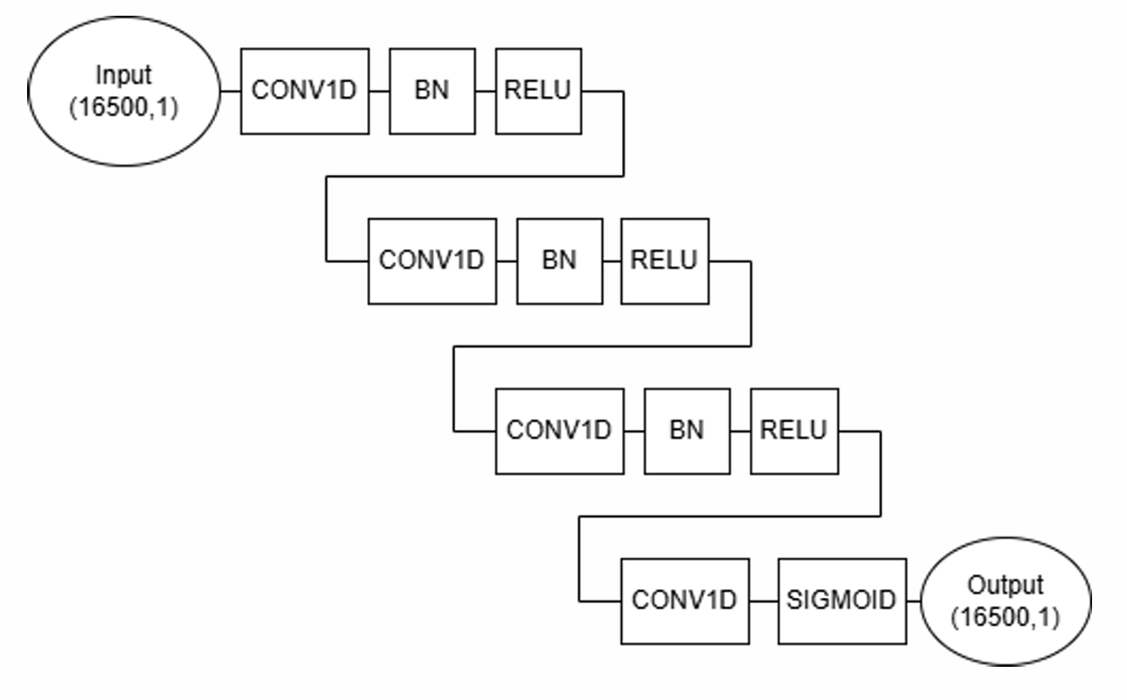
CNN-1D
Model Objective
Analyze 1D waveforms of length 1024 samples.
Detect and separate overlapping pulses (pile-up).
Output a probability mask over time: where each sample likely contains a valid signal.
Layer | Type | Description
conv1 | Conv1D(4) | 5-point convolution, 4 filters — learns edge & slope patterns
relu1 | ReLU | Introduces non-linearity with reduced bit-width
conv2 | Conv1D(8) | 3-point convolution, 8 filters — captures short-range interactions (optional dilation)
relu2 | ReLU
conv3 | Conv1D(16) | Deeper layer with 16 filters — models overlapping or decaying tails
relu3 | ReLU
conv4 | Conv1D(8) | Reduces back to 8 filters — focuses on compressed representation
relu4 | ReLU
output | Conv1D(1) | Final 1x1 convolution — returns per-sample score
sigmoid | Sigmoid | Converts score to [0, 1] probability (signal present vs. noise)
ICSC Italian Research Center on High-Performance Computing, Big Data and Quantum Computing
Missione 4 • Istruzione e Ricerca
Notes:
Template e guide lines

Slide 32
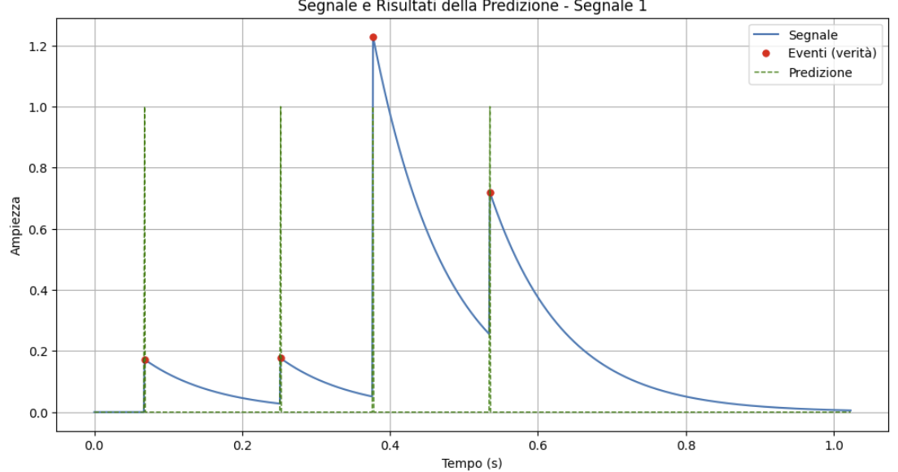
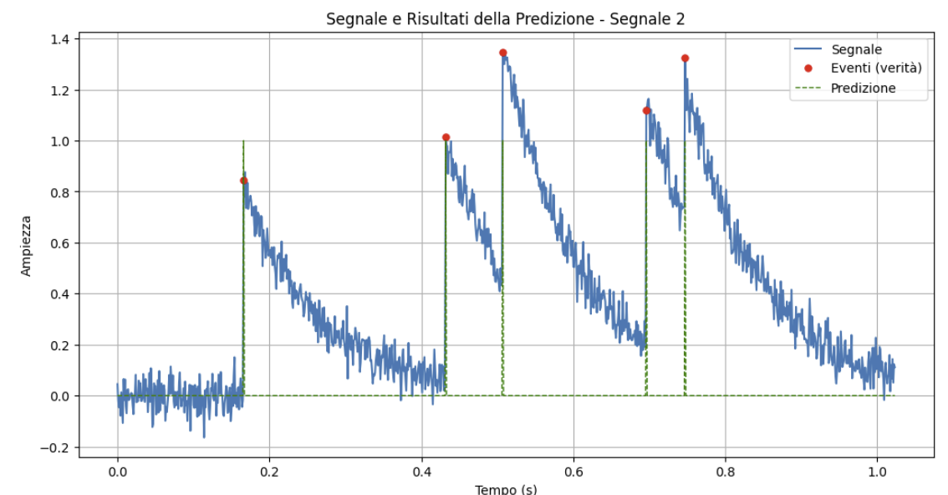
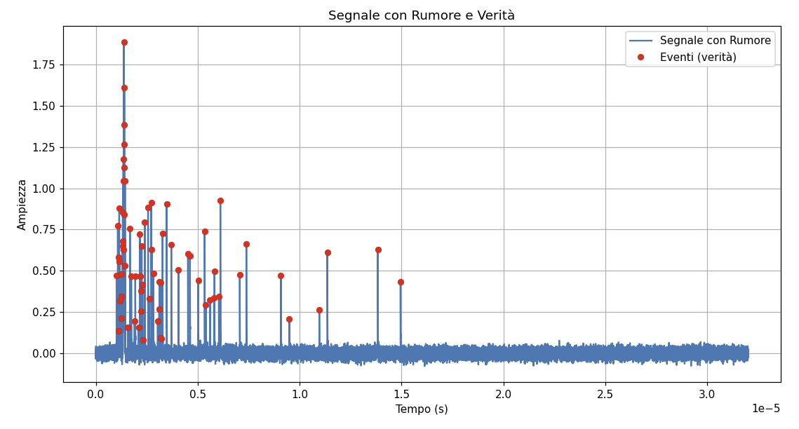
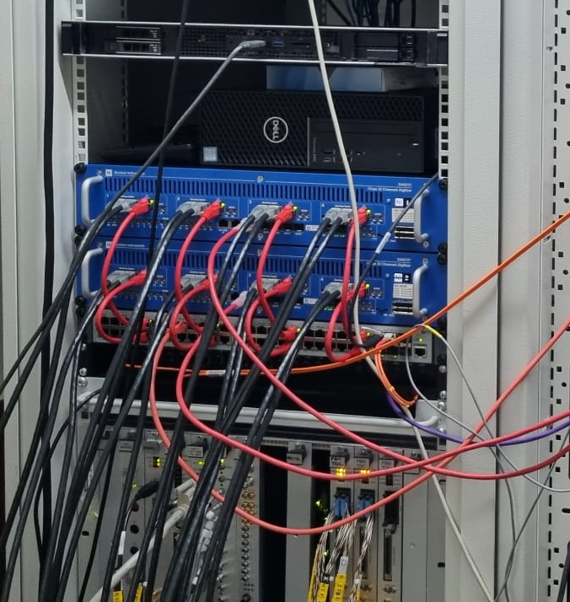
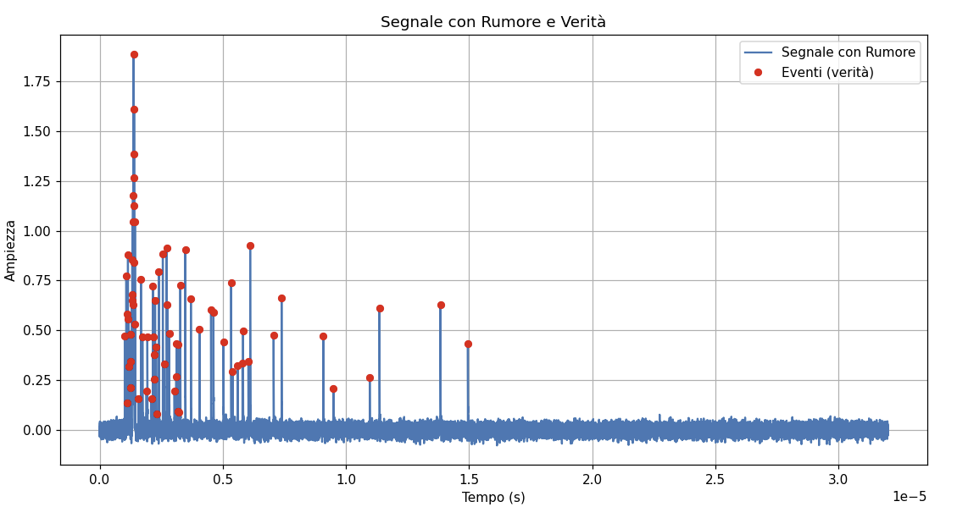
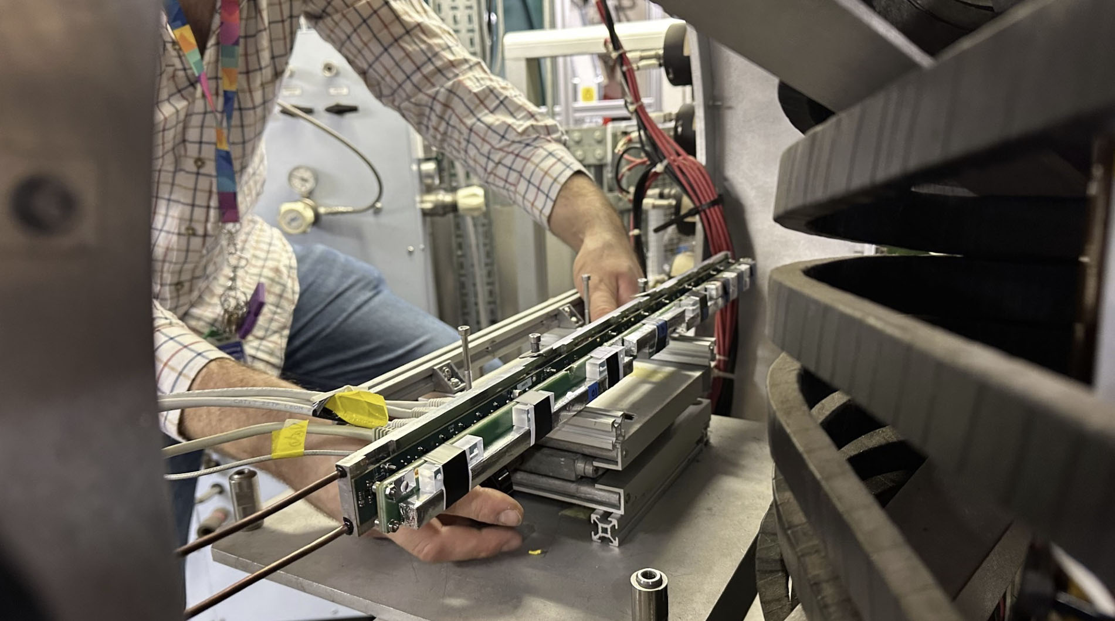
Training
Modelized data
Noise
Time Distribution
Read Data
Classic trigger
ICSC Italian Research Center on High-Performance Computing, Big Data and Quantum Computing
Missione 4 • Istruzione e Ricerca
Notes:
Template e guide lines

Slide 33

HLS4ML
hls4ml is an open-source tool that converts trained neural networks into synthesizable firmware for FPGAs and ASICs, using High-Level Synthesis (HLS).
It bridges the gap between machine learning frameworks (like Keras, PyTorch, QKeras) and hardware description languages (like VHDL or Verilog), enabling ML deployment on edge devices with limited power and latency constraints.
Unlike GPU/CPU/NPU inference engines, hls4ml transforms the model into a true hardware architecture — not a software process
A custom, dataflow-pipelined architecture, fully tailored to the neural network. Neural network becomes a real circuit, like a digital filter or FSM
No CPU cores, no external memory access, no generic ML accelerator Inference happens clock-by-clock, at the speed of the FPGA fabric.
Fully pipelined: One result every N clock cycles
ICSC Italian Research Center on High-Performance Computing, Big Data and Quantum Computing
Missione 4 • Istruzione e Ricerca
Notes:
Template e guide lines

Slide 34
LEGIMAC user case
Keras Model
Quantized with Qkeras
Compiled via hls4ml → Vitis Backend
Deployed as hardware logic inside a Xilinx Zynq Ultrascale+ FPGA
hls4ml
C++ HLS
Netlist
Bitstream
ICSC Italian Research Center on High-Performance Computing, Big Data and Quantum Computing
Missione 4 • Istruzione e Ricerca
Notes:
Template e guide lines

Slide 35
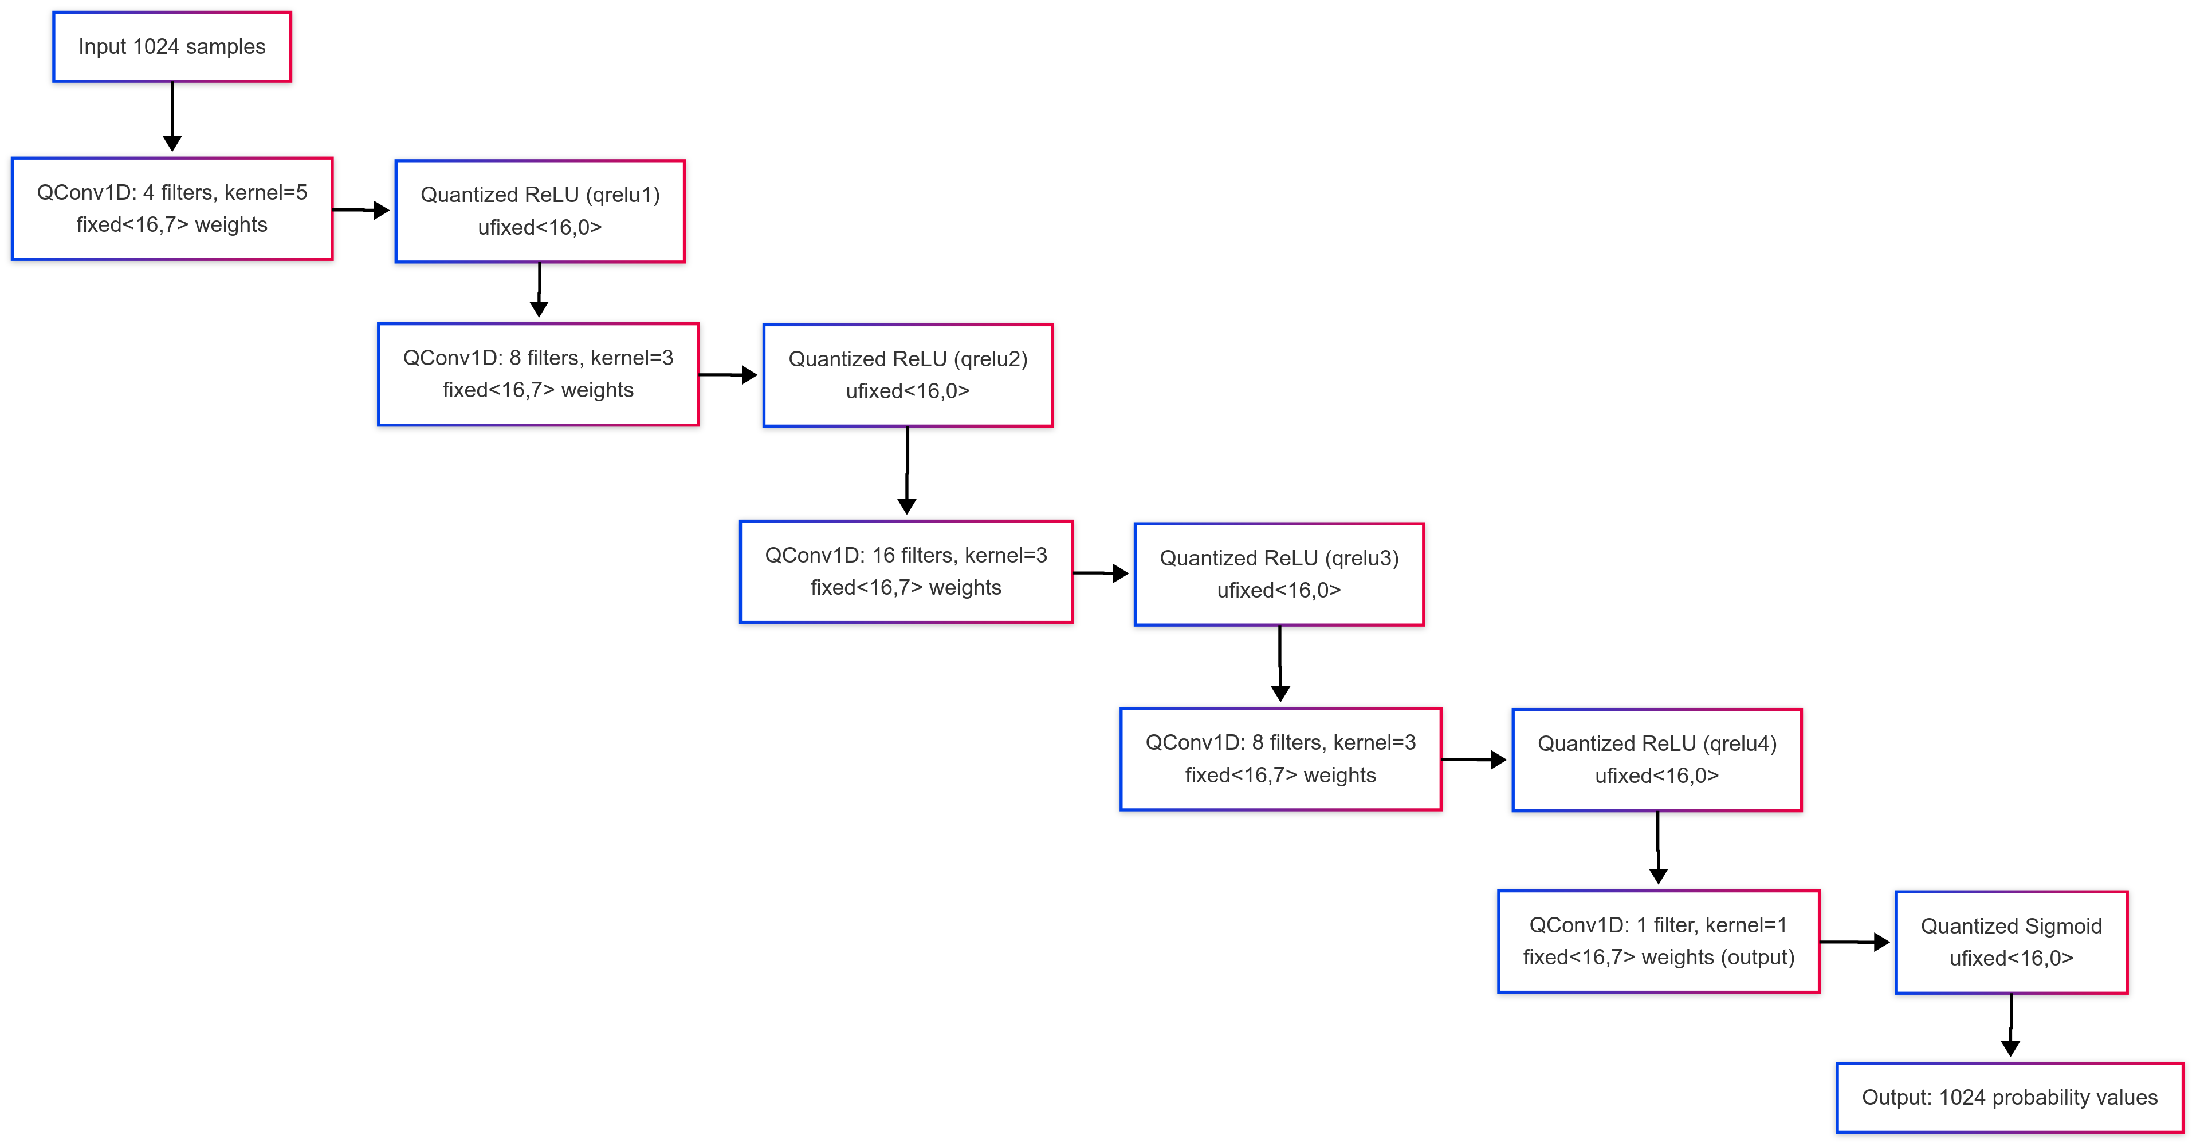
LEGIMAC HLS Implementation
ICSC Italian Research Center on High-Performance Computing, Big Data and Quantum Computing
Missione 4 • Istruzione e Ricerca
Notes:
Template e guide lines

Slide 36
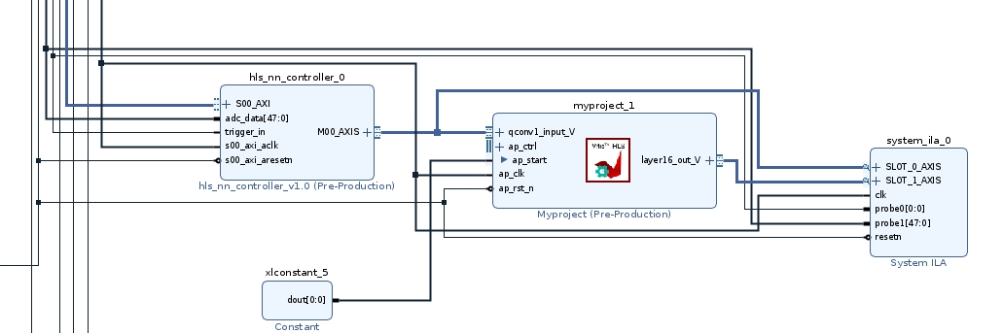
LEGIMAC HLS Implementation
JESD 204B
FRAMER
Neural Network CONTROLLER
Neural Network
ADC
ADC
ADC
ILA
AXIS
SCINTILLATOR TRIGGER
ICSC Italian Research Center on High-Performance Computing, Big Data and Quantum Computing
Missione 4 • Istruzione e Ricerca
Notes:
Template e guide lines

Slide 37
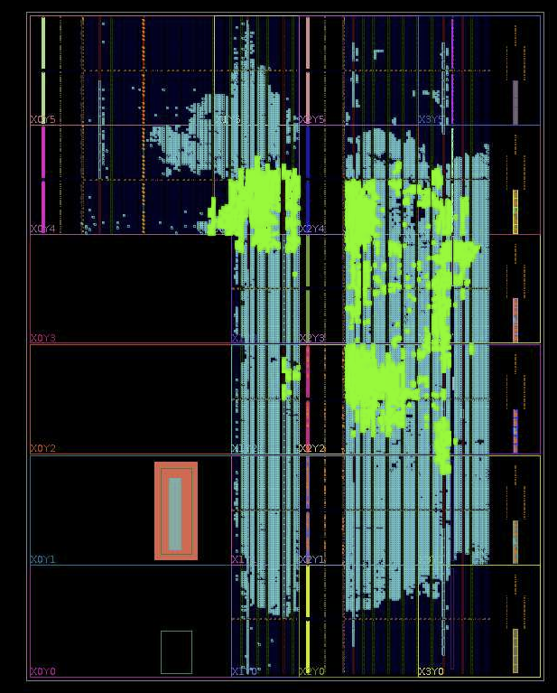
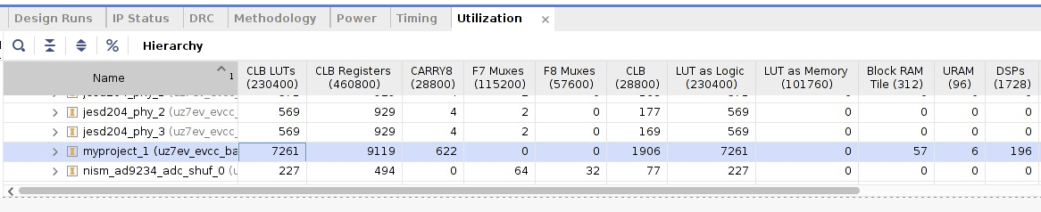
LEGIMAC HLS Implementation
Clock Frequency: 250 MHz
LUT 3.5%
RAM: 18.2%
DSP: 11.3%
ICSC Italian Research Center on High-Performance Computing, Big Data and Quantum Computing
Missione 4 • Istruzione e Ricerca
Notes:
Template e guide lines

Slide 38
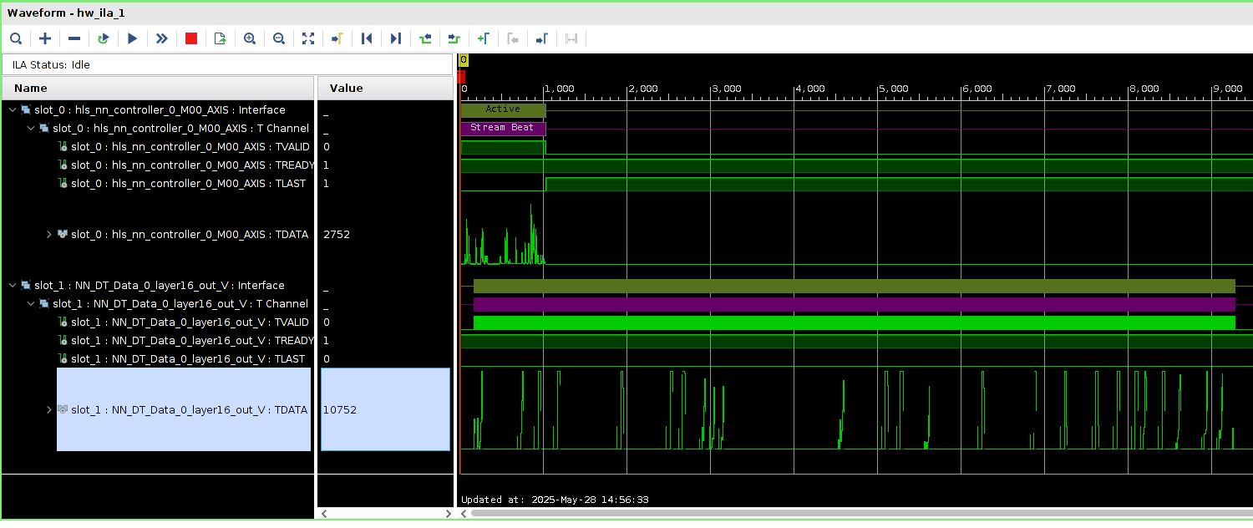
LEGIMAC HLS Output
INPUT
OUTPUT
ICSC Italian Research Center on High-Performance Computing, Big Data and Quantum Computing
Missione 4 • Istruzione e Ricerca
Notes:
Template e guide lines

Slide 39
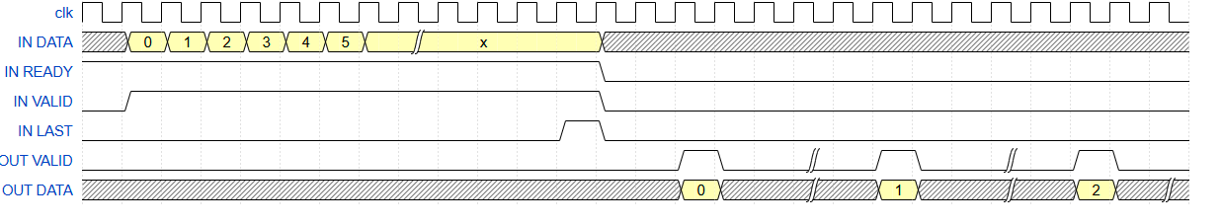
LEGIMAC HLS Timing
Input interval 1:1
DATA
LOAD
DATA
OUTPUT
Output interval 1:6
Total = 1024 + (1024 * 6) + overhead = 7500 clock cycles → 30us (clock 250MHz) = 34000 inference/s
4 engine x FPGA = 135 k inference/s → 135Msamples/s
ICSC Italian Research Center on High-Performance Computing, Big Data and Quantum Computing
Missione 4 • Istruzione e Ricerca
Notes:
{signal: [
{name: 'clk', wave: 'p...........................'},
{name: 'IN DATA', wave: 'x3333333|....xxxxxxxxxxxxxxx', data: ['0', '1', '2', '3', '4', '5', 'x']},
{name: 'IN READY', wave: '1............0..............'},
{name: 'IN VALID', wave: '01...........0..............'},
{name: 'IN LAST', wave: '0...........10..............'},
{name: 'OUT VALID', wave: '0..............10.|.10.|.10.'},
{name: 'OUT DATA', wave: 'x..............3xx|x3x.|x3x|', data: ['0', '1', '2', '3', '4', '5', '6', '7', '8', '9', 'x']},
]}

Slide 40

LEGIMAC HLS Output
Input is Time rescaled 1:6 to match output pipeline cycle
INPUT
OUTPUT
ICSC Italian Research Center on High-Performance Computing, Big Data and Quantum Computing
Missione 4 • Istruzione e Ricerca
Notes:
Template e guide lines

Slide 41


LEGIMAC Processed Output
ICSC Italian Research Center on High-Performance Computing, Big Data and Quantum Computing
Missione 4 • Istruzione e Ricerca
Notes:
Template e guide lines

Slide 42
LEGIMAC Realtime and low latency
First ADC Sample of the spill
First Result
700 clock cycles → 2.8us
INPUT
OUTPUT
ICSC Italian Research Center on High-Performance Computing, Big Data and Quantum Computing
Missione 4 • Istruzione e Ricerca
Notes:
Template e guide lines

Slide 43


LEGIMAC HLS Implementation
330mW for 35000 inference/s!!!
ICSC Italian Research Center on High-Performance Computing, Big Data and Quantum Computing
Missione 4 • Istruzione e Ricerca
Notes:
Template e guide lines

Slide 44
Comparison with GPU
Model | RAM | Inference/s | Power
FPGA Implementation | 257 kbytes | 34000 | 0.35W
GTX4060 | 30 Mbytes / 8Gb | 30000 | 100W
Jetson Orin Nano | 30 Mbytes / 4Gb | 11500 | 5W
ICSC Italian Research Center on High-Performance Computing, Big Data and Quantum Computing
Missione 4 • Istruzione e Ricerca
Notes:
Template e guide lines

