Slide 1
Symmetric solutions for the N-body problem: a computational approach
V.L. Barutello*, M. Bergomi, D. Berti*, G.M. Canneori*, R. Ciccarelli,* I. De Blasi*, D. Ferrario, M. Introna*, D. Polimeni*, S. Terracini*, P. Vertechi
*Dept. of Mathematics, University of Turin
Spoke 3 III Technical Workshop, Perugia 26-29 Maggio, 2025
ICSC Italian Research Center on High-Performance Computing, Big Data and Quantum Computing
Missione 4 • Istruzione e Ricerca
Notes:
Cover

Slide 2
Scientific Rationale
N-body problem: predict the motion of N distinct particles under the action of the mutual gravitational interaction.
Poincaré conjecture: the periodic solutions are dense in the space of all possible bounded solutions.
The chaoticity of the N-body problem is one of the most famous problems in Celestial Mechanics, and the presence of (more and more complex) periodic solutions, which visit the many different regions of the phase space, goes in that direction.
= class of all the possible periodic paths in the configuration space (functions from to a subset of )
The solutions are found as critical points of the Lagrangian action
G-equivariance: analytical tool that can be used to find symmetric periodic solutions (based on invariance with respect to a group action).
ICSC Italian Research Center on High-Performance Computing, Big Data and Quantum Computing
Missione 4 • Istruzione e Ricerca
Notes:
Template e guide lines

Slide 3
Technical Objectives, Methodologies and Solutions
Making use of the G-equivariance principle, search for highly complex periodic orbits:
start by creating a database of “simple” symmetric solutions, using the SymOrb program. SymOrb, originally written in FORTRAN, Python and GAP in the 2000s and today translated in Julia, returns symmetric solutions for the N-body problem obtained as (non necessarily minimal) critical point for the Lagrangian action. The orbit is computed starting from random initial guesses and using different numerical methods (gradient descent, Newton,...) to find critical points;
such numerical solutions can be transformed into actual mathematical solutions by means of computer assisted proofs;
the database can be enriched by computing numerically, for each solution, stability indicators like the Floquet exponents (to estimate the rate of separation of close orbits) or the Morse index (to estimate the variation in action for close orbits);
the orbits in the database can be clustered in terms of their shape and stability similarity (in Fourier space), to group together the ones with similar properties;
starting from the above database, one can use optimization algorithms to produce new orbits, not necessarily periodic (for example, as combinations of the ones already found).
ICSC Italian Research Center on High-Performance Computing, Big Data and Quantum Computing
Missione 4 • Istruzione e Ricerca
Notes:
Template e guide lines

Slide 4
Technical Objectives, Methodologies and Solutions
Example of database for 3 bodies in and
In this case, there are more than 100 different symmetries. For every of them, one can start with different initial data and different methods to find critical points. The construction of the database is divided into two steps:
first set: minimal critical trajectories (already done, over 1000 numerically computed solutions have been found);
second set: critical trajectories which are not necessarily minimal (using the results already obtained with step 1 to optimize the process; at present, over 2000 solutions have been found);
stability analysis: once the solutions are found, their stability indicators can be numerically computed with suitable routines.
ICSC Italian Research Center on High-Performance Computing, Big Data and Quantum Computing
Missione 4 • Istruzione e Ricerca
Notes:
Template e guide lines

Slide 5
Main Results
Theoretical framework: starting from the existing literature on the G-equivariant orbith of the N-body problem (Ferrario - Terracini, 2004), a detailed documentation on the theoretical framework has been written, and it has been the subject of a PhD course held in Spring 2023. After that, an extensive study on how to construct new, non trivial symmetry groups has been carried on (preprint submitted).
SymOrb routine: originally written in Fortran, Python and GAP, it has been translated in Julia and an optimised interface has been added, along with visualization tools (code in an online repository)
Database: rerunning the routine in Julia, an extended database, has been produced for 3 bodies in 2 and 3 dimensions (see next slides). More details on the orbits have been added (database in an online repository).
Stability indicators: the routines for the numerical computations of stability indicators have been created (from scratch). They have been tested on several orbits and optimised. The results obtained numerically have been compared with the existing literature (preprint in preparation).
ICSC Italian Research Center on High-Performance Computing, Big Data and Quantum Computing
Missione 4 • Istruzione e Ricerca
Notes:
Template e guide lines

Slide 6
Main results
The new database
We employed the new routine in Julia to reconstruct the database of orbits of three bodies in two/three dimensions.
Advantages:
the routine is much faster;
we have more details on the orbits, such as the initial points of the optimization routine.
Keeping tracks of the initial points is crucial if we want to establish a hierarchy between the orbits and to generate new ones: we would like to know which are the region of initial points when we expect to find “interesting” trajectories.
Final result → around 1200 raw orbits, some of them never found before.
ICSC Italian Research Center on High-Performance Computing, Big Data and Quantum Computing
Missione 4 • Istruzione e Ricerca
Notes:
Template e guide lines

Slide 7
Main results
The problem of close encounters
Running the stability indicators routines on the database, we found a problem.
The N-body potential is singular when two bodies collapse in the same point (or are very close to each others) → numerical methods in this case may fail.
Numerical evidences of the problem:
anomalous fluctuations in the energy;
critical points which disappear when changing the parameters of the problem (e.g. number of Fourier coefficients considered);
anomalous results when testing the stability indicators routines (e.g. values which are too high).
ICSC Italian Research Center on High-Performance Computing, Big Data and Quantum Computing
Missione 4 • Istruzione e Ricerca
Notes:
Template e guide lines

Slide 8
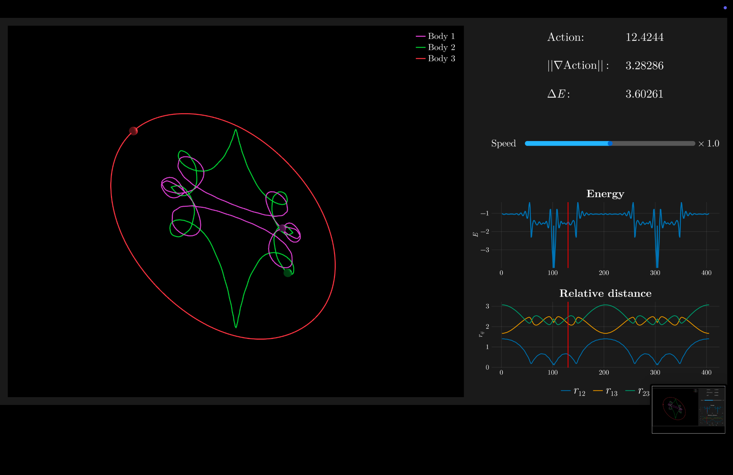
Main results
The problem of close encounters - Energy fluctuations
ICSC Italian Research Center on High-Performance Computing, Big Data and Quantum Computing
Missione 4 • Istruzione e Ricerca
Notes:
Template e guide lines

Slide 9
Main results
The problem of close encounters - Solution
We developed a new routine with a new numerical integrator, which has a much better control of the error, even close to singularities.
The new numerical integrator is much slower, so we use it only when needed.
In such way, we can test the orbits already found with the “fast” integrator and refine the results.
We expect around 10% of them will survive the refinement.
ICSC Italian Research Center on High-Performance Computing, Big Data and Quantum Computing
Missione 4 • Istruzione e Ricerca
Notes:
Template e guide lines

Slide 10
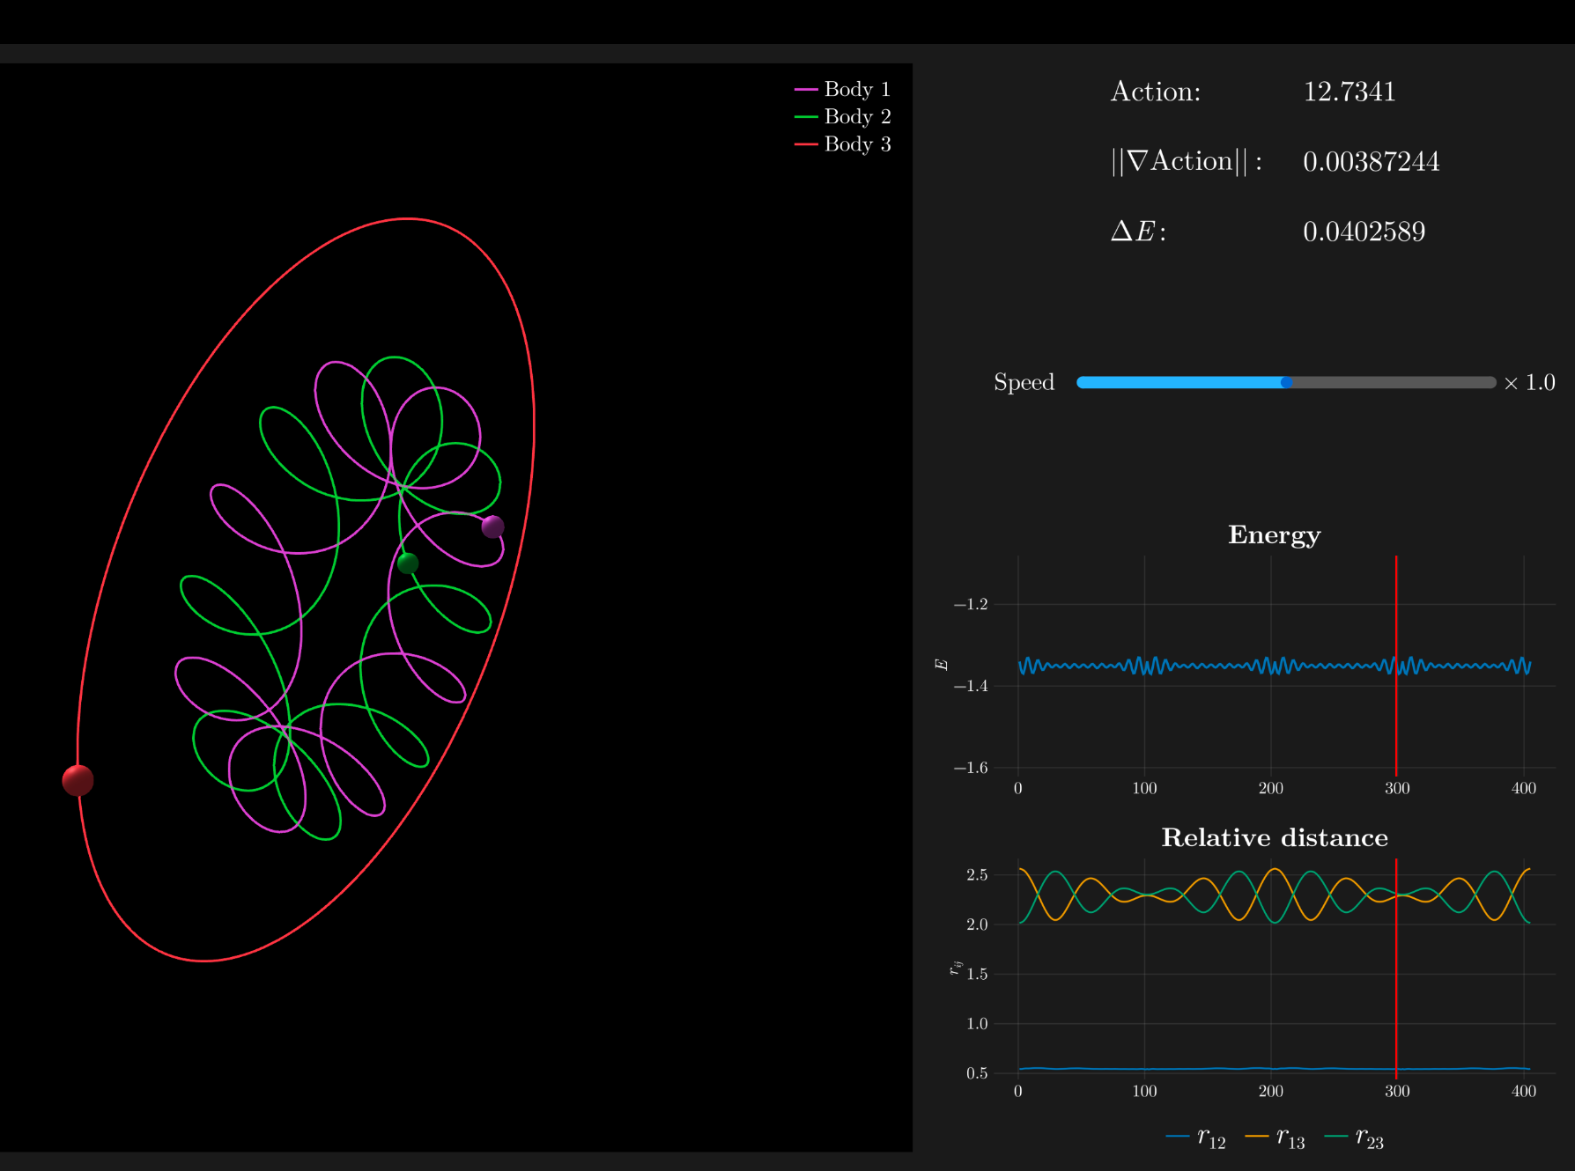
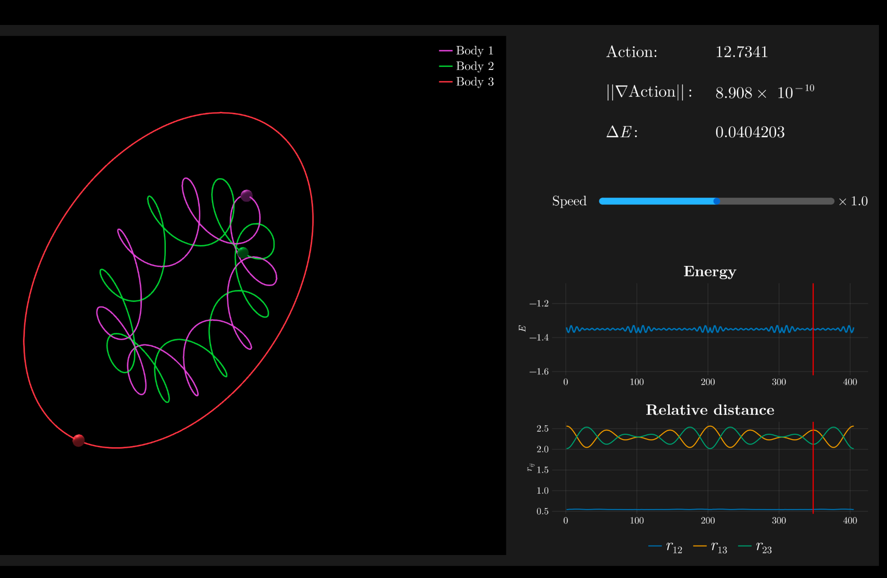
Main results
New integrator - Surviving orbits
ICSC Italian Research Center on High-Performance Computing, Big Data and Quantum Computing
Missione 4 • Istruzione e Ricerca
Notes:
Template e guide lines

Slide 11
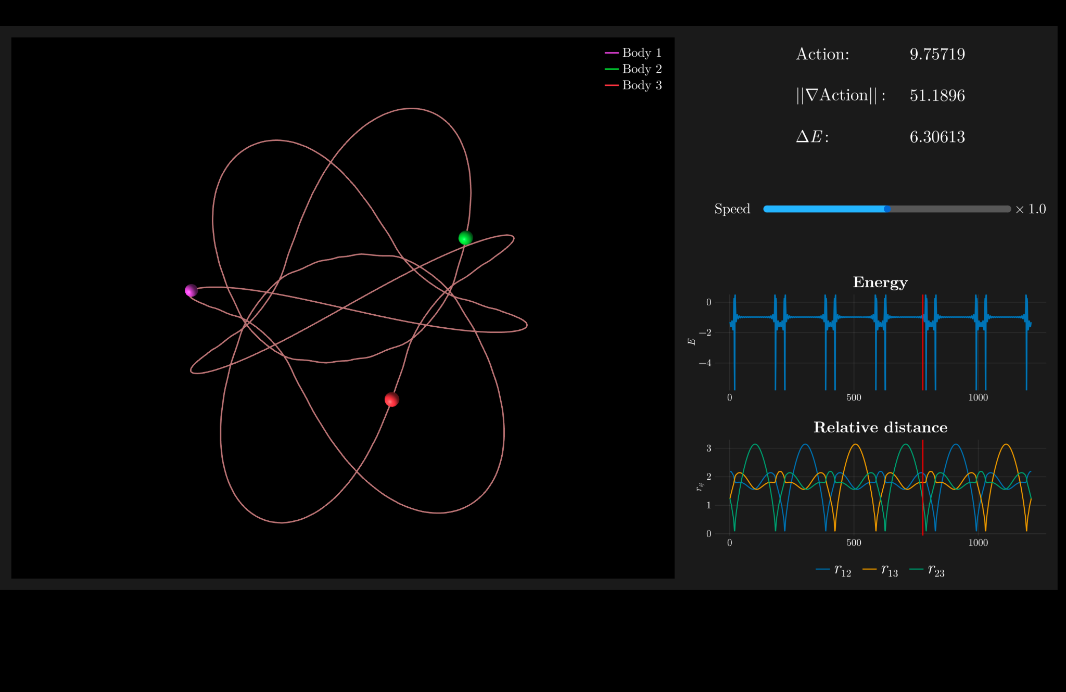
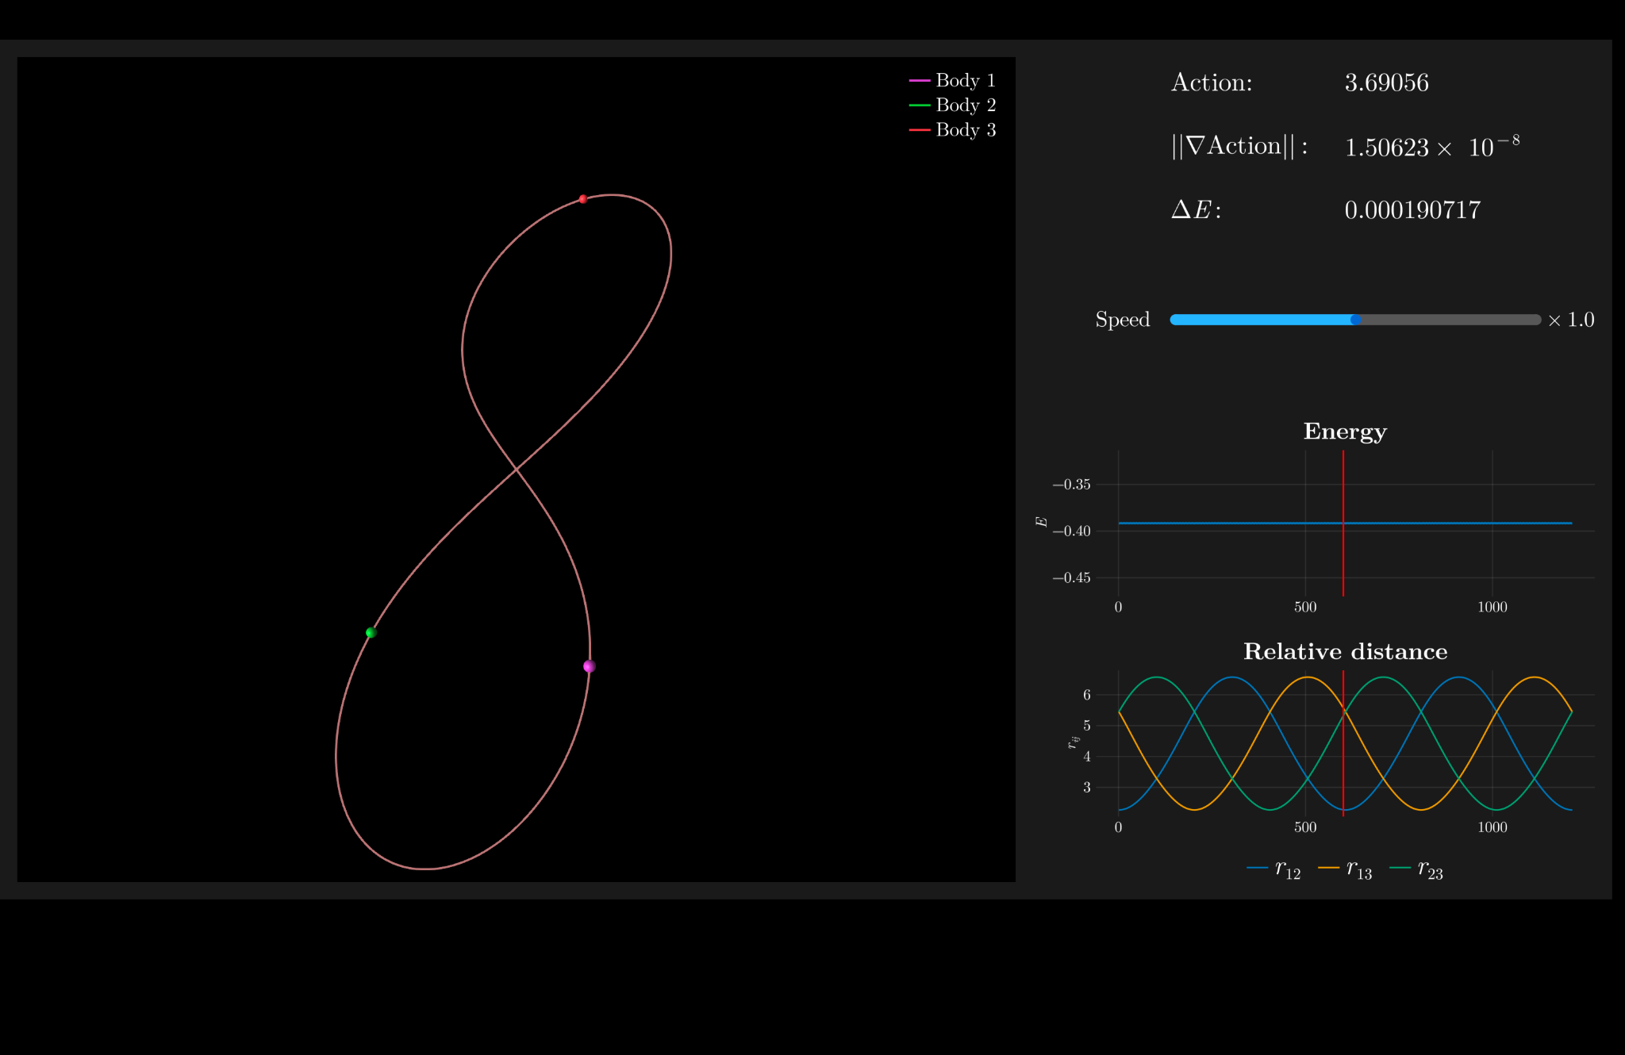
Main results
New integrator - Disappearing orbits
ICSC Italian Research Center on High-Performance Computing, Big Data and Quantum Computing
Missione 4 • Istruzione e Ricerca
Notes:
Template e guide lines

Slide 12
Main results
New integrator - New complex orbits
ICSC Italian Research Center on High-Performance Computing, Big Data and Quantum Computing
Missione 4 • Istruzione e Ricerca
Notes:
Template e guide lines

Slide 13
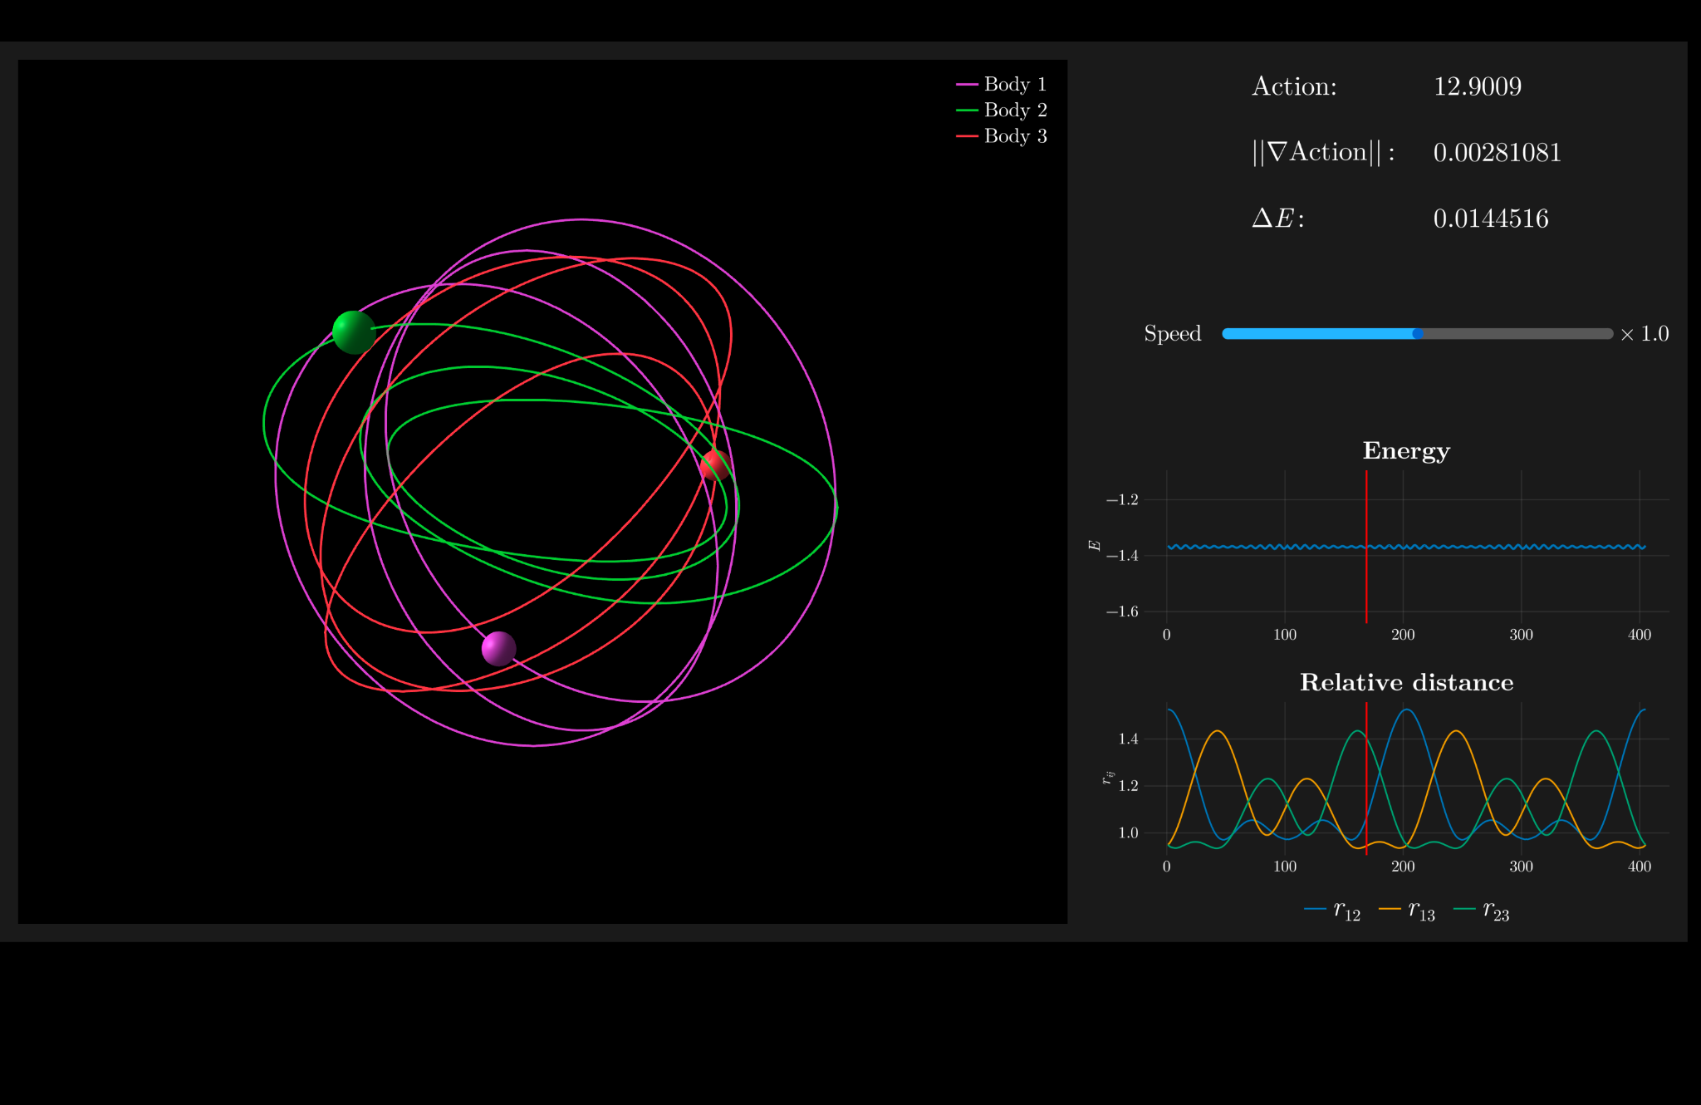
Main results
New integrator - New complex orbits
ICSC Italian Research Center on High-Performance Computing, Big Data and Quantum Computing
Missione 4 • Istruzione e Ricerca
Notes:
Template e guide lines

Slide 14
Final steps
Database: the database has to be refined with the new integrator. The final result should be a set of orbits + initial conditions + stability properties.
Computer assisted proofs: to prove rigorously the existence of solutions, starting from numerically computed ones.
Clustering: une orbits can be grouped on the basis of similar dynamic properties.
A hierarchy of initial conditions: by observing the database, one can detect the regions of initial conditions where it is more likely to find complex orbits.
Parametrise the chaos: find solutions that visits many different regions of the phase space, starting from initial conditions in the most “promising” regions of the phase space. This is the ultimate objective of our analysis, since theoretically the chaotic behaviour is related to the presence of a solution dense in the phase space; such trajectory can be found as a limit of complex periodic solutions.
ICSC Italian Research Center on High-Performance Computing, Big Data and Quantum Computing
Missione 4 • Istruzione e Ricerca
Notes:
Template e guide lines

