Slide 1

gPLUTO: a multi-physics code for astrophysical plasma
A. Mignone¹, A. Suriano¹, V. Berta¹, M. Rossazza¹, S. Truzzi¹
¹Physics Department , University of Torino (UNITO)
Spoke 3 III Technical Workshop, Perugia 26-29 Maggio, 2025
ICSC Italian Research Center on High-Performance Computing, Big Data and Quantum Computing
Missione 4 • Istruzione e Ricerca
Notes:
Cover

Slide 2
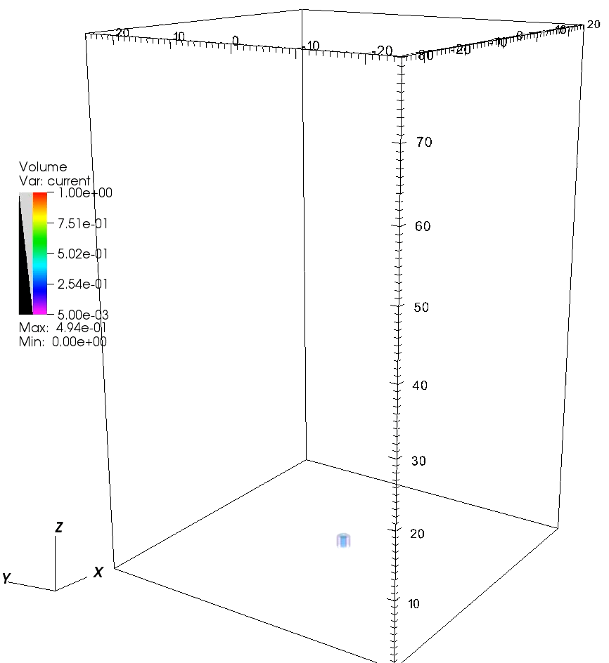
The PLUTO (Legacy Code)
PLUTO^{1,2} is a finite volume Godunov-type modular parallel code providing a multi-physics and multi-algorithm framework for solving the equations of astrophysical plasma;
Written in the C programming language;
Target: multidimensional compressible plasma with high Mach numbers:
  Compressible Euler/Navier Stokes;
  Newtonian (ideal/resistive) MHD;
  (Special) Relativistic MHD;
  Heating/cooling processes, chemical network, …
Freely distributed at http://plutocode.ph.unito.it (v. 4.4)
¹Mignone et al. ApJS (2007), 170, 228-242; ²Mignone et al, ApJS (2012), 198, 7
ICSC Italian Research Center on High-Performance Computing, Big Data and Quantum Computing
Missione 4 • Istruzione e Ricerca

Slide 3
Prototype Equations: ideal MHD
MHD suitable for describing plasma at large scales;
Good first approximation to much of the physics, even when some of the conditions are not met.
Draw some intuitive conclusions concerning plasma behavior without solving the equations in detail.
Ideal MHD equations are hyperbolic conservation laws.
ICSC Italian Research Center on High-Performance Computing, Big Data and Quantum Computing
Missione 4 • Istruzione e Ricerca
Notes:
PLUTO starting point are the MHD eq
- MHD is the simplest mathematical description of a plasma.

Slide 4
PLUTO Modularity
PLUTO dates back to 2007 and it comes with several physics modules:
…and algorithms:
Basics Physics | Dissipation | Thermodynamics | Geometry | Particles
[HD] Euler Equations; [MHD] Magnetohydrodynsmics; [RHD] Relativistic Hydro; [RMHD] Relativistic (ideal) MHD; [ResRMHD] Relativistic non-ideal MHD | Viscosity Thermal Conduction Resistivity Hall MHD | Ideal Isothermal Non-constant Synge Gas | Cartesian Cylindrical Spherical | Cosmic Rays Lagrangian Dust
Time Stepping | Reconstruction | Riemann Solver | ∇∙B = 0
Hancock / Char- tracing RK2 / RK3 | Linear PPM WENO 3rd and 5th MP5 | Exact Roe HLL / HLLC / HLLD TVDLF GFORCE | Eight wave GLM Constrained transport
ICSC Italian Research Center on High-Performance Computing, Big Data and Quantum Computing
Missione 4 • Istruzione e Ricerca
Notes:
MHD is the simplest mathematical description of a plasma.

Slide 5
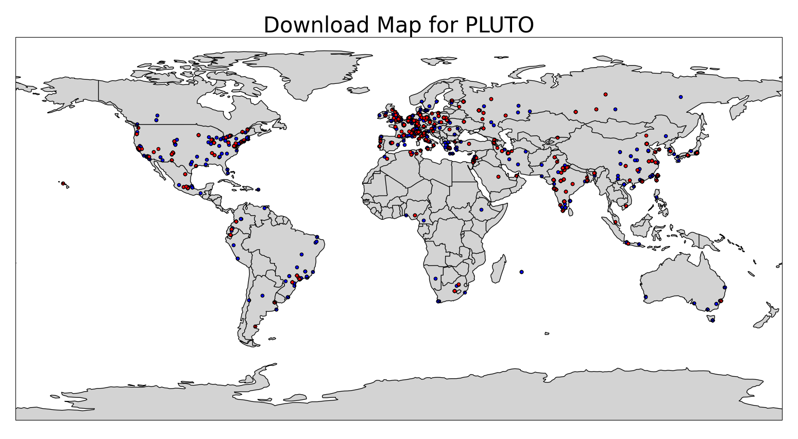
PLUTO Download Worldwide Map
PLUTO 4.3 (2018-2021)
∼ 1360 downloads
PLUTO 4.4 (2020-2021)
∼ 460 downloads
PLUTO 4.3
PLUTO 4.4
ICSC Italian Research Center on High-Performance Computing, Big Data and Quantum Computing
Missione 4 • Istruzione e Ricerca

Slide 6

gPLUTO: Development
Still me… But gBETTER!
ICSC Italian Research Center on High-Performance Computing, Big Data and Quantum Computing
Missione 4 • Istruzione e Ricerca
Notes:
Part of this work is supported also by the SPACE CoE.

Slide 7
The exascale challenge: gPLUTO
The standard PLUTO codewill be maintained although will no longer receive major upgrades.
Drastic re-design and re-engineer in order to cope with new exa-scale hardware solution, typically endowed with heterogenous architectural complexity.
gPLUTO – the next line of development - is a full rewrite of the PLUTO code targeting exascale facilities and new generation hardware.
C++ & OpenACC (a high-level directive-based programming model developed by NVIDIA) chosen as our programming paradigm.
Aims: i) exhaustive porting of the code to GPU, ii) targeting exa-scale facilities with both CPU and GPUs; iii) complete code revision (PLUTO is 18 years old !);
ICSC Italian Research Center on High-Performance Computing, Big Data and Quantum Computing
Missione 4 • Istruzione e Ricerca
Notes:
The standard version of PLUTO will survive, although our major efforts now go into the next generation version.
In fact, in order to efficiently exploit exa-scale computing capabilities (heterogeneous unprecedented architectural complexity) a drastic re-design and extensive re-engineering of the code was necessary. This also allowed us to engage with new computational solutions and adopt innovative programming paradigms.
Why OpenACC ? → i) high-level, ii) requires few changes to the code, iii) directive-based;

Slide 8
Activities Timelime
 | Achievement
Oct 2022: Simple 2D HD miniapp (C, ∼1000 lines); | Code restructure, array re-organization, etc..
March 2023: Added OpenACC functionality; | Achieved ~ 10 x speedup (GPU vs CPU);
Oct 2023: Imported new kernels (MHD, MPI support for CPU, new Riemann solvers, etc..); user-interface; | More physics, increased user-friendliness & portability;
Jan 2024: Switched to C++; some macro re-design; added relativistic modules; Particles | More versatile construct (e.g., templates, classes, vectors); improved readability & speedup (up to 50 x)
June 2024: implementation & optimization of new features (4th-order methods) and kernels (ResRMHD), 𝛼-release; | Increased parallel performance with MPI on both CPU and GPU; more physics and complex algorithms; documentation started;
February 2025: OpenMP; Geometry | Added non-Cartesian geometries and OpenMP
Aug 2025: 1st stable release;
-
-
-
-
-
-
-
ICSC Italian Research Center on High-Performance Computing, Big Data and Quantum Computing
Missione 4 • Istruzione e Ricerca
Notes:
Back in 2020: create mini version of the code, featuring only the HD module;
This simplified our 1st approach to GPU, allowing transitioning of the entire computational skeleton — an essential step for optimal performance.
We incrementally added modules and algorithms ever since, reaching the point where MHD, relativistic and resistive MHD modules, and many algorithms are now mplemented.
Throughout this process we made many small, not invasive changes, to adapt the code to the new parallel approach. Besides these, we decided to move to C++ to exploit
some features (templates, classes & vectors).
This for example made easier handling index ordering of multidimensional arrays, memory coalescence.

Slide 9

Ported Modules
MODULE | PLUTO (C) | gPLUTO (C++)
HD / MHD / RHD / RMHD / ResRMHD | YES | YES
General Relativity | NO | In Progress [80%]
Cylindrical / Spherical Geom | YES | YES
Non-Uniform Grid | YES | YES
Diffusion Processes (Visc / TC / Resistivity) | YES | In Progress [20%]
ShearingBox | YES | NO
FARGO | YES | YES
Cooling | YES | In Progress [40%]
Poisson Solver | NO | YES
Particles | YES | In Progress [60%]
AMR | YES | In Progress [40%]
Documentation / User Interface | YES | YES
Parallel I/O Support (bin, HDF5, VTK) | YES | YES
OpenACC / OpenMP Support | NO | YES
SPACE CoE
https://www.space-coe.eu/
ICSC Italian Research Center on High-Performance Computing, Big Data and Quantum Computing
Missione 4 • Istruzione e Ricerca
Notes:
Approximately 70 % of the original code modules have been ported to gPLUTO.
But we also are working on new features not presented in the older version, Poisson Solver, GR and a built-in AMR

Slide 10
GPU Computing: keypoints
OpenACC: programming model based on compute (e.g., #pragma acc parallel loop) and data directives (e.g., #pragma enter data …) to accelerate loop and data transfer from CPU to GPU memory:
Data Locality: reduce data movement between CPU and GPU memory as much as possible: moved all computational intensive part of the program to GPUs.
The #pragma acc parallel loop is c compute directive used to accelerate a loop on the the GPU:
#pragma acc parallel loop vector
for (i = 0; i < N; i++){
// Loop body
// ... Things to do here ...
}
The #pragma enter data copying directive explicitly transfers data from the CPU memory to the GPU memory.
#pragma acc enter data copyin (A,B)
// ... Code where A ad B are used in GPU computations
#pragma acc exit data delete (A,B)
ICSC Italian Research Center on High-Performance Computing, Big Data and Quantum Computing
Missione 4 • Istruzione e Ricerca
Notes:
..
Data Locality: Data transfer major bottleneck → all computational part of the program should reside in GPU memory !
Without precautions, simultaneous operations are performed at the same memory address leading to incorrect results.
The main limiting factor of GPU acceleration is the movement of data from CPU to GPU memory.
When transfering execution from device to host, data have to be updated, potentially wasting the acceleration gained with GPUs.
To avoid this on gPLUTO we keep main data arrays on the GPU as long as possible, don't update data on host memory.
In practice the whole computational part of the application is executed on GPUs.

Slide 11
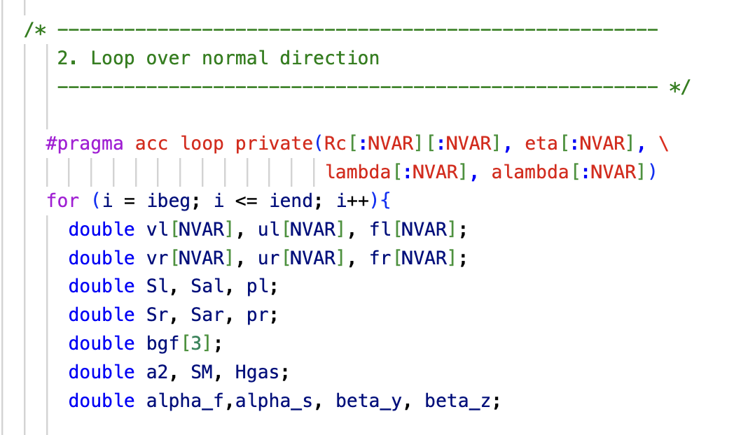
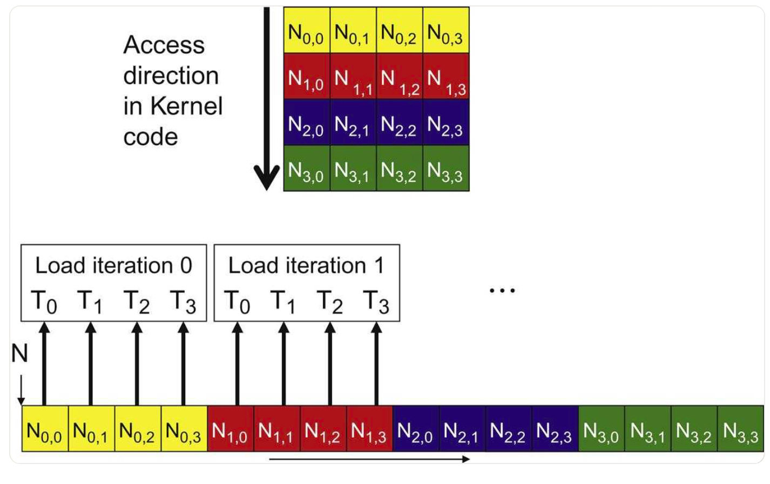
GPU Computing: keypoints
Private Variables:
  GPU threads should perform identical operations but on different memory addresses;
  Private variables have local scope and are allocated individually for each thread.
Coalesced Memory Access: as consecutive threads access consecutive memory addresses, memory coalescing allows optimal usage of the global memory bandwidth. → Requires different array ordering.
ICSC Italian Research Center on High-Performance Computing, Big Data and Quantum Computing
Missione 4 • Istruzione e Ricerca
Notes:
Privatization: GPU threads execute the same operation on different memory addresses to avoid conflicts leading to wrong results. To avoid this, each variable inside a kernel must have a memory space private to the thread;
Coalesced memory: When a thread requires an element on an arrays, it receives (within a single memory transaction) not only a single element but a bunch of consecutive elements. If a neighbour thread needs an element, it can work with it, otherwise it has to wait wasting resource. This situation depends on array ordering --> fastest index of the array must coincide with the index of most inner parallelized loop. This is the reason why we changed the order of many indexes with respect to PLUTO.

Slide 12
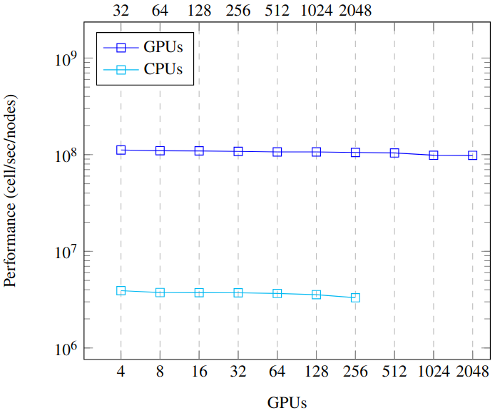
Weak Scaling Performance: CPU vs GPU [Leonardo]
System: Leonardo Booster Partition (Cineca).
Application: performance at increasing number of nodes at fixed resolution per node:
Problem Size: 704 x 704 x 352 cells per node = 352³ per GPU (176³ per CPU)
#Nodes | T_{GPU} (sec) | T_{CPU} (sec) | Acceleration [T_{CPU}/T_{GPU}]
1 | 312 | 8910 | 28.55
2 | 318 | 9136 | 29.29
4 | 319 | 9345 | 29.29
8 | 323 | 9382 | 29.04
16 | 327 | 9520 | 29.11
32 | 327 | 9795 | 29.95
64 | 331 | 10547 | 31.86
128 | 335 | - | -
256 | 354 | - | -
512 | 355 | - | -
ICSC Italian Research Center on High-Performance Computing, Big Data and Quantum Computing
Missione 4 • Istruzione e Ricerca
Notes:
Here are shown the performance and the acceleration of the application, with weak scaling tests on Leonardo.
Left: performance of the application at increasing number of nodes at fixed resolution per node (computed multiplying the number of cells and the number of steps done and dividing by time and nodes)
Right: table reporting the exact execution times and the acceleration of GPUs runs to CPUs.
A factor 30 of speed-up is noted. I remind you that this compares runs on 4 GPU per node to 32 CPU-cores per node.

Slide 13
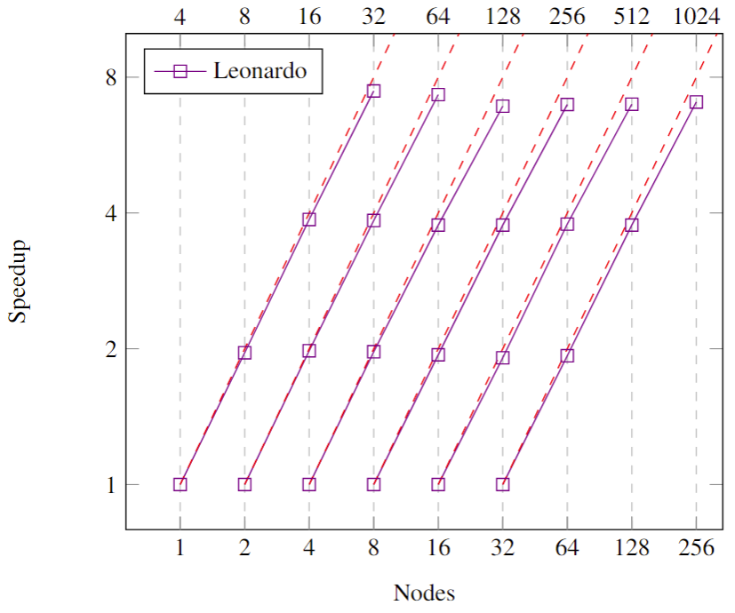
Strong & Weak Scaling: Speedup [Leonardo GPUs]
System: Leonardo (4 GPUs x Node);
Max # used cores: 1024 GPUs (256 nodes)
Scaling type: weak and strong (6 different runs with increasing resolutions and # of nodes):
#Run | #Nodes | Resolution | Parallel Efficiency
1 | 1,2,4,8 | 416 x 832 x 832 | 1, 0.98, 0.97, 0.93
2 | 2,4,8,16 | 832 x 832 x 832 | 1, 0.99, 0.96, 0.92
3 | 4,8,16,32 | 1664 x 832 x 832 | 1, 0.99, 0.94, 0.86
4 | 8,16,32,64 | 1664 x 1664 x 832 | 1, 0.97, 0.94, 0.87
5 | 16,32,64,128 | 1664 x 1664 x 1664 | 1, 0.96, 0.95, 0.87
6 | 32,64,128,256 | 3328 x 1664 x 1664 | 1, 0.97, 0.94, 0.88
ICSC Italian Research Center on High-Performance Computing, Big Data and Quantum Computing
Missione 4 • Istruzione e Ricerca

Slide 14
Scientific Case:
Hybrid Fluid – Particles Methods
ICSC Italian Research Center on High-Performance Computing, Big Data and Quantum Computing
Missione 4 • Istruzione e Ricerca

Slide 15
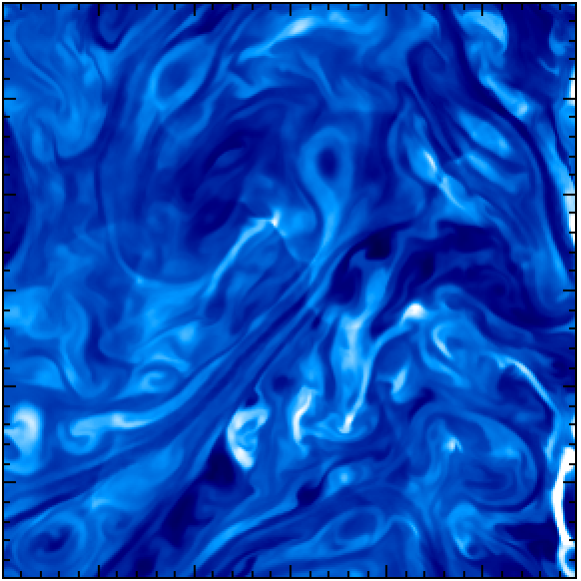

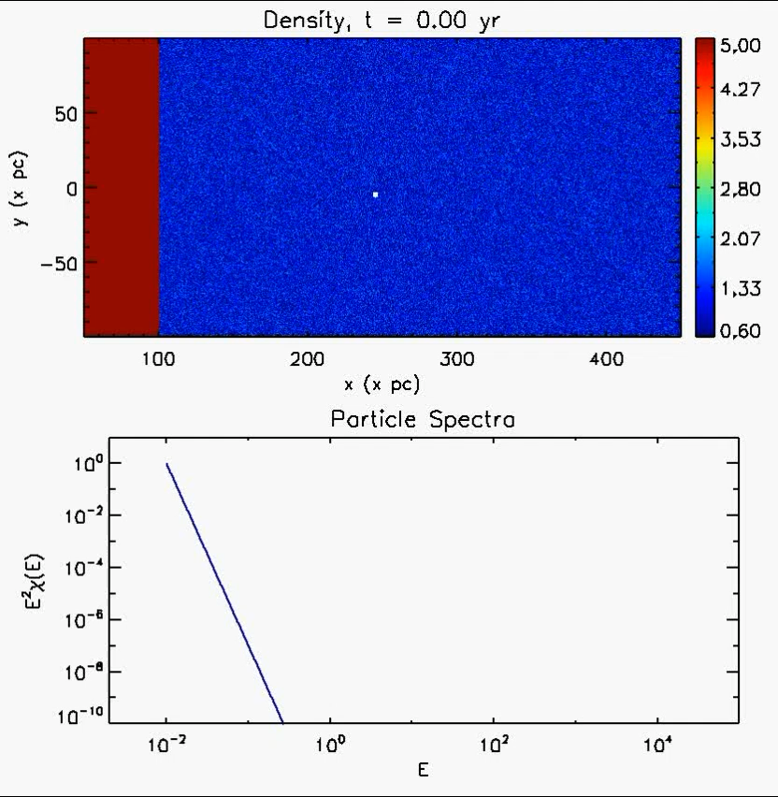
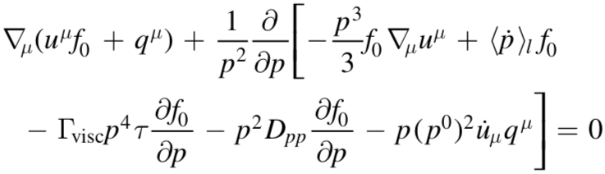
Hybrid Fluid – Particles Methods
Target: Large-scale non-thermal emission from high-energy sources.
Lagrangian Particles (LP¹): cloud of electrons close in physical space, characterized by energy distribution function f=dN/dE(ε,t).
LP transported at the fluid speed (dx/dt = v_{g}), spectra is evolved by solving, for each particle, a Fokker-Planck equation:
Single LP, Fermi I
Shock Acceleration
¹Vaidya et al. ApJS (2018), 865, 144V
ICSC Italian Research Center on High-Performance Computing, Big Data and Quantum Computing
Missione 4 • Istruzione e Ricerca
Notes:
PLUTO also allows particles to be included in the computations, in similar way to what is done by N-body or PIC codes.
Here I focus only on the kind of particles are being ported to GPU.
. . .
Adiabatic Expansion, Synchtotron / IC cooling, FERMI II acceleration but also FERMI I using a shock detection algorithm.
--> Comment movie

Slide 16
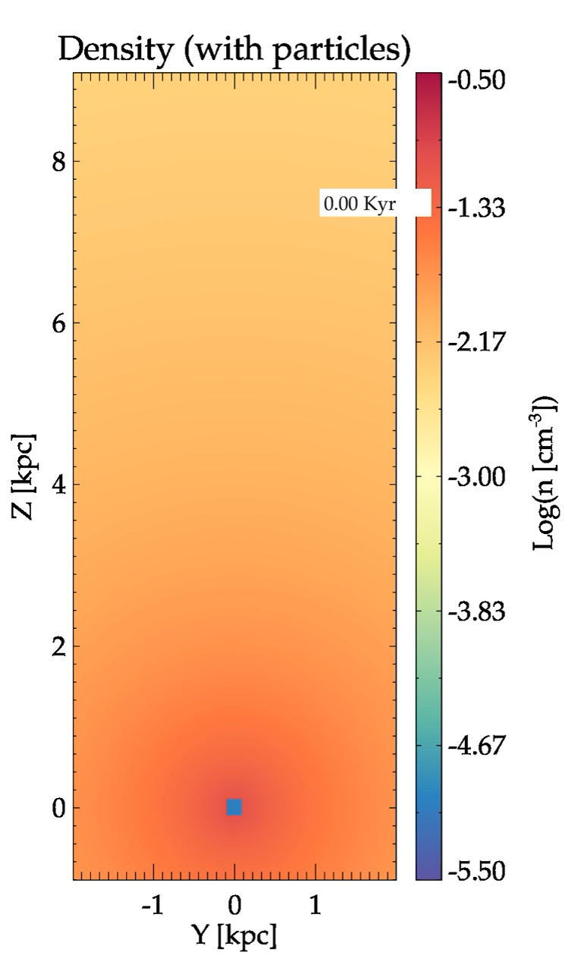
Synthetic Spectra from 3D Jets
Non thermal radiation from relativistic jet simulations essential for a comparison with observations;
Observed spectra results from the interaction between high-energy electrons and the in-situ magnetic and radiation fields.
Scale separation forbids full theoretical modelling.
Challenge: to build a quantitative connection between scales by means of sub-grid models exploiting Lagrangian particles describing non-thermal component.
Particle color: time since
last shock [part. age]
ICSC Italian Research Center on High-Performance Computing, Big Data and Quantum Computing
Missione 4 • Istruzione e Ricerca

Slide 17
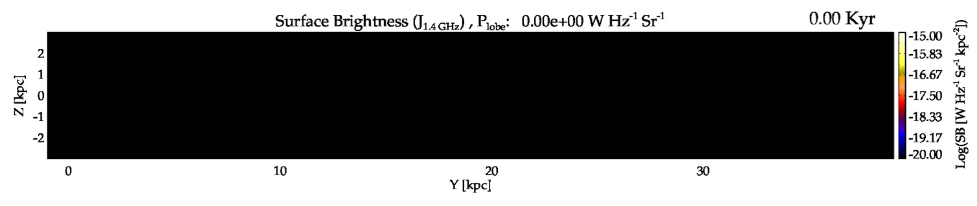
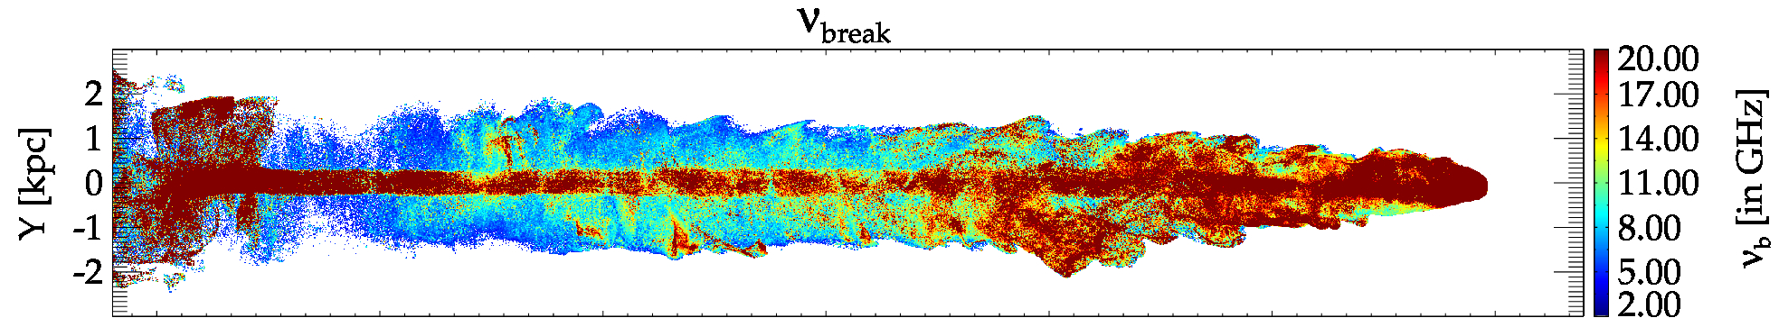
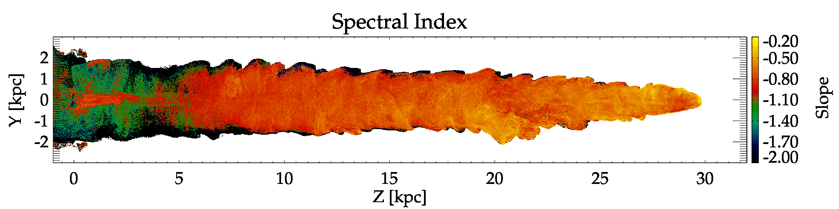
Connecting to observations: surface brightness maps
ICSC Italian Research Center on High-Performance Computing, Big Data and Quantum Computing
Missione 4 • Istruzione e Ricerca

Slide 18
Summary
gPLUTO: the next line of development of the code (70 % ported); moved to C to C++ for more versatile syntax; publicly available at: https://gitlab.com/PLUTO-code/gPLUTO
Successfully ported to multi-GPU, using both OpenACC and OpenMP (in progress). Weak scaling reveals ≳ 85 % efficiency and a speedup (CPU/GPU) of ≈ 30.
gPLUTO is already being used for production runs (internally) and a beta release is schedule by the end of Aug 2025.
Dissemination & Traning events to help user migrating. Next PLUTO Symposium: June 2026 (Germany).
ICSC Italian Research Center on High-Performance Computing, Big Data and Quantum Computing
Missione 4 • Istruzione e Ricerca

Slide 19
THANK YOU!
ICSC Italian Research Center on High-Performance Computing, Big Data and Quantum Computing
Missione 4 • Istruzione e Ricerca
Notes:
Template e guide lines

Slide 20
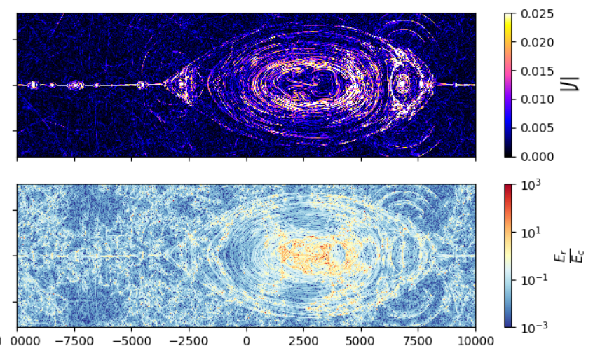
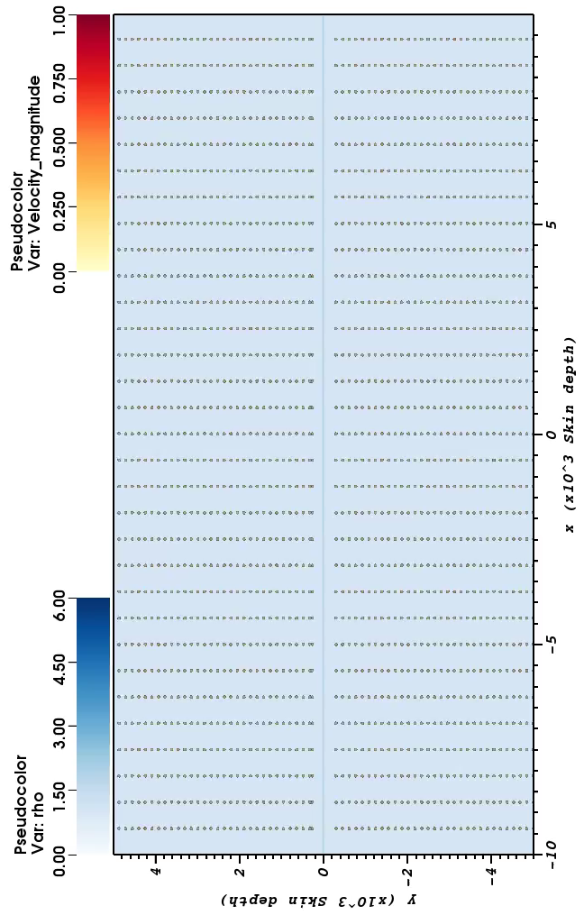
Scientific Case #1: Relativistic Reconnection
Resistive relativistic reconnection: powerful mechanism to quickly dissipate kinetic & magnetic energy at small scales.
It occurs in regions with thin and strong electric currents where resistivity 𝜼 dominates the dynamics.
Dissipated energy available to accelerate particles to ultra-relativistic energies.
Challenge: low values of 𝜼 → high resolution + high accuracy to lower numerical dissipation below physical resistivity.
ICSC Italian Research Center on High-Performance Computing, Big Data and Quantum Computing
Missione 4 • Istruzione e Ricerca

Slide 21
Main Results
Main Results Achived
Are the results in line with timescale, milestones and KPIs identifyed?
ICSC Italian Research Center on High-Performance Computing, Big Data and Quantum Computing
Missione 4 • Istruzione e Ricerca
Notes:
Template e guide lines

Slide 22
Final Steps
ICSC Italian Research Center on High-Performance Computing, Big Data and Quantum Computing
Missione 4 • Istruzione e Ricerca
Notes:
Template e guide lines

