Slide 1
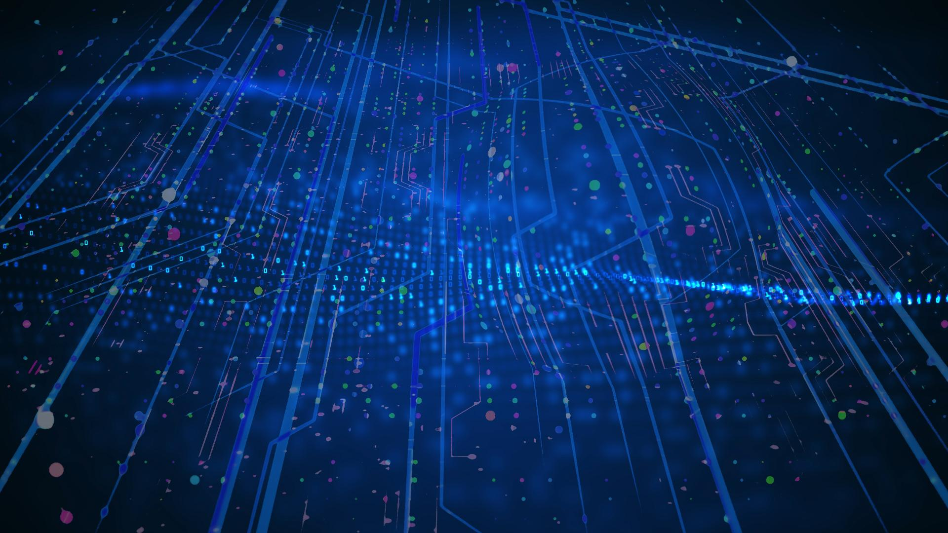
OpenGadget3: a new implementation of massive black holes dynamics
Alice Damiano
Spoke 3 III Technical Workshop, Perugia 28 Maggio, 2025
ICSC Italian Research Center on High-Performance Computing, Big Data and Quantum Computing
Missione 4 • Istruzione e Ricerca
Notes:
Cover

Slide 2
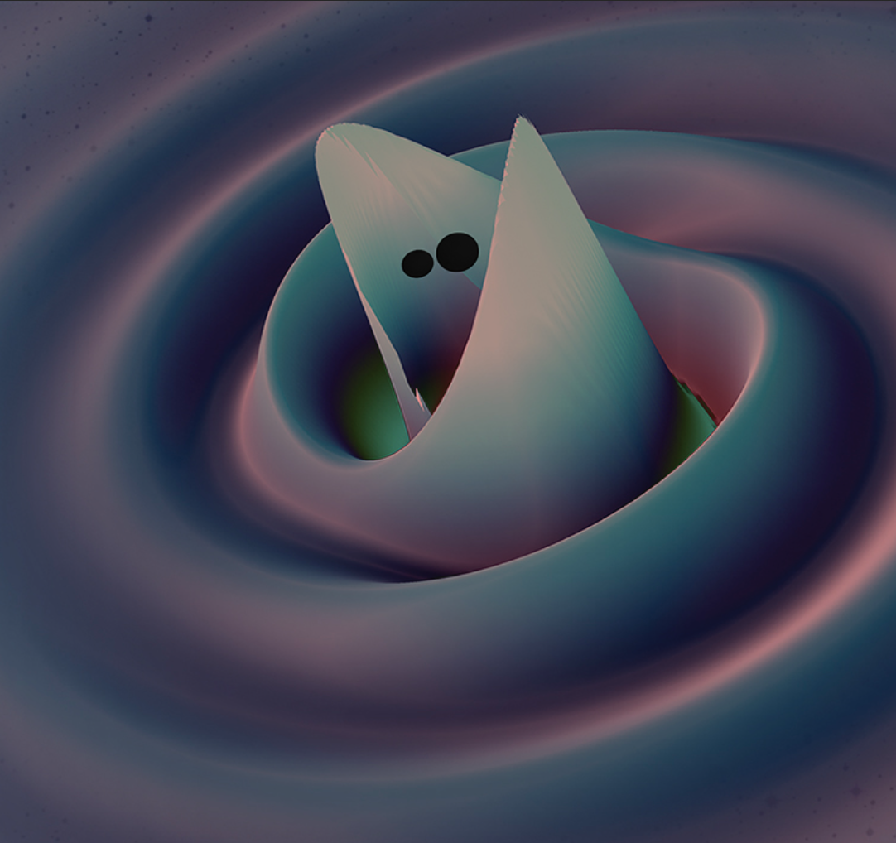
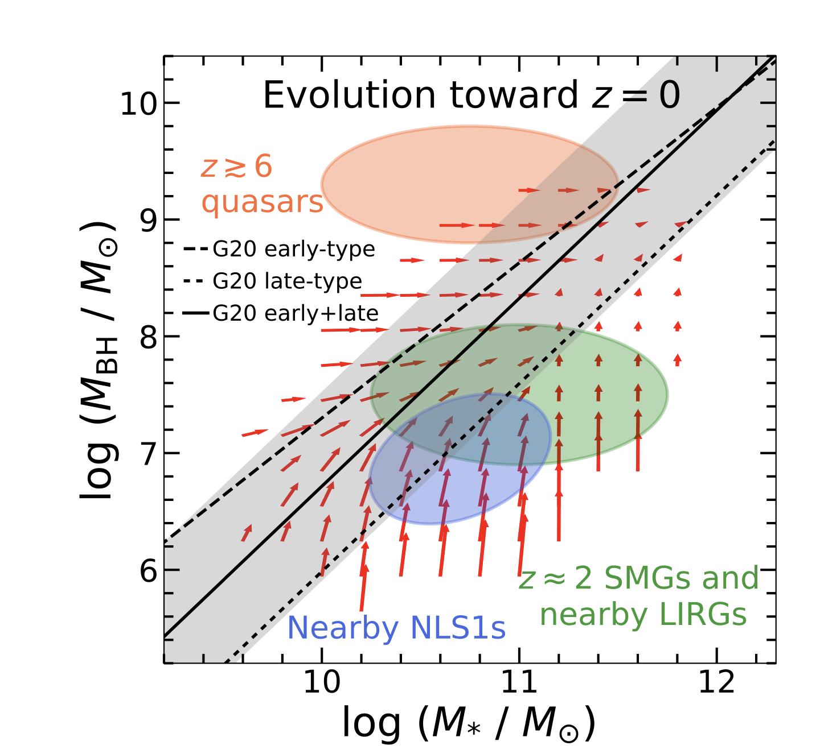
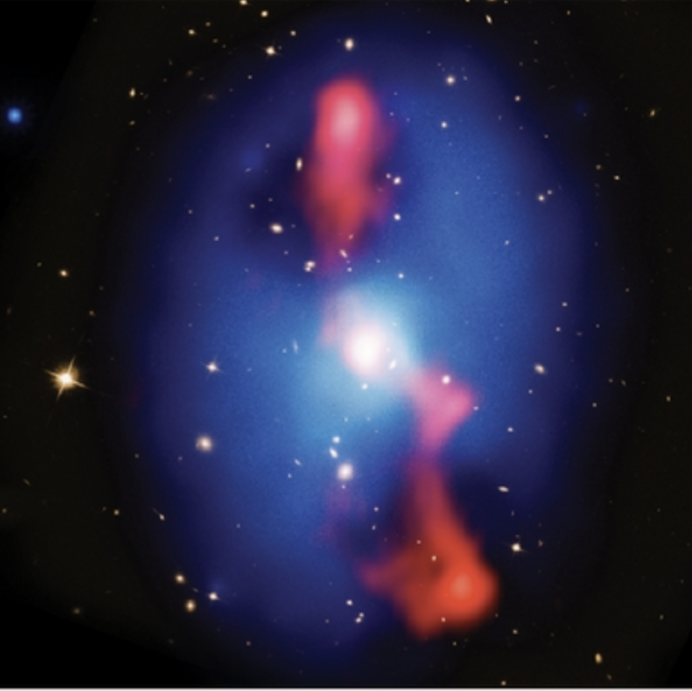
State-of-the-art cosmological simulations demand for an accurate tracing of Massive Black Holes (MBHs) dynamics
MBH location affects where feeding and feedback process take place with significant influence on the BH-galaxy interconnected evolutionary processes
Present and upcoming gravitational waves facilities need to be provided with statistical analysis of the merging rate
Scientific Rationale
Image credits: Maya collaboration;Superposition of Chandra,VLA and HST image of MS0735+7421; Zhuang&Ho, Nature Astronomy, 376–1389 (2023)
ICSC Italian Research Center on High-Performance Computing, Big Data and Quantum Computing
Missione 4 • Istruzione e Ricerca
Notes:
Template e guide lines

Slide 3
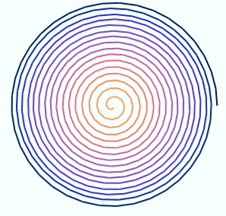
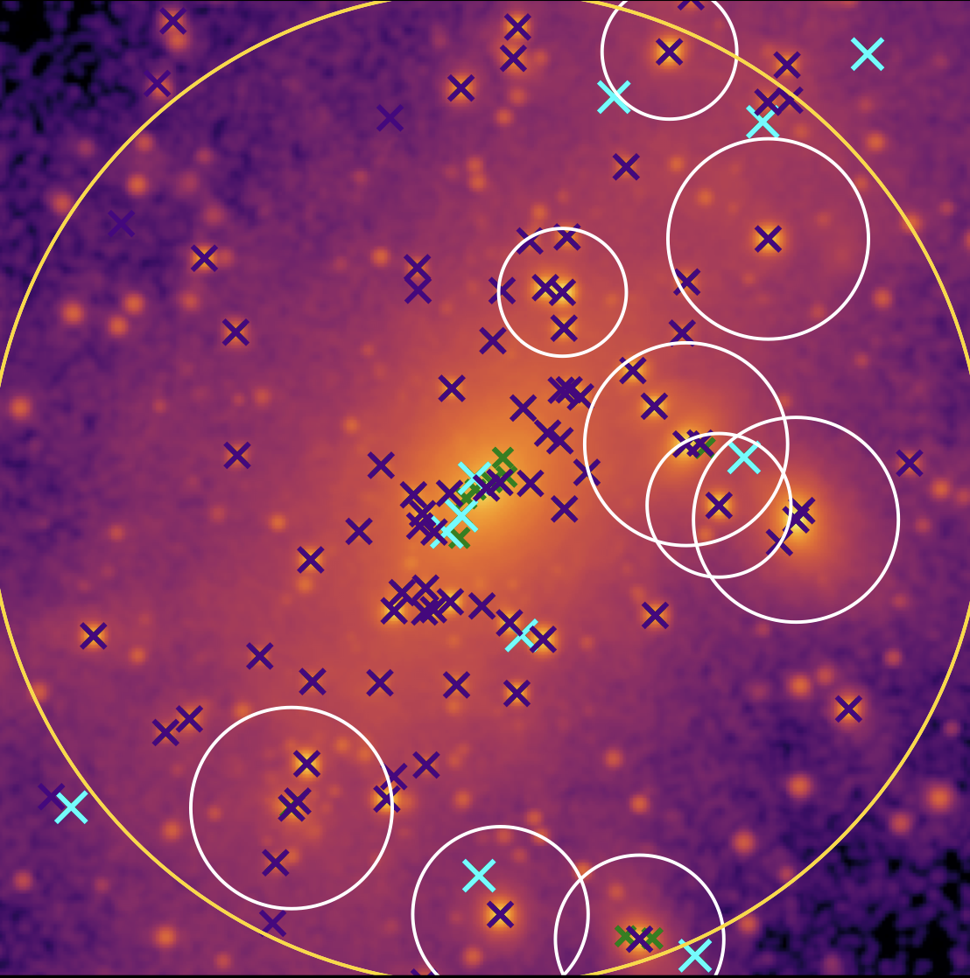
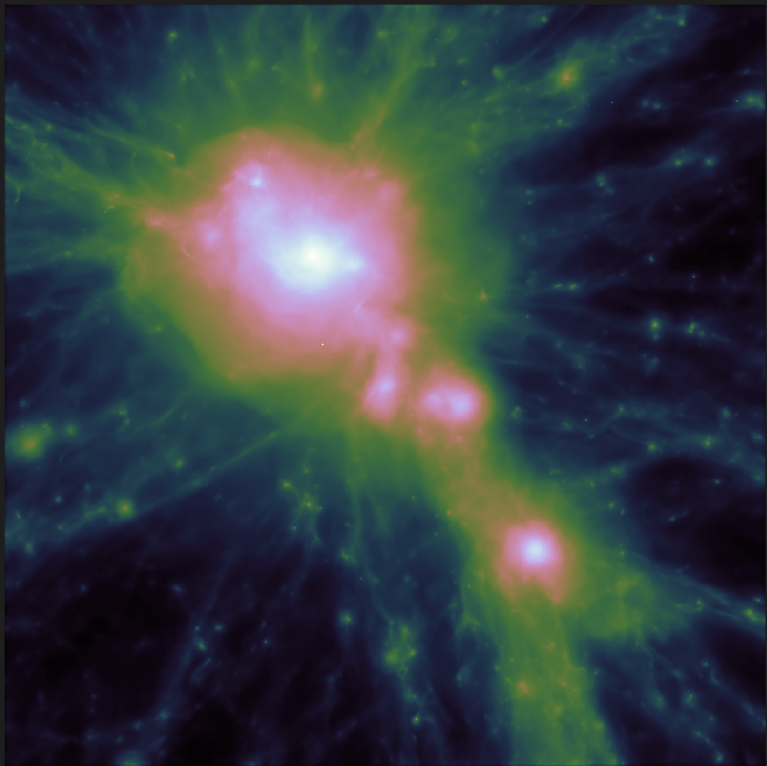
A new implementation for black hole dynamics
1
Implementation in the code
2
Testing against other techniques
3
Refinements
4
Applications
Technical Objectives, Methodologies and Solutions
ICSC Italian Research Center on High-Performance Computing, Big Data and Quantum Computing
Missione 4 • Istruzione e Ricerca
Notes:
Template e guide lines

Slide 4
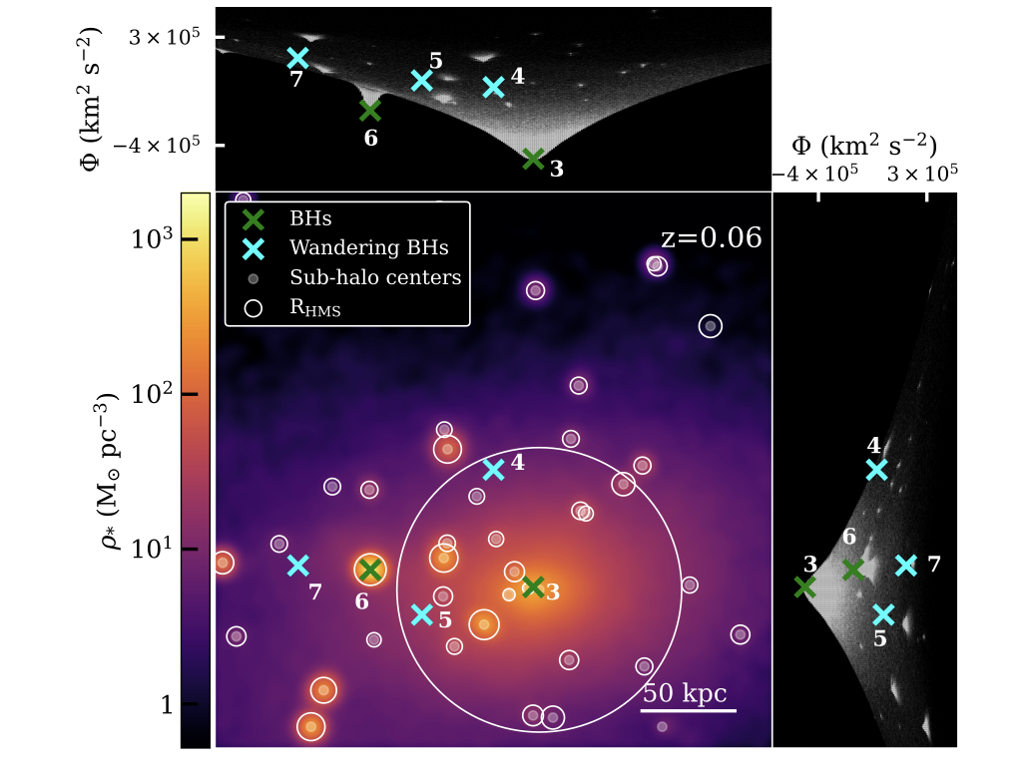
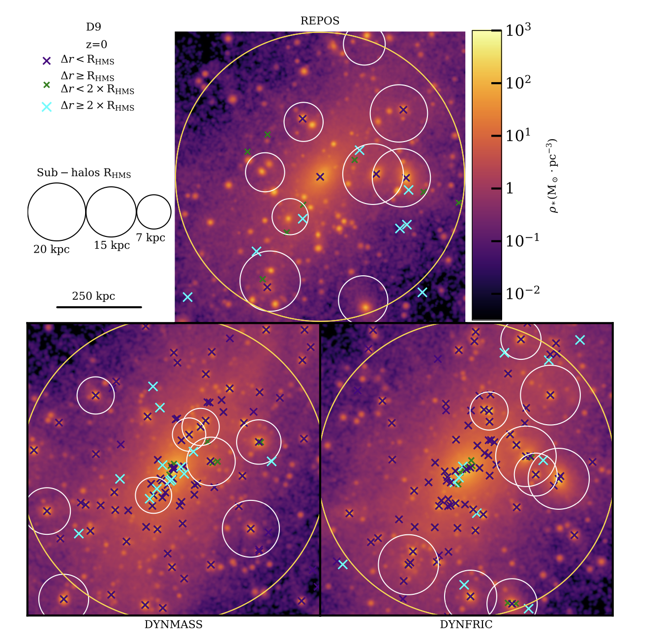
Refinement and tests of the DF correction
Study of the effects of galactic morphology on the host BH dynamics
BH demography in galaxy clusters
Project timeline
Project timeline
Main results
The DF implementation and comparison to other techniques
DF correction is capable to center the BH in the host galaxies
Produces the lover fraction of spurious numerical wandering BHs
Leads to more realistic sinking timescales during mergers
ICSC Italian Research Center on High-Performance Computing, Big Data and Quantum Computing
Missione 4 • Istruzione e Ricerca
Notes:
Template e guide lines

Slide 5
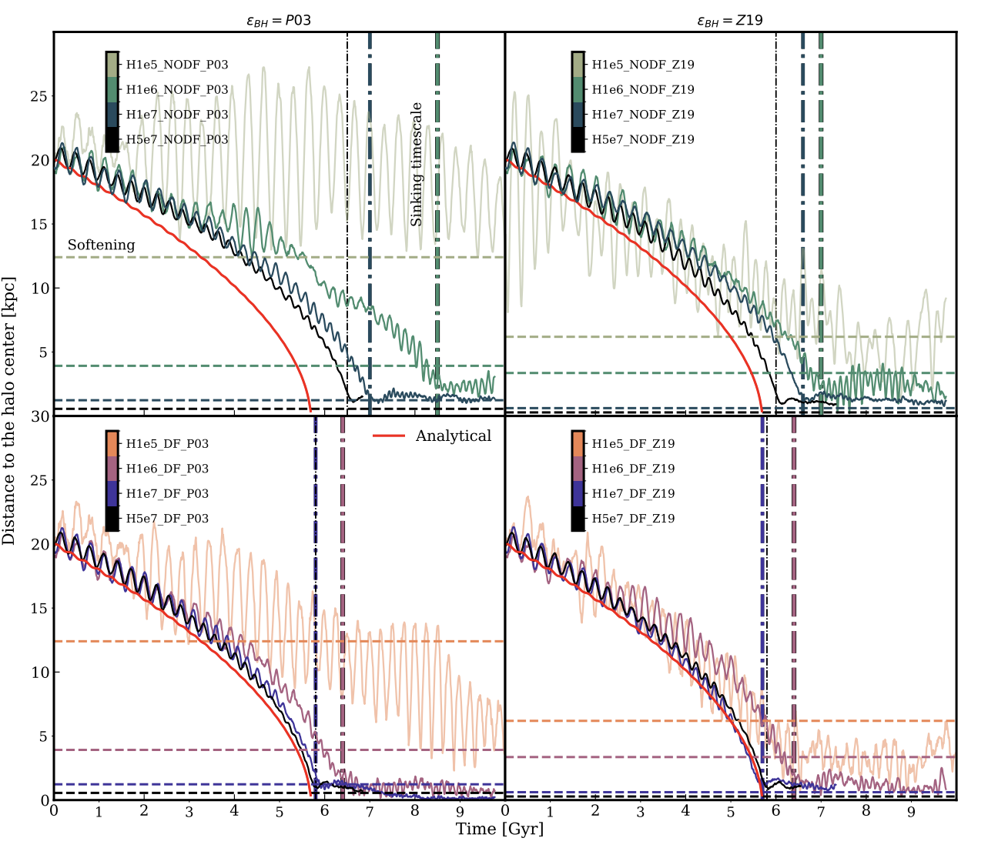
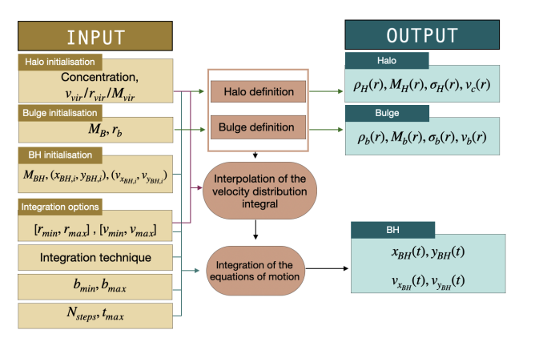
The DF implementation and
comparison to other techniques
Study of the effects of galactic morphology on the host BH dynamics
BH demography in galaxy clusters
Project timeline
Main results
Refinement and tests of the DF correction
The OTIS python library is designed to provide an analytical interpretative background for controlled simulations
The DF prescription produces faster sinking timescales , in good agreement with theoretical results across different resolutions
The DF implementation was refined to reproduce the sinking of BH lighter than the surrounding particles
ICSC Italian Research Center on High-Performance Computing, Big Data and Quantum Computing
Missione 4 • Istruzione e Ricerca
Notes:
Template e guide lines

Slide 6
The DF implementation and
comparison to other techniques
BH demography in galaxy clusters
Refinement and tests of the DF correction
Project timeline
Project timeline
Main results
Study of the effects of the galactic morphology on the host BHs dynamics
IC from DICE: tuning the Toomre parameter to reproduce the galaxy instability
Collisionless simulations of disk and barred galaxies with OG3 and ChaNGa + DF prescription
Delay of the sinking timescale on barred-barred mergers
ICSC Italian Research Center on High-Performance Computing, Big Data and Quantum Computing
Missione 4 • Istruzione e Ricerca
Notes:
Template e guide lines

Slide 7
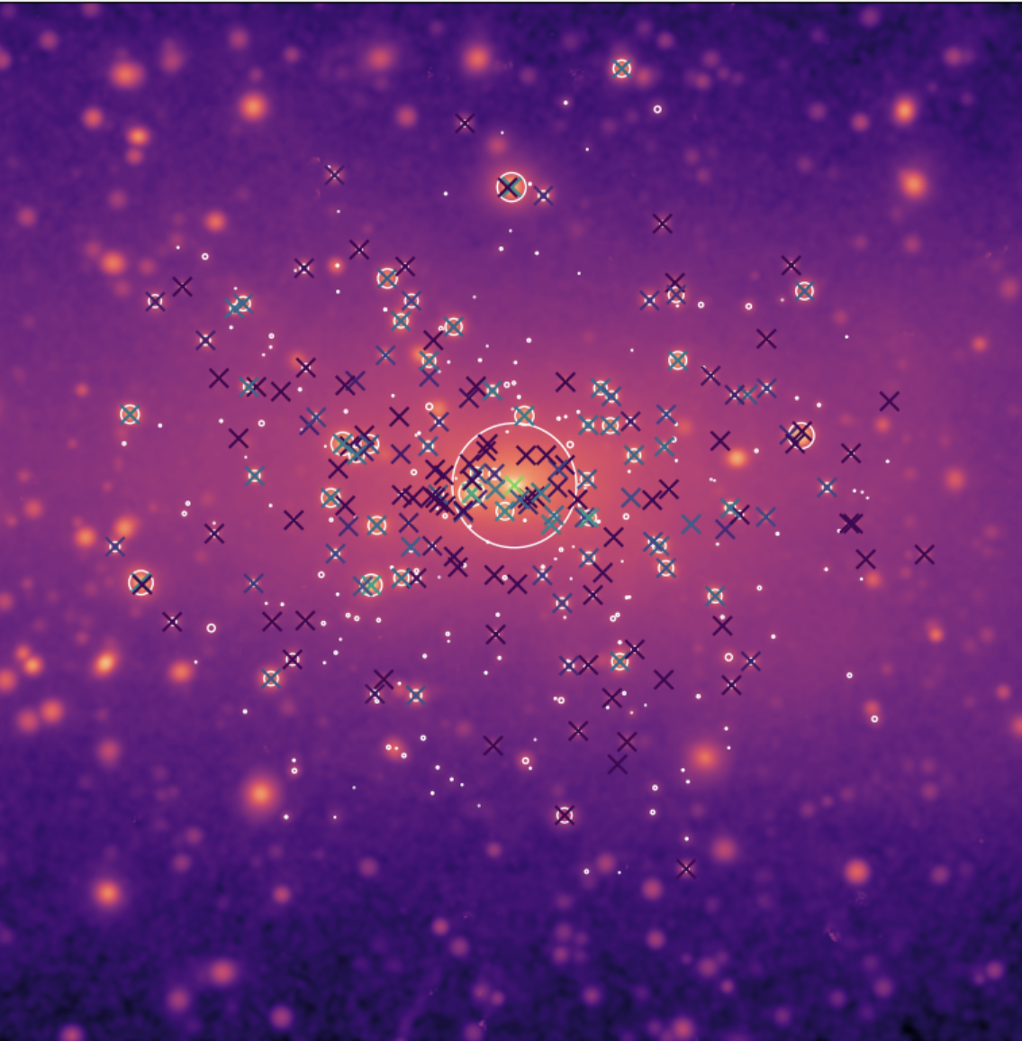
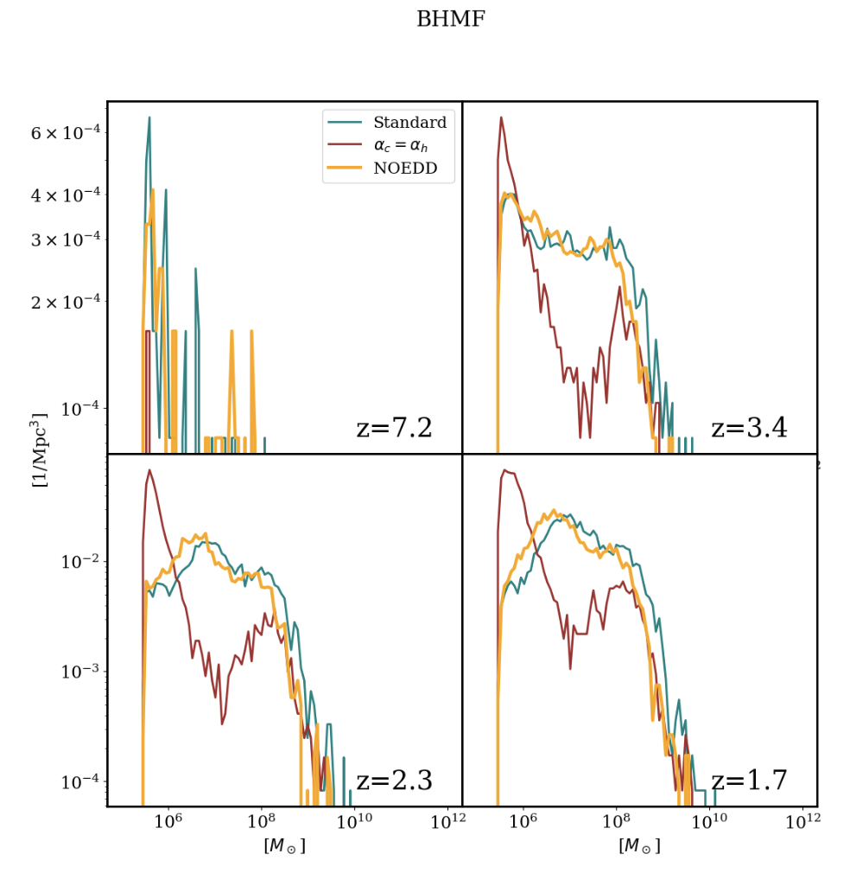
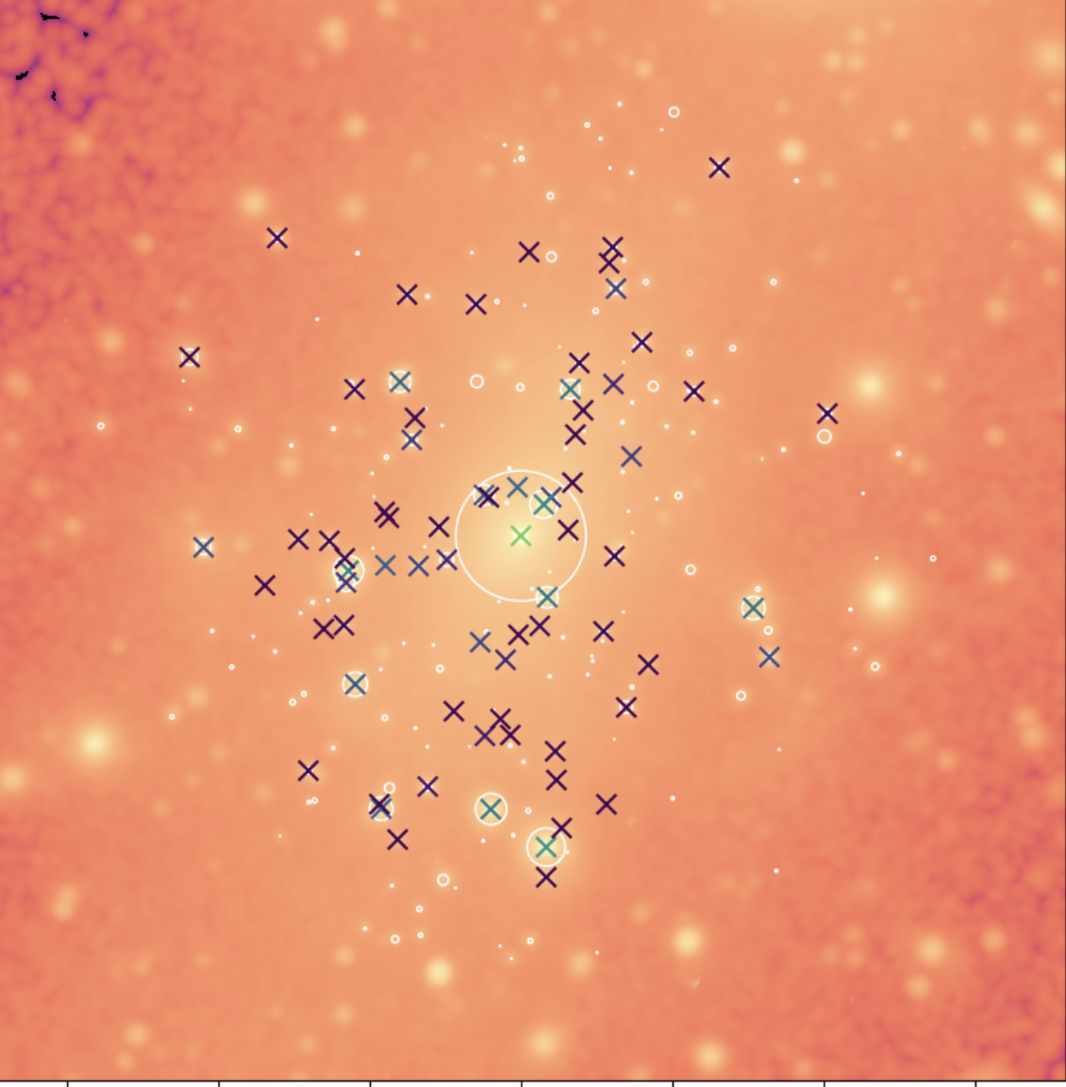
The DF implementation and
comparison to other techniques
Refinement and tests of the DF correction
Study of the effects of galactic morphology on the host BH dynamics
Project timeline
Main results
BH demography in galaxy clusters
HR 29 simulations of galaxy clusters from the DIANOGA set
Exporation of different parameters regulating AGN feedback and accretion (BH feedback factor, accretion boost, non-Eddington limited accretion)
Study of the BH demography, BH mass function
Esposito et al. (2025)
ICSC Italian Research Center on High-Performance Computing, Big Data and Quantum Computing
Missione 4 • Istruzione e Ricerca
Notes:
Template e guide lines

Slide 8
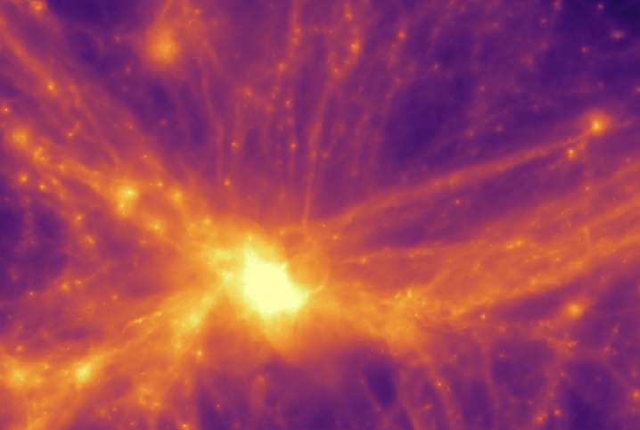
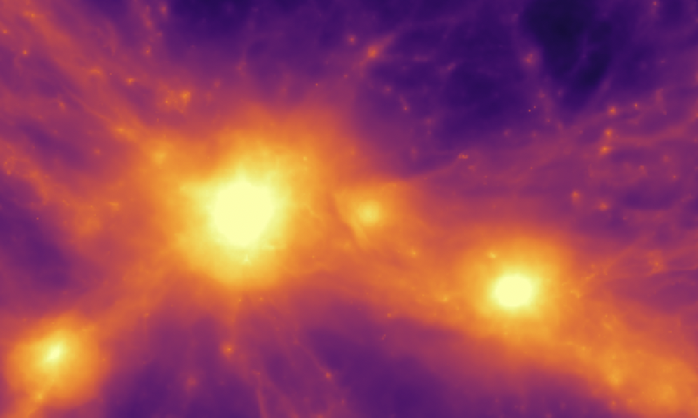
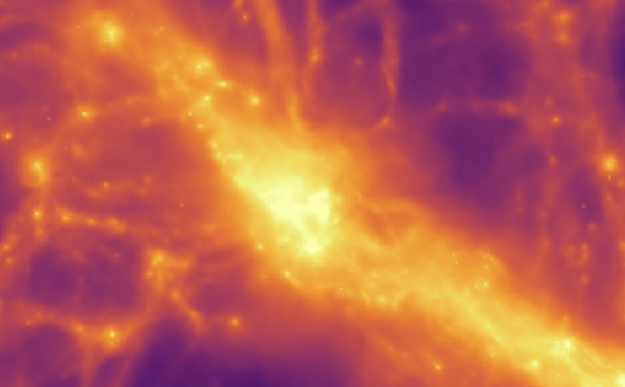
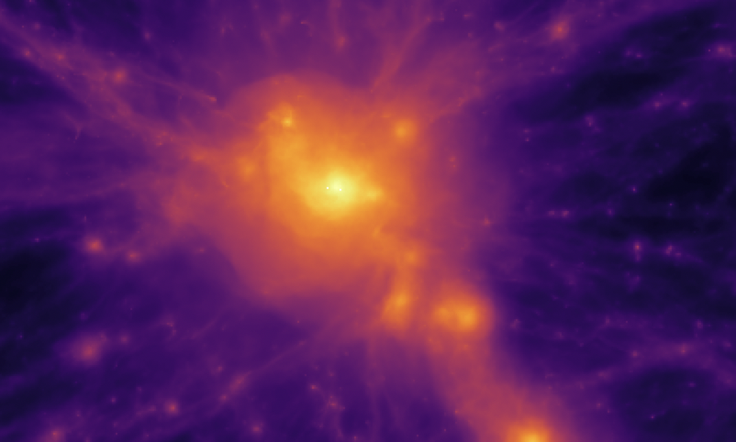
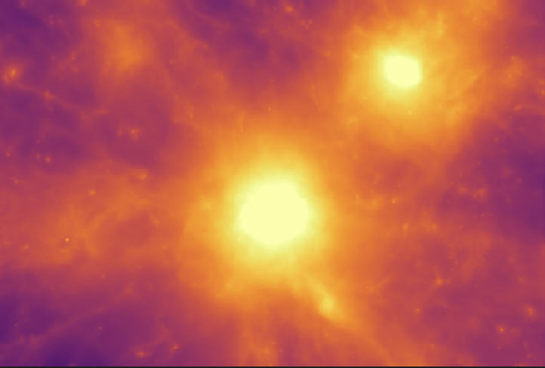
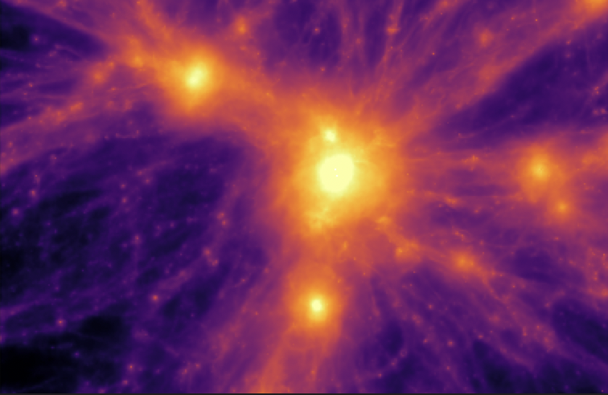
Final steps
Implementation and testing: successful implementation in OpenGadget3 overcoming limitations of previous ad-hoc numerical recipes.
Refinements: extensive tests in controlled enviroment compared with analytical solutions using OTIS. The implementation is robust also in critical resolution regimes.
Applications
Merging galaxies: merger timescale of MBHs hosted in barred galaxies is longer. On going work!
Galaxy clusters: effects of DF on global BH demography and evolution. On going work!
Damiano, Valentini, Borgani et al. (2024)
Damiano, Borgani, Valentini+ to be submitted.
Damiano et al. (in prep)
Borgani et al. (in prep)
Gas density map of six DIANOGA BCG
Damiano et al. (in prep)
ICSC Italian Research Center on High-Performance Computing, Big Data and Quantum Computing
Missione 4 • Istruzione e Ricerca
Notes:
Template e guide lines

