Slide 1
From cosmic rays to noise characterization in the microwave detector experiment
Giovanni Cavallotto (INFN MiB), Stefano Della Torre (INFN MiB)
Spoke 3 III Technical Workshop, Perugia May 26 - 29, 2025
ICSC Italian Research Center on High-Performance Computing, Big Data and Quantum Computing
Missione 4 • Istruzione e Ricerca
Notes:
Cover

Slide 2
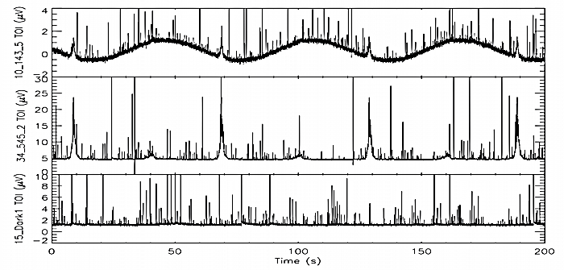
Scientific Rationale
Experiment with Cryogenic Transition Edge Sensors (TES) bolometers
In space environment
Long exposure (faint signal along the visible universe)
Planck CR glitches
ICSC Italian Research Center on High-Performance Computing, Big Data and Quantum Computing
Missione 4 • Istruzione e Ricerca

Slide 3
Scientific Rationale
Experiment with Cryogenic Transition Edge Sensors (TES) bolometers
In space environment
Long exposure (faint signal along the visible universe)
Planck CR glitches
Detector surface $=65 {cm}^{2}$
Detector higth $=1 mm$
CR direct hit rate $=8 Hz$
CR wafer hit rate $=124 Hz$
CMB B modes are around
${10}^{−2}$ CMB E modes
${10}^{−3}$ CMB fluctuation signal
Average energy deposited $=1.4 MeV$
Maximum energy deposited $≈2−3 GeV$
ICSC Italian Research Center on High-Performance Computing, Big Data and Quantum Computing
Missione 4 • Istruzione e Ricerca

Slide 4
Scientific Rationale
CR spectra at L2
Instrument and probes design
Generated by COSMICA
(stay tuned for it in BaC session)
CAD and design assumptions
Geant4 simulations
Tracks selection
Energy deposit extraction
Response of the detectors
COMSOL thermal diffusion
TODs
ICSC Italian Research Center on High-Performance Computing, Big Data and Quantum Computing
Missione 4 • Istruzione e Ricerca

Slide 5
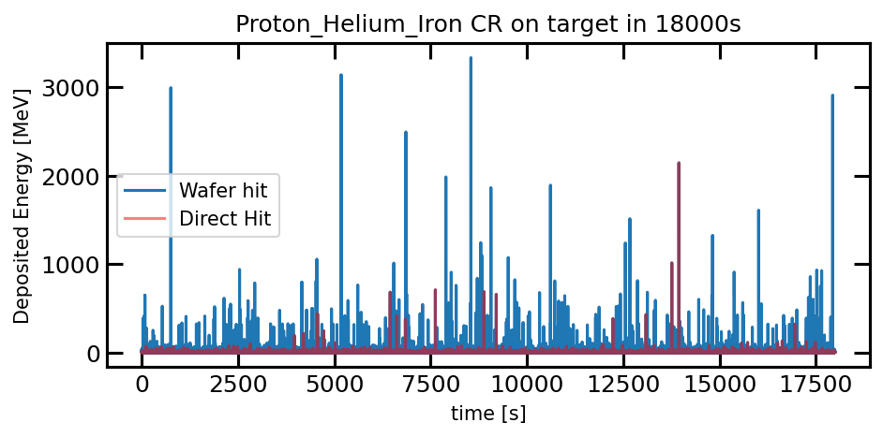
Scientific Rationale
CR spectra at L2
Instrument and probes design
Geant4 simulations
Tracks selection
Energy deposit extraction
Response of the detectors
COMSOL thermal diffusion
TODs
ICSC Italian Research Center on High-Performance Computing, Big Data and Quantum Computing
Missione 4 • Istruzione e Ricerca

Slide 6
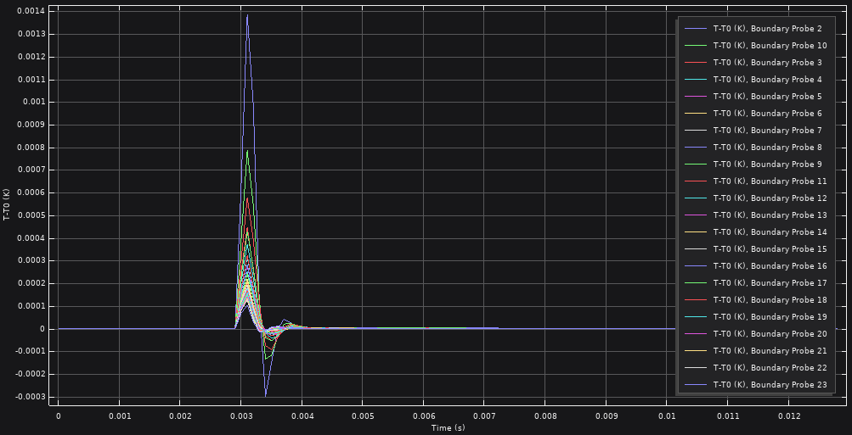
Scientific Rationale
CR spectra at L2
Instrument and probes design
Delta peak $σ\sim 0.5 ms$
Geant4 simulations
Tracks selection
Amplitude depends only on hit distance
Energy deposit extraction
Response of the detectors
COMSOL thermal diffusion
TODs
ICSC Italian Research Center on High-Performance Computing, Big Data and Quantum Computing
Missione 4 • Istruzione e Ricerca

Slide 7
Scientific Rationale
CR spectra at L2
Instrument and probes design
Geant4 simulations
Tracks selection
3 different software
Not easy insertion in CMB analysis workflow (CR noise injection)
Computationl time around 2-30 x TOD lenght
Energy deposit extraction
Response of the detectors
COMSOL thermal diffusion
ML data augmentation
More TODs
ICSC Italian Research Center on High-Performance Computing, Big Data and Quantum Computing
Missione 4 • Istruzione e Ricerca

Slide 8
Technical Objectives
Synthetically generate the time series representative of the whole mission
Achieve a reasonable generation computational time
Genuine statistically independent AI generation
Mimic MC data sample peculiar features
Power spectrum and NEP
Channels correlations
Amplitude and rate
ICSC Italian Research Center on High-Performance Computing, Big Data and Quantum Computing
Missione 4 • Istruzione e Ricerca

Slide 9
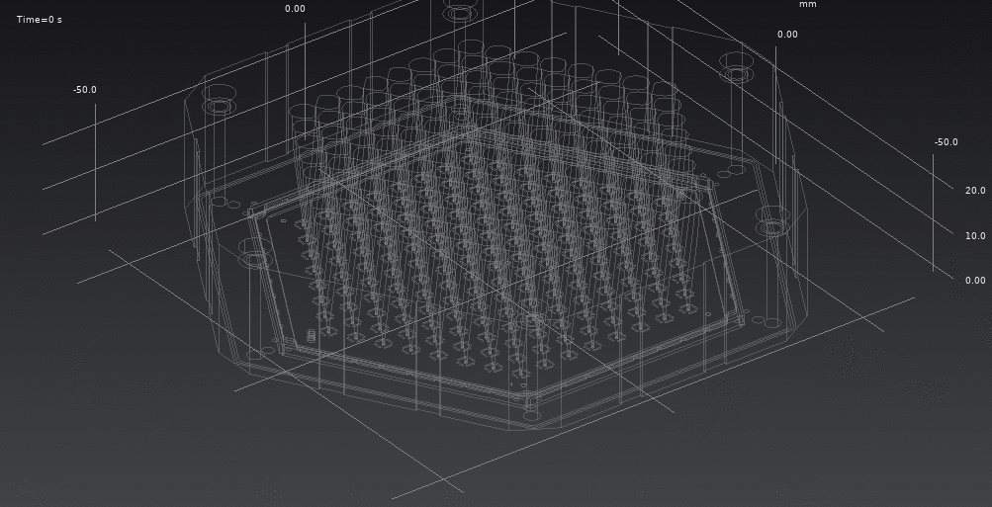
Technical Objectives
Power spectrum
Channels correlations
Amplitude and rate
ICSC Italian Research Center on High-Performance Computing, Big Data and Quantum Computing
Missione 4 • Istruzione e Ricerca

Slide 10
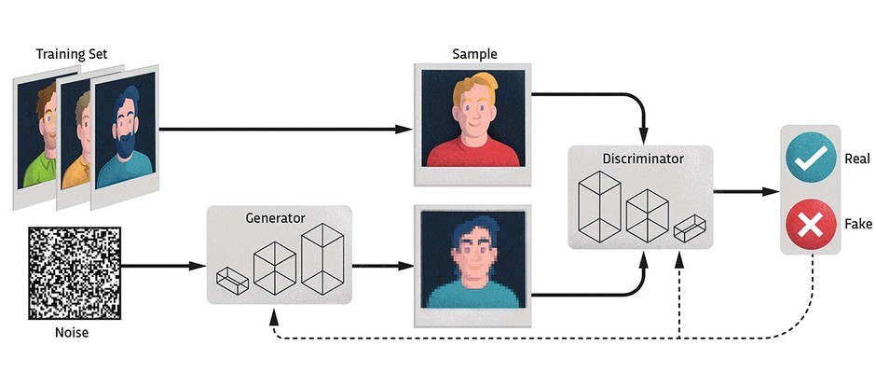
Methodologies
Generative Adversarial Network
Convolutional layers (Discriminator)
De-Convolutional layers (Generator)
ICSC Italian Research Center on High-Performance Computing, Big Data and Quantum Computing
Missione 4 • Istruzione e Ricerca

Slide 11
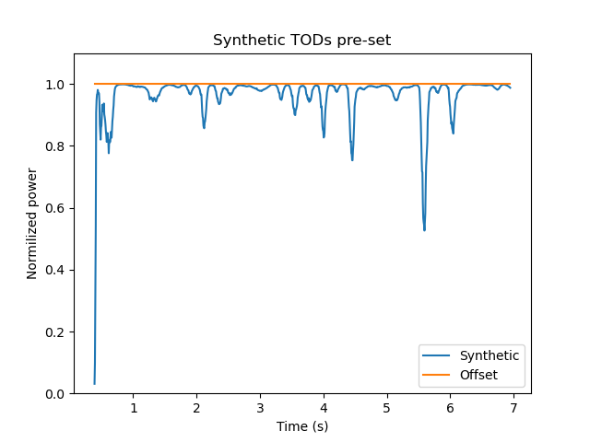
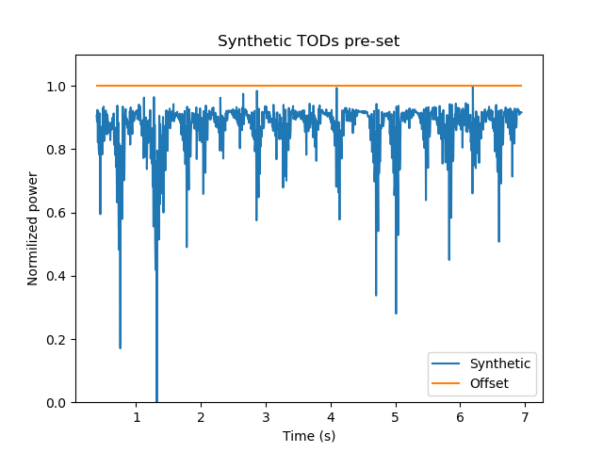
Results: CRAB tuning
Smaller convolutional window
Sigmoid normalization
Instead of TOD normalization
Not reproducing
small scale features
Normalization constrains the TODs on average neglecting offset
ICSC Italian Research Center on High-Performance Computing, Big Data and Quantum Computing
Missione 4 • Istruzione e Ricerca

Slide 12
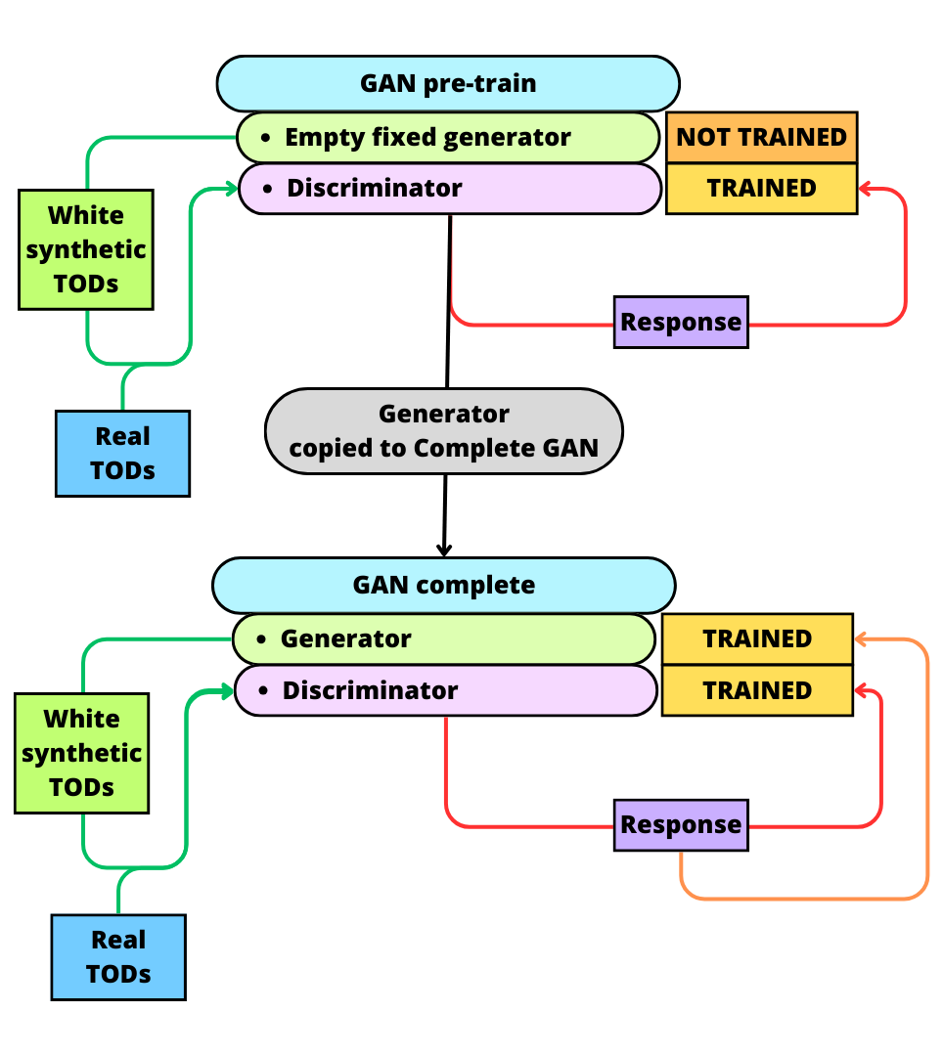
Results: CRAB tuning
Offset
Generator
TRAINED
MAE (tried MSE)
Real TODs
Generator
TRAINED
MAE (tried MSE)
Forward propagation
Backward propagation
ICSC Italian Research Center on High-Performance Computing, Big Data and Quantum Computing
Missione 4 • Istruzione e Ricerca

Slide 13
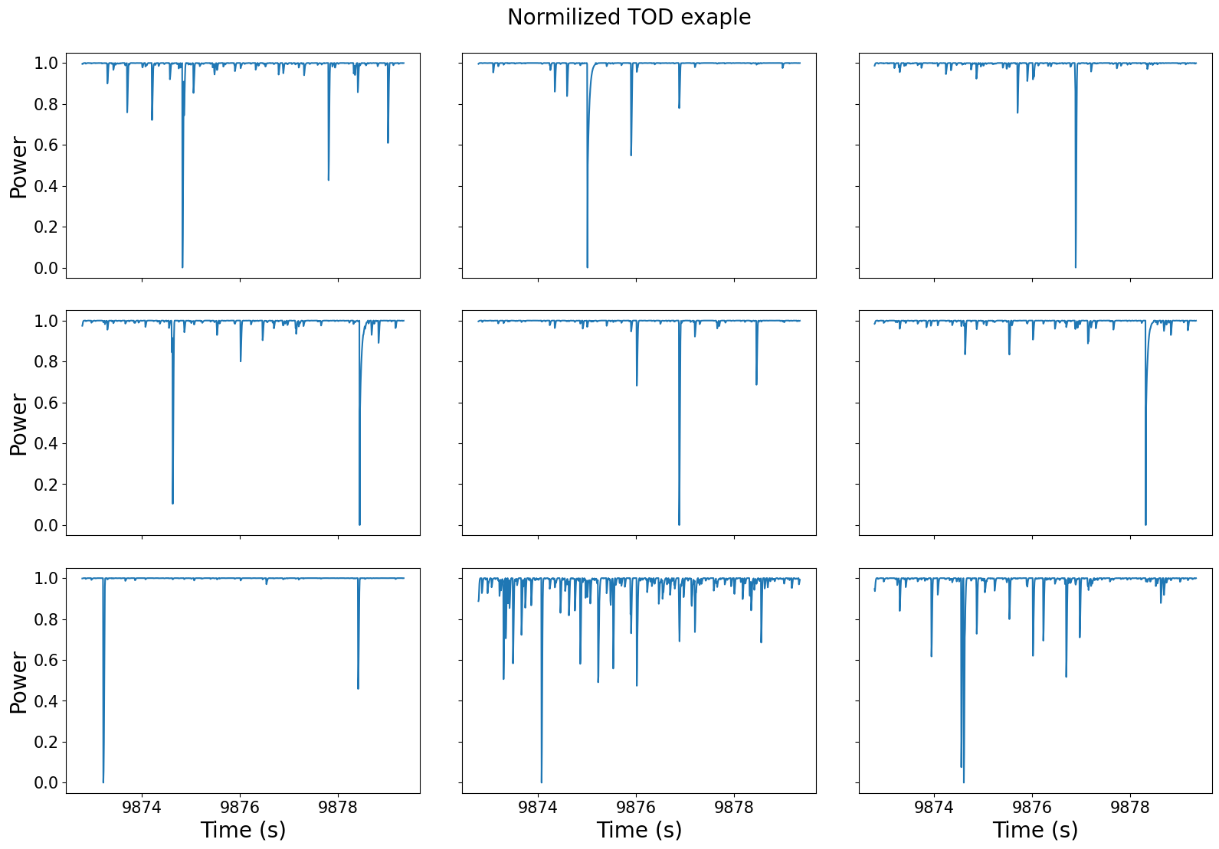
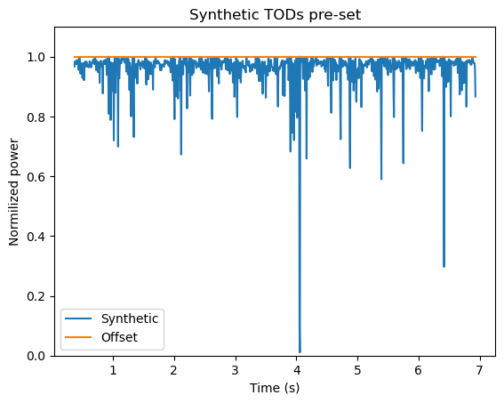
Results: CRAB tuning
Offset
Generator
TRAINED
MAE (tried MSE)
Real TODs
Generator
TRAINED
MAE (tried MSE)
ICSC Italian Research Center on High-Performance Computing, Big Data and Quantum Computing
Missione 4 • Istruzione e Ricerca

Slide 14
Accomplished Work
Produce the MC training dataset with realistic instrument design, investigating CR hits thermal properties in detector
Computational speedup
Chunck large data training procedure
CRAB (5h data):
$\sim 10^{−2}$ Training (3-4 mins)
$\sim 10^{−4}$ Production (< 1 s)
Known issues
Power spectrum and NEP OK
Channels correlations NO
Amplitude and rate NI
Correlation between channels not reproduced
Peculiar TODs features further tuning needed
ICSC Italian Research Center on High-Performance Computing, Big Data and Quantum Computing
Missione 4 • Istruzione e Ricerca

Slide 15
Final steps
Solve the Know issues
Paper pablication on Astronomy and Computing
Milestone 10
Estimation of CR background
Meta analysis of TODs features
Code documentation
ICSC Italian Research Center on High-Performance Computing, Big Data and Quantum Computing
Missione 4 • Istruzione e Ricerca

Slide 16
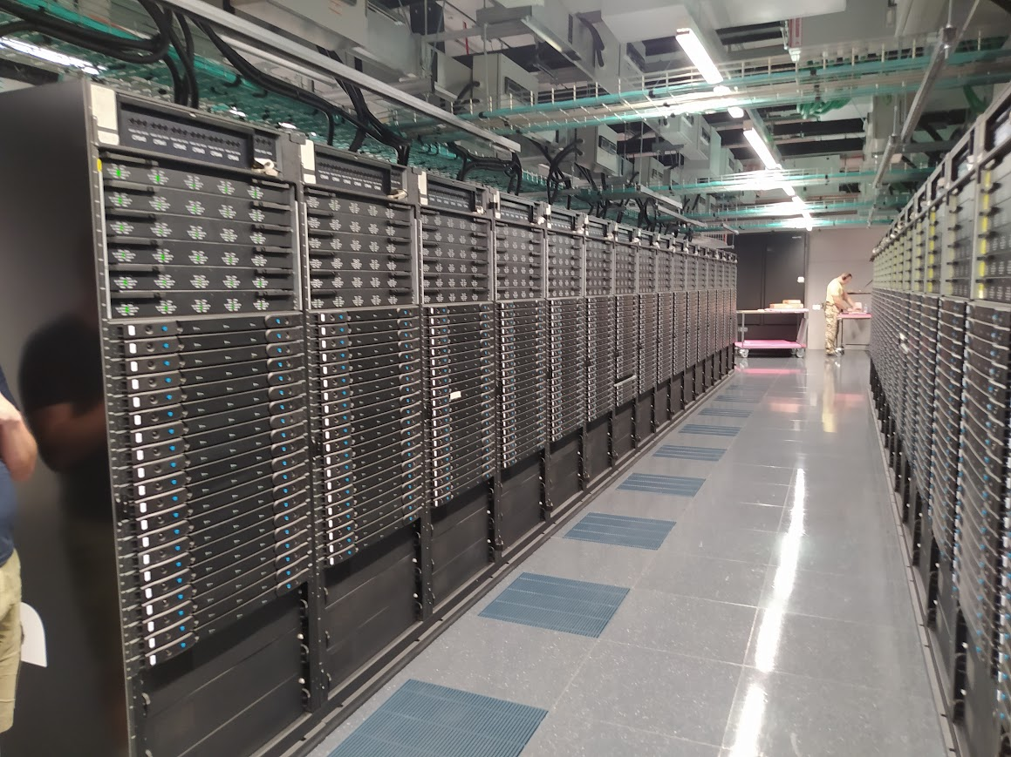
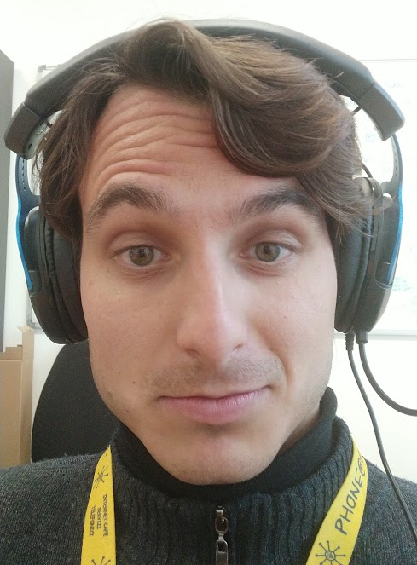

Slide 17
BACKUPS

Slide 18
COMSOL simulation configuration
Material parameters:
Initial all materials $T_{0}=100 mK$
Silicon thermal conductivity $=100{\left(\frac{T}{1K}\right)}^{3}\frac{W}{m·K}$
Silicon heat capacity $=7∙{10}^{−3}{\left(\frac{T}{1K }\right)}^{3}\frac{J}{kg∗K}$
Thermal link $=3,03∙{10}^{3}\frac{K}{W}$
Simulation configuration:
Single hit energy :
maximum (87.32 MeV)
mode (0.80 MeV)
Simulation time $=2∙t_{Rate}=0.0128 s$
Time step = $0.1 ms$
ICSC Italian Research Center on High-Performance Computing, Big Data and Quantum Computing
Missione 4 • Istruzione e Ricerca
Notes:
Template e guide lines

Slide 19
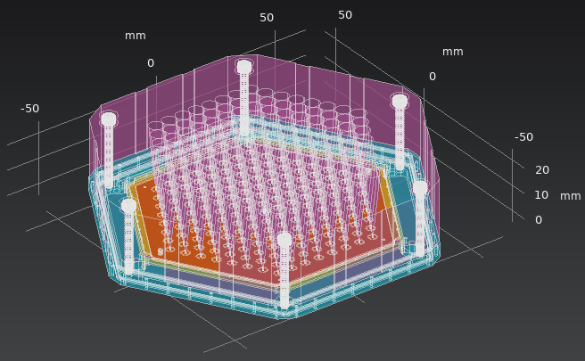
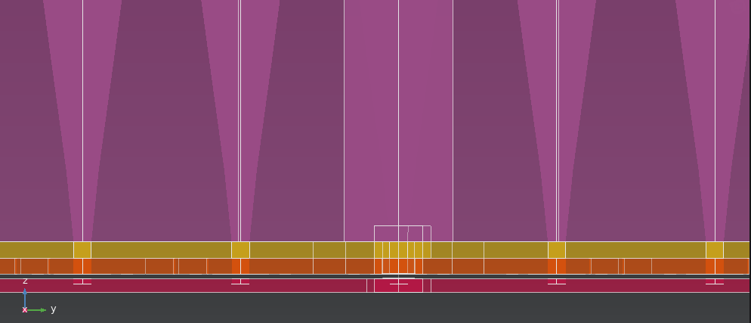
Methodologies: custom data production
Horns
Screw
Thermal link
Thermometers
Probes
Horns
Structure
Wafers
Wafers
ICSC Italian Research Center on High-Performance Computing, Big Data and Quantum Computing
Missione 4 • Istruzione e Ricerca
Notes:
Template e guide lines

Slide 20
COMSOL results
Istantaneous spherical heat propagation
Independent hits
Thermal link dominates
ICSC Italian Research Center on High-Performance Computing, Big Data and Quantum Computing
Missione 4 • Istruzione e Ricerca
Notes:
Template e guide lines

Slide 21
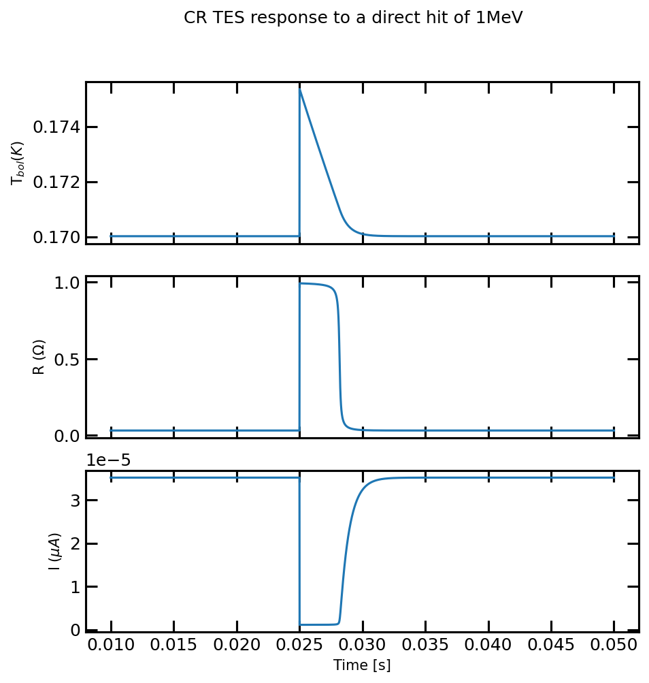
TES response
Direct hits
Wafer hits
$$I\left(singal\right)=\frac{V_{TES}}{R(T)}≈\frac{V_{TES}}{arctan\left(T−T_{Crit}\right)}=\frac{V_{TES}}{arctan\left(T_{CR} e^{−\frac{G}{C}t}−T_{Crit}\right)}$$
OLD
$$\frac{Δ T}{Δ t} = \frac{k}{ρ{ C}_{P}} ∇^{2 }T$$
$$\frac{{∆E}_{CR}}{C}=T_{CR}$$
NEW
$$T_{CR}(r_{TES})=\frac{T_{CR}(r_{hit})}{r^{2}}$$
$$∆T=\left[P_{TES}−G\left(T−T_{bath}\right)\right]\frac{∆t}{C}$$
$$T(t)=T_{CR} e^{−\frac{G}{C}t}$$
ICSC Italian Research Center on High-Performance Computing, Big Data and Quantum Computing
Missione 4 • Istruzione e Ricerca
Notes:
Template e guide lines

Slide 22
Results: CRAB tuning
Model: "Generator" hit_len = 32
====================================
Dense(time_bins//8 , activation = LeakyReLU)
Conv1DTranspose(8, hit_len, strides = 1, activation = LeakyReLU)
BatchNormalization()
Conv1DTranspose(16, hit_len*2, strides=2 , activation = LeakyReLU)
BatchNormalization()
Conv1DTranspose(32, hit_len*4, strides=4 , activation = LeakyReLU)
BatchNormalization()
SeparableConv1D(bolom_number, hit_len*8, strides = 1 , activation = LeakyReLU)
Lambda(normalize_synth)
Model: "Generator" hit_len = 4
====================================
Dense(time_bins//8 , activation = LeakyReLU)
Conv1DTranspose(8, hit_len, strides = 1, activation = LeakyReLU)
BatchNormalization()
Conv1DTranspose(16, hit_len*2, strides=2 , activation = LeakyReLU)
BatchNormalization()
Conv1DTranspose(32, hit_len*4, strides=4 , activation = LeakyReLU)
BatchNormalization()
SeparableConv1D(bolom_number, hit_len, strides = 1 , activation = sigmoid)
Smaller convolutional window
Sigmoid normalization
Instead of TOD normalization
ICSC Italian Research Center on High-Performance Computing, Big Data and Quantum Computing
Missione 4 • Istruzione e Ricerca
Notes:
Template e guide lines

Slide 23
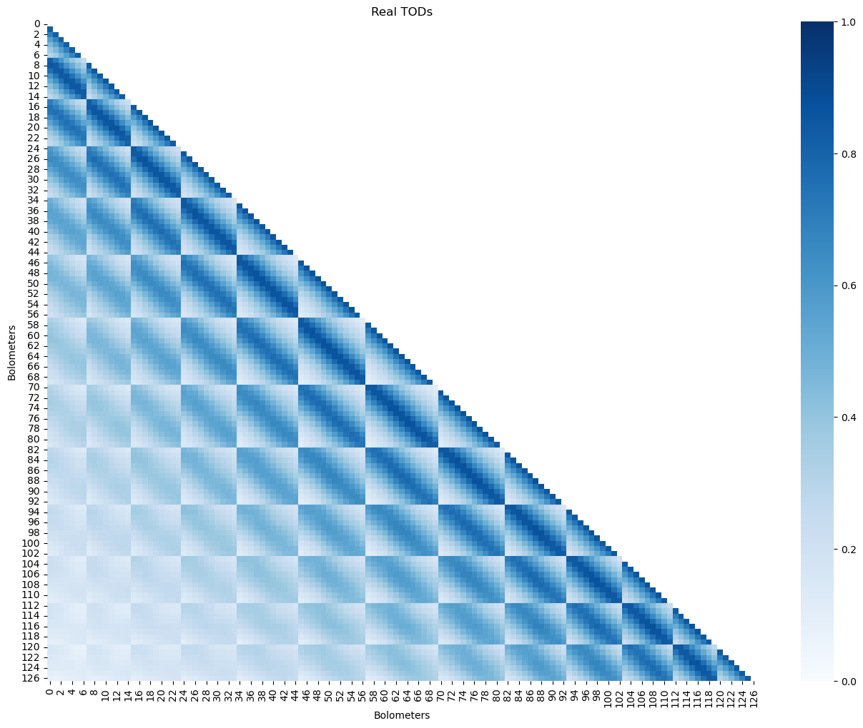
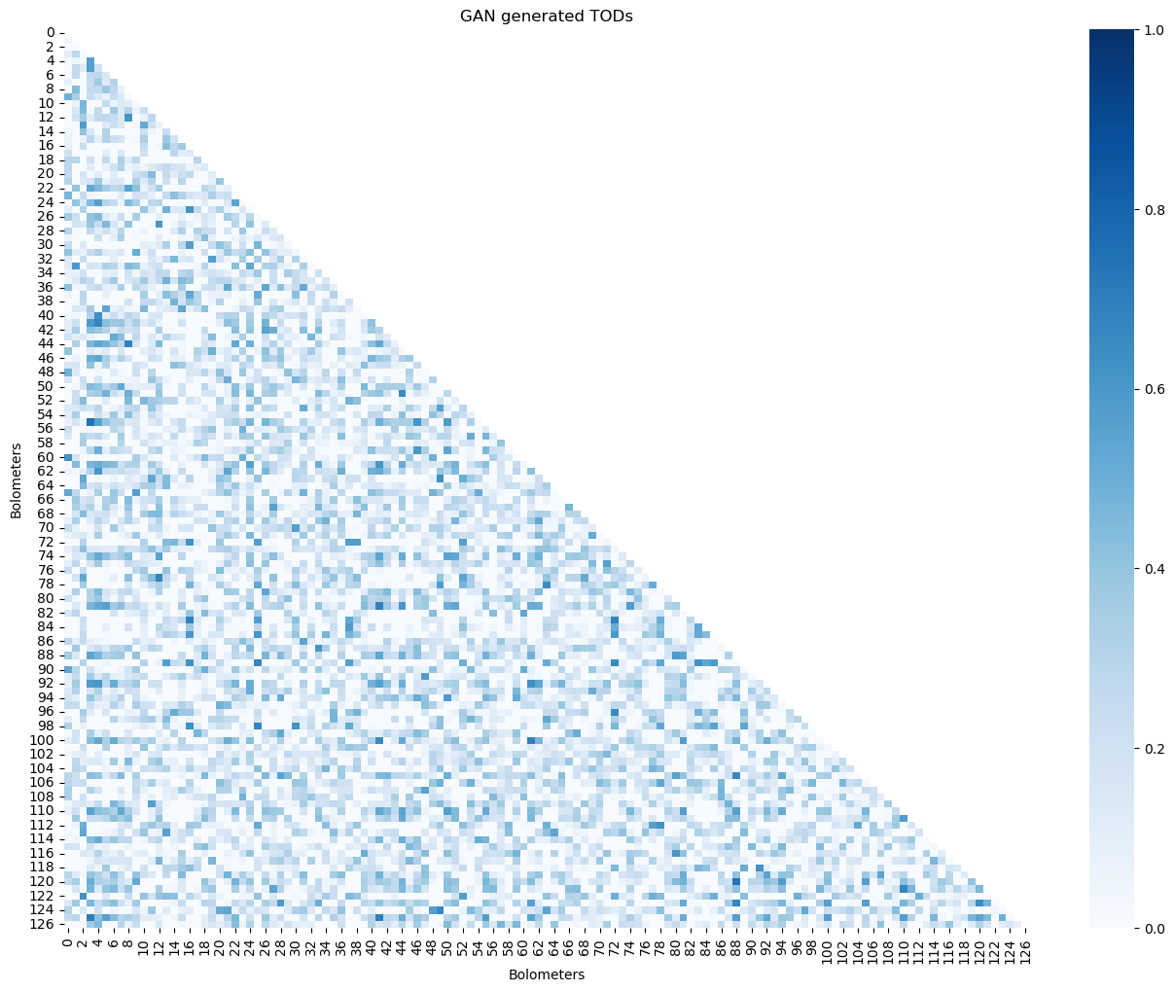
Known issues
ICSC Italian Research Center on High-Performance Computing, Big Data and Quantum Computing
Missione 4 • Istruzione e Ricerca
Notes:
Template e guide lines

Slide 24
CRAB development roadmap
M6
Litterature algorithm
M10
intermediate
Customization = 40%
M7
Prototype
Customization of TODs on instrument desing and mission requirements
GAN tuning
M8
Data production
Meta analysis
M9
Estimation of CR background
Meta analysis features
Code documentation
M10
final
Scientific production = 10%
ICSC Italian Research Center on High-Performance Computing, Big Data and Quantum Computing
Missione 4 • Istruzione e Ricerca

