Slide 1

TECLA - Clustering of FLUX and EW Maps Across Energy Bands in Supernovae Using Deep Learning Methodologies
Salvatore Miccichè, UNIPA-DiFC
salvatore.micciche@unipa.it
Spoke 3 III Technical Workshop, Perugia 26-29 Maggio, 2025
ICSC Italian Research Center on High-Performance Computing, Big Data and Quantum Computing
Missione 4 • Istruzione e Ricerca
Notes:
Cover

Slide 2
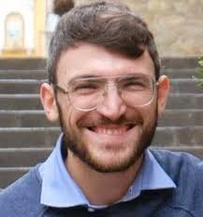

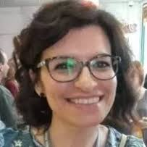
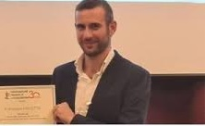
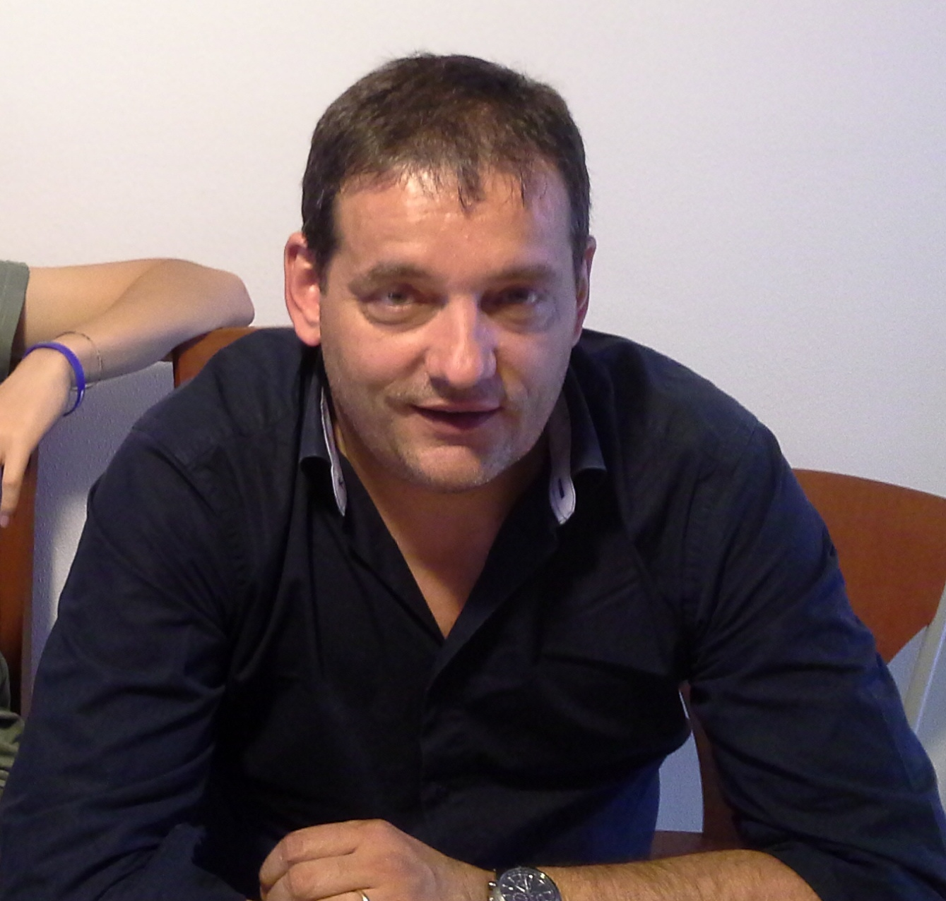

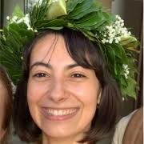

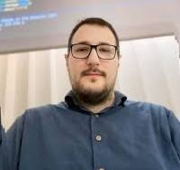
Scientific Rationale
TECLA
SNRs
INAF OAPA
Light curves
UNITOV
Cultural Heritage data
UNIPA
Astro-particle data
AUGER UNIPA
D
A
T
I
Miceli
Sapienza
Mazzotta
Saladino
Armetta
Marsella
M
E
T
O
D
I
Mantegna
Miccichè
Parisi
Lo Bosco
Calderaro
Fazio
ICSC Italian Research Center on High-Performance Computing, Big Data and Quantum Computing
Missione 4 • Istruzione e Ricerca
Notes:
Template e guide lines

Slide 3
Scientific Rationale
TECLA
SNRs
INAF OAPA
Light curves
UNITOV
Cultural Heritage data
UNIPA
Astro-particle data
AUGER UNIPA
We aim at developing innovative techniques for the detection, recognition and classification of coherent structures in astrophysical images. It is planned to study astrophysical images using statistical physics techniques, time series analysis techniques, techniques based on information theory and techniques based on Artificial Intelligence.
On the one hand, we will be interested in investigating the correlations existing between pixels present in the images of X-ray emissions of different metals. This will be done starting from the construction of a correlation-based network of pixels and the subsequent use of clustering techniques that allow us to identify the most significant correlations between pixels.
On the other hand, we will exploit the possibility of using machine learning techniques to enhance the power of the methodologies previously investigated.
ICSC Italian Research Center on High-Performance Computing, Big Data and Quantum Computing
Missione 4 • Istruzione e Ricerca
Notes:
Template e guide lines

Slide 4
Technical Objectives, Methodologies and Solutions
WP2
1. Correlation–based networks
Correlations
correlations existing between pixels in X-ray emission images of different metals construction of a correlation-based network of pixels. The most scientifically relevant aspect concerns the choice of the similarity measure between the numerical matrices representing the astrophysical image. Potential candidates are the Frobenius and Kullback-Leibler distances.
Clustering
Subsequently, we will use filtering techniques that allow us to identify the most significant correlations between pixels. We will use unsupervised clustering techniques in order to identify anisotropies and typify supernova remnants.
2. Bipartite networks
We will evaluate an investigation approach based on a description in terms of Bipartite Networks between elements and pixels.
ICSC Italian Research Center on High-Performance Computing, Big Data and Quantum Computing
Missione 4 • Istruzione e Ricerca
Notes:
Template e guide lines

Slide 5
Technical Objectives, Methodologies and Solutions
WP3
1. ML on original images
Data augmentation
By using standard IT techniques we generate surrogated images starting from original ones in order to train the Deep Learning (DL) net (see point 2. below)
Embedding
Image embeddings are compact, dense vector representations of images in a high-dimensional latent space. These embeddings capture the underlying patterns, features, and semantics of an image, making them ideal for downstream tasks. It enables similarity-based tasks like clustering, retrieval, and classification. A Siamese Neural Network is a class of neural network architectures containing two identical sub-networks with the same configuration parameters and weights.
Clustering
Different clustering techniques are therefore applied to the embedded images.
ICSC Italian Research Center on High-Performance Computing, Big Data and Quantum Computing
Missione 4 • Istruzione e Ricerca
Notes:
Template e guide lines

Slide 6
Technical Objectives, Methodologies and Solutions
WP3
2. Generation of synthetic images
Encoder-decoder approach
Considering the limited quantity of available images, we generate synthetic ones using deep-learning models in this step. In particular, we use the so-called Variational Autoencoder (VAE), a generative model that learns a probabilistic latent space from input data to generate new synthetic samples.
The proposed VAE consists of an encoder, a latent space, and a decoder:
1. Encoder: A series of four convolutional layers progressively downsamples a grayscale image to a feature map with 256 channels. This is then flattened and passed through fully connected layers to produce the mean and log-variance of the latent distribution.
2. Latent Space: A reparameterization trick samples a latent vector from the learned Gaussian distribution.
3. Decoder: Fully connected layers transform the latent vector back into a feature map, followed by four transposed convolutional layers, progressively up-sampling the representation to reconstruct the original image.
Embedding
Clustering
3. Attention is all you need
ICSC Italian Research Center on High-Performance Computing, Big Data and Quantum Computing
Missione 4 • Istruzione e Ricerca
Notes:
Template e guide lines

Slide 7
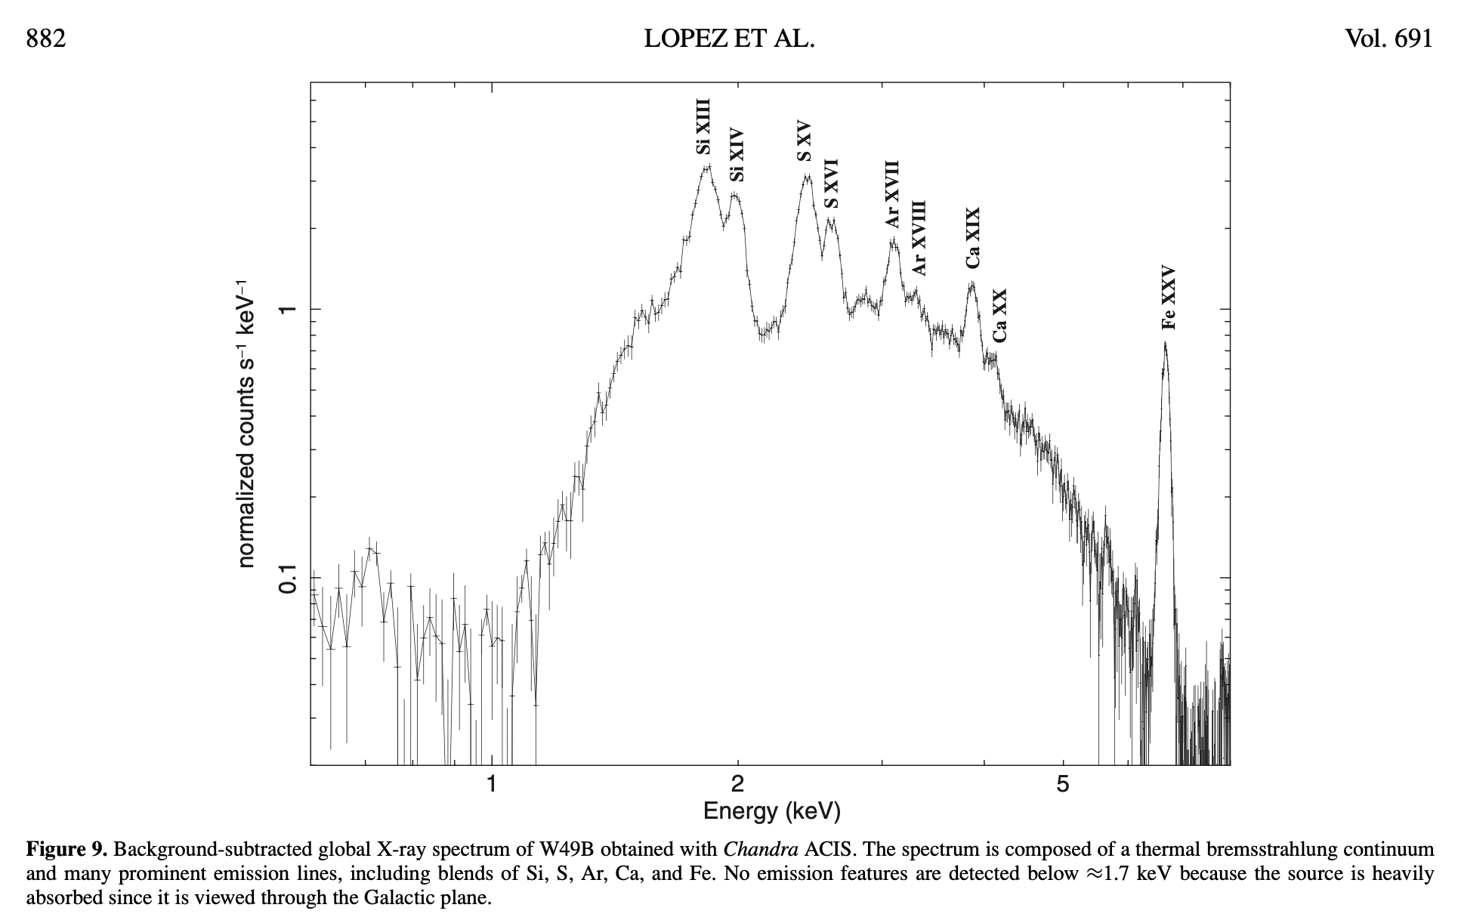
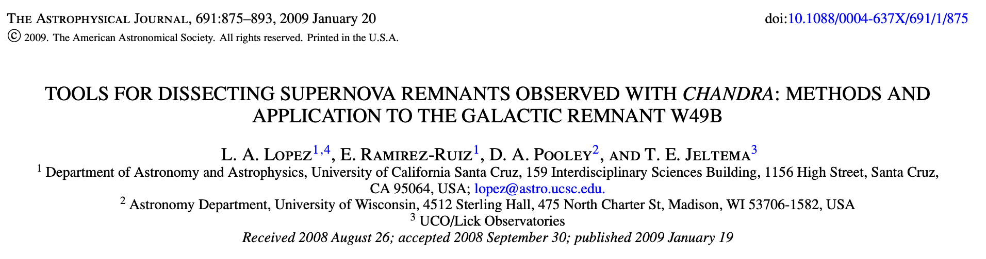
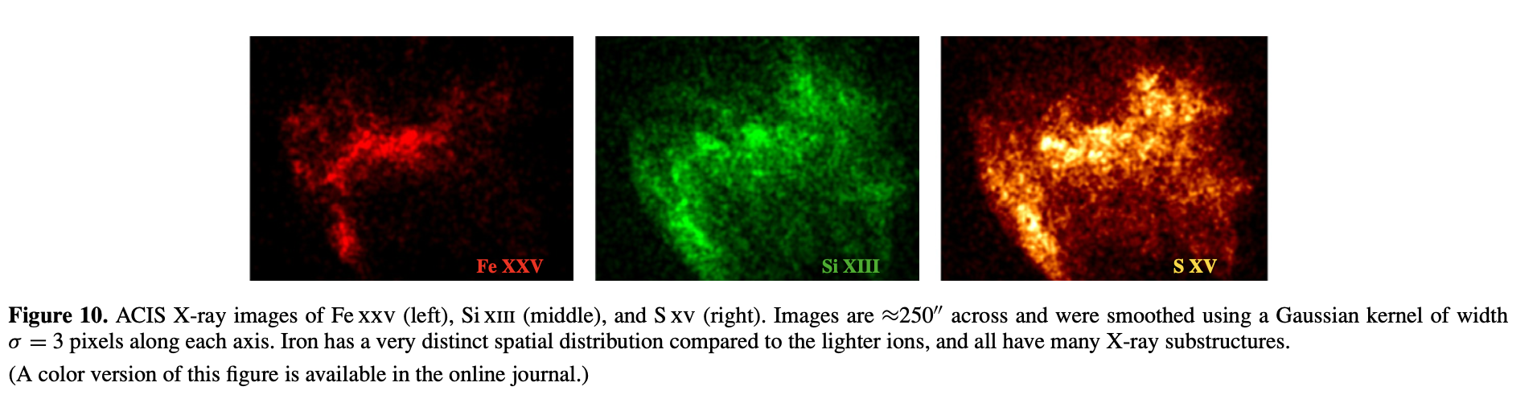
RESULTS: Narrow Band
CAS-A
TYCHO
G292
KEPLER
W49B
ICSC Italian Research Center on High-Performance Computing, Big Data and Quantum Computing
Missione 4 • Istruzione e Ricerca
Notes:
Template e guide lines

Slide 8
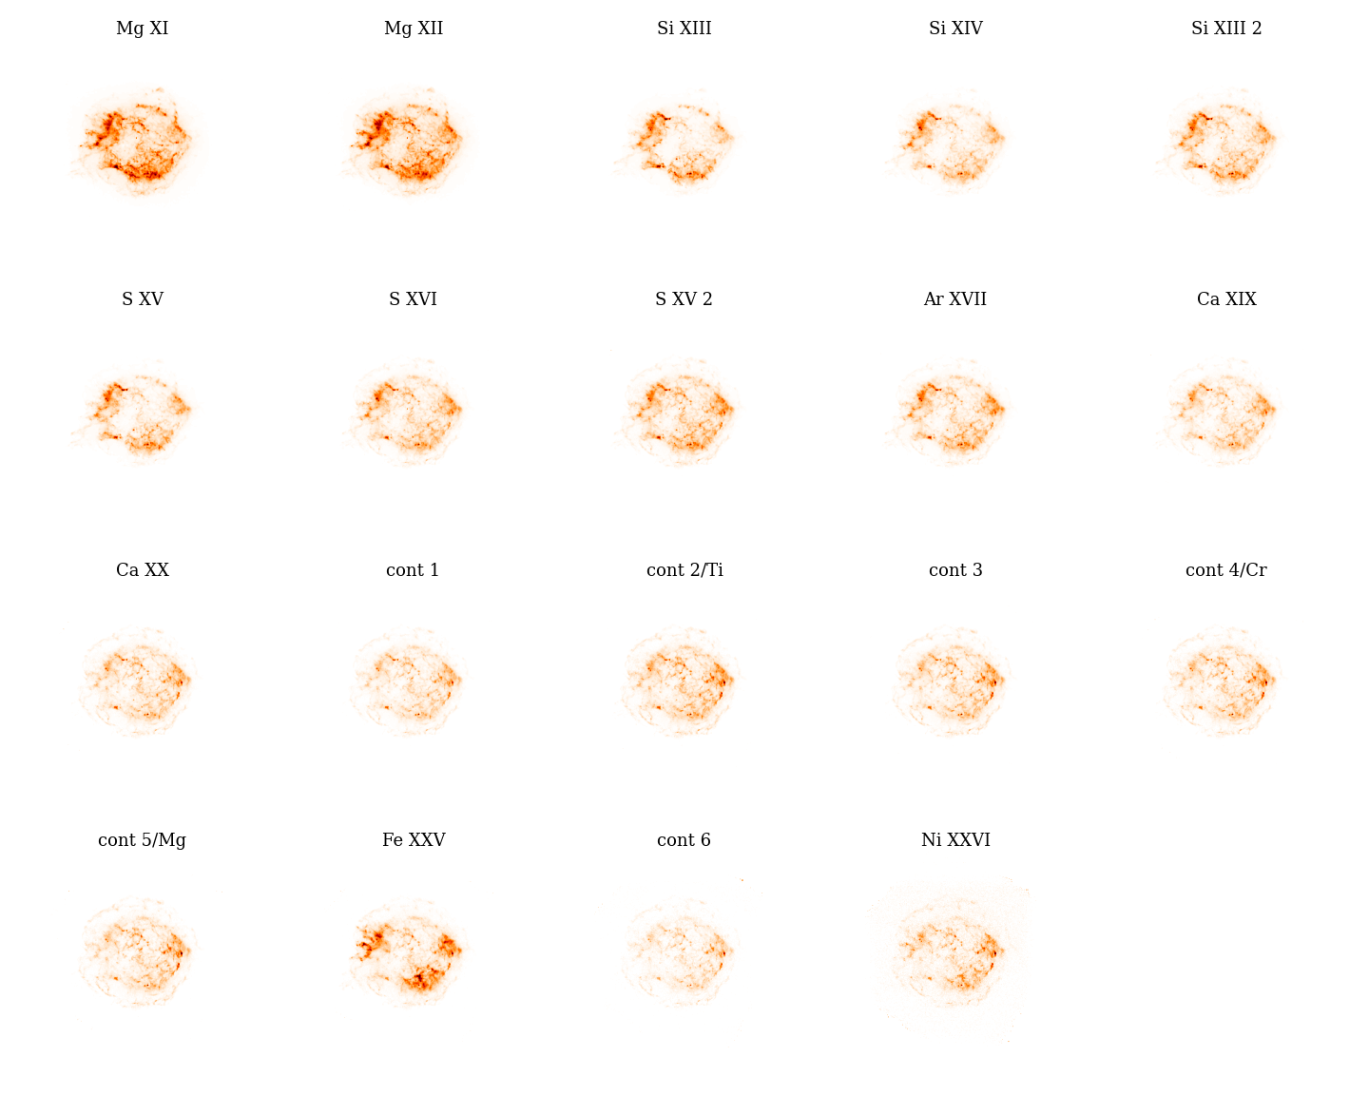
RESULTS: Narrow Band
Input data
observations of the supernova remnant (SNR) Cassiopeia A (Cas A)
ICSC Italian Research Center on High-Performance Computing, Big Data and Quantum Computing
Missione 4 • Istruzione e Ricerca
Notes:
Template e guide lines

Slide 9
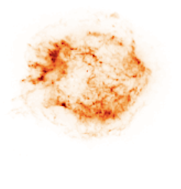
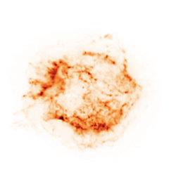
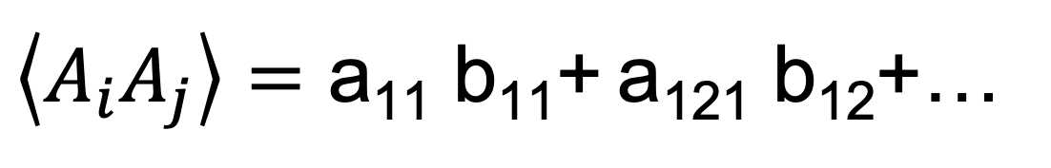
RESULTS: Narrow Band
A_{i}={{a₁₁,a₁₂,a₁₃, ….},{a₂₁,a₂₂,a₂₃,…}, … }
A_{j}={{b₁₁,b₁₂,b₁₃, ….},{b₂₁,b₂₂,b₂₃,…}, … }
$\left\langle A_{i}A_{j}\right\rangle =\text{a}\text{11}$ b₁₁+ a₁₂₁ b₁₂+…
More or less
ICSC Italian Research Center on High-Performance Computing, Big Data and Quantum Computing
Missione 4 • Istruzione e Ricerca
Notes:
Template e guide lines

Slide 10
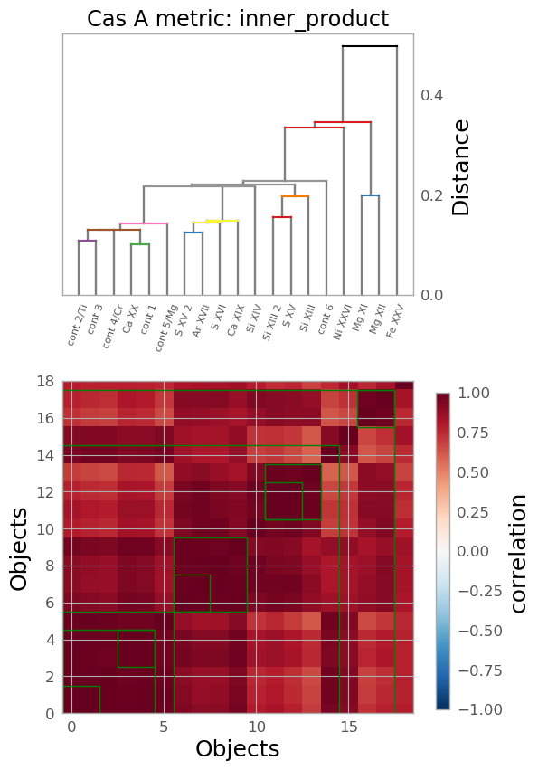
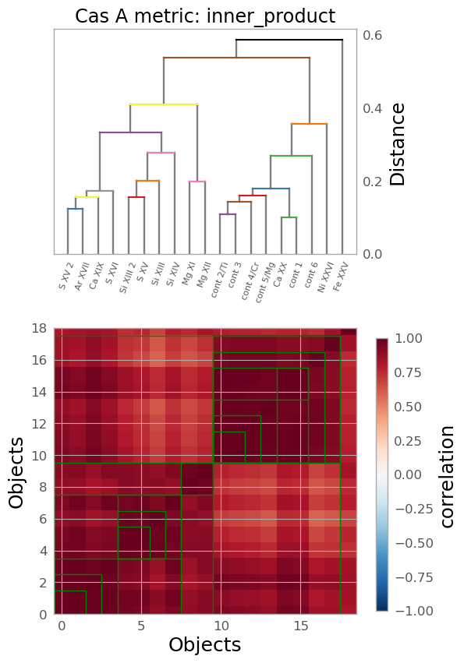
RESULTS: Narrow Band
CAS-A
HC with cosine distance
Fe is separated from other elements. Ni is «far”
SVHC/HC and ML tell us different things
single
average
Fe is separated from other elements. Ni is «far”
Ni is mixed with while Fe/Mg join other elements at higher distances
SVHC with Frobenius distance
ML with cosine distance
ICSC Italian Research Center on High-Performance Computing, Big Data and Quantum Computing
Missione 4 • Istruzione e Ricerca
Notes:
Template e guide lines

Slide 11
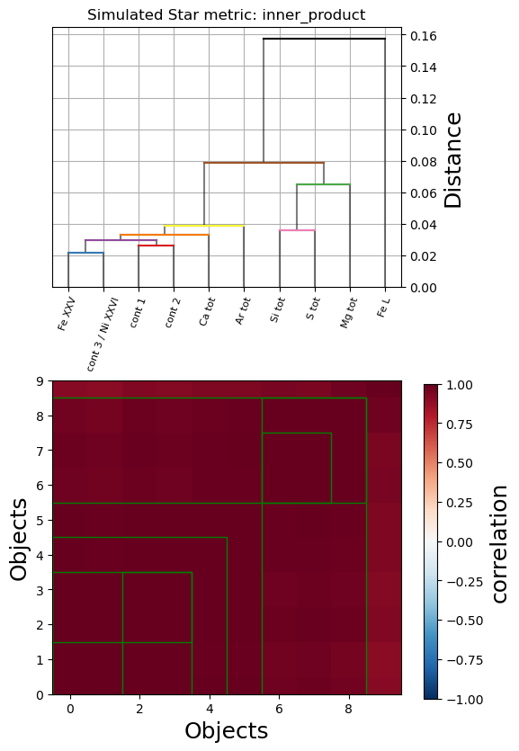
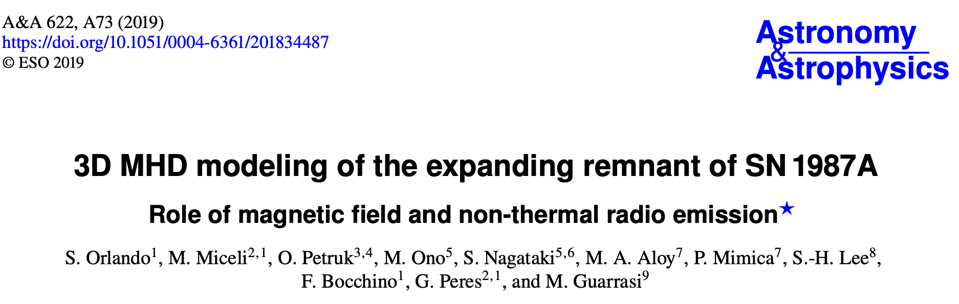
RESULTS: Narrow Band
SVHC with Frobenius
SVHC with Frobenius
Simulated data at 350 years
CAS-A
Empirical vs surrogate data
In empirical and simulated data, elements cluster essentially in the same way
Such clustering is congruent with the way the model was built.
ICSC Italian Research Center on High-Performance Computing, Big Data and Quantum Computing
Missione 4 • Istruzione e Ricerca
Notes:
Template e guide lines

Slide 12
RESULTS: Narrow Band
CAS-A
Empirical vs simulated data
Empirical
Fe is separated from other elements. Ni is «far”
SVHC/HC on simulations and ML on real data tell us the same thing
HC with cosine distance
Fe/Mg join other elements at high levels of distance. Ni is more mixed with other elements
Simulated
at 350 years
ICSC Italian Research Center on High-Performance Computing, Big Data and Quantum Computing
Missione 4 • Istruzione e Ricerca
Notes:
Template e guide lines

Slide 13
RESULTS: Narrow Band
CAS-A
Empirical vs simulated data
ML on simulations and ML on real data tell us the same thing
… and tell the same thing as SVHC/HC on simulations
Empirical
Ni is mixed with while Fe/Mg join other elements at higher disstances
ML with
cosine
distance
Ni is mixed with while Fe/Mg join other elements at higher disstances
Simulated
at 350 years
ICSC Italian Research Center on High-Performance Computing, Big Data and Quantum Computing
Missione 4 • Istruzione e Ricerca
Notes:
Template e guide lines

Slide 14
RESULTS: Narrow Band
RESULT 1 – methodological issue
Probably the large training allows to better undress the signal from noise
ML on simulations and ML on real data tell us the same thing
… and tell the same thing as SVHC/HC on simulations
ICSC Italian Research Center on High-Performance Computing, Big Data and Quantum Computing
Missione 4 • Istruzione e Ricerca
Notes:
Template e guide lines

Slide 15
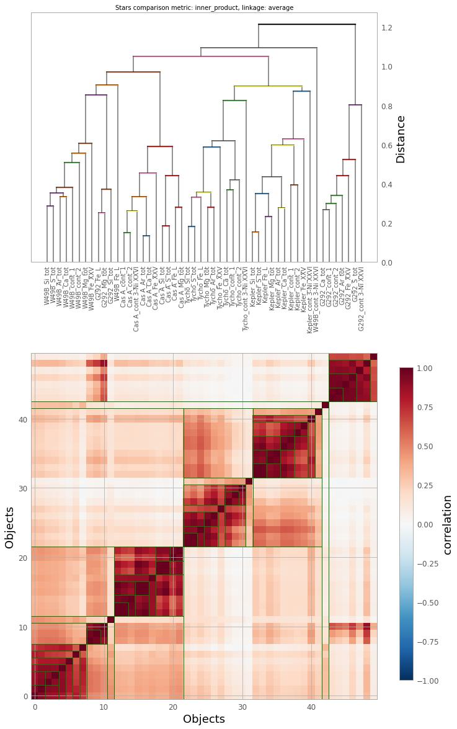
RESULTS: Narrow Band
We have used the same partitioning of the spectra for all the 5 SNRs
All elements same bands
This would indicate that W49B is closer to CAS-A/G292
W49B
G292 part
CAS-A
TYCHO
KEPLER
G292 part
W49B first links to some of the G292 elements
TYCHO first links to KEPLER
Both are linked to CAS-A
Then they link to the remaining elements of G292
ICSC Italian Research Center on High-Performance Computing, Big Data and Quantum Computing
Missione 4 • Istruzione e Ricerca
Notes:
Template e guide lines

Slide 16
RESULTS: Narrow Band
We have used the same partitioning of the spectra for all the 5 SNRs
All elements same bands
HC
All elements same bands
ML
ML and SVHC/HC tell us different things
TYCHO first links to KEPLER
CAS-A first links to W49B and a few G292 elements
W49B first links to CAS-A
G292 first links to TYCHO
Both are then linked to the remaining elements of G292
Both are linked to KEPLER
ICSC Italian Research Center on High-Performance Computing, Big Data and Quantum Computing
Missione 4 • Istruzione e Ricerca
Notes:
Template e guide lines

Slide 17
RESULTS: Narrow Band
Here we have selected only specific elements: Ar, Ca, Fe, Si_{tot}, S_{tot}
specific elements same bands
HC
Again, ML and SVHC/HC tell us different things
ML
TYCHO first links to KEPLER
CAS-A first links to W49B
W49B first links to CAS-A
G292 first links to TYCHO
Both are then linked to G292
Both are linked to KEPLER
ICSC Italian Research Center on High-Performance Computing, Big Data and Quantum Computing
Missione 4 • Istruzione e Ricerca
Notes:
Template e guide lines

Slide 18
Main Results
SV-HC methodology
with Frobenius distance
ML methodology
with cosine distance
W49B
G292 part
CAS-A
TYCHO
KEPLER
G292 part
HC methodology
with cosine distance
KEPLER
CAS-A
TYCHO
W49B
G292
Flux Maps
Narrow bands data
W49B
G292 part
CAS-A
TYCHO
KEPLER
G292 part
ICSC Italian Research Center on High-Performance Computing, Big Data and Quantum Computing
Missione 4 • Istruzione e Ricerca
Notes:
Template e guide lines

Slide 19
RESULTS: Narrow Band
RESULT 2 – Classification of SNRs
Controversial result
SV-HC methodology
with Frobenius distance
ML methodology
with cosine distance
W49B
G292 part
CAS-A
TYCHO
KEPLER
G292 part
TYCHO
G292
KEPLER
CAS-A
W49B
ICSC Italian Research Center on High-Performance Computing, Big Data and Quantum Computing
Missione 4 • Istruzione e Ricerca
Notes:
Template e guide lines

Slide 20
CAS-A
RESULTS: Equivalent Width
On empirical data ML and SVHC/HC tell us different things
Empirical EW maps HC
Fe and Ni are separated from other elements
Empirical EW maps ML
Fe is mixed with while Ni is separated from the other elements
On simulated data ML and SVHC/HC tell us very similar things
Simulated EW maps HC
Unfortunately, Ni is not present due to the fact that it is not clearly distinguishable from the continuum in the MHD simulations
Simulated EW maps ML
ICSC Italian Research Center on High-Performance Computing, Big Data and Quantum Computing
Missione 4 • Istruzione e Ricerca
Notes:
Template e guide lines

Slide 21
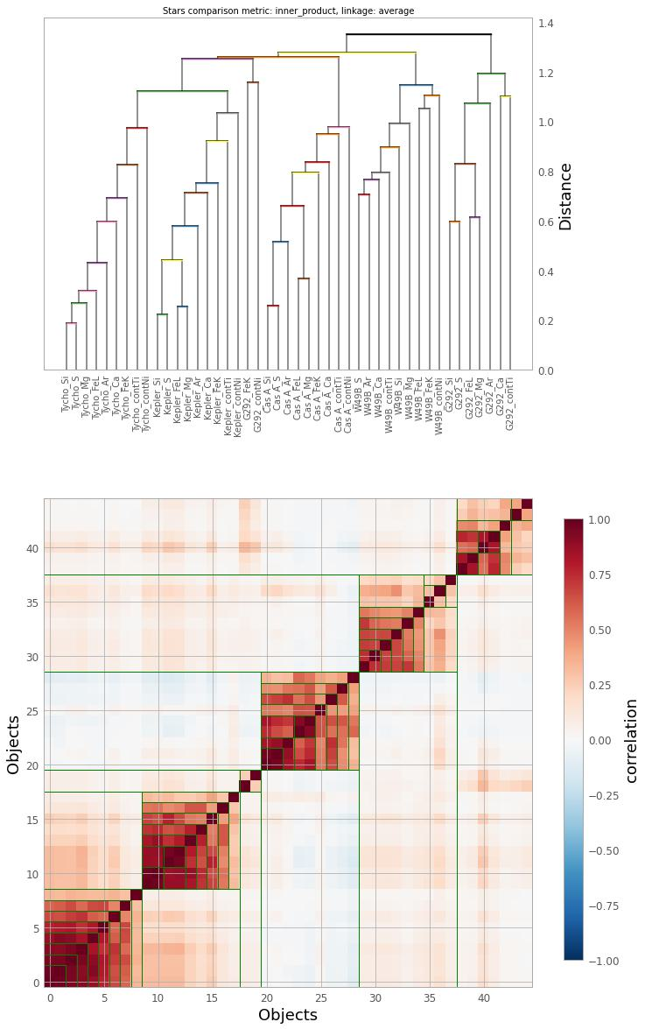
RESULTS: Equivalent Width
We have used the same partitioning of the spectra for all the 5 SNRs
All elements same bands
This is not validated !!!!
SV-HC methodology
with Frobenius distance
Again, this would indicate that W49B is closer to CAS-A/G292
Average linkage
TYCHO
KEPLER
CAS-A
W49B
G292 part
ICSC Italian Research Center on High-Performance Computing, Big Data and Quantum Computing
Missione 4 • Istruzione e Ricerca
Notes:
Template e guide lines

Slide 22
RESULTS: Equivalent Width
Average linkage
HC
ML
W49B first links to CAS-A
Both are linked to W49B
W49B first links to CAS-A
KEPLER first links to TYCHO
THEN to CAS-A
Both are linked to G292
THEN to G292
ICSC Italian Research Center on High-Performance Computing, Big Data and Quantum Computing
Missione 4 • Istruzione e Ricerca
Notes:
Template e guide lines

Slide 23
RESULTS: Equivalent Width
RESULT 3 – methodological issue
When noise is smaller SVHC/HC and ML give very similar results
ML methodology
with cosine distance
RESULT 4 – Classification of SNRs
This is the same thing we find for:
SVHC/HC for EW maps
SVHC/HC for narrow bands
Still to understand why ML for narrow bands gives something different
G292
CAS-A
TYCHO
KEPLER
W49B
ICSC Italian Research Center on High-Performance Computing, Big Data and Quantum Computing
Missione 4 • Istruzione e Ricerca
Notes:
Template e guide lines

Slide 24
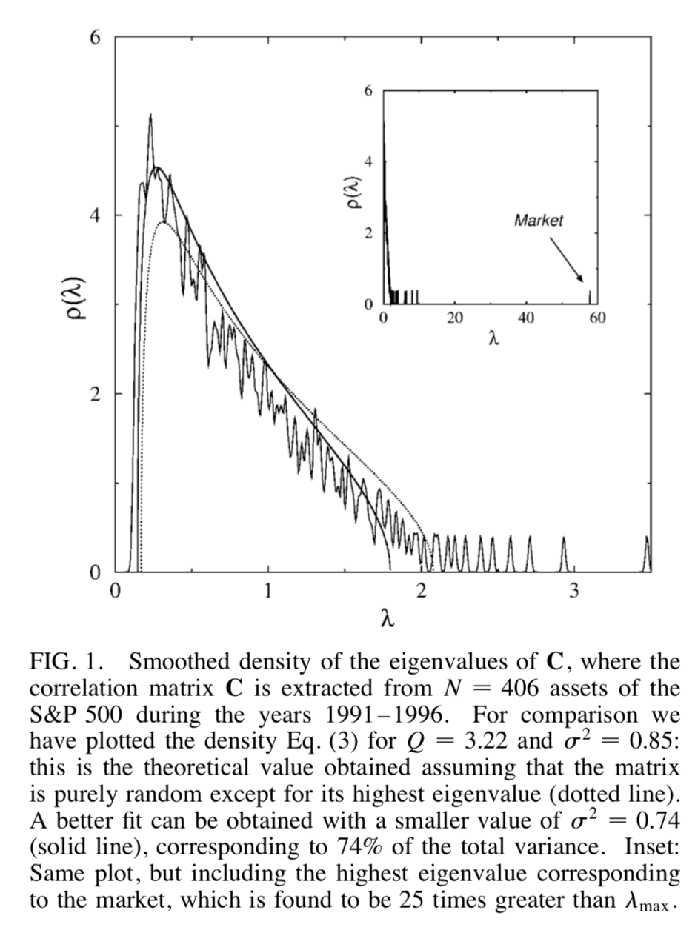
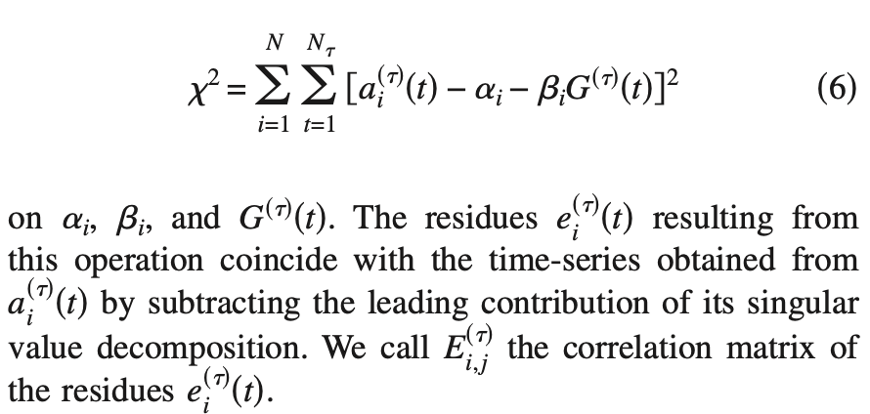
Final Steps
Light Curves - ML approach 40%
we are able to detect “anomalous” portions of the light curves
we are characterizing these regions
SNRs clustering and ML 100%
very good results
waiting for Marco to write a manuscript
Light Curves - correlation based approach 30%
Subract the largest eigenvalue of the correlation matrix amongst bands
We are trying to investigating the physical interpretation of the Residues
SNRs bipartite network approach 20%
we wrote down the protocol for randomizing the bipartite network preserving BOTH total metal intensities and number of connections with pixels
we need tooptimize the code
afterwards we will perform massive simulations
ICSC Italian Research Center on High-Performance Computing, Big Data and Quantum Computing
Missione 4 • Istruzione e Ricerca
Notes:
Template e guide lines

Slide 25
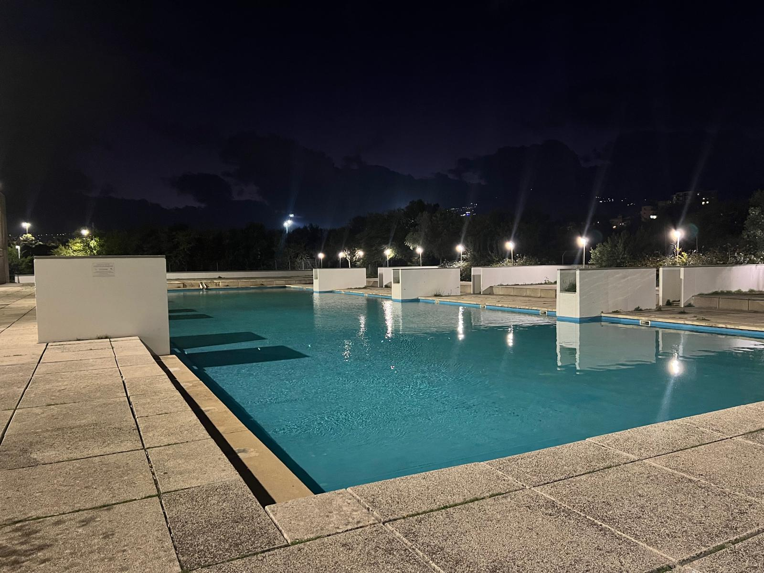
salvatore.micciche@unipa.it
The End
ICSC Italian Research Center on High-Performance Computing, Big Data and Quantum Computing
Missione 4 • Istruzione e Ricerca
Notes:
Template e guide lines

