Slide 1
CUDA-powered Large Scale Investigation of Cosmic Rays Spatial Propagation with Monte Carlo SDEs
SDEGnO (SDE on GPU for Optimization) Optimization and performances testing of CUDA-(multi)GPU-accelerated codes for the automatic parameterization of physical models based on SDE Monte Carlo algorithms
Leone Bacciu ¹, Matteo Grazioso ¹ ², Sabina Rossi ¹, Marco S. Nobile ¹
Spoke 3 Advisors: Giovanni Cavallotto ², Stefano Della Torre ²
1: Ca’ Foscari University of Venice
2: National Institute of Nuclear Physics (INFN) Milano Bicocca Division
Spoke 3 III Technical Meeting, Perugia 26-29 Maggio, 2025
ICSC Italian Research Center on High-Performance Computing, Big Data and Quantum Computing
Missione 4 • Istruzione e Ricerca
Notes:
https://docs.google.com/presentation/d/1_DYpiuJ9yX7kMaxVHYK_sSS4lwL06eHd/edit

Slide 2
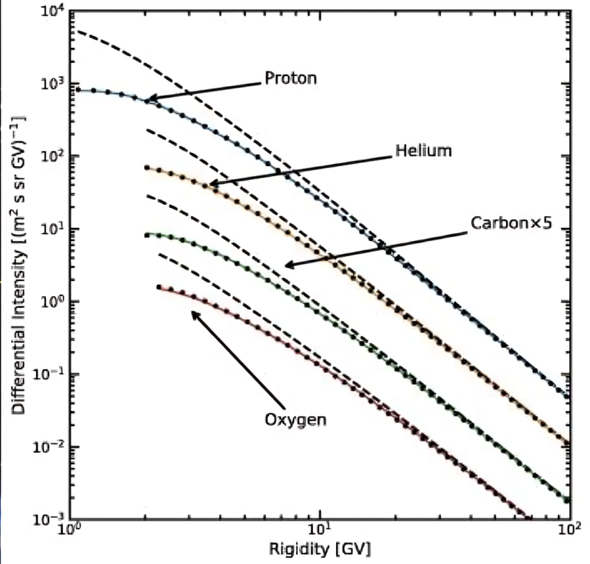
Scientific Rationale: Background & Motivation
Cosmic Rays (CRs) are charged particles originating from Sun, Galactic and Extragalactic sources – maybe even dark matter –.
When travelling through the heliosphere, i.e. “nearby” the Sun, they are affected by solar Modulation:
suppression of low-energy CR that is time dependent and correlated to Sun activity.
This phenomena can be described by the Parker Transport Equation (a Fokker-Planck like equation).
Boschini, M. J., et al. "Fast and accurate evaluation of deep-space galactic cosmic ray fluxes with HelMod-4/CUDA." Advances in Space Research 74.9 (2024): 4302-4320.
COSMICA (WP1) implements the PTE on GPU architecture.
ICSC Italian Research Center on High-Performance Computing, Big Data and Quantum Computing
Missione 4 • Istruzione e Ricerca

Slide 3
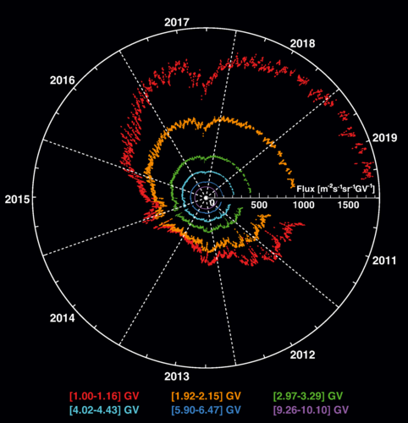
Scientific Rationale: Background & Motivation – Scalability
COSMICA was originally developed only to speedup the simulations, but it was missing of integration with algorithm for search the optimal parameters on such large set of data.
AMS-02 is measuring CR spectra with an unprecedented precision (~1%) since 2011.
Monthly and daily spectra for H, He, e-, e+, Ions,... are available for the analysis.
In particular: 140 solar events from 2011 to 2019 were identified using daily cosmic ray data.
These phenomena demand large-scale modeling efforts to understand their evolution and impact.
Aguilar, M., et al. "Periodicities in the daily proton fluxes from 2011 to 2019 measured by the Alpha Magnetic Spectrometer on the International Space Station from 1 to 100 GV." Physical review letters 127.27 (2021): 271102.
ICSC Italian Research Center on High-Performance Computing, Big Data and Quantum Computing
Missione 4 • Istruzione e Ricerca

Slide 4
SDEGnO
SDEGnO (SDE on GPU for Optimization) is a project developed by Ca’ Foscari University of Venice, aiming to integrate SDE solvers – like COSMICA (WP1) – with parameter search algorithms.
The project has two main components:
Development of parameter search algorithms
Implement and evaluate various optimization strategies for multiple parameters search.
Explore techniques such as evolutionary algorithms, swarm optimization, and meta-heuristics.
Adapting COSMICA
Adapt the framework for seamless integration with external tools, and compatibility with different physical models.
Improve efficiency and scalability.
Enable execution of multiple parallel parametrizations.
ICSC Italian Research Center on High-Performance Computing, Big Data and Quantum Computing
Missione 4 • Istruzione e Ricerca

Slide 5
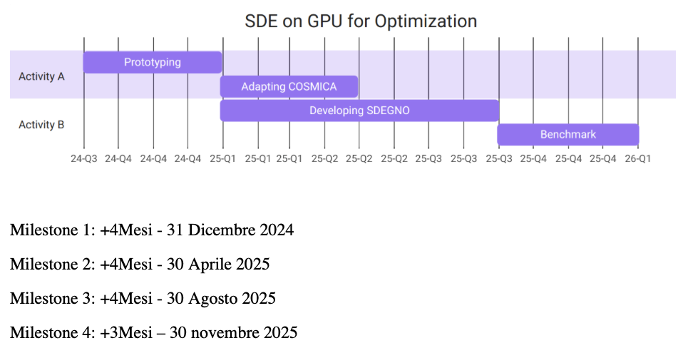
Technical Objectives: Planning
The project is divided into two main activities:
Activity A: focused on updating and optimizing the COSMICA codebase – together with the COSMICA team – and easing the integration with external tools. This coincided with Spoke3 M10.
Activity B: dedicated to designing and implementing advanced parameter search methods for model optimization.
ICSC Italian Research Center on High-Performance Computing, Big Data and Quantum Computing
Missione 4 • Istruzione e Ricerca

Slide 6
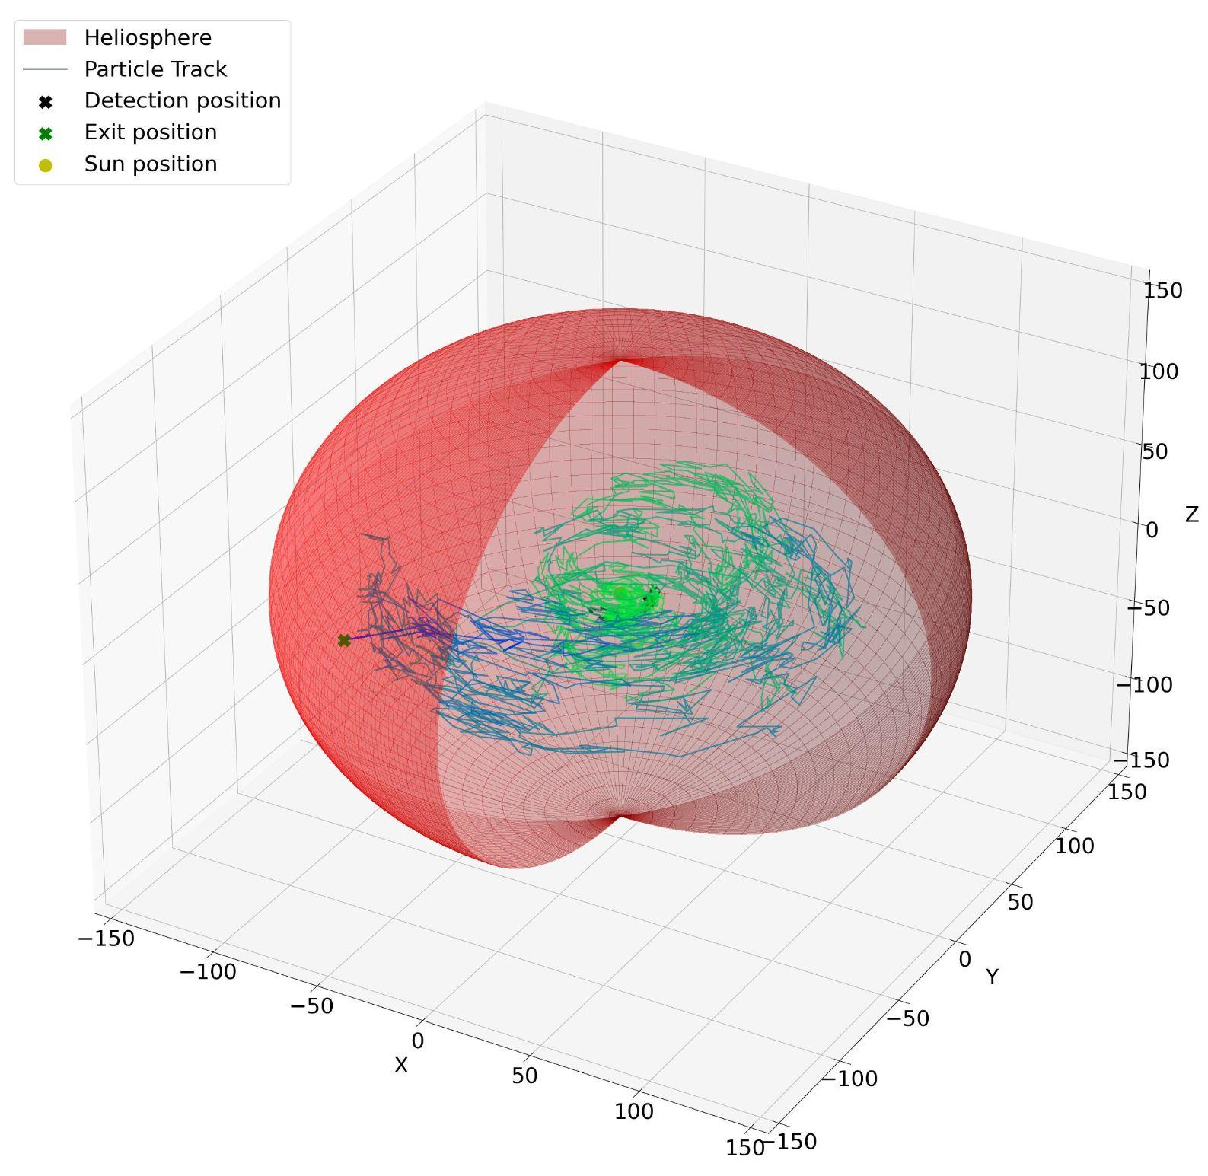
Technical Description: COSMICA
It simulates quasi-particle propagation backward in time by solving the PTE using a Monte Carlo method on SDE.
The task is embarrassingly parallel, with each GPU thread simulating one quasi-particle in a loop until it reaches the boundary.
A peculiarity is the strictly compute-intensive, rather than memory-intensive, nature of the problem.
ICSC Italian Research Center on High-Performance Computing, Big Data and Quantum Computing
Missione 4 • Istruzione e Ricerca

Slide 7
Methodologies and Solutions
To ensure higher performance and proper integration with the SDEGnO framework, during the prototyping phase the following key area of improvement were identified.
Implementation improvements
🛠️ Language Standard & Library Migration
🔢 Data Type Consistency
🔀 Branching Optimization
🧠 Memory Management & Layout
🚀 Compilation & GPU Tuning
Architecture improvements
💻 Command-Line Interface (CLI)
🎲 Simulation Reproducibility & Flexibility
📝 Logging & Monitoring
📊 Multiple Parametrizations & Isotopes
📥 Input/Output Handling
ICSC Italian Research Center on High-Performance Computing, Big Data and Quantum Computing
Missione 4 • Istruzione e Ricerca

Slide 8
Methodologies and Solutions – Implementation improvements
First attempt: JAX migration
COSMICA was entirely ported to JAX.
The performance was about 2x slower than the CUDA version.
Different branches need to be executed for different particles in the same time step, causing divergence.
JAX does not appropriately optimize diverging branches in vectors conditionals, thus all branches are executed all the time.
Thus we decided to optimize the pure CUDA approach, and implementing an ad-hoc interface with SDEGnO.
SDEGnO is also being developed in Python.
JAX is a Python library for accelerator-oriented array computation, which supports Just-In-Time compilation for GPUs.
It automatically optimizes vector operations.
ICSC Italian Research Center on High-Performance Computing, Big Data and Quantum Computing
Missione 4 • Istruzione e Ricerca

Slide 9
Implementation improvements
🔢 Data Type Consistency
Single-precision floats, PTX and SASS optimization, safe casting, reduced math library dependency.
🔀 Branching Optimization
Restructure if-statements to reduce GPU divergence in branching, reduce conditional variable scope to reduce register usage.
ICSC Italian Research Center on High-Performance Computing, Big Data and Quantum Computing
Missione 4 • Istruzione e Ricerca

Slide 10
Implementation improvements
🛠️ Language & Library Migration
🧠 Memory Management & Layout
Upgrade to C++20 and CUDA 12.4, switch to smart pointers; introduce well-documented structs for clarity.
Grouped constants in read-only constant cache, unified memory, local random states, reference-based APIs.
🚀 Compilation & GPU Tuning
CMake + scripts, zero-warning builds, profile-based thread/block configurations, multithreaded job queue.
ICSC Italian Research Center on High-Performance Computing, Big Data and Quantum Computing
Missione 4 • Istruzione e Ricerca

Slide 11
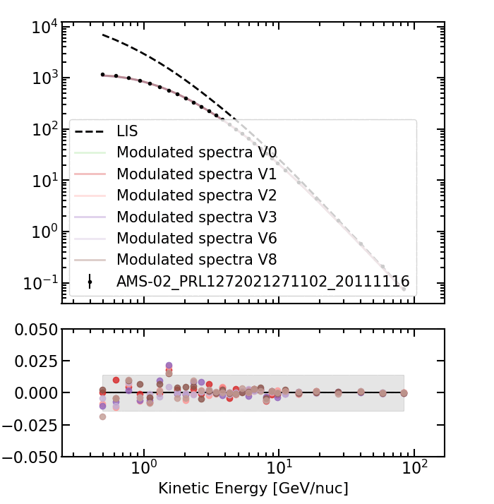
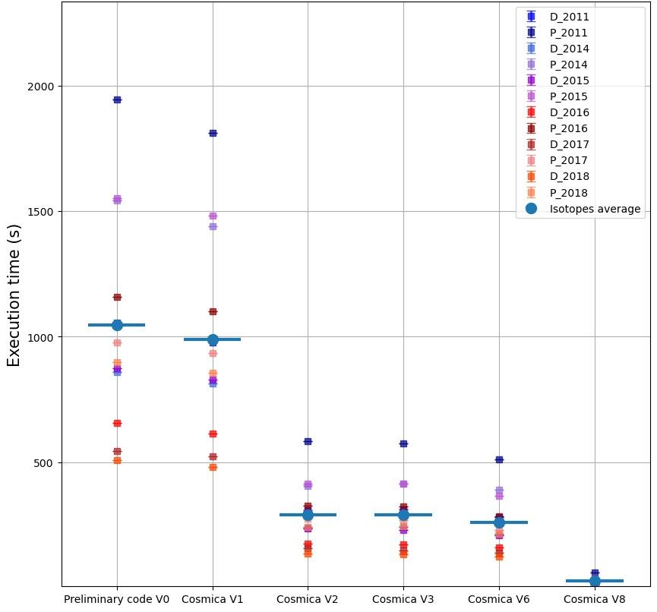
Main Results: Execution Time and Stability
COSMICA
performances
COSMICA + SDEGnO updates
(M10)
at M9
Execution time of COSMICA versions on a single Nvidia A40
ICSC Italian Research Center on High-Performance Computing, Big Data and Quantum Computing
Missione 4 • Istruzione e Ricerca

Slide 12
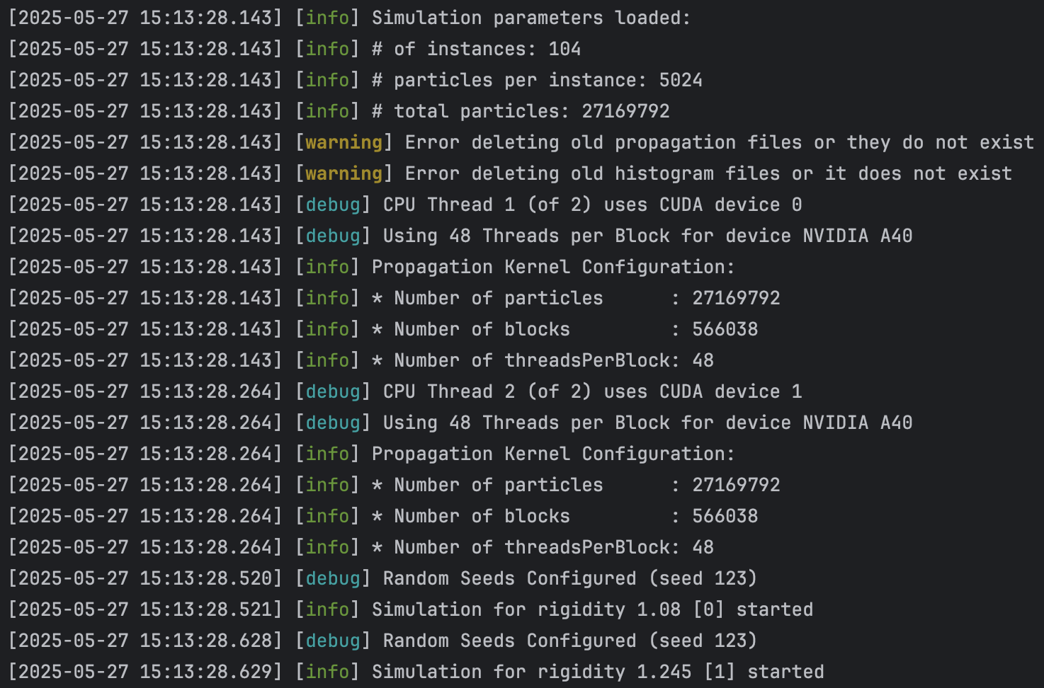
Architecture improvements
💻 Command-Line Interface
📝 Logging & Monitoring
Robust CLI parser, YAML I/O via stdin/stdout, batch testing without temp files.
Categorized, timestamped logging framework with high-precision timers for in-depth profiling.
🎲 Reproducibility & Flexibility
User-provided random seed, deterministic pseudo-random sequences for consistent debugging.
ICSC Italian Research Center on High-Performance Computing, Big Data and Quantum Computing
Missione 4 • Istruzione e Ricerca

Slide 13
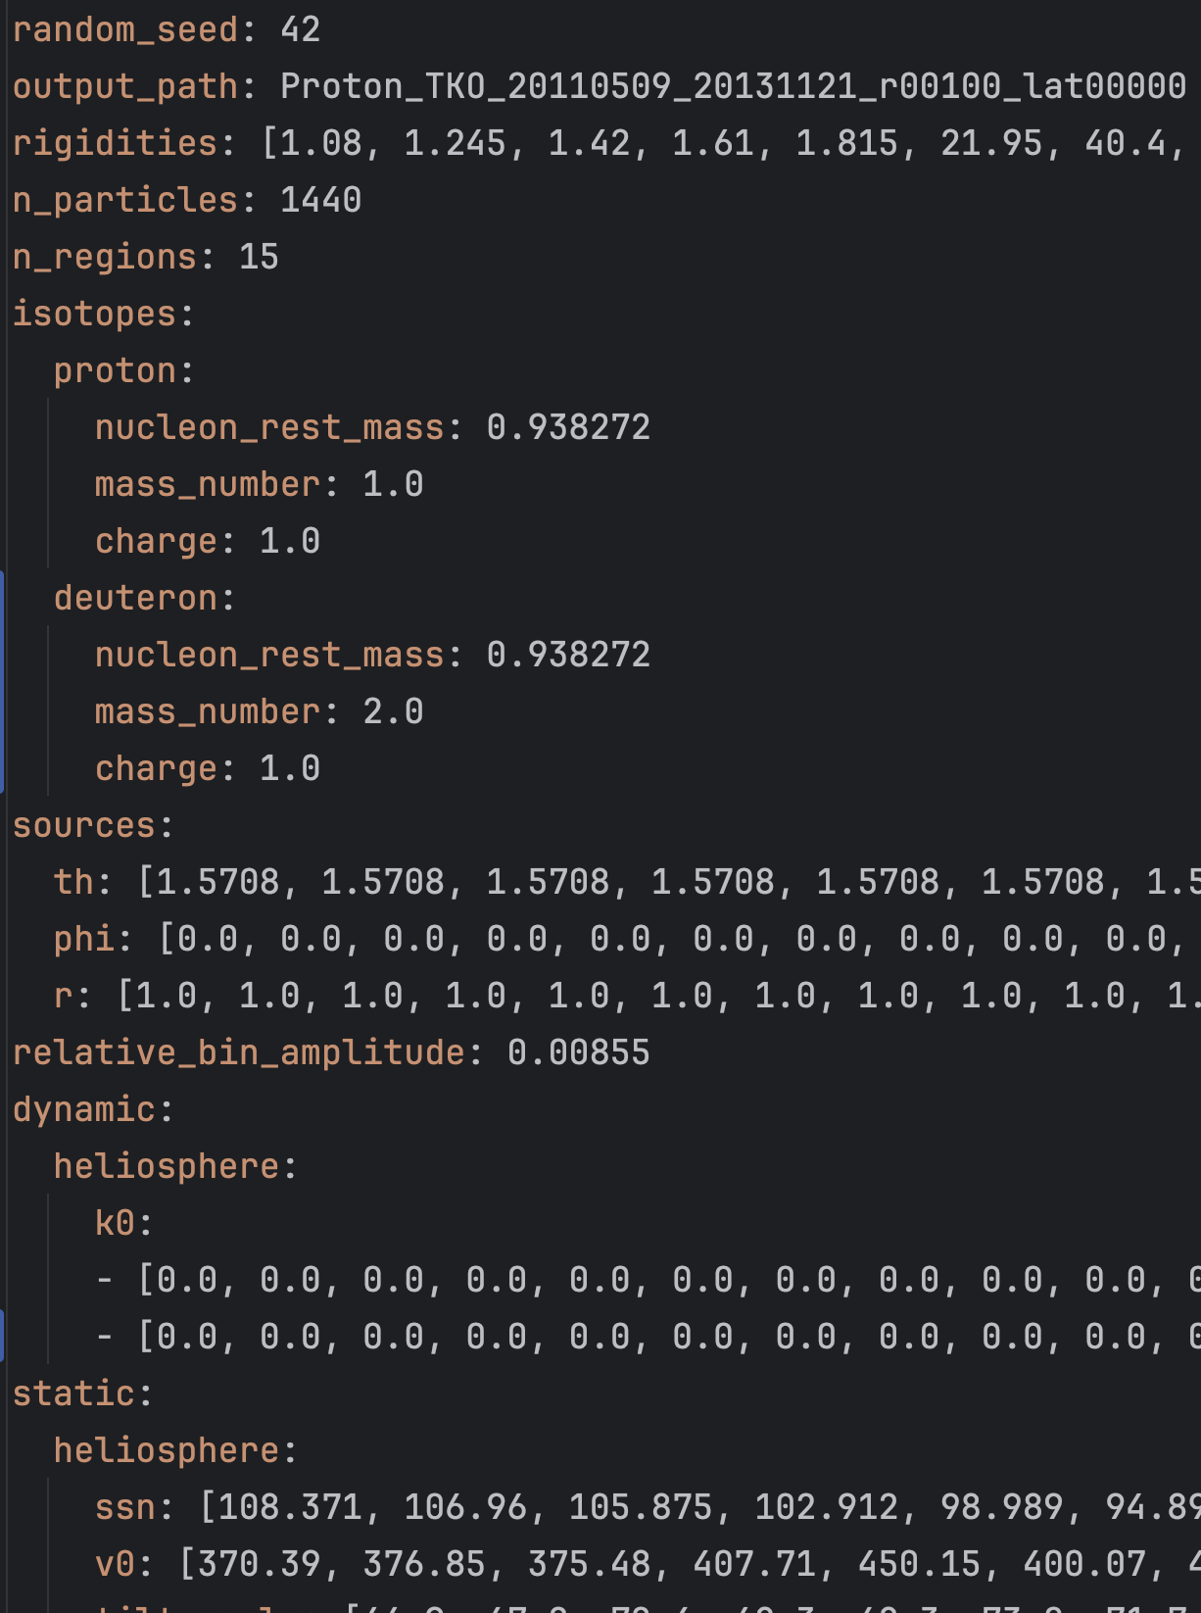
Architecture improvements: SDEGnO Interface
📊 Parametrizations & Isotope Support
Batch parametrization, multi-isotope simulation, index vectors for scheduling.
📥 Input/Output Handling
C++ library parser, YAML for human-readable configs, standardized I/O for seamless visualization, pipeline tools compatibility.
ICSC Italian Research Center on High-Performance Computing, Big Data and Quantum Computing
Missione 4 • Istruzione e Ricerca

Slide 14
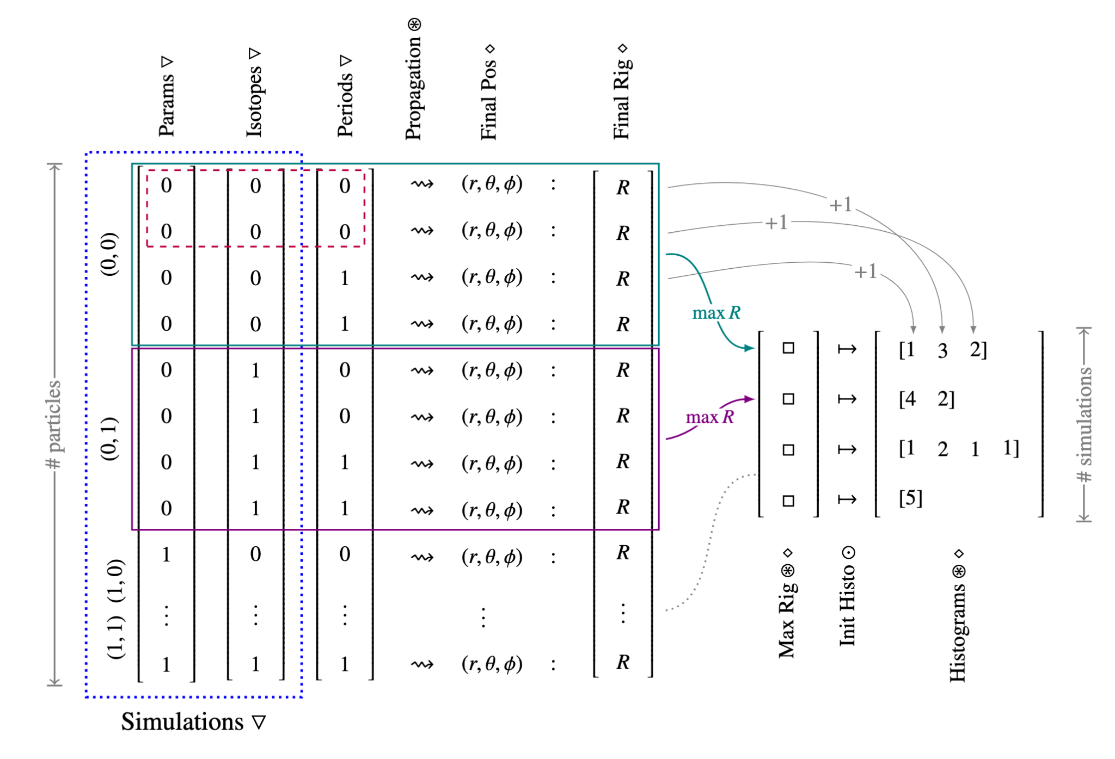
Architecture improvements
Simulations for multiple parametrizations, isotopes and periods can be dispatched in parallel on the same run.
This ensures maximal GPU utilization.
ICSC Italian Research Center on High-Performance Computing, Big Data and Quantum Computing
Missione 4 • Istruzione e Ricerca

Slide 15
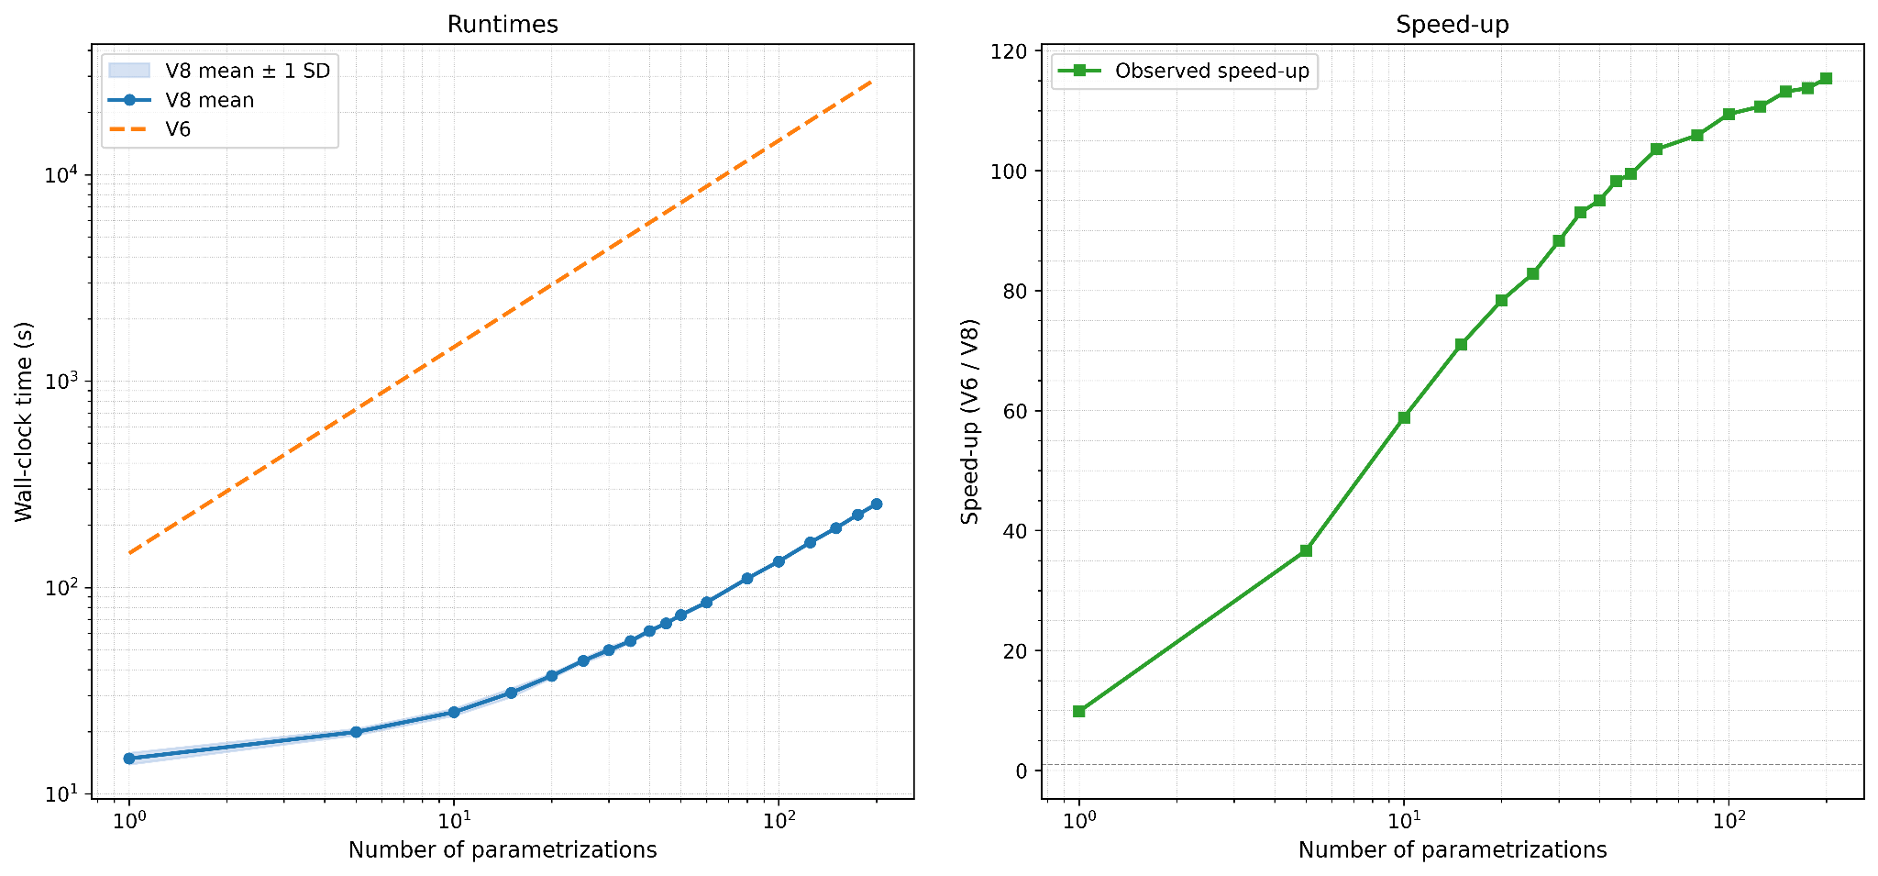
Main Results: >115 times speedup ([M9]/[M10]) 🤩
COSMICA at M9 (V6)
COSMICA + SDEGnO interface (V8)
ICSC Italian Research Center on High-Performance Computing, Big Data and Quantum Computing
Missione 4 • Istruzione e Ricerca

Slide 16
SDEGnO Backbone
We built a streamlined framework to:
Dynamically generated inputs by integrating multiple hyperparameter sources and parameter grid.
Launch parallel simulations across multi-GPU environments.
Parse and aggregate simulation outputs.
Compute modulated spectra for each isotope.
Plot results from single or multiple simulations for comparison.
Evaluate simulation fitness by comparison with experimental data.
We are currently in the process of evaluating and testing various black-box optimization meta-heuristic methods, such as…
ICSC Italian Research Center on High-Performance Computing, Big Data and Quantum Computing
Missione 4 • Istruzione e Ricerca

Slide 17
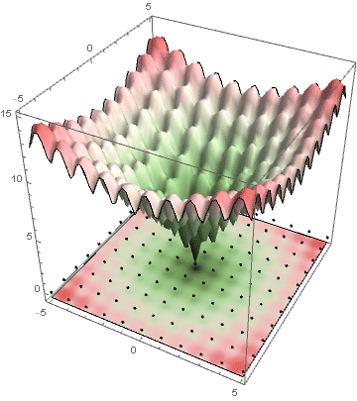
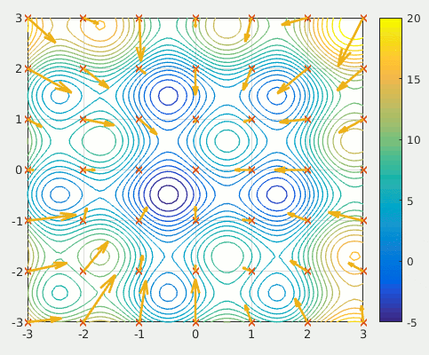
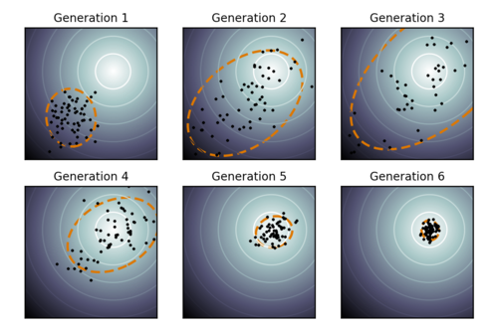
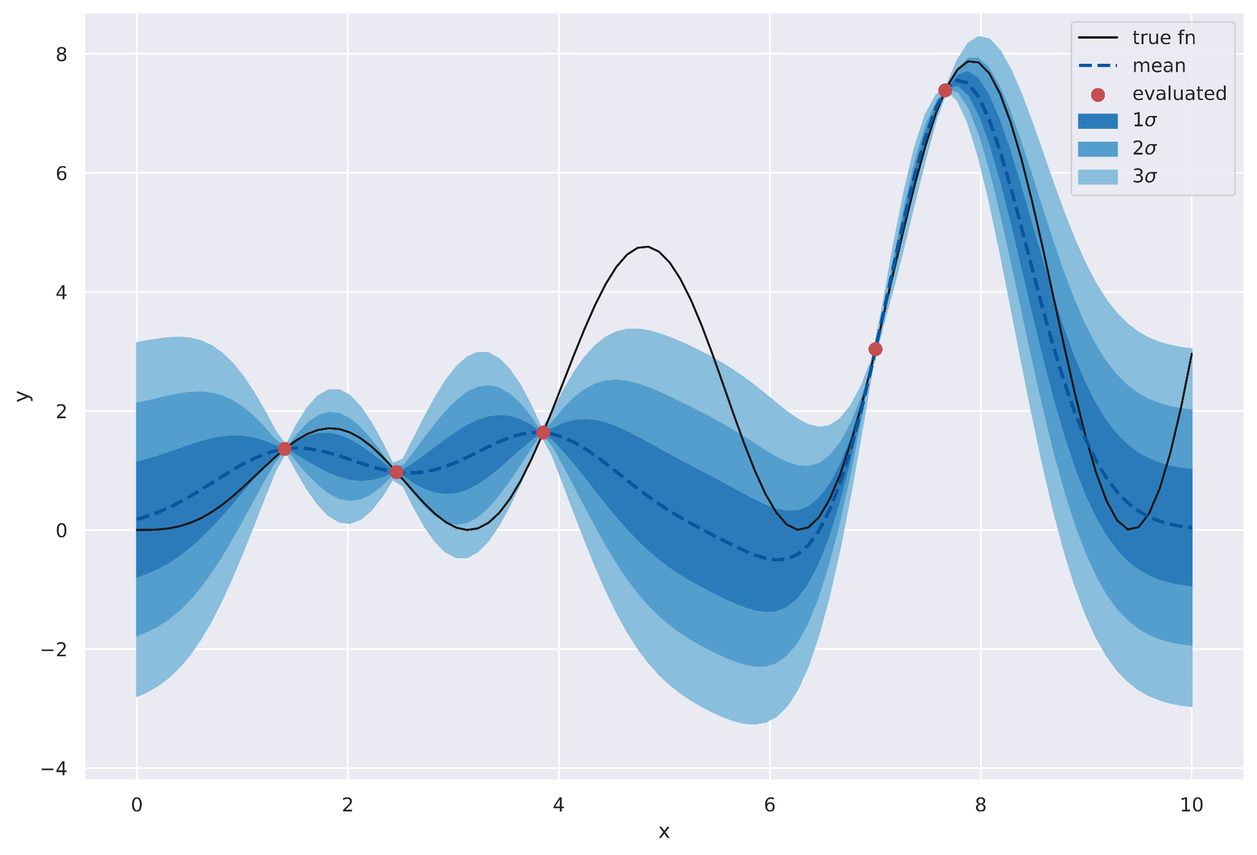
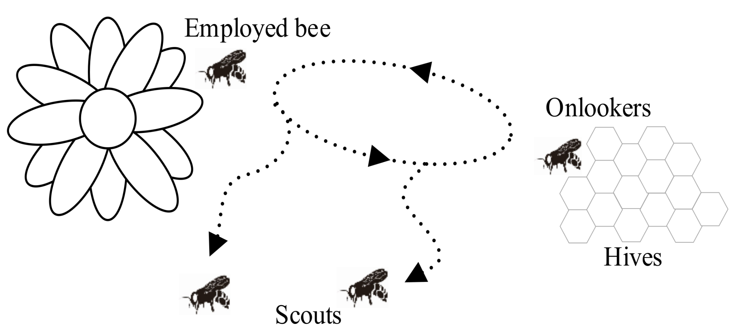
SDEGnO Methods
Differential Evolution (DE)
Particle Swarm Optimization (PSO)
Covariance Matrix Adaptation Evolution Strategy (CMA-ES)
Bayesian optimization surrogate model
Artificial Bee Colony (ABC)
ICSC Italian Research Center on High-Performance Computing, Big Data and Quantum Computing
Missione 4 • Istruzione e Ricerca

Slide 18
Status and Perspectives: KPIs
Milestone​ | Target​ | KPI​ | Completion
1 | In-depth analysis of the problem ​ | Prototype SDEGNO code for parameter search​ | 100%​
2​ | Adapting COSMICA code for running parameter search on GPU and interfacing SDEGNO code​ | Release patch to COSMICA​ | 100%​
3​ | Expanding SDEGNO code with parameters search algorithm​ | Release SDEGNO code​ | 50%​
4​ | Benchmark SDEGNO performances with actual grid based method​ | Benchmark analysis​ | 0%​
No criticalities!
ICSC Italian Research Center on High-Performance Computing, Big Data and Quantum Computing
Missione 4 • Istruzione e Ricerca

Slide 19
Goals we expect to achieve in next months
🔍 Apply the parameter search to a real case study
automated parameter optimization to model solar events events with high precision.
💻 Open Source release
of tools and frameworks developed, promoting transparency, collaboration, and reproducibility.
🧩 Development of a modular and scalable framework
adaptable to a wide spectrum of physical modeling scenarios and reusable across HPC research.
ICSC Italian Research Center on High-Performance Computing, Big Data and Quantum Computing
Missione 4 • Istruzione e Ricerca

Slide 20
CUDA-powered Large Scale Investigation of Cosmic Rays Spatial Propagation with Monte Carlo SDEs
SDEGnO (SDE on GPU for Optimization) Optimization and performances testing of CUDA-(multi)GPU-accelerated codes for the automatic parameterization of physical models based on SDE Monte Carlo algorithms
Leone Bacciu ¹, Matteo Grazioso ¹ ², Sabina Rossi ¹, Marco S. Nobile ¹
Spoke 3 Advisors: Giovanni Cavallotto ², Stefano Della Torre ²
1: Ca’ Foscari University of Venice
2: National Institute of Nuclear Physics (INFN) Milano Bicocca Division
Spoke 3 III Technical Meeting, Perugia 26-29 Maggio, 2025
ICSC Italian Research Center on High-Performance Computing, Big Data and Quantum Computing
Missione 4 • Istruzione e Ricerca

Slide 21
Additional Notes

Slide 22
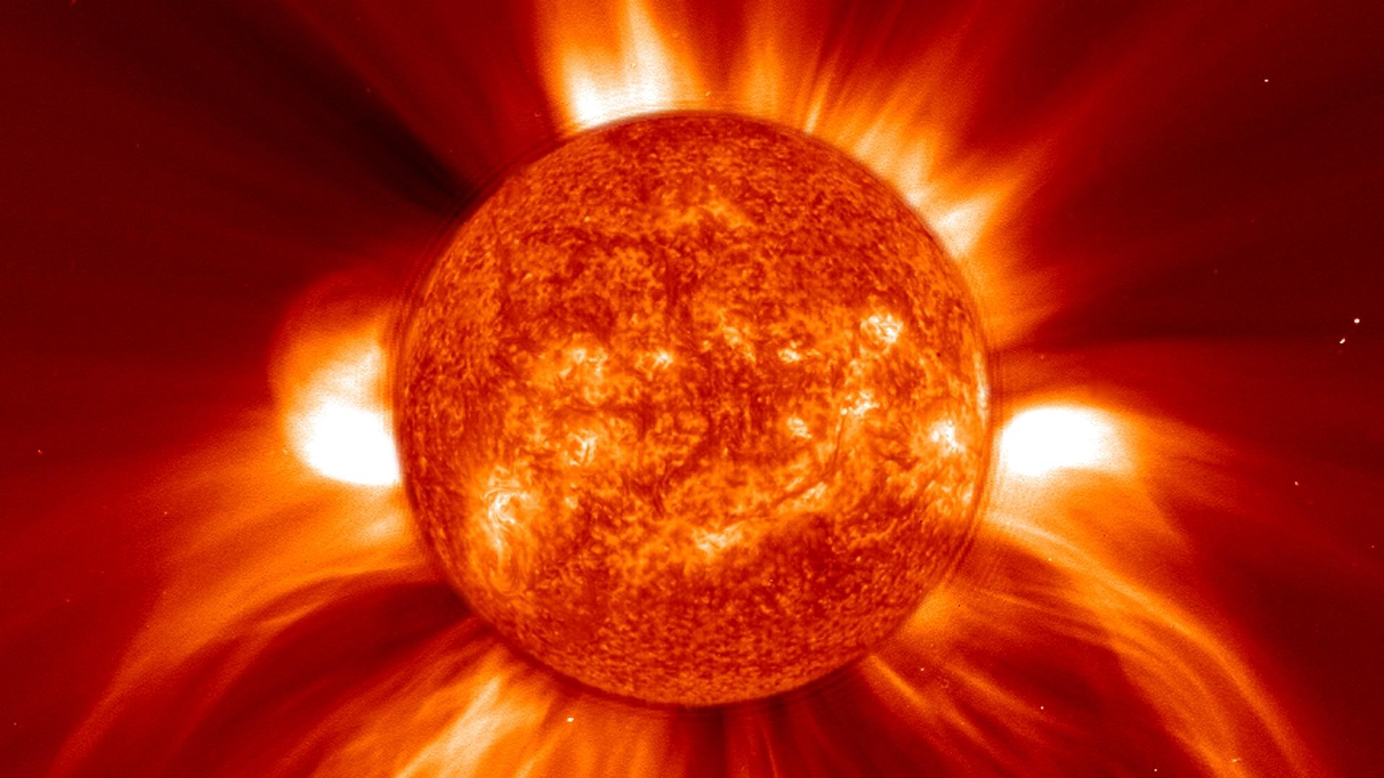
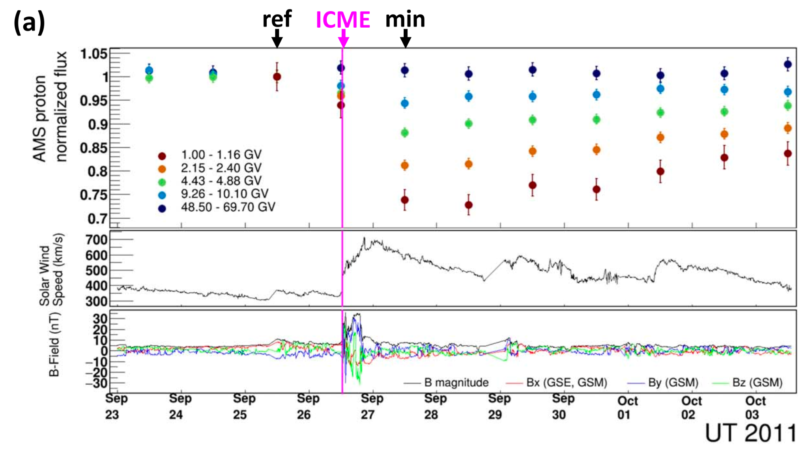
SDEGnO Case Study: Forbush Decrease
It’s a rapid, short-term reduction in galactic cosmic ray intensity observed at Earth.
Caused by interplanetary disturbances – mainly CMEs and their magnetic fields – which block or deflect cosmic rays.
Useful for studying solar activity, space weather effects, and assessing radiation exposure risks for satellites and astronauts.
Some heliospheric parameters change during these events, and are not modelled traditionally.
We intend to find them by simulating and optimizing.
Coronal Mass Ejection (CME)
ICSC Italian Research Center on High-Performance Computing, Big Data and Quantum Computing
Missione 4 • Istruzione e Ricerca

Slide 23
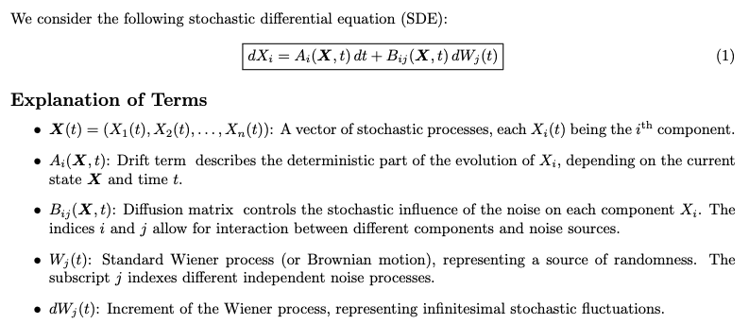
Scientific Rationale
Transport Equation and SDE Formalism
Fokker–Planck equation describes the CR distribution function. Includes diffusion, convection, adiabatic energy changes, and drift.
Advantages of SDEs:
Efficient for multidimensional, time-dependent systems;
Naturally suited for Monte Carlo simulations;
Flexible boundary conditions.
ICSC Italian Research Center on High-Performance Computing, Big Data and Quantum Computing
Missione 4 • Istruzione e Ricerca

Slide 24
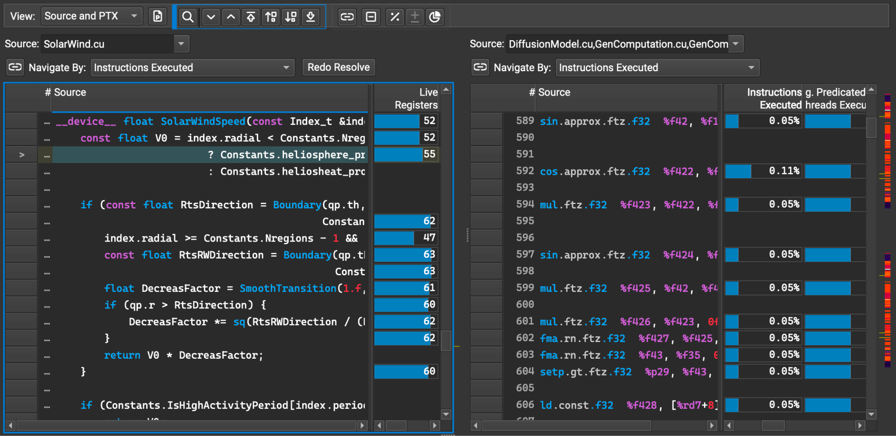
Implementation improvements
NVIDIA Nsight Compute
ICSC Italian Research Center on High-Performance Computing, Big Data and Quantum Computing
Missione 4 • Istruzione e Ricerca

