Slide 1
CATMAD
Anna Marretta, Università degli Studi di Palermo
SPEAKER
Fabrizio Bocchino, INAF-Osservatorio Astronomico di Palermo
ICSC Italian Research Center on High-Performance Computing, Big Data and Quantum Computing
Missione 4 • Istruzione e Ricerca
Notes:
Cover

Slide 2
CATMAD
Comparing Astrophysical observations with Theoretical Models: Advanced tools for Diagnostics
Theoretical model
Observations

Slide 3
Methodology: forward modeling
upgrade del modello
Confronto dati sintetici e dati reali
No
Sintesi dei dati dal modello
Modello fisico
OK?
Sì
Modello valido (non unico)
Predizione dati futuri

Slide 4
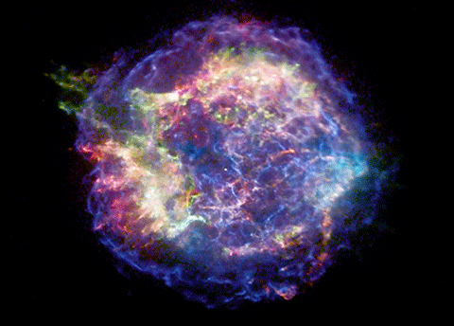
Introduction: SNRs
Complex physics
High-energy emission (X-ray and γ-rays)
Different emission mechanisms
Superposition of thermal emission from shock-heated plasm and non-thermal emission
onda d’urto
Need for advanced diagnostics
ejecta

Slide 5
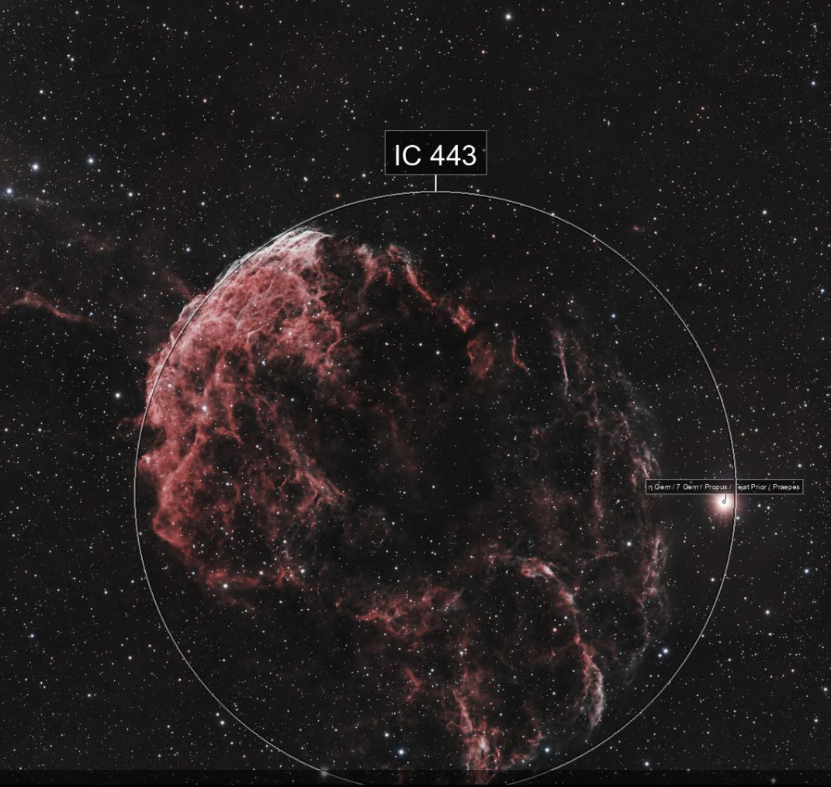
Case study: IC443, the jellyfish nebula
IC 443 is a member of the mixed morphology SNR (MMSNR) class, in which the ejecta from the explosion interacts with the circumstellar/interstellar medium (CSM/ISM), resulting in a rather complex morphology.
It interacts with a molecular cloud in the northwestern (NW) and southeastern (SE) regions, and with an atomic cloud in the northeastern (NE) region.
Molecular cloud
Atomic cloud
Known features:
Distance: 1.5 kp
Diameter:$∼50$ arcmin
Age:$∼8400$ yr
Emission: wide frequency range (Radio, IR, X, Gamma)
Optical image of IC 443

Slide 6
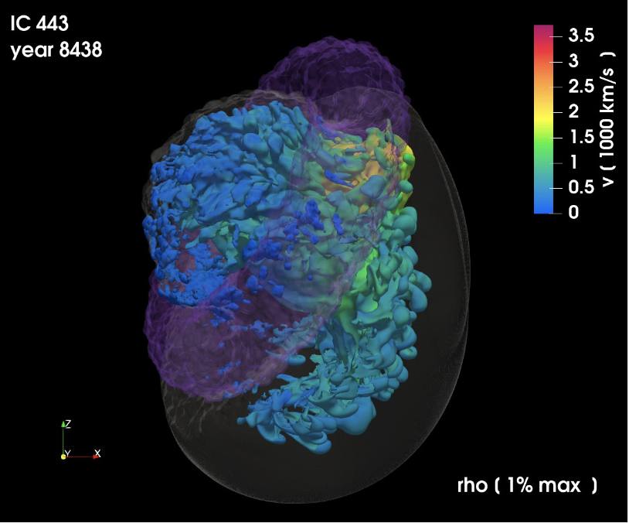
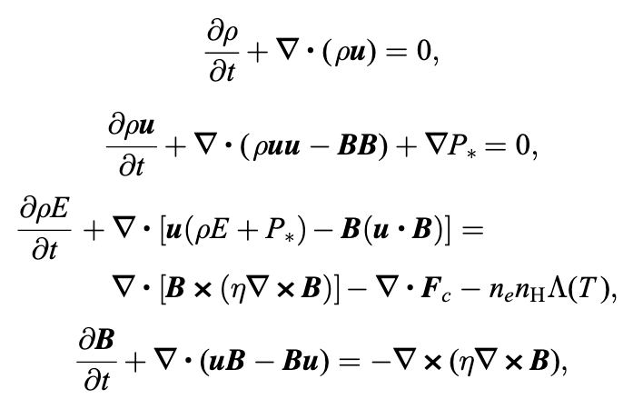
Case study: IC443, the jellyfish nebula
PLUTO Simulation output: datacubes of 622³ cell density, temperature, magnetic field, velocity, etc
MHD equations:
Ustamujic et al. 2021

Slide 7
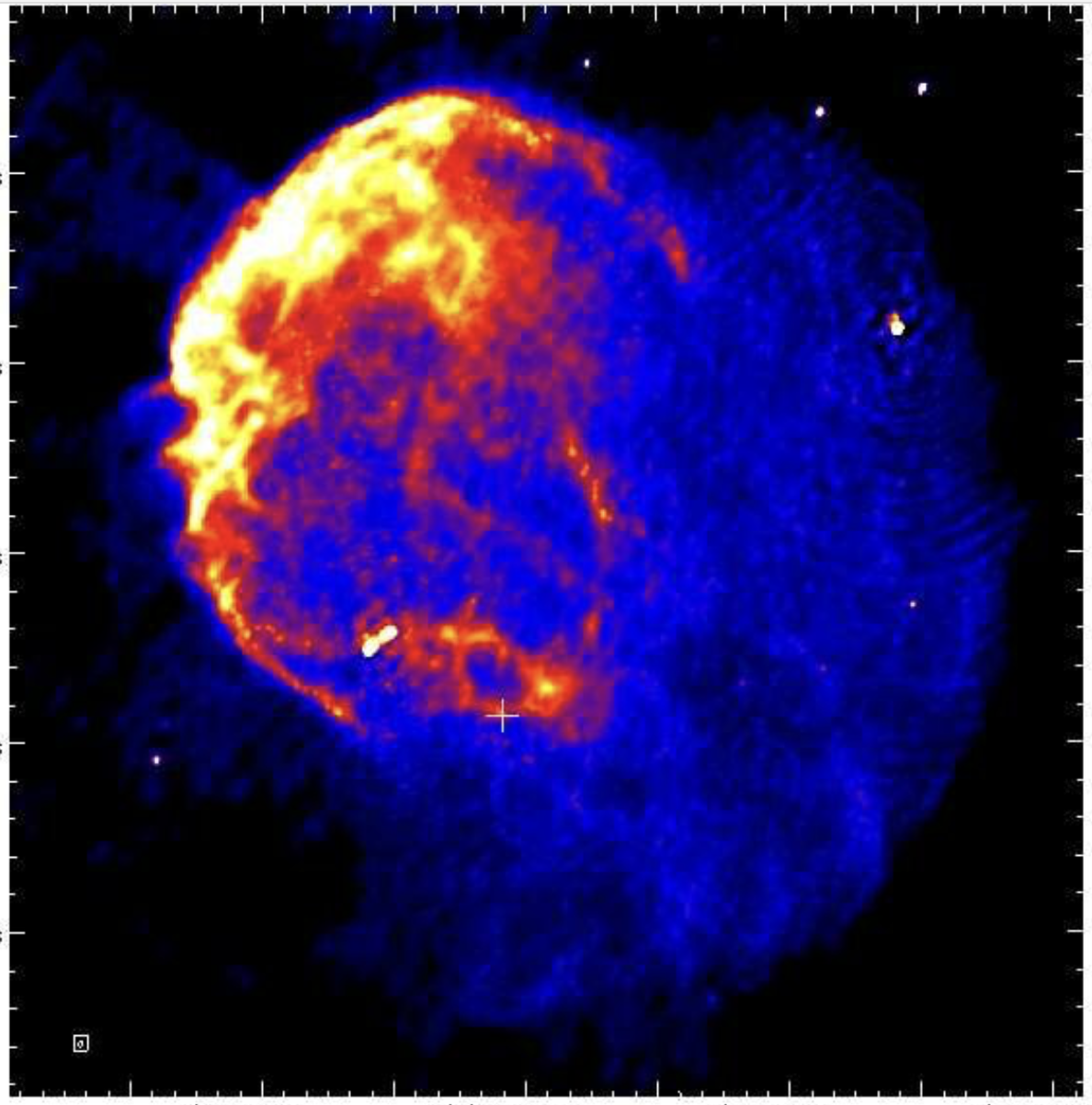
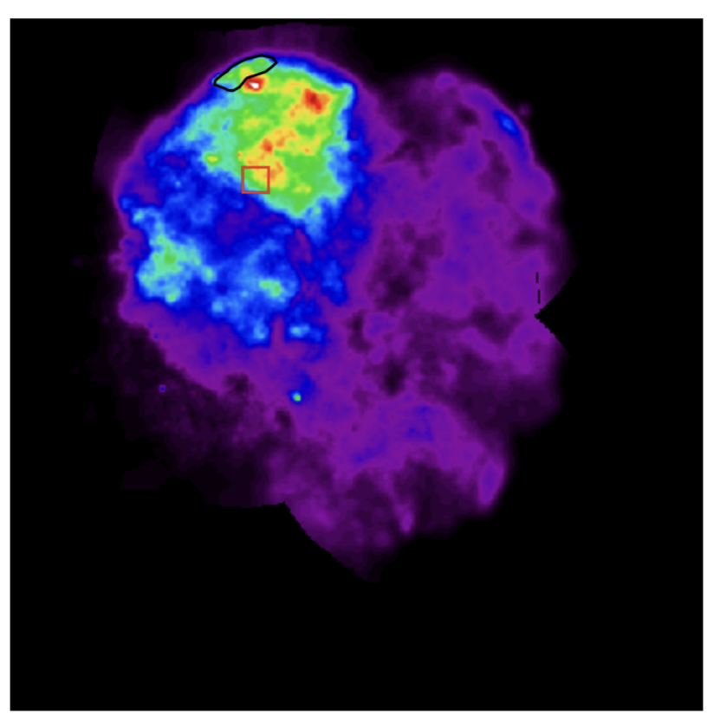
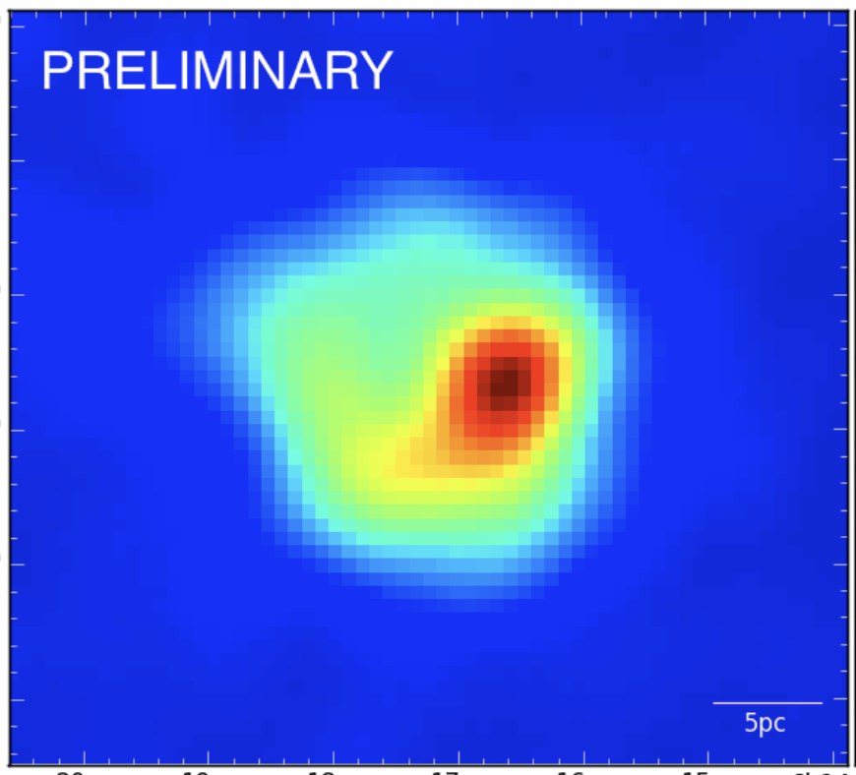
CATMAD: synthesis of non-thermal emission
Synthesis of non-thermal emission in radio, X-ray and γ-rays: crucial to understand origin and diffusion of cosmic rays in the Milky Way
?
Model
Radio
X-rays
γ-rays
Currently, observations of the same objects in different bands are analyzed separately (with phenomenological model). Multi-wavelength models are limited (one-zone models)

Slide 8
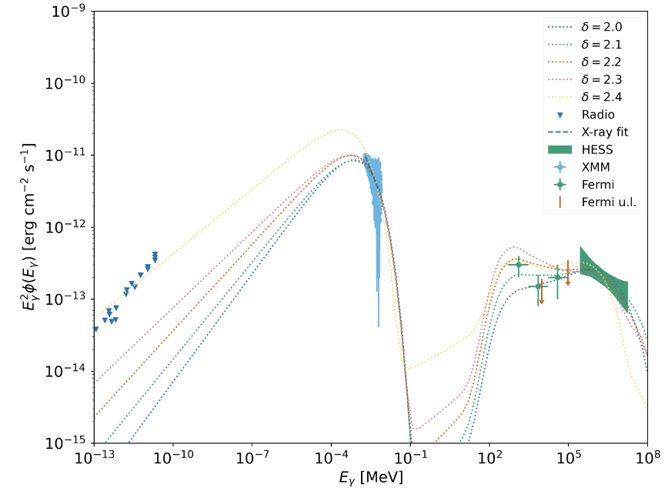
CATMAD: beyond the limits of one-zone models
Radio
X-rays
γ-rays
One zone models cannot resolve the intrinsic inhomogeneities and anisotropies in the system
Application example of the NAIMA tool for Cassiopeia A

Slide 9
CATMAD – Project Aims
Cell-by-cell synthesis of non-thermal emission from high-resolution 3D MHD simulations
Folding through the instrumental response of current (and future) telescopes
Direct comparison with existing multi-wavelength observations
Predictive capability for upcoming missions in various bands
Open-source framework for self-consistent synthesis of X-ray and γ-ray emission from MHD data, tailored to different instruments

Slide 10
Synthesis of IC443’s hadronic emission:
In inelastic collisions, accelerated protons interact with ambient protons, producing neutral pions (π⁰), which decay into gamma-ray photons.
$$π^{0}→γ+γ$$
We know that gamma flux is given by:
$$F_{γ}=\frac{L_{γ}}{4πD^{2}}=\frac{E_{CR}τ_{pp}}{12πD^{2}}$$
Where $τ_{pp}=\frac{1}{n_{H}σ_{pp}ck}$ is the proton cooling time.
Cosmic ray energy ($E_{CR}$) and gas density ($n_{H}$) vary spatially within the remanent.
These point-to-point variations directly influence the cooling time $τ_{pp}$ and thus the local gamma-ray luminosity (and consequently the flux).
For a realistic and self-consistent model, it is essential to consider the spatial distribution of $E_{CR}$ and $n_{H}$, avoiding global approximations or uniform averages.

Slide 11
Followed steps:
Shock Evolution and Proton Acceleration in SNRs
From the final frame of the PLUTO simulation, we reconstruct the history of acceleration.
What is the maximum proton energy since the explosion?
$$E_{max}∼C×∫_{T_{0}}^{T}v_{sh}^{2}(t)B(t)dt$$
Drury et al. 1983
Shock velocity:
$v_{sh}∝t^{−\frac{3}{5}}$ Sedov-Taylor phase
$v_{sh}=V_{0}$ Free expansion
Magnetic field

Slide 12
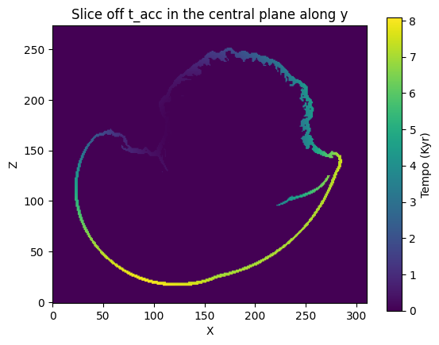
Shock Evolution and Proton Acceleration in SNRs
How to compute the shock velocity
🧭 Basic assumption
The shock evolves according to the classical evolution of a supernova remnant (SNR):
• Free expansion phase for the first 120 years
Followed by the Sedov–Taylor phase
Atomic cloud
Molecular cloud
🔹 Case 1 – No Cloud Interaction
The shock propagates freely in the ambient medium
As long as the shock is fast, proton acceleration continues
Acceleration, and thus velocity, is computed from the explosion up to the current time
🔹 Case 2 – With Cloud Interaction
The shock encounters a dense, neutral cloud
Upstream diffusion halts → cosmic rays escape → acceleration stops
Acceleration, and thus velocity, is computed only until the time when the shock hits the cloud
After this point, particles no longer gain energy, but may still propagate

Slide 13
Shock Evolution and Proton Acceleration in SNRs
How to compute the magnetic field
In modeling the magnetic field within the SNR, we follow in an autoconsistent way the magnetic field in evolution in the history of the SNR:
1. Constant Magnetic Field
Simplified assumption.
Suitable for late-stage remnants or when amplification is negligible.
2. Amplified Magnetic Field
More realistic for young SNRs.
Accounts for magnetic field amplification due to Bell instabilities.
$$B_{sat}∼v_{sh}^{\frac{3}{2}}$$
Bell et Al. 2013
⚠️ The choice of model significantly affects particle acceleration and emission estimates.

Slide 14
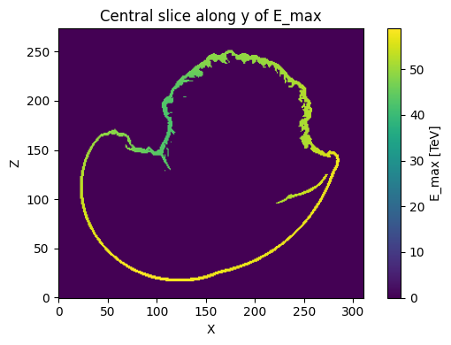
Shock Evolution and Proton Acceleration in SNRs
How to compute the maximum proton energy:
By solving
$$E_{max}∼C×∫_{T_{0}}^{T}v_{sh}^{2}(t)B(t)dt$$
(Drury et Al. 1983)
for each point of the cell and using the amplified B
(Bell et Al. 2013) :
$$B_{sat}∼v_{sh}^{\frac{3}{2}}=t^{−\frac{9}{10}}$$
Atomic cloud
Moleculat cloud

Slide 15
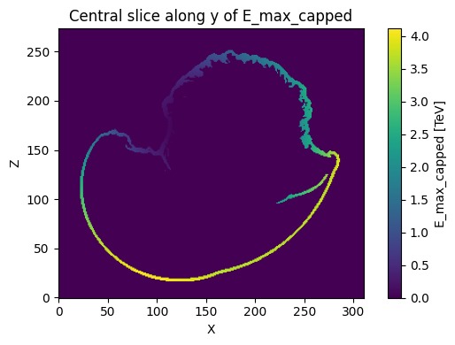
Shock Evolution and Proton Acceleration in SNRs
Escape energy of cosmic ray:
In old remnants like IC 443, the maximum proton energy is limited by escape.
As the remnant ages, the shock velocity and magnetic field strength decrease, leading to a progressive release of cosmic rays into the surrounding environment.
We have:
Atomic cloud
Molecular cloud
$$E_{escape}∝B×R_{sh}^{2}×t_{remnant}^{−1}$$
Vink, 2012
And thus:
$$E_{Max}=E_{escape}$$
when
$$E_{Max}>E_{escape}$$
Cell by cell, we limit the maximum energy of protons
Vink, J. (2012). Physics and Evolution of Supernova Remnants. Cambridge University Press.

Slide 16
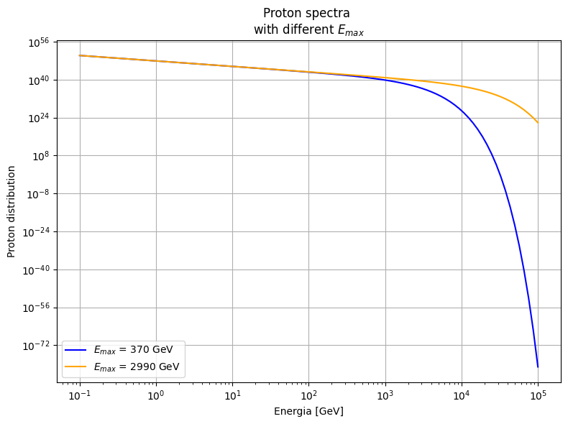
Shock Evolution and Proton Acceleration in SNRs
Modeling the proton spectrum cell by cell:
The energy computed in each cell is used as the cut-off energy of the proton spectrum.
The proton spectrum is derived using Naima, specifically:
Exponential Cutoff Power-Law model:$\frac{dN}{dE}=A(\frac{E}{E_{0}})^{−α}exp(−(\frac{E}{E_{cut}})^{β})$
$α$ is the spectral index (free parameter).
For supernova remnants (SNRs), typical values of $α$ lie between 2.0 and 2.3

Slide 17
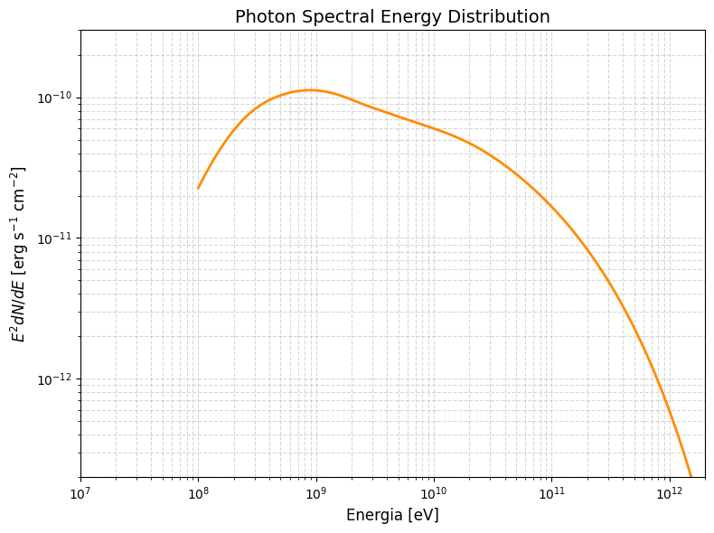
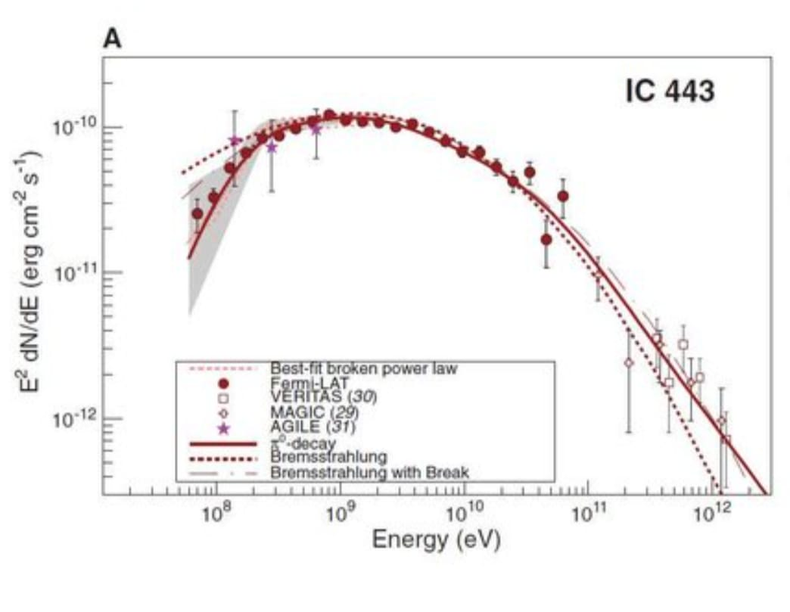
Synthesis of IC443’s hadronic emission:
Preliminary results:
Starting from the proton spectrum and density in each cell, we use the NAIMA tool to compute the corresponding photon spectrum and gamma-ray map, ultimately obtaining both the local contribution and the integrated emission and map for the entire simulation domain.
Simulated:
Observed:
Morselli et Al. (2014)
Energy (eV)
Energy (eV)

Slide 19
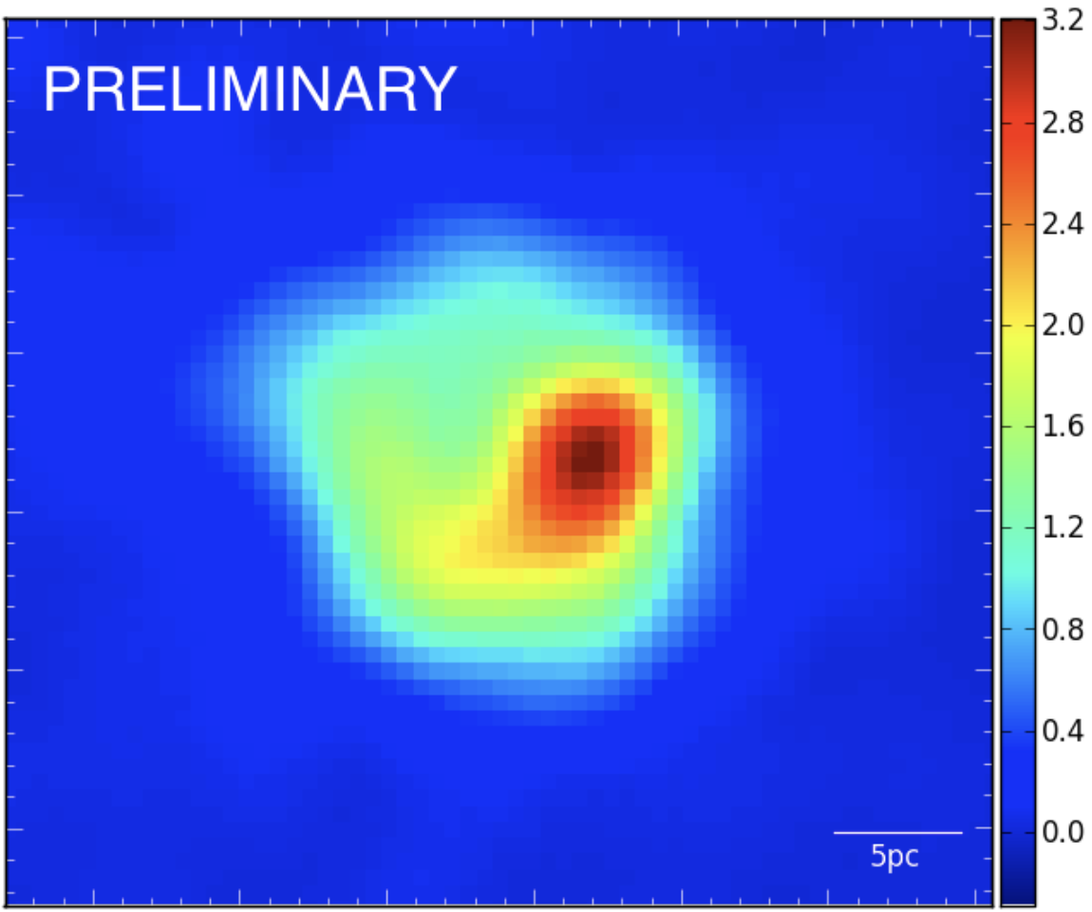
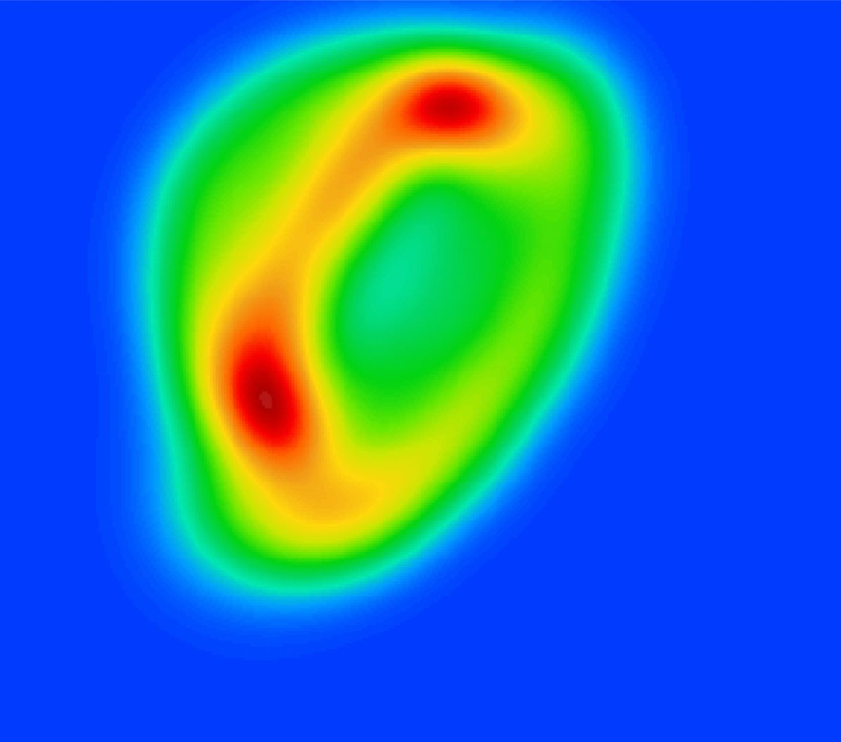
Synthesis of IC443’s hadronic emission:
Preliminary results:
Gamma ray map:
Observed:
Simulated:

Slide 20
Conclusion
CATMAD provides a framework for coupling MHD simulations with the NAIMA tool.
We developed a self-consistent hadronic emission model that reconstructs the entire acceleration and escape history from a single simulation snapshot, and synthesizes the hadronic gamma-ray emission.
The model has been applied to an evolved supernova remnant with known gamma-ray emission, and shows excellent agreement between simulated and observed data.
Future Applications:
Improve morphological predictions
Extension to model leptonic emission
Application to other astrophysical sources

