Slide 1
Spoke 3 - Astrophysics and Cosmos Observations
Technical Report
G. Taffoni - C. Gheller
SPOKE 3 III Technical Meeting
Perugia
26-29 May 2025
ICSC Italian Research Center on High-Performance Computing, Big Data and Quantum Computing
Missione 4 • Istruzione e Ricerca
Notes:
Cover

Slide 2
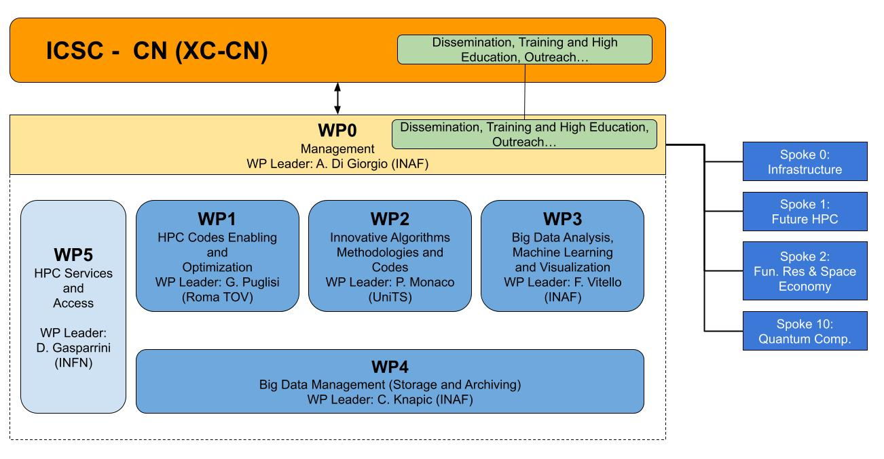
Spoke 3 – Struttura dei WP
Project Coordination Board
Spoke Leader: U. Becciani
co-Leader: P. Lubrano
System Engineer: G. Taffoni
Supervisor: C. Gheller
ICSC Italian Research Center on High-Performance Computing, Big Data and Quantum Computing
Missione 4 • Istruzione e Ricerca

Slide 3
WPs Progress Summary (snapshot at 03/2025)
Activity | 10% | 20% | 30% | 40% | 50% | 60% | 70% | 80% | 90% | 100%
WP1 HPC Codes enabling and optimization
WP2 Innovative algorithms, towards exascale
WP3 Big Data, Machine Learning and Viz
WP4 Big Data manag., storage and archiving
WP5 HPC services and access
SPOKE 3
FINAL GOAL
ICSC Italian Research Center on High-Performance Computing, Big Data and Quantum Computing
Missione 4 • Istruzione e Ricerca
Notes:
Template e guide lines

Slide 4
WP1: HPC Codes Enabling and Optimization.
This WP aims at identifying codes that require intensive computational resources to face the next generation of scientific challenges and performs their re-design, re-factoring and optimisation in order to effectively exploit state-of-the-art HPC solutions.
Main Tasks overview:
 | Selection, Analysis and testing of codes, algorithms and programming models; development plan. Status: Completed
 | Software Development, Refactoring, and Optimization. Status: On time, progressing according to plan.
 | Integration, Verification, and Validation Status: On time, progressing according to plan.
ICSC Italian Research Center on High-Performance Computing, Big Data and Quantum Computing
Missione 4 • Istruzione e Ricerca
Notes:
Template e guide lines

Slide 5
WP1: HPC Codes Enabling and Optimization.
Task 1.1: Selection, Analysis, and Testing of Codes, Algorithms, and Programming Models (Completed)
Objective: Identify and analyze reference codes and performance-critical software components in the astrophysics and astroparticle community.
Activities:
✅ Selected codes based on interactions with the scientific community and international collaborations (e.g., SKA, EUCLID, LSST).
✅ Developed and validated performance models of selected codes.
✅ Created prototype software components for testing performance improvements.
✅ Selected candidate codes: 11 codes .
Status:
✅ Completed on time
ICSC Italian Research Center on High-Performance Computing, Big Data and Quantum Computing
Missione 4 • Istruzione e Ricerca
Notes:
Template e guide lines

Slide 6
WP1: HPC Codes Enabling and Optimization.
Task 1.2: Software Development, Refactoring, and Optimization (In Progress)
Objective: Redesign and refactor performance-critical components of the selected codes to enhance scalability and efficiency on HPC systems. Implementing a strong collaboration between domain scientists, computer scientists, and HPC experts.
Activities:
Following the development plan from T1.1, implementing performance-critical code sections.
Created prototype software components for testing performance improvements.
Documenting and version-controlling the new code.
Status:
✅ On time, progressing according to plan.
Percentage of achievement 80%
ICSC Italian Research Center on High-Performance Computing, Big Data and Quantum Computing
Missione 4 • Istruzione e Ricerca
Notes:
Template e guide lines

Slide 7
WP1: HPC Codes Enabling and Optimization.
Task 1.3: Integration, Verification, and Validation (In Progress)
Objective: Integrate optimized software components into community codes and verify performance.
Activities:
Continuous integration newly optimized code components into original community codes.
Performing verification and validation through comparisons with reference solutions and use cases.
Evaluating performance improvements.
Status:
✅ On time, progressing according to plan. Percentage of achievement 70%
ICSC Italian Research Center on High-Performance Computing, Big Data and Quantum Computing
Missione 4 • Istruzione e Ricerca
Notes:
Template e guide lines

Slide 8
WP1: HPC Codes Enabling and Optimization.
Development Activities:
Two active tasks are working in parallel and they interact with each other continuously.
Tasks are working on the codes identified in Task 1.1.
Codes has been organized into 3 development activities that are proceeding in parallel
Task 1.2
Integration
Optimization
Task 1.3
Dynamic Simulations
11 A&C CODES
Data Processing
Numerical Modeling
ICSC Italian Research Center on High-Performance Computing, Big Data and Quantum Computing
Missione 4 • Istruzione e Ricerca
Notes:
Template e guide lines

Slide 9
WP1: HPC Codes Enabling and Optimization.
Dynamic Simulations
WP.id | Topic | App. Name | Ref. Person/Inst. | % Achiev.
1.1 | The PLUTO Code for Computational Plasma Astrophysics | PLUTO | Andrea Mignone UNITO | 96.3
1.3 | RAMSES GPU porting of hydrodynamical modules: | RAMSES GPU | Raffaele Pascale UNIBO | 77.5
1.5 | Mercury-Arxes - GPU porting of n-body and protoplanetary disk simulator | Mercury-Arxes | Diego Turrini INAF-OATO | 71.4
1.7 | COSMICA Development of a GPU-optimized code for solving particle transport equation in the heliopshere. | COSMICA | Stefano Della Torre INFN | 65.0
1.8 | ISTEDDAS porting of Globular Cluster code on HPC | ISTEDDAS | Mario Spera SISSA | 70.0
1.9 | TURBO: optimize and port numerical solvers for incompress. turbulent flows to GPUs. | TURBO | Filippo De Lillo UNITO | 85.0
1.11 | GPU porting of a Cosmological Boltzmann solver | BOLTZMANN | M. Lattanzi INFN | 25.0
Data Processing
WP.id | Topic | App Name | Ref. Person/Inst. | % Achiev.
1.2 | SRSI - Sparse representations for spectral-imaging codes | SRSI | Hervé Bourdin - uniTOV | 80
1.6 | RICK code for radio astronomy on HPC systems | RICK | Emanuele de Rubeis INAF-IRA | 86.7
1.13 | BrahMap: Map-making for CMB experiments | BrahMap | Marina Migliaccio - UniTOV | 72.9
Numerical Modeling
WP.id | Topic | App Name | Ref. Person/Inst. | % Achiev.
1.4 | NP_TMCode - GPU porting of analytical solution of T-Matrix | NP_TMcode | Giacomo Mulas - INAF OA Cagliari | 75
1.10 | Identification of non-stationary periodicities in timeseries | PULSAR | Andrea Possenti INAF-Cagliari | 80.0
1.12 | Development and optimization of high-performance codes for the modeling of exoplanetary atmospheres | GUIBRUSH® | Gloria Guilluy INAF OATo | 72.5
Average % of achievement: 76 %
ICSC Italian Research Center on High-Performance Computing, Big Data and Quantum Computing
Missione 4 • Istruzione e Ricerca
Notes:
Template e guide lines

Slide 10
WP2: Design of innovative algorithms, methodologies and codes towards exascale and beyond
This WP aims at identifying innovative algorithms and methodologies upgrading their capability to exploit, and scale on, the exascale and post exascale architectures, reintegrating the resulting improved features in codes, workflows and pipelines. The energy impact will also be specifically considered.
Main Tasks overview:
 | Science Cases Definition, Algorithms Identification, Parallelism Assessment, and Profiling Status: Completed
 | Algorithm Co-design, Scalability Enhancements, and Innovative Solutions Status: On time, progressing according to plan.
 | Architectural Solutions for Post-Exascale Infrastructures Status: On time, progressing according to plan.
 | Integration of Algorithms into Big-Data Analysis Applications Status: On time, progressing according to plan.
ICSC Italian Research Center on High-Performance Computing, Big Data and Quantum Computing
Missione 4 • Istruzione e Ricerca
Notes:
Template e guide lines

Slide 11
WP2: Design of innovative algorithms, methodologies and codes towards exascale and beyond.
Task 2.1: Science Cases Definition, Algorithms Identification, Parallelism Assessment, and Profiling (Completed)
Objective: Define scientific cases, identify key algorithms, and assess their scalability and efficiency for Exascale computing.
Activities:
✅ Defined a comprehensive set of Scientific Cases.
✅ Engaged with the scientific community to select algorithms for innovation.
✅ Assessed parallelism levels (multi-threading and multi-node communication).
✅ Selected candidate codes: 7 algorithms/codes + 7 Science Cases.
Status:
✅ Completed on time
ICSC Italian Research Center on High-Performance Computing, Big Data and Quantum Computing
Missione 4 • Istruzione e Ricerca
Notes:
Template e guide lines

Slide 12
WP2: Design of innovative algorithms, methodologies and codes towards exascale and beyond.
Task 2.2: Algorithm Co-design, Scalability Enhancements, and Innovative Solutions (In Progress)
Objective: Improve algorithm scalability, eliminate inefficiencies, and explore new methodologies.
Activities:
Redesigning critical algorithms based on T2.1 findings
Investigating innovative approaches for Science Cases optimization.
Enhancing fine-grained (node-level) and coarse-grained (multi-node) parallelism.
Exploring alternative algorithms or data layouts beyond legacy implementations.
Status:
✅ On track and progressing.
Percentage of achievement 70%
ICSC Italian Research Center on High-Performance Computing, Big Data and Quantum Computing
Missione 4 • Istruzione e Ricerca
Notes:
Template e guide lines

Slide 13
WP2: Design of innovative algorithms, methodologies and codes towards exascale and beyond.
Task 2.3: Architectural Solutions for Post-Exascale Infrastructures (In Progress)
Objective: Develop solutions to leverage emerging architectures (GPUs, FPGAs, vector accelerators, ARM, HBM, NVM). Activities are focused on WP1/WP2 codes/kernels and Scientific Cases.
Activities:
Enhancing offloading of computation-intensive kernels to accelerators.
Optimizing code quality and data structures to improve vectorization.
Establishing a shared library of optimized algorithms.
Developing experimental kernels.
Status:
✅ On track and progressing.
Percentage of achievement 70%
ICSC Italian Research Center on High-Performance Computing, Big Data and Quantum Computing
Missione 4 • Istruzione e Ricerca
Notes:
Template e guide lines

Slide 14
WP2: Design of innovative algorithms, methodologies and codes towards exascale and beyond.
Task 2.4: Integration of Algorithms into Big-Data Analysis Applications (In Progress)
Objective: Integrate optimized algorithms into big-data applications and verify their performance on Exascale platforms when and if available in the project.
Activities:
Embedding optimized methodologies into numerical simulations and data analysis workflows
Validating community codes against reference use cases.
Establishing a shared library of optimized algorithms.
Testing applications on HPC platforms for extrapolating for post-Exascale readiness.
Status:
✅ On track and progressing.
Percentage of achievement 65%
ICSC Italian Research Center on High-Performance Computing, Big Data and Quantum Computing
Missione 4 • Istruzione e Ricerca
Notes:
Template e guide lines

Slide 15
WP2: Design of innovative algorithms, methodologies and codes towards exascale and beyond.
Development Activities:
The active tasks are working in parallel and they interact with each other continuously.
Tasks are working on the codes identified in Task 1.1 and Task 2.1
Codes and Algorithms has been organized into 3 development activities that are proceeding in parallel
WP1
CODES
Algorithms
WP2
Dynamic Simulations
7 A&C CODES
Data Processing
Numerical Modeling
ICSC Italian Research Center on High-Performance Computing, Big Data and Quantum Computing
Missione 4 • Istruzione e Ricerca
Notes:
Template e guide lines

Slide 16
WP2: Design of innovative algorithms, methodologies and codes towards exascale and beyond
Data Processing
WP.id | Topic | App Name | Ref. Person/Inst. | % Achiev.
2.3 | High performance Stingray | Stingray | Matteo Bachetti - INAF-OAC | 70.0
Dynamic Simulations
WP.id | Topic | App. Name | Ref. Person/Inst. | % Achiev.
2.1 | The Lagrangian OpenGadget3 code | OpenGadget | Stefano Borgani - UniTs | 75.0
2.4 | PINOCCHIO - Cosmological simulations to produce large sets of realizations of a galaxy survey like Euclid | PINOCCHIO | Pierluigi Monaco - UniTS | 70.2
Numerical Modeling
WP.id | Topic | App Name | Ref. Person/Inst. | % Achiev.
2.2 | Coupling neural network driven chemical emulation with RAMSES | RAMSES | Andrea Pallottini - SNS | 60.0
2.5 | GalaPy - the Spectral modelling tool for galaxies on the GPU | GalaPy | Andrea Lapi SISSA | 75.0
2.6 | LiteBIRD simulation framework. Simulate crosstalk effects between detectors | LiteBIRD | Giovanni Signorelli, Andrea Sabatucci INFN | 65.0
2.7 | TEPID-WINE for generating spectroscopic models for AGN | TEPID-WINE | Alfredo Luminari - UniTOV | 65.0
Average % of achievement: 70.0 %
ICSC Italian Research Center on High-Performance Computing, Big Data and Quantum Computing
Missione 4 • Istruzione e Ricerca
Notes:
Template e guide lines

Slide 17
WP3: Big Data Analysis, Machine Learning and Visualization.
This WP develops a prototype framework of data analysis, based on Machine Learning (ML) and Visualization tools exploiting diverse computing platforms and combining them with exascale applications. The framework will be tailored to the community, identifying the use case best suited to tackle high-performance visualization tools and ML techniques. Furthermore, it copes with observational data coming from challenging large experiments (e.g. LOFAR, MeerKAT, SKAO data challenges, Large Simulations Datasets, CTA etc).
Affiliate Institutions: INAF 225 PM, UniTS 25 PM, SISSA 47 PM, Unito 34 PM, UniCT 62 PM, INFN 118 PM, SNS 49 PM, ROMTOV 30 PM
Total effort: 590 PM
Main Tasks overview:
 | Requirements from SPOKE 3 Community Status: Completed
 | Innovative Machine Learning . Status: On time, progressing according to plan.
 | HPC/Cloud Visualization Services Status: On time, progressing according to plan.
ICSC Italian Research Center on High-Performance Computing, Big Data and Quantum Computing
Missione 4 • Istruzione e Ricerca
Notes:
Template e guide lines

Slide 18
WP3: Big Data Analysis, Machine Learning and Visualization.
Task 3.1: Requirements from SPOKE 3 Community (Completed)
Objective: Assess the requirements of the community for ML and Visualization tools, focusing on large simulations and observational data.
Activities:
✅ Collected requirements from the SPOKE 3 community and major experiments (e.g., SKAO, LOFAR, MeerKAT, ASKAP)..
✅ Evaluated solutions for processing large-scale simulations and observational datasets.
✅ Identified SKAO use cases as a primary challenge for processing complex, large-scale data.
Status:
✅ Completed on time Selected 18 Applications
ICSC Italian Research Center on High-Performance Computing, Big Data and Quantum Computing
Missione 4 • Istruzione e Ricerca
Notes:
Template e guide lines

Slide 19
WP3: Big Data Analysis, Machine Learning and Visualization.
Task 3.2: Innovative Machine Learning (In Progress)
Objective: Design, implement, and evaluate ML components for pipelines to handle data transformations and enrichment tasks.
Activities:
Designing ML models for classification, segmentation, reduction, and emulation.
Implementing efficient and scalable versions of the ML components.
Assessing performance, both computationally and in terms of outcomes.
Collaborating with industrial partners (innovation grants): Pattern search, Anomaly detection, Privacy-preserving ML
Status:
✅ On track and progressing.
Percentage of achievemet 70%
ICSC Italian Research Center on High-Performance Computing, Big Data and Quantum Computing
Missione 4 • Istruzione e Ricerca
Notes:
Template e guide lines

Slide 20
WP3: Big Data Analysis, Machine Learning and Visualization.
Task 3.3: HPC/Cloud Visualization Services (In Progress)
Objective: Develop interactive visualization services using HPC and cloud platforms, providing fast access to large datasets.
Activities:
Developing fast, interactive visualization tools accessible from user desktops.
Remote, large-scale interactive visualization.
Testing and validating visualization tools on HPC facilities for large data repositories..
Collaborating with industrial partners (innovation grants): Data set visualization for ….(Hammon)
Status:
✅ On track and progressing.
Percentage of achievemet 75%
ICSC Italian Research Center on High-Performance Computing, Big Data and Quantum Computing
Missione 4 • Istruzione e Ricerca
Notes:
Template e guide lines

Slide 21
WP3: Big Data Analysis, Machine Learning and Visualization.
Development Activities:
The active tasks are working in parallel and independently on the different topics.
Tasks are working on the codes identified in Task 3.1
Codes and Algorithms has been organized into 3 thematic areas
Advanced Data Analysis Methods/Time Series
Task 3.2: Innovative Machine Learning
18 Applications
Numerical Modeling
Image processing/Visualization
Task 3.3: HPC/Cloud Visualization Services
ICSC Italian Research Center on High-Performance Computing, Big Data and Quantum Computing
Missione 4 • Istruzione e Ricerca
Notes:
Template e guide lines

Slide 22
WP3: Big Data Analysis, Machine Learning and Viz
Image processing/Visualization
WP.id | Topic | App Name | Ref. Person/Inst. | % Achiev.
3.1 | VisIVO | VisIVO | Giuseppe Tudisco (INAF OACt) | 75.7
3.3 | Radio U-NET for source detection in LOFAR data | radioUNET | Chiara Stuardi IRA-INAF | 65.0
3.9 | Data curation for self supervised learning tasks improvement. | VLASS | Thomas Cecconello - INAF | 84.2
3.13 | AI for source detection and classification | TIRAMISU | Simone Riggi (INAF-OACT) | 70.0
Advanced Data Analysis Methods/Time Series
WP.id | Topic | App. Name | Ref. Person/Inst. | % Achiev.
3.2 | PULSAR Timing Array, customize the Normalizing Flows in Ness AI for the PTA likelihood for the CURN mode | NessAI | Eleonora Villa (INAF-IASF-Mi) | 76.7
3.4 | Machine Learning for complex N-body problems | SymOrb | Terracini, De Blasi - UNITO | 59.2
3.6 | Radial Velocities and metallicities from RR Lyrae spectra | VelCode | Karina Baeza (ROMTOV) | 88.0
3.8 | Deep Learning for tracking reconstruction: DL approach with GNN for tracking reconstruction. | Tracker | Federica Cuna, Roma TOV | 80.0
3.11 | HERD detector simulator: DL with Transformer for classification task | HERD tools | Maria Bossa (INFN Napoli) | 73.8
3.15 | STRATLEARN: ML for photometry | STRATLEARN | Trotta - Moretti (SISSA) | 78.3
3.16 | Poisson-FOCuS: anomaly detection pipeline able to analyse multi variate time series to find anomalies | Poisson-FOCuS | Andrea Adelfio (INFN - PG) | 72.0
3.17 | Multi-tracer simulation based inference of the first billion years | Multitracer | SNS - Andrei Albert Mesinger | 56.7
Numerical Modeling
WP.id | Topic | App Name | Ref. Person/Inst. | % Achiev.
3.5 | Map-level emulator of CMB systematics | MapEmulator | Paolo Campeti (INFN) | 70.0
3.7 | GAN for TODs generation: synthetic scientific data augmentation for LiteBIRD mission | CRAB | Stefano Della Torre (INFN) | 52.5
3.10 | Super-resolution cosmological simulations for Euclid | SRS | Melita Carbone (IASF Milano) | 71.4
3.12 | Deep Learning for SN: ML methods to infer explosion parameters from light curves | SN Tools | Marco Grassia - UniCT | 81.3
3.14 | Generative ML for galaxy emission: training and tuning | galaML | Giuseppe Puglisi- UNICT | 87.5
Average % of achievement: 73.1 %
ICSC Italian Research Center on High-Performance Computing, Big Data and Quantum Computing
Missione 4 • Istruzione e Ricerca
Notes:
Template e guide lines

Slide 23
WP4: Big Data Management, Storage and Archiving.
WP4 will analyze, explore, standardize and store data of different collections, characterizing them in the appropriate way in order to facilitate the respect of the FAIR principles and enable users to benefit from an innovative storage and archiving platform. A distributed archive infrastructure with hot and cold storages and proper access tools will be implemented or customized by existing ones, respecting the interoperability directives (RDA, IVOA, ...). The requirements of the storage in terms of identification of data collection characteristics (data models, data dimension, accessibility methods, cold or hot storage etc...) will be analyzed, defining and implementing suitable technical solutions.
Main Tasks overview:
Average % of achievement: 56.2 %
 | Data Management, standardization and interoperability Status: On time, progressing according to plan
 | Local and Distributed Long and Short term Storage Optimization Status: On time, progressing according to plan.
 | Archive and Repository Definition and Implementation Status: On time, progressing according to plan.
ICSC Italian Research Center on High-Performance Computing, Big Data and Quantum Computing
Missione 4 • Istruzione e Ricerca
Notes:
Template e guide lines

Slide 24
WP4: Big Data Management, Storage and Archiving.
Task 4.1: Data Management, Standardization, and Interoperability (In Progress)
Objective: This task involves collecting, organizing, analyzing, preserving, and sharing data while ensuring interoperability.
Activities:
GAIA Data Model (100%): Defined a definitive model, format, and queries using HDF5 and FITS/HDF5, ensuring optimal performance and compliance with IVOA standards.
Support for Simulated Data Models (50%): Preliminary models for RAMSES, Pluto, and OpenGadget were designed, with ongoing efforts to harmonize the approach for interoperability.
Data Management Plan (30%): Developing a comprehensive plan covering data structure, metadata, accessibility, intellectual property, and interoperability standards
Status:
✅ Progressing, DMP requires input and coordination with the HUB
Percentage of achievement 50%
ICSC Italian Research Center on High-Performance Computing, Big Data and Quantum Computing
Missione 4 • Istruzione e Ricerca
Notes:
Template e guide lines

Slide 25
WP4: Big Data Management, Storage and Archiving.
Task 4.2: Local and Distributed Long and Short term Storage Optimization (In Progress)
Objective: This task collaborates with WP3 and WP5 to optimize data transfer and storage, ensuring efficiency in data-intensive computations
Activities:
Deployment on HPC Infrastructure (50%): Rebuilding software components on ICSC infrastructure, ensuring persistence and optimized storage allocation.
Data Injection Software (20%): Developing ingestion software to manage metadata handling, currently being tested in a final deployment environment.
Activity Reporting (80%): Documenting the development, installation, and performance verification of data management systems.
Status:
✅ Progressing, possible delays due to storage and computing resources acquisition
Percentage of achievement 60%
ICSC Italian Research Center on High-Performance Computing, Big Data and Quantum Computing
Missione 4 • Istruzione e Ricerca
Notes:
Template e guide lines

Slide 26
WP4: Big Data Management, Storage and Archiving.
Task 4.3: Archive and Repository Implementation (In Progress)
Objective: This task focuses on integrating a Distributed Data Archive Framework with access tools for data storage, retrieval, and exploitation.
Activities:
Integration of Authentication & Authorization (50%): Migrating from RAP to IAM authentication, ensuring compliance with security standards.
Development of Interoperable VO Services (70%): Implementing Table Access Protocol (TAP) and DataLink services to enhance data accessibility.
Status:
✅ Progressing, possible delays due to storage and computing resources acquisition
Percentage of achievement 60%
ICSC Italian Research Center on High-Performance Computing, Big Data and Quantum Computing
Missione 4 • Istruzione e Ricerca
Notes:
Template e guide lines

Slide 27
WP5: HPC Services and Access
The WP is in charge of managing, maintaining and deploying an integrated environment providing the tools for the efficient development of the work described in WPs 1-4.
Main Tasks overview:
Average % of achievement: 66,7 %
 | Scientific Hub deployment: Collaborative Software Development, Management, and Continuous Integration Platform Status: On time, progressing according to plan
 | Design, Implementation, and Validation of an Interoperable Service Architecture Status: On time, progressing according to plan.
 | ML and Visualization Enabling Services Deployment and HPC/Cloud Integration Status: On time, progressing according to plan.
ICSC Italian Research Center on High-Performance Computing, Big Data and Quantum Computing
Missione 4 • Istruzione e Ricerca
Notes:
Template e guide lines

Slide 28
WP5: HPC Services and Access
Task 5.1: Collaborative Software Development, Management, and Continuous Integration Platform (In Progress 80%)
Objective: Creation of a Scientific Hub for Spoke 3, integrating HPC and cloud resources into a scalable, user-friendly platform for research analysis and simulation.
Activities:
✅ Provide an access for the projects of interest of the Spoke to the infrastructure of the National Center
✅ Select a number of case studies to understand the capabilities and the desiderata of the other WP projects
Extend the call to all the project interested in a easy access to the computational resources
Provide assistance to the selected case studies in the use of the scientific hub. Feedback for the users.
Status:
✅ Ongoing -- Percentage of achievement 75%
ICSC Italian Research Center on High-Performance Computing, Big Data and Quantum Computing
Missione 4 • Istruzione e Ricerca
Notes:
Template e guide lines

Slide 29
WP5: HPC Services and Access
Task 5.2: Design, Implementation, and Validation of an Interoperable Service Architecture (In Progress 50%)
Objective: Develop standardized data services adhering to FAIR and VO standards to ensure interoperability.
Activities:
✅ Provide an access for the projects of interest of the Spoke to the infrastructure of the National Center
✅ Select a number of case studies to understand the capabilities and the desiderata of the other WP projects
Provide assistance to the selected case studies in the use of the scientific hub
Status:
✅ Progressing -- Percentage of achievement 65%
ICSC Italian Research Center on High-Performance Computing, Big Data and Quantum Computing
Missione 4 • Istruzione e Ricerca
Notes:
Template e guide lines

Slide 30
WP5: HPC Services and Access
Task 5.3: ML and Visualization Enabling Services Deployment and HPC/Cloud Integration (In Progress 70%)
Objective: Deploy ML and Visualization services from WP3 using HPC and cloud resources.
Activities:
✅ Provide an access for the projects of interest of the Spoke to the infrastructure of the National Center
✅ Select a number of case studies to understand the capabilities and the desiderata of the other WP projects
Provide assistance to the selected case studies in the use of the scientific hub
Status:
✅ Progressing on time
Percentage of achievement 55%
ICSC Italian Research Center on High-Performance Computing, Big Data and Quantum Computing
Missione 4 • Istruzione e Ricerca
Notes:
Template e guide lines

Slide 31
Key Science Projects
27 May
7 projects highlights the scientific results obtained by the developments done in the Spoke
ICSC Italian Research Center on High-Performance Computing, Big Data and Quantum Computing
Missione 4 • Istruzione e Ricerca
Notes:
Template e guide lines

Slide 32
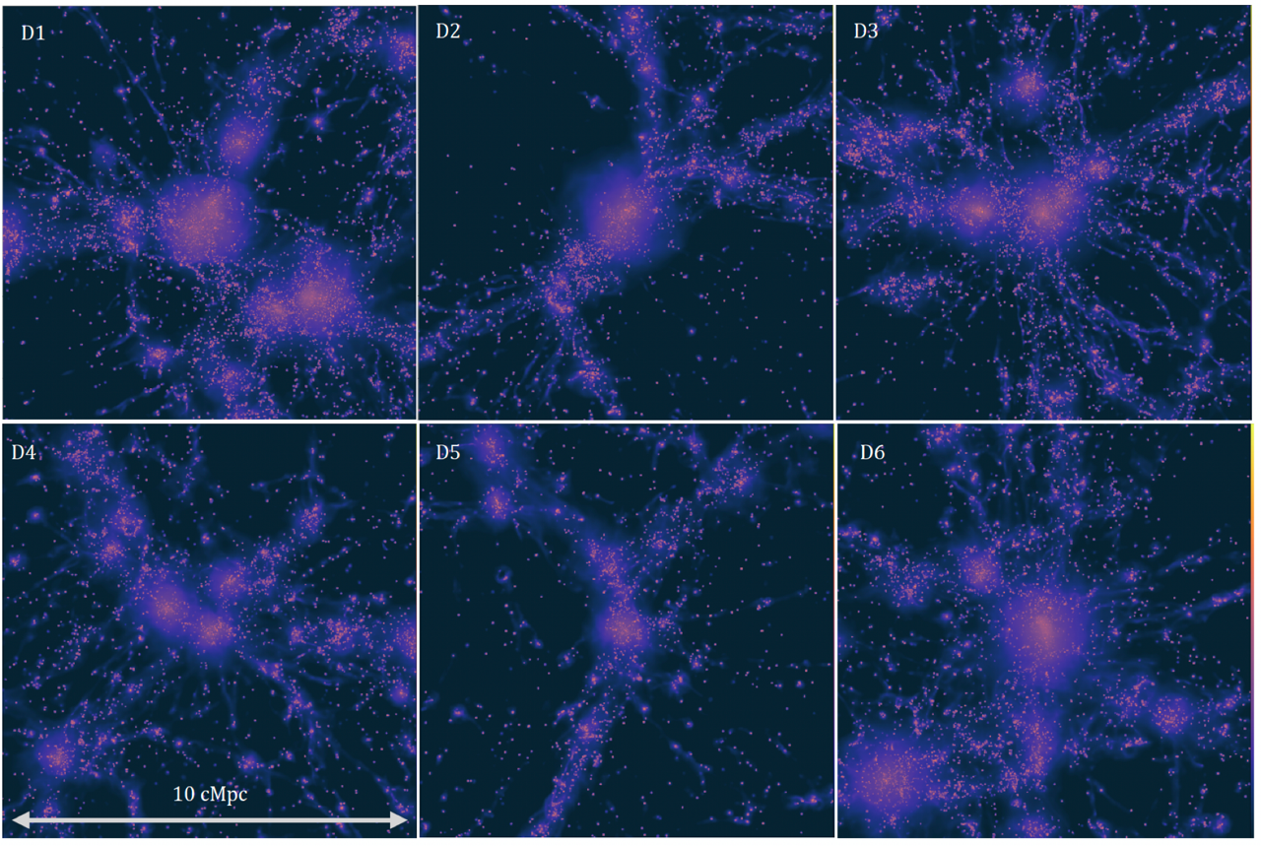
Key Science Projects (KSP)
Flagship projects selected for their scientific relevance, exploiting the codes developed in the Spoke and the resources obtained through the ICSC RAC
KSP1 - EAGER: Evolution of gAlaxies and Galaxy clustErs in high-Resolution cosmological simulations
PI: Stefano Borgani (University of Trieste)
Rationale: Set of hydrodynamic cosmological simulations of various cosmic structures (galaxies, groups and clusters of galaxies, cosmological volumes) to study how the formation and evolution of structures evolves in environments with different densities and at different cosmic epochs, and how galaxies and their surrounding diffuse medium evolve together in the large-scale structure in which they reside.
Resources: 4 Million core hours on Leonardo@CINECA
Progress level: 50%
Six different simulated galaxy clusters, at z=0
ICSC Italian Research Center on High-Performance Computing, Big Data and Quantum Computing
Missione 4 • Istruzione e Ricerca
Notes:
Template e guide lines

Slide 33
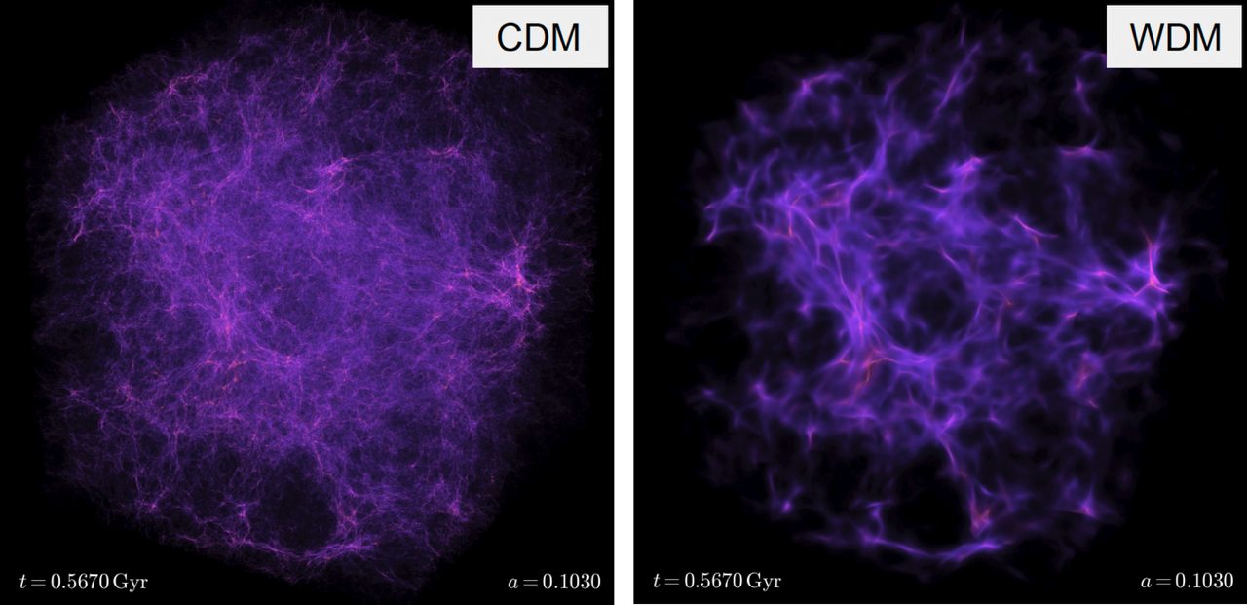
Key Science Projects (KSP)
Flagship projects selected for their scientific relevance, exploiting the codes developed in the Spoke and the resources obtained through the ICSC RAC
KSP2 - SLOTH: Shedding Light On dark matter wiTH cosmological simulations
PI: Milena Valentini (University of Trieste)
Rationale: Set of N-body simulations aimed at better understanding the formation of structures in the high redshift Universe from a theoretical perspective, and characterizing the nature of dark matter, also through comparison with the most recent available observations.
Resources: 4 Million core hours on Leonardo@CINECA
Progress level: 45%
Density map at z=9, box size: 10 Mpc/h, 1024^3 particles
ICSC Italian Research Center on High-Performance Computing, Big Data and Quantum Computing
Missione 4 • Istruzione e Ricerca
Notes:
Template e guide lines

Slide 34
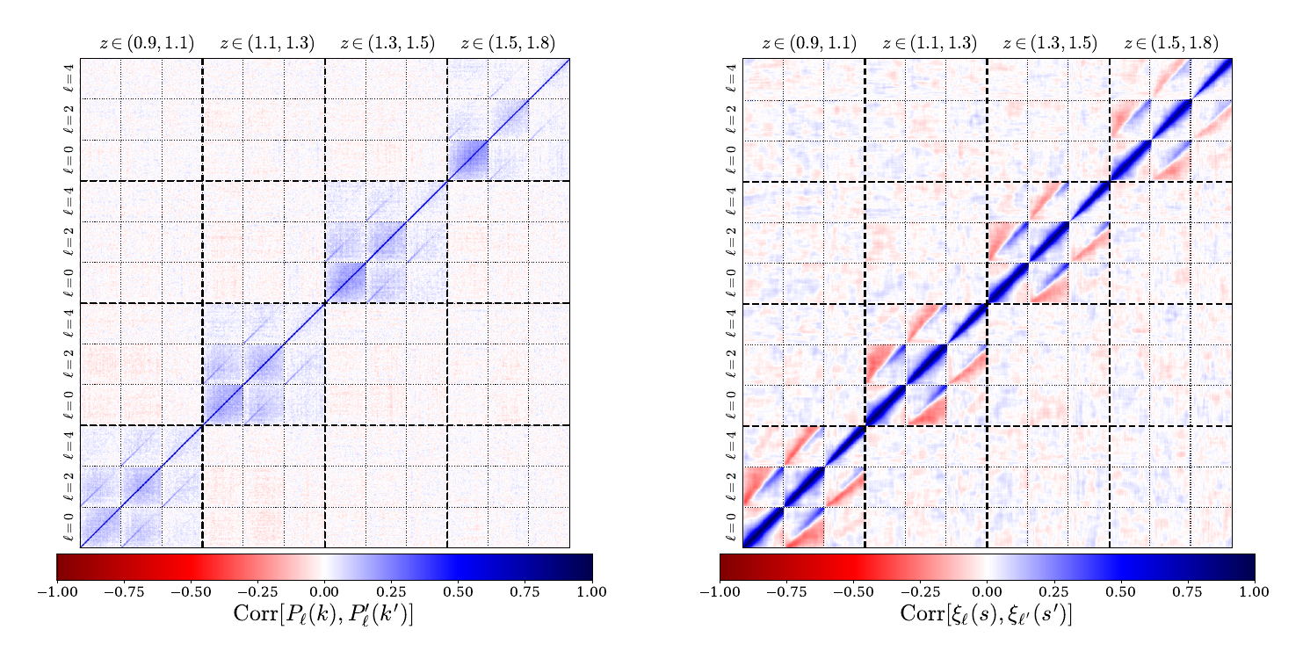
Key Science Projects (KSP)
Flagship projects selected for their scientific relevance, exploiting the codes developed in the Spoke and the resources obtained through the ICSC RAC
KSP3 - EuMocks: Simulating thousands of Euclid skies
PI: Pierluigi Monaco (University of Trieste)
Rationale: Set of simulations, performed with the PINOCCHIO code, of the matter field in huge cosmological volumes that contain the Euclid Wide Survey, covering nearly 15,000 square degrees on the sky and probing the Universe to redshift z~1.8 in the Hα emission line.
Resources: 1.8 Million core hours on Leonardo@CINECA
Progress level: 60%
Covariance matrix (normalized to its diagonal to better show its structure) of power spectrum and 2-point correlation function from measuring 1000 Euclid-like simulations.
This correlation matrix can be used in a likelihood to compare a model prediction with a measurement, to assess the significance of a discrepancy; use of Monte Carlo Markov Chains will lead to an estimation of model parameters.
ICSC Italian Research Center on High-Performance Computing, Big Data and Quantum Computing
Missione 4 • Istruzione e Ricerca
Notes:
Template e guide lines

Slide 35
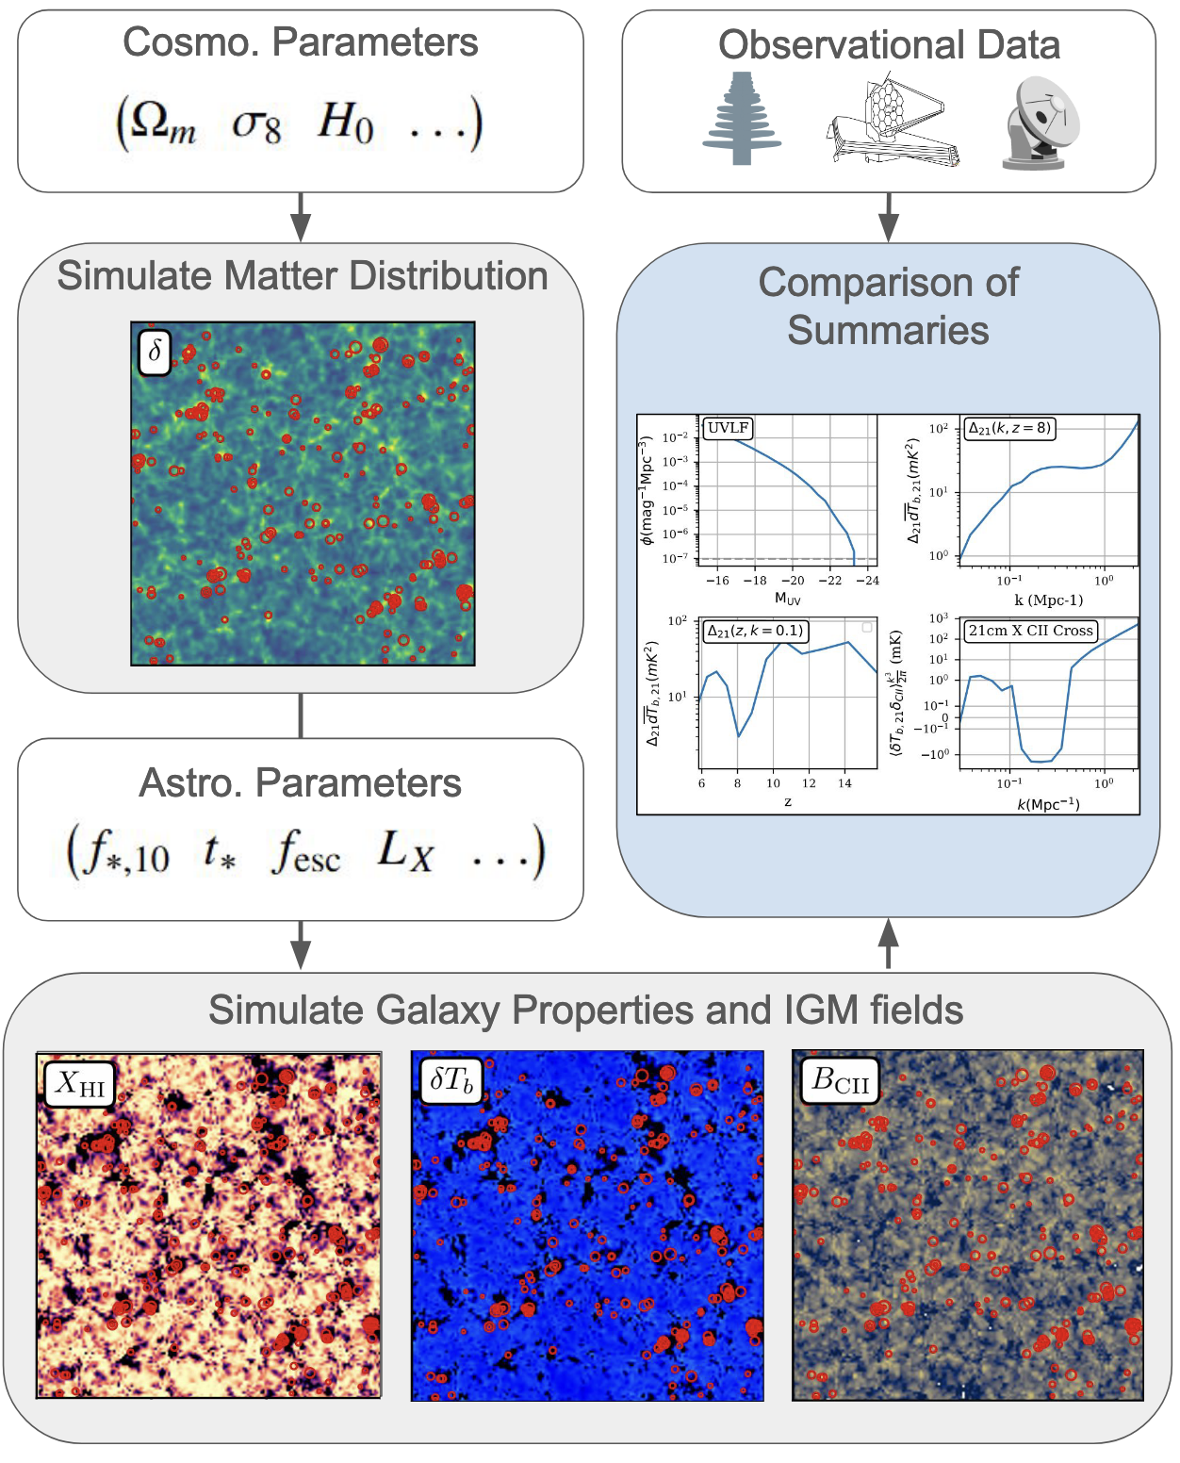
Key Science Projects (KSP)
Flagship projects selected for their scientific relevance, exploiting the codes developed in the Spoke and the resources obtained through the ICSC RAC
KSP4 - Multi-tracer inference of the first billion years
PI: Andrei Mesinger (Scuola Normale Superiore Pisa)
Rationale: Generating a large database of 3D lightcones of the first billion years of our Universe, spanning the Cosmic Dawn and Reionization. This will be used to train state of the art simulation based inference pipelines which for the first time correctly leverage the complementary information provided by different probes to learn about astrophysics and cosmology to unprecedented precision.
Resources: 1.5 Million core hours on Leonardo@CINECA
Progress level: 50%
ICSC Italian Research Center on High-Performance Computing, Big Data and Quantum Computing
Missione 4 • Istruzione e Ricerca
Notes:
Template e guide lines

Slide 36
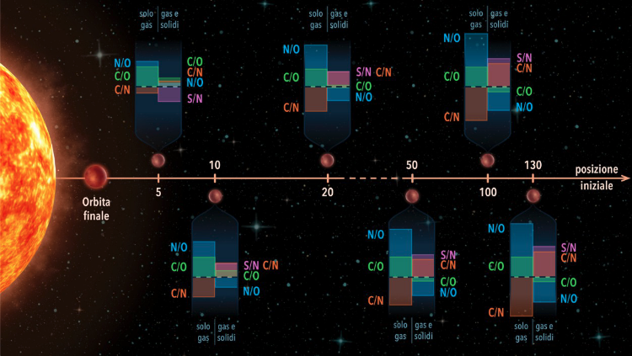
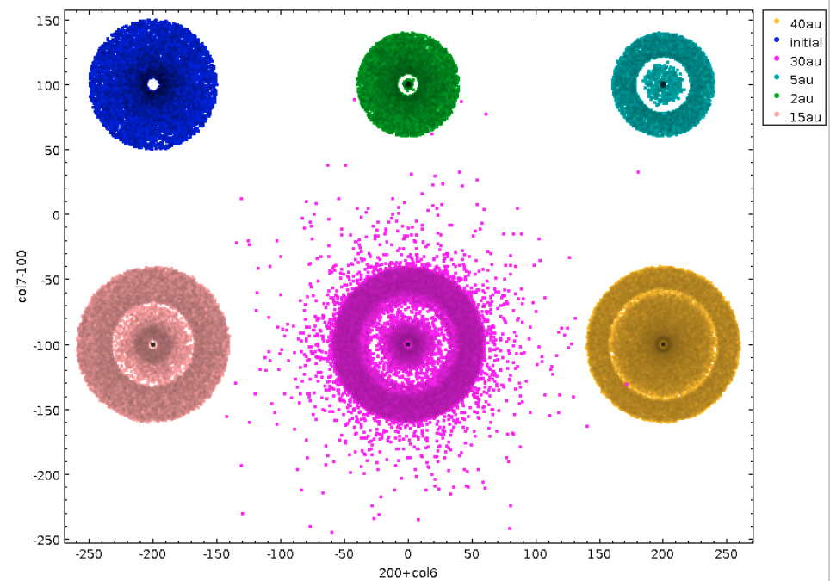
Key Science Projects (KSP)
Flagship projects selected for their scientific relevance, exploiting the codes developed in the Spoke and the resources obtained through the ICSC RAC
KSP5 - OPAL: simulating the Origins of Planets for ArieL
PI: Diego Turrini, Romolo Politi (INAF OATo)
Rationale: OPAL is the next frontier in computational planetary science: combining multi-domain and multi-physics ab initio simulations to fully understand the information encoded into planetary atmospheres. Goals of the project are: a) Simulate the origins of planets and their bulk compositions from the interplay of the planet formation process with the chemical and physical evolution of circumstellar disks; b) Simulate the composition of exoplanetary atmospheres resulting from the interaction of primordial planetary compositions and the irradiation from central star; c) Build an extensive and detailed syntethic dataset of atmospheric compositions to test the official processing and retrieval pipelines of the Ariel space mission
Resources: 4 Million core hours on Leonardo@CINECA
Progress level: 50%
ICSC Italian Research Center on High-Performance Computing, Big Data and Quantum Computing
Missione 4 • Istruzione e Ricerca
Notes:
Template e guide lines

Slide 37
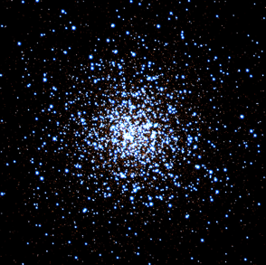
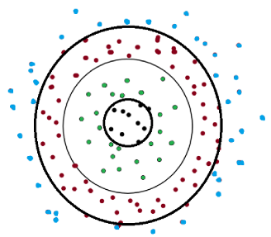
Key Science Projects (KSP)
Flagship projects selected for their scientific relevance, exploiting the codes developed in the Spoke and the resources obtained through the ICSC RAC
KSP6 - ISTEDDAS: Revealing the populations of compact remnants in dense stellar systems
PI: Mario Spera (SISSA)
Rationale: Using the new ISTEDDAS code to run direct N-body simulations of dense stellar systems (e.g., globular clusters) with up-to-date stellar evolution physics and unprecedented accuracy and performance. Release up-to-date catalogs of the evolution of dense stellar systems - to be used not only for the project but for generic applications concerning the evolution of stellar systems
Resources: 2 Million core hours on Leonardo@CINECA
Progress level: 40%
ICSC Italian Research Center on High-Performance Computing, Big Data and Quantum Computing
Missione 4 • Istruzione e Ricerca
Notes:
Template e guide lines

Slide 38
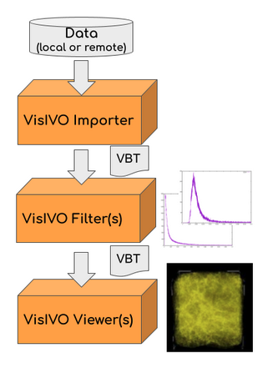
Key Science Projects (KSP)
Flagship projects selected for their scientific relevance, exploiting the codes developed in the Spoke and the resources obtained through the ICSC RAC
KSP7 - VisIVO: a framework both for batch and interactive visualization services
PI: Giuseppe Tudisco (INAF OACt)
Rationale: UWe will provide is an in-situ visualization and interactive visual analytic services for HPC architectures (distributed computing) with support for many-core nodes and GPUs . The services will rely on VisIVO capabilities (https://visivo.readthedocs.io/en/latest/)
Resources: 0.5 Million core hours on Leonardo@CINECA
Progress level: 70%
ICSC Italian Research Center on High-Performance Computing, Big Data and Quantum Computing
Missione 4 • Istruzione e Ricerca
Notes:
Template e guide lines

Slide 39
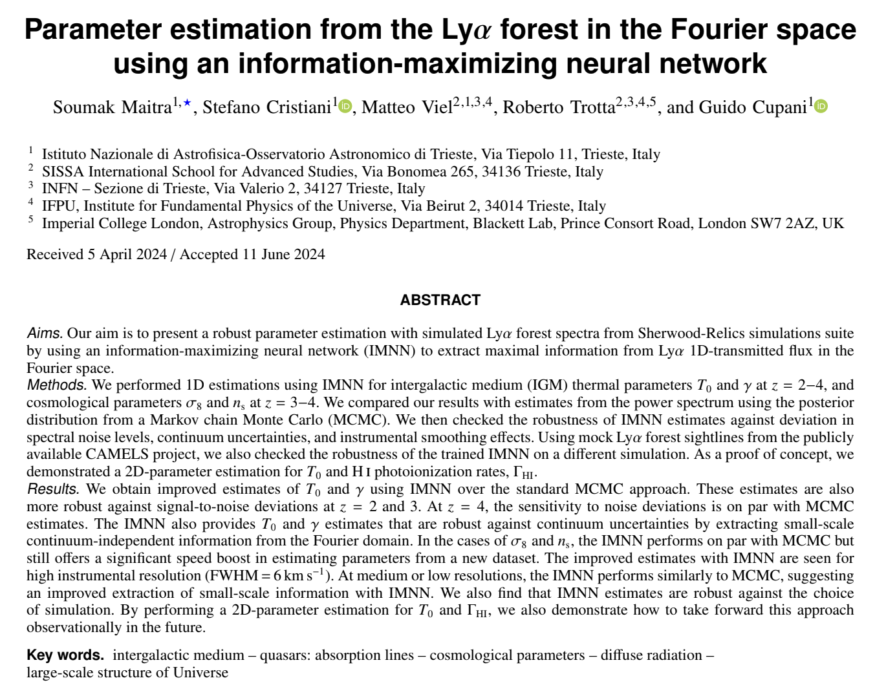
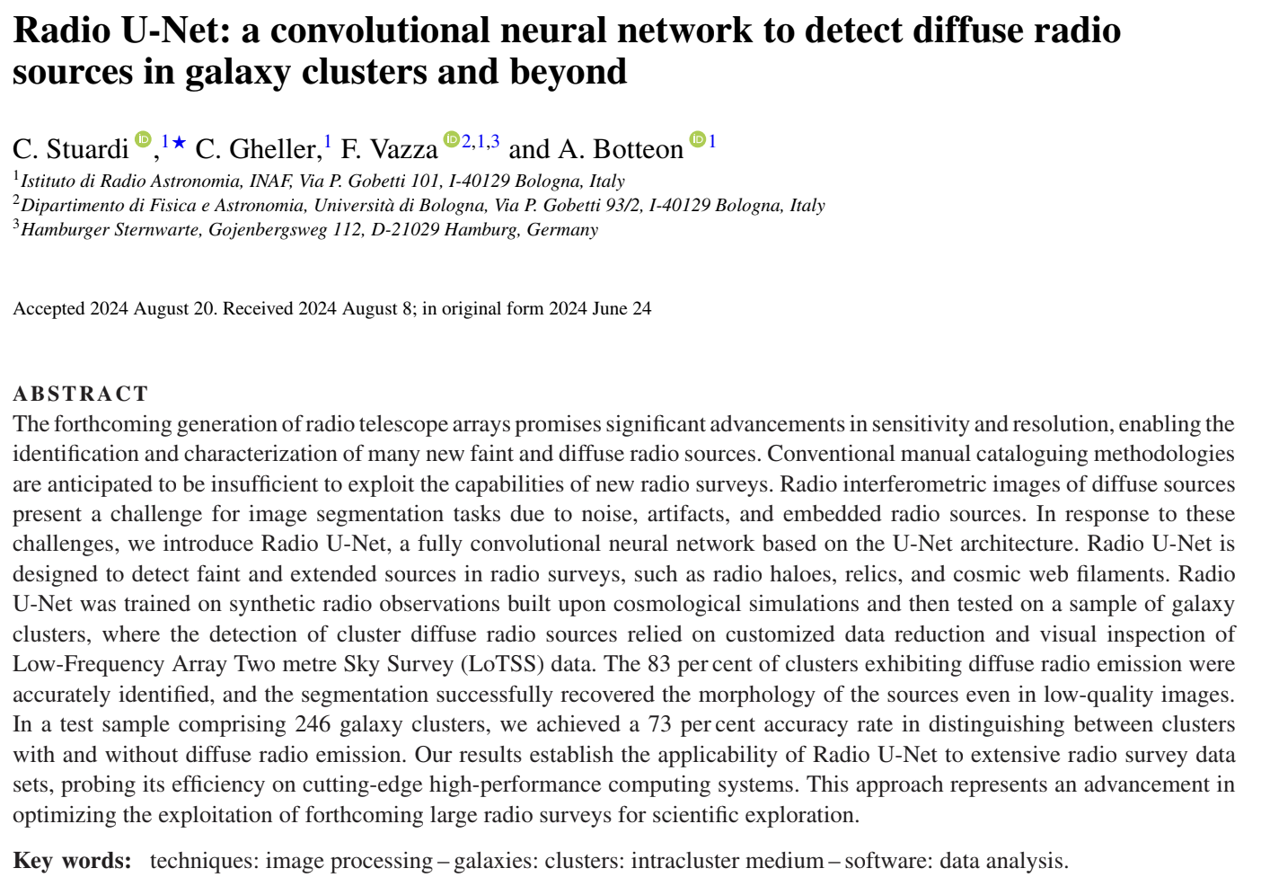
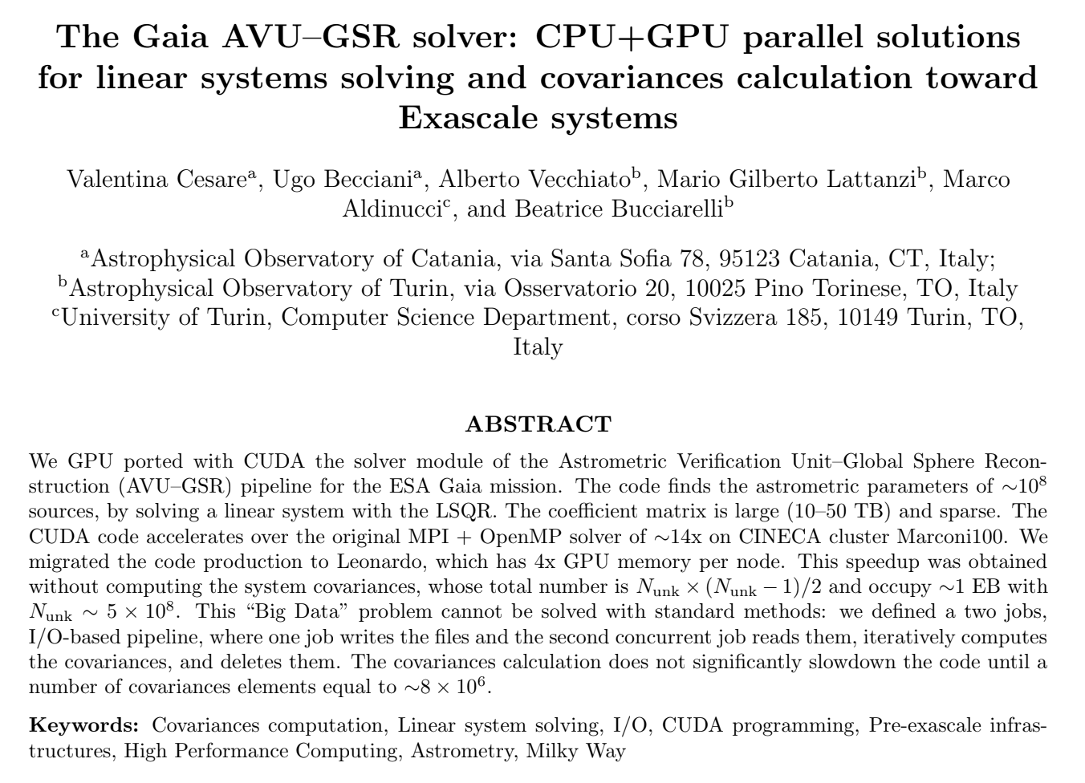
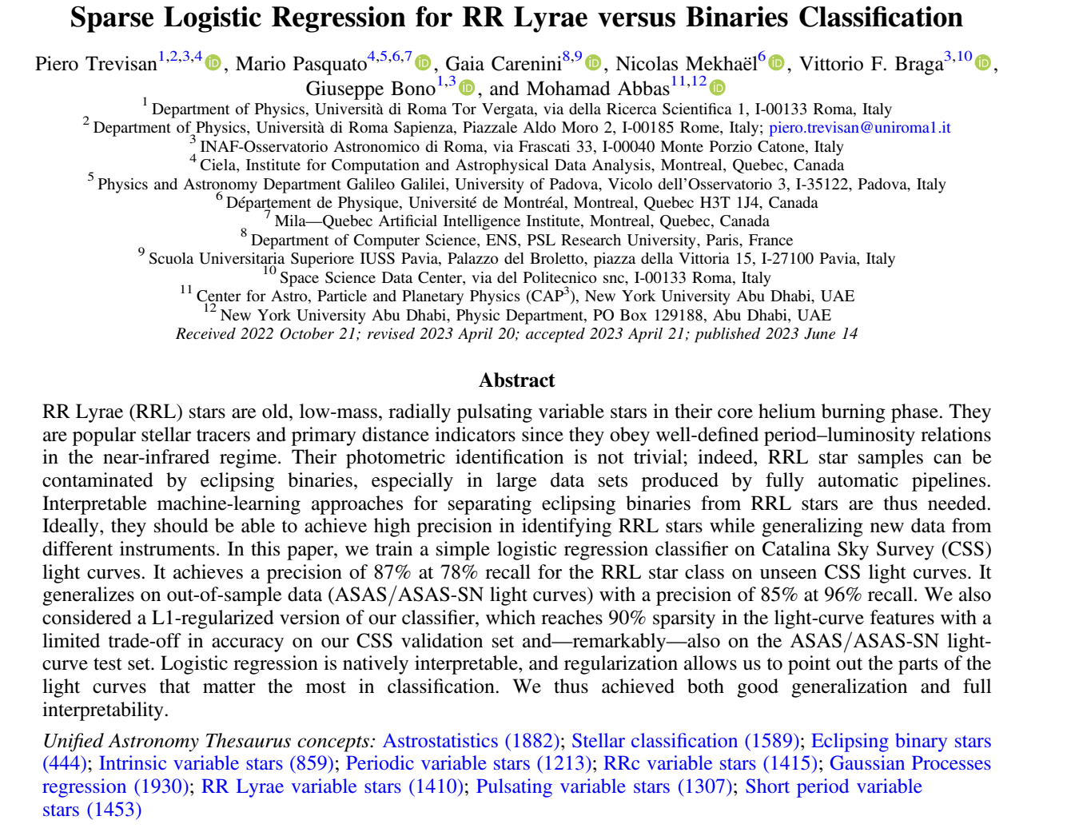
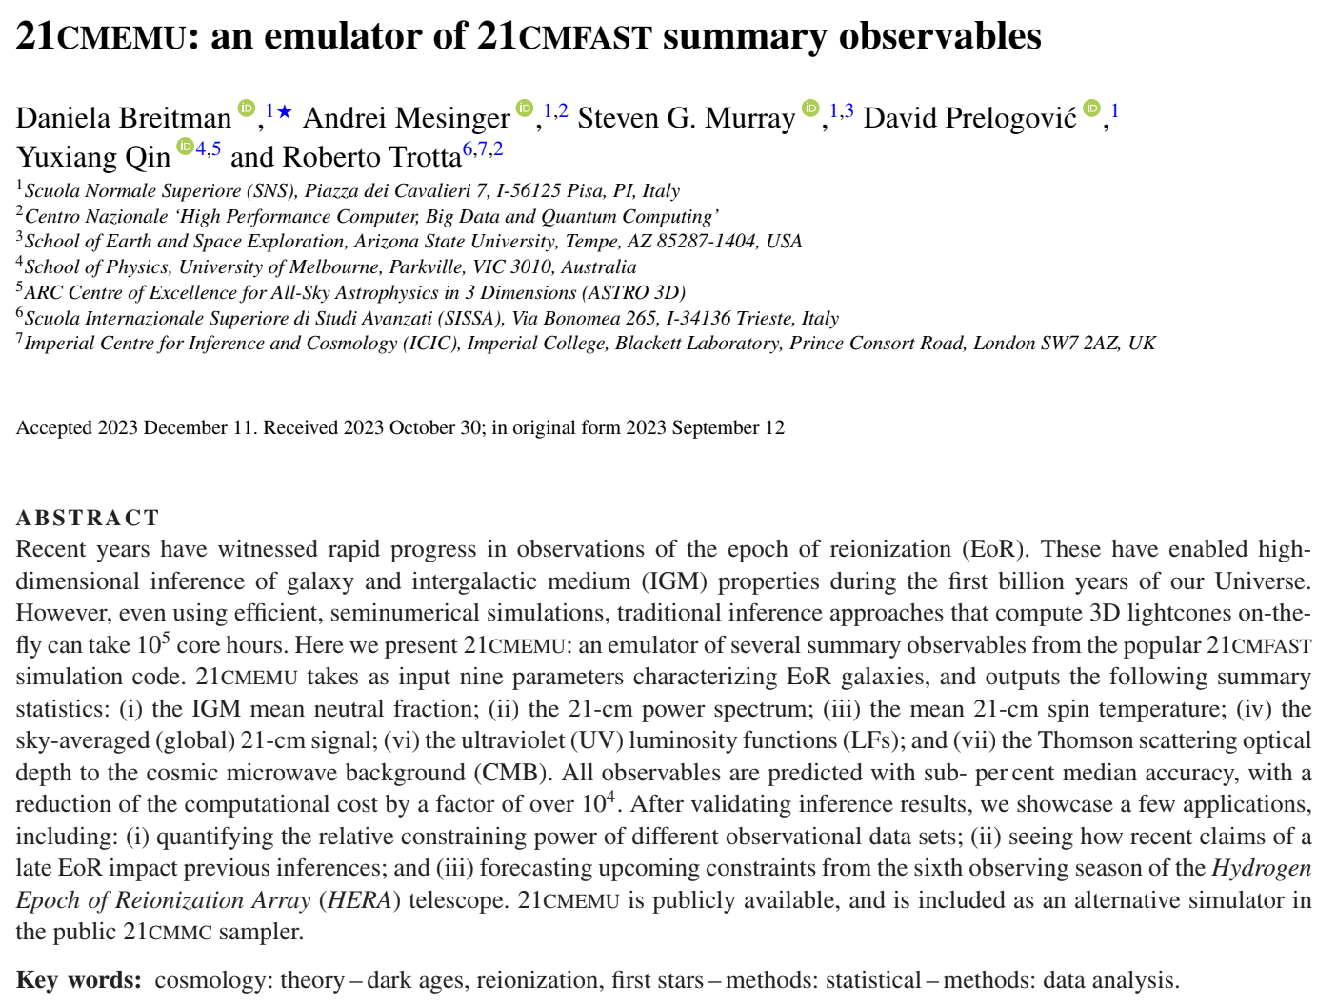
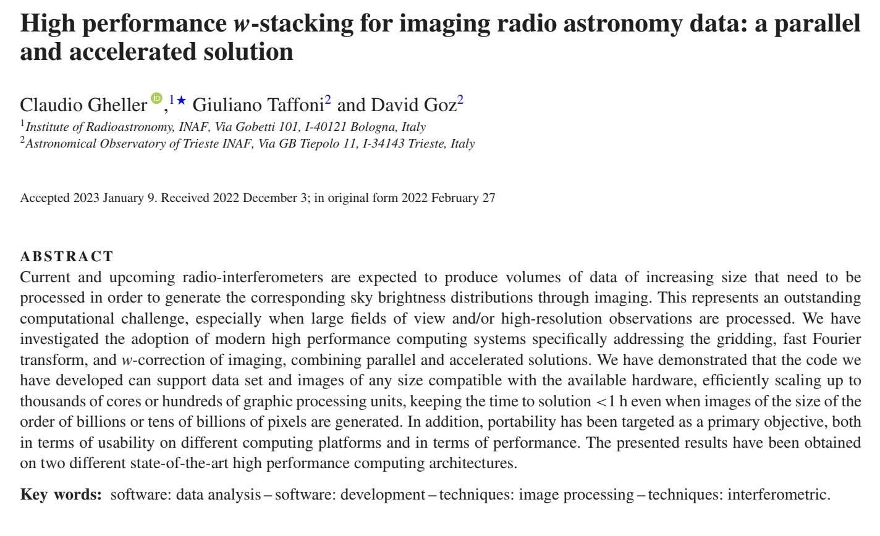
Scientific Publications
More than 150 papers have been published on peer-reviewed Journals within the R&D activities of Spoke 3
The list (updated at the beginning of December 2024) is available at:
https://drive.google.com/drive/folders/1s5cFVAH12R0Xx75yvyAy97Iou7SAtvHG
ICSC Italian Research Center on High-Performance Computing, Big Data and Quantum Computing
Missione 4 • Istruzione e Ricerca
Notes:
Template e guide lines

Slide 40
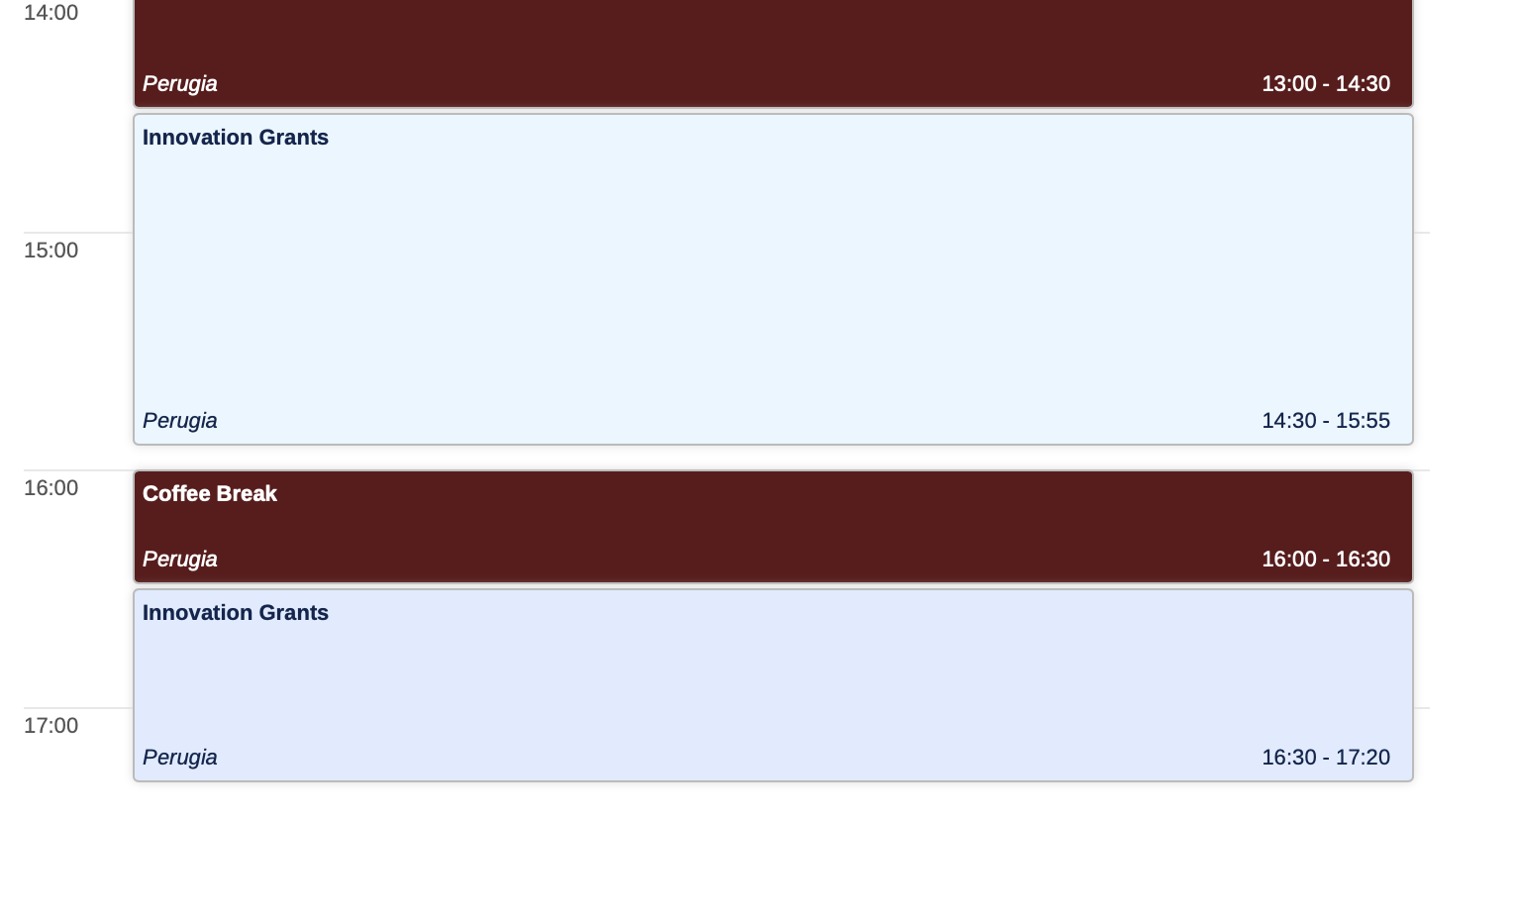
Innovation Grants (IGs)
28 May
ICSC Italian Research Center on High-Performance Computing, Big Data and Quantum Computing
Missione 4 • Istruzione e Ricerca
Notes:
Template e guide lines

Slide 41
Spoke 3 - Innovation Grants
- HaMMon/HMMA/HAEQ: The HaMMon (Hazard Mapping and Vulnerability Monitoring) project aims at developing tools and methodologies for the quantification of the impact of extreme natural events on the Italian territory. Unipol and ICSC started the acquisition of a first significant set of datasets (UAV, satellite, street view) for Mapping the main characteristics of the built environment in Italy, integrating data on landslides and geological instability to provide a comprehensive understanding of territorial risks. Spoke 3 is involved on the creation of digital twins from uav photogrammetry and development of algorithms for the damage identification and estimation and the classification of the built environment. The activities planned in the Hammon project are compliant with the research program of Spoke 3 and will contribute to further enhance their scientific/technological outcomes: Artificial intelligence techniques and Scientific Visualization. This techniques are mainly developed on Spoke 3/WP3 and will be also adopted for Big Data analysis of the large projects: SKA, Large Scale Simulations. Spoke activities completed at 60% on average. Unipol the proponent of the projects and Spoke 3 is the coordinating Spoke.
- IDL/IGUC: The Project aims at creating a Data Lake service, supporting a seamless access to space and ground-based observations and simulated data. The project addresses the design and commissioning of an interoperable, distributed data archive, relying on state-of-the-art open technologies, supporting both science and industry. Spoke 3 WP4 target are strictly related to the activities carried out in this project: SKA, LOFAR, BIrales, Fermi and Gaia ESA mission to study and the implement an IVOA/FAIR compliant data model for the correct description and handling of the data sets. Spoke 3 is the proponent Spoke of the projects. Spoke activities completed at 40-45%. Leonardo is the proponent of the projects and Spoke 3 is the coordinating Spoke.
Notes:
Template e guide lines

Slide 42
Spoke 3 - Innovation Grants
TSBS: The project applies ML techniques to analyze sparse time series data in banking, focusing on fraud detection, credit risk, and churn analysis. Intesa Sanpaolo has provided a dataset of one million daily time series to identify anomalies and ensure data quality. The project integrates statistical and ML methods, including Isolation Forest and Kalman filters, contributing to Spoke 3 by advancing time series analysis and anomaly detection techniques (techniques commonly used in Astrophysics). Intesa Sanpaolo is the proponent of the projects and Spoke 3 is the coordinating Spoke. Essentially all but one task completed: Python library ready at 50%.
ATS: The project aims to develop a robust anomaly detection solution for time series in banking and astrophysics, addressing suspicious events and data issues. Although not yet started, it is expected to contribute to Spoke 3 through cross-collaboration in software development and interdisciplinary validation of anomaly detection techniques. Intesa Sanpaolo is the proponent of the projects and Spoke 3 is the coordinating Spoke. Spoke activities completed at <10% (due to the personnel recruitment).
SCP: The project aims to rewrite Machine Learning algorithms in languages optimized for High-Performance Computing (HPC) and Quantum Computing, with the goal of preventing cyber attacks in real time. Despite initial delays, the first milestones have been initiated, including the selection of algorithms and the definition of rewriting methodologies. The project supports Spoke 3’s R&D activities by enhancing cybersecurity, computational efficiency, and future scalability. Intesa Sanpaolo is the proponent of the projects and Spoke 3 is participant Spoke. Spoke activities completed at 40-45%.
ICSC Italian Research Center on High-Performance Computing, Big Data and Quantum Computing
Missione 4 • Istruzione e Ricerca
Notes:
Template e guide lines

Slide 43
Cascade Funding: Overview and progress status
First KO Meeting 24 Sept. 2024
22 Projects started on Sept.
Second KO Meeting 9 Jan. 2025
13 Project Started on Dec.
N. | Thematich Area and Spoke WP correlations | Approved Euros
1 | Scientific Visualization with Artificial Intelligence Support. WP 3 – 10 Projects Collaborative Activity for all of these !! | 1.585.800
2 | Accelerated Alghorithms WP 2– 2 Projects | 332.642
3 | Parallelization and acceleration of scientific codes WP 2 – 4 Projects 2 Collaborative Activities | 517.400
4 | Intelligenza Artificiale applicata alla features detection e classificazione WP 1 and 3 - 3 Projects 2 Collaborative Activities | 448.371
5 | Intelligenza Artificiale applicata a missioni spaziali WP 1 3 and 4 - 7 Projects 3 Collaborative Activities | 910.800
6 | Metodologie avanzate di analisi dati WP1 2 and 3 - 10 Projects 2 Collaborative Activities | 1.471.500
The projects are synergic with the research activities of the WPs and contribute to their outcomes.
22 Projects are submitted from private PMI
An internal Spoke 3 Reviewer or collaborator is supervising the activity.
- Initial funds assignment 3,200,000 Euros
- Additional funds on October 2024. 2,066,513 Euros
ICSC Italian Research Center on High-Performance Computing, Big Data and Quantum Computing
Missione 4 • Istruzione e Ricerca
Notes:
Template e guide lines

Slide 44
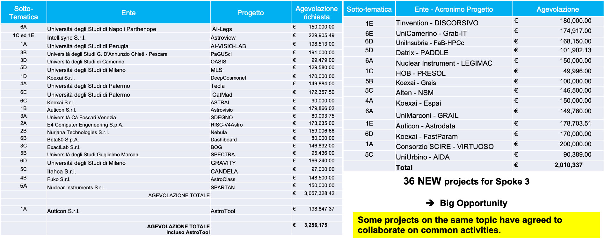
Cascade Funding: Overview and progress status
ss
ICSC Italian Research Center on High-Performance Computing, Big Data and Quantum Computing
Missione 4 • Istruzione e Ricerca
Notes:
Template e guide lines

Slide 45
Spoke 3 - Forthcoming Technical activities (highlights)
Basic and Intermediate FPGA programming school, Jun 2025
Advanced FPGA programming techniques school, Nov 2025
HPC School (Catania), Sept. 2025
HPC Advanced Course Nov 2025 (TBC)
Spoke3 (FINAL) Meeting, 15-19 Dec 2025, Sesto Pusteria (Bz) https://www.sexten-cfa.eu/event/icsc-spoke3-fm
Joint meeting with SPACE (Scalable Parallel and distributed Astrophysical Code for Exascale)
The proceedings of this meeting will be published in a special issue of the journal Astronomy&Computing
ICSC Italian Research Center on High-Performance Computing, Big Data and Quantum Computing
Missione 4 • Istruzione e Ricerca
Notes:
Template e guide lines

Slide 46
Upcoming events
31 May
Astronomy and Computing Special Issue Opens
31 Aug
Periodic Technical Activity Report for HUB
31 Aug
Astronomy and Computing Special Issue Close
31 DIC
FINAL Activity Report for HUB
ICSC Italian Research Center on High-Performance Computing, Big Data and Quantum Computing
Missione 4 • Istruzione e Ricerca
Notes:
Template e guide lines

