Slide 1
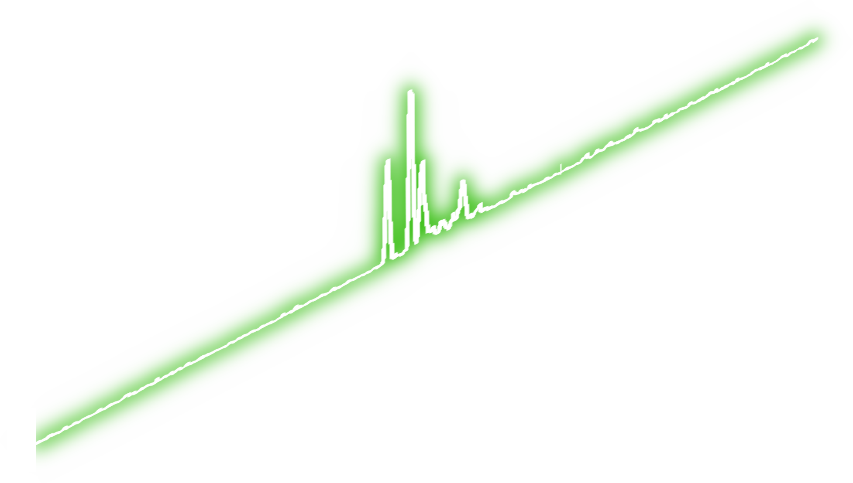
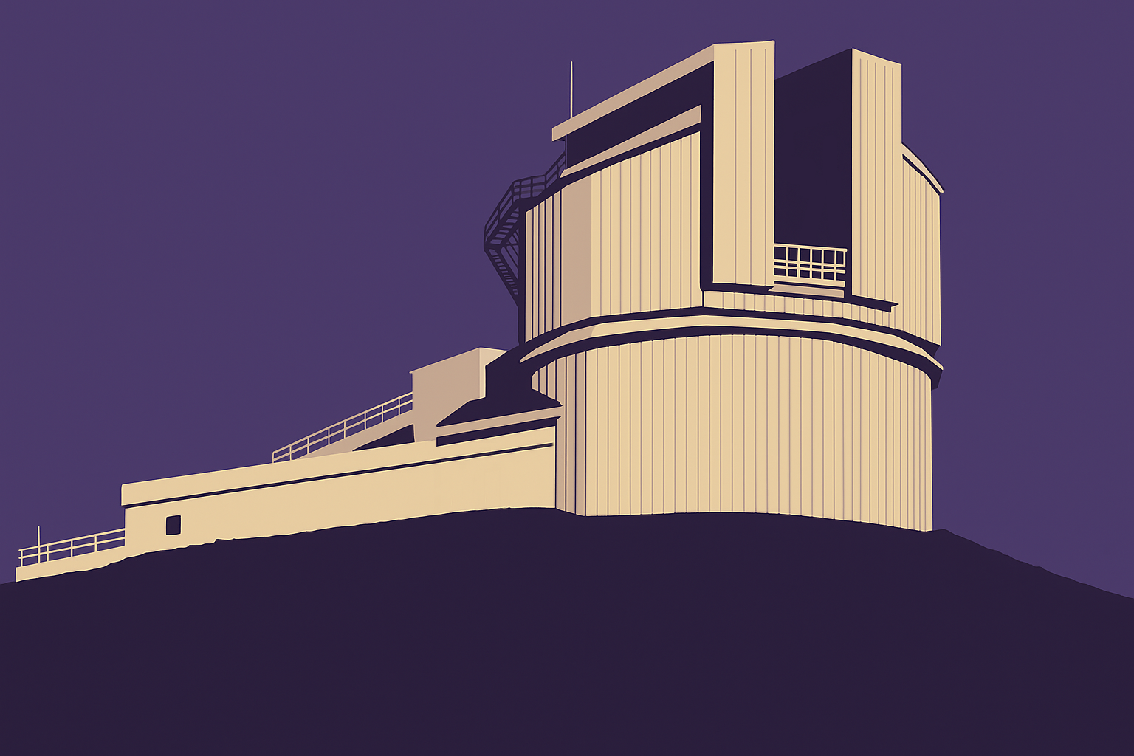
A TRICKY STATISTICAL SEARCH FOR FAST OPTICAL BURSTS
Carlo Campa Filippo Ambrosino Piergiorgio Casella Riccardo La Placa Roberta Amato and many others
TNG image credits: ChatGPT from a photo by Renato Cerisola

Slide 2
Search for sub-second transients
Common in gamma-ray, X-ray, radio bands
Image credit: modified from NASA’s Goddard Space Flight Center/S. Wiessinger
Notes:
An example of recently discovered 'transient' events are Fast Radio Bursts: they are fast, millisecond-duration, extremely bright bursts that have so far only been observed in the radio band. Even after a decade of observations, their origin is still to be fully understood.

Slide 3
Search for sub-second transients
Common in gamma-ray, X-ray, radio bands
Optical astronomy focused on longer timescales
Image credit: modified from NASA’s Goddard Space Flight Center/S. Wiessinger
Notes:
An example of recently discovered 'transient' events are Fast Radio Bursts: they are fast, millisecond-duration, extremely bright bursts that have so far only been observed in the radio band. Even after a decade of observations, their origin is still to be fully understood.

Slide 4
Search for sub-second transients
Common in gamma-ray, X-ray, radio bands
Optical astronomy focused on longer timescales
Now new larger telescopes & new generation detectors
Image credit: modified from NASA’s Goddard Space Flight Center/S. Wiessinger
Notes:
An example of recently discovered 'transient' events are Fast Radio Bursts: they are fast, millisecond-duration, extremely bright bursts that have so far only been observed in the radio band. Even after a decade of observations, their origin is still to be fully understood.

Slide 5
SiFAP2 – Telescopio Nazionale Galileo
Mounted on TNG: the largest italian telescope
Image credit: modified from Giovanni Tessicini, public domain via Wikimedia Commons

Slide 6
SiFAP2 – Telescopio Nazionale Galileo
Mounted on TNG: the largest italian telescope
Time resolution of 80 ps (previously 8 ns)
Image credit: modified from Giovanni Tessicini, public domain via Wikimedia Commons

Slide 7
SiFAP2 – Telescopio Nazionale Galileo
Mounted on TNG: the largest italian telescope
Time resolution of 80 ps (previously 8 ns)
Field of view of 7’’
Image credit: modified from Giovanni Tessicini, public domain via Wikimedia Commons

Slide 8
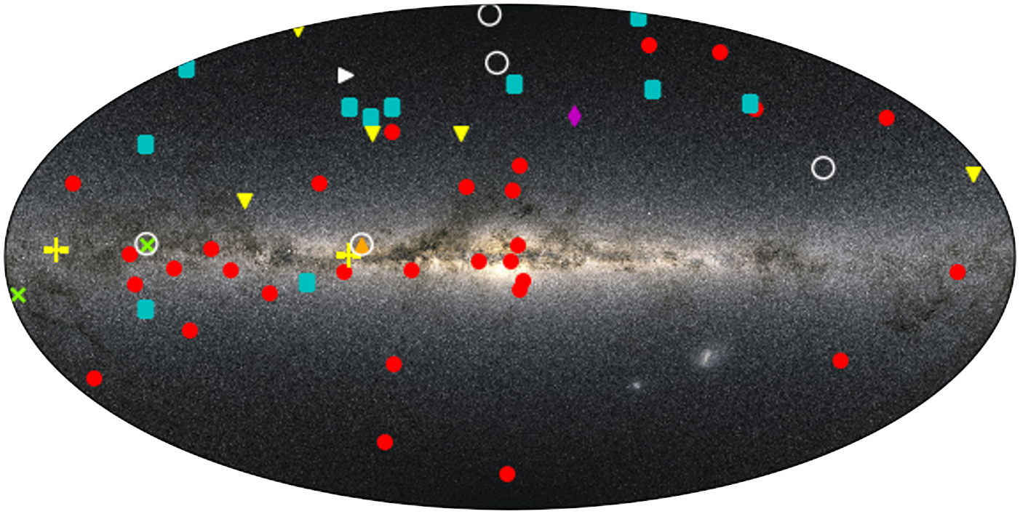
Astronomical observations
Pulsar
Fast Radio Burst
Magnetar
White Dwarf
Black Hole Binary
Blazar
Gamma-ray burst
Supernova
Blank field

Slide 9
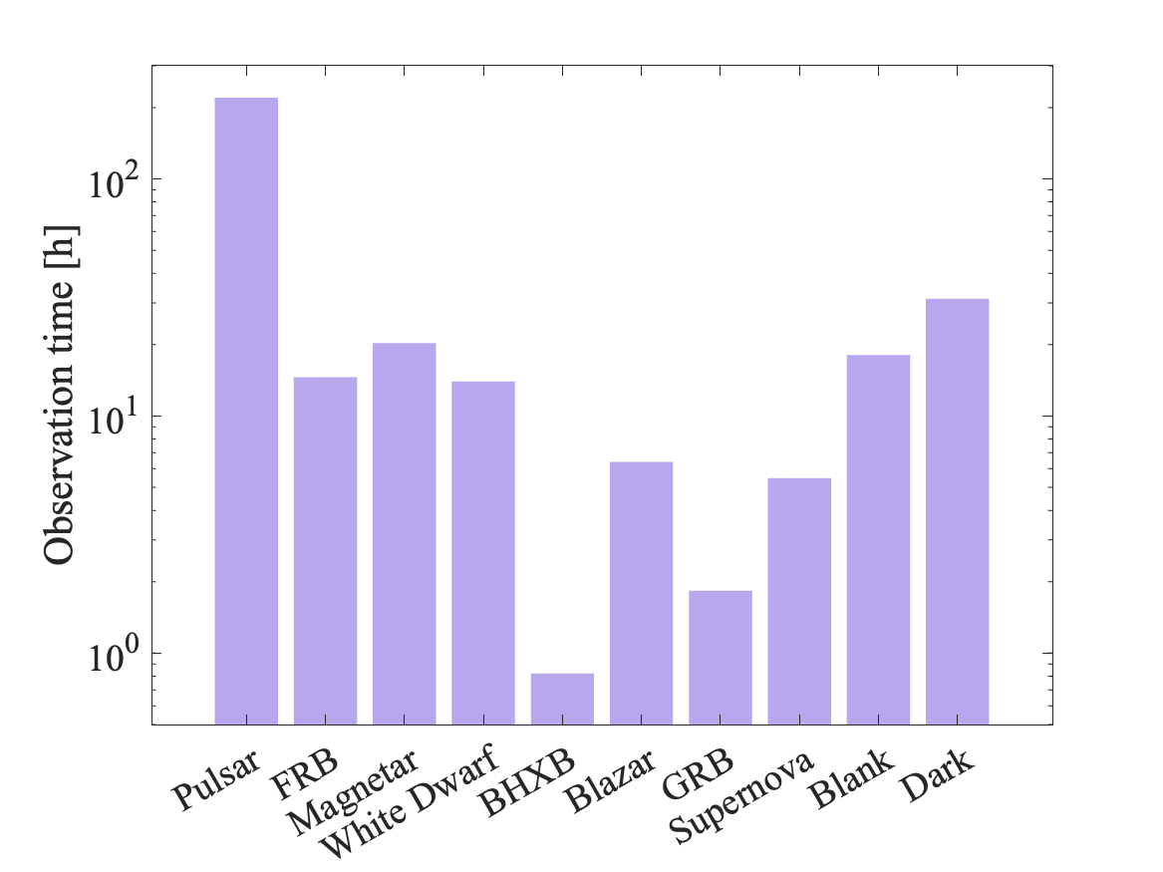
Astronomical observations
200 observations
~333 hours
63 targets

Slide 10
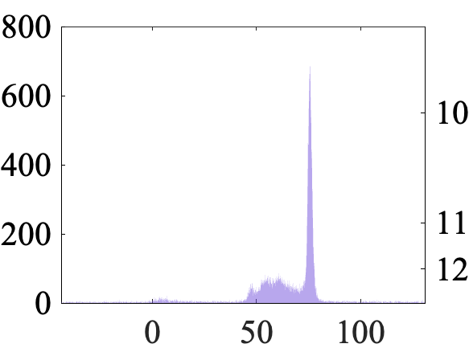
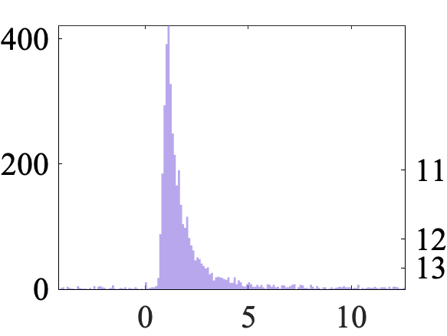
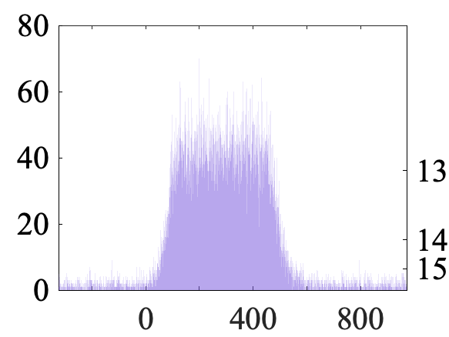
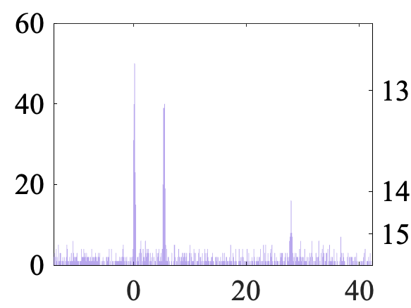
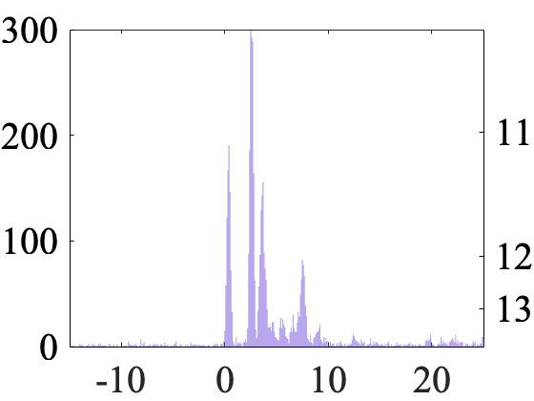
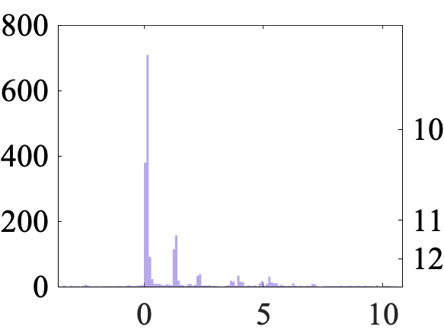
Fast Optical Bursts
Counts / 0.1 ms
V band magnitude
Time [ms]

Slide 11
Fast Optical Bursts
Find them
Characterize them
Counts / 0.1 ms
V band magnitude
Time [ms]

Slide 12
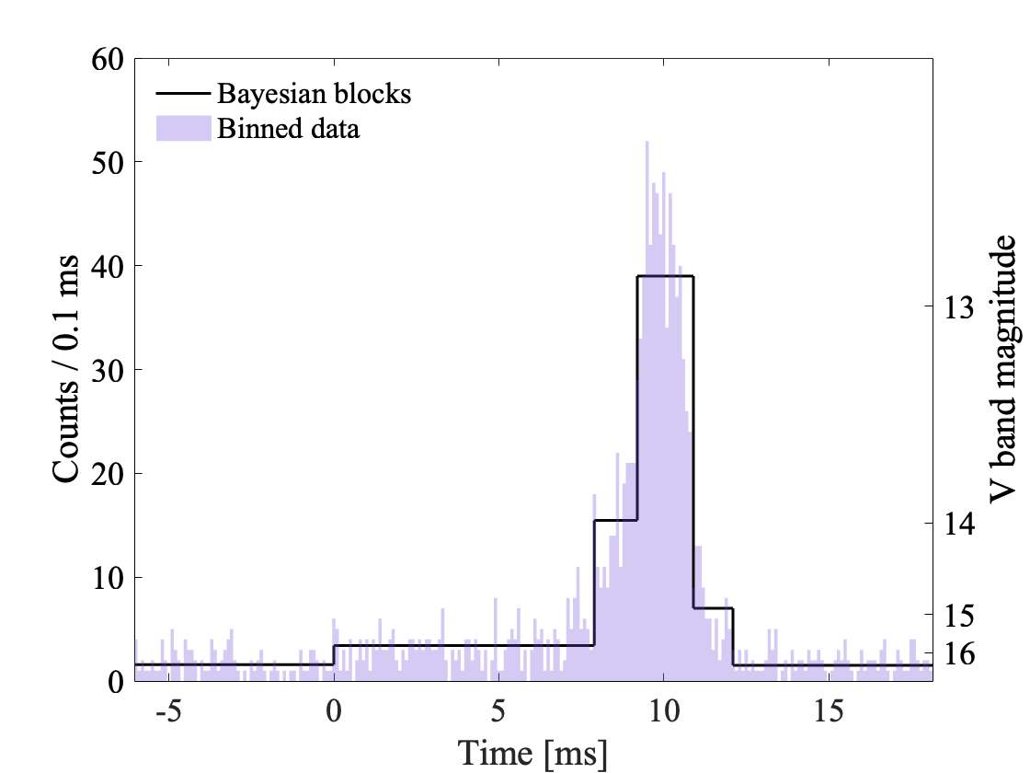
Classic Bayesian blocks
Adaptive binning algorithm
Identifies statistically significant local variation
Aims to eliminate Poisson noise
Link to the paper by Scargle and collaborators (2013)

Slide 13
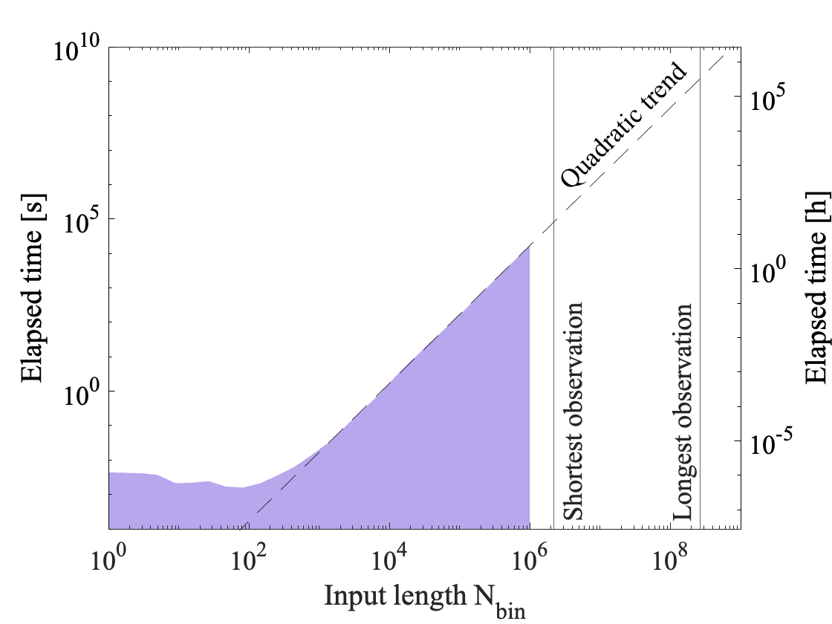
Classic Bayesian blocks

Slide 14
Classic Bayesian blocks
~6 centuries of runtime

Slide 15
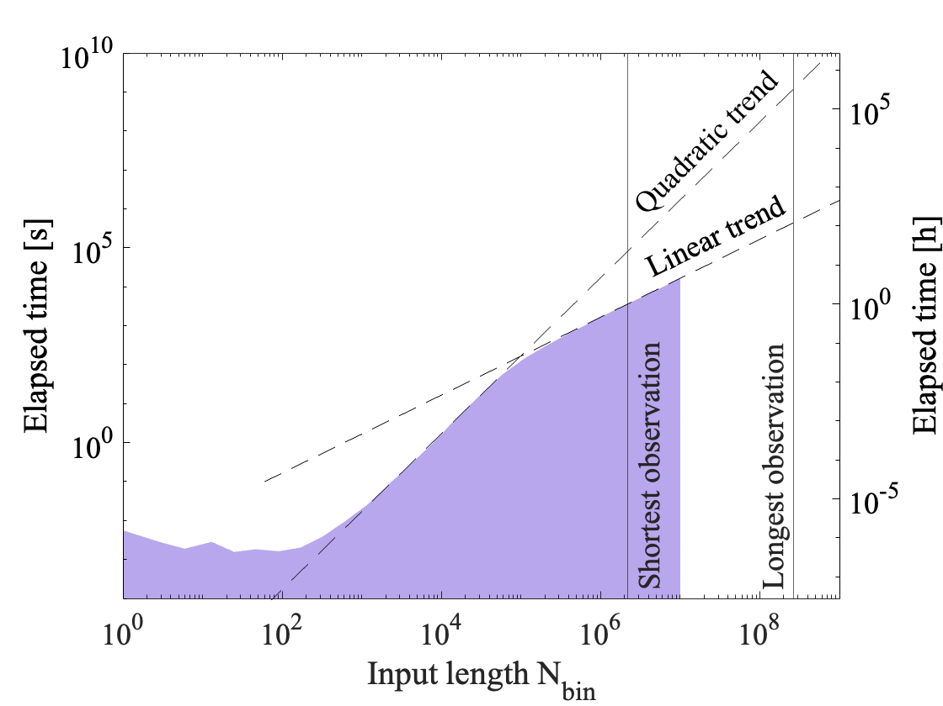
1st change: Linearized Bayesian blocks

Slide 16
1st change: Linearized Bayesian blocks
~9 days of runtime

Slide 17
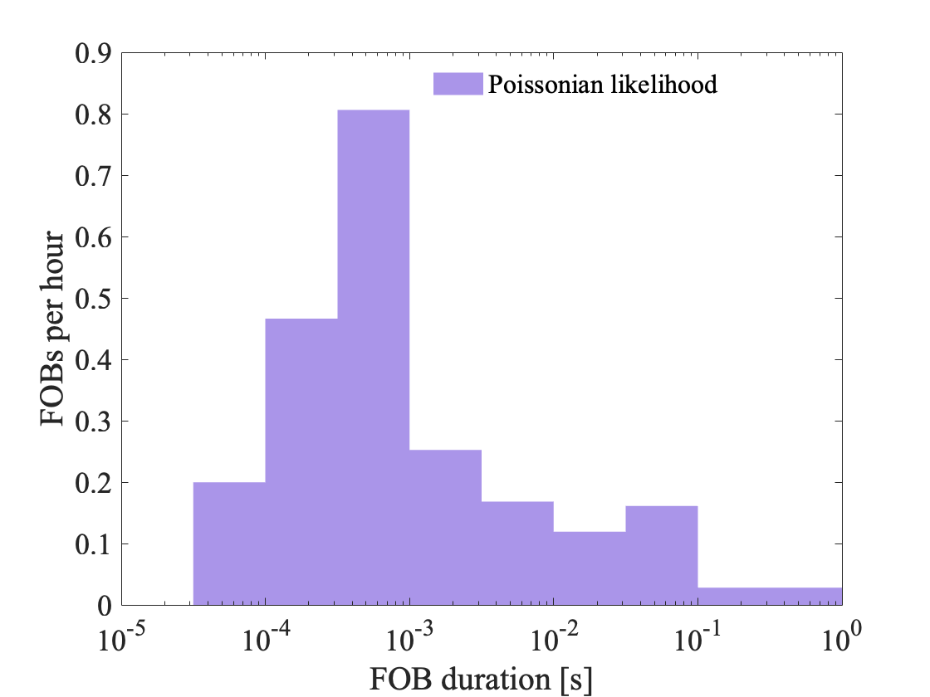
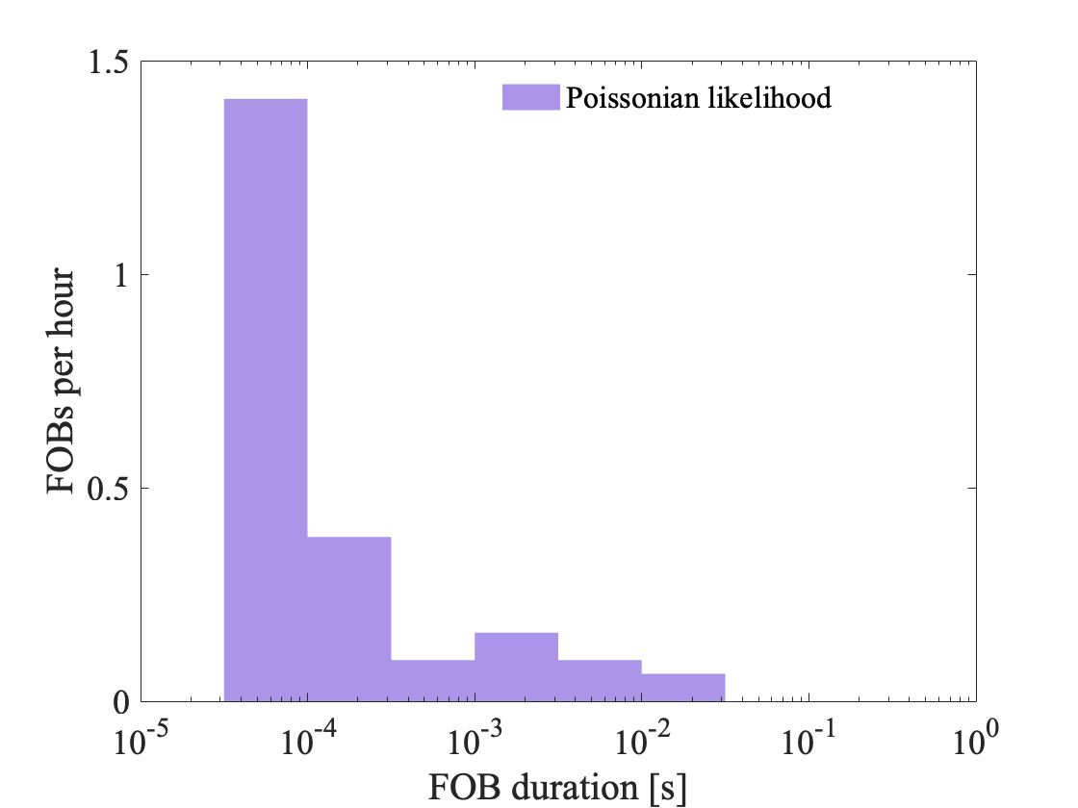
2nd change: Modified-Poisson Bayesian blocks
From real observations
From dark observations

Slide 18
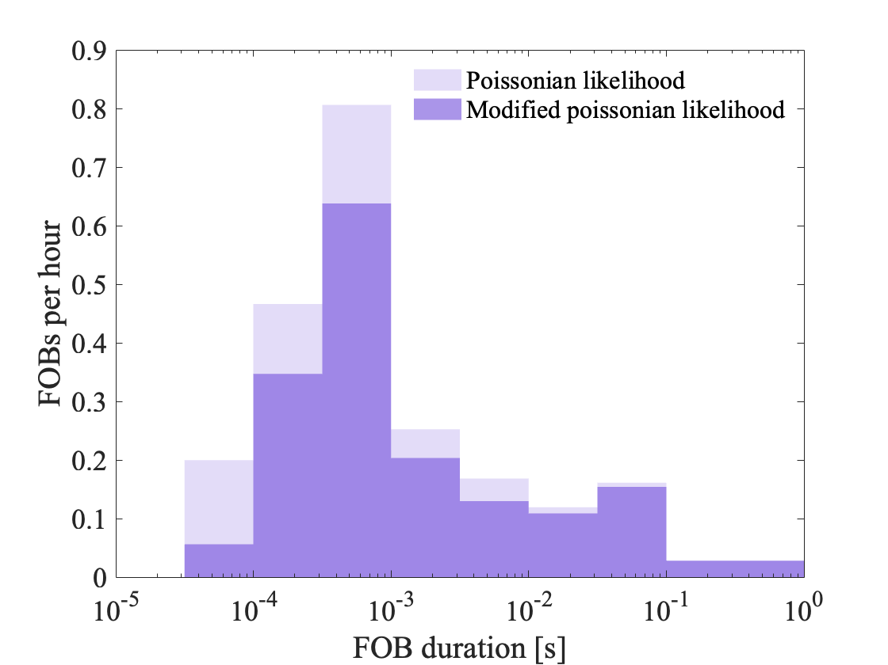
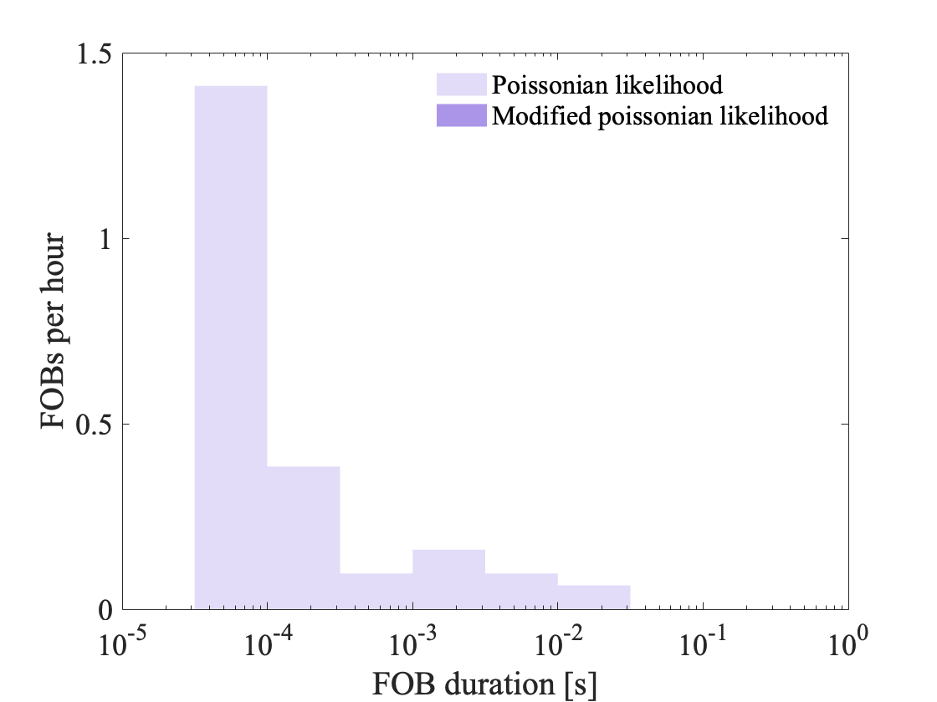
2nd change: Modified-Poisson Bayesian blocks
From real observations
From dark observations

Slide 19
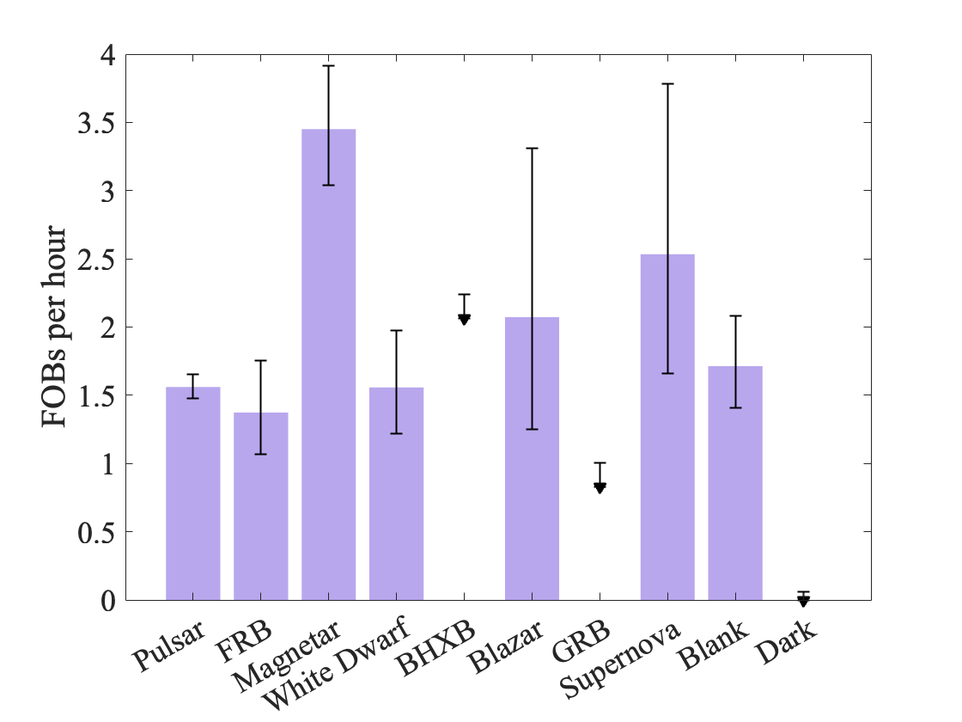
FOBs per observed source class

Slide 20
FOBs per observed source class
4x10¹¹ FOBs/day/sky

Slide 21
FOBs per observed source class
4x10¹¹ FOBs/day/sky

Slide 22
FOBs per observed source class
+4.5 σ

Slide 23
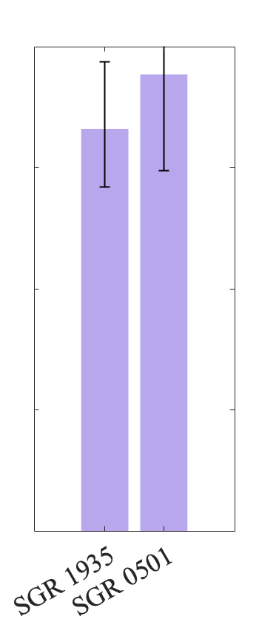
FOBs per observed source class
+2.8 σ
+3.6 σ
+4.5 σ

Slide 24
FOBs per observed source class
+2.8 σ
+3.6 σ
+4.5 σ

Slide 25
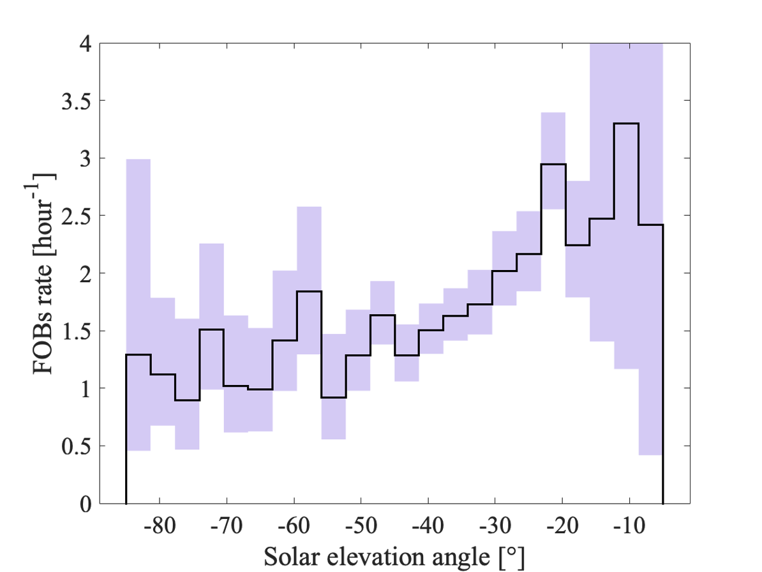
FOBs with solar elevation angle

Slide 26
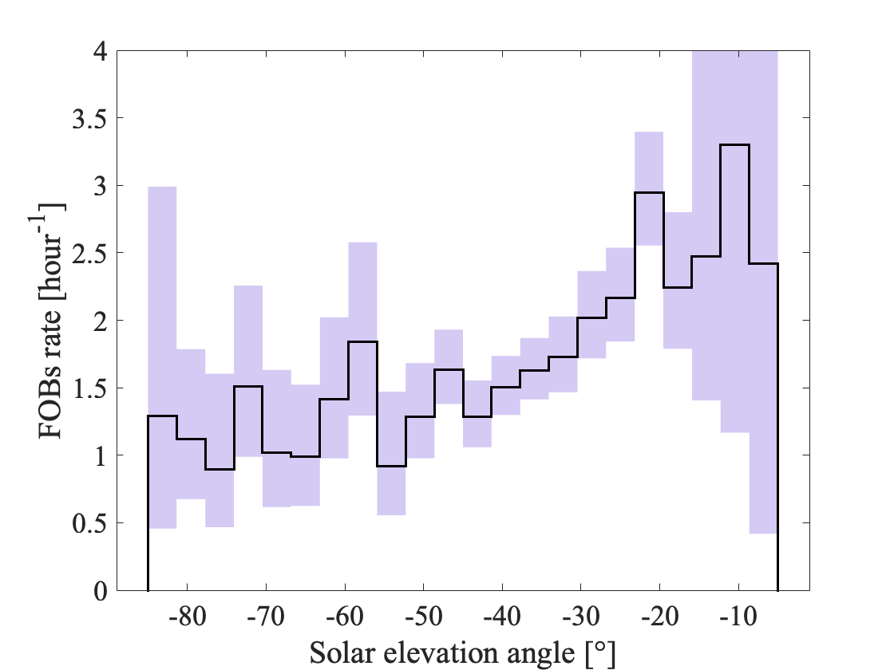
FOBs with solar elevation angle

Slide 27
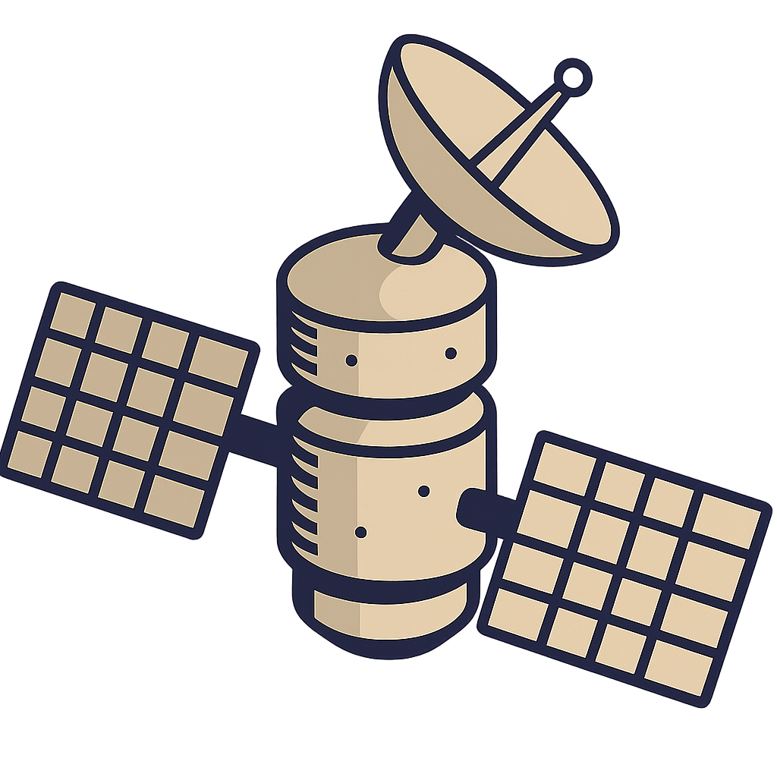
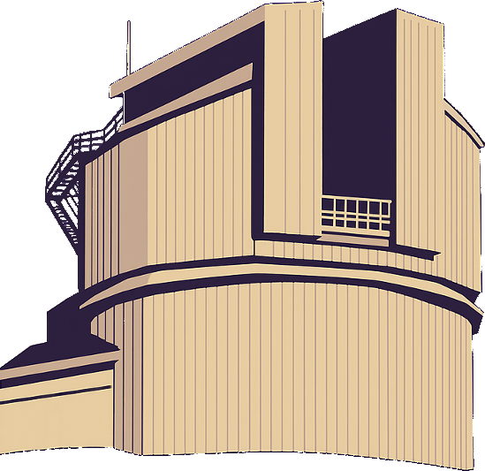
FOBs with solar elevation angle
Line of sight
Earth’s shadow
-20°
Sun

Slide 28
FOBs with solar elevation angle
Line of sight
Earth’s shadow
Earth’s shadow
-80°
Sun

Slide 29
FOBs with solar elevation angle
Line of sight
Earth’s shadow
Earth’s shadow
-40°
Sun

Slide 30
FOBs with solar elevation angle
Line of sight
800 km
Earth’s shadow
Earth’s shadow
-40°
Sun

Slide 31
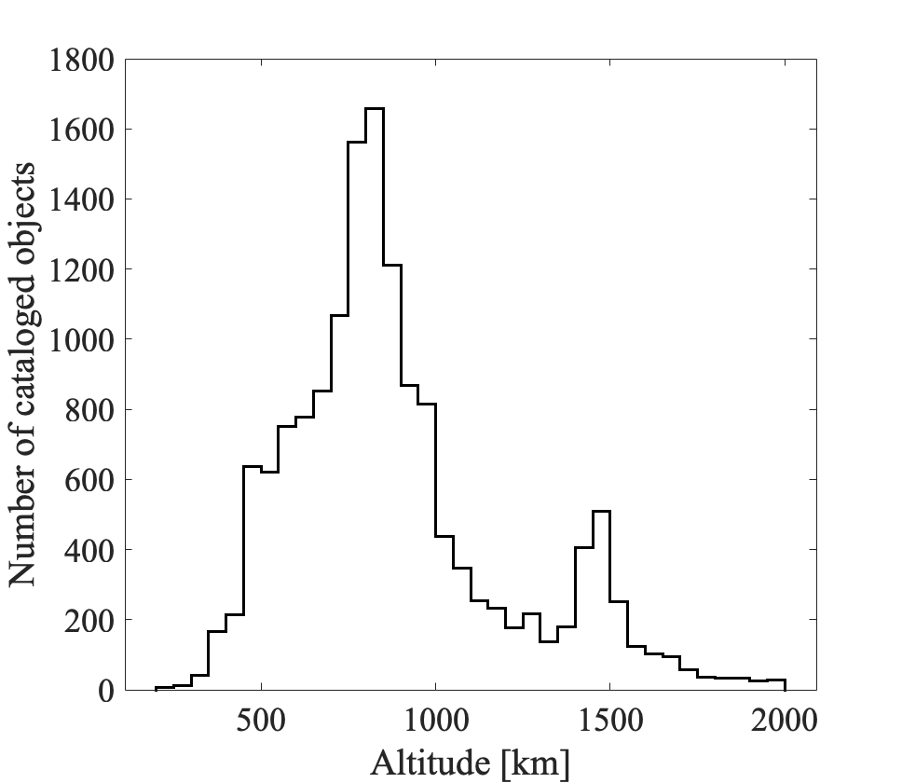
FOBs with solar elevation angle
800 km

Slide 32
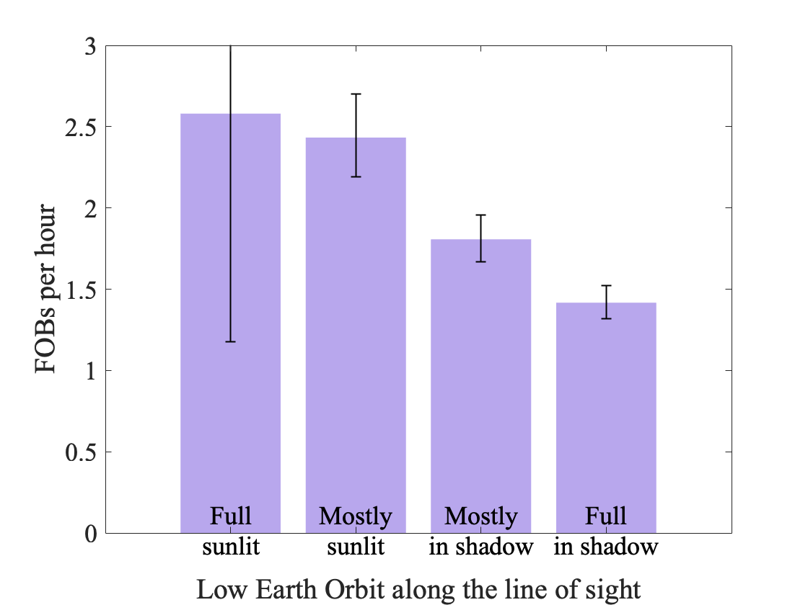
FOBs with Low Earth Orbits sunlight exposure
Earth’s shadow
Low Earth Orbits
Earth
Line of sight
Night
Day
Sun

Slide 33
FOBs with Low Earth Orbits sunlight exposure
Earth’s shadow
Low Earth Orbits
Line of sight
Earth
Night
Day
Sun

Slide 34
FOBs with Low Earth Orbits sunlight exposure
Earth’s shadow
Low Earth Orbits
Line of sight
Earth
Night
Day
Sun

Slide 35
FOBs with Low Earth Orbits sunlight exposure
Earth’s shadow
Low Earth Orbits
Line of sight
Earth
Night
Day
Sun

Slide 36
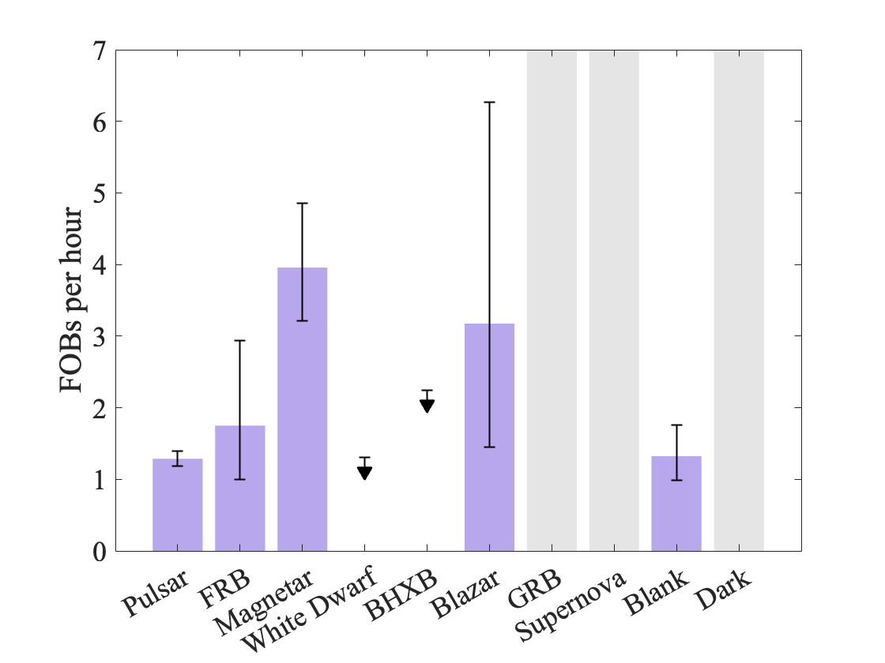
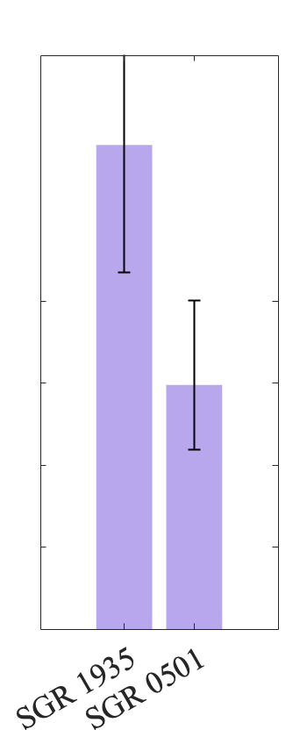
FOBs per observed source class (LEO in shadow)
Earth’s shadow
Low Earth Orbits
Line of sight
+3.0 σ
Earth
Night
+3.6 σ
+2.1 σ
Day
Sun

Slide 37
Final recap
Developed a modified Bayesian blocks algorithm to search for FOBs

Slide 38
Final recap
Developed a modified Bayesian blocks algorithm to search for FOBs
Linearized version to improve speed

Slide 39
From real observations
Final recap
Developed a modified Bayesian blocks algorithm to search for FOBs
Linearized version to improve speed
Poisson likelihood including Crosstalk correction
From dark observations

Slide 40
Final recap
Developed a modified Bayesian blocks algorithm to search for FOBs
Linearized version to improve speed
Poisson likelihood including Crosstalk correction
Most FOBs does not originate from the targeted source

Slide 41
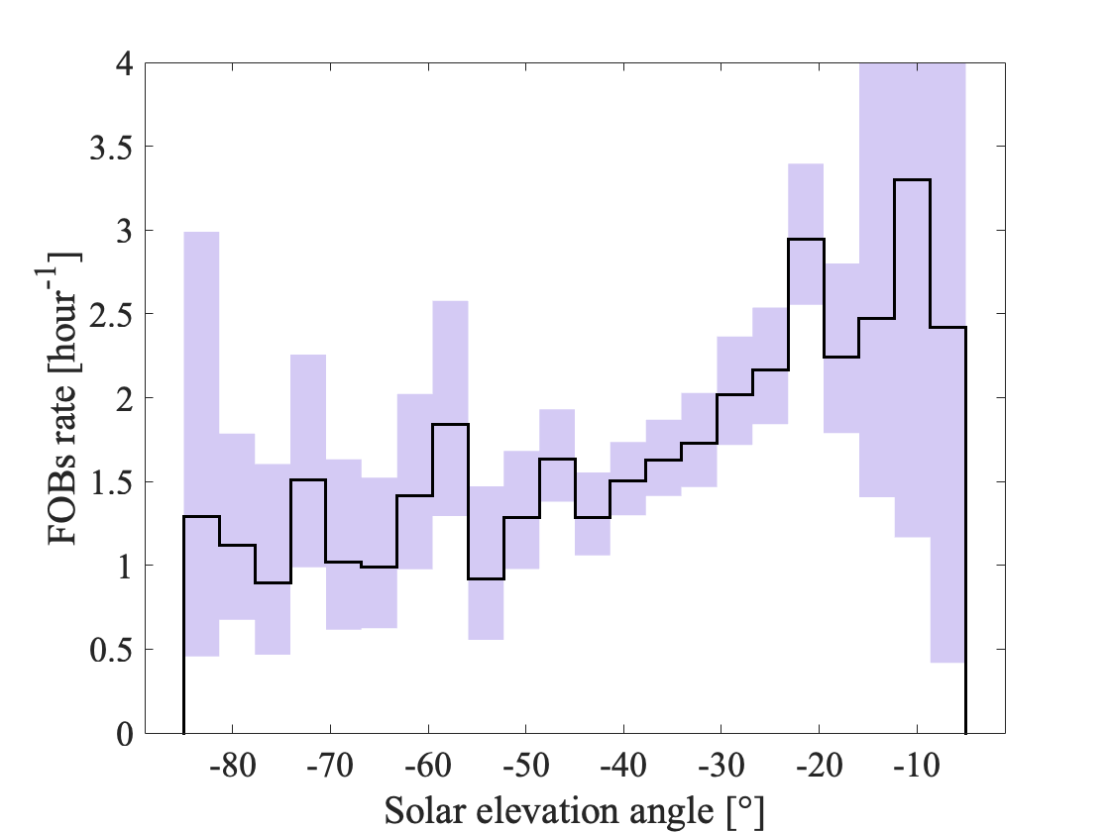
Final recap
Developed a modified Bayesian blocks algorithm to search for FOBs
Linearized version to improve speed
Poisson likelihood including Crosstalk correction
Most FOBs does not originate from the targeted source
Sunlight reflection of object in LEO?

Slide 42
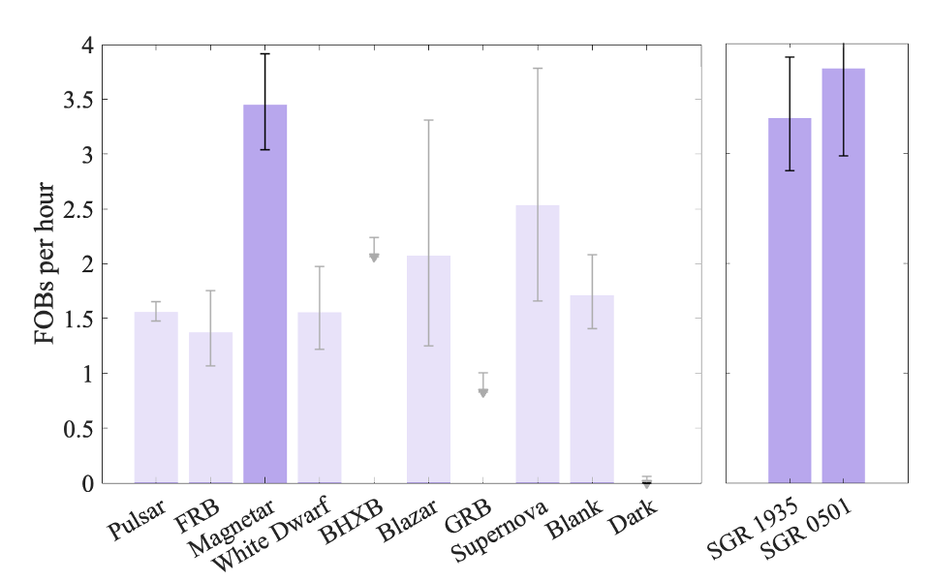
Final recap
Developed a modified Bayesian blocks algorithm to search for FOBs
+2.8 σ
+3.6 σ
Linearized version to improve speed
Poisson likelihood including Crosstalk correction
+4.5 σ
Most FOBs does not originate from the targeted source
Sunlight reflection of object in LEO?
Excess from the directions of the magnetars

Slide 43
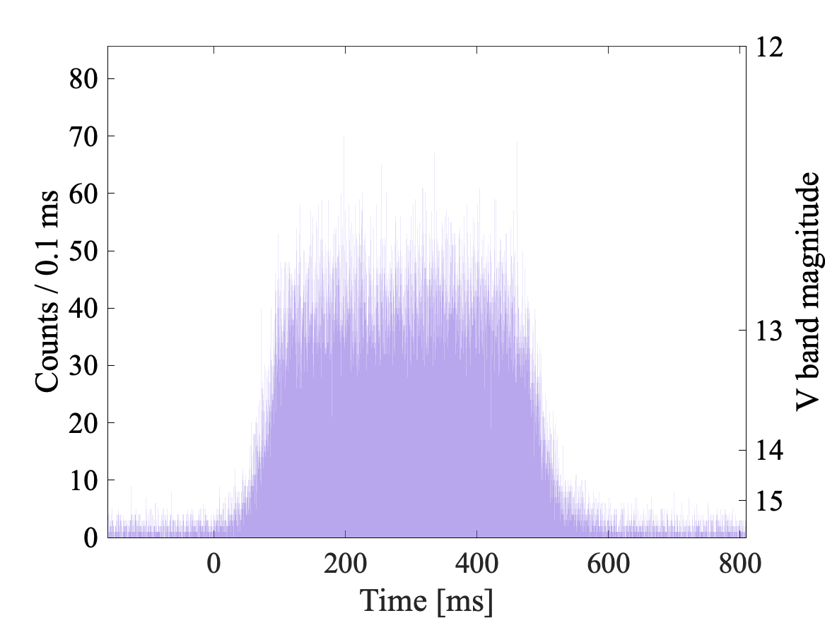
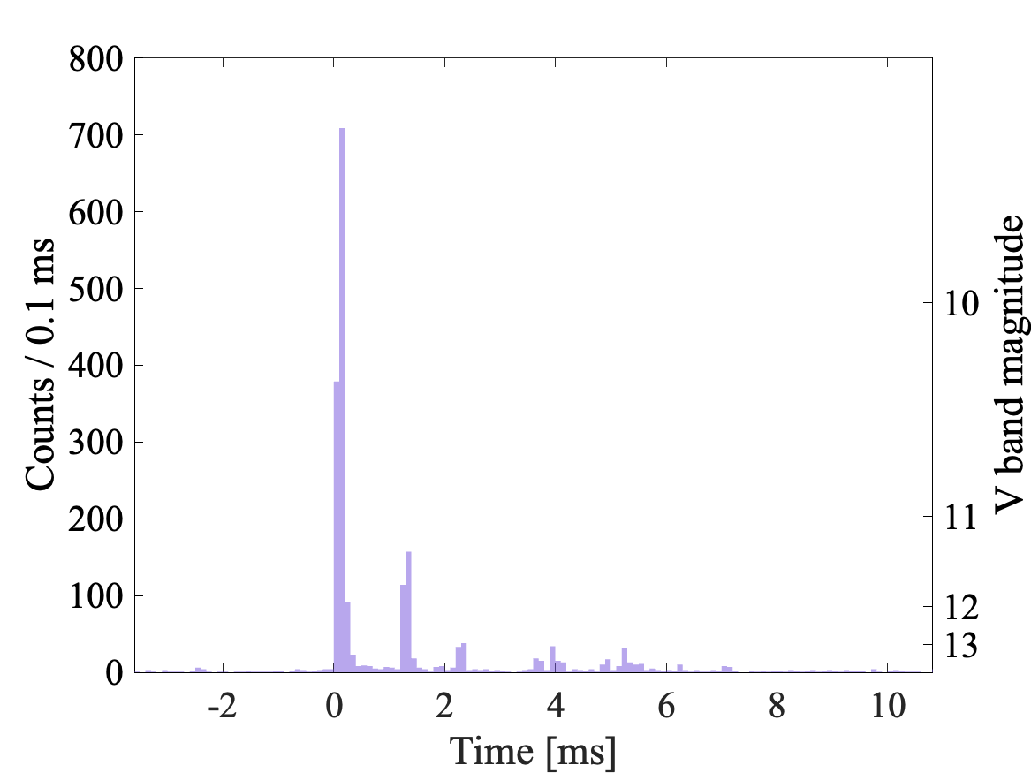
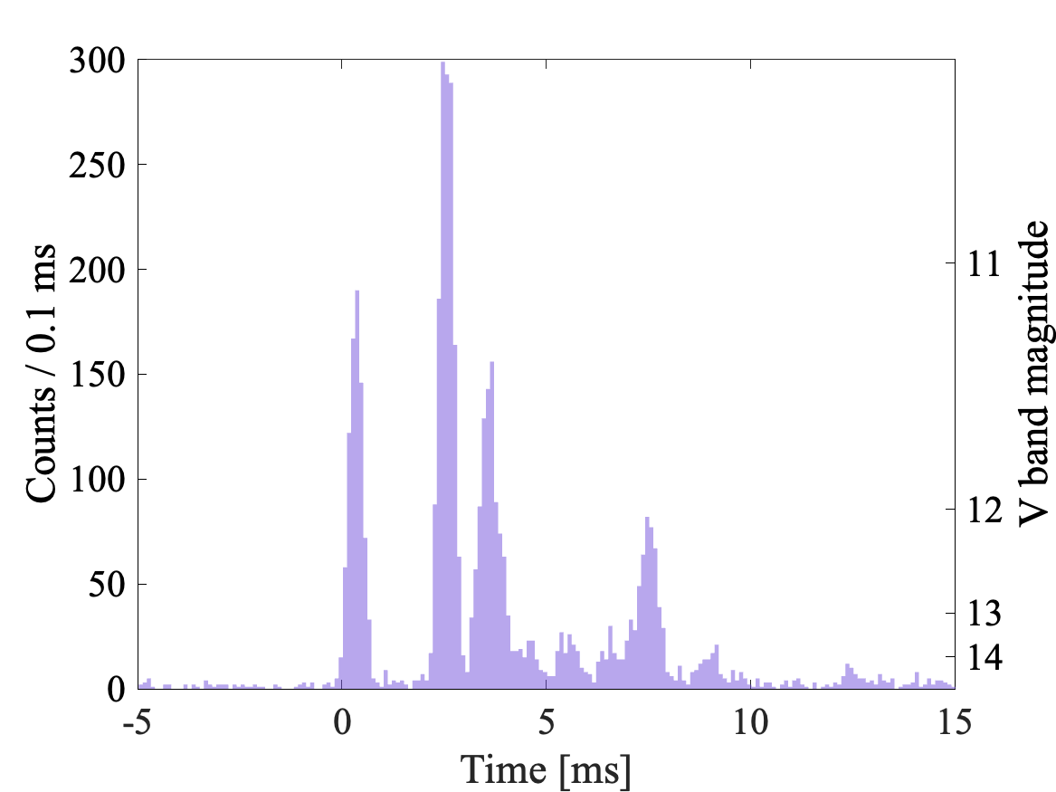
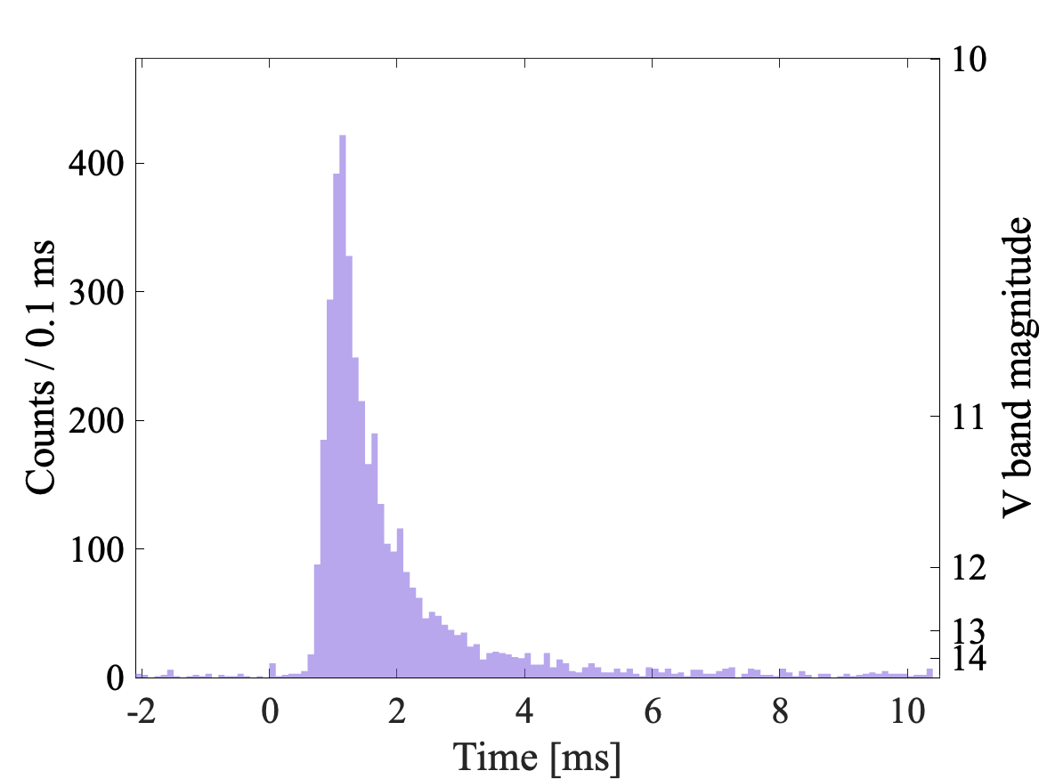
Future steps
Morphology analysis of bursts, starting with simmetry

Slide 44
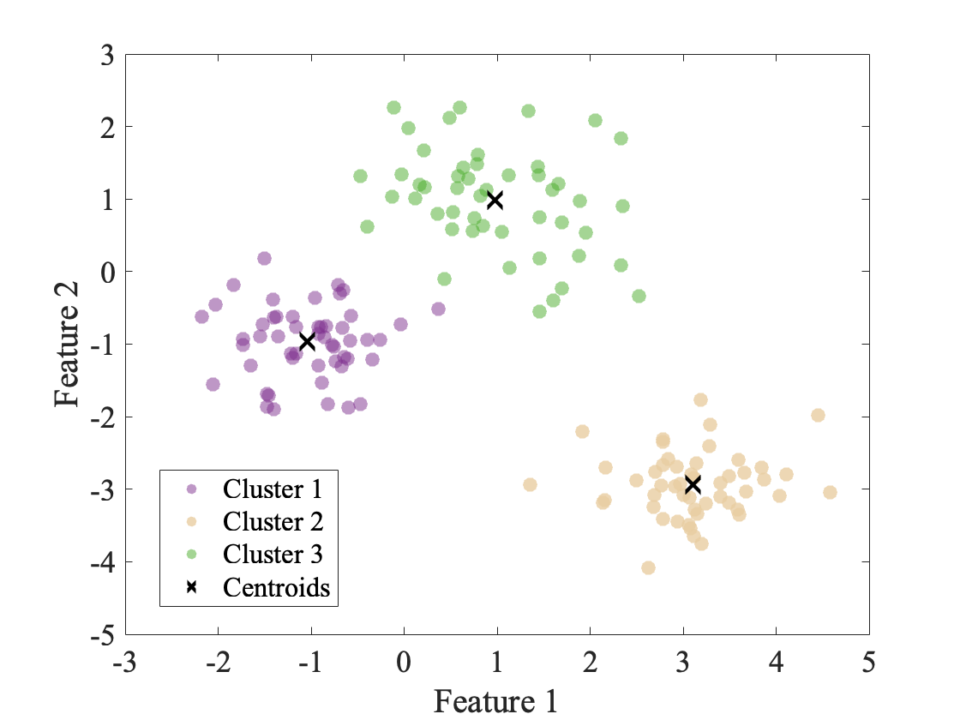
Future steps
Morphology analysis of bursts, starting with simmetry
Unsupervised machine learning for clustering

Slide 45
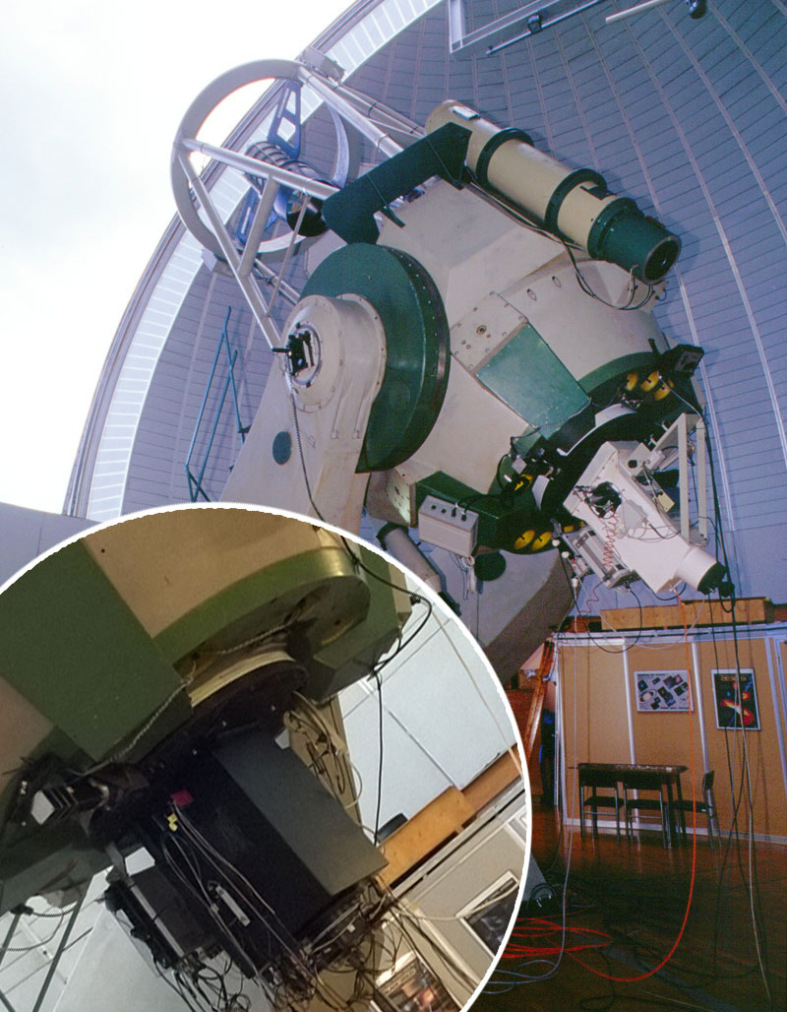
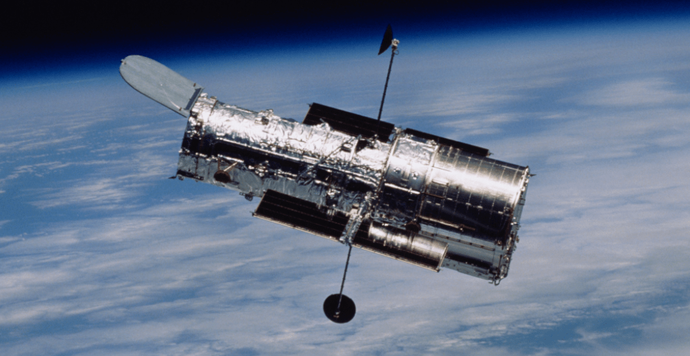
Future steps
Morphology analysis of bursts, starting with simmetry
Unsupervised machine learning for clustering
Simultaneous observations with optical and multi-wavelength facilities

