Slide 1
ItaliaN Single-dish radio telescopes enhancement for studying Transients And GRAvitational Waves (INSTAGRAW)
Andrea Melis - INAF Cagliari
FRB – Italy 2025 – Area Territoriale di Ricerca di Bologna, May 8th 2025

Slide 2
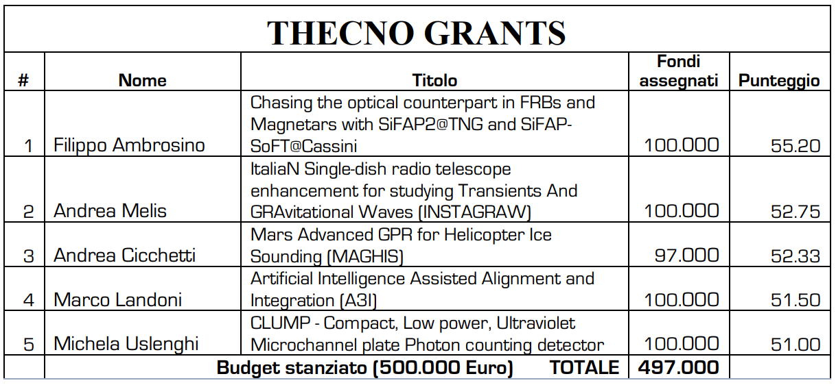
Techno Grant financed with 100k euros

Slide 3
Short Abstract

Slide 4
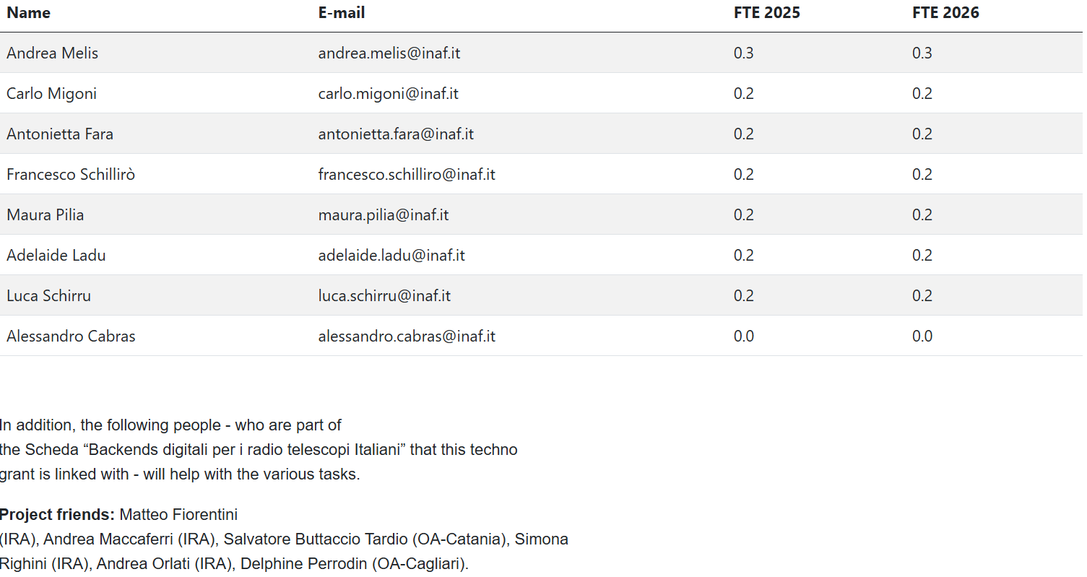
INSTAGRAW team

Slide 5
Current digital platforms for transients at the three antennas
LEAP cluster (SRT only)
Pulsar Digital Filter Bank (SRT only)
SARDARA
Notes:
Allineare le informazioni per tipo sui tre slot, integrazione antenne con il frontend aggiungere nei punti

Slide 6
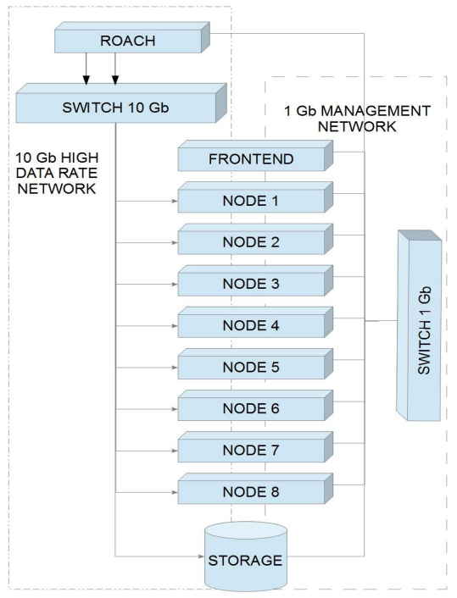
Large European Array for Pulsars
- Two 512 MHz IF are split into 32 channels and outputs the spectrum over two 10GbE CX4 links. A switch distribute the 32 outputs over 32 possible servers. SRT only uses 8 sub-bands 16 MHz-wide each, for a total of 128 MHz bandwidth.
- ROACH board is deprecated, as well as the CX4 switch. LEAP nodes and the storage out of production.
Notes:
Allineare le informazioni per tipo sui tre slot, integrazione antenne con il frontend aggiungere nei punti

Slide 7
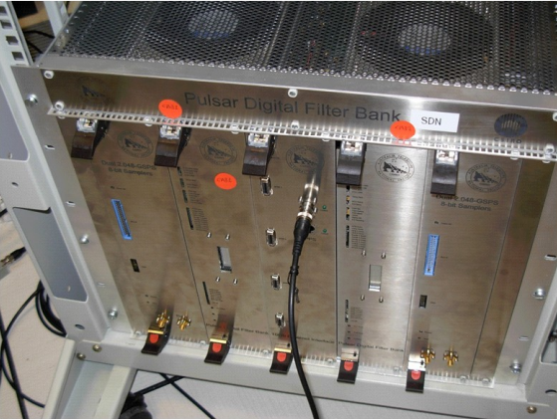
Pulsar Digital Filter Bank
4 IF, max BW 1 GHz
Sample coded with 8 bits
No allowed raw data recording
Limited combinations BW/channels
Deprecated technology
Notes:
Allineare le informazioni per tipo sui tre slot, integrazione antenne con il frontend aggiungere nei punti

Slide 8
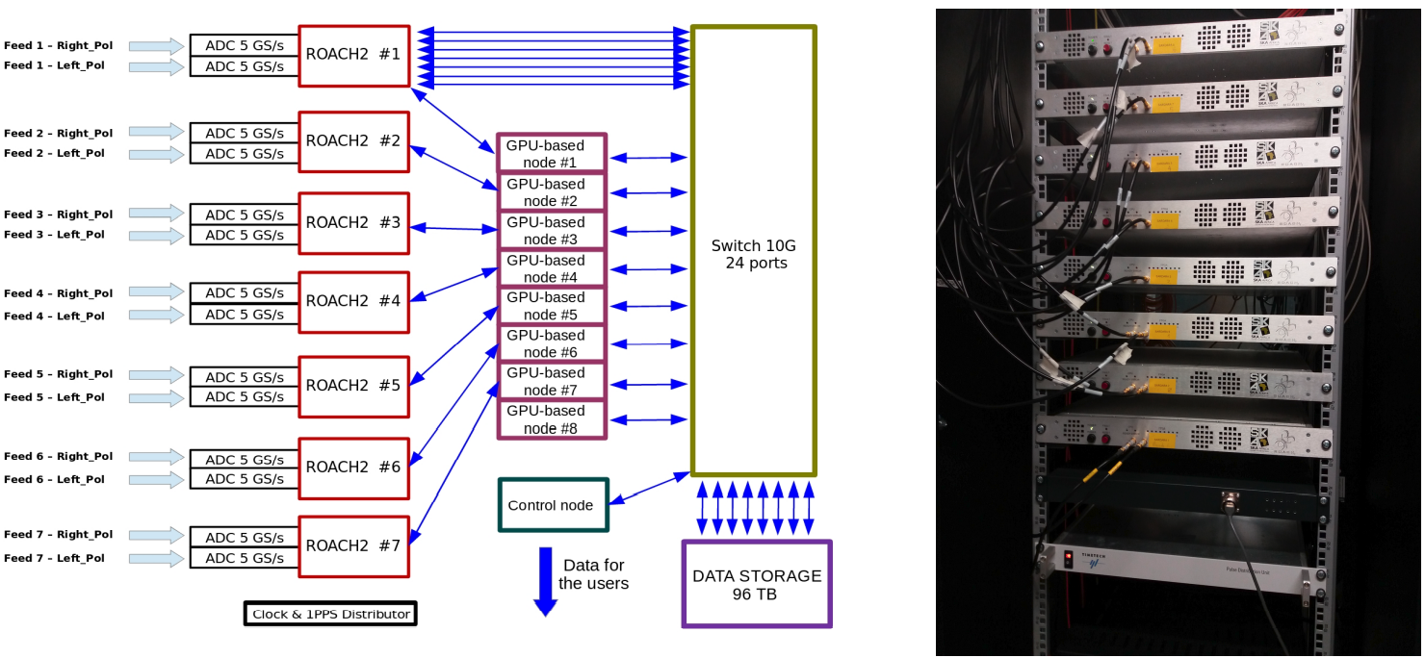
SARDARA (Sardinia ROACH2-based Digital Architecture for Radio Astronomy)
Deployed for SRT, ported to Medicina and Noto for single-feed modes only.
ROACH2s deprecated and out of production
10G technology limits the throughput.
Notes:
Allineare le informazioni per tipo sui tre slot, integrazione antenne con il frontend aggiungere nei punti

Slide 9
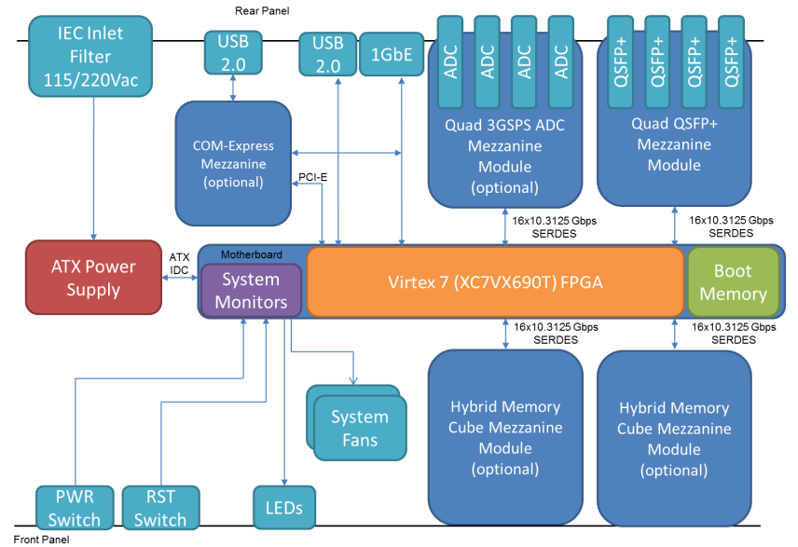
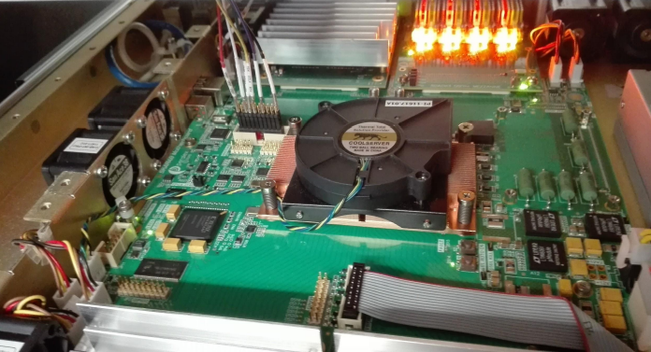
SKARAB (Square Kilometer Array Reconfigurable Application Board)

Slide 10
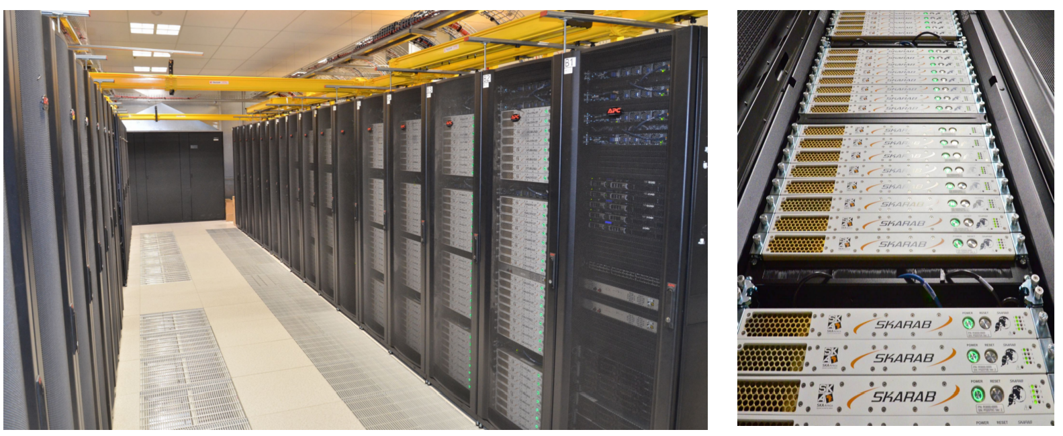
SKARAB as a main processing engine at MeerKAT

Slide 11
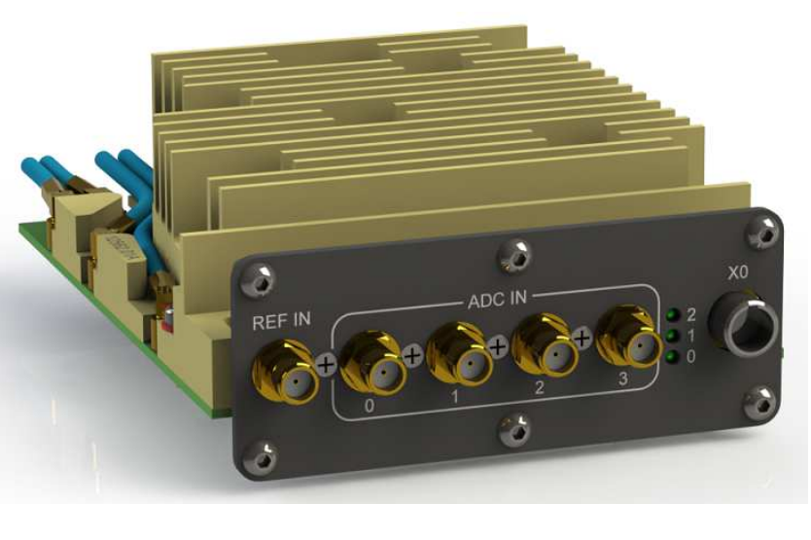
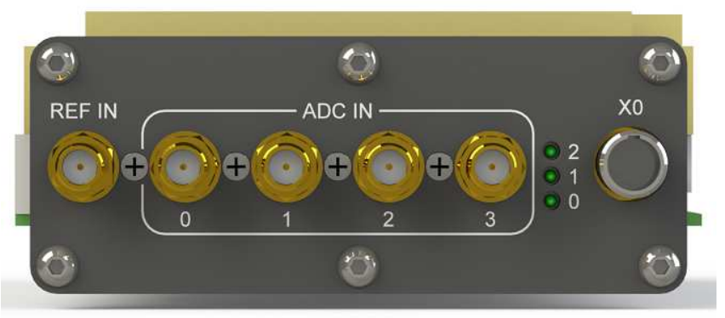
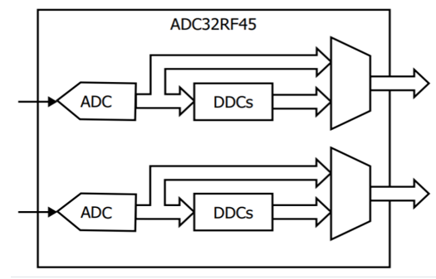
ADC mezzanine card
4 IF, maximum output sample rate 2800 Msample/sec
5.6 GHz of instantaneous bandwidth (4x1.4 GHz)
Each sample coded with 12 (full-band) or 16 (medium/narrow band) bits -> very high dynamic range.
A digital output devoted for the fast noise mark

Slide 12
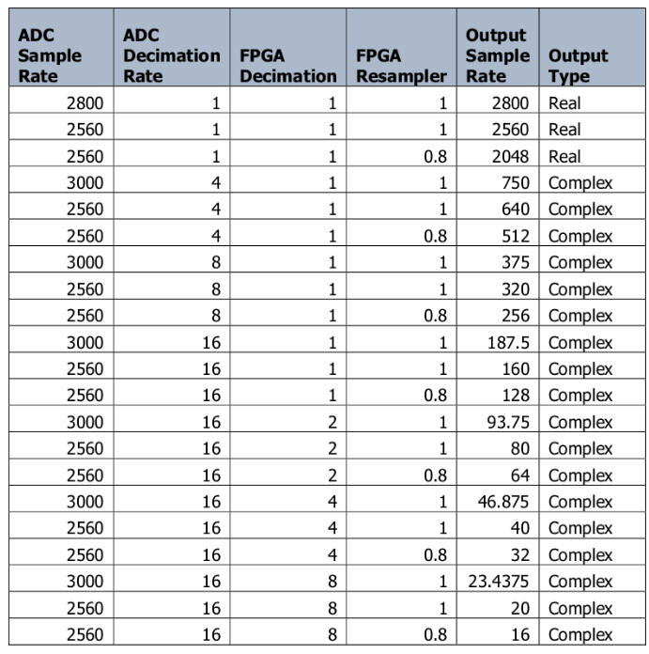
ADC available sampling rates

Slide 13
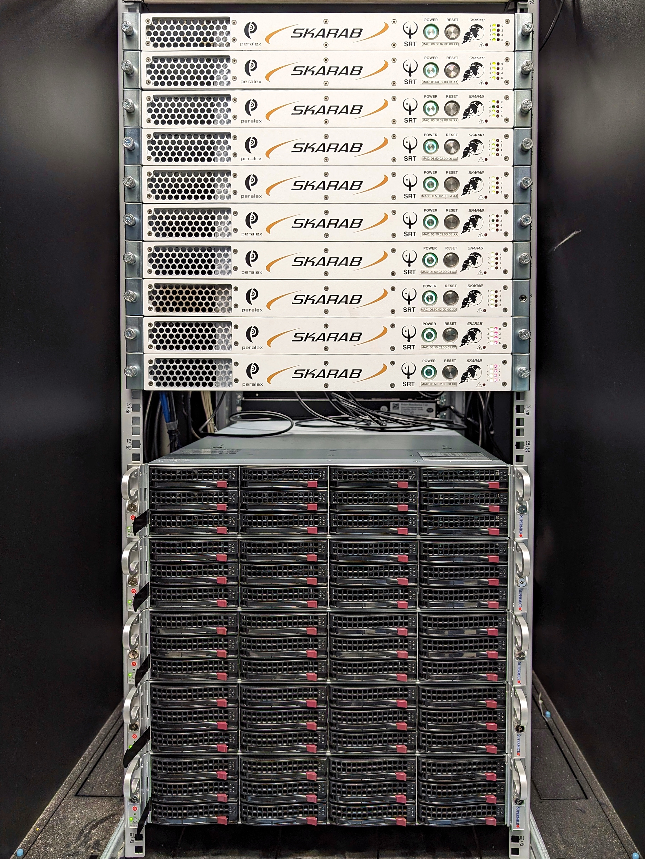
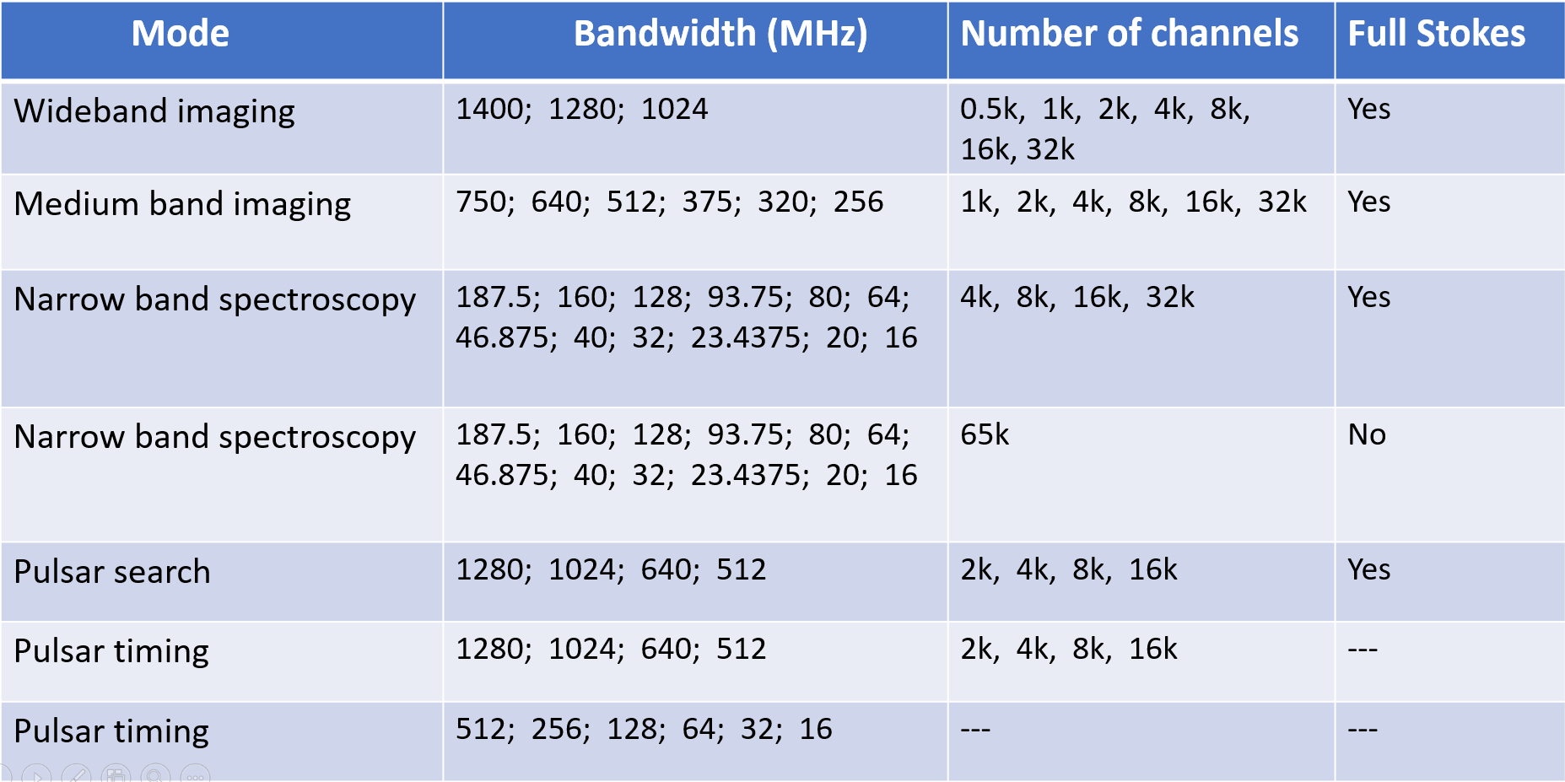
MUSKAS (MUlti-feed SKARAB-based backend for the Sardinia radio telescope)
Medicina currently has a SKARAB board
Noto will have two SKARABs, purchased in the framework of the PNRR KM3
Notes:
Allineare le informazioni per tipo sui tre slot, integrazione antenne con il frontend aggiungere nei punti

Slide 14
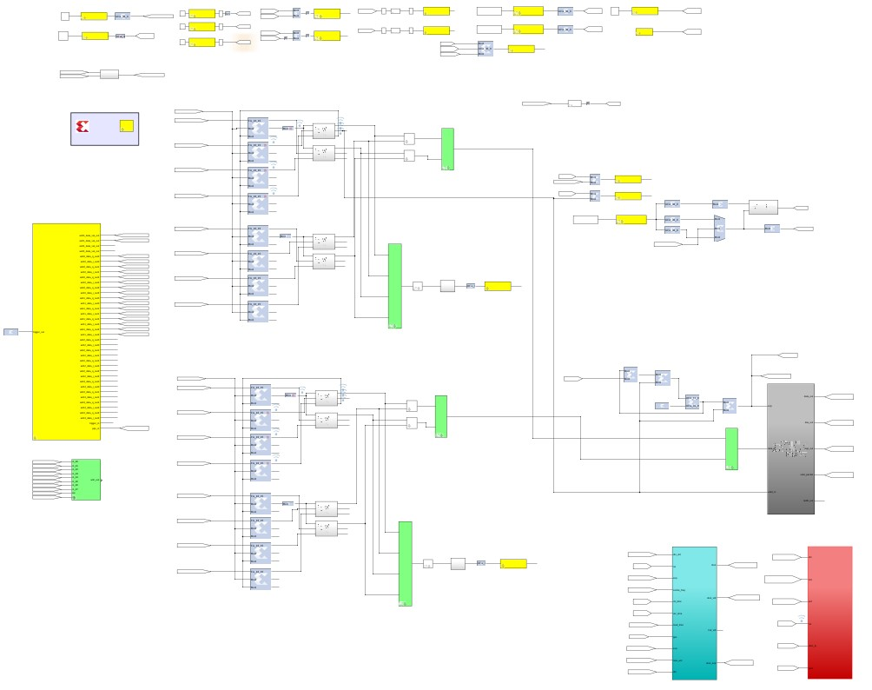
FPGA firmware designed in the framework of the CASPER (Collaboration for Astronomy Signal Processing and Electronics Research) Toolflow
256 MHz complex voltage baseband data
Notes:
Allineare le informazioni per tipo sui tre slot, integrazione antenne con il frontend aggiungere nei punti

Slide 15
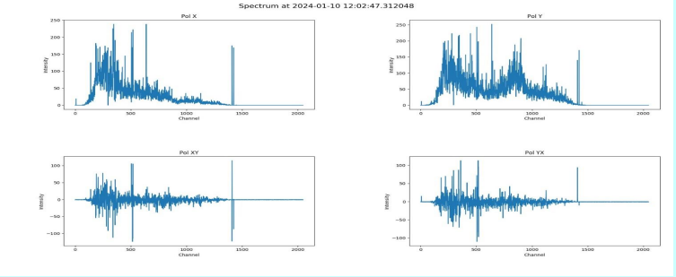
Pulsar/FRB search full-Stokes spectra
Main features:
2048 channels
Integration time: 16 microsec (62500 spectra/sec)
Data saved in binary files
Notes:
Allineare le informazioni per tipo sui tre slot, integrazione antenne con il frontend aggiungere nei punti

Slide 16
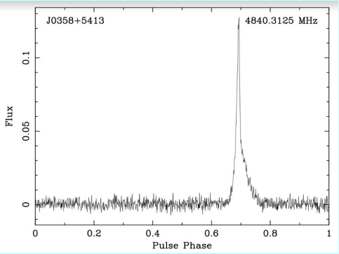
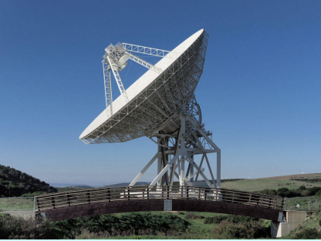
Pulsar B03354+54 observed at 5 GHz with the SRT
Pulse profile of B03354+54, the signal to noise ratio is in agreement with corresponding literature measurements.
Notes:
Allineare le informazioni per tipo sui tre slot, integrazione antenne con il frontend aggiungere nei punti

Slide 17
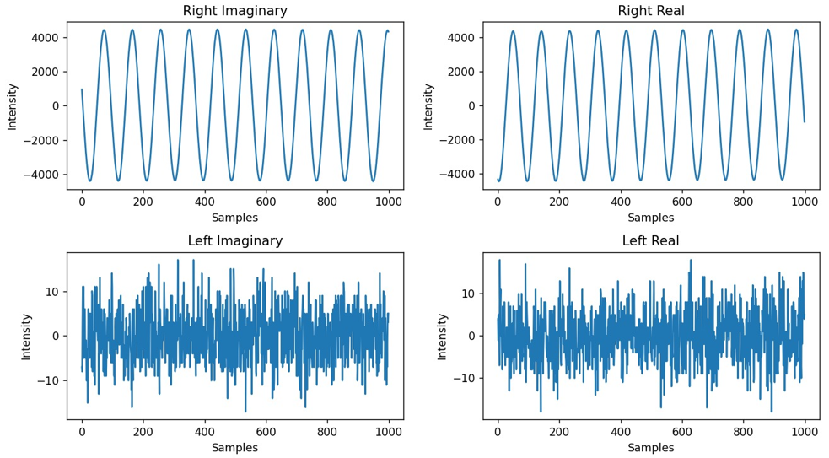
Coherent mode first tests
Single tone in input
2x16 MHz bandwidth successful raw data recording mode (128 MB/sec)
Next steps: optimizing code to gradually widen the bandwidth to be recorded on SP4000C
Notes:
Allineare le informazioni per tipo sui tre slot, integrazione antenne con il frontend aggiungere nei punti

Slide 18
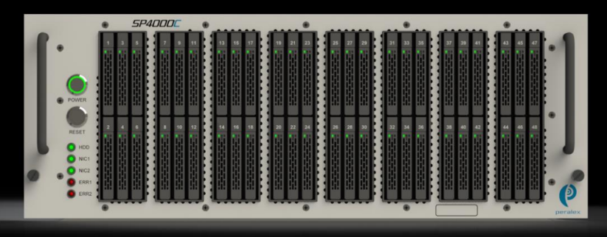
High-performing SSD based recorder SP4000C to be installed at SRT, Medicina and Noto
Main features:
96 TB (48 disks 2TB)
QSFP+ port
Recording capacity: up to 38 Gbit/sec
Fully operational at MeerKAT as a large memory buffer
Notes:
Allineare le informazioni per tipo sui tre slot, integrazione antenne con il frontend aggiungere nei punti

Slide 19
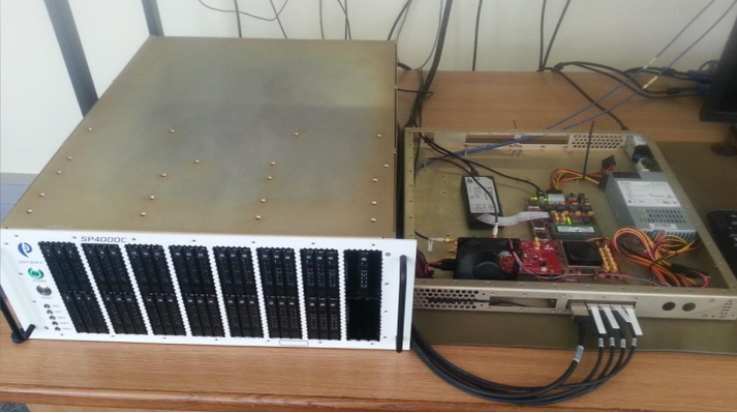
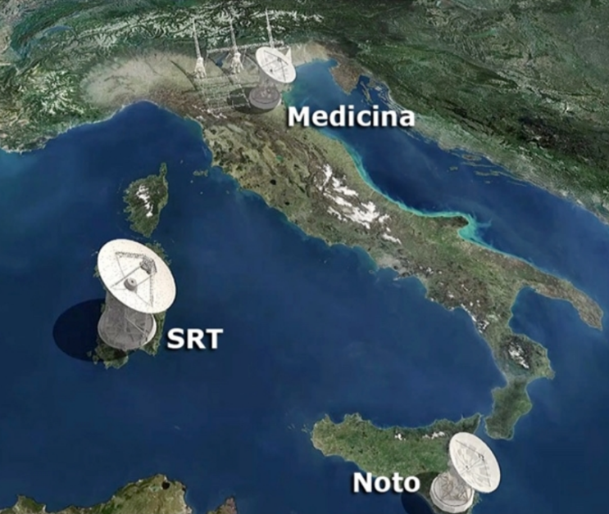
SKARAB + Recorder SP4000C
Notes:
Allineare le informazioni per tipo sui tre slot, integrazione antenne con il frontend aggiungere nei punti

Slide 20
Efficient Data Acquisition Using the Producer-Consumer Model
Retrieves data packets from the NIC and inserts them into a shared queue
PRODUCER
Processes, formats, and writes the data to file
CONSUMER
Advantages:
Separation of concerns to improve efficiency
Facilitates handling of high-speed, high-volume data streams

Slide 21
Examples of Producers: PF_RING Library
Fetch data
High performance: up to 40 Gbps
Low CPU overhead thanks to "zero-copy" mode
Packets are acquired directly in kernel space without transfer to user space
Compatibility with libpcap-based applications and tools
Optimized for traffic monitoring and analysis applications
Add new data
RING BUFFER
Release old data

Slide 22
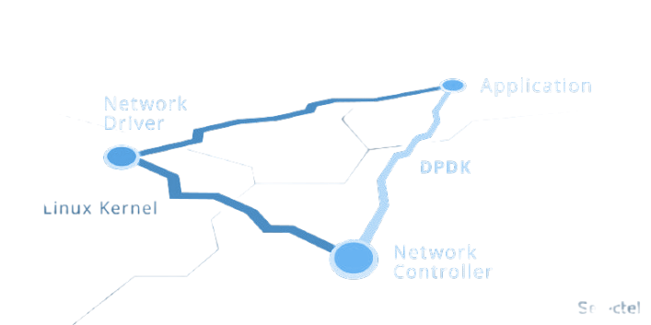
Examples of Producers: DPDK (Data Plane Development Kit)
Superior performance: up to 40–100+ Gbps on compatible hardware
Very low latency (kernel bypass)
Optimized for multi-core CPUs
Advanced control over packet flow and scheduling
Broad hardware support and active community
Application
DPDK
Linux kernel
Network Controller

Slide 23
Deliverables and Milestones
M1: Beginning of the project (TBD)
D1: Completion of all SKARAB FPGA firmware
D2: Testing the overall chain SKARAB + Recorder SP4000C
M2: Payment of the three recorders
D3: Full integration in the control software of the three telescopes and
scientific commissioning
M3: Submitting a paper describing the whole project
Notes:
Allineare le informazioni per tipo sui tre slot, integrazione antenne con il frontend aggiungere nei punti

Slide 24
Notes:
Allineare le informazioni per tipo sui tre slot, integrazione antenne con il frontend aggiungere nei punti

Slide 25
THANKS!
Email: andrea.melis@inaf.it
INAF - Astronomical Observatory of Cagliari
Notes:
Sorry if the presentation was very high-level, but if you have any very specific questions, you can also contact me via email, and I will forward them to the colleagues who deal with that

