Slide 1
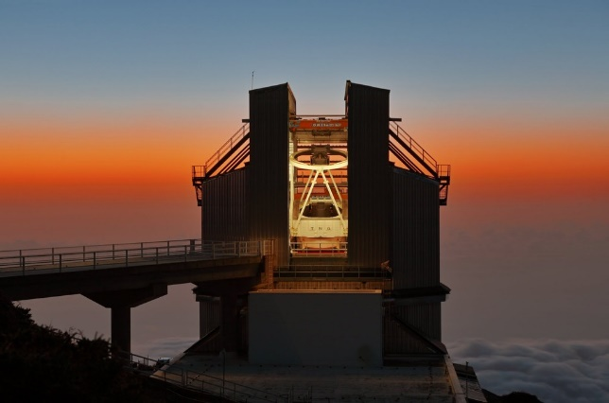



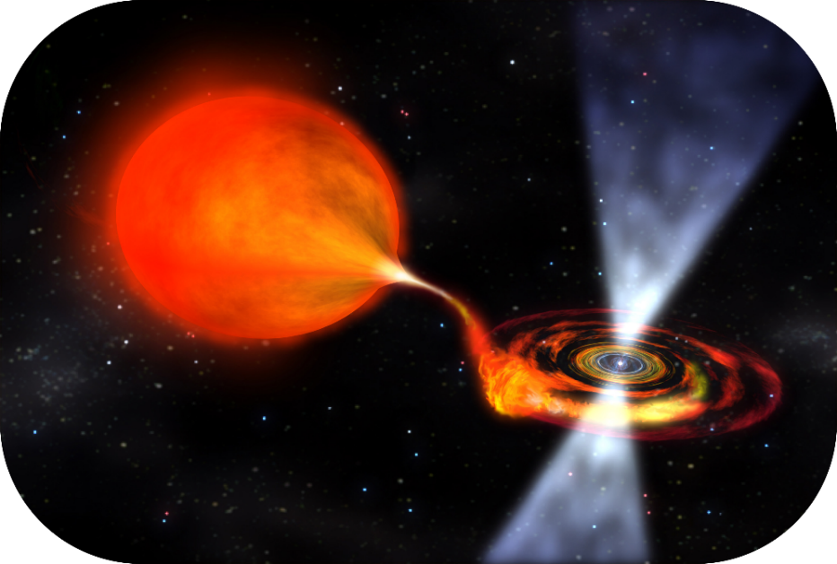
Search for optical counterparts of FRBs with SiFAP2@TNG
Filippo Ambrosino
filippo.ambrosino@inaf.it
Collaborators: Piergiorgio Casella, Carlo Campa, Alessandro Papitto, Riccardo La Placa, Roberta Amato, Gianluca Israel,
Luigi Stella (INAF-OAR)
Giulia Illiano (INAF-OAB), Arianna Miraval Zanon (ASI)
Franco Meddi (Sapienza Università di Roma), Franco Leone (Università di Catania)
Adriano Ghedina, Massimo Cecconi, Manuel Gonzales, Marcos Hernandez, Hector Perez Ventura (INAF-FGG)
… and many others

Slide 2

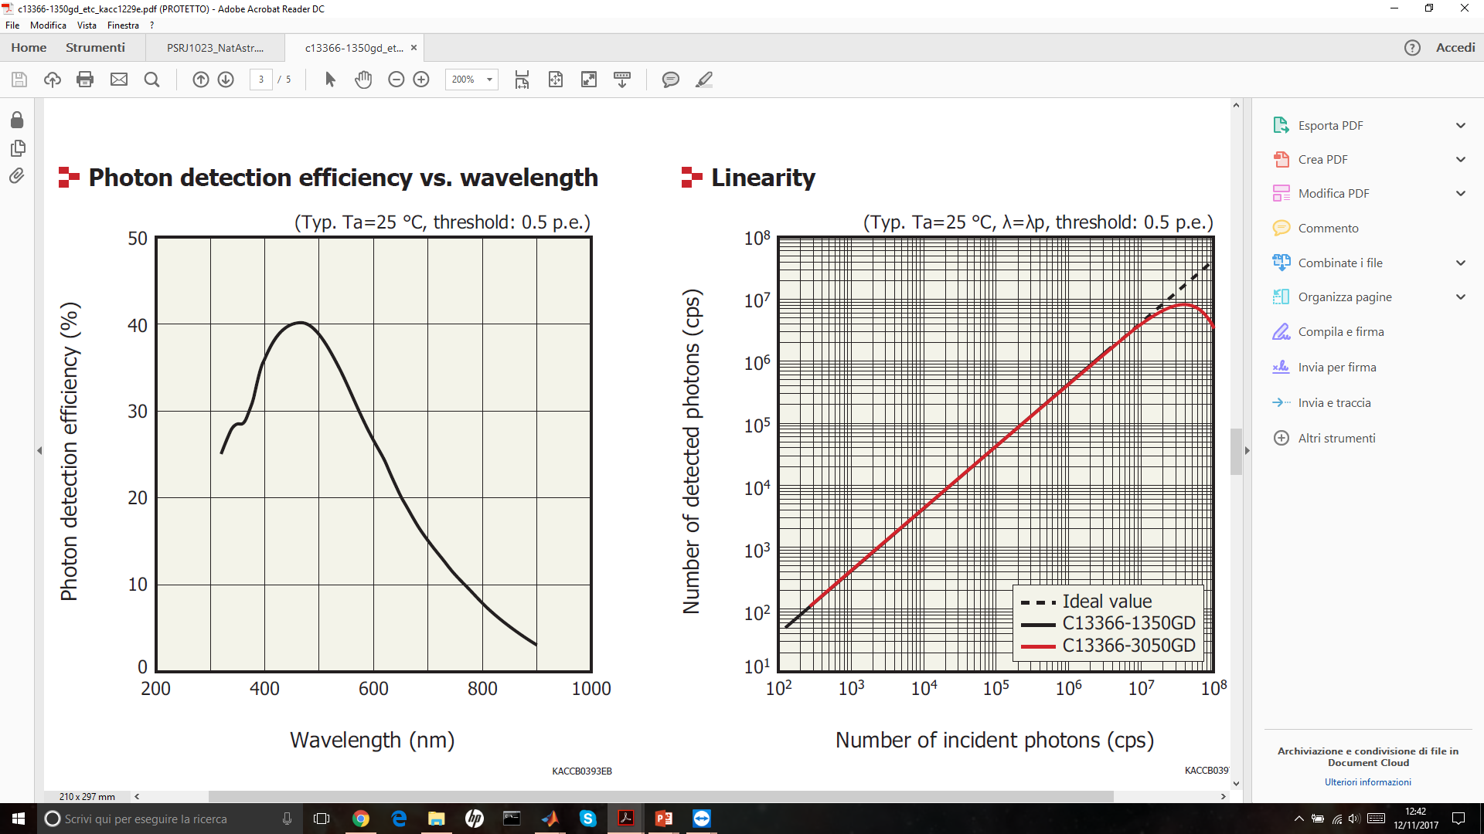
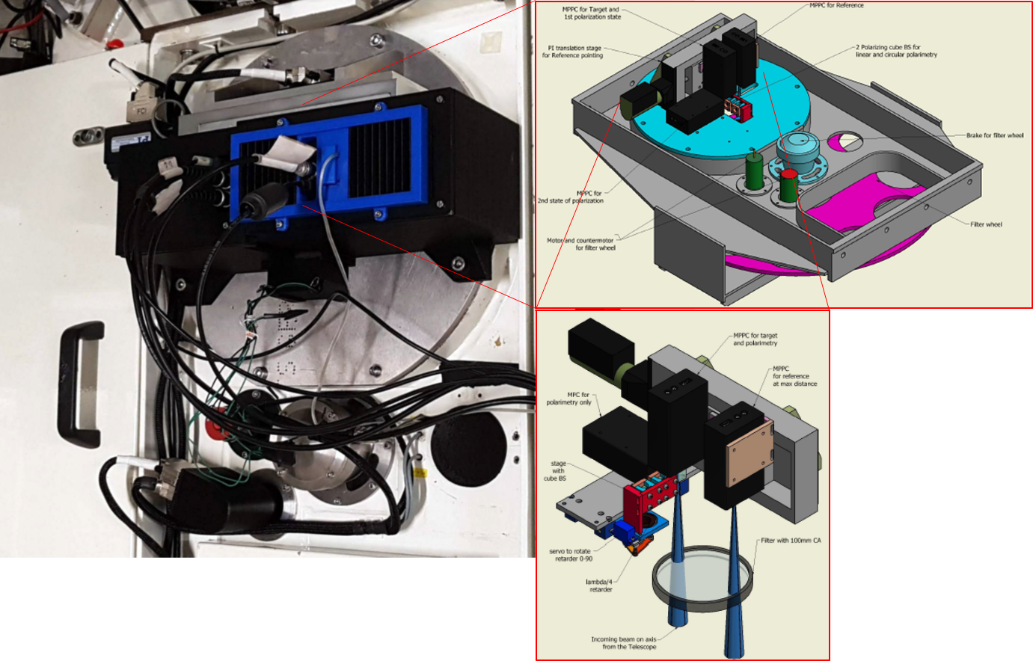
SiFAP2@TNG
http://www.tng.iac.es/instruments/sifap2/
[Ghedina et al., 2018]
spectral range: 320 – 900 nm
time resolution: 80 ps
relative time accuracy: 10⁻¹⁰
absolute time accuracy: <60 µs
Nasmyth A focus

Slide 3
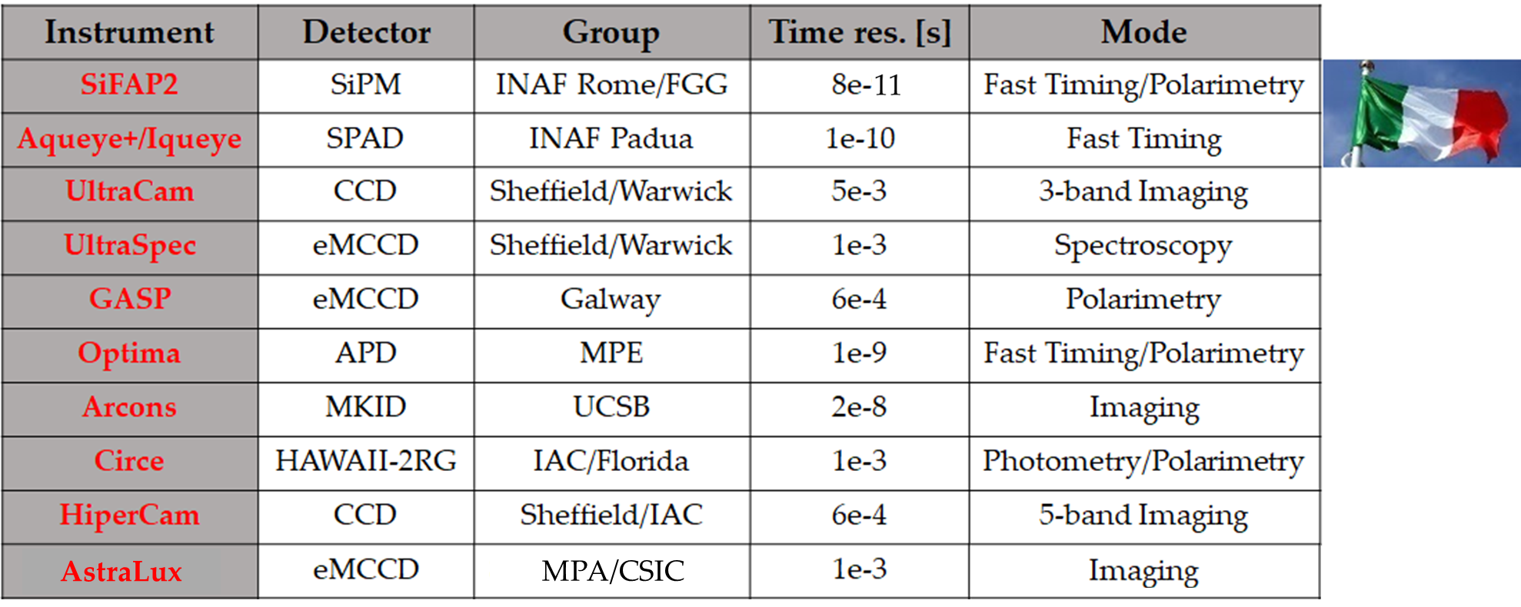
State of the art: HTRA instruments

Slide 4
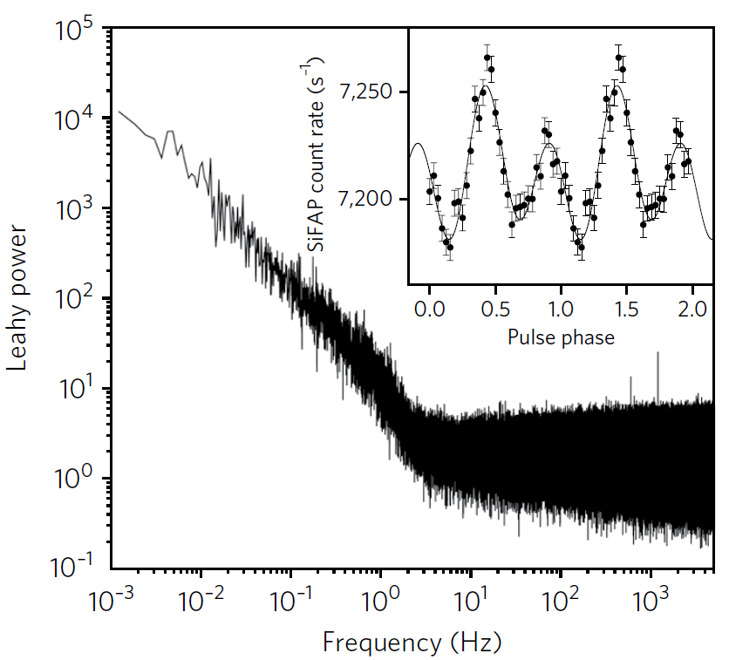
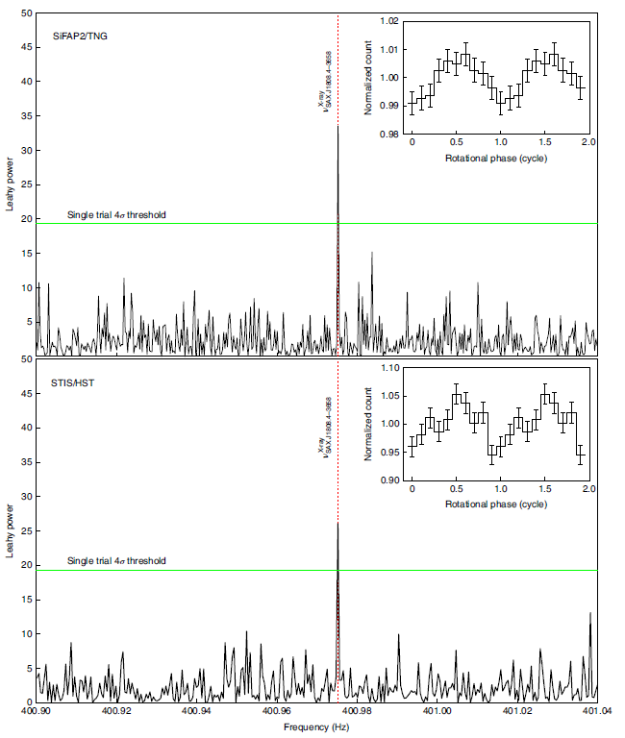
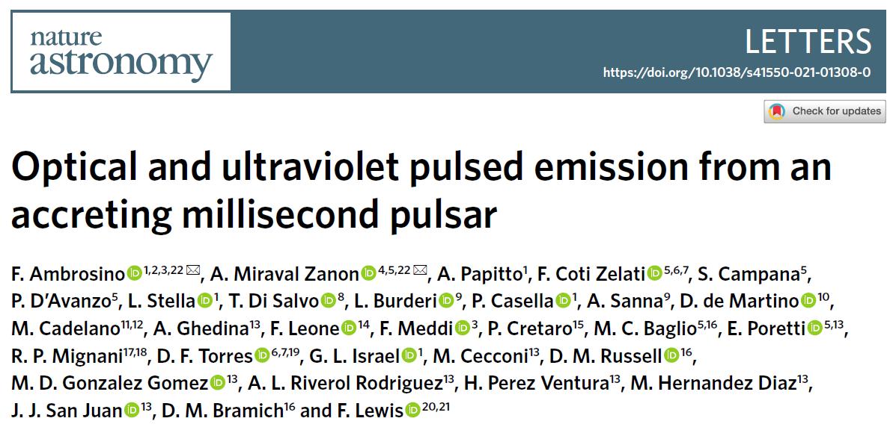
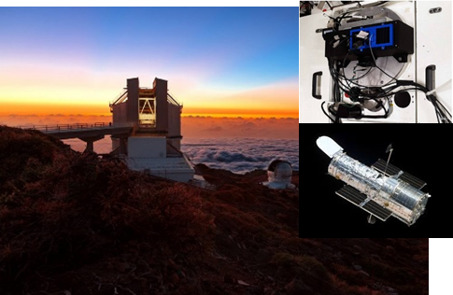
PSR J1023+0038 & SAX J1808.4-3658
First optical pulsations from a tMSP discovered!!!
First optical/UV pulsations from an AMXP discovered!!!
[Ambrosino, Papitto et al. 2017,
Nature Astronomy]
[Ambrosino, Miraval Zanon et al. 2021,
Nature Astronomy]

Slide 5
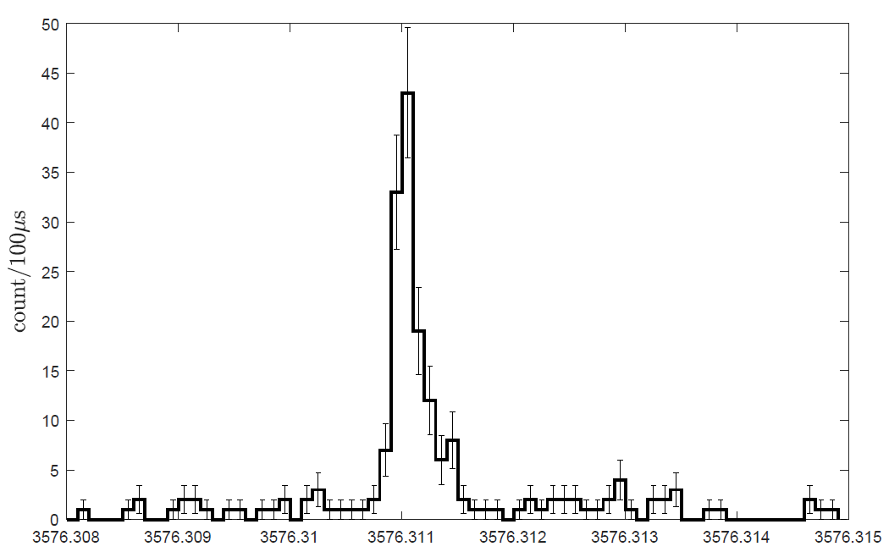
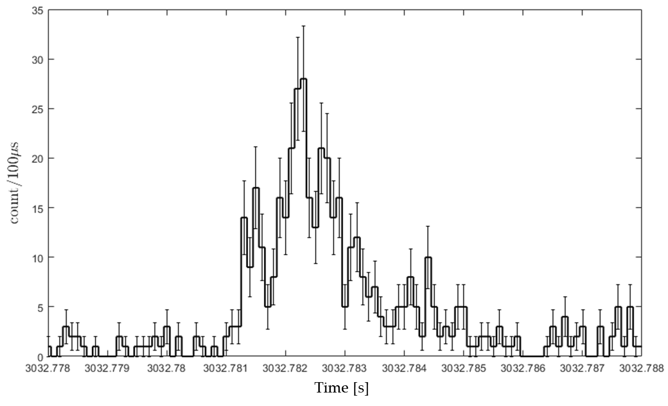
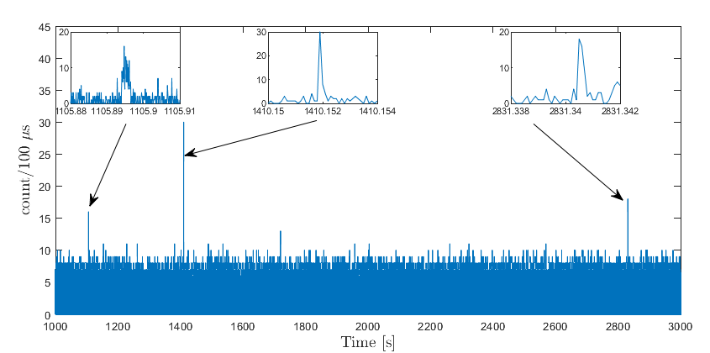
Fast Optical Bursts (FOBs)
FRBs
A new class of fast (ms) optical transients?
1 ms
Rate of ~1.5/hr in a FoV of 7 x 7 arcsec²!!!
  Meteors/Fireballs? (rate of FOBs several orders of magnitude higher than that expected for meteors from MAGIC estimates)
  Space debris?
  Satellites passages?
  Atmospheric origin (optical flashes)?
Pulsars
Need for more statistics to identify the optical counterpart of impulsive events with simultaneous (optical) campaigns!

Slide 6
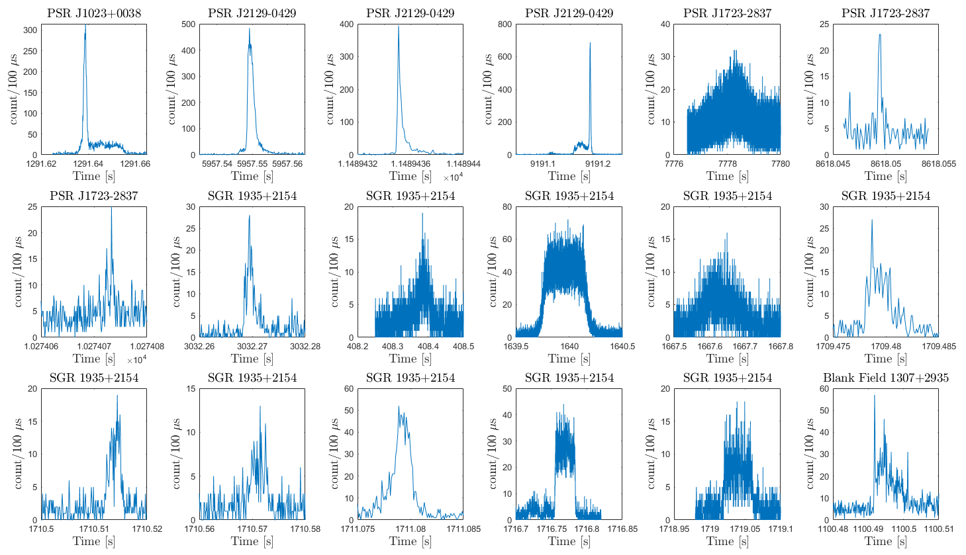
FOBs morphology

Slide 7
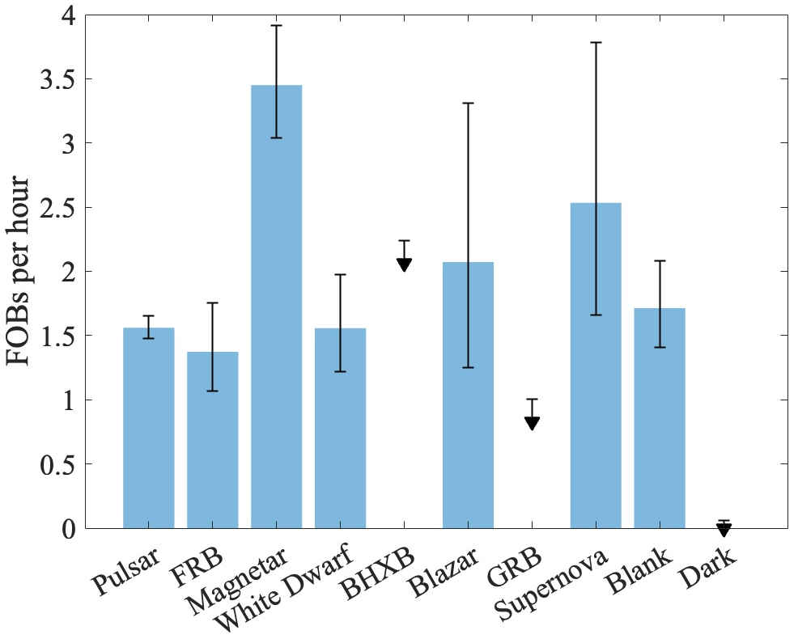
FOBs statistics
More than 300 hr of observations on different classes of objects
  more than 450 events detected
  ~1.5 events/hour on average
  most of hours spent on (ms) pulsars
  SGR1935 shows an interesting excess
(see Carlo Campa’s presentation for details)
[Campa et al., in prep.]

Slide 8
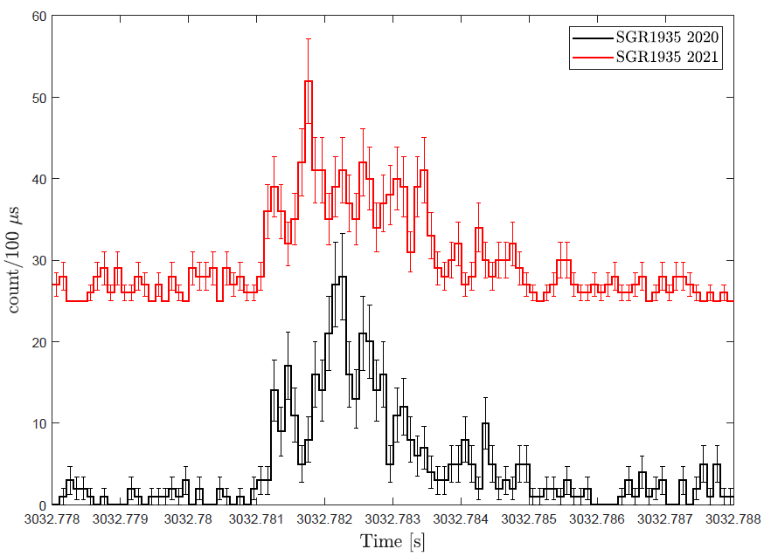
SGR 1935+2154
Two bursts from SGR 1935+2154
  Very similar shape
  Very similar duration (~3 ms)
  Similar peak magnitude (V~12.6)
Likely to come
from the magnetar

Slide 9
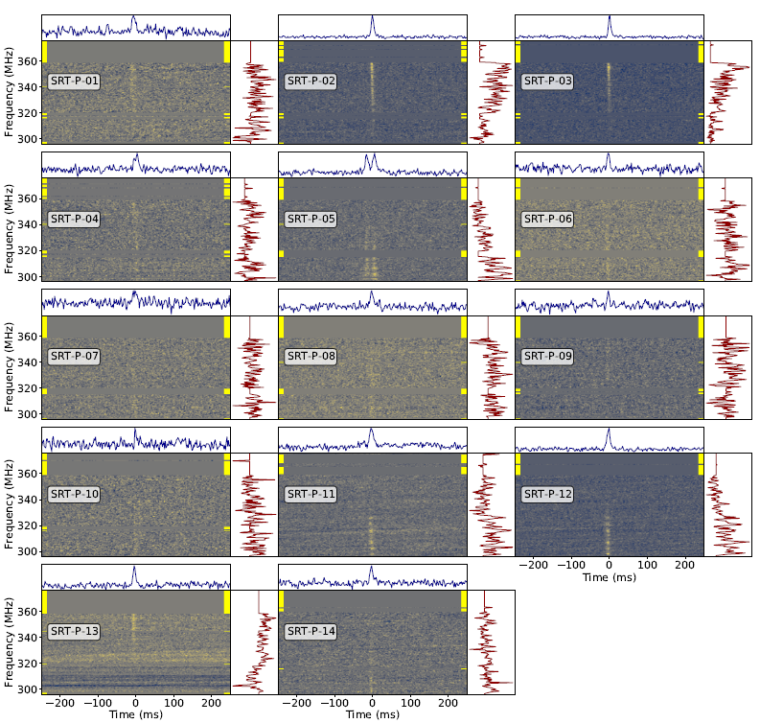
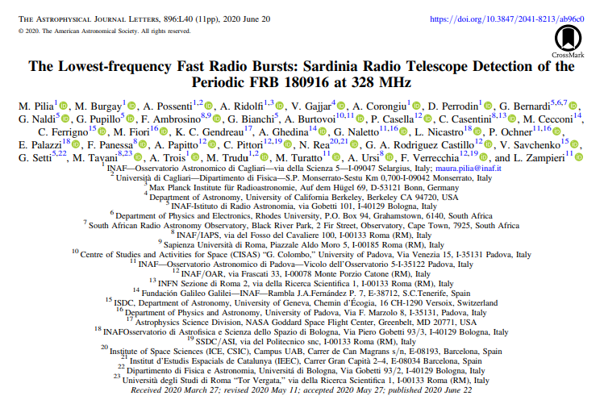
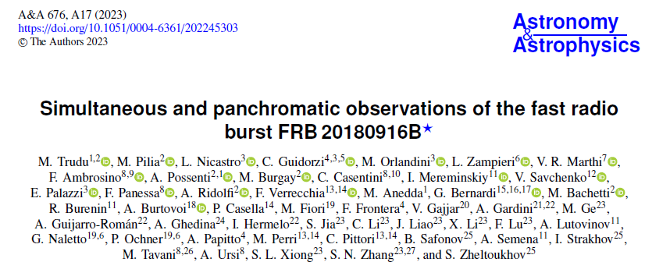
FRB20180916B (R3)
Ongoing MWL campaigns on the source from 2020
Radio: SRT, NC, uGMRT, GBT, Effelsberg, Torun
Optical: SiFAP2@TNG, Aqueye+/Iqueye@Asiago,
HiperCam@GTC, AstraLux@CAHA
X/γ-rays: NICER, Swift, HXMT, AGILE, INTEGRAL
[Pilia et al., 2020]
[Trudu et al., 2023]
[Trudu et al., 2023]

Slide 10
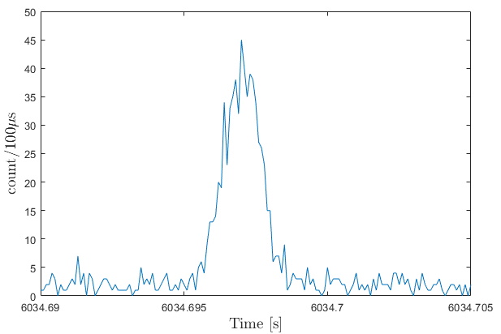
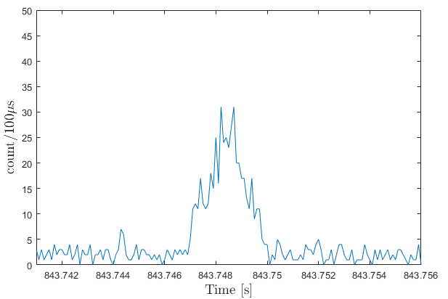
FRB20180916B (R3) – Latest results
2025-02-01
2025-02-02
5 ms
2 ms
SiFAP2@TNG
SiFAP2@TNG
SiFAP2@TNG simultaneous observations with
  Optical: Aqueye+@Copernicus
  Radio: SRT
No FRB found with SRT
  No optical simultaneous events
Other active FRB MWL campaigns on FRB20121102A, FRB20240114A, FRB20240209A, FRB20240619D, FRB20250316A

Slide 11
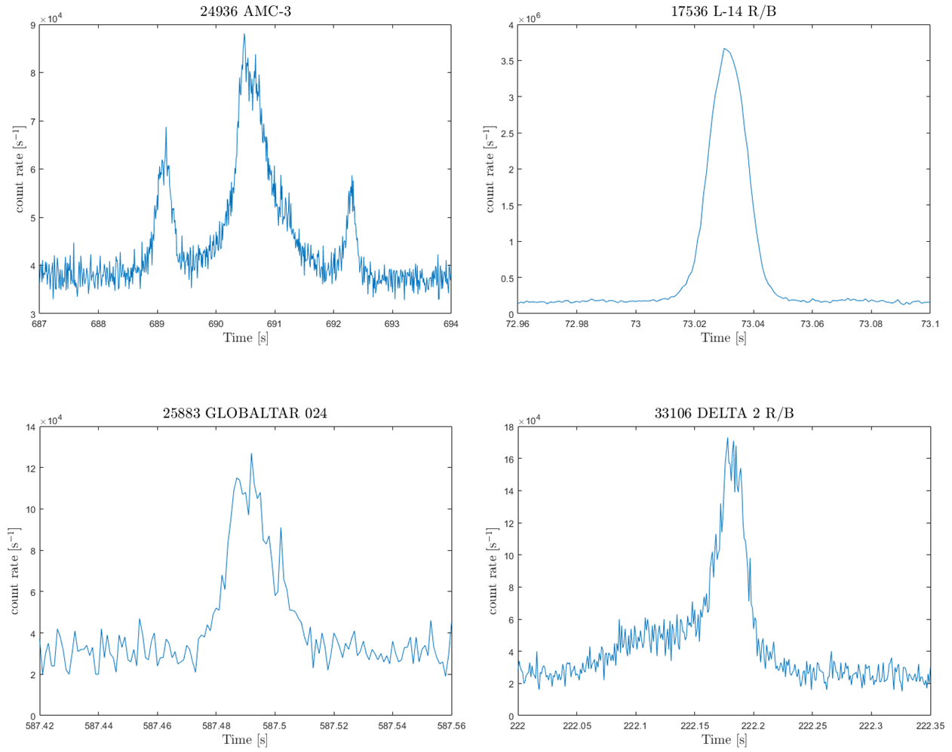
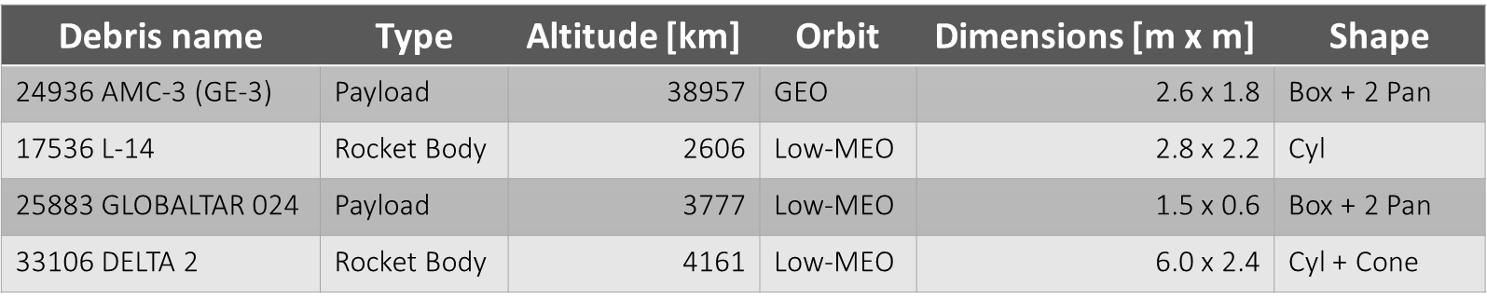
Space debris – Collaboration with PoliMi/Leonardo
1 s
20 ms
Debris ephemeris predicted by
U. Colangelo (PoliMi/Leonardo)
  4 out of 22 events detected (~20%)
  mid-high object dimensions (~m)
  mid-high orbit (Low-MEO and GEO)
  time scales from tens of ms up to seconds
  quasi-simmetric shape
20 ms
50 ms
No LEO object detected!
➔ ephemeris not enough accurate

Slide 12
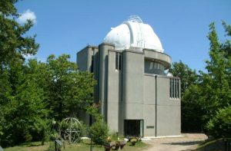
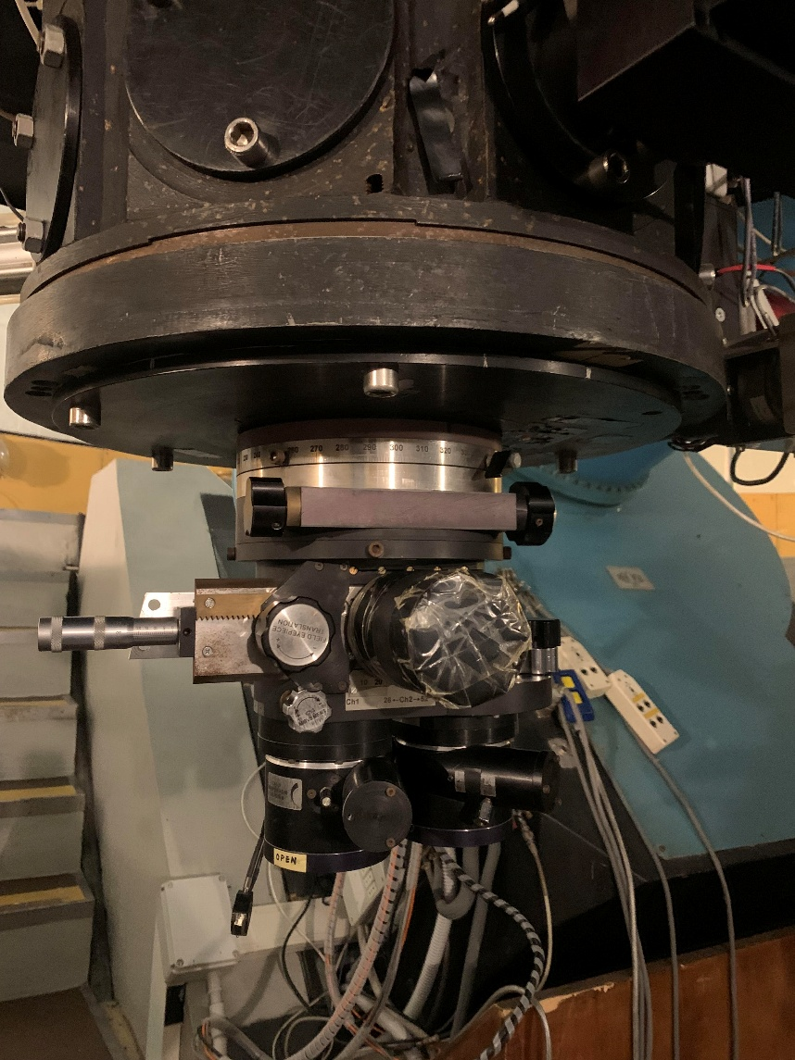
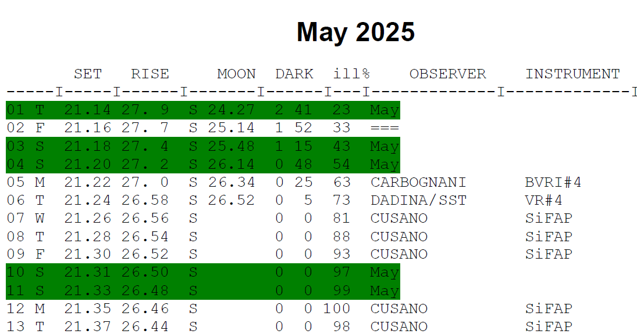
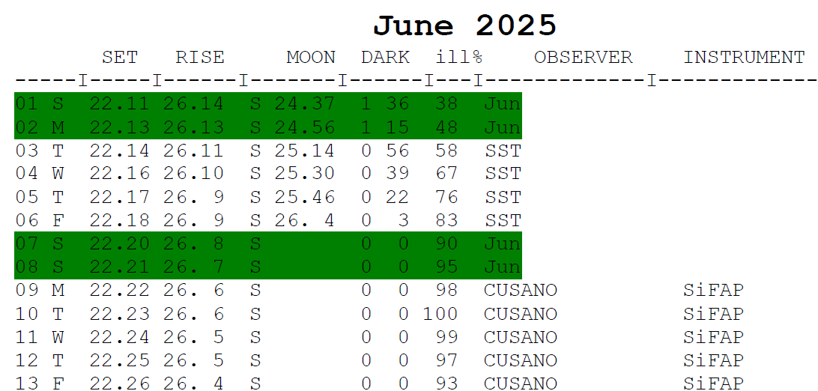
SiFAP-SoFT@Cassini: INAF Techno Grant (100 k€)
1.5 m Cassini
Simultaneous observations with SiFAP2@TNG and NC
  50 – 100 hr reserved per semester
  FRBs
  Space Debris
First tests are currently ongoing
  old detectors
  old electronics

Slide 13
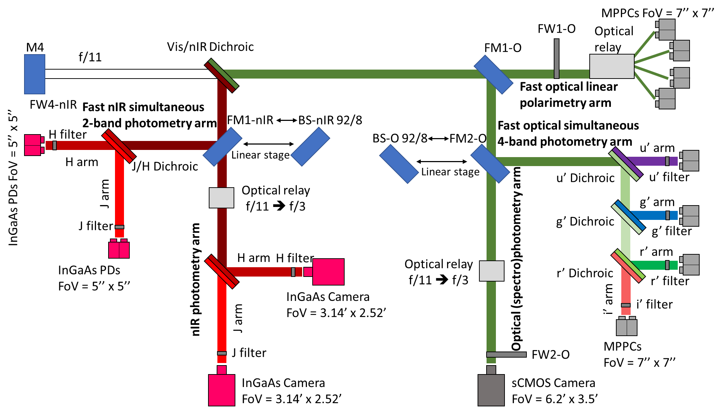
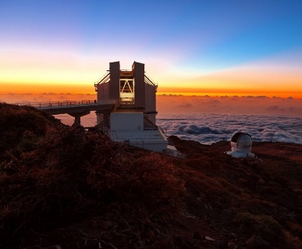
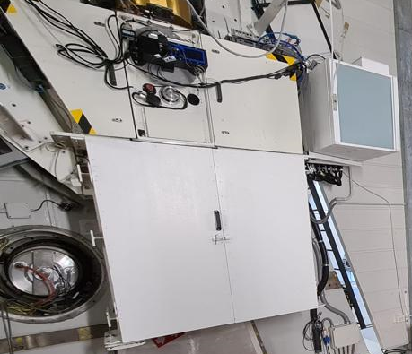
eSiFAP@TNG: PNRR/CTA+ project (~600 k€)
3.6m TNG
AdOpt box
Optical/nIR simultaneous fast photometry and polarimetry

Slide 14

Conclusions and future perspectives
SiFAP2@TNG
  More than 450 impulsive events (FOBs) detected so far from different class of sources
  ~1.5 FOBs/hr on average
  Very interesting excess from the magnetar SGR 1935+2154
  Ongoing campaigns on (repeating) FRBs (expecially FRB 20180916B)
➔ Optical upper limit at 1.02 mJy ms
  Collaboration with PoliMi/Leonardo for space debris monitoring
      ➔4 events detected out of 22
      ➔ mid-high orbit (low-MEO and GEO) and dimensions (~m)
Technological improvements
  INAF Techno Grant (100 k€) to build up a new instrument (SiFAP-SoFT) to be mounted at 1.5 m Cassini Telecope (Loiano)
    50 – 100 hr reserved for simultaneous optical observations on FRBs and space debris
    possibly move the instrument to South facilities
  PNRR/CTA+ project fundings (~600 k€) to build up a new instrument (eSiFAP) to be mounted at 3.6 m TNG (ORM)
    simultaneous fast photometry in the optical/nIR bands
    simultaneous optical observations on CTA targets (blazars, pulsars, magnetars), FRBs, space debris

Slide 15


