Slide 1
FRB-Italy Strategies for Effective Science Communication
Maura Sandri

Slide 3
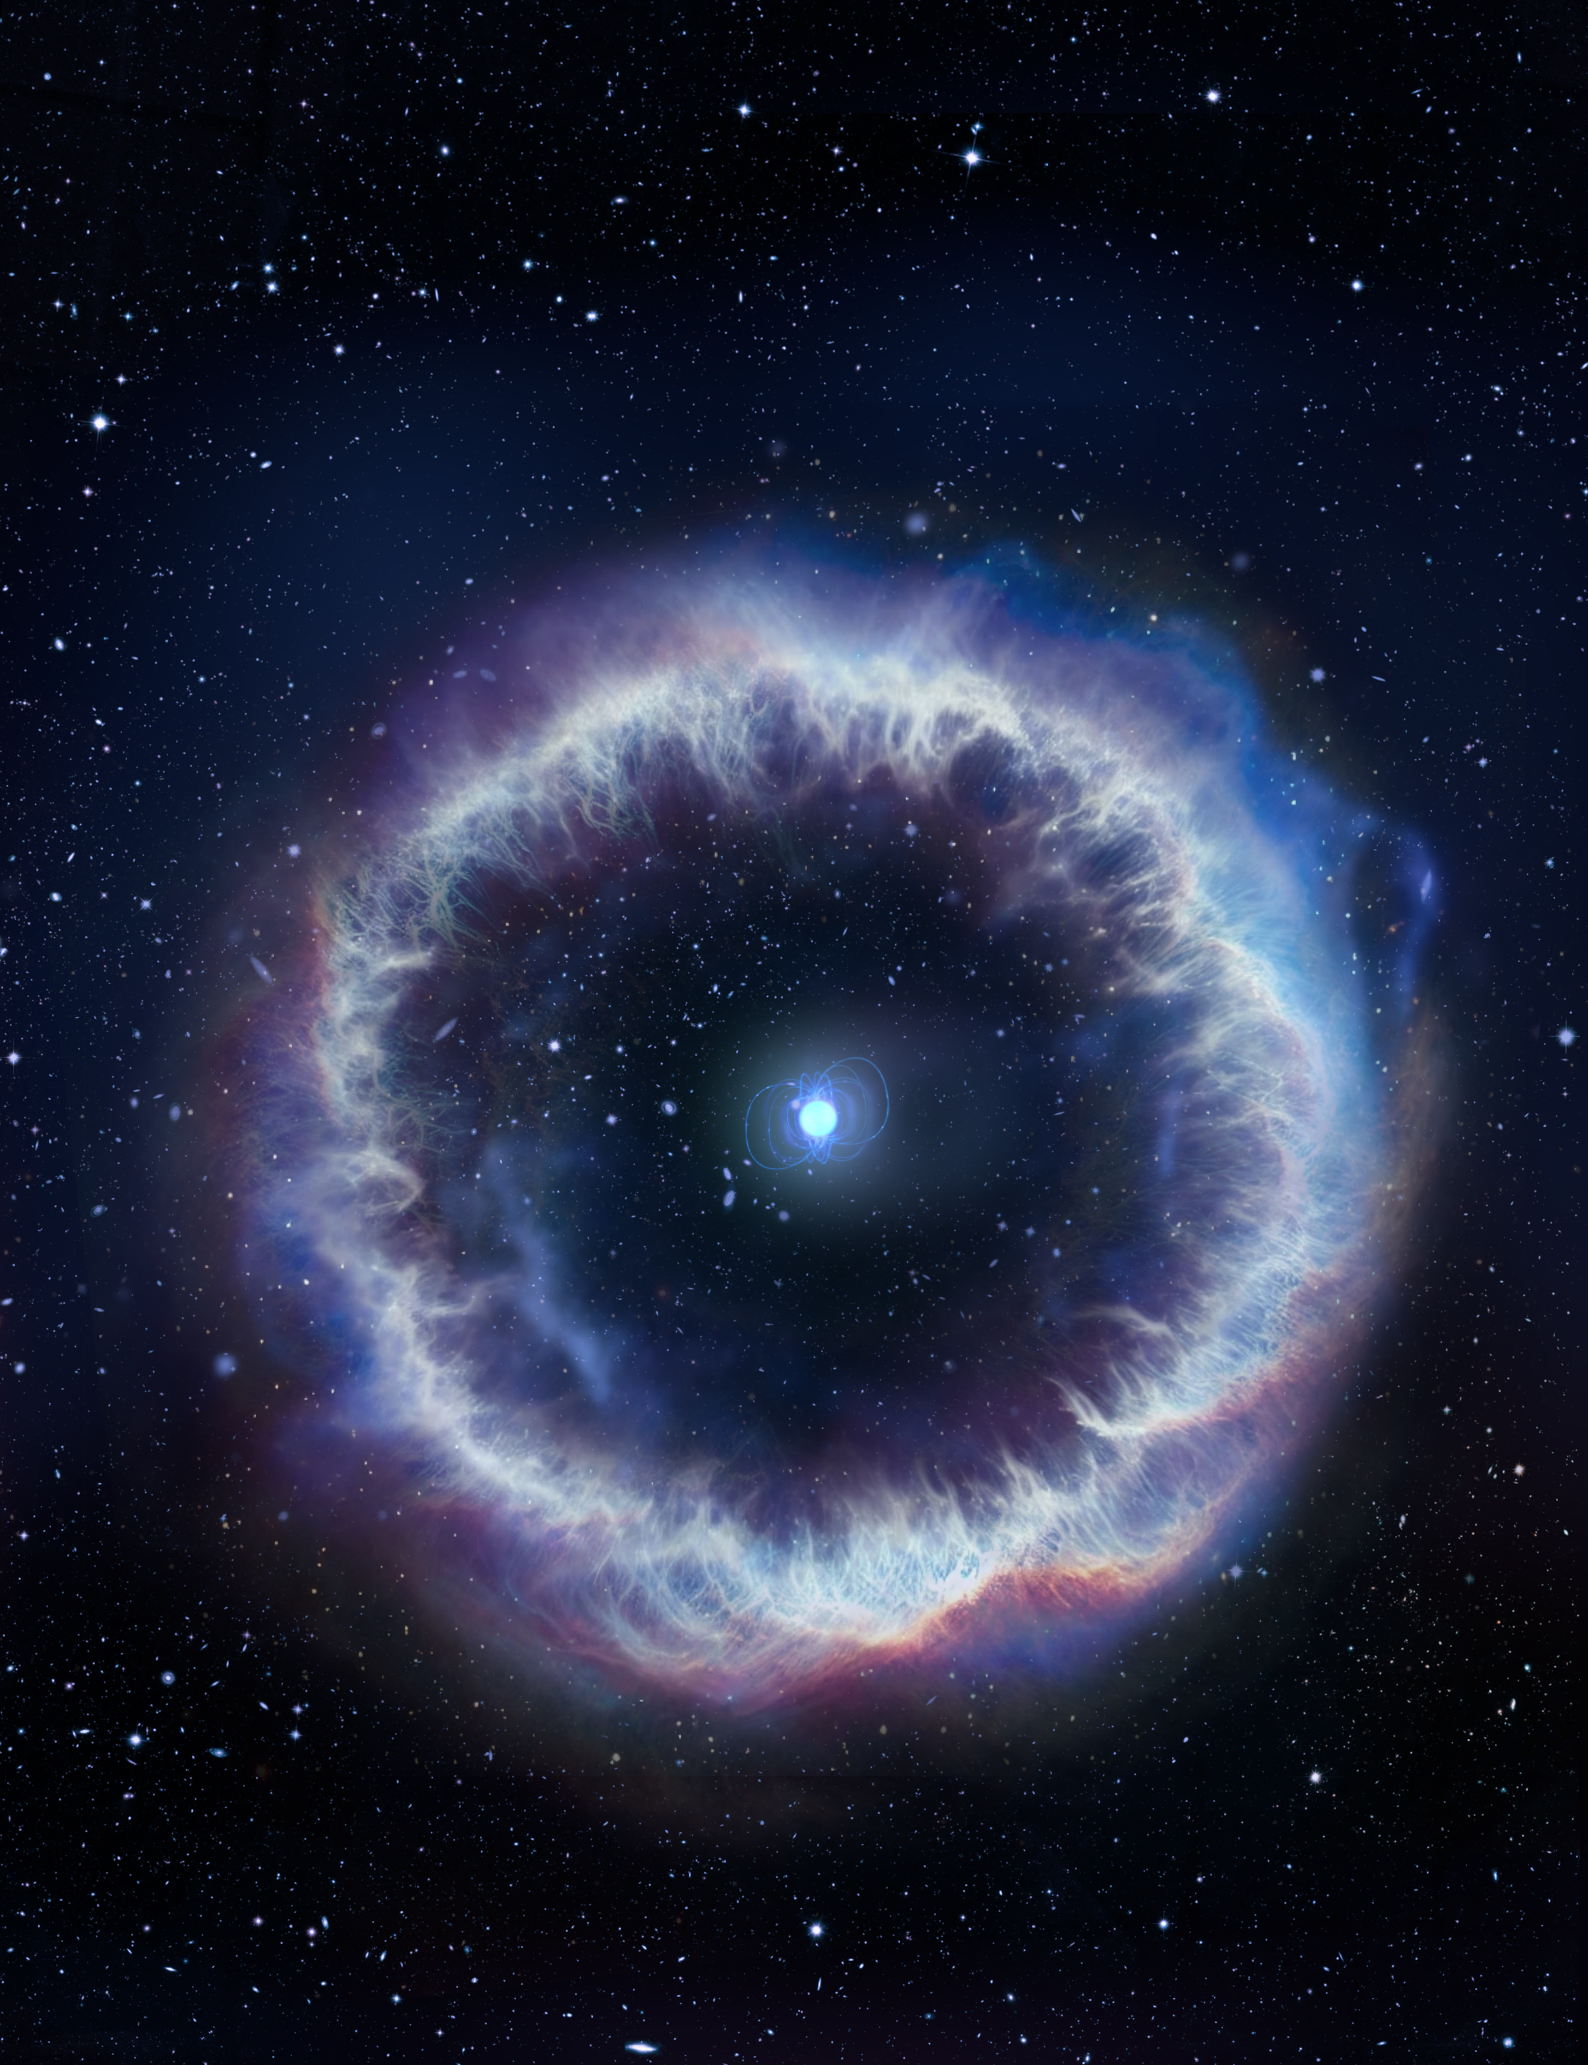
Index
Introduction
Why Science Communication matters
Goals of the communication strategy
Strategy 1: Website
Strategy 2: Press Releases
Strategy 3: Social Media
Tone and Style
Measuring Impact
What’s Next?
Conclusion

Slide 4
Introduction
Fast Radio Bursts (FRBs) are among the most fascinating astrophysical phenomena discovered in recent decades
The Italian scientific community around FRBs is growing
Communication plays a strategic role in fostering development and collaboration

Slide 5
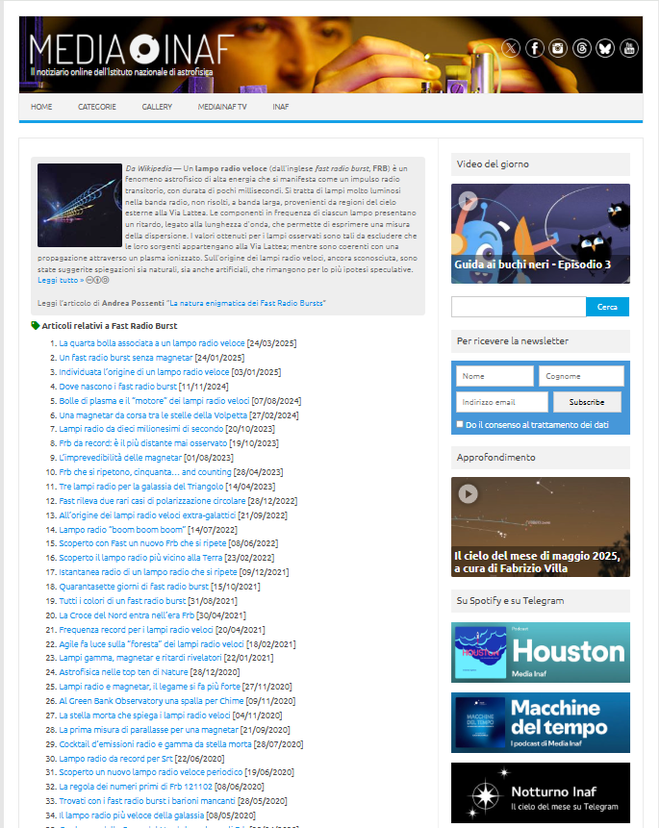
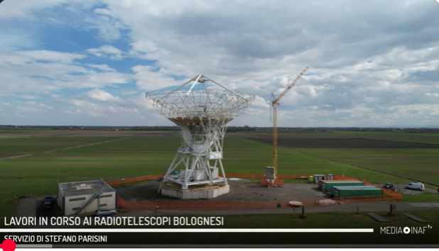
Why Science Communication matters
Makes complex science relatable
Engages experts and the public
Supports funding and collaboration
About 70 news on FRBs in ten years!
and videos…

Slide 6
Goals of the Communication Strategy
Increase the visibility of the Italian community
Build a recognizable community identity
Attract media and young researchers

Slide 7
Strategy 1: Website
A website where anyone can find articles, studies, and resources
Public + scientific content
Long-term archive and outreach resources
A great deal of material already exists — and continues to be produced — in English, which we could translate or adapt into Italian with the help of the FRB community

Slide 8
Strategy 2: Press Releases (and News)
Tailored to reach both general and specialized scientific media, ensuring broad and relevant coverage
Collaborate closely with both local and central press offices to ensure consistent messaging and timely distribution
https://tinyurl.com/formulario-inaf
Strategically timed to coincide with key milestones, such as major publications, events, and scientific discoveries

Slide 9
Strategy 3: Social Media
X (formerly Twitter) to engage directly with journalists, sharing updates, news, and resources in real-time
Instagram/Facebook for the general public
Telegram channel (with a dedicated bot)
Infographics, videos, and impactful quotes to enhance engagement

Slide 10
Tone and Style
Clear, accurate, engaging
Use analogies and storytelling
Avoid hype, highlight relevance
Avoid self-referentiality
These points help build clear, effective, and audience-centered communication, capable of explaining complex concepts without being heavy or distant.

Slide 11
Measuring Impact
Website and social metrics
Press mentions
Community and public feedback

Slide 12
What’s Next?
Build the website
Create social media profiles
Train researchers in communication
Develop educational content (Rachele Toniolo et al.)

Slide 13
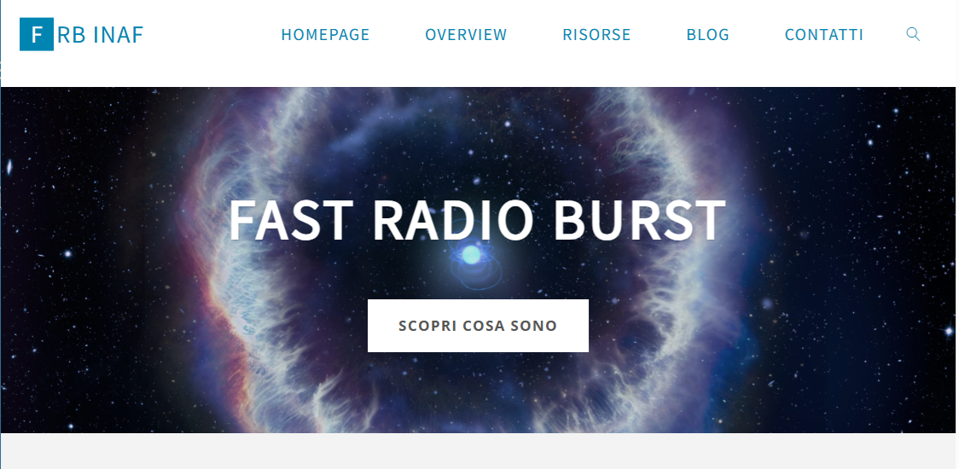
https://frb.inaf.it/

Slide 14
THANKS!
Maura Sandri (maura.sandri@inaf.it)

