Slide 1


The FRB host galaxies catalogue
A community powered repository
Luciano Nicastro, INAF – OAS Bologna

Slide 2


The project: who
Keywords: Community powered archive – Accessibility – Science for all
A joint effort
FRB-Italy people
M. Cinus - OAC
L. Nicastro - OAS
E. Palazzi - OAS
D. Pelliciari - IRA
S. Savaglio - UniCal
Fast and Fortunate for FRB Follow-up (F⁴)
GitHub FRB project
(https://github.com/FRBs/FRB)
T. Eftekhari - NW Uni., IL
M. Glowacki - Curtin Uni., AUS
J. X. Prochaska - UC Santa Cruz, CA
FRB-Italy 2025. LN @ INAF – OAS Bologna

Slide 3
The project: motivation
Keywords: Community powered archive – Accessibility – Science for all
Reliability & Durability
Repository & DB tables supervised and managed ⟹ periodic version release
Peer-review ⟹ content provided and validated by the community
Access and select data subset in any language (not just Python) + Web
Data input
Publication table
Manual data conversion
GitHub
Web access
Project repository
Registered contributor
Anonymous submitter
TOCats
Web browsing (TOCatsweb)
Script access
User’s submission
Various formats allowed:
JSON, ECSV, FITS
FRB-Italy 2025. LN @ INAF – OAS Bologna

Slide 4
The project: implementation
Keywords: Community powered archive – Accessibility – Science for all
Implementation
The initial phase foresees the collection of the existing data
Three set of host galaxy parameters: measured, derived and FRB related
Management of user-feed new data via public GitHub
User browsing and retrieval via relational DB + Web tool ⟹ HTTPS protocol
User friendly ⟹ usable also by non professional astronomers
Available through the existing frb-hosts.org website
It will complement existing general-purpose FRB archives, such as TNS and Blinkverse
FRB-Italy 2025. LN @ INAF – OAS Bologna

Slide 5
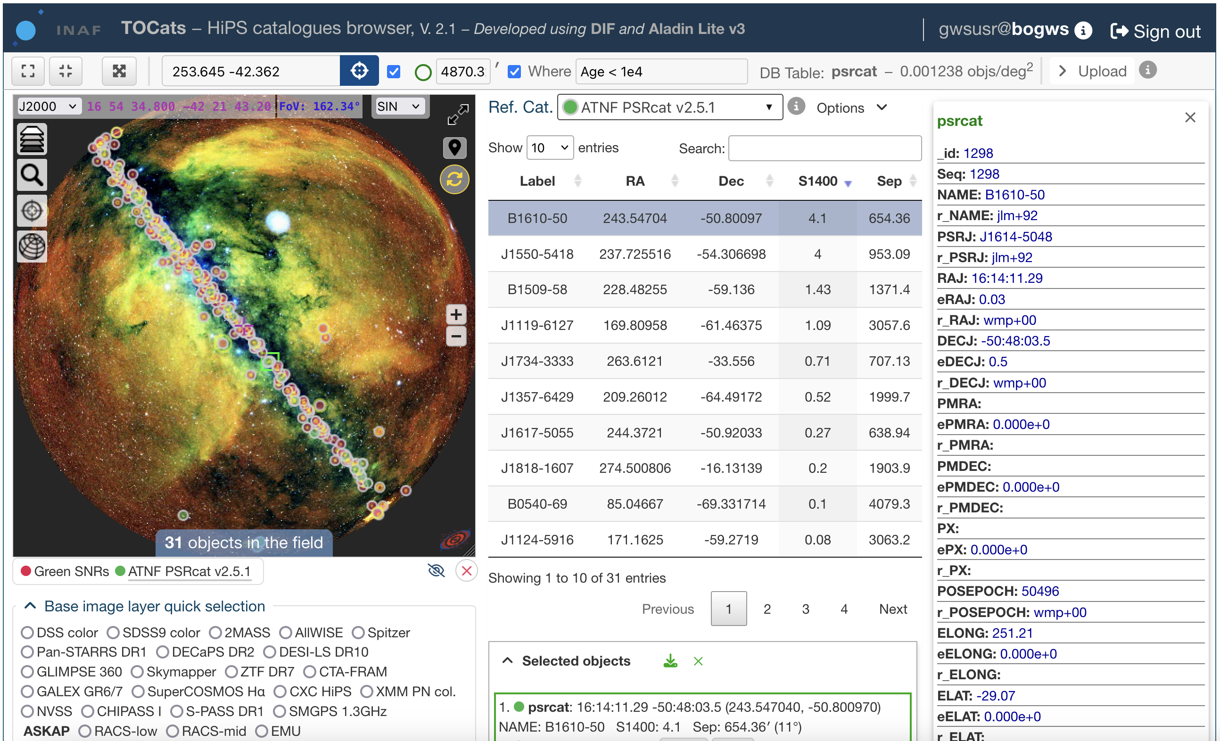
TOCats & TOCatsweb
A tool for fast access to astronomical surveys and object catalogues by using hierarchical scheme techniques to split the celestial sphere, in particular the HEALPix scheme.
catsweb.oas.inaf.it
TOCats three main components
A relational DBMS, with hierarchically structured tables containing various types of catalogues and associated metadata
A web service that makes images and catalogues easily queryable and accessible from a browser or a script
A repository of Hierarchical Progressive Surveys (HiPS) with images and object density maps
FRB-Italy 2025. LN @ INAF – OAS Bologna

Slide 6
TOCats & TOCatsweb – main components
Built on
MySQL: dev.mysql.com
DIF: github.com/lnicastro/DIF
Aladin Lite: aladin.cds.unistra.fr/AladinLite/doc
Hipsgen: aladin.cds.unistra.fr/hips
DataTables: datatables.net
amCharts: www.amcharts.com
… and
Web server ⇒ Apache
Languages ⇒ C++, PHP, HTML5, CSS3, JavaScript, Python
+ JS packages ⇒ JQuery, JS9, custom code
∼ 110 public catalogues (Opt/IR/NIR/Radio/UV/X-𝛾)
∼ 100 private catalogues
∼ 20 TB (raid 1)
10 projects
FRB-Italy 2025. LN @ INAF – OAS Bologna

Slide 7
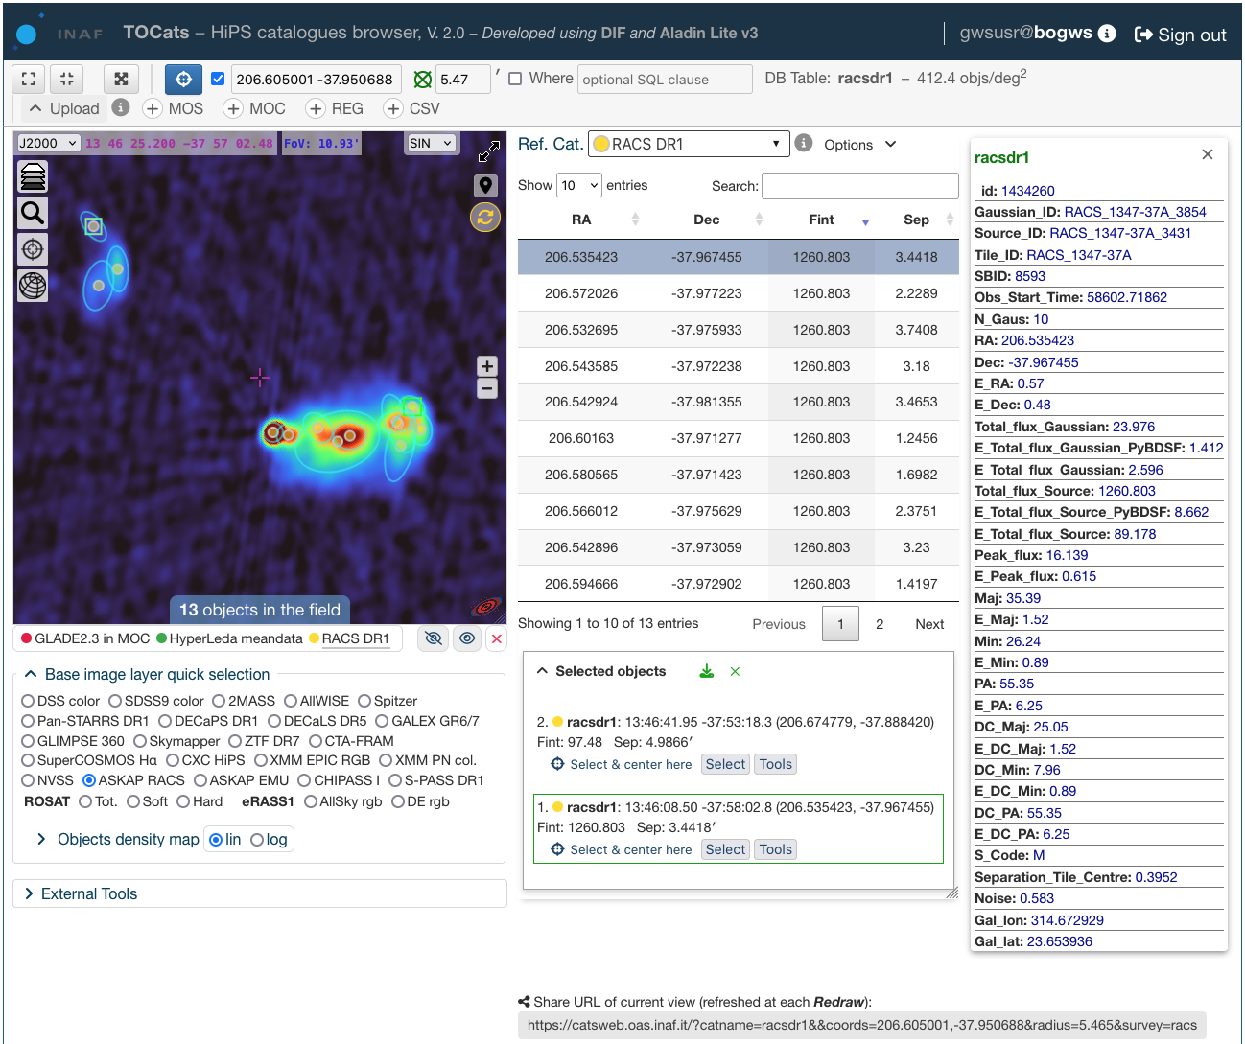
TOCats & TOCatsweb – capabilities
Combine DIF managed catalogues with HiPS public and private surveys and
Handle extended sources / footprint
Retrieve the catalogue’s data in multiple formats from the interface or a script (API)
Accessible from VO tools (e.g. TOPCAT)
One click external tools access
Add your project and implement your plug-in tools to handle any type of data
Take advantage of all the Aladin Lite v.3 capabilities:
  Multi-surveys view (jpg, png, fits)
  FITS files (etc.) drop-in
  HIPS2FITS tool
  Etc.
Note:
Aladin Lite is being upgraded continuously
Click & share
FRB-Italy 2025. LN @ INAF – OAS Bologna

Slide 8
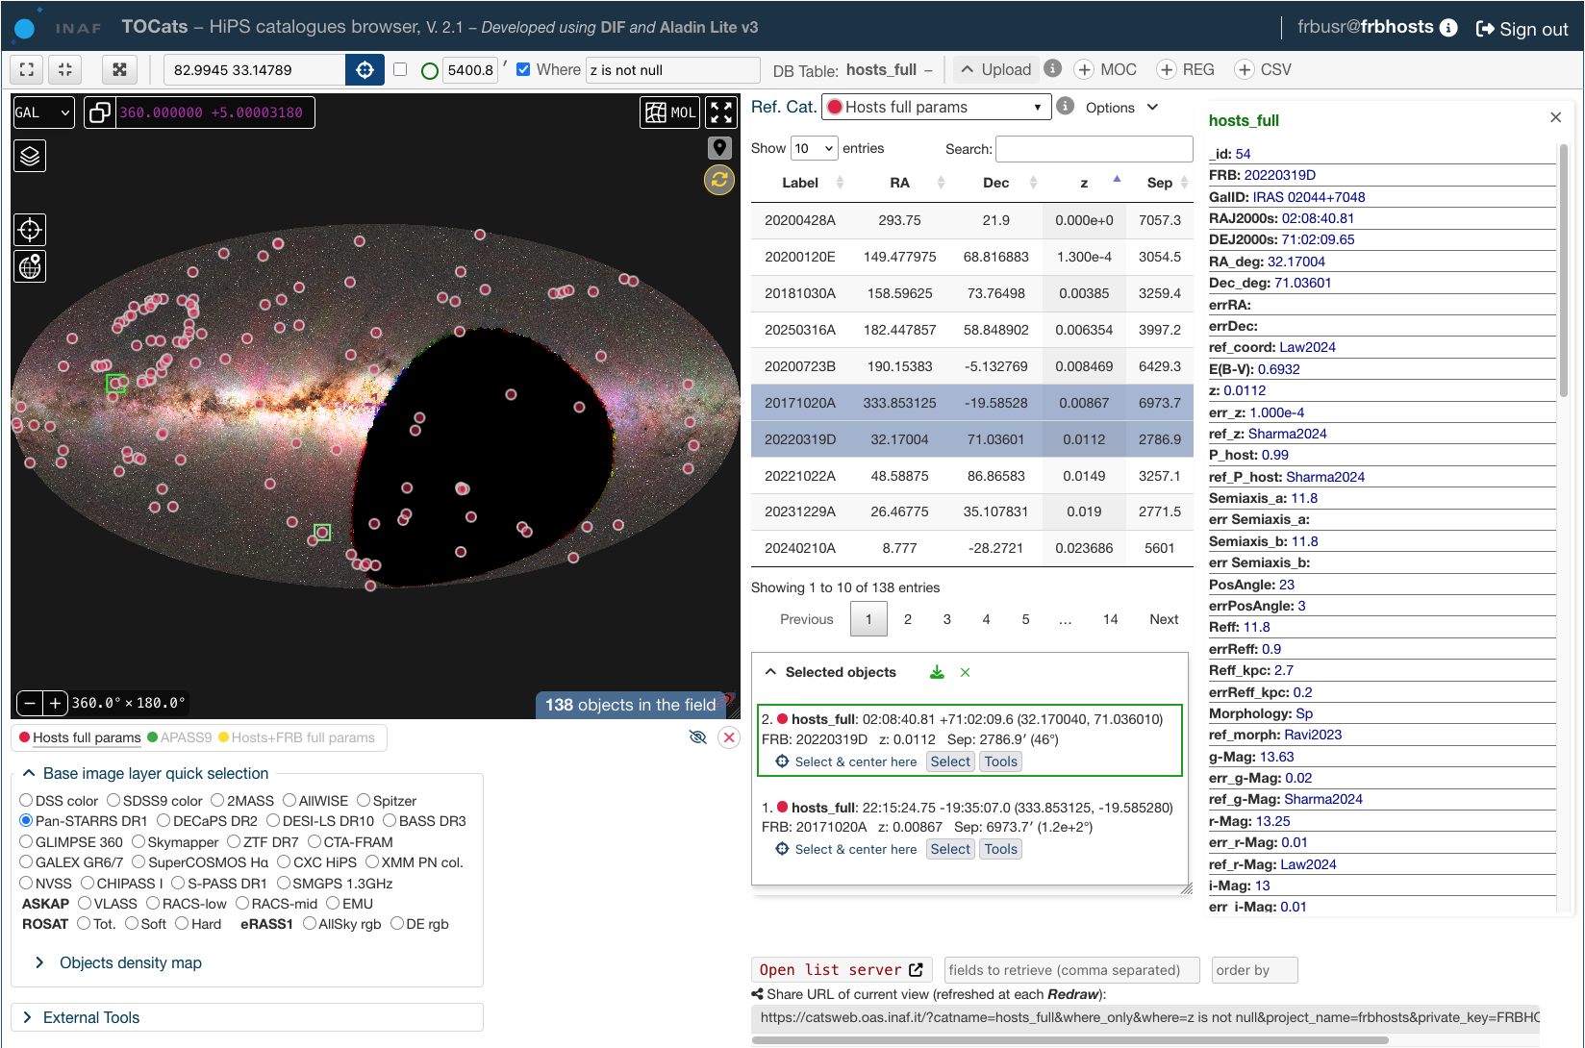
TOCats & TOCatsweb – FRB Host galaxies catalogue
Not yet released
Accessible only to registered users
6 DB tables
4 primary + 2 derived
137 objs, 122 colums
Note: Data uncertainties and origin (refs.) are mandatory for all the measured and (most of) the derived parameters
8 unknown z
Z_{max} = 1.35
FRB-Italy 2025. LN @ INAF – OAS Bologna

Slide 9
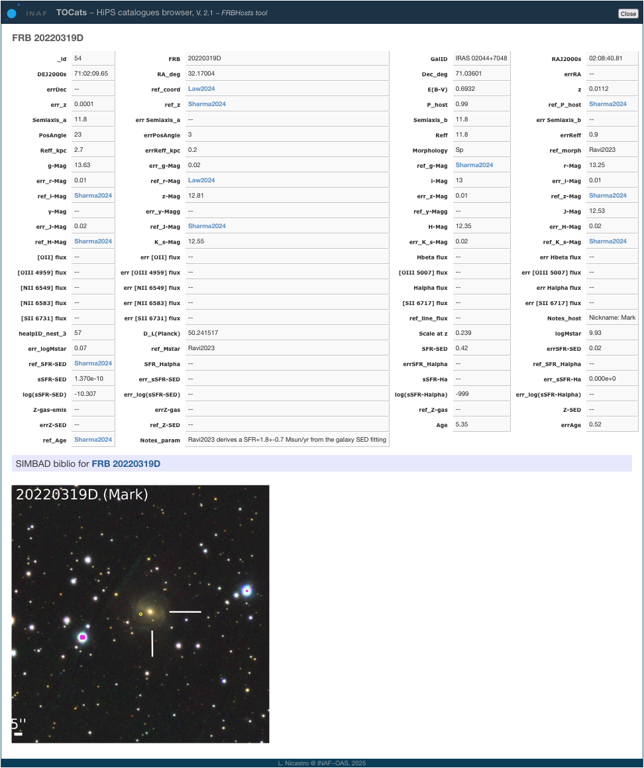
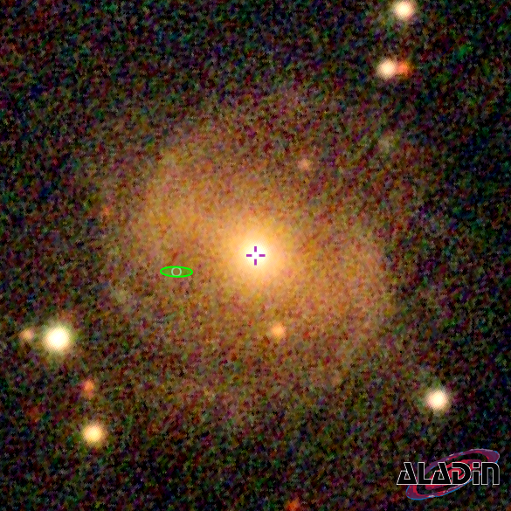
FRB Hosts catalogue – details
Host+FRB detailed view
(work in progress)
SIMBAD link
20220319D
FRB-Italy 2025. LN @ INAF – OAS Bologna

Slide 10
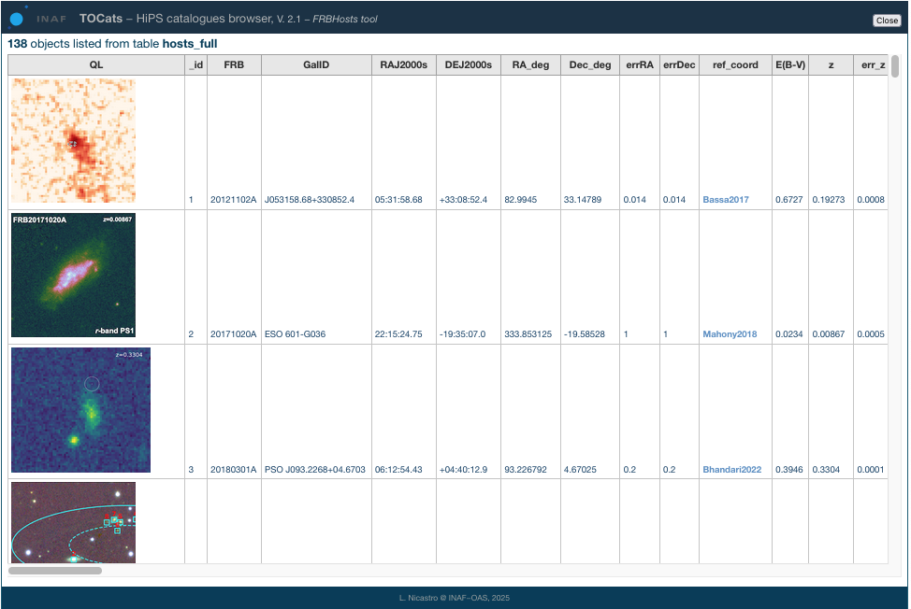
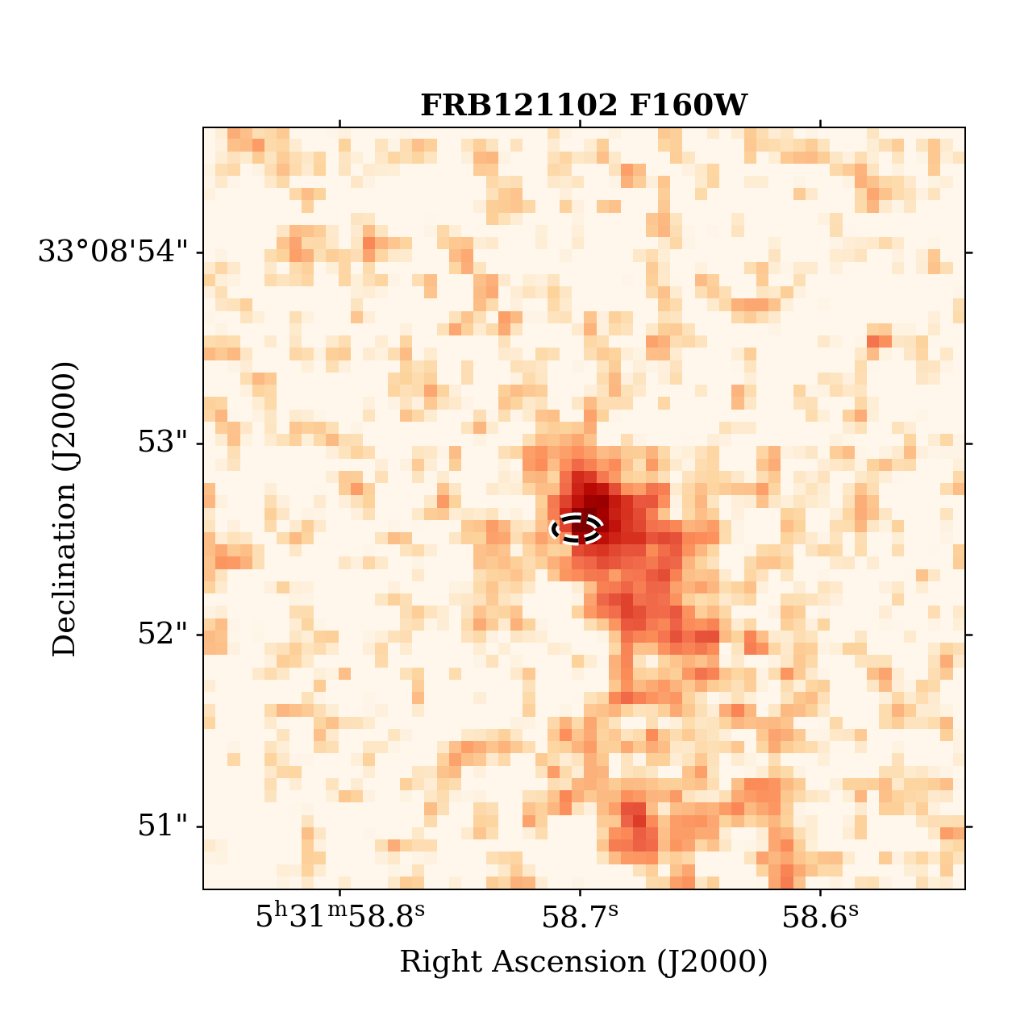
FRB Hosts catalogue – list server
Full or partial (row/column) listing
Click & zoom
ADS link
FRB-Italy 2025. LN @ INAF – OAS Bologna

Slide 11
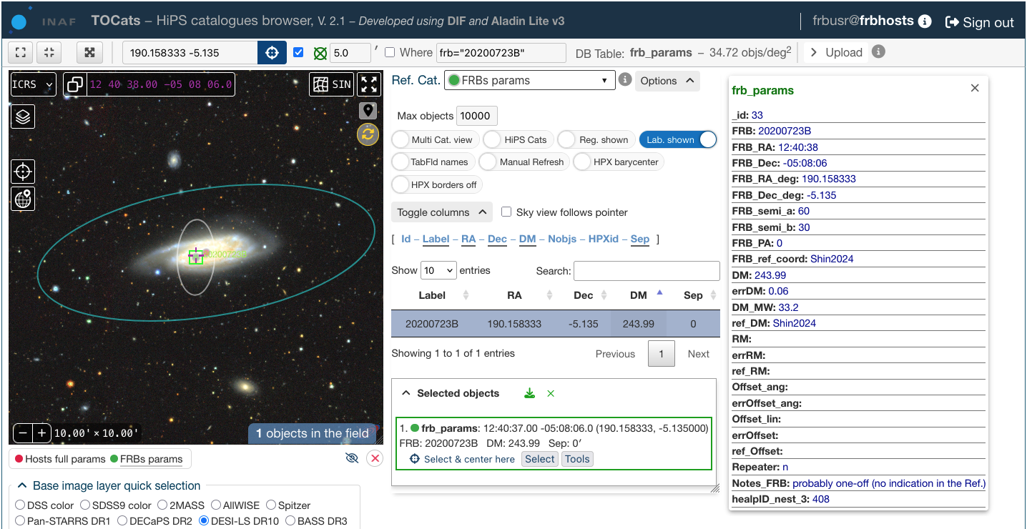
FRB Hosts catalogue – FRB 20200723B
NGC 4602
FRB-Italy 2025. LN @ INAF – OAS Bologna

Slide 12
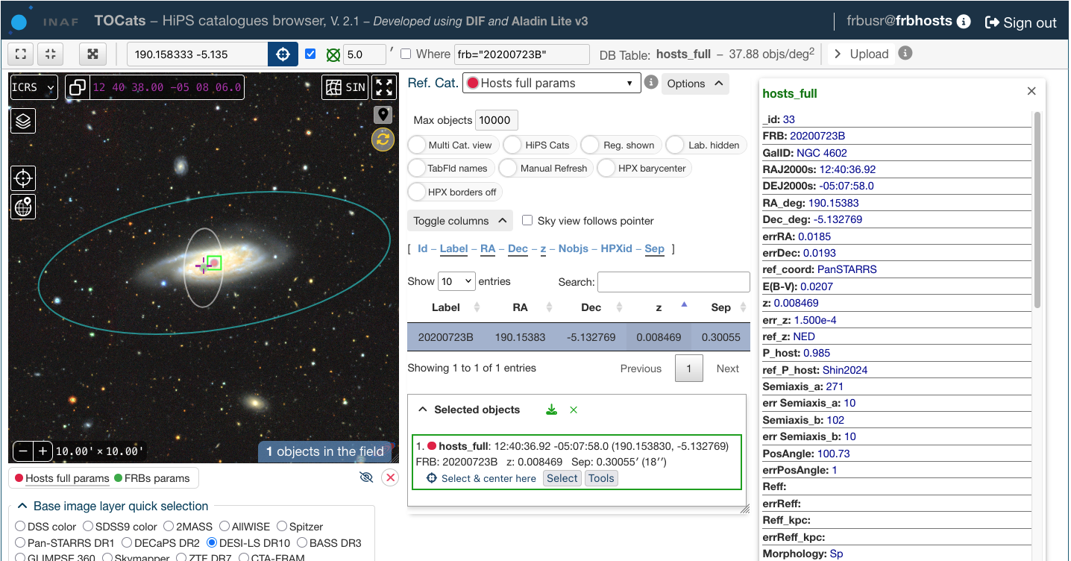
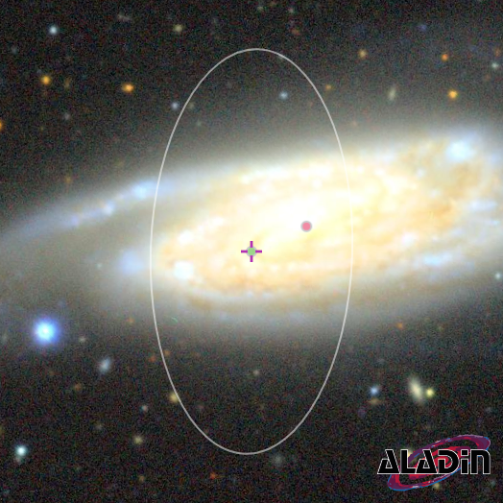
FRB Hosts catalogue – FRB 20200723B
FRB-Italy 2025. LN @ INAF – OAS Bologna

Slide 13
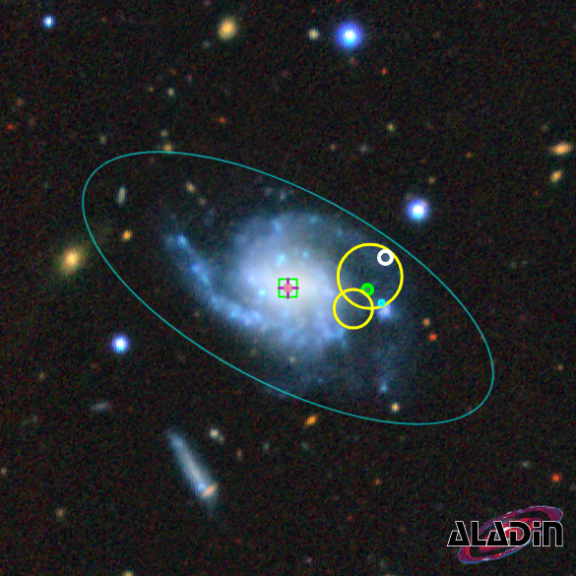
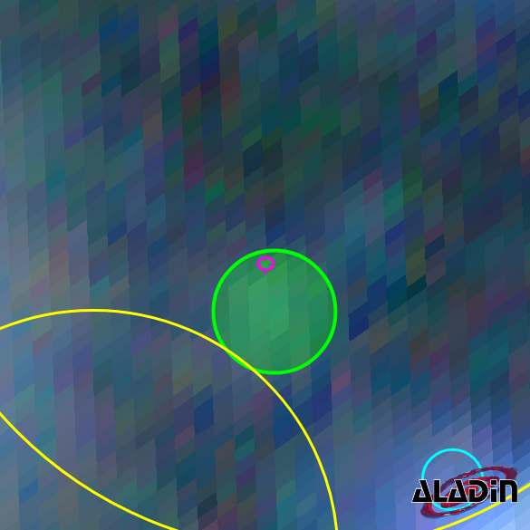
FRB Hosts catalogue – FRB 20250316A
3 × 3 arcmin
13 × 13 arcsec
NGC 4141
20250316A
EP-FXT
Chandra src
Swift-XRT
FRB-Italy 2025. LN @ INAF – OAS Bologna

Slide 14
FRB Hosts catalogue – script query
Retrieve table data as VOTable, HTML, csv, tsv, JSON
curl query (csv output):
curl –o myhosts.csv "https://cats.oas.inaf.it/hosts_full/radius=30&ra=26.5&dec=35.5&project_name=frbhosts&private_key=secret&csv"
Python query (HTML output, sorted by z):
import requests
url =
"https://cats.oas.inaf.it/hosts_full/radius=30&ra=26.5&dec=35.5&project_name=frbhosts&private_key=secret&orderby=z&html"
response = requests.get(url)
print(response.text)
Note: Direct, SQL DB queries possible on demand
FRB-Italy 2025. LN @ INAF – OAS Bologna

Slide 15
Discussion on going
Non-exhaustive list …
Which “observed” parameter should be mandatory?
Which “derived” parameters should be reported / computed?
Which FRB parameters should we list?
Multiple figures for the same parameter (e.g. SFR / distance / reference / etc.)?
Should we convert multi-photometric mags to a common filter set?
Which parameter uncertainties should be non-symmetric (upper-lower)?
Should we have all the archival data into the DB or just a subset?
How do we handle versioning and updates of the archive and DB tables?
Should we accept data submission when no paper reference exists yet?
More technical: how do we store and define the parameters metadata?
FRB-Italy 2025. LN @ INAF – OAS Bologna

Slide 16
catsweb.oas.inaf.it
FRB-Italy 2025. LN @ INAF – OAS Bologna

