Slide 1
Regression models for Astronomical data:
A brief layout
Giuseppe Angora, Stefano Cavuoti
Giuseppe Angora:
giuseppe.angora@inaf.it
Stefano Cavuoti:
stefano.cavuoti@inaf.it
AI in Astronomy Workshop, Hands-on, 23/05/2025, INAF-OACT, Catania

Slide 2
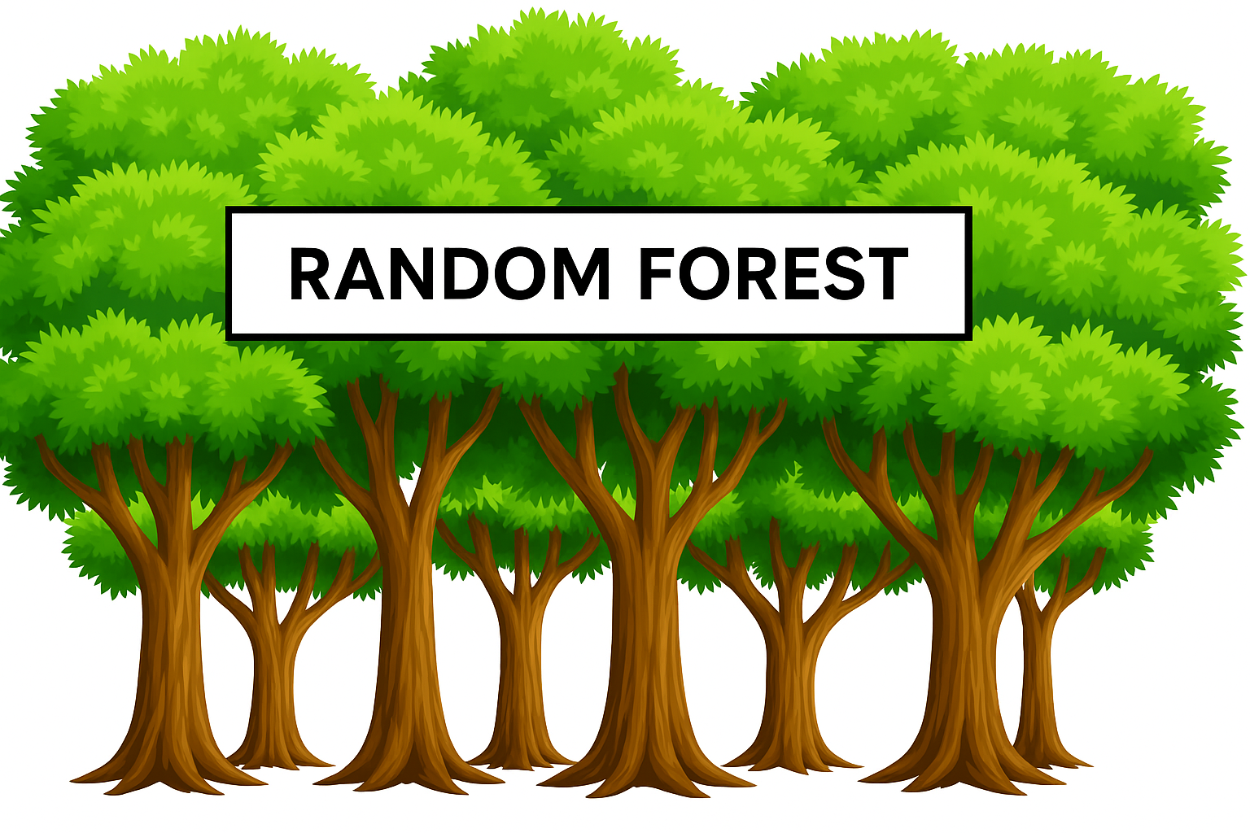
Layout
Astrophysics introduction:
photometric-redshift estimation
comparison with traditional sed fitting algorithms
Decision Trees (DTs):
Algorithm elements
Simple method explanation
Crucial metrics
Random Forests (RFs):
DT “generalization”
Comparison between RF and DT
Overfitting
Feature Importance from RF
Application: photometric redshift estimation with SDSS data

Slide 3
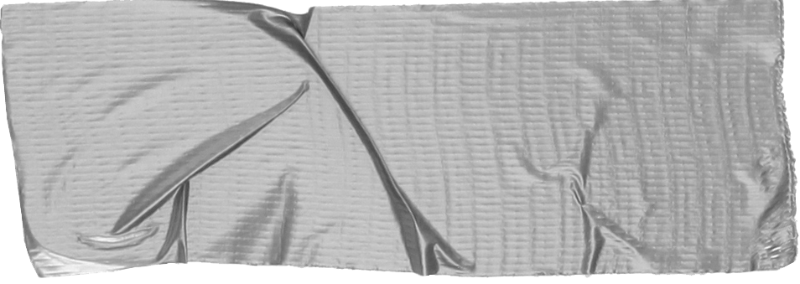
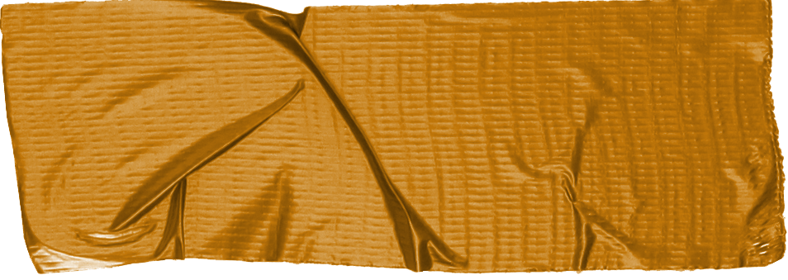
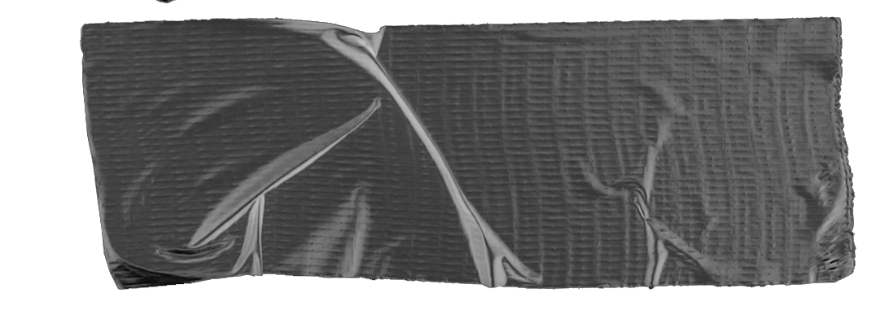
Photo-z are crucial to:
Studies of large scale structure
Weak lensing (hence dark matter and dark energy distribution)
Tests of cosmological models
Galaxy evolution and mass assembly
Classification of galaxies
etc....
How can we derive photo-z?
Surveys in which are crucials:
DES
PANSTARRS
KiDS
VST - VOICE
EUCLID
LSST
LOFAR
EMU
almost all

Slide 4
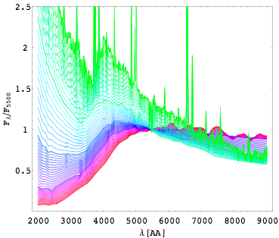
Spectral Energy Distribution (SED) template fitting methods
Interpolative (empirical) methods
Library of M template spectra (M<100)
Convolve with filter bandpasses for
a specific survey
Stretch templates for redshift (z) assuming constant step Δz in an interval range z_{min} , z_{max}
Let f be the complex (unknown) function which maps the input photometric parameter space onto the redshift space:
Are the input parameters, (hereafter features)
Empirical methods use a subset of the objects (TRAINING SET) for which the spectroscopic redshifts (or in this case, target) are known, to infer the mapping function
Performances are then evaluated on a second disjoint dataset (TEST SET) for which the target is known and which has not been used during the training (BLIND TEST)
Find best fitting i,j using any optimization method
Templates: either synthetic or observed
Arbitrary choice of templates, lots of assumptions on physics, strong dependence on zero points, photometric calibrations, etc.
More accurate
No assumptions on physics, almost independent on zero points, photometric calibrations, etc.
But they go very deep, well beyond the spectroscopic limit
They are bounded by the spectroscopic limit

Slide 5
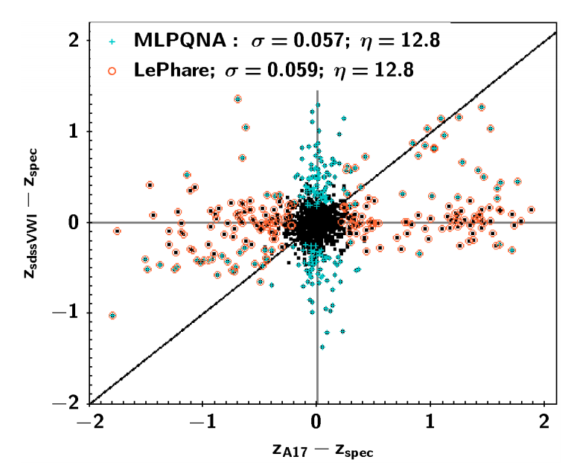
Machine Learning vs Template Fitting
Δz ML
η is the percentage of
sources with |Δz|>0.15
σ is the standard deviation
Δz SED
Brescia, M. et al. 2019 MNRAS 489, 1, 663 (QSO stripe 82 SDSS)
Notes:
Let's consider photometric redshift, I spent most of my career trying to improve the quality of photometric redshift,
in doing so I found at certain point a barrier, some objects are outliers not because the method is not working properly
but because they are rare objects, problems with the data (photometric or spectroscopic and so on)
and this will affect the results no matter what you did unless you're able to filter them out somehow,
It is ironic that sometimes what is the research core of some people could be just garbage for someone else.
Here we have a ML method and a classical template fitting method applied to the same data

Slide 6
Machine Learning vs Template Fitting
Black points are the ones for which both methods are reasonable and they are the majority
Δz ML
η is the percentage of
sources with |Δz|>0.15
σ is the standard deviation
Δz SED
Brescia, M. et al. 2019 MNRAS 489, 1, 663 (QSO stripe 82 SDSS)
Notes:
we can see that for most of the objects both methods are fine

Slide 7
Machine Learning vs Template Fitting
Highlighted Cyan points are the ones for which machine learning is failing but SED fitting is doing well:
Points for which we have the theory but not enough points in the training set
Δz ML
η is the percentage of
sources with |Δz|>0.15
σ is the standard deviation
Δz SED
Brescia, M. et al. 2019 MNRAS 489, 1, 663 (QSO stripe 82 SDSS)
Notes:
there are points for which template fitting is doing well and ML is failing, so there is probably a lack
in our training set, since the let's say theory is capable to obtain the correct result

Slide 8
Machine Learning vs Template Fitting
Highlighted orange points are the ones for which SED is failing and ML is doing well:
Our theory is not strong enough but data are capable to solve the problem
Δz ML
η is the percentage of
sources with |Δz|>0.15
σ is the standard deviation
Δz SED
Brescia, M. et al. 2019 MNRAS 489, 1, 663 (QSO stripe 82 SDSS)
Notes:
there are of course points for which there is the opposite, so the theory is not capable to get the proper answer while the ML is able to get that

Slide 9
Machine Learning vs Template Fitting
Highlighted points are the ones for which both methods are failing but they are agreeing…
Theory and data say the same thing which is different from ground truth
Maybe spectroscopic redshift are wrong in this case?
Δz ML
η is the percentage of
sources with |Δz|>0.15
σ is the standard deviation
Δz SED
Brescia, M. et al. 2019 MNRAS 489, 1, 663 (QSO stripe 82 SDSS)
Notes:
finally there are points for which both are saying the same thing, often this is related to an error in the spectra itself

Slide 10
Machine Learning vs Template Fitting
Highlighted points are outliers for both methods both theory and information within the data are not enough
those are scary points!
Δz ML
η is the percentage of
sources with |Δz|>0.15
σ is the standard deviation
Δz SED
Brescia, M. et al. 2019 MNRAS 489, 1, 663 (QSO stripe 82 SDSS)
Notes:
those are scary points for which our theory and ML are not able to get a proper answer

Slide 11
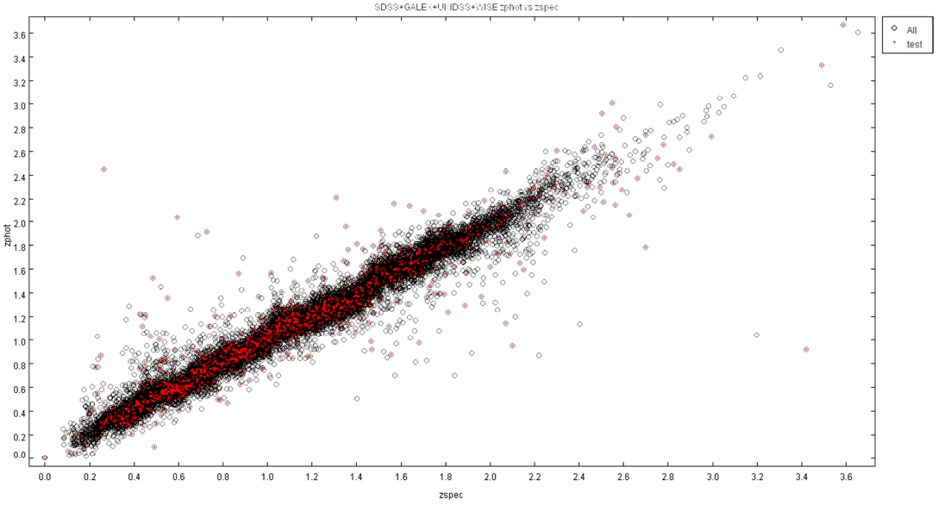
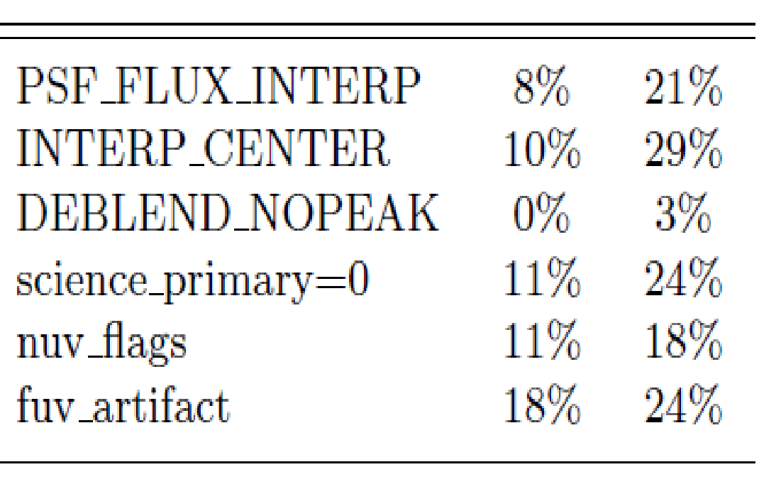
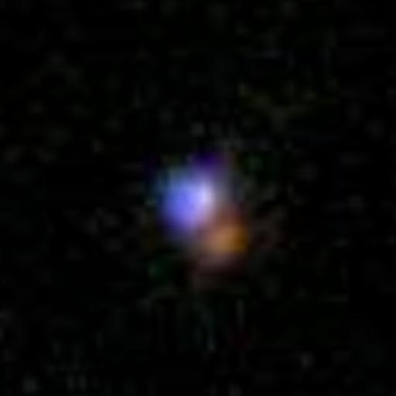
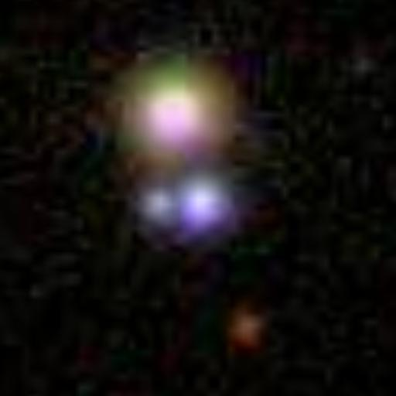
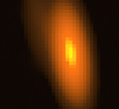
What are Catastrophic Outliers?
GALEX+SDSS+UKIDSS+WISE
Blue dots: blazars
Green dots: rare configuration
Red triangles: gravitationally lensed QSOs
Catastrophic Outliers could be an indirect serendipity tool, e.g. tracers of peculiar object types.
Inspection of SDSS quality flags for outliers shows that these flag are practically useless to discriminate them
Brescia et al. 2013 ApJ 772, 2 (QSO SDSS + GALEX + UKIDSS + WISE)
Notes:
if we look at outliers one by one often we found that they are rare objects such as blazar lens or something that could have some problem in their photometry given some rare configuration
But this is something that we can look when we have spectra, on a new point there is nothing that we can do in that way, so what can we do

Slide 12
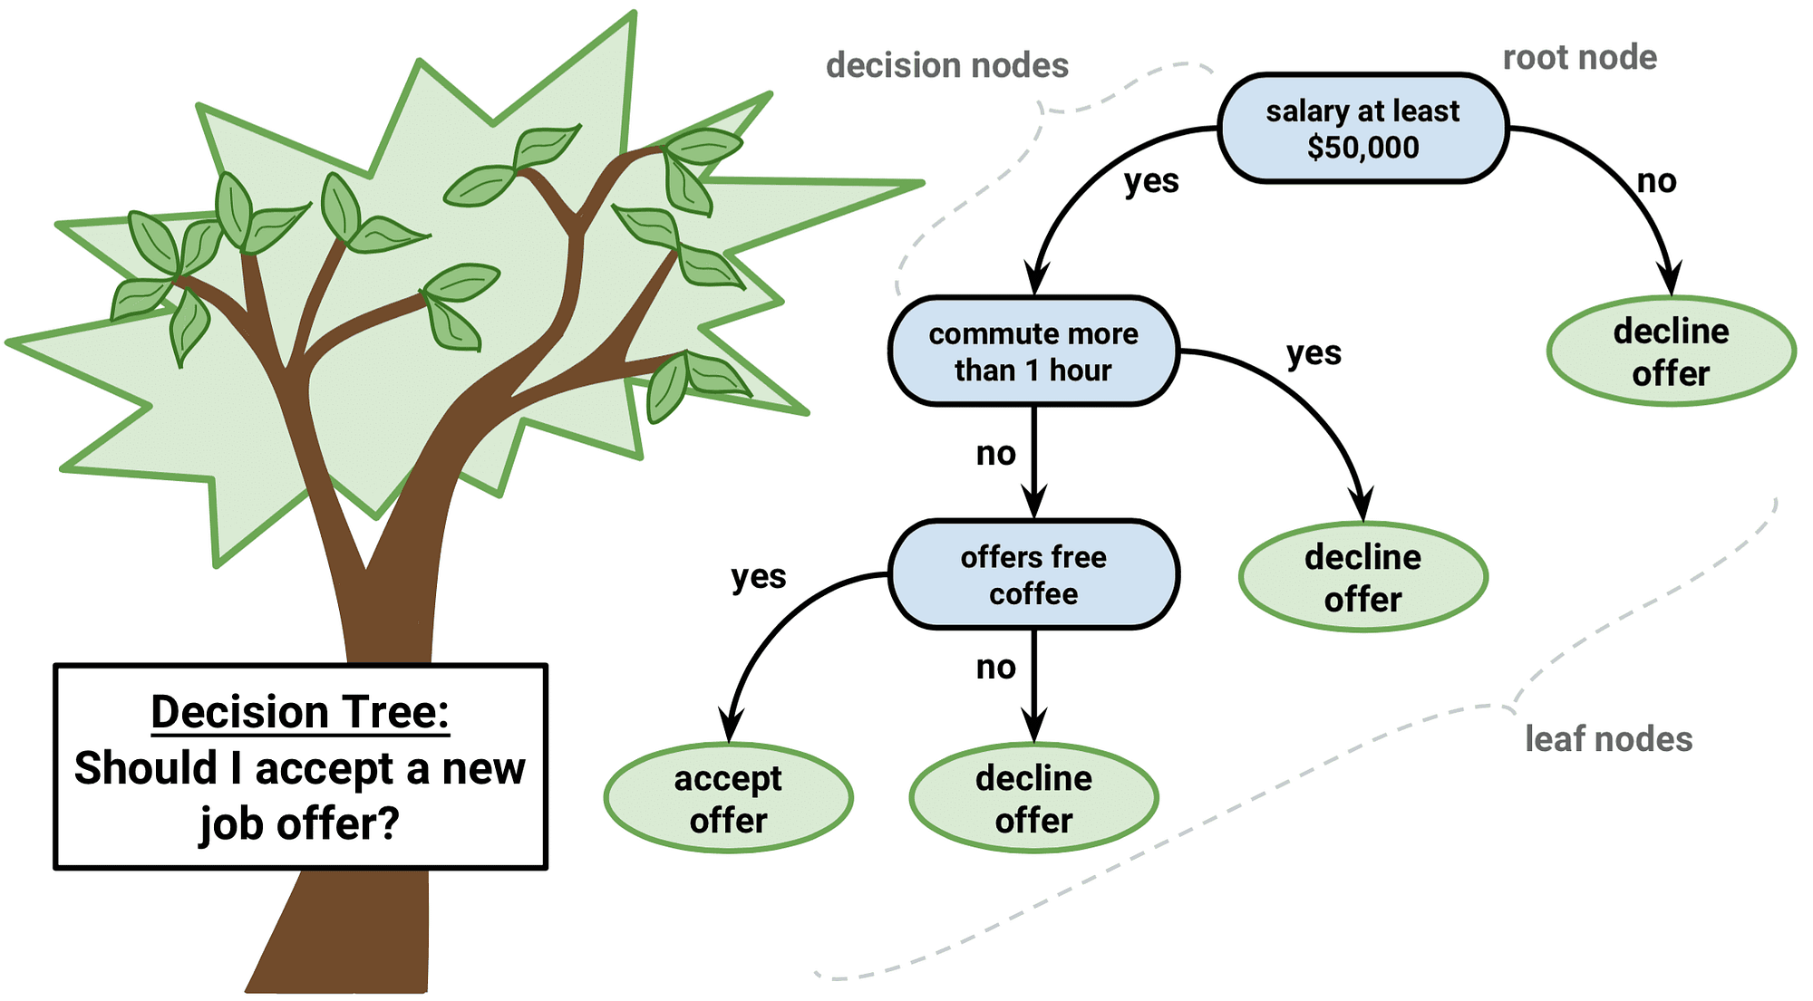
Decision Trees

Slide 13
Decision Trees
Specs:
• A flow-chart-like tree structure
• Internal node denotes a test on a single attribute
• Branch represents an outcome of the test
• Leaf nodes represent class labels or class distribution
Tree construction:
Top-down, by recursively splitting the training set using conditions on the attributes.
Identify and remove branches reflecting noise or outliers (tree pruning).
How splitting conditions are found is one
of the key issues of decision tree induction.

Slide 14
Decision Trees: Algorithm
Basic algorithm for categorical attributes
Top-down recursive divide-and-conquer manner
• At start, all the (training) samples are at the root
• Examples are partitioned recursively based on test attributes
• Test attributes are selected on the basis of a heuristic or statistical measure (e.g., information gain)
Conditions for stopping partitioning
• All samples for a given node belong to the same class
• There are no remaining attributes for further partitioning
• There are no samples left
Attribute Selection
Measure Information Gain

Slide 15
Node-splitting
Based on Nominal Attributes:
Based on Ordinal Attributes:
Based on Continuos Attributes:
• Discretization: producing an ordinal categorical attribute (static – once at the beginning – or dynamic – clustering, percentiles)
• Binary or multi-way Decision: find the best cut among all possible splits

Slide 16
How to split
Simplified approach:
Nodes with homogeneous class distribution are preferred
Node impurity measure (prevent ambiguity in the decision flow)
Going deeper: information measured as (binary) entropy $I\left(p,n\right)=−\frac{p}{p+n}\log_{2}\frac{p}{p+n}−\frac{n}{p+n}\log_{2}\frac{n}{p+n}$
where we are assuming:
(1) two classes (P and N) with p and n are their cardinalities
(2) the attribute A partitions the data collection S into $\left\{S_{1}, S_{2},⋯, S_{M}\right\}$
Thus, if $S_{i}$ contains $p_{i}$ examples of P and $n_{i}$examples of N, the expected information needed to classify objects in all the subtrees $S_{i}$ is:
$$E\left(A\right)=\sum_{i=1}^{M}{\frac{p_{i}+n_{i}}{p+n}I(p_{i},n_{i})}$$
The information gained by a split can be determined as the difference of the amount of information needed to correctly classifing before and after the split:
$$G\left(A\right)=I\left(p,n\right)−E(A)$$

Slide 17
DT building: example

Slide 18
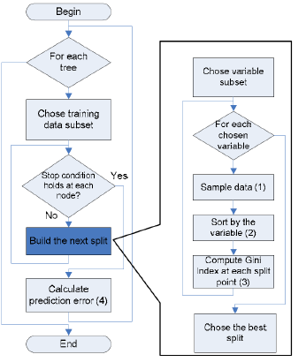
DT building: algorithm
A decision tree is based on the following algorithm:
Given: number of training examples (N), number of variables (i.e. features) in the classifier (M), number m of variables used to determine the decision at a node of the tree.
Choose a training subset (n<N). The rest of the cases are used to estimate the error by predicting their classes.
For each node, randomly choose m variables and calculate the best split.
Each tree is fully grown and not pruned (as may be done in constructing a normal tree classifier).

Slide 19
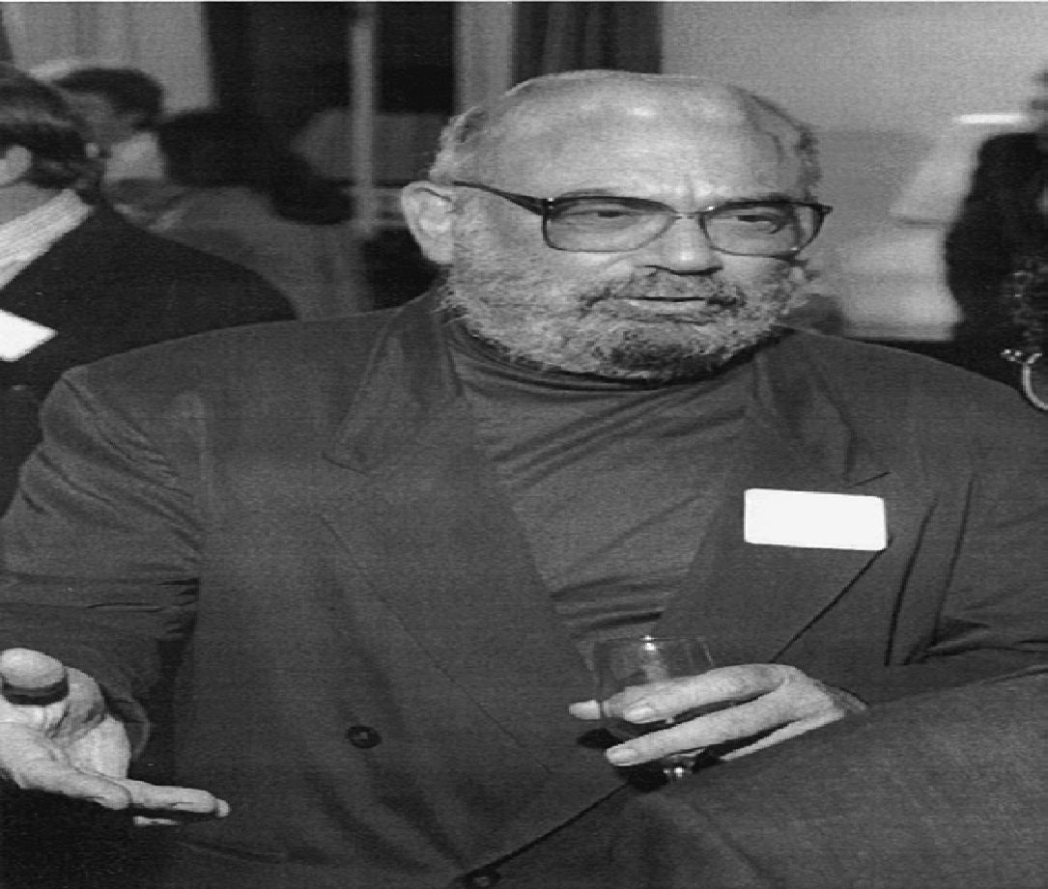
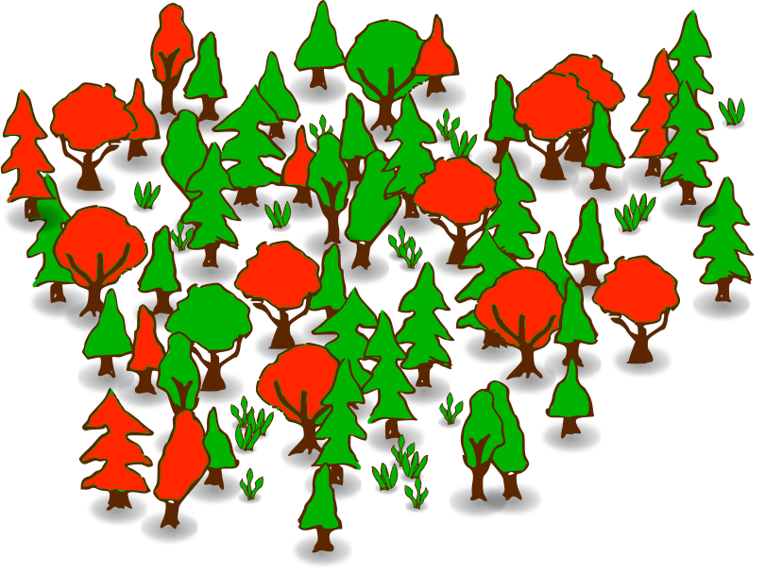
Random Forest
Learning ensemble consisting of a bagging of decision tree learners with a randomized selection of features at each split.
Leo Breiman (2001) “Random Forests”, Machine Learning, 45, 5-32
RF Specs:
Random tree: randomly constructed from a set of possible trees having K random features at each node.
Efficiently generated (and computationally optimized)
Combination of large sets of random trees generally leads to accurate models.
RFs average multiple deep decision trees, trained on different parts of the same training set, with the goal of overcoming over-fitting problem of individual decision trees.
In other words, RFs are an ensemble learning method that operate by constructing a lot of decision trees and outputting the class that is the single (uni-modal) mode of the classes output by individual trees.
Leo Breiman, 1928 - 2005

Slide 20
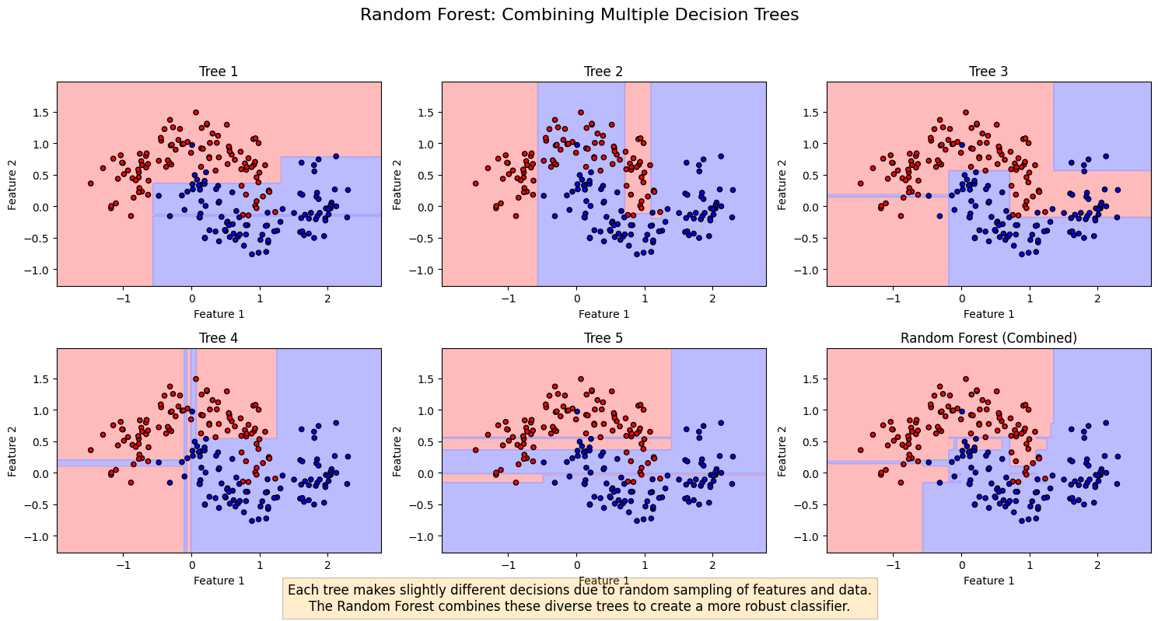
Random Forest vs Decision Tree
Each DT makes slightly different decisions due to random sampling of features and data.
RF combines these trees to create a more robust method.
A single deep DT tends to overfit the training data.
RF creates a smoother decision boundary that better generalizes to new data

Slide 21
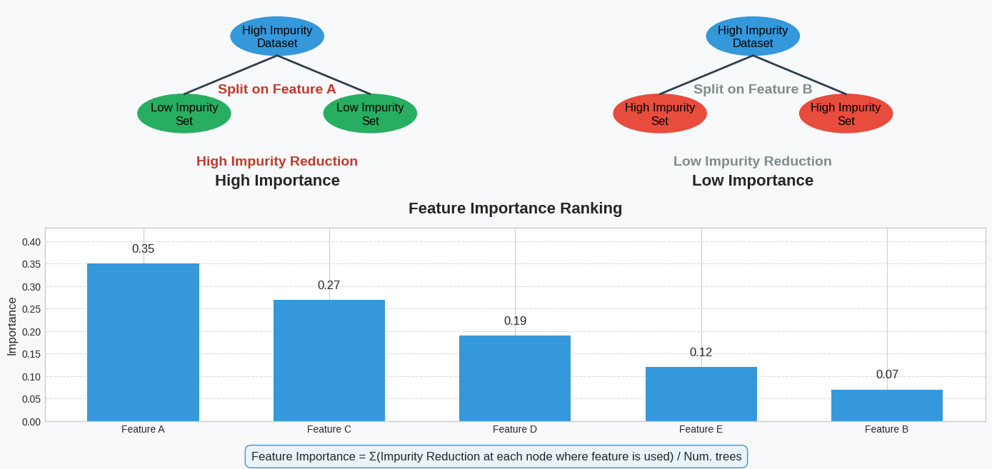
Feature Importance in Random Forest
…
Please note that the importance is connected with the number of items involved by the split

Slide 23
Decision Trees
• A flow-chart-like tree structure
• Internal node denotes a test on a single attribute
• Branch represents an outcome of the test
• Leaf nodes represent class labels or class distribution
Use of decision tree: Classifying an unknown sample Test the attribute values of the sample against the decision tree
Generally a decision tree is first constructed in a top-down manner by recursively splitting the training set using conditions on the attributes. How these conditions are found is one of the key issues of decision tree induction.
Decision tree generation usually consists of two phases
Tree construction
• At start, all the training samples are at the root
• Partition samples recursively based on selected attributes. After the tree construction it usually is the case that at the leaf level the granularity is too fine, i.e. many leaves represent some kind of exceptional data.
Tree pruning
• Identify and remove branches that reflect noise or outliers. Thus in a second phase such leaves are identified and eliminated

Slide 24
Decision Trees
attribute values of an unknown sample are tested against the conditions in the tree nodes, and the class is derived from the class of the leaf node at which the sample arrives.

Slide 25
Tree Induction
Greedy strategy
–Split the records based on an attribute test that optimizes certain criterion.
Issues
–Determine how to split the records
•How to specify the attribute test condition?
•How to determine the best split?
–Determine when to stop splitting
Before Splitting: 10 records of class 0, 10 records of class 1
Which test condition is the best?

Slide 26
How to determine the best split
Simplified approach:
Nodes with homogeneous class distribution are preferred
Node impurity measure (prevent ambiguity in the decision flow)

Slide 27
How to determine the best split
Greedy approach:
– Nodes with homogeneous class distribution are preferred
• Need a measure of node impurity: the easy way is to assign a distance threshold among classes (to prevent ambiguity in the decision flow).

Slide 28
How to split during DT building
Assuming that we have a binary category, i.e. two classes P and N into which a data collection S needs to be classified:
compute the amount of information required to determine the class, by I(p, n), the standard entropy measure, where p and n denote the cardinalities of P and N.
Given an attribute A that can be used for partitioning the data collection in the decision tree,
calculate the amount of information needed to classify the data after the split, according to attribute A.
Attribute A partitions S into {S₁, S₂ , …, S_{M}}
If S_{i} contains p_{i} examples of P and n_{i} examples of N, the expected information needed to classify objects in all subtrees S_{i} is

Slide 29
How to split during DT building
calculate I(p, n) for each of the partitions and weight these values by the probability that a data item belongs to the respective partition.
The information gained by a split can be determined as the difference of the amount of information needed for correct classification before and after the split.
G a in ( A) = I ( p , n ) − E ( A)
Thus we calculate the reduction in uncertainty that is obtained by splitting according to attribute A and select, among all possible attributes, the one that leads to the highest reduction.

Slide 30
Random Forest
Learning ensemble consisting of a bagging of decision tree learners with a randomized selection of features at each split.
Leo Breiman (2001) “Random Forests”, Machine Learning, 45, 5-32
Leo Breiman, 1928 - 2005
Grow a forest of many trees.
Grow each tree on an independent sample from the training data.
At each node:
1.Select m variables at random out of all M possible variables (independently for each node).
2.Find the best split on the selected m variables.
Grow the trees to maximum depth (classification).
Vote/average the trees to get predictions for new data.

Slide 31
Random Forest
What is Random Tree?
Is a tree constructed randomly from a set of possible trees having K random features at each node.
Trees have a uniform distribution.
It can be generated efficiently and the combination of large sets of random trees generally leads to accurate models.
It is group of un-pruned classification or regression trees made from random selections of samples of the training data.
Random forests are way of averaging multiple deep decision trees, trained on different parts of the same training set, with goal of overcoming over-fitting problem of individual decision trees.
In other words, random forests are an ensemble learning method for classification and regression that operate by constructing a lot of decision trees at training time and outputting the class that is the single (uni-modal) mode of the classes output by individual trees.

