Slide 1
OATo/UniGe Synergy - Integrating Observations and AI: Transformative Approaches for Unraveling Solar Activity
D. Telloni¹ & S. Guastavino²
¹National Institute for Astrophysics - Astrophysical Observatory of Torino, I-10025 Pino Torinese, Italy
²University of Genova - Department of Mathematics, I-16146 Genova, Italy
AI in Astronomy Workshop - May 21, 2025

Slide 2
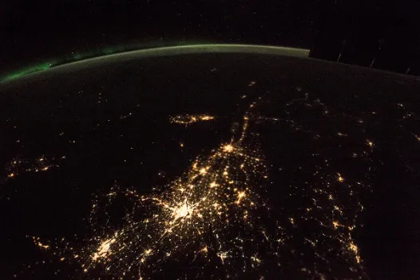
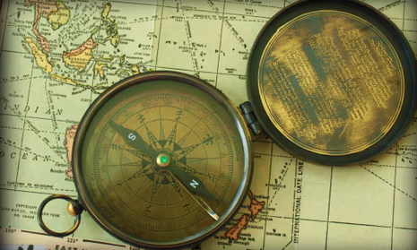
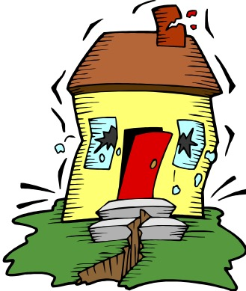
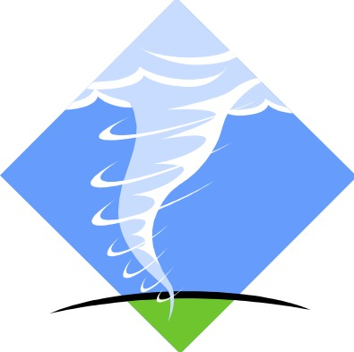
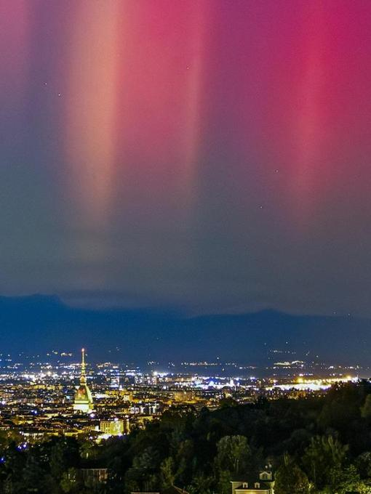
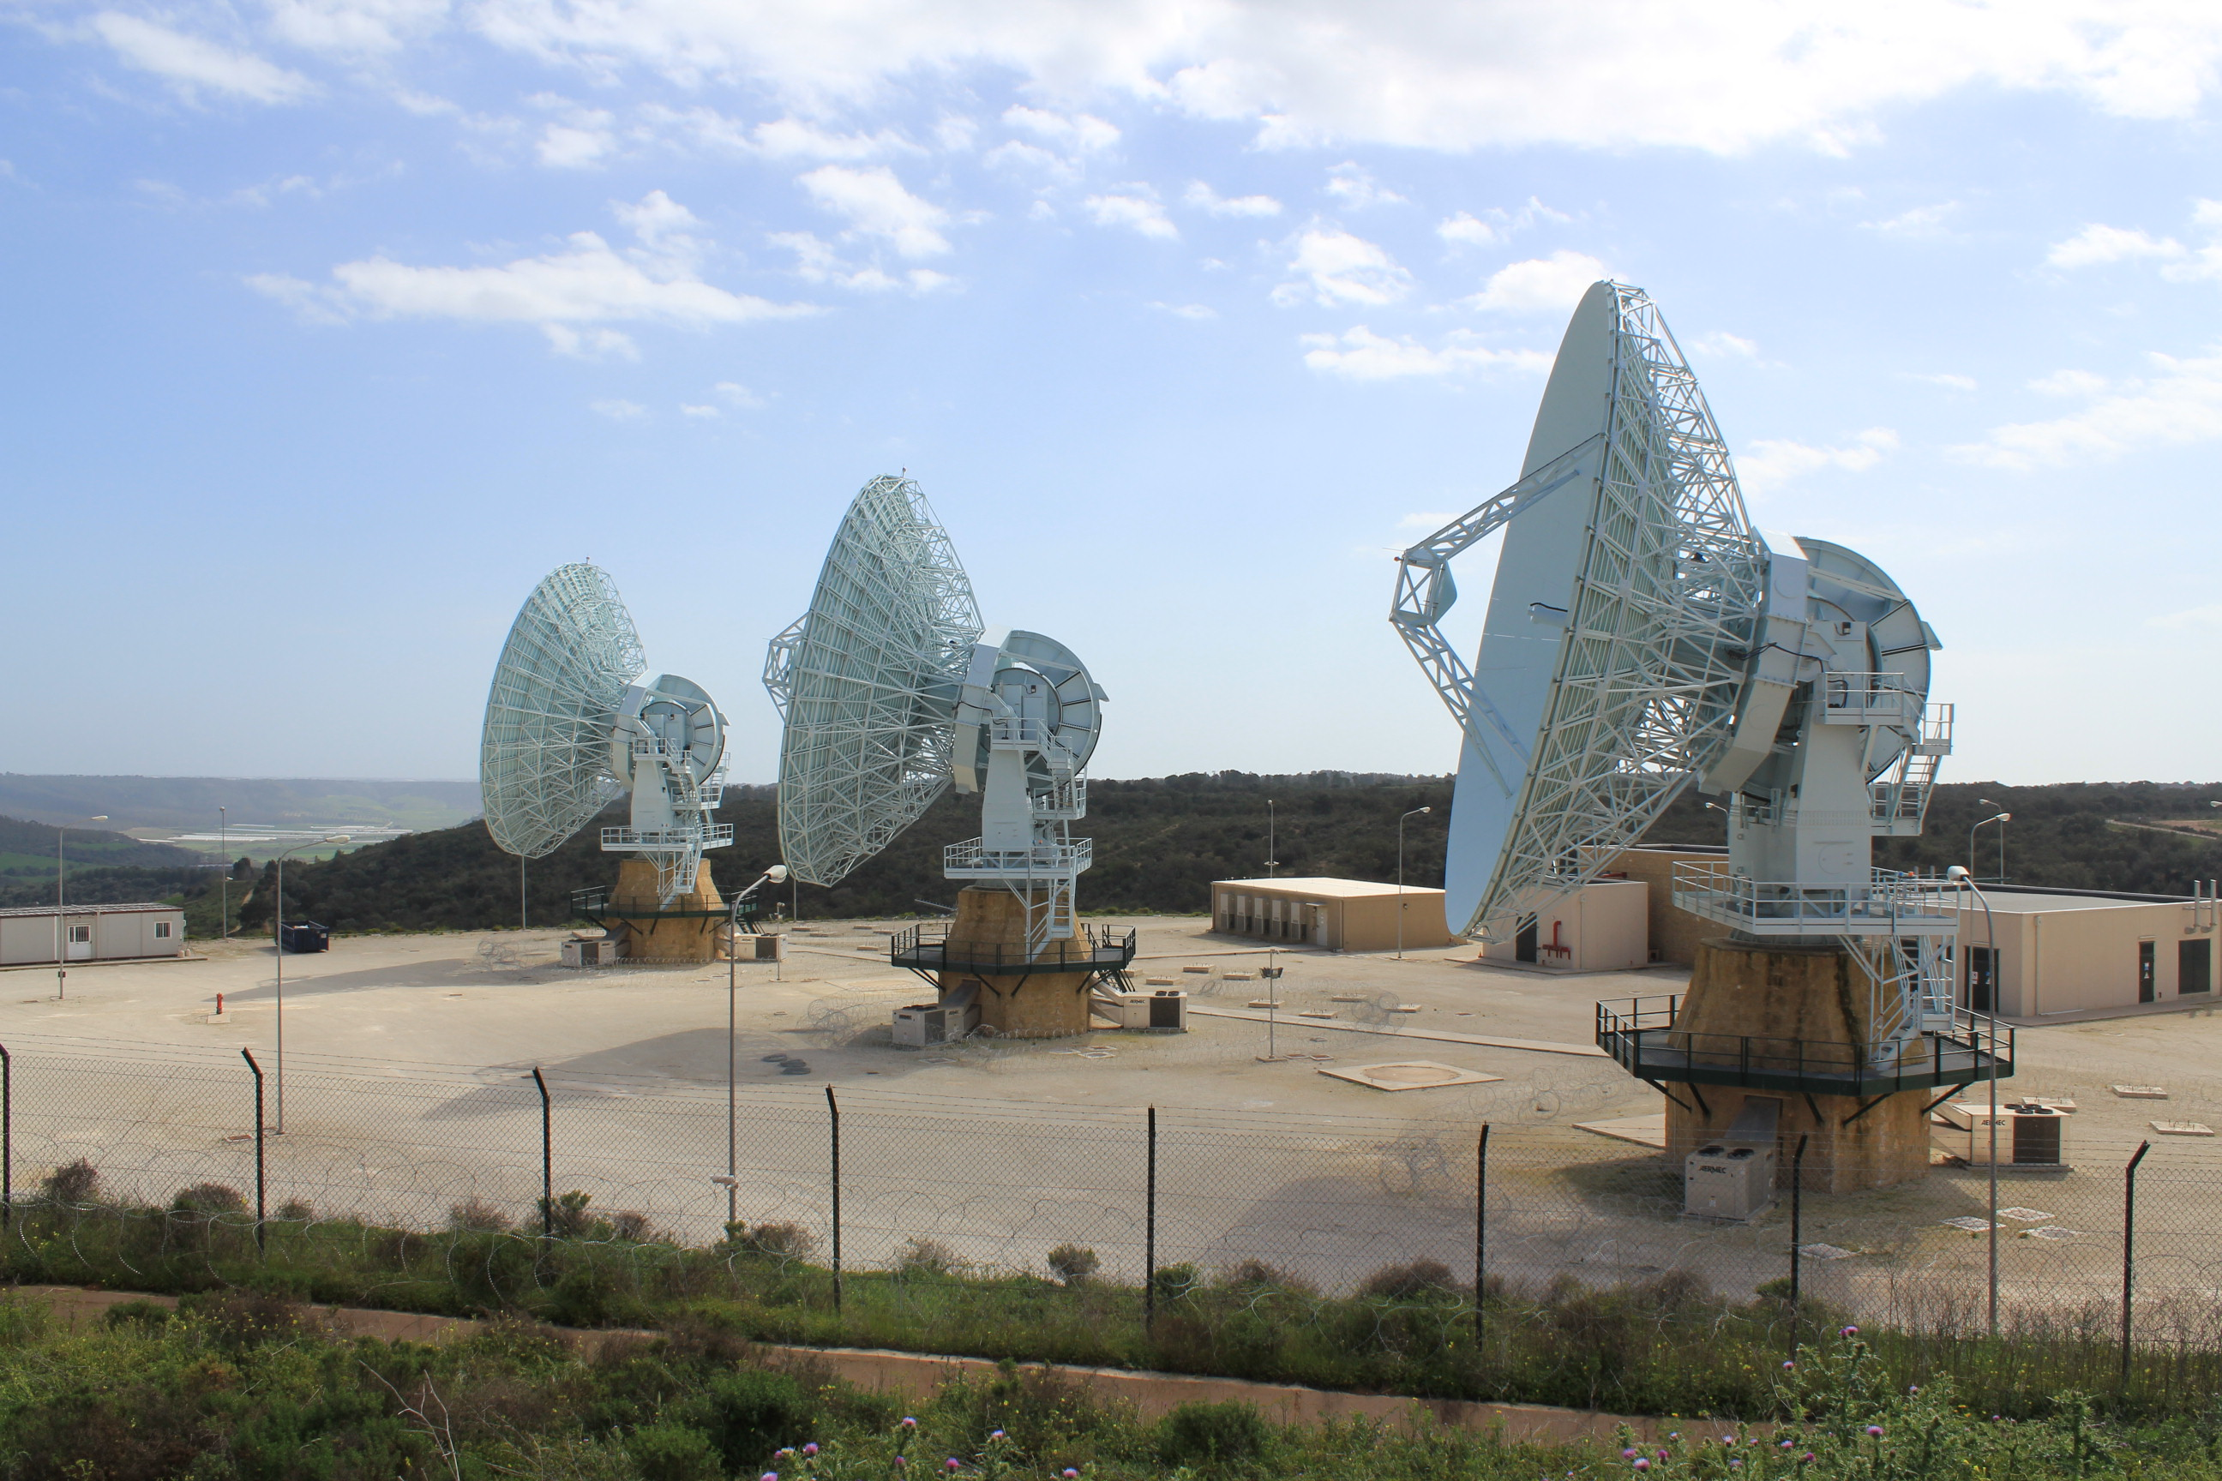
AI in Astronomy Workshop D. Telloni & S. Guastavino - May 21, 2025
Space weather
A massive 9-hr blackout leaves millions of people without power in Québec (Canada) in 1989
GPS signals are disrupted and magnetic compasses start pointing to a different location
This is neither due to earthquakes, tornadoes, nor even alien invasions…
The aurore are being spotted as far south as Torino as on October 11, 2024!
Communications are disrupted between the
ground- and space-based infrastructures
…but to the Sun! Space Weather is a branch of science that focuses on the study of the dynamic interaction between eruptive events at the Sun and the terrestrial environment
OATo/UniGe Synergy - Integrating Observations and AI: Transformative Approaches for Unraveling Solar Activity
2/10

Slide 3
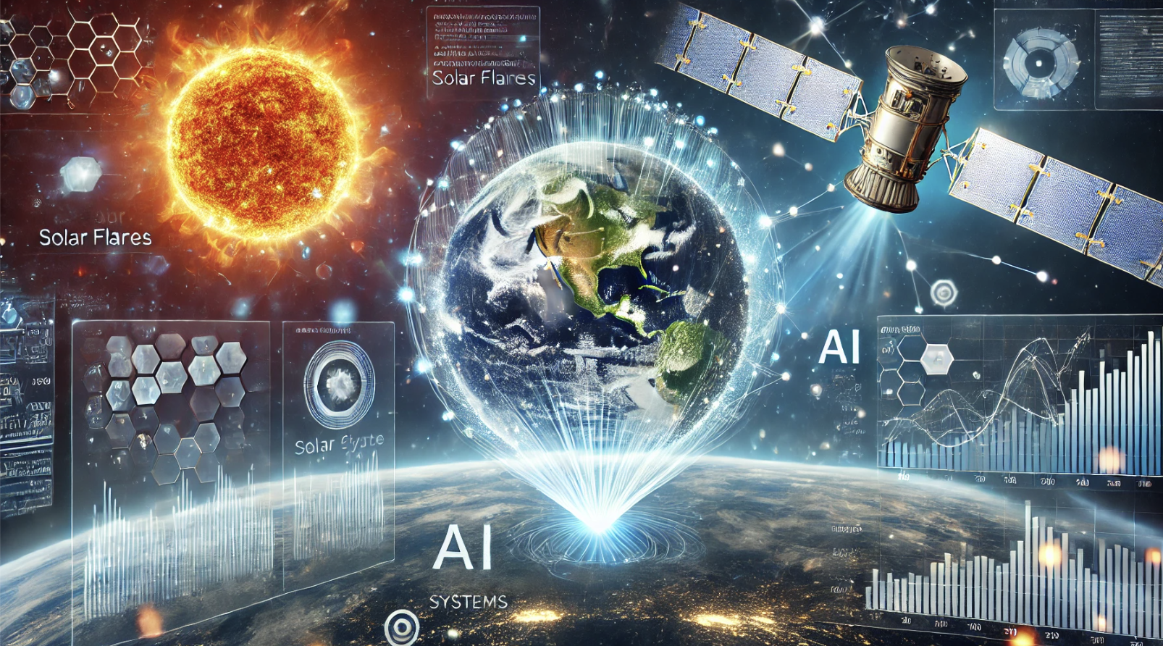
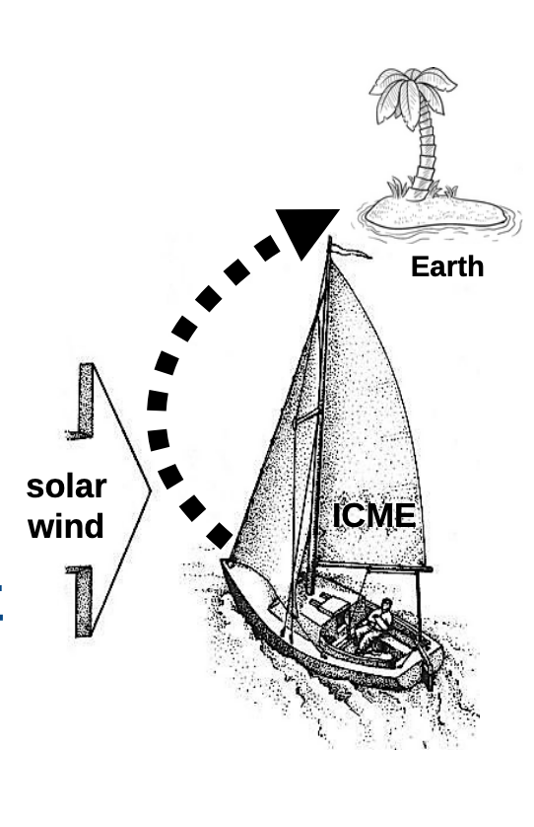
AI in Astronomy Workshop D. Telloni & S. Guastavino - May 21, 2025
OATo-UniGe joint collaboration
The collaboration between the Solar Physics group at the Astrophysical Observatory of Torino (OATo) and the Methods for Image and Data Analysis (MIDA) group from the Department of Mathematics at the University of Genova focuses on advancing Space Weather research
Joint OATO/UniGe Projects:
ESA Space Weather European Network (SWESNET)
AIxtreme project, funded by Fondazione Compagnia di San Paolo and Fondazione Cassa Depositi e Prestiti (CDP)
ASI/MUR Space It Up!
MIDA contributes expertise in advanced mathematical and computational techniques, especially in Artificial Intelligence (AI), while OATo brings deep knowledge of solar physics, particularly the physical processes driving solar eruptive events and regulating their evolution
There are basically two approaches to predicting Space Weather events: 1) physical models (computer demanding that fail to capture all the physical processes involved) and 2) AI models (often seen as “black boxes”). Integrating the two approaches (exactly what the OATO/UniGe synergy aims to do) leads to so-called physics-based AI models (see Guastavino, S., et al. 2023, ApJ, 954, 151)
OATo/UniGe Synergy - Integrating Observations and AI: Transformative Approaches for Unraveling Solar Activity
3/10

Slide 4
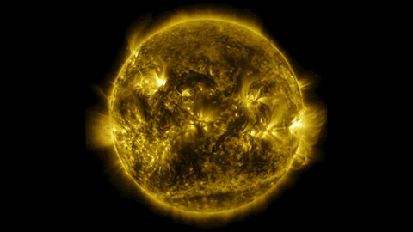
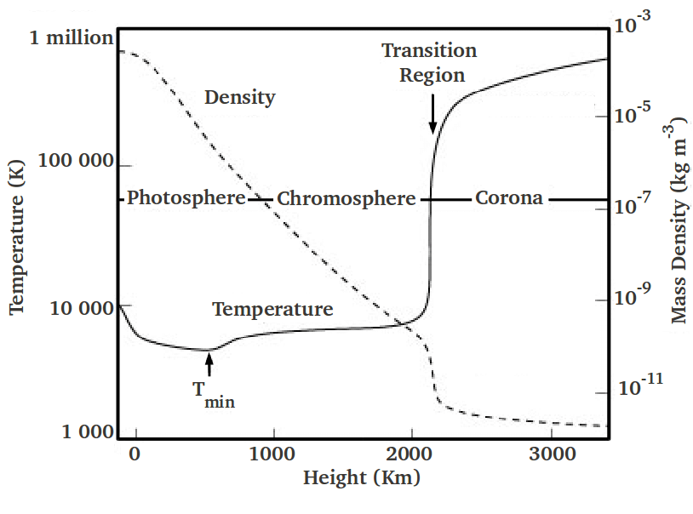
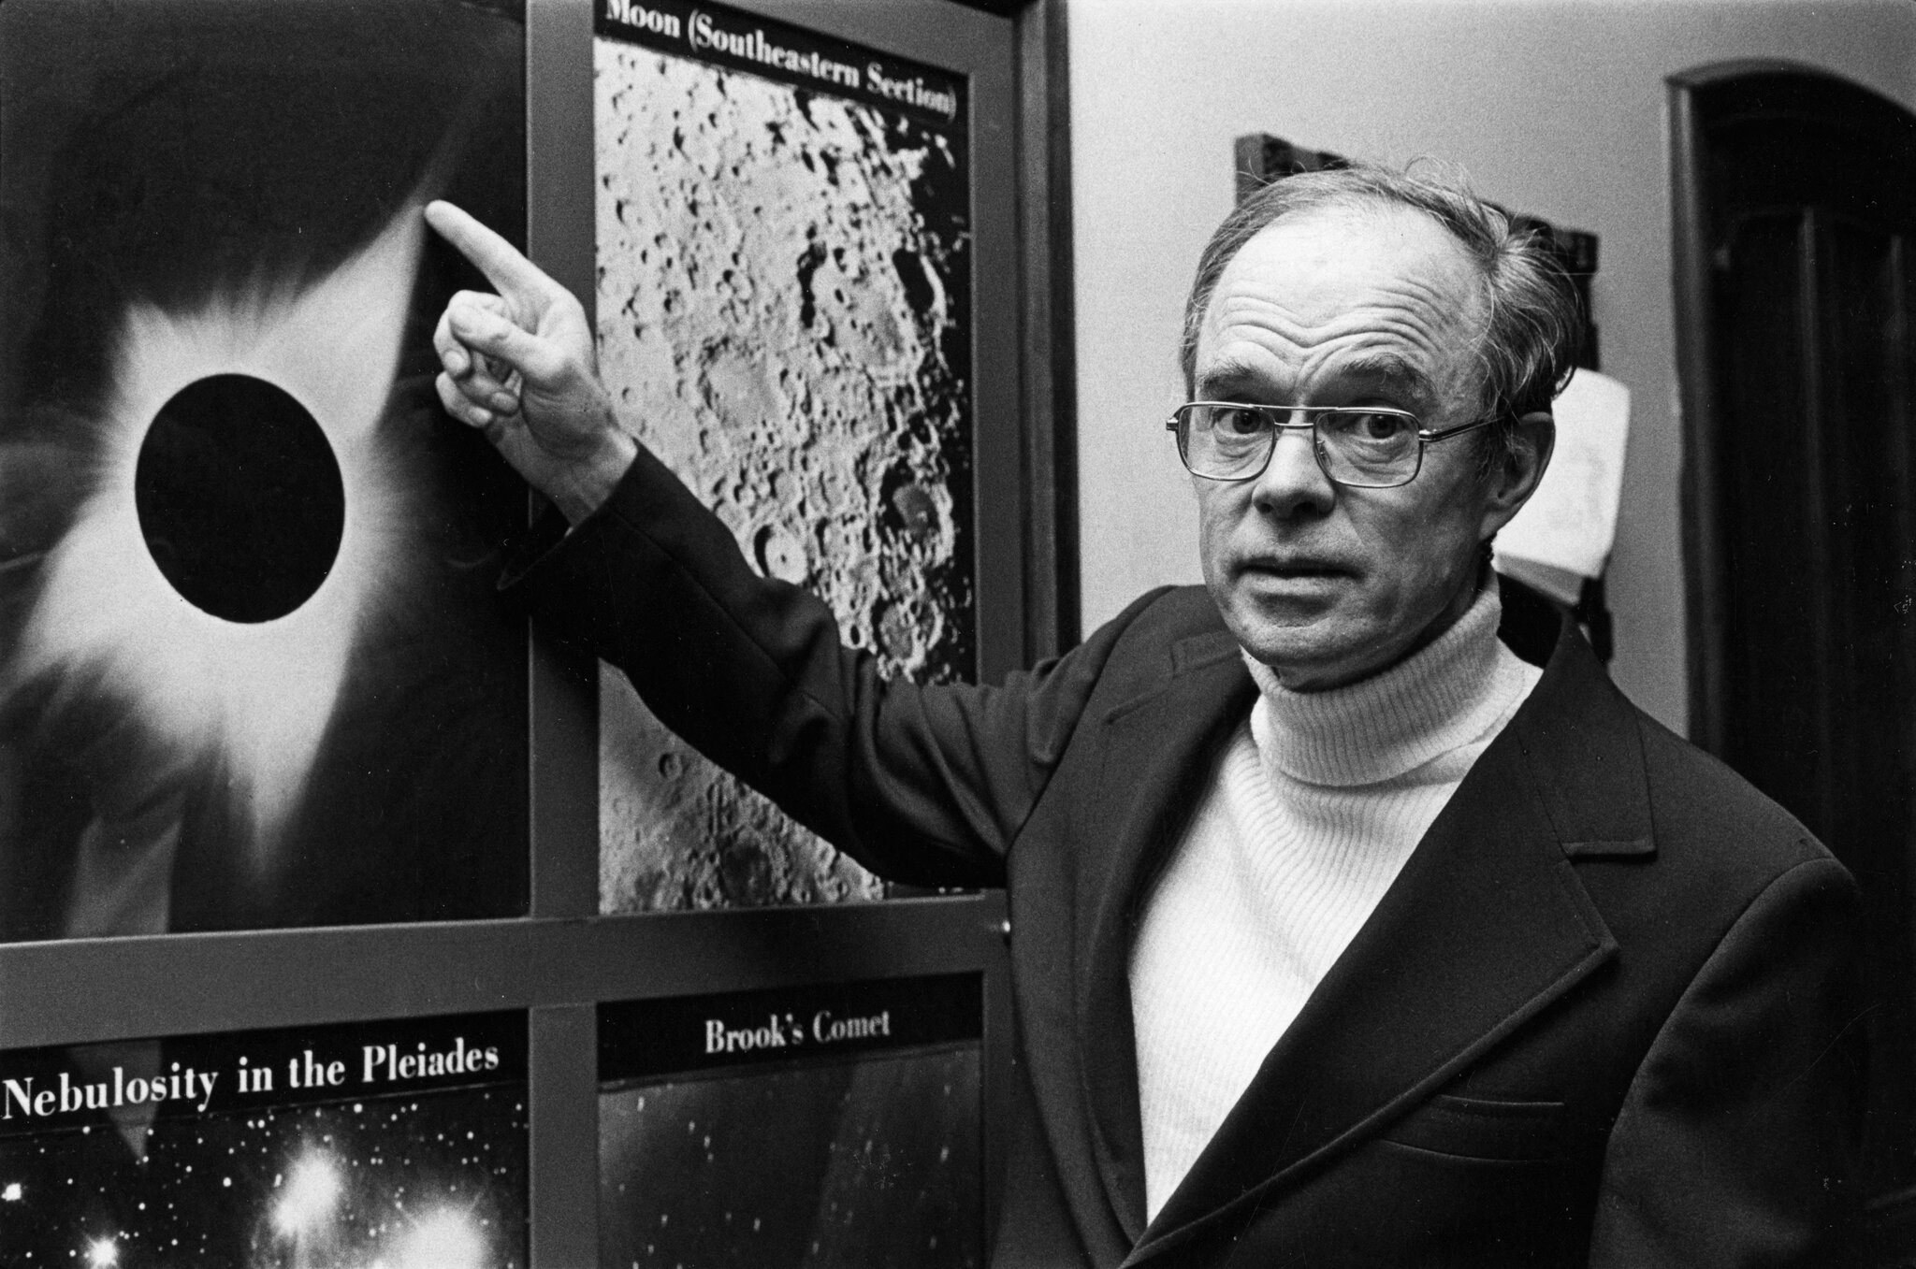
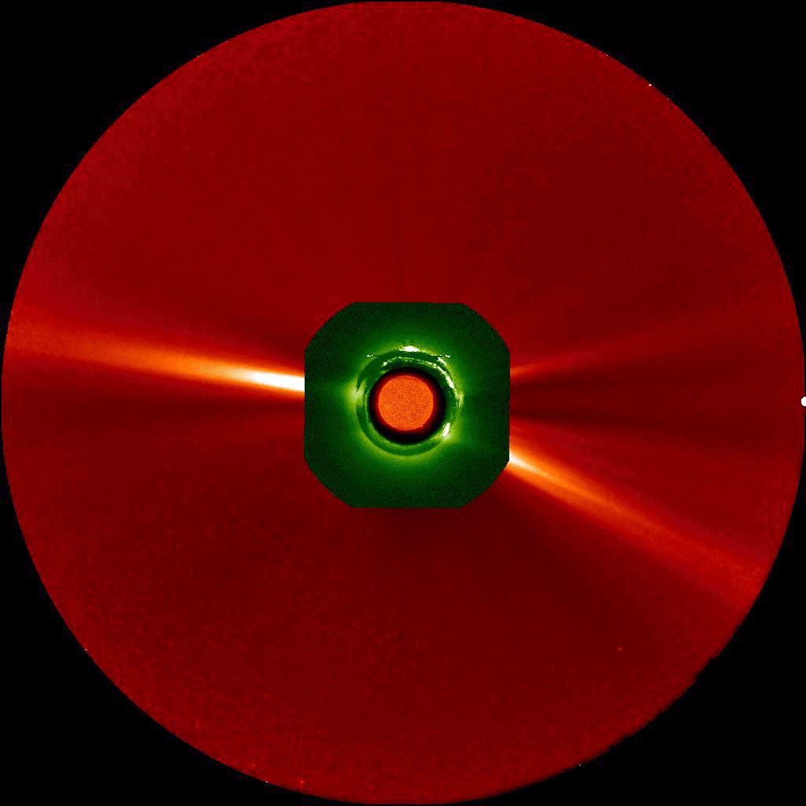
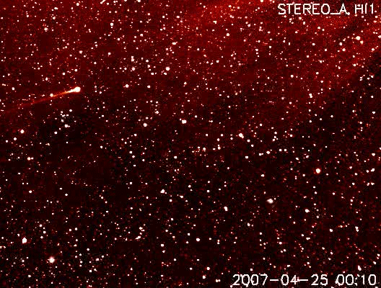
AI in Astronomy Workshop D. Telloni & S. Guastavino - May 21, 2025
The solar corona and the solar wind
AIA/SDO
The solar corona (the outermost part of the Sun’s atmosphere) is so hot that the Sun’s gravity cannot hold it in: solar wind. Predicted theoretically by E. Parker in 1958, it is observed (by mistake) for the first time in 1959 by Luna 1
COR 1-2/STEREO-A
E. Parker
HI 1/STEREO
Comet’s tail disrupted by solar wind
COR 1-2, HI 1-2/STEREO-A
OATo/UniGe Synergy - Integrating Observations and AI: Transformative Approaches for Unraveling Solar Activity
4/10

Slide 5
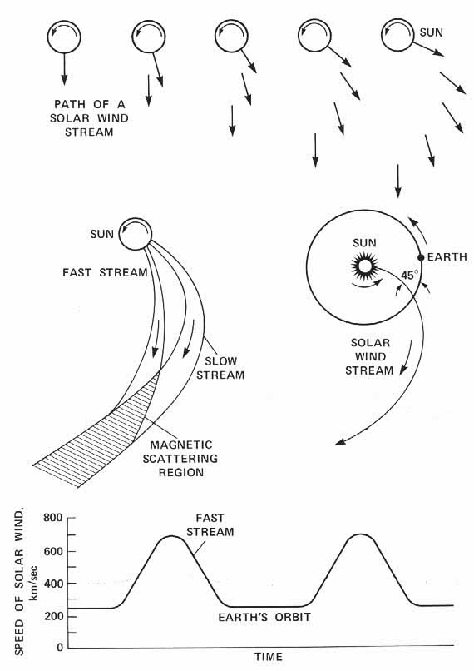
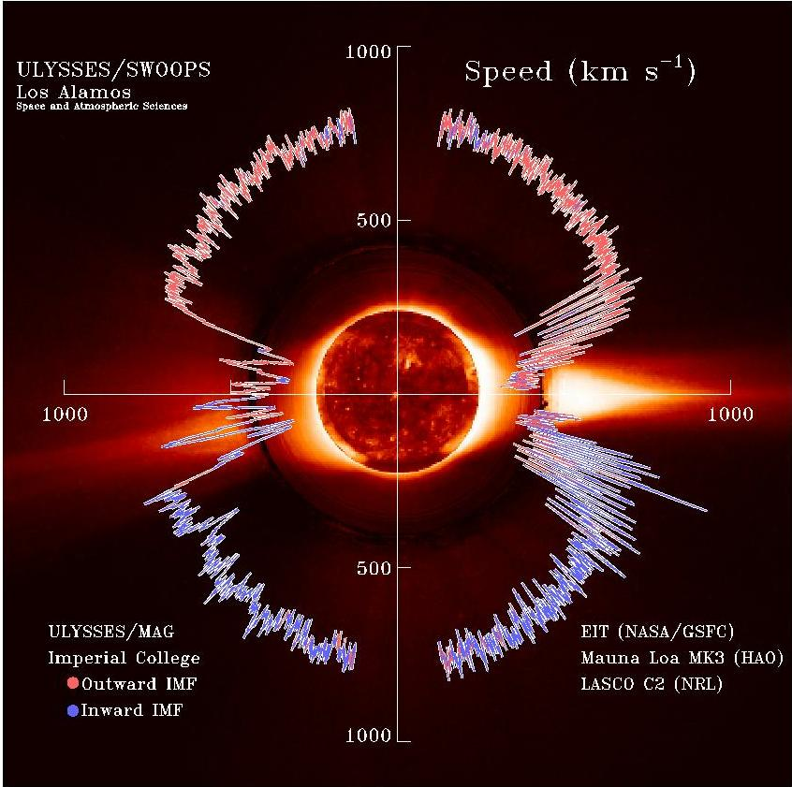
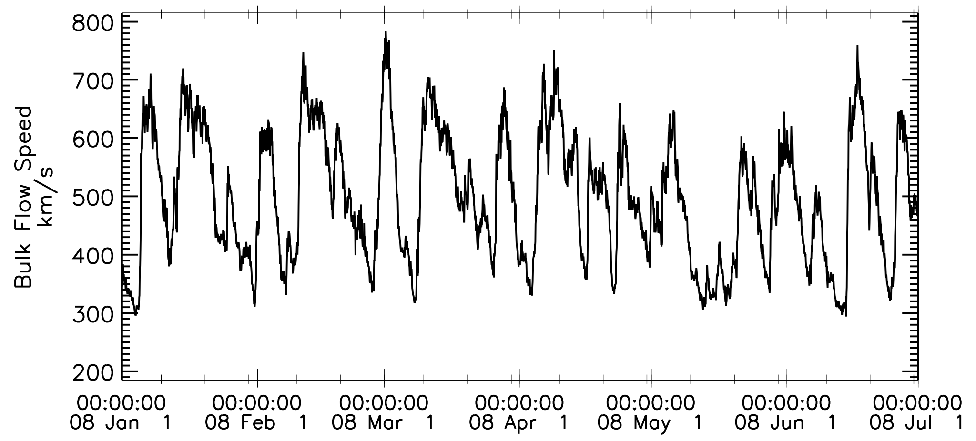
AI in Astronomy Workshop D. Telloni & S. Guastavino - May 21, 2025
Parker’s spiral and the dual nature of the solar wind
Telloni+ (2021), A&A, 656, A5
Wind
Alternation of high- and low-speed streams at 1 au: the region of interactions (MHD compression) between them, co-rotating with the Sun, give rise to CIRs
OATo/UniGe Synergy - Integrating Observations and AI: Transformative Approaches for Unraveling Solar Activity
5/10

Slide 6
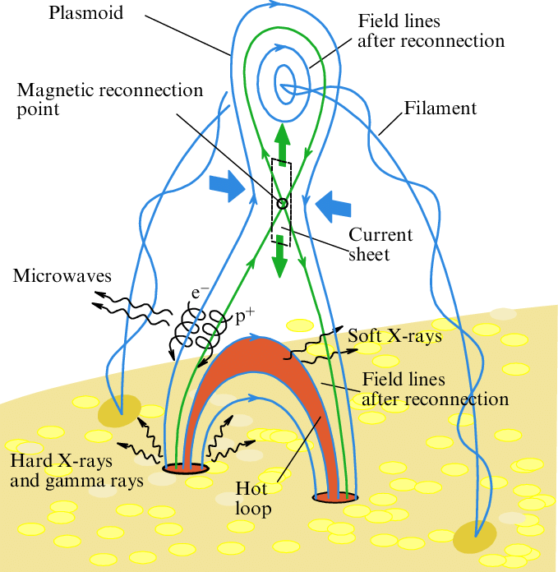
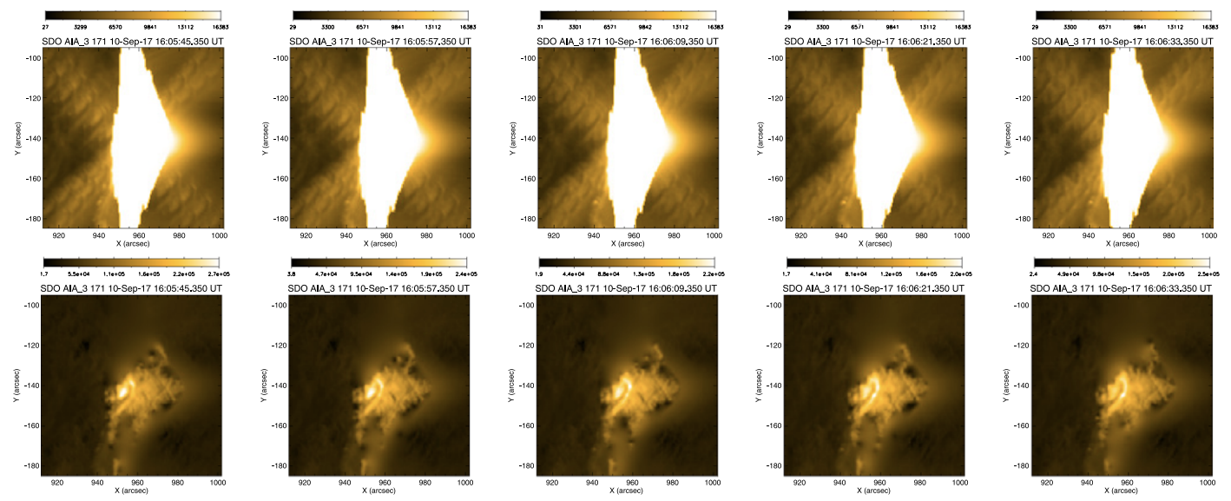
AI in Astronomy Workshop D. Telloni & S. Guastavino - May 21, 2025
Solar flares…
AIA/SDO
The magnetic field lines near sunspots (cooler regions of the Sun’s surface due to the strong magnetic field that prevents some of the Sun's heat from reaching the surface) often tangle, cross and reorganize. This can lead to magnetic reconnection that causes a sudden burst of energy called a solar flare. Solar flares release a large amount of radiation into space. If a solar flare is very intense, the radiation it releases can interfere with radio communications on Earth
Lysenko+ (2020) Phys.-Usp., 63, 818
Solar flares can be so intense as to saturate images at the flaring site, thus requiring the need to apply sophisticated desaturation techniques (DESAT) at the intersection of learning and inverse problem approaches in order to study the phenomena
Guastavino+ (2019), ApJ, 882,109
Magnetic reconnection: the flaring mechanism
OATo/UniGe Synergy - Integrating Observations and AI: Transformative Approaches for Unraveling Solar Activity
6/10

Slide 7
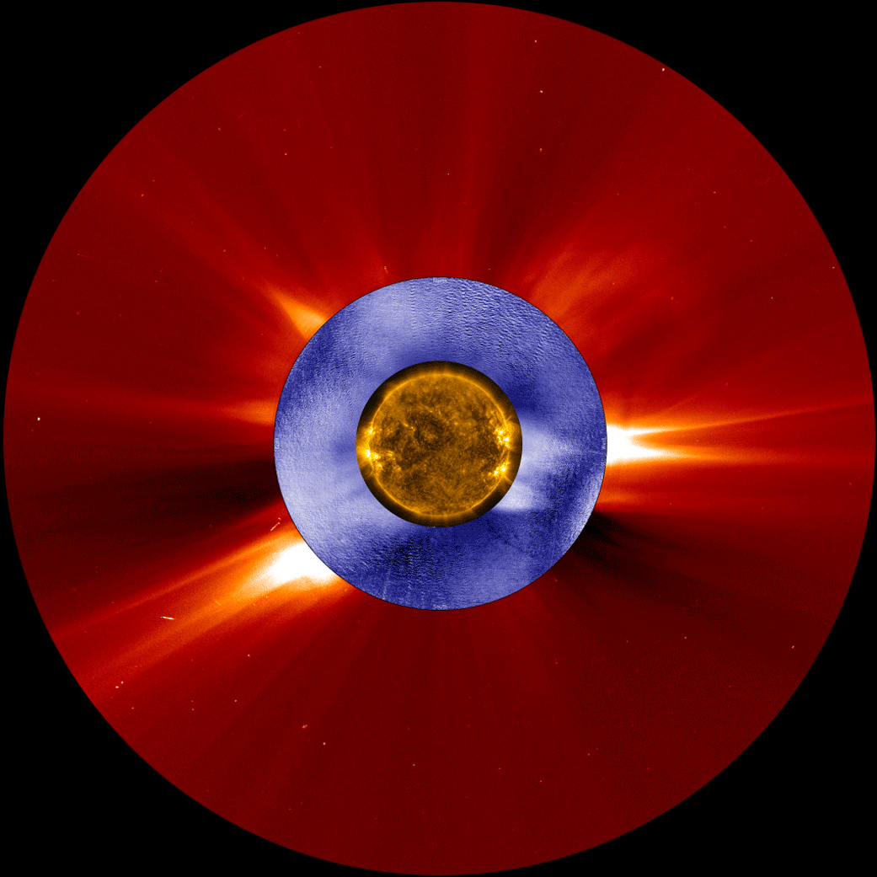
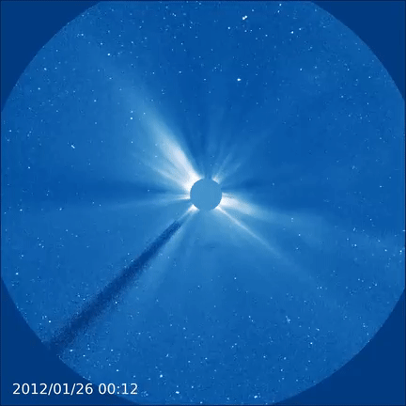
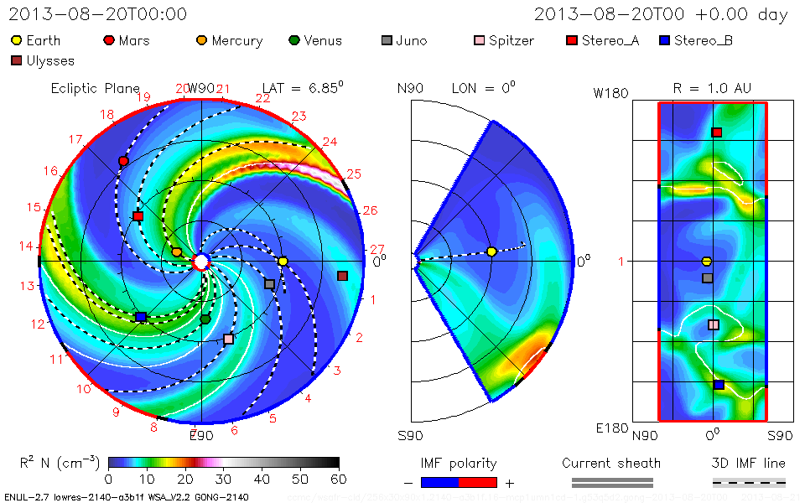
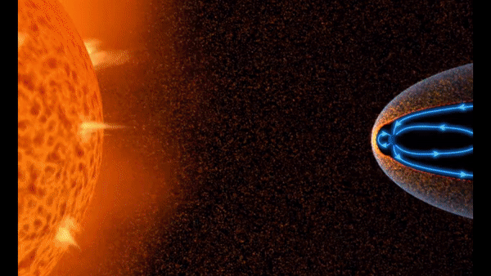
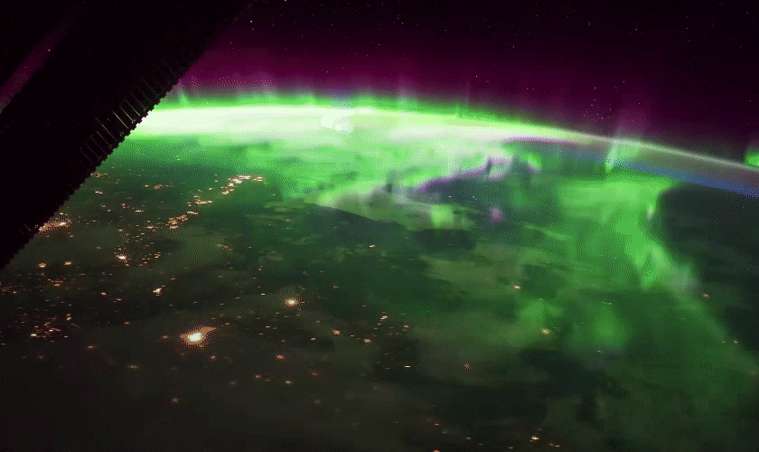
AI in Astronomy Workshop D. Telloni & S. Guastavino - May 21, 2025
…Coronal Mass Ejections (CMEs), but not only…
3D simulations of the Earth impact of a CME and its interaction with the background solar wind (Enlil)
CMEs are huge ejections of magnetized plasma from the corona which can easily exceed 1000 km/s…
EIT+LASCO C2/SOHO - Mark-IV
LASCO C3/SoHO
…their impact on Earth triggers geomagnetic storms, producing the amazing polar auroras (due to the interaction of charged particles with gases in Earth’s atmosphere)
While CMEs are the most important, they are not the only drivers of geomagnetic storms: CIRs, HCS crossings, HSSs
OATo/UniGe Synergy - Integrating Observations and AI: Transformative Approaches for Unraveling Solar Activity
7/10

Slide 8
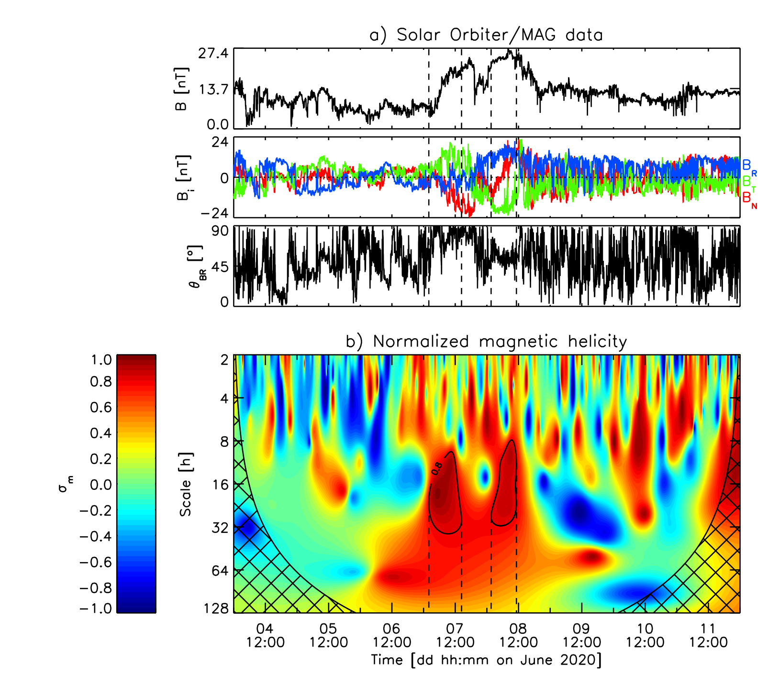
AI in Astronomy Workshop D. Telloni & S. Guastavino - May 21, 2025
Flux ropes and magnetic helicity
The internal core of any CME is the flux rope, highly twisted magnetic field structures. The MHD quantity that measures the degree of magnetic field twisting is the magnetic helicity. CMEs therefore can be detected as regions of high magnetic helicity
During Solar Orbiter’s first perihelion passage in June 2020, two interacting CMEs impacted the spacecraft
EUHFORIA simulation
Telloni+ (2021), A&A, 656, A5
$$H_{m}=∫A⋅Bd^{3}r$$
$$B=∇×A$$
$$H_{m}=\frac{ϵ_{ijk}V_{0,i}ℑ\left[W_{j}^{*}(t,s)W_{k}(t,s)\right]}{π}s$$
Telloni+ (2020), ApJL, 899, L25
Telloni+ (2021), A&A, 656, A5
OATo/UniGe Synergy - Integrating Observations and AI: Transformative Approaches for Unraveling Solar Activity
8/10

Slide 9
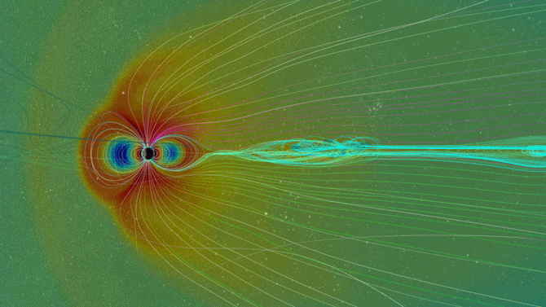
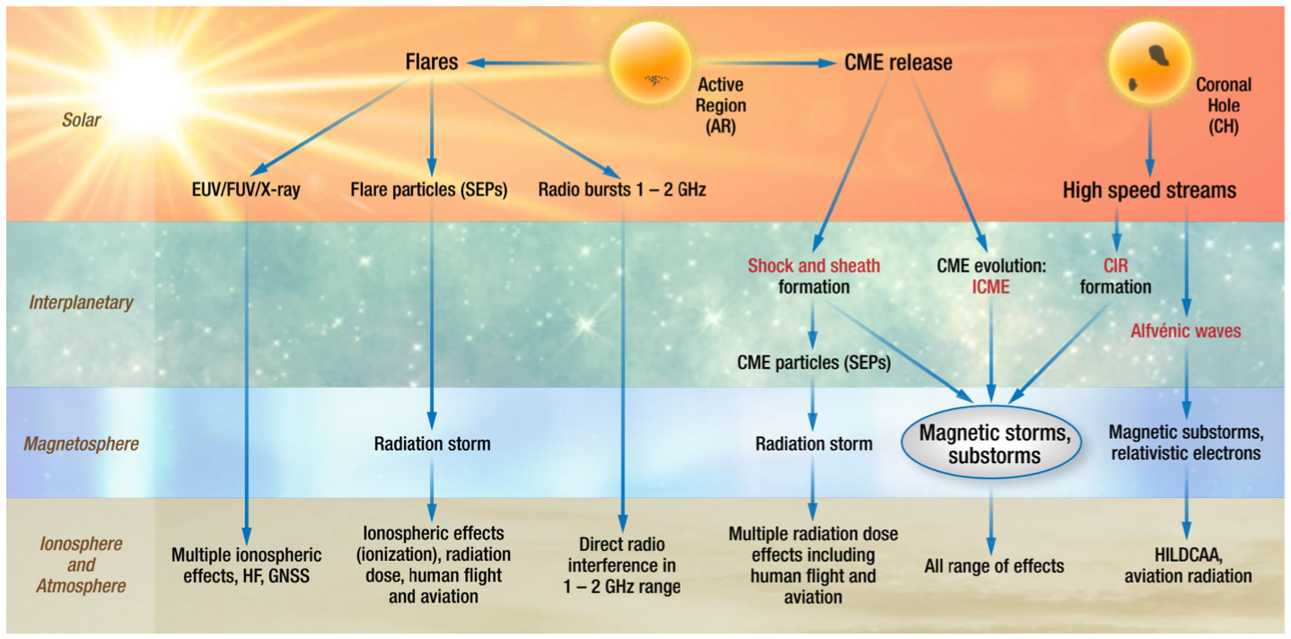
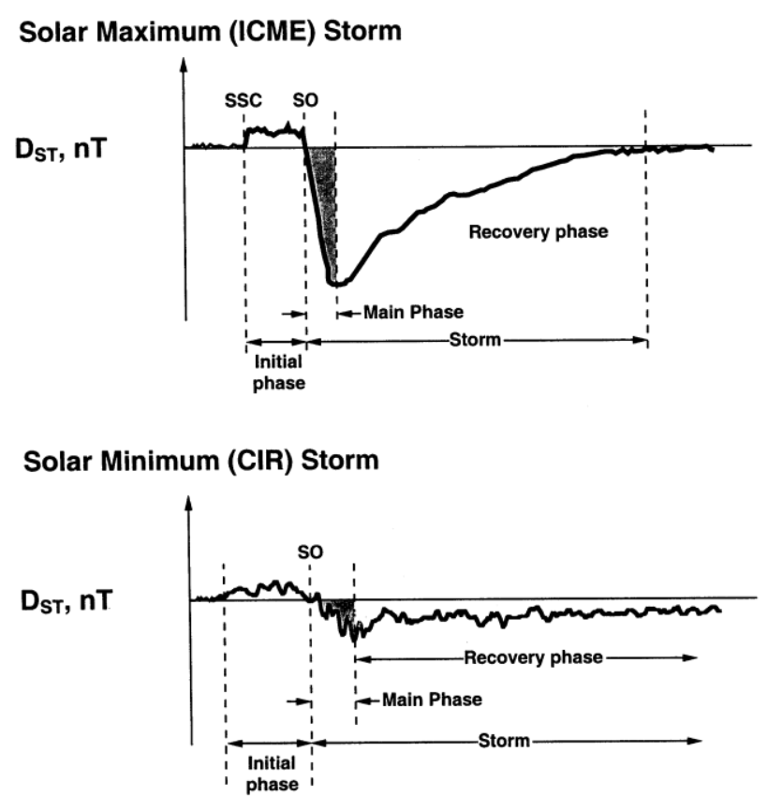
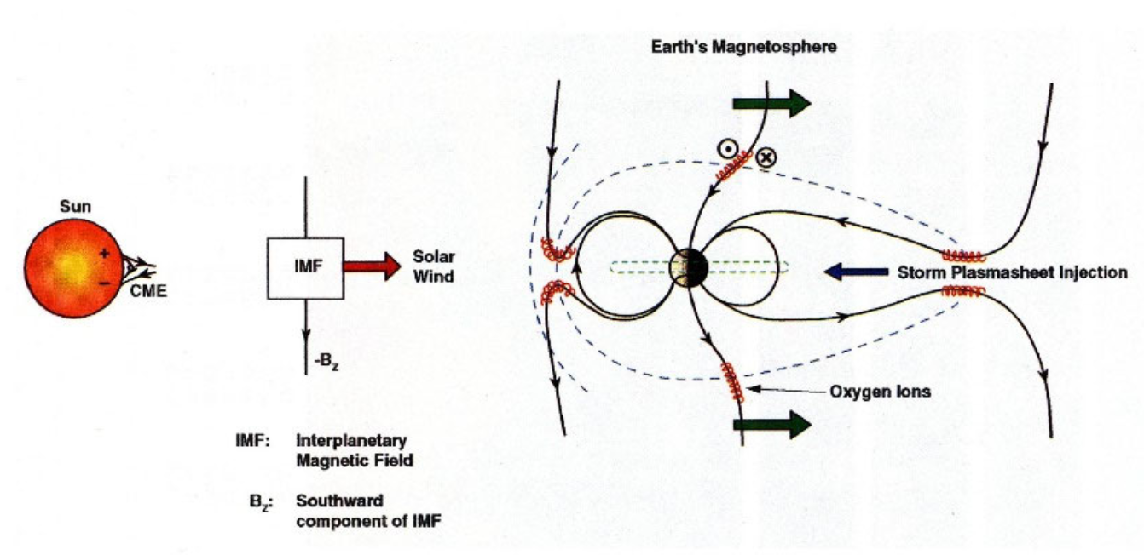
AI in Astronomy Workshop D. Telloni & S. Guastavino - May 21, 2025
Solar-terrestrial interactions
Magnetic reconnection opens the Earth’s magnetic field, exposing the Earth and its infrastructure to radiation from the Sun. Obviously, the more intense (i.e., energetic) the solar event, the larger the geomagnetic storm. As a result, an essential parameter for studying the intensity of the geo-effectiveness of CMEs (but not only) is the transported energy budget
Animation of the interaction of the solar wind and CMEs with the Earth’s magnetosphere
Tsurutani+ (2023), IEEE Trans. Plasma Sci., 51, 1595
Geomagnetic activity driven by CMEs and CIRs
Different phases of the solar storm: SSC (i.e., initial phase), main phase, recovery phase
Tsurutani+ (2023), IEEE Trans. Plasma Sci., 51, 1595
Magnetic reconnection drives geomagnetic storms
OATo/UniGe Synergy - Integrating Observations and AI: Transformative Approaches for Unraveling Solar Activity
9/10

Slide 10
AI in Astronomy Workshop D. Telloni & S. Guastavino - May 21, 2025
That’s all…
…and let’s move on to the more AI-focused and Space-Weather-oriented talk by Sabrina
OATo/UniGe Synergy - Integrating Observations and AI: Transformative Approaches for Unraveling Solar Activity
10/10

