Slide 1

FaB-HPCc
(Fast, robust Bayesian analysis for very high-dimensional problems on high-performance computing clusters)
Alessandro Lupi - Università degli Studi dell’Insubria
AREA TEMATICA: 6 - SOTTO-TEMATICA: d
Spoke 3 Progetti Bandi a Cascata, 09/01/2025
ICSC Italian Research Center on High-Performance Computing, Big Data and Quantum Computing
Missione 4 • Istruzione e Ricerca
Notes:
Cover

Slide 2
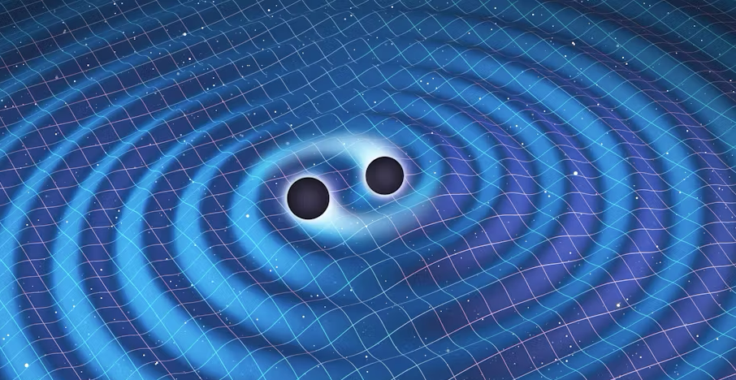
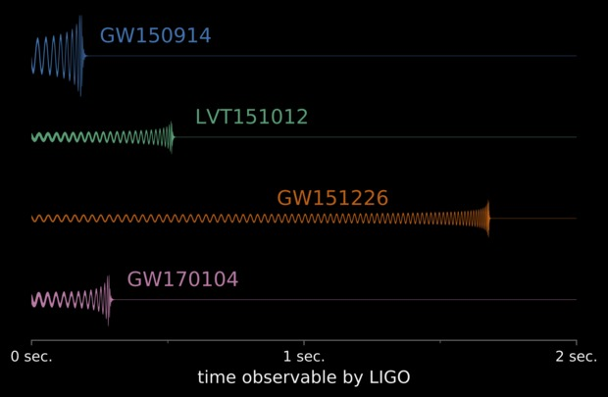
Project Overview
The detection of gravitational waves (GWs) at various frequencies, from hertz to nanohertz, has been one of the most significant achievements in the past decade (LVK 2016, PTA 2022)
Bayesian methods have since then become key tools to estimate astronomical parameters from noisy data, as they allow to rigorously consider prior astrophysical knowledge and model uncertainties.
ICSC Italian Research Center on High-Performance Computing, Big Data and Quantum Computing
Missione 4 • Istruzione e Ricerca
Notes:
Template e guide lines

Slide 3
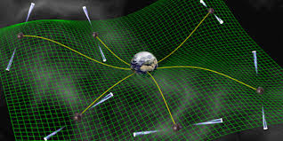
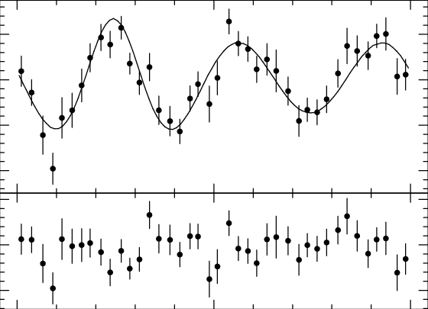
Project Overview
In GW and radio astronomy, the superposition of multiple signals and noise sources, as in the case of PTA sources, or the environmental effects of LVK sources, makes the analysis somewhat cumbersome, because of the large number of parameters involved.
This complexity is also reflected in the impossibility to directly calculate the Bayes evidence of observing the data across all possible parameters. For these reasons, approximate sampling methods are commonly used, as those based on Markov Chain Monte Carlo or nested sampling algorithms.
Even with a relatively clean signal (the residuals of the time-of-arrival series from each pulsar), the number of parameters over which the Bayesian analysis is performed is around a few hundreds.
ICSC Italian Research Center on High-Performance Computing, Big Data and Quantum Computing
Missione 4 • Istruzione e Ricerca
Notes:
Template e guide lines

Slide 4
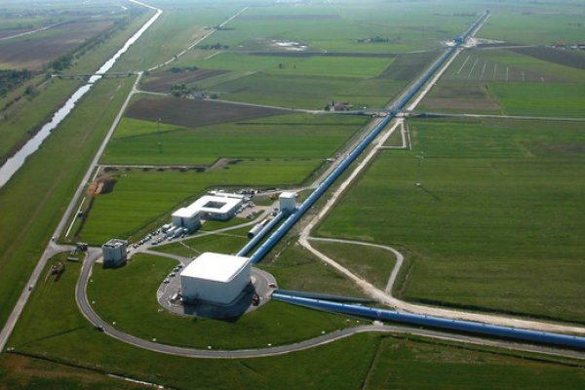
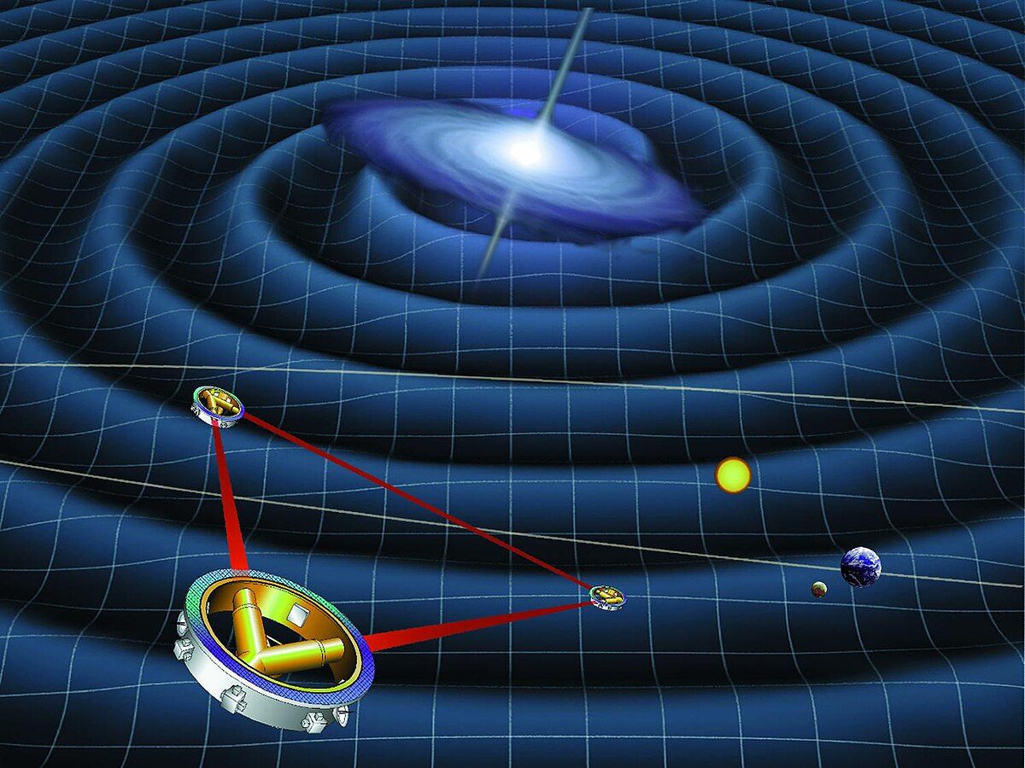
Project Overview
Similar problems to the ones of PTA and LVK will be also faced in the future analysis of LISA sources.
Exploring such a large parameter space is highly demanding for current workstations, hence the calculations are typically offloaded on HPC infrastructures.
Unfortunately, a brute-force or ‘one-size-fits-all’ approach, as typically done with common Bayesian inference tools, is far from optimal, given the highly different nature of the data to be analysed. This is the main motivation for a project as FaB-HPCc (“Fast, robust Bayesian analysis for very high-dimensional problems on high-performance computing clusters”).
ICSC Italian Research Center on High-Performance Computing, Big Data and Quantum Computing
Missione 4 • Istruzione e Ricerca
Notes:
Template e guide lines

Slide 5
Technical Objectives, Methodologies and Solutions
The key objective of this proposal is to speed up Bayesian inference on very high dimensional problems (e.g. GW inference for PTAs, complex radio astronomy data). In this context, effective solutions must be tailored to the individual use case, at the same time ensuring:
To reach this goal, we will:
design a Bayesian framework able to ensure reproducibility and robustness across different computing environments.
develop interfaces to a diverse array of sampling techniques and their software implementations, to accommodate diverse modelling scenarios and speed up Bayesian inference by allowing users to identify optimal sampling strategies for their specific problem.
accelerate Bayesian inference tools via CPU parallelisation
accelerate Bayesian inference tools adding GPU off-load for expensive calculations. Although CPU-parallelisation is often sufficient, for very high dimensional problems GPUs will provide the largest speed-up.
VERSATILITY
ADAPTABILITY
EFFICIENCY
ROBUSTNESS
ICSC Italian Research Center on High-Performance Computing, Big Data and Quantum Computing
Missione 4 • Istruzione e Ricerca
Notes:
Template e guide lines

Slide 6
Technical Objectives, Methodologies and Solutions
In order to achieve the goals of the project, we will employ the following methodologies:
We will create modular, containerised environments tailored for efficient Bayesian analysis. These environments will enhance flexibility, scalability, and ease of deployment, also ensuring robustness across different environments.
We will validate their effectiveness by comparing multiple samplers on PTA data. To date PTMCMC is the default sampler in the field, but it suffers from potential slow-down or trapping in low-likelihood regions. By incorporating additional samplers (e.g. dynasty, NessAI, Zeus, or custom samplers suitably developed for PTA and LVK data analysis), we will be able to identify the optimal samplers for different problems.
We will parallelise our framework using MPI, OpenMP (multi-threading) and Ray (a scalable framework for distributed computing) to enhance the efficiency and scalability of our analysis workflow on CPU. At the same time, we will adapt our framework to GPU off-load and we will implement GPU parallelisation for the most expensive calculations, guaranteeing the largest speed-up for extremely demanding analyses.
The containers will be released publicly via a public GitHub repository. This choice will encourage collaboration and community involvement, allowing researchers to contribute new features, fix bugs, and propose improvements to the container ecosystem. We will develop a suite of unit tests which will be used to validate any change/update of the tools, before expensive analyses are carried out.
ICSC Italian Research Center on High-Performance Computing, Big Data and Quantum Computing
Missione 4 • Istruzione e Ricerca
Notes:
Template e guide lines

Slide 7
Involved Staff and new recruitments
Dr. Alessandro Lupi (PI, Università degli Studi dell’Insubria) – 3 months
    Expert on theoretical/numerical modelling of black hole formation and evolution, including the evolution of massive black hole binaries that will be detected by the LISA mission and PTA
    PI/Co-I of multiple successful computational proposals, for a grand total of 20M CPU hours to date
Prof. Francesco Haardt (Co-PI, Università degli Studi dell’Insubria) – 3 months
Expert on theoretical astrophysics and cosmology, he supervised many students working on numerical studies on HPC resources
- Reference person @ INAF: Dr. Andrea Possenti (OAC)
2 post-doc (starting on February 1st, 2025) – 1 year (2 months covered by indirect costs)
        The hiring is currently in progress (potential candidates already identified)
ICSC Italian Research Center on High-Performance Computing, Big Data and Quantum Computing
Missione 4 • Istruzione e Ricerca
Notes:
Template e guide lines

Slide 8
Timescale, Milestones, SAL
Objectives:
development of modular, containerised environments for efficient parallelised Bayesian analysis of gravitational wave (GW) and radio astronomy data, to enhance flexibility, scalability, and ease of deployment
Porting and parallelisation on GPUs of Bayesian inference frameworks
Quarter | 12/2024 – 02/2025 | 03/2025 – 05/2025 | 06/2025 – 08/2025 | 09/2025 – 11/2025
Tasks | Literature surveys of existing efforts at parallelising Bayesian inference on CPU and GPUs. Post-doc hiring | Development and deployment of Singularity Containers Adaptation of Bayesian inference code for GPU acceleration | Development of the interface with different samplers Implementation of GPU accelerated optimisation | Final testing, deployment and integration of the CPU and GPU tools
Milestones | Survey results and choice of the best suited tools; definition of the activity timeline for the 2 post-docs | Singularity containers ready for HPC (parallalisation on CPUs) Code ready for GPU acceleration | Framework interfaced with different samplers, with optimised parameters defined according to the specific problem. GPU-accelerated version of the tools | GitHub repository with all the developed tools, ready for use and open to the community
ICSC Italian Research Center on High-Performance Computing, Big Data and Quantum Computing
Missione 4 • Istruzione e Ricerca
Notes:
Template e guide lines

