Slide 1





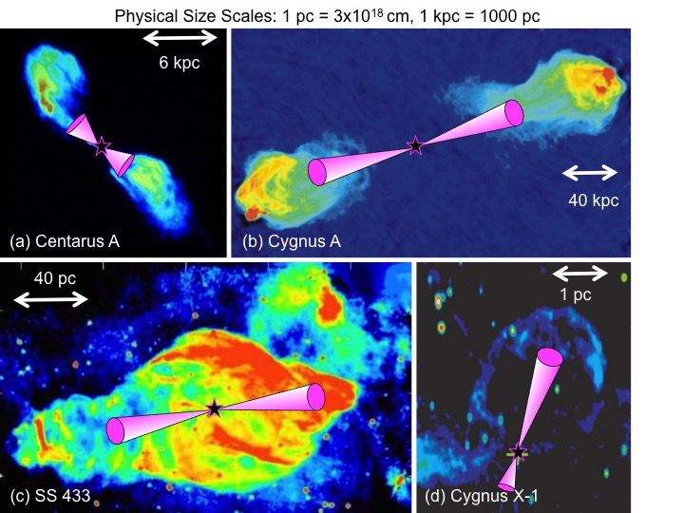
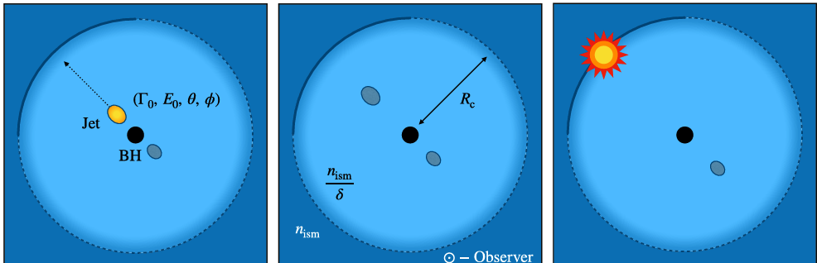



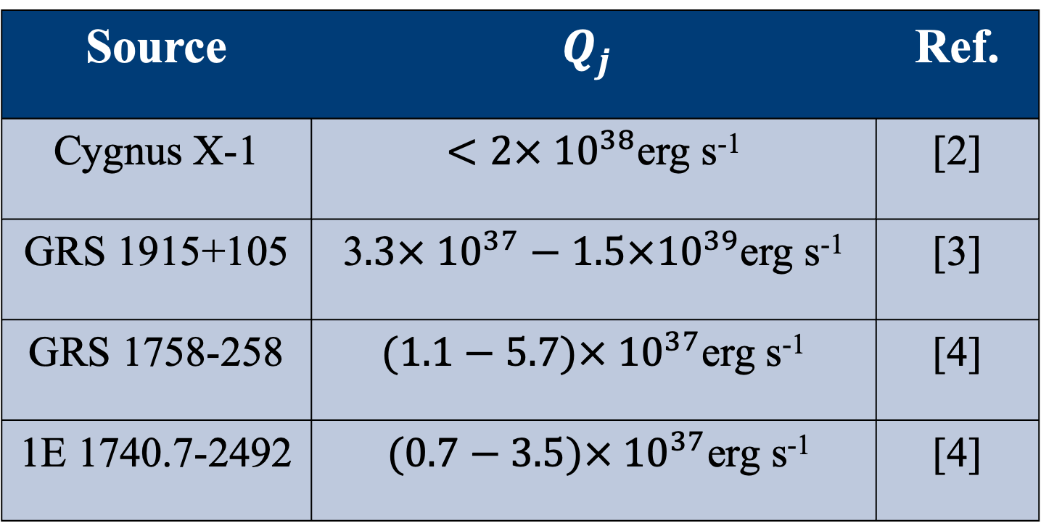

New ALMA observations reveal a jet-ISM interaction site near MAXI J1348-630
Pau Bosch-Cabot¹, Alexandra Tetarenko¹, Erik Rosolowsky², Francesco Carotenuto³, James Miller-Jones⁴, David Russell⁵, Stéphane Corbel^{6,7}, Thomas Russell⁸ and Gregory Sivakoff²
¹University of Lethbridge, ²University of Alberta, ³INAF-Roma, ⁴Curtin University, ⁵NYU Abu Dhabi, ⁶Université Paris Cité, ⁷ORN Observatoire de Paris, ⁸INAF-Palermo
Introduction
ALMA ¹³CO(J=1-0) observations
Deriving jet properties
When Black Hole X-ray binary (BHXB) jets interact with the Interstellar Medium (ISM), they can give rise to structures that can be used as calorimeters to measure jet energetics [1,2,3].
Combining calorimetry with established astrochemistry techniques allows us to more efficiently find and measure the ISM properties of such structures, leading to more accurate jet power measurements [4].
By modeling the emission with non-Local Thermal Equilibrium models [7], we narrow down the density to $n_{ISM}\sim 100−5000 cm^{−3}$, and we take the shock velocity to be the linewidth $v\sim 3 km s^{−1}.$Assuming a jet opening angle smaller than $1^{o}$[6], we recover a power of ${10}^{24}<Q_{j}<7×{10}^{28} erg s^{−1}$ over a lifetime of $t\sim 5×{10}^{4} years$. The unknown duty cycle poses challenges interpreting this result.
Approaching jet impact site
Possible displaced material
Receding jet impact site
Source | $$Q_{j}$$ | Ref.
Cygnus X-1 | $<2× {10}^{38}$erg s⁻¹ | [2]
GRS 1915+105 | 3$.3× {10}^{37}−1.5×{10}^{39}$erg s⁻¹ | [3]
GRS 1758-258 | $(1.1−5.7)× {10}^{37}$erg s⁻¹ | [4]
1E 1740.7-2492 | $(0.7−3.5)× {10}^{37}$erg s⁻¹ | [4]
Cavity boundary
Table 1 - BHXB calorimetry measurements.
Figure 1 - Jet-ISM interaction structures around BHXBs [1,5].
T(K)
Summary
MAXI J1348-630
A bright molecular structure was found in the vicinity of MAXI J1348-630, a BHXB.
The shape and spectral properties of the structure are consistent with a jet-ISM interaction.
Transient jets might have a significantly reduced feedback effect when compared to more persistent, compact jets.
MAXI J1348-630 is a BHXB observed to launch transient ejecta. These ejecta appeared to decelerate as they travelled away from the source, hinting at a possible cavity structure in the surrounding ISM [6]. In this work, we present ALMA observations to map molecular line emission in the region and search for evidence of jet-ISM interactions.
2022
Evidence of a jet-ISM interaction
Velocity ranges of the observed emission lines fall within the range expected for the source’s distance.
The structure is inconsistent with a supernova remnant.
Bright sites of emission are aligned with the jet axis.
Emission found at the region where the ejecta were observed decelerating in MeerKAT radio observations [6].
Spectral Features A and B show gas moving at different velocities, pointing towards a collisional interaction potentially fueled by jet impacts.
Velocity shifts between spectral feature peaks at Regions 2 and 3 could indicate material being deflected at the cavity wall.
References
[1] Gallo, E., et al., 2005, Nature, 436, 819-821.
[2] Sell, P. H., et al., 205, MNRAS, 446, 3579-3592.
[3] Motta, S. E., et al., 2025, A&A, 696, A222.
[4] Tetarenko, A. J., et al., 2020, MNRAS, 497, 3504-3524.
[5] Dubner, G. M., et al., 1998, ApJ, 116.4, 1842.
[6] Carotenuto, F., 2022, MNRAS, 511, 4826-4841.
[7] Van der Tak, F. F. S., et al., 2007, A&A, 468, 627-635.
Figure 2- Motion of the ejecta through a cavity carved in the ISM near MAXI J1348-630 [6].
Acknowledgments

