Slide 1

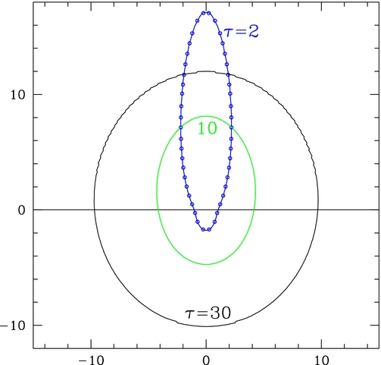
Direct Solution of the Time-Dependent Covariant Radiative Transfer Equation and its coupling to General Relativistic Magnetohydrodynamics with cuHARM
John Wallace, Damien Begue and Asaf Pe’er
GR-R-MHD codes become crucial tool in solving disk-corona-jet systems
In recent years: (1) Addition of radiation
(2) Use of graphical processing units (GPUs) becomes standard.
Most existing schemes solve moments of the radiative transfer + closure (M1) = angular intergation.
Cannot properly handle regions of intermetiate τ.

Slide 2
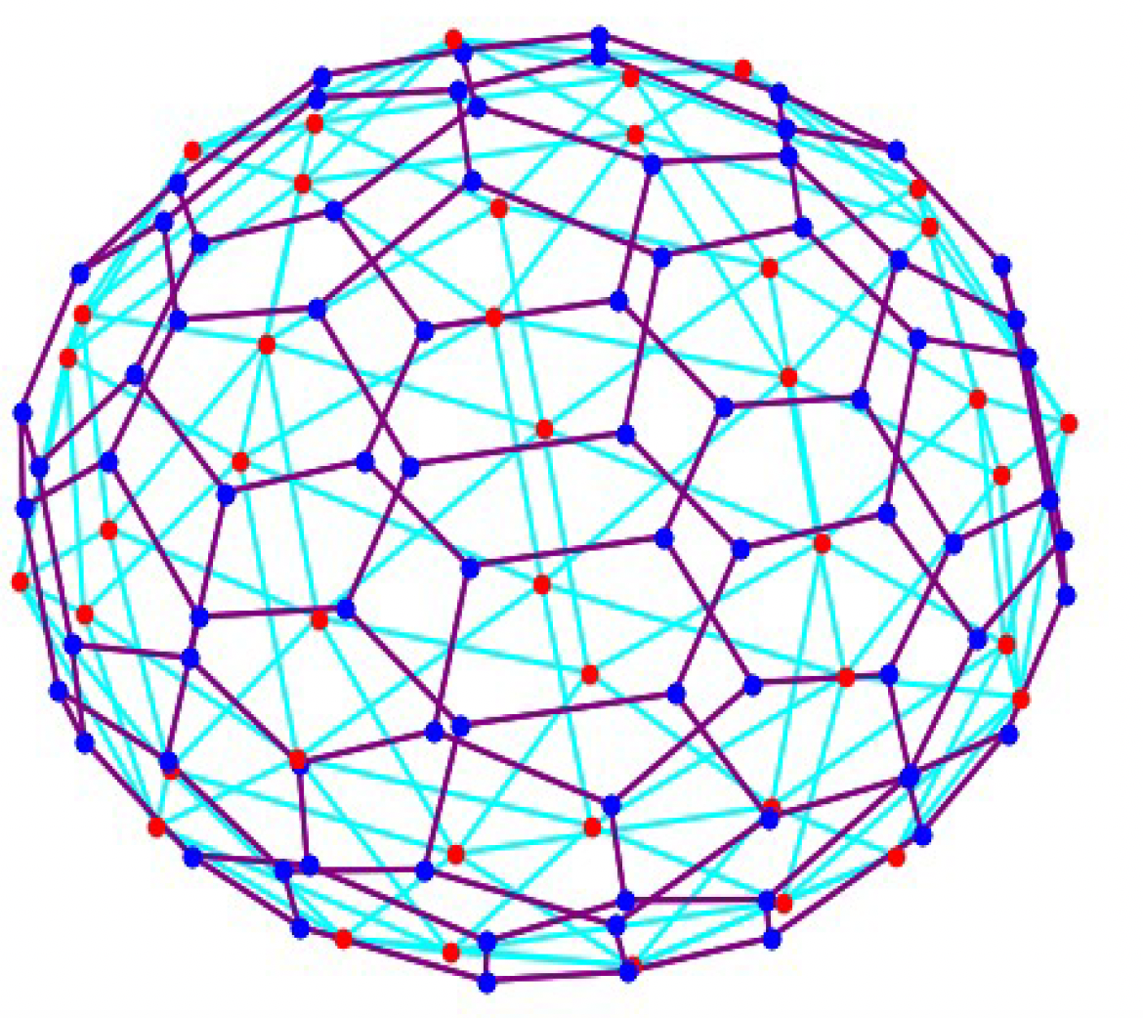
Direct Solution of the Time-Dependent Covariant Radiative Transfer Equation and its coupling to General Relativistic Magnetohydrodynamics with cuHARM
John Wallace, Damien Begue and Asaf Pe’er
GR-R-MHD codes become crucial tool in solving disk-corona-jet systems
In recent years: (1) Addition of radiation
(2) Use of graphical processing units (GPUs) becomes standard.
Most existing schemes solve moments of the radiative transfer + closure (M1) = angular intergation.
Cannot properly handle regions of intermetiate τ.
In cuHARM we use grid-based Boltzmann approach =
Radiation is solved on a separate, geodesic (angular) grid
Total: 6d (3 space + 2 angles + 1 energy)

Slide 3
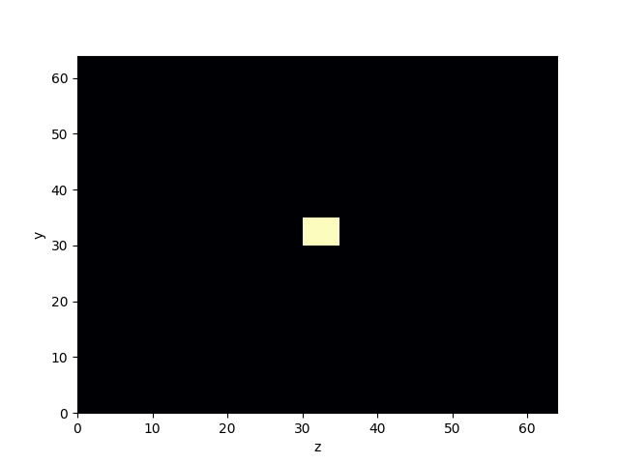
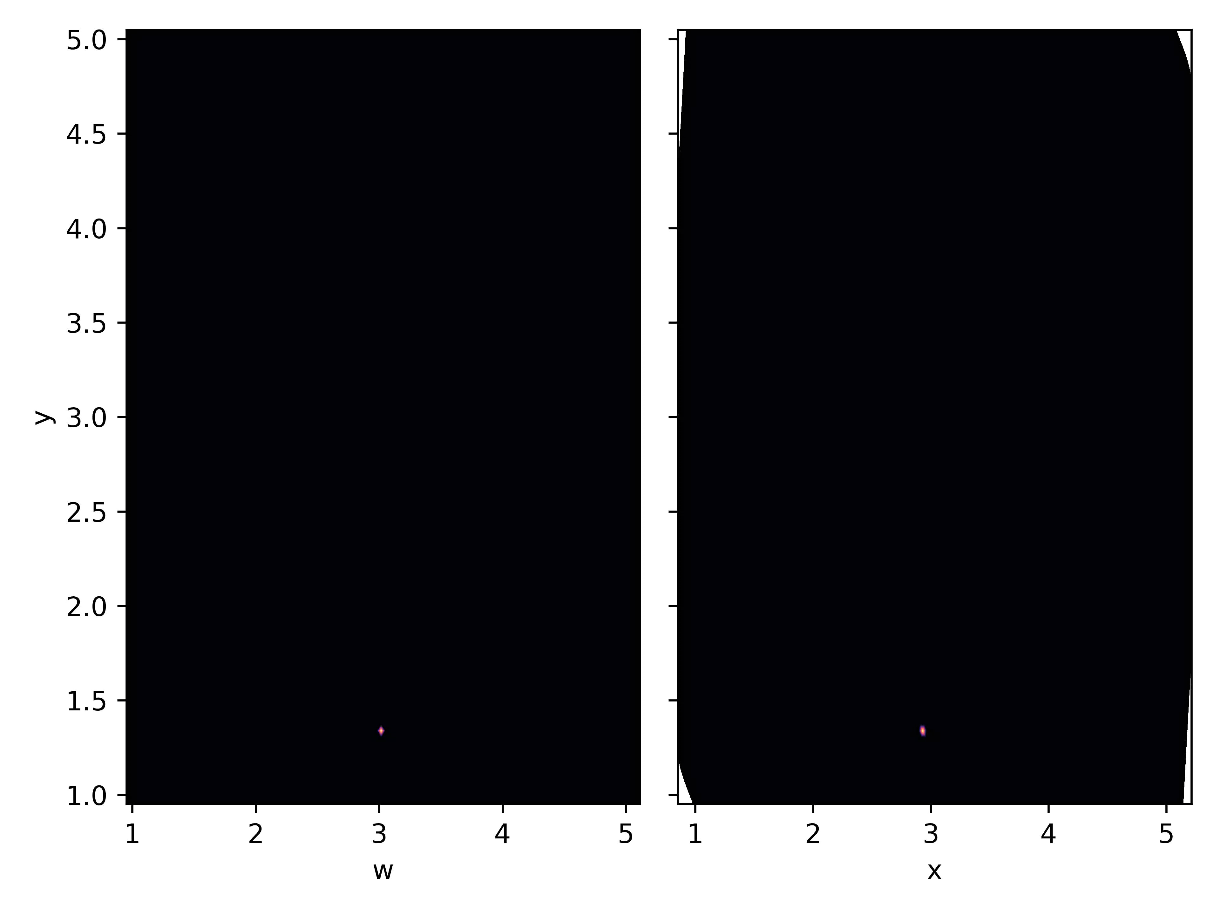
Direct Solution of the Time-Dependent Covariant Radiative Transfer Equation and its coupling to General Relativistic Magnetohydrodynamics with cuHARM
John Wallace, Damien Begue and Asaf Pe’er
GR-R-MHD codes become crucial tool in solving disk-corona-jet systems
In recent years: (1) Addition of radiation
(2) Use of graphical processing units (GPUs) becomes standard.
Most existing schemes solve moments of the radiative transfer + closure (M1) = angular intergation.
Cannot properly handle regions of intermetiate τ.
In cuHARM we use grid-based Boltzmann approach =
Radiation is solved on a separate, geodesic (angular) grid
Total: 6d (3 space + 2 angles + 1 energy)
Rad. Module development completed; key tests passed
Snake
coordinates
Beam crossing
Circular photon orbits around BH

Slide 4
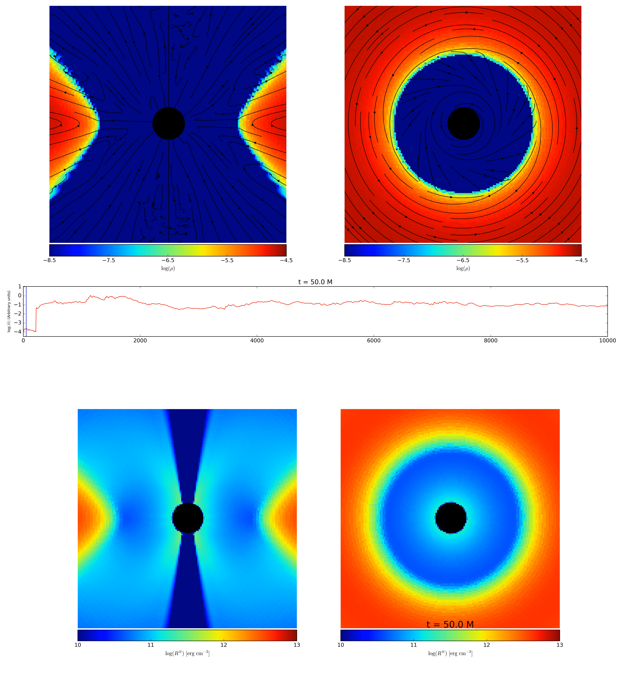
Rad-cuHARM: First full-scale run
Density, ρ
Radiation
energy density, R⁰⁰
Resulting disk is colder and thinner
Wallace, Begue & Pe’er,
arXiv:2508.15532

